Slide 1
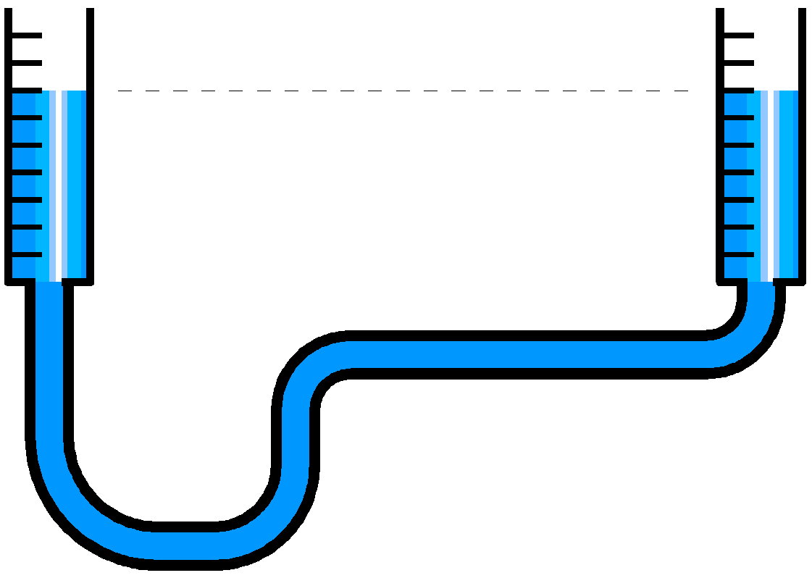
Towards Operational Leveling by β*
J. Wenninger, K. Fuchsberger, M. Hostettler
BE-OP-LHC

Slide 2
Levelling options
Levelling by separation
Levelling by crossing angle
Levelling by β*
Complexity scale

Slide 3
Existing levelling techniques: offset
Offset levelling:
Extremely simple and local to each IP.
Operational since run 1.
No (little) impact on collimators (TCT & TCLs) due to smallness of orbit shifts.
Baseline technique for ALICE and LHCb, driven by the experiments.
Possible future improvement: better integration with the orbit FB.
  Orbit reference update at each levelling step (take over work done for xing levelling), cohabitation with OFB mitigated for the moment by ‘gentle’ OFB correction configuration.
We have not observed problems of beam stability in the various fills where offset levelling was used between 2015-2017 with ATLAS and CMS.
  Only a vdm fill for ALICE and LHCb gave some trouble in 2017 – ‘positive’ effect on LRBB?
  We should keep offset levelling as a serious candidate also for HL-LHC, partly in combination with beta* levelling.

Slide 4
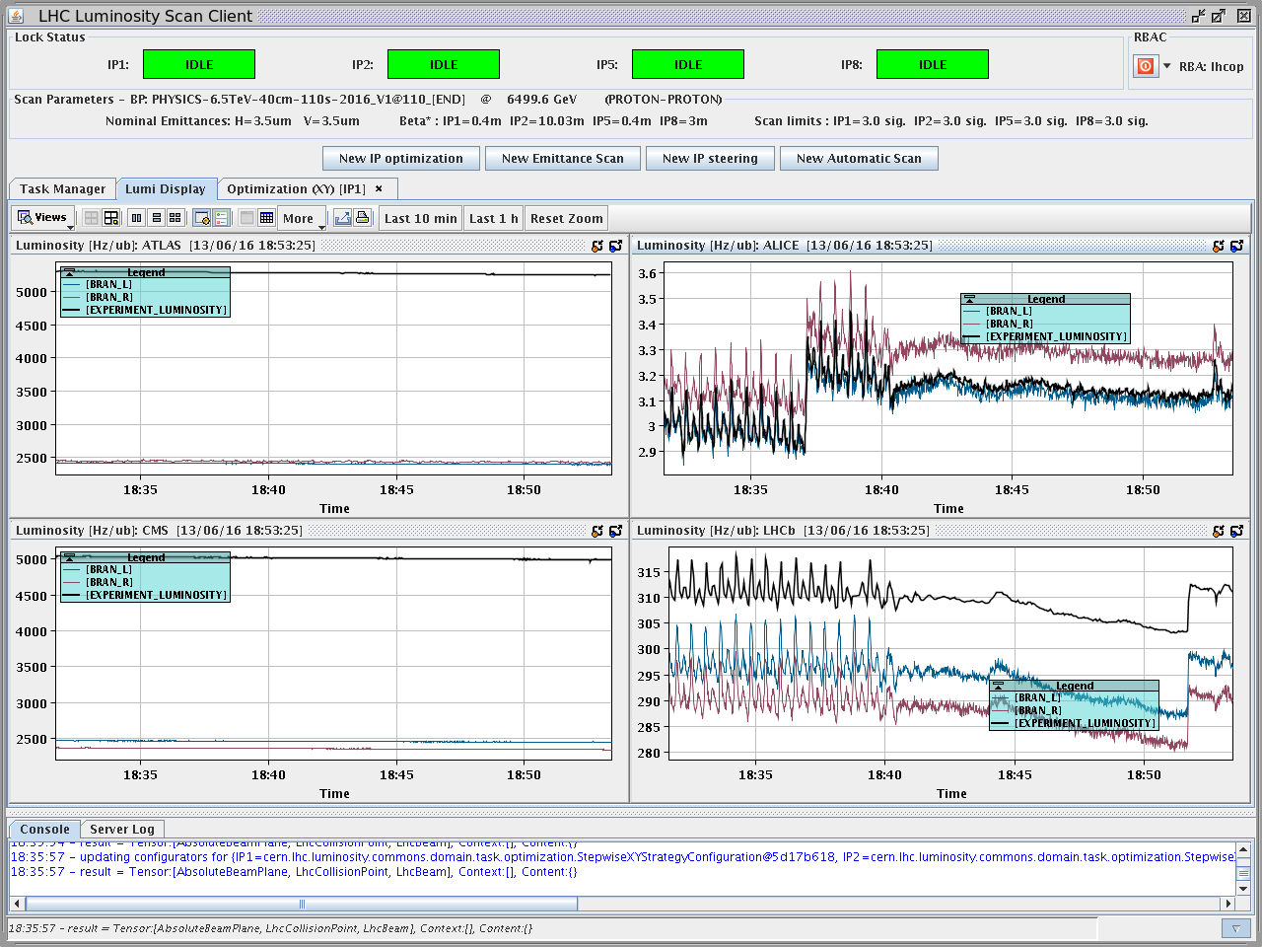
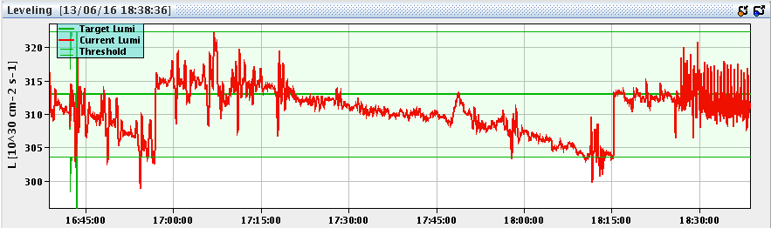
Side effects of offset levelling
A side effect of not colliding head on is the increased sensitivity to beam separation fluctuations induced by ‘orbit noise’ → L fluctuations.
Periodic noise is clearly visible on the ALICE and LHCb luminosity.
  Source not identified, but B2(H) is much more affected.
Noise with period of ~15 s, duration typically 15 mins, appears every 4 hours.
Amplitude ~ μm
Spikes with period 6.25 mins, ~ permanent ?
Amplitude ~ few μm

Slide 5
Existing levelling techniques: xing
Crossing angle anti-levelling:
Local to each IP, limited in range due to aperture (+ trims) and LRBB (- trims)
Operational since June 2017.
Due to the larger bumps and impact of non-closures, operation and synchronization with the orbit FB is mandatory, collimator centre shifts are also integrated.
Implemented in a simple ‘trim’ format through the luminosity client/server software.
Possible future improvements: automated steps, trim speed and collimation.
  Steps could be finer and linked to bunch intensity (currently not possible due to CTPPS).
  Slow trim preparation (orbit FB reference and OFB data synchronization) could be improved.
  Update of collimator interlock limits.
This is not an all-round levelling method, but rather an end of fill improvement.

Slide 6
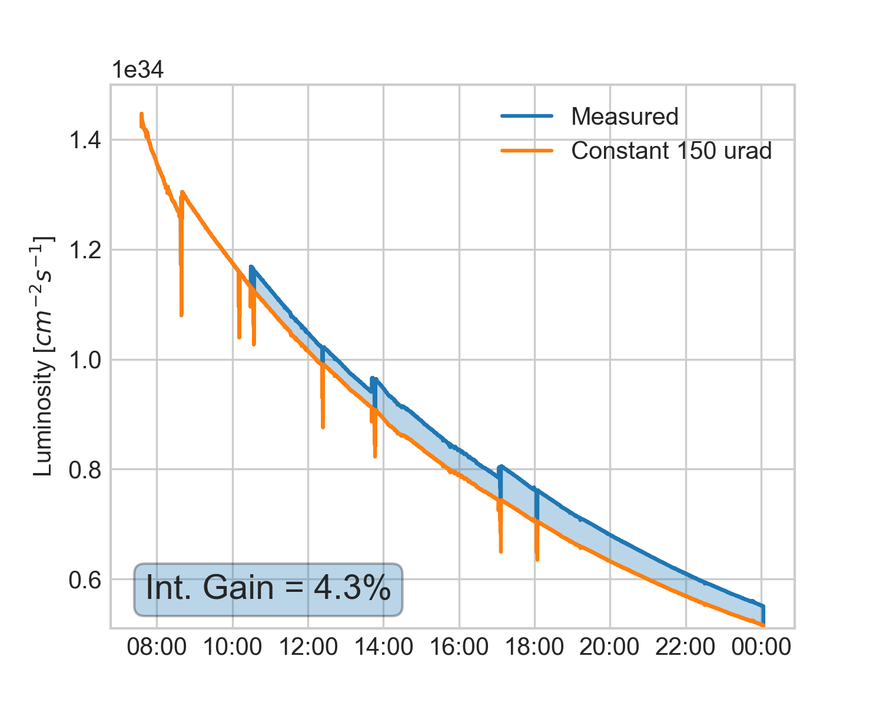
Crossing levelling
After each crossing levelling step:
  the luminosity is optimized (imperfection of orbit tracking),
    This would also apply to future beta* levelling.
  the tunes are re-adjusted - could be automated if it would be fully reproducible.
    Automatic tune re-adjustment poses however the question of where to store the trims.
Fill 5872
ATLAS Luminosity

Slide 7
Levelling complexity
Offset levelling:
  Local orbit bump with simple trim.
Crossing angle levelling:
  Local orbit bump with complex trim:
    Orbit bump, orbit FB reference, collimator shifts.
    Synchronized action of bump, orbit FB and collimators.
β* levelling:
  Local or global optics change – complexity of a ramp or a squeeze step.
  This technique involves close to all systems / settings:
    Bumps at IP (shape and value), orbit corrections,
    Optics corrections,
    Q, Q’ and coupling trims,
    Collimators,
    Beam feedbacks – orbit,
    Internal update of LSA DB (optics etc).
    ….
  And the beams should remain ~ in place at the IPs.

Slide 8
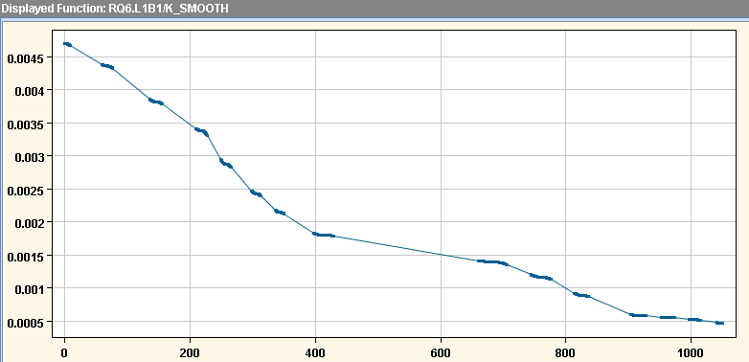
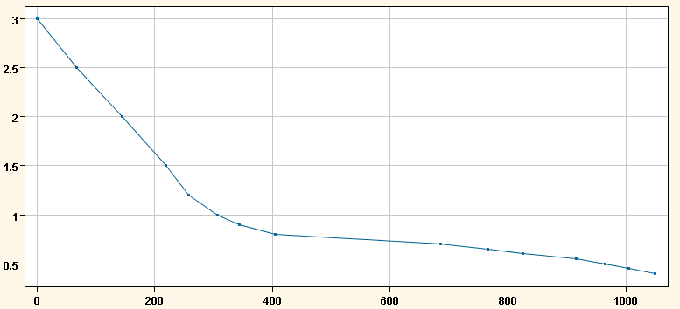
Optics handling in LSA
During the squeeze we transit from one matched optics (matched point) to the next. Each optics corresponds to a β* combination of the 4 IRs.
Between 2 points the settings are interpolated and follow a parabolic-linear-parabolic change to be able to stop at both end points (dI/dt = 0).
  The duration and parameters each segment are determined by LSA from the circuit parameters (ramp & acceleration rates).
Gradient of one IR1 quadrupole
2016 IR1 & IR5 β* [m]:
β* in ATLAS

Slide 9
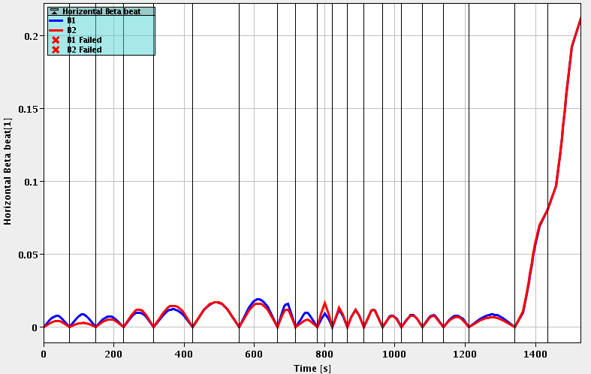
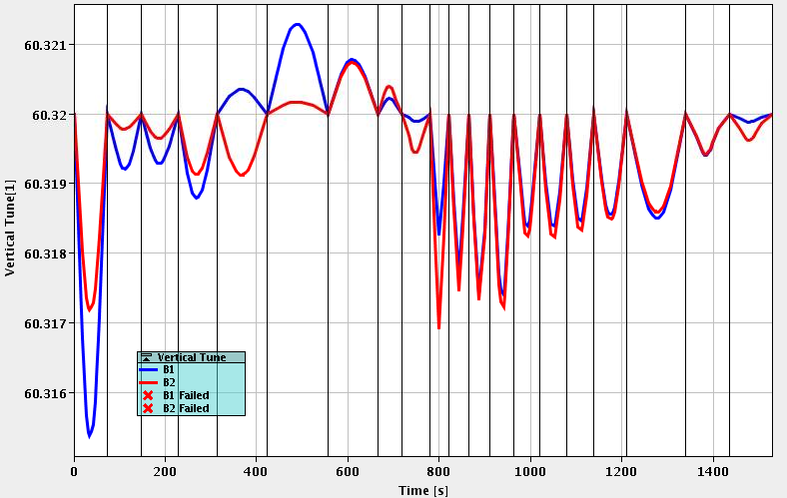
Optics handling in LSA
By construction transient optics errors (tune, chromaticity, beta-beating, orbit) appear between two matched optics points.
  Transients can be observed on losses. The tune transients are corrected by feed-forward.
The density of β* matched points is chosen to keep the transients reasonable.
Transient beta-beating for the 2017 squeeze 11m-33cm
Horizontal beta-beating
Vertical tune
At small β* the transient error is ~1%.
Artefact due to the telescope

Slide 10
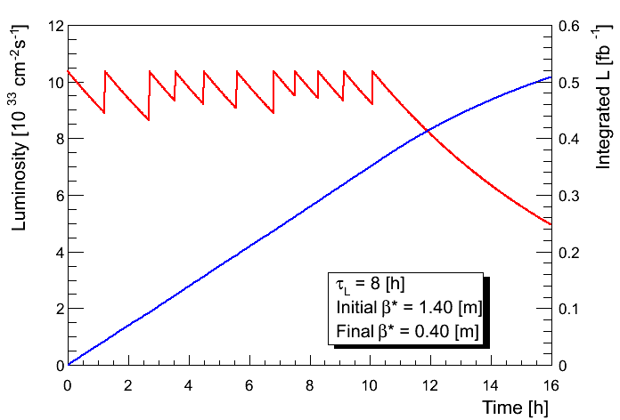
Beta* In practice
Currently (and probably also for run 3) a β* levelling scheme has to be built on top of the existing settings structure.
  Start from a squeeze segment with N matched points,
  Execute the squeeze segments one by one during stable beams at regular time intervals.
Matched optics
Collide
Squeeze
Stable beams
Squeeze
Stable beams
Collide

Slide 11
Beta* levelling MDs - past
Up to 2015 β* levelling MDs used the standard squeeze (in ATS language pre-squeeze) to gain some experience with setup and reproducibility.
  The advantage of the pre-squeeze is that it is fully local to a given IP – at least from the point of view of the theoretical strength changes: reduces the coupling between IPs.
  The transients from one step to another were however quite important in particular above β* of 1-2m: the beam separation trims varied a lot along the squeeze.
    Partly due to the fact that MDs took over standard squeeze setups where orbit control at the micron is not an issue.
  Once setup, the reproducibility was good, sufficient to maintain beams well in collision (~1σ) even a few months later.
    A by-product of the MD: development of better software for orbit FB references, generated from the knob settings (separation, xing, lumi scans etc).
In 2017 the ATS telescopic squeeze from 40cm to 30cm offered a good opportunity for β* MD.
  Telescopic squeeze should ease life for IR1 & IR5 – no local settings change (in theory) – and possibly make like more difficult in IR2 and IR8 – local settings changes in critical IRs.
  If successful this could be a potential option for operation in 2018.
  Open the door for tests of new levelling software.

Slide 12
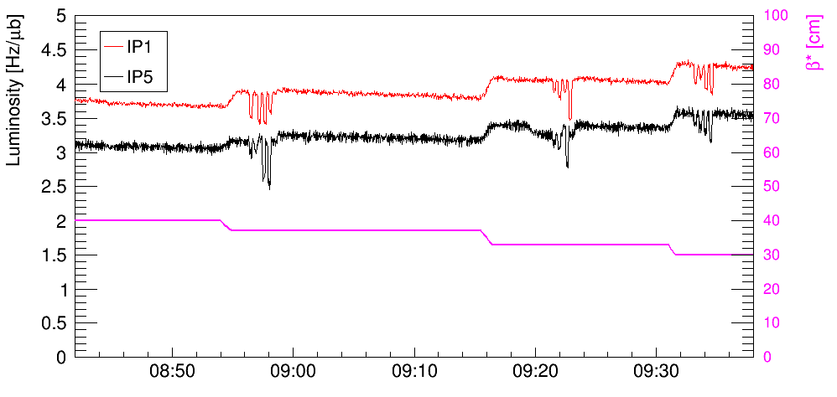
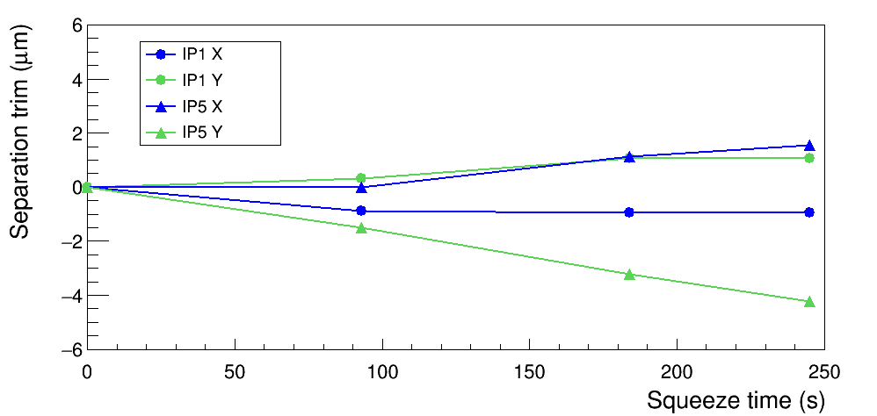
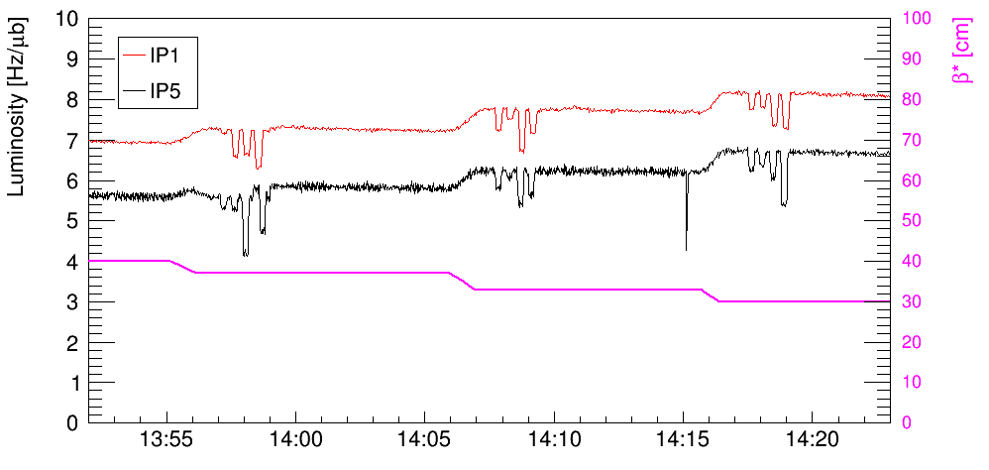
Beta* levelling MD
Last week’s MD on β* levelling in telescopic mode is based on executing a squeeze segment step-wise with collisions. It confirmed that when β* is changed with the telescope the transients are ‘easy’ to cope with in IR1&5.
  In practice there are small changes due to optics corrections.
    Small but measureable trims on the beam separations.
  Levelling worked well in IR1 and IR5 at the first attempt without any setup !
Separation trims along the squeeze segment
First fill
Second fill

Slide 13
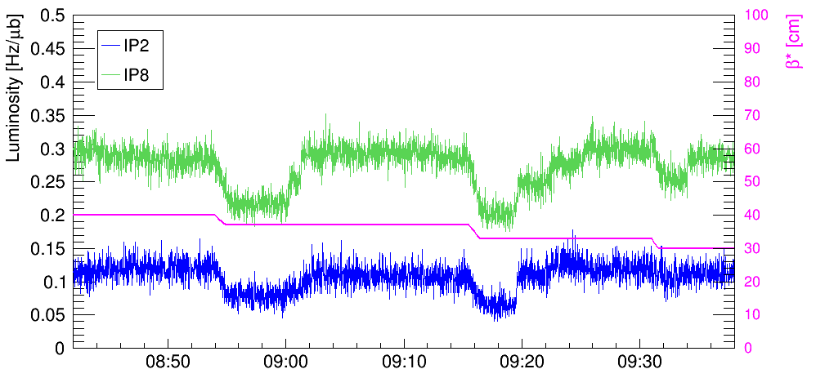
Beta* levelling MD
During the MD IR2 and IR8 were setup with a 1σ separation (~ max. sensitivity to separation drifts).
Between steps the separation had to be corrected by up to 0.3σ (~10-15 μm) at certain steps – not a real surprise as not prior orbit setup (→ feed-forward) was made.
  The telescope makes life more difficult in IR2 and IR8. Reproducibility?
Unfortunately in the second fill the separation was much smaller (by accident) and the reproducibility could not be tested – next MD.
First fill

Slide 14
Next steps – twisting LSA a bit
To ease levelling in the near / pre-HL future we are trying to implement β* levelling as a trim based on a function beam process.
  A function BP is generated with fixed matched points. It is used to store the settings and corrections (Q, Q’, coupling, orbit, optics, beam separation etc) and to track the evolution.
  The segments between matched points are loaded and applied as a ‘mega-trim’ through the luminosity server using the stored function pieces.
  The mega-trim must involve the orbit FB (drive reference change, relative or absolute?), the collimators (may be more complex than for crossing leveling), the PC interlocking and an update of LSA internals, for example the optics (→ knob definitions).
    Mega-trim may be stretched to make it smoother etc…
Squeeze
‘Colliding’ squeeze
Collide
Take a segment and apply as trim
Can go backward and forward !

Slide 15
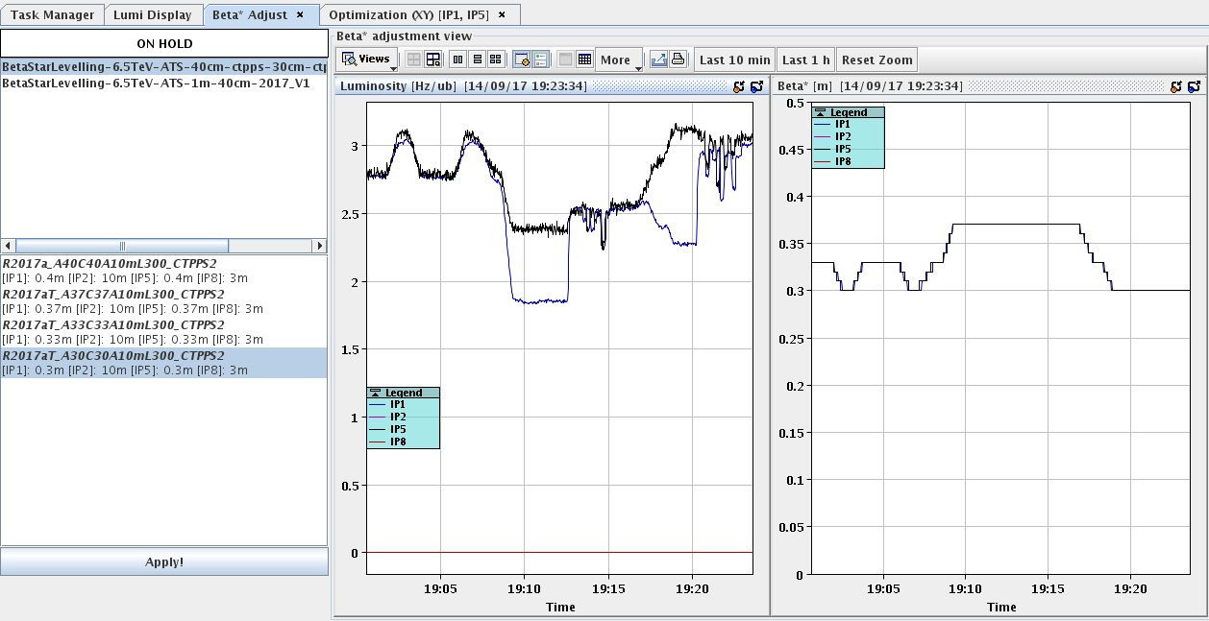
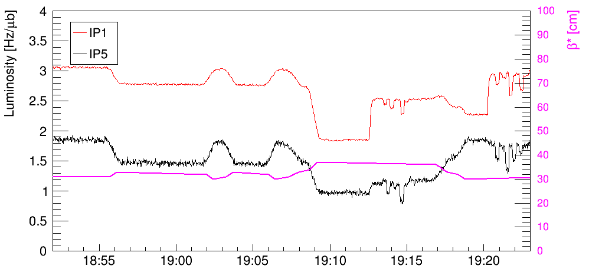
Twisting test
During last week’s MD a first test was made of the mega-trim, but it only involved the PC settings – no orbit FB, no collimators.
Given the prototyping state of this work, the results are very encouraging.
The plan is to use the settings established in MD3 (essentially separation corrections) for a more advanced test of the mega-trim in MD4.

Slide 16
Outlook
The new scheme of beta* ‘mega-trim’ could bring us to a point where β* levelling can be considered for operation based on a sequence of discrete matched optics.
  Steps of 5-15% in luminosity seem reasonable.
  This could be combined with offset-levelling in the same IRs to flatten the lumi curve (but some small humps will remain – unlikely to be of any relevance for the experiments).
  This could well be sufficient up to and including the beginning of the HL area – then the real requirements may become clearer.
Requiring independent beta* for IR1 and IR5 opens a Pandora box for settings, machine setup and operation.
  Non-linear knobs to trim β* cannot be used directly as mapping to corrections can currently only be done through a BP (i.e. versus time).
  Such a scheme requires orthogonal corrections, and may lead to an important increase in setup and testing time (playing back in different orders…).
  Currently I see no real need since both experiments either operate at the maximum or at very low pile-up, special fills for tests at lower luminosity are handled well with offset levelling.
To improve control at the IP, one can consider in the longer term to build another feedback loop inside the orbit FB to maintain the IP positions with DOROS.
  Requires a reliable and available DOROS system – not yet !
  Very large impact on the orbit FB design – important and heavy changes.

Slide 18
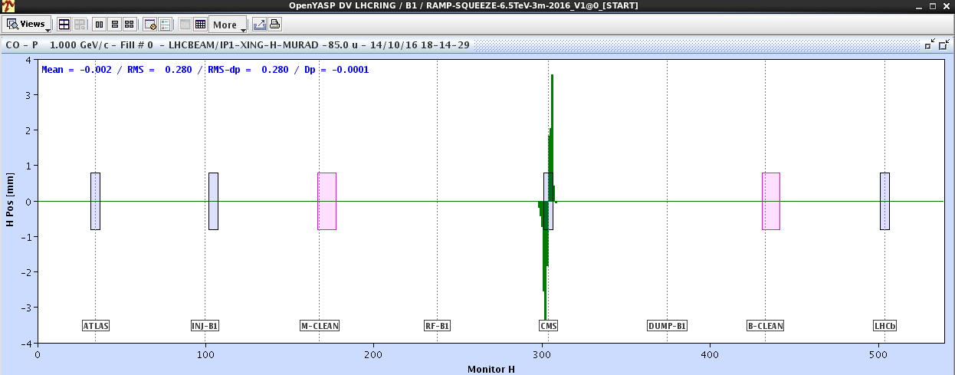
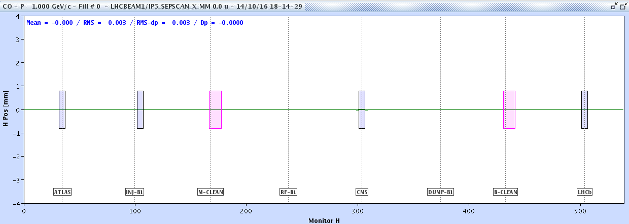
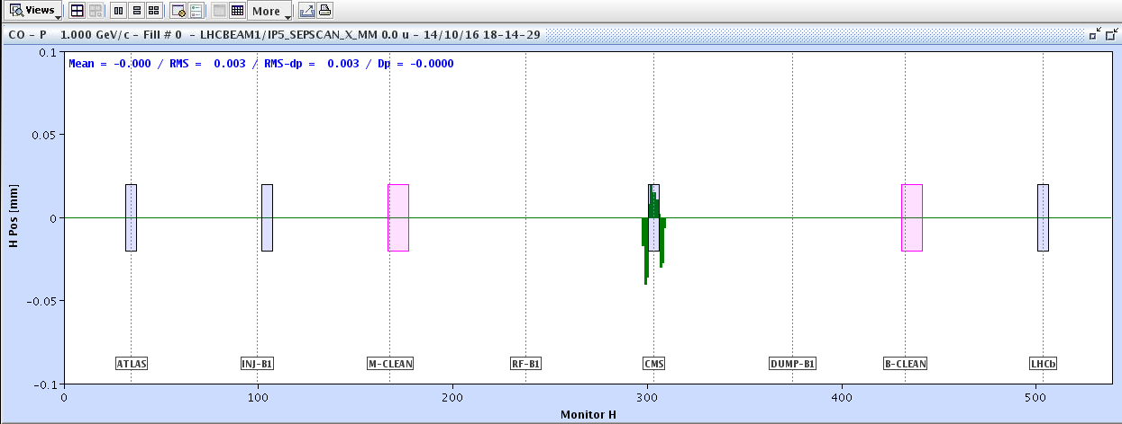
Separation versus crossing
Separation and crossing levelling are both controlled with local orbit bumps. But the amplitudes differ vastly → reason for the higher complexity of xing levelling.
Comparison of the bumps for B1 in CMS for ~ the same luminosity change
Crossing bump
Separation bump (lumi scan)

