Slide 1
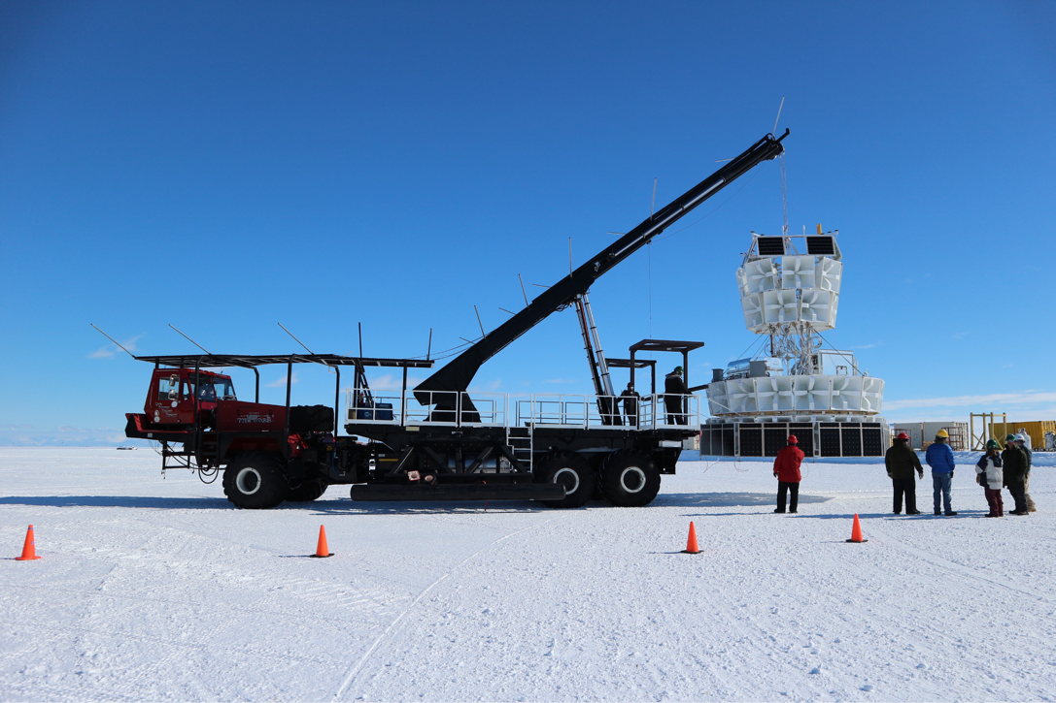
Results from the Third Flight of ANITA
Abby Vieregg for the ANITA Collaboration
University of Chicago
ARENA, 2018
13 June 2018

Slide 2
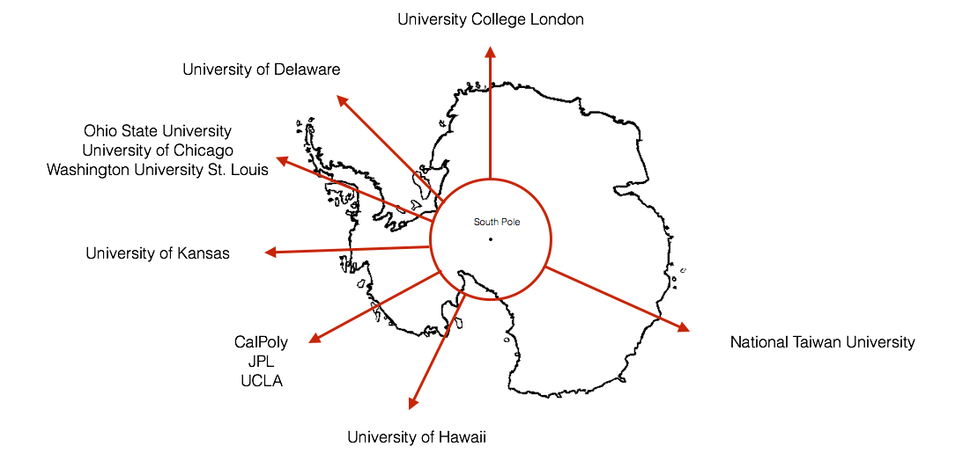
ANITA Collaboration
11 institutions, ~50 collaborators spanning 18 time zones

Slide 3
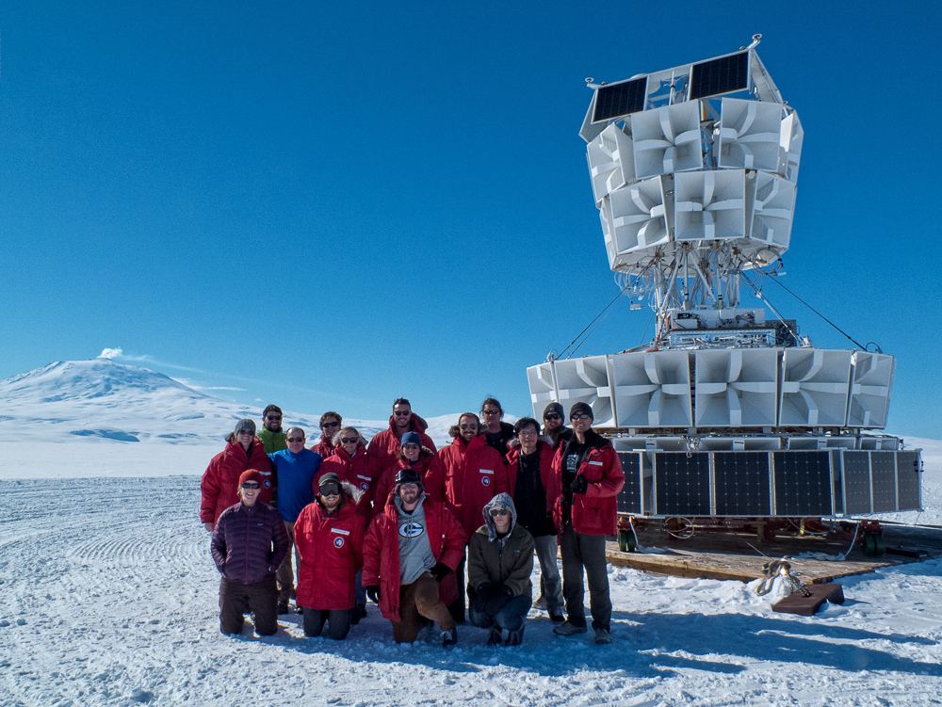
ANITA-3 Deployment Team

Slide 4


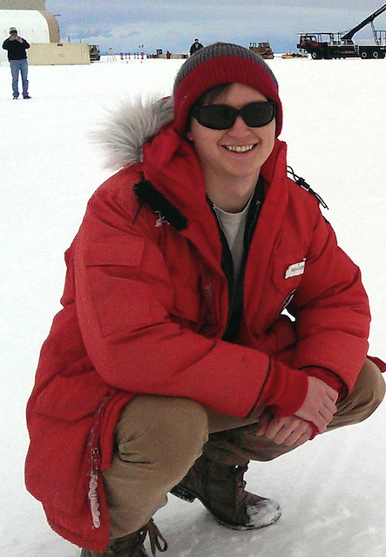
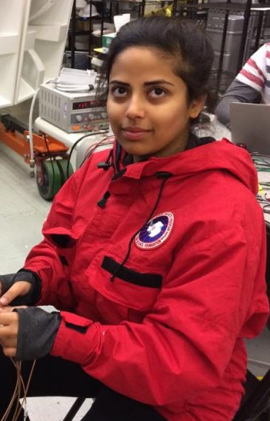



ANITA-3 Analyzers: Postdocs and Grad Students
Linda Cremonesi, UCL
Cosmin Deaconu, Chicago
Ben Strutt, UCL/UCLA
Oindree Banerjee, OSU
Jacob Gordon, OSU
Ben Rotter, Hawaii
Sam Stafford, OSU

Slide 5
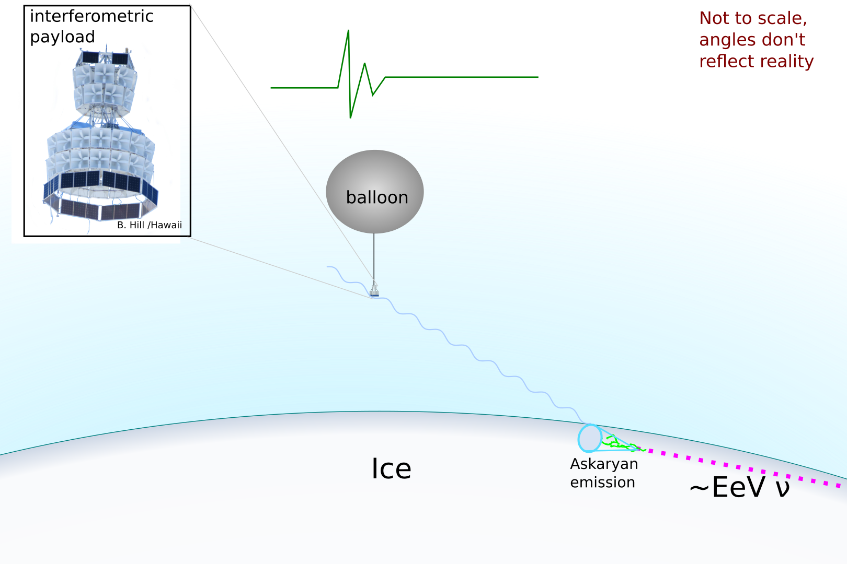
1) Neutrino-Induced Askaryan Emission in Ice
Signals are vertically polarized

Slide 6
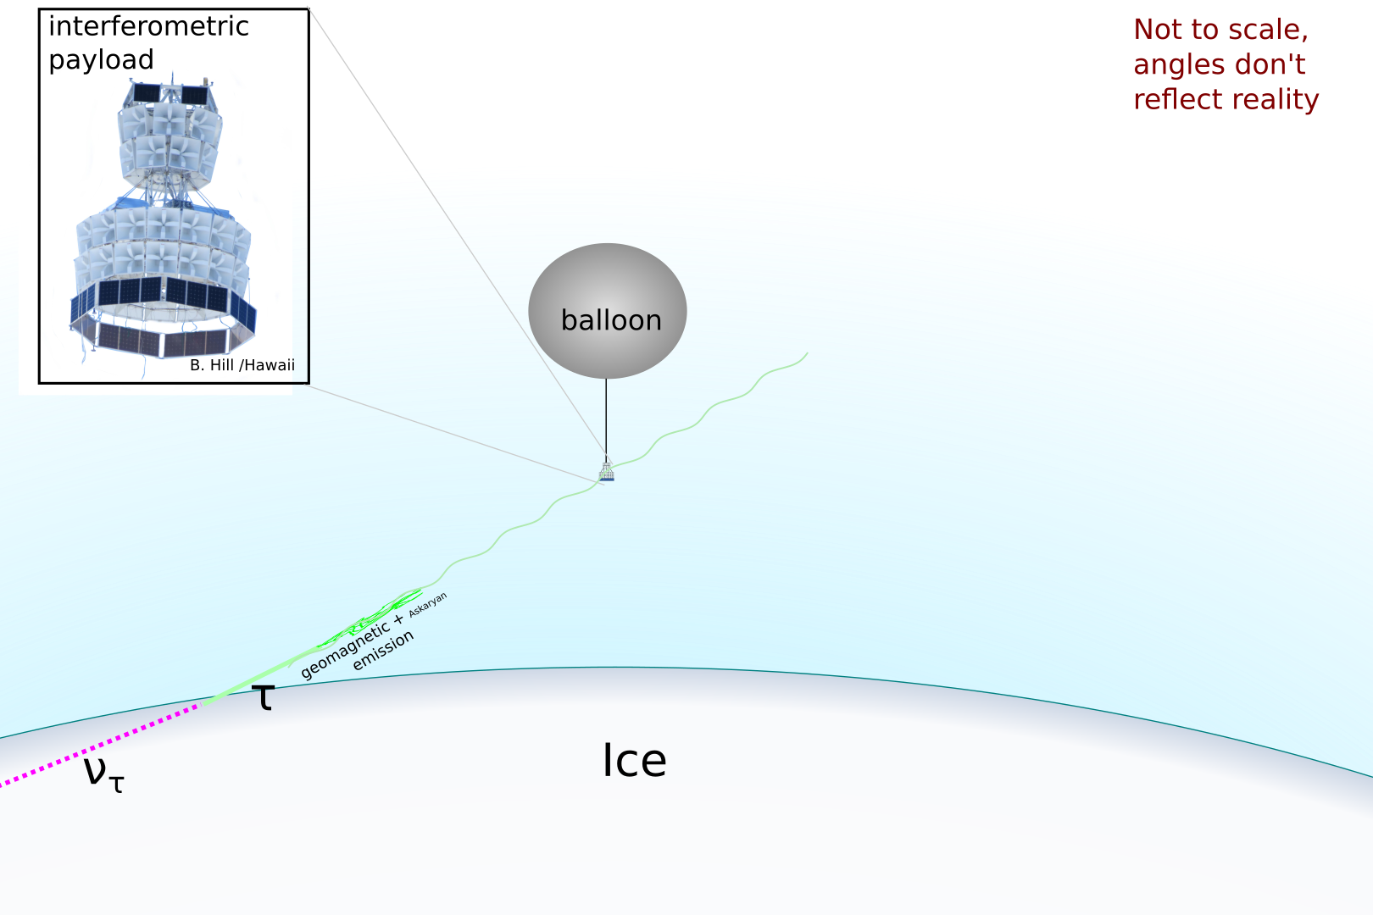
2) Radio Emission from Tau-Neutrino-Induced EAS
Signals are horizontally polarized
Comes from below the horizon

Slide 7
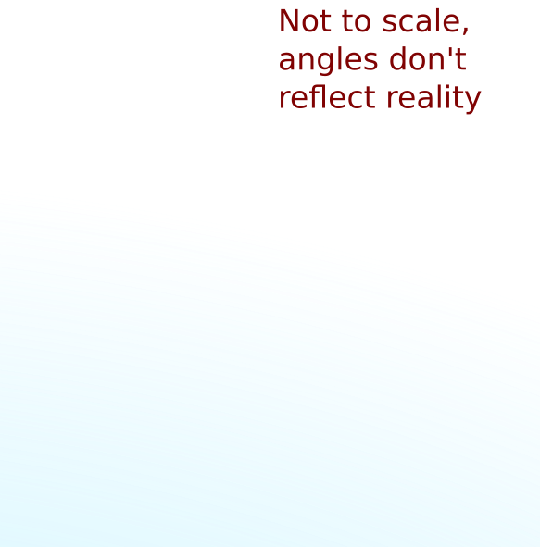
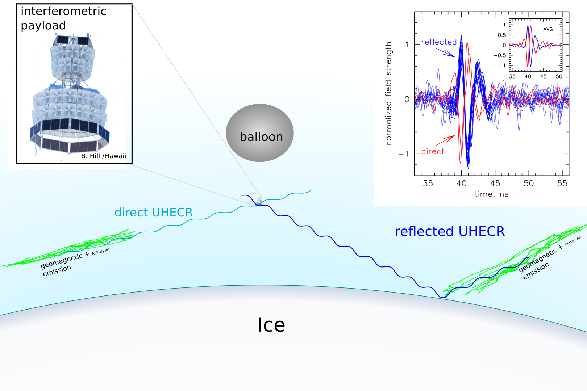
3) Radio Emission from Cosmic-Ray-Induced EAS
Signals are horizontally polarized
Polarity of reflected (below-horizon) signal is inverted compared to direct (above-horizon) signal and tau neutrino (below-horizon) signal

Slide 8
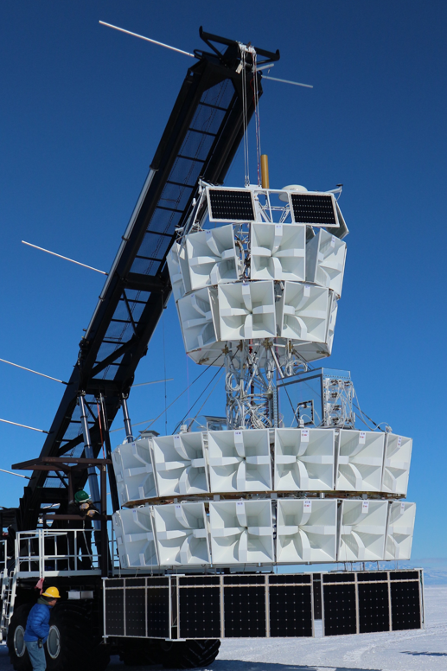
The ANITA Instrument
Telemetry (TDRSS and
Iridum Antennas)
GPS Antennas
Instrument Box
NASA Instrument Box
48 Quad-ridged Horn Antennas (200-1200 MHz)
Solar Panels

Slide 9
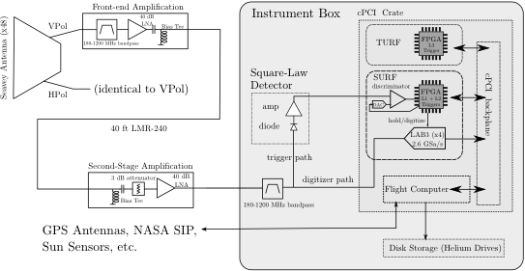
ANITA System Diagram
200-1200 MHz, 2.6 GSa/sec digitizers
50 Hz global trigger rate (coincidence between threshold-crossing triggers in adjacent antennas)
Gorham et al. arXiv:1803.02719

Slide 10
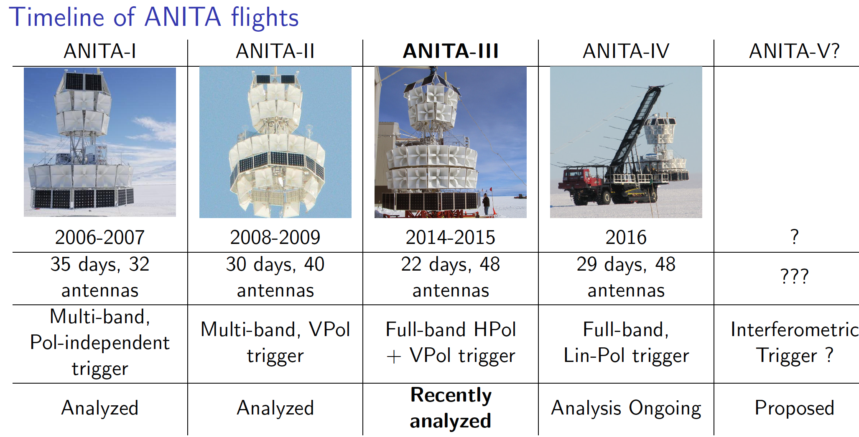
ANITA Timeline
Diffuse neutrino limit published, EASs detected and published
Diffuse neutrino limit published
Recent Results on the arXiv in March 2018

Slide 11
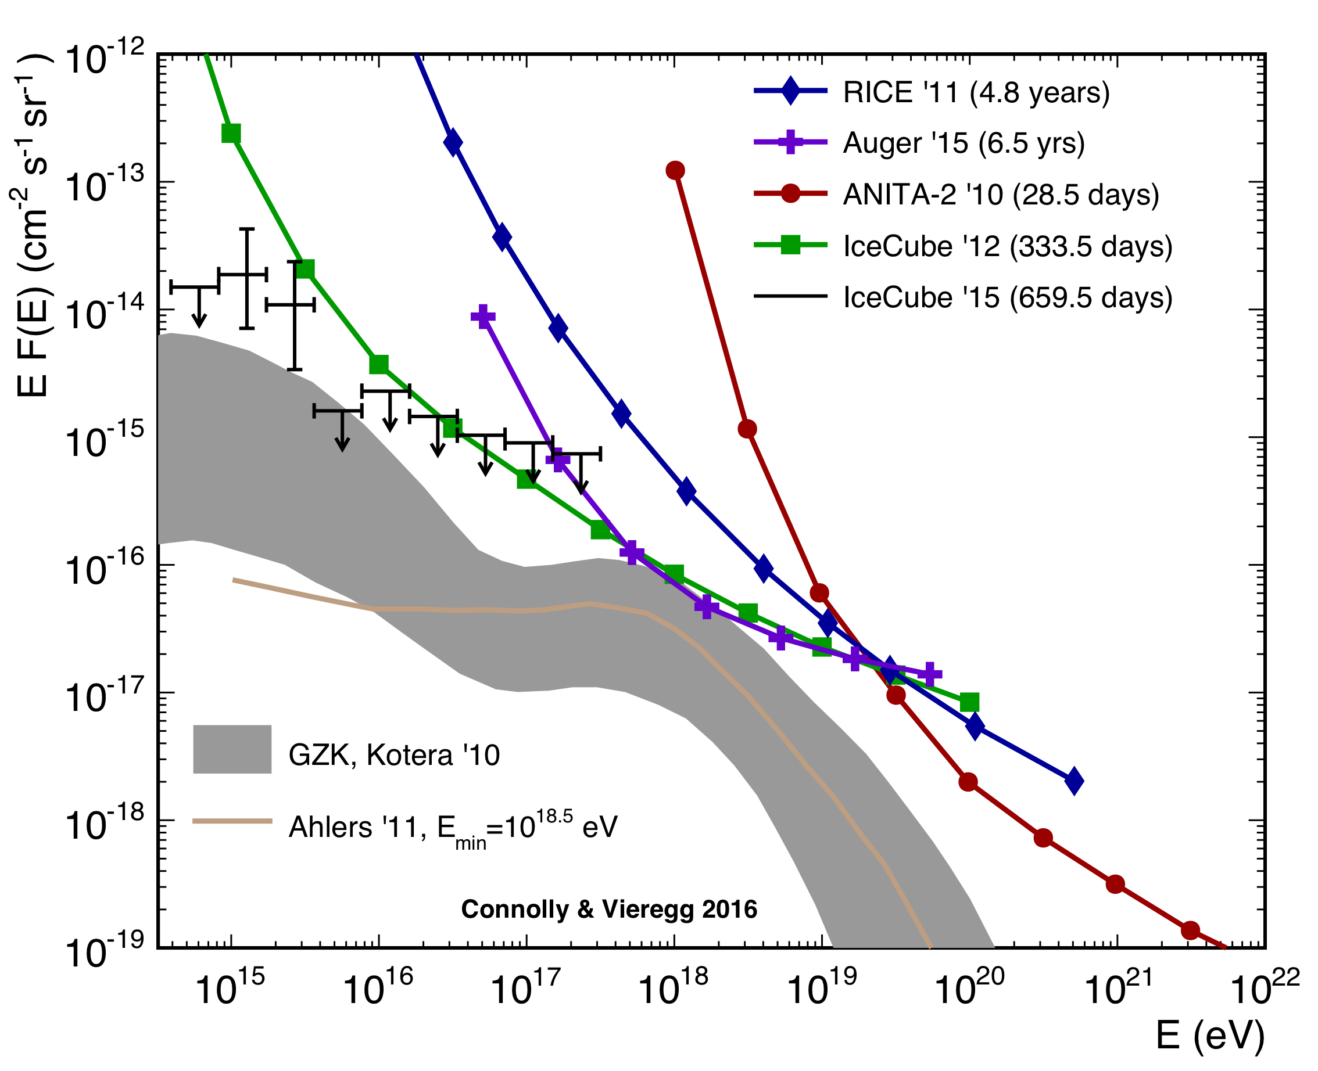
Previous ANITA Diffuse Neutrino Results
ANITA-II: best neutrino limit above 10^{19.5} eV
ANITA-II Limit from:
Gorham et al. PRD 2010

Slide 12
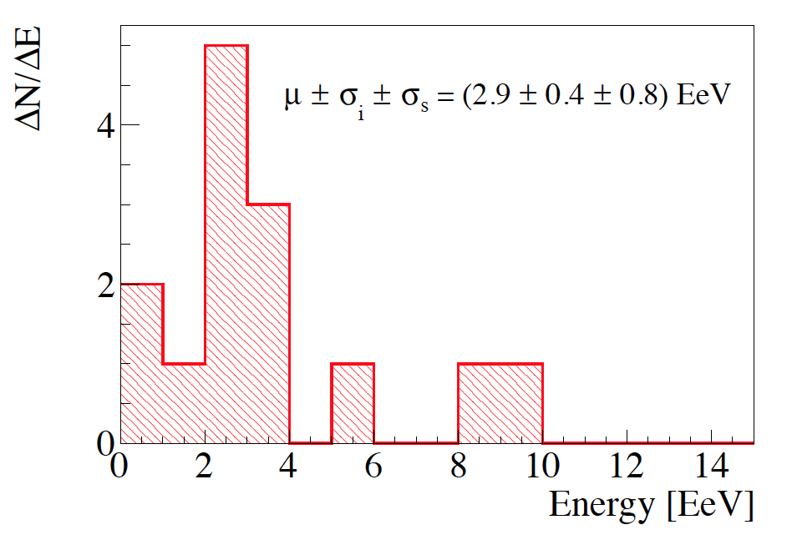
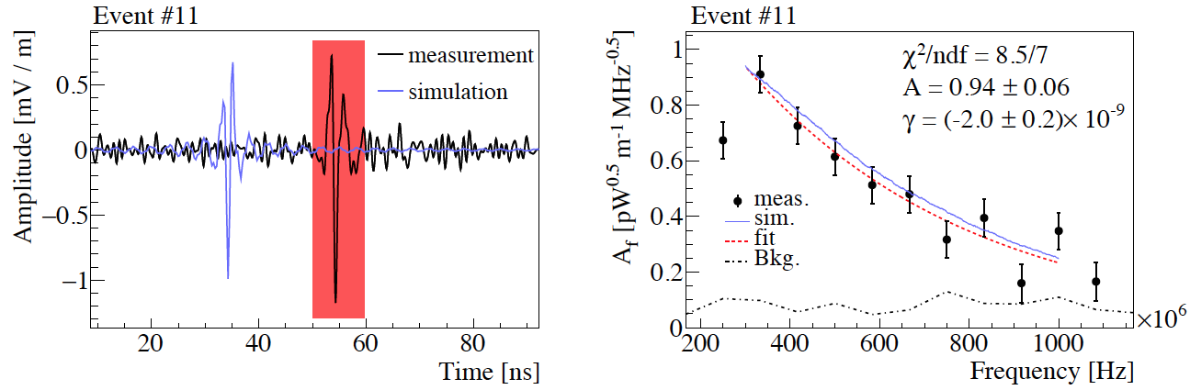
Previous ANITA Cosmic Ray Results
ANITA-I: 16 UHECR events (14 reflected + 2 direct)
  Using Auger flux, expected 16 reflected from MC simulation
  Mean energy: 2.9 EeV
ANITA-II: 4 more (3 reflected + 1 direct) consistent with UHECR events (no CR trigger!)
Hoover et al. PRL, 2010; Gorham et al., PRL 2016 ; Schoorlemmer et al. Astropart. Phys., 2016

Slide 13
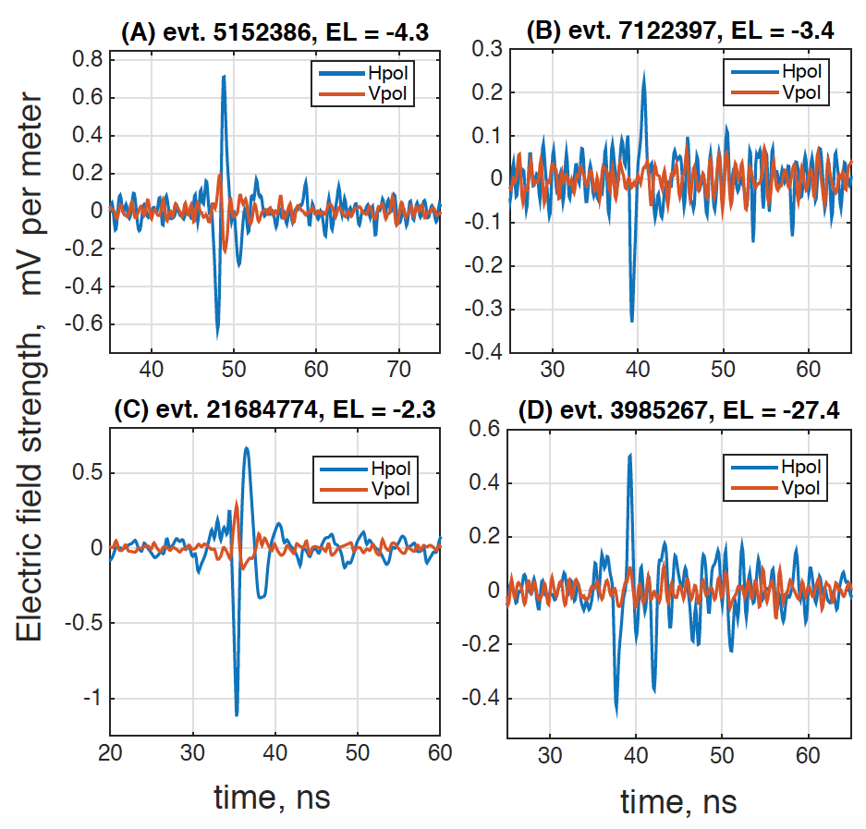
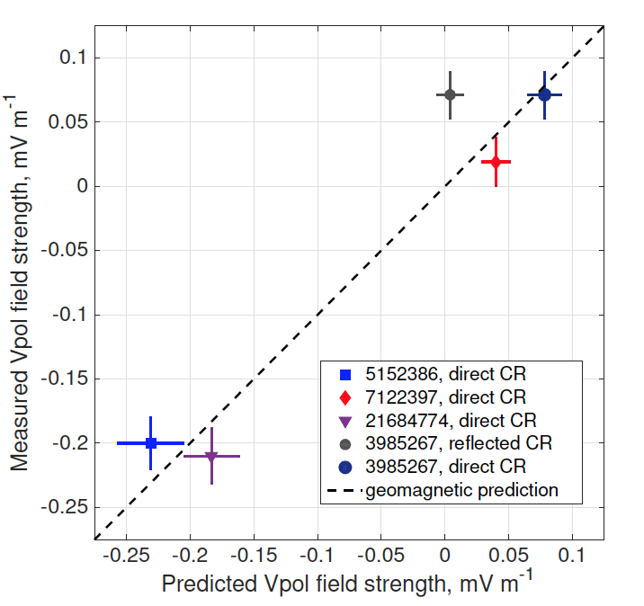
Previous ANITA “Mystery Event” Results
ANITA-I saw 1 “mystery event” that passes all cuts, and looks like the 3 direct UHECRs except that comes from below the horizon
Background estimate (likelihood analysis, a posteriori) is 10⁻³ events
What is this thing?
  Consistent with tau neutrino hypothesis, except steeply upgoing
  Energy estimate is 0.60 EeV
Gorham et al. PRL 2016

Slide 14
New: ANITA-III Results
Diffuse neutrino limit published, EASs detected and published
Diffuse neutrino limit published
Recent Results on the arXiv in March 2018

Slide 15
ANITA-III Diffuse (Askaryan Neutrino Search)

Slide 16
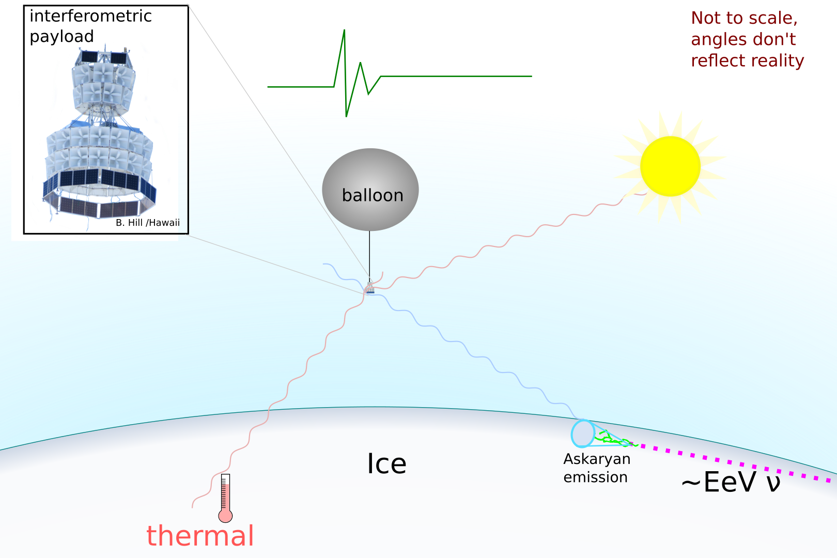
ANITA-III Diffuse (Askaryan Neutrino Search)
Thermal Noise

Slide 17
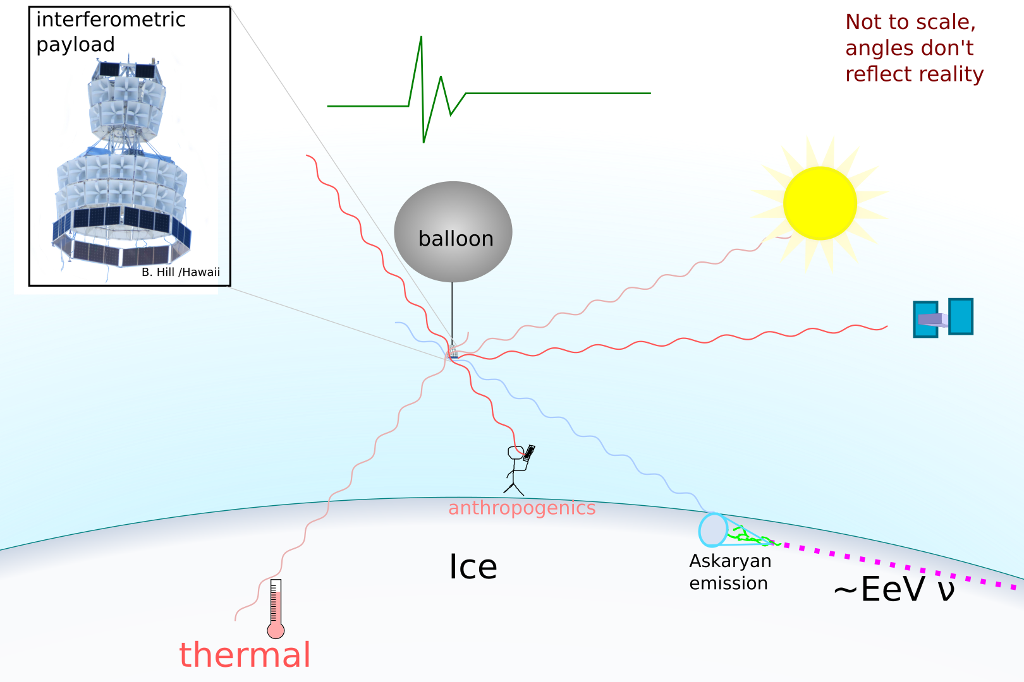
ANITA-III Diffuse (Askaryan Neutrino Search)
Thermal+Man-made Noise

Slide 18
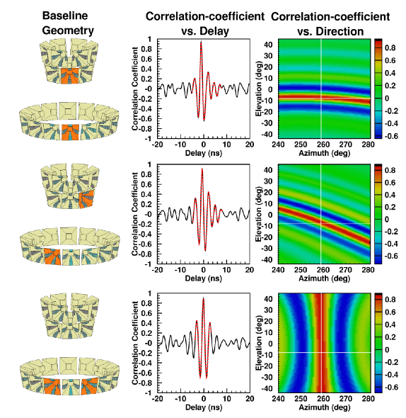
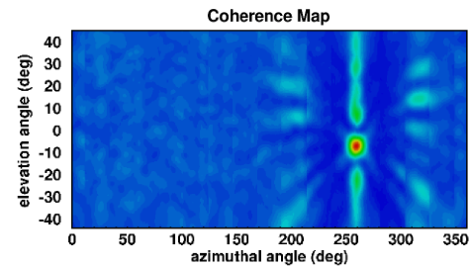
The Interferometric Analysis Technique
Use timing delays between antennas to determine direction
Developed for fast, broadband signals for ANITA, now used by other experiments
Good at distinguishing between signal-like (EAS or Askaryan neutrino) and thermal noise events
Romero-Wolf et al., JCAP 2015

Slide 19
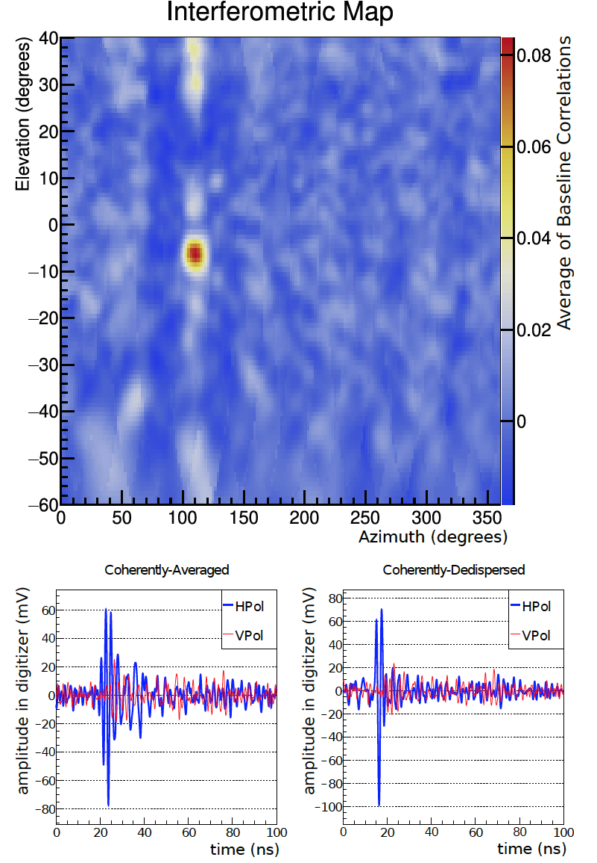
Diffuse Neutrino Search Strategy
Simulated Event from MC
Neutrinos are impulsive, broadband, isolated events
77 million triggers (expect ~few neutrinos)
3 separate blind analyses (leading to 4 PhDs)!
3 sources of background to battle:
  Noise from onboard the payload
  Thermal noise (99% of triggers)
  Man-made noise
Gorham et al. arXiv:1803.02719, 2018

Slide 20
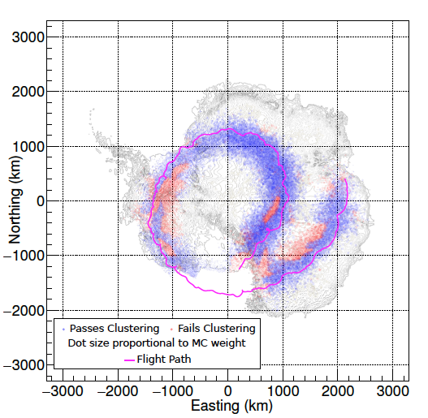
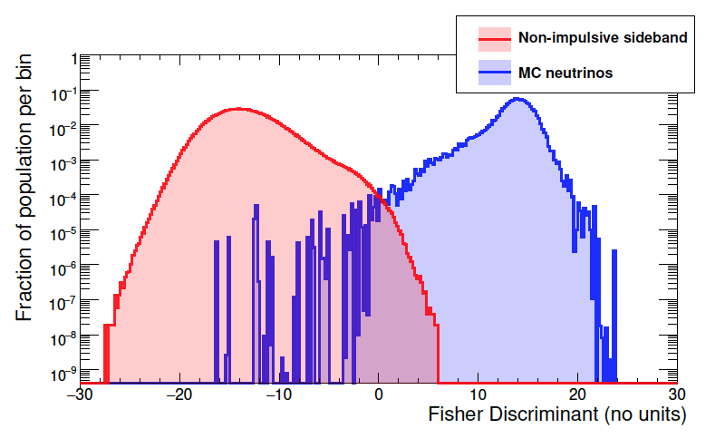
2 Clustering-Based Analyses
3-stage analysis:
  Round 1) Separate onboard-noise-like events
  Round 2) Separate thermal-noise-like events using interferometry, etc.
  Round 3) Separate man-made-like noise events using clustering
Round 1+2 Cut Separation (96% efficient)
Round 3 Cuts: Efficiency on MC
Neutrinos from Clustering (88%)
Gorham et al. arXiv:1803.02719

Slide 21
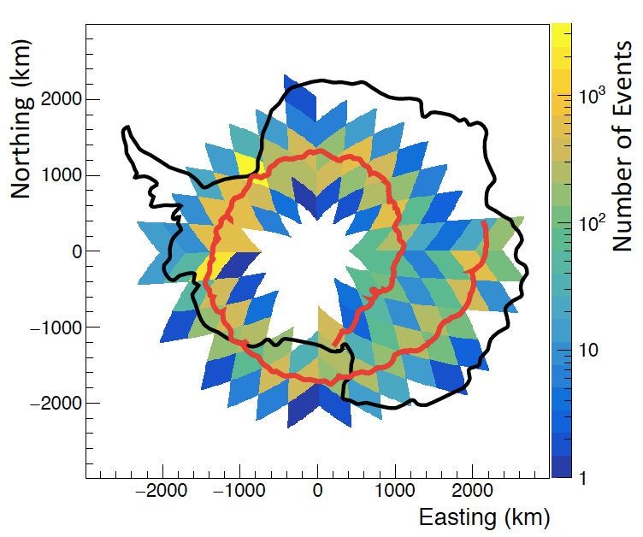
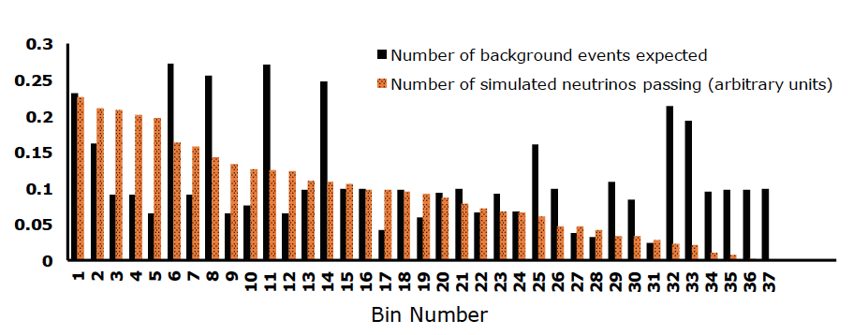
New Analysis Approach:
1 Analysis Based on Geographic Binning
Conduct an independent search in each HEALPix bin, set different cuts in different bins according to the properties of the events in that bin
Background estimates and efficiencies calculated bin-by-bin
Especially good for point source and transient searches
O. Banerjee
Monte Carlo Expectation
Gorham et al.
arXiv:1803.02719

Slide 22
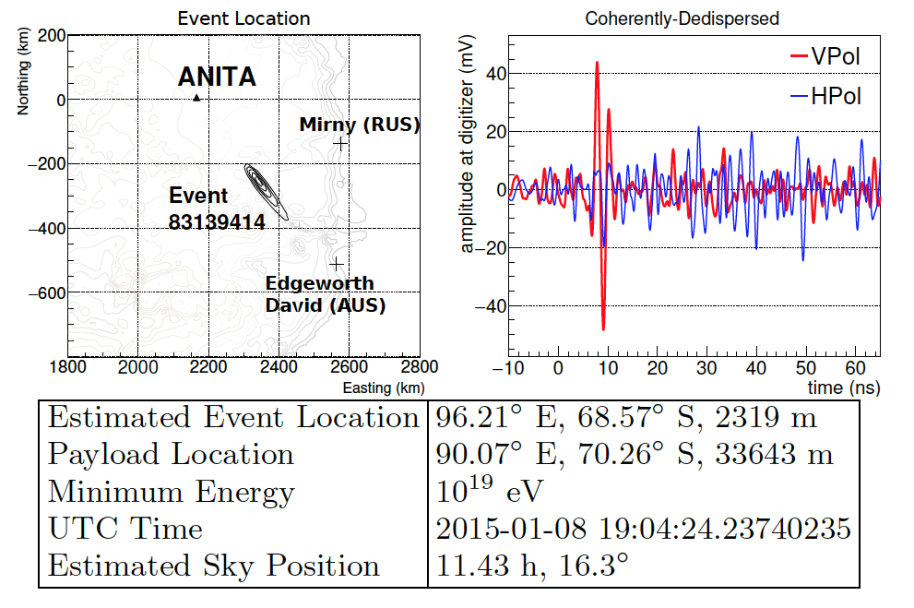
Askaryan Neutrino Search Results
For the most sensitive of the three analyses:
  Total analysis efficiency: 84%
  Total background estimate: 0.7^{+0.5}_{-0.3} events
  1 event in signal region
Gorham et al.
arXiv:1803.02719

Slide 23
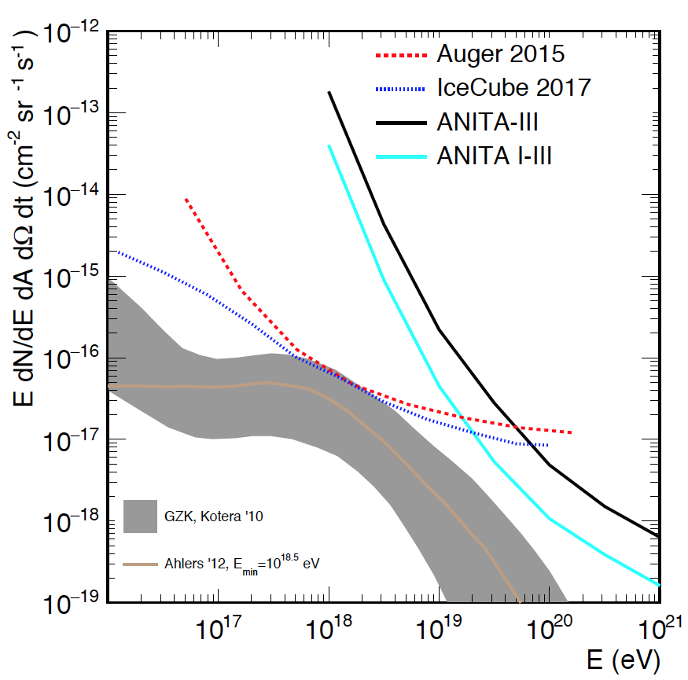
ANITA-3 Neutrino Flux Constraints
ANITA-III suffered from significant man-made noise (mostly satellites that had been launched after ANITA-II), and therefore low livetime
Combined ANITA constraints are the best above 10^{19.5} eV
Analysis techniques have been significantly improved, and new techniques have been developed
Gorham et al.
arXiv:1803.02719

Slide 24
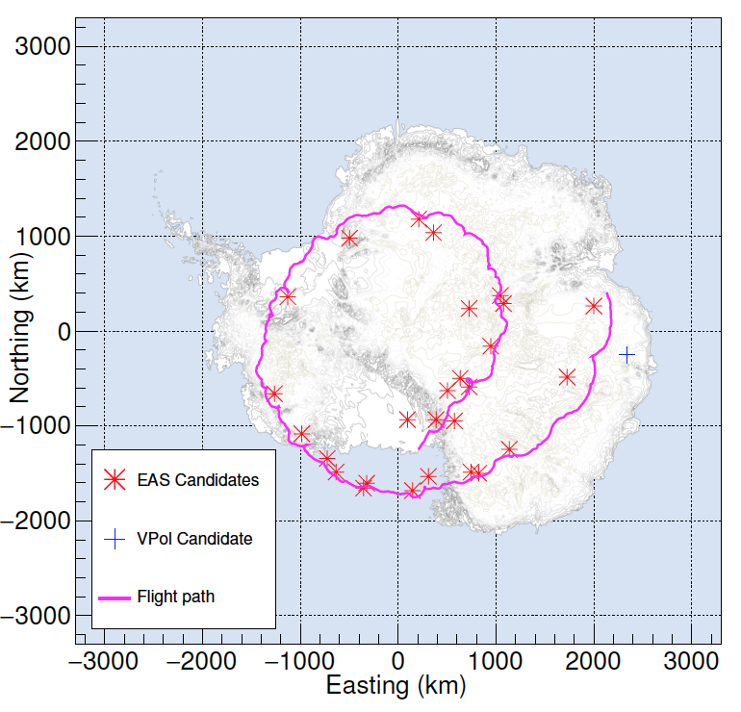
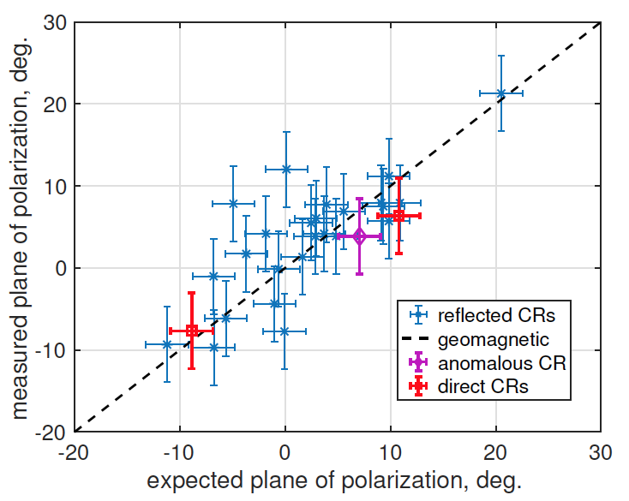
ANITA-III Air Showers
(Cosmic Rays + Tau Neutrinos)
EAS Signals are horizontally-polarized (HPol)
Performed additional dedicated EAS search using template matching
ANITA-III: 28 (26 below-horizon +2 above-horizon) HPol events consistent with EAS observed
  Simulation and energy estimate to come
Gorham et al. arXiv:1803.02719
Gorham et al., arXiv:1803.05088

Slide 25
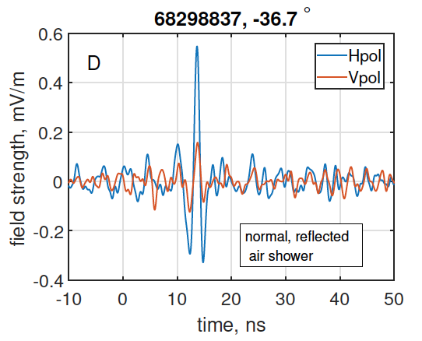
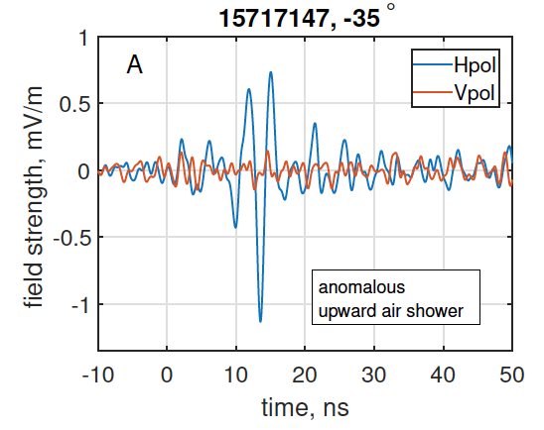
A Second “Mystery Event” in ANITA-III
Polarity should be the same for all reflected cosmic ray events
One of the 26 below-horizon air showers is NOT the same polarity as the rest
Background estimate (a posteriori) is < 10⁻²
Sign of an upgoing (tau neutrino?) air shower?
Problem: too steeply upgoing for standard model cross sections
Energy estimate of 0.56 EeV
Typical Cosmic Ray-like Event
Mystery Event
Gorham et al., arXiv:1803.05088

Slide 26
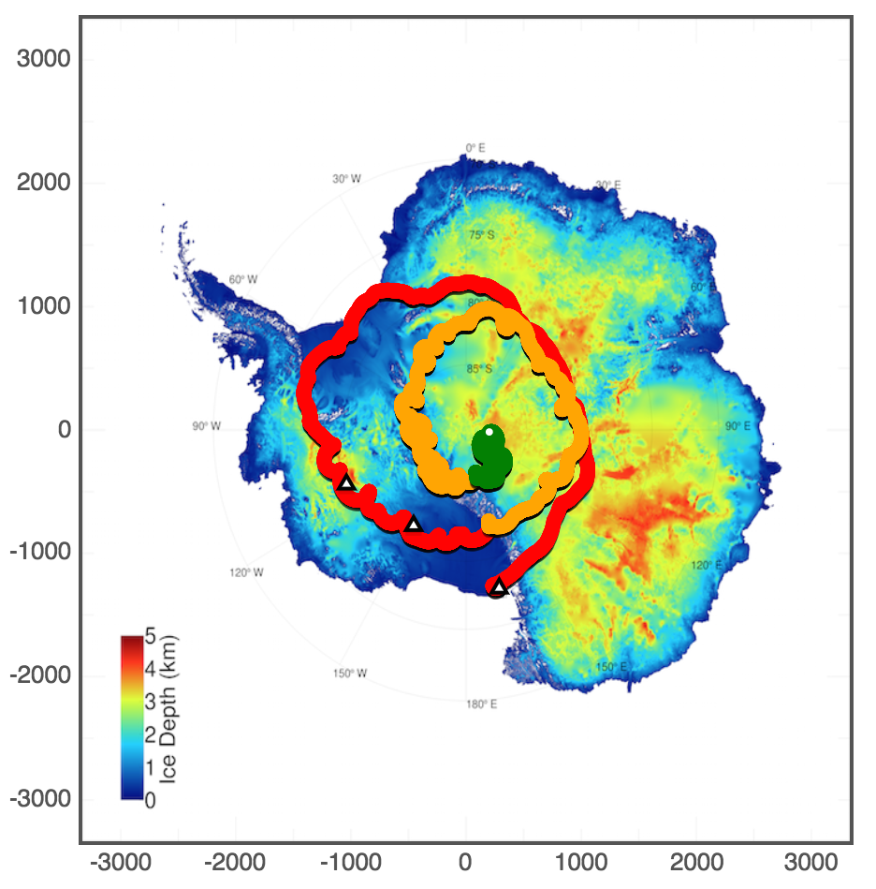
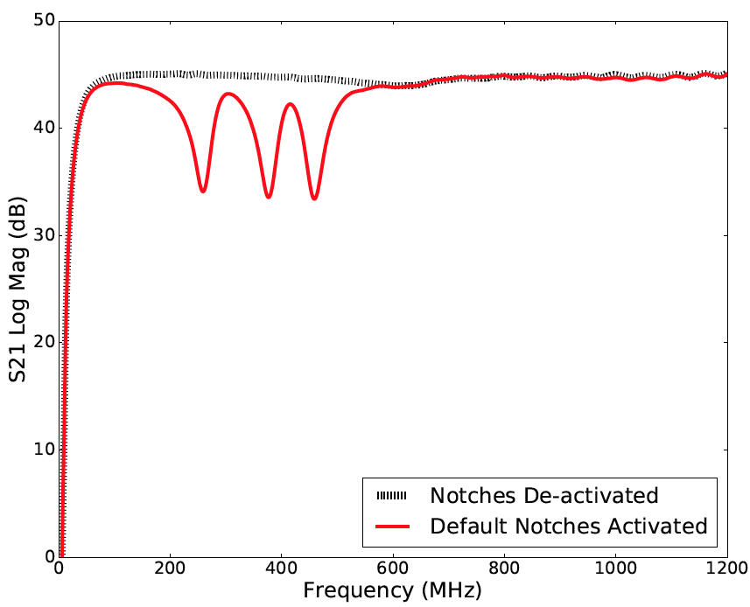
ANITA-IV: Flight in 2016-17
New programmable notch filter to improve livetime (x2.8!)
Expect 100’s of EASs and a factor of a few sensitivity to neutrinos
Stay tuned
TUFF Performance
ANITA-IV Flight Path
Allison et al., NIM, 2017

Slide 27
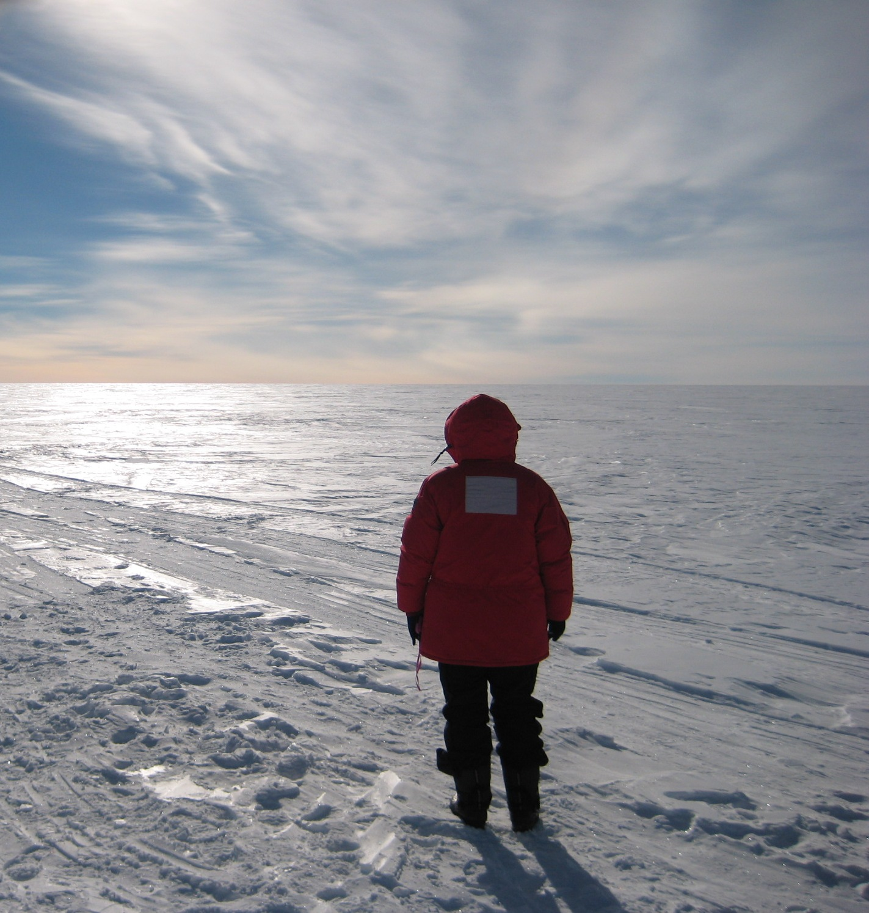
Summary and Future
ANITA has a rich physics program, with the best neutrino sensitivity at 10^{19.5} eV and above and self-triggered UHECR events >10¹⁸ eV
Published things I didn’t talk about:
  Lorentz invariance violation, Magnetic monopole searches, Neutrinos from GRBs, HiCal ice property measurements, etc.
ANITA-IV is expected to be ~x4 better than ANITA-III and ANITA-I
  If any mystery events are tau neutrinos, we should see more…
ANITA-V will have new hardware! An interferometric trigger to reduce thresholds and increase sensitivity

Slide 29

ANITA Sensitivity to $ν_{τ}$-Induced Air Showers
~2 month ANITA exposure more than 2 orders of magnitude lower than ~ 10 years of IceCube & Auger
Acceptance comparable to IceCube / Auger for energies > 10¹⁹ eV

Slide 30
Variations on the Exposure

