Slide 1


Imaging the Earth’s environment via ENA:
Space Weather applications
BepiColombo SERENA team

Slide 2

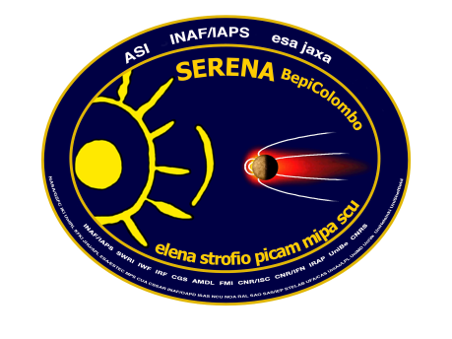


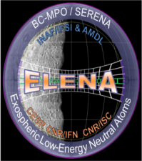







Instrument package on board BepiColombo/MPO
SERENA
Search for Exospheric Refilling
and Emitted Natural Abundances
Neutral and Ionized Particle Detectors for Hermean Environment Investigations
S. Orsini (PI), S. Livi (CoPI-STROFIO), K. Torkar (CoPI-PICAM), S. Barabash (CoPI-MIPA)
A. Milillo (PI Dep., Sci. Coord.), P. Wurz (Sci. Coord.), A. Olivieri (ASI PM), E. Kallio (SGS),
and the SERENA TEAM
ELENA: Emitted Low Energy Neutral Atoms
Neutral particle emission form Mercury’s surface
STROFIO: Exososphere Mass Spectrometer
Exospheric density and composition
PICAM: Planetary Ion CAMera
Planetary ions composition and distribution
MIPA:Miniature Ion Precipitation Analyzer
Solar wind ion precipitation
INDUSTRY: OHB-CGS (Milano) & AMDL (Roma)

Slide 3
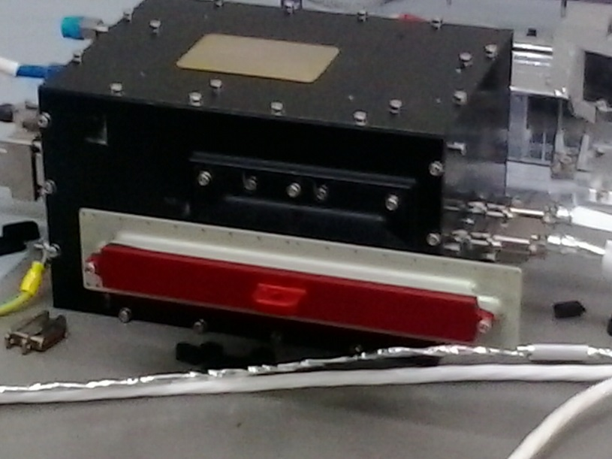
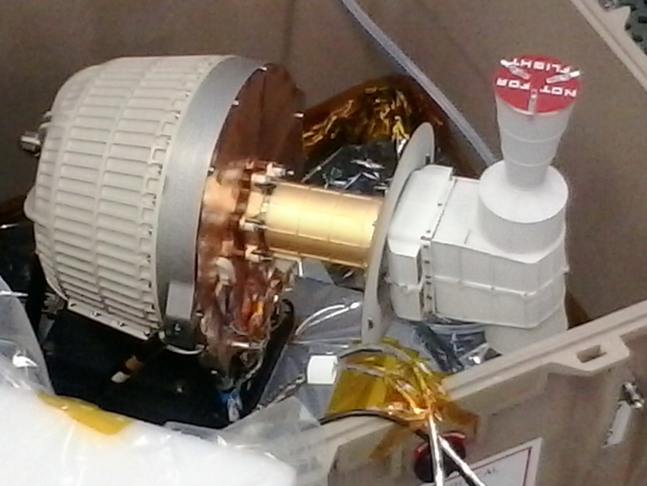

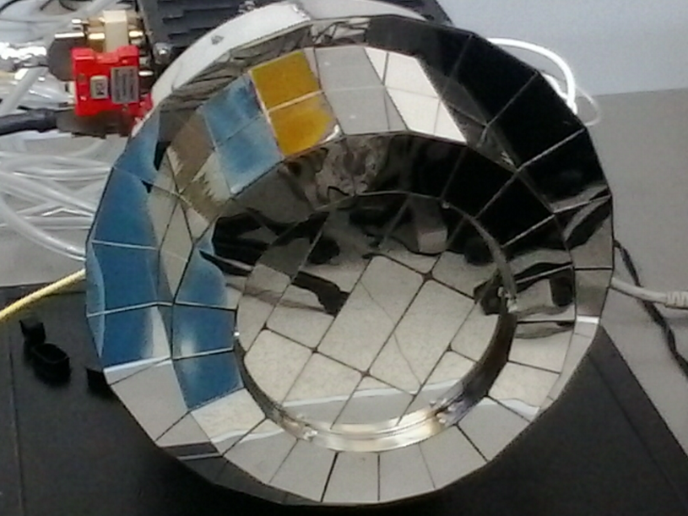
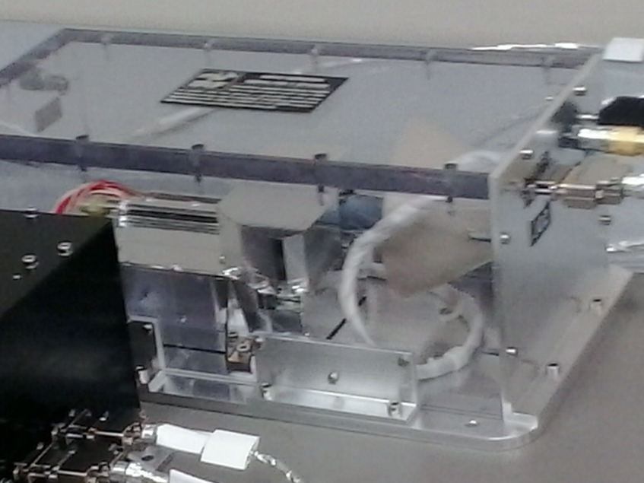

Instrument package on board BepiColombo/MPO
SERENA
S. Orsini - Master Scienza e Tecnologia Spaziale, 2016
Notes:
SERENA with its 4 units is an appropriate instrument for investigating these interactions

Slide 4
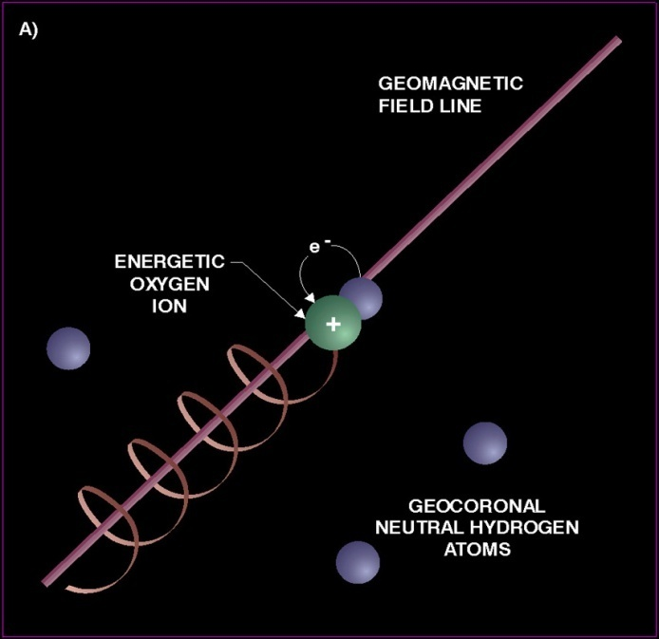
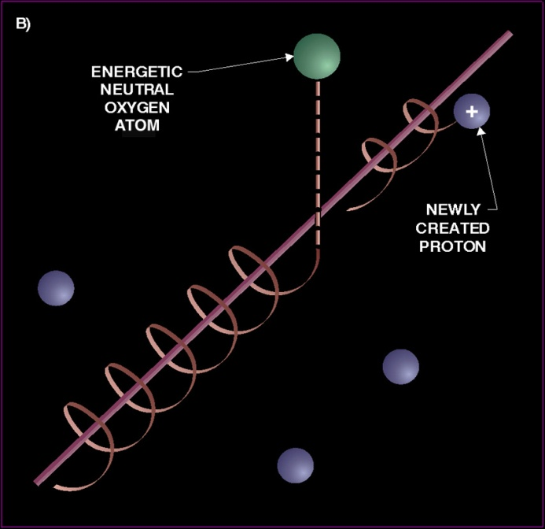
Plasma imaging via ENA detection
Whenever magnetospheric plasma interacts via charge exchange with the Earth’s exosphere (geocorona), Energetic Neutral Atoms (ENA) escape from the generation region, and transfer the plasma parameters well far away, to any ENA imager properly located in space.

Slide 5
Line of sight integration
The ENA flux of energy E originating from R and arriving at the observation point R_{o} along the direction s due to a single ion specie (ion) is:
dR
where D_{H}(s,E) is the destruction of energetic H or the portion of H generated at R but not arriving at R_{o} generally this can be considered negligible in the exospheres.

Slide 6
Charge-exchange process at the Earth and ENA generation
GEOCORONA
ENA
Plasma
ATMOSPHERE
Charge-exchange
Earth

Slide 7
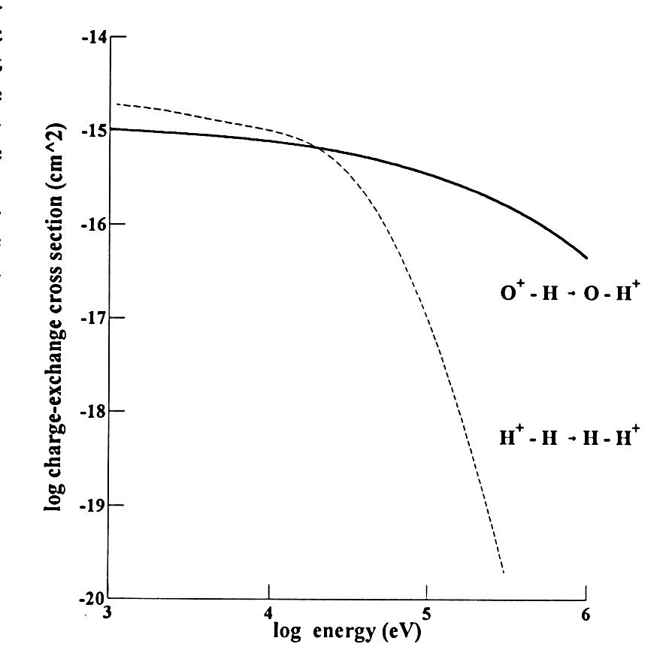
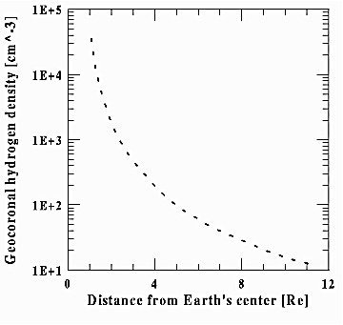
dENA flux =
Cross section
* exospheric density
*Ion Flux* dR
???

Slide 8
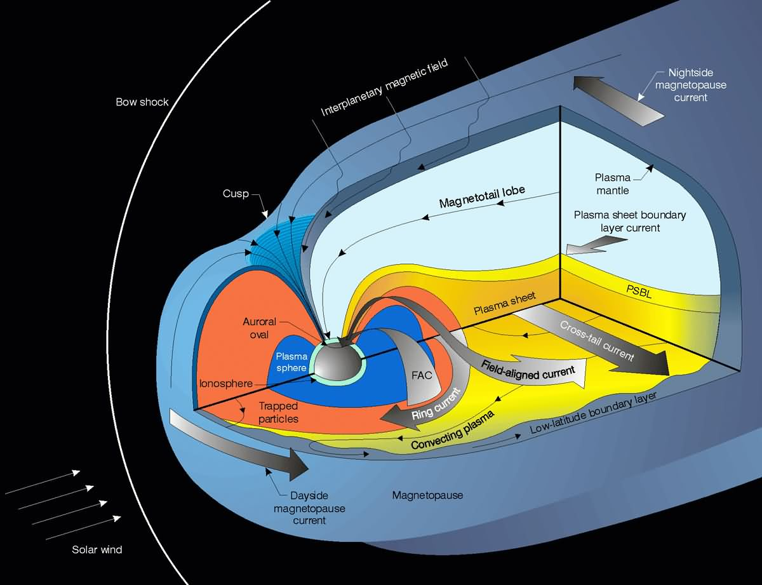
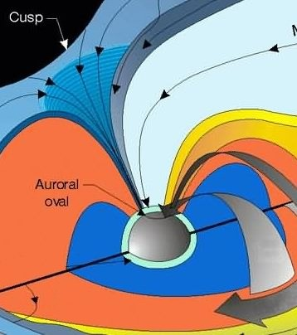
DAYSIDE
Cusp / LLBL
particle precipitations
NIGHTSIDE
SUBSTORMS
poleward expansions
BOUNDARY
PHENOMENA
LLBL / BPS
S. Orsini - Master Scienza e Tecnologia Spaziale, 2016

Slide 9
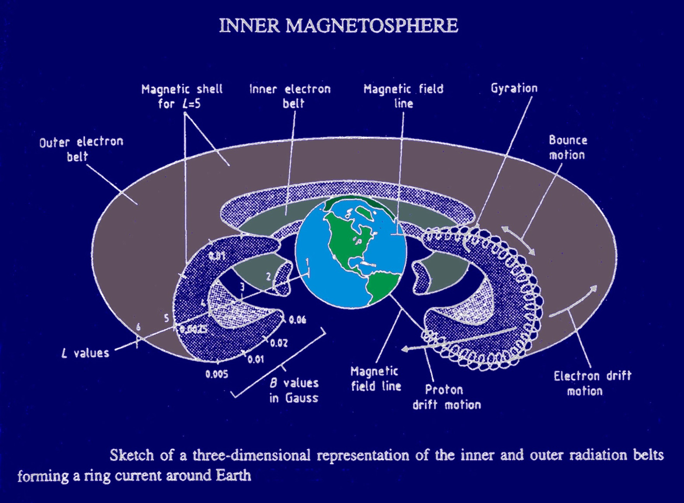
THE RING CURRENT
S. Orsini - Master Scienza e Tecnologia Spaziale, 2016
Master Scienza e Tecnologia Spaziale, 2014

Slide 10
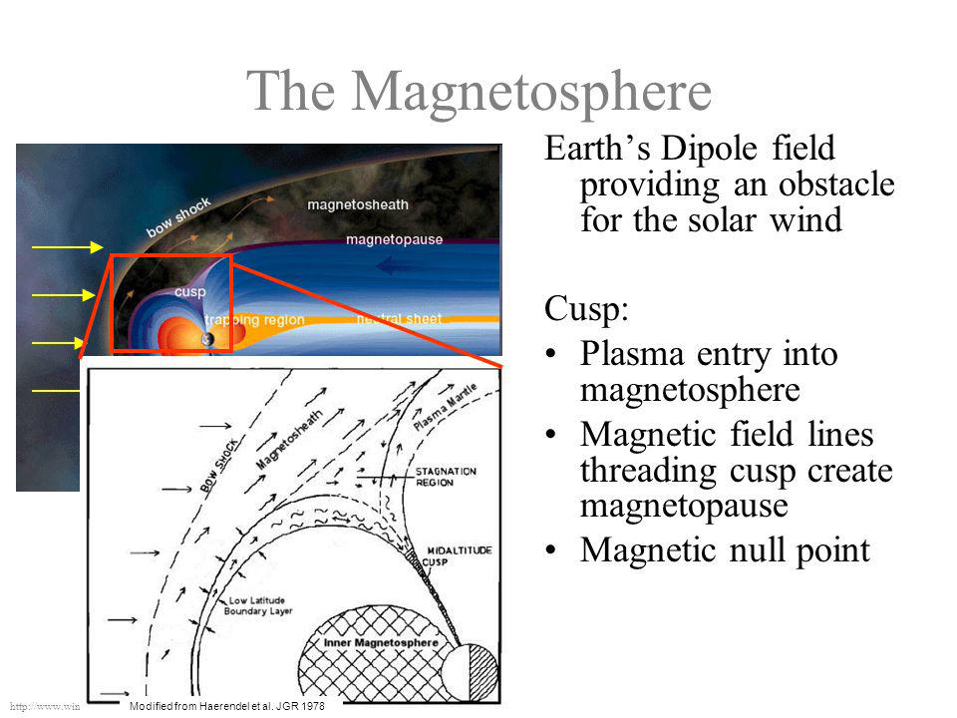
S. Orsini - Master Scienza e Tecnologia Spaziale, 2016

Slide 11
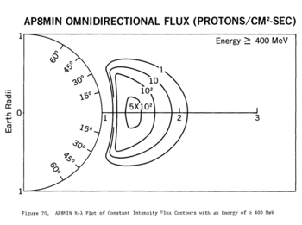
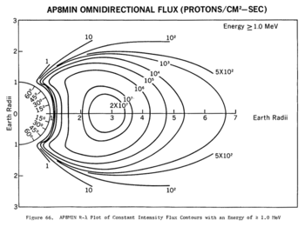
THE RADITION BELTS
SATELLITE ORBIT
S. Orsini - Master Scienza e Tecnologia Spaziale, 2016
Master Scienza e Tecnologia Spaziale, 2014

Slide 12
ENA imaging in planetary environments
ENA imaging is very powerfull in the planetary environments remote sensing, since in situ observations cannot provide information on plasma global dynamics, as in the Terrestrial case …

Slide 13
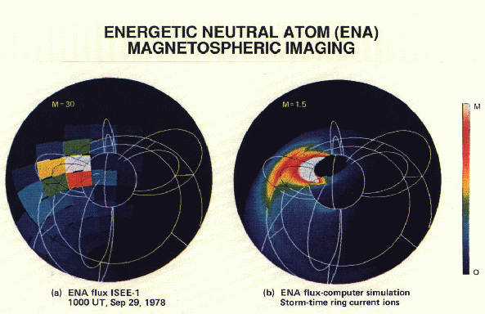
Energetic Neutral Atoms discovery
Roelof et al, 1985 and Roelof and Williams [1988] constructed the first ENA image of the geomagnetosphere.
Roelof

Slide 14
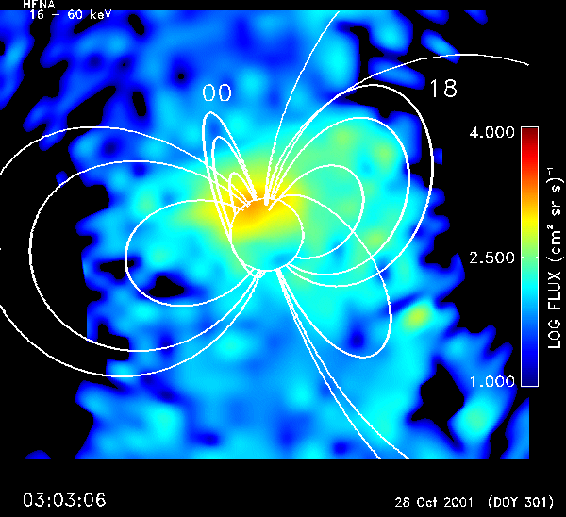
Hydrogen ENA from IMAGE/HENA
(fm.: Mitchell et al., Yosemite 2002 Magnetospheric Imaging Workshop )

Slide 15
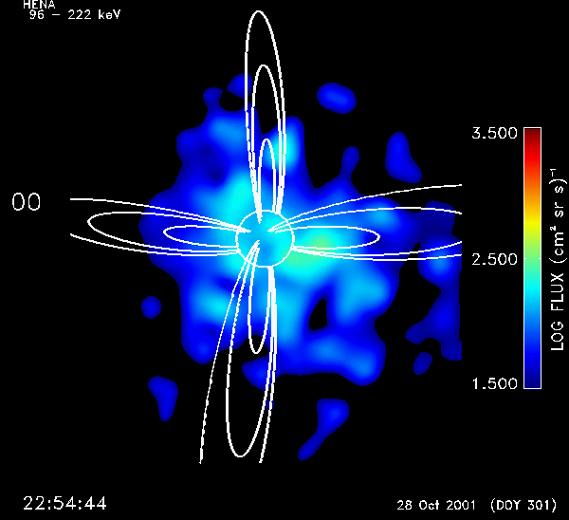
An Oxygen ENA
Image of the
Earth Environment
(IMAGE / HENA,
fm.Mitchell et al.)

Slide 16
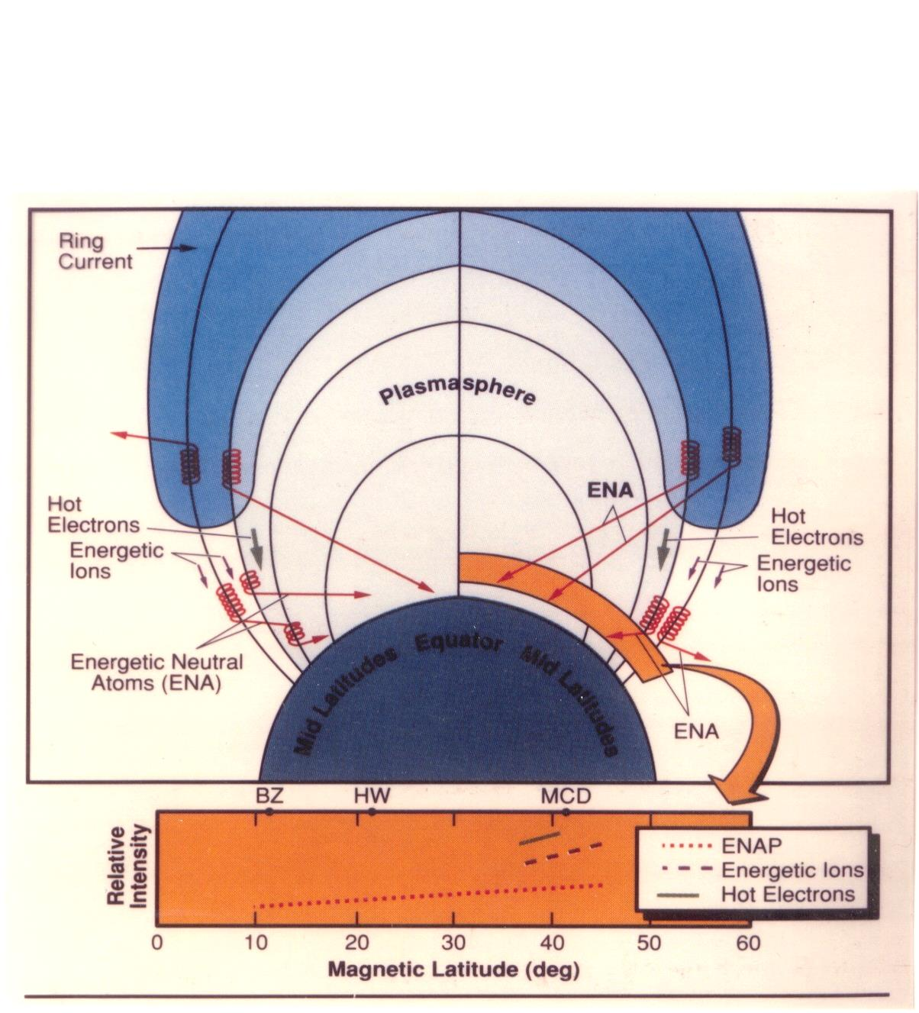
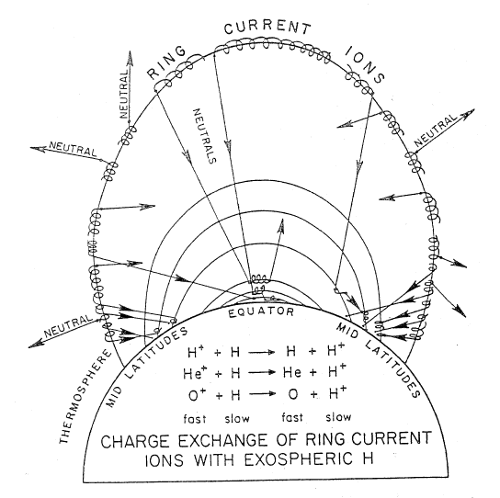
ENA precipitating at low altitudes
Tinsley et al., 1984
S. Orsini - Master Scienza e Tecnologia Spaziale, 2016

Slide 17
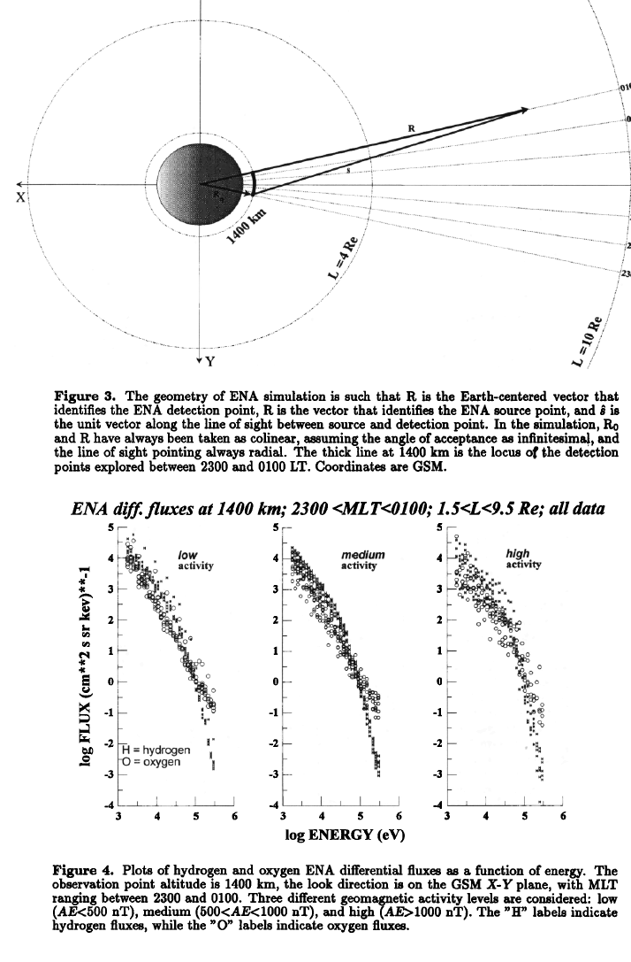

Slide 18
S. Orsini - Master Scienza e Tecnologia Spaziale, 2016

Slide 19
ENA from TWINS mission
(Goldstein and McComas, SSR, 2013)

Slide 20
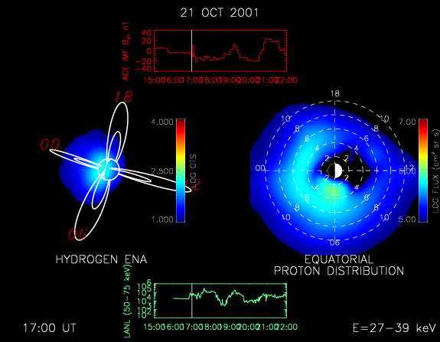
ENA signal deconvolution
(fm.: Brandt et al., Yosemite 2002 Magnetospheric Imaging workshop )

Slide 21
ENA detection concept and instruments

Slide 22
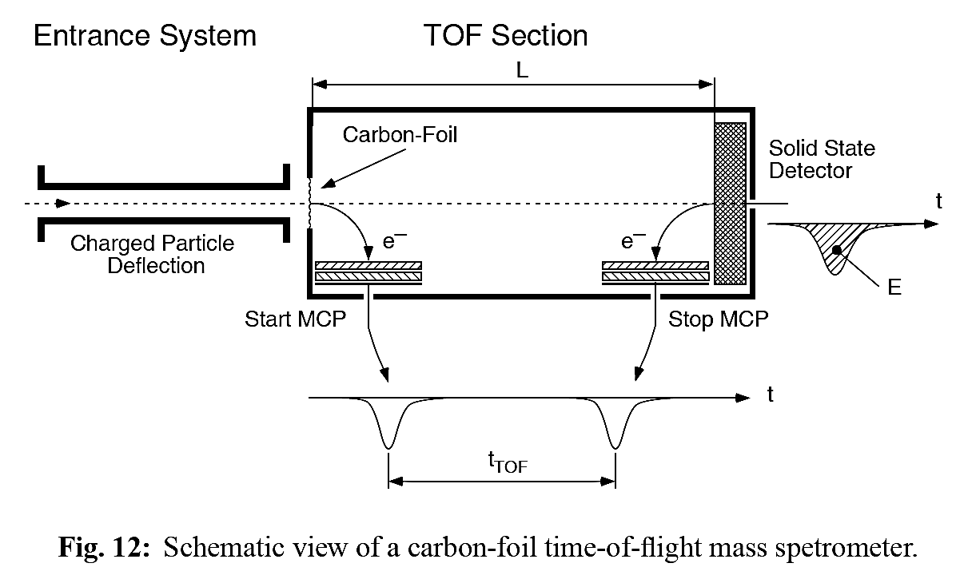
H-ENA Instrument techniques: ~ tens keV
A commonly used method to identify high-energy neutral atoms in terms of mass, energy and direction is schematically shown in the figure. Basic elements are a carbon foil (start section) and a solid state detector (SSD, stop section)
This technique has been used in various H-ENA instruments
(e.g.: IMAGE/HENA; CASSINI/INCA; IBEX Hi, etc.).
Notes:
Indirect:problema scattering angolare …noi buona risoluzione angolare

Slide 23
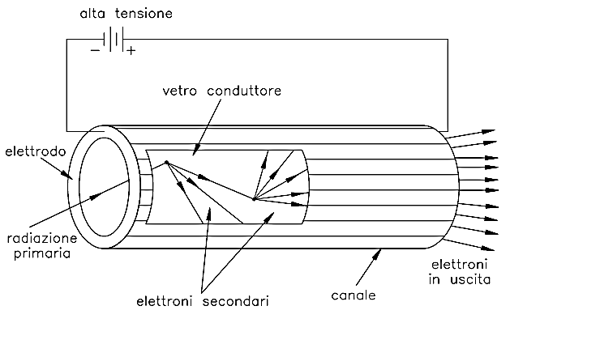
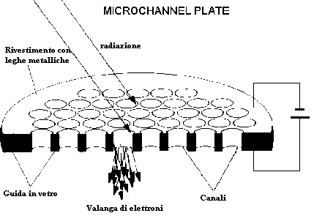
Micro Channel Plate
The MCP is formed by micro channels that are electron multipliers. The multiplication takes place under the presence of a strong electric field. A particle or photon that enters one of the channels through a small orifice hits the wall of the channel. The impact starts a cascade of electrons that propagates through the channel, which amplifies the original signal by several orders of magnitude depending on both electric field strength and geometry.
Micro channel plate arrays may be fabricated in a wide variety of formats.
The electrons exit the channels on the opposite side where they are detected by a discrete ensemble of anodes measuring total current with information on position

Slide 24
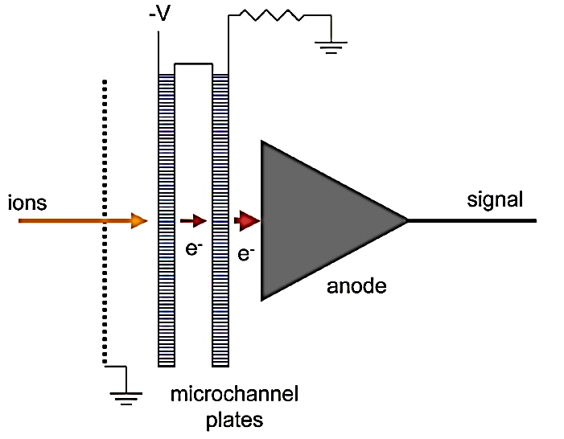
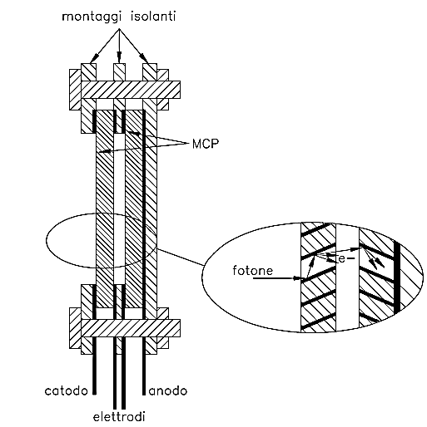
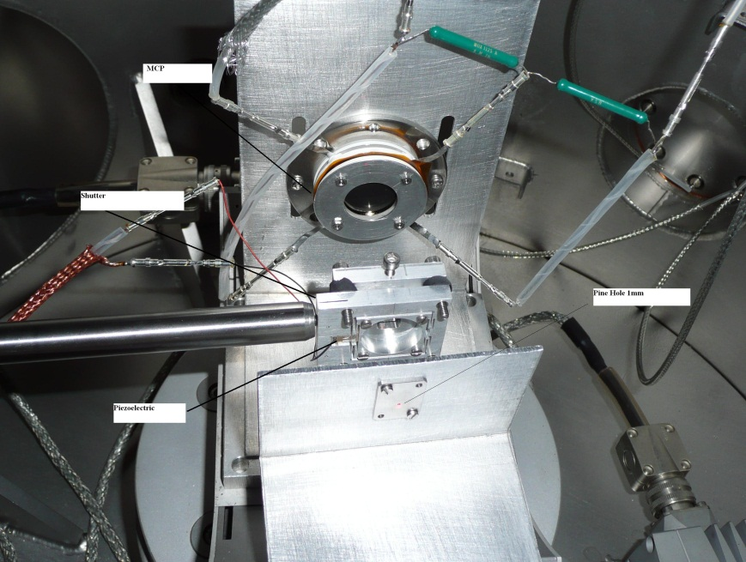
Chevron MCP
In a chevron MCP the electrons that exit the first plate start the cascade in the next plate. The advantage of the chevron MCP over the straight channel MCP is significantly more gain at a given voltage. A single input event will generate a pulse of 10^7 or more electrons at the output
Notes:
Per elena abbiamo una configurazione di tipo chavron in cui 2 microchannel plate vengono accoppiate in modo che gli elettroni uscenti dalla prima generauno una cascata nella seconda. Ovviamente si avrà un netto migliormento del guadagno che puo’ anche essere superiore ai 10^7 ordini di grandezza.

Slide 25
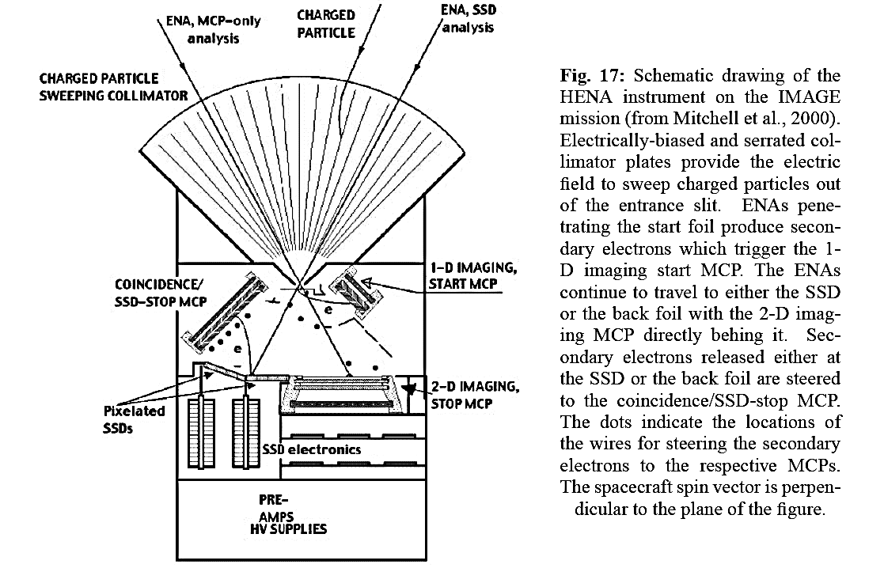
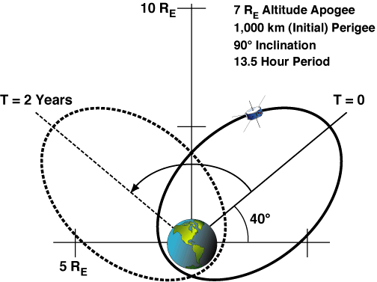
SAMPLE INSTRUMENT: IMAGE HENA
Notes:
25

Slide 26
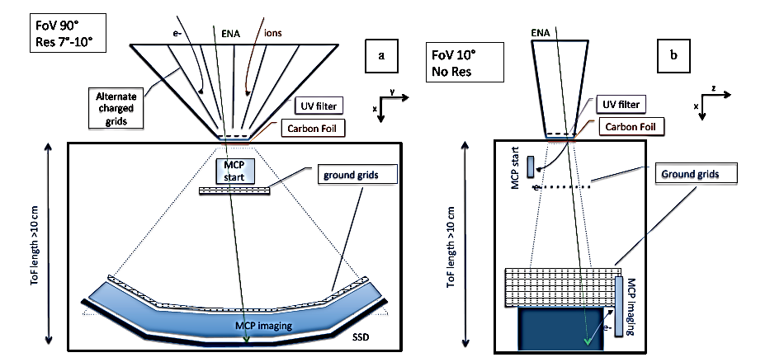
SAMPLE INSTRUMENT: ENAMISS PROPOSAL
The solid-state detector (SSD) provides a STOP event characterized in energy and 1D position, and it is made of thin dead-layer Silicon Avalanche Photodiodes (Si-APDs), which provide high-resolution and reliable detection efficiency with low mass and power even at room temperature (Ogasawara et al, 2012). The APDs provide a proportional signal which allows to determine the energy of incident particles by analyzing the charge pulse amplitude from the detector.
Notes:
26

Slide 27
ENA detectors performances to improve

Slide 29
Angular Resolution
For energies between 10-100s keV the angular resolution of the ENA imaging achieved with the present technology is about 4°-15° degrees.
For sub keV- keV ENA, The Chandrayaan-one/CENA sensor has angular resolution of 25°. IBEX sensor has a resolution of about 7°, while the angular resolution obtained by the ELENA sensor for the BepiColombo mission devoted to sub keV- keV ENA is about 5°.
The possibility to obtain angular resolution better than 5° would open new potentialities of ENA investigation at any energy range.

Slide 30
Field of View
A particle 2D imager can be obtained with various strategies.
Generally, when a wide FoV is required, as in the magnetospheric imaging, a spinning spacecraft is the optimal solution, so that the FoV can be constituted by an array of sectors (about 160° x Δα) since the second dimension is obtained by short-time series of acquisitions within the spin period.
Whenever ENA imaging of a surface is required, the FoV could be a nadir-pointing array of about 60° x Δα and the second dimension can be obtained with the cross-track of three-axis stabilized s/c, nadir pointing (like BepiColombo).
Any 2D instantaneous imaging intrinsic capability would greatly improve the observations quality, in terms of geometrical factor and time resolution.

Slide 31
Mass resolution
Generally the mass discrimination of the ENA is not a major requirement, since the expected species are mainly H, He and O, so that 5 mass channels are enough. Anyway, having a triple coincidence detection (ToF and Energy) helps also in the false counts analysis.

Slide 32
Flux intensity dynamical range
The charge-exchange ENA production is generally not too efficient, depending on the very low cross section. Anyway, the long line-of-sight integration path usually makes the magnetospheric ENA flux detection feasible (10- 10⁴ (cm² s keV)⁻¹). This necessity increases the uncertainty related to the source regions extension.
For such reasons, any possible technique able to improve the detector sensitivity and efficiency is strongly required

Slide 33
Thank you for your attention

