Slide 1
Gaseous and dual-phase time projection chambers for imaging rare processes
Diego Gonzalez Diaz, Francesc Monrabal, Sebastien Murphy
26/09/2017
*link to appear in arXiv soon
(60 pages, 450 references)

Slide 2
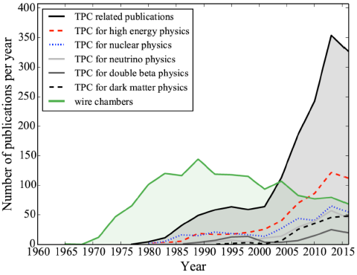
from scopus (efficiency and purity of selections verified to be within 20%)

Slide 3
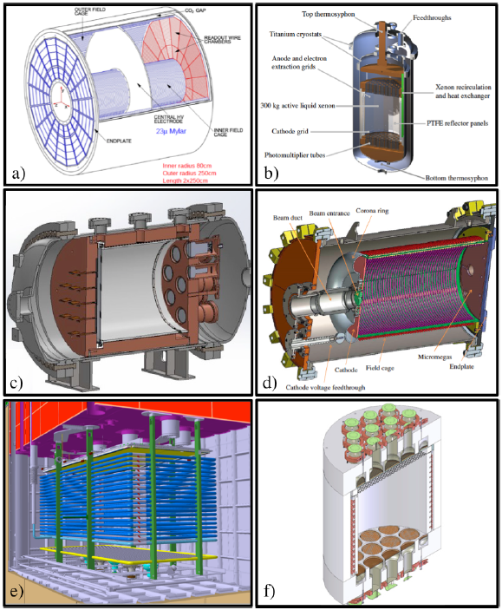
ALICE
LUX
NEXT-NEW
AT-TPC
DUNE Far Detector
(dual phase prototype)
DarkSide-50
*many more in text
…

Slide 4
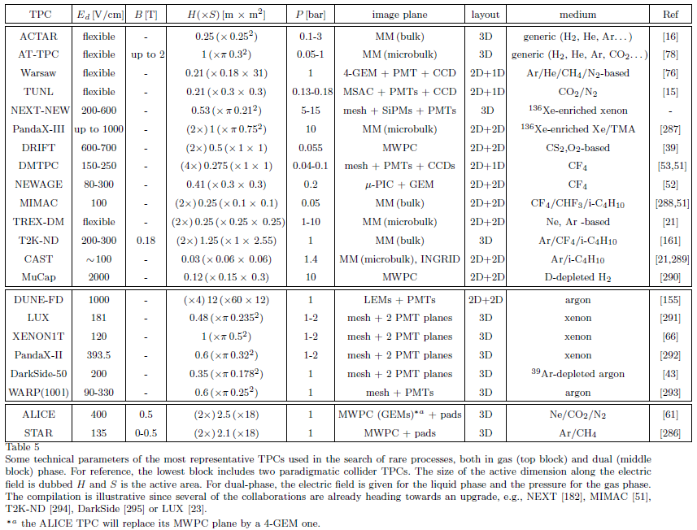
*more in text
…

Slide 5
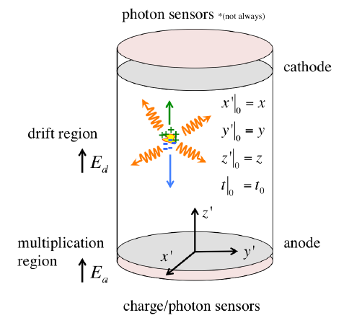
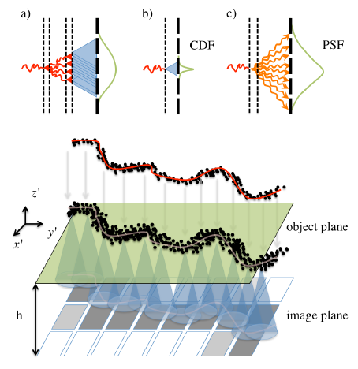




A generic TPC for rare event searches
A generic image formation process in a TPC
point spread function
Aimed at complex topologies and maximal collection
of event information.
Seamless! (no beam pipe).
Usually no space-charge issues.
No ageing issues (interaction rate is low).
Radiopurity issues (in some cases).
B-field seldom found.
impulse response function

Slide 6
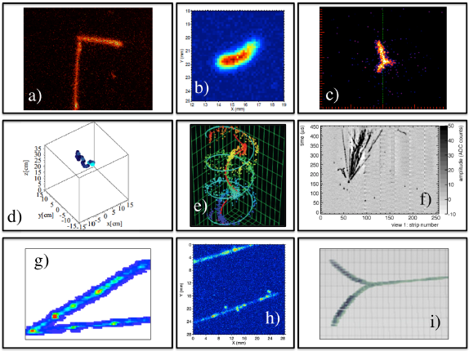
Warsaw TPC
[β-delayed proton emission from ⁴⁶Fe]
DMTPC-related R&D
(214keV_{r} F nucleus)
TUNL TPC
[photo-dissociation of ¹²C
into 3 α tracks]
ILC-related R&D
(low energy e⁻)
NEXT-MM
(1.25MeV e⁻)
DUNE-FD R&D
(cosmic ray- induced
nuclear breakup
HARPO
(pair production by 74.3GeV photon)
DMTPC-related R&D
(~30keV e⁻)
AT-TPC
(α-α scattering)
*more in text
…

Slide 7
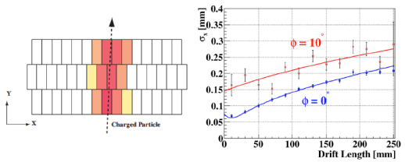

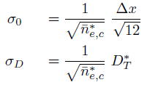
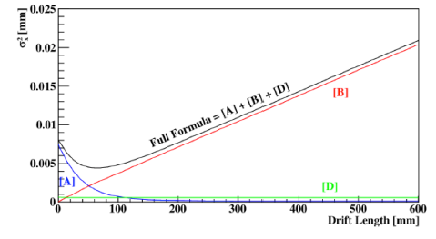


Topology reconstruction in collider/tracker TPCs
Aim: reconstruct the effective position at various track segments and
develop a track model (to obtain curvature and vertex)
Position ‘resolution’ is paramount (pixel size is not!). Typical: few 100’s μm.
Ambiguities due to high track multiplicity enforce pixel/pad-based (3D) readout.
T₀ obtained from trigger.
(e.g., for conventional Micromegas)

Slide 8
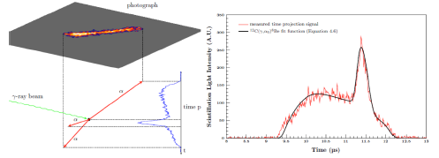
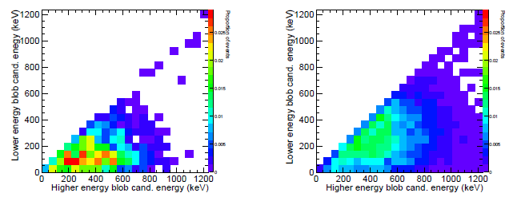
Topology reconstruction in rare event TPCs
(frequent) aim: reconstruct the energy loss path with high accuracy (to obtain particle(s) type, direction and energy, and event multiplicity)
xy projection
z projection
Fine track sampling and energy resolution is paramount (fine-pitch readout and high S/N needed).
Low track multiplicity can allow 2D+2D o 2D+1D readouts but small pitch relative to track size is essential.
T₀ often obtained by additional means! (scintillation, minority carriers)
background
signal

Slide 9
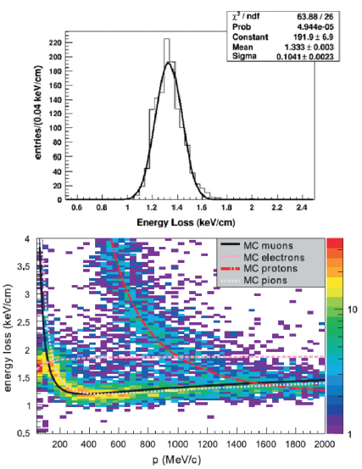
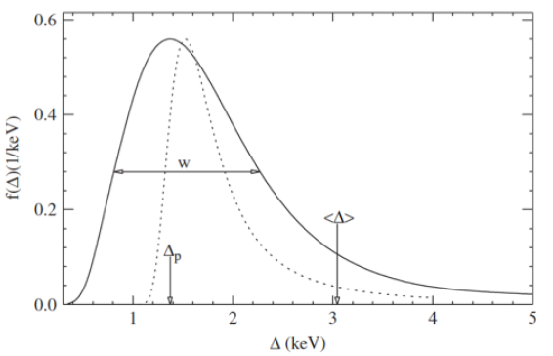
Energy reconstruction in collider/tracker TPCs
Problem: tracks are usually not contained and Landau fluctuations dominate
T2K-TPC
A popular phenomenological formula by Walenta, Allison
and Cobb (still in use):

Slide 10
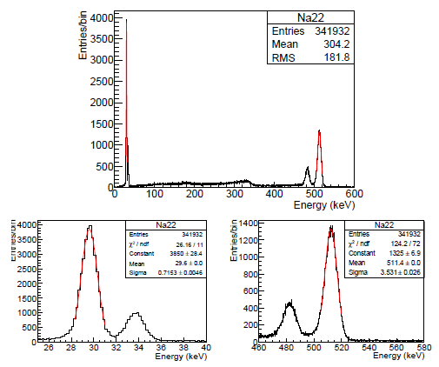

Energy reconstruction in rare event TPCs
Advantage: tracks are usually contained and Landau fluctuations are absent!
xy projection
z projection

Slide 11

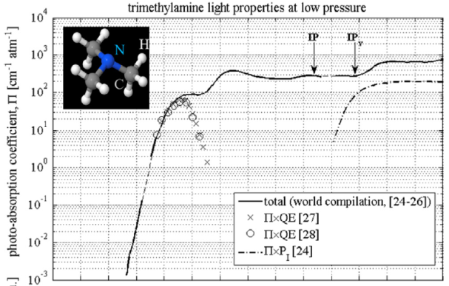
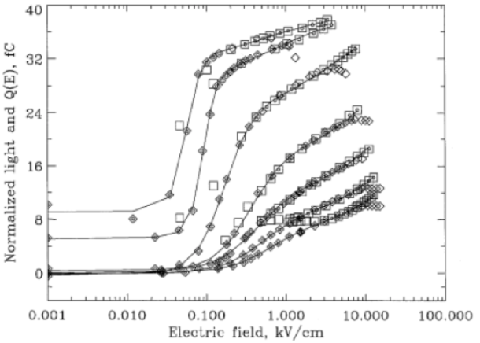
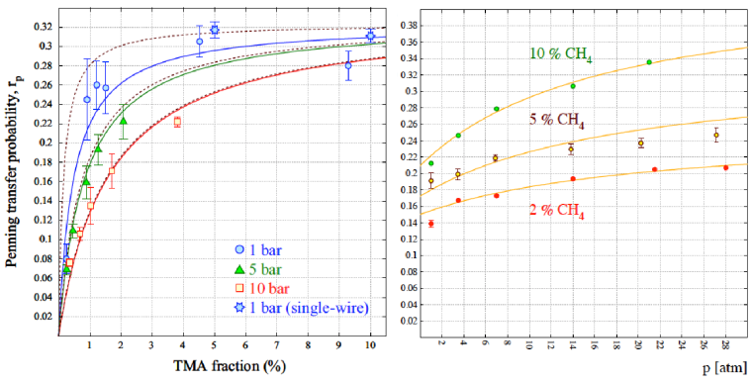




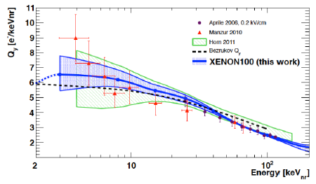
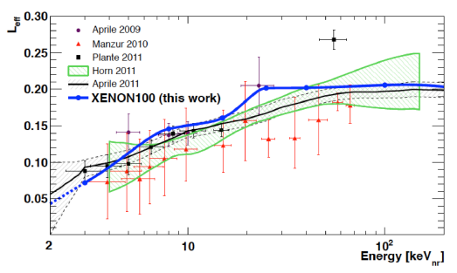
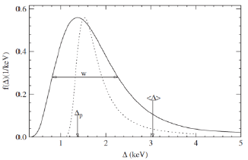
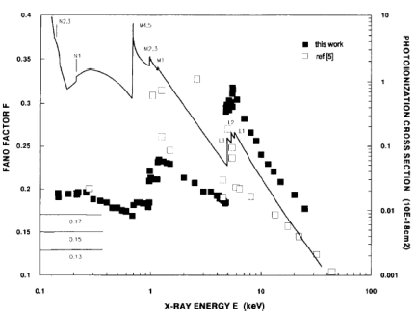
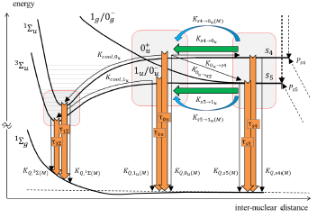
Primary processes of interest
P~10bar
density
Jesse effect / Penning transfers
photo-ionization
charge recombination
ionization ‘quenching’
scintillation ‘quenching’
Landau fluctuations
IR emission (1250nm) for Xe and Ar+Xe.
Heat (bubble-formation of low energy nuclei recently demonstrated in liquid xenon).
Negative ions formation.
Positive ions formation.
Appearance of daughter nuclei in nuclear reactions (e.g., ¹³⁶Ba in ¹³⁶Xe).
Fano fluctuations
scintillation mechanisms and wls
(some) other primary processes

Slide 12


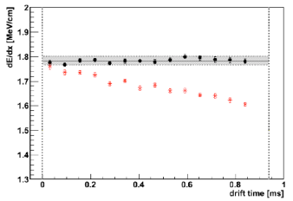
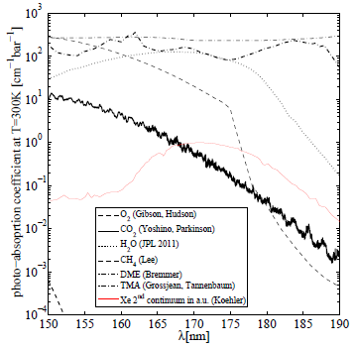
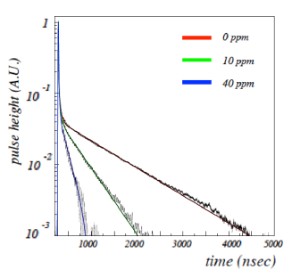




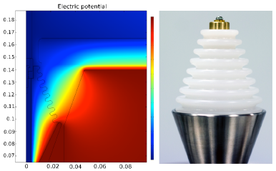
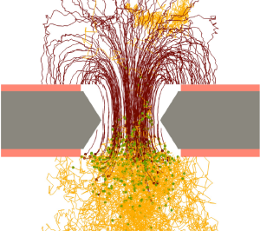
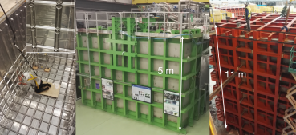
(Ar gas)
Technical problems /enabling assets
(Ar liquid)
light transparency/collection
attachment / purification
VUV-quenching
contained events
uncontained events
fluctuations during multiplication
energy resolution and sensitivity limits
readout layout and electronics
HV
cryogenics
simulation tools

Slide 13
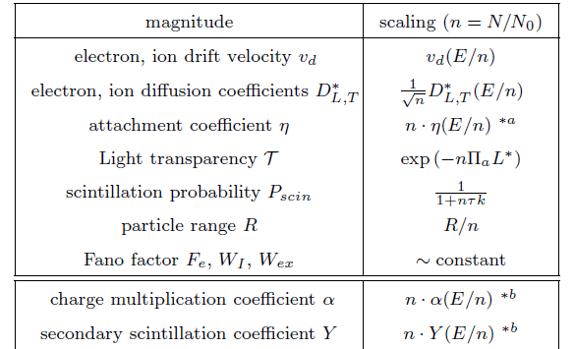
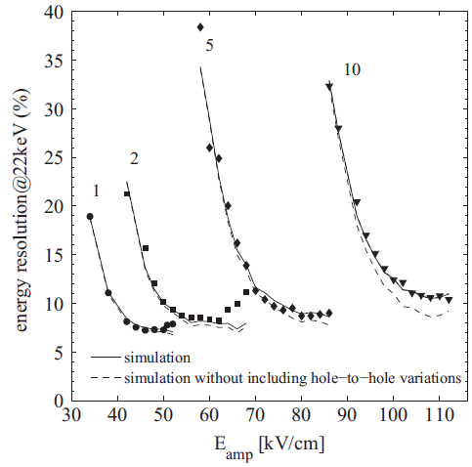
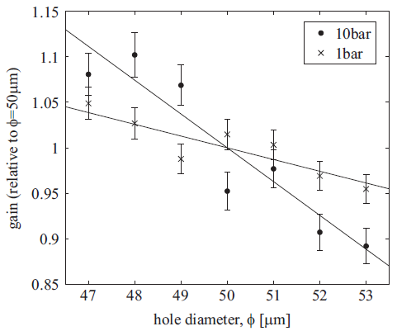
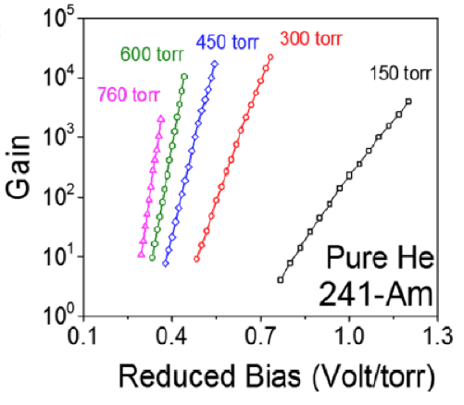
Gas magic I (pressure dependencies)

Slide 14
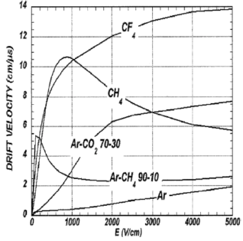
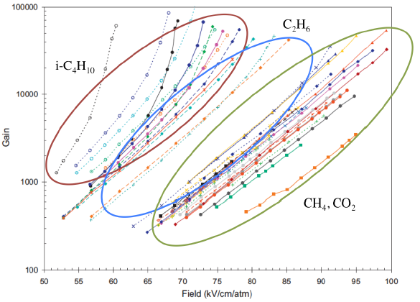
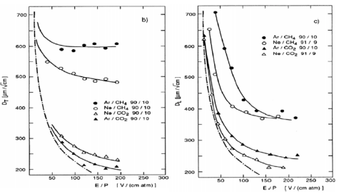
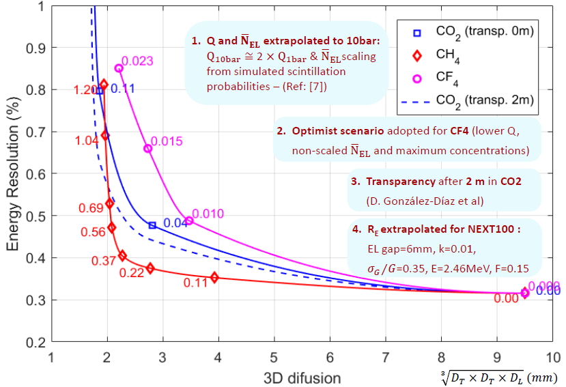
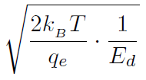

Gas magic II (gas mixture)
argon mixtures

Slide 15
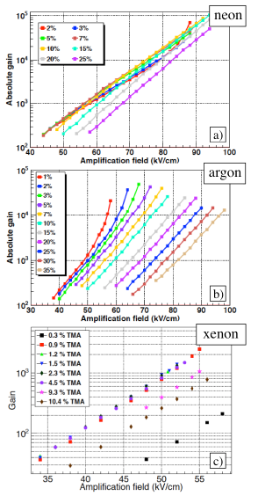
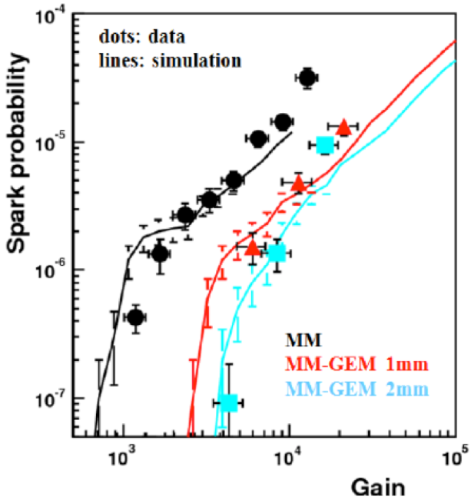
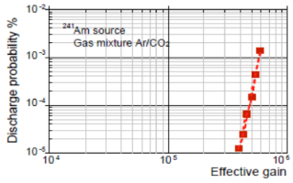
Ionization detection (I): multiplication in quenched gases
maximum gain increases the lower
the charge density
results consistent with an overall charge density limit ~2x10⁹ e/mm²
(see also P. Gasik’s presentation at WG2)
maximum gain decreases the heavier
the noble gas

Slide 16
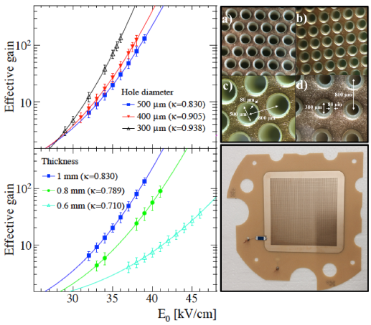
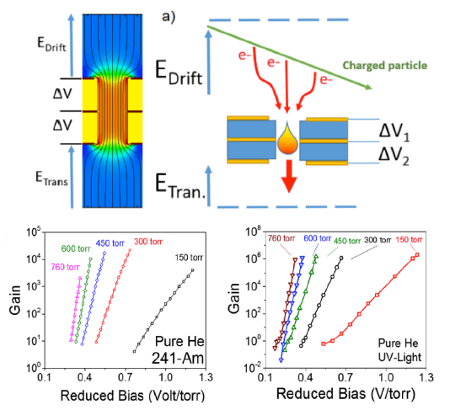
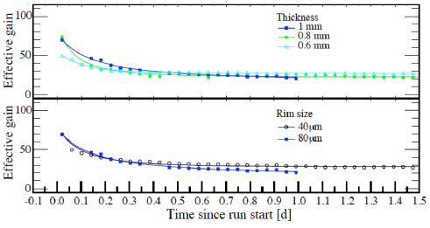
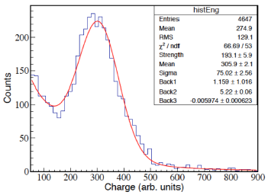
Ionization detection (II): operation under extreme conditions
ultra-pure argon
‘pure’ helium
‘pure’ SF₆ at 40mbar!

Slide 17
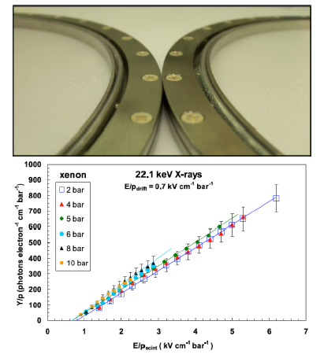
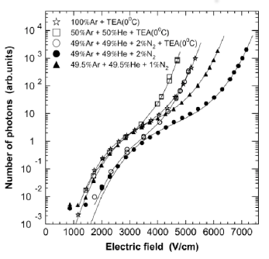


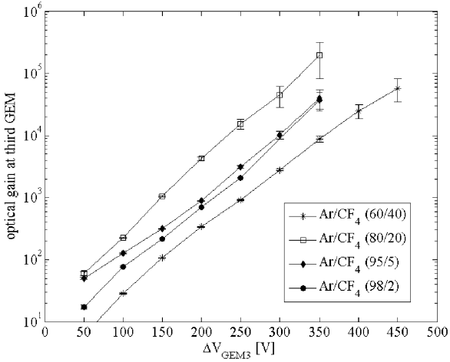
electroluminescence
Ionization detection (III): secondary scintillation
avalanche scintillation
uniform field
3-GEM

Slide 18
some paradigmatic examples

Slide 19
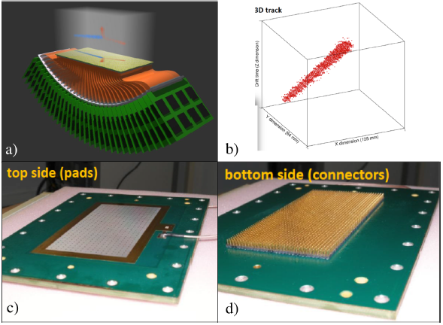
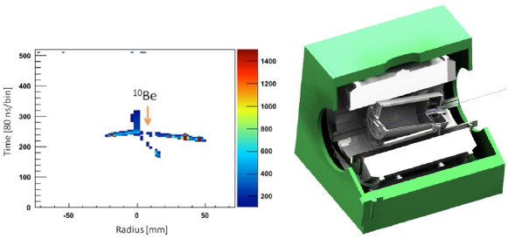
Active targets
ACTAR TPC
AT-TPC
General-purpose TPC for reaction (but also decay) studies, with a size of 25cm x 25cm x 25cm.
High density readout (2mm x 2mm pixels) with gas-tight punch-through pins for socket connection.
Micromegas readout.
16384 channels.
Operation from -1 to 3 bar.
Makes use of the AGET chip.
Under commissioning.
General-purpose cylindrical TPC for reaction studies in a variety of gases (H₂, He, Ar, CO₂…) with a size of 100 cm x π30² cm.
At FRIB in Michigan.
10240 radial pads.
Microbulk Micromegas readout.
Makes use of the AGET chip.
Magnetic field available up to 2T.
Can be tilted (!).
Running.
*more in text
…

Slide 20
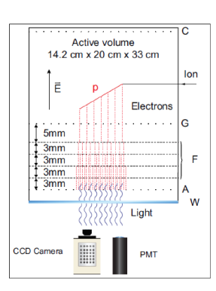

Decay/implantation
Warsaw TPC
2p-decay (⁴⁵Fe)
General-purpose TPC for decay studies, with a size of ~(20 cm)³.
2D+1D readout (CCD camera + PM).
~100μm equivalent pixel size at the object plane.
Operation at ~1bar.
(Ar)+He+N₂+(CH₄).
Scintillation generated via a 4-GEM structure.
Running since around 10y.

Slide 21


Neutrino-less double beta decay
NEXT-NEW
NEXT phase-I 10bar-TPC for the measurement of ββ0 in ¹³⁶Xe, with a size of ~ 50 cm x π20² cm².
Double readout: PM (3inches) + SiPM (10mm-pitch).
Optical TPC operated in electroluminescent mode.
Radiopure.
Running at Laboratorio Subterraneo de Canfranc (LSC).

Slide 22





*see talk of K. Miuchi at WG2 as well
Directional Dark Matter detectors
DMTPC
DRIFT
nucleus in CF₄
About 1m³ optical-TPC at ~100mbar of pure CF₄.
Scintillation produced with meshes.
Double CCD+PM readout.
Radiopure.
Scheduled to run at SNOLab in 2017.
Negative-ion (CS₂+O₂) 1m³ wire-based TPC at ~50mbar.
50μm voxel-size in z-direction (much coarser in x,y directions).
Radiopure.
Running at Boulby mine.

Slide 23



Solar axions
CAST
3x6x6cm³ mini-TPC for solar axion detection (via conversion to ~3keV x-rays), in Ar/i-C₄H₁₀ at 1.4bar.
Microbulk Micromegas (x-y readout, 500μm-pitch).
InGrid readout (50μm-pitch).
Radiopure.
Just ended.

Slide 24



Near-Detectors in ν-oscillation experiments
T2K-ND
3-module tracker for the ND of the T2K oscillation experiment.
Each module’s size ~2.5 x 2.5 x 1 m³.
Pad-readout (1cm x 1cm).
First implementation of bulk Micromegas in a large particle physics experiment.
Magnetic field at around 0.2T for PID.
Makes use of the AFTER electronics.
Running since 2010.

Slide 25



Far-Detectors in ν-oscillation experiments
DUNE-FD
Recent results!
(see talk by S. Murphy)
5ton detector

Slide 26



Xenon-based Dark Matter detectors (not directional)
PANDAX, LZ, XENON-1T
Several dual-phase TPCs (LZ, PandaX, Xenon-1t) approaching the 1m³ active volume.
Very similar technology in all 3 cases.
Double PM plane.
Extraction from liquid to gas and electroluminescence achieved with meshes.
Excellent reflectivity of Teflon panels (>95%).
Single electron identification capability.
Electron and nuclear recoils well separated when considering ionization (S₂) and scintillation (S₁) signals.
Radiopure.
Running through successive upgrades since about 7years.

Slide 27


Argon-based Dark Matter detectors (not directional)
DarkSide50
DarkSide: Dual-phase argon TPC with size 35 x π0.178² cm³.
Based on underground argon, for the first time!.
Double PM plane.
Extraction from liquid to gas and electroluminescence achieved with meshes.
Surfaces coated with TPB to allow detection of Ar-light.
Electron and nuclear recoils well separated when considering ionization (S₂) and scintillation (S₁) signals.
Prevalence of singlet component in the scintillation signal of nuclei allows to suppress electron backgrounds to ppms.
Radiopure.
Running since recently.

Slide 28





TREX-DM
Other TPCs
NEWAGE
Mu-Cap
Ar-DM
NEWS
*more in text
…

Slide 29







Other ideas
columnar recombination
barium tagging with laser
barium tagging via SMFI
positive ion TPC
bubble-chamber TPC
bubble-assisted scintillation
low diffusion electroluminescent TPC
direct charge detection
*more in text
…

Slide 30

Conclusions
thanks!

