Slide 1
Progress report on the modelling of slewing and timing resolution effects in the PICOSEC-MicroMegas detector
Konstantinos Paraschou & Spyros Eust. Tzamarias
Laboratory of Nuclear and Particle Physics
Aristotle University of Thessaloniki
Many thanks to Rob Veenhof for his help and collaboration
Study the response of a PICOSEC-MICROMEGAS to single photoelectrons, for different anode and drift fields and the chamber filled with
COMPASS (80% Ne + 10% CF₄ + 10% C₂H₆) or CF4 (80% CF₄ + 20% iC₄H₁₀) gas
(This talk focuses on simulation results assuming COMPASS gas filling)

Slide 2
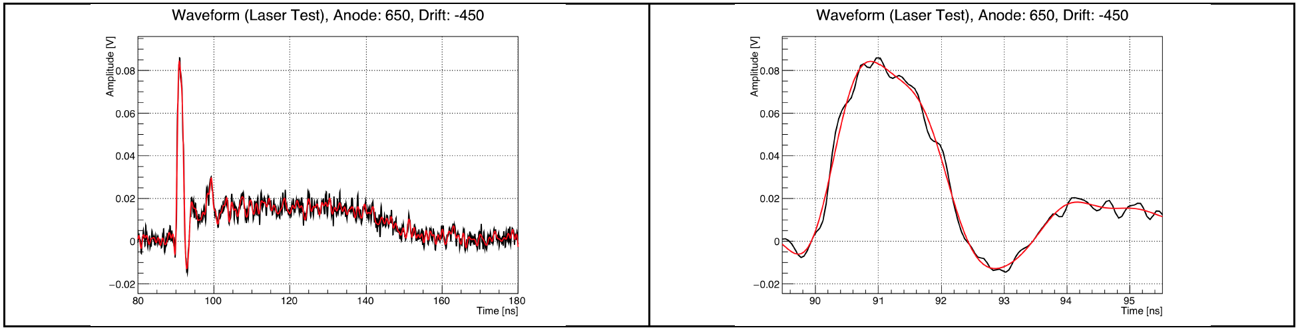
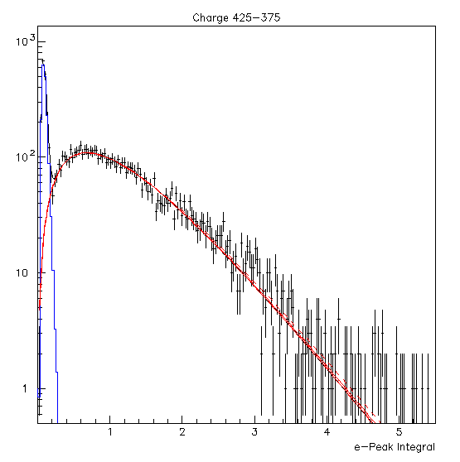
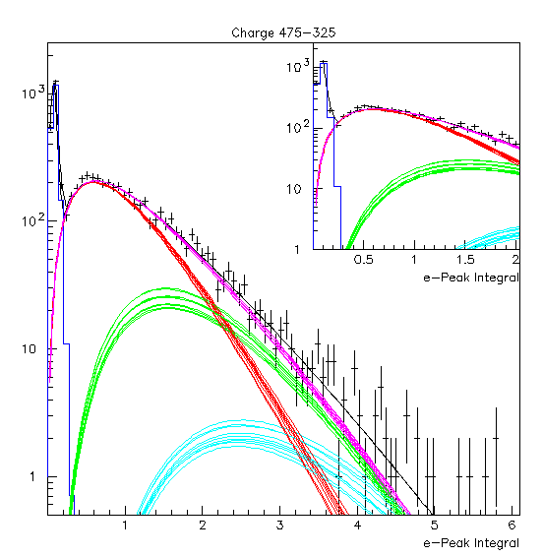
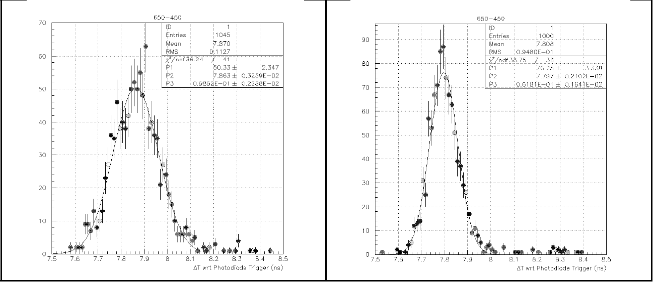


Experimental Observations
(Paco, Lukas and Ioannis talks)
Typical PICOSEC-MICROMEGAS Waveform
The e-peak amplitude and e-peak charge distributions, corresponding to single or to many photoelectrons, can be parameterized using the Polya function.
The timing distributions, in narrow bins of e-peak charge (or amplitude) are Gaussians. However the mean and sigma values of the timing distributions are dependent on the size of the e-peak.

Slide 3
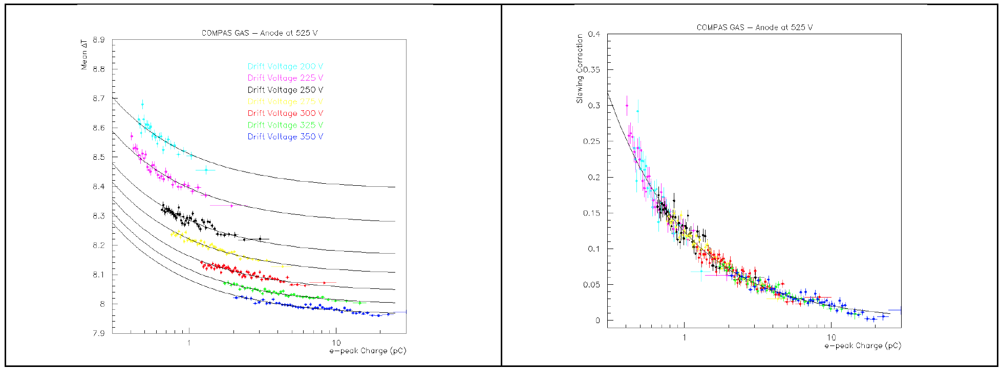
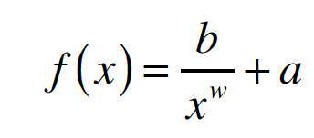
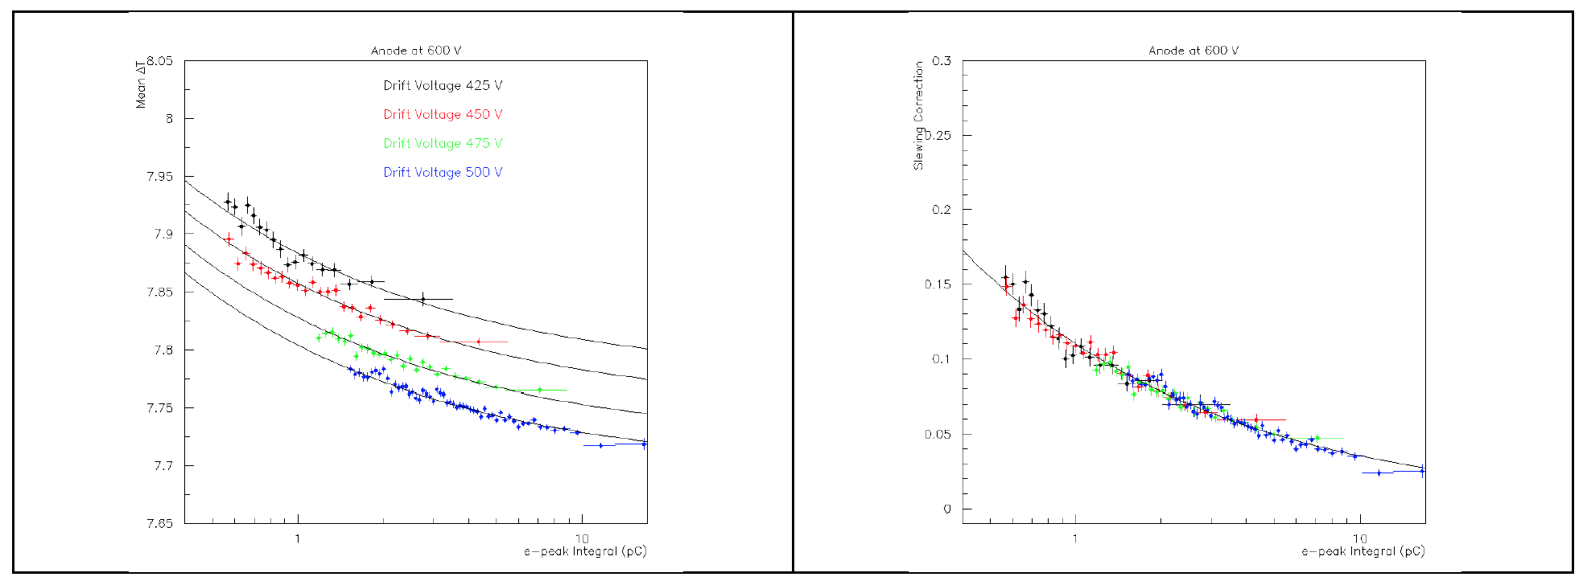
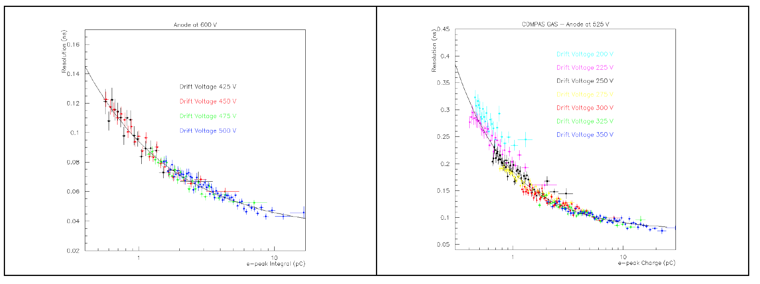
Experimental Observations (cont.)
(Paco, Lukas and Ioannis talks)
The dependence of the mean value of ΔΤ on the e-peak size (slewing or time walk) is well described by the simple function:
For data sets collected with the same anode field, the power law terms (b and w) are independent of the applied drift voltage, whilst the constant term, a, is related to the drift velocity and depends on the drift voltage.
The dependence of the timing resolution on the e-peak size, for data collected with the same anode field, follows the same function as the slewing dependence, whilst all the parameters are independent of the drift field.

Slide 4
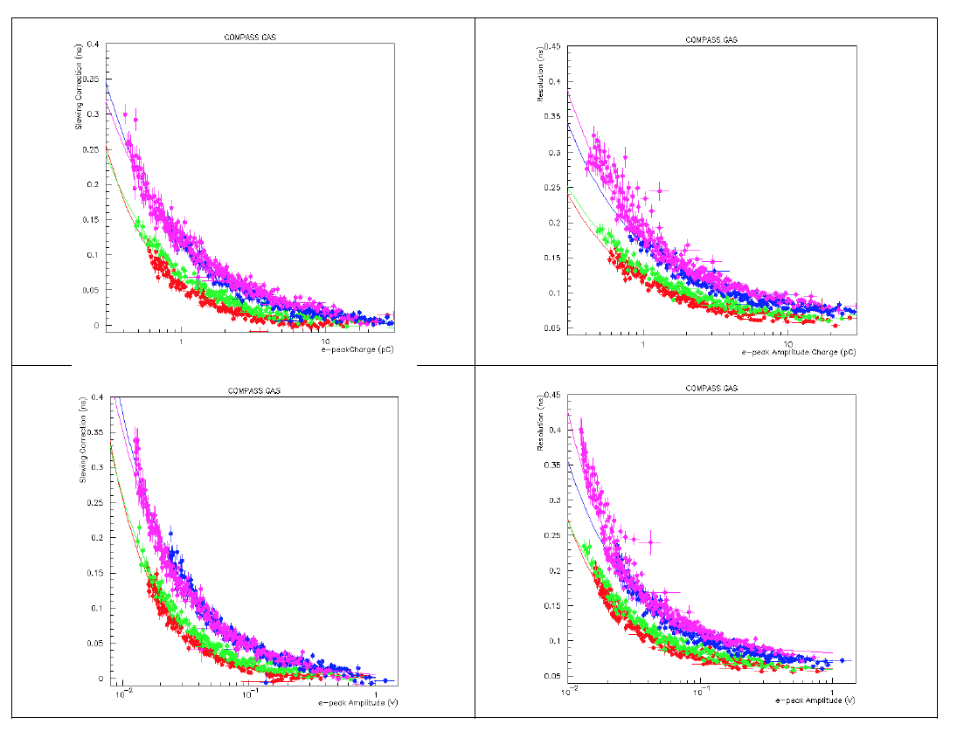
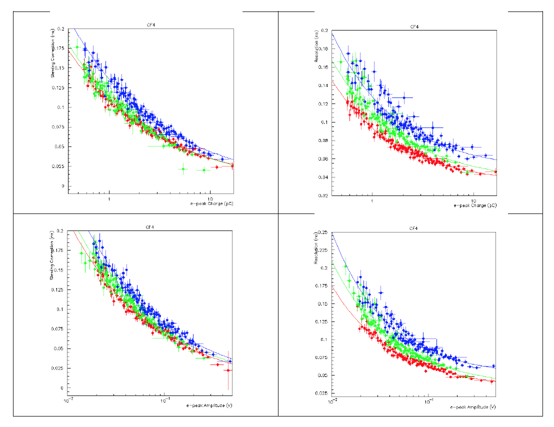
Experimental Observations (cont.)
(Paco, Lukas and Ioannis talks)
The slewing (constant term subtracted) and the timing resolution dependence on the e-peak charge and amplitude for all the analyzed calibration data. The different colors signify different anode fields, whilst data collected with different drift fields are presented collectively

Slide 5
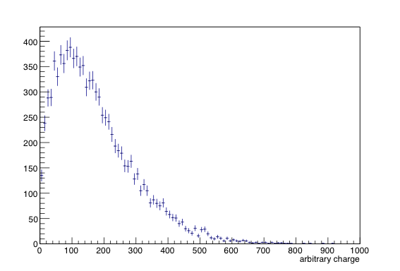
An attempt to use GARFIELD++ package convoluted with a parameterization of the MICROMEGAS and electronics response in order to study the timing resolution and the slewing dependence on the voltage settings.
GARFIELD++ parameters: No penning, Microscopic tracking, No ions
Factorize the simulation chain to: a) simulation of a single photoelectron drift and pre-amplification, b) single e avalanche formation, c) estimation of the single e avalance pulse shape, and d) convolution of (a), (b) and (c) to simulate the MICROMEGAS response to a single photoelectron
Full simulation, microscopic tracking (AvalancheMicrosopic). The passing through the mesh is microscopically simulated, mesh modeling: woven but not calendered. Output: the arrival time of each produced electron before and after passing through the mesh. Estimation on event-by-event basis of the mesh transparency and timing distortions due to the transmission through the mesh (negligible).
Full simulation of single electron avalanches, full simulation of the produced MICROMEGAS signal’s charge, evaluation of the single electron avalanche charge distribution.

Slide 6
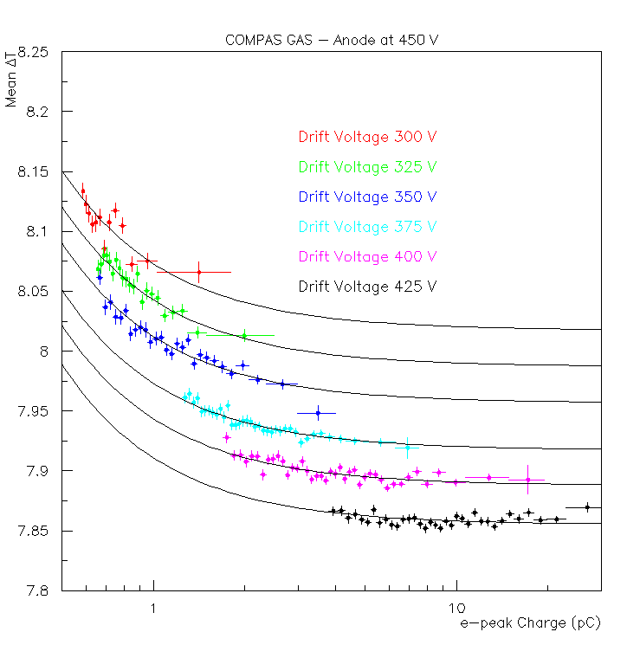
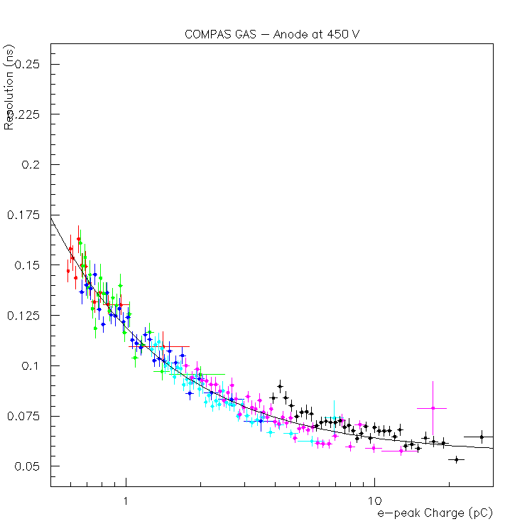
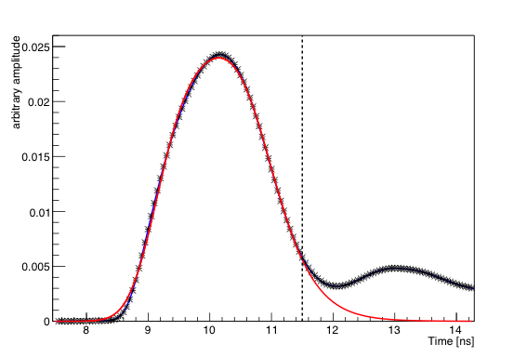
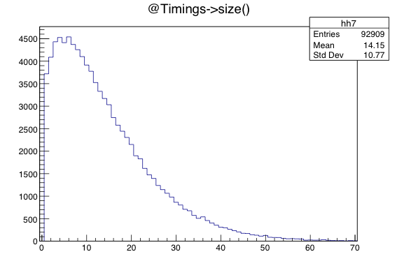
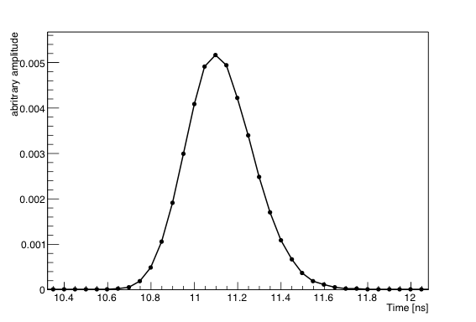

c) Use the data to define the average e-peak pulse shapes, in a region where the slewing and timing resolution do not vary significantly with the e-peak size.
Fit result
Average e-peak pulse for 450V, 425V anode and drift voltages, for e-peaks with charge >15pc
From the preamplification-stage simulation use the distribution of the number, N, of es passing through the mesh. Select a region of N that corresponds to the above charge region (e.g. use scaling). Use the time distribution, when these es passed through the mesh.
Combine the electrons time distribution with the single e avalanche charge distribution and its normalized shape in order to fit the experimental e-peak shape. Evaluate the single e- avalanche pulse shape
Parameterization of the e-peak corresponding to only one e passing through the mesh and produce an avalanche

Slide 7
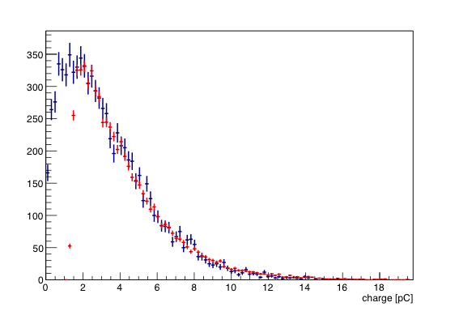
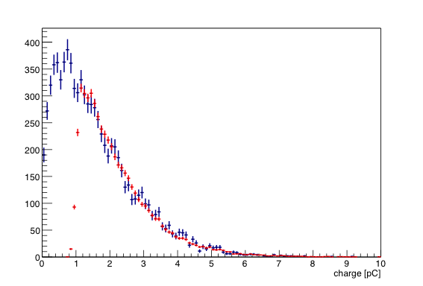
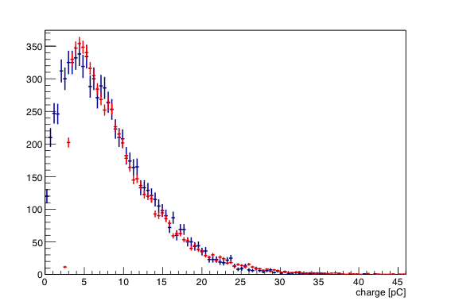
Known Problems with unknown solutions…
The MC needs trimming….
We have to scale the MC charge (or amplitude) predicted distributions in order to take into account the electronics' gains. We expected that by adjusting the scale factor at some drift operating voltage we should predict all the other distributions of events collected with the same anode but different drift voltages, WITHOUT any extra fine tuning
However…
450-400
G=27.8
450-375
G=30.2
450-425
G=21.9
In general, this simulation describes qualitatively the observed timing effects but fails to describe with accuracy the exact functional dependencies

Slide 8
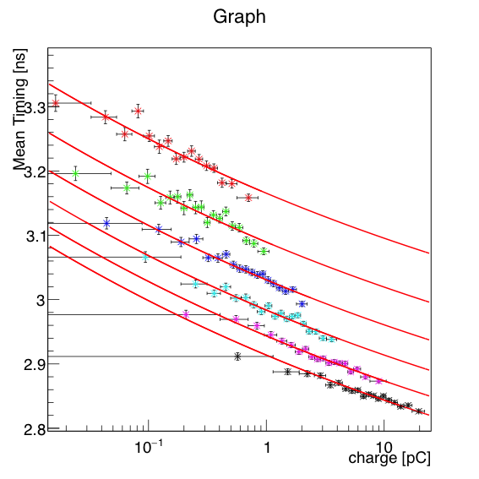
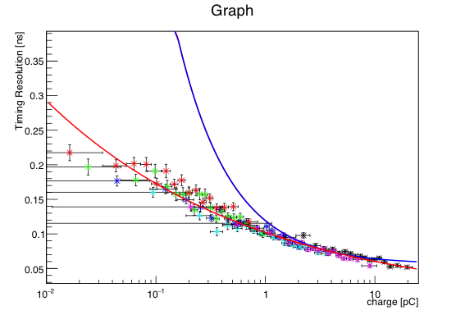
Simulation Prediction of the timing resolution and slewing dependence on the e-peak size
(the simulated waveforms have been treated as the experimental data)
Data
Simulation
The simulation predicts the independence on the drift voltage of the timing resolution and slewing variation as functions of the e-peak size. The variation predictions are less steep than the the observed dependencies in the data
There are not noise effects in the simulation that distort the waveform shape (we expect that this is a small effect but we should check). Do we simulate accurately the response of the electronics ?

Slide 9
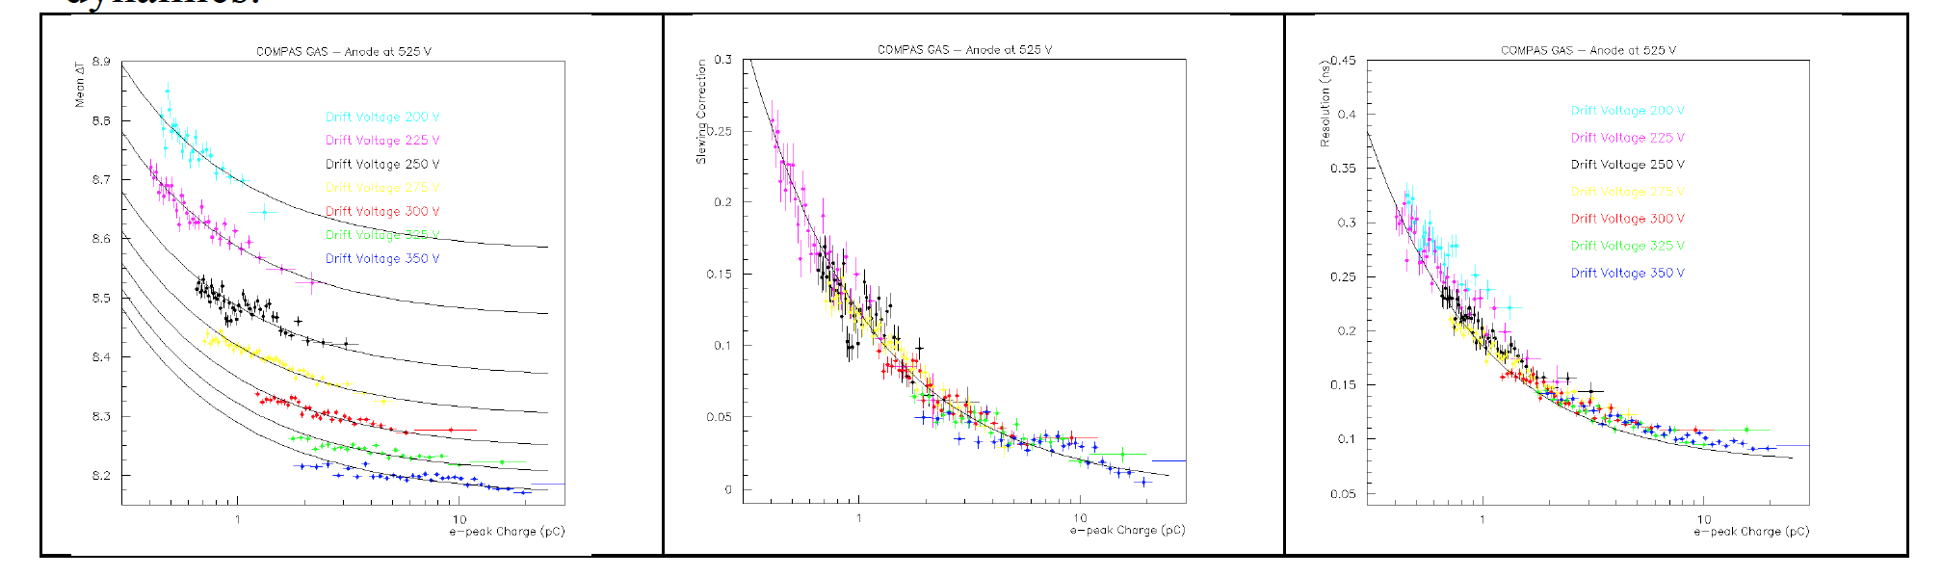
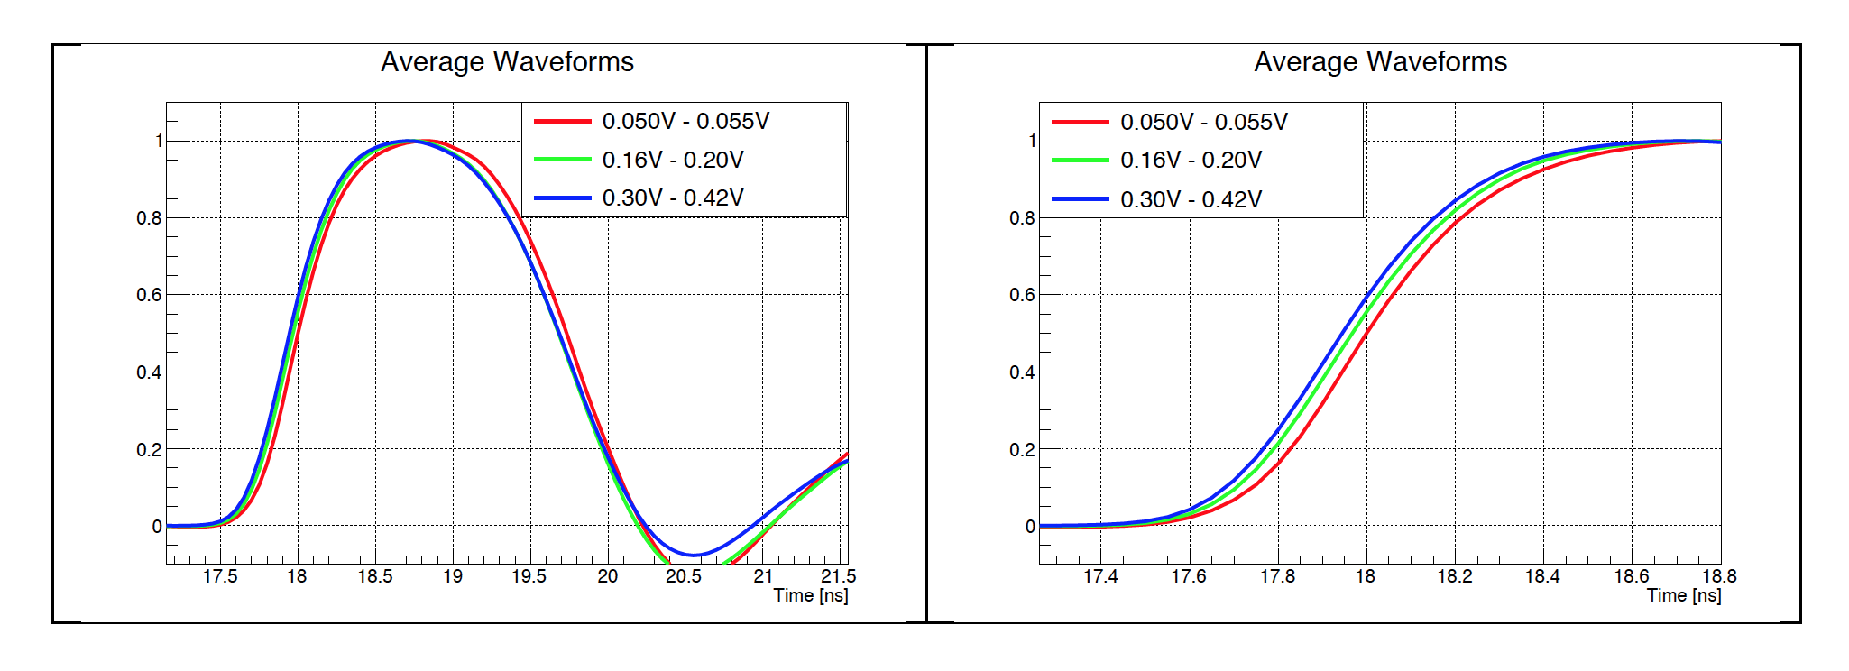
The data indicate that the slewing effect is not due to a waveform-shape change. On the contrary, they indicate a parallel walk in time of an almost constant pulse shape
The simulation supports the experimental observation

Slide 10
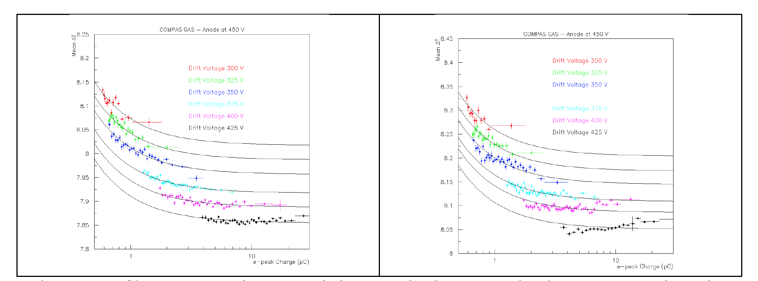
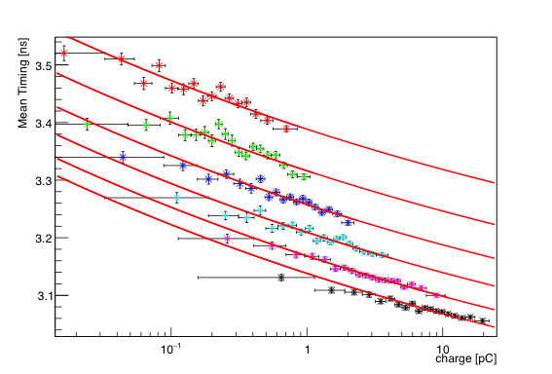
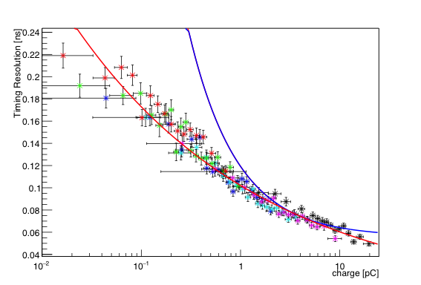
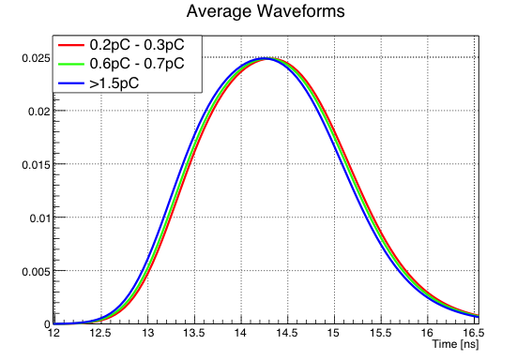
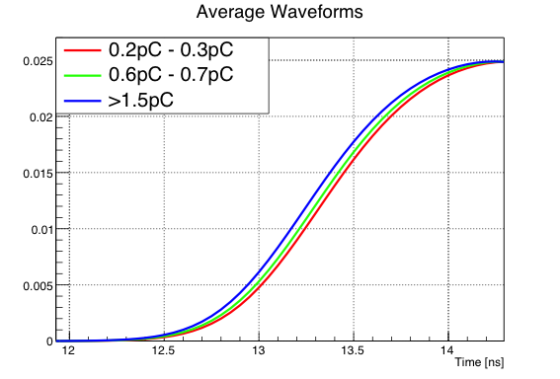
Timing at 20% CFD
Timing at 40% CFD
DATA
The solid lines, in both data and MC plots, represent fits to the timing results at 20% CFD
Timing at 40% CFD
Timing at 40% CFD
SIMULATION
The simulation predicts that slewing id due to a parallel time shift of the e-peaks

Slide 11
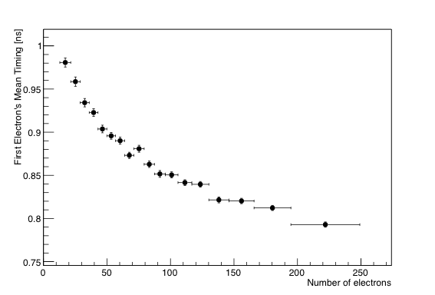
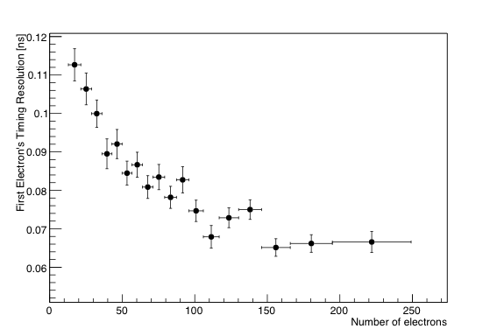
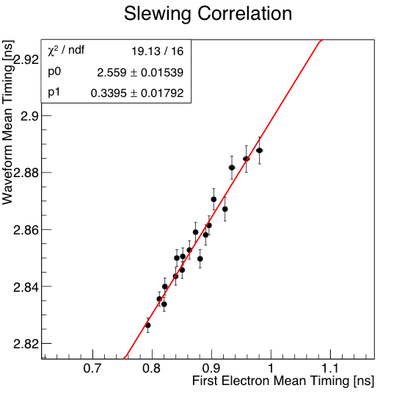
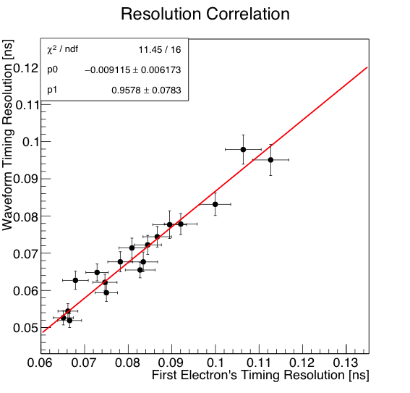
Having a simulation package that describes, at least qualitatively, the timing resolution and the slewing dependence on the pulse height we can search for the physical mechanism which produces this dependence.
“ We should write a book on how to develop models, which we later-on falsify” S.E. T
Let us take as an example the “first arriving electron model”, i.e. the timing properties of the PICOSEC-MICROMEGAS signal are inherited from the first electron passing through the mesh.
Slewing properties of the first electron
Resolution properties of the first electron
However, this model does not explain why the e-peak shifts parallel in time. It is also strange that the correlation (slope) is almost one for the resolution but 0.34 for the slewing.
Correlation of the first arriving electron slewing and time resolution with the e-peak slewing and timing resolution

Slide 12
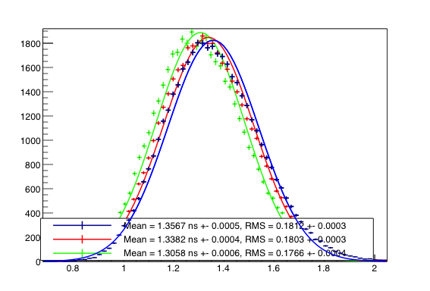
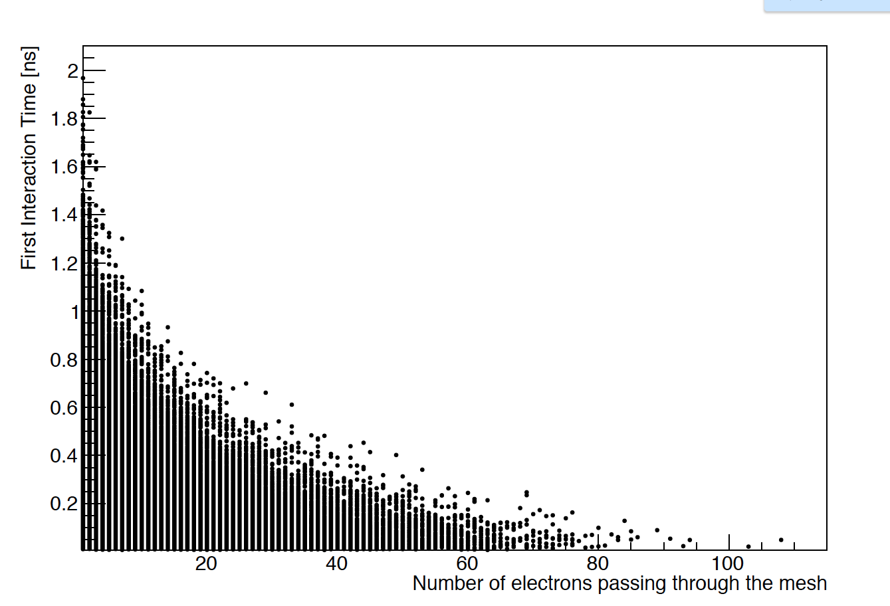
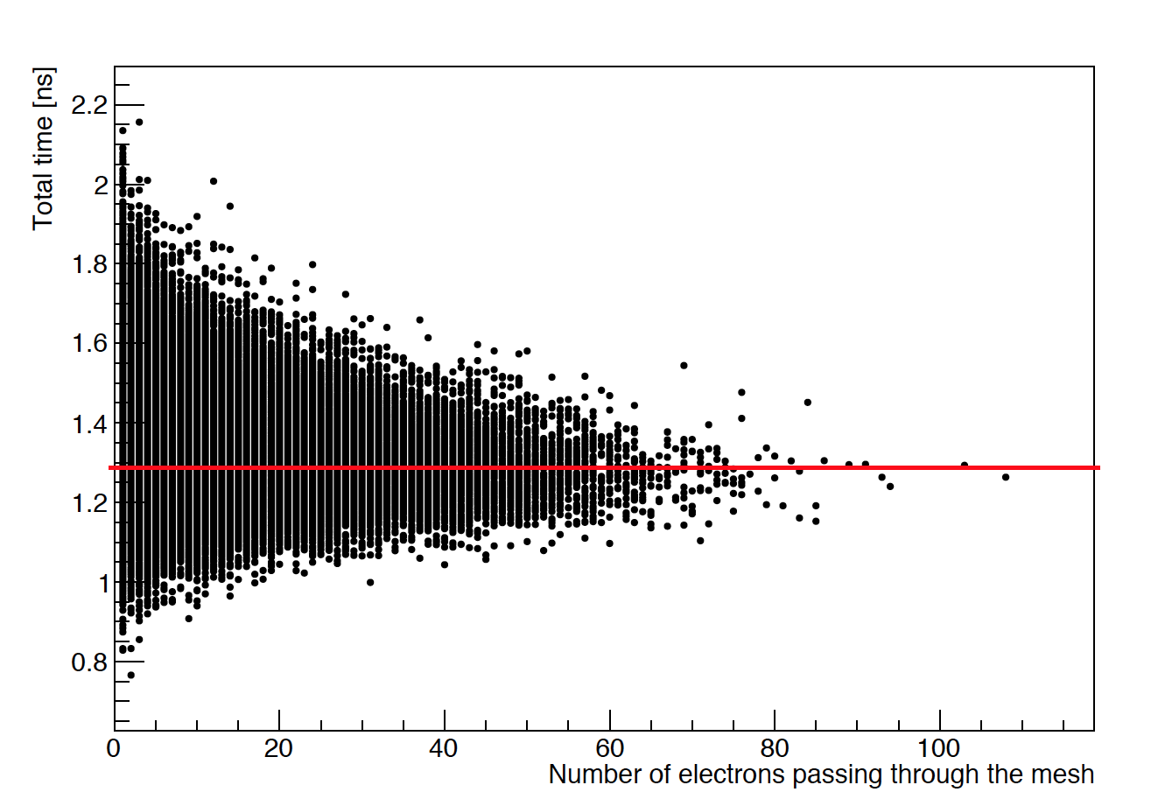
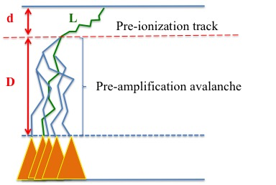
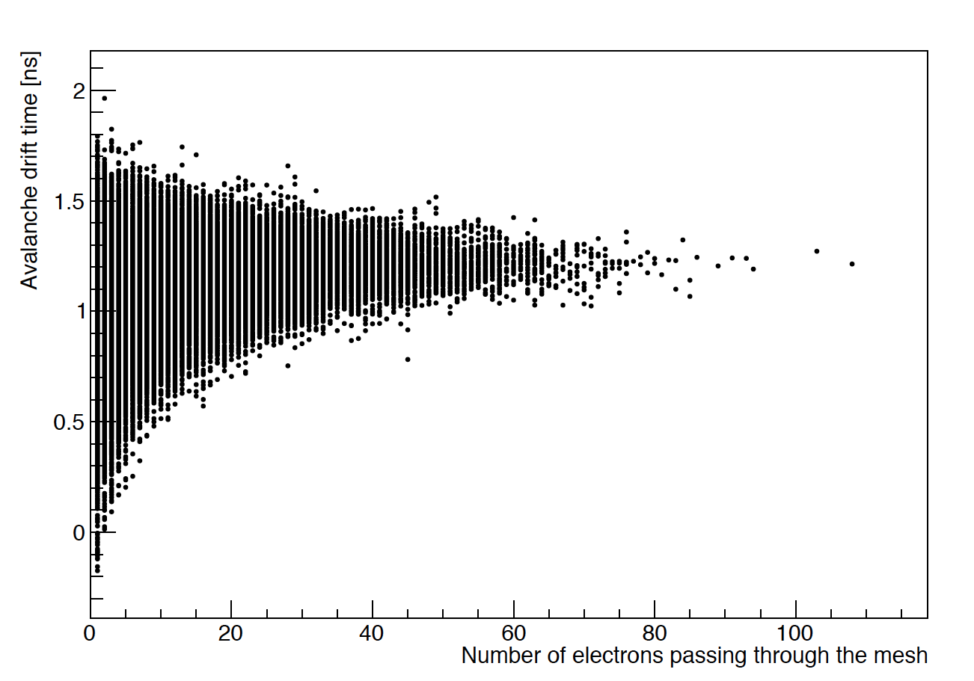
An observation using the simulation….
Number of electrons passing through the mesh
5-10
10-15
30-35
The distribution of times when the electrons produced in the pre-amplification region pass through the mesh, are almost Gaussians BUT with mean and sigma values which are depended on the number of electrons produced in the pre-amplification stage
The shorter the time it takes the photoelectron to ionize for the first time, naturally, the more the electrons produced in the pre-amplification. The shorter the time it takes the photoelectron to ionize for the first time, the longer the time it takes to the avalanche to reach the mesh. The sum of the above times are not constant, the time of the first ionization dictates the result. Why?

Slide 13
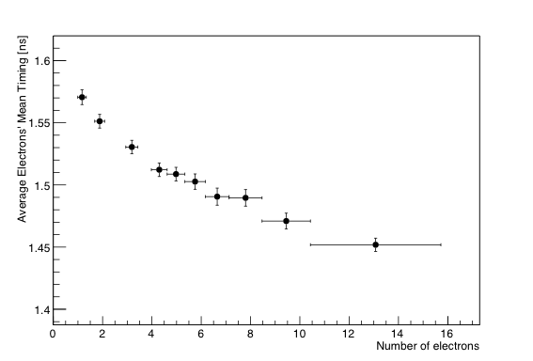
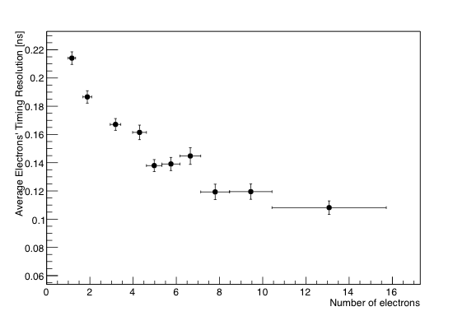
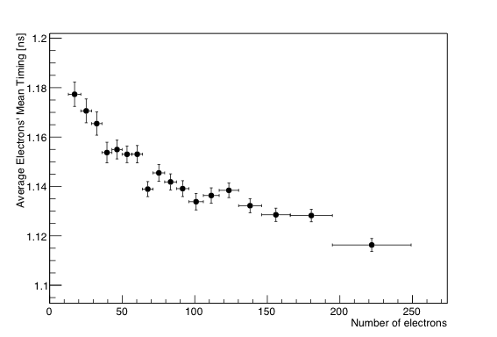
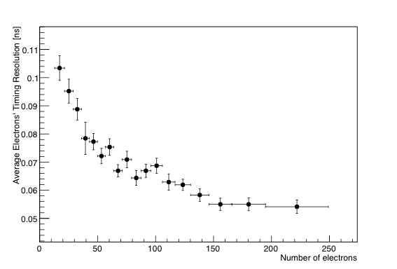
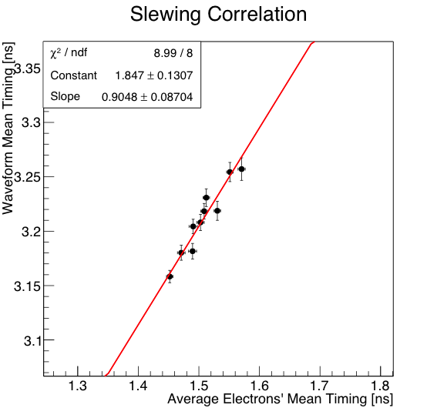
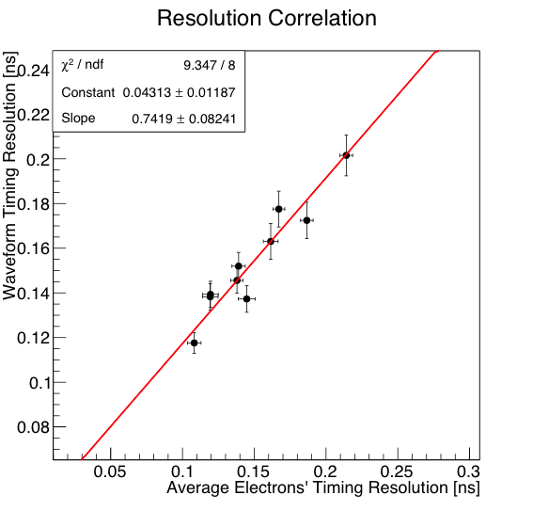
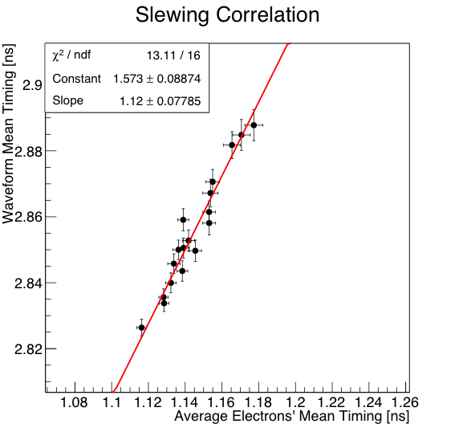
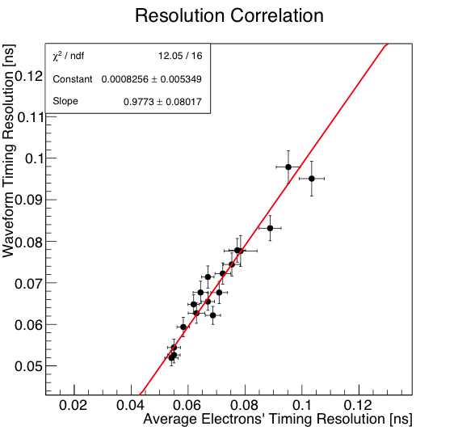
Try to see if the distribution of the times, when the electrons pass the mesh can explain slewing and time resolution dependence on the e-peak size
The mean value shift and the variation of the time distribution of all the electrons passing the mesh are 100% correlated (slope equal to unity) with the slewing and time dependence on the e-peak size measured by timing the e-peak pulses.
This is true for all the drift voltage settings.

Slide 14
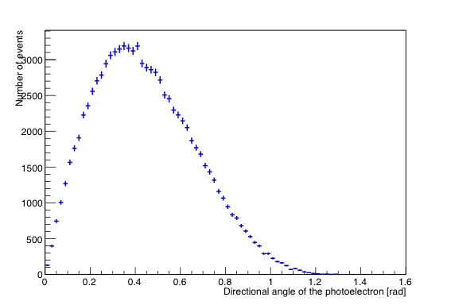
The only remaining question: Why at small number of electrons produced during the pre-amplification (i.e. at small pulses) the delay of the first ionization is not compensated by the shorter drift distance of the avalanche?
d
L
Pre-ionization track
The arrival time of an electron produced in the pre-amplification avalanche follows a distribution with a mean D/V and a sigma smaller, due to correlation, by the one given by the longitudinal diffusion for length D. This is independent of the actual track of each of avalanche’s electrons.
θ
D
Pre-amplification avalanche
On the contrary, the time before the first ionization is not a “mean value” but is related to the track of the photoelectron. The smaller the D, the larger the d, the smaller the number of produced electrons. Furthermore, the time before the first ionization is proportional to L=d/cosθ, where the angle θ is distributed according to the shown above distribution

Slide 15
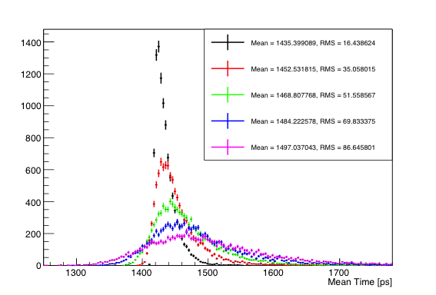
We use a toy MC to model the intuitive arguments claimed before. It simulates a simplified chain multiplication, with a constant longitudinal step for the next interaction .
We varied the longitudinal step (d) for the first interaction.
We constrained the photoelectron, before the first ionization, to move on a straight line with directional angle θ following the distribution observed in the simulation
This simple study concludes that indeed the extra delay due to longer photoelectron “walk” before the first interaction is not compensated by the related shortening of the pre-amplification avalanche drift distance.
d=20 μm
d=40 μm
d=60 μm
d=80 μm
d=100 μm

Slide 16
Conclusions
We developed a simulation tool to study the slewing and timing resolution dependence on the e-peak size, observed by studying the PICOSEC-MICROMEGAS response to single photoelectrons.
We have indication that we should tune better the simulation parameters
The simulation describes, at least, qualitatively the observed experimental effects.
We have used this simulation to pinpoint the origin of the observed effects. By using an extra toy-MC we concluded that the observed effects are due to the non compensation of the delay induced by the time-walk of the photoelectron, before the first ionization, by the shortening of the pre-amplification avalanche drift time.
We have not yet studied the reason that the timing resolution vs e-peak size does not seem to depend on the drift voltage, even if we expect different longitudinal diffusion.

Slide 17
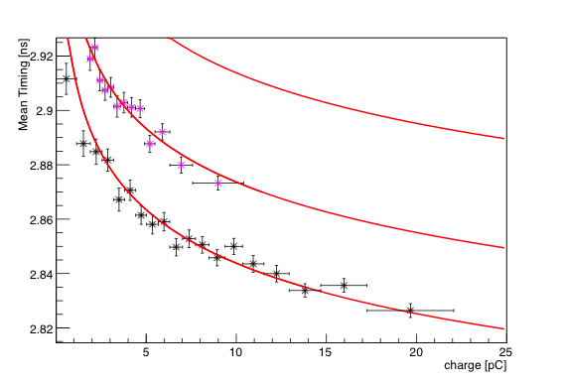
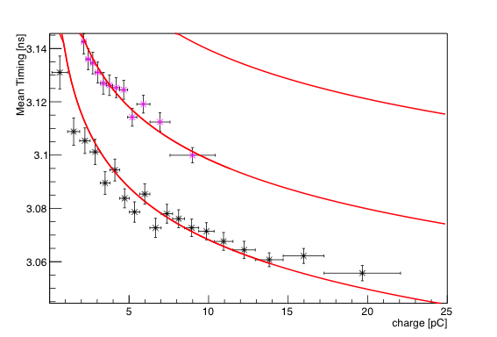
A detail….
SIMULATION
DATA
Timing at 40% CFD
Timing at 20% CFD
Timing at 40% CFD

Slide 18
d
L
Pre-ionization track
D
Pre-amplification avalanche

