Slide 1
Signal Processing and Statistical Analysis Techniques for the PICOSEC-MICROMEGAS
Ioannis Manthos
Laboratory of Nuclear & Particle Physics
Physics Department
Aristotle University of Thessaloniki
many thanks to F. J. Iguaz, Jona Bortfeldt, G.K. Fanourakis and the AUTH team
A sort review on the methods used to analyze calibration data, in order to evaluate the timing performance of the PICOSEC-MICROMEGAS detector
All the shown results are PRELIMINARY

Slide 2
Study of the PICOSEC-MICROMEGAS Response to a laser Beam
For the most of the data sets the MicroMegas detector was responding to a single photoelectron.
Several anode and drift voltage settings
COMPASS (80% Ne + 10% CF₄ + 10% C₂H₆) or CF4 (80% CF₄ + 20% C₄H₁₀) gas

Slide 3
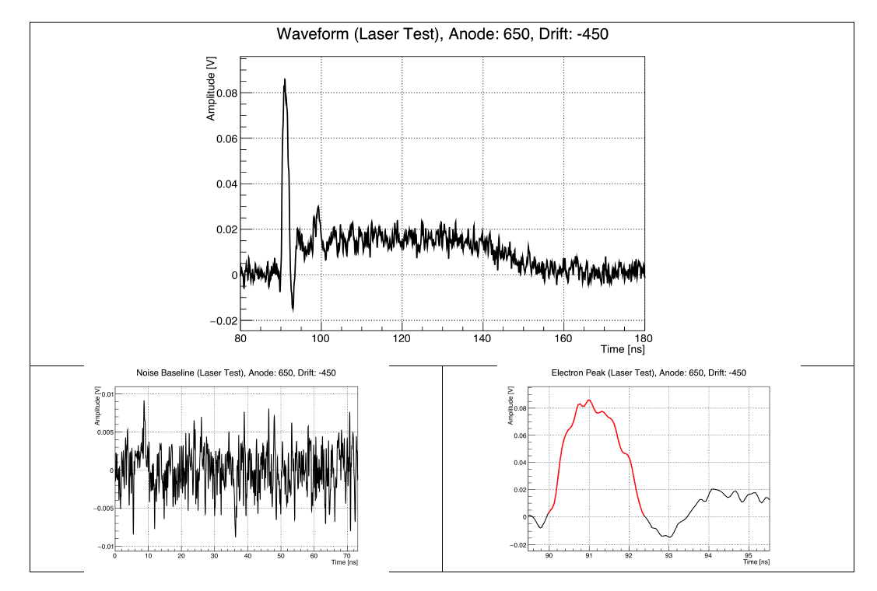
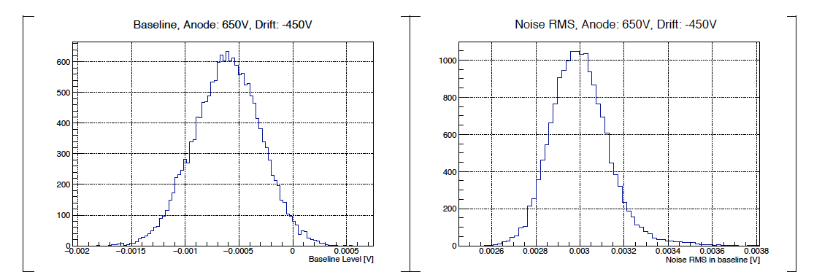
As presented already in F.J. Iguaz, K.Paraschou talks and it will presented by L. Sohl talks

Slide 4
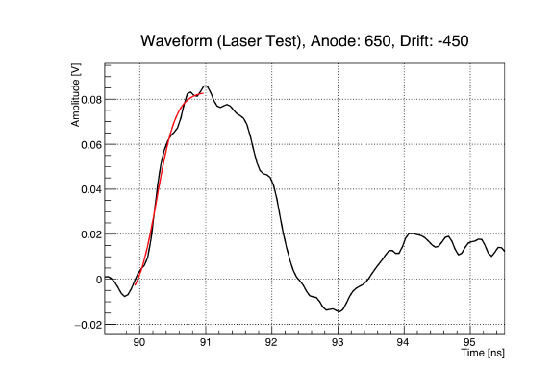
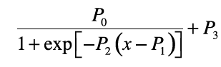
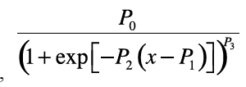
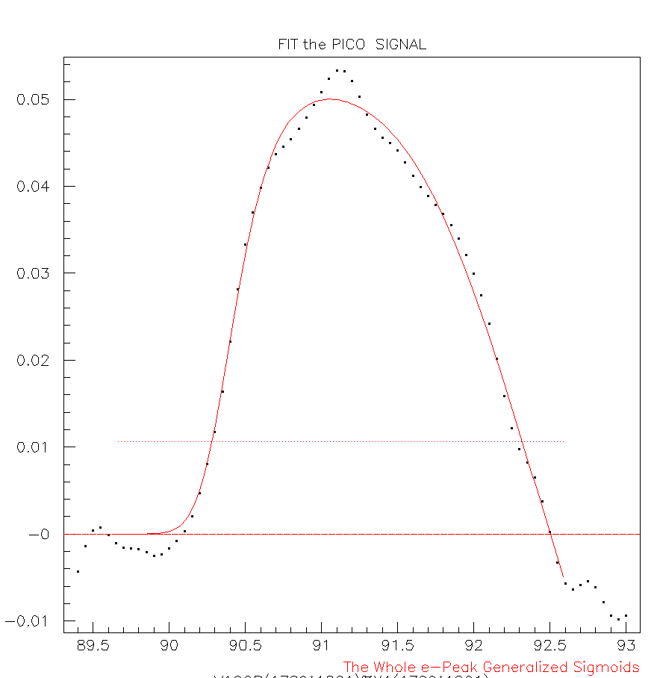
Definition of the e-peak Arrival Time
Fit the e-peak leading edge in order to neutralize noise effects.
Several Functions have been used in the fits, including quadratic and cubic polynomials as well as logistic and generalized logistic functions
A fit of the whole e-peak was also tried using the difference of two logistic functions
(it is used by K. Paraschou to describe the signal in the simulation of the PICOSEC-MICROMEGAS response)
All the e-peak fitting methods give almost the same results.
For the results shown in this talk, fits of the leading edge with a logistic function were used and the e-peak arrival time was defined at 20%CFD.
Why not reject the noise using filters ?

Slide 5
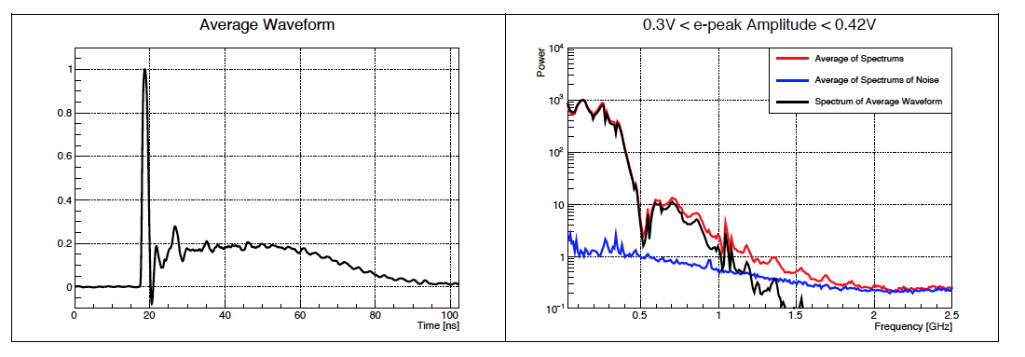
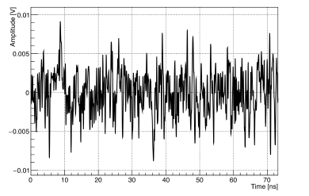
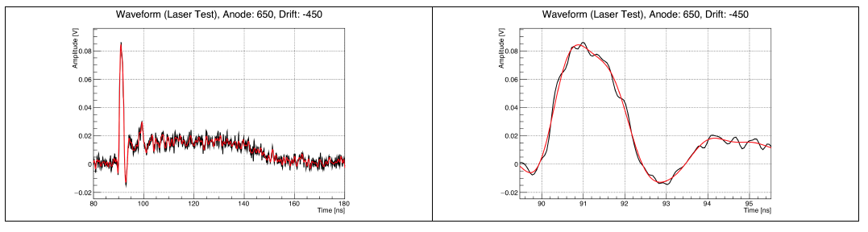
When a frequency cut was applied, or more sophisticated filters (e.g. “PICOSECOND-MICROMEGAS Signal Processing with Kaiser-Bessel Filters”, V. Niaouris Diploma Thesis) to reject the noise on the signal, it was also worsened the timing resolution.
An example of filtering out the noise

Slide 6
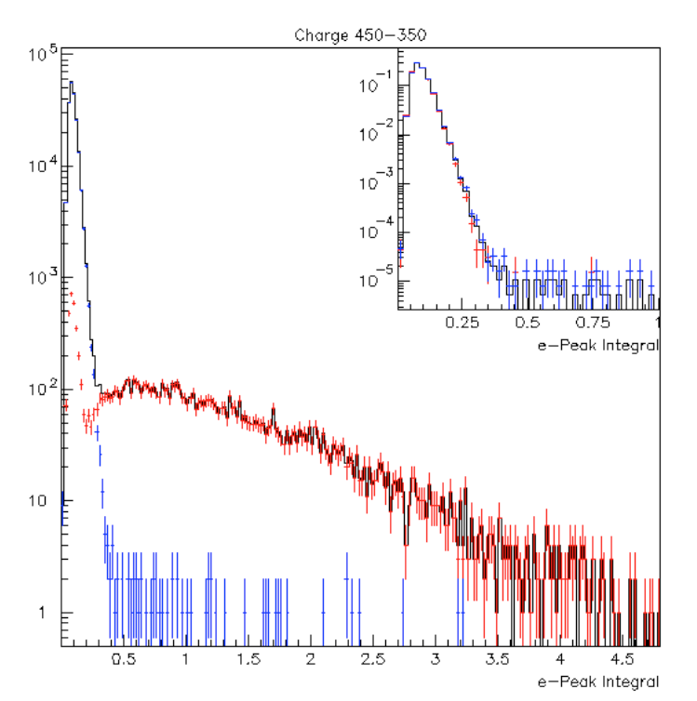
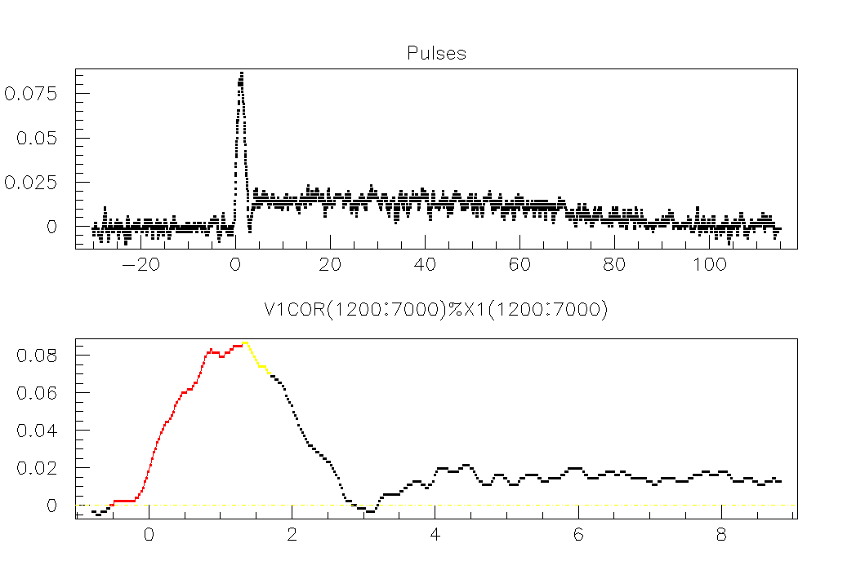
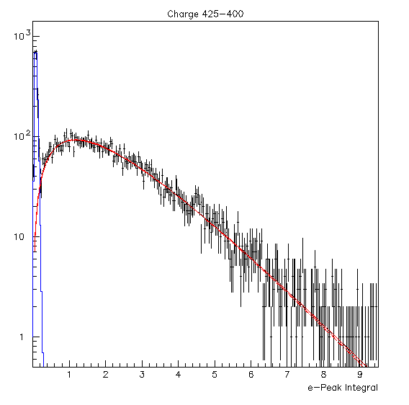
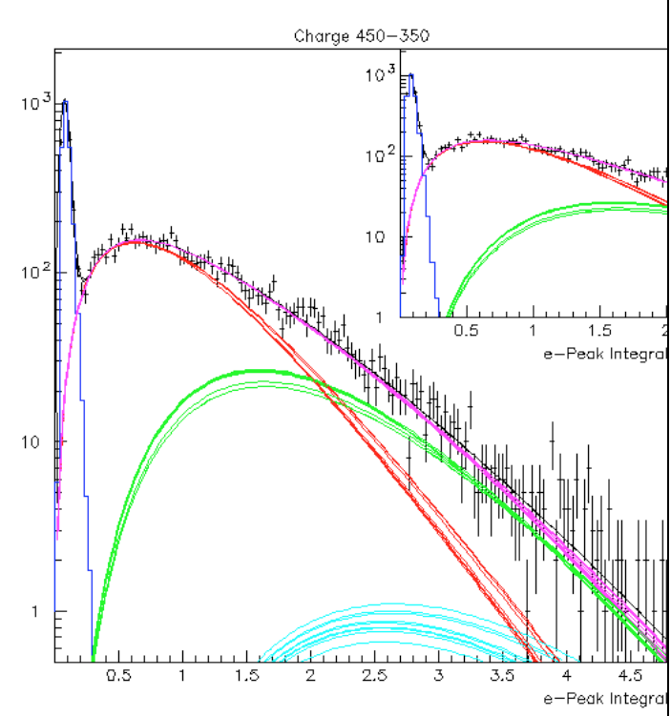
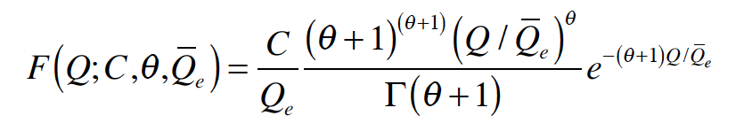
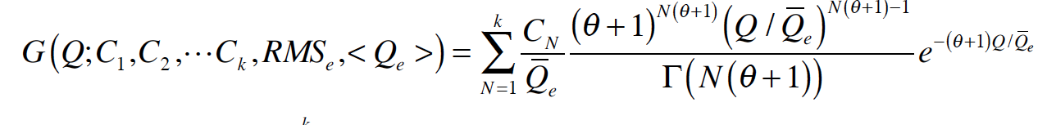
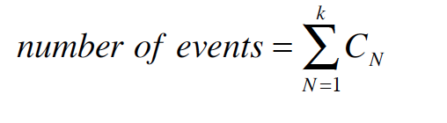
Does the “Polya” shape describes the e-peak charge and amplitude distributions?
Use data sets collected without any threshold on the picosec-MM signal cut to test the “Polya Hypothesis”
Recognize the “start” and “end” of the e-peak, as well as the “end” of the ion tail
Use out-of-time events to model the noise
T₃
T_{p}
Time (ns)
T₁
T₂
Fit the charge spectrum produced by a single photoelectron
Fit the charge spectrum produced by up to three photoelectrons

Slide 7
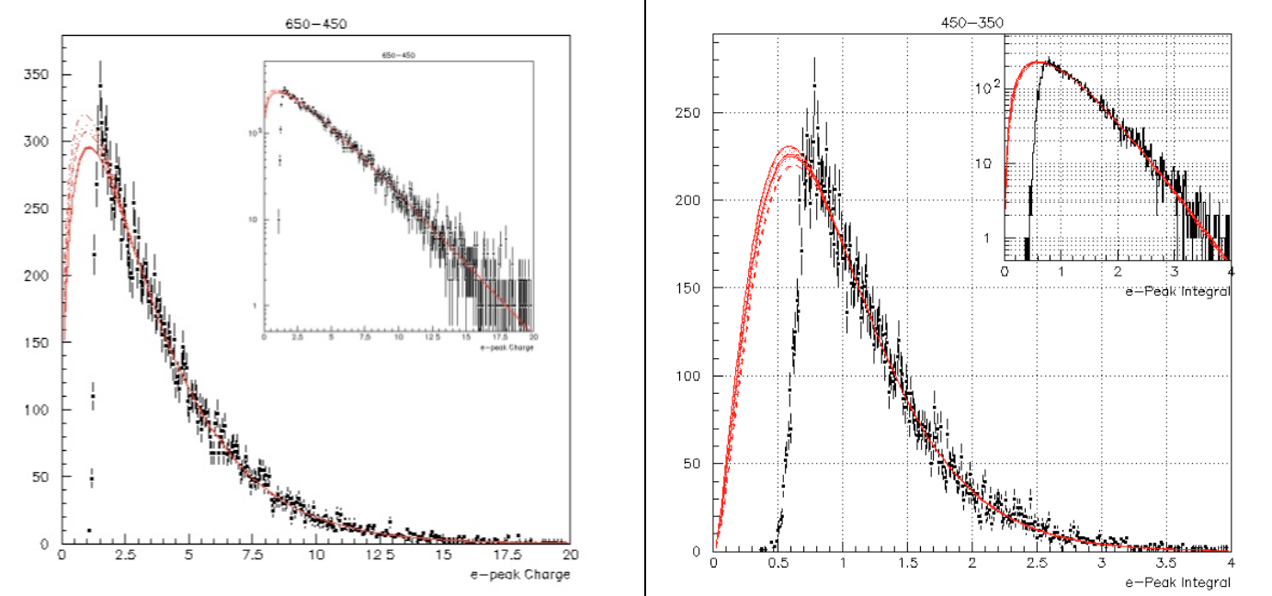
Unfortunately at the most of the collected data an amplitude threshold has been applied
CF4
COMPASS
In order to estimate the systematics, several fits have been performed on the same distribution, by varying the region to fit (first point) and the size of the bins . Notice that the fits always agree at the observed region but their extrapolations, to low charge values, diverge.

Slide 8
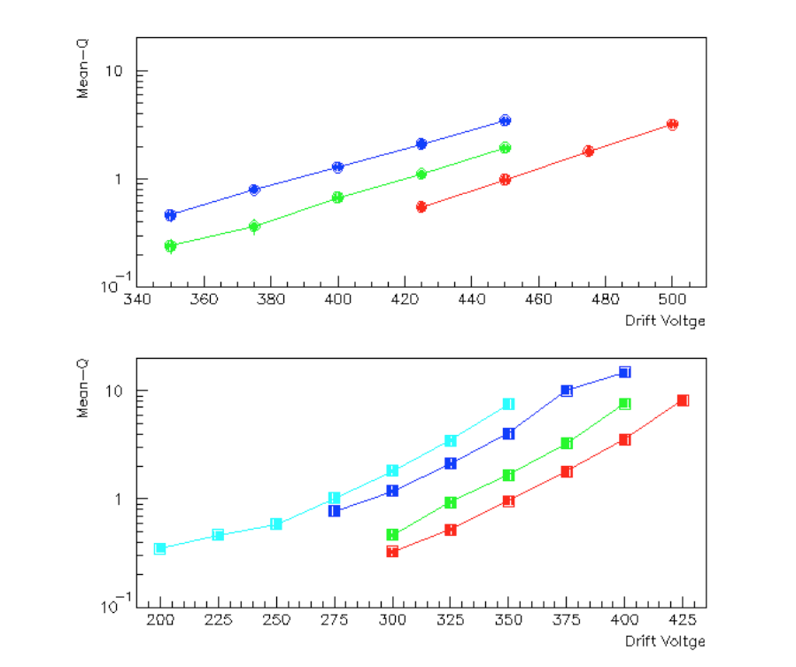
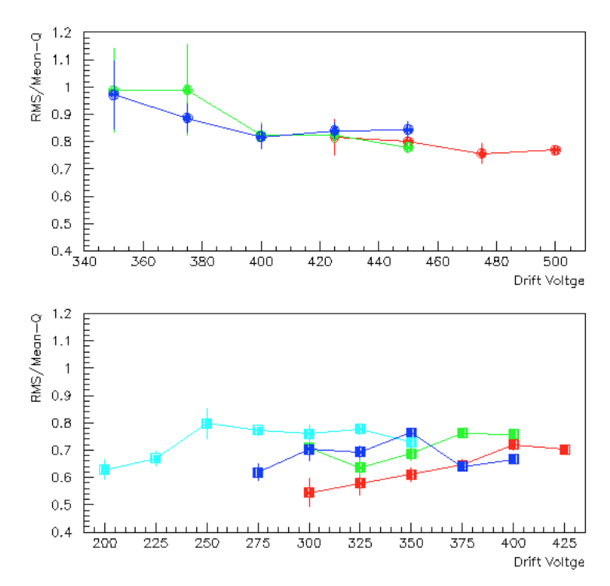
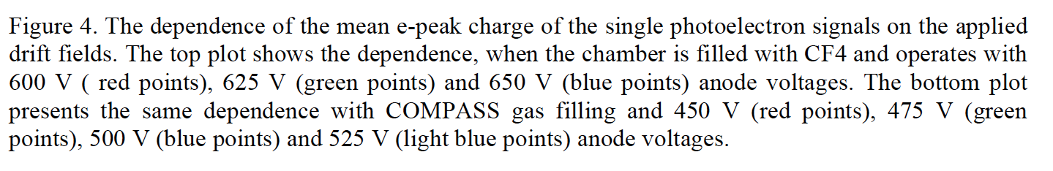
CF4
COMPASS

Slide 9
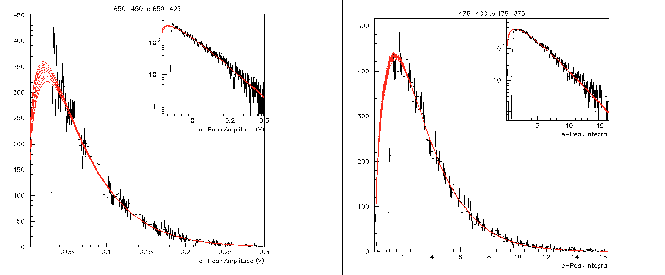
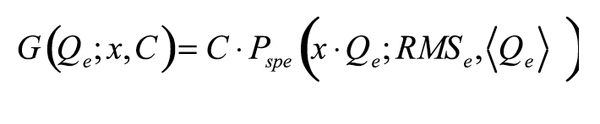

An almost flat RMS/Qe vs drift voltage indicates that the e-peak charge distribution shapes can be scaled.
(for details see the PICOSEC-MM Note “Analysis Methods and Results of the Picosecond-MicroMegas laser beam data”, Part A )
CF4
COMPASS
Distribution at 650-425
Reference (e.g. the Polya at 650-450)

Slide 10
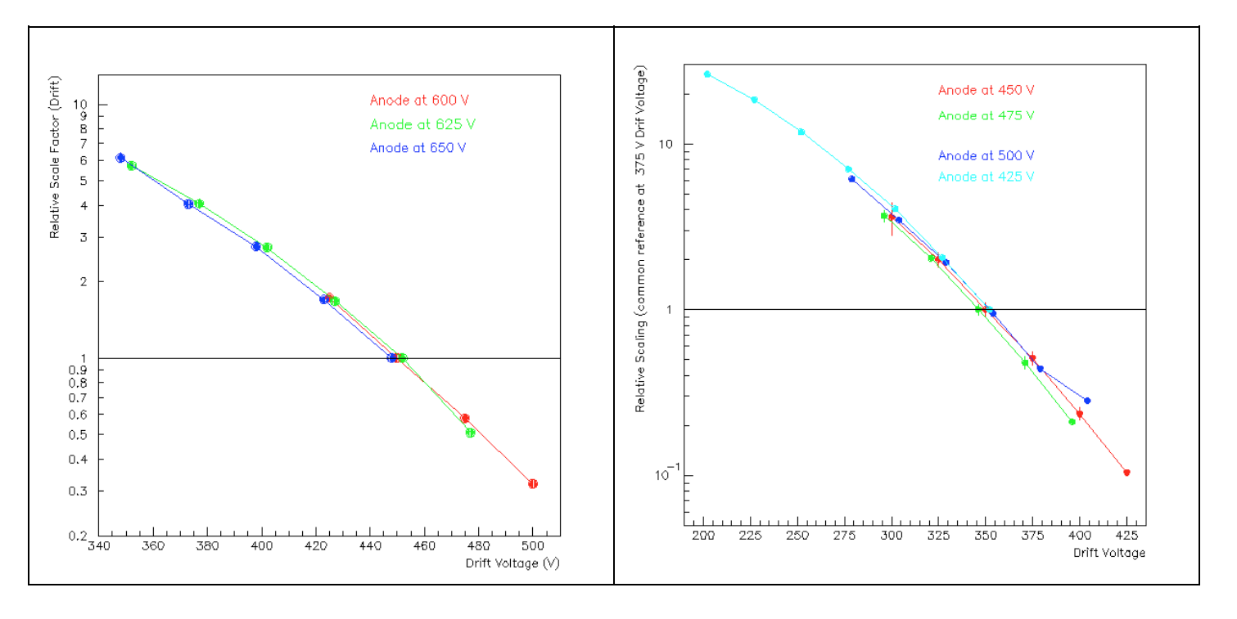
CF4
COMPASS

Slide 11
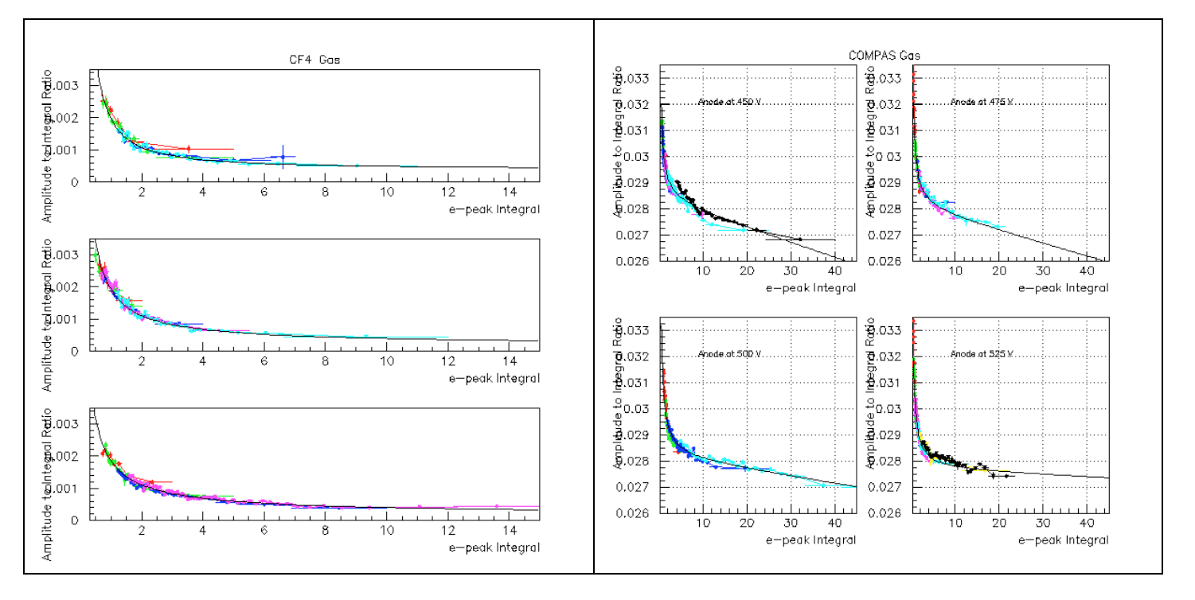
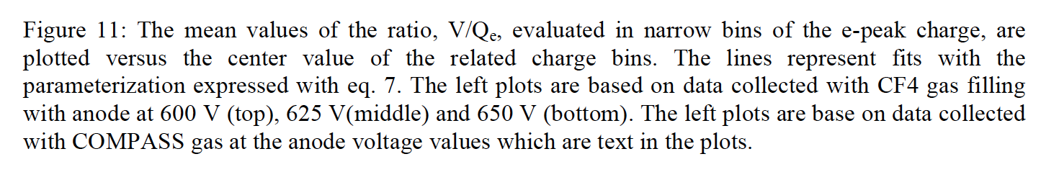
The stability of the e-peak pulse shape

Slide 12
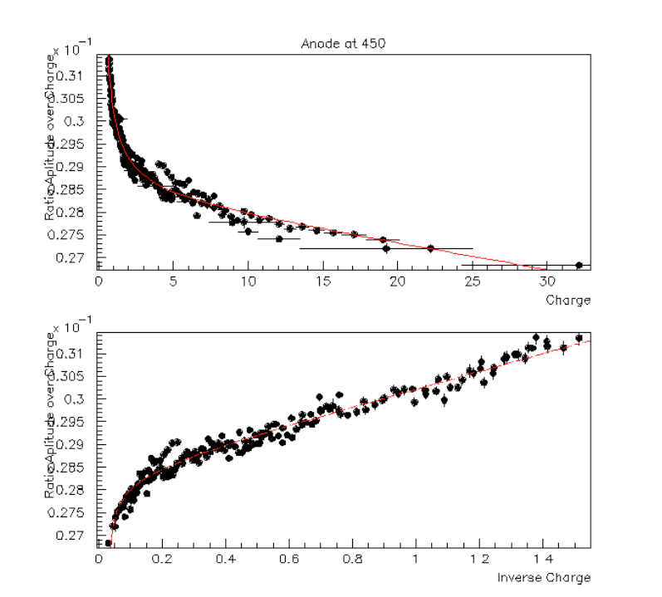

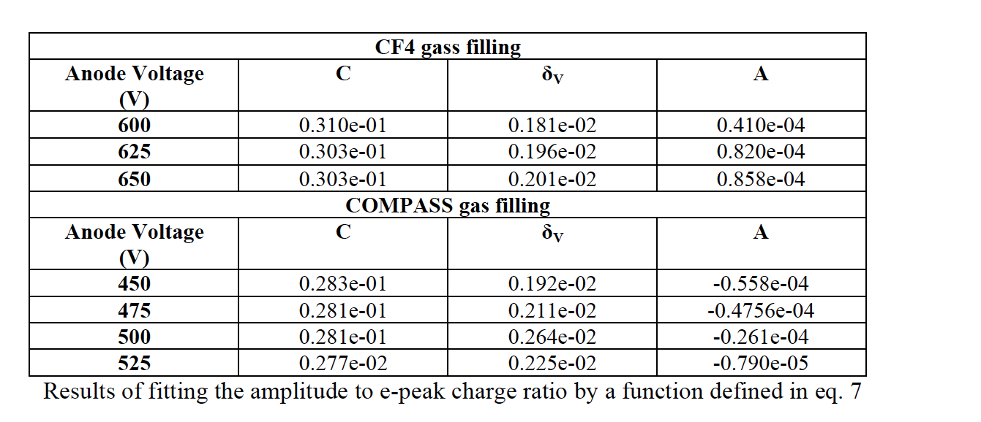
However…
The amplitude to charge ratio is almost independent of the e-peak size
The error of δ_{v} is 0.3mV
The error of C equals to 0.002
The error of A is almost 0.1·10⁻⁴
The estimated parameter are mildly correlated (about 20%)

Slide 13
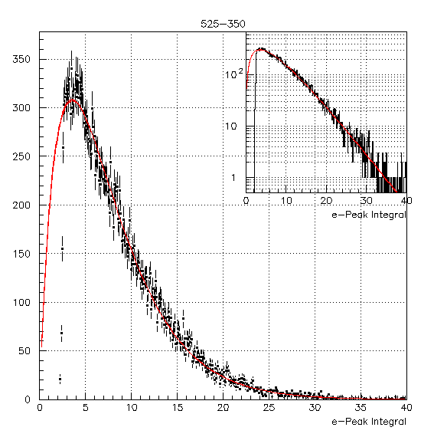
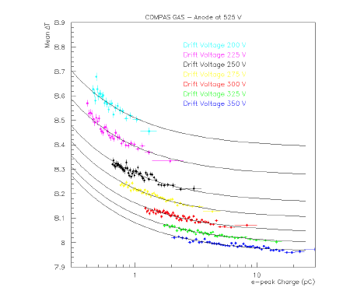
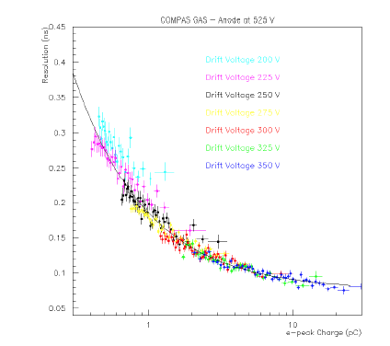
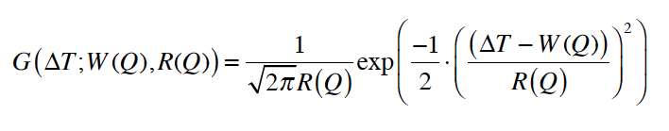
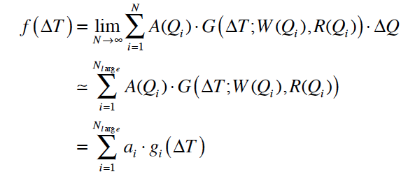
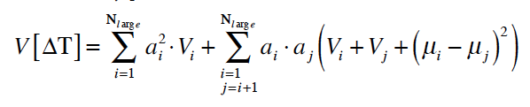
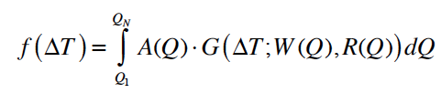
In order to study the dependence of the timing resolution on the anode and drift voltages we should “extrapolate” to the unobserved part of the e-peak spectrum.
As shown, the e-peak charge distributions have been fitted to Polya functions.
As presented by F. J. Iguaz and K. Paraschou, the slewing and timing resolution vary as functions of the e-peak size but this dependences have been parameterized for all the data sets.
We have developed an accurate, numerical method to perform this extrapolation (for details see the PICOSEC-MM Note “Analysis Methods and Results of the Picosecond-MicroMegas laser beam data”, Part B )

Slide 14
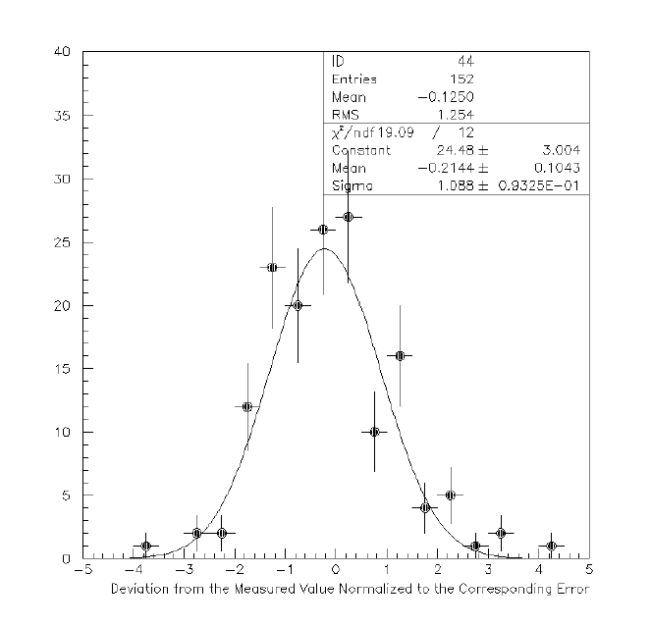
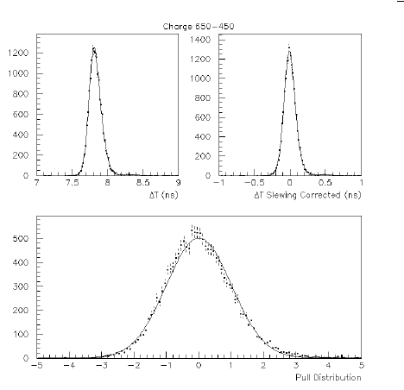
Before the end try a test…
Use the parameterized slewing and timing resolution dependence on the e-peak size, as well as the numerical convolution formula to predict the timing resolution for the observed e-peak charge spectrum.
Then compare with the direct measurements of the time resolution
Direct measurements of the timing resolution

Slide 15
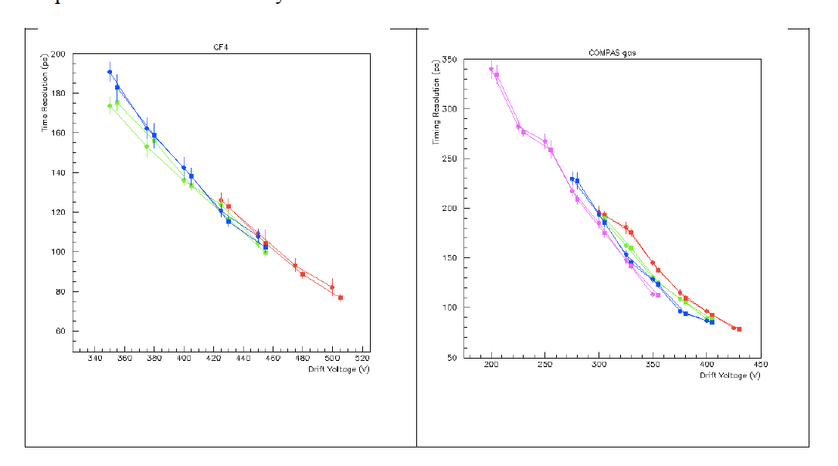
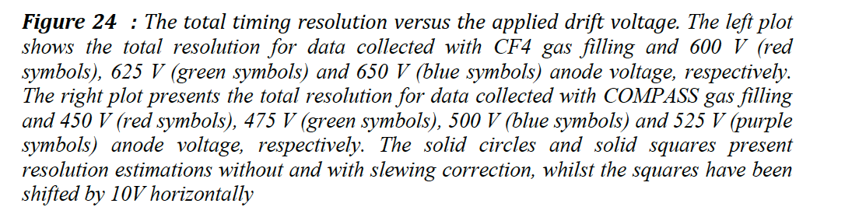
The timing resolution of PICOSEC-MICROMEGAS responding to a single photoelectron as a function of the drift voltage for different anode voltage settings. Corresponds to e-peaks with amplitude greater than 10 mV or, equivalently, with charge greater than 0.333 pC.

Slide 16
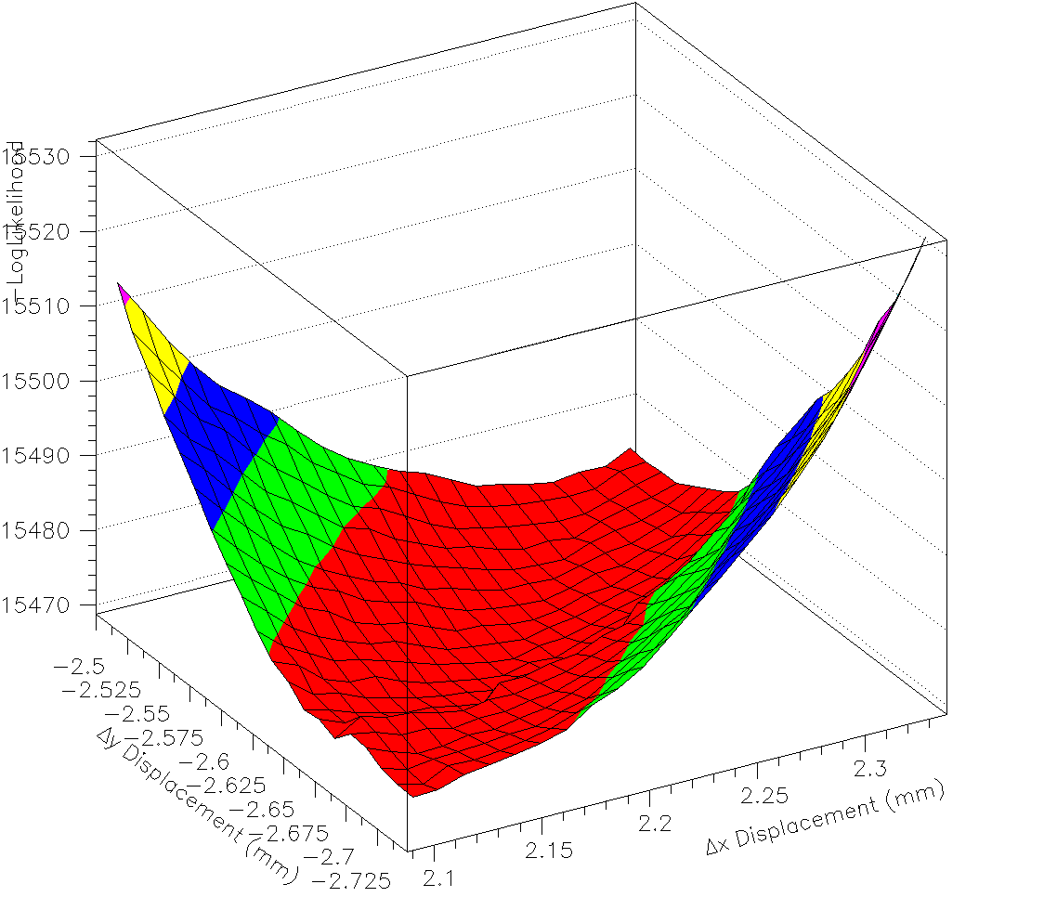
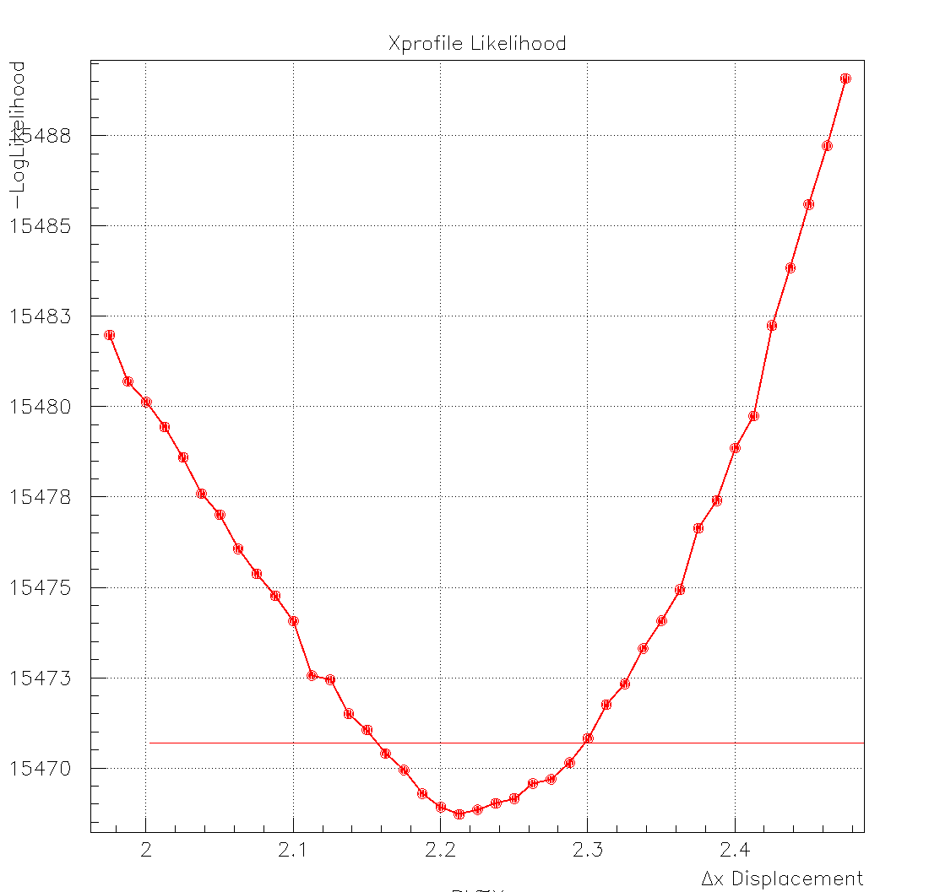
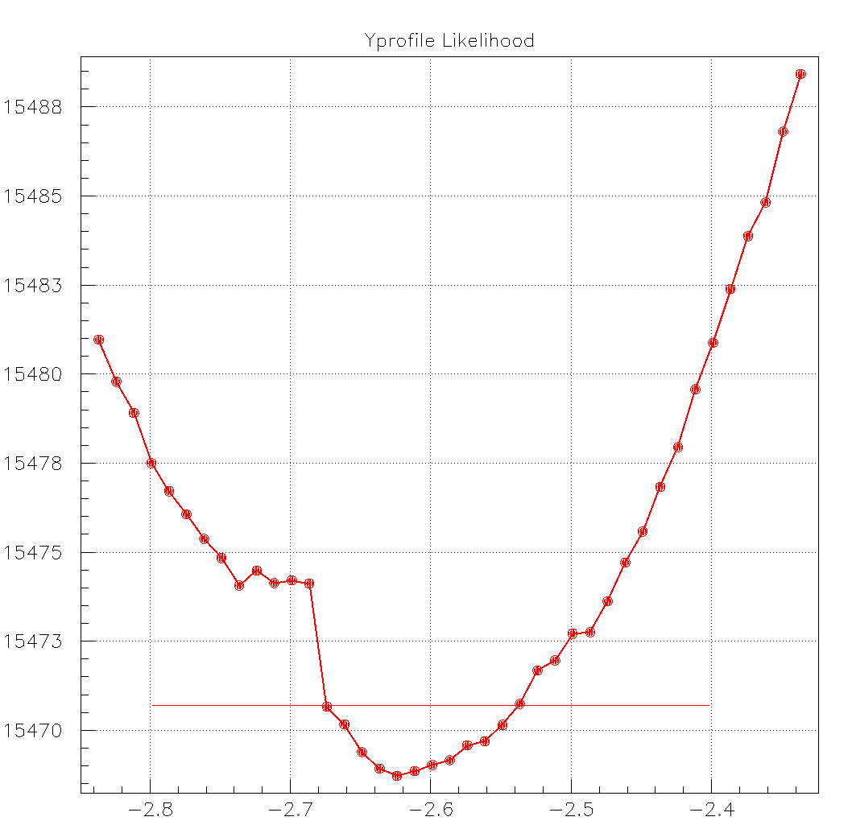
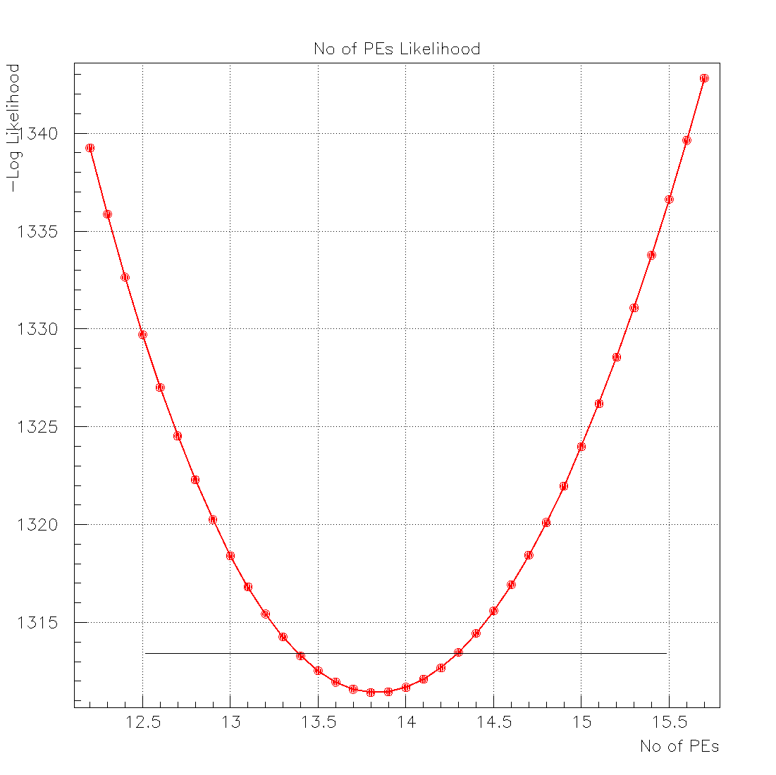
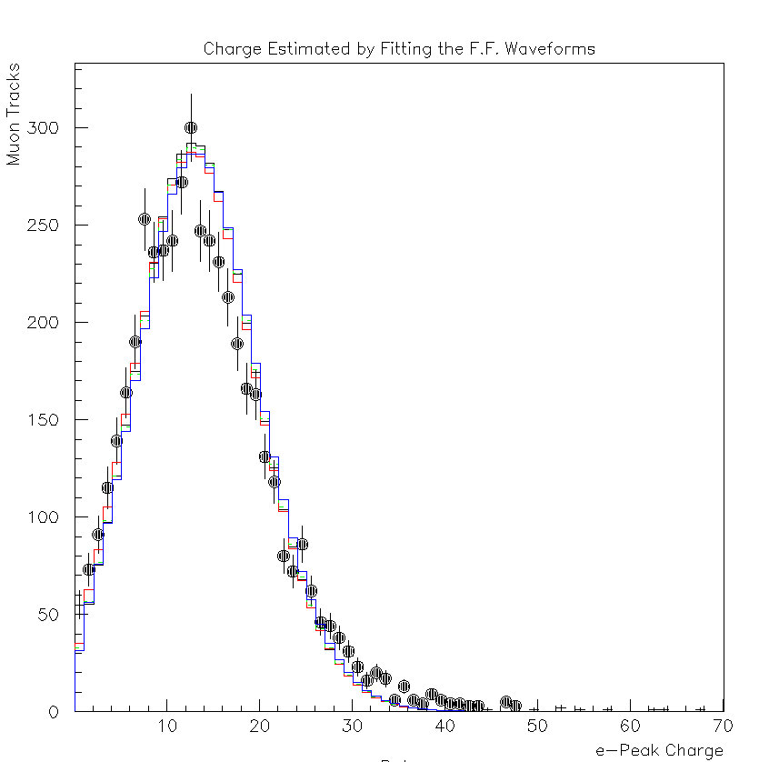
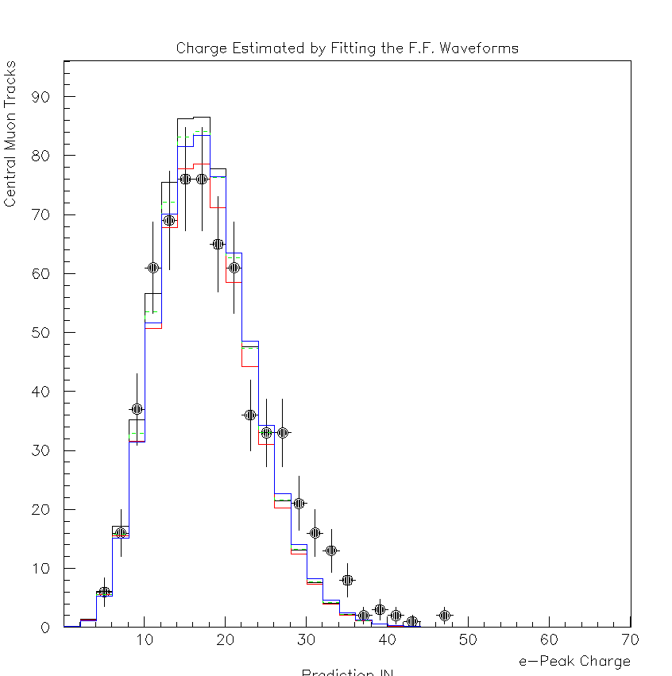
A data analysis procedure has been developed for the Muon Test Beam Calibration, which:
Aligns the detector (remember only one channel) by comparing the charge of the e-peak signal to the expected charge, combining the tracking information with the single pe e-peak spectrum, on an event-by-event basis
Estimates the mean number of photoelectrons produced my the muon’s Cherenkov photons, assuming Poissonian statistics
Combines the alignment results with the estimation of the number of photoelectrons to predict the e-peak charge and amplitude distributions
All tracks
Prediction of the e-peak charge distribution (histograms) with the experimental distribution
Central tracks

Slide 17
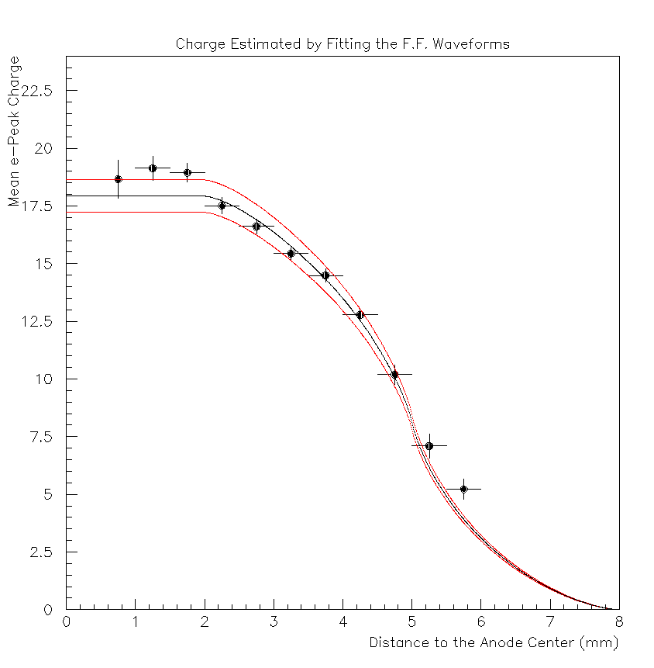
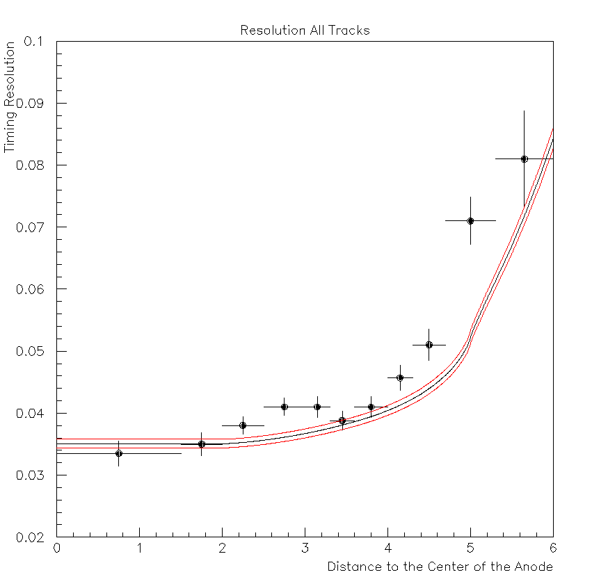
Muon Test Beam Calibration

Slide 18
Summary
The picosec-MicroMegas calibration data reveal interesting properties concerning the signal production dynamics, including the features of the e-peak amplitude and charge distributions as well as timing resolution and slewing properties.
We have developed tools to analyze the data, perform consistent and unbiased estimations and conclude to results which are independent on the particular conditions applied during the selection of calibration data.
As shown in K. Paraschou talk, the simulation tool has been developed as well, and the results that I presented will be compared with the simulation.
An accurate analysis technique to estimate the number of photoelectron per muon track, offering a tool to evaluate the yields of different radiators and photocathodes has been developed and is currently used to analyze data.

