Slide 1
Comparison between a THGEM made of ARLON and a traditional THGEM made of FR4
Jinky Agarwala
INFN, Trieste - ICTP, Trieste

Slide 2
Outlines
ARLON and FR4 THGEMs
Set up and conditions of the measurements
Comparison of results
Effect of x-ray illumination
Previous characterization of a THGEM made of Permaglass
Conclusions

Slide 3
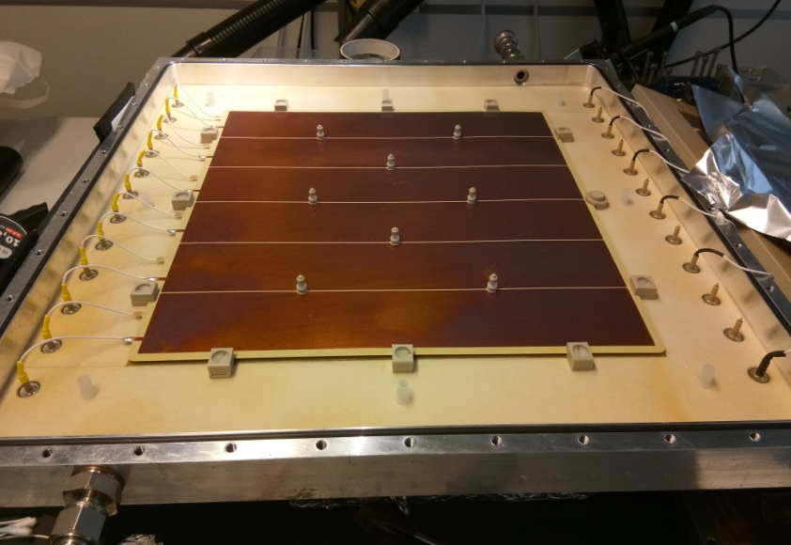
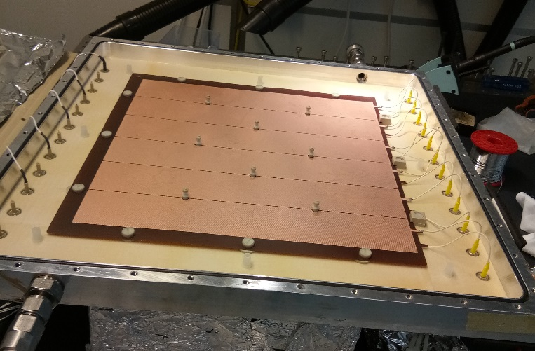
ARLON and FR4 THGEMs
ARLON 25 FR
Dielectric constant: 3.58
Ceramic-filled fiberglass material
Fiberglass FR4
Dielectric constant: 4.7
Woven fiberglass and epoxy resin
Area: (300 x 300) sq. mm Thickness of the piece: 0.4 mm
Pitch: 0.8 mm Hole diameter: 0.4 mm No Rim
Both produced by ELTOS

Slide 4
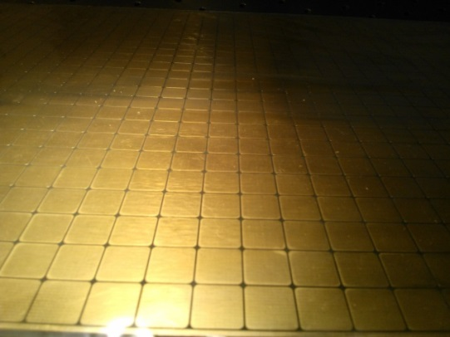
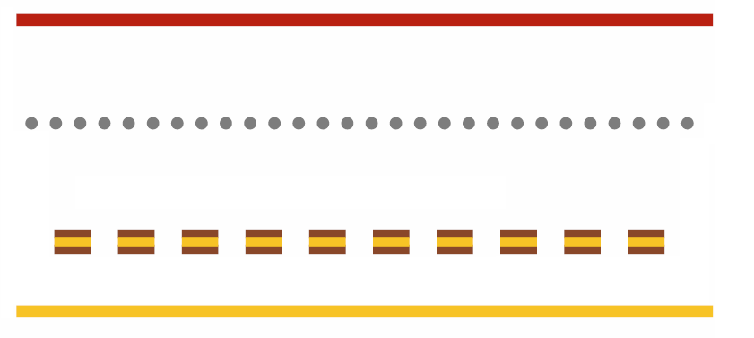
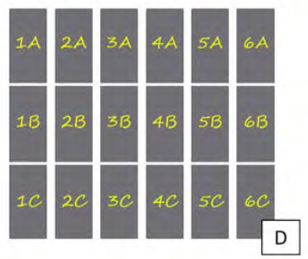
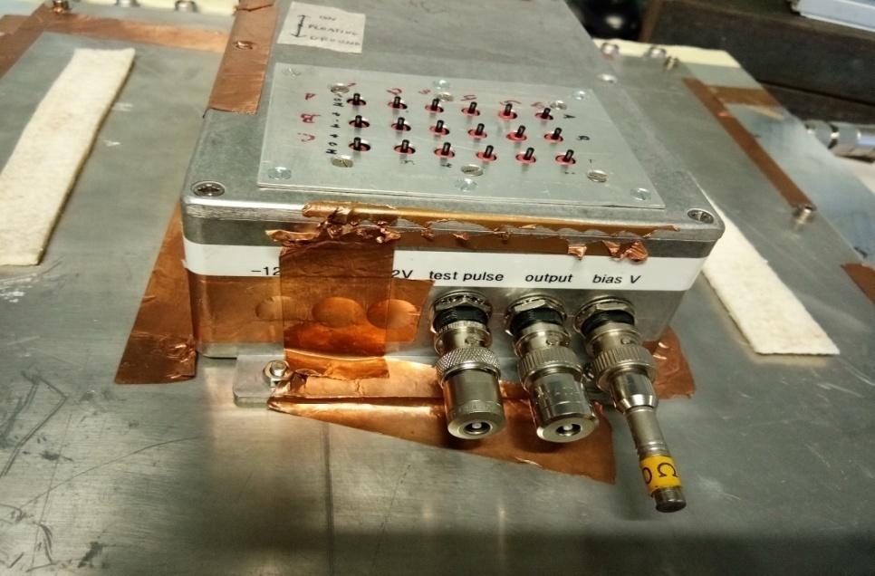
Gas Used:
Ar:CO₂= 70:30
Source: ⁵⁵Fe (5.9 keV)
Rate: 5 kHz
HVPS: CAEN N1471H
Software for HVPS: GECO 2020
PreAmplifier: CREMAT 110
Amplifier: Ortec 672
MCA: AMPTEK 8000A
Multi-Pad Anode (12mm X 12mm)
KAPTON
Drift
Thickness: 0.4 mm
17.5 mm
2.5 mm
The Readout Pads (Anode):
24 x 24 matrix
Divided into 18 regions
Each region has 32 (4 x 8) pads read together

Slide 5
Measurements: Drift Scans and Induction Scans
Similar responses

Slide 6
Effective Gain
FR4
E_Ind= 2kV/cm, E_D= 0.8 kV/cm
Vc | 889 V
|Ec| | 22.2 kV/cm
ΔV₁₀ | 178 V
|ΔE₁₀| | 4.45 kV/cm
ARLON
Vc | 902 V
|Ec| | 22.6 kV/cm
ΔV₁₀ | 192 V
|ΔE₁₀| | 4.8 kV/cm
Very similar effective gains

Slide 7
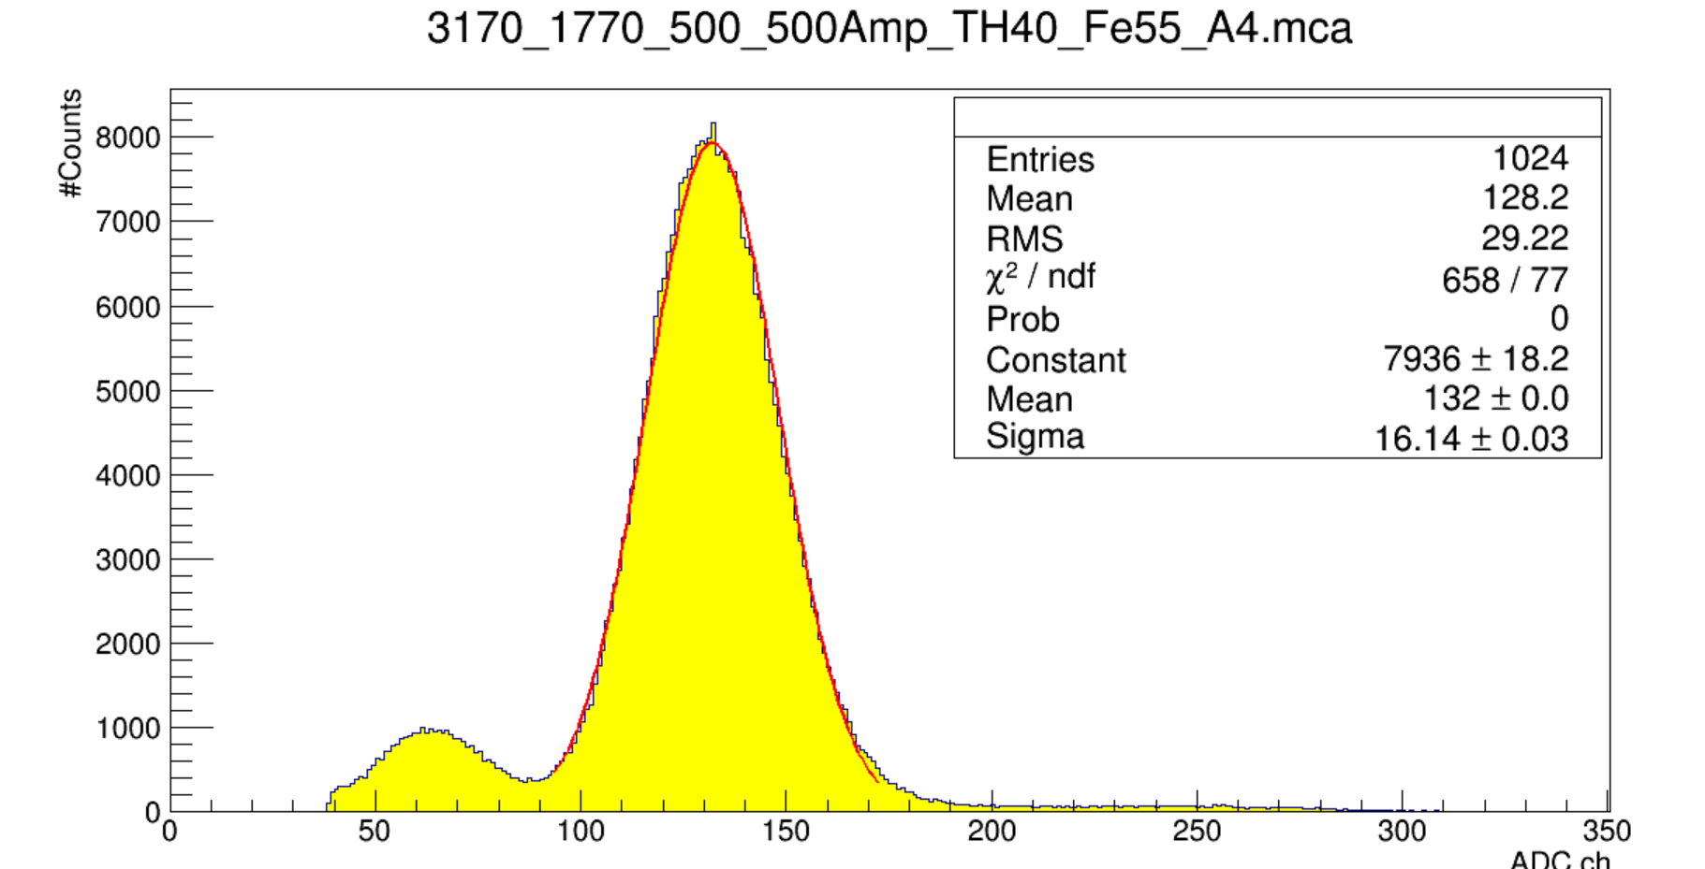
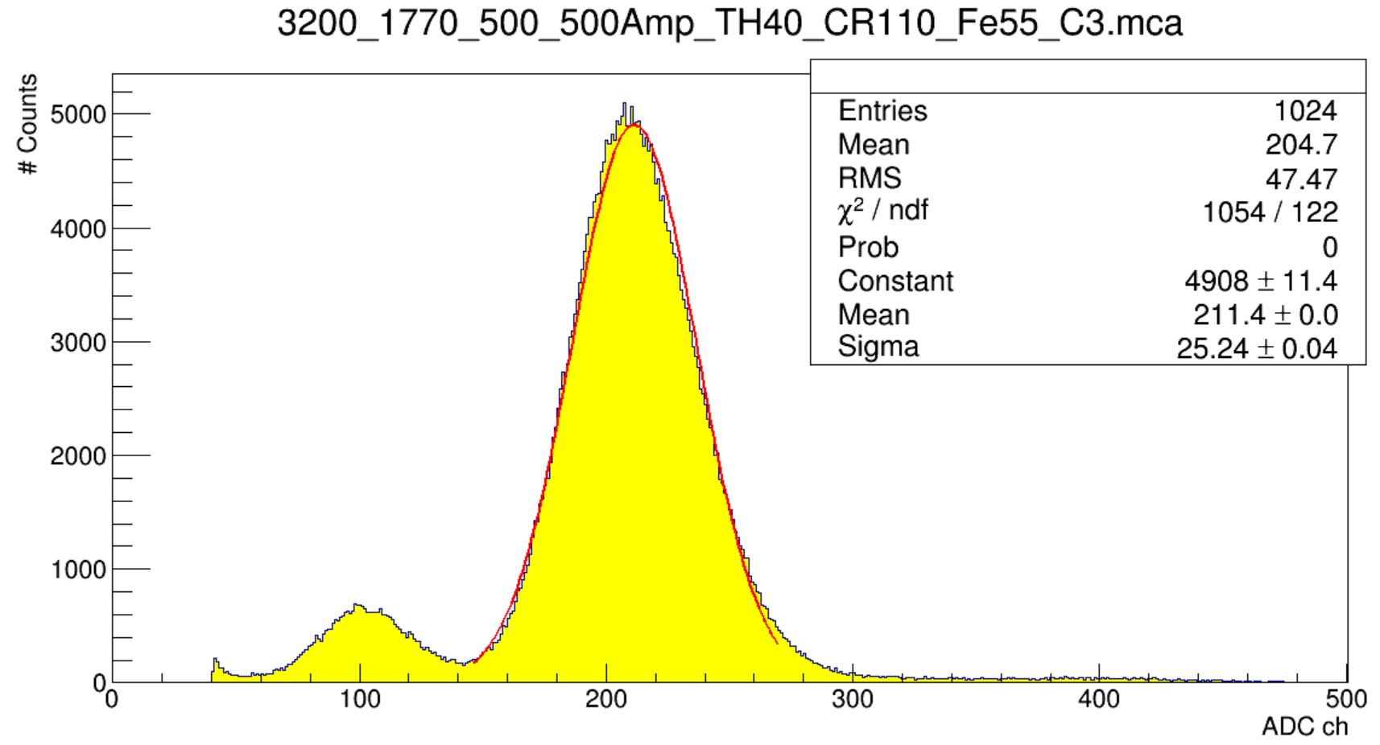
Energy Resolution
ARLON
FR4
Energy Resolution: 12.2 %
Energy Resolution: 11.9 %
Calibration factor:1.048228
231 electrons per channel,
27 channels/fC
They have the same Energy Resolution

Slide 8
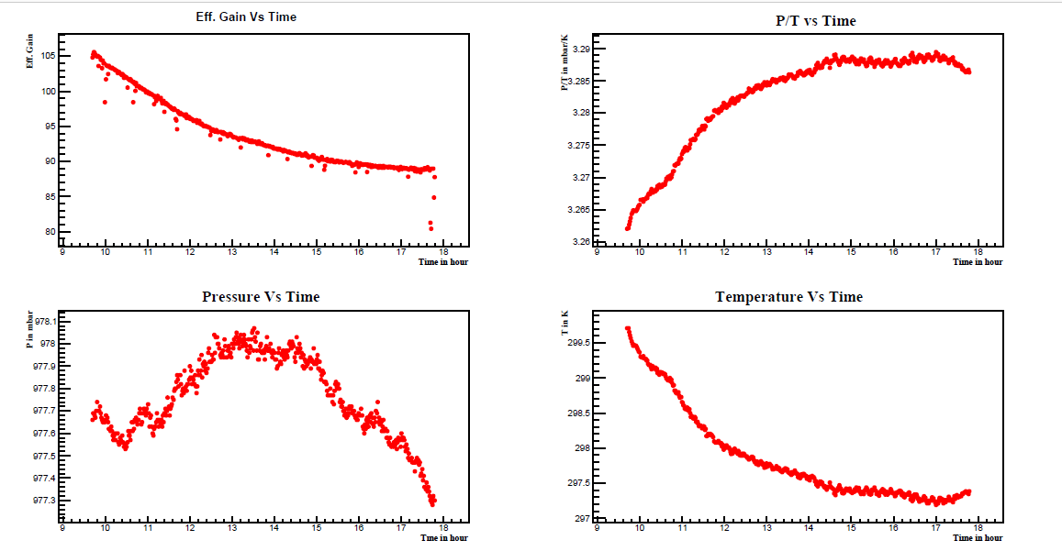
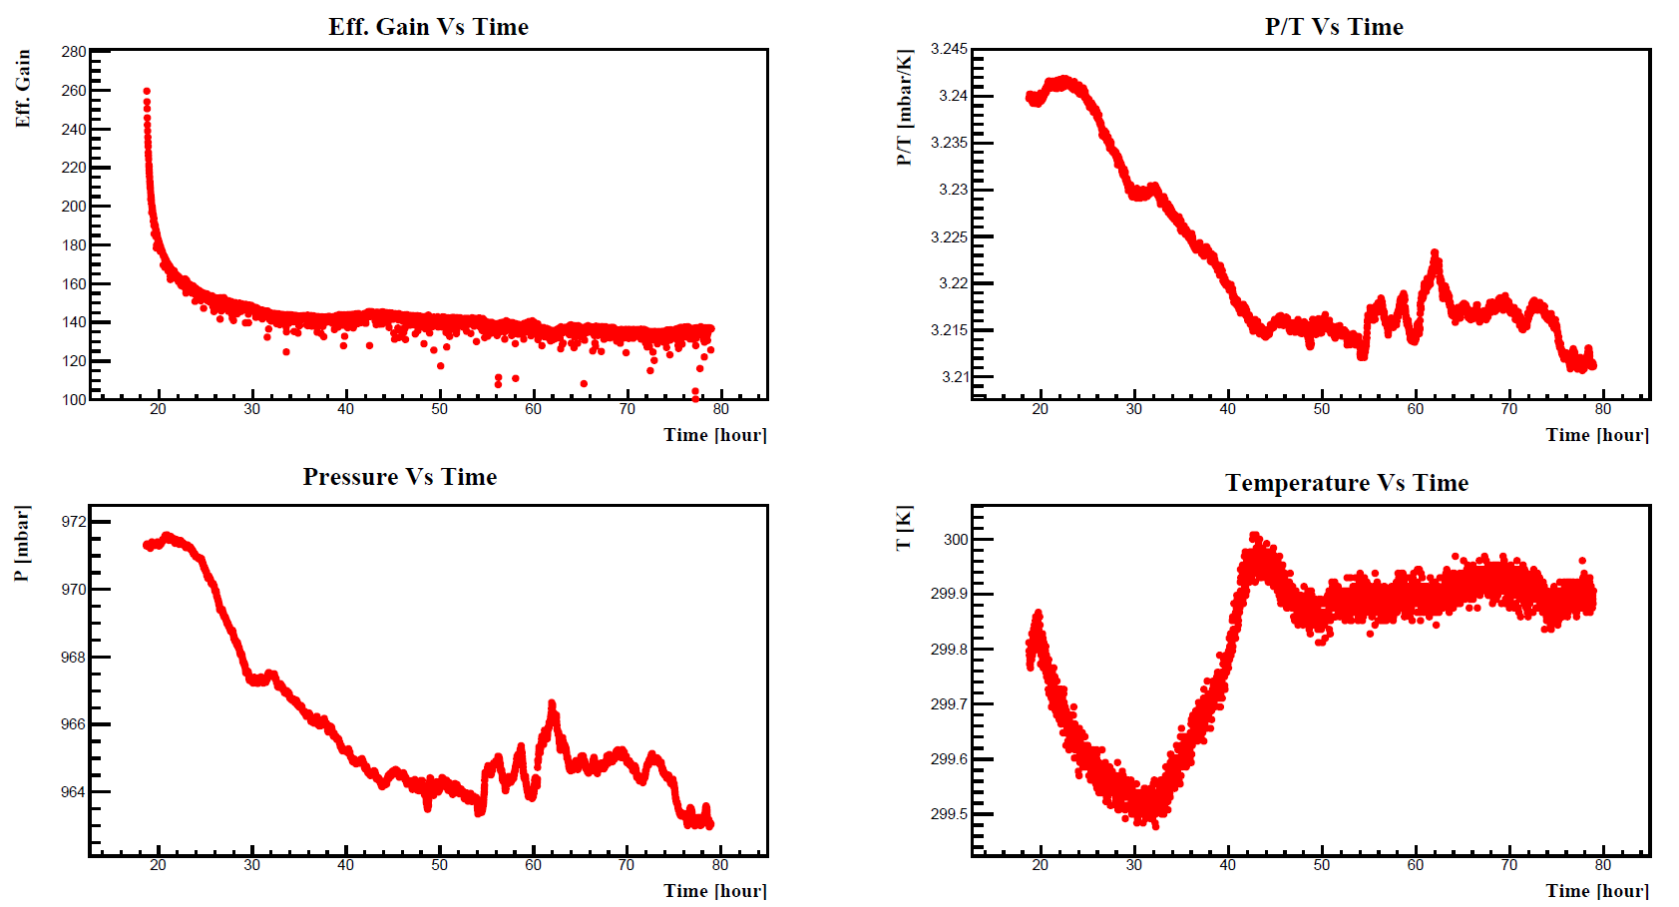
Effective gain variation with time
ARLON
FR4
8 h
60 h
Gain variations with time for the two pieces are not the same

Slide 9
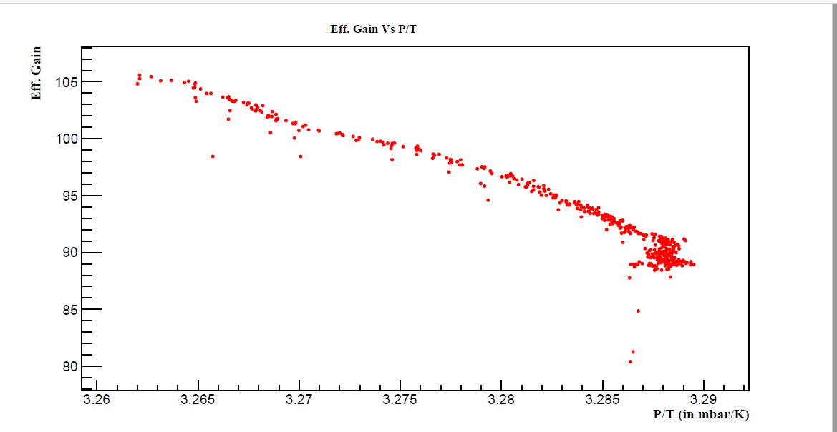
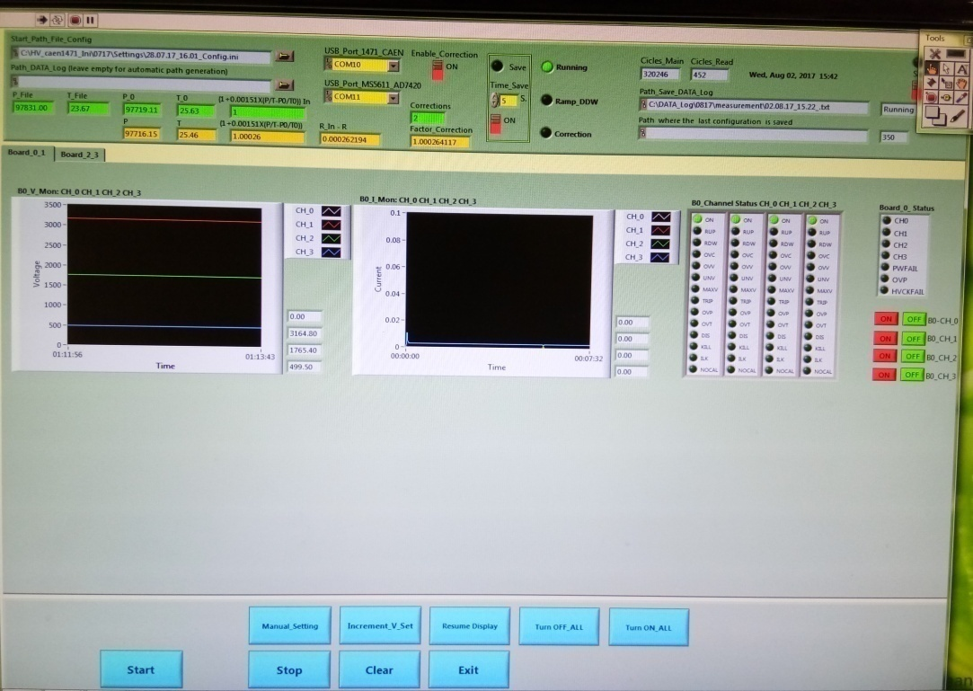
Correlation between effective gain and P/T
Labview HV control program with P, T corrections
HV bias modified to compensate for P and T variations
Correction Factor (C): 1+0.00151X{(P/T)-(P_0/T_0)}
Correction is applied if: 0.01 < |1-C| < 0.001
This recipe is used by COMPASS RICH-1 hybrid detectors

Slide 10
Gain stabilization with HV corrections
Variation within +(-) 2.5%

Slide 11
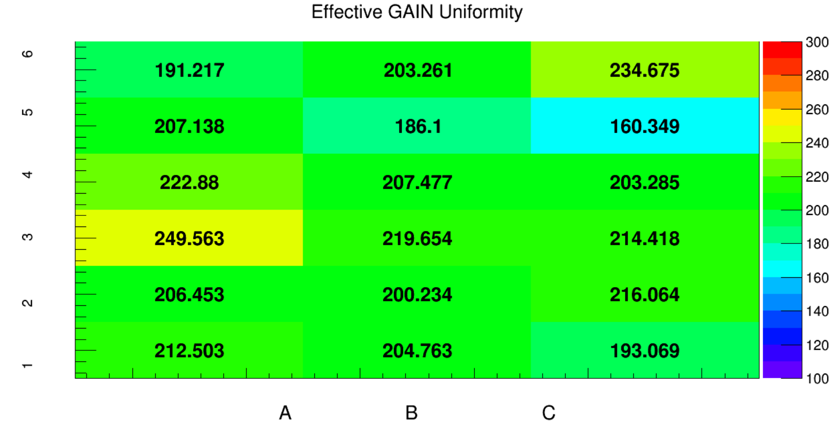
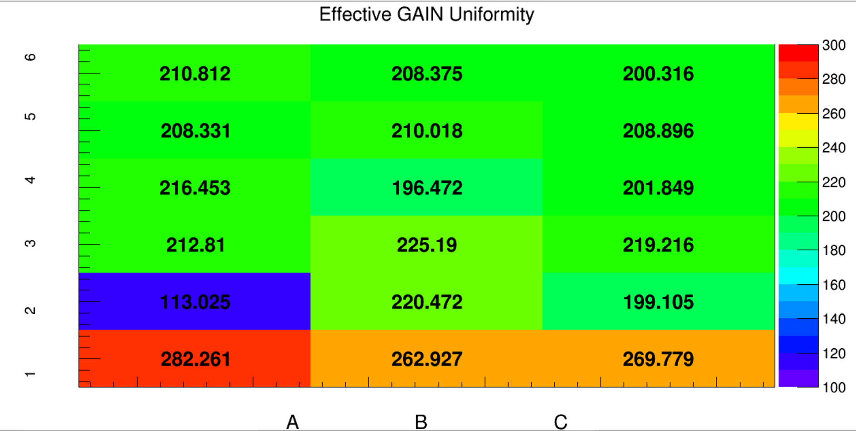
Gain Uniformity
ARLON
FR4
σ= 9.1 %
σ= 16.1 %

Slide 12
Effect of illumination by ⁵⁵Fe source
Uniformity scan performed after A6 was illuminated for 5 hours
Broadening of the spectra
Uniformity scan performed after A4 was illuminated for 67 hours

Slide 13
Long term persistence of the illumination effect on ARLON and FR4
ARLON
FR4
26-Jun 21-July 24-July 01-Aug 09-Aug 06-Sept 08-Sept
70 DAYS
08-Sept 11-Sept 13-Sept 15-Sept 18-Sept
10 DAYS

Slide 14
Conclusions
The responses of identical THGEMs made of ARLON and FR4 have been compared
The gain and the energy resolution are the same
The charging up is faster in FR4
The recovery from the illumination effect is much slower in ARLON
The ARLON material is not suitable for high rate THGEM application

Slide 15
About PERMAGLAS
Permaglas ME730 by RESARM Engineering Plastics SA
  Epoxy glass fibre material, amorphous, machinable
  The plate planarity is obtained by machining
    Purchased by us:

Slide 16
THICKNESS UNIFORMITY
Raw material characterization
Nominal thickness 0.7 mm
  /Δ/ < 4%; σ < 2%
Nominal thickness 1 mm
  /Δ/ < 2%; σ < 1%
→ Very good thickness uniformity!
Cu layers glued at CERN by Rui de Oliveira
Drilling performed by ELTOS

Slide 17
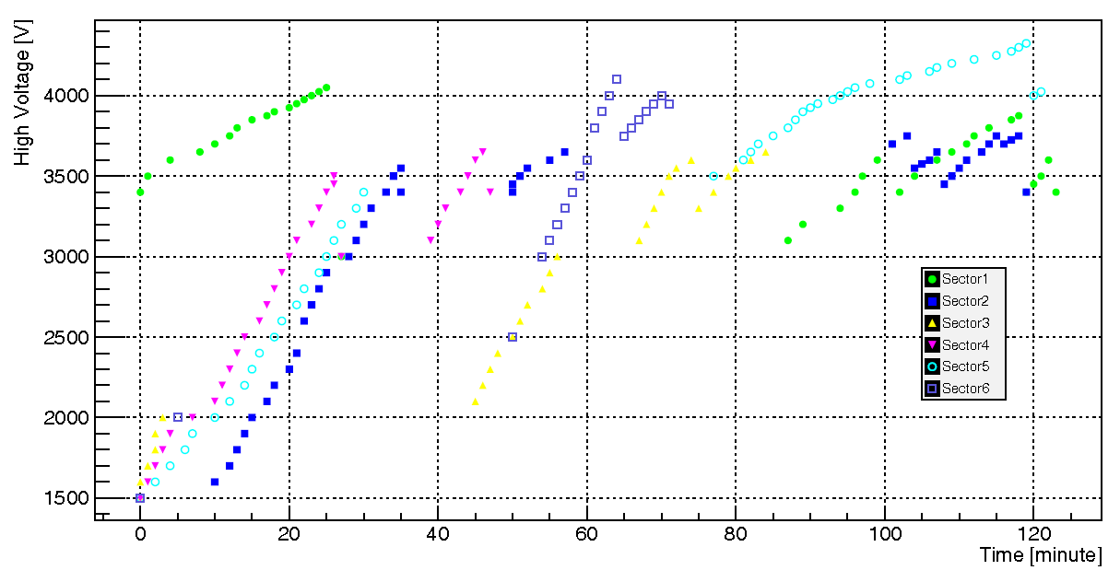
ELECTROSTATIC PROPERTIES
PASCHEN test for 1mm thick piece
90% PASCHEN limit

Slide 18
RESULTS
UNIFORMITY SCAN:
  σ: 13%
ENERGY RESOLUTION:
  20 %
GAIN PERFORMANCE:
  A robust device
Gas:
Ar:CO₂= 70:30
Source: ⁵⁵Fe

Slide 19
TIME DEPENDENT EFFECTS
CHARGING UP STUDIES
Effect of the ion motion in the material

Slide 20
CONCLUSIONS about PERMAGLAS THGEM
Robust material with good uniformity performance
Difficult to get good quality thin foils
Limited gain dependence on rate (charging up) and time (ion displacement in the bulk dielectric)

Slide 21
Thank You

