Slide 1
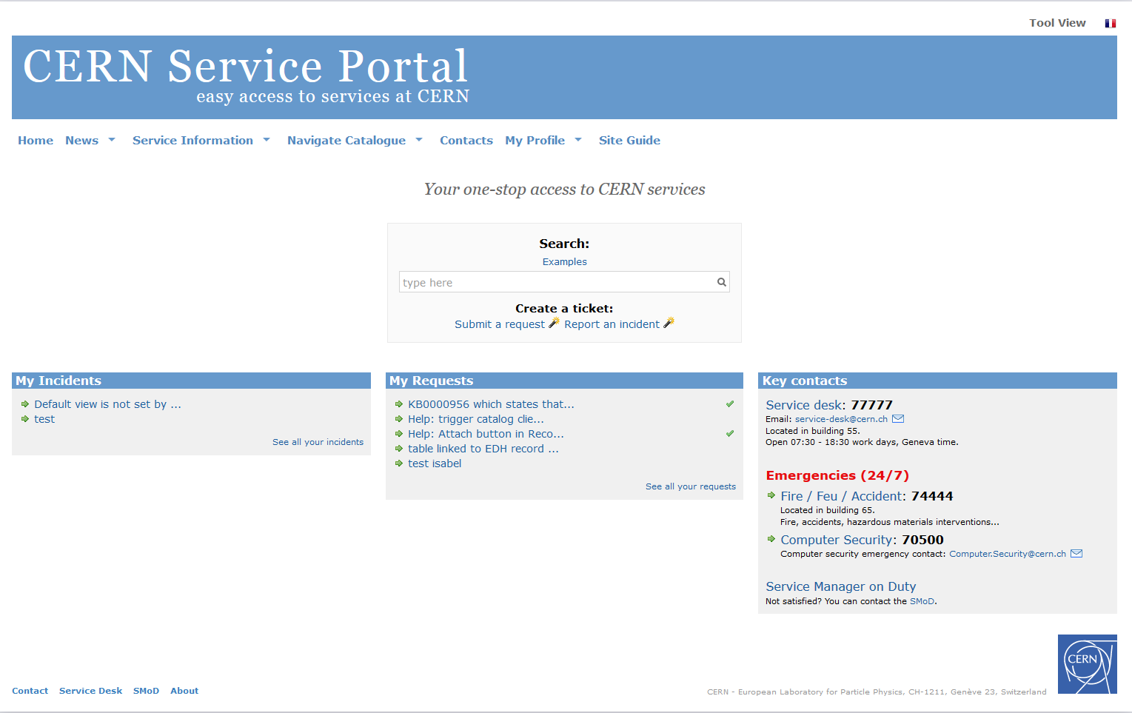


Like a town…
Like a town
Easy access to services at CERN
Notes:
Good morning everybody,
My name is XXXX and I would like to welcome you warmly on behalf of CERN Service Management team.
The aim of this presentation is to explain easy access to services at CERN thanks to CERN Service Portal and CERN Service Desk.

Slide 2
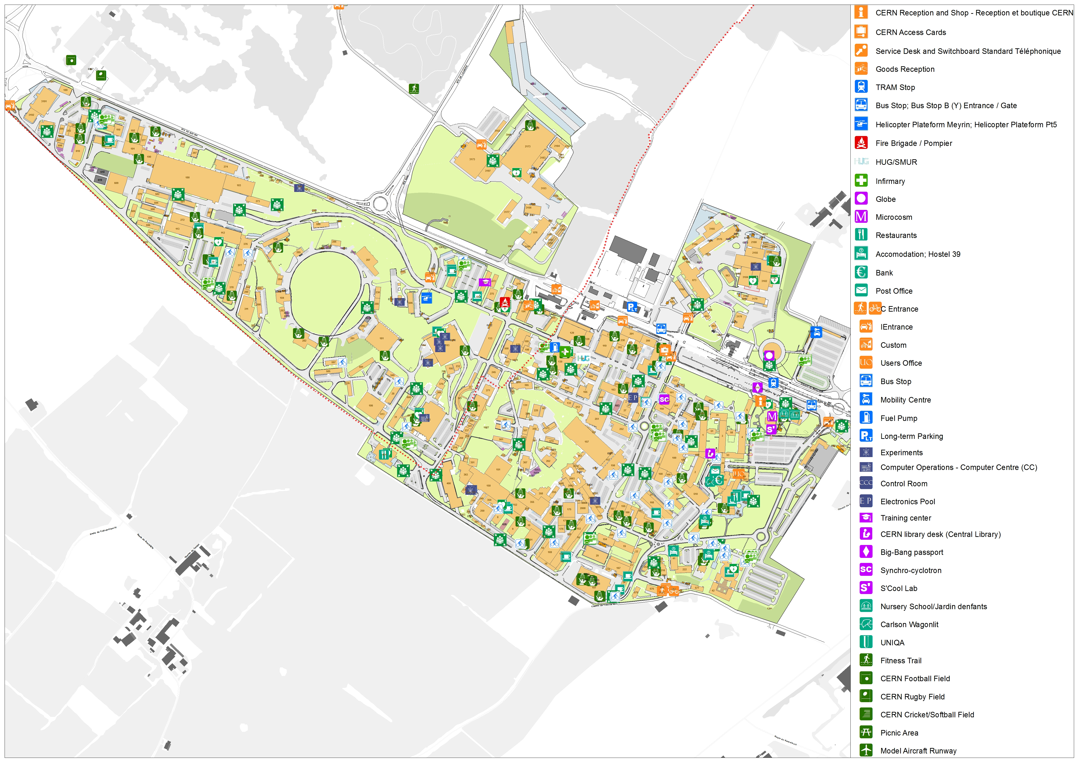

Like a town
Many different services working together
for
CERN’s
unique purpose
And you take part of it !
Notes:
As you all probably know, CERN is a big laboraty hosting thousands of people and offering many different services.
We are all working together, supporting each other, to reach CERN unique’s purpose.
And you are taking part of it!
(to gain understading of the most fundatemntal particles and laws of the universe)

Slide 3

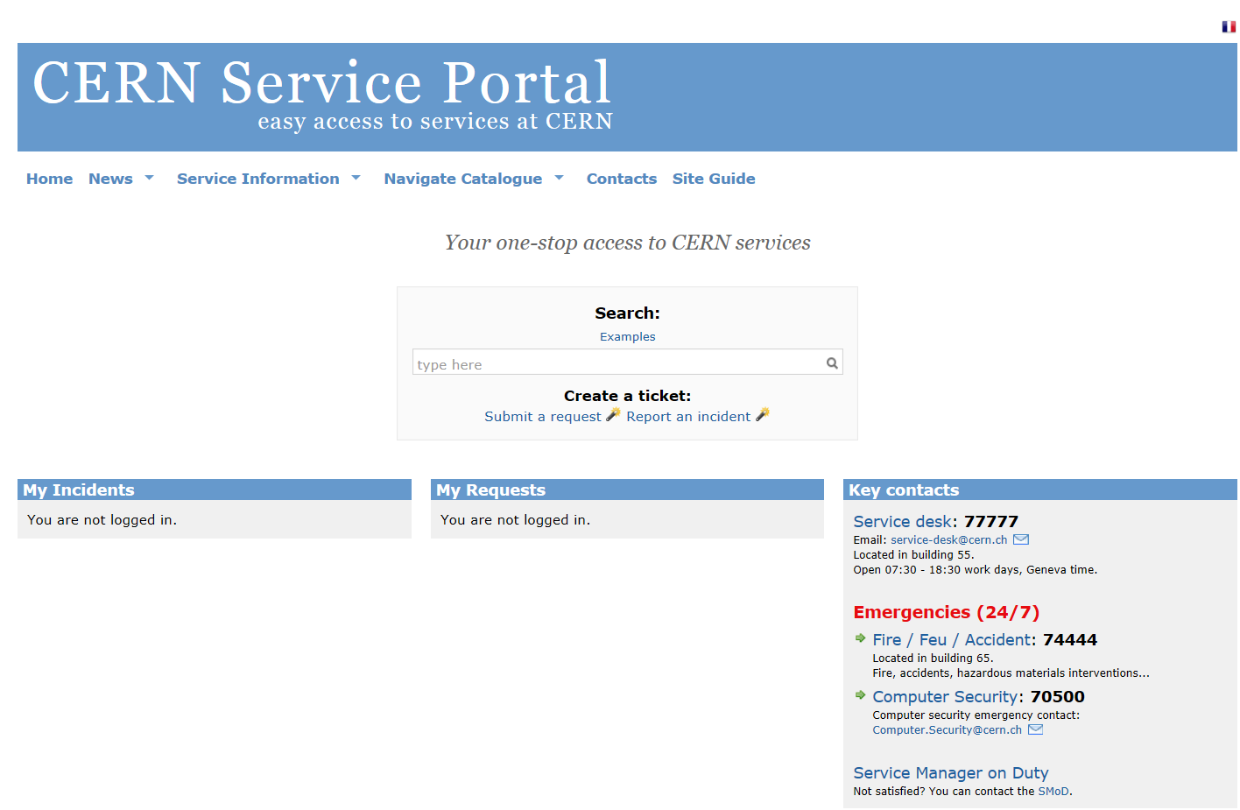






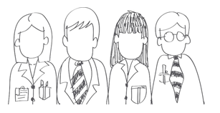






CERN Service Portal / CERN Service Desk
Service desk
  Account is blocked
  Wifi connexion
  LXPLUS batch issue
  Help with Car sharing
  Heating issue
  Door lock issues
  Printer blocked
  Order new material
  Identity management
  WIFI Service
  LXPLUS Service
  Car pool and Rental Service
  Heating, ventilation, Air Conditioning and Compressed Air Service
  Locks and Keys Service
  Printing service
Easy access to services at CERN
Notes:
During your time at CERN you will need most probably to get in contact with those services…
You may encounter informatiques issues like
Computer problems,
Network connection
Printer blocked
Y
ou may need to submit requests to services, as example:
Need to reserve a car from the car sharing pool
Order material for your
Or you may simply ask for information, find how to do something..
Who should you contact?
You have 2 options:
The 1st one is a human interface through the CERN Service desk
The 2nd one is a web interface through the CERN Service Portal
Both are here to channel your request to the most appropriate service

Slide 4
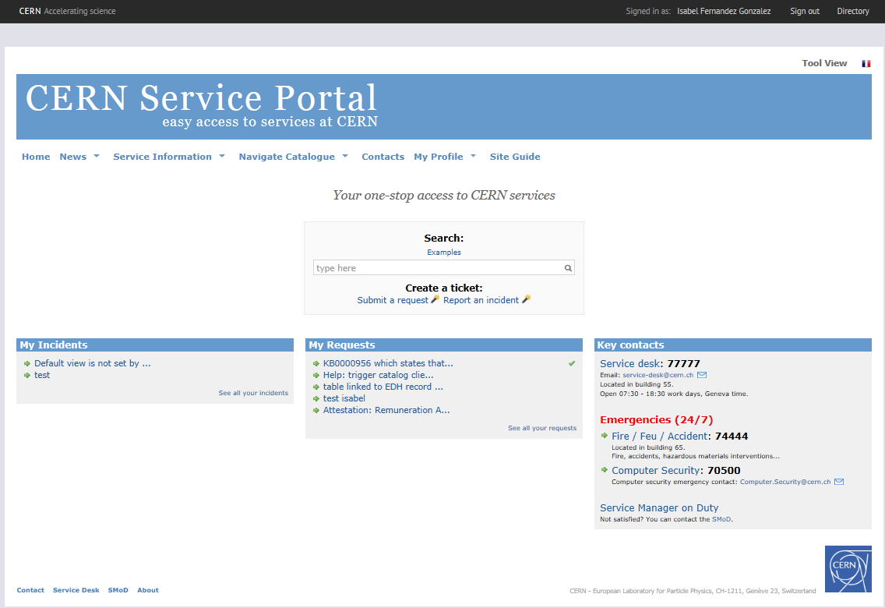

CERN Service Portal
Service desk
https://cern.ch/service-portal
Notes:
This is the CERN Service Portal main page.
You will find the Key contacts on the botton right corner
Please, remember that in case of fire or an accident call the Emergency number 74444 and not the Service desk, otherwise for any other kind of issue you can contact the Service Desk

Slide 5


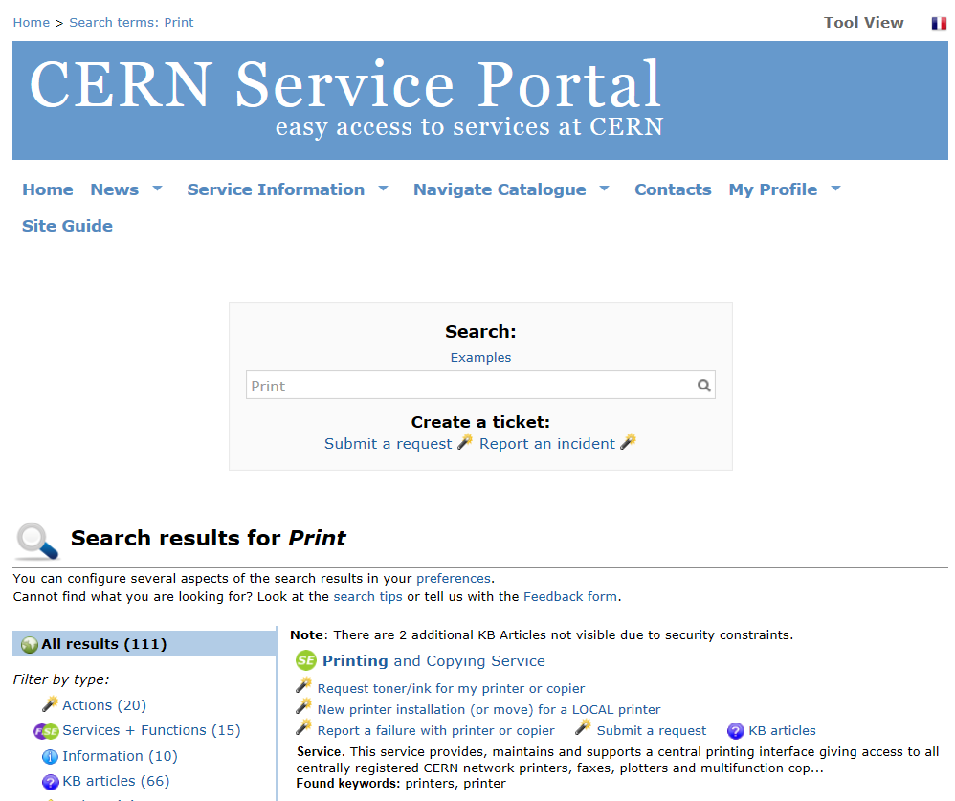
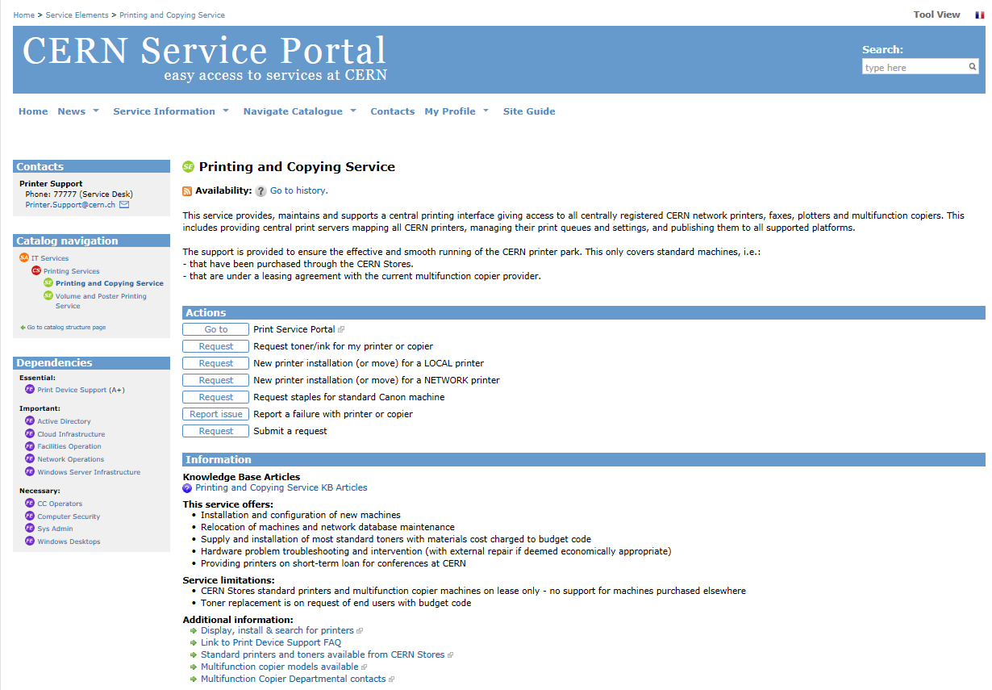
Easy access to CERN Services
Search base on English / French keywords
https://cern.ch/service-portal
Notes:
CERN Service Portal proposes you a search tool based on keywords,
You can search in English and in French.
Search will give you access to CERN Service Catalogue
If you search ‘Print’:
it proposes you Printing and Copying Service
Click on it
You access to Service description, its contact information, actions proposing web-form to report issues and submit requests, and other related information
All services in the catalogue appear in the same way.

Slide 6
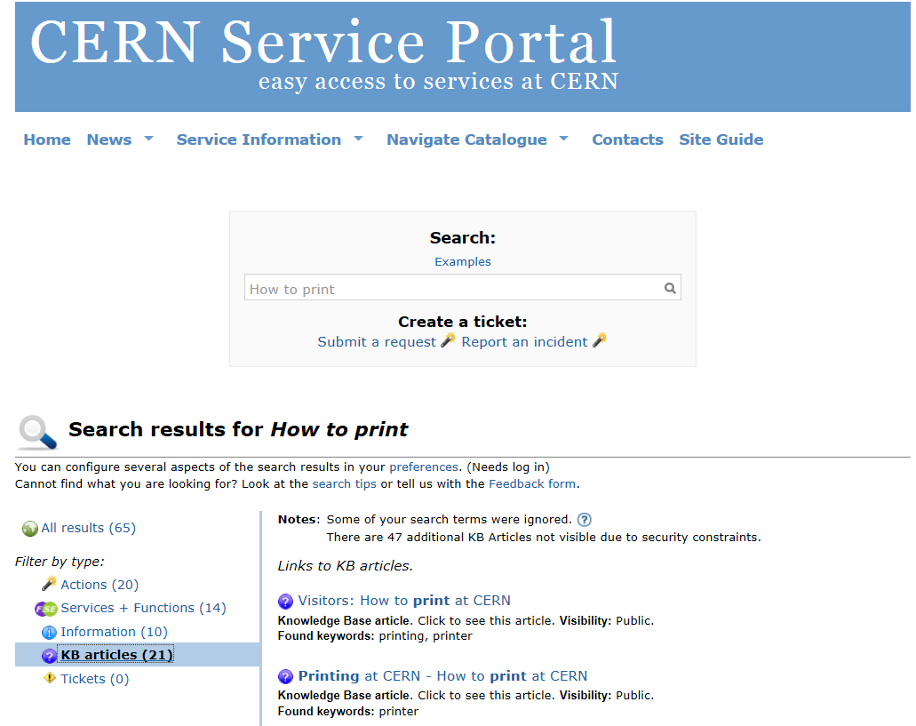
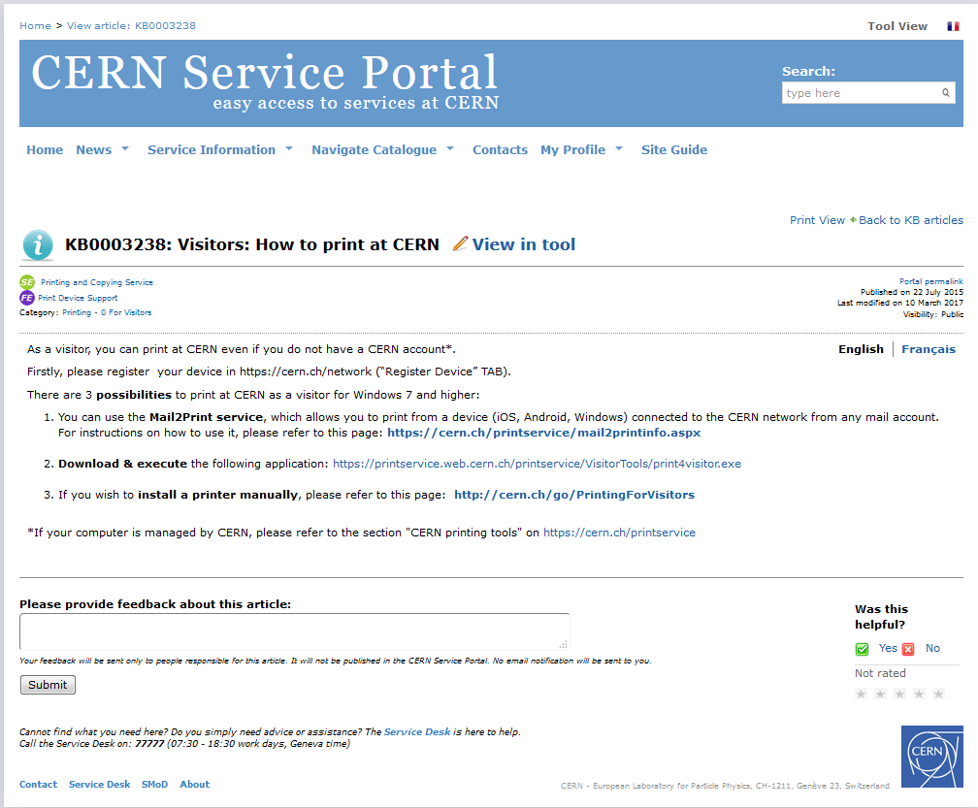

Services sharing knowledge
Ask your questions, get answer
How to print
https://cern.ch/service-portal
Notes:
Should you have any question, need information?
Services are sharing their knowledge, they provide an up-to-date knowledge database with the most common questions and answers, recipes.
If your search “How to print”
Related knowledge articles will appear.
Knowledge articles are identified with question mark icon
Click on it, read it,
You can provide your feedback on the article, rate it..

Slide 7

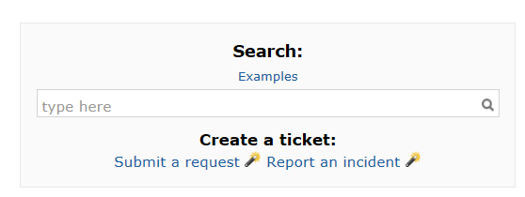
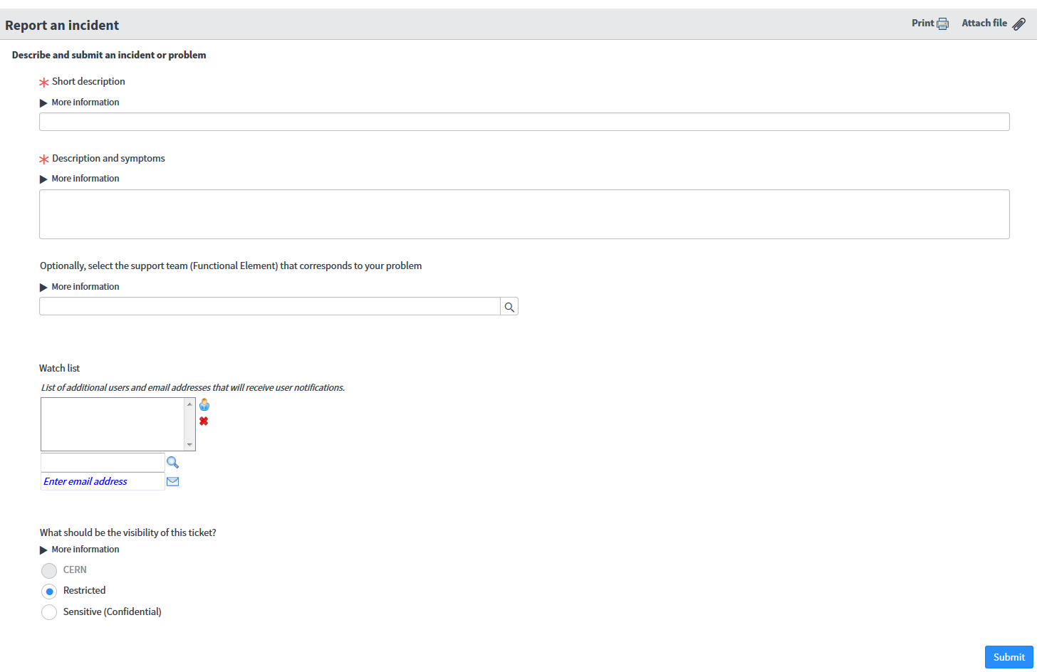


Report an incident
Something does not work as expected
https://cern.ch/service-portal
Notes:
If something does not work as you would expect,
You can report an incident from CERN Service Portal.
From the main page:
once you are log in
Click on Report an incident, a simple form appears
Provide:
A short description of the issue
A more detailed explanation
And you may add someone to watchlist to follow your issue as you would use the CC field
Once submitted:
a ticket will be created with a reference number INC,
It will be handled by the Service Desk who will send it to appropiate service if they can not solve it. Good to know Service desk has 10 minutes to either solve your request or to escalate it.
You will receive a notification email confirming the creation of the ticketand resolution.

Slide 8

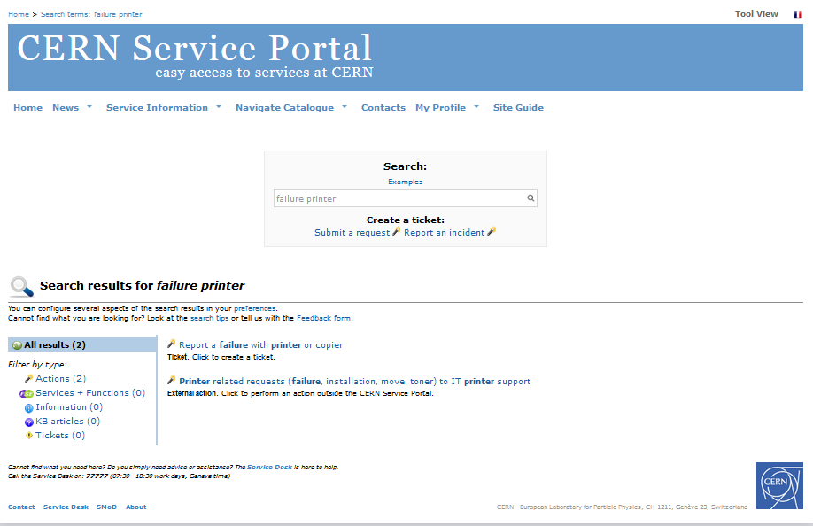
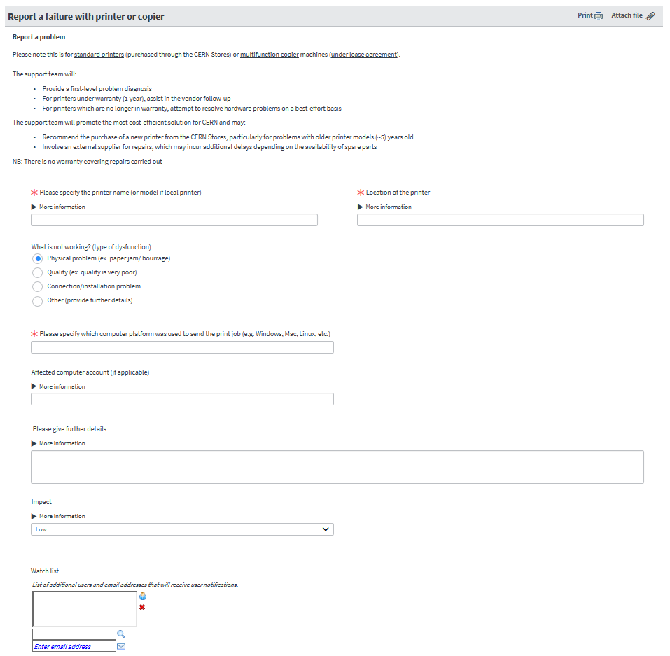
Report an incident with forms proposed by Service
failure printer
Specific actions asking for the relevant information needed, it makes easier for others to help you!
https://cern.ch/service-portal
Notes:
Services provide specific web-forms to report issues:
Providing the requested information will allow services to solve your issue more efficiently
It makes easier for others to help you!
The portal search will also assist you to find web-form if any, just by typing in the search box keywords related to your problem. They appear with an magic light icon ☺
For example:
If your printer does not work any more…
And you type “failure printer”
It proposes you the form that help you to describe your issue.
Once submitted, the ticket will be assigned to the service with the required information to take care of it!

Slide 9

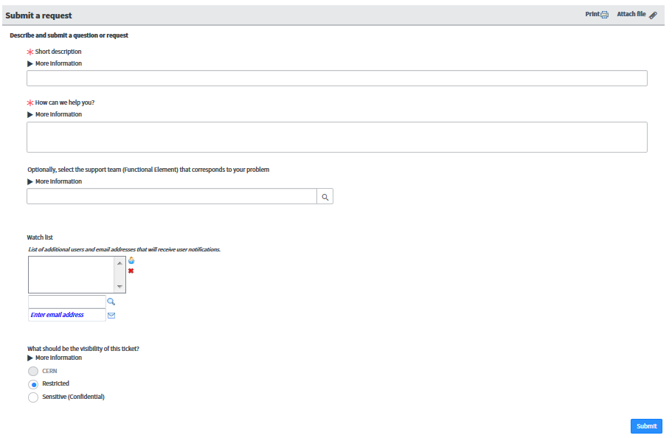
Submit a request
Ask for something, request access…
https://cern.ch/service-portal
Notes:
You will not only have incidents!
You will need to contact services with requests…
For that you will be able to submit a request from the main page of the service portal.
Services are providing web-form to assist you to describe your request, and be able to take care of them.

Slide 10

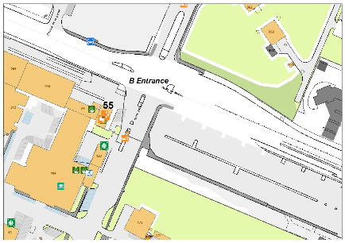
CERN Service Desk
3 possible ways to contact the Service Desk
Email: service-desk@cern.ch
Phone: 77777 (+41 22 76 77777 from outside CERN)
By visiting: building 55 (entrance B)
Open
from 07:30 to 18:30
Work days
Geneva time
Assist you, resolve or escalate your issues to appropriate service
Notes:
If CERN Service Portal, did not provide answer to your issue, request…
In you prefer, human contact, CERN Service Desk will be pleased to assist you
You can contact the Service desk
By email
By phone 77 7 77
You can visit the Service Desk, is located in building 55 next to Entrance B,
- the building where you are going to activate your computer access, and get your access card.
The Service Desk is open from 07:30 to 18:30 on work days.
Service Desk will do its best to help you with any question.
- Your requests done:
via email/telephone/visiting the Service Desk or via the portal are registered and tracked in a ticket based system.

Slide 11

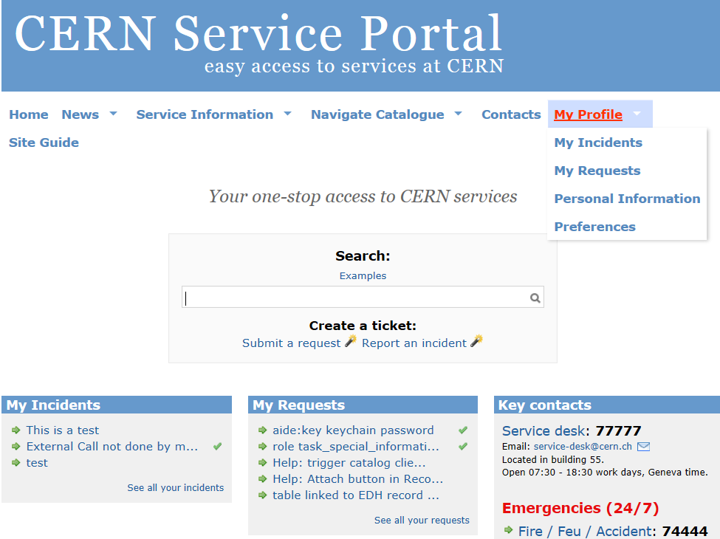
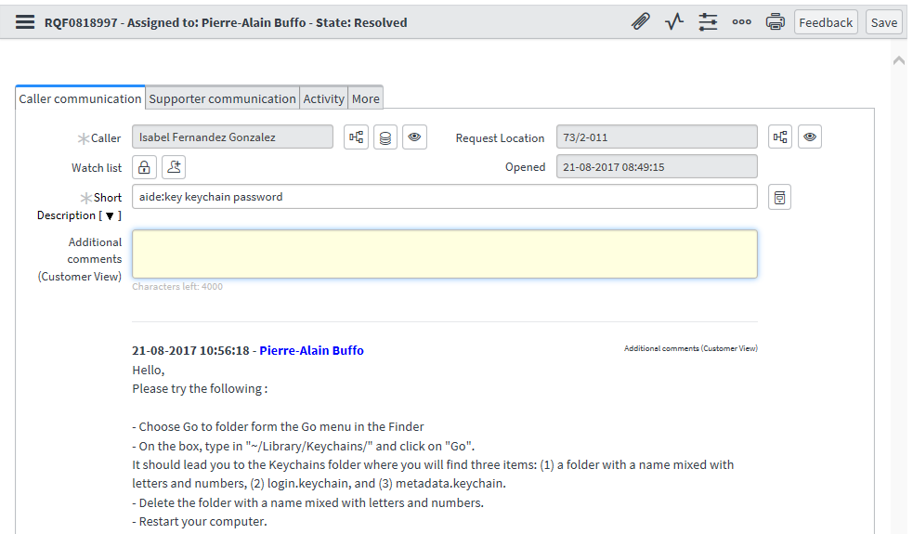
Track your issues
All your issues are registered in a ticket based system
Access your tickets from the portal
Check and update your tickets
https://cern.ch/service-portal
Notes:
All your issues are registered in a ticket,
You can follow the status of your issue and update the information via:
the portal
or by replying to the email notifications you have received.
From the portal:
you can see the list of your ‘on-going’ tickets and you can follow their status
Should you need to update the information,
Click on the ticket , provide your comments and don’t forget to save it!

Slide 12

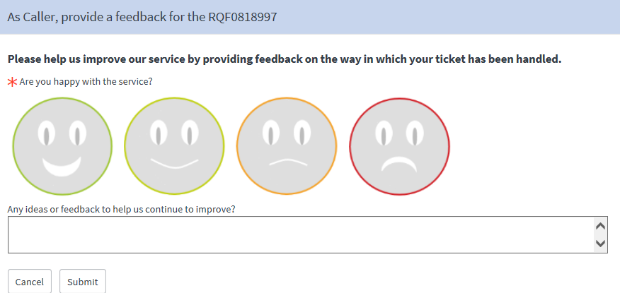
Your feedback matters!
Provide feedback on the resolution of your ticket
Notes:
Please note that all notifications comes from CERN Service desk even if the Service desk is not dealing with your issue.
When your issue is been resolved, you will be invited to provide your feedback on the way it was resolved.
Your feedback is sent to Service responsible.
Your ideas and feedback matters
We welcome your feedback, and every single comment you send us is read by service and by us!
It helps services continue to improve!

Slide 13
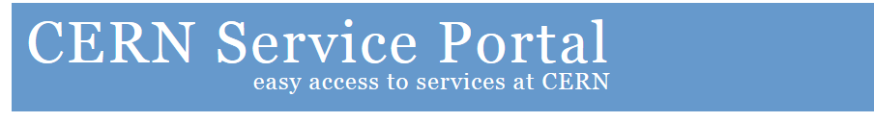



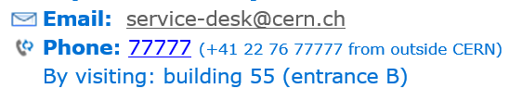
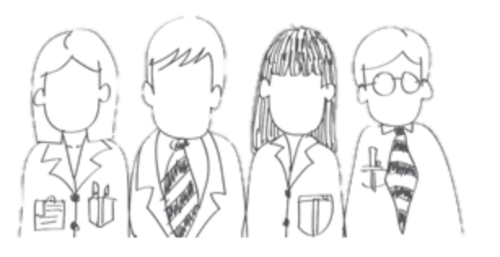
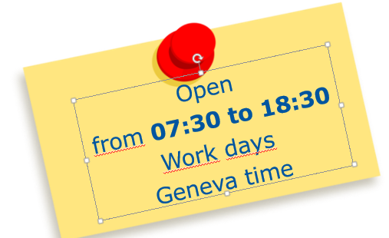

Services
Services info
in a glance!
Find your answer!
Report an issue!
Submit a request!
Your feedback maters!
CERN Service Desk
Notes:
You have seen the main highlights of the CERN Service Portal and the Service Desk to be on board.
We hope they will be helpful during your stay.
Do you have any questions?
If not, I wish you a pleasant and fulfilling stay at CERN!
Thanks et bon voyage!!

