Slide 1
Notes:
On behalf of the Safety Unit,
W e l c o m e a t C E R N !
This presentation is about :
* CERN is a safe place.
* What CERN does to keep you safe
* What are your responsibilities

Slide 2







Slide 3
Safety at CERN
La sécurité au CERN
Notes:
What does S a f e t y a t C E R N cover?

Slide 4
➊ Occupational Health & Safety
Santé et sécurité au travail
H
S
Read CERN Safety Policy
E
➋ Environmental Protection
Protection de l'environnement
➌ Safe Equipment and Operation
Sécurité des équipements et de l'exploitation
Notes:
At CERN, Safety covers 3 major aspects:
1. Occupational Health
Ensure the best possible protection in health and safety matters of all persons
independently of their status
participating in the Organization’s activities or present on its site
population living in the vicinity of its installations
You return home healthy at the end of your working day
Going intact at the end of the day
2. Limit the impact of the Organization's activities on the environment
3. Safe Equipment and Operation

Slide 5
Safety Responsibilities
Responsabilités en matière de Sécurité
Notes:
Safety Responsibilities
Responsibilities in matters of Safety follow…

Slide 6
Director General
Director General
Sectors
Accelerators &
Technology
Finance &
Human Resources
International
Relations
Research &
Computing
Dep.
BE
EN
TE
FAP
IPT
HR
SMB
…
ECO
EP
TH
IT
Groups
Accelerator
Beam Transfer
Cryogenics
Electrical Power
Converter
Machine Protection
Electrical Integrity
Magnets, Super-
conductors, Cryostats
Vacuum, Surfaces
and Coatings
Sections
Beam Transfer
Physics
Electronics
& Controls
Fast Pulsed
Systems
Septa
Notes:
…the hierarchical line
Your 3 main partners in matters of Safety are:
HSE Unit
The HSE Unit supports the Organization in the implementation of
* the CERN Safety Policy,
* the CERN Safety Rules,
* the CERN Safety Objectives and
* best practices at all levels.
It is in particular responsible
* for Radiation Protection and
* the establishment of the CERN Safety Rules.
It grants Safety clearance for
* Installations, including special equipment,
* activities,
* projects and
* CERN Experiments with major Safety implications
Therefore the HSE is composed of

Slide 7
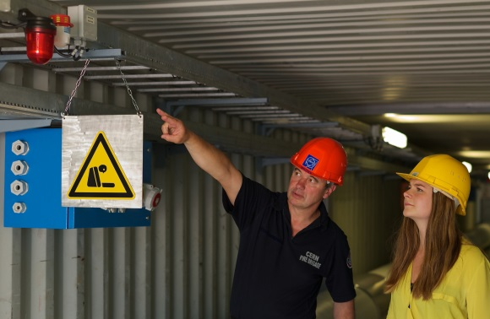
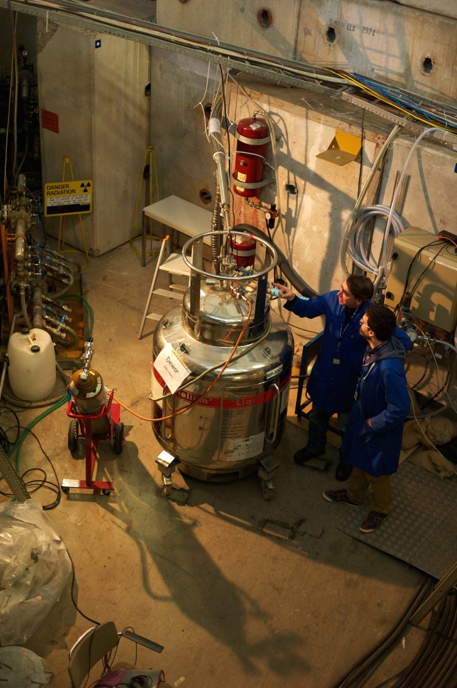
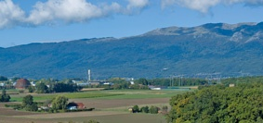

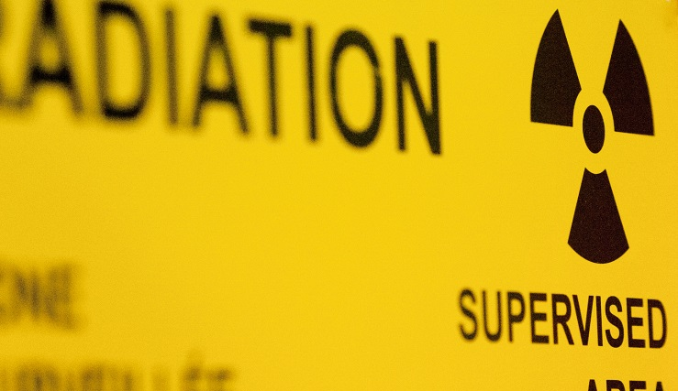

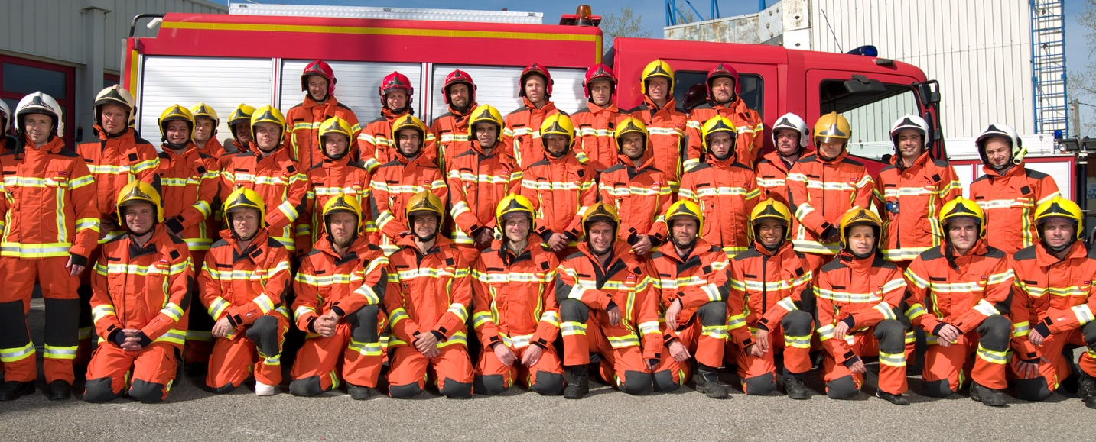

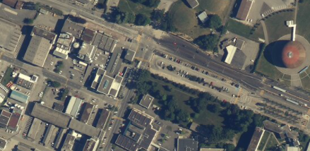

Read CERN Safety Policy
Record emergency number
Environment Monitoring
Safety Engineering
Occupational Safety
Safety Inspections
Safety Training
Safety Engineering
& Environment
Ingénierie de Sécurité
& Environnement
Research & Design Studies
Operational Radiation Protection
Personal Dosimetry
Radioactive Waste
Radiation Monitoring
Radiation
Protection
Radioprotection
Ambulance
Prevention
Intervention
Drill
74444
+41 22 767 4444
Fire & Rescue
Service
Service Secours & Feu
Health Monitoring
First Aid
Medical Ckeck-ups
Health Campaigns
Medical Service
Service Médical
Notes:
4 groups
a. Safety Engineering & Environment Group
* cover all aspects re Occupational Health & Safety and Environmental Protection.
b. Radiation Protection Group
* ensures that all personnel on the CERN sites and the public are protected from potentially harmful effects of ionizing radiation linked to CERN activities.
c. Fire & Rescue Service
* CERN has its own Fire Brigade.
* 58 professionnals firefighters do
* ensure the safety of all CERN personnel, contractors, visitors and users due to fire and other threats.
* provide emergency ambulance care due to accident or illness.
* act in case of environment incidence
* hold Safety training courses
* in case of emergency (like a fire, work accident, any medical emergencies, pollution) call the Fire Brigade at 7 44 44
hold the line if a machine is answering!
remain calm and wait for instructions from the Fire Brigade.
FB is open 24/24 and able to receive any call in French and English.
d. Medical Service
2 Medical doctors, 4 Nurses, 1 Psychologist, 2 Admin. Assistants- Bdg 57 grd +1st floor
* Evaluate staff’s fitness to work through medical examinations, risk-related complementary examinations, workstation visits in coordination with HSE security inspectors.
* Offers Primary Care Medicine for all people on the CERN site (staff, users, students, trainees, visitors) in the case of emergencies, accidents or illnesses.
* Psychological support for members of the personnel.
* Resource centre offering medical information for neighbouring France and Switzerland.
* Prevention campaigns and actions: seasonal flu vaccination, year-long vaccination centre, Health campaigns (hearing, BP, diabetes, lifestyle), Defibrillator training sessions.
The HSE Unit – support, monitor and grant Safety clearance

Slide 8
Environment Monitoring
Safety Engineering
Occupational Safety
Safety Inspections
Safety Training
Safety Engineering
& Environment
Ingénierie de Sécurité
& Environnement
Safety Engineering
& Environment
Research & Design Studies
Operational Radiation Protection
Personal Dosimetry
Radioactive Waste
Radiation Monitoring
Radiation
Protection
Radioprotection
Radiation
Protection
Ambulance
Prevention
Intervention
Drill
74444
+41 22 767 4444
Fire & Rescue
Service
Service Secours & Feu
Fire &
Rescue
Health Monitoring
First Aid
Medical Ckeck-ups
Health Campaigns
Medical Service
Service Médical
Medical
Service

Slide 9
Director General
Safety Engineering
& Environment
Director General
Radiation
Protection
Fire &
Rescue
Medical
Service
Accelerators &
Technology
Finance &
Human Resources
International
Relations
Research &
Computing
BE
EN
TE
FAP
IPT
HR
SMB
…
ECO
EP
TH
IT
Accelerator
Beam Transfer
Cryogenics
Electrical Power
Converter
Machine Protection
Electrical Integrity
Magnets, Super-
conductors, Cryostats
Vacuum, Surfaces
and Coatings
Beam Transfer
Physics
Electronics
& Controls
Fast Pulsed
Systems
Septa
Notes:
2. First Aiders
HSE gets support in case of emergency by voluntary First Aiders.

Slide 10
Director General
Safety Engineering
& Environment
Director General
Radiation
Protection
Fire &
Rescue
Medical
Service
Accelerators &
Technology
Finance &
Human Resources
International
Relations
Research &
Computing
BE
EN
TE
FAP
IPT
HR
SMB
…
ECO
EP
TH
IT
Accelerator
Beam Transfer
Cryogenics
Electrical Power
Converter
Machine Protection
Electrical Integrity
Magnets, Super-
conductors, Cryostats
Vacuum, Surfaces
and Coatings
Beam Transfer
Physics
Electronics
& Controls
Fast Pulsed
Systems
Septa
Notes:
2. First Aiders
HSE gets support in case of emergency by voluntary First Aiders.

Slide 11
Read CERN Safety Policy
Record emergency number
Meet First Aider
FIRST AIDER
SECOURISTE
First Aider
Secouriste
NAME : Jean-Pierre DUCHEMIN
VALIDITY : 12 November 2019
Notes:
2. First Aiders
At CERN we have many first aiders. Background:
* People at work can suffer injury
* Immediate help and attention can save lives and avoid major complications in case of injuries
* Therefore every building has at least one First Aider
* Just have a look at the sticker on the door

Slide 12
Director General
Safety Engineering
& Environment
Director General
HSE
HSE
Radiation
Protection
Occupational Health & Safety
and Environment Protection Unit
Fire &
Rescue
Medical
Service
Accelerators &
Technology
Finance &
Human Resources
International
Relations
Research &
Computing
BE
EN
TE
FAP
IPT
HR
SMB
…
ECO
EP
TH
IT
Accelerator
Beam Transfer
Cryogenics
Electrical Power
Converter
Machine Protection
Electrical Integrity
Magnets, Super-
conductors, Cryostats
Vacuum, Surfaces
and Coatings
Beam Transfer
Physics
Electronics
& Controls
Fast Pulsed
Systems
Septa
+
+
+
Notes:
3. Safety Officers

Slide 13
Director General
Safety Engineering
& Environment
Director General
HSE
HSE
Radiation
Protection
Occupational Health & Safety
and Environment Protection Unit
Fire &
Rescue
Medical
Service
Accelerators &
Technology
Finance &
Human Resources
International
Relations
Research &
Computing
BE
EN
TE
FAP
IPT
HR
SMB
…
ECO
EP
TH
IT
Accelerator
Beam Transfer
Cryogenics
Electrical Power
Converter
Machine Protection
Electrical Integrity
Magnets, Super-
conductors, Cryostats
Vacuum, Surfaces
and Coatings
Beam Transfer
Physics
Electronics
& Controls
Fast Pulsed
Systems
Septa
+
+
+
Notes:
3. Safety Officers

Slide 14
Read CERN Safety Policy
Record emergency number
Meet First Aider
BUILDING Nº: _ _ _
Territorial Safety Officer
_ _ _ _ _ _ _ Dep.: _ _ _ _
Tel / GSM: _ _ _ _ _ _ _ _
192
+ TSO
T. Jones
TE
74711
Territorial
Safety Officer
Délégué à la Sécurité
Territoriale
T
S
O
Notes:
3. Safety Officers
* Safety officers are specialized in certain safety matters
* There are several types of safety officers at CERN:
DSO Departmental CSO Cryogenic
TSO Territorial FGSO Flammable Gas
EXSO Experiment RSO Radiation
PSO Project ESO Electrical
LSO Laser
* To take one example: Territorial Safety Officer (TSO)
* Every building has a TSO.
* The TSO is responsible for the building in matter of Safety.
* Name and phone number of the TSO can be found on labels attached to the doors of the building

Slide 15
Director General
Safety Engineering
& Environment
Director General
HSE
HSE
Radiation
Protection
Occupational Health & Safety
and Environment Protection Unit
Fire &
Rescue
Medical
Service
Accelerators &
Technology
Finance &
Human Resources
International
Relations
Research &
Computing
BE
EN
TE
FAP
IPT
HR
SMB
…
ECO
EP
TH
IT
DSO
DSO
DSO
DSO
DSO
DSO
DSO
DSO
DSO
DSO
DSO
DSO
Accelerator
Beam Transfer
Cryogenics
Electrical Power
Converter
Machine Protection
Electrical Integrity
Magnets, Super-
conductors, Cryostats
Vacuum, Surfaces
and Coatings
Beam Transfer
Physics
Electronics
& Controls
Fast Pulsed
Systems
Septa
TSO
TSO
TSO
PSO
FGSO
RSO
EXSO
CSO
+
+
+
Notes:
In summary, at CERN there is
* Service: HSE
* Person: First Aiders
* Person: Safety Officers
You and your supervisor
Most important persons in matter of Safety are
* YOU and
* Your supervisor

Slide 16
Director General
Safety Engineering
& Environment
Director General
HSE
HSE
Radiation
Protection
Occupational Health & Safety
and Environment Protection Unit
Fire &
Rescue
Medical
Service
Accelerators &
Technology
Finance &
Human Resources
International
Relations
Research &
Computing
BE
EN
TE
FAP
IPT
HR
SMB
…
ECO
EP
TH
IT
DSO
DSO
DSO
DSO
DSO
DSO
DSO
DSO
DSO
DSO
DSO
DSO
Accelerator
Beam Transfer
Cryogenics
Electrical Power
Converter
Machine Protection
Electrical Integrity
Magnets, Super-
conductors, Cryostats
Vacuum, Surfaces
and Coatings
Beam Transfer
Physics
Electronics
& Controls
Fast Pulsed
Systems
Septa
sup
you
TSO
TSO
TSO
PSO
FGSO
RSO
EXSO
CSO
+
+
+
Notes:
In summary, at CERN there is
* Service: HSE
* Person: First Aiders
* Person: Safety Officers
You and your supervisor
Most important persons in matter of Safety are
* YOU and
* Your supervisor

Slide 17
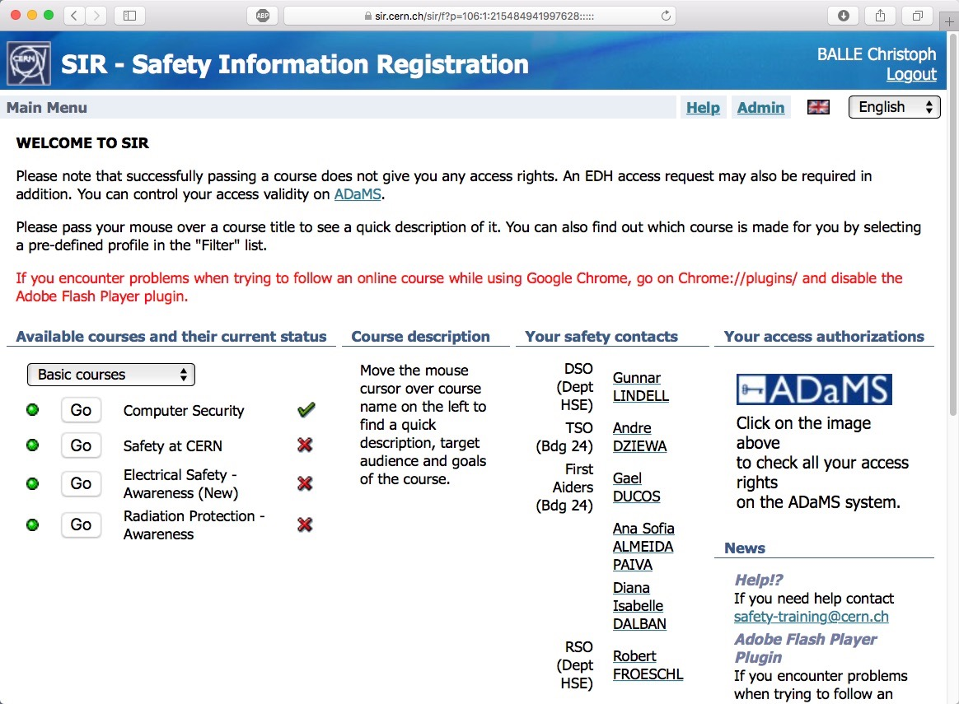

Read CERN Safety Policy
Record emergency number
Meet First Aider + TSO
Do basic safety courses > SIR
you
Notes:
*

Slide 18
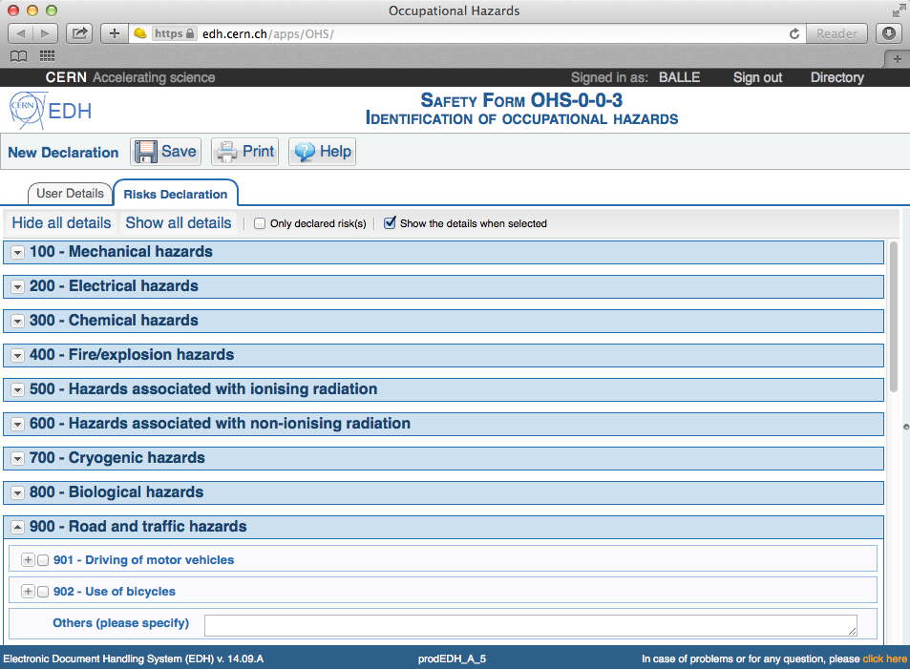
Read CERN Safety Policy
Record emergency number
Meet First Aider + TSO
Do basic safety courses > SIR
Make Risk Declaration > EDH
sup
you
Notes:
You and your supervisor
* Your supervisor is your first contact in matter of Safety!
Do not hesitate to ask him questions.
Your supervisor will tell you about:
* workplace related risks,
* the preventive measures,
* …

Slide 19

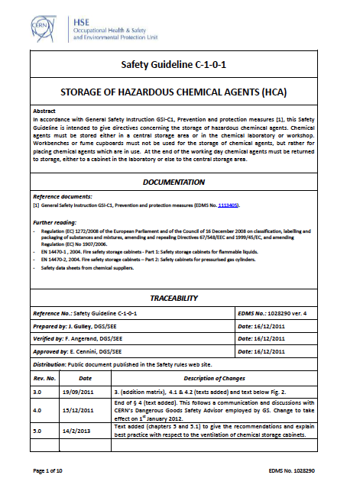
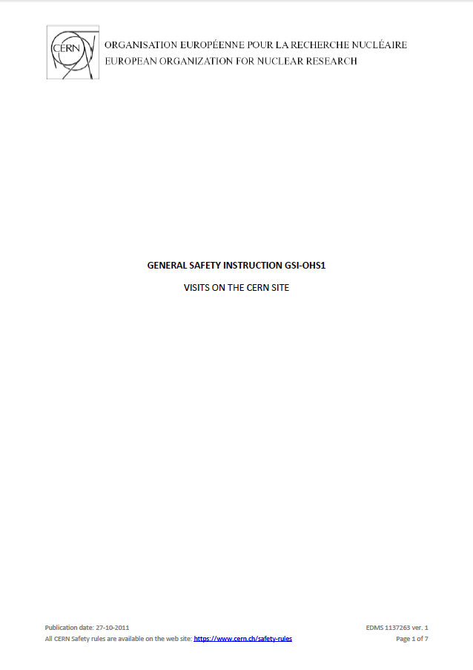
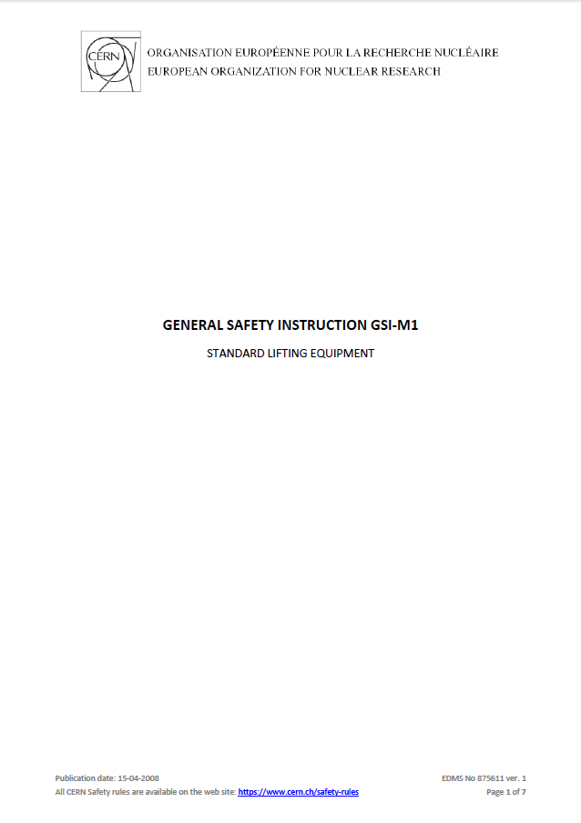
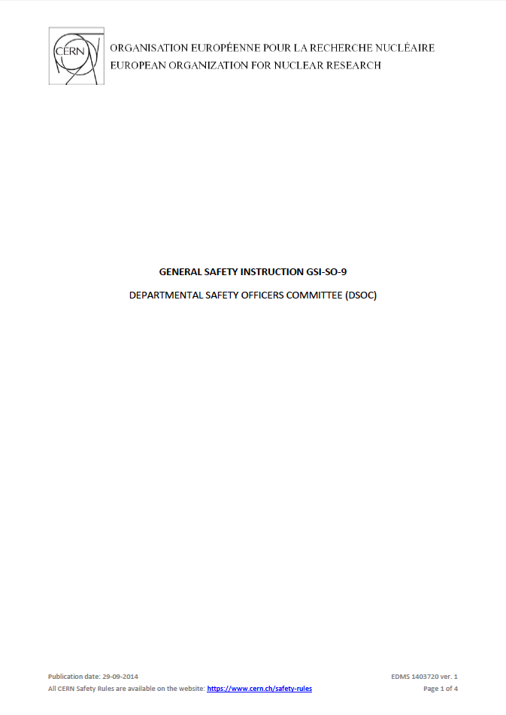
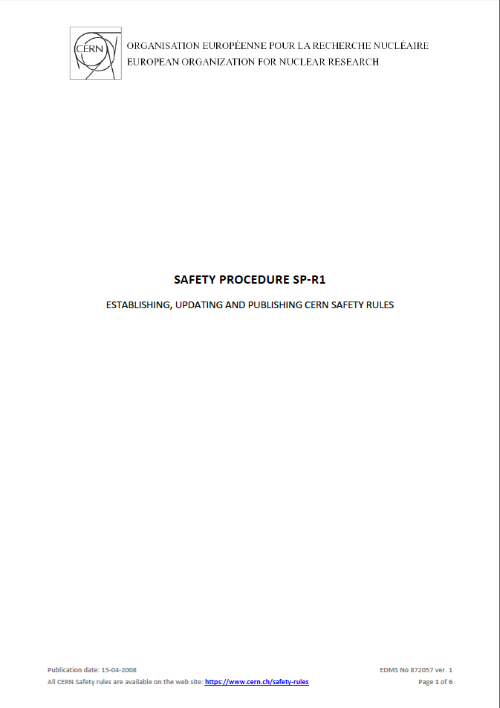
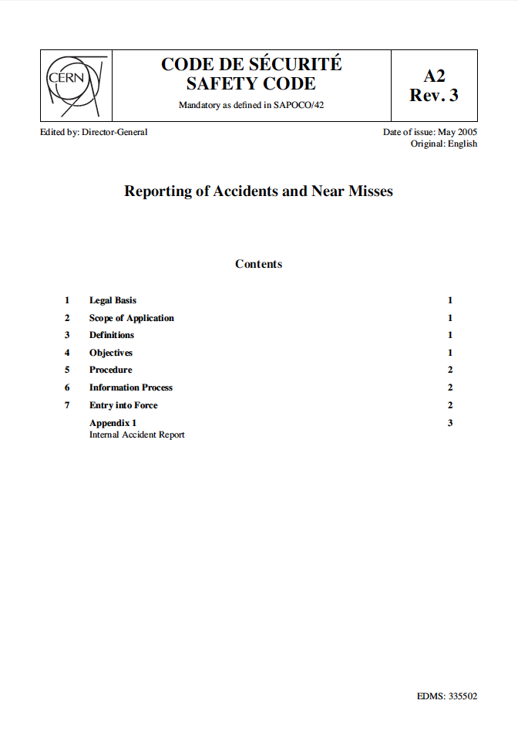
you
Notes:
You
* There are some CERN regulations you should be aware of.
* Ask your supervisor in case of questions

Slide 20
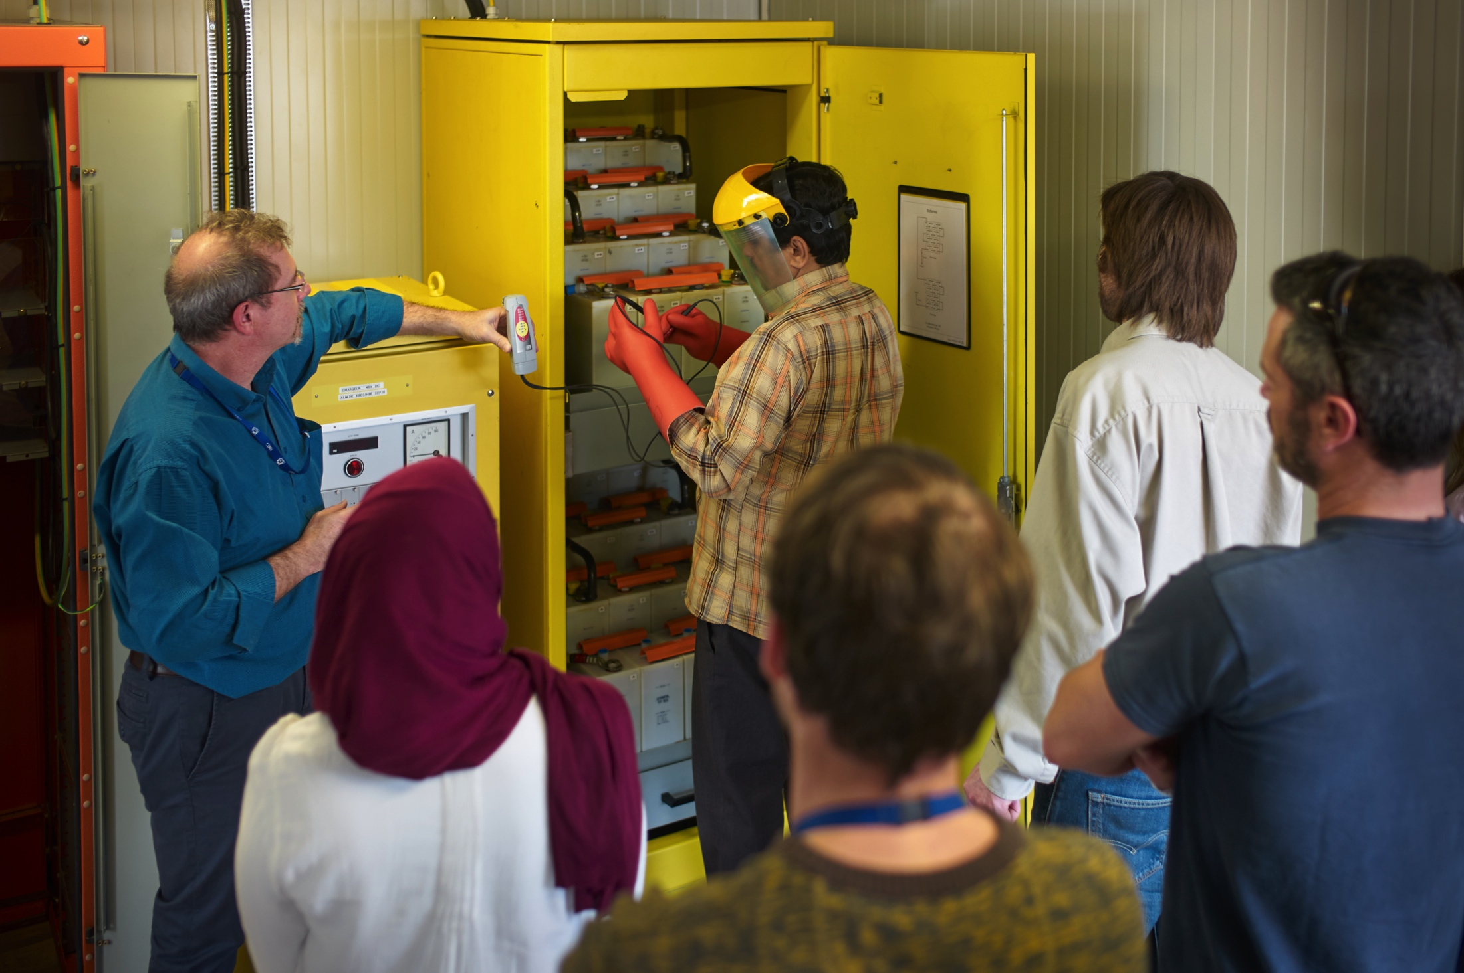
you
Notes:
* Safety Training needs
-> classroom (theory + practice) courses, see CERN’s training catalog on the web

Slide 21
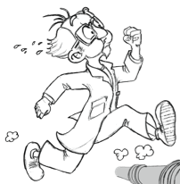








you
Personal Protective Equipment
Equipement de Protection Individuelle
Notes:
* Personal Protective Equipment required (PPE)

Slide 22

Safety
you
Notes:
You
To summarize:
* Safety is an integral part of CERN and your daily life

Slide 23
Read CERN Safety Policy
Record emergency number
Meet First Aider + TSO
Do basic safety courses > SIR
Make Risk Declaration > EDH
✔
✔
✔
✔
✔

Slide 24

www.cern.ch

