Slide 1
Status of C-based materials development and perspectives
1st Workshop of ARIES WP17 PowerMat
27-28 Nov 2017 | Politecnico di Torino, Turin, Italy
Jorge Guardia-Valenzuela
CERN & University of Zaragoza

Slide 2


Outline
Introduction
Molybdenum carbide – graphite
  Production
  Role of the structural features in the final use of the material
Perspectives of graphite-carbide composites
Other candidate materials
  HOPG
  C-Foam
Notes:
Explain quick summary

Slide 3

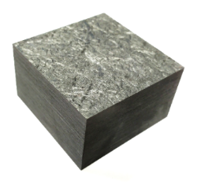
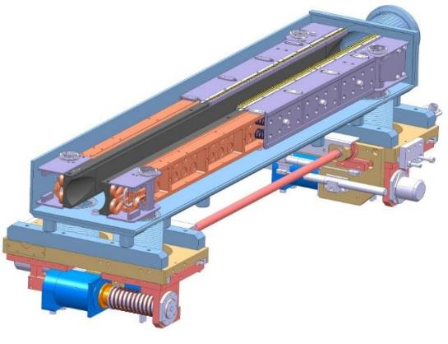
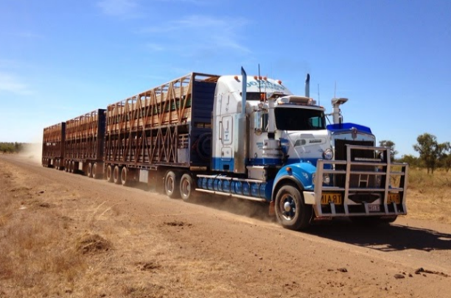
Introduction: LHC Collimation Project at CERN
The energy of the circulating particle beams is equivalent to that needed for melting one ton of copper in few μs LHC: 362 MJ HL-LHC: 693 MJ
Need of a protection system → Collimators
CFC successfully used for LHC baseline but not enough conductive for HL-LHC (resistive wall beam instabilities) → New graphite-based composite
CFC
HL-LHC beam energy: 693 MJ
~1.2 m
CFC Jaw Block
Particle Beam
Vacuum Vessel
v = 390 km/h
Jaw Cooling system
120 t Australian road train
LHC typical collimator
Cutaway
Actuation system
Notes:
Braking system
Key-component made of CFC

Slide 4
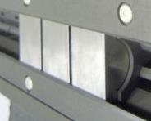
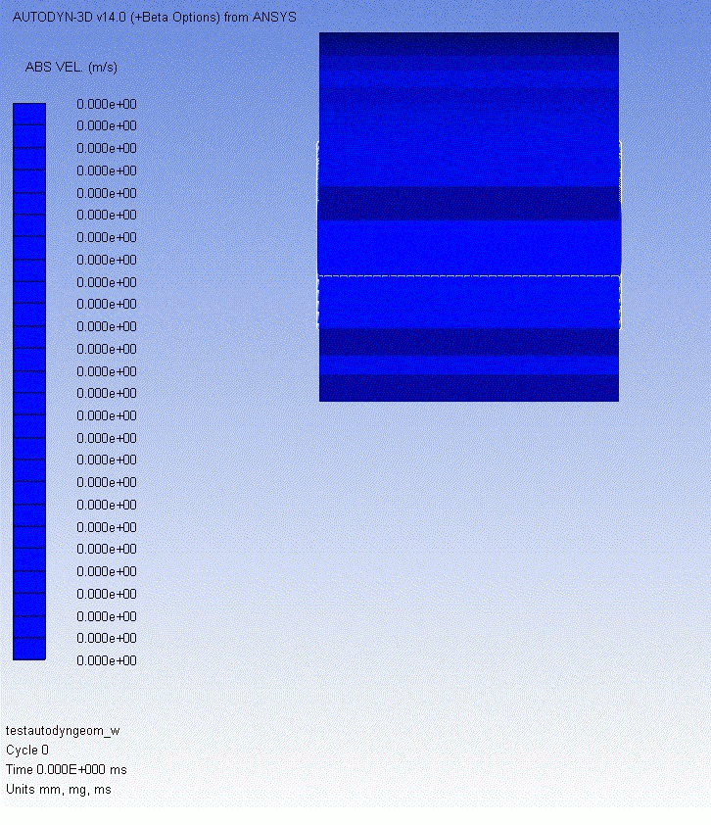
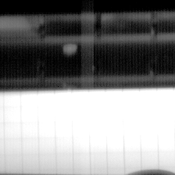
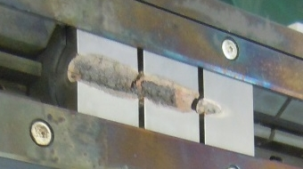
Introduction: Requirements of collimator materials
Extreme environment: thermal shocks (accidental beam impacts), UHV, ionizing radiation, high geometrical stability required…
Electrical Conductivity: limit resistive-wall impedance (beam instabilities)
Thermal Conductivity: maintain geometrical stability under steady-state thermal loads
CTE: increase resistance to thermal shock induced by accidental beam impact
Melting/Degradation Temperature: withstand high temperatures reached in case of accidents
Specific Heat: improve thermal shock resistance (lowers temperature increase)
Ultimate Strength: improve thermal shock resistance
Density: balance to limit peak energy deposition while maintaining adequate cleaning efficiency
Radiation-hardness: improve component lifetime under long term particle irradiation
Outgassing Rate: ensure UHV compatibility
Carbon-based materials have the best compromise of properties: baseline.
Need of higher electrical conductivity → R&D
Before:
Beam
Beam
After:
90mm
W-alloy

Slide 5

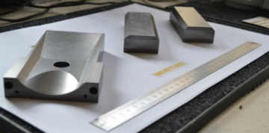
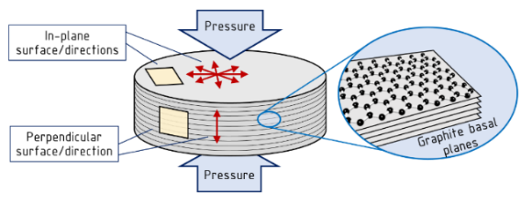
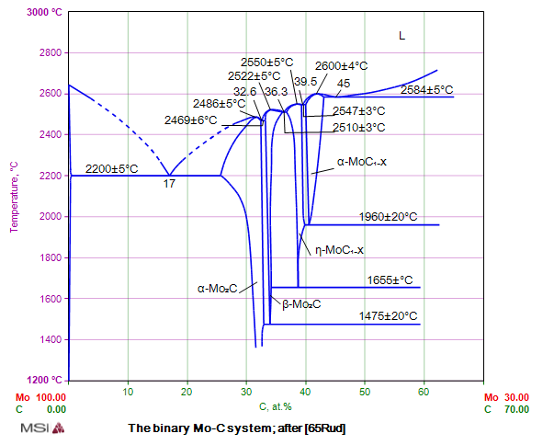
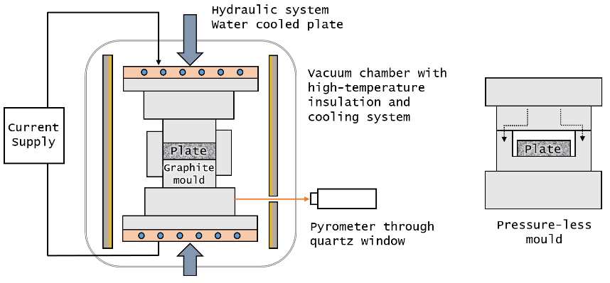
Molybdenum carbide - graphite
Co-developed with SME Brevetti Bizz (Italy)
Production: spark plasma sintering (SPS)
Powders of graphite (~90-95vol.%), Mo (~4.5vol.%), CF (0-5vol.%) and Ti
Melting point of the carbide (~ 2600 ºC) reached: Liquid phase sintering
Post-sintering pressure-free thermal treatment: ~2100 °C (under M.P.) or ~2600 °C (above M.P.)

Slide 6
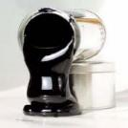
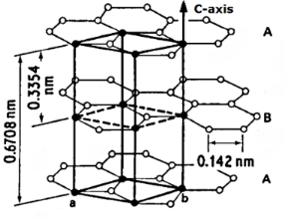
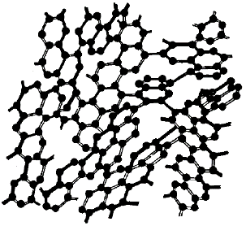
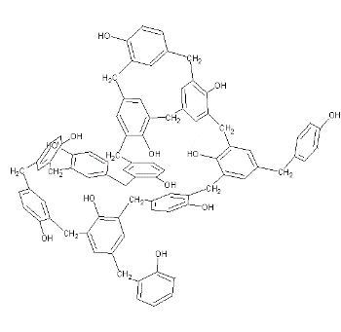

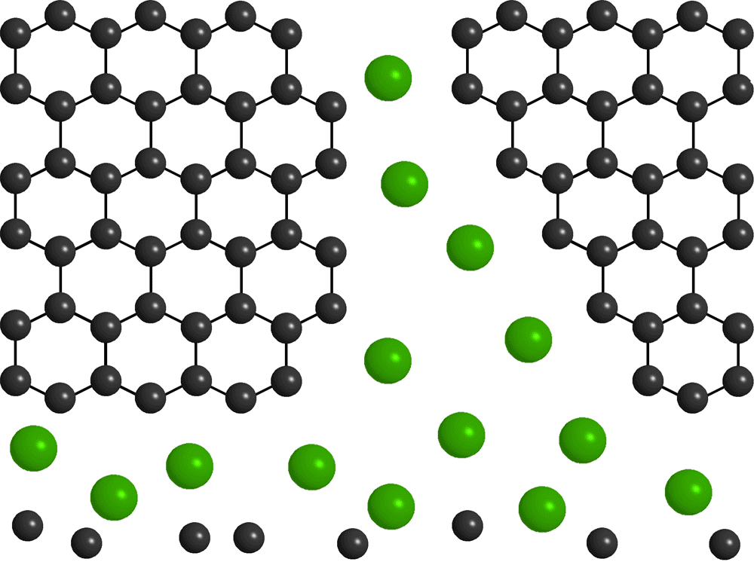
Catalytic graphitization
Graphitization
T>2200 K
(~3000 K, days/weeks)
Precursors
Graphite
Catalytic graphitization
Use of “catalytic additions” to accelerate the process
Dissolution-precipitation mechanism
  Carbon dissolution
  Carbon diffusion
  Precipitation of graphite on active sites
Grain growth and grain connection
  Well connected graphite-matrix
  Orientation of graphite grains
Carbon fibres appear to be dissolved and re-precipitated
Certain influence in thermophysical properties & radiation hardness

Slide 7
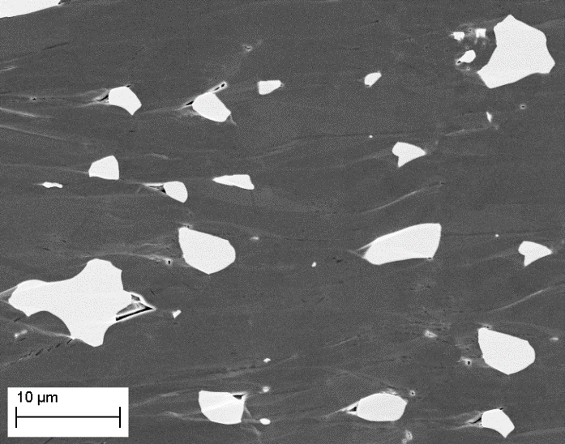
Through-plane reinforcement
T-plane strength also reinforced by the carbide bridges between planes
Sintering pressure direction
Bad conductivity in the matrix
(Through-graphite planes)
Excellent conductivity along graphite planes.
Carbide particles bridge between planes

Slide 8
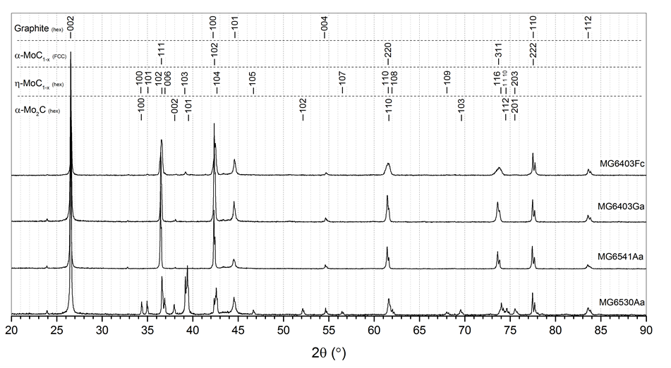
Molybdenum carbide phases
Titanium doping ~10Mo-1Ti (at) → α-MoC_{1-x} phase stabilizer
X-Ray Diffraction (XRD)
Ti
Ti
Ti
No Ti
If no Ti is added, there are hexagonal/orthorhombic carbides
with If Ti is added, there is only FCC carbide (same structure as TiC)
FCC α-MoC_{1-x} carbide stable from RT to melting point → thermal stability, radiation hardness
Graphite matrix with very high quality. C-spacing: 3.36 Å

Slide 9
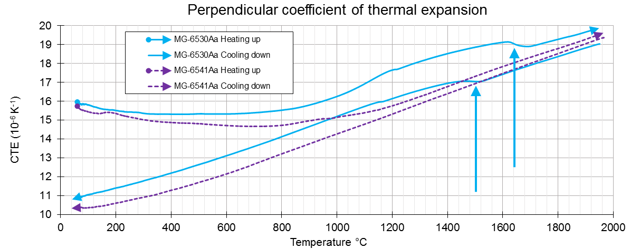
Mo-carbide phase changes
Changes of volume due to phase changes detected in dilatometry measurements.
Risk of cracks during severe thermal excursions (collimator operation)
~1655°C
~1475°C

Slide 10
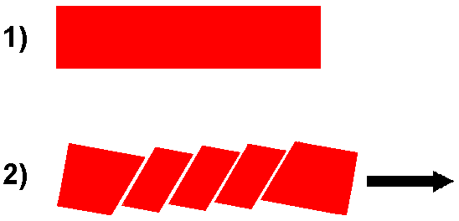
Mo-carbide cubic carbide
Thermal expansion shows more isotropic behaviour in grades showing the cubic α-MoC_{1-x} phase, stabilized down to RT by Ti.
Hexagonal carbides have anisotropic CTE. Cubic carbides are isotropic.
CTE Example [10⁻⁶ K⁻¹]:
η-MoC_{1-x} (hex): 4.7 (a), 19 (c), measured with XRD *
TiC (FCC): 7.4
* Acta Metallurgica 36 (8) (1988) 1903 – 1921
doi: 10.1016/0001-6160(88)90293-3.
 | MG-6400U | MG-6530Aa | MG-6541Aa | MG-6403Ga | MG-6403Fc | NB-8403Je
Cubic phase | No | No | Yes | Yes | Yes | Partially
ǁ CTE 20-1000°C [µm.K⁻¹] | 1.72 | 1.74 | 2.27 | 2.24 | 2.95 | 1.77
Ⱶ CTE 20-1000°C [µm.K⁻¹] | 12.94 | 15.33 | 13.55 | 12.49 | 11.09 | 15.43
Ratio ǁ/Ⱶ | 0.13 | 0.11 | 0.17 | 0.18 | 0.27 | 0.12
Proposal: Study CTE via X-ray diffraction (XRD) measurements with varying temperature
Advantages: it measures the changes in d-spacing between atomic planes, no matter the orientation in the composite. It measures all directions in one test. Texture could be assessed

Slide 11
Ti addition: catalytic graphitization aid
Grades with Ti have a boost in thermo-mechanical performance.
Specially noticeable in electrical conductivity:
 | MG-6400U | MG-6530Aa | MG-6541Aa | MG-6403Ga | MG-6403Fc | NB-8403Je
Ti | No | No | Yes | Yes | Yes | Yes
σ MS/m | 0.86 | 0.83 | 1.1 | 0.93 | 1.01 | 0.96
Probably due to higher carbon solubility in the molten phase Mo-Ti-C vs Mo-C.
Also higher carbon affinity of Ti vs Mo
 | Eutectic Temp [°C] | Eutectic at% C | Eutectic Vol% C (Vol. at RT) | Carbide MP [°C]
Mo-C | ~2584 | 45 | 31.7 | 2600
Ti-C | ~2740 | 65 | 48.1 | 3084
100% Ti is probably better, but the eutectic Ti-C is even more difficult to reach than Mo-C

Slide 12
Increase graphite grain size & cohesion & minimise defects
Will Improve in-plane properties, HOPG as reference:
Measured (CERN) electrical conductivity of HOPG (Momentive “TPG”) is 2.5 MS/m. Single layer perfect graphene 100 MS/m, quasi-single crystalline graphite 38.5 MS/m *
Thermal conductivity of HOPG is >1600 W/m/K. Single layer perfect graphene ~5000 W/mK
In-plane CTE RT-1000°C of HOPG is ~0
Will worsen through-plane properties, HOPG as reference:
Measured (CERN) electrical conductivity of HOPG (Momentive “TPG”) is ~0.0009 MS/m.
Measured (CERN) thermal conductivity of HOPG (Momentive “TPG”) is ~8 W/m/K
Will affect the stiffness:
Ideal graphite stiffness: In-plane ~1 TPa, Through-plane 36 GPa. Could be problematic for strain-imposed loads (such as thermal loads, while low CTE could improve the situation).
* Igor L. Shabalin. Ultra-High Temperature Materials I. Carbon (Graphene/Graphite) and Refractory Metals. Springer, 2014.

Slide 13
Role of the structural features in the final use of the material
 | Act on | Good for | Bad for | Comments
Initial Constituents | Increase graphite grain size, less defects in carbon lattice | + Thermal and elec. conductivity | - Strength | Foreseen test
 | Reduce carbide grain size | + Strength Probably easier to machine | - Through-plane properties | Current size ~5µm
 | Metal content | + Electrical and thermal conductivities - Through-plane CTE + Strength | Specific heat. + Density + In-plane CTE | Already optimized: +Performance -Energy deposition
 | Phase stability | Avoid changes of volume due to phase changes (cracks) | - | Ti addition provides stabilized cubic carbide (both). Content to be studied
 | Cubic carbide | + Isotropic CTE. (Easier XRD analyses) | - Harder (machining)
 | Carbon fibres | + mechanical properties - Radiation swelling | - | GSI irradiation tests
Processing (sintering) | Increase graphite texture | + In-plane properties | - Through-plane properties | Foreseen test
 | Porosity | + Accommodation of internal stresses? Radiation swelling? Outgassing? | - Thermo-mechanical properties
 | Improve graphite grains cohesion | + Strength + Thermal and elec. conductivity | + Stiffness | Foreseen test

Slide 14
Graphite-carbide composites perspectives
Tests of new carbide-graphite material grades
  Binder pitch
  Big graphite flakes
  Carbon black
HOPG
C-Foam

Slide 15
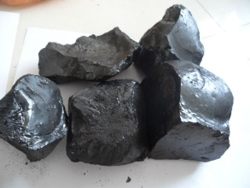

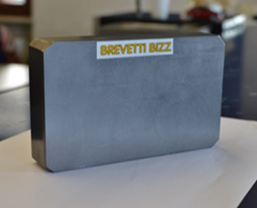
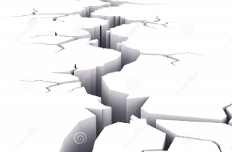
Test with binder pitch
Used in graphite/CFC industry as binder.
It will help to bond graphite crystals together
It decomposes volatile compounds and those in hydrogen.
Use small volumes
The decomposition produces gas and volume reduction.
For graphite manufacturing, the bodies are heat-treated to carbonise the pitch (no pressure) in order to degas slowly (hours-days). The final product is porous, then is densified. Different approach.
For a plate 150x100x30 mm, if 20 vol% pitch is used:
Carbon yield 70%, initial density 1.2 g/cm³
Final density carbonised pitch ~2 g/cm³.
Volatiles average at. Mass~ 60 g/mol
(anthracene C₁₄H₁₀, pyrene C₁₆H₁₀, methane CH₄…)
Volatiles produced: 0.1 L
Average increase of pressure on the plate: 6.5 MPa (35 to 41.5 MPa)
Volatiles will decompose in carbon and hydrogen (around 0.03 L)
Hydrogen can diffuse out from the plate and mould at high temperature.

Slide 16
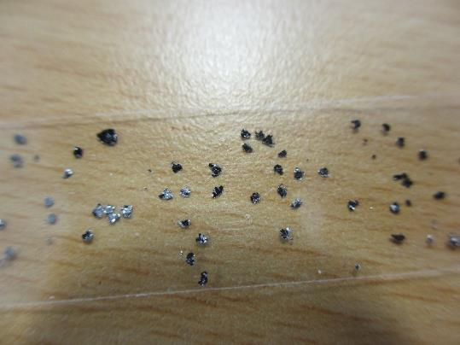
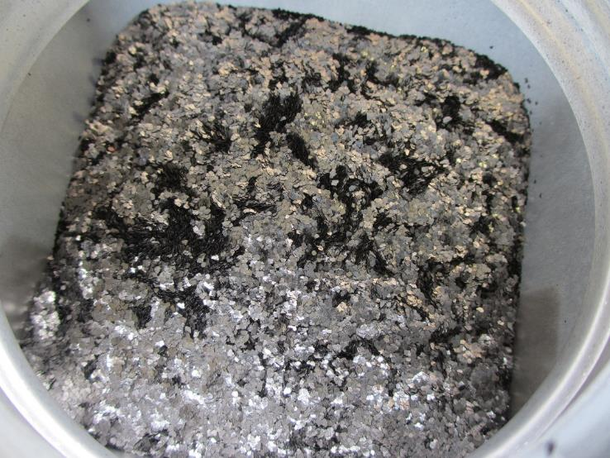
Test with “big” graphite flakes
15mm
Asbury 3763
High-purity natural-graphite flat-flakes
Diameter ~1 mm
Few defects from production (few milling steps)
Goals:
In-plane properties will improve (thermal-electrical conductivities). Best initial conditions for this.
Check how much the transversal properties will worsen
Check how is the strength

Slide 17
Test with carbon black
Asbury 5303
High-purity carbon black
Diameter 50-100 nm
Smallest possible carbon powder
Goals:
Study full graphitization of the initial carbon content, with complete initial isotropy.
Study the connection of graphite grains during sintering
Straightforward to compact (spheres, no flat flakes)
Study vacuum behaviour
Check final properties. Extent of graphitization?

Slide 18

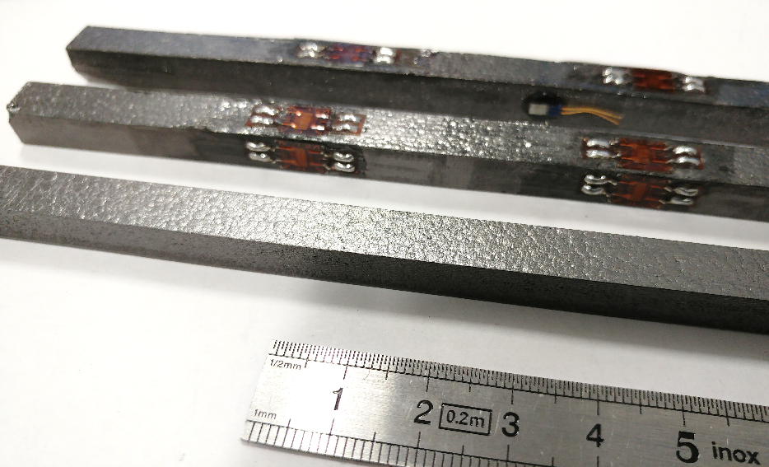
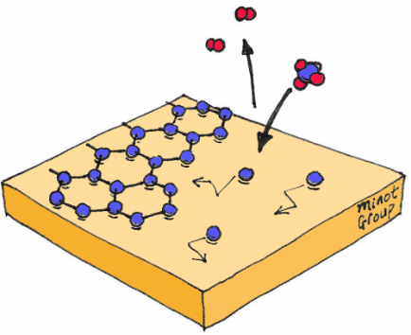
HOPG (Thermal pyrolytic graphite “TPG”)
Produced by CVD from methane gas. Usually is annealed at graphitizing temperatures (~3000°C), with or without strain.
Is a “thick” coating. Thickness limitation around 15mm. Typical size up to 300x100 mm
Price per volume unit increases with thickness: ~100 USD 250x8x7 mm (1 HRMT36 bar). ~150 USD 30x30x10 mm
Image credit: “Minot Group, Oregon State University”
HRMT36 bars came slightly bent (~1mm Sagitta in 250 mm).
Probably due to thermal stresses during production

Slide 19
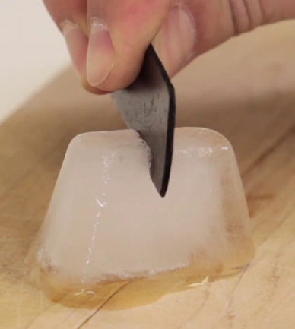
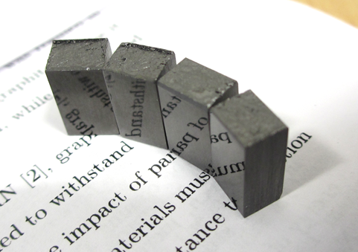
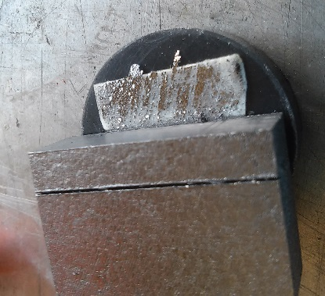
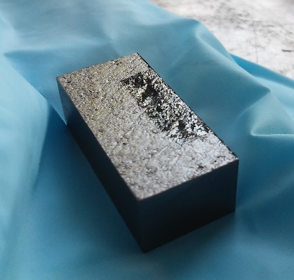
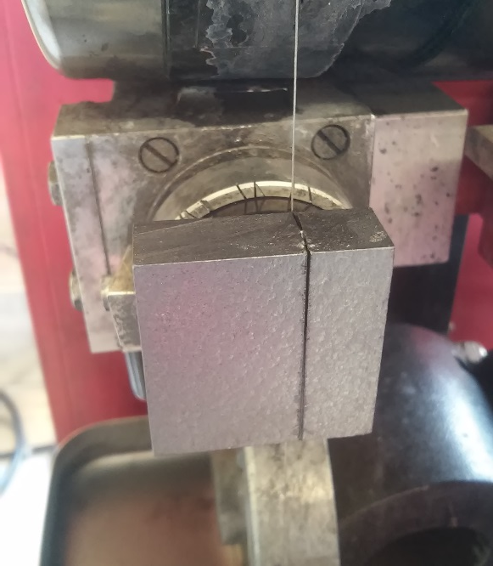
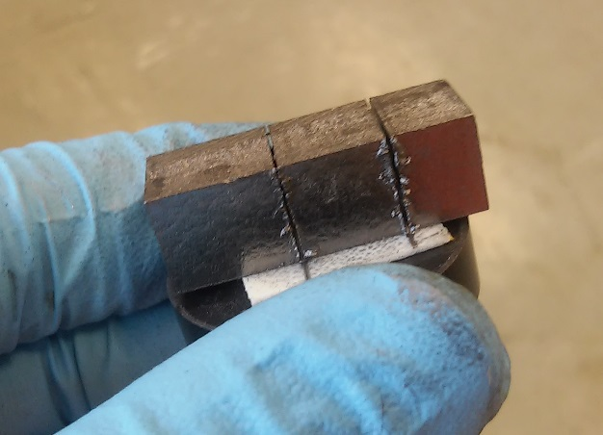
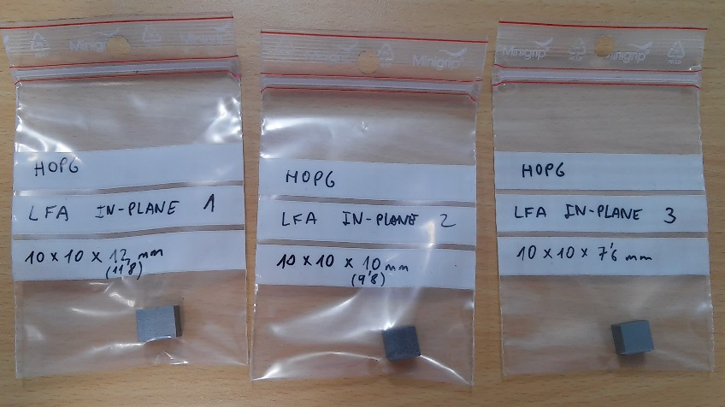
HOPG
Excellent in-plane properties. Electrical conductor material with the highest thermal conductivity
Very weak (mechanically) in through-plane direction.
Needs some special care with machining: the company advised not to machine the in-plane surface
No problems to cut it (diamond wire) if careful with bending stresses
Delaminates very easily if weak direction is stressed. Peeling off some glue only removes a very thin layer of material
Transversal surfaces are very easy to mirror polish. In-plane surface not tested yet

Slide 20
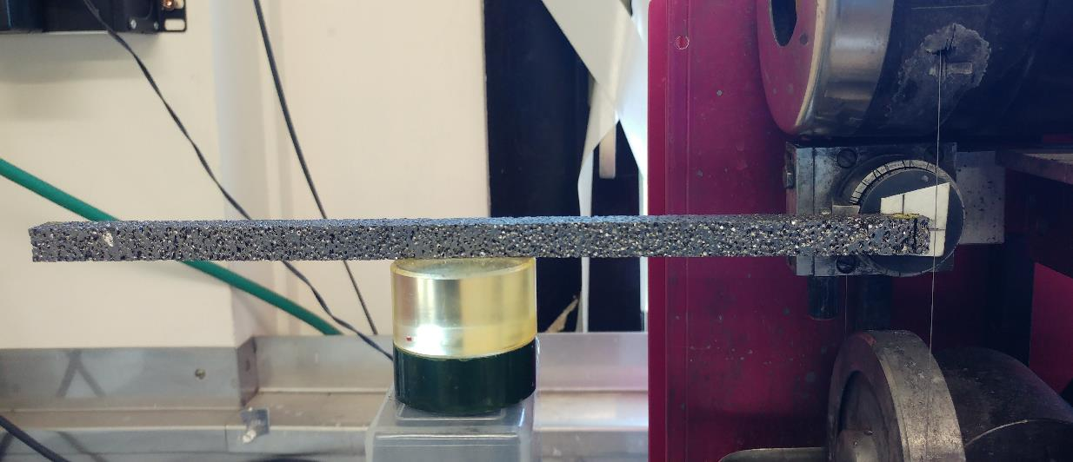
C-Foam
Produced by a US company, spin off from Oak Ridge National Laboratory
Profits from volatiles generated during carbonization of pitch to form bubbles → pores
Very low density ~0.4 g/cm3 → FCC collimator absorber candidate
Highly graphitized pore walls (3D graphite network) → High thermal conductivity
Tends to keep a lot of graphite dust from machining in the pores:
Difficult cleaning (vacuum cleaner is the most effective)
Ultrasound bath seems not to damage the structure
Easy to machine
Breaks easily if is impacted or bent.

Slide 21
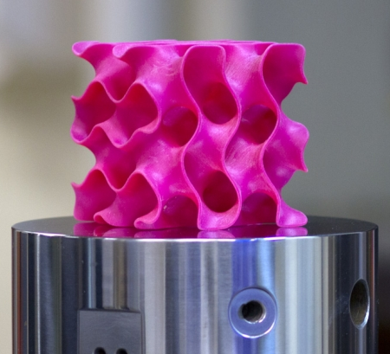
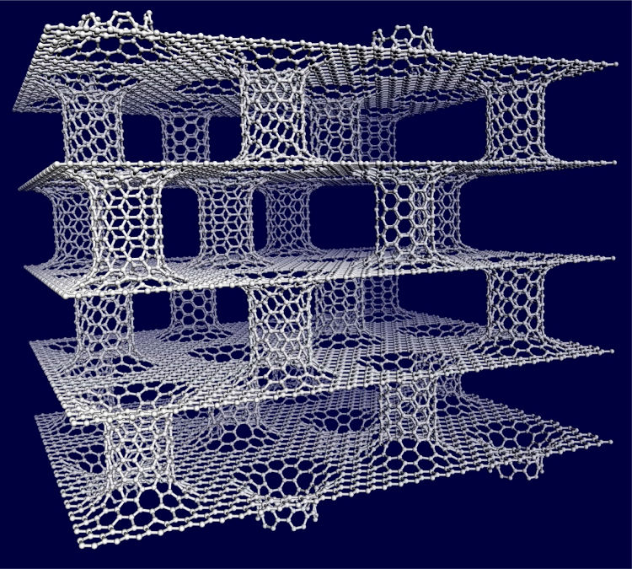
Future challenges in graphene-based materials
Translate 2D advantages of graphene/HOPG into 3D materials
3D-printed “Gyroid” geometry
Science Advances 06 Jan 2017:
Vol. 3, no. 1, e1601536
DOI: 10.1126/sciadv.1601536
Graphene-nanotube hybrid

Slide 22

Thank you for your attention!

Slide 23
Backup slides

Slide 24

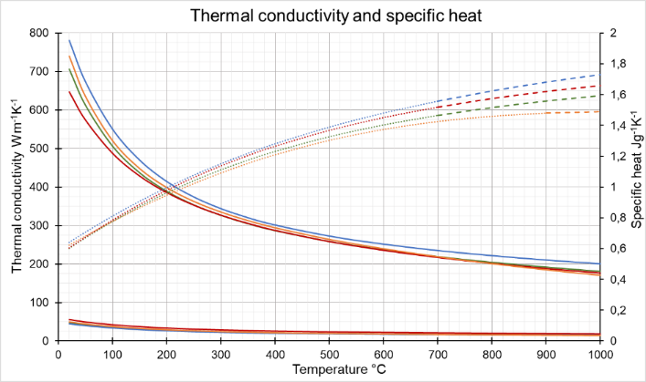
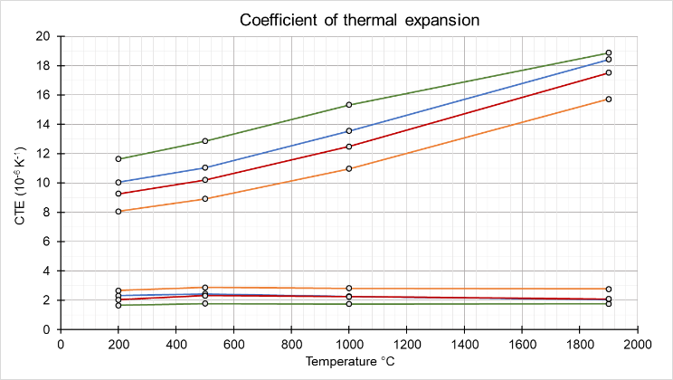
Typical MoGr properties
10-15x isotropic graphite
 | In-plane | Perpendicular
Electrical conductivity [MS/m] | ~1 | ~0.08
Thermal Conductivity [W/(mK)] | 700 – 800 | ~50
CTE RT÷200 °C [10⁻⁶K⁻¹] | 1.7 - 2.7 | 8 - 12
Flexural Strength [MPa] | 60 – 80 | 10 - 12
Specific Heat [J/(gK)] | 0.6 - 0.65
Density [g/cm³] | 2.5 – 2.6
2x Cu
~ isotropic graphite
Si
Carbides: Improvement of the weak direction with respect to HOPG
Al
In-plane direction
Specific heat
Perpendicular direction
In-plane direction
Perpendicular direction

Slide 25
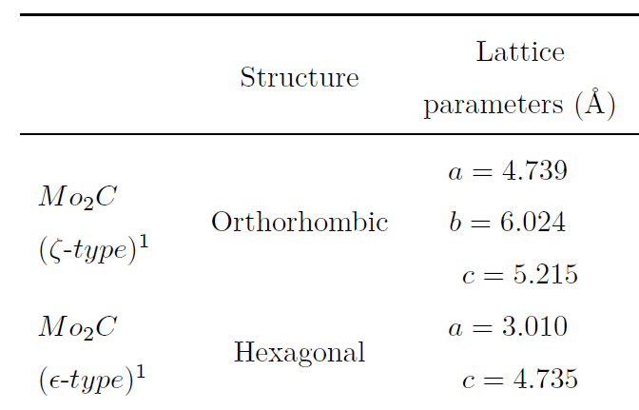
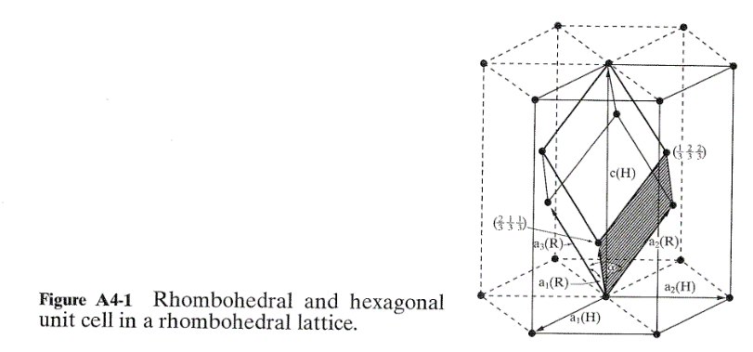
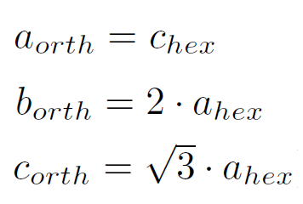
Rhombohedral-hexagonal transformation
ξ-Mo2C carbide is orthorhombic, with Mo sub-lattice being hexagonal.
XRD shows hexagonal structure when using X-rays (Cu) because they hardly “see” the carbon atoms. Neutron diffraction is more appropriate to distinguish the orthorhombic structure.
E. Parthé, V. Sadagopan, The structure of dimolybdenum carbide by neutron diﬀraction technique,
Acta Crystallographica 16 (3) (1963) 202–205. doi:10.1107/S0365110X63000487.

Slide 26
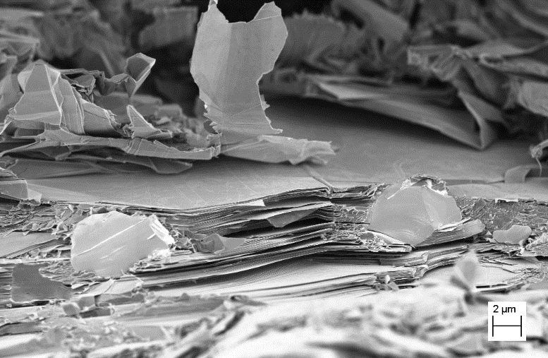
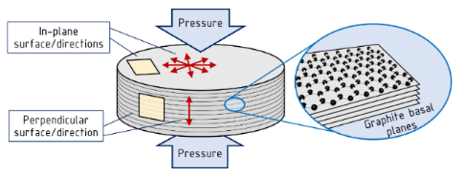
Microstructure
Sintering pressure direction
In-plane polished surface Perpendicular fracture surface
Carbides: ~5 µm diameter
Well-connected graphite matrix
Well-compacted: porosity <0.5 vol.%
Molybdenum carbide particles reinforce the graphite, holding together the graphite in the weak direction
Perpendicular ion-polished surface

