Slide 1
Thermophysical and mechanical characterization of advanced graphitic materials
1st Workshop of ARIES WP17 PowerMat, Politecnico di Torino 27/11/2017
Laura Bianchi (CERN)

Slide 2
Outline
Introduction
Characterization techniques
Latest characterization campaigns:
  Highly Oriented Pyrolytic Graphite
  Metal Carbide Reinforced Ceramics
  Carbon Fiber – Carbon
Summary
Future steps

Slide 3
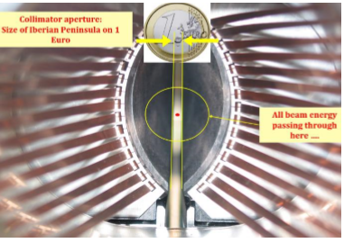
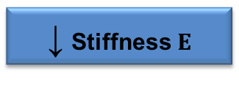

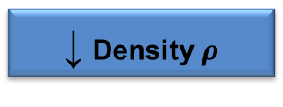
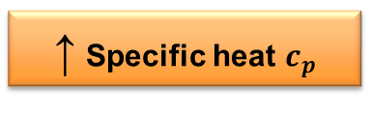


Introduction
The collimators’ jaws are made of absorber materials which interacts with high energetic particles
They must withstand a harsh environment…
  Thermal shocks
  Ultra High Vacuum
  Radiation
while performing the required tasks
  Cleaning
  Low RF impedance
↑ Thermal conductivity $λ$
↑ Electrical conductivity $γ$
↓ Density $ρ$
↑ Specific heat $c_{p}$
↑ Mechanical strength $R_{M}$
↓ CTE α
↓ Stiffness $E$

Slide 4
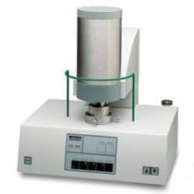
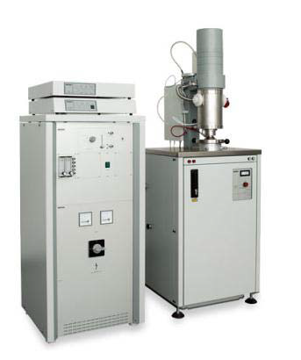
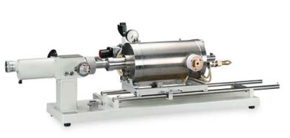

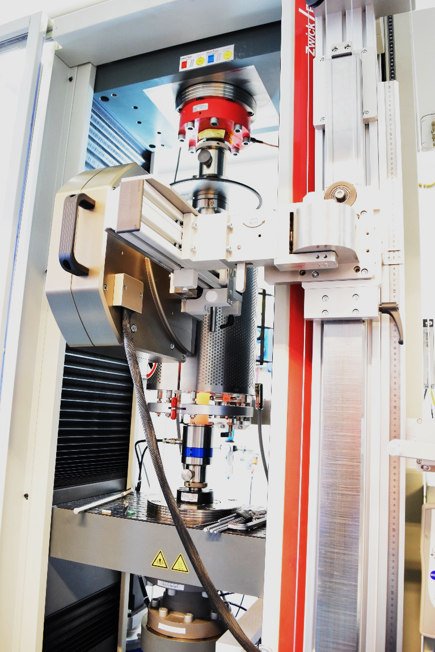
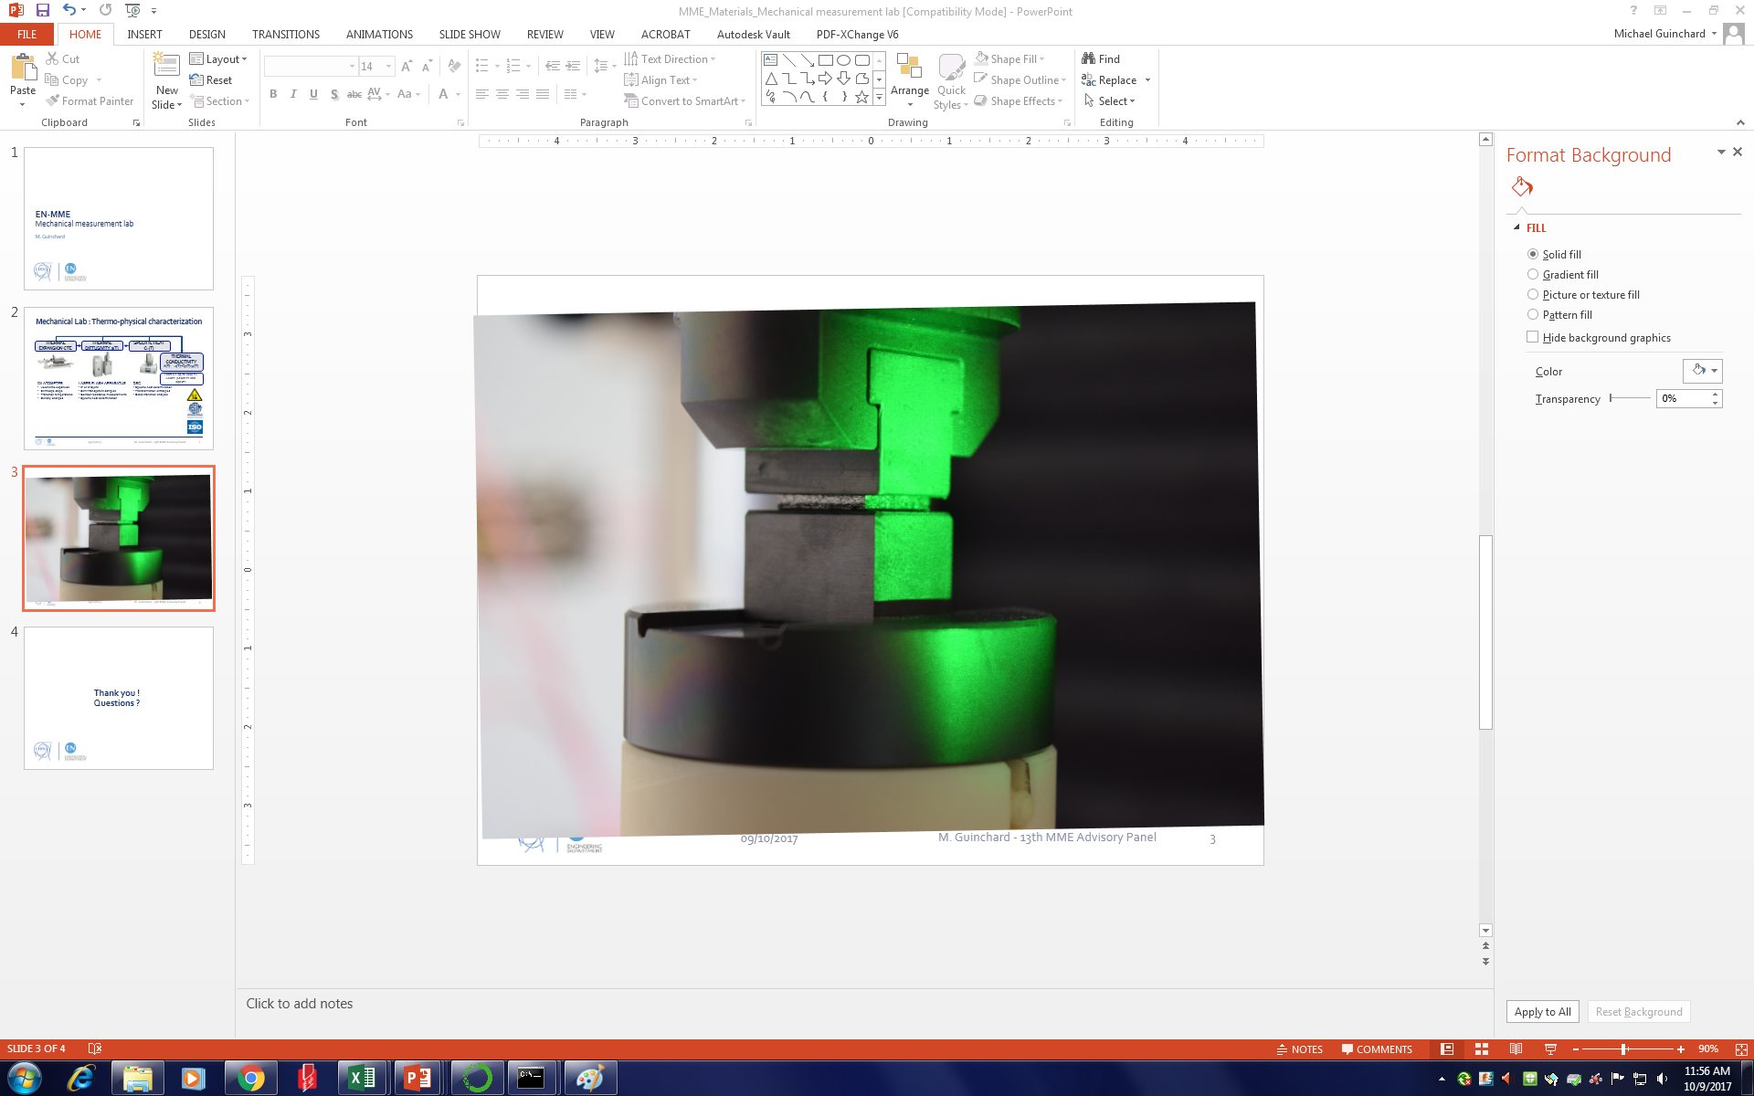
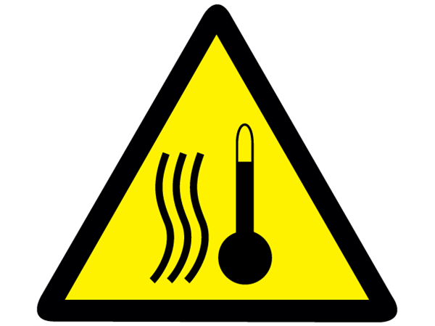

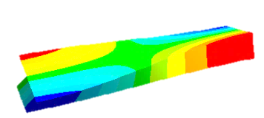


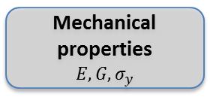
Thermophysical and mechanical characterization
Thermal
Expansion & CTE
Specific Heat cp(T)
Thermal
Diffusivity a(T)
Thermal
Conductivity
λ(T) = a(T)·cp(T)·ρ(T)
Thermo-physical characterization
From RT up to 2000 °C
Solids, powders and liquids
PUSHROD DILATOMETER
ASTM E228
DIFFERENTIAL SCANNING CALORIMETER
DIN 51007
LASER FLASH APPARATUS
ASTM E2585
Mechanical characterization
First Flexural Mode → E
First Torsional Mode → G
UNIVERSAL TESTING MACHINE
Furnace up to 1200 °C
Cryostat down to -200 °C
Laser-Extensometer
IMPACT EXCITATION TECHNIQUE
Non-destructive test
ASTM C1259
From RT up to 1200 °C
Tensile, compression, bending testing
Mechanical properties
$$E, G, σ_{y}$$
Impact testing

Slide 5
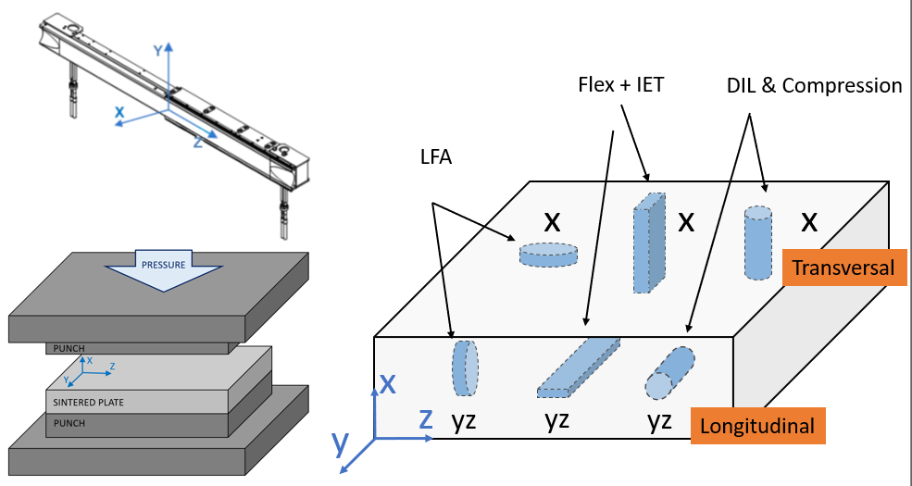
Preamble
Conventional Reference System
Thermal diffusivity results marked with * corresponds to a non-negligible underestimate of the measured true value

Slide 6
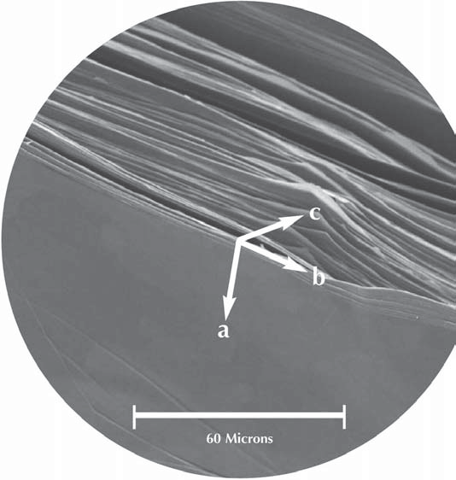
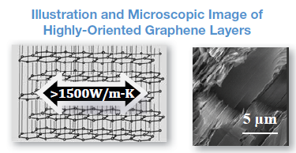
Highly Oriented Pyrolytic Graphite
Manufactured by Momentive
It features:
  Highly oriented crystals in a layered structure
  In-plane conductivity 4 times copper

Slide 7
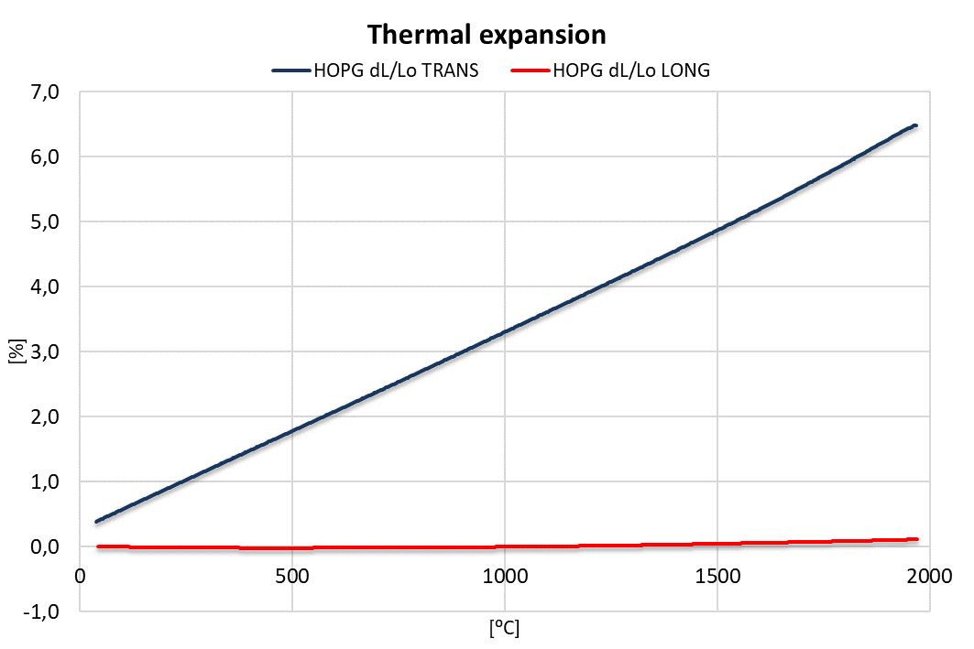
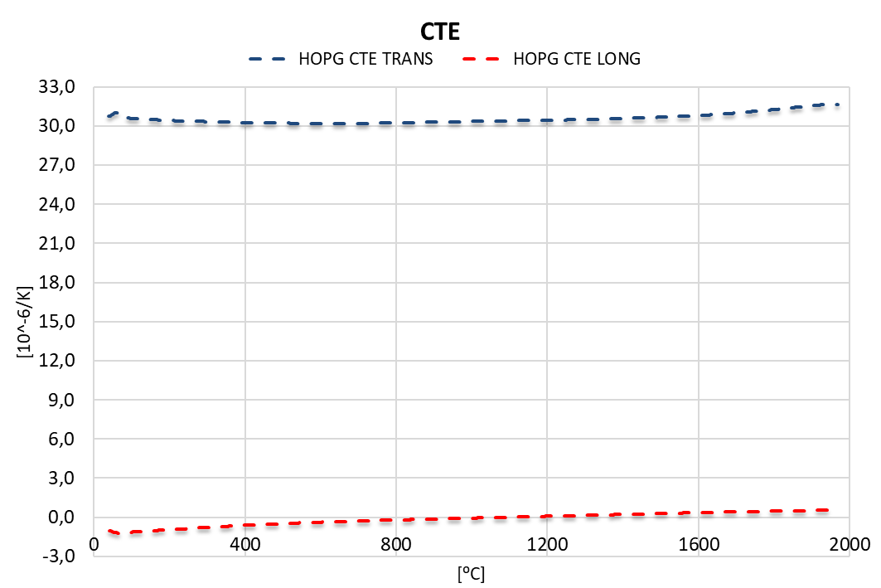
HOPG: Thermal properties 1/2

Slide 8
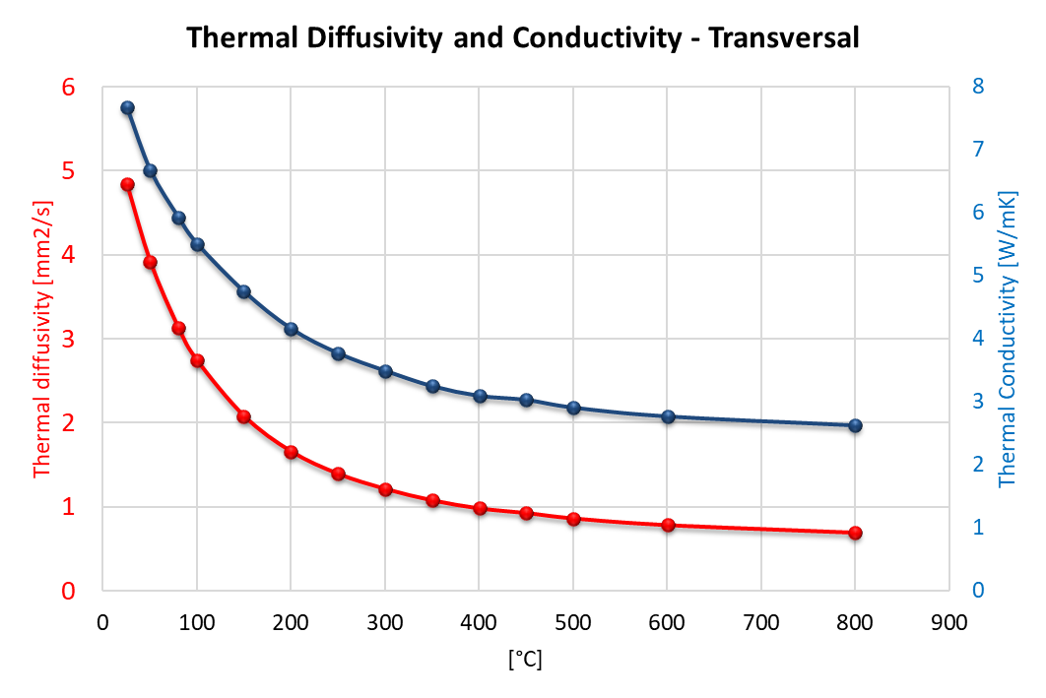
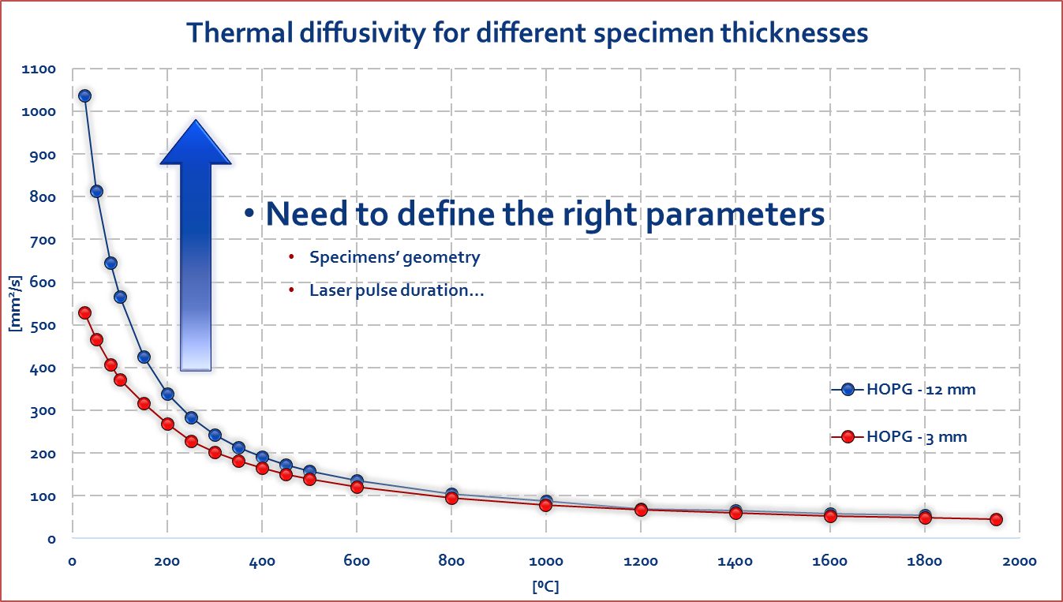
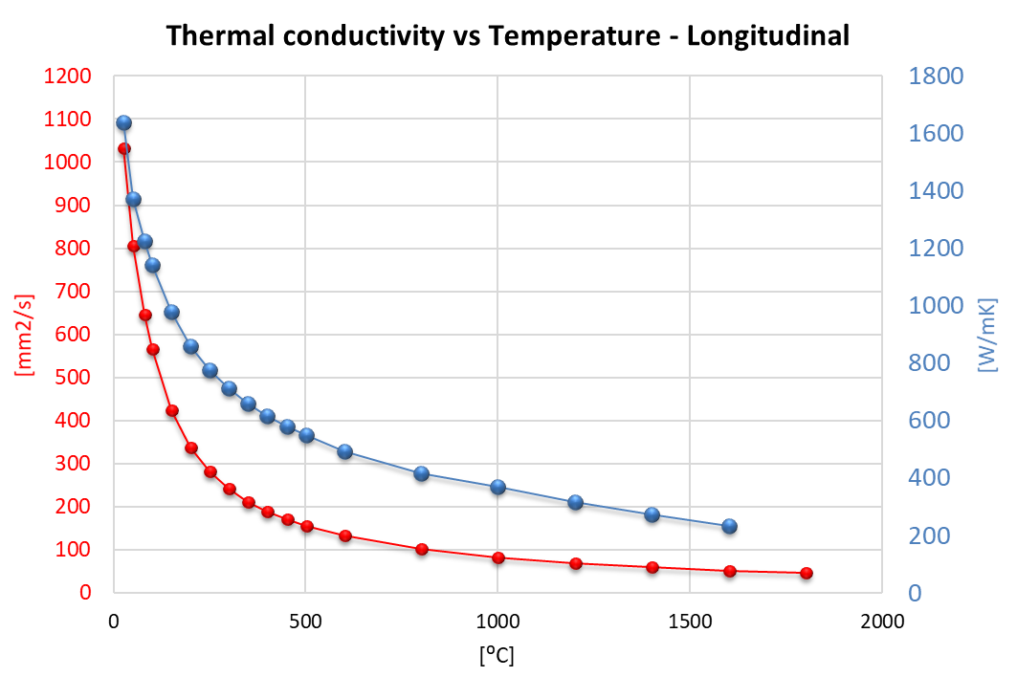
HOPG: Thermal properties 2/2
More info: EDMS_1606182

Slide 9
Metal Carbide Reinforced Ceramics
Nb-8304Je by Nanoker
  Molybdenum carbide as reinforcement
  Ti 0.6 %vol
  T_{Sintering}=2660 ⁰C, T_{Post-sintering}=2450 ⁰C
TG-1100 by Brevetti BIZZ
  Titanium carbide as reinforcement
  Ti 5.7 %w
Notes:
Transversely isotropic

Slide 10
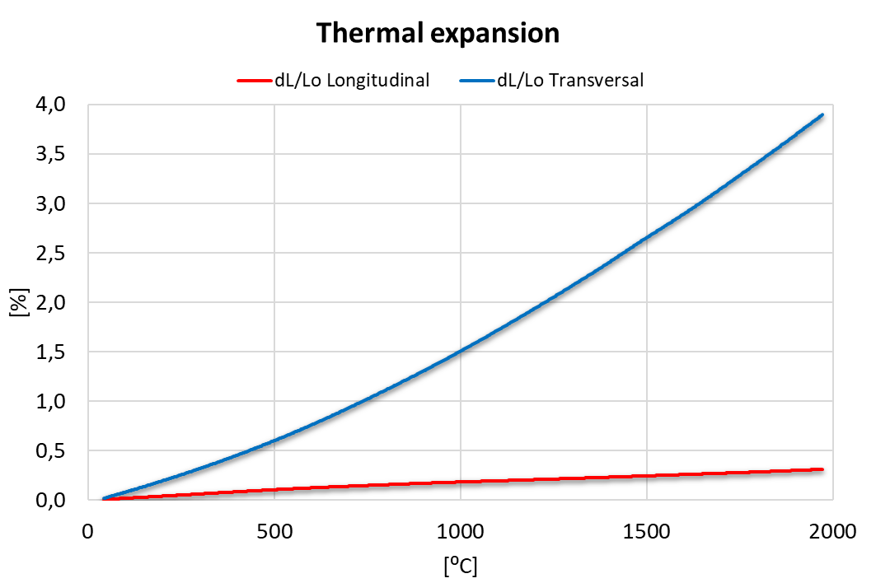
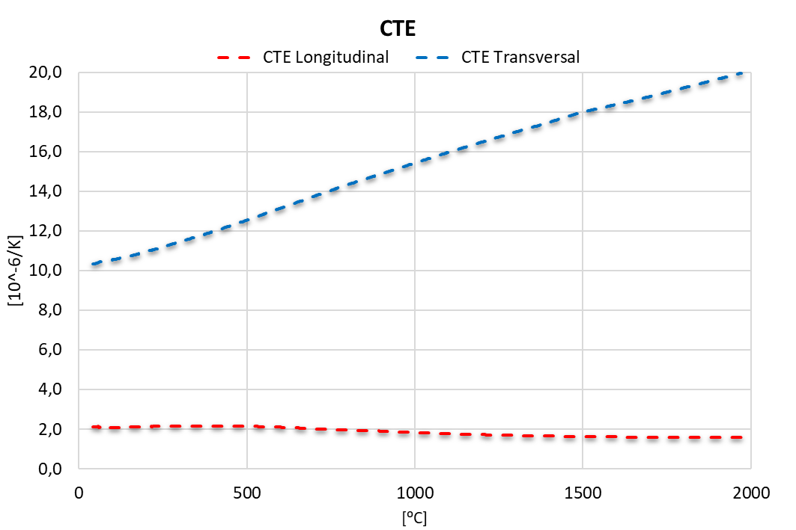
Nb-8304Je: Thermal properties 1/2

Slide 11
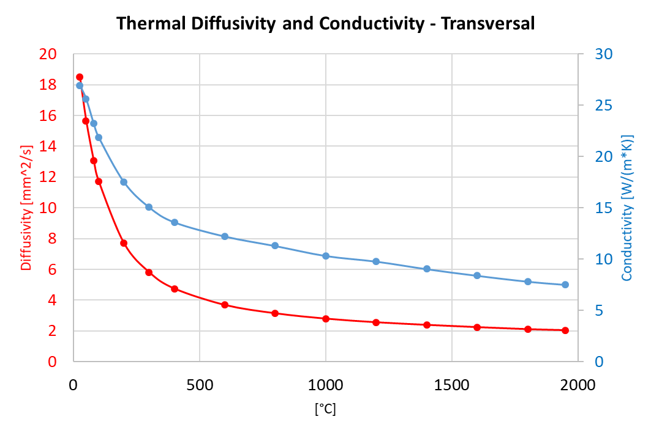
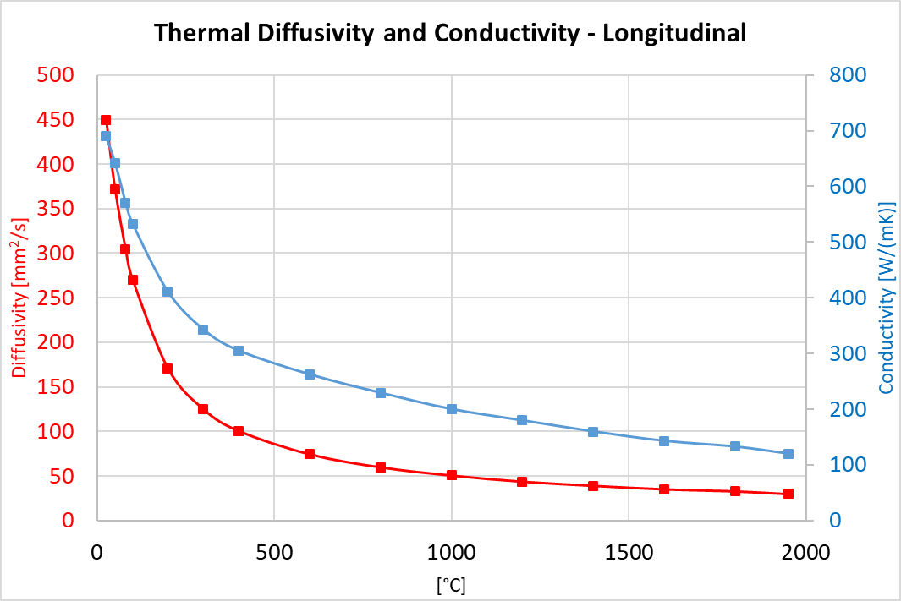
Nb-8304Je: Thermal properties 2/2
8 mm thick sample

Slide 12
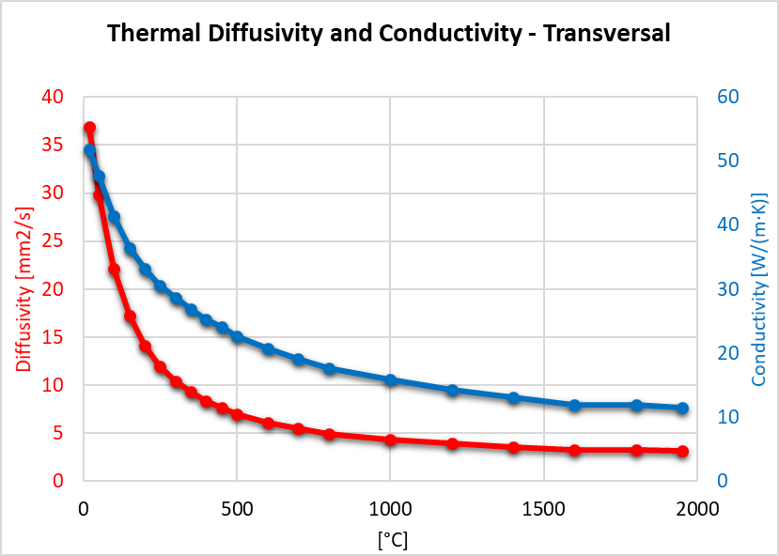
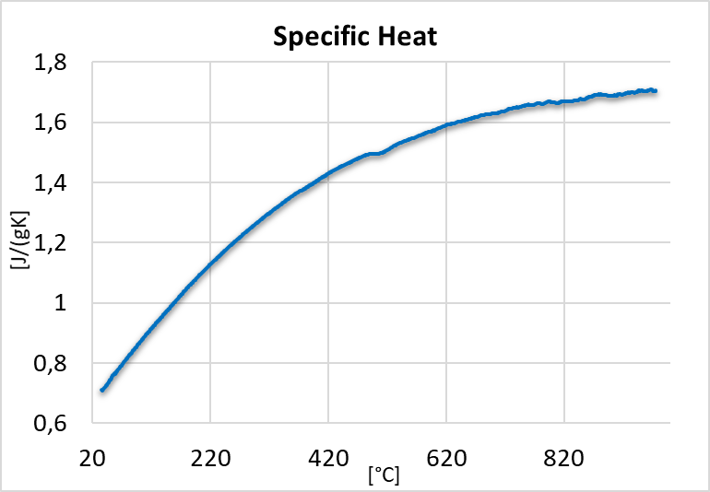
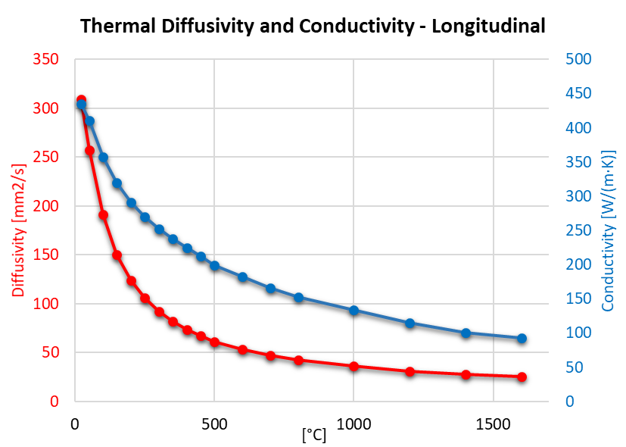
TG-1100: Thermal properties
*2 mm thick samples

Slide 13
Carbon Fiber-Carbon
Comparison of three grades whose production process differ in the final baking temperature (which plays an important role in the diffusivity properties).
  CFC AC150K, currently embarked in the collimators, Tf= 2800 ⁰C
  CFC FS140, characterised in 2016, Tf= 2500 ⁰C
  CFC FS140, characterisation ongoing, Tf= 2800 ⁰C
In between the first and the second two grades, Tatsuno changed the raw material (AC150 Across Co → FS140 CFC Design Co)
Notes:
Higher graphitization = higher diffusivity properties

Slide 14
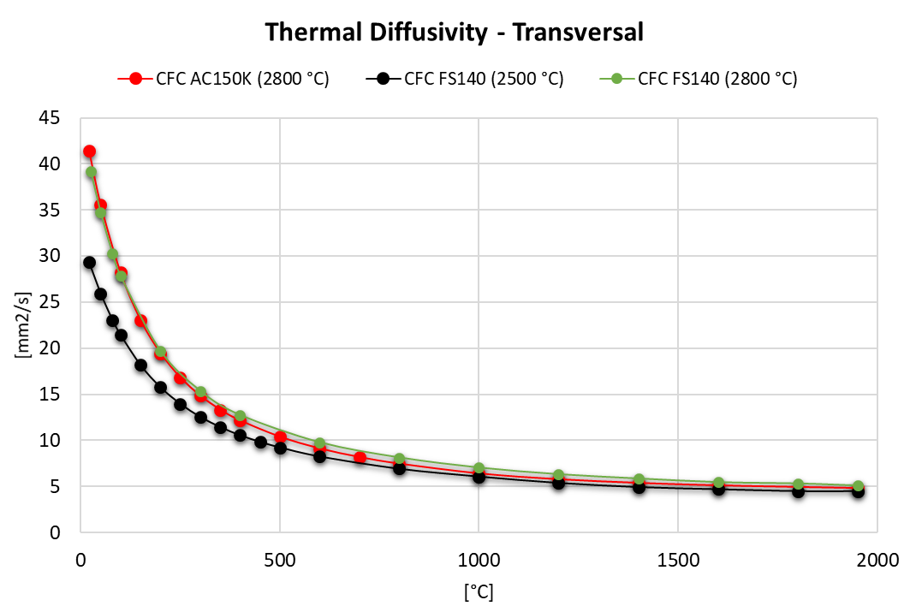
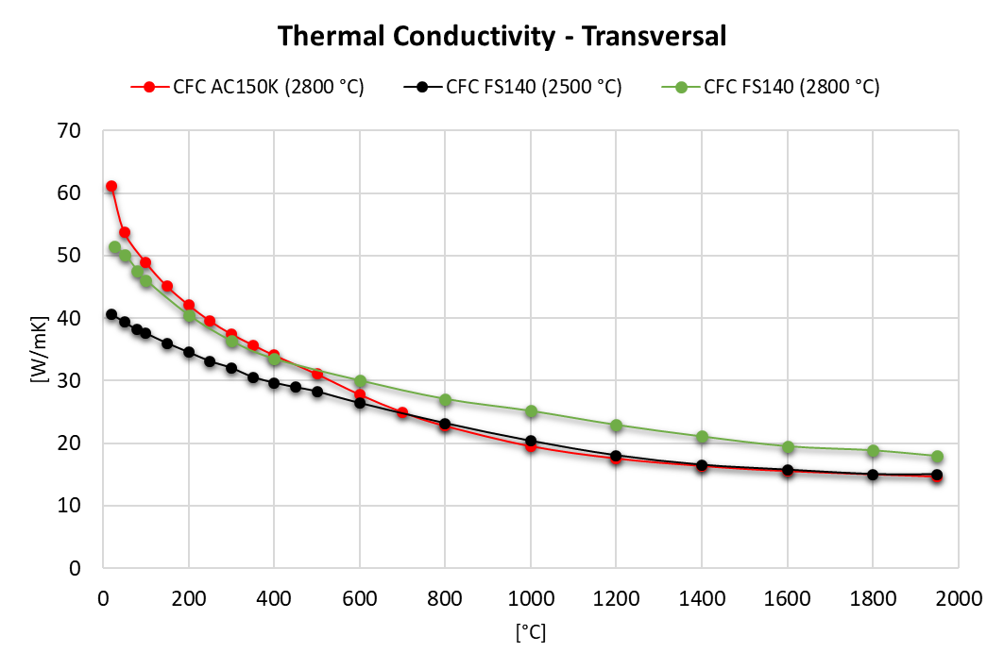
Carbon Fiber-Carbon: Thermal properties 1/4

Slide 15
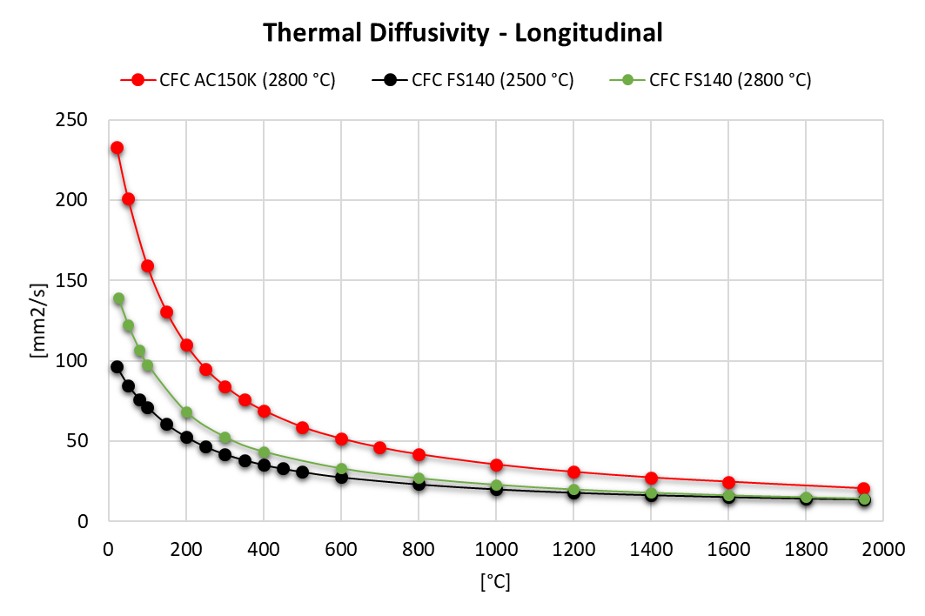
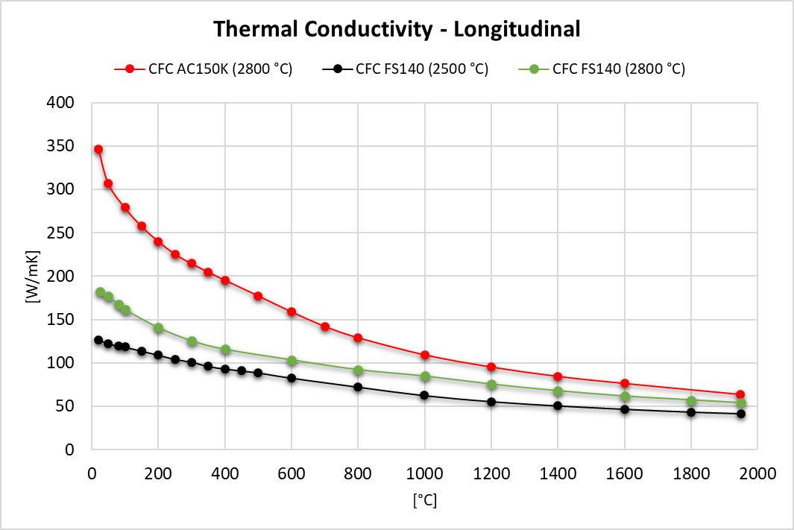
Carbon Fiber-Carbon: Thermal properties 2/4
Electrical conductivity measurements revealed orthotropy of CFC
→ Longitudinal = y or z?
*3 mm thick samples
Notes:
Graphitization also depends on the final baking time, might have been longer for the first batch.

Slide 16
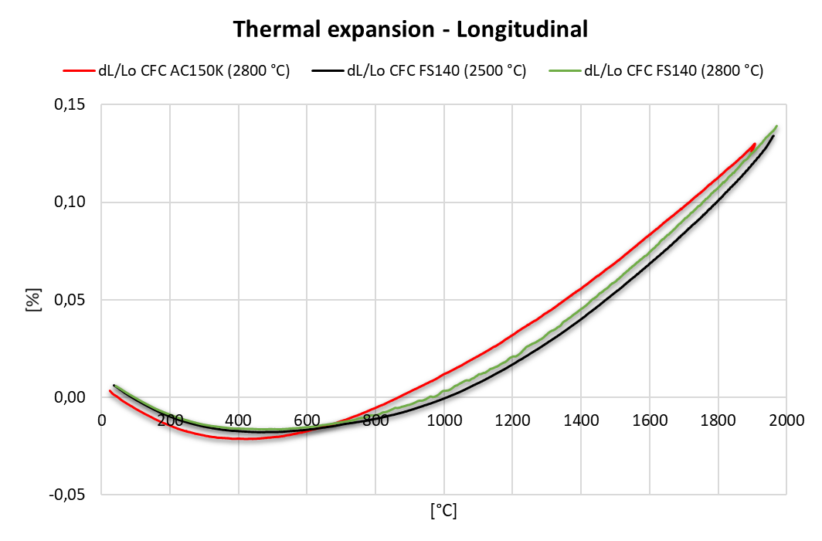
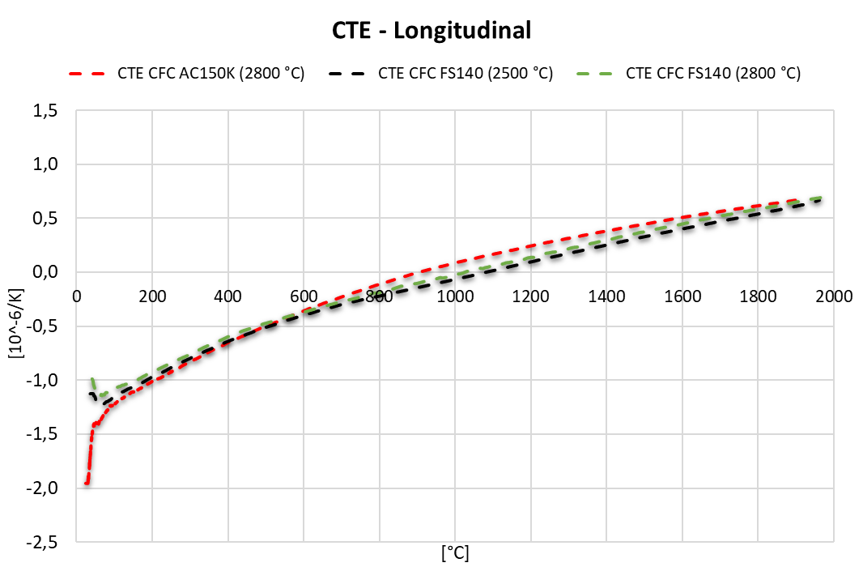
Carbon Fiber-Carbon: Thermal properties 3/4

Slide 17
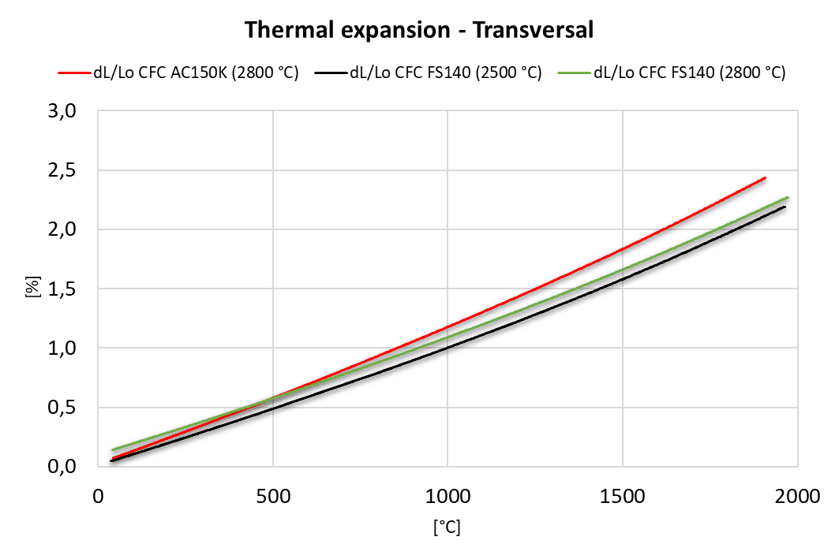
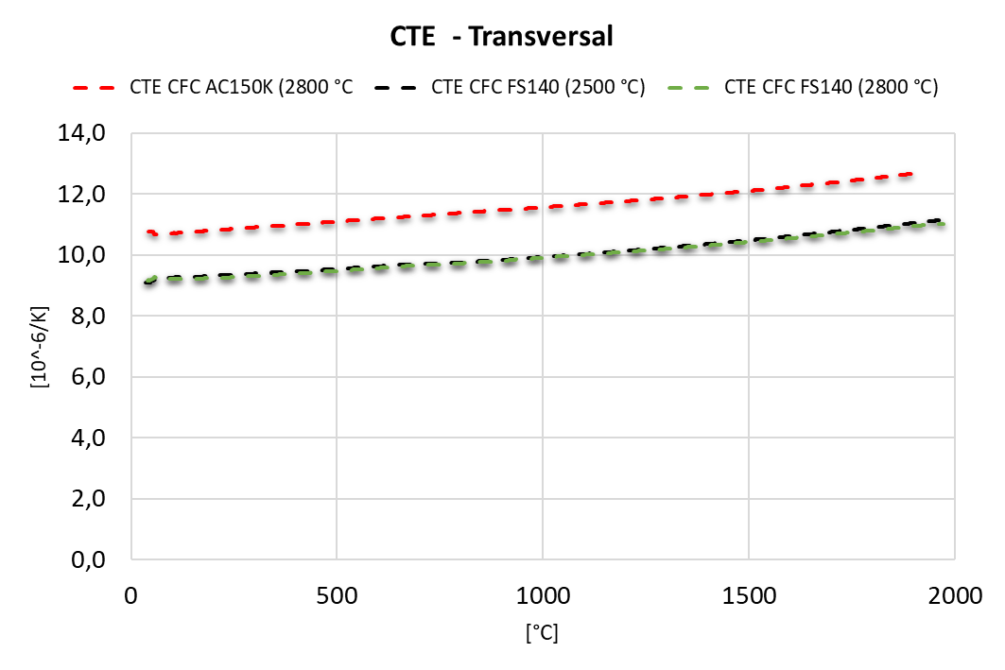
Carbon Fiber-Carbon: Thermal properties 4/4

Slide 18
Summary
Property |  | CFC AC150K | CFC FS140 (2500 ⁰C) | CFC FS140 (2800 ⁰C) | Nb-8304Je | TG-1100 | HOPG | MG-6403Fc
Density [g/cm³] |  | 1.89 | 1.87 | 1.92 | 2.57 | 2.19 | 2.25 | 2.54
cp @ 20⁰C [J/gK] |  | 0.76 | 0.72 | 0.74 | 0.63 | 0.64 | 0.69 | 0.62
CTE RT-1000⁰C [10⁻⁶/K] | L | 0.03 | -0.07 | -0.04 | 1.77 | Tests planned | 0.04 | 2.82
 | T | 11.6 | 9.93 | 9.93 | 15.4 | Tests planned | 33.6 | 10.9
λ @ RT [W/mK] | L | 233 | 124 | 171 | 720 | 435 | 1685 | 738
 | T | 54 | 42 | 50 | 29 | 52 | 7.8 | 50
Flexural strength [MPa] | L | 139 | 165 | 156 | 94 | Tests planned | 25.5 | 58
 | T | 10 | 9 | 10 | 13 | Tests planned | Tests planned | 10
Reference E [GPa] |  | 62 | 73 | Tests planned | 83 | Tests planned | 25 | 60
Electrical conductivity [MS/m]# | L | Y=0.24 Z=0.18 | Y=0.12 Z=0.09 | Tests planned | 0.96* | Tests planned | 2.5* | 1.01*
 | T | 0.03 | 0.02 | Tests planned | 0.05 | 0.08 | 0.0009* | 0.07
Uncertainties of measurements: EDMS_1371429, EDMS_1371432
*sigmatest
^{#Jorge G. Valenzuela}
Notes:
Electrical conductivity according to ASTM C611
Sigmatest done with another instrument
E evaluated with optimized algoritm from IET measured frequencies.
Cp extrapolated at 20C
U_dL/Lo=3,8
U_CTE=5,3
U_TD=5,6
U_cp=3,5

Slide 19
Future steps
Ongoing
  CuCD (market survey)
  CFC FS140 (2800 °C) dilatometry, IET, compression test
Characterization of MultiMat spare specimens:
  MG-6541-FC (New!)
  TG-1100
  CFOAM
  HOPG Mechanical tests
  …
Investigate LFA capabilities with NETZSCH (→ meeting in Jan 2018)
Benchmark with Material Research Facility UKAEA

Slide 20
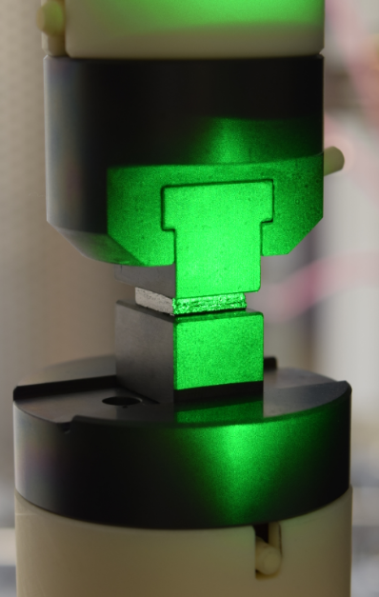
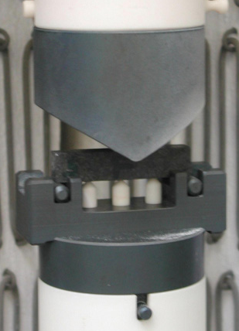
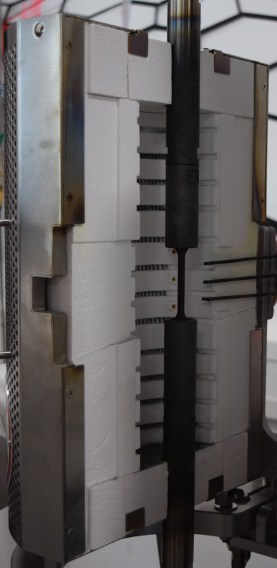
Future steps
Mechanical characterization up to 1200 °C
Compression test
Cylindrical specimen
Ø4-14.5 x h10
3- and 4-point bending test
DIN EN 843-1
Square specimen
60x4x3mm
Tensile test
ISO 6892-2
Ø5mm specimen
M8 threaded rods

Slide 21
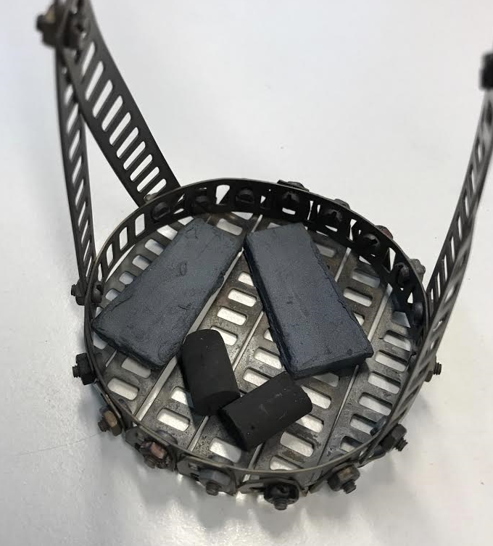
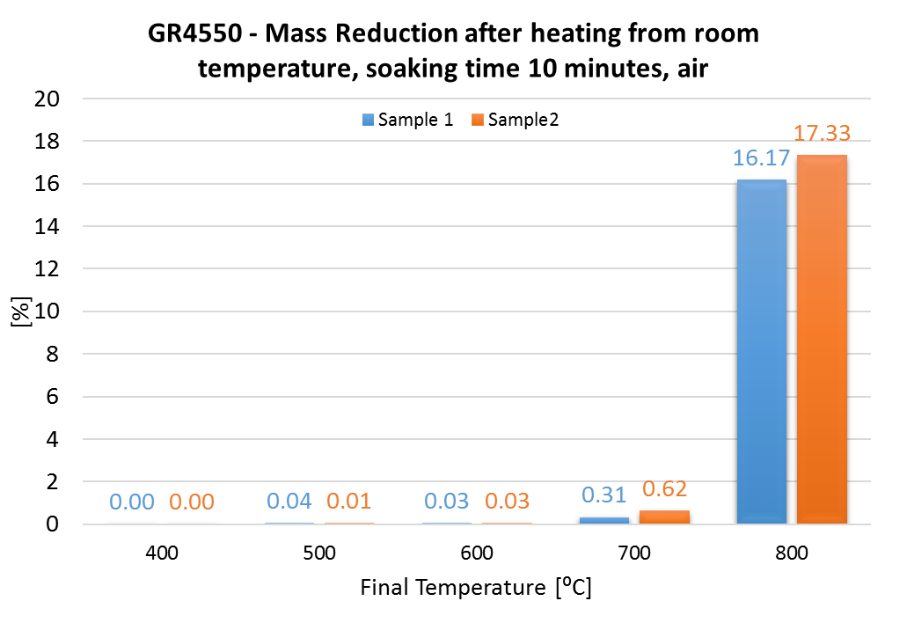
Future steps
Mechanical characterization up to 1200 °C
For graphitic material below 700 °C
Possibility to flush inert gas

Slide 22
Thank you for your attention!
Questions?

Slide 23
Back-up slides

Slide 24
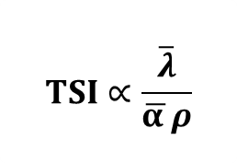
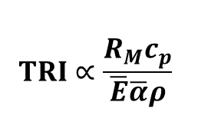

Figures of Merit
Material | TRI | TSI | RFI
CFC AC150K | 1372 | 47 | 0.24
CFC FS140 (2500 ⁰C) | 1943 | 28 | 0.12
CFC FS140 (2800 ⁰C) | ongoing | ongoing | ongoing
Nb-8304Je | 253.9 | 49.2 | 0.92
TG-1100 | not enough data | not enough data | not measured
HOPG | ongoing | ongoing | ongoing
  $$TSI∝\frac{\overline{λ}}{\overline{α }ρ}$$
  $$TRI∝\frac{R_{M}c_{p}}{\overline{E}\overline{α}ρ}$$
  $$RFI= γ$$
Material | TRI | TSI | RFI
MG-6530Aa | 200 | 35 | 0.83
MG-6541Aa | 226 | 37 | 0.98
MG-6403Fc | 246 | 58 | 0.91

Slide 25
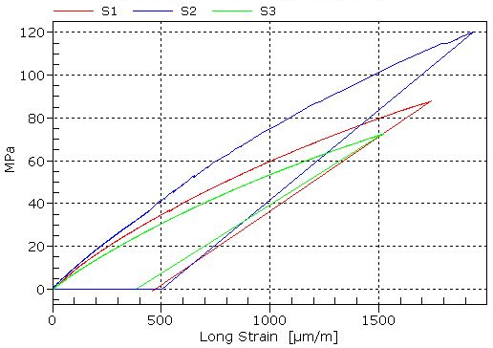
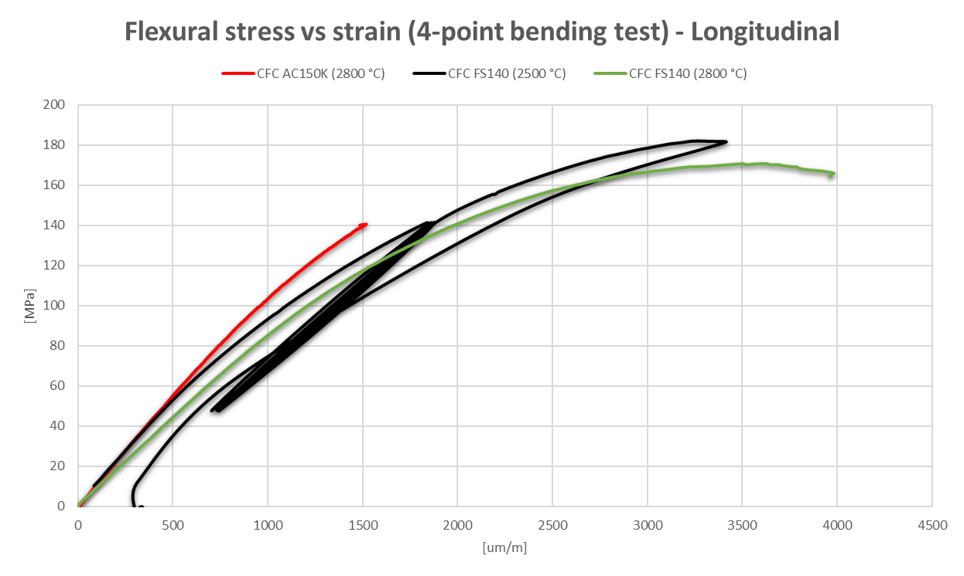
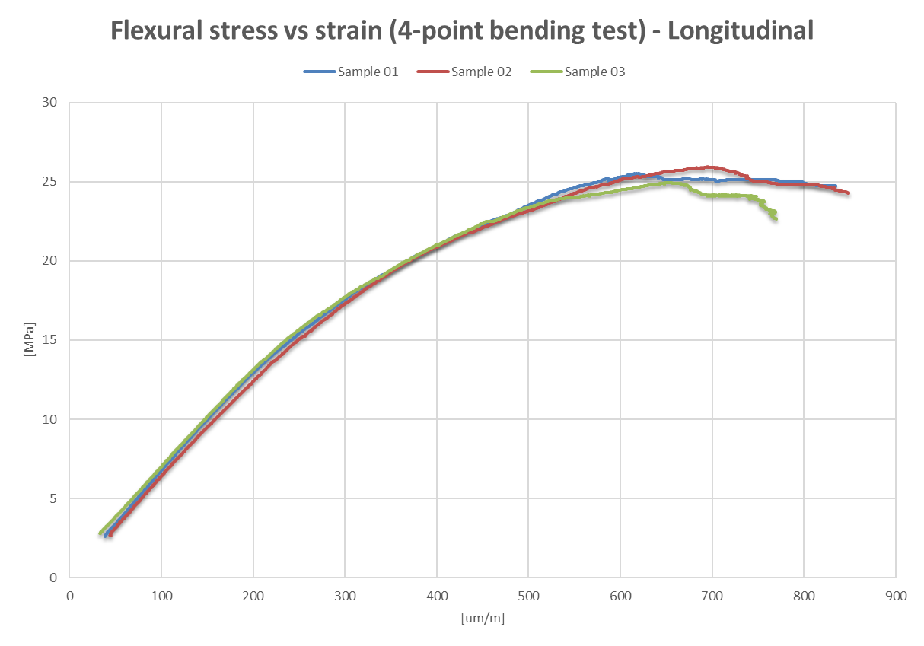
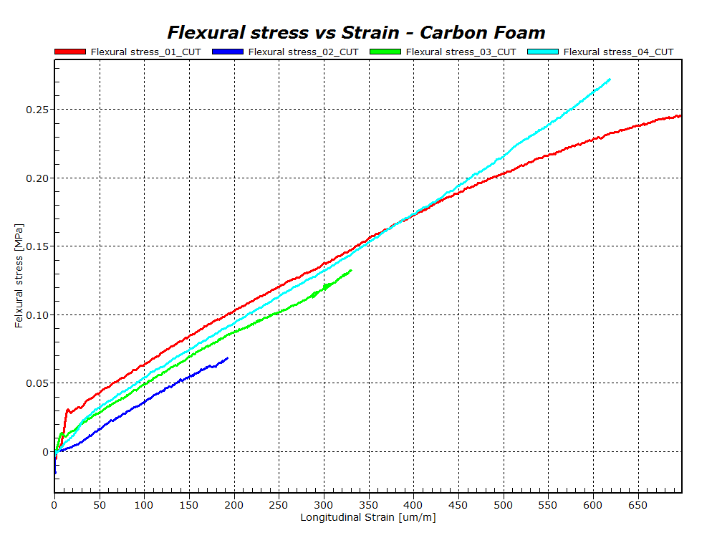
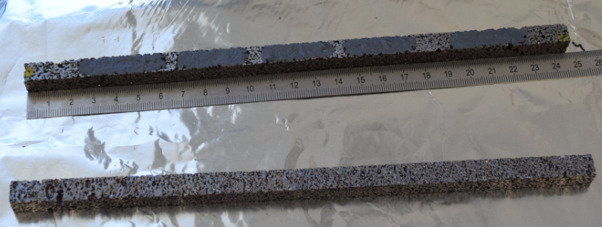
Flexural tests (4-point bending)
Nb-8304Je - Longitudinal
CFC - Longitudinal
HOPG - Longitudinal
Non-standard geometry

Slide 26
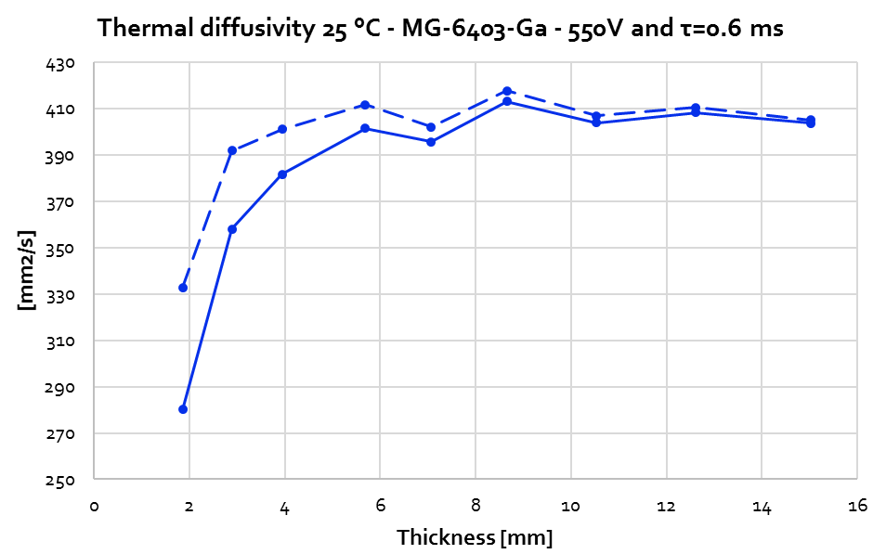
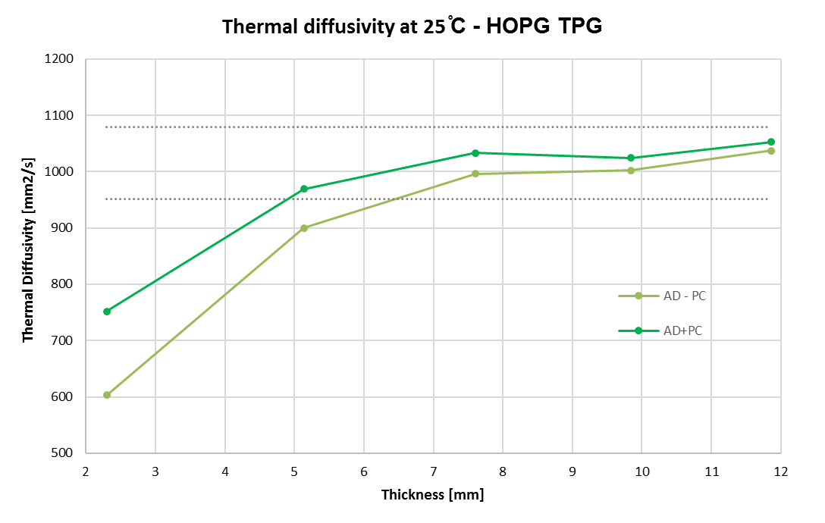
LFA limits: Thickness sensitivity

Slide 27
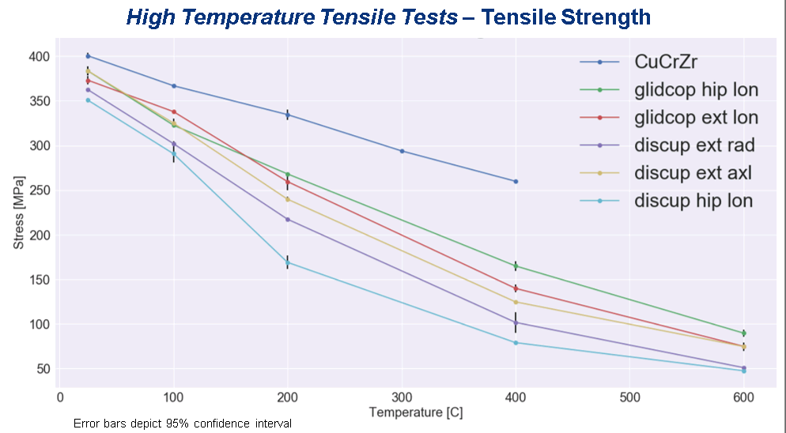
Mechanical testing at HT – Cu alloys
Mechanical characterization up to 1200 °C

Slide 28

Nb-8304Je: Flexural test
4-point bending tests
Longitudinal
Transversal

