Slide 1

UHV characterization of advanced materials and their coatings
Carlotta Accettura EN/MME, with many contributions of TE/VSC
1st Workshop of ARIES PowerMat (WP17)
Turin- 27 November 2017

Slide 2
Outline
Introduction: the LHC and the UHV
Outgassing of collimator materials:
  Graphite, CFC and MoGr
  MoGr investigation – bulk material
  MoGr investigation – coating
  CuCD
Conclusions and outlook

Slide 3
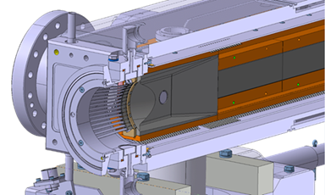
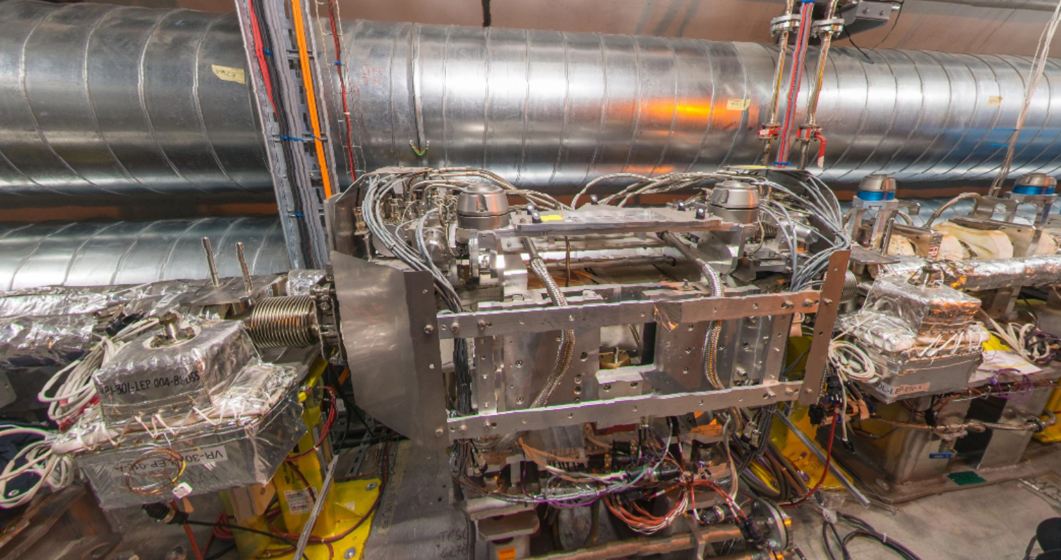
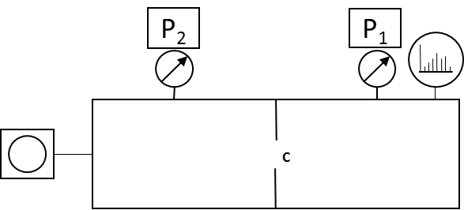

The UHV requirements
In all the particle accelerators an high or ultra-high vacuum is required: beam stability and lifetime (beam-gas scattering)
LHC vacuum acceptance limits for collimators:
  Low outgassing rate (1·10⁻⁷ mbar·l/s)
  No NEG saturation (N₂, CO, CO₂,..)
  Low SEY (ESD, electron cloud)
$$Q=\left(P1−P2\right)·C$$

Slide 4
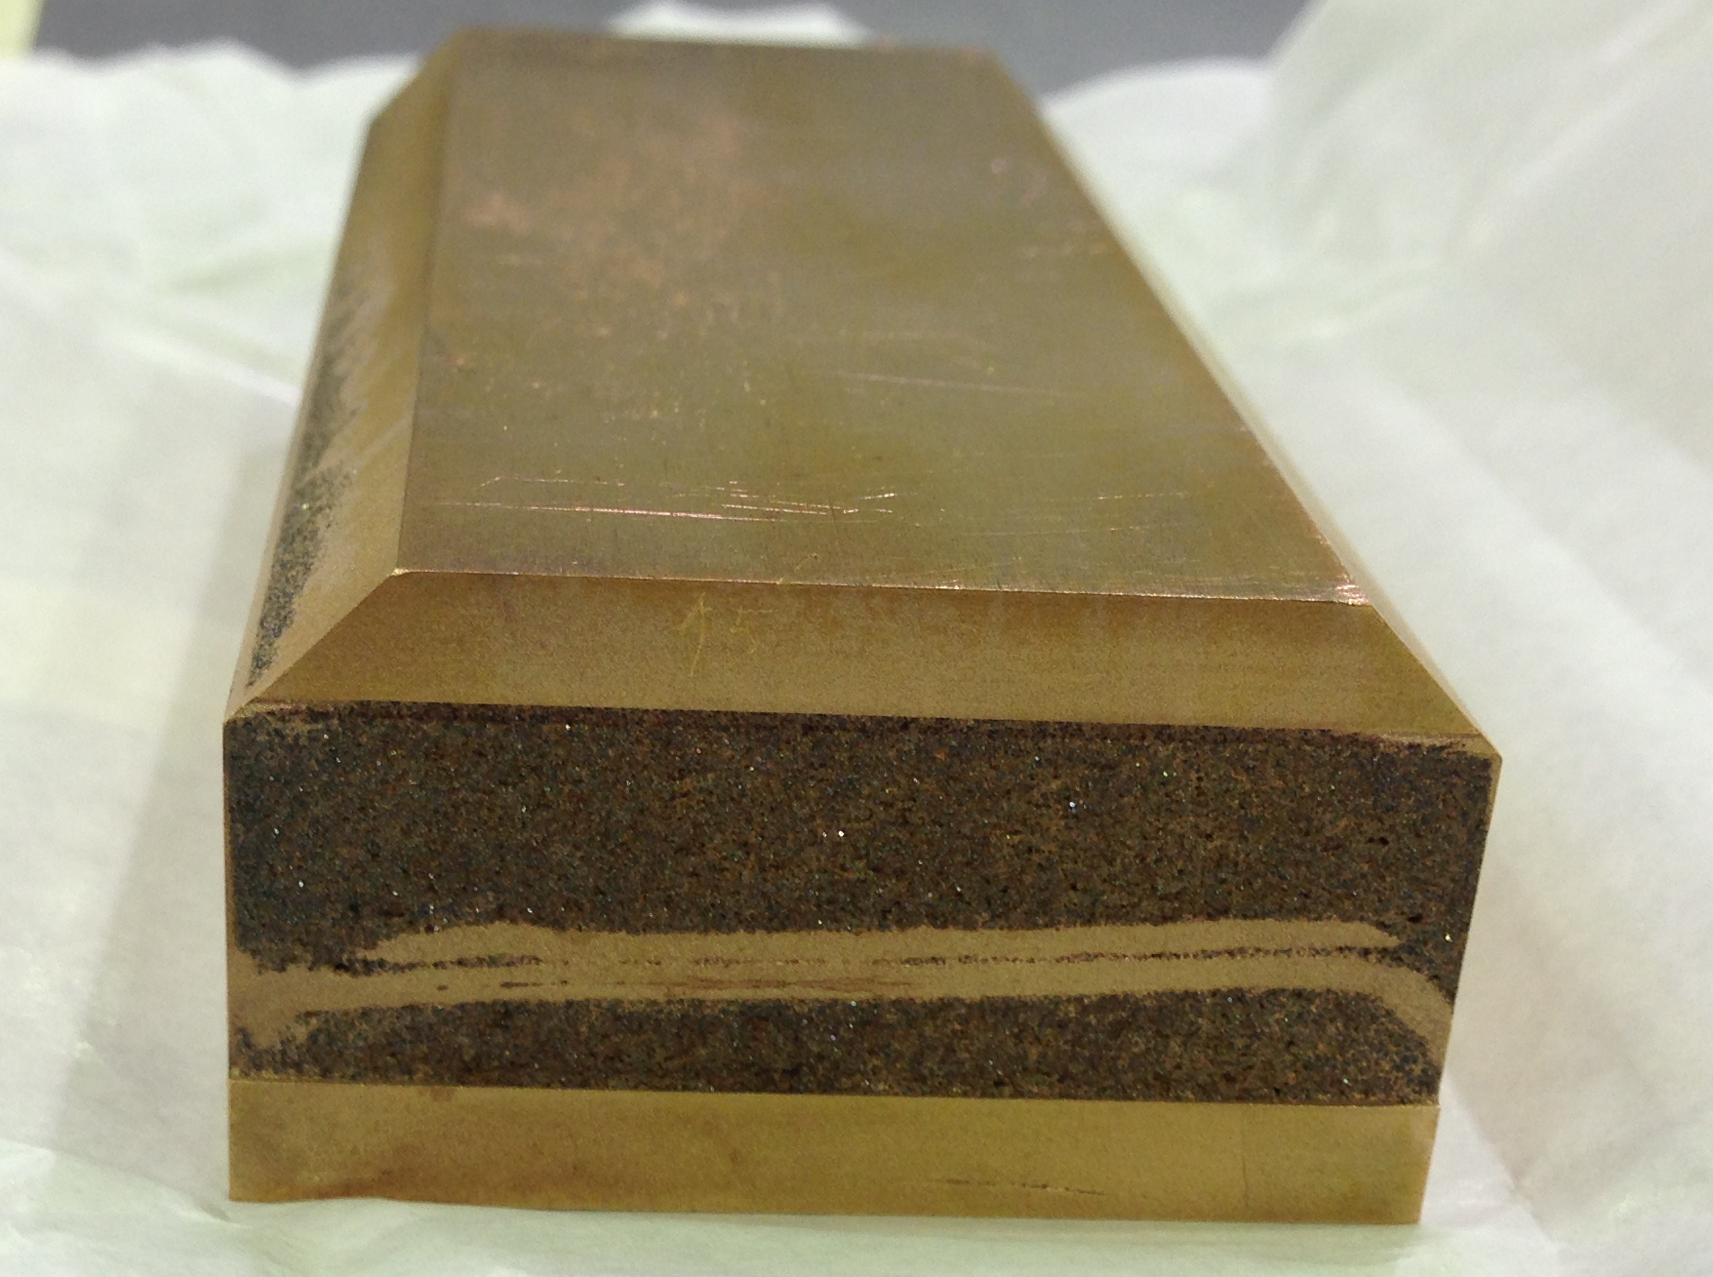
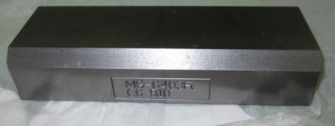
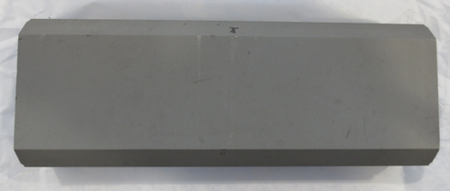
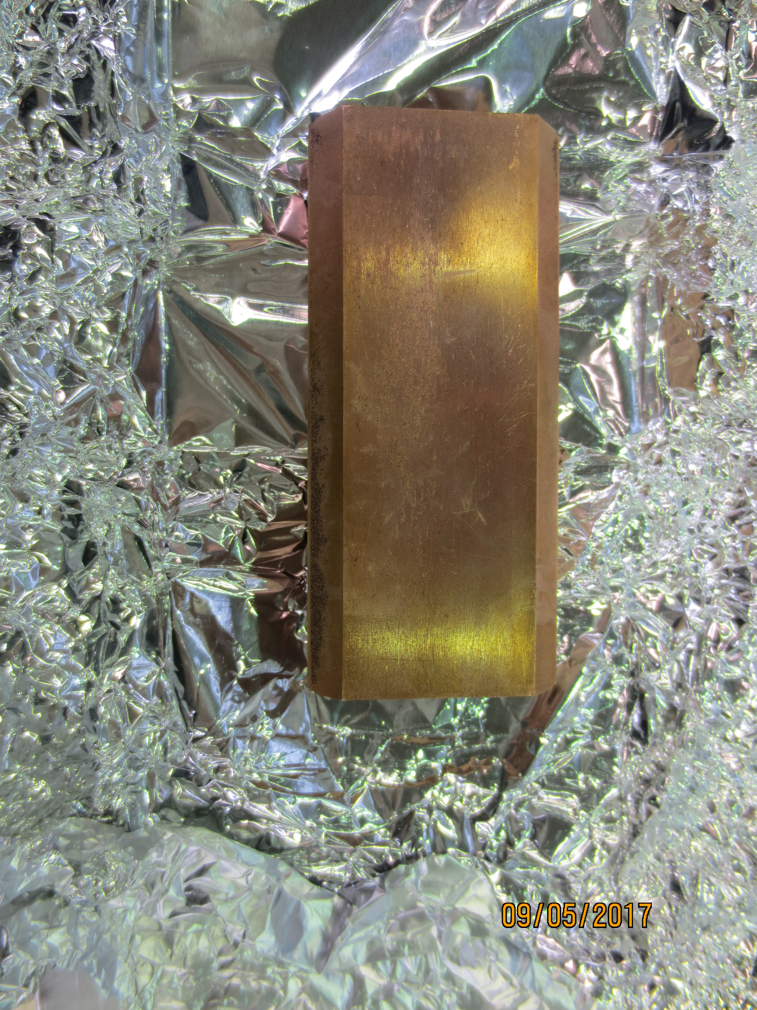
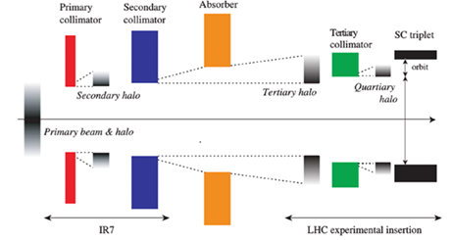
Collimation system upgrade
MoGr
MoGr with Mo coating
CuCD

Slide 5
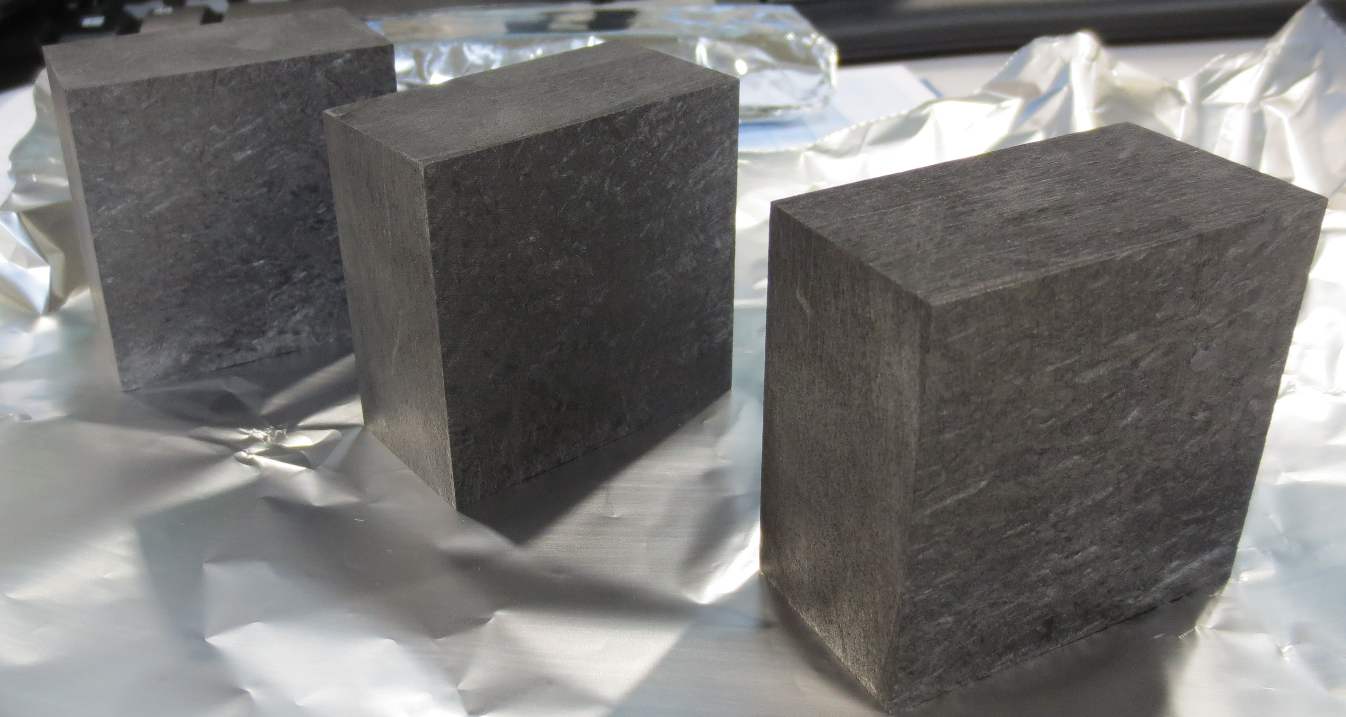
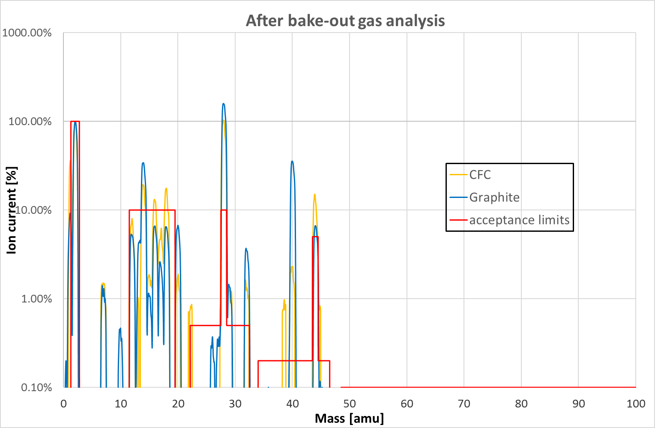
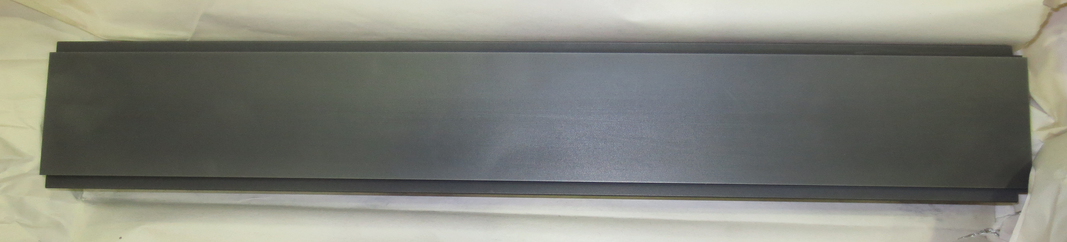
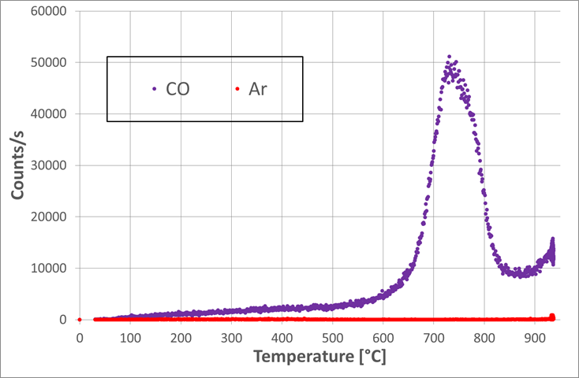
Graphite outgassing – Air content
2D Carbon-Fibre-reinforced Carbon (CFC)
Avoid high T treatment with inert gas
H₂
N₂
CO
CH₄
Ar
CO₂
Graphite

Slide 6
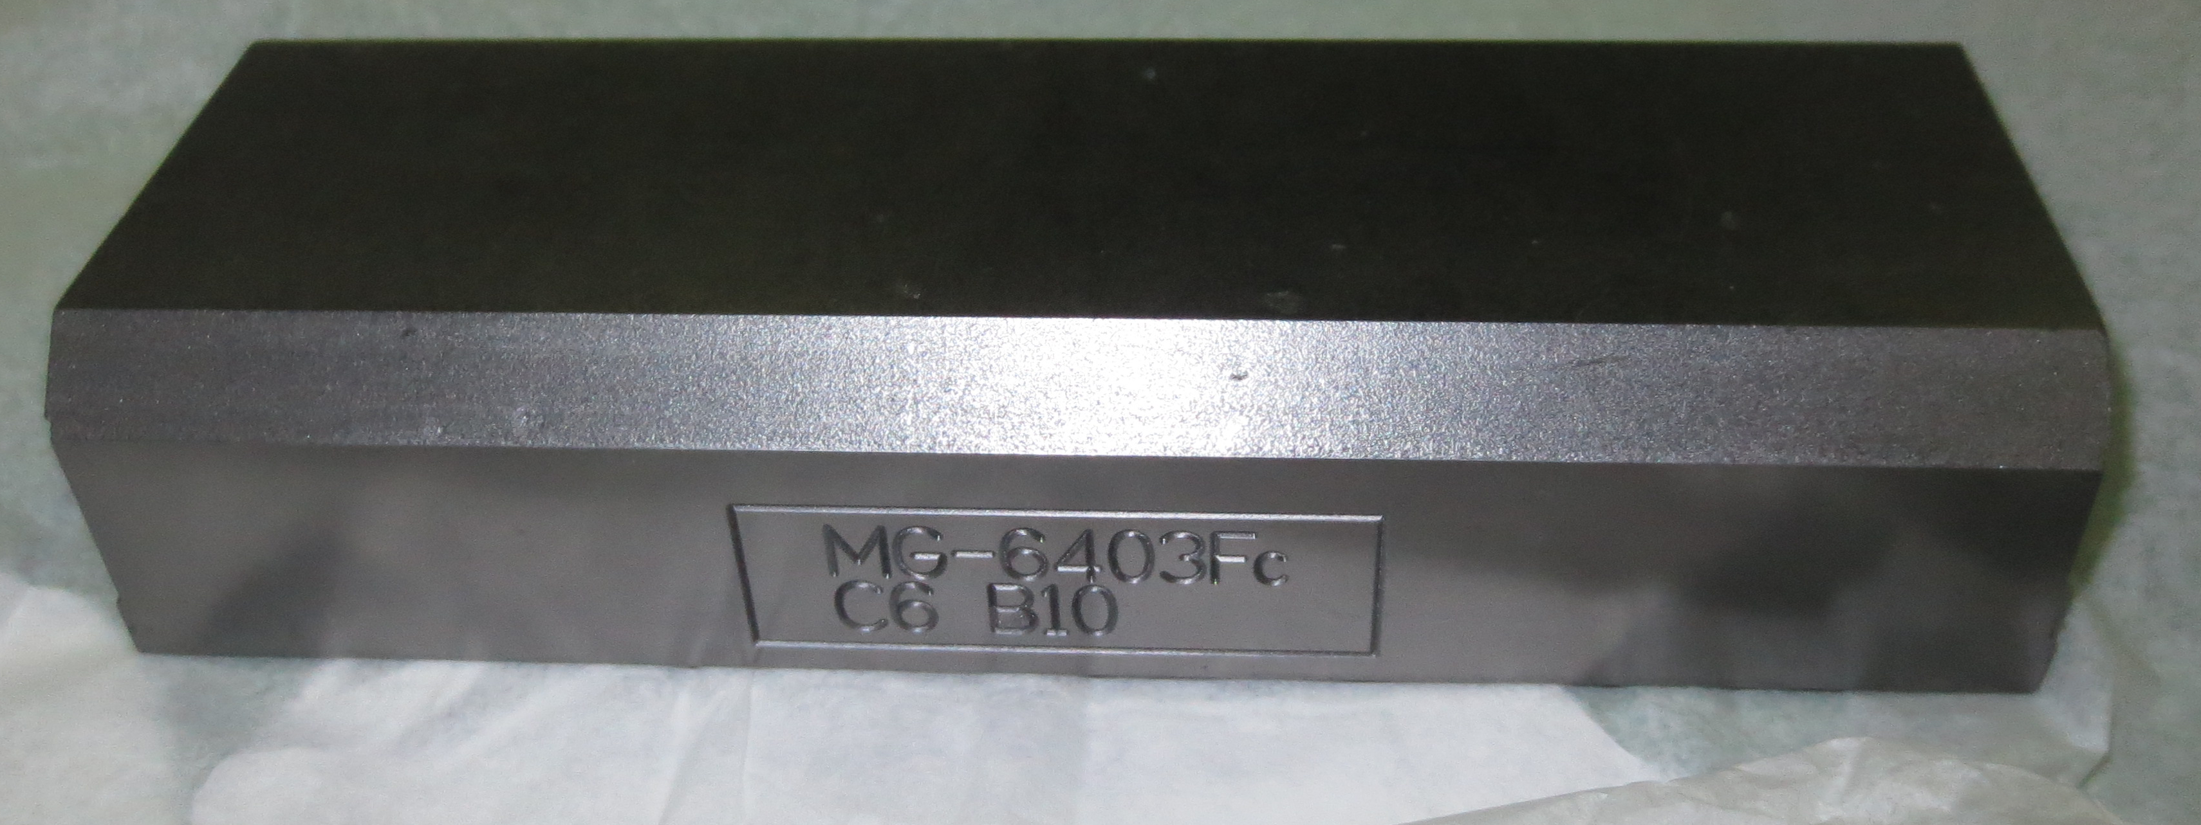
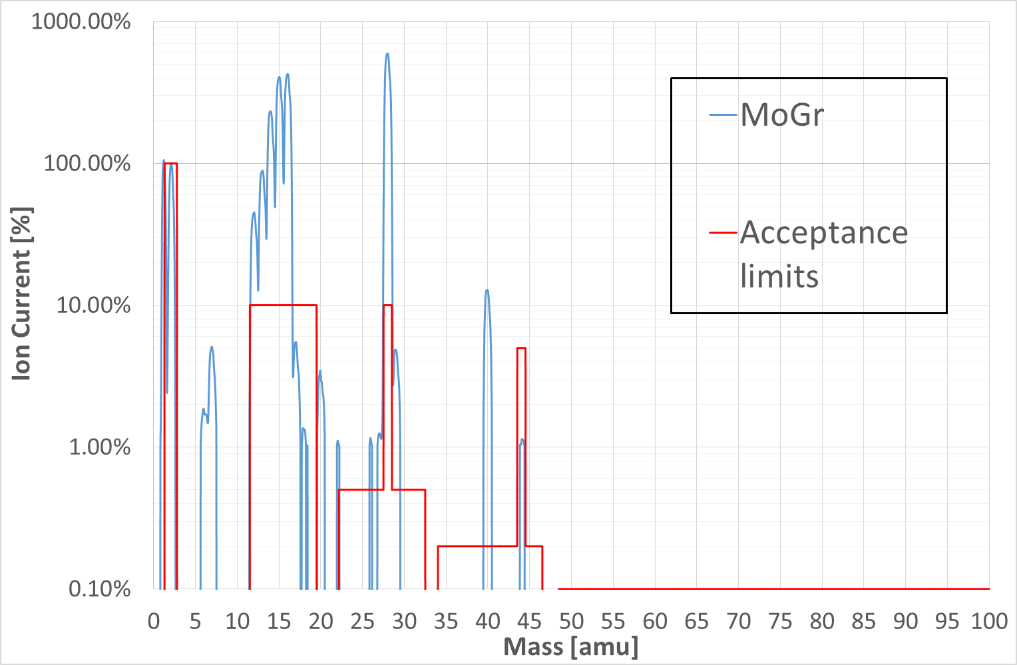
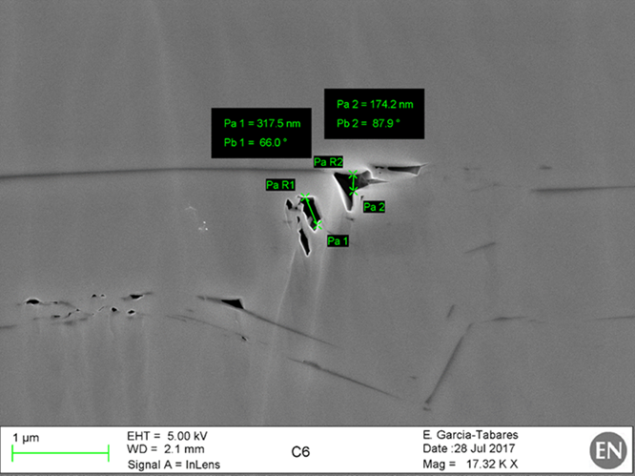
Molybdenum-Carbide Graphite
N₂
CO
CH₄
H₂
Ar
Material | Q_{s} [ mbar∙l/ s∙cm²]
MoGr | 1.9∙10⁻¹⁰
Graphite | 1.3∙10⁻¹¹
CFC | 1.9∙10⁻¹¹
CO₂
Surface damage
Bulk porosities

Slide 7
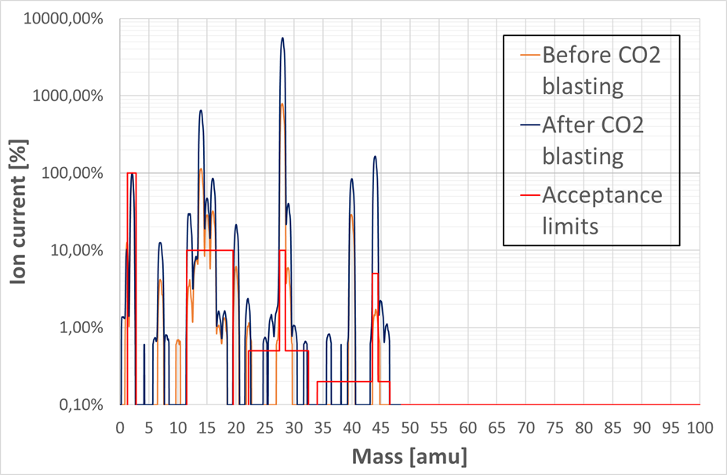
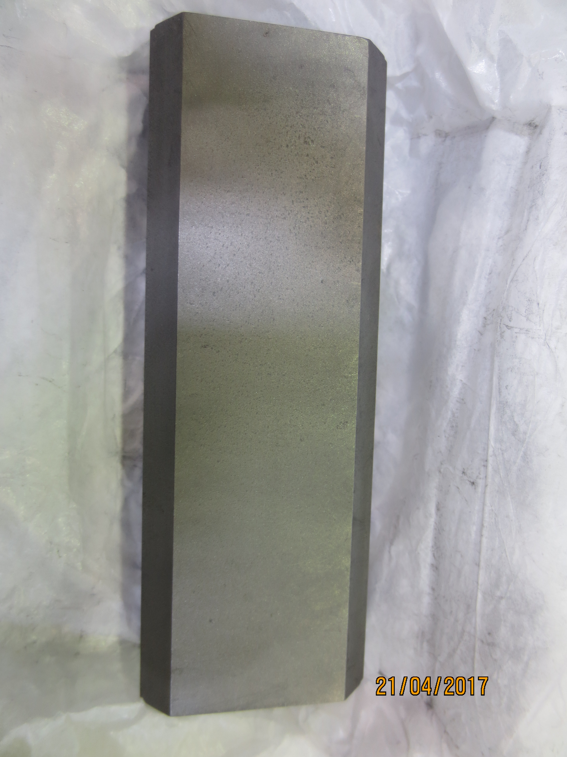
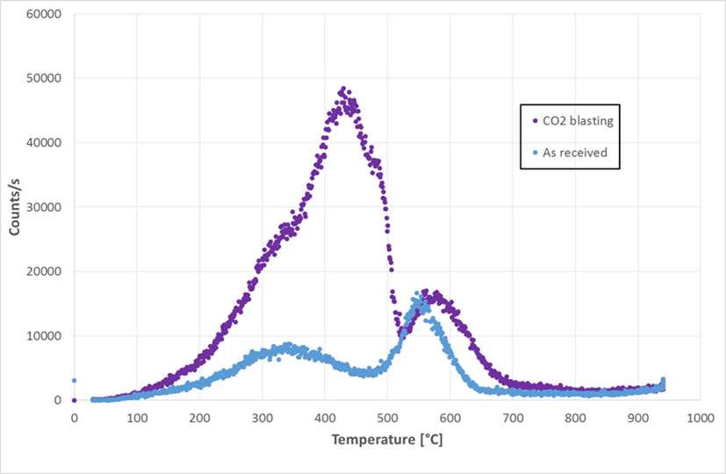
MoGr treatment
CO₂
Surface peak
CO₂ blasting:
Q_{after}/Q_{before}= 50
CO₂ adsorption
Air content (N₂, Ar) increased
Bulk peak

Slide 8
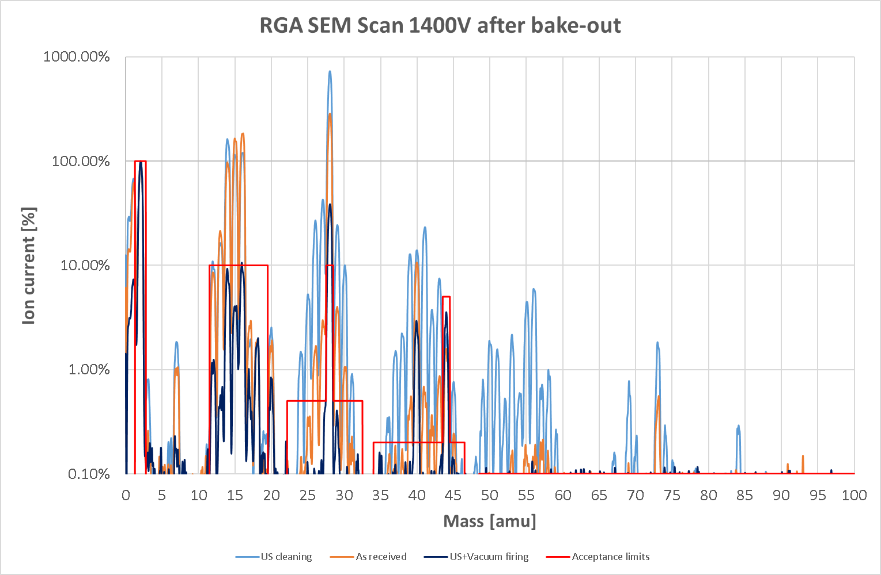
US cleaning-last grade
US cleaning:
Q_{after}/Q_{before}= 3
Solvent contamination
Completely recovered after 48h firing

Slide 9
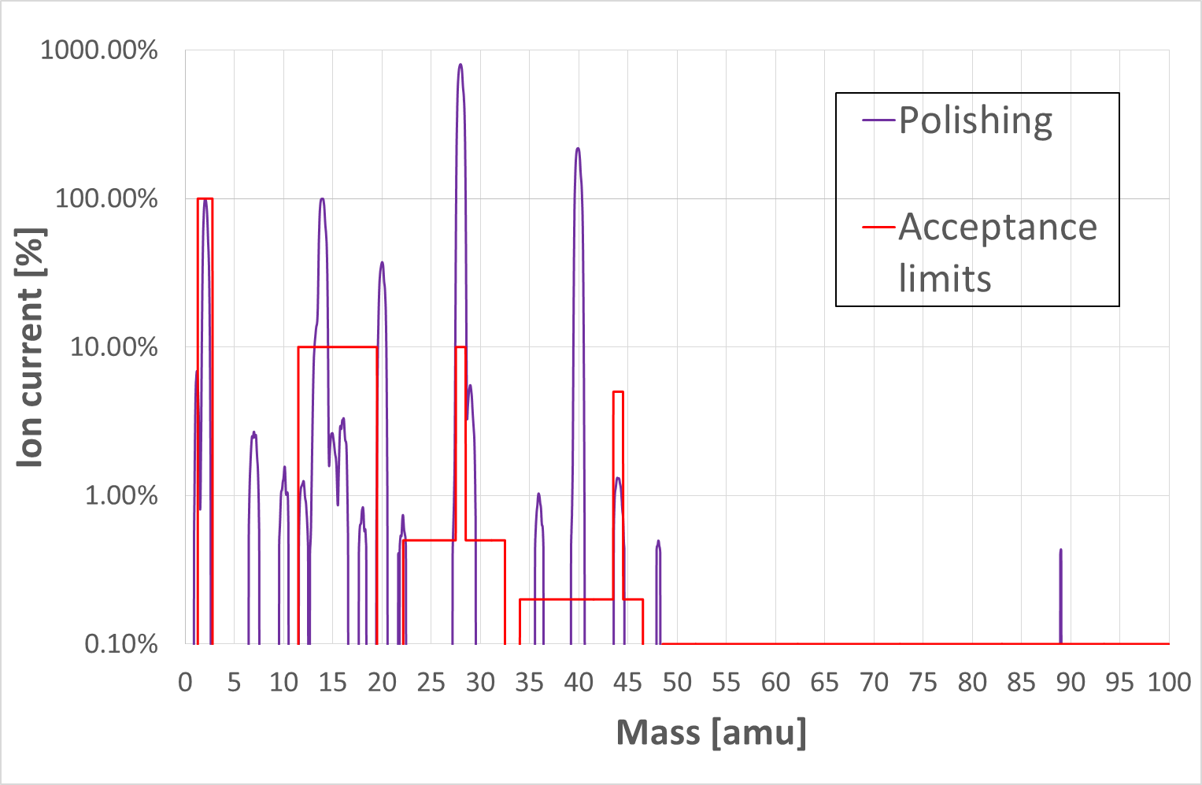
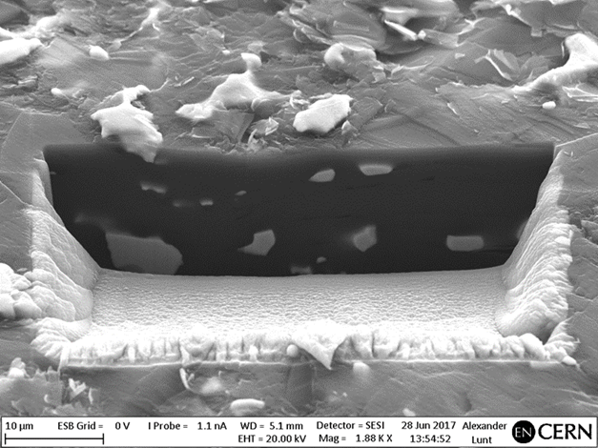
MoGr treatment
N₂
CO
Diamond paste polishing (particle size 1μm):
Q_{jaws}= 5.4∙10⁻⁷ mbar∙l/s ☒
Air still dominant
Surface damage seems removed
H₂
N
Ar
CO₂
The surface plays a role (CO₂ blasting), but there should be also a bulk contribution to air trapping

Slide 10
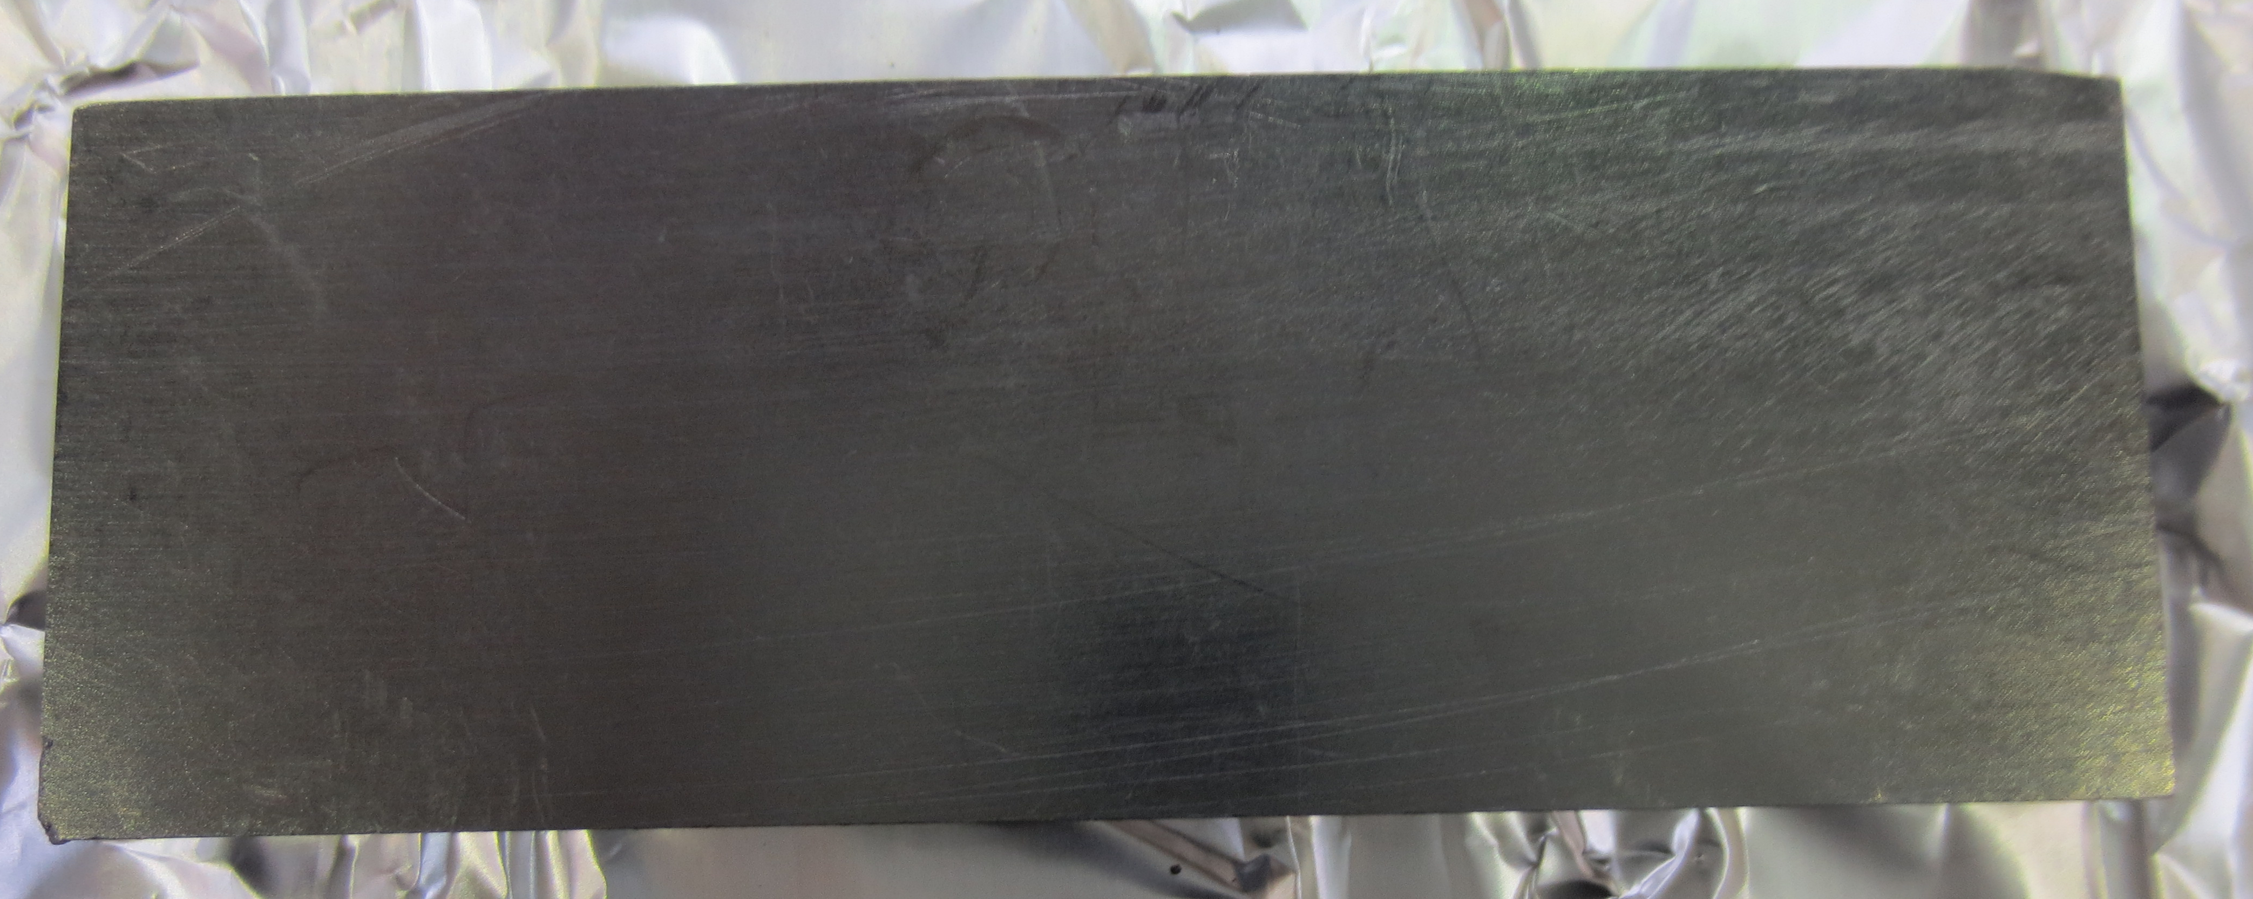
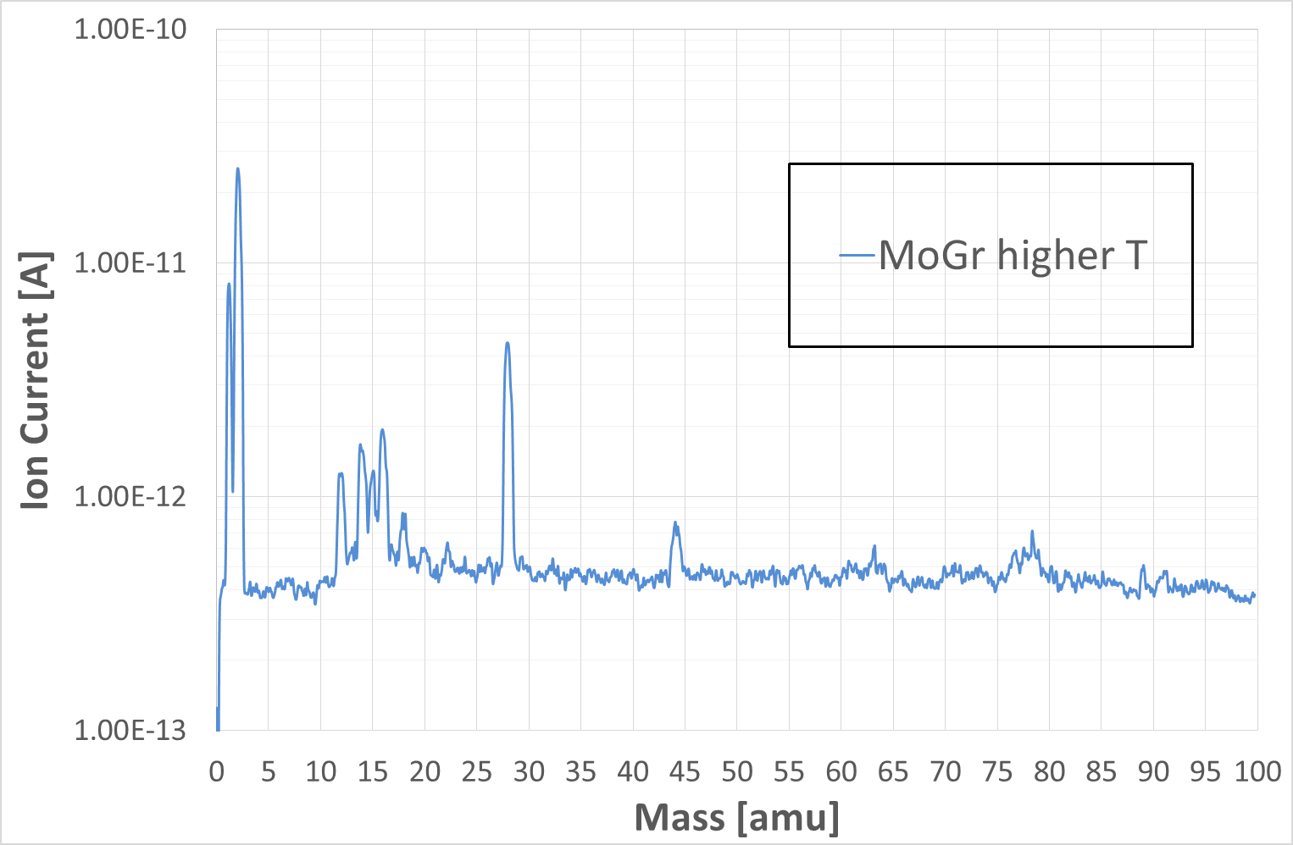
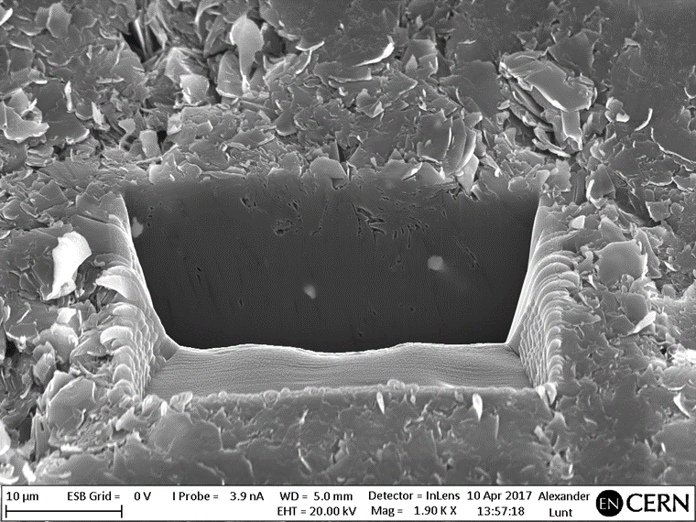
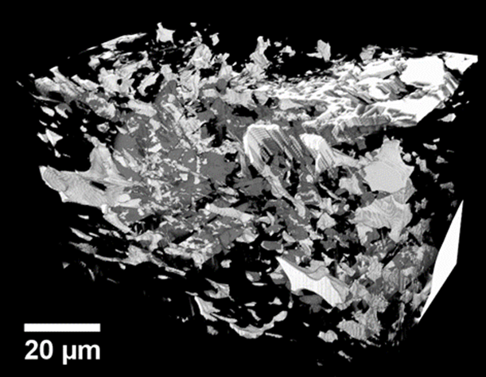
Solution 1: Higher T process
Higher temperature during production process:
Q_{jaws}= 3.1∙10⁻⁸ mbar∙l/s ☑
H₂ dominated
Similar surface damaged (FIB)
Lower density: similar void fraction, lower carbide content (3D FIB)
25x70x6 mm
 | Compliant sample | Non-compliant sample
%vol carbide | 4.5 | 7.8
%vol void | 5.1 | 5.7

Slide 11
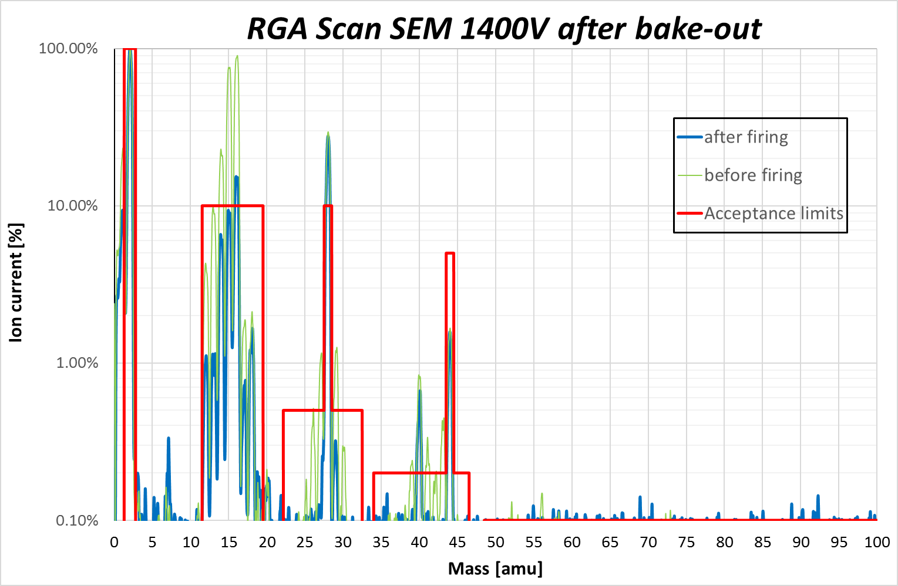
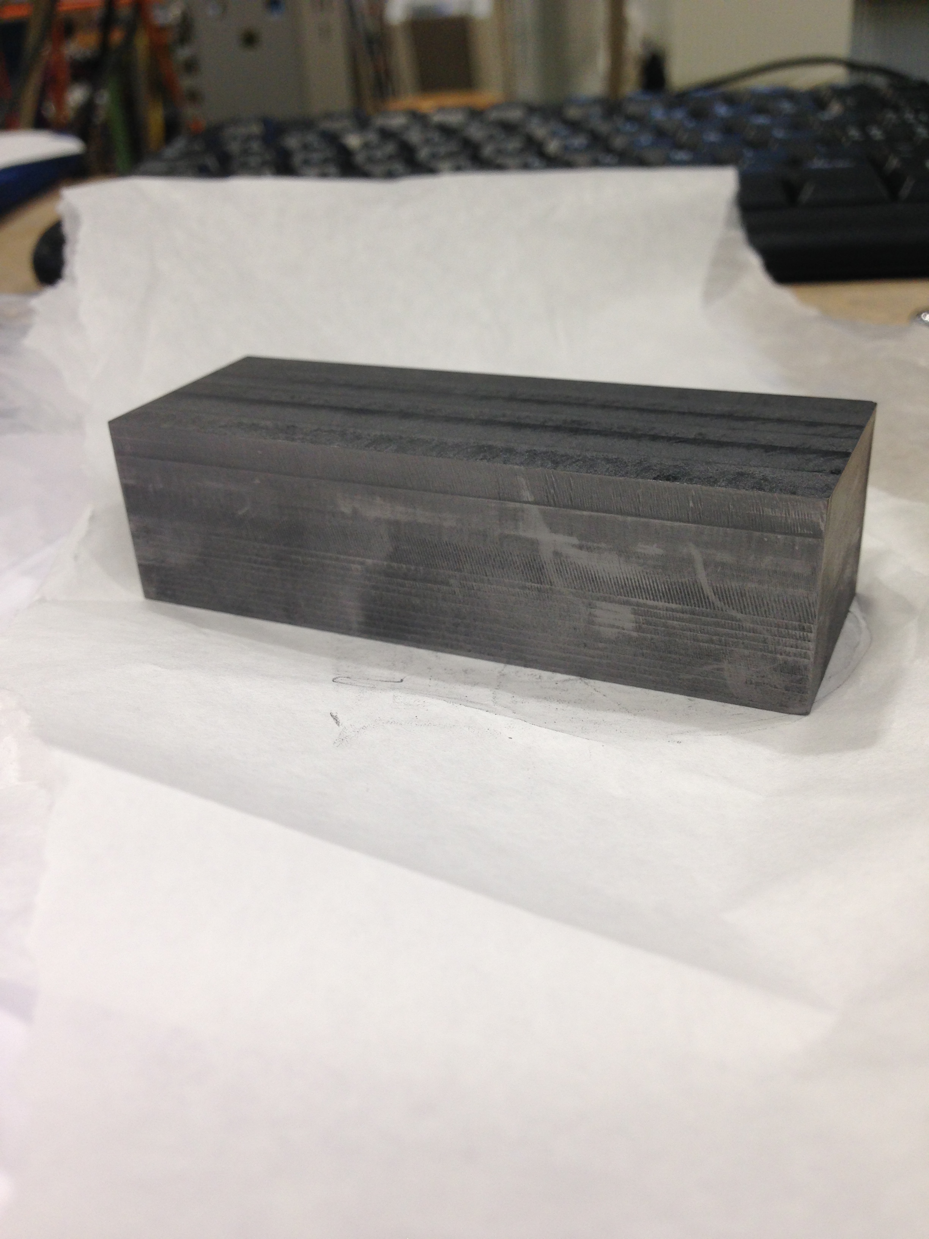
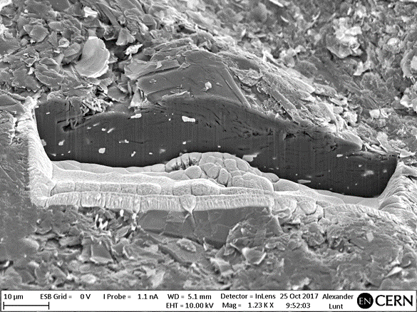
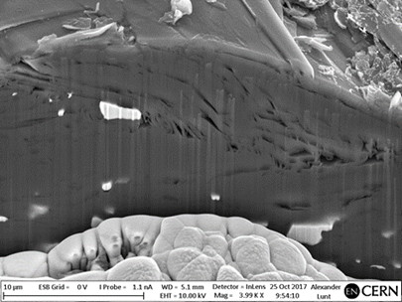
Solution 2: Different compaction
Material | Q_{s} [ mbar∙l/ s∙cm²]
As received | 4.7∙10⁻¹¹
48h firing | 3.5∙10⁻¹²

Slide 12
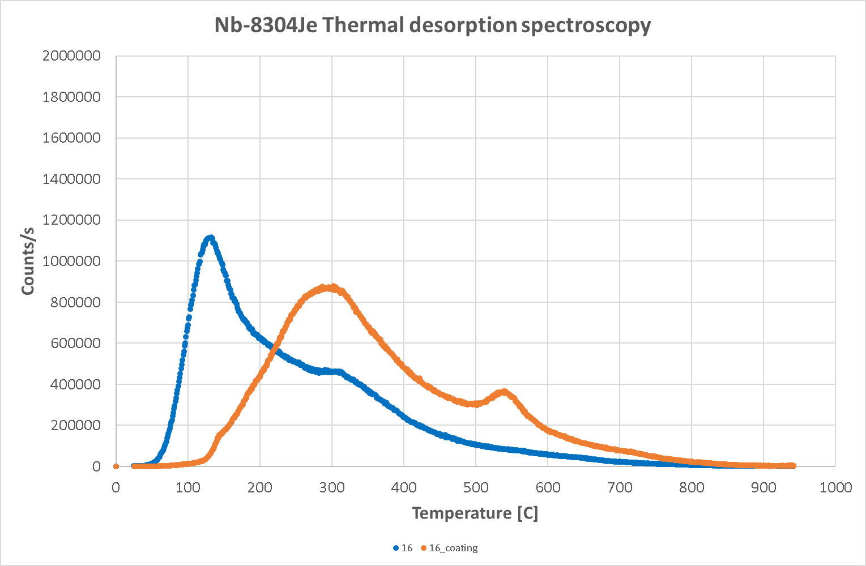
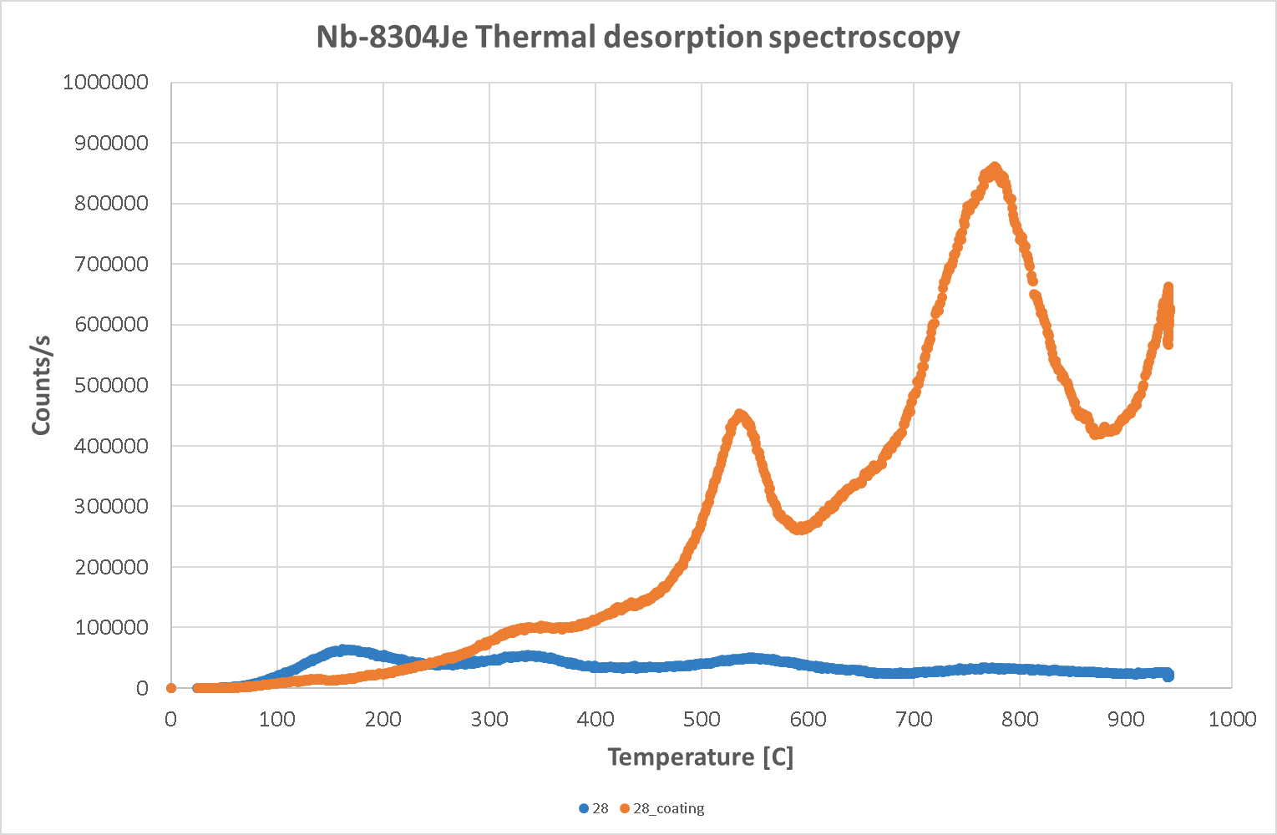
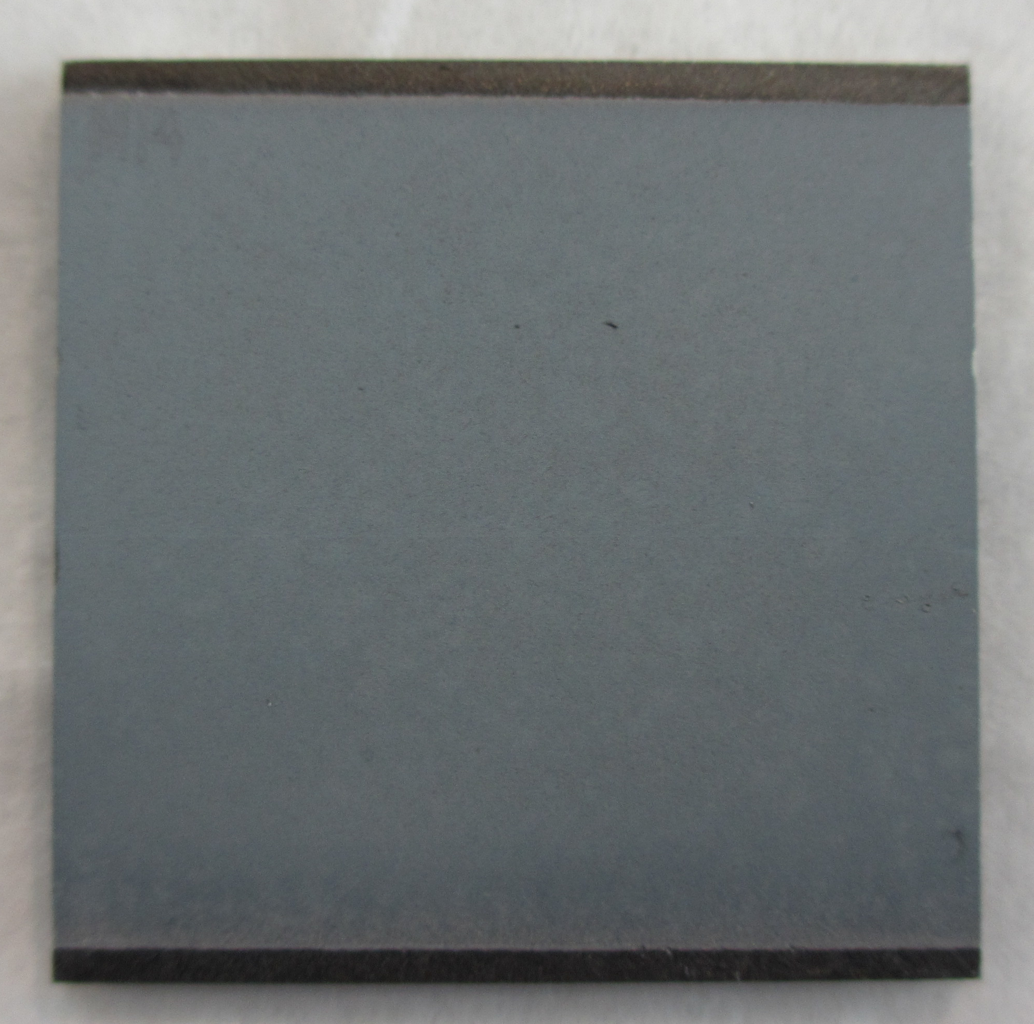
Mo coating on MoGr – TDS
CH₄
CO₂
The coating:
  reduces the outgassing up to 200-250°C (oxide layer?)
  increases the outgassing above these T (CO₂ blasting) with a proper preparation should be compliant
CO₂ blasted MoGr with Mo coating

Slide 13
Mo coating on MoGr – SEM
Need to verify possible air trapping within the Mo layer
CO₂ BLASTING
US CLEANING

Slide 14
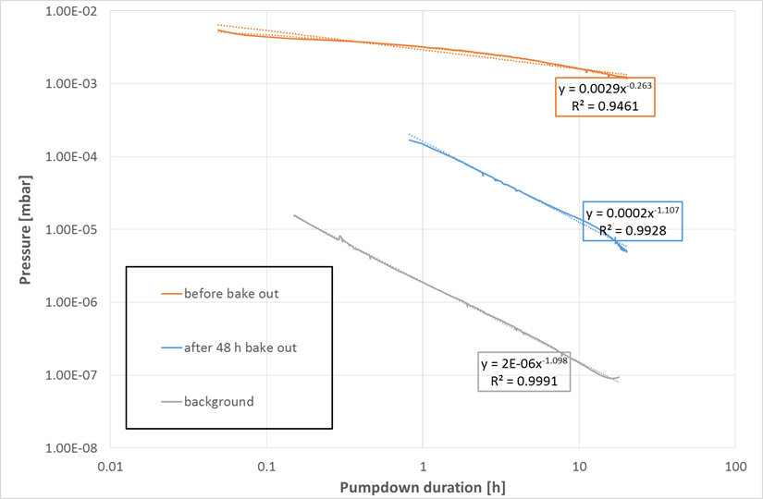
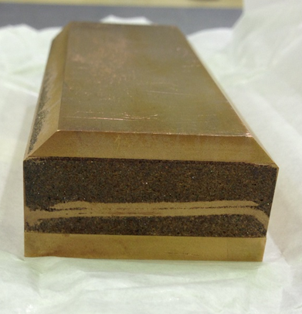
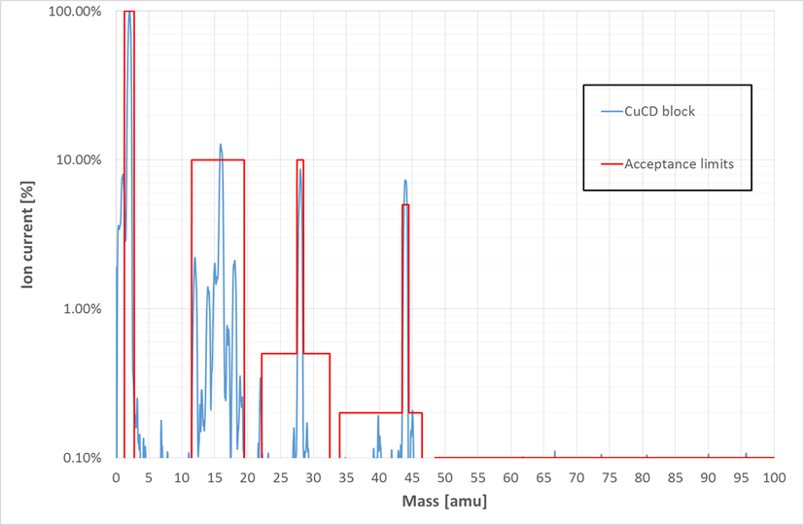
Copper-Diamond
Robustness against accident situation: W alloy CuCD
US cleaning before the test→ impossible to pump-down
After 48+24 h of bake-out at 250°C
Material | Q_{s} [ mbar∙l/ s∙cm²] | Q_{jaws} [ mbar∙l/ s]
CuCD + cladding | 7.4∙10⁻¹² | 2.9∙10⁻⁸ ☑

Slide 15
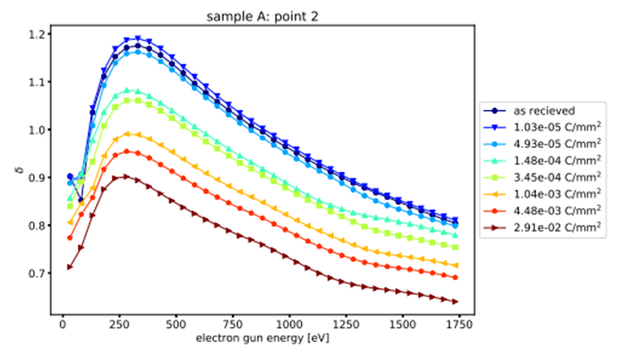
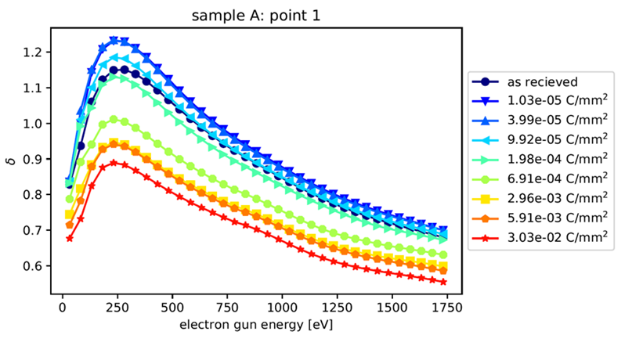
Secondary Electron Yield
Graphite
Copper
Courtesy of V. Baglin
SEY max collimator~ 1.4
MoGr
CuCD
Courtesy of D. Zanin (TE/VSC)

Slide 16
Conclusions and outlook
A complete characterization (outgassing, TDS, microscopy, knowledge of the production process,..) is required to understand the phenomena
Air content in MoGr has to be reduced during the production:
  higher T (Reproducible? Why?)
  under vacuum compaction
  longer annealing
CuCD: promising material, air exposure to be checked
Coating characterization:
  surface preparations effect on outgassing ✔
  coating effect on outgassing (ongoing)
  adhesion

Slide 17
Thank you for the attention!

Slide 18
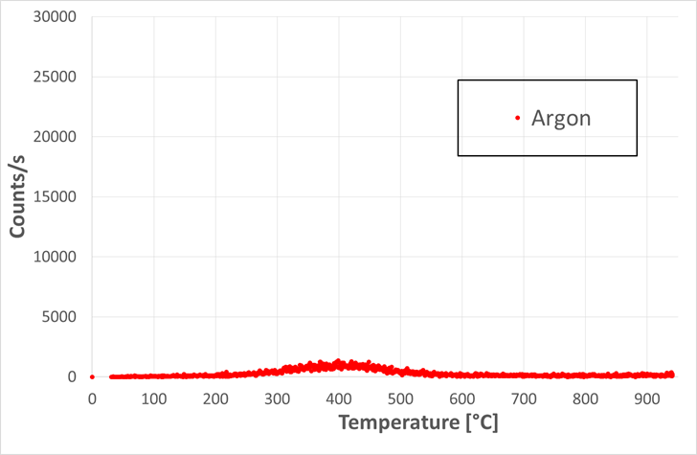
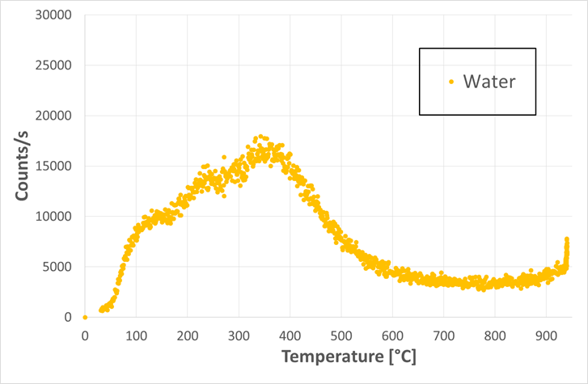
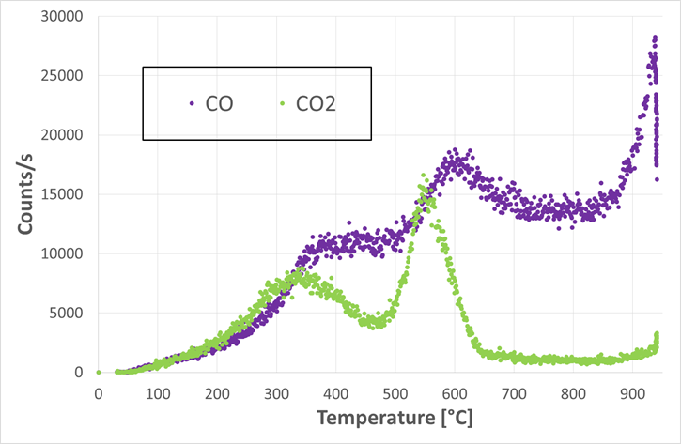
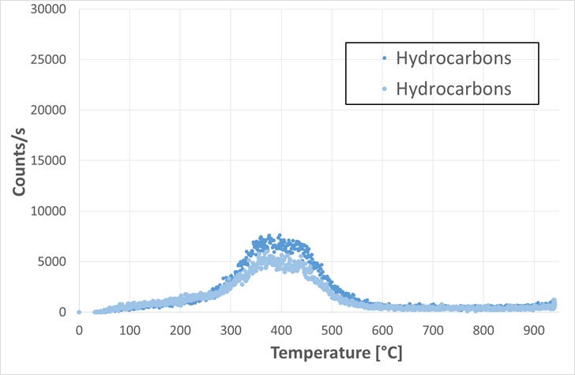
TDS-MoGr

Slide 19
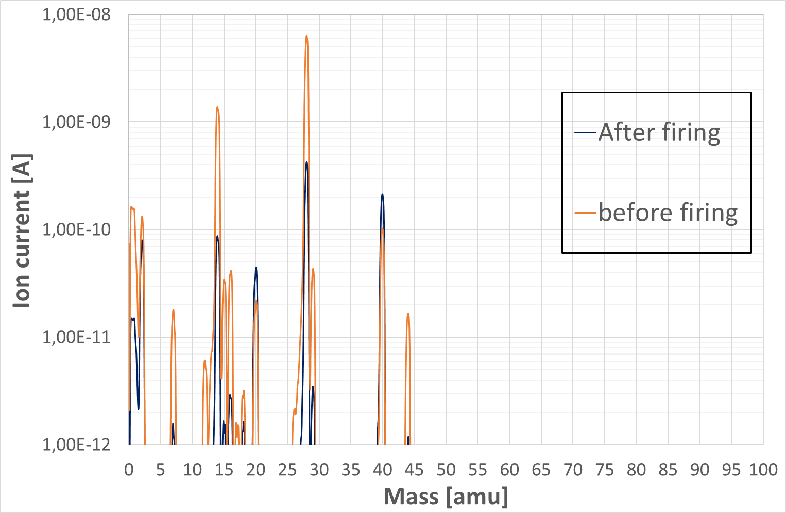
MoGr- 48h firing
48 h, 950°C vacuum firing:
Q_{before}/Q_{after}= 7, but still out of the limits (~2.5 for 2h firing)
H₂ decreased
N₂ decreased, Ar not

Slide 20
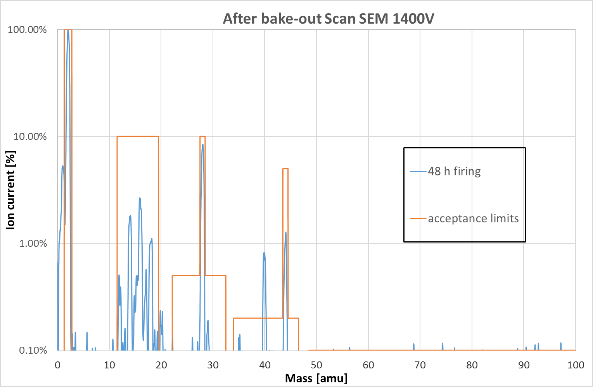
CFC- 48h firing
H₂
N₂
Ar
Treatment | Total outgassing [mbar*l/s] | Internal leak [mbar*l/s]
None | 7.5·10⁻⁸ ☒ | 8.3·10⁻⁹ ☒
2h firing, 950°C | 1.1·10⁻⁸ ☑ | 5.7·10⁻⁹ ☒
48h firing, 950°C | 6.9·10⁻⁹ ☑ | 3.5·10⁻¹⁰ ☑

Slide 21
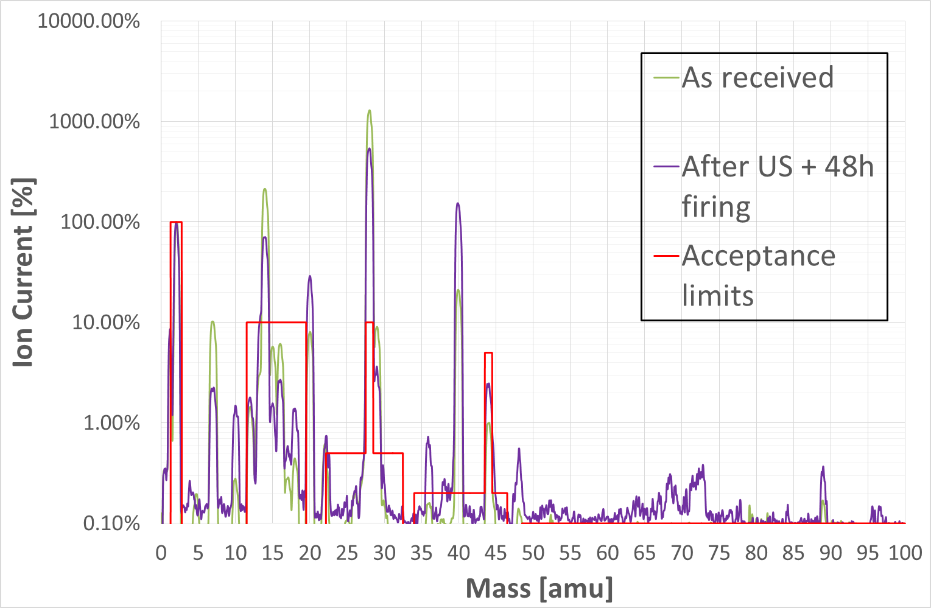
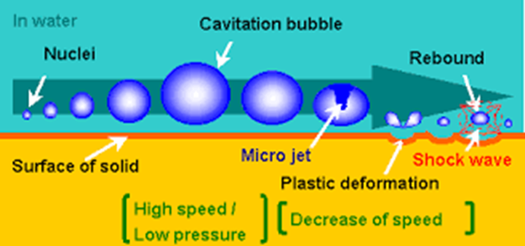
US cleaning-first supplier
US cleaning + 48 h firing:
Q_{before}/Q_{after}= 16
N₂ decreased, Ar constant (normalized graph)
→ result similar to just 48 h vacuum firing

Slide 22
US cleaning-last grade

Slide 23
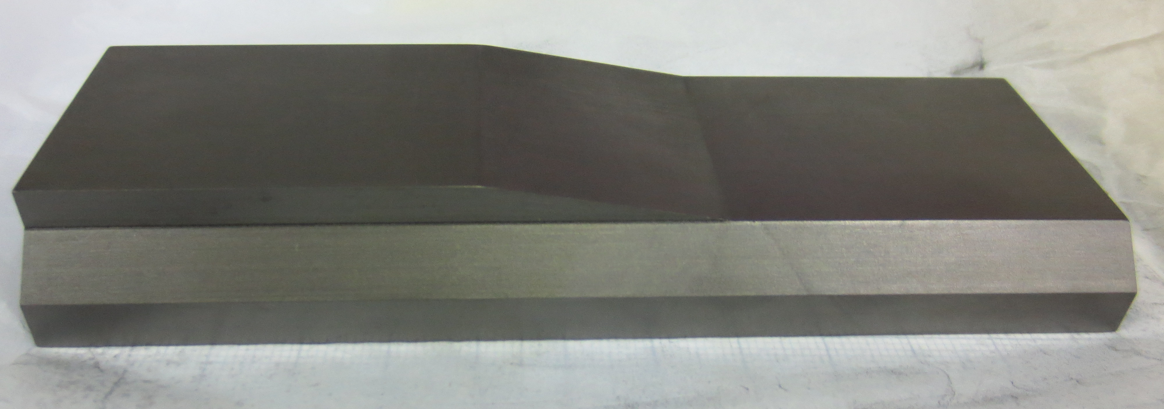
Outgassing and thermal treatment
Grade | Thermal treatment | Total outgassing jaws [mbar*l/s] | Internal leak [mbar*l/s] | Gas analysis
Nd-7301Cb | VF 950°C 48h, Ar venting | 1·10⁻⁸ ☑ |  | ☒
Nd-7301Cb | VF 950°C 48h, Ne venting | 2.5·10⁻⁹ ☑ | 2.2·10⁻⁹ ☑ | ☑
Nw-8301Ed | None | 1.8·10⁻⁷ ☒ | 9.3·10⁻⁹ ☒ | ☒
Nw-8301Ed | VF 950°C 48h, air venting | 1.4·10⁻⁸ ☑ | 5.3·10⁻⁹ ☑ | ☑
Reduction~10
Reduction~1.8
Nd-7301Cb
Nw-8301Ed

Slide 24
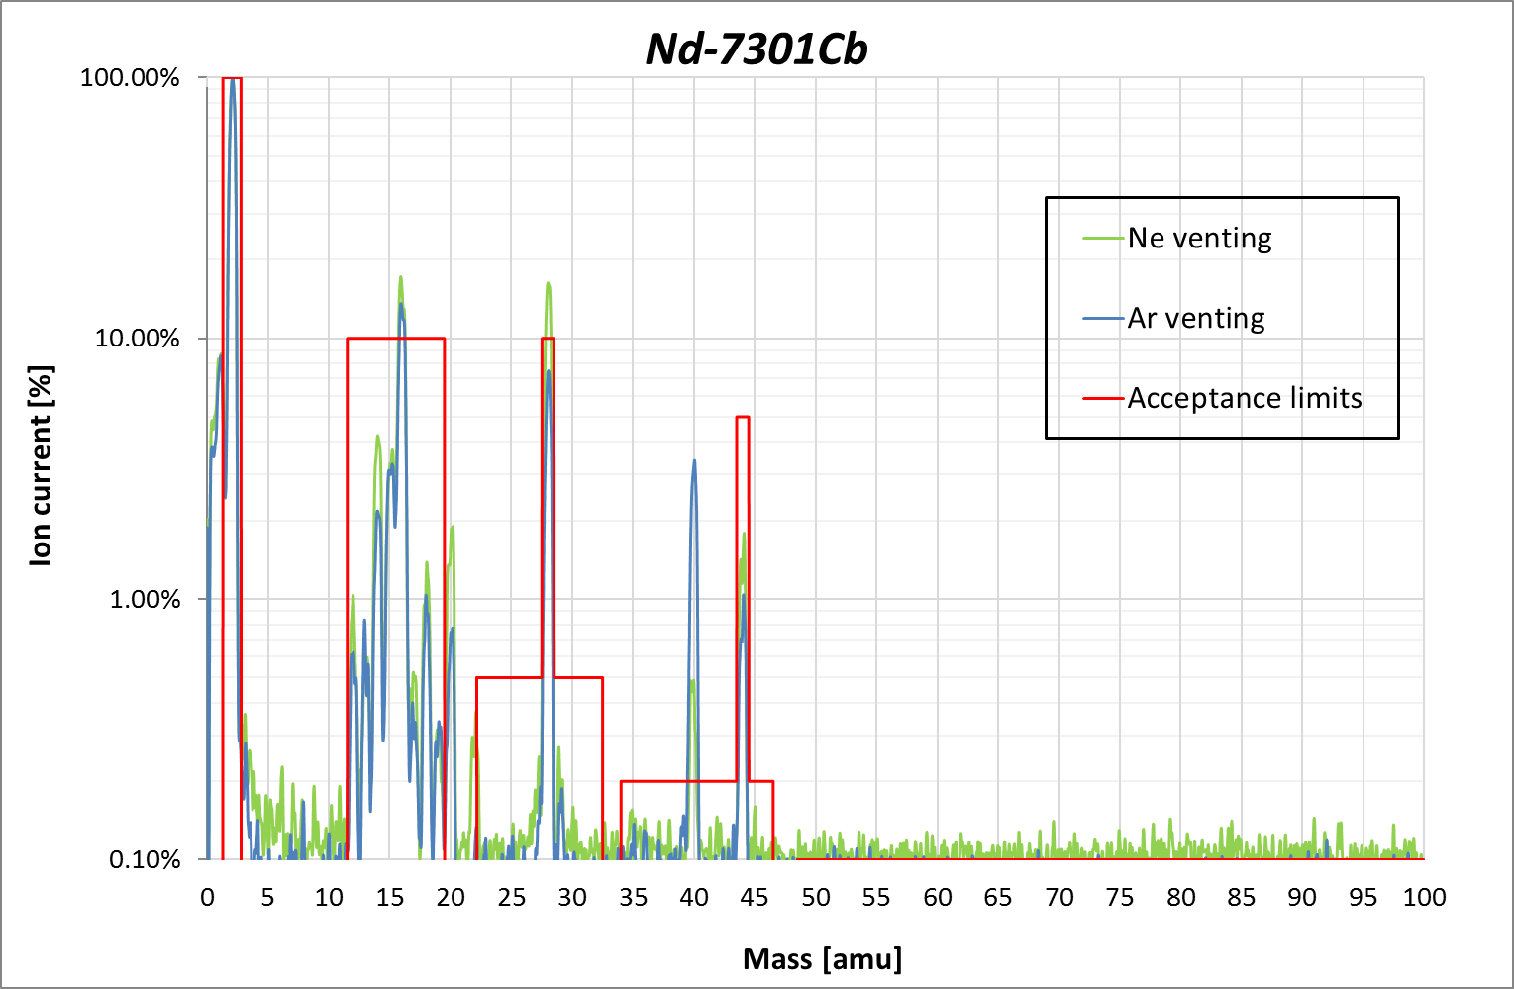
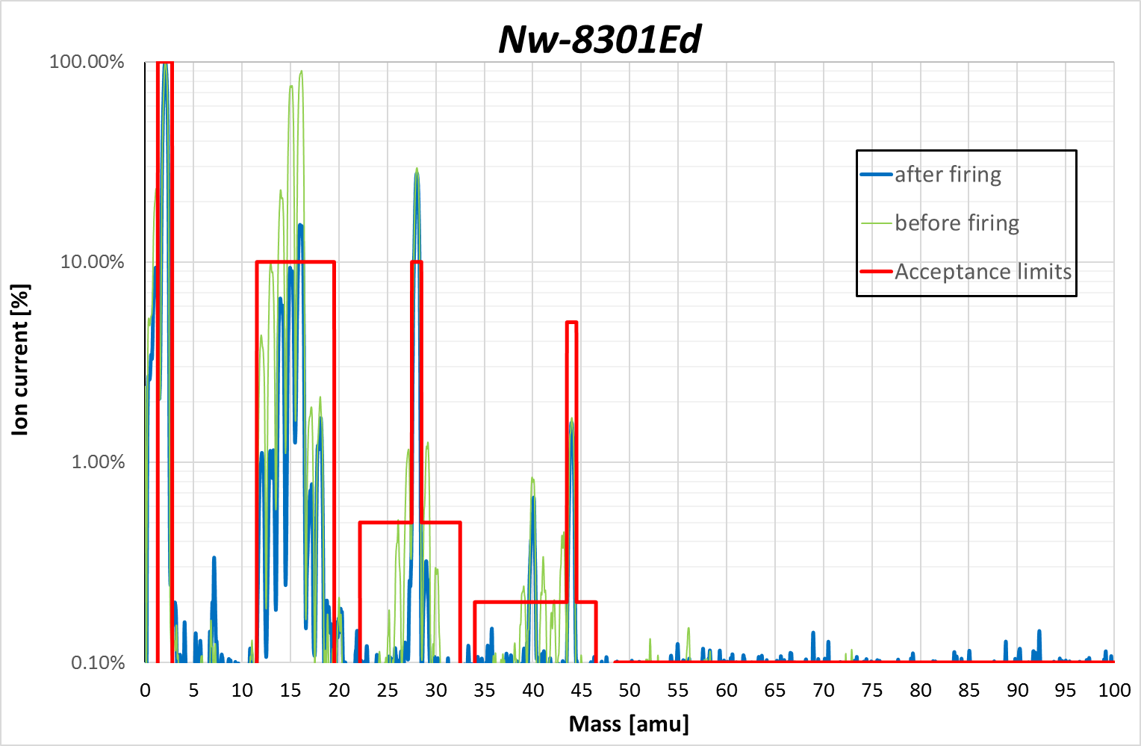
Gas venting after firing 48h
N₂
N₂
Ne
Ar
Ar
H₂ dominated
Adsorption of venting gas
H₂ dominated
CH₄ reduction
Low outgassing
H2 dominated spectra
Low internal leak
Compliant after 48h firing
+
+

Slide 25
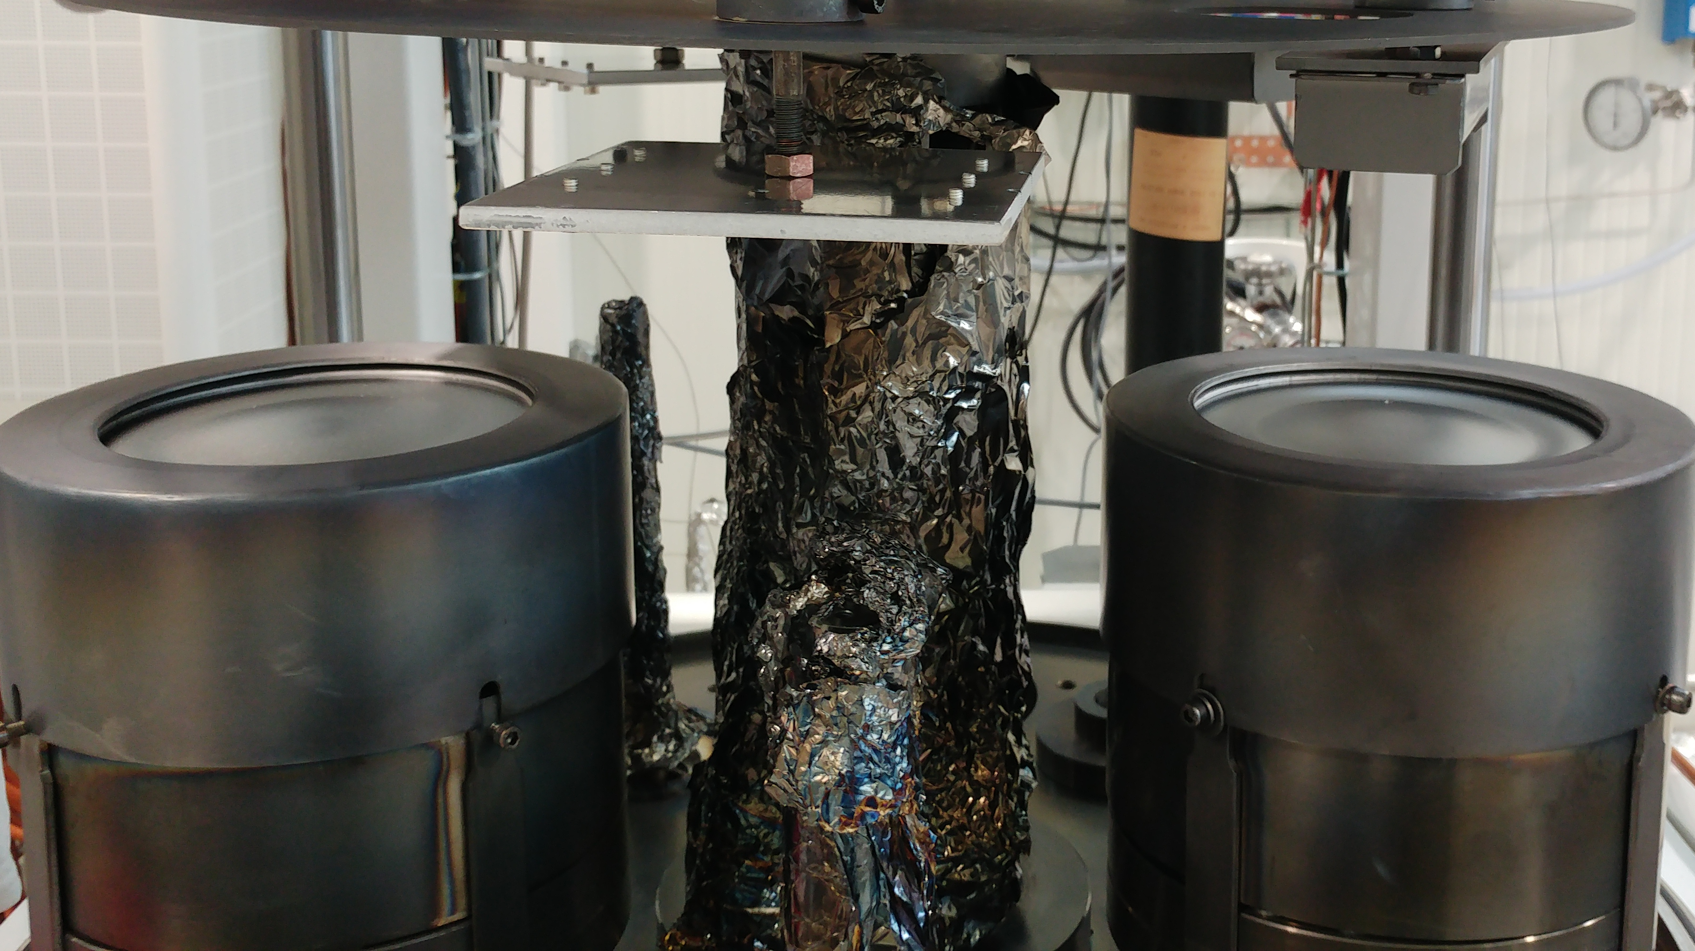
Mo coating machine

Slide 26
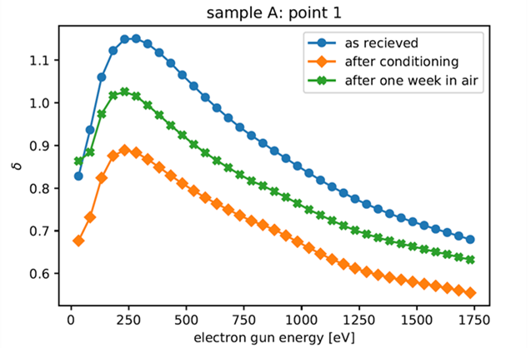
Secondary Electron Yield
Graphite ☑
SEY max collimator~ 1.4
MoGr as received ☑
MoGr air exposure ☑

