Slide 1
Results from recent investigations and characterizations at GSI
Philipp Bolz
Roberto Colina-Ruiz, Fabian Jäger, Daniel Schmitt, Pascal Simon, Marilena Tomut

Slide 2
Table of content
Motivation
Materials
Structural characterization
  Raman spectroscopy
  Infrared thermography
  Functional characterization
  Indentation
  3-point bending test
  Laser flash analysis
  Conclusion and outlook

Slide 3
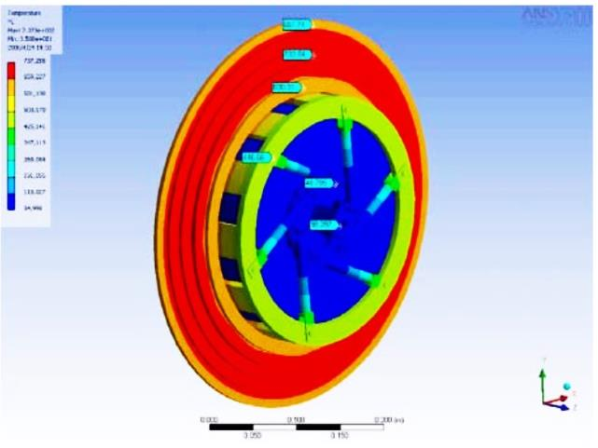
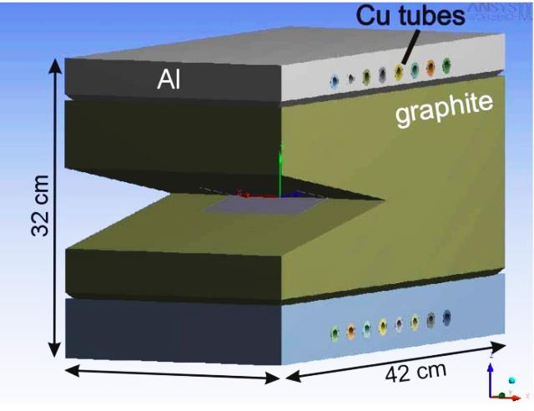
Motivation
Properties of graphite:
Low density
High thermal conductivity
Low coefficient of thermal expansion
High service temperature
Graphite materials are used for:
Target wheel and beam catchers in Super Fragment Separator
Beam dumps in experimental caves
Collimators
Super-FRS working group, 2008

Slide 4
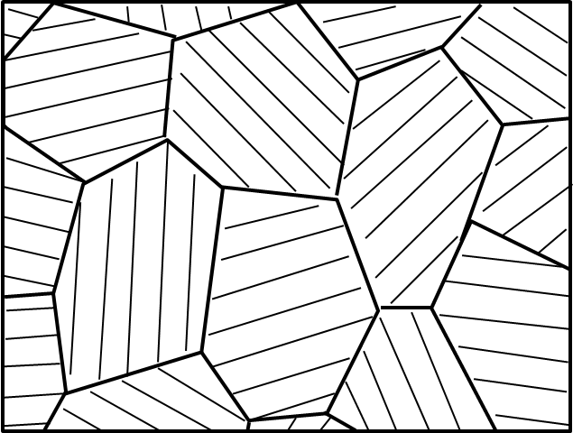
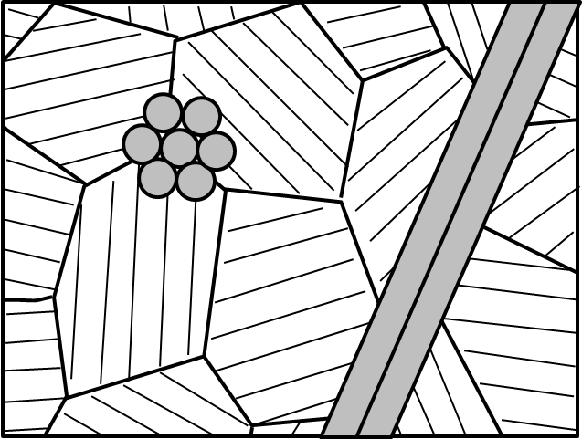
Investigated materials
Polycrystalline graphite (PG)
Carbon fibre reinforced carbon (CFC)
2 dimensional fibre orientation
Fibre plane parallel or perpendicular to surface
PG
CFC
Material | Particle size [µm]
R6300 | 20
R6500 | 10
R6550 | 10
R6650 | 7
POCO ZEE | 1
In plane ‖
Transversal ⊥

Slide 5
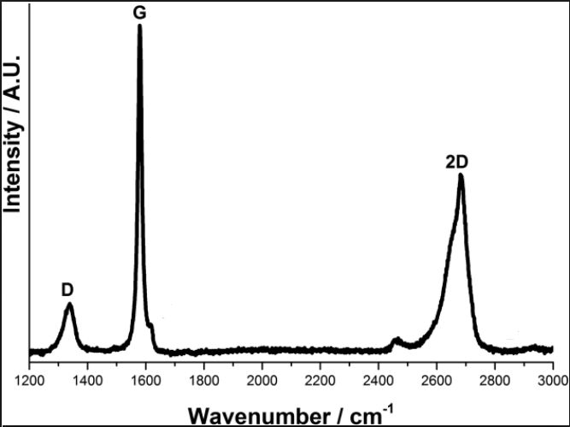
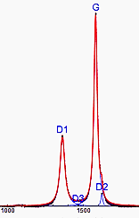

Structural characterization
Raman spectroscopy
Main peaks for graphite:
  D-peak ≈ 1380 cm⁻¹
  G-peak ≈ 1580 cm⁻¹
  2nd D-peak ≈ 2700 cm⁻¹
Ratio of I_{D}/I_{G} allows determination of defect concentration and lattice parameters
Bands included for Raman spectra deconvolution:
D1-D3: Lorentzians
D2: Gaussian
G: Lorentzian
G‘2D-G‘3DA-G‘3DB: Lorentzians
P7: Splitlorentzian
P9: Lorentzian
N. Larouche, B.L. Stansfield, Carbon N. Y. 48 pp. 620–629, 2009

Slide 6
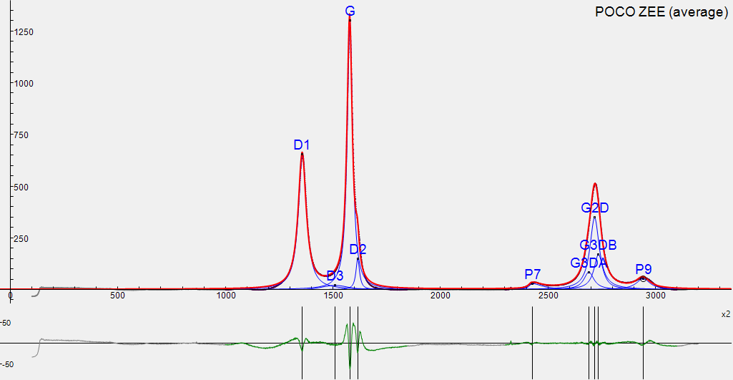
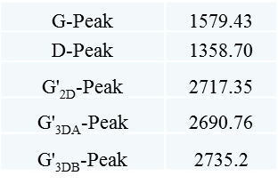
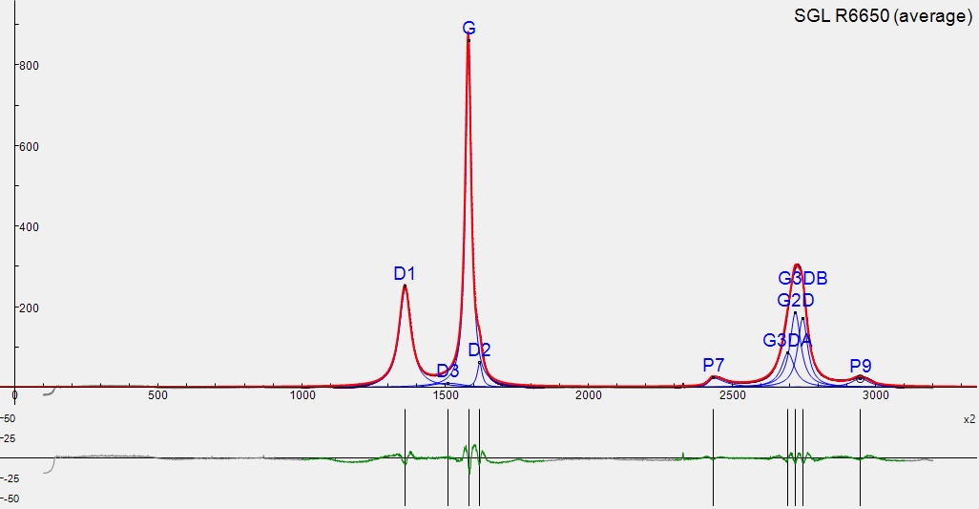
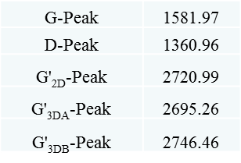
Raman results of isotropic polycrystalline graphite grades
POCO ZEE
Particle size: 1 µm
Porosity: 20%
Pore size: 0.3 µm
Density: 1.77 g/cm³
I_{D}/I_{G} = 0.455
I_{D}/I_{G} = 0.288
SGL R6650
Particle size: 7 µm
Porosity: 10%
Pore size: 1.1 µm
Density: 1.84 g/cm³

Slide 7
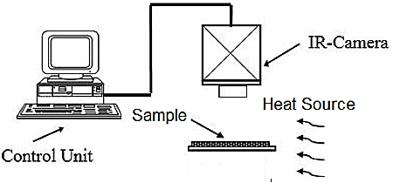
Infrared thermography
Infrared thermography acquires and processes thermal information from non-contact measurement devices
Experimental setup
Infrared camera
Control unit
sample
heat
heat source

Slide 8
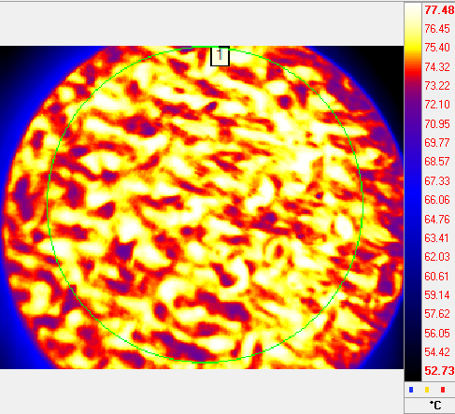
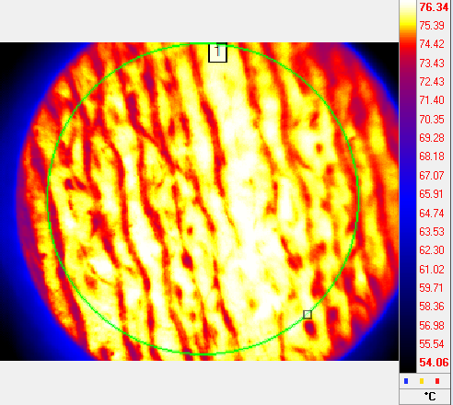
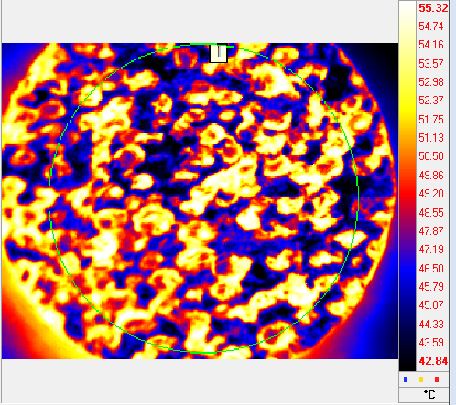
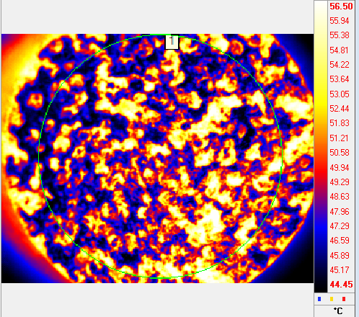
Infrared thermography
2D-CFC
Fibre plane parallel to surface
Fibre plane normal to surface
SGL Mechanical
Parallel
Normal
Graphitic Foam
POCO FOAM

Slide 9
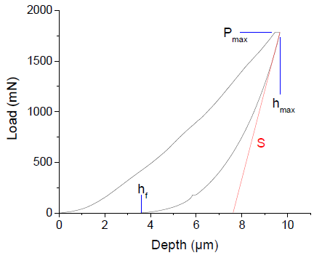

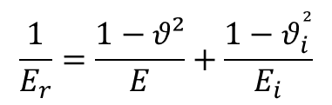
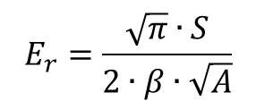
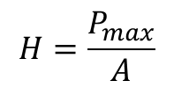
Functional characterization
Microindentation
Area function A:
$$A=24.5{ h}_{f}^{²}$$
Hardness H:
$$H=\frac{P_{max}}{A}$$
Reduced modulus E_{r}:
$$E_{r}=\frac{\sqrt{π}∙S}{2∙β∙\sqrt{A}}$$
Young’s modulus E:
$$\frac{1}{E_{r}}=\frac{1−θ²}{E}+\frac{1−θ_{i}^{²}}{E_{i}}$$
β = Geometrical correction factor
ϑ = Poisson’s ratio
Oliver and Pharr, J. Mater. Res., vol. 7, no. 6, pp. 1564-1583, 1992

Slide 10
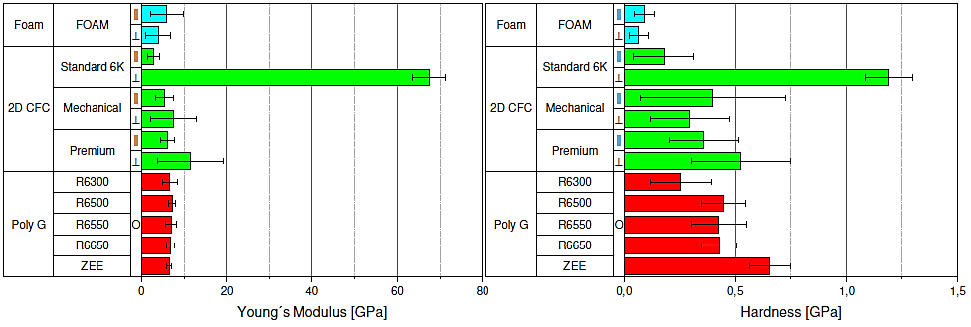
Microindentation of investigated materials
Young’s modulus
Hardness
Material | Particle size [µm]
R6300 | 20
R6500 | 10
R6550 | 10
R6650 | 7
POCO ZEE | 1
In plane ‖
Transversal ⊥

Slide 11


Dynamic indentation
Indenter is accelerated with constant force towards the sample
Resulting bouncing of the indenter on the surface of the sample is measured
Dynamic hardness DH:
Damping constant k:
$$DH∝\frac{v_{out}}{v_{in}}$$
$$d=Ae^{−kt}+d_{0}$$

Slide 12
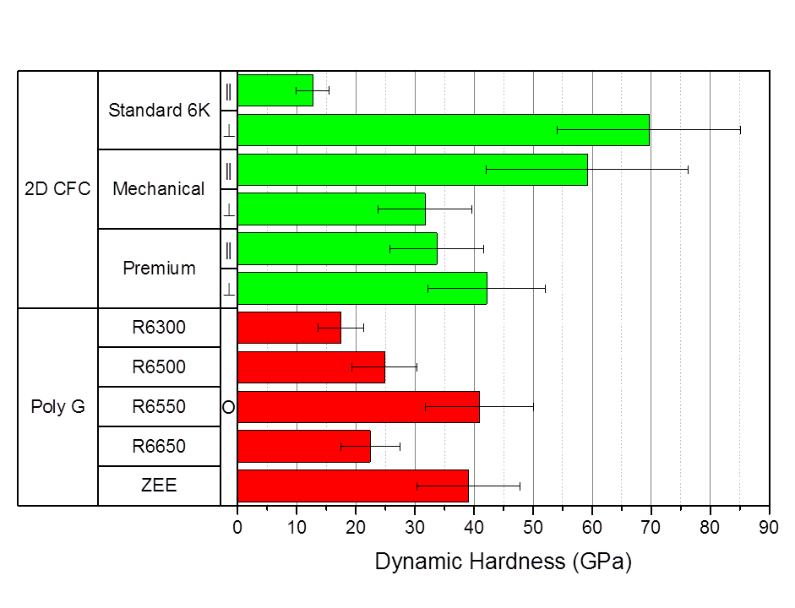
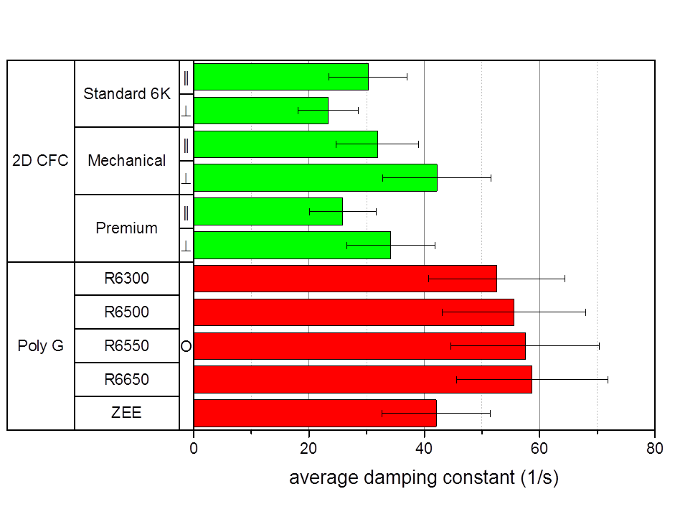
Dynamic indentation results of polycrystalline graphite and carbon fibre reinforced carbon grades
Dynamic hardness
Damping constant
In plane ‖
Transversal ⊥

Slide 13
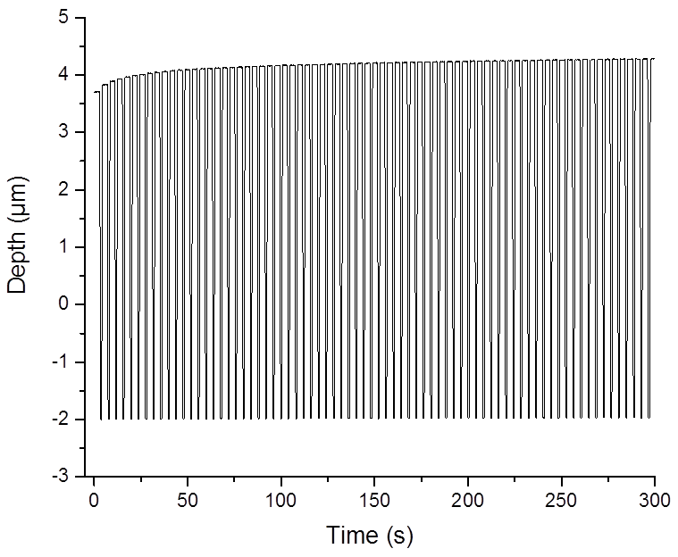
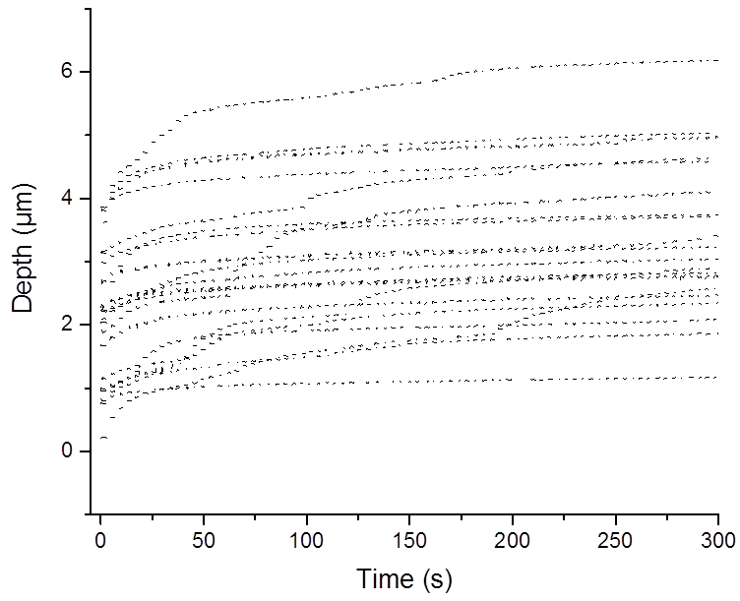
Multiple Impulse indentation
Indenter is accelerated with constant force towards the sample
Indenter is moved back to the initial position and accelerated again
Allows measurement of fatigue
Polycrystalline graphite:
SGL R6550
Carbon fibre reinforced carbon:
SGL Premium in plane

Slide 14
Multiple impulse results of polycrystalline graphite grades
Material | Particle size [µm]
R6300 | 20
R6500 | 10
R6550 | 10
R6650 | 7
POCO ZEE | 1

Slide 15
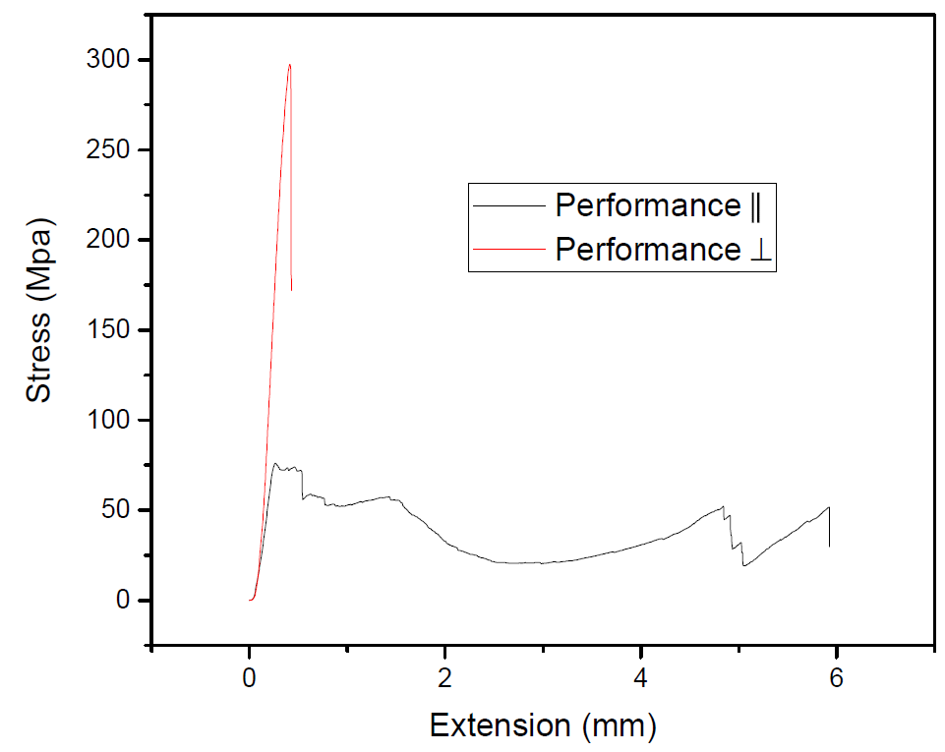
3-point bending test
A = 4x4 mm²
Stress (MPa)
l = 20 mm
In plane ‖
Transversal ⊥

Slide 16
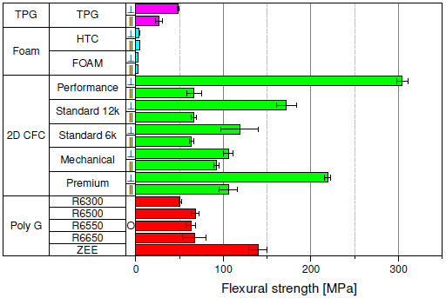
Flexural strength
In plane ‖
Transversal ⊥

Slide 17
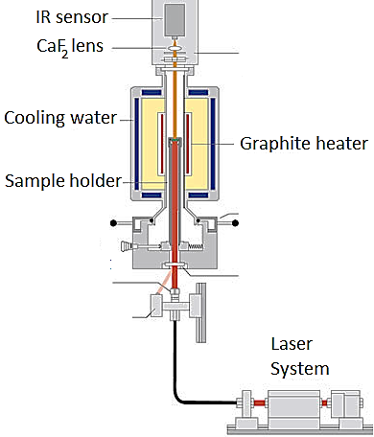
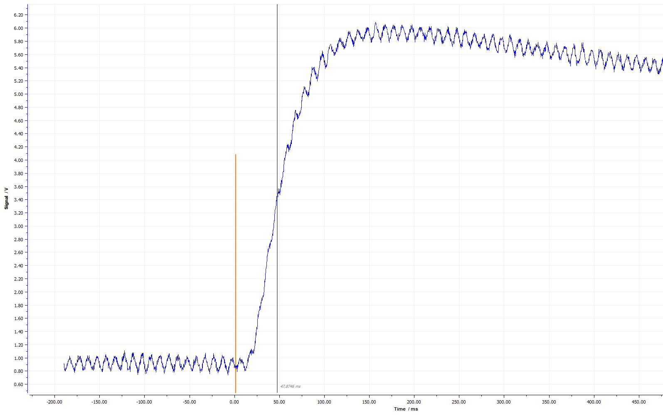
Laser flash analysis
6
5
4
Voltage (V)
3
2
1
-200
0
200
400
Time (ms)
https://www.netzsch-thermal-analysis.com/de/produkte-loesungen/waerme-und-temperatur-leitfaehigkeitsbestimmung/lfa-427/ (23.11.2017)

Slide 18
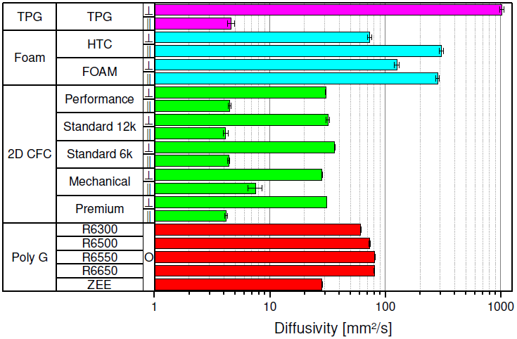
Laser flash analysis results
In plane ‖
Transversal ⊥
Thermal diffusivity [mm²/s]

Slide 19
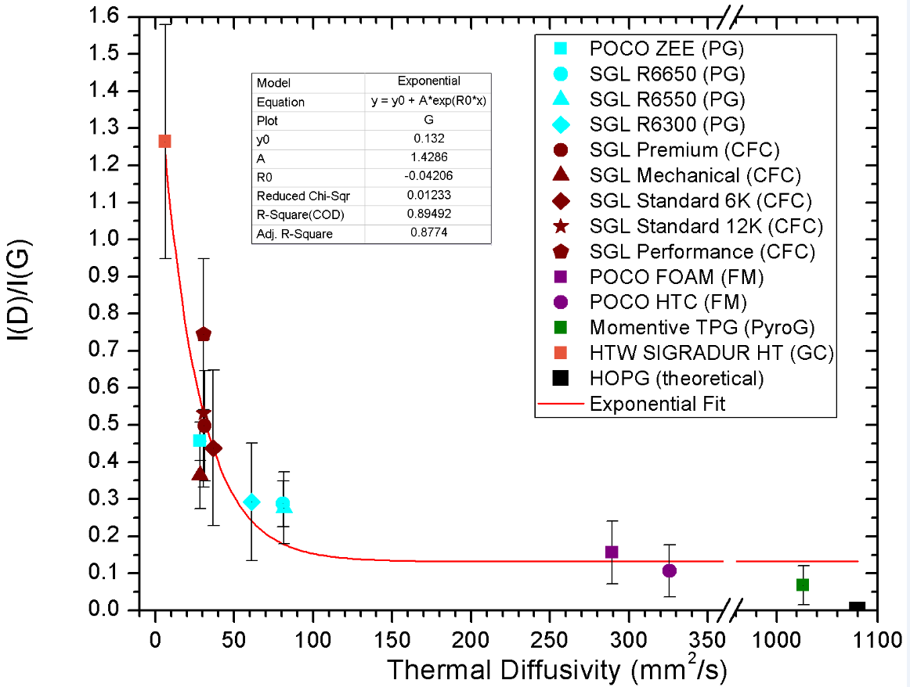
Empirical relation between I_{D}/I_{G} and thermal diffusivity
HOPG was used as reference (Ideal case has I_{D} zero)
The relation shows an exponential behavior
Lower I_{D} /I_{G} implies larger thermal diffusivity

Slide 20
Conclusion and outlook
Properties of polycrystalline graphite depend on the grain size
Carbon fibre reinforced carbon and graphite foams properties depend on orientation with a strong and a weak direction
The thermal diffusivity is decaying exponentially with increasing defect concentration
Results allow calculation of figures of merit and improved simulations to predict the behaviour during irradiation
Experiments at HiRadMat and at GSI will allow evaluation of beam induced effects and property changes of the different irradiated graphitic materials

Slide 21
Acknowledgment
Thank you for your attention
Thanks to Roberto Colina-Ruiz, Fabian Jäger, Daniel Schmitt, Pascal Simon and Marilena Tomut for providing data
This project has received funding from the European Union’s Horizon 2020 Research and Innovation programme under Grant Agreement No 730871

