Slide 1
Requirements for radiation damage simulations regarding FAIR targets, beam dumps / catchers and previous experiments at GSI
PowerMat
M. Tomut
With input from P. Katrik, H. Weick et al.

Slide 2
Radiation damage in beam dumps and beam catchers
Radiation damage in the carbon part of the beam dump is caused by three mechanisms:
Elastic collisions of the primary beam, fragments or neutrons with the carbon atoms
For high linear energy deposition the heating by the electronic energy loss can cause microscopic material transformation and track formation. This happens in graphite above a threshold of dE/dx = 18 keV/nm and will therefore occur only in the Bragg peak close to the end of the range
• Spallation of the nuclides and creation of other chemical elements

Slide 3
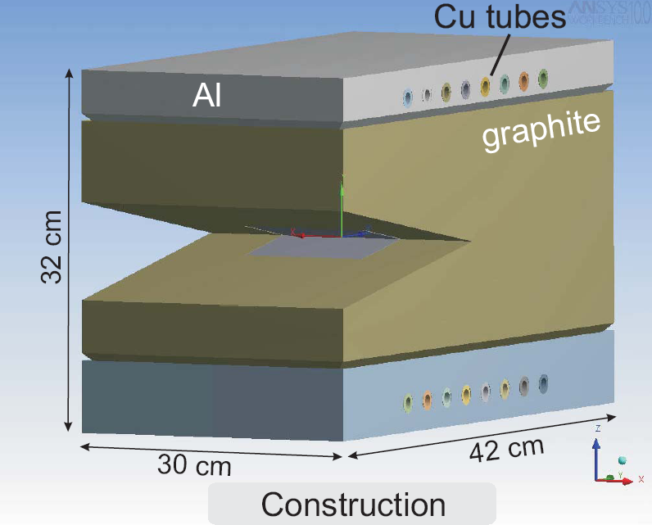
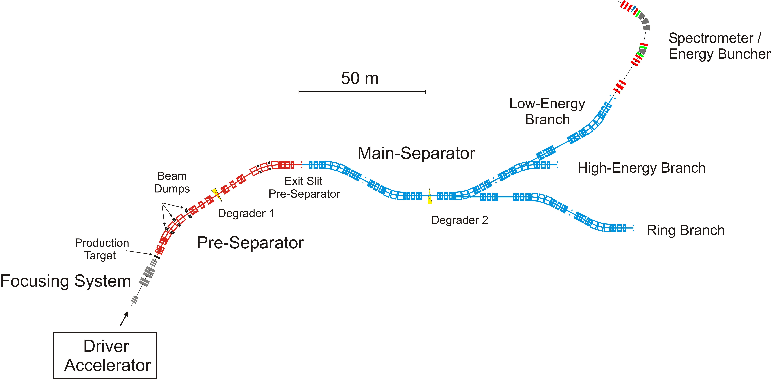
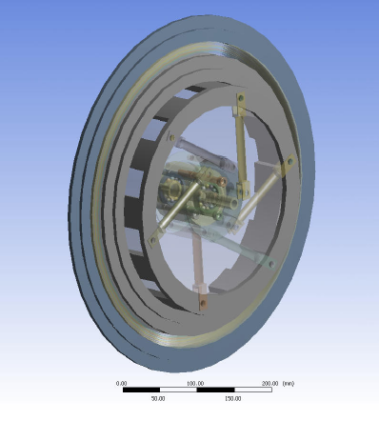
Super-FRS Target and Beam Catcher
Beam Catchers (graphite + iron)
Production
Target (graphite)
Driver beams:
¹²_{C to} ²³⁸_{U up to}
1.5 GeV/u

Slide 4
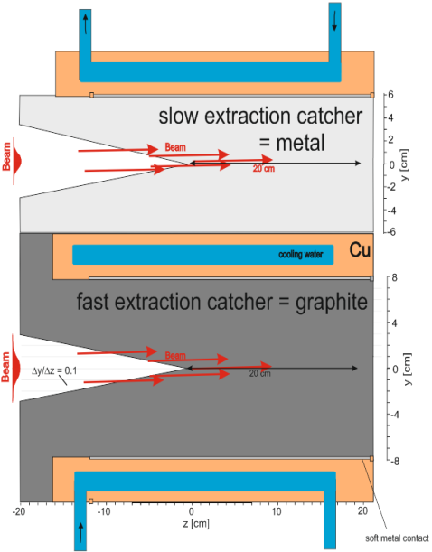
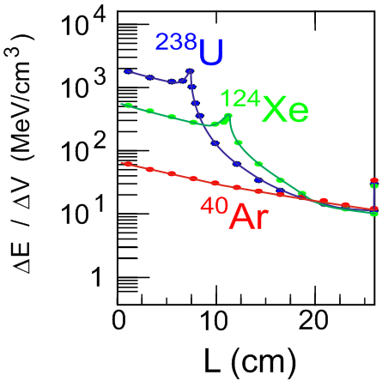
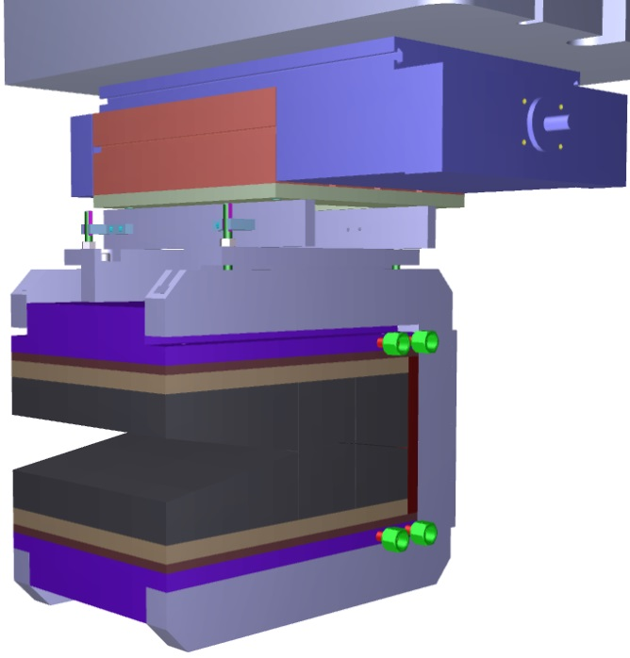
Super-FRS Beam Catcher
linear drive
Be/Cu
copper
graphite
graphite
460 mm
.
Beam energy: 750 MeV/u.
Courtesy H. Weick
Thermal simulation shows cooling problem
with radiation damaged graphite,
λ = 70-40 W/(m K) --> 15 W/(m K),

Slide 5
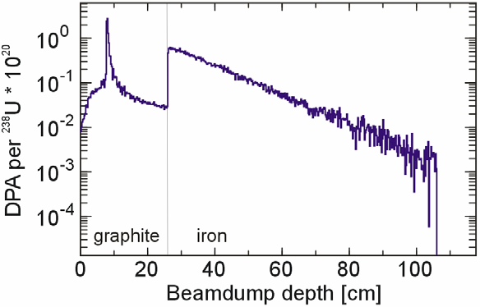
PHITS simulation of DPAs from elastic collision, all values stay below 1 DPA for the whole lifetime of the device even with full uranium beam intensity over 15 years with 77 days continuous operation in each year . The peak in carbon represents the end of the range near the maximum of nuclear stopping power.
Courtesy H. Weick

Slide 6
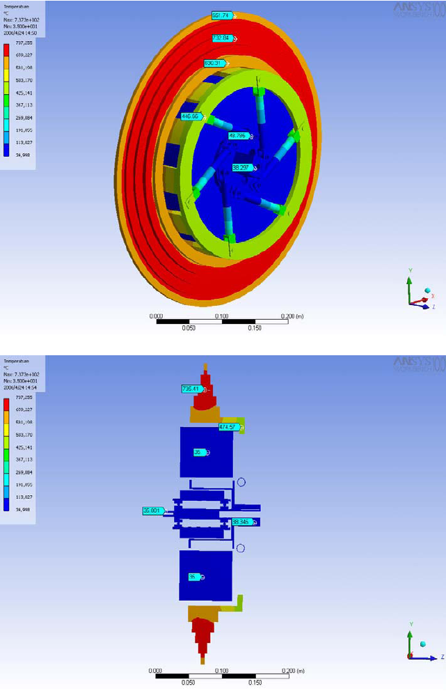
DPA calculation for the Super-FRS graphite target
Graphite wheel cooled only by radiation
5 concentric graphite rings, 16 mm wide
thicknesses of 1, 2.5, 4, 6 and 8 g/cm²
beam parameters:
1. Slow extraction mode:
  extraction time ~1s; 10¹² ions/cycle
  beam energies: 1 GeV/u.
  beam spot: two-dimensional Gaussian with σ_{x} = 1 mm and σ_{y} = 2 mm
  ions fluence per year: 10¹⁷ ions/cm² ⁽assuming an annual accumulation of 10⁷ pulses )
  The temperature distribution for the worst case (10¹² ions/spill, 1 GeV/u ²³⁸U on the 4 g/cm2 ring) The target layer is heated to a maximum temperature of 750 ºC
2. Fast extraction mode:
  10¹² ions extracted within 50 ns

Slide 7
DPA calculation for the Super-FRS graphite target
max DPA/source~ 4x10⁻¹⁹
DPA/ year ~ 4 x 10⁻³
H prod ~ 50 appm/year (diffuses out)
He prod ~ 5 appm/year
(high enthalpy of solution, can reach very high concentration in material - accumulates in bubbles)

Slide 8
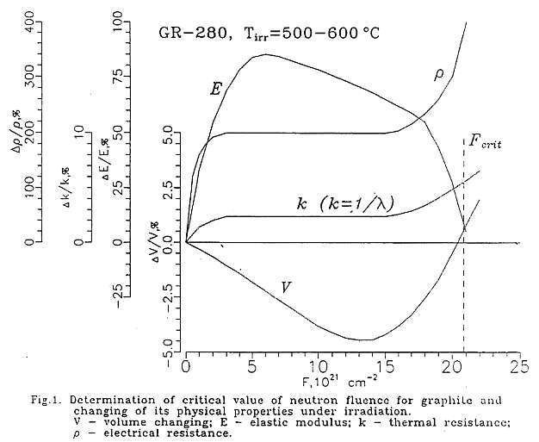
Radiation Damage Estimate with Neutrons
10
20
DPA
Radiation Damage and Life-time Evaluation of RBMK Graphite Stack, XA9642904,
P.A.Platonov, O.K.Chugunov, V.N.Manevsky, V.I.Karpukhin, Russian Research Center Kurchatov Institute

Slide 9
How long will the Super-FRS graphite target last: low extraction
10¹³ tracks/cm² is a critical density of ion tracks:
        high values of swelling and induced stresses which are relaxed through crack formation
Fluence/puls = 10¹² / A ring =1.11*10¹⁰ i/ cm²
Fluence /year = 10⁷pulses/year x fluence/puls ~ 10¹⁷ i/cm²
M.Tomut, GSI

Slide 10
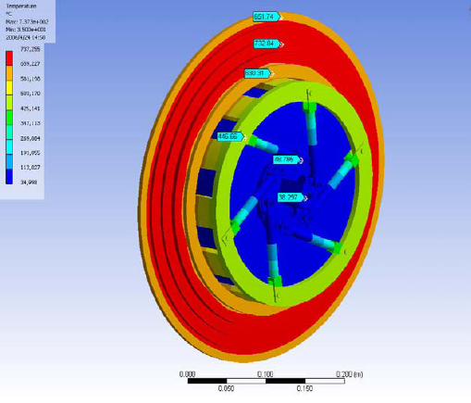
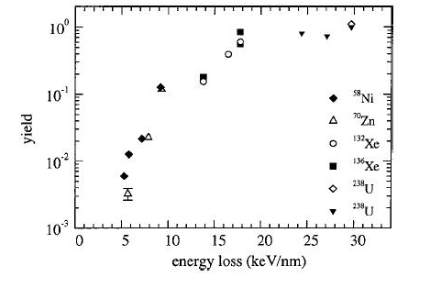
Heavy ion track yield at Super-FRS energies of primary beam and target temperatures
Track yield is highly reduced at high ion energy and target temperature (Liu et al, PRB 64 (2001) 184115)
10⁻³ efficiency of track formation at Super-FRS energies
10⁻³ efficiency of track formation at temperatures above 800 K
(J.Liu et al./ NIM B 245 (2006) 126-129)
estimation of the track density/ year in the Super-FRS target:
10 ¹¹ tracks/cm²
750 ºC
10¹² ²³⁸U/s
4 g/cm² C target
12 kW power
Gaussian vertical profile,
σ_{y} = 2 mm
5 steps (1 – 8 g/cm²)
B. Achenbach,
ANSYS workbench
M.Tomut, GSI

Slide 12
He implantation experiments

Slide 13
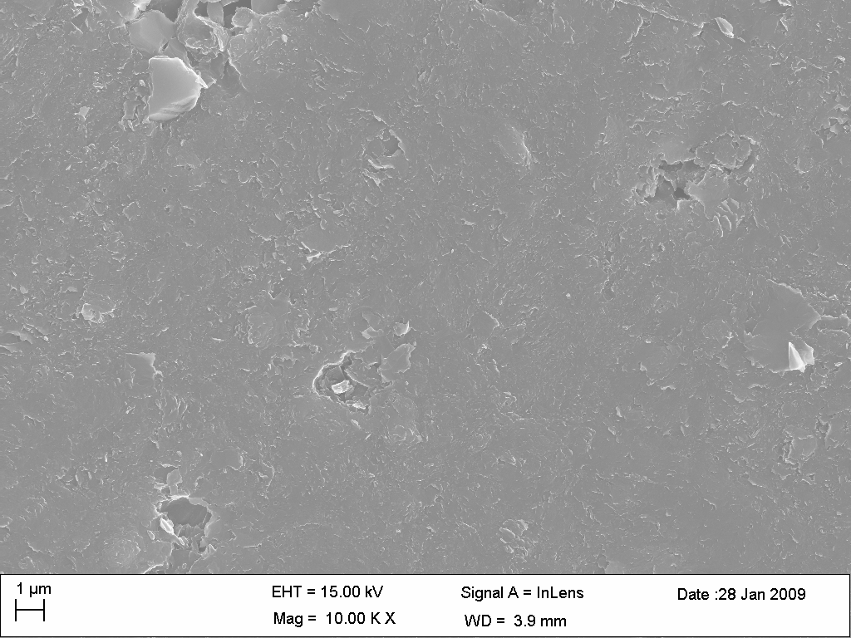
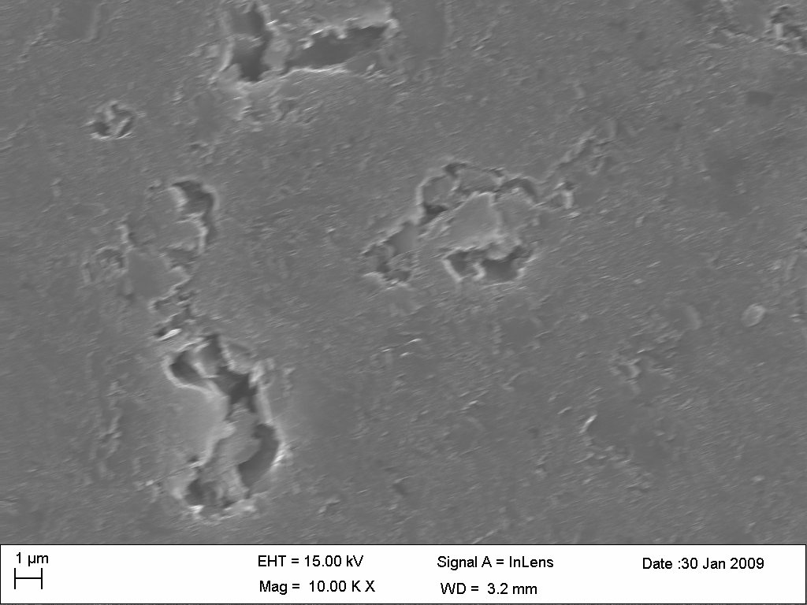
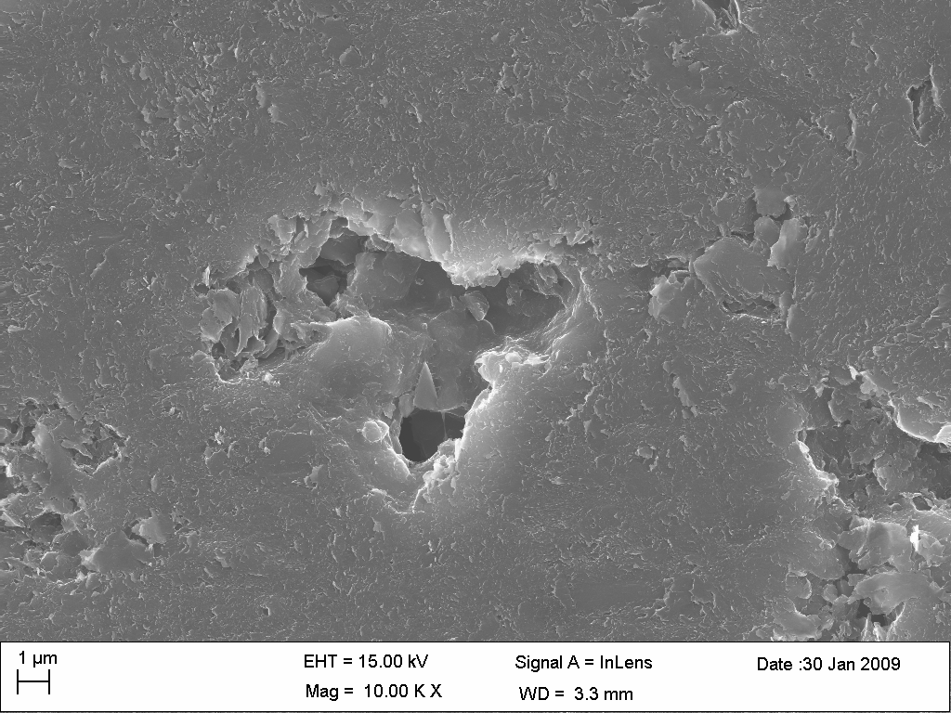
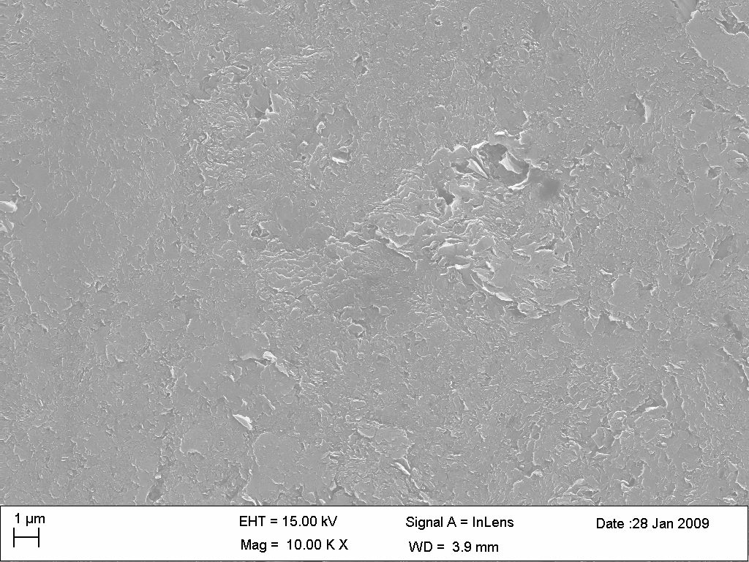
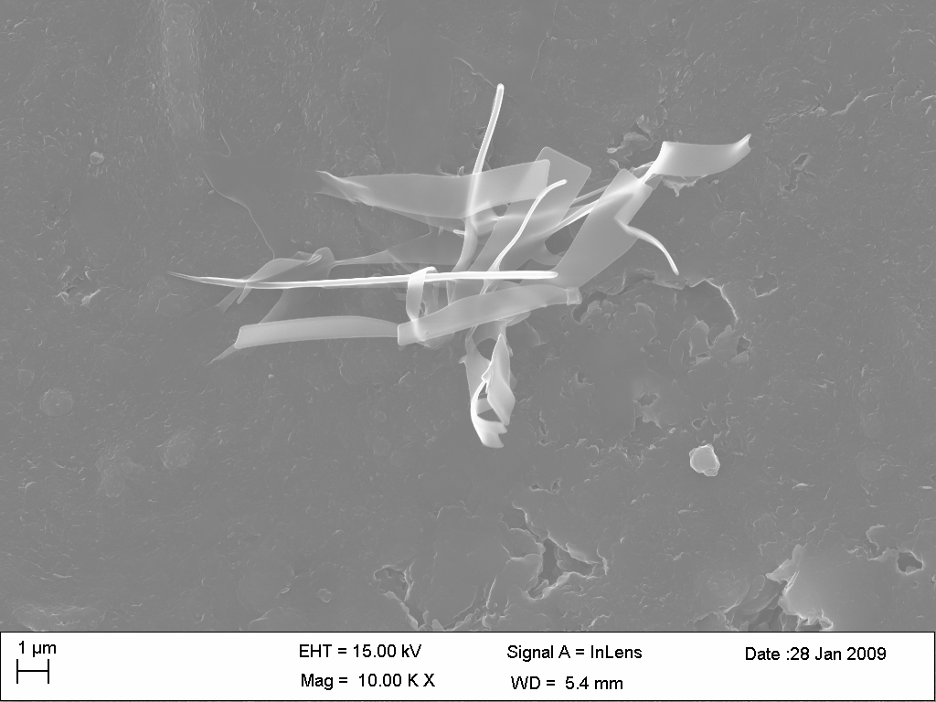
Morphology evolution with
He⁺ fluence
Virgin
1∙10¹⁵
1 ∙ 10¹⁶
5 ∙ 10¹⁶
1 ∙ 10¹⁷

Slide 14
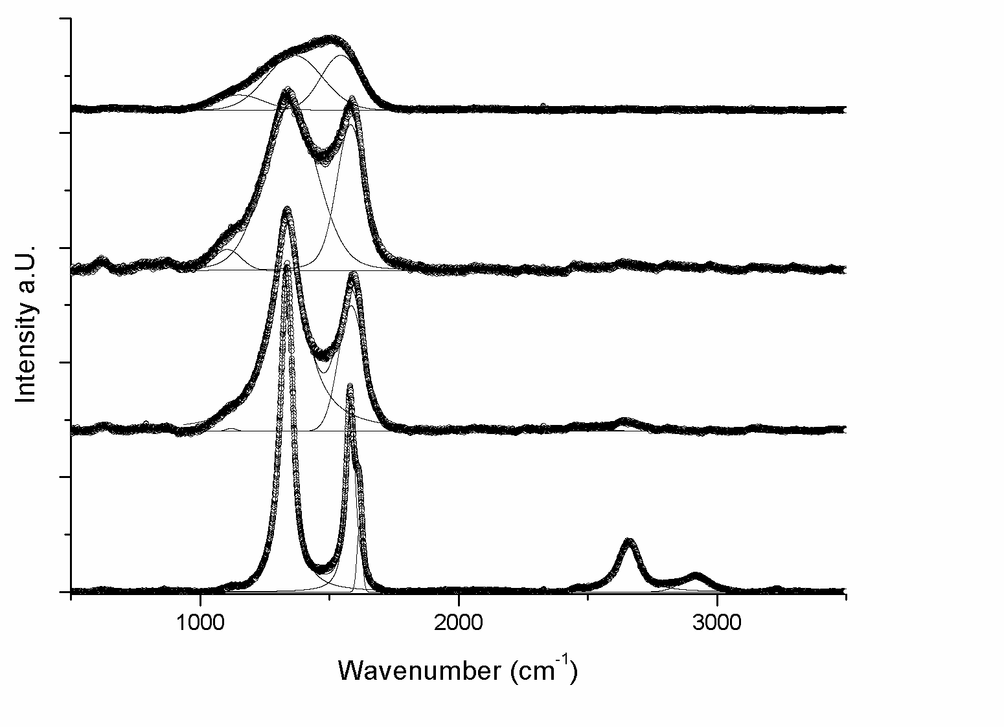
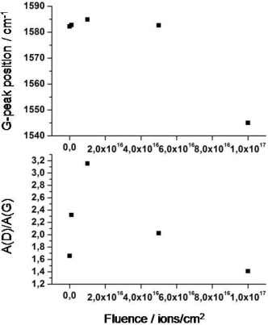
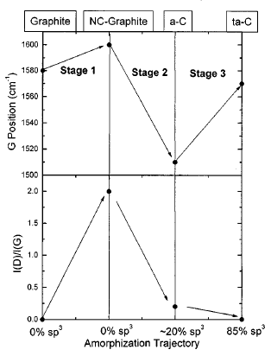
Raman spectra of graphite irradiated with 100keV He⁺-ions
Fluence: 1∙10¹⁷
Fluence: 5∙10¹⁶
Fluence: 1∙10¹⁶
Fluence: 1∙10¹⁵
G-peak shifts first to higher then to lower wavenumbers
Increase of D-peak to G-peak ratio followed by decrease of this ratio

Slide 15
Experiments at GSI
for dpa calculations
Sample
¹⁹⁷Au, 11.1 MeV/u
Ion: C, Ca, Sm, Au and U
Energy : 4.8 MeV/u
Material:
graphite 1.8 g/cm³
MoGr 2.6 g/cm³
dpa/ primary
as a function of depth
Damage evolution with depth

