Slide 1



Modelization of
Radiation-Induced Damage in FLUKA and
Material damage estimates for CERN injectors and future facilities
Jose A. Briz
    EN-STI-FDA, CERN
    V. Vlachoudis and F. Cerutti EN-STI-FDA (CERN)
1st Workshop of ARIES WP17 PowerMat – 27-28/11/2017

Slide 2
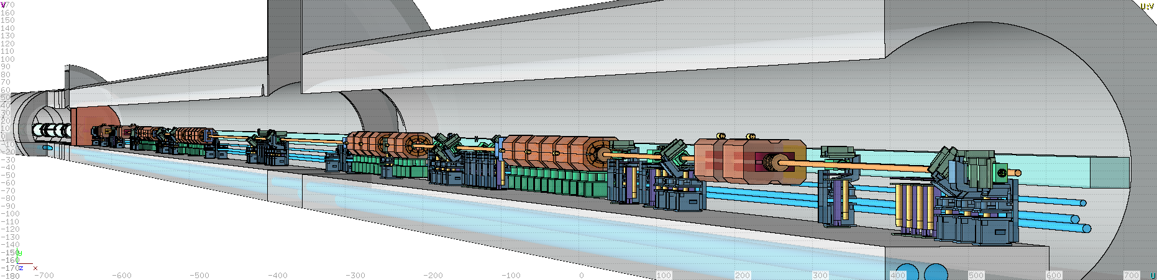
FLUKA
FLUKA is a Monte Carlo code for calculations of particle transport and interactions with matter.
Wide range of applications:
      Proton and electron accelerator shielding, target design, calorimetry, activation, dosimetry, detector design, Accelerator Driven Systems, cosmic rays, neutrino physics, Radiotherapy, etc.
Extensively used at CERN for:
  Beam-machine interactions
  Radio-Protection calculations
  Facility design of future projects
FLUKA geometry of the LHC warm section of IR7
Courtesy: E. Skordis

Slide 3
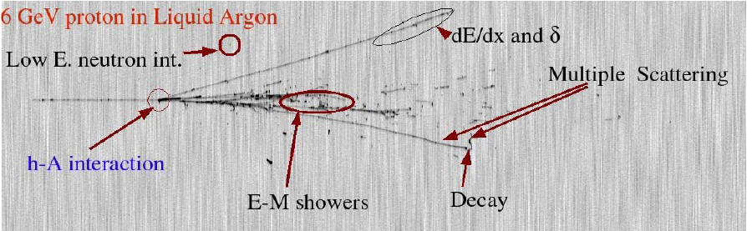
Interaction and Transport Monte Carlo Code
Hadron-nucleus interactions
Nucleus-Nucleus interactions
Electron interactions
Photon interactions
Muon interactions (inc. photonuclear)
Neutrino interactions
Decay
Low energy neutrons
Ionization
Multiple scattering
Combinatorial geometry
Voxel geometry
Magnetic field
Analogue or biased
On-line buildup and evolution of induced radioactivity and dose
User-friendly GUI thanks to Flair
Info: http://www.fluka.org

Slide 4
Different kinds of damage
from Radiation-Matter interaction
Precious materials (healthy/tragic damage)
energy (dose) deposition, radioisotope production and decay & positron annihilation and photon pair detection
Oxidation by generation of chemically active radicals (e.g. PVC
de-hydrochlorination by X and g-rays, radiolysis,…)
Accidents energy (power) deposition
Degradation energy (dose) deposition, particle fluence, DPA
Gas production residual nuclei production
Electronics high energy hadron fluence, neutron fluence, energy (dose) deposition
Activation residual activity and dose rate
F.Cerutti

Slide 5
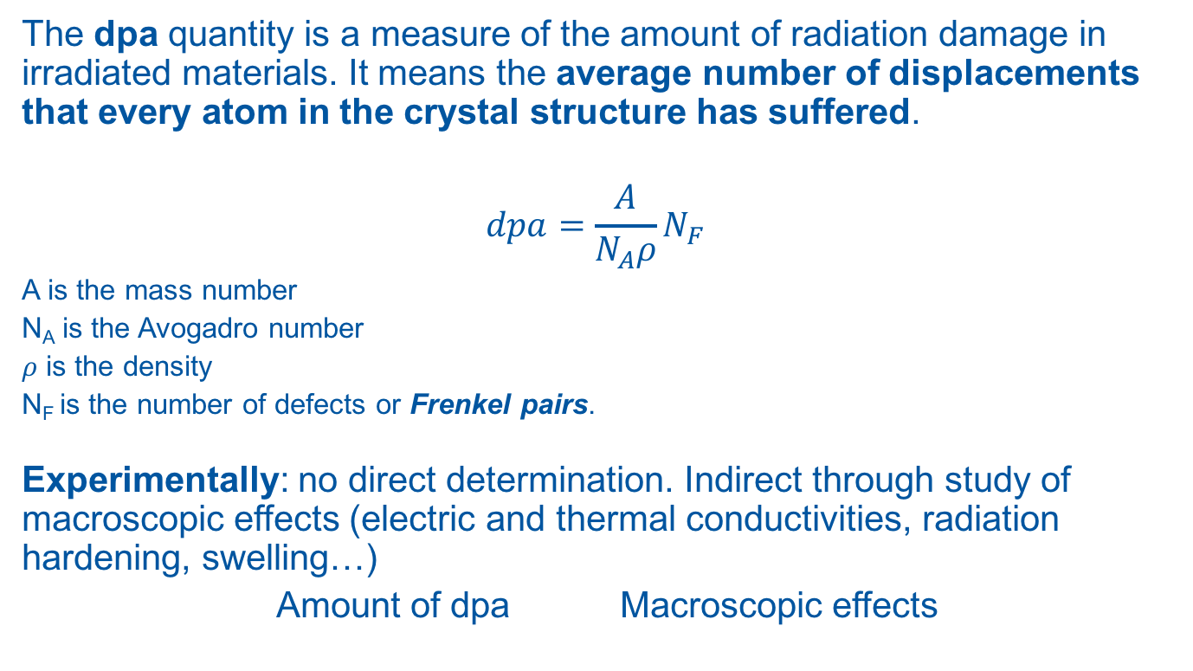
DPA as Radiation Damage Estimator
The dpa quantity is a measure of the amount of radiation damage in irradiated materials. It means the average number of displacements that every atom in the crystal structure has suffered.
$$dpa=\frac{A}{N_{A}ρ}N_{F}$$
A is the mass number
N_{A} is the Avogadro number
𝜌 is the density
N_{F} is the number of defects or Frenkel pairs.
Experimentally: no direct determination. Indirect through study of macroscopic effects (electric and thermal conductivities, radiation hardening, swelling…)
Amount of dpa Macroscopic effects

Slide 6
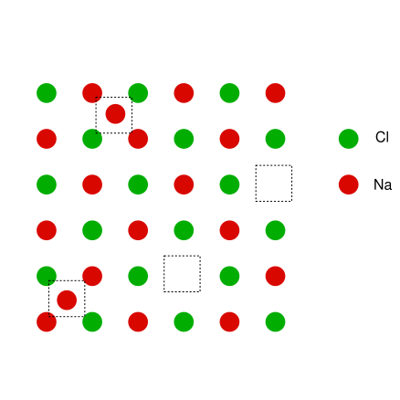
Frenkel pairs
Frenkel pair N_{F} (defect or disorder), is a compound crystallographic defect formed when an atom or ion leaves its place in the lattice (leaving a vacancy), and lodges nearby in the crystal (becoming an interstitial)
N_{NRT} Defects by Norgert, Robinson and Torrens
κ=0.8 is the displacement efficiency
T kinetic energy of the primary knock-on atom (PKA)
ξ(T) partition function (LSS theory)
ξ(T) T directly related to the NIEL(non ionizing energy loss)
E_{th} damage threshold energy
interstitial
vacancy

Slide 7
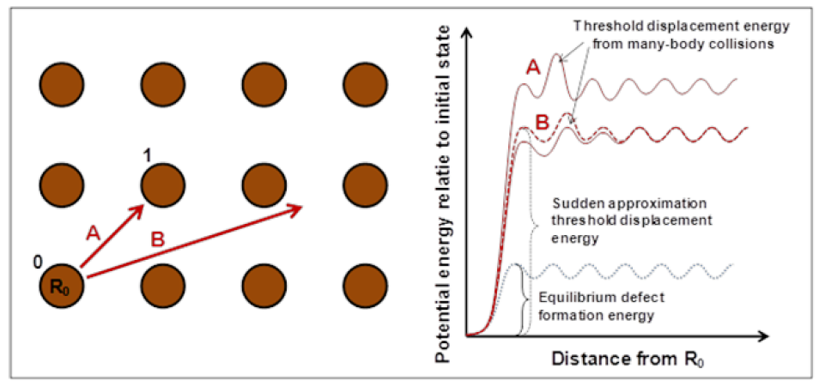
Damage Threshold
From: NEA/NSC/DOC(2015)9
Damage threshold depends on the direction of the recoil in the crystal lattice.
Also depends on the compound combination:
FLUKA use the “average” threshold over all crystallographic directions (user defined)
Sensitivity studies using different E_{th} values can provide upper and lower limits on dpa
e.g. NaCl: E_{th}(Na-Na), E_{th}(Na-Cl), E_{th}(Cl-Na), E_{th}(Cl-Cl)
Typical values used
in NJOY99 code

Slide 8
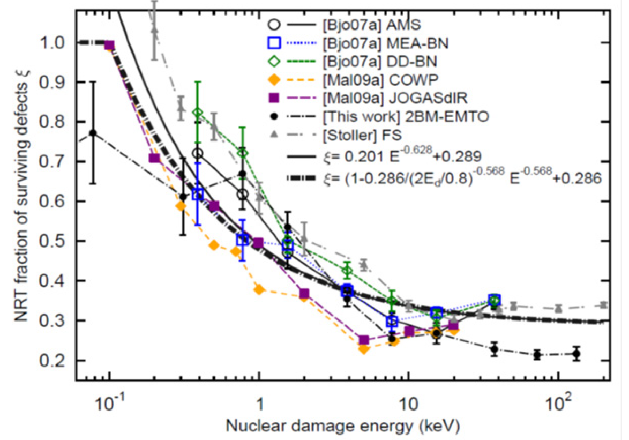
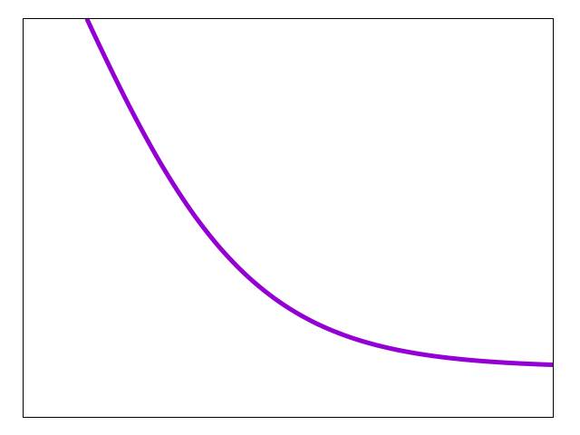
Displacement efficiency
κ Stoller vs Nordlund
Recombination
from overlap of
collision cascades,
“athermal recombination-corrected” dpa:
Arc-dpa
Nordlund
FLUKA (Stoller Fit)
Stoller results
Comes from
Molecular Dynamics
simulations
Thermal recombination
of defects not considered
becomes relevant
for high temperatures
Overestimation of dpa’s
27-28/11/2017
1st Workshop of ARIES WP17 Power Mat - Politecnico de Torino
8

Slide 9
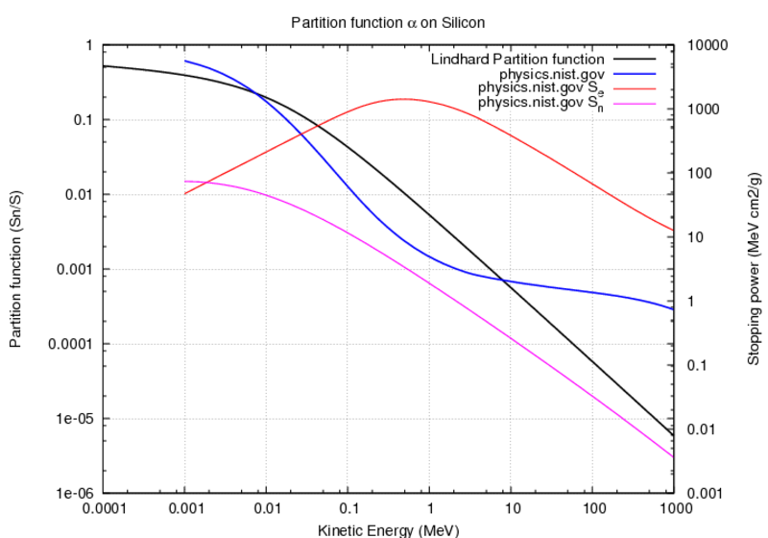

Lindhard partition function ξ
Fraction of
stopping power
S(T) going
into NIEL
(non-ionizing
energy loss)
$$ξ\left(T\right)=\frac{S_{n}(T)}{S(T)}=\frac{S_{n}(T)}{S_{n}\left(T\right)+S_{e}(T)}$$
BAD Strong discrepancies for high energies

Slide 10

Nuclear Stopping Power
$$ξ\left(T\right)=\frac{S_{n}(T)}{S(T)}$$
O on Si
Ag on Au
The total (S), nuclear (S_{n}) and electronic (S_{e}) stopping power. The partition function S_{n}/(S_{n}+S_{e}) is also plotted. The abscissa is the ion total kinetic energy
Partition function decreases with energy
And increases with charge
NIEL/DPA are dominated by
Low energy (heavy) recoils
F.Cerutti

Slide 11
Restricted Nuclear Stopping Power
Lindhard approximation uses the unrestricted NIEL. Including all the energy losses also those below the threshold E_{th} → Overestimation of DPAs
FLUKA is using a more accurate way by employing the restricted nuclear losses
where:
S(E,E_{th}) is the restricted energy loss
N atomic density
T energy transfer during ion-solid interaction
dσ/dT differential scattering cross section
maximum fraction of energy transfer during collision

Slide 12
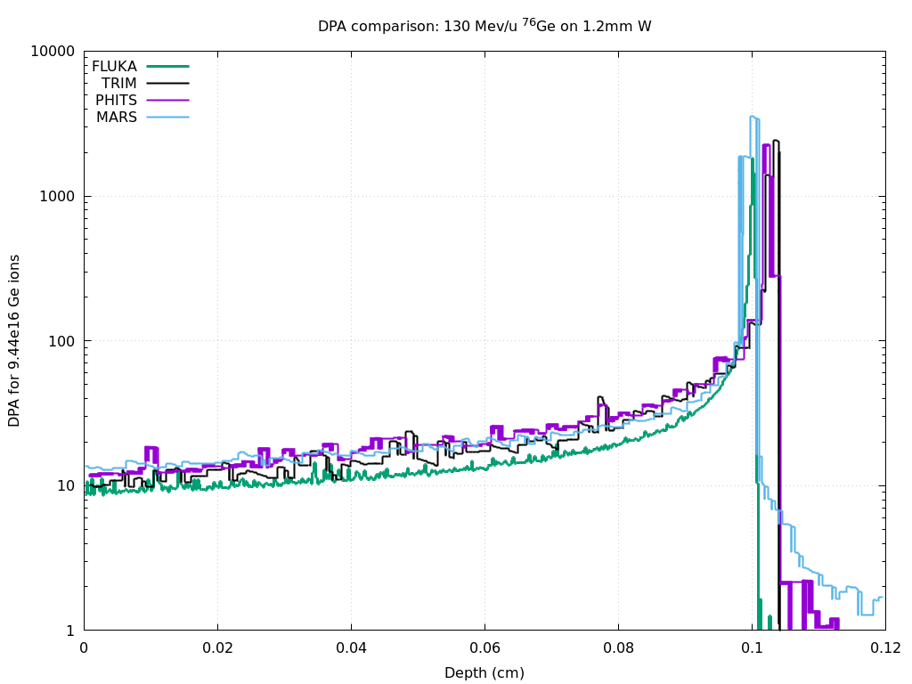
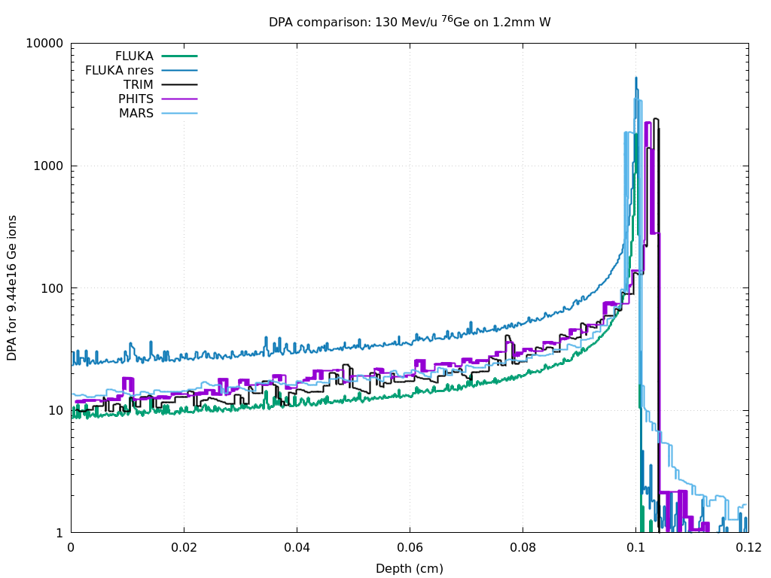
Comparison with other simulation codes
⁷⁶Ge ion pencil beam of 130 MeV/A uniform in W target a disc of R=0.3568 mm, 1.2 mm thickness
Non-restricted
provides higher
values if we consider fixed
Displ. Effic.
Overestimation of DPA
×2.5 with a κ=0.8 fixed efficiency

Slide 13
FLUKA Implementation
Charged particles and heavy ions
During transport
  Calculate the restricted non ionizing energy loss
Below threshold
  Calculate the integrated nuclear stopping power with the Lindhard partition function
At (elastic and inelastic) interactions
  Calculate the recoil, to be transported or treated as below threshold
Neutrons:
High energy E_{n}>20 MeV
  Calculate the recoils after interaction
  Treat recoil as a “normal” charged particle/ion
Low energy E_{n}≤20 MeV (group-wise)
  Calculate the NIEL from NJOY
Low energy E_{n}≤20 MeV (point-wise)
  Calculate the recoil if possible
  Treat recoil as a “normal” charged particle/ion
Implementation in FLUKA: A. Fasso et al. Prog. In Nucl. Science and Technology, Vol. 2, p769-775 (2011)

Slide 14
Example of fission/evaporation
1 A GeV ²⁰⁸Pb + p reactions Nucl. Phys. A 686 (2001) 481-524
Evaporation
600 possible emitted
particles/states (A<25)
Quasi-elastic
Spallation
Data
Deep
spallation
after pre-equilibrium
Fission
Fragmentation
A<18 nuclei
~ 50000 combinations
up to 6 ejectiles
after cascade

Slide 15
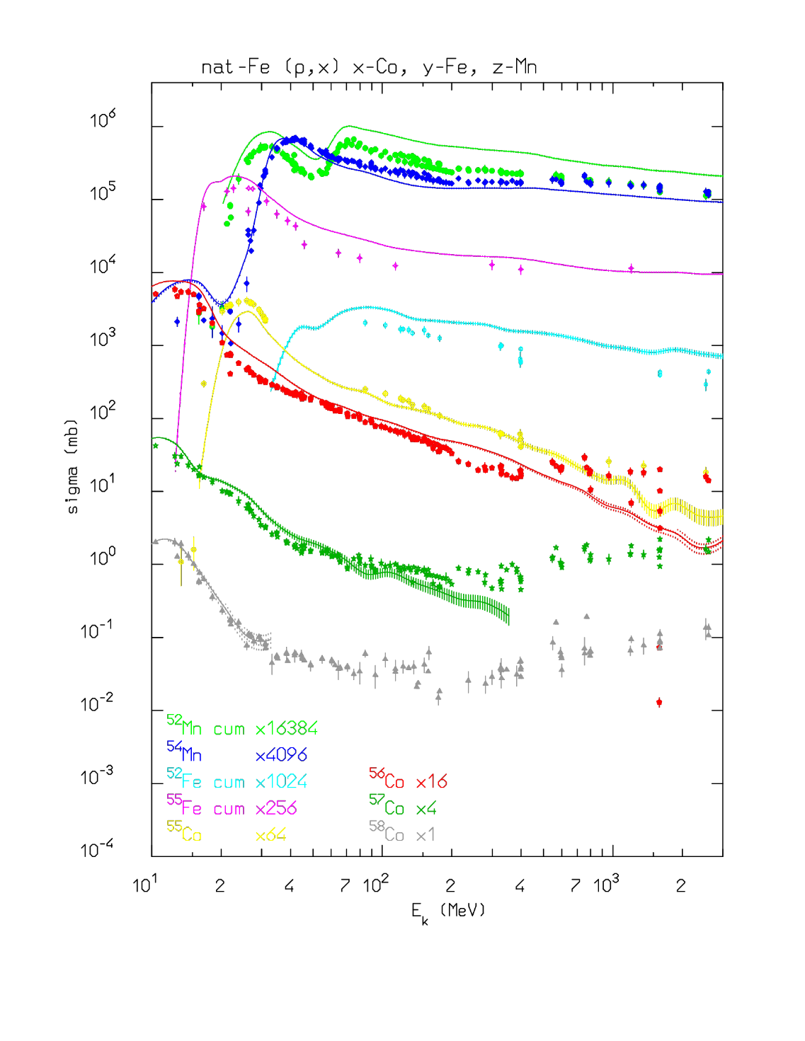
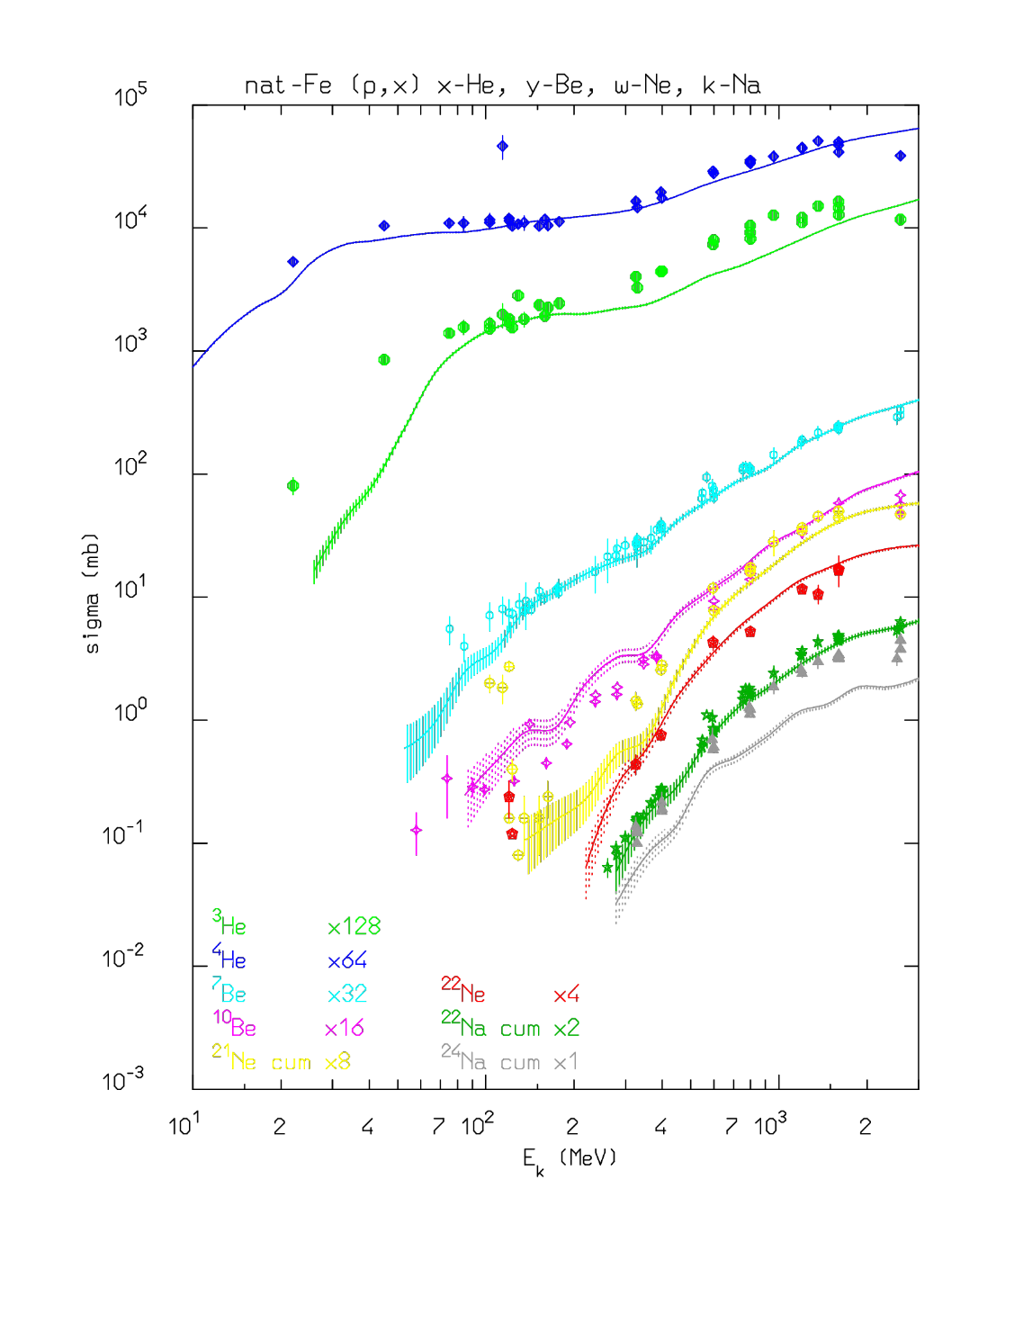
Isotope production for ^{nat}Fe(p,x):
Data: Michel et al. 1996 and 2002

Slide 16
Estimates for CERN injectors and future facilities
Beam Dump Facility
BLIP capsule
PS Internal Beam Dumps

Slide 17
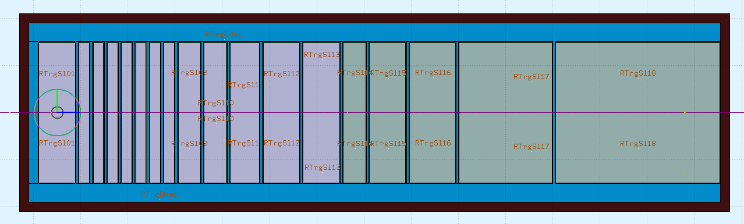
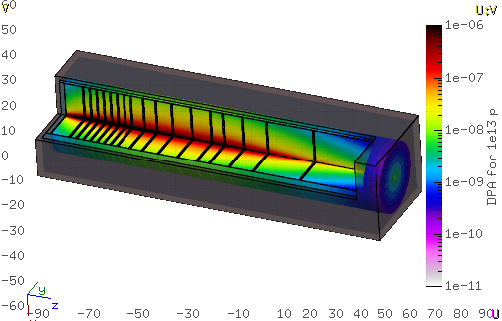
Beam Dump Facility (BDF)
Beam:
Protons: 400 GeV/c
Sweep pattern:
  radius 3 cm
  1σ 0.6 cm
Geometry:
1.4 m long cylinder discs of
TZM enclosed in Ta
W enclosed in Ta
1.5 mm Ta cladding and
5 mm water gaps
Materials:
Tungsten E_{d}=90 eV
SS 316N E_{d}=40 eV
Tantalum E_{d}=53 eV
TZM (Mo,Zr,Ti…) E_{d}=60 eV
TZM
W
Ta cladding
Water cooling
Courtesy: J. Canhoto-Espadanal
Notes:
https://indico.cern.ch/event/679079/contributions/2781694/attachments/1560677/2456781/Students_coffee_BDF.pdf

Slide 18
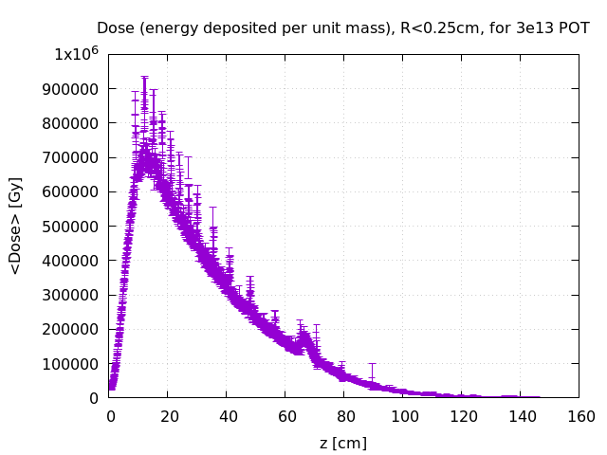
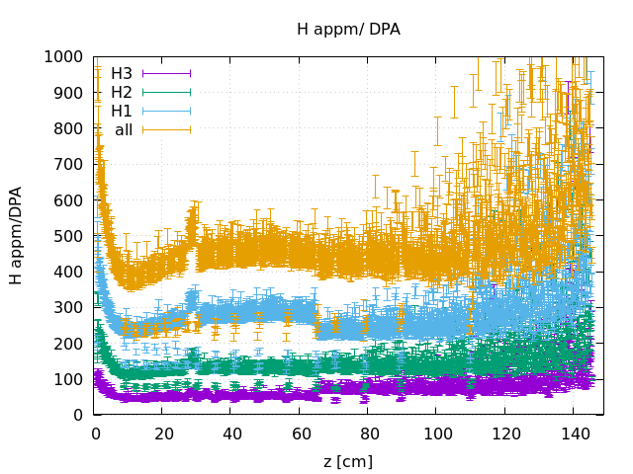
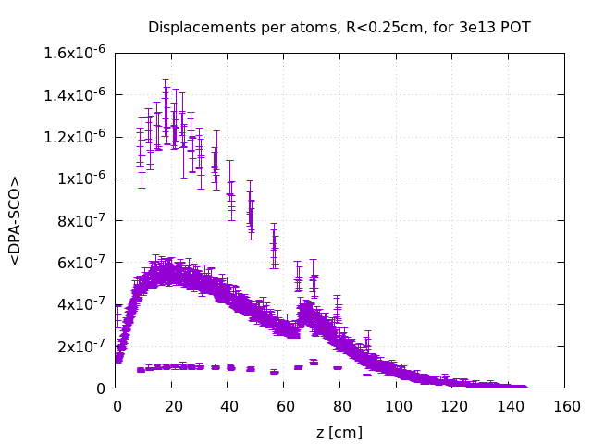
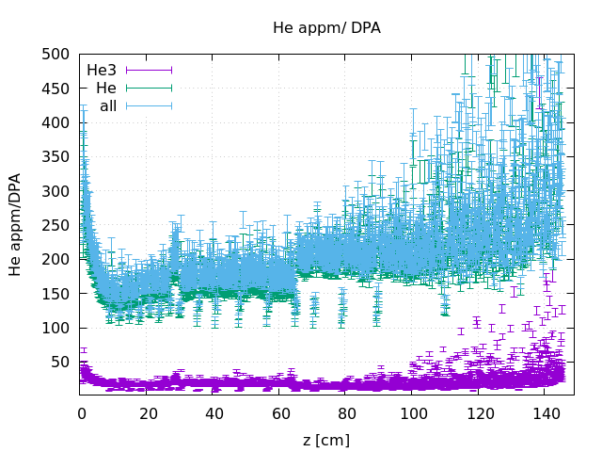
BDF Results: H/He[appm] vs DPA
Water
TZM
W
Ta
Courtesy: J. Canhoto-Espadanal
Notes:
Suggestion that only H1 and He4 should be included but we do see as H2 and H3 are not negligible…

Slide 19
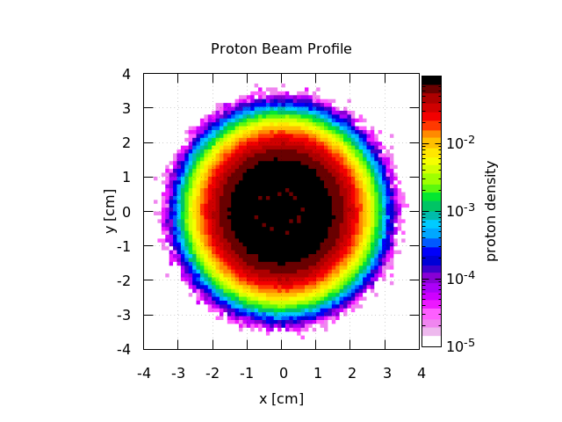
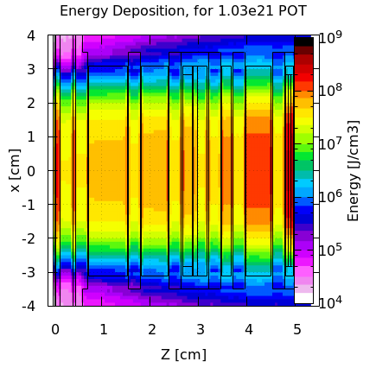
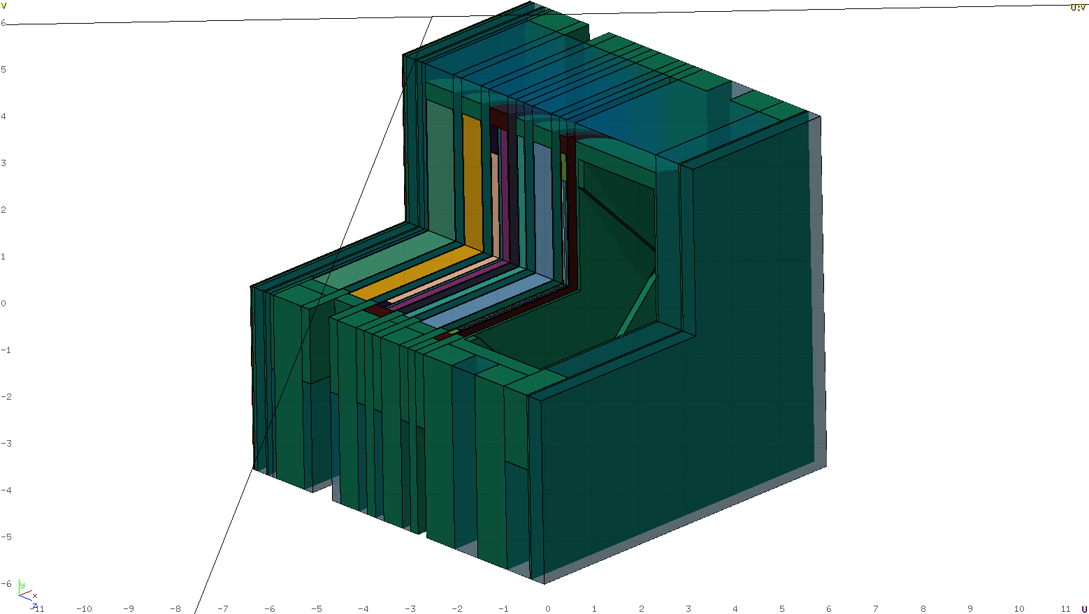
BLIP capsule
Beam
  Proton E=181 MeV
  σ_{x,y} = 5.1 mm
Geometry: Layers of
  Window SS304L 0.3mm
  TZM 0.5mm
  CuCrZr 0.5mm
  Ir 0.5mm
  Graphite(0.85g/cm3) 0.1mm
Courtesy: J. Canhoto-Espadanal

Slide 20
DPA High-Z BLIP [FLUKA vs MARS]
DPA / 1.03 10¹²p⁺
Courtesy: J. Canhoto-Espadanal
Note: NRT model of MARS

Slide 21
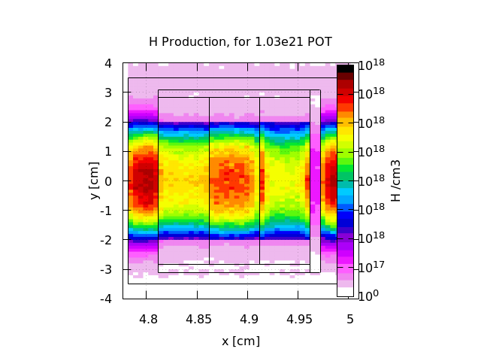
H appm/DPA High-Z BLIP
TZM
CuCrZr
Ir
C85
Courtesy: J. Canhoto-Espadanal

Slide 22
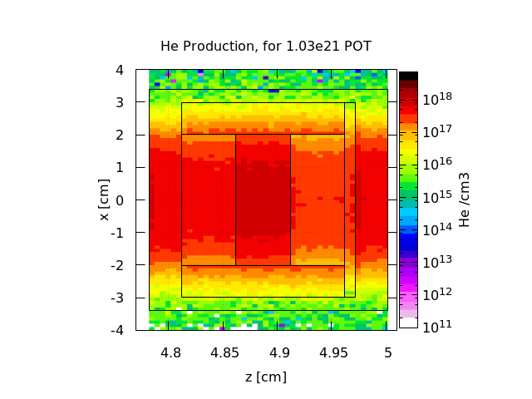
He appm/DPA High-Z BLIP
Probably due to “Old” MARS
event generator used
Warning:
Log-scale
TZM
CuCrZr
Ir
C85
Courtesy: J. Canhoto-Espadanal

Slide 23
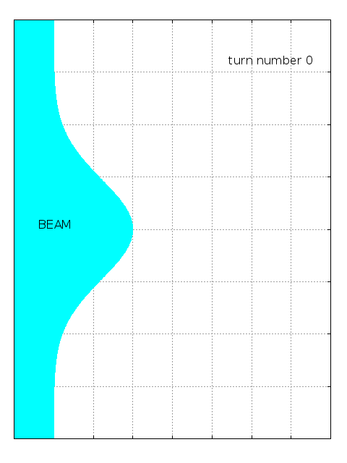
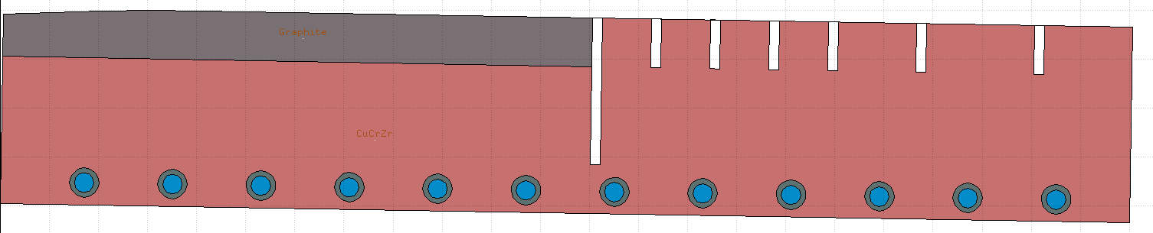
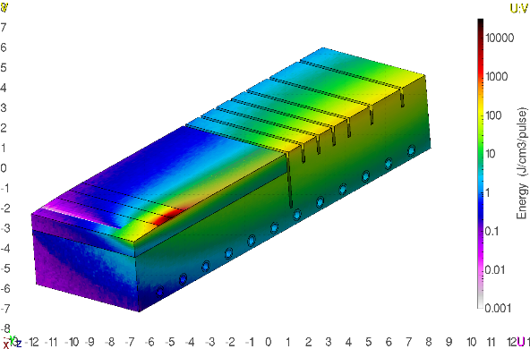
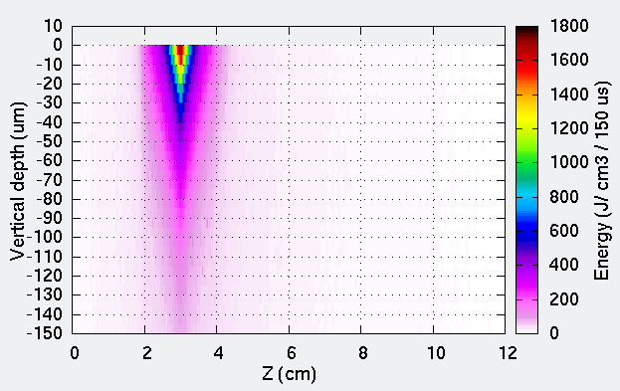
PS Internal Beam Dumps
BEAM
23 cm
4 cm
Challenging Energy density
Superficial energy deposition
40 µm
BEAM

Slide 24
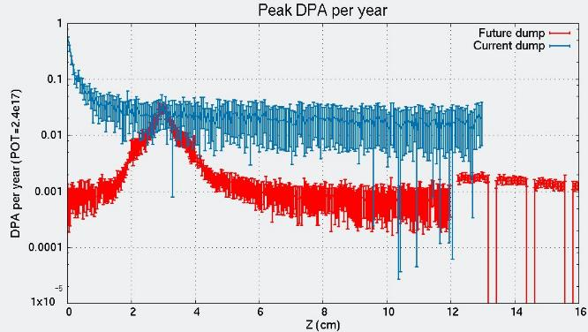
PS Internal Beam Dumps: Damage
BEAM
23 cm
0.5 DPA/year
0.03 DPA/year in Graphite
0.02 DPA/year
0.002 DPA/year
in CuCrZr
4 cm
Beam properties:
26 GeV/c proton beam
2.4e17 POT per year
𝞼_{h}=1.74 mm 𝞼_{v}=0.87 mm
Beam is shaved in a thin top most layer
Graphite:
Experience at CERN with CNGS air cooled graphite target (SPS beam). About 1200°C reached for each pulse. At the end of operation: 1.5 DPA
    →No problem observed on graphite
Graphite
CuCrZr
Damage threshold energies considered:
E_{th}(Graphite) = 30 eV - typical value 30-35 eV
E_{th}(CuCrZr and SS304L) = 40 eV
  CuCrZr:
  Literature on neutron irratiation indicated for similar dpa damage some possible radiation hardening and thermal conductivity degradation but not dramatic effects

Slide 25
Summary
FLUKA dpa model uses a restricted NIEL computed during initialization and run time.
Not based on Lindhard but reworked all formulas
The only free parameter for the user is the damage threshold. It depends on the direction of the recoil. Simple averaging is not correct
Uniform treatment from the transport threshold up to the highest energies
Use of Stoller displacement efficiency instead of a fixed 0.8 as NRT suggests
Not considered thermal recombination of defects → overestimation of dpa. Improving the estimate would require Molecular Dynamics simulations

Slide 26
Summary
FLUKA is employed to evaluate radiation-induced damage on new dumps facilities (BDF, BLIP) and elements of the CERN injector chain (PS internal dumps)
Simulations provided a way of quantifying the damage through estimation of dpa and gas production (H, He)
Comparison of estimations of dpa (simulations) and modifications of macroscopic quantities (experimental: thermal, electric, etc…, properties) helps to extract conclusions on radiation-induced damage
Possible Future improvements:
  Implementation of the Nordlund arc-dpa
  More accurate recoil momentum cross section for pair production and Bremsstrahlung
  Point wise treatment of low energy neutrons will provide correct recoil information
  Multiple damage thresholds for compounds

Slide 27
Thank you for your attention!
Any question?

Slide 28
Extra slides

Slide 29
Outline
Introduction to FLUKA
Radiation damage estimation: dpa
dpa estimation in FLUKA:
  Damage threshold
  Displacement efficiency
  Lindhard partition function and Restricted Nuclear Stopping Power
Damage estimates for CERN Injectors and Future Facilities
Summary

Slide 30
E_{th} Damage Threshold Energy
E_{th} is the value of the threshold displacement energy averaged over all crystallographic directions or a minimum energy to produce a defect
Typical values used in NJOY99 code
The only variable requested for FLUKA
MAT-PROP WHAT(1) = E_{th} (eV)
WHAT(4,5,6) = Material range SDUM = DPA-ENER

Slide 31
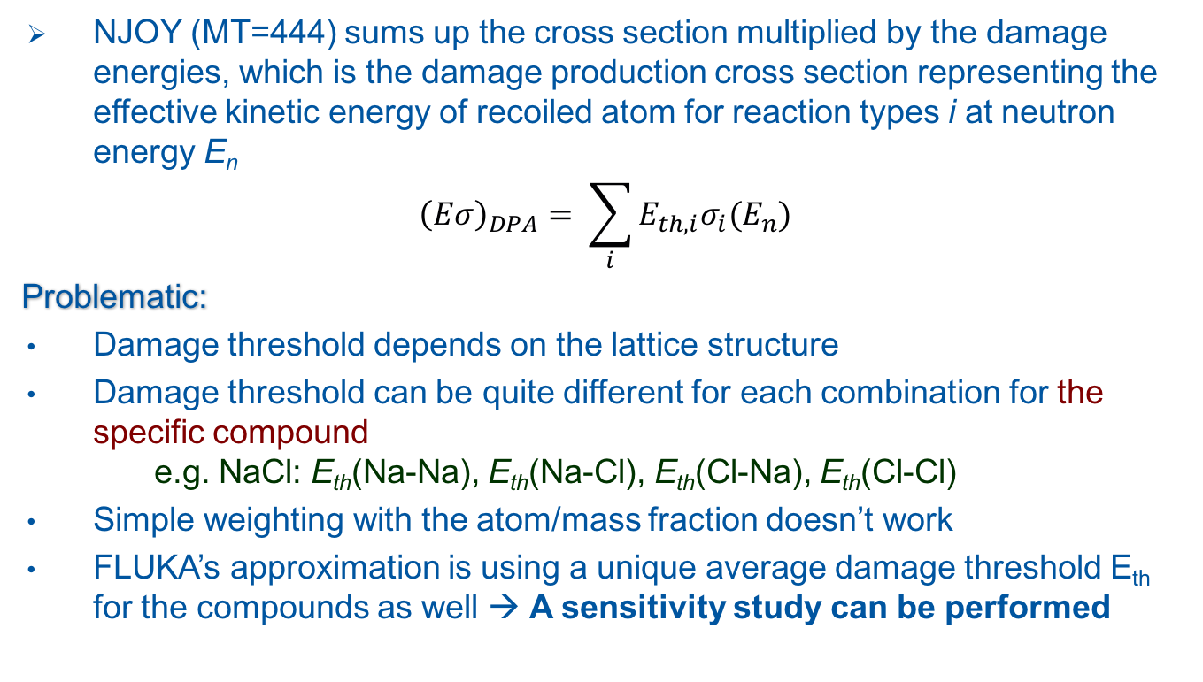
Damage Threshold in Compounds
NJOY (MT=444) sums up the cross section multiplied by the damage energies, which is the damage production cross section representing the effective kinetic energy of recoiled atom for reaction types i at neutron energy E_{n}
$${\left(Eσ\right)}_{DPA}= \sum_{i}{E_{th,i}σ_{i}(E_{n})}$$
Problematic:
Damage threshold depends on the lattice structure
Damage threshold can be quite different for each combination for the specific compound
e.g. NaCl: E_{th}(Na-Na), E_{th}(Na-Cl), E_{th}(Cl-Na), E_{th}(Cl-Cl)
Simple weighting with the atom/mass fraction doesn’t work
FLUKA’s approximation is using a unique average damage threshold E_{th} for the compounds as well → A sensitivity study can be performed
Only free parameter for the FLUKA user is E_{th}

Slide 32
κ displacement efficiency
κ=0.8 value deviates from the hard sphere model (K&P), and compensates for the forward scattering in the displacement cascade
The displacement efficiency κ can be considered as independent of T only in the range of T≤1−2 keV. At higher energies, the development of collision cascades results in defect migration and recombination of Frenkel pairs due to overlapping of different branches of a cascade which translates into decay of κ(T).
From molecular dynamics (MD*) simulations of the primary cascade the number of surviving displacements, N_{MD}, normalized to the number of those from NRT model, N_{NRT}, decreases down to the values about 0.2–0.3 at T≈20−100 keV. The efficiency in question only slightly depends on atomic number Z and the temperature. N_{MD}/N_{NRT} = 0.3–1.3
where X ≡ 20 T (in keV).
Roger E. Stoller, J. Nucl. Mat., 276 (2000) 22
D.J. Bacon, F. Gao and Yu.N. Osetsky, J. Comp.-Aided Mat. Design, 6 (1999) 225.

Slide 33
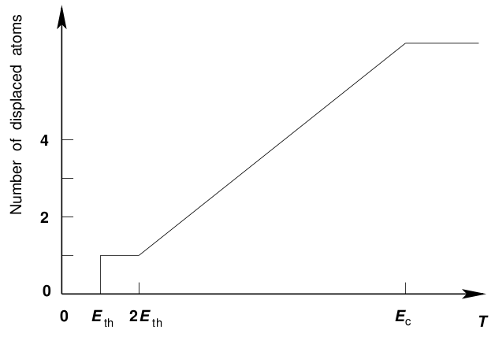
Factor of 2 (Kinchin & Pease)
The cascade is created by a sequence of two-body elastic collisions between atoms
In the collision process, the energy transferred to the lattice is zero
For all energies T < E_{c} electronic stopping is ignored and only atomic collisions take place. No additional displacement occur above the cut-off energy E_{c}
The energy transfer cross section is given by the hard-sphere model.
ν(T)=0 for 0<T< E_{th} (phonons)
ν(T)=1 for E_{th}<T<2E_{th}
ν(T)=T/2E_{th} for 2E_{th}<T<E_{c}
ν(T)=E_{c}/2E_{th} for T > E_{c}
Schematic relation between the number of displaced atoms in the cascade and the kinetic energy T of the primary knock-on atom
Energy is equally shared between two atoms after the first collision
Compensates for the energy lost to sub threshold reactions

Slide 34
Lindhard partition function ξ ^{[1/2]}
The partition function gives the fraction of stopping power S that goes to NIEL
Approximations used: Electrons do not produce recoil nuclei with appreciable energy, lattice binding energy is neglected, etc...
where
approximated to
Z,A charge and mass
1 projectile
2 medium
T recoil energy (eV)
Nice feature: It can handle any projectile Z₁,A₁ whichever charged particle

Slide 35
Nuclear Stopping power
Nuclear stopping power (unrestricted)
Energy transferred to recoil atom
Deflection angle, by integrating over all impact parameters b
Universal potential
where: F_{s}(x) = Σ a_{i} exp(-c_{i} x) screening function
r_{s}=0.88534 r_{B} / (Z₁^{0.23} + Z₂^{0.23}) screening length
r_{s}=0.88534 r_{B} Z₁^{-1/3} in case of particle
ICRU-49

Slide 36
Ziegler approximation
Reduced kinetic energy ε (T in keV)
Reduced stopping power
if
if
Important features of Reduced Stopping Power
  Independent from the projectile and target combination
  Accurate within 1% for ε<1 and to within 5% or better for ε>3
Stopping power (MeV/g/cm²)
ICRU-49

Slide 37
Restricted Stopping Power
The restricted nuclear stopping power is calculated the same way only integrating from 0 impact parameter up to a maximum b_{max} which corresponds to a transfer of energy equal to the
E_{th}= W_{min}(θ_{min},T)
To find b_{max} we have to approximately solve the previous θ integral using an iterative approach for
This can be done either by integrating numerically for θ or using the magic scattering formula from Biersack-Haggmark that gives a fitting to sin²(θ/2)

Slide 38
Implementation: Charged Particles
During the transport of all charged particles and heavy ions the dpa estimation is based on the restricted nuclear stopping power while for NIEL on the unrestricted one.
For every charged particle above the transport threshold and for every Monte Carlo step, the number of defects is calculated based on a modified multiple integral
Taking into account also the second level of sub-cascades initiated by the projectile
Below the transport threshold (1 keV) it employs the Lindhard approximation
Lindhard
partition function
restricted
partition function

Slide 39
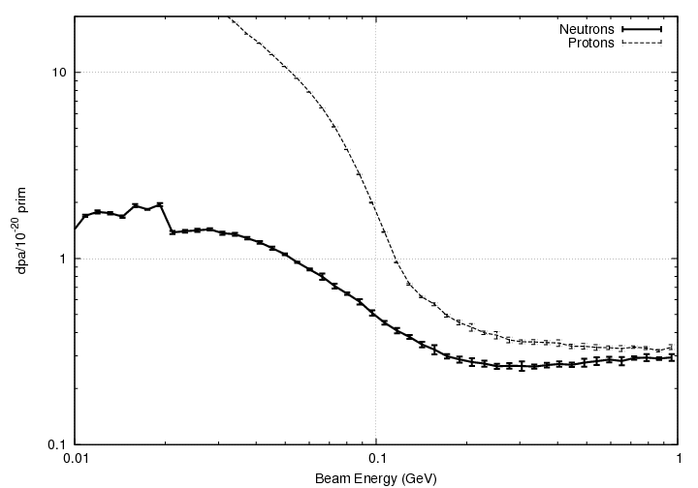
Group Wise Neutron Artifacts
Due to the group treatment of low-energy neutrons, there is no direct way to calculate properly the recoils.
Therefore the evaluation is based on the KERMA factors calculated by NJOY, which in turn is based on the Unrestricted Nuclear losses from using the NRT model.
<20MeV
using NRT from NJOY
>20MeV
using models
with more accurate treatment

Slide 40
Implementation: others
For Bremsstrahlung and pair production the recoil is sampled randomly from an approximation of the recoil momentum cross section
Bremsstrahlung
Pair production
both can be written in the same approximate way as
where the recoil momentum is sampled randomly by rejection from a similar function

Slide 41
Coalescence:
d, t, ³He, and alpha’s generated during the (G)INC and preequilibrium stage
All possible combinations of (unbound) nucleons and/or light fragments checked at each stage of system evolution
FOM evaluation based on phase space “closeness” used to decide whether a light fragment is formed rather than not
  FOM evaluated in the CMS of the candidate fragment at the time of minimum distance
  Naively a momentum or position FOM should be used, but not both due to quantum non commutation
  … however the best results are obtained with a Wigner transform FOM (assuming gaussian wave packets) which should be the correct way of considering together positions and momenta
Binding energy redistributed between the emitted fragment and residual excitation (exact conservation of 4-momenta)

Slide 42
Coalescence
High energy light fragments are emitted through the coalescence mechanism: “put together” emitted nucleons that are near in phase space.
Example : double differential t production from 542 MeV neutrons on Copper
Warning: coalescence is OFF by default
Can be important, ex for . residual nuclei.
To activate it:
PHYSICS 1. COALESCE
If coalescence is on, switch on Heavy ion transport and interactions (see later)

Slide 43
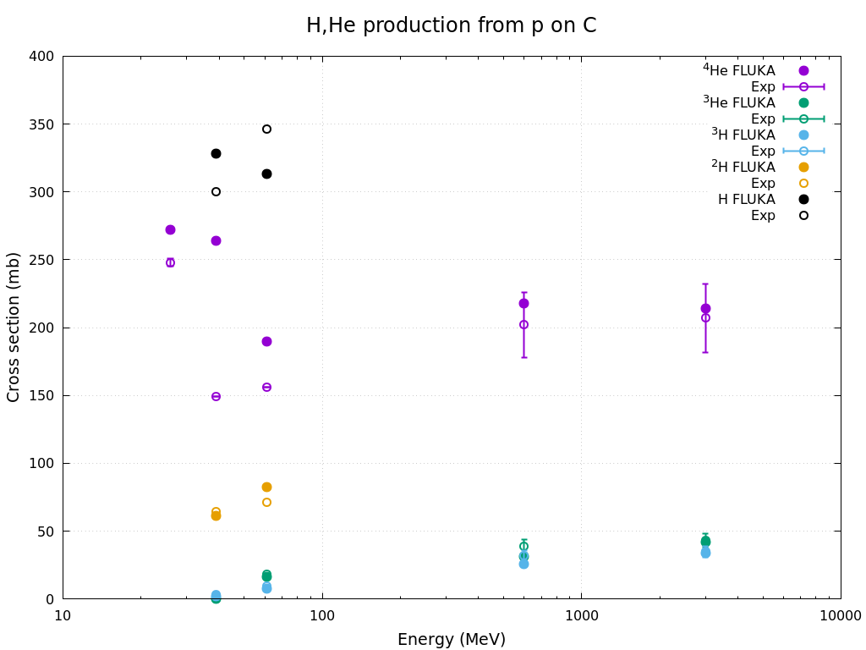
Particle production in C(p,x) reaction
Data: JNST36 313 1999, PRC7 2179 1973

Slide 44
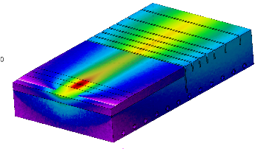
Energy Density Distribution from FLUKA
Values shown are accumulated per pulse
HL-LHC
HL-LHC beam
p=26 GeV/c
2.4e13 ppp
σ_{x}xσ_{y}=1.74 mm x 0.87 mm
ε_{x}=1.8 mm mrad
ε_{y}=1.8 mm mrad
CuCrZr
Graphite
CuCrZr
BEAM

Slide 45
Structural Damage on Dump Core
0.5 DPA/year
Lower general damage than current dump
(~1 order of magnitude)
Lower peak DPA on copper region than
current dump
(~2 orders of magnitude)
Graphite protects the copper block from structural damage
0.03 DPA/year in Graphite
0.02 DPA/year
0.002 DPA/year
in CuCrZr
Graphite
CuCrZr
Damage threshold energies considered:
E_{th}(Graphite) = 30 eV - typical value 30-35 eV
E_{th}(CuCrZr and SS304L) = 40 eV
POT=2.4e17 (assumed same POT for current and future dumps)

Slide 46
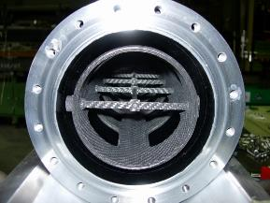
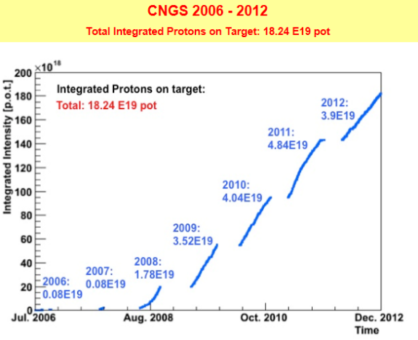
Irradiation on Graphite
0.03 DPA/year estimated in Graphite block of PS dump
Experience at CERN: CNGS air cooled graphite target (SPS beam)
About 1200°C reached for each pulse
At the end of operation: 1.5 DPA
No problem observed on graphite
→3.5 x 10¹³ protons per pulse,
→10.5 µs pulse length < 1 mm spot size
→2 extractions per cycle separated by 50 ms, occurring every 6 s
→ 2 000 000 extractions achieved by end of 2009
→ 4.5 x 10¹⁹ protons at 400 GeV/c on CNGS target per year
Graphite rods 2020PT (Mersen)
[Ref]: Spallation materials R&D for CERN’s fixed target program, M. Calviani et al. IWSMT, Oct. 2014, Austria
PS dump graphite irradiation shall not be a concern

Slide 47
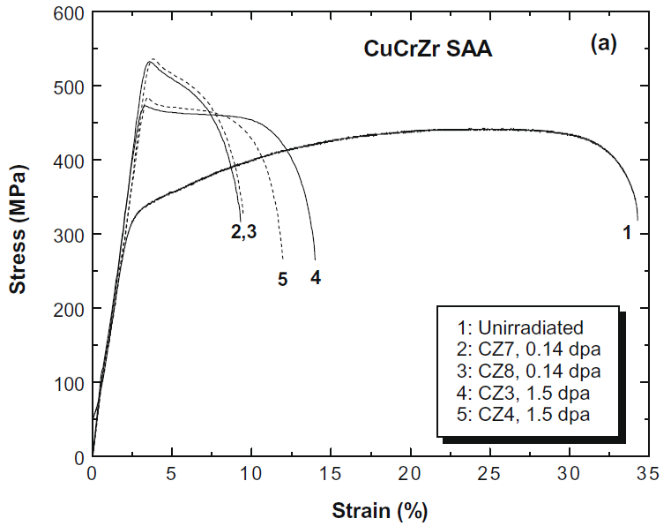
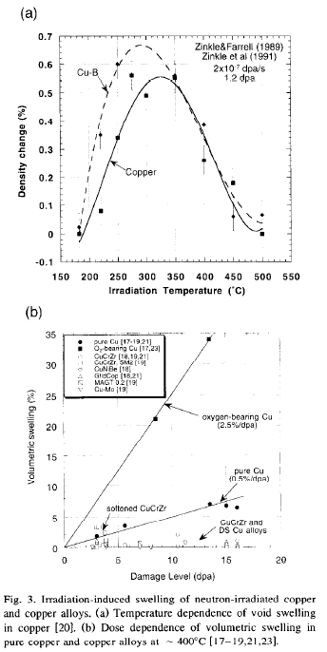
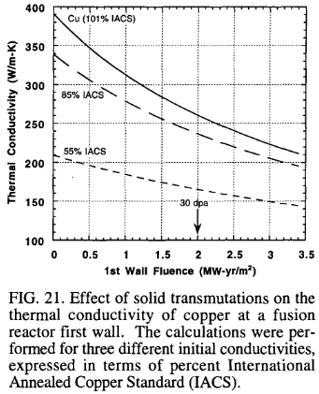
Irradiation on CuCrZr
[3]
Plastic
region
Peak value obtained of 0.002 DPA per year (0.04 DPA in 20 years) in CuCrZr block of PS Dump
Localized peak DPA
Information for neutron irradiation found in literature
CuCrZr shows radiation hardening until saturation values around 0.1 – 0.5 DPA [1][3] → Some hardening may occur
CuCrZr is void swelling resistant [1][2]
(below 2% density change for up to 150 DPA [1])
Some thermal conductivity degradation
may occur (5 – 10 % reduction for doses
> 0.1 DPA at < 150 °C [2])
Elastic
region
[2]
[1]
[1] C. Bobeldijk (ed.). (1994). Atomic and Plasma-Material Interaction Data for Fusion. Vol. 5. Supplement to the Journal Nuclear Fusion
[2] S.A. Fabritsiev & S.J. Zinkle & B.N. Singh. (1996). Evaluation of copper alloys for fusion reactor divertor and first wall components. Journal of Nuclear Materials. Vol. 233-237. pp. 127-137.
[3] M. Li & M.A. Sokolov & S.J. Zinkle. (2009). Tensile and fracture toughness properties of neutron-irradiated CuCrZr. Journal of Nuclear Materials. Vol. 393. pp. 36-46.

