Slide 1
CERN's activities within the RaDIATE Collaboration
C. Torregrosa (CERN)
On behalf of:
M. Calviani (CERN), P. Hurh (FNAL, RaDIATE program coordinator)
and
K. Ammigan (FNAL), E. Fornasiere, R. Ferriere, M. Timmins,
A. Perillo-Marcone, D. Horvath, J. Canhoto (CERN) + Makimura (J-PARC)
1st Workshop of ARIES WP17 PowerMat
Torino, 27-28 November 2017

Slide 2
Outline
Introduction to RaDIATE collaboration
Effects and challenges of radiation damage in BIDs
Outlook to RaDIATE R&D activities
2017 and 2018 BLIP-BNL proton irradiation campaigns and CERN participation
Conclusions

Slide 3
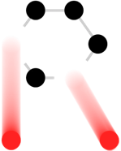











RaDIATE
Collaboration
Radiation Damage In Accelerator Target Environments
Stablished from 2012
Broad aims are threefold:
to generate new and useful materials data for application within the accelerator and fission/fusion communities
to recruit and develop new scientific and engineering experts who can cross the boundaries between these communities
to initiate and coordinate a continuing synergy between research in these communities, benefitting both proton accelerator applications in science and industry and carbon-free energy technologies
radiate.fnal.gov
Currently adding CERN and J-PARC to the MOU
P. Hurh, FNAL

Slide 4
Research Focus of RaDIATE
Challenges in Targetry technologies
  Target system simulations (physics & reliability)
  Rapid heat removal
  Radiation protection
  Remote handling
  Radiation accelerated corrosion
  Manufacturing technologies
Challenges in predicting Target material behavior
  Thermal “shock” response
  Radiation damage
  Highly non-linear thermo-mechanical simulation
Main focus within RaDIATE

Slide 5
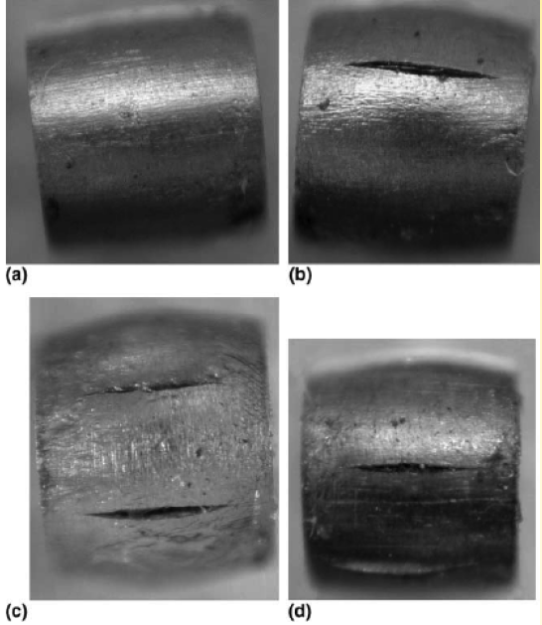
Effects of Radiation Damage
Displacements in crystal lattice
(expressed as Displacements Per Atom, DPA)
  Embrittlement
  Creep
  Swelling
  Transmutation products
    H, He gas production can cause void formation and embrittlement
    (expressed as atomic parts per million per DPA, appm/DPA)
  Fracture toughness reduction
  Thermal/electrical conductivity reduction
  Coefficient of thermal expansion
  Modulus of Elasticity
  Fatigue response
Dependent upon material condition and irradiation conditions (e.g. temp, dose rate)
0 DPA
3.2 DPA
14.9 DPA
23.3 DPA
S. A. Malloy, et al., Journal of Nuclear Material, 2005. (LANSCE irradiations)
P. Hurh, FNAL
Notes:
One notes that all the properties that are important for thermo-mechanical health of the target are affected by radiation damage. The dependence on irradiation temperature is due to annealing (or healing) the crystal structure is faster at higher temperatures.

Slide 6
Challenges of Radiation Damage
1) Challenge to estimate DPA by MC codes and benchmark against experimental data.
2) Challenge to link microscopic effects (DPA) to changes in macroscopic properties.
  Historically, this has been done by irradiation in nuclear reactors and subsequent PIEs.
  However, when applied to accelerator technology or fusion reactors:
Effects from low energy neutron irradiations do not equal effects from high energy proton irradiations.
n
1-14 MeV
p
100+ MeV
Table comparing typical irradiation parameters
Irradiation Source | DPA rate (DPA/s) | He gas production (appm/DPA) | Irradiation Temp (˚C)
Mixed spectrum fission reactor | 3 x 10⁻⁷ | 1 x 10⁻¹ | 200-600
Fusion reactor | 1 x 10⁻⁶ | 1 x 10¹ | 400-1000
High energy proton beam | 6 x 10⁻³ | 1 x 10³ | 100-800
P. Hurh, FNAL
Cannot directly utilize data from nuclear materials studies!

Slide 7
High Energy Physics HPT Future Needs
Exp/Facility | Laboratory | Time frame (yrs) | “On the books”? | Beam Power (kW) | Comments
ANU/NOvA | FNAL | 0.1 | Y | 700 | Full power soon
T2K | J-PARC | 2 | Y | 750 | Ramping Up!
LBNF-1.2 MW | FNAL | 10 | Y | 1,200 | PIP-II enabled
T2K Upgrade | J-PARC | 10? | ? | 1,300 | ~4 MW long-term?
Next-Gen Nu Facility –2.5 MW | FNAL | 20? | N | 2,500? | Mid-Term
Next-Gen Nu Facility - 5 MW | FNAL | 30? | N | 5,000? | Longer-term
BDF | CERN | 10 ? | Y/N | 500 | High-Z target
Future beam power and intensities present major challenges to reliable and efficient high power target facilities
Other low power (but high intensity) target facilities will also be needed. Notably follow-on experiments to Mu2e/COMET, CERN AD-T, CERN n_TOF, TIDVG absorber etc… These are still challenging targets due to high-Z targets and small beam spots, but are not listed here.
P. Hurh, FNAL + Marco

Slide 8
Radiation Damage at CERN’s BIDs and Related Devices
Type of device | Device | Materials subjected to radiation damage | DPA
Targets | AD-Target | Ir, Ta, Ti-6Al-4V container | ~1 DPA/year in the core
 | nTOF | Pb, Ti-6Al-4V container | ~1 DPA/year in the core 0.2-0.5 DPA/year container
 | BDF | TZM, W, Ta, Ta2.5W | ~4 DPA over operation
Absorbers and Collimators | TIDVG | Graphite, CuCrZr, Inermet180 | 0.5 DPA over operation (on a large surface, tens of cm2)
 | PS Internal Dump | Graphite, CuCrZr | 0.04 DPA/year (on a large surface, tens of cm2)
 | LHCTDE (external dump) | Graphite, Expanded Graphite | -
 | FCCTDE (external dump) | Graphite, Expanded Graphite | -
 | TCSPM Collimators TCTPM Collimators | -MoGr / CfC coated in Mo -CuCD | ~0.1 DPA over operation (over small surface 50x100 um2)
Other Devices related to BIDs | Beam windows | Be, Ti-6Al-4V, GlassyC | -
 | Collection Optics (horns, solenoids) | Aluminum Alloys | -
 | Monitors and Instrumentation |  | -
8

Slide 9
The High Costs of High-Energy Radiation Damage Studies
High energy, high fluence, large volume proton irradiations are needed to entirely replicate the HEP target environment and provide “bulk” samples for analysis
    High cost of irradiation “station” (4+ M$)
        Beam line and building not included in cost estimate
    High cost of irradiation beam time (0.5 M$ per 12 weeks)
    High cost of Post-Irradiation Examination (PIE) of activated samples (20+ k$ per sample)
High-Energy irradiations including PIE are expensive and can take a very long time
P. Hurh, FNAL

Slide 10
Low Energy Ion Irradiations Instead?
Fission and Fusion materials R&D community (e.g. University of Michigan Ion Beam Laboratory, MIBL ++ Europe as well)
Positives:
  Low to zero activation (PIE in “normal” lab areas)
  Greatly accelerated damage rates (several DPA in a day)
  Significantly lower cost irradiations
Negatives:
  Very shallow penetration (0-10 microns)
  Little gas production in samples
Promising Solutions:
  Micro-mechanics may enable evaluation of critical properties
  Simultaneous implantation of He and H ions (triple-beam irradiation)
But still need HE proton irradiations to correlate and validate techniques
P. Hurh, FNAL

Slide 11
Brief Outlook on RaDIATE R&D Activities
181 MeV p irradiation @ BNL’s BLIP facility
    2010 BLIP Irradiation
    2017 BLIP Irradiation (part of international collaboration)
    2018 BLIP Irradiation (part of international collaboration)
NuMI Be window PIE & future work (FNAL, Oxford)
He implantation studies at Surrey/Oxford
In-beam thermal shock test on Be and GlassyC at CERN’s HiRadMat (FNAL, RAL, CERN, Oxford)
    HRMT-24 BeGrid (2015)
    BeGrid-2 (2018) will test materials already irradiated in BLIP-2017 run
NuMI target (NT-02) autopsy and graphite PIE ++ potential CNGS?
Meso-scale fatigue testing (Oxford)
and subsequent PIEs
(see later)

Slide 12
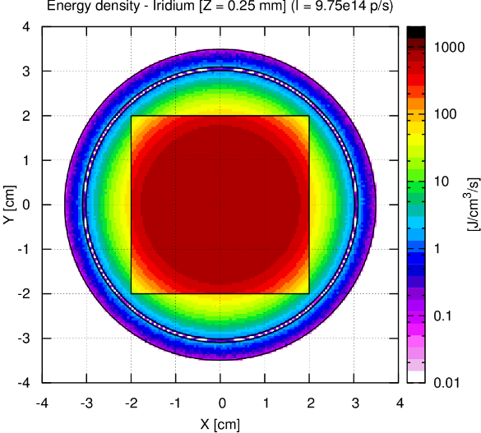
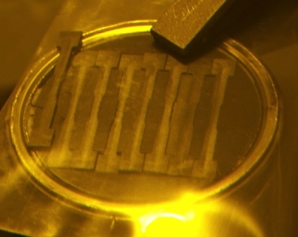
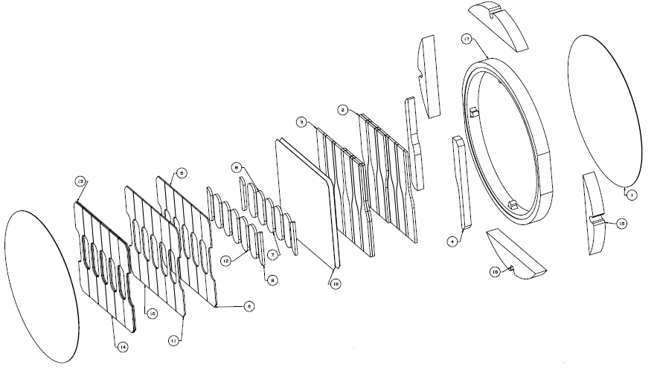
2017 BLIP run
Organized by the RaDIATE Collaboration
Included graphite at various temperature (up to 1000 C)
Also Be, Ti alloys, Si, TZM, Al, CuCrZr, Ir, SiC-coated C
Post-irradiation examination (2018) includes mechanical, thermal, microstructural and fatigue evaluation
Participants: BNL, PNNL, FRIB, ESS, CERN, JPARC, STFC, Oxford, LANL
181 MeV proton beam

Slide 13
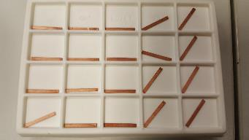
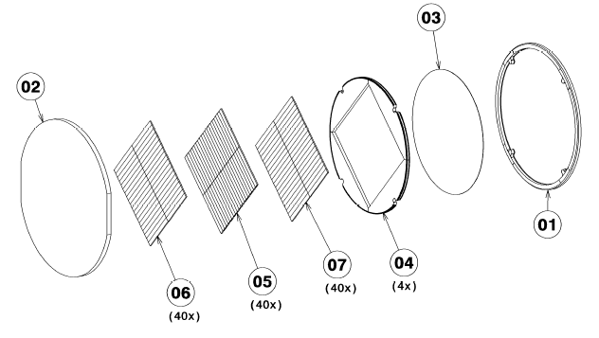
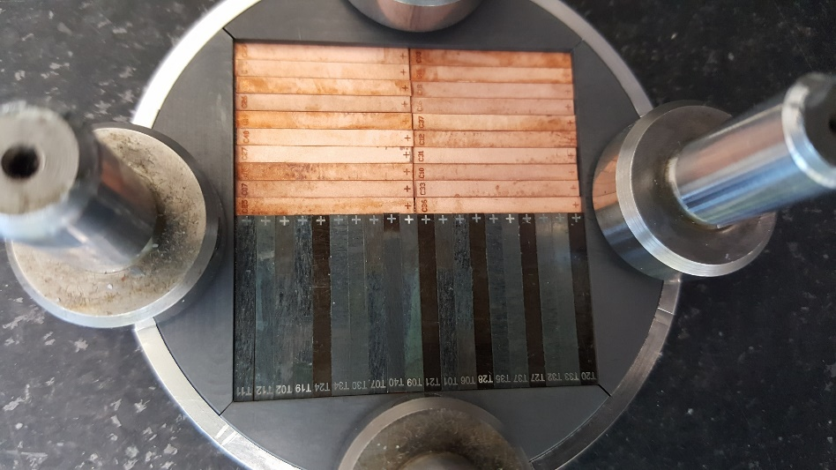
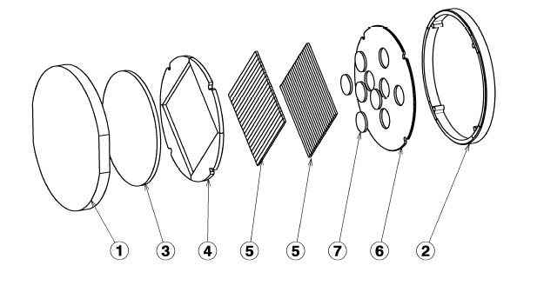
CERN’s Materials Irradiated in 2017 BLIP run
Two CERN’s capsules were irradiated:
    High-Z Capsule -> Max irr. T = ~840°C
      Iridium up to 0.35 DPA
      TZM up to 0.15 DPA
      CuCrZr up to 0.19 DPA
    Low-Z Capsule -> Max irr. T = 240°C
      Polycrystaline Si up to 0.18 DPA
      SiC-coated graphite (KEK) up to 0.03 DPA
      Expanded graphite up to 0.04 DPA
PIEs will take place in 2018 in PNNL (US)
    4 point bending tests at different temperatures (up to 800 °C)
    Thermal & Physical characterization (diffusivity, thermal expansion, density and density)
samples of 20x2x0.5 mm
Flexible graphite
TZM, Ir and CuCrZr bend specimens
samples of 40x1x2 mm
Expanded graphite
Si bend specimens
SiC-coated graphite discs

Slide 14
PIE @ PNNL – Mechanical Properties I
With the courtesy of D. Senor (PNNL) – ATS Seminar @CERN

Slide 15
PIE @ PNNL – Mechanical Properties II
With the courtesy of D. Senor (PNNL) – ATS Seminar @CERN

Slide 16
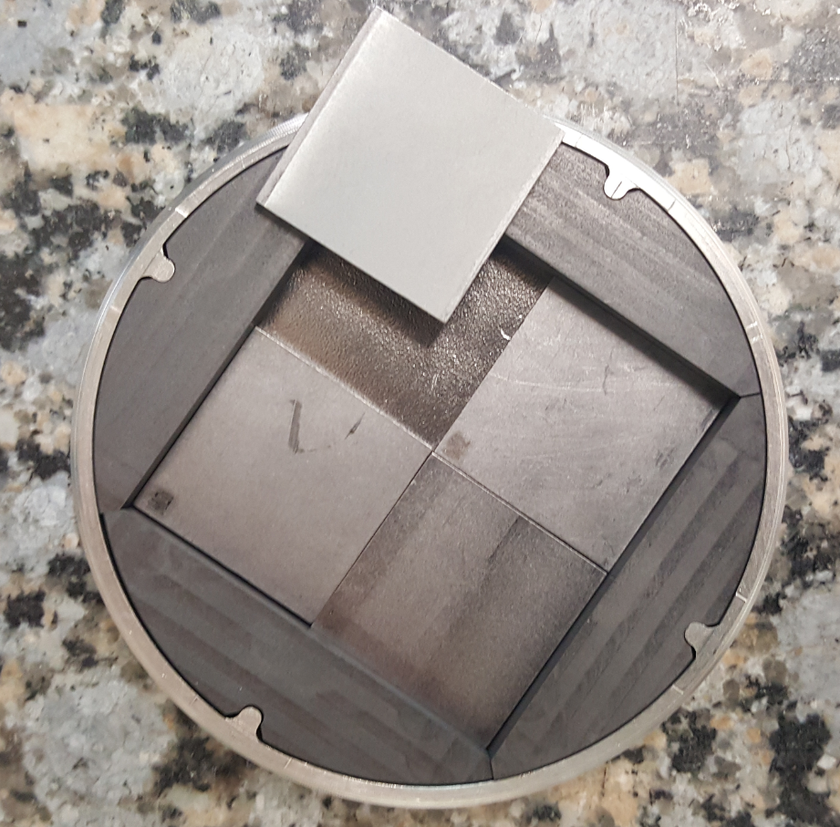
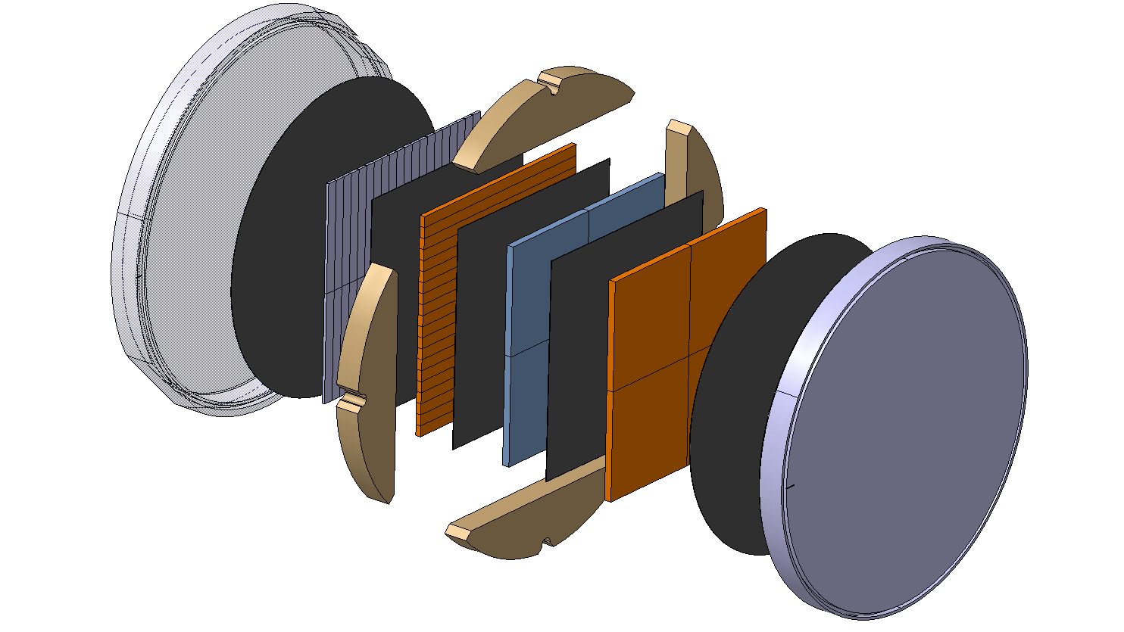
CERN’s Materials Irradiation in 2018 BLIP run
Materials:
  TaW(2.5%): Used as cladding material for BDF target
  Mo-coated CFC & Mo-coated MoGr:
      For TCSPM Collimators
      Test Mo adherence under radiation
  Monocrystalline Si: For crystal collimation
Currently being assembled, will be sent to Brookhaven by the end of December 2017
0.1 PNG + 0.5 TaW + 0.1 PNG + 1 Si + 0.1 PNG + 1.35 CfC + 0.1 PNG + 1.35 MoGr + 0.1 PNG
Similar PIEs as the ones foreseen for BLIP run 2017 irradiated materials
C. Torregrosa

Slide 17
Conclusions
The RaDIATE Collaboration has been active for the past ~4 years and is starting to produce results benefitting primarily HEP targetry global community (KEK, FNAL, CERN)
Radiation damage and thermal shock are highest priority
  Mechanisms and conditions unique to accelerator target facilities
  Sustained efforts with multiple approaches.
CERN has an active participation in 2017 & 2018 proton irradiation campaigns using the BLIP line in BNL.
Foreseen PIEs at PNNL aim at extracting mechanical and thermal macroscopic properties of the irradiated materials, directly applicable to the design of BIDs.

