Slide 1
Task 17. 5 description
Task 5: Broader accelerator and societal applications
(M. Tomut – GSI)
  This task will follow broader applications of new developed materials for high-power accelerators, space, society (energy, medicine, computing)
  Irradiation induced defect centers in diamond for luminescent screens, medical imaging and quantum computing.
  Application of novel materials for high power targets, beam catchers, beam windows.
  Applications for advanced engineering solutions, efficient energy solutions, space.
  Applications for thermal management.
  Participants: CERN, GSI, Brevetti Bizz, RHP Technology

Slide 2
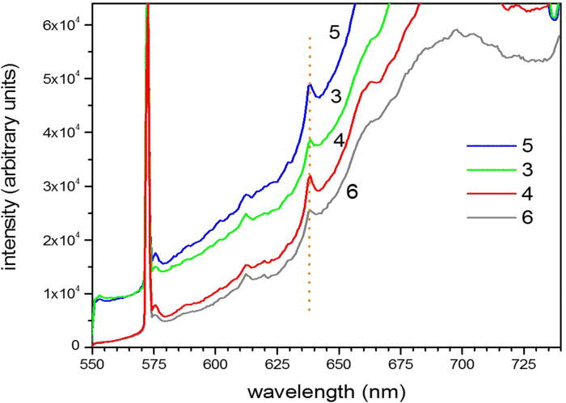
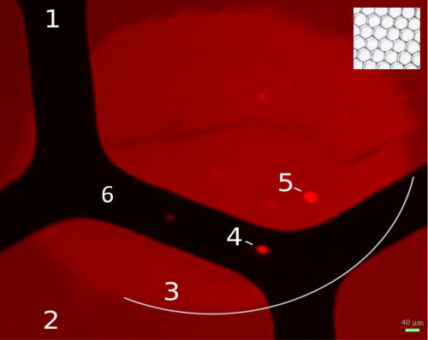
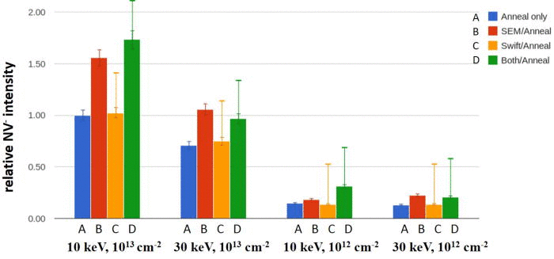
Local NV-center formation by electronic excitation from swift, heavy ions – yields after thermal annealing
J. Schwartz, et al., J. Appl. Phys., 2014
NV yields higher by factor 1.7x for e-beam and then thermal annealing vs. thermal annealing alone (850°C, 1 h, in vacuum)
But no evidence for additive effect of swifts and thermal annealing
Formation yield is ~0.1 of yield from high fluence e-beam and ~0.02 of yield from thermal annealing
absolute NV/N ~ 10⁻⁴–10⁻³
M. Tomut, EuCARD2, Glasgow, 2017

Slide 3
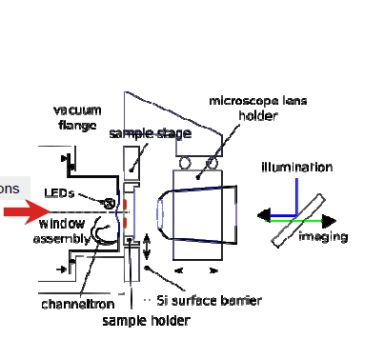
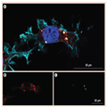
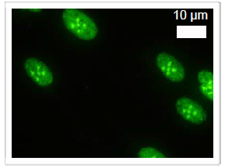
Biophysics and medical applications
Radiation effects in cells-
Ion beam microprobe
Functionalized nanodiamond
particles for medical imaging
M. Tomut, EuCARD2, Glasgow, 2017

Slide 4
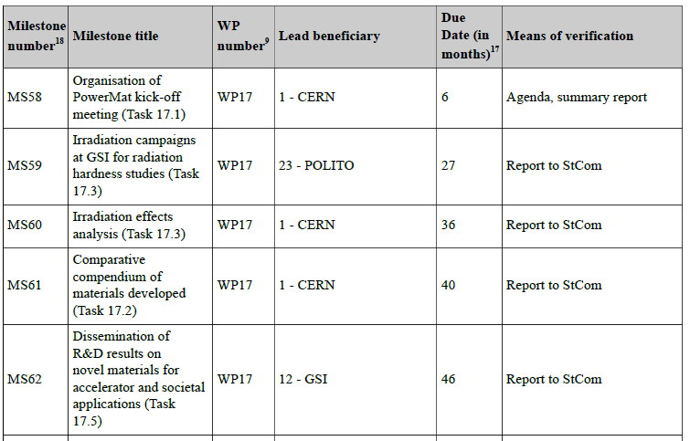
Milestones

Slide 5
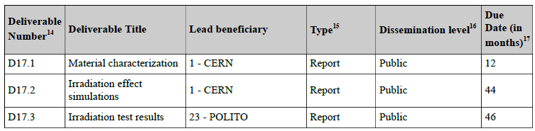
Deliverables

Slide 6

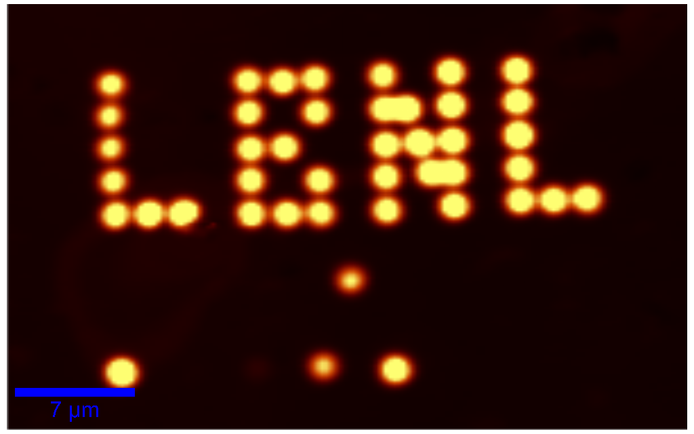
Activities
Optimize metal matrix for better response to fast extracted heavy ion beams -ongoing with RHP
Optimize diamond particle sizes and distribution for different applications – to be started (RHP-GSI)
Optimize color centers in diamond for different applications (luminescence screens, QD’s and medical imaging) - using different doping recipe- GSI, collaboration LBNL
Notes:
short ion pulses excite dynamics, paired with fast probes of structural dynamics (UED, XRD, ion scattering, …)
analog to swift heavy ion case
some opportunities in niche applications with potentially high impact

Slide 7
Contributions to task 17.5. session
11:45 - 11:55
David Grech
Development of new diamond based composites for luminescence screens
11:55 - 12:20
Pascal Simon et al.
First characterization tests and planned experiments on diamonds and diamond based composites for luminescence applications

