Slide 1
Task 17.5 - Development of new diamond based composites for luminescence screens
David Grech

Slide 2
Aim
Embedding of diamond particles onto metallic substrates
Diamonds will act as scintillators upon excitation/relaxation from incident high energy beam
Requirements:
  Smaller the diamond particle size -> the higher the resolution of the incident beam
  Smaller the Z-number of the substrate -> lesser interaction between high energy beam and substrate material
  Tougher substrate -> higher resistance to induced heat / sputtering damage
Notes:
The sample has been manufactured with IHP process

Slide 3
Methodology
Sample size: Dm20mm Height 1mm
Substrate materials: Ti, Ti6Al4V, TiAl, Ti composites, Al alloys
Diamond powders: 45/20-30/6-10/1-3 µm
Diamond type/purity: yet to be investigated
Induction hotpress: Graphite die, uniaxial pressure, pyrometer control, under vacuum
Die preparation
  Use of hard inert material to force diamonds into softer substrate
  Use least amount of diamonds
  Variation of temperature/time/holding time
  Process optimisation
Hard inert platelet
Pyro
Loose diamond powder
Substrate
Notes:
The sample has been manufactured with IHP process

Slide 4
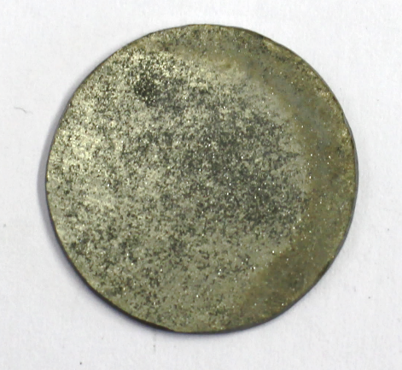
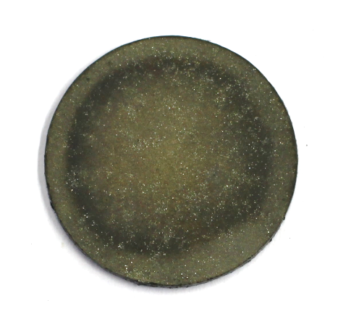
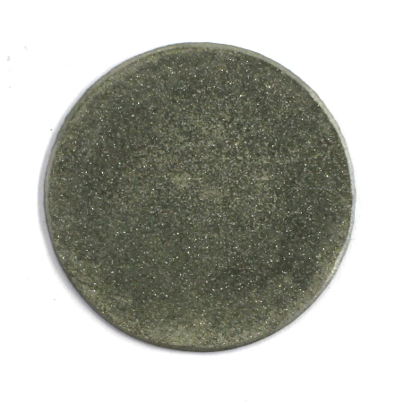
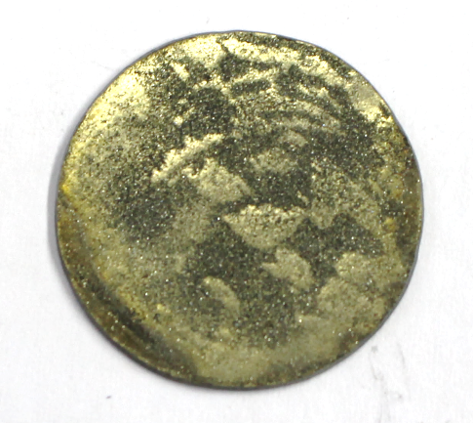
First trials
Processing
  Homogeneous distribution
  Amount of diamonds to be added
  Substrate mechanical properties
  Substrate reactivity with diamonds
  Adhesion of diamonds to substrates
Parameters
  Softening of substrate material
  Graphitisation of diamonds, catalysed by carbide forming elements
  Holding time
  Contamination of exposed diamond surface
IHP5140 – Dia45 on Ti6Al4V
IHP5142 – Dia45 on TiAl
IHP5136 – Dia45 on Ti
IHP5138 – Dia45 on Ti6Al4V

Slide 5
Adapted methodology
Sample size: Dm20mm Height 1mm
1x Ti, 1x Ti6Al4V substrates
Same processing conditions
Diamond 45 µm MBD8 quality
Homogenised the surface finish of substrates and hard platelet
Hard inert platelet
Pyro
Loose diamond powder
Substrate
Notes:
The sample has been manufactured with IHP process

Slide 6
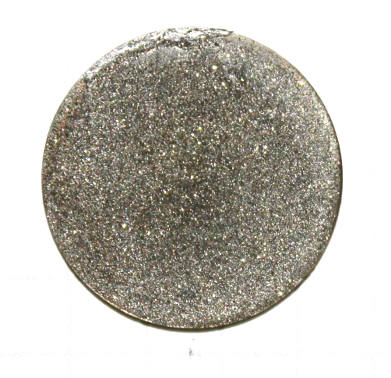
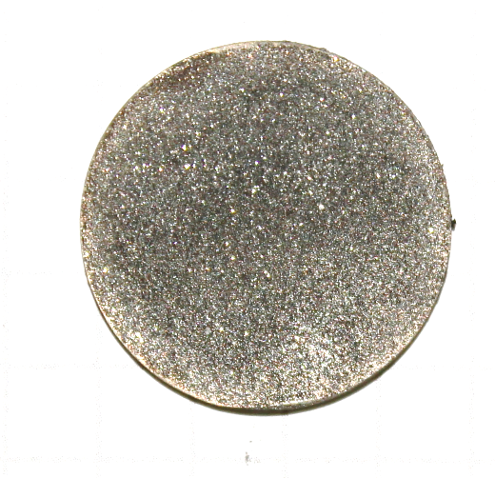
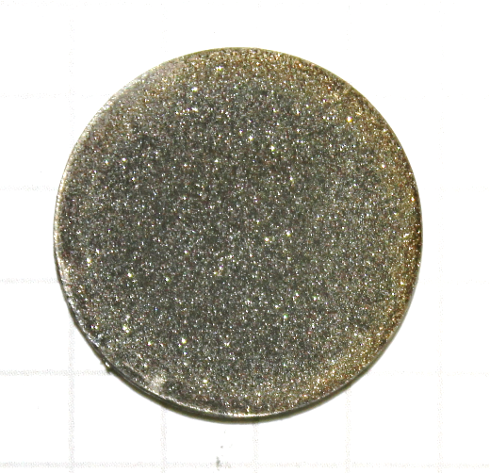
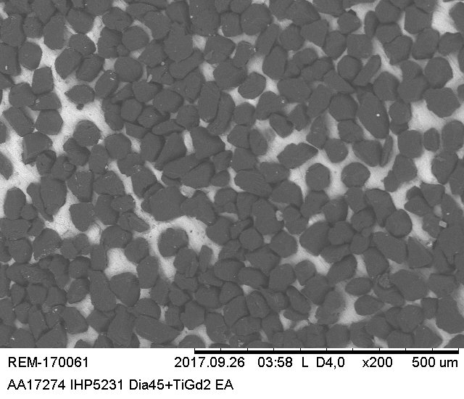
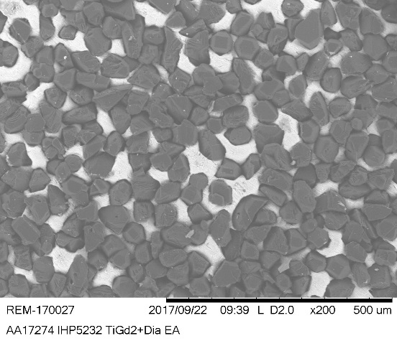
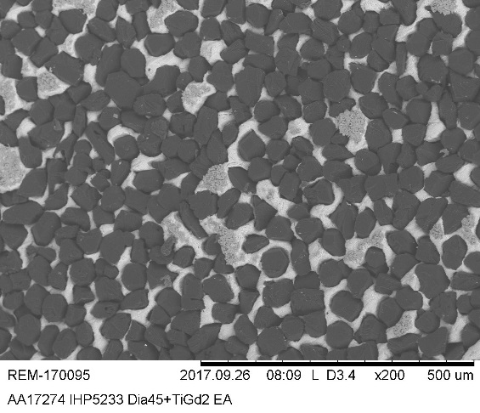
Results – Ti substrates
IHP5231-A
900°C/5min/30MPa
IHP5232-A
900°C/15min/30MPa
IHP5233-A
900°C/30min/30MPa

Slide 7
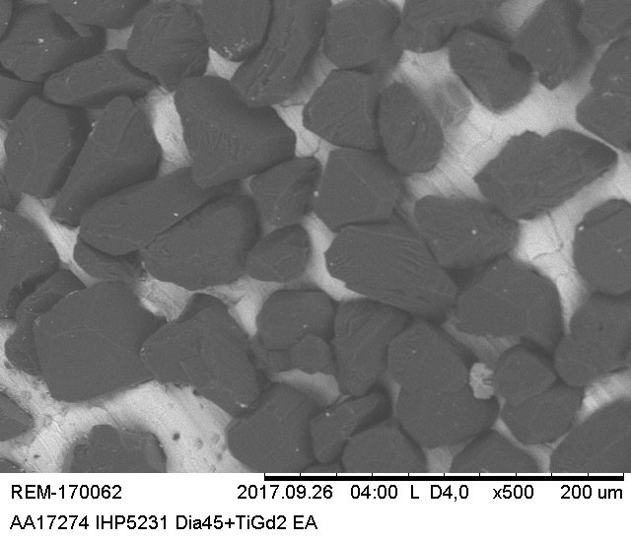
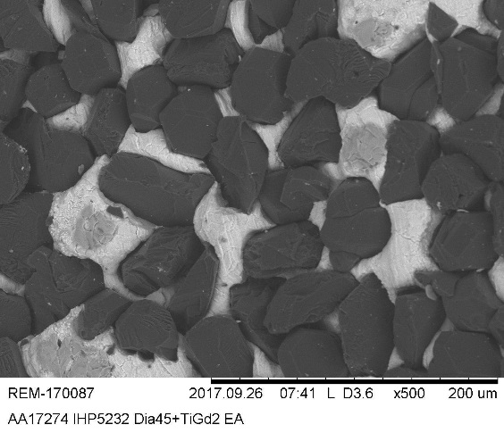
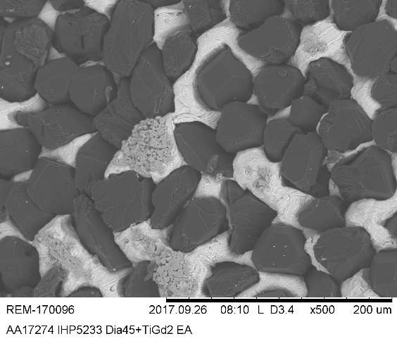
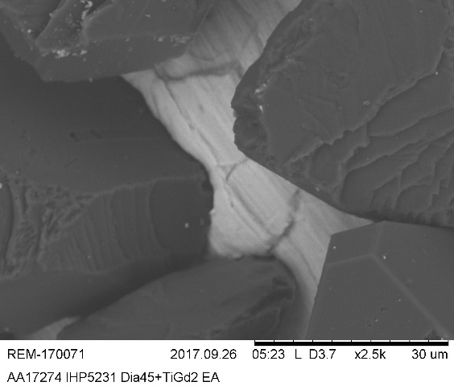
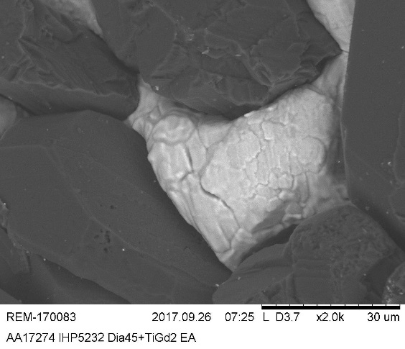
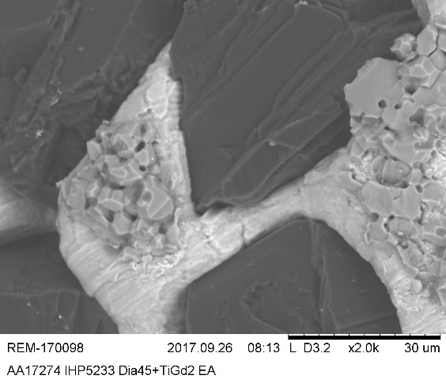
Results – Ti substrates
IHP5231-A
900°C/5min/30MPa
IHP5232-A
900°C/15min/30MPa
IHP5233-A
900°C/30min/30MPa

Slide 8
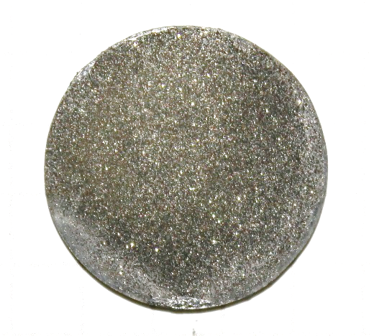
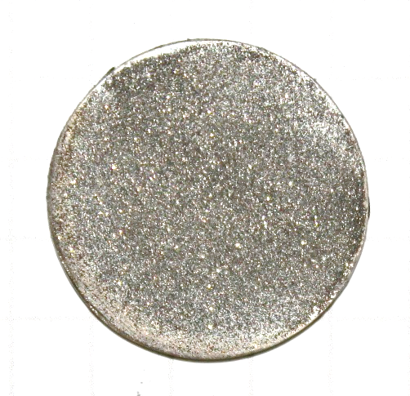
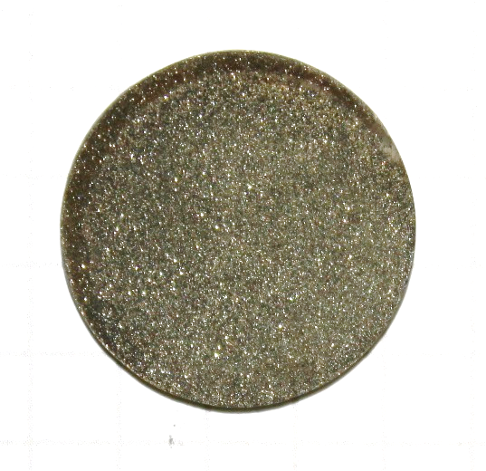
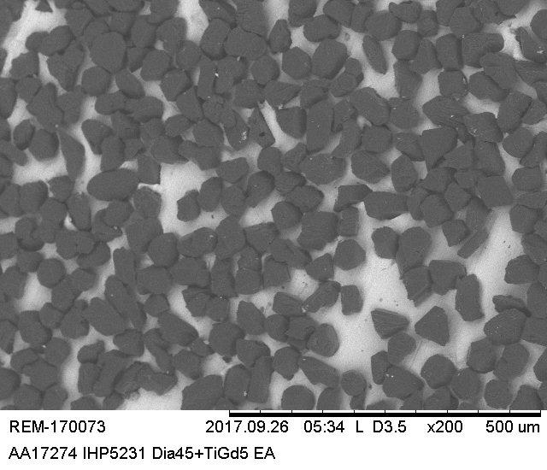
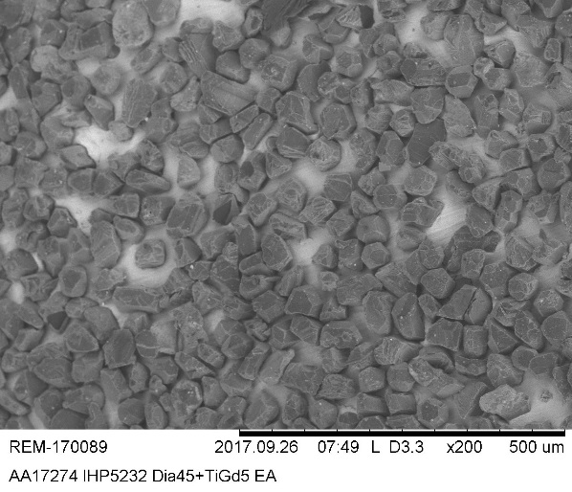
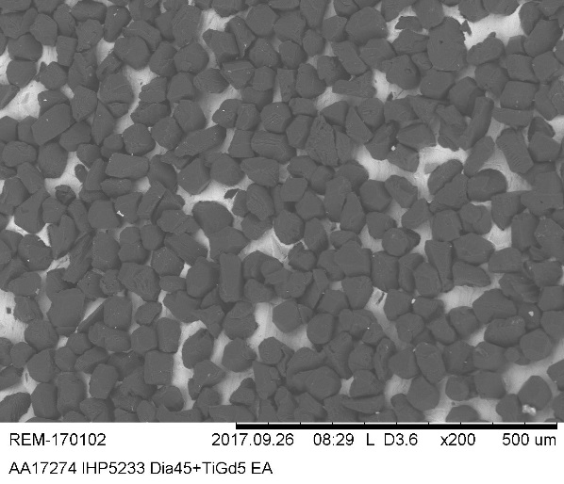
Results – Ti6Al4V substrates
IHP5231-B
900°C/5min/30MPa
IHP5232-B
900°C/15min/30MPa
IHP5233-B
900°C/30min/30MPa

Slide 9
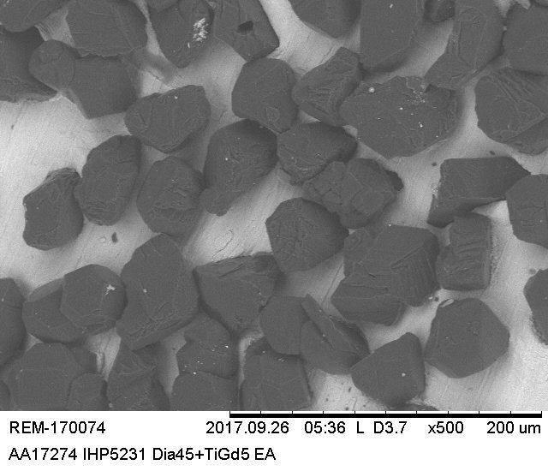
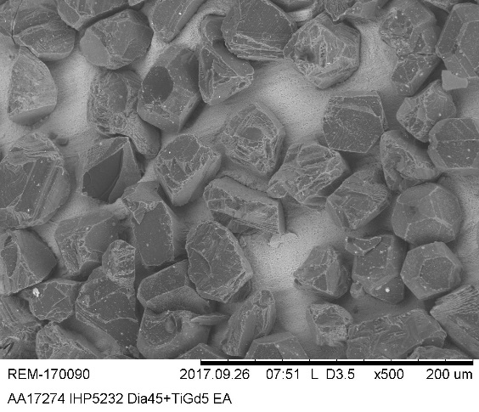
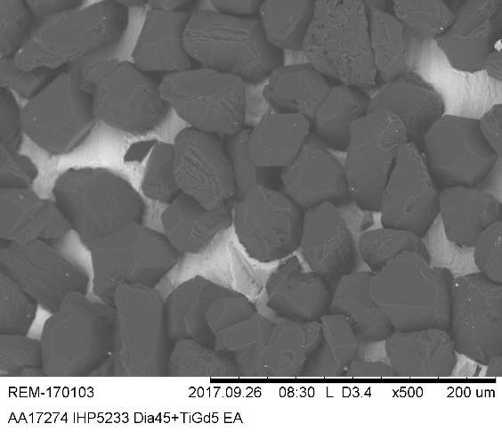
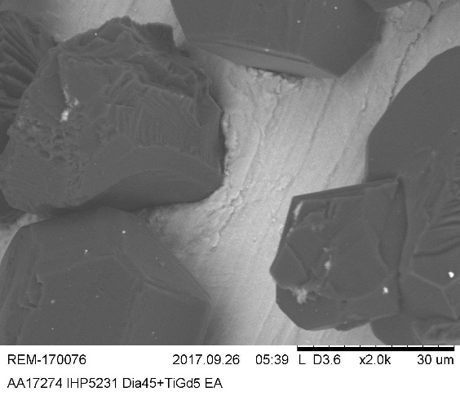
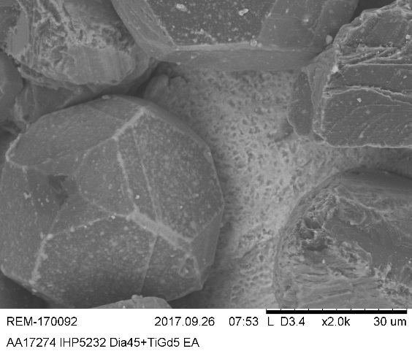
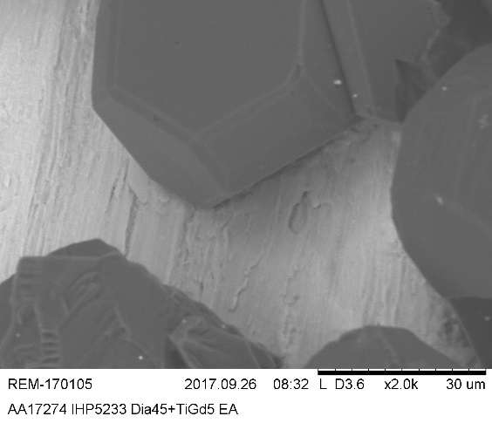
Results – Ti6Al4V substrates
IHP5231-B
900°C/5min/30MPa
IHP5232-B
900°C/15min/30MPa
IHP5233-B
900°C/30min/30MPa

Slide 10
Future plans/samples
Smaller diamond fractions -> Nanodiamonds??
Test further substrate materials
Diamond particles characterisation
Improve diamond embedding into substrate
Thinner substrates
Improve diamond distribution
Custom particle surface density
Notes:
The sample has been manufactured with IHP process

