Slide 1
Materials for extreme thermal management PowerMat (WP17)
WP17 1st Workshop, Politecnico di Torino
Lorenzo Peroni (POLITO)

Slide 2
Task 3 description
Task 3: Dynamic testing and online monitoring
  Testing of material samples in a broad range of environments:
  Mechanical testing in quasi-static and dynamic conditions, at various temperatures
  Tests under very high power laser and particle beams
  Irradiation tests with online monitoring of properties evolution
  Hydrodynamic simulations of experiments - constitutive models, spall strengths for new materials
  Participants: CERN, ELI-NP, GSI, POLIMI, POLITO

Slide 3
Milestones & Deliverables
Task 17.3) Irradiation, with publication of report on web[month 27]
Task 17.3) Irradiation effects analysis, with publication of report on web[month 36]
Task 17.3) Irradiation test results: Beam impact on new material and composite [month 48]

Slide 4
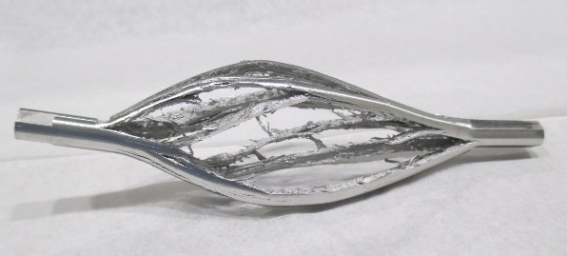
Task 17.3 today
An overview of the executed and planned HiRadMat experiments with particular reference to the materials under testing, methodologies and technique adopted, problems and solutions
Spall
fracture
Reflected shockwaves
Radiation damage
Molten zone/plasma
P>100GPa
BEAM
HRMT 27 | Rod Targ
r
depth
Vapour
Gas
SPLASH
Cylindrical shockwaves
attenuation
Solids

Slide 5
HiRadMat in the past
2012
​​Exp-ID | ​Title | ​Description | ​Contact Person | ​Status​ | ​Beam Period | Mobile Table​ | Storage (temporary)
​HRMT-09 | ​LCOL | ​LHC collimator tests | ​A. Rossi - CERN | Completed | w32,2012​ | (Table-04​)Table-04​)
​HRMT-14 | ​LCMAT | ​LHC collimator material R&D | ​A. Bertarelli - CERN | ​Completed | w39,w40-2012​ | Table-02​
2015
Exp-ID | Title | Description | Contact person | Status | Beam period | Mobile Table | Storage
HRMT 27 | Rod Targ | Benchmarking AD Target | Marco CALVIANI | Completed | 2015W45 | (Table 08)
HRMT 23 | Jaws | Prototyping LHC Collimator Jaws | Allessandro BERTARELLI | Completed | 2015W28 | (Table 02)

Slide 6
HiRadMat 2017
Exp-ID | Title | Description | Contact person | Status | Installation | Mobile Table | Storage
HRMT 35 | TDICoat | Même expérience que TCDI avec matériaux différents à tester. | Inigo Lamas Garcia | Completed | 2017W32 | Table 01 (CR002201) | 867-R-P58
HRMT38 | Flex MAT | (with "Girafe") |  | postponed | 2018 | #Table 03#
HRMT36 | Multi Mat | Validation of Collimator Materials (JAWS 2) | Allessandro BERTARELLI | Approved | 2017W40 | Table 02 (CR025436) | TNC Table B
HRMT18 | CRY2 | Structural tests of bending Crystals | Simone MONTESANO - Anton LECHNER-Marco Calviani | Completed | 2017W17 + W36 | Table 08 (CR002208) | Cooldown stand 1
HRMT 21 | RotColl | Validating the concept of a rotating collimator for MHC | Stefano Redealli | Completed | 2017W29 | Table 04 (CR002204) | Cooldown stand 2
HRMT 28 | TCDI | Prottyping TCDI collimator of LHC | Francois Xavier NUIRY | Completed | 2016W14 -> 2017W26 | (Table 01)
HRMT 37 | SextSc | test es(with "Girafe") |  | Postponed | 2018 | #table 08#
HRMT32 | MicOpt2 | testing opticale microphone as beam loss monitor | ​ | Postponed | 2018 | ​Special support | ​TNC
HRMT41 | Atlas Pixel |  |  | Completed | 2017W32 | Table 03 (CR002203) | 876-R-017
HRMT42 | TaScat |  | Claudio Loepoldo MARTIN | Completed | 2017W17 | (Table 08)

Slide 7
HiRadMat 2018
Exp-ID | Title | Description | Contact person | Status | Beam | Mobile Table | Storage Table
HRMT 32 | MicOpt | Measure performance of new radiation hard optical microphone | Daniel Deboy | Approved | 2018 W?? | Special support | TNC
HRMT 37 | SextSc | Measure damage limit of superconducting magnets | Daniel Wollmann | Approved | 2018 W34 | #Table 08# | Cooldown stand 1
HRMT 38 | Flex MAT | Test range of carbon material and target with intense proton beam | Marinela Tomut | Approved | 2018 W36 | ​#Table 03# | 876-R-017
HRMT 47 | Atlas PixRad | Estimate damage threshold of ATLAS inner detector & electronics | Antonio Sbrizzi | Approved | 2018 W19 | Table 03 (CR002203) | 876-R-017
​HRMT 48 | ​PROTAD | ​Test Prototype for future antiproton production target | ​Claudio Torregrosa, Marco Calviani | Approved | 2018 W21 | ​#Table 04# | ​Cooldown stand 2
HRMT 46 | Ntof-Target | Evaluate two different solution for n-ToF Target | Marco Calviani, Raffaele Esposito | Approved | 2018 W23 | #Table 08# | Cooldown stand 1
HRMT 45 | TDIS-TZM | Validation test of TDIS jaw sub assembly | David Perez, Antonio Perillo-Marcone | Approved | 2018 W30
HRMT 44 | TCDIL-DEEP | Test 2 designs of TCDIL collimator jaw | Francois-Xavier Nuiry | Approved | 2018 W28 | #Table 01# | 867-R-P58
HRMT 43 | BeGrid 2 | Test Thermal shock response of conventional and novel materials | ​Marco Calviani | Approved | 2018 W41 | ​#Table 03# | ​876-R-017
HRMT 19 | BLM2 | Verification of ionization chamber | Slava Grishin | Approved | 2018 W?? | Special support | TNC

Slide 8
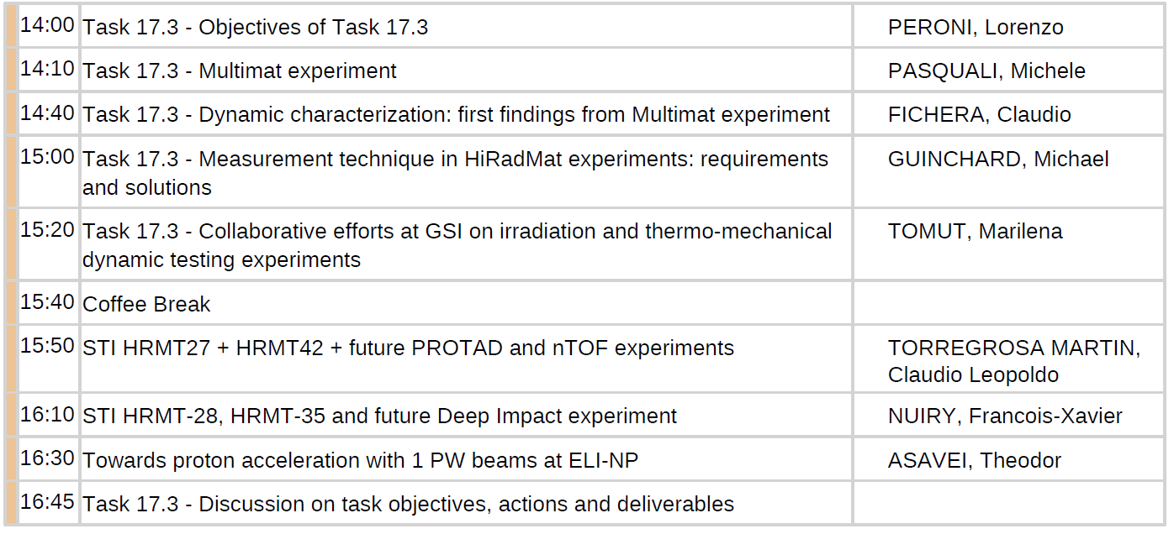
Task 17.3 today

Slide 9
Thank you!

