Slide 1


The HRMT-36 Experiment (MultiMat)
Michele Pasquali, CERN (EN/MME)
with contributions from A. Bertarelli, A. Dallocchio, E. Berthome, F. Carra, T. Furness, G. Gobbi, J. Guardia, M. Guinchard.
1st Workshop of ARIES WP17 PowerMat
Politecnico di Torino, Turin – November 27-28, 2017

Slide 2
Outline
The HRMT-36 Experiment (MultiMat)
    Introduction and Motivations
    Context of the Experiment
    Goals of the HRMT-36 Experiment
    Overview of the Experiment Design
    Controls and Actuation
    Data Acquisition and Instrumentation
    Test Run Description
    Materials Tested
    Theoretical Analysis and Expected Signals
Post-irradiation

Slide 3
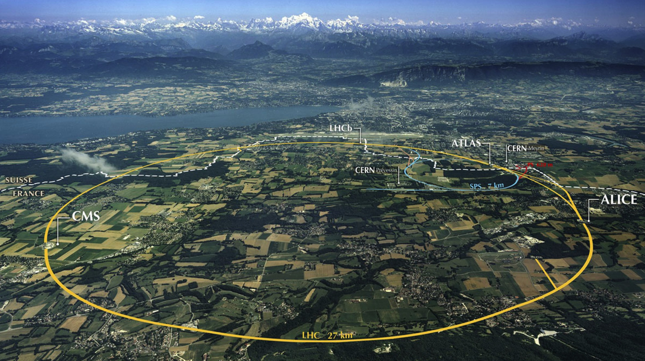
Large Hadron Collider (LHC): Big, Cold, Highly Energetic
Collimation
Injection B2
Beam dumps
Injection B1
Collimation
RF
CERN flagship. World’s largest scientific experiment
27 km underground tunnel
2 counter-rotating 7 TeV proton beams (bunched) in Ultra-High Vacuum at 1.9 K
8 Sections (Arcs and Straight Sections)
1 Radio Frequency System (Acceleration)
1 Beam Dump Point
2 Collimation Regions (Beam Cleaning and Machine Protection)

Slide 4
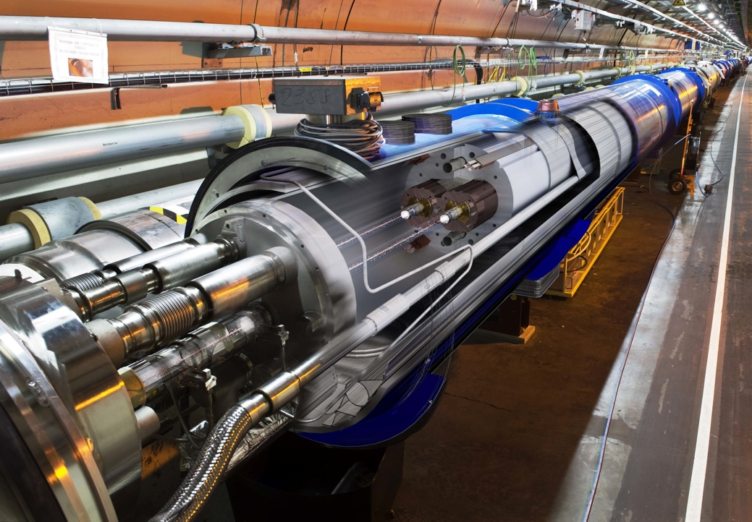
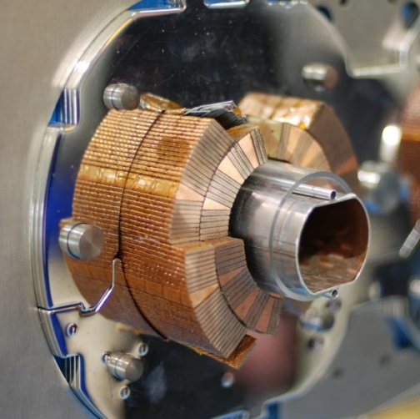
1232 Superconducting Magnets bend the particles!
Superconducting coil (T = 1.9 K)
Exposed to particle induced Quench
Proton beam: 362 MJ
(HL-LHC Upgrade: 690 MJ)

Slide 5
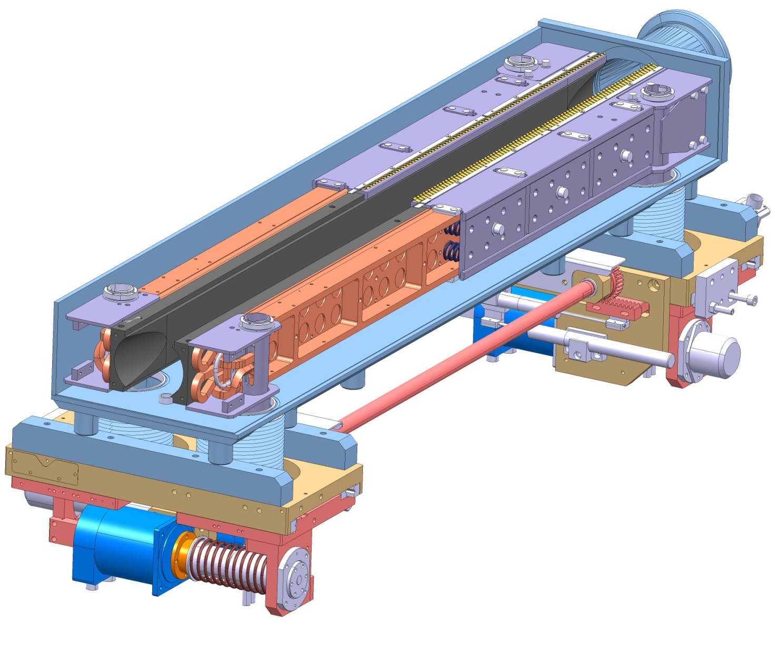
LHC Collimation System
Introduction and Motivations
Several types of collimators for multi-stage cleaning (primary, secondary, tertiary units) at multiple LHC locations (100+ Collimators).
Active part of jaws made of various materials
(Carbon-Carbon, Graphite, Copper,
Tungsten Heavy Alloy...)
Jaw Assembly (1.2 m long)
Jaw Block
(Carbon-Carbon)
Vacuum Vessel
Particle Beam
Jaw Cooling system
Actuation system
LHC Secondary Collimator (TCSG) Cutaway
Notes:
5

Slide 6
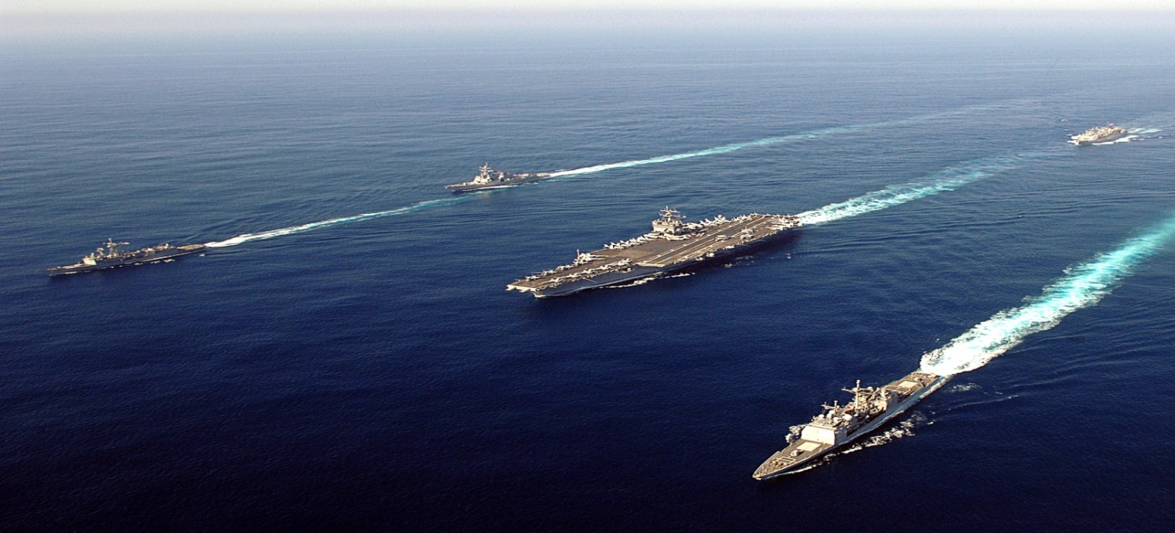
LHC Collimator Requirements
Introduction and Motivation
Collimators are required to survive the beam-induced accidents to which they are inherently exposed given their vicinity to the beam
They must possess extremely accurate jaw flatness to maintain their beam cleaning efficiency
The collimation system is, by far, the highest contributor to accelerator impedance which may significantly limit machine performances: they must have lowest possible electrical resistivity
Their lifetime and efficiency should be conserved under long-term particle irradiation
No existing material can simultaneously meet all requirements for LHC Future Upgrades!
Development of Novel advanced materials,
along with state-of-the-art simulations to face these challenges.
Bunched charged particles passing near a non-perfect conductor generate EM wake-fields, which perturb following bunches (as ship wakes in the sea …)

Slide 7
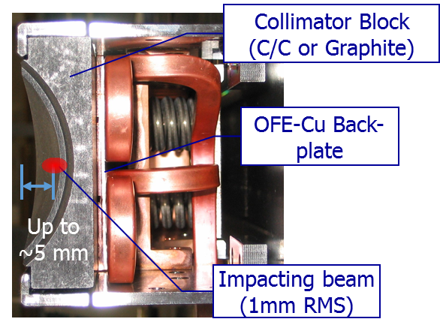
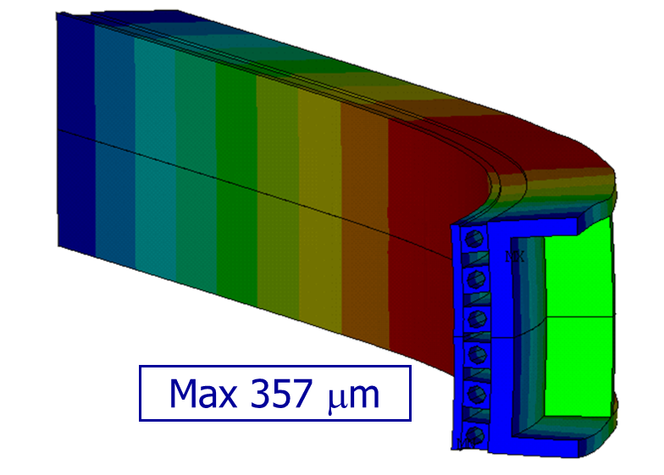
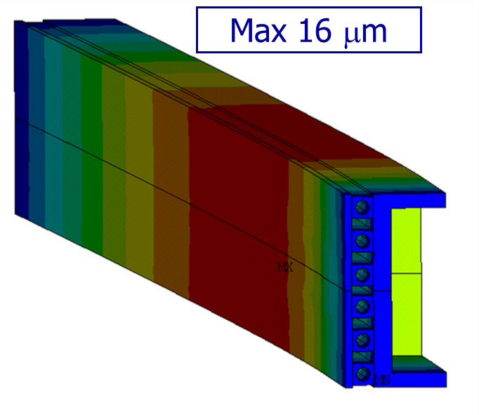
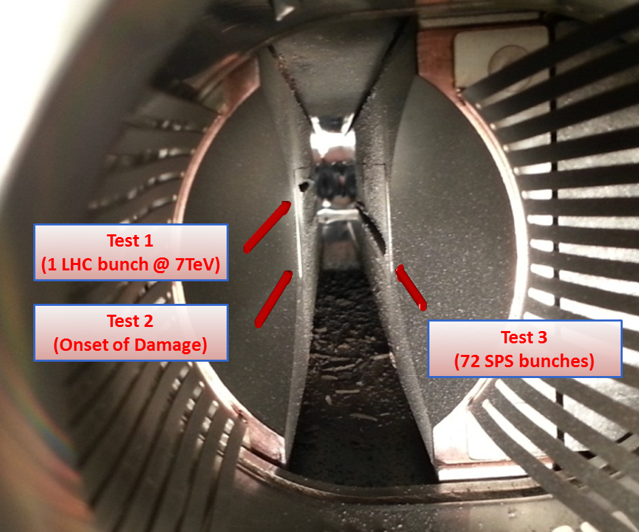
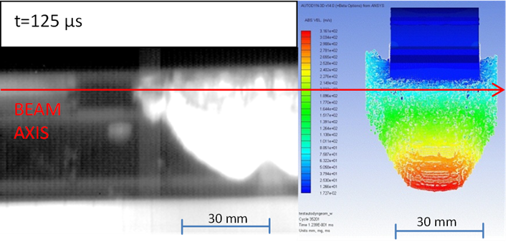
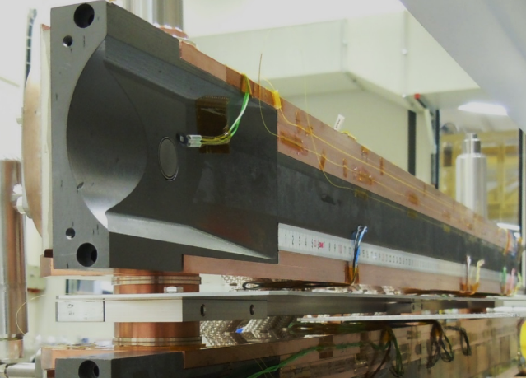
History of Collimation Impact Tests
Context of the Experiment
2004: full TCSG collimator in TT40 (CFC + Graphite blocks)
  Block material ok, but unacceptable deformation found on Cu jaw support! Cu back-plate was then changed to Glidcop.
2006: full TCSG collimator in TT40 (CFC)
  Validated final TCP/TCS design!
2012 HRMT-09: full TCT collimator (Tungsten alloy) in HiRadMat
  Allowed deriving damage limits for Tertiary Collimator jaw
2012 HRMT-14: test of specimens from 6 different materials, including novel composites
  Materials characterization, constitutive models and simulation benchmarking
2015 HRMT-23: 3 full jaws (1 TCSG C/C + 2 new TCSPM MoGr and CuCD)
  Validated TCSPM with MoGr against HL-LHC density; confirmed C/C robustness with HL-LHC; validated CuCD robustness as TCT alternative; confirmed Glidcop tapering limits in deep accident.

Slide 8
Objectives and Rationale of HRMT-36 Experiment
Goals of the HRMT-36 Experiment
Request by the LHC Collimation project mainly to assess/validate materials for the HiLumi upgrade.
Offer a single, flexible platform to test specimens of a large palette of materials (including coatings, anisotropic materials, foams etc.) used in Collimators (and other Beam Intercepting Devices) under high brightness beams (as close as possible to HL-LHC and LIU/BCMS).
Dedicate target stations to assess behaviour of components (sensors, electronic devices, beam diagnostics, etc.) in close vicinity of high intensity beams.
Acquire online material dynamic responses and derive / extend constitutive models (to be reused in simulating full scale devices) without reaching extensive material degradation (with the possible exception of coatings)
Benchmark complex numerical simulations with little known constitutive equations
Design the experiment to be cost effective and reusable
Reuse existing equipment and instrumentation as much as possible
Allow rapid specimens disassembling in view of Post Irradiation Examination completing material characterization.

Slide 9
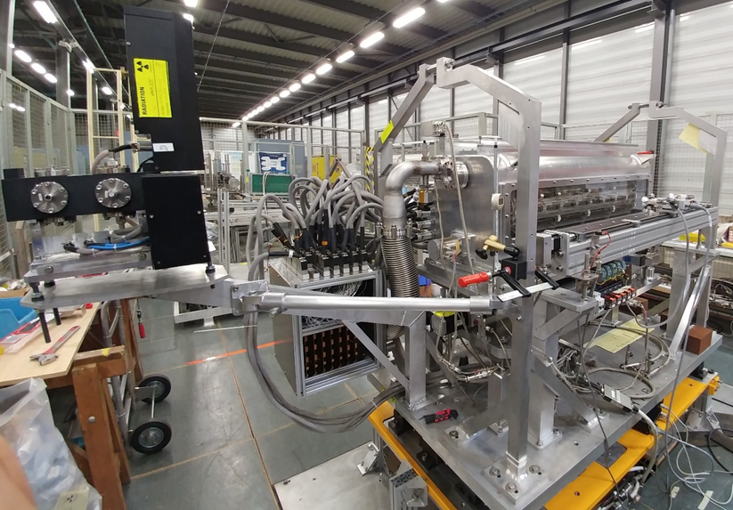
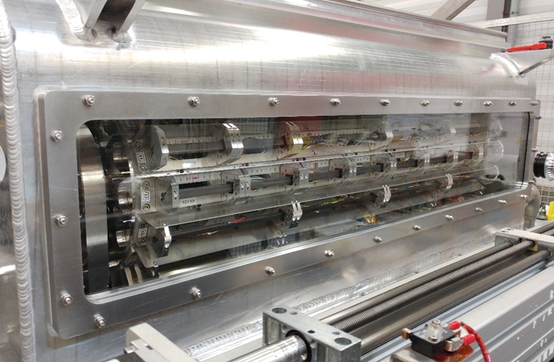
MultiMat Experiment Overview
Overview of the Experiment Design
Al vessel hosting 16 target stations on a rotatable barrel. Each target station equipped with several specimens of 18 materials
Vessel cooled by forced Ar inert gas (rapid cooling ⇒ faster pulse repetition; ΔP ≈ 0 bar ⇒ lighter structure/larger optical windows/lower costs)
Comprehensive Acquisition system based on Strain Gauges, Temperature probes, LDV, Rad-hard Camera
Dedicated station for Adaptive Collimation System demonstrator (University of Huddersfield)
Beam monitoring always-on Glassy C OTR BTV on Table A and embarked BPKG and BTV.
LDV and non rad-hard controls located in TT61 and TJ7

Slide 10
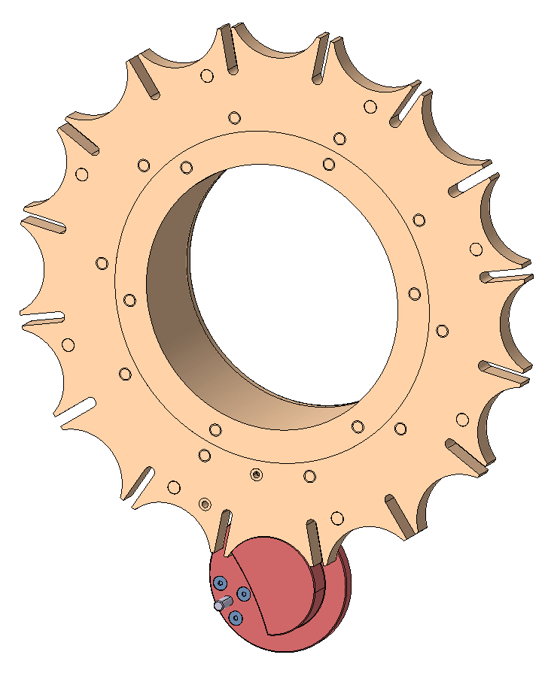
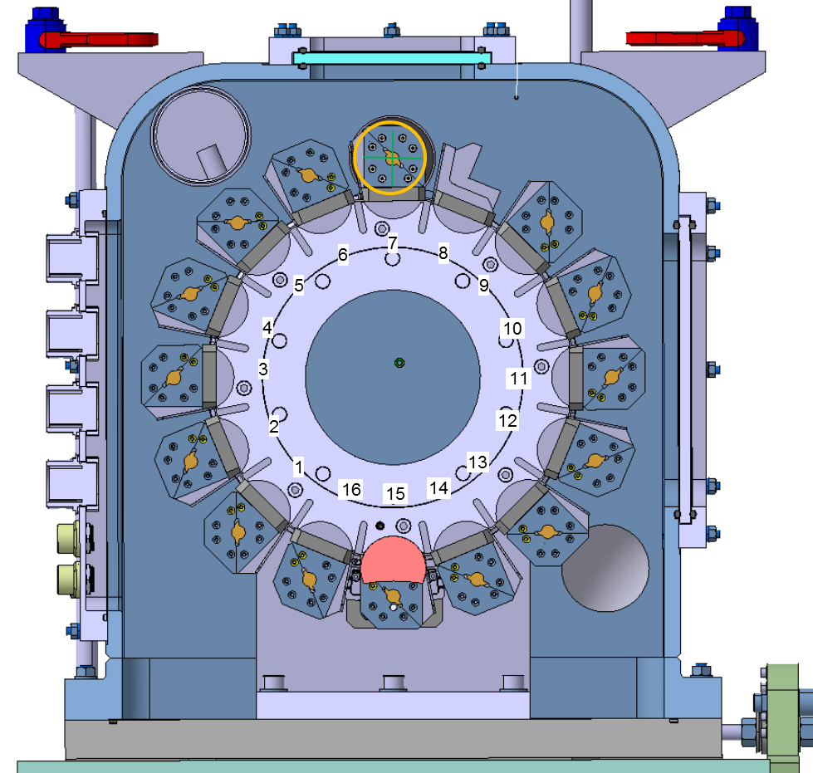
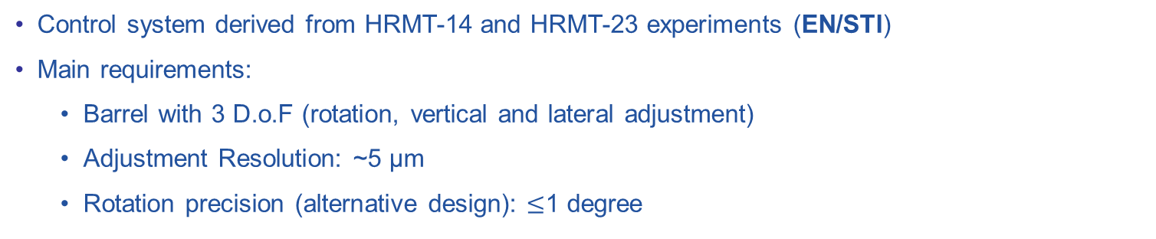
HRMT-36 Actuation Controls
Controls and Actuation
Control system derived from HRMT-14 and HRMT-23 experiments (EN/STI)
Main requirements:
  Barrel with 3 D.o.F (rotation, vertical and lateral adjustment)
  Adjustment Resolution: ~5 μm
  Rotation precision (alternative design): $≤$1 degree
Maltese cross for 16 lines (Geneva mechanism)
Mirror translation:
1100mm
2 mm/rev
Barrel rotation
+180°/-180°
Stepper Motor
22.5° / rev
(with Malta Cross)
Lateral Adjustment
+/-15mm
Stepper Motor
0.25 mm/rev
Vertical Adjsustment
+/-15mm
Stepper Motor
0.25 mm/rev
Camera translation
1200mm
2 mm/rev
M. Pasquali, CERN 1st Workshop of ARIES WP17 PowerMat – November 27-28, 2017

Slide 11
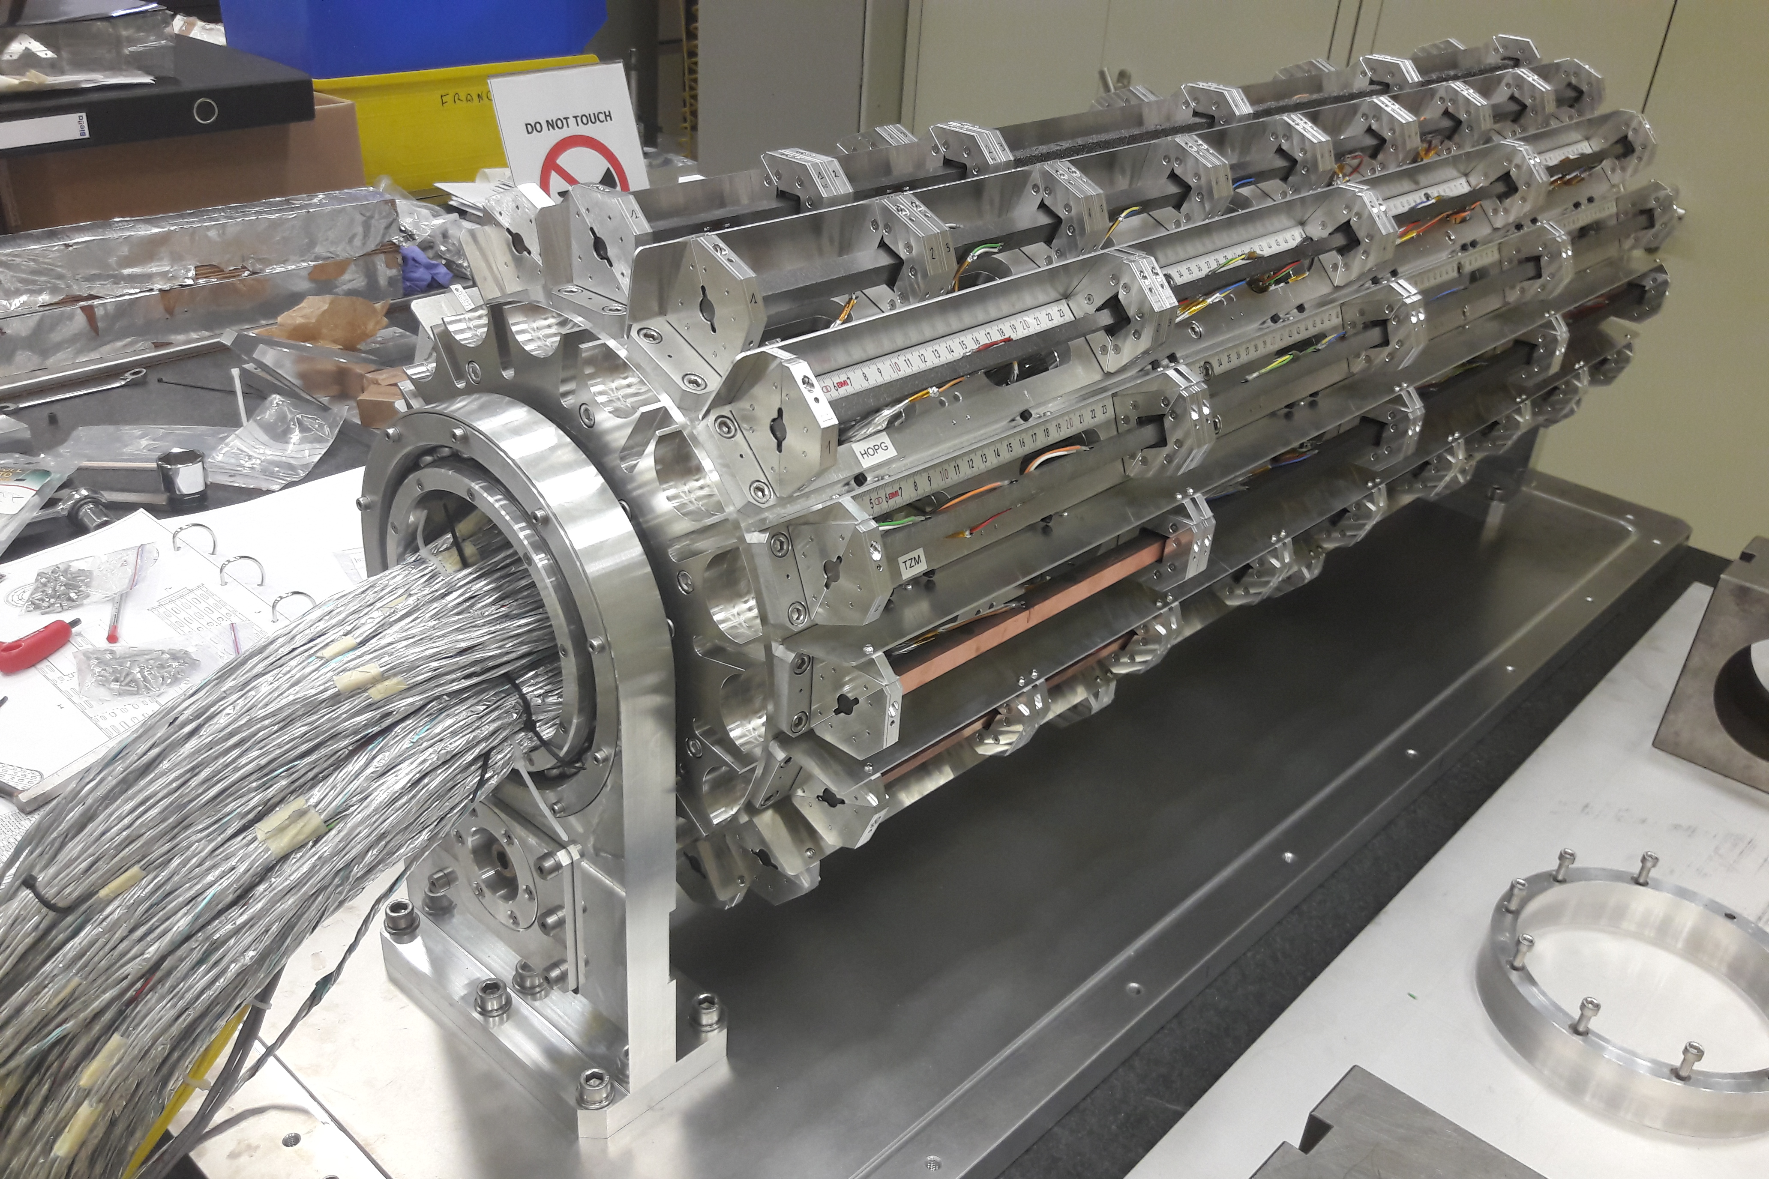
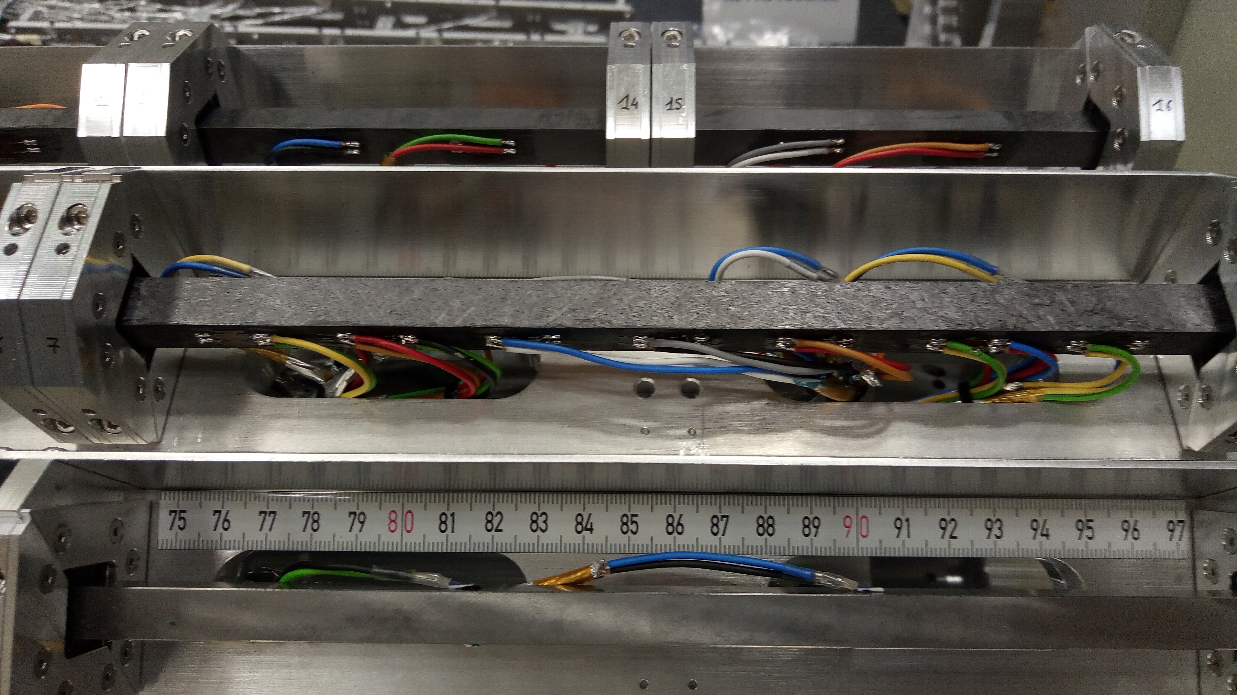
The Acquisition System
Data Acquisition and Instrumentation
The acquisition system featured:
335 electrical strain gauges placed depending on the material and on the deposited energy distribution (longitudinal/transverse strain);
112 electrical temperature probes (total of 894 wires);
1 laser-doppler vibrometer (speed of spec. top faces);
1 Rad-hard camera (side-mounted);
4 optic fibers integrated on the Adaptive Collimation System demonstrator (University of Huddersfield)
Physical effects | Amplitude threshold | Freq. range | Samp. Freq. | Sensors selected
Longitudinal waves | 20 μm/m | ≈ 50kHz + pulse | 1MHz | Electrical strain gauges
Bending waves | 20 μm/m | ≈ 2000Hz | 1MHz | Electrical strain gauges
Temperature | 20°C | ≈ 1Hz | 100Hz | Pt100
Radial oscillation | 0,05 m/s | ≈ 2000Hz | 1MHz | Laser Doppler Vibrometer
Surface damage | - | - | - | Rad-hard camera or 4K Camera

Slide 12
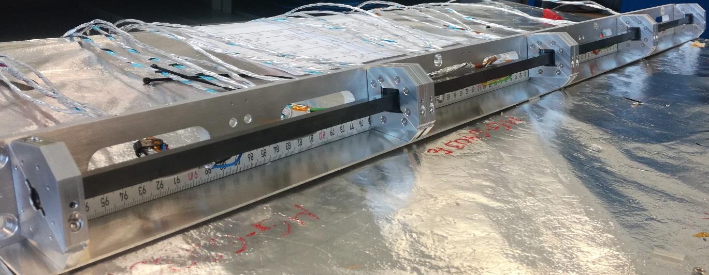
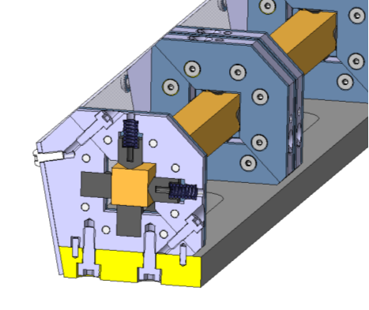
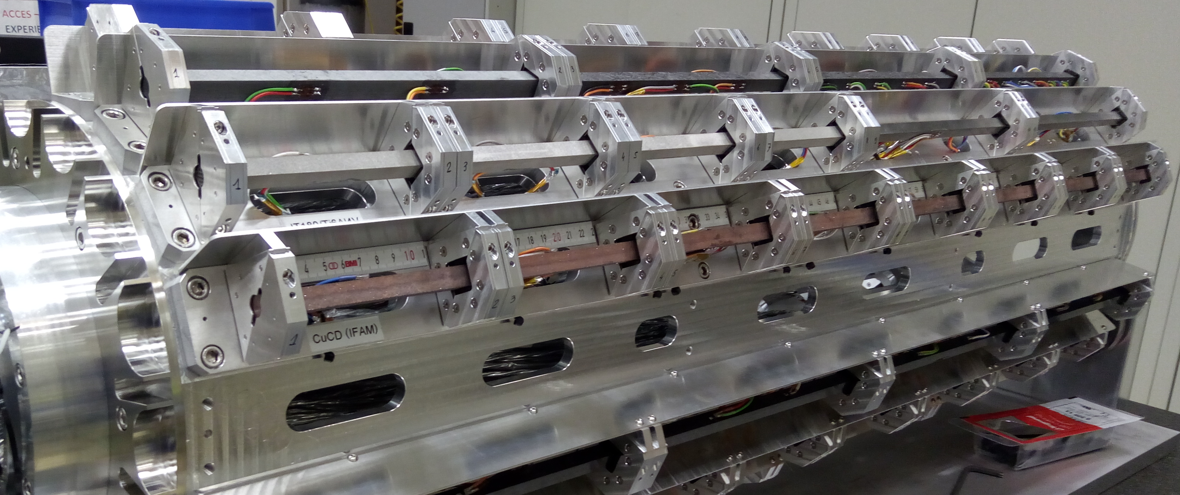
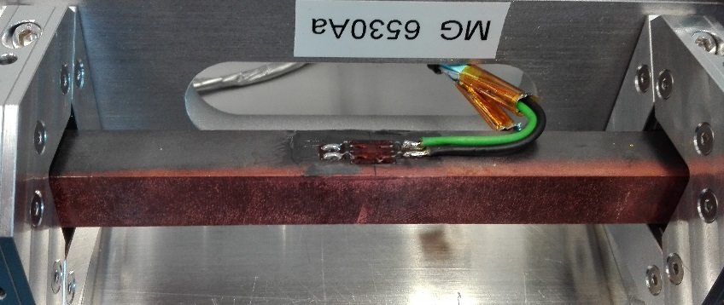
Specimens description
Overview of the Experiment Design
Specimens of simple geometry (slender bars, length 120 or 247 mm) to generate simple wave signals, relatively easy to acquire and benchmark. Some low-Z samples coated (Mo, Cu, TiN)
Simply supported bars, axially free to expand.
Mainly square cross section (8×8 to 12×11.5 mm²) to disentangle anisotropy and simplify PIE

Slide 13
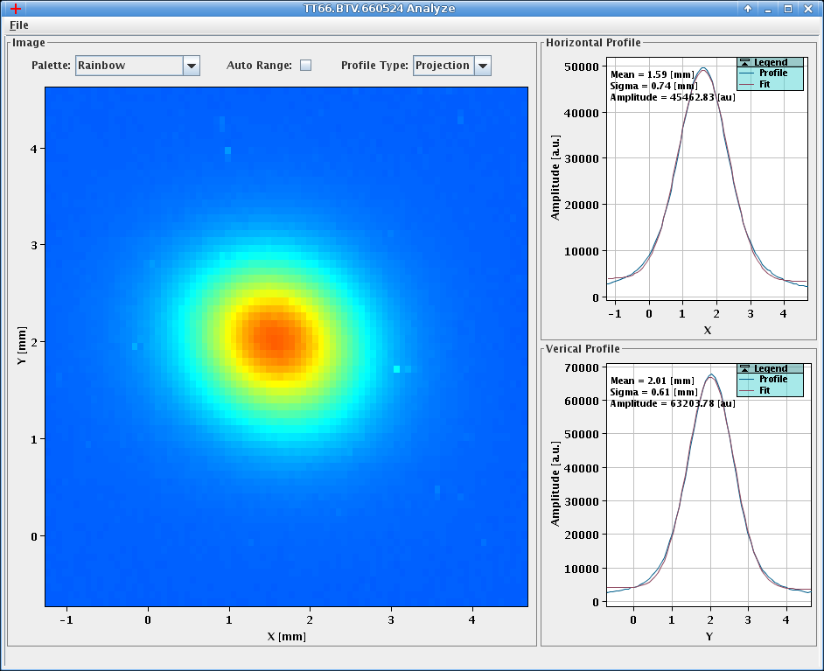
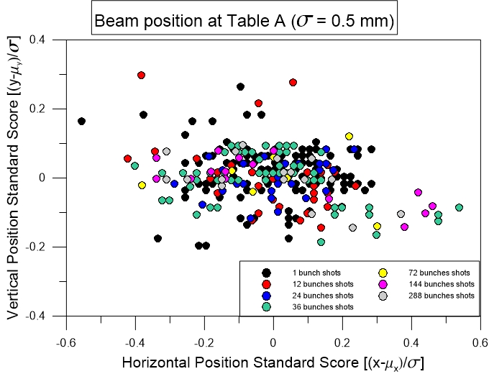
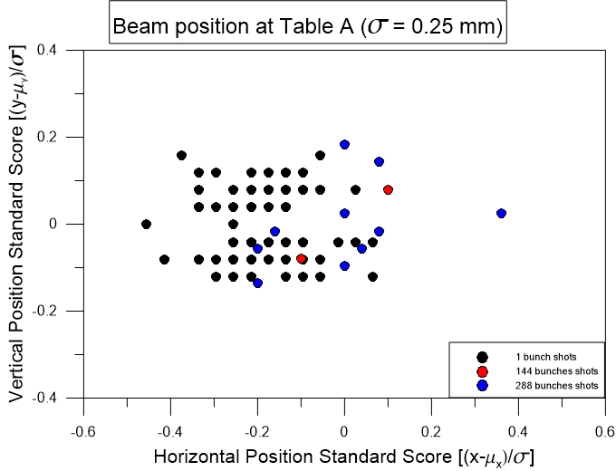
Experiment Runs
Test Run Description
Installed 2 October at HiRadMat facilities
Experimental runs from 3 October to 17 October
478 pulses (including BBA and parking position) 2.25x10¹⁵ POT
Intensity ranging from 1 to 288 b, typically 1.3x10¹¹ p/b
Beam rms size (nom.): 0.25×0.25, 0.5×0.5, 2×2 mm²
Good beam stability and repeatability, particularly important for grazing impacts;

Slide 14
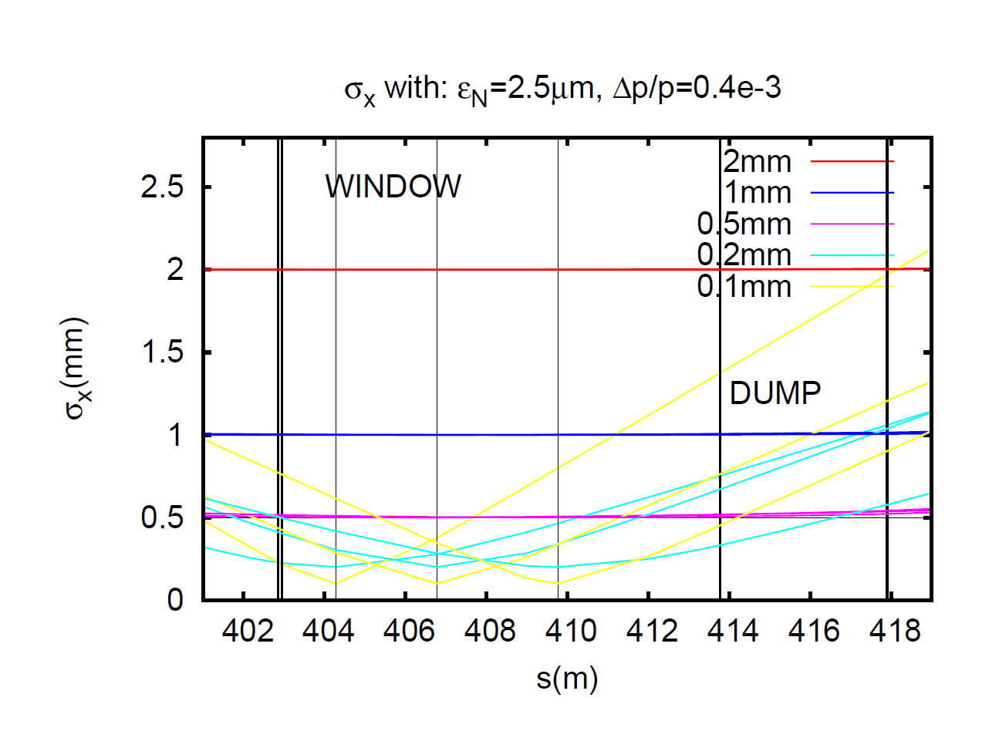
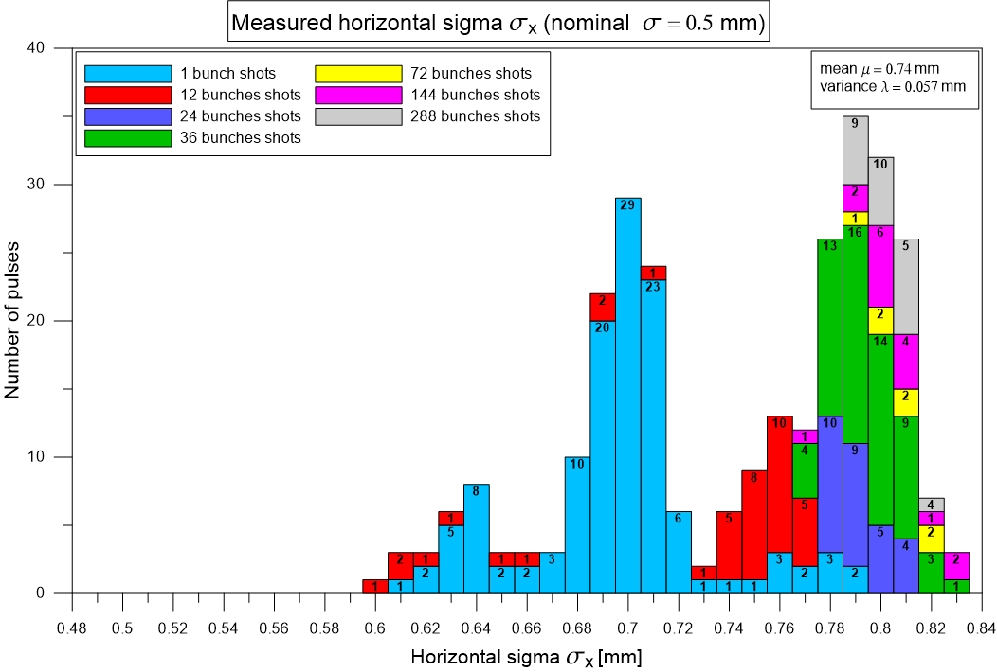
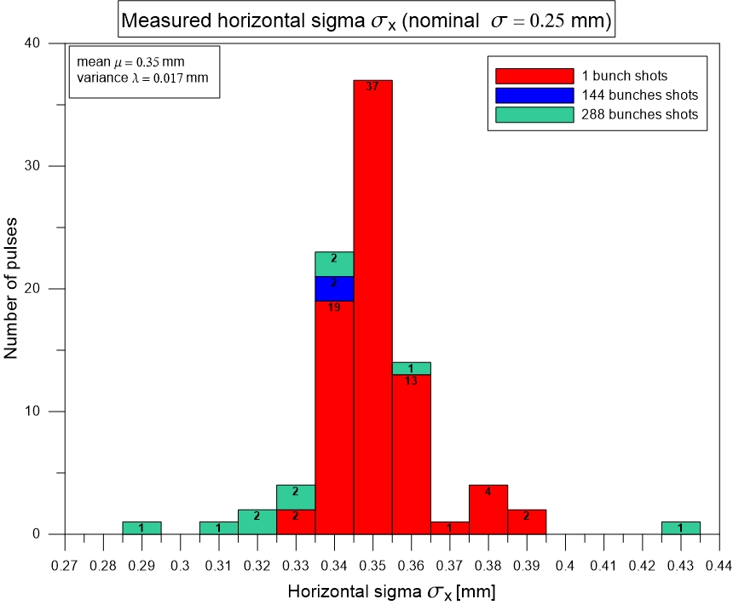
Experiment Runs
Test Run Description
Beam position and sigma (BTV/BPKG)
* Estimations still under evaluation

Slide 15
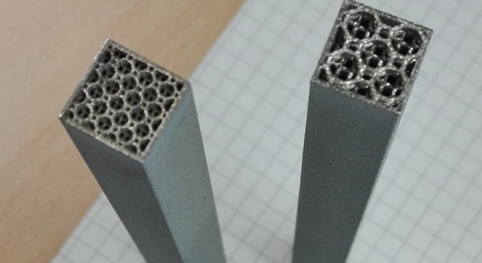
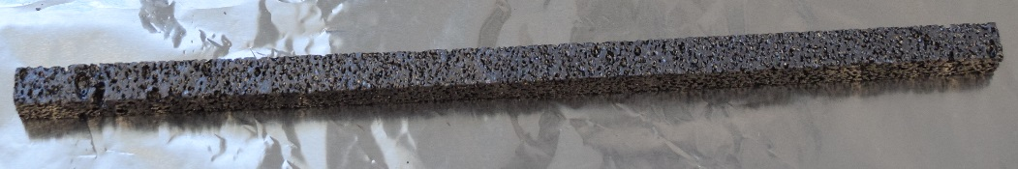
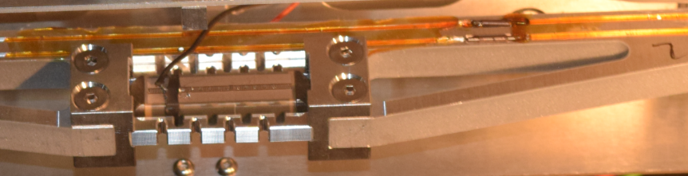
Materials Tested in the HRMT-36 Experiment
Tested Materials
18 materials/grades tested.
4 grades of MoGr from 2 manufacturers (BB and Nanoker)
3 coatings, Cu, Mo (CERN) and TiN (DTI)
Different combination of surface and thermal treatments (48h firing, CO2 blasting, US cleaning);
2 grades of CuCD from 2 suppliers (RHP and IFAM)
Novel carbon-based materials as HOPG (Highly-Ordered Pyrolitic Graphite) and Titanium-Graphite (TG-1100)
Additively Manufactured Titanium samples (Ti6Al4V);
Actively controlled (via piezoelectric transducers) Al samples (UoH)
# | Material | Density [g/cm³] | Coated | Coating Material
1 | IT180 | 18.0 | ✗
2 | Ta10W | 16.9 | ✗
3 | Ta2.5W | 16.7 | ✗
4 | TZM | 10.0 | ✗
5 | CuCD IFAM | 5.40 | ✗
6 | CuCD RHP | 5.40 | ✗
7 | SiC | 3.21 | ✗
8 | MG-6403Fc | 2.54 | ✓ | 5μm TiN
9 | ND-7401-Sr | 2.52 | ✗
10 | MG-6530Aa | 2.50 | ✓ | 2μm Cu
11 | MG-6541Fc | 2.49 | ✓ | 8μm Mo
12 | HOPG | 2.26 | ✗
13 | TG-1100 | 2.19 | ✗
14 | R4550 | 1.90 | ✓ | 2μm Cu
15 | CFC AC150K | 1.88 | ✓ | 8μm Mo
16 | Ti6Al4V (AM) | 1.62 | ✗
17 | CFOAM | 0.40 | ✗
18 | Al 6082-T651 (UoHud) | 2.70 | ✗
high
density
medium
density
low
density
Dedicated setup

Slide 16
Materials Requirements for BIDs
Tested Materials
Key properties must be optimized to meet requirements for Beam Intercepting Devices in High Energy Particle Accelerators …
Electrical Conductivity. Maximize to limit Resistive-wall impedance
Thermal Conductivity. Maximize to maintain geometrical stability under steady-state losses
Coefficient of Thermal Expansion. Minimize to increase resistance to thermal shock induced by accidental beam impact
Melting/Degradation Temperature. Maximize to withstand high temperatures reached in case of accidents
Specific Heat. Maximize to improve thermal shock resistance (lowers temperature increase)
Ultimate Strength. Maximize to improve thermal shock resistance
Density. Balance to limit peak energy deposition while maintaining adequate cleaning efficiency
Radiation-induced Degradation. Minimize to improve component lifetime under long term particle irradiation
Outgassing Rate. Minimize to ensure compatibility with UHV environment.
Most requirements shared with applications requiring highly efficient Thermal Management and Thermal Shock Resistance! Possibility of spin-offs

Slide 17
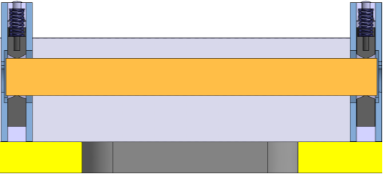
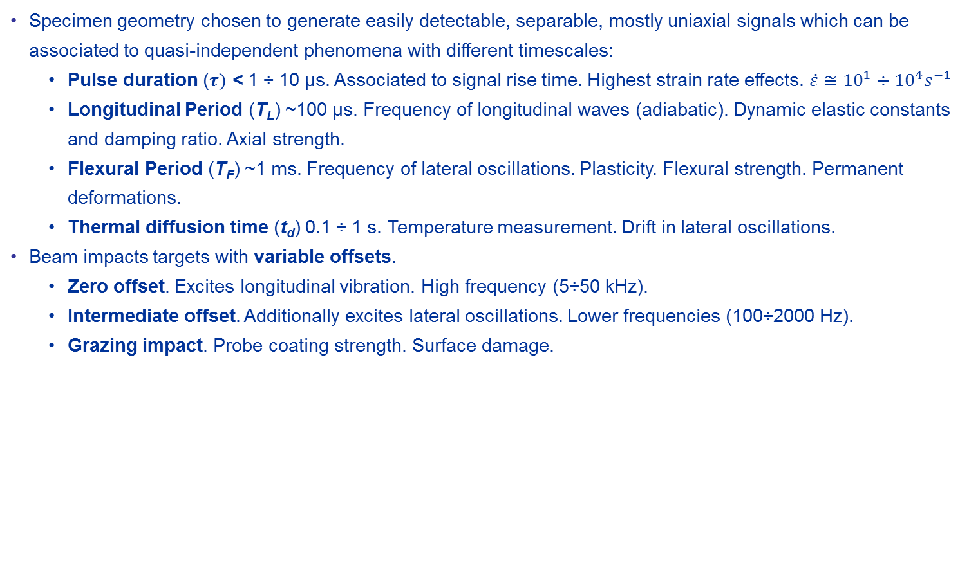
Expected Signals and Material Modelling
Theoretical Analysis and Expected Signals
Specimen geometry chosen to generate easily detectable, separable, mostly uniaxial signals which can be associated to quasi-independent phenomena with different timescales:
  Pulse duration ($τ)$ < 1 ÷ 10 μs. Associated to signal rise time. Highest strain rate effects. $\dot{ε}≅{10}^{1}÷{10}^{4}s^{−1}$
  Longitudinal Period (T_{L}) ~100 μs. Frequency of longitudinal waves (adiabatic). Dynamic elastic constants and damping ratio. Axial strength.
  Flexural Period (T_{F}) ~1 ms. Frequency of lateral oscillations. Plasticity. Flexural strength. Permanent deformations.
  Thermal diffusion time (t_{d}) 0.1 ÷ 1 s. Temperature measurement. Drift in lateral oscillations.
Beam impacts targets with variable offsets.
  Zero offset. Excites longitudinal vibration. High frequency (5÷50 kHz).
  Intermediate offset. Additionally excites lateral oscillations. Lower frequencies (100÷2000 Hz).
  Grazing impact. Probe coating strength. Surface damage.

Slide 18
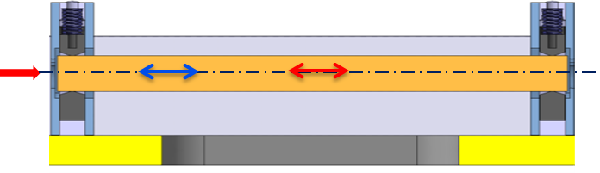
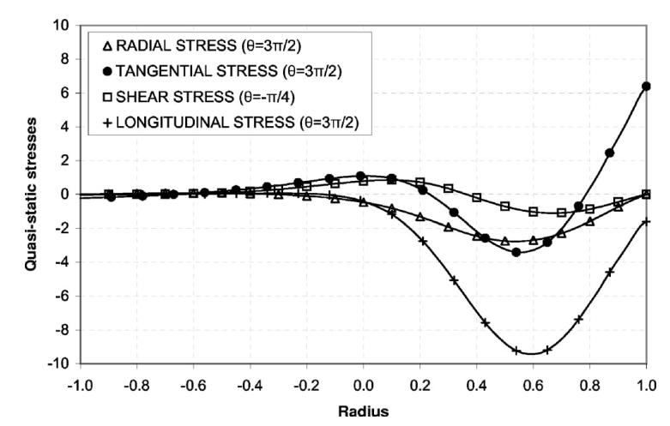
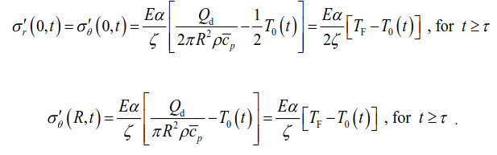

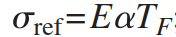
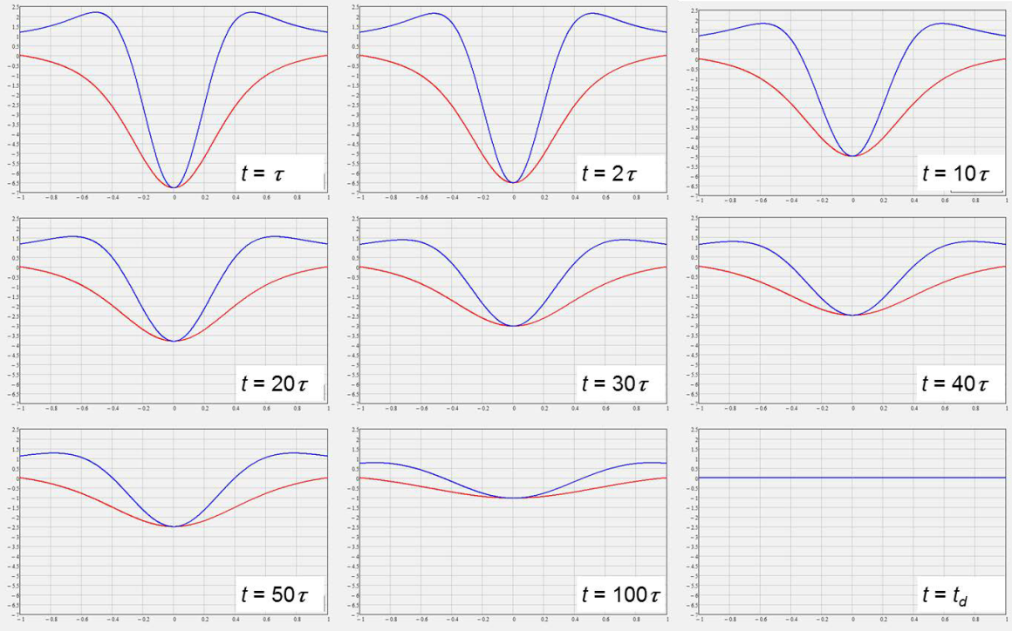
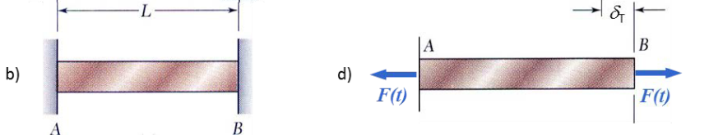
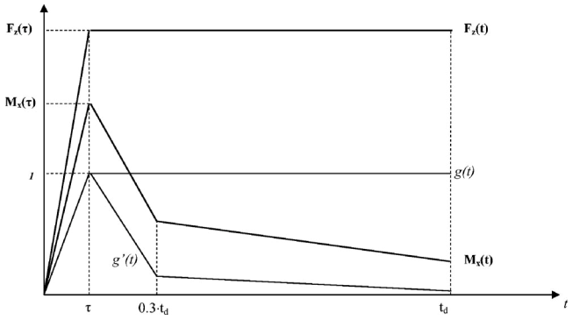


No Offset Impact
Theoretical Analysis and Expected Signals
Excites longitudinal vibration.
High frequency (5÷50 kHz).
Shock. Strain rate effects. Internal damping.
Main Hypotheses:
Linear elastic model - No cost. dep. on T
Weak thermo-mechanical coupling
Negligible radial inertia effects
+
F(t)
F(t)
Deposition time
τ ~ 10⁻⁸ ÷10⁻⁶ s
Diffusion time (section)
t_{d} ~ 1 s

Slide 19
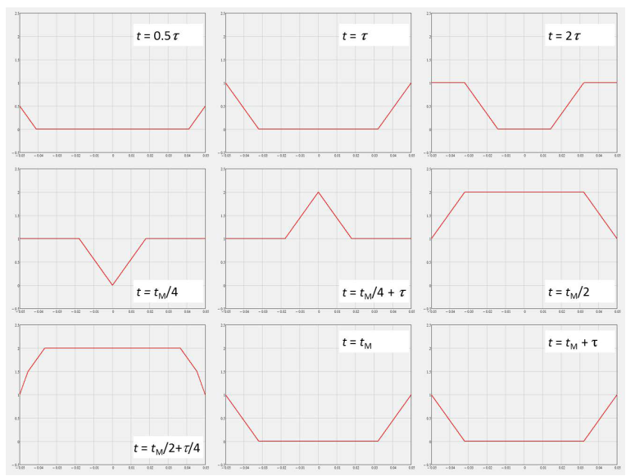
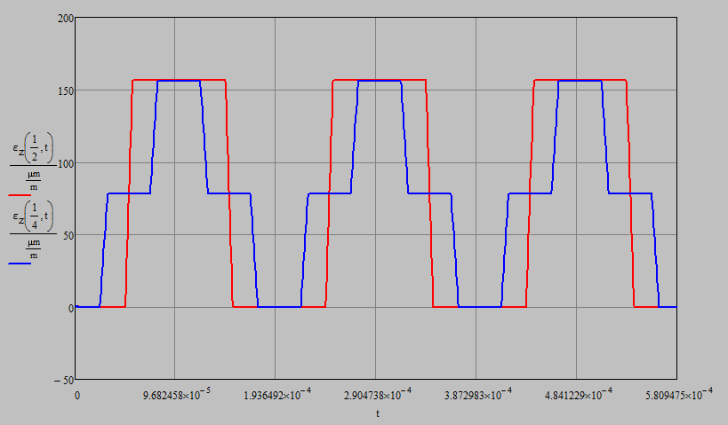
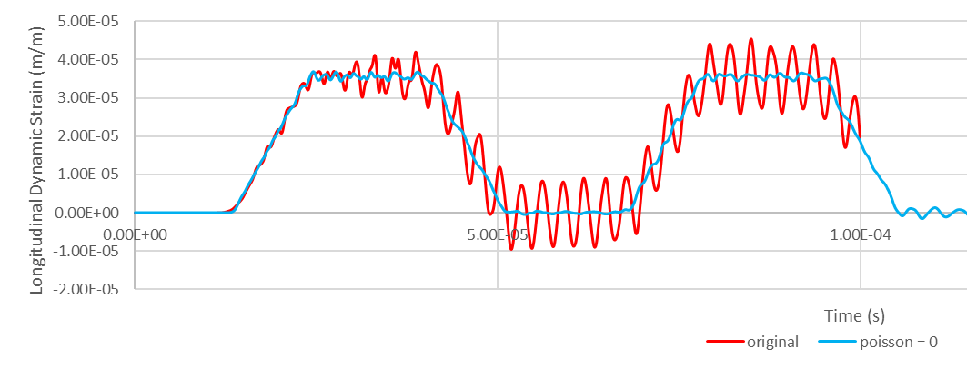
No Offset Impact
Theoretical Analysis and Expected Signals
Excites longitudinal vibration.
High frequency (5÷50 kHz).
Shock. Strain rate effects. Internal damping.
Weaker signals for low-Z materials → Small cross-section
Larger beam size (2 mm) to prevent excessive radial and azimuthal stresses in high-Z materials
Radial waves (ignored in analytical approximation) depending on Poisson’s ratio and target geometry

Slide 20
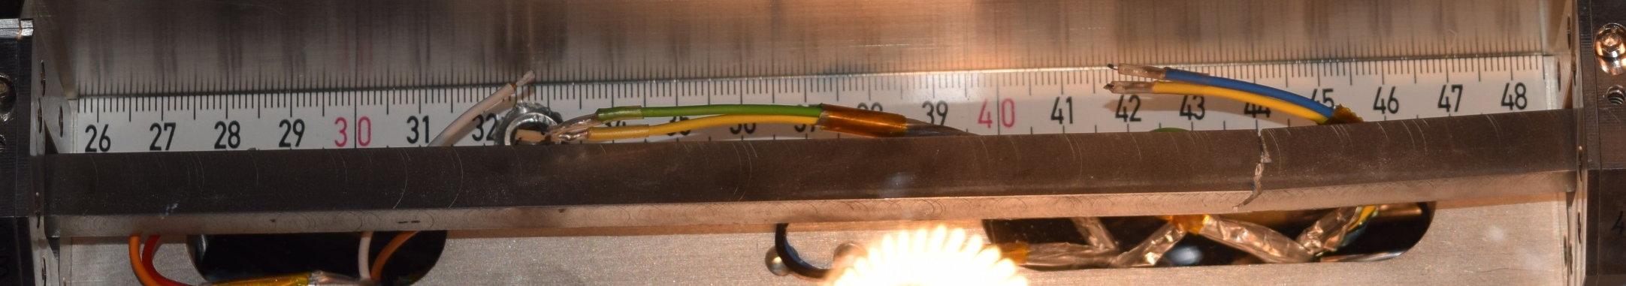
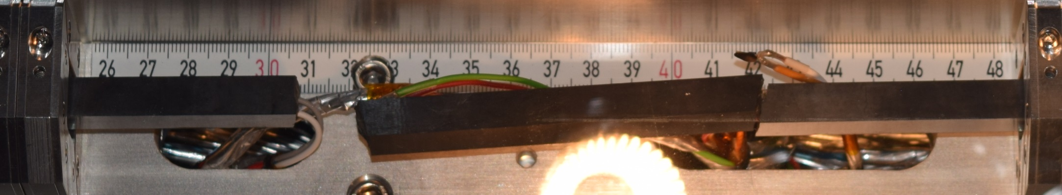
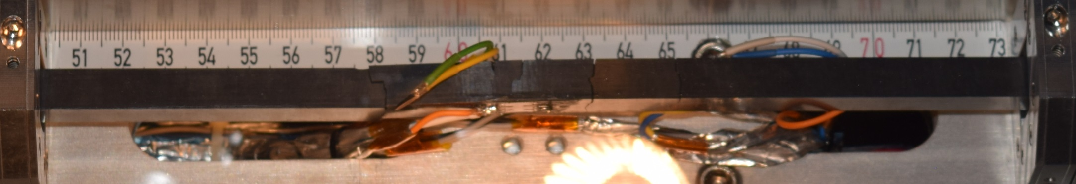
No Offset Impact: TZM and SiC
Theoretical Analysis and Expected Signals
TZM after 12 b,
No offset
SiC after 36 b,
No offset
SiC after 36 b,
No offset

Slide 21
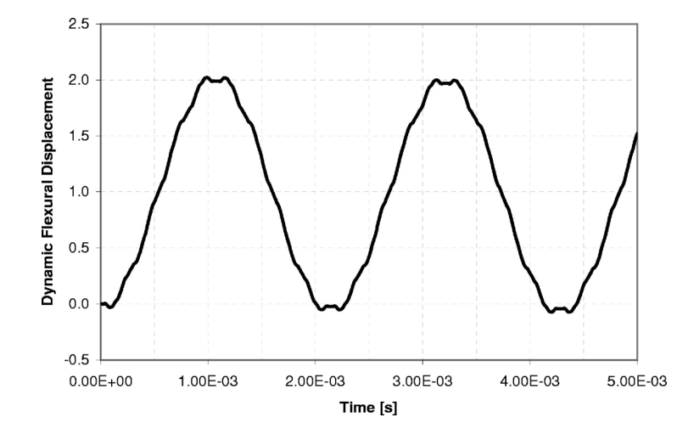
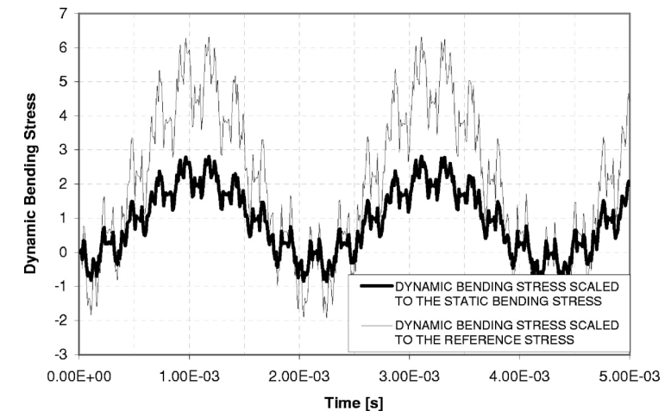

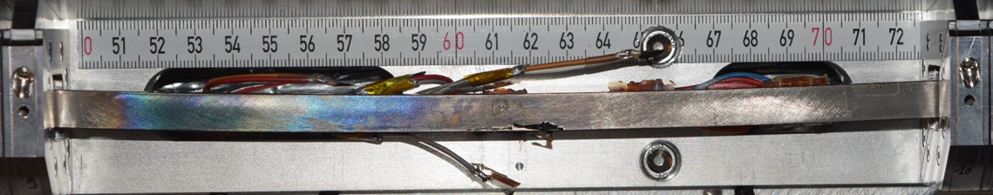
Offset Impact
Theoretical Analysis and Expected Signals
Intermediate offset.
Lower frequencies (100÷2000 Hz).
Material strength. Delamination. Internal damping.
Larger signal intensity
+
F(t)
F(t)
M(t)
M(t)
Drift
IT180 after 24 b,
2 mm offset

Slide 22
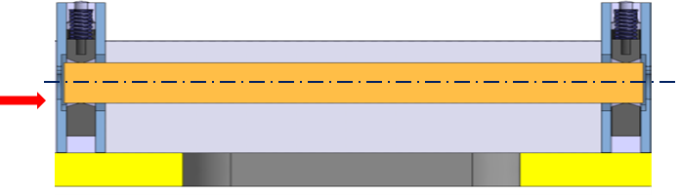


Grazing Impact
Theoretical Analysis and Expected Signals
288 b, σ 0.25 mm, impact -500 µm
Grazing impact. Probe coating strength (Cu, Mo, TiN) and surface damage.
Coating on 0 – 250 mm (first specimens)
Smallest available beam size (0.25×0.25 mm²) at max bunch intensity (1.4e11 p/b) to mimic or exceed HL-LHC energy density
Impacts at 144 (on Cu) and 288 b (all) at different spots
2 impact parameters: -150 µm and -500 µm from the surface
Target alignment by BTV combined with Beam-based alignment
144 b, σ 0.25 mm, impact -150 µm
MoGr (MG6530Aa) with
2 µm Cu + 0.5 µm Ti coating – US cleaning
144 b, σ 0.25 mm, impact -150 µm
288 b, σ 0.25 mm, impact -500 µm

Slide 23




MACS (UoH Line)
Theoretical Analysis and Expected Signals
Multimat Adaptive Collimator System (MACS)
Fibres survived with same returned light intensity as started
Piezo actuators still operational – observed by increased noise in signal response
Noisy results on flexural response: UoH working on new algorithm to cope with low intensity data.
Termination cavity issue solved as future fibres will be fusion spliced.

Slide 24


Post Irradiation Examination
The HRMT-36 Experiment (MultiMat)
HRTM-36 currently transferred to cooldown area.
After irradiation, additional analyses are foreseen. These include:
Remote observation of impacted specimens through cameras.
Close-by observation through viewports at the sides of experiment.
After appropriate cool-down time, rapid opening of the tank, dismounting of target stations and removal of single specimens.
After RP approval Metrology, NDT and analysis of specimens. If appropriate, cutting and destructive testing of specimens

Slide 25
Summary
The HRMT-36 Experiment (MultiMat)
MultiMat experiment was successfully concluded in October 2017 totalling ~2.3e15 POT
Good stability and repeatability of delivered pulses
All carbon-based materials (Cu Foam, CFC, Isotropic Graphite, HOPG, MoGr, TiGr) survived impacts at maximum available intensities, in all conditions
Unexpected failure was only achieved in SiC. A TZM sample failed possibly because of fabrication defect.
Plastic permanent deflections induced in high-Z materials (IT180, Ta10W, TZM).
Surface damage was induced on coatings: larger in Cu coatings (lower melting point), smaller in Mo and TiN. Damaged stripes ~ 1÷3 mm wide
Online instrumentation worked very well: a wealth of data available for post-processing. Preliminary analyses indicate good matching with numerical and analytical predictions
A number of unknown materials properties can be derived: dynamic constants, damping, viscoelastic parameters, dynamic strength.
MACS still operational after high intensity impact: low signal to noise ratio makes assessment of flexural response difficult. System to be improved in next demonstrator
Post Irradiation analysis will be performed at CERN with standard equipment (existing experience with HRMT-14), including NDT and (if required) DT.

Slide 26
Thank you for your attention!
The research leading to these results has received funding from the European Commission under the FP7 Research Infrastructures project EuCARD-2, Grant Agreement 312453 and HiLumi LHD Design Study, Grant Agreement 284404
michele.pasquali@cern.ch

Slide 27





High Energy Particle Accelerators Challenges
Introduction and Motivations
Particle beams have reached unprecedented energy and energy density. This trend is set to continue for future accelerators (690 MJ for HL-LHC, 8500 MJ for future 100 km FCC-hh proposal)
Beam-induced accidents, beam losses and beam stability are among the most relevant issues for high power particle accelerators!
Beam Intercepting Devices (such as collimators) are inherently exposed to such events!
What is HL-LHC Energy equivalent to?
v = 7 knots
30 kg Milk Chocolate
USS Harry S. Truman
v = 210 km/h
TGV
160 kg TNT

Slide 28


Collimator aperture:
Size of Iberian Peninsula on 1 Euro
All beam energy passing through here ….
The collimation system must satisfy 2 main functions:
Multi-stage Beam Cleaning, i.e. removing stray particles which would induce quenches in SC magnets.
Machine Protection, i.e. shielding the other machine components from the catastrophic consequences of beam orbit errors.

Slide 29
Materials Performances and Benchmarking
Tested Materials
Material properties are combined and evaluated through FOMs
Parameter | AC150k | R4550 | MoGr (6403Fc) | CuCD | TZM | Ta10W | IT180 | Cu | Mo | W
Density [g/cm³] | 1.88 | 1.9 | 2.5 | 5.4 | 10.0 | 16.9 | 18.0 | 8.93 | 10.22 | 19.26
Radiation length | 22.8 | 25.8 | 15.8 | 4.8 | 1.0 | 0.4 | 0.42 | 1.44 | 0.96 | 0.35
Melting Temp [°C] | 3650 | 3650 | 2589 | 1083 | 2620 | 3044 | 1350 | 1083 | 2623 | 3422
Thermal cond. [W/mK] | 197 | 142 | 508 | 319 | 126 | 65 | 109 | 398 | 142 | 163
Specific heat [J/kgK] | 712 | 600 | 624 | 340 | 250 | 139 | 140 | 385 | 251 | 130
Volumetric CTE [μm/K] | 3.9 | 5.1 | 5.5 | 10.6 | 6.1 | 7.0 | 5.5 | 17.3 | 5.5 | 4.3
Electrical cond. [MS/m] |  | 18.7 | 0.9 | 12.6 |  |  | 8.4 | 58.0 | 18.7 | 17.7
Young’s modulus [GPa] | 62 | 12 | 61 | 146 | 320 | 205 | 360 | 82 | 330 | 410
Ultimate strength [MPa] | 122 | 60 | 58 | 100 | 800 | 500 | 690 | 210 | 560 | 980
Thermomechanical Robustness Index (TRI)
TRI is related to the ability of a material to withstand the impact of a rapid particle pulse
Thermal Stability Index (TSI)
TSI provides an index of the ability of the material to maintain geometrical stability of the component during steady-state
RFI Impedance Index (RI)
RF-impedance is inversely proportional to electrical conductivity

Slide 30
Materials Performances and Benchmarking
Tested Materials
Material properties are combined and evaluated through FOMs
Required FOM for LHC Collimators |  |  | FOM for Existing Materials |  |  |  |  |  | FOM for some Novel Materials
LHC (nominal) | HL-LHC |  | AC150k | R4550 | IT180 | Cu | Mo | W | MoGr (6403Fc) | CuCD | TZM | Ta10W
300÷500 | 600÷1000 | TRI | 1372.02 | 2152.8 | 0.5 | 5.8 | 6.2 | 1.06 | 231 | 8.5 | 6.79 | 0.88
~20 | ~40 | TSI | 47.34 | 18.1 | 0.14 | 0.96 | 0.74 | 0.34 | 55.9 | 5.0 | 0.60 | 0.10
~0.4 | ~1 | RFI | 0.38 | 0.22 | 2.9 | 7.6 | 4.3 | 4.2 | 1 | 3.5
No current material fits all the requirement!
Carbon-based materials feature the best TRI and TSI thanks to low-Z, low CTE, low density, high degradation temperature, high conductivity ….
However low electrical conductivity penalizes C-C if RF-impedance is an issue.
CuCD possesses very good RFI. With its limited robustness but higher density could be a good candidate for HL-LHC tertiary collimators
MoGr presents very similar properties to those of CFC but with much better impedance → HL-LHC primary and secondary collimators

Slide 31
Description of the materials tested in HRMT-36
Tested Materials
High density materials:
Inermet180: Tungsten alloy used in LHC collimators. Cu-Ni binder phase melts at around 1350°C.
Ta10W/Ta2.5W: Tantalum alloys with W. Alternative to IT180, very high strain to rupture compared with Inermet (X10).
TZM: Molybdenum alloy with Zr and Ti additions to improve high temperature mechanical behaviour. Very high strength to rupture.
Medium density materials:
SiC: Candidate material for BID, with irradiation studies at Kurchatov institute.
CuCD: Option for HL-LHC tertiary collimators. Good electrical cond (Cu), low CTE (diamond). CuCD already tested in HRMT23.
MoGr - Main option for HL-LHC (primary and secondary) collimators
MG-6530Aa: grade tested in HRMT23. Contains no Ti doping.
MG-6403Fc: grade with Ti doping and sintering+post-sintering cycles modified for improved outgassing behaviour.
MG-6541Fc: grade with Ti dopping, carbon fibres and sintering+post-sintering cycles modified for improved outgassing behaviour.
ND-7401-Sr: grade with good outgassing behaviour.
Graphitic materials:
CFC AC150K: used in LHC collimators. Graphite + 2D carbon fibres composite material.
Graphite R4550: Isotropic nuclear grade, used in dumps and components.
HOPG: Good electrical conductor (2-3 times MoGr), refractory, low density, high thermal conductivity. Poor transverse properties.
TG-1100: Titanium + graphite. Lower density and potential to have better robustness. Needs higher production temperatures.
Cfoam/AM Ti: ultra-low density C/Ti-based materials for extreme-intensity beams (possibly FCC)

