Slide 1
Collaborative efforts at GSI on irradiation and thermo-mechanical dynamic testing experiments
PowerMat
M. Tomut

Slide 2
PowerMat Participants
 | Laboratories
1 | CERN | Geneva, Switzerland
2 | ELI-NP (Extreme Light Infrastructure – Nuclear Physics) | Bucharest-Magurele, Romania
3 | GSI | Darmstadt, Germany
4 | POLIMI | Milan, Italy
5 | POLITO | Turin, Italy
6 | UM | Malta
X | NIMP (National Institute of Materials Physics)* | Bucharest, Romania
 | Industries (in WP1 Innovation)
X | Brevetti Bizz | Verona, Italy
X | RHP Technology | Seibersdorf, Austria
* Participating as associated (subcontractor)

Slide 3
PowerMat Collaborations
 | Irradiation, Beam impact
1 | Facility: HiRadMat; SPS, CERN Experiments: MultiMat ; PI: Alessandro Berrtarelli Participants: CERN, Malta, GSI FlexMat; PI: Marilena Tomut Participants: GSI, CERN, Malta | Geneva, Switzerland 2017 2018
2 | Facility: M-Branch; UNILAC, GSI Darmstadt, Germany Experiments: Materials for high dose, high energy density application- on-line measurements and irradiation experiments” 2018 - 2019 PI: Marilena Tomut Participants: GSI, ESS & Radiation damage scaling in accelerator materials for beam intercepting devices: from high flux light ions to high energy protons” PI: Alessandro Bertarelli 2018 - 2019 Participants: CERN, GSI, Polimi

Slide 4
PowerMat Collaborations
 | Laser induced shock waves and laser driven particle beam irradiation
1 | Facility: PHELIX laser and LIGHT beamline, GSI Darmstadt, Germany Aproved Experiments: Study of fast processes induced by laser-driven short pulse proton beam in carbon materials ; PI: Marilena Tomut Previous experiment - 2015: Laser driven spallation in carbon materials ; PI: Marilena Tomut Proposal 2019 ?: Laser driven shock waves Facility: E5 experimental area for materials in extreme conditions at ELI-NP Bucharest, Romania Planned Experiments – during commissioning phase – 2019? Materials response to laser driven short proton beam pulses
2

Slide 5
PowerMat Collaborations
1 | Thermomechanical simulations of transient response to particle/laser beam impact
 | Expertise: University of Malta- ANSYS Polito – Autodyn, LS DYNA Benefiting experiments: HiRadMat: MultiMat, FlexMat, … Low energy U beam impact- M-branch Laser induced shock waves: GSI Laser driven proton beam induced pressure wave: GSI, ELI-NP
2 | FLUKA simulations relevant to operation conditions and irradiation experiments Operation conditions: HL-LHC: collimators FAIR: production targets: Super-FRS, antiproton, beam catchers, Suoer-FRS, beam dumps Irradiation experiments : M-branch at GSI: light and medium Z ions He implantation combined with light ion irradiation for modulating dpa

Slide 6
PowerMat Collaborations
1 | Fracture mechanics and high strain rate tests
 | Expertise / Host : Polito Benefiting experiments / materials: CERN – collimator and beam absorber materials GSI – high power target, beam dumps /catchers, luminescence screen materials Expertise GSI: impact nanoindentation and fatigue

Slide 7
GSI facility
SIS
all ion species
p, Ar, Au, Pb, U
UNILAC
M-Branch
Ion Sources
SIS 18 beam dump
E up to 1 GeV/u
Range: cm
X0
100 m
Mikroprobe
UNILAC beamlines
E: 3.6-11.4 MeV/u
Range: 40-120 µm
beam spot area : 10x10 mm to 50x50 mm
Cave A
E 100- 300 MeV/u
Range: mm-cm
beam spot: 4 mm²
to 25 mm² with
scanning
Cave A
Notes:
In the new M-Branch, we plan radiation tests of FAIR materials (insulators) using in particular the new in-situ analytical methods such as spectroscopy or residual gas analysis at cryo temperature (operation temperature of FAIR magnets)

Slide 8
UNILAC: beam parameters
3.6 / 4.8 / 5.6 / 8.6 / 11.4 MeV/u typical energies
50 Hz Mode (Penning, ECR)
50 Hz
5 ms length of macropulse
high-current mode (MEVVA source)
(for SIS experiments)
1-2 Hz
100-200 µs length of macropulse
100 µs
5 ms
15 ms
1 s

Slide 9
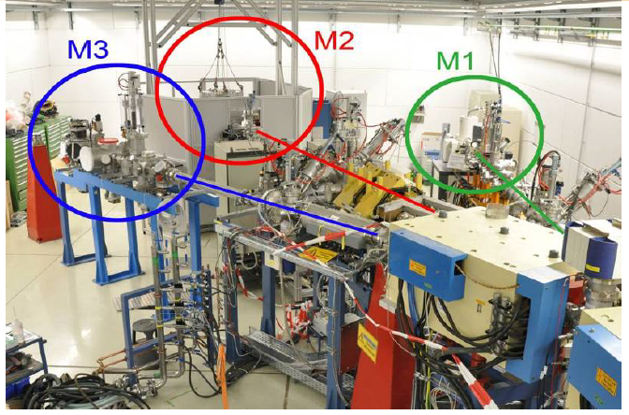
M-branch irradiation facility at GSI
In situ experiments
energies close to Bragg peak:
  to maximize energy deposition and damage
  to avoid activation
online and in situ monitoring: video camera, fast IR camera, SEM, XRD, IR spectroscopy
U
Au
Xe
Kr
Ar
SRIM code
ion species ..C…Xe...U
flux:
up to10¹⁰ ions/cm² s

Slide 10
Beamtime application at GSI
2018-2019

Slide 11
Beamtime application at GSI
2018-2019

Slide 14
Planned experimental cave at
SIS 18 - GSI
unique combination of intense relativistic heavy-ion beams and high-energy laser pulses - start 2020?
Laser:
- up to 200J in 1-10ns pulses
- pulse shaping capability (but then probably less energy)
- 2-omega (527nm)
- possibility for phase plate and 3-omega (150J)
Heavy ion beam:
- Ions with Z from 1 (protons) up to 92 (uranium)
- Energy: several 100 MeV/u (--> range of several mm in solid density target !!)
- Pulses with up to 4e10 ions per pulse
- Pulse duration from 100ns up to few us
- Focusing down to approx. 1mm spot size
---> energy deposition approx. 10kJ/g (depends a bit on the material)
---> heating to approx. 1eV temperature (so well above the boiling temperature, entering WDM regime)
Proton microscope (instead of heavy ion beam):
- demonstrated 30um spatial resolution (expect 10um)
- temporal resolution (=exposure time) down to 10ns
- density resolution on %-level
- multi-frame capability (e.g. 4 frames within 1 us)

Slide 15
Thank you and looking forward to further collaboration

