Slide 1

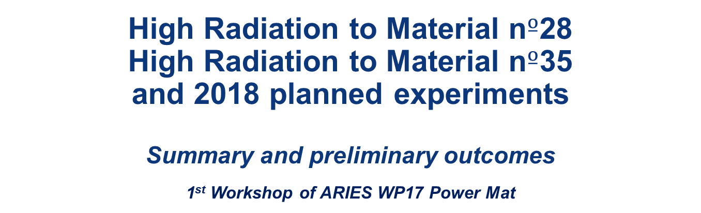
High Radiation to Material n$º$28
High Radiation to Material n$º\text{35}$ and 2018 planned experiments
Summary and preliminary outcomes
1st Workshop of ARIES WP17 Power Mat
Low Density Carbon Based Material Testing through High Energy Proton Beams at CERN for BIDs* applications
François-Xavier Nuiry, Inigo Lamas Garcia, Mark Butcher, Maxime Bergeret, Lucian-Mircea Grec, Stefano Pianese, Anton Lechner and all the HRMT28&35 teams
CERN EN-STI-TCD
27/11/2017
*Beam Intercepting Devices

Slide 2
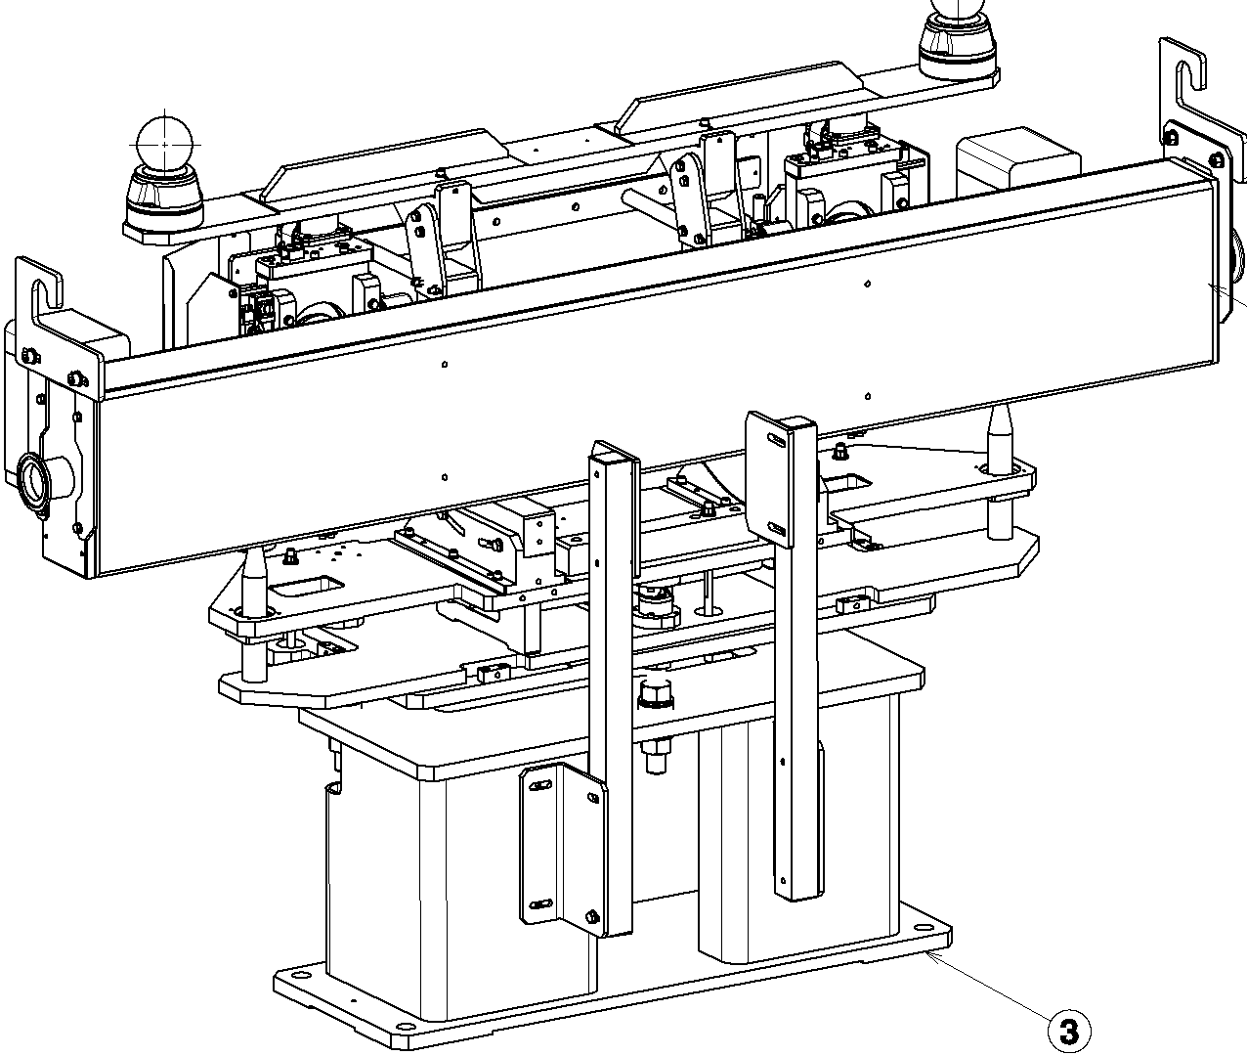
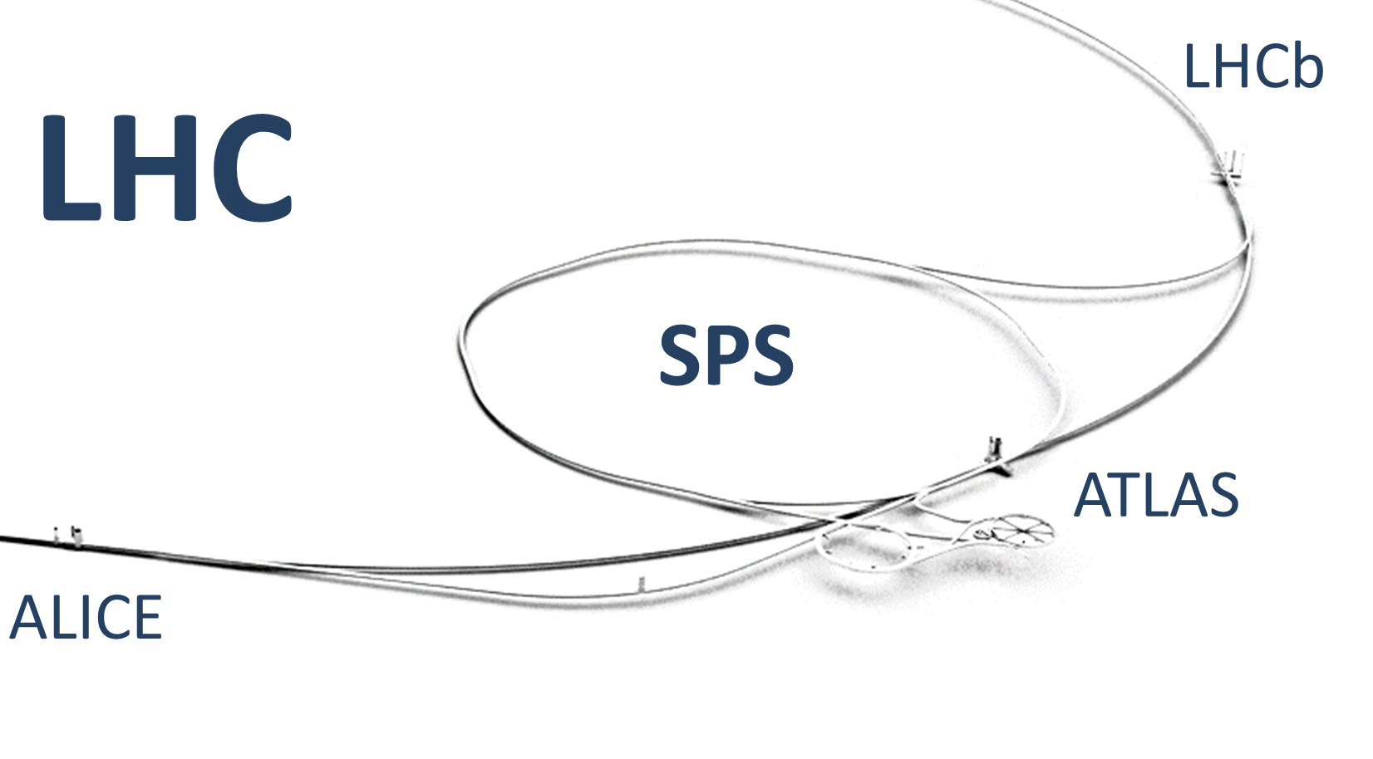
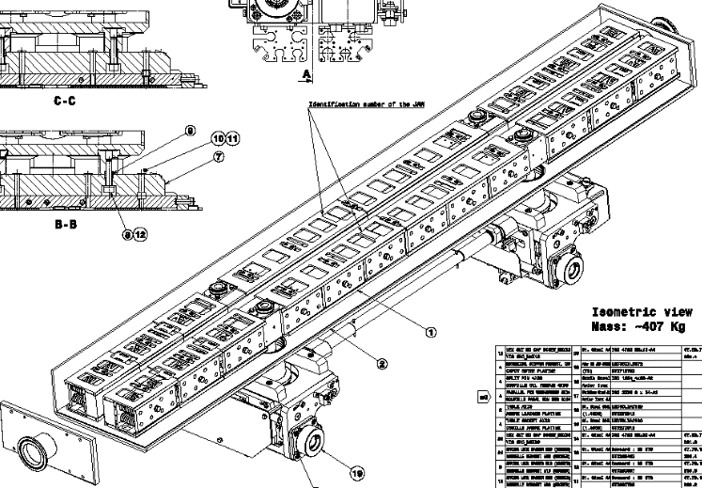
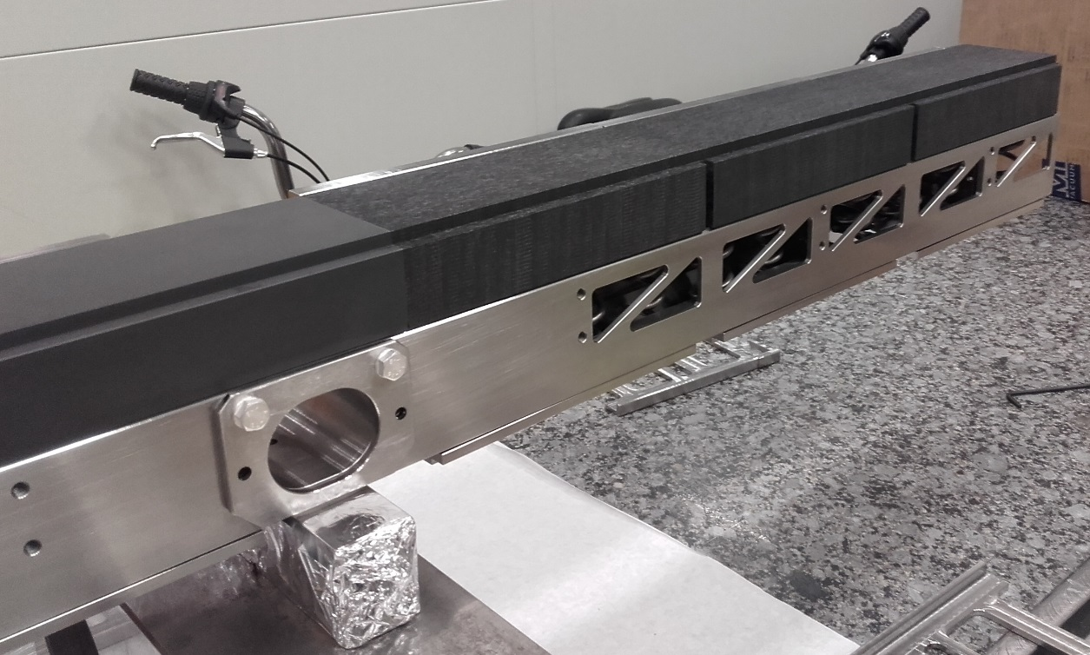
Material Studies in the framework of HL-LHC and LIU projects
6+6 new collimators in Ti2 and Ti8
TI8
TI2
Isostatic graphite R7550 SGL (vacuum fired)
3D CC (Novoltex PAN fibres) (vacuum fired)
Beam

Slide 3
HiRadMat 28

Slide 4
Motivations for HRMT28
Assess the Integrity of Graphite for TCDIs and TDIs during Run 3 and test an alternative material: 3D CC. The goal is to reproduce the highest intensity beam that the TCDI and the TDI can see during their life time.
Cross-check simulations.
Beam | Intensity | Sig X[mm] × Sig Y[mm] | Max Temperature [°C] | M-C Safety Factor*
Run 3 BCMS | 5.76 E13 | 0.320×0.511 | 1450 | 0.8 [~1]
HiRadMat requested beam | 3.46 E13 (originally requested 1.3 E11 ppb) | 0.313×0.313 | 1342 | 0.75 [0.96]
HiRadMat alternative beam (phase II) | 2.6 E13 | 0.25×0.25 | 1371 | [0.97]
*The Mohr Coulomb safety factors are calculated with a graphite tensile limit of 30 MPa, and the values between brackets consider a graphite tensile limit of 40 MPa which is the value considered by SGL for the R7550 graphite.

Slide 5
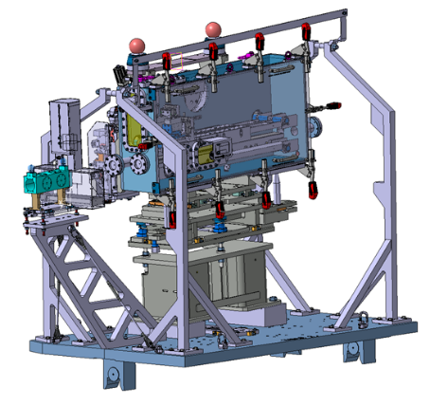
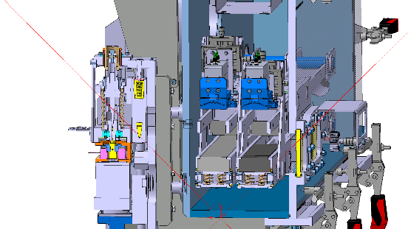
The High Radiation to Materials experiment nº28: Overview
Radiation-Hard Camera
Laser Doppler Vibrometer
View Port
Vacuum Tank
Beam optics Instruments
Vacuum Tank
Beam
Jaw Motors
Target Materials
Beam instrumentation:
BTV, working also for high intensity shots
BPKG (Working only in the horizontal plane)
Wire scanner (in SPS ring), working for up to 3 batches
Collimator Feet
Transversal movement

Slide 6
The High Radiation to Materials experiment nº28: target material layout
Vacuum Tank
Graphite 2123 PT
3D C/C A412
Target Materials
Target Materials
Graphite Sigrafine® R7550
Sepcarb® 3D C/C
Beam
Beam
Tank transversal translation

Slide 7
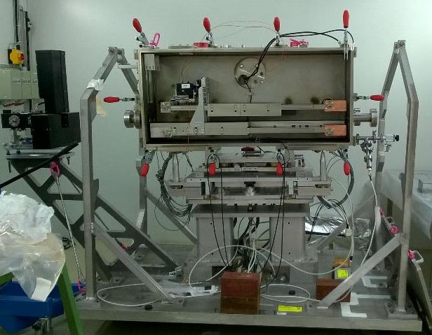
The Experimental Set Up
Experiment preparation in CERN Radioactive Bunker
Beam

Slide 8
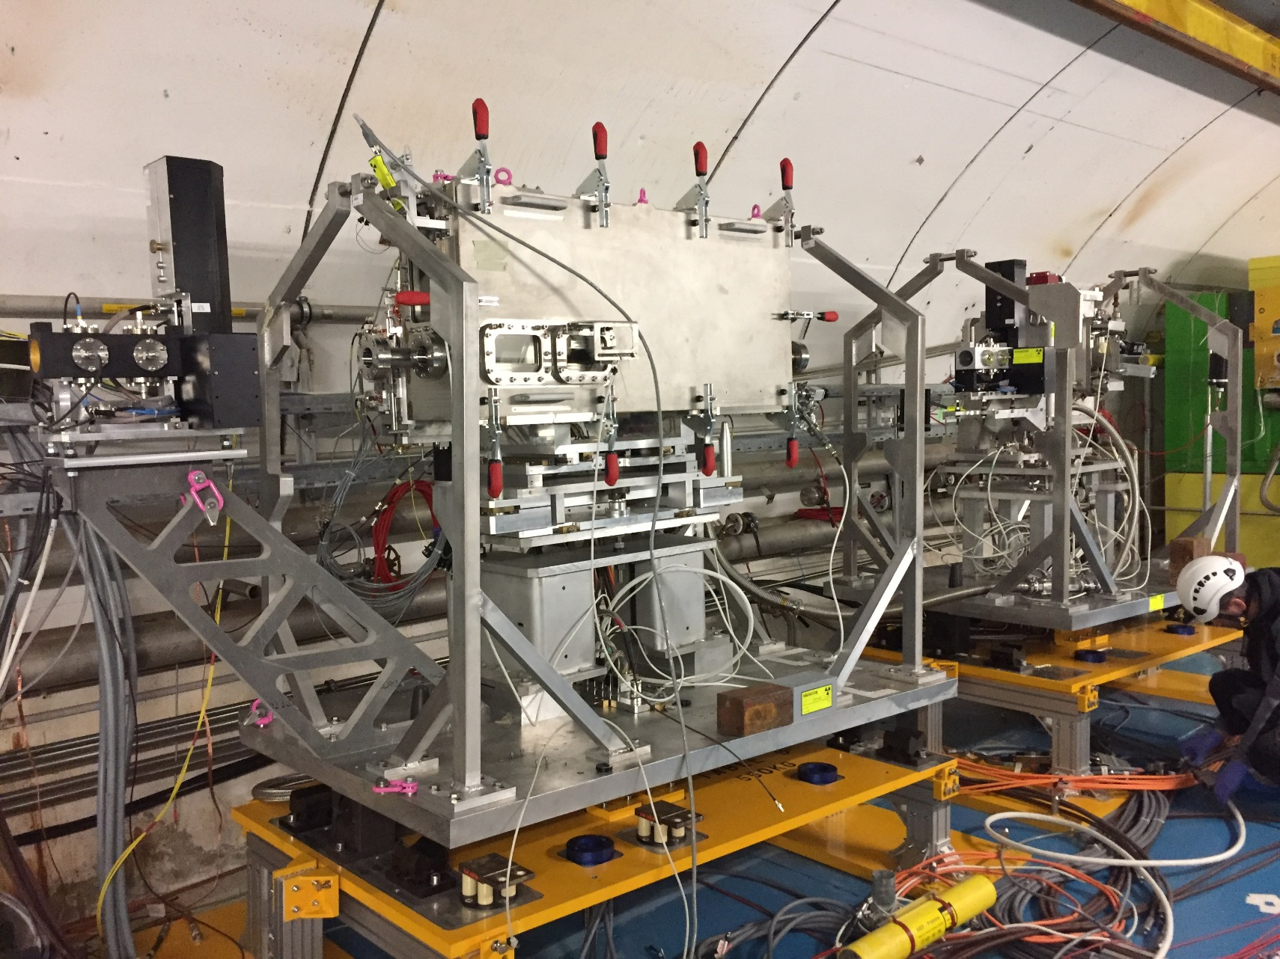
The Experimental Set Up
Experiment installation in CERN Accelerator complex
Beam

Slide 9
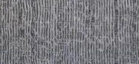

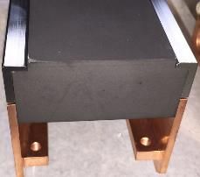
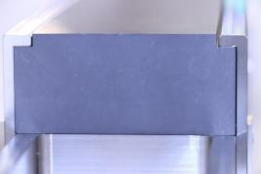
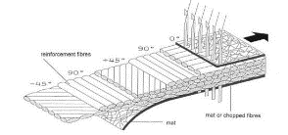
Materials tested
 | Isostatic graphite |  | 3D CC
 | Sigrafine® R4550 * | 2123 PT | Sepcarb® | A412
Density [g/cm³] | 1.83 | 1.84 | >1.80 | 1.7
Thermal Conductivity [W. ̊C⁻¹.m⁻¹] | 100 | 112 | Non-Disclosure Agreement | -
Coefficient of Thermal Expansion 10⁻⁶ [̊C-1] | 4 | 5.6 | 2 | -
Young’s modulus [GPa] | 11.5 (dynamic) | 11.4 | Non-Disclosure Agreement | 15
Tensile Strength [MPa] | 40 | 35 | Different in the 3 directions ~100 (Sepcarb®), 60 (A412)
MST [ ̊C] | >2600 | 2760 | 3000 | -
* Extensively used at CERN

Slide 10
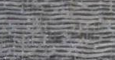
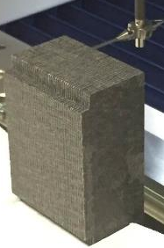
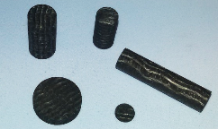
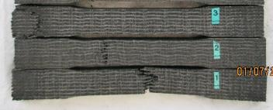
3D CC Material production summary
PAN “White”
Pre-carbonisation
Peroxyded PAN
Getting a wire
Getting a 2D bidirectional peroxyded .
Tissue + mat association
Wrapping (cylindrical of flat)
Needling
Getting 3D block
High temperature carbonisation
Densification. Low pressure and High temperature (methane / propane) → Carbon deposition on fibbers and hydrogen removal.
→Very pure Carbon Matrix.
Several densification steps done for CERN.

Slide 11
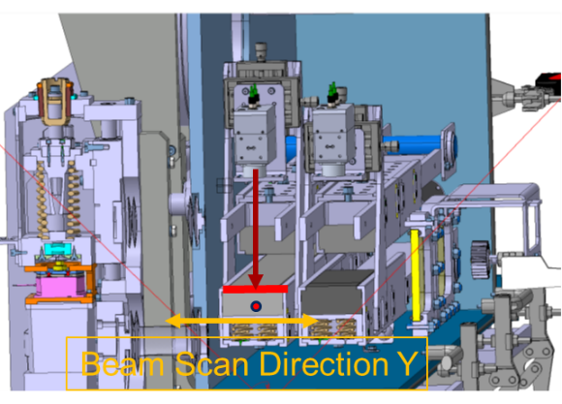
Optometer alignment with the beam (graphite)
A precise alignment of the LDV with the beam was achieved (better than 0.15 mm)

Slide 12
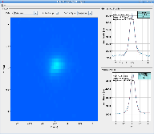
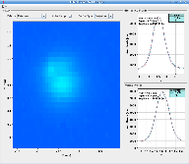
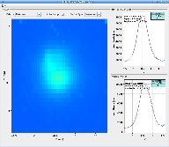
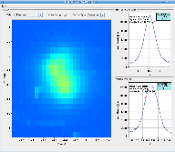
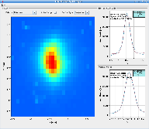
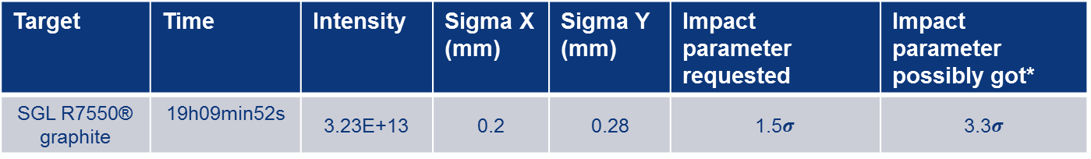
High intensity shot analysis
*under investigations
Target | Time | Intensity | Sigma X (mm) | Sigma Y (mm) | Impact parameter requested | Impact parameter possibly got*
SGL R7550® graphite | 19h09min52s | 3.23E+13 | 0.2 | 0.28 | 1.5$σ$ | 3.3$σ$
Discussions about the impact parameter
BTV524 OD 0 – 1 bunch
BTV524 OD 0.7 – 12 bunches
BTV524 OD 1.3 – 72 bunches
BTV524 OD 2 – 216 bunches
BTV524 OD 2 – 288 bunches
3D CC
Number of bunch | Screen | Filter [OD] | H[mm] | V[mm]
1 bunch | SiC | 0-0 [0] | -0.401 | 1.070
12 bunches af. Correction | SiC | 1-0 [0.7] | -0.452 | 0.868
72 bunches | SiC | 2-1 [1.3] | -0.463 | 0.637
216/288 bunches | SiC | 3-0 [2] | -0.448 | 0.730
Diff [HIS - 1 Bunch] | SiC |  | -0.047 | -0.340
Observed for 3D CC in one direction and for graphite in the other direction!

Slide 13
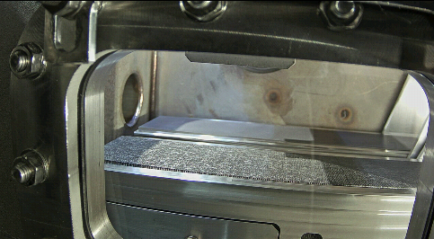
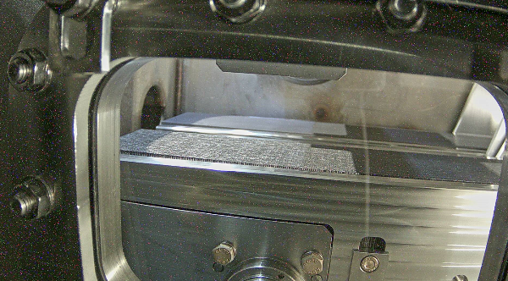
Jaw surfaces (ASL 3D CC and SGL Graphite)
Online pictures
After 2x216 and 2x288 bunches shots on graphite
Before impact on graphite
Beam

Slide 14
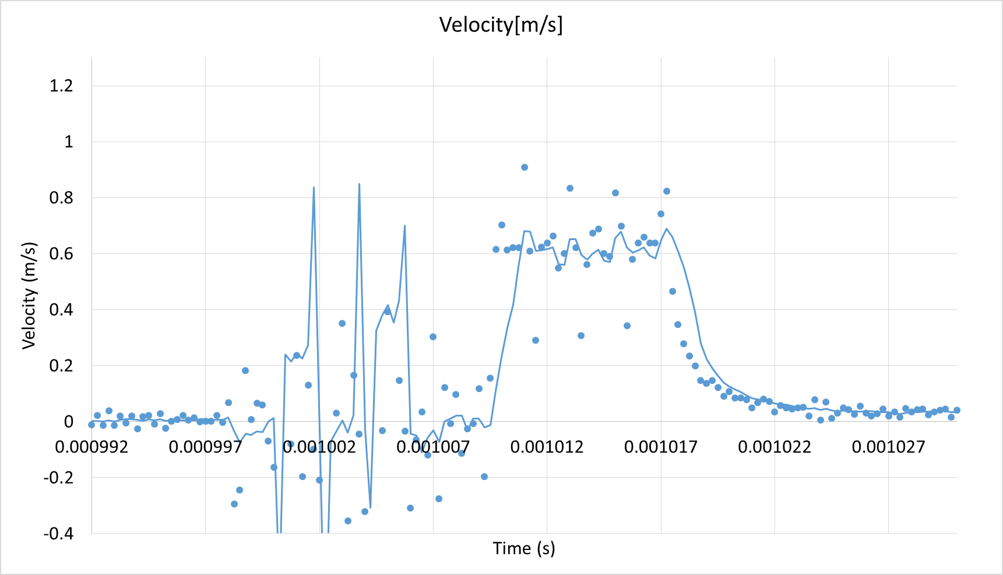
Graphite (SGL) surface displacement when impacted
4.9 kJ /cm3 of peak energy deposition
7.75 µs
~7.5 µs
~5.7 µm
~0.6 m/s
Ramping displacement: The proton beam interacts with the Graphite and continuously deposes energy.
Quasi-static step: After the beam passage and regarding the very low time scale, the adiabatic thermal response fixes the thermal-strains. The structural response is quasi-static.

Slide 15
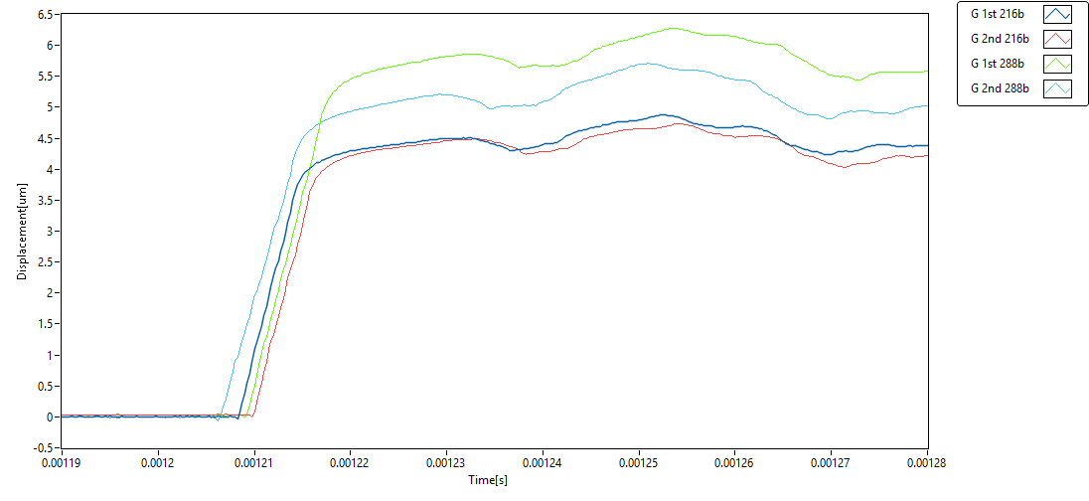
Graphite (SGL) surface displacement for 4 consecutive high intensity shots
Intensity
2.39E+13
2.37E+13
3.23E+13
3.23E+13
The very similar (shape) surface displacement curves over time shows that no beam induced damage occurs on the material, shot after shot;
The amplitude difference for the last two shots can be due to the impact parameter difference (last pulse is 0.3 mm deeper).

Slide 16
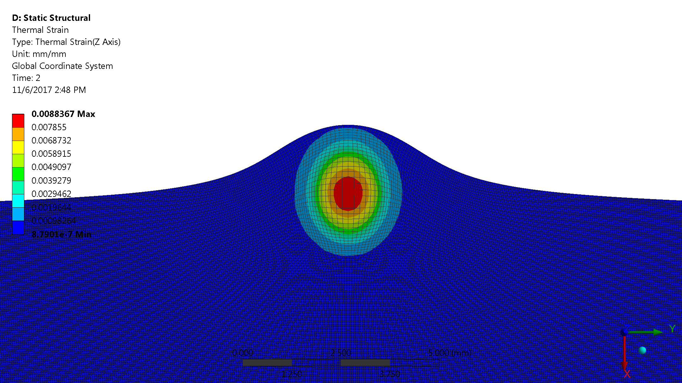
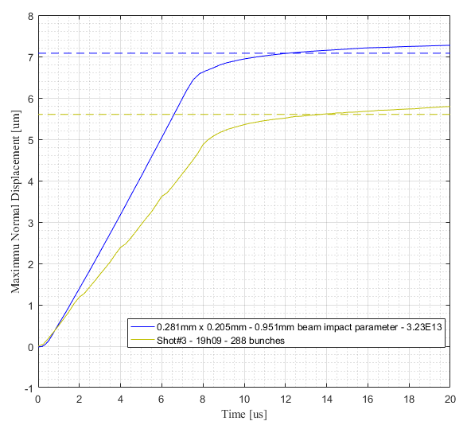
Simulated impacts on R7550 Graphite
Courtesy: Maxime Bergeret EN/STI-TCD CERN
The thermo-structural responses of the material is calculated in ANSYS by importing the FLUKA energy map :
Peak temperature: 1608°C
Bumping amplitude: 7.08µm
Comparison of the Experimental (OPTOMET) and the Simulation displacement plot
Thermal strain (Scale: X300)
Simulation
Measurement
Error between Experimentation and Simulation:
The curve are very similar with ramping and stepping displacement at the end of the pulse (7.2μs);
26% Amplitude error.

Slide 17
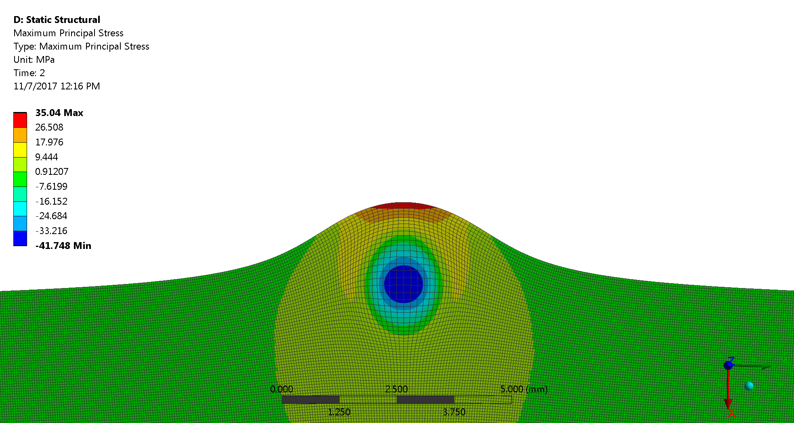
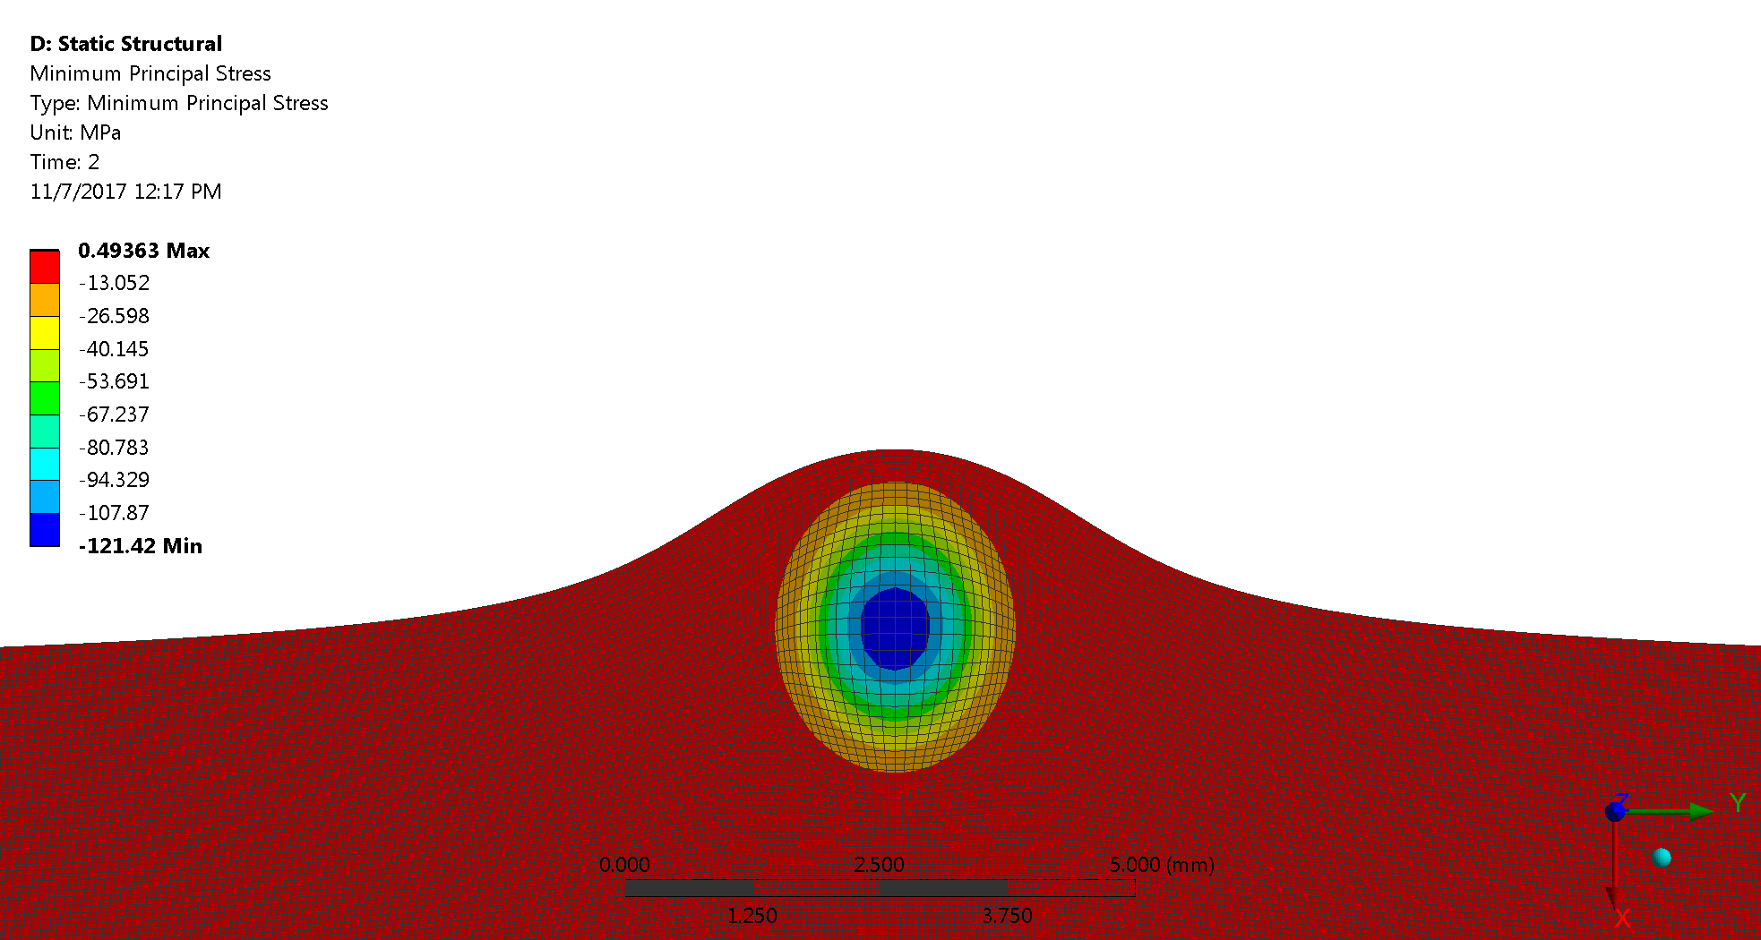
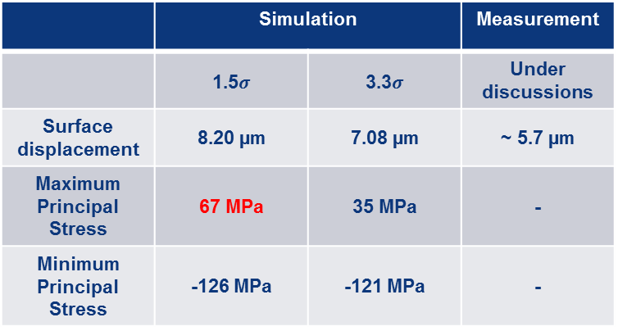
Simulated impacts on R7550 Graphite
 | Simulation |  | Measurement
 | 1.5$σ$ | 3.3$σ$ | Under discussions
Surface displacement | 8.20 µm | 7.08 µm | ~ 5.7 µm
Maximum Principal Stress | 67 MPa | 35 MPa | -
Minimum Principal Stress | -126 MPa | -121 MPa | -
Maximum principal stress after high intensity shot
Courtesy: Maxime Bergeret EN/STI-TCD CERN
At room temperature the limits are:
Tensile Strength: 38.5MPa (SGL Tensile Tests)
Compressive Strength: 130MPa (SGL Datasheet)
Minimum principal stress after high intensity shot

Slide 18
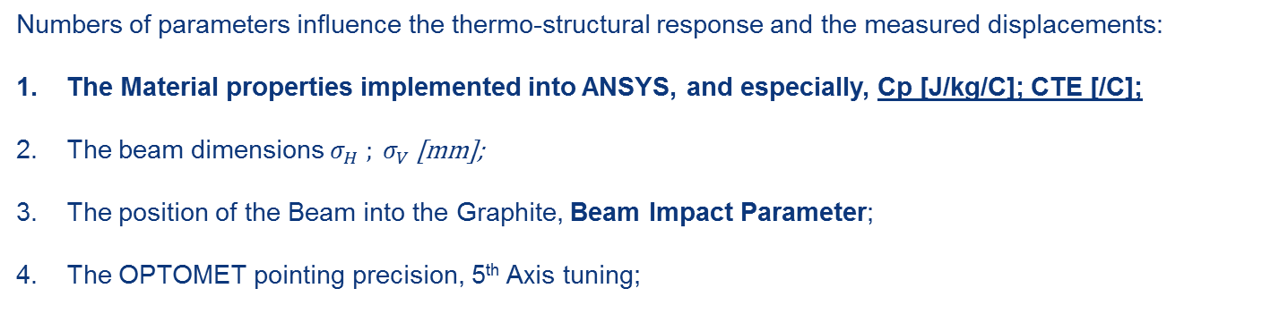
Ongoing studies
Numbers of parameters influence the thermo-structural response and the measured displacements:
The Material properties implemented into ANSYS, and especially, Cp [J/kg/C]; CTE [/C];
The beam dimensions $σ_{H} ; σ_{V}$ [mm];
The position of the Beam into the Graphite, Beam Impact Parameter;
The OPTOMET pointing precision, 5th Axis tuning;

Slide 19
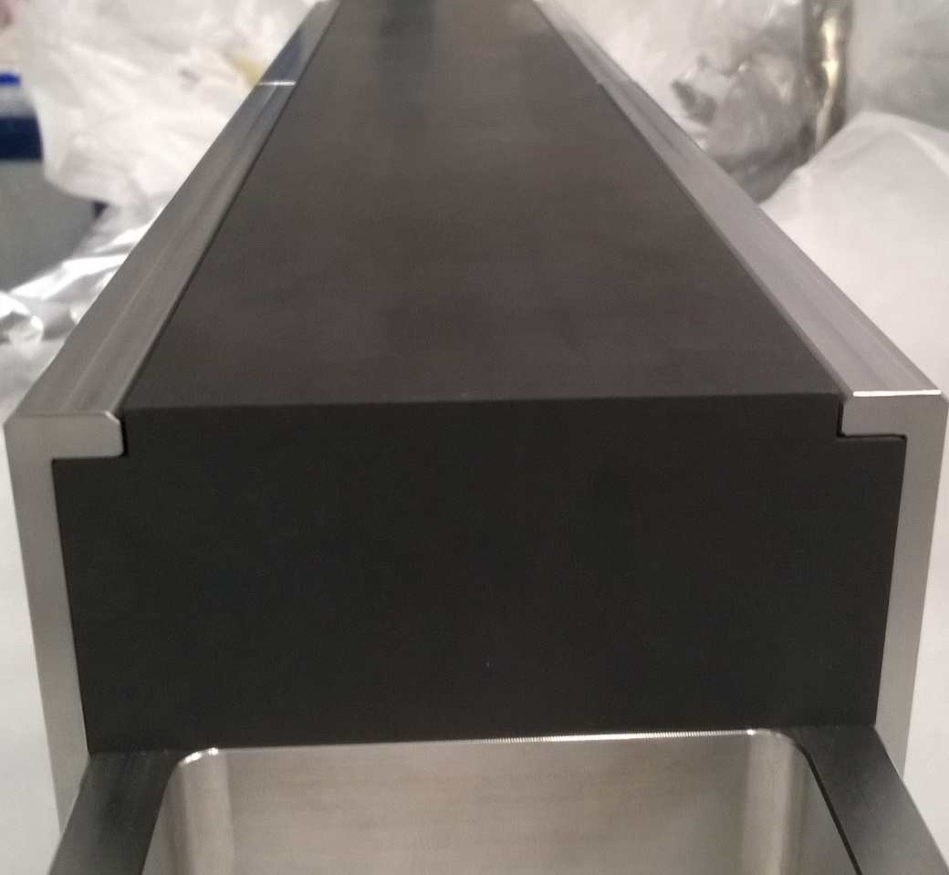
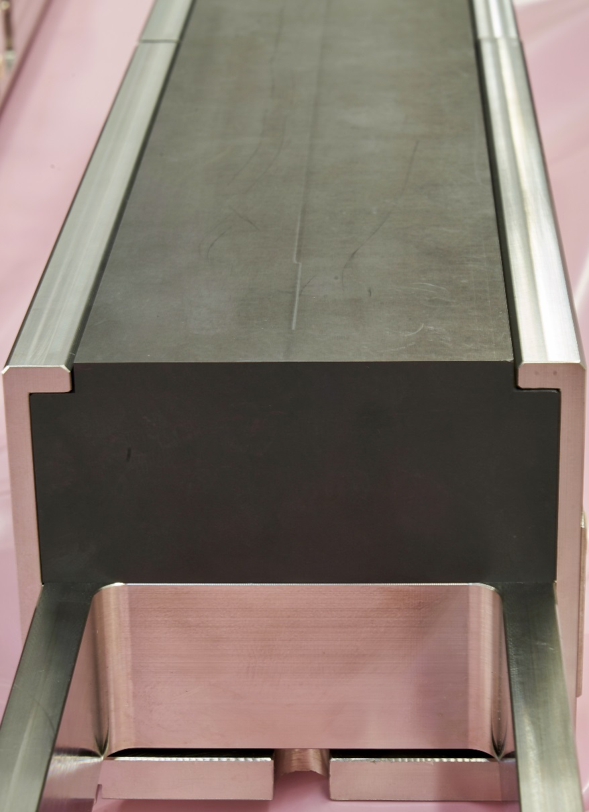
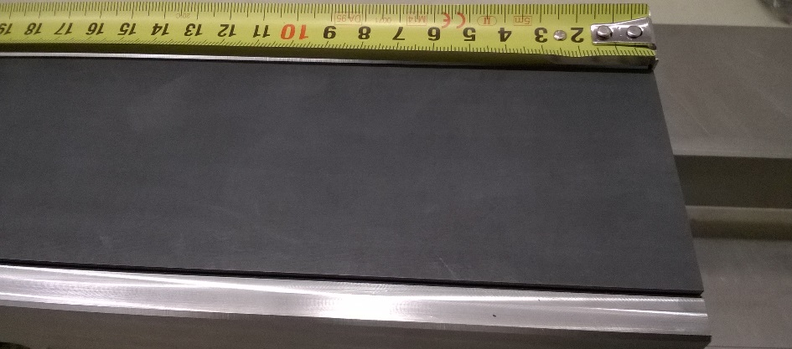
Mersen 2123 PT graphite pictures
Local flatness analysis
Before beam impact
After beam impact
Black line

Slide 20
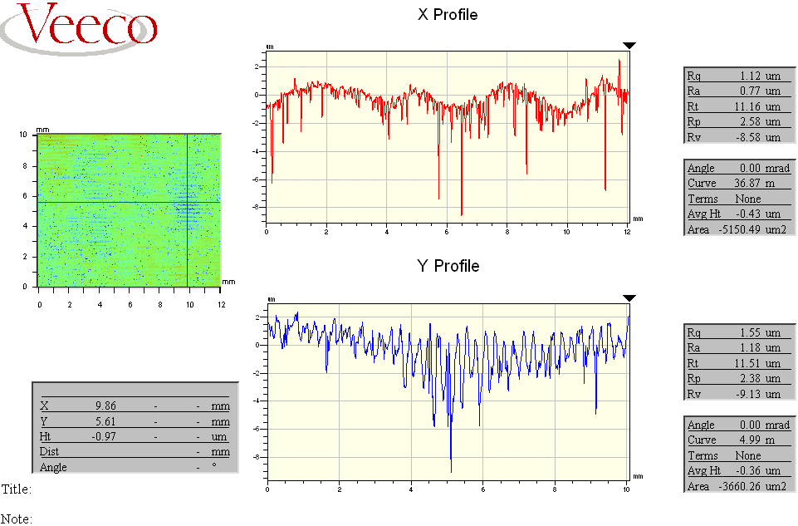
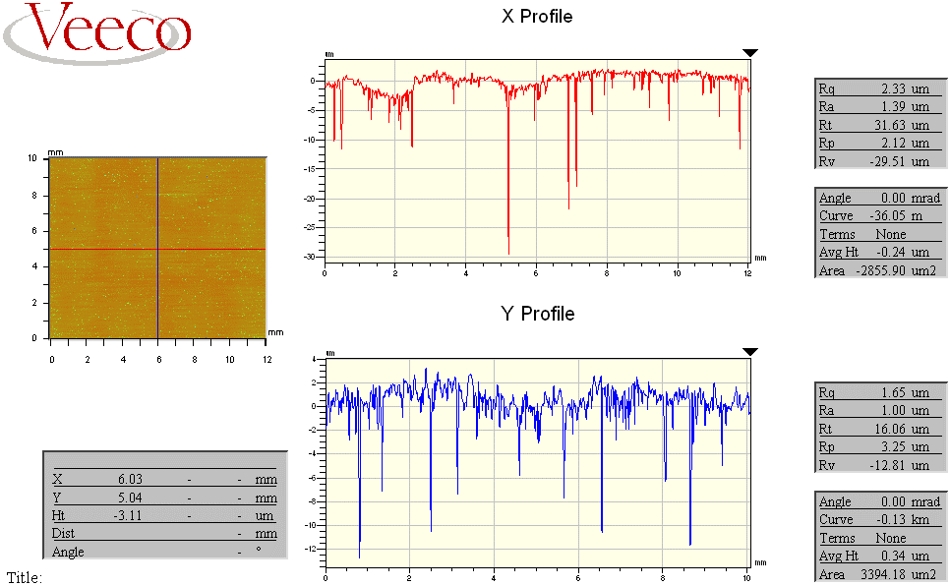
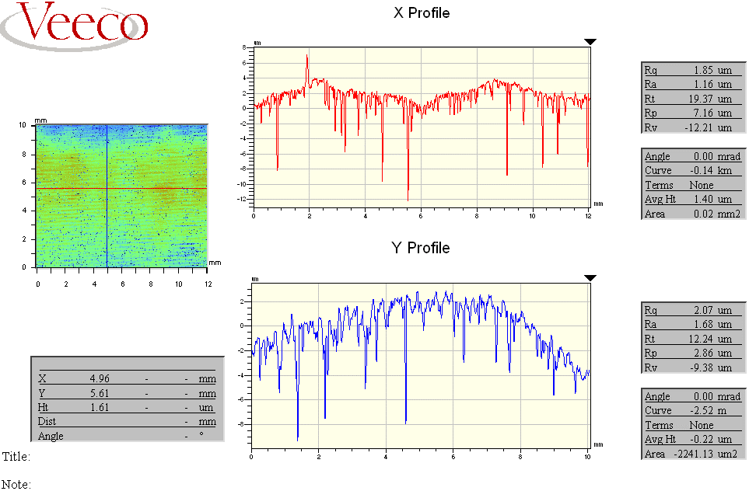
SPSXTCDIL0003_Mersen Graphite→ Veeco Inspection
Beginning of the block
Apparatus used:
Profilometer Veeco NT 3300
No contact probing system
After impact
Courtesy: Stefano Pianese EN/STI-TCD CERN, and CERN EN-MME Metrology lab
Middle of the block
End of the block

Slide 21

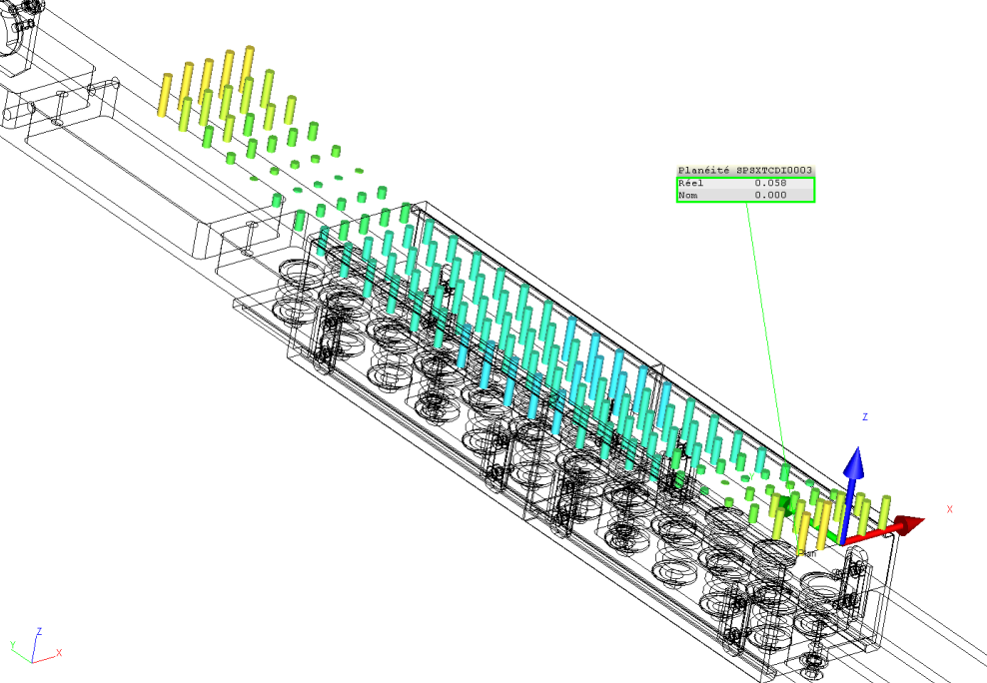
Targets (jaws) metrology measurements (summary)
Courtesy: Stefano Pianese EN/STI-TCD CERN, and CERN EN-MME Metrology lab
Jaw flatness measurement before and after beam impact:
Jaw flatness | Graphite Sigrafine® R7550 (SGL) | Graphite 2123 PT (Mersen) | 3D C/C A412 (Mersen) | Sepcarb® 3D C/C (Airbus Safran Launchers)
Before Impacts | 80 µm | 56 µm | 128 µm | 44 µm
After Impacts | 96 µm | 58 µm | 82 µm | 44 µm
Bloc movement during handling
Before beam impact
After beam impact

Slide 22
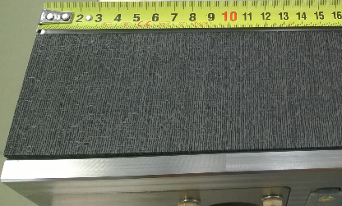
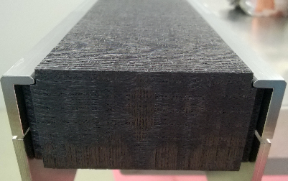
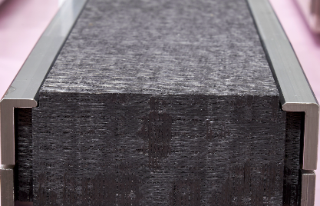
SPSXTCDIL0006_ASL_3D C-C 170 mm → Before and after impact, visual Inspection.
Before impact
After impact
Courtesy: Stefano Pianese EN/STI-TCD CERN

Slide 23
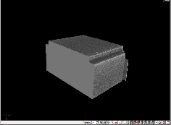
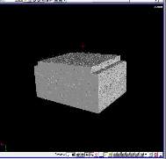
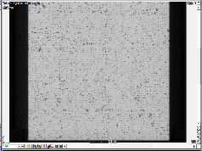
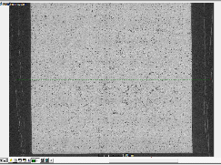
Micro tomography (ESRF collaboration)
Courtesy: Stefano Pianese EN/STI-TCD and MME CERN
Before Impact
After Impact
Beam
The two pictures have been taken at the same location, before and after impact,
where the beam has impacted.

Slide 24
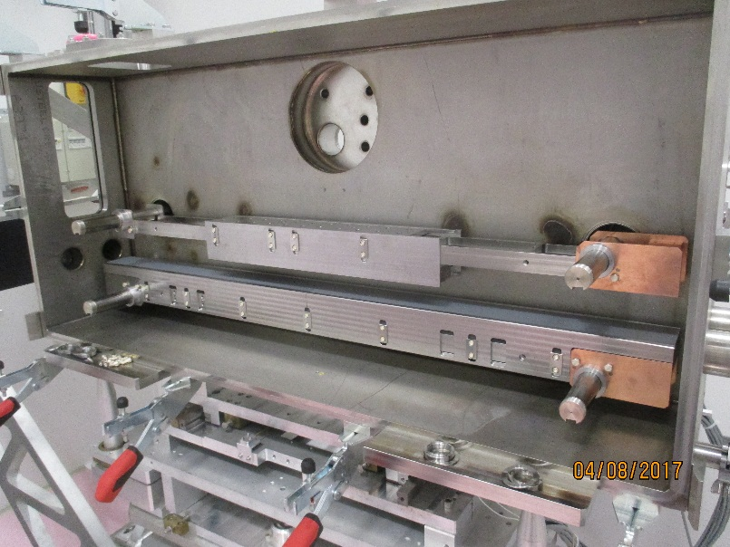
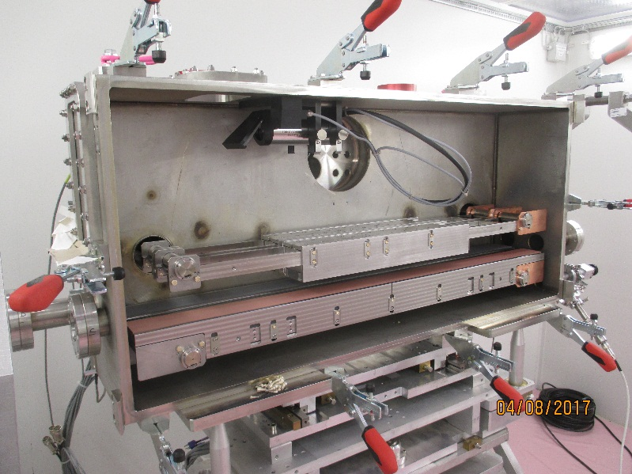
HiRadMat 35

Slide 25
HRMT 35 Aim
Assess the level of damage on the coating that the current TDI (LHC Injection absorber) could face (grazing impact).
For LS2 collimators, experience on the coating behaviour for different coatings configurations and material subtracts.

Slide 26



After impact
3.5E13 protons per pulse
440 GeV
0.3mm nominal spot size
Impact 2
Graphite with Cu coating
Impact 1
Impact 3
Impact 3
CFC with Mo coating
Impact 1
Impact 2
Impact 2
Graphite with Mo coating
Impact 1
Impact 3
Courtesy: Inigo Lamas EN/STI-TCD CERN

Slide 27
Main outputs
Graphite coated with Mo and graphite coated with Cu OK
Tatsuno CFC with Mo coating OK
Possible materials for secondary collimators
Actual TDI (Graphite + Cu coating) shall survive the ongoing beams

Slide 28
Summary
SGL Graphite and ASL 3D CC are undamaged after several high intensity shots;
SGL Graphite and ASL 3D CC are “behaving” as expected by the simulations;
Metrology is showing the same global shape before and after impact;
HD pictures are showing no differences between before and after impact, excepted for the 2123PT graphite.
Micro-tomography of the 3D CC shows no difference before and after impact.
Simulation results are sensitive with the spot size, the beam impact parameter and intensity, the material model.
The actual TDI shall survive ongoing beams.
IPAC Paper:
F-X. Nuiry^{†1}, O. Aberle, M. Bergeret, A. Bertarelli, N. Biancacci, R. Bruce, M. Calviani, F. Carra, A. Dallocchio, L. Gentini, S. Gilardoni, R. Illan, I. Lamas Garcia², A. Masi, A. Perillo-Marcone, S. Pianese, S. Redaelli, E. Rigutto, B. Salvant,
Design and Prototyping of New CERN Collimators in the Framework of the LHC Injector Upgrade (LIU) Project and the High-Luminosity (HL-LHC) Project

Slide 29

Future Experiments TCDIL DEEP and TDIS-TZM
Assess the TDIS and TCDIL jaw flatness for extreme accidental deep impacts in the jaw.
Proposed experiment configuration:
One jaw with the updated design
One jaw with design baseline

Slide 30
Thanks for your attention

Slide 31

Multi-experiment tank
HRMT 28 Phase I : April 2016
HRMT 28 Phase II : June 2017
HRMT35 : August 2017
Allows to shorten time from one experiment to another one, save money, and reduces radioactive waste.
Could be used for other HRMT experiments:
Big volume: 545*247*1234 mm³ with large access;
LHC Collimator size compatible;
Several vacuum feedthroughs;
5 independent translation axis;
2*2 beam windows;
4 view ports.

Slide 32
HRMT 28 in a nutshell
4 low density materials impacted for BID applications;
About 15 people involved in the experiment operation itself;
About 1.12E15 total POT spread over 3 runs;
23 hours spent in the CCC, aligning the experiment and data acquisition;
3 Gb of collected data;
Residual dose rate | After 9h of cool down | After 44h of cool down
PMIHR02 | 1 mSv/h | 227 µSv/h

Slide 33
Summary of the experiment
13/06/2017 → Impacts on Graphite jaws
Start at 11h00 → Beam Steering done with 12 bunches beams;
14h40 → End of the BBA (1 bunch);
17h13 → End of the Optomet LDV alignment (12 bunches beam);
18h32 → End of high intensity shots test (jaws opens);
19h27 → End of the high intensity shot (216/288 bunches) on the SGL graphite;
19h57 → End of the high intensity shot (216/288 bunches) on the MERSEN graphite.
16/06/2017 → Impacts on 3D CC jaws
Start at 9h46 → Beam Steering done with 1 bunch beam;
12h43 → End of the BBA (1 bunch);
LHC Filling
14h39 → End of the 12 bunches beam for statistics;
15h35 → End of the Optomet LDV alignment tentative (12 bunches beam);
18h00 → End of the Optomet LDV alignment tentative (72 bunches beam);
18h53 → End of high intensity shots test (jaws opens);
19h29 → End of the high intensity shot (216/288 bunches) on all 3D CC jaws.

Slide 34
Summary of the experiment
27/06/2017 → New impacts on 3D CC jaw (ASL)
Start at 9h00 → Beam position checks with 1 bunch and 12 bunches beams. Adjustment of the vertical position of the beam, cross check with BTV;
10h51 → Start of 72 bunches extraction for optomet alignment;
12h47 → End of the Optomet LDV alignment (72 bunches beam);
12h57 → Start of high intensity shots on ASL jaw;
13h13 → End of the high intensity shot (216/288 bunches) on the ASL jaw.

Slide 35
High intensity shots on the 13/06/2017
BTV.524 measurements
Target | Time | Intensity | Sigma X (mm) | Sigma Y (mm) | Position in X (mm) | Position in Y (mm)
SGL R4550® graphite | 18h43min28s | 2.39E+13 | 0.44 | 0.49 | -0.22 | 0.9
 | 18h57min04s | 2.37E+13 | 0.43 | 0.42 | -0.29 | 0.89
 | 19h09min52s | 3.23E+13 | 0.42 | 0.48 | -0.3 | 0.91
 | 19h27min28s | 3.23E+13 | 0.43 | 0.44 | -0.23 | 0.85 | Jaw moved by 0.3mm within the beam
Mersen 2123UHP5® graphite | 19h42min40s | 2.42E+13 | 0.49 | 0.28 | -0.3 | 0.88
 | 19h46min40s | 2.44E+13 | 0.52 | 0.3 | -0.33 | 0.86
 | 19h50min40s | 3.25E+13 | 0.4 | 0.24 | -0.29 | 0.91
 | 19h57min04s | 3.25E+13 | 0.38 | 0.39 | -0.32 | 0.79 | Jaw moved by 0.3mm within the beam

Slide 36
High intensity shots on the 16/06/2017
BTV.524 measurements
Target | Time | Intensity | Sigma X (mm) | Sigma Y (mm) | Position in X (mm) | Position in Y (mm)
ASL Sepcarb 3D CC | 18h42min24s | 2.77E+13 | 0.29 | 0.4 | -0.32 | 0.95
 | 18h52min48s | 2.94E+13 | 0.28 | 0.4 | -0.28 | 1.02
 | 19h26min24s | 3.82E+13 | 0.3 | 0.34 | -0.33 | 0.88
 | 19h30min24s | 3.81E+13 | 0.36 | 0.29 | -0.36 | 0.9
Mersen 3D CC | 19h00min00s | 2.91E+13 | 0.26 | 0.38 | -0.32 | 1
 | 19h04min00s | 2.91E+13 | 0.28 | 0.34 | -0.31 | 1
 | 19h20min00s | 3.89E+13 | 0.28 | 0.33 | -0.32 | 0.92
 | 19h22min24s | 3.77E+13 | 0.28 | 0.37 | -0.33 | 0.91

Slide 37

High intensity shots on the 27/06/2017
BTV.524 measurements
Target | Time | Intensity | Sigma X (mm) | Sigma Y (mm) | Position in X (mm) | Position in Y (mm)
ASL Sepcarb 3D CC | 12h54min02s | 2.47E+13 | No Signal on BTV
 | 12h58min07s | 2.49E+13 | 0.24 | 0.25 | -0.46 | 0.73 | Strange signal on LDV
 | 13h06min14s | 2.50E+13 | 0.24 | 0.24 | -0.45 | 0.74
 | 13h10min21s | 3.35E+13 | 0.2 | 0.23 | -0.44 | 0.73
 | 13h14min26s | 3.34E+13 | 0.2 | 0.22 | -0.44 | 0.72
For this run, a red filter in front of the BTV camera in TT61 has been installed
216 bunches beams
288 bunches beams
RP Monitor PMIHR02, showing residual dose rate versus time
72 bunches beams on dump
72 bunches beams on target
12 bunches beams on dump
Some BTV tests after HRMT28 experiment
1 bunch beams on dump

Slide 38
Optometer alignment with the beam (3D CC)
A precise alignment of the LDV with the beam was achieved (better than 0.15mm)

Slide 39


3D CC surface displacement when impacted (LDV 10 MHz)
Preliminary results
7.5 µs
~7.5 µs
Quick analysis:
Correct bunch length
Expected magnitude of the surface displacement

Slide 40
3D CC surface displacement when impacted (LDV 10 MHz)
7.5 µs
~7.5 µs
1.65 µm
~0.3 m/s
Quick analysis:
Correct bunch length
Expected magnitude of the surface displacement

Slide 41

3D CC (ASL) surface displacement for 5 consecutive high intensity shots (LDV interface 10 MHz), 27-06-2017 (one 216 b shot not recorded)
Intensity
2.47E+13
2.50E+13
3.35E+13
3.34E+13
The very similar surface displacement curves over time are is an indicator that no beam induced damage occurs on the material, shot after shot.
The amplitude difference for the 1st and 3rd shots at 216b can be due to a small beam spot jitter in X.

Slide 42



Experiment dismantling in 867/R-P58
Installation in a fully cleaned bunker
The opened vacuum vessel with jaws removed

Slide 43

Targets (jaws) dismounting in 867/R-P58
4
3
2
1
RP measurements on the 25.07.17 at 16h45
1 / contact: 320 µSv/h, 10 cm: 70 µSv/h, 40 cm: 25 µSv/h
2 / contact: 370 µSv/h, 10 cm: 73 µSv/h, 40 cm: 27 µSv/h
3 / contact: 280 µSv/h, 10 cm: 52 µSv/h, 40 cm: 15 µSv/h
4 / contact: 280 µSv/h, 10 cm: 63 µSv/h, 40 cm: 17 µSv/h

Slide 44
High intensity shots on the 13/06/2017
Target | Time | Intensity | BTV Sigma X (mm) | BTV Sigma Y (mm) | BTV Position in X (mm) | BTV Position in Y (mm) |  | Calculated Sigma X (mm) | Calculated Sigma y (mm) | Position in X (mm) BPKG | Impact parameter expected
SGL R4550® graphite | 18h43min28s | 2.39E+13 | 0.44 | 0.49 | -0.22 | 0.9 |  | 0.203054 | 0.232736 | Meaningless because BPKG not perfectly aligned with BTV524
 | 18h57min04s | 2.37E+13 | 0.43 | 0.42 | -0.29 | 0.89 |  | 0.208802 | N/A
 | 19h09min52s | 3.23E+13 | 0.42 | 0.48 | -0.3 | 0.91 |  | 0.205414 | 0.280867 |  | ??
 | 19h27min28s | 3.23E+13 | 0.43 | 0.44 | -0.23 | 0.85 | Jaw moved by 0.3mm within the beam | 0.204648 | 0.286383 |  | 1.5 σ
Mersen 2123UHP5® graphite | 19h42min40s | 2.42E+13 | 0.49 | 0.28 | -0.3 | 0.88 |  | 0.192967 | 0.283735
 | 19h46min40s | 2.44E+13 | 0.52 | 0.3 | -0.33 | 0.86 |  | 0.197366 | 0.285878
 | 19h50min40s | 3.25E+13 | 0.4 | 0.24 | -0.29 | 0.91 |  | N/A | 0.275063
 | 19h57min04s | 3.25E+13 | 0.38 | 0.39 | -0.32 | 0.79 | Jaw moved by 0.3mm within the beam | 0.195948 | 0.276492

Slide 45
High intensity shots on the 16/06/2017
Target | Time | Intensity | BTV Sigma X (mm) | BTV Sigma Y (mm) | BTV Position in X (mm) | BTV Position in Y (mm) | Calculated Sigma X (mm) | Calculated Sigma y (mm) | Impact parameter expected
ASL Sepcarb 3D CC | 18h42min24s | 2.77E+13 | 0.29 | 0.4 | -0.32 | 0.95 | 0.200881 | 0.388974
 | 18h52min48s | 2.94E+13 | 0.28 | 0.4 | -0.28 | 1.02 | 0.194461 | 0.283627
 | 19h26min24s | 3.82E+13 | 0.3 | 0.34 | -0.33 | 0.88 | 0.203367 | 0.293693 | 1.5 σ
 | 19h30min24s | 3.81E+13 | 0.36 | 0.29 | -0.36 | 0.9 | 0.19739 | 0.288927 | 1.5 σ
Mersen 3D CC | 19h00min00s | 2.91E+13 | 0.26 | 0.38 | -0.32 | 1 | 0.20366 | 0.256023
 | 19h04min00s | 2.91E+13 | 0.28 | 0.34 | -0.31 | 1 | 0.191674 | 0.279542
 | 19h20min00s | 3.89E+13 | 0.28 | 0.33 | -0.32 | 0.92 | 0.194497 | 0.298098 | 1.5 σ
 | 19h22min24s | 3.77E+13 | 0.28 | 0.37 | -0.33 | 0.91 | 0.204685 | 0.295752 | 1.5 σ

