Slide 1



ARIES WP14 – Task 14.4:
Industrial production of materials for extreme thermal management
1st Workshop of ARIES
WP17 PowerMat
Politecnico di Torino, Turin (IT)
27-28 November 2017
F. Carra¹
¹CERN – European Organization for Nuclear Research

Slide 2
WP task 14.4
WP14: Promoting Innovation (PI) – WP leader M. Losasso (CERN). Close relation to industry, final aim to provide society with identified commercial applications of the supported research potential.
Task 14.4: Industrial production of materials for extreme thermal management
  Contribute to material development in collaboration with WP17 (PowerMat)
  Produce at least 10 samples of MgB₂ by Additive Manufacturing on Copper substrate for characterization of the R&D → applications in critical accelerator environments (beam pipes, RF cavities) and other technical domains
  Demonstrate feasibility of production for industrialisation (with large dimensions, small tolerances)
Production objectives:
  30 samples of MgB₂ on metal substrate
  30-50 samples of CuCD
  40 samples of metal-diamond composite for luminescence studies
  50 samples of carbide-graphite or metal-graphite composites
  1 large size block of carbide-graphite or metal-graphite composite with tight mechanical tolerance to proof industrialisation
RHP
CERN with industrial partner (BrevettiBizz)

Slide 3
Deliverable
Deliverable Number | Deliverable Title | Lead beneficiary | Type | Dissemination level | Due Date (in months)
D14.3 | Production of material samples of carbon-based composites and metal-diamond composites | CERN | Demonstrator | Public | 24
D14.3 : Production of material samples of carbon-based composites and metal-diamond composites
Production of: 50 samples of carbon-based composites with different production cycles and 30 samples of metal-diamond composites, 20 for high energy impact studies and 10 for luminescence studies
Our goal: complete it by month 12, to provide inputs for WP17

Slide 4
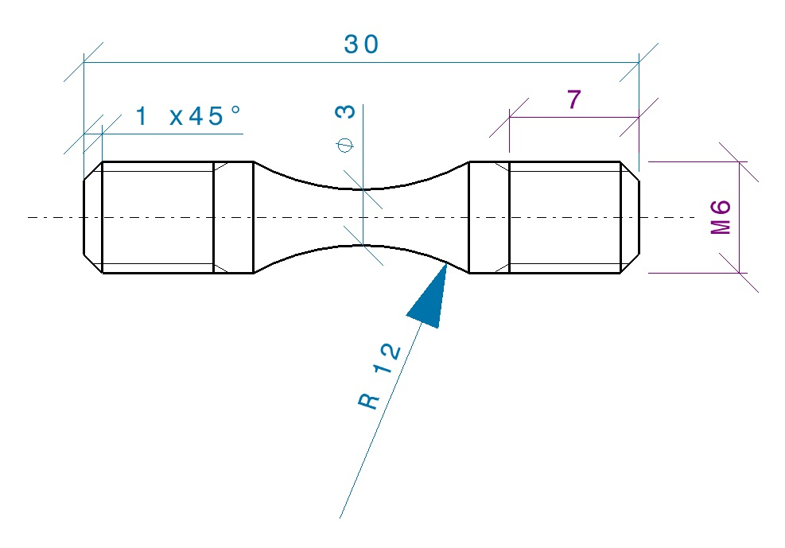
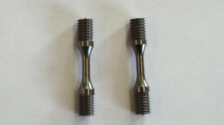
Deliverable Status
Brevetti Bizz: 50 samples of ceramic carbide – graphite
  December 2017: 25 threaded samples of MG6403Fc (or equivalent), for dynamic characterization at PoliTo
  Mid 2018: 25 threaded samples of another material, composition to be decided
  2020?: Industrialization (not in the scope of the deliverable), can we go to 45 mm thick (and longer/larger) blocks?

Slide 5
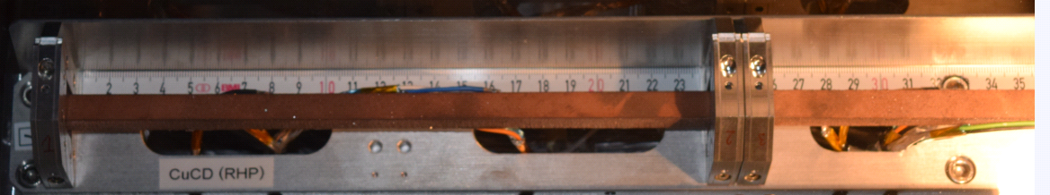
Deliverable Status
RHP: 20 samples of copper-diamond for high-energy impact studies, 10 samples for luminescence
  July 2017: 10 rods 247x10x10 mm produced for tests in Multimat ✔
  End 2017, 2018: can we identify a suitable geometry for dynamic testing at PoliTo and produce samples?
  Luminescence: several samples produced, 6 delivered to GSI (important to document the production for the deliverable).
  MgB₂ (not in the scope of the deliverable): production plan drafted, to be discussed with M. Losasso at the WP14 kickoff meeting (8th December 2017)

Slide 6
Next: WP14 KoM
CERN, 8th December 2017

Slide 7
Budget
Beneficiary short name* | Person - months | Monthly personnel costs | Personnel direct costs | Travel direct costs | Equipment and consumables | Other direct costs | Sub-contracting costs | Material direct costs | Total direct costs | Total indirect costs** | Total costs (direct + indirect) | EC requested funding
CERN | 3.00 | 8'000.00 | 24'000.00 | 3'000.00 | 0.00 |  |  | 3'000.00 | 27'000.00 | 6'750.00 | 33'750.00 | 9'312.50
Bizz Brevetti | 6.00 | 3'500.00 | 21'000.00 | 5'000.00 | 50'000.00 | 10'000.00 |  | 65'000.00 | 86'000.00 | 21'500.00 | 107'500.00 | 60'000.00
RHP | 6.00 | 3'500.00 | 21'000.00 | 5'000.00 | 110'000.00 | 10'000.00 |  | 125'000.00 | 146'000.00 | 36'500.00 | 182'500.00 | 91'250.00
Total | 15.00 | 59'365.00 | 66'000.00 | 13'000.00 | 160'000.00 | 20'000.00 | 0.00 | 193'000.00 | 259'000.00 | 64'750.00 | 323'750.00 | 160'562.50

