Slide 1

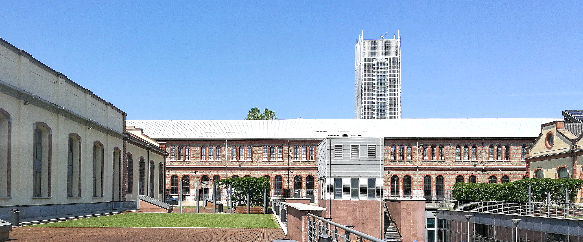
1st PowerMat Workshop
Materials for extreme thermal management
WP17
Turin, 27-28 November 2017
WP17 1st Workshop, Politecnico di Torino
Lorenzo Peroni (POLITO)

Slide 2
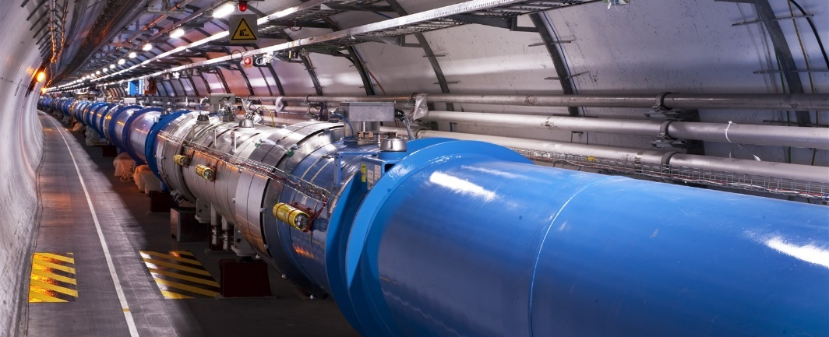

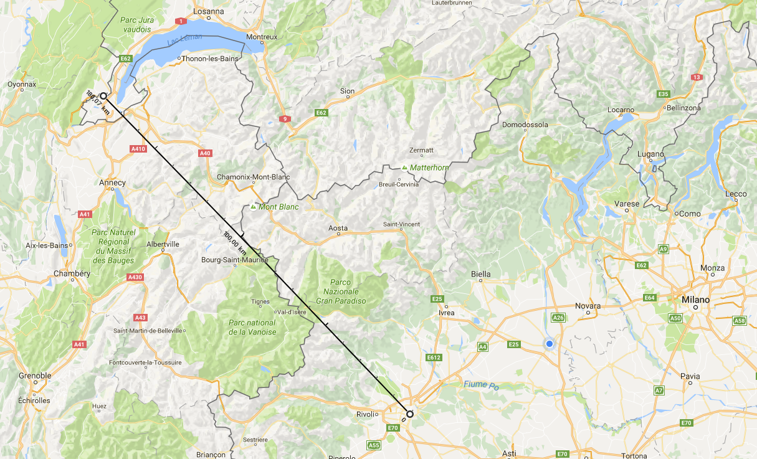
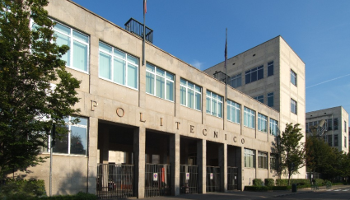

Welcome @ Politecnico di Torino
20 km
LHC
Ginevra
Torino

Slide 3
Politecnico di Torino
Politecnico di Torino is known both in Italy and abroad as a leading institution to study engineering and architecture.
Our university has around 32,000 students, with 50% from outside the region and about 15% who are foreign - the highest percentage in Italy
The "Cittadella Politecnica" is a new campus area where research, teaching and training go hand in hand with local and student services as well as financial and cultural activities. It also houses the Business Research Center, where various international companies have established their most advanced research centers. The new areas also contain classrooms, study rooms, a canteen and a sports center which will open shortly.

Slide 4
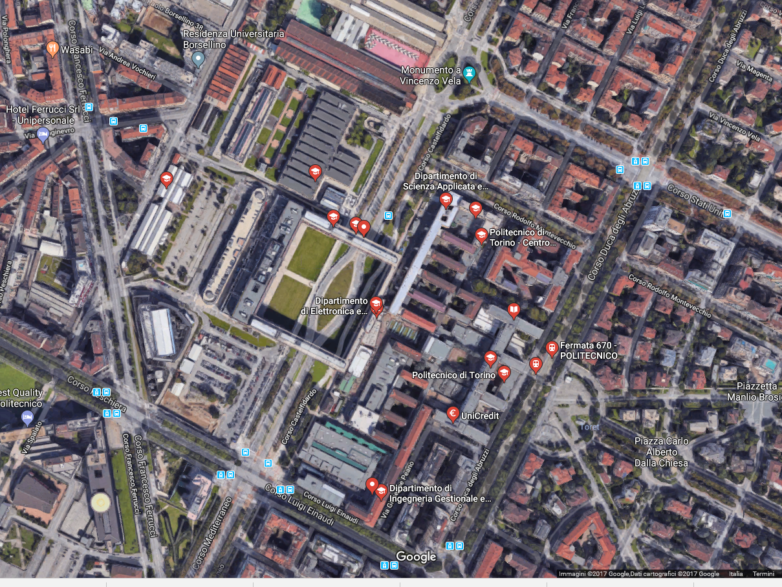
Politecnico di Torino
Cittadella Politecnica
50 m

Slide 5
