Slide 1
Welcome to the 1st Workshop of ARIES WP17
(PowerMat)
Politecnico di Torino, Turin 27.11.2017
Marilena Tomut (GSI), Alessandro Bertarelli (CERN)

Slide 2
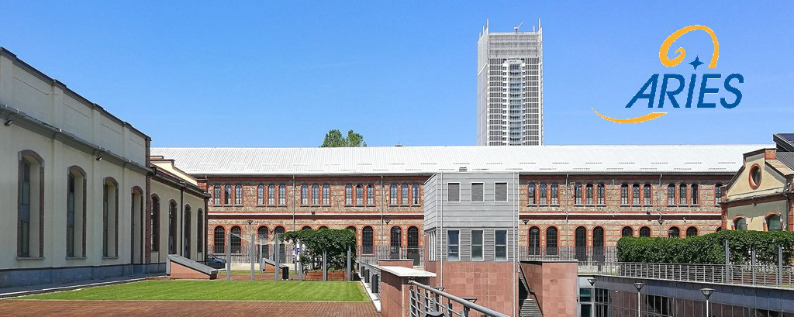
ARIES WP17 PowerMat
Thanks to Polito and particularly to Lorenzo and Martina for organizing this workshop in such an inspiring and beautiful location

Slide 3
PowerMat WP in a nutshell
Develop and characterize novel composite materials based on graphitic and metal matrices with carbide and diamond reinforcements
Test and online monitor materials behaviour under thermal shock (particle- or laser-beam induced) and irradiation
Investigate radiation damage using numerical and experimental approaches.
Identify and test novel materials for broader accelerator applications for high power targets, beam catchers, beam windows and luminescence screens
Explore societal applications of these novel materials such as advanced engineering, medical imaging, quantum computing, energy efficiency, aerospace, and thermal management

Slide 4
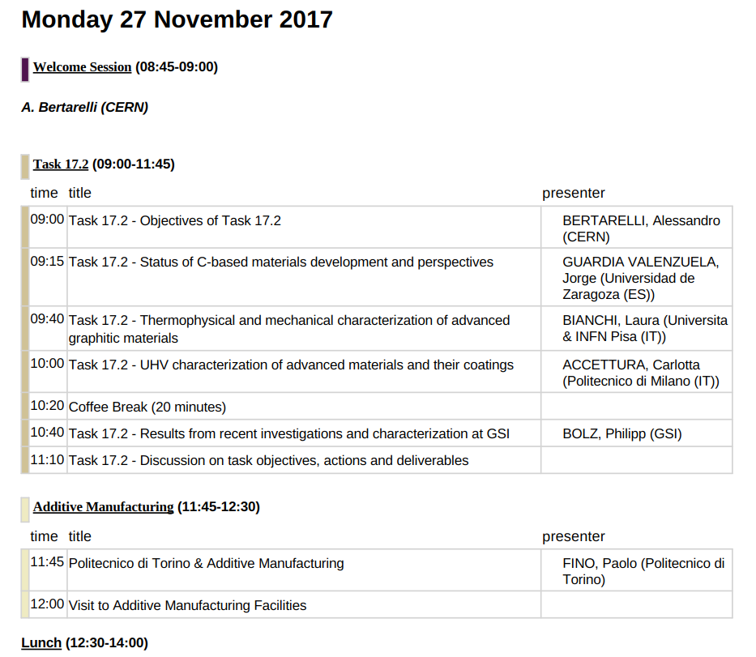
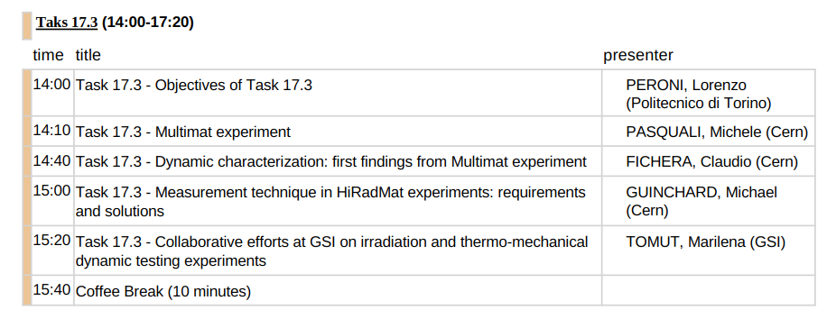
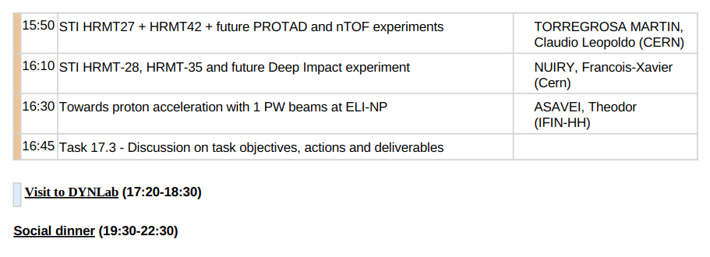
ARIES WP17 PowerMat: Timetable

Slide 5
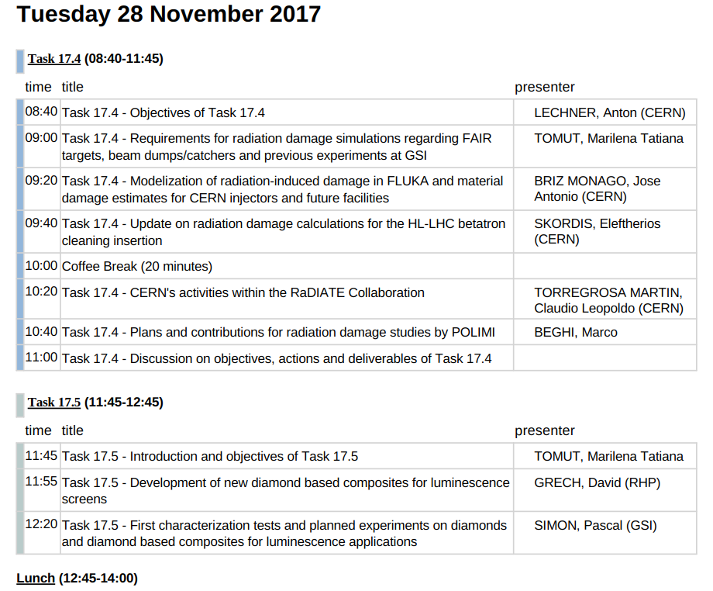
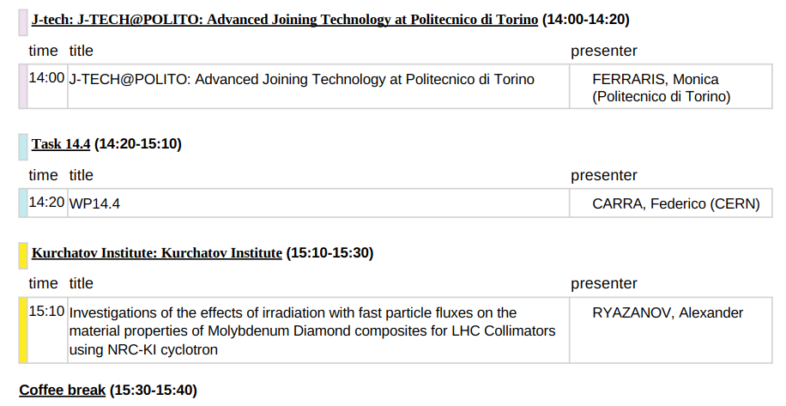
ARIES WP17 PowerMat: Timetable

Slide 6
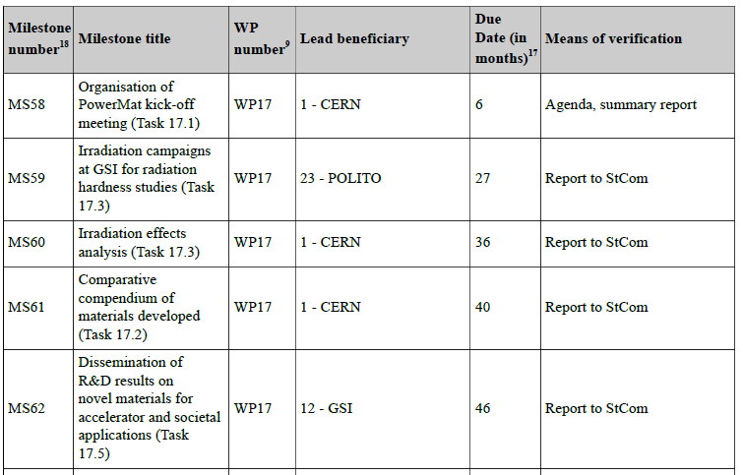
Milestones

Slide 7
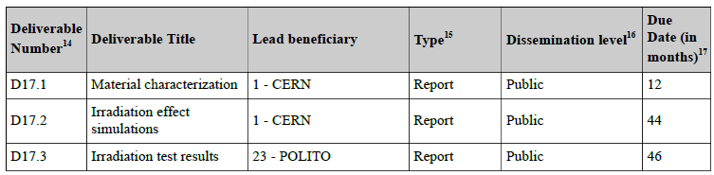
Deliverables

Slide 8
Deliverables and Milestones
Task | Year 1 |  |  |  | Year 2 |  |  |  | Year 3 |  |  |  | Year 4
 | Q1 | Q2 | Q3 | Q4 | Q1 | Q2 | Q3 | Q4 | Q1 | Q2 | Q3 | Q4 | Q1 | Q2 | Q3 | Q4
17.1 |  | M
17.2 |  |  |  | D |  |  |  |  |  |  |  |  |  | M
17.3 |  |  |  |  |  |  |  |  | M |  |  | M |  |  |  | D
17.4 |  |  |  |  |  |  |  |  |  |  |  |  |  | D
17.5 |  |  |  |  |  |  |  |  |  |  |  |  |  |  |  | M
1.4 |  |  |  |  |  |  |  | D

Slide 9
ARIES WP17 PowerMat: Workshop goals
The main goals of this workshop are:
  Define the WP work program for the next 6 – 12 months, including Deliverables and Milestones
  Foster discussions, exchanges and collaboration between partners
  Prepare the list of experiments, sampling, testing and characterization campaigns
  Define next steps and meetings, e.g. annual meeting (ARIES annual meeting in Riga, LV, 22-25 May ‘18)
You should not leave this event unless you clearly know what you should do in the next 6 – 12 months!
So let’s start …. And enjoy the Workshop

