Slide 1
1st Workshop of ARIES WP17 (PowerMat):
Outcome, Actions, Deliverables
Politecnico di Torino, Turin 27.11.2017
Marilena Tomut (GSI), Alessandro Bertarelli (CERN)

Slide 2
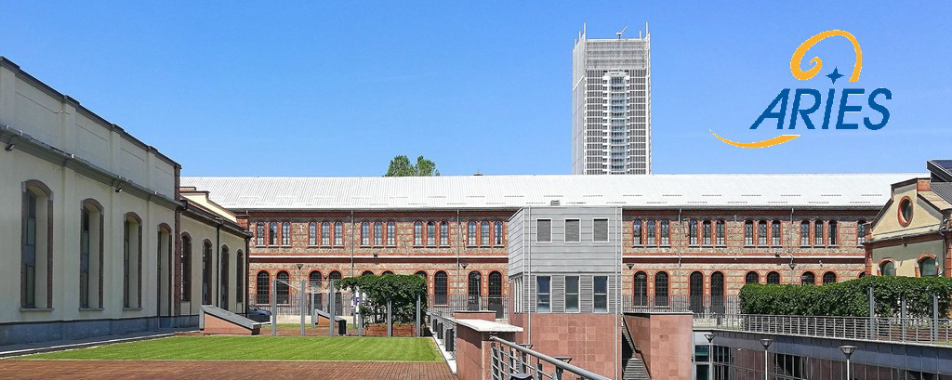
ARIES WP17 PowerMat
Thanks to Polito and particularly to Lorenzo and Martina for organizing this workshop in such an inspiring and beautiful location

Slide 3
PowerMat WP in a nutshell
Develop and characterize novel composite materials based on graphitic and metal matrices with carbide and diamond reinforcements
Test and online monitor materials behaviour under thermal shock (particle- or laser-beam induced) and irradiation
Investigate radiation damage using numerical and experimental approaches.
Identify and test novel materials for broader accelerator applications for high power targets, beam catchers, beam windows and luminescence screens
Explore societal applications of these novel materials such as advanced engineering, medical imaging, quantum computing, energy efficiency, aerospace, and thermal management

Slide 4
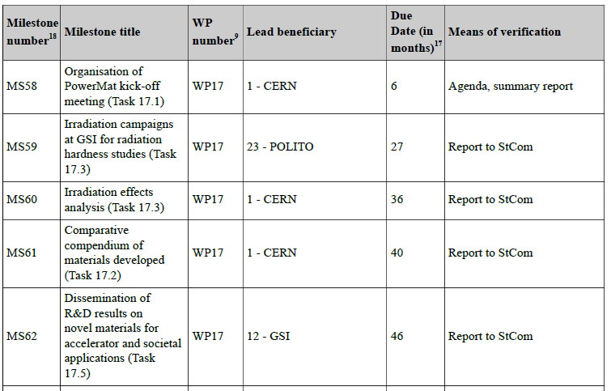
Milestones

Slide 5
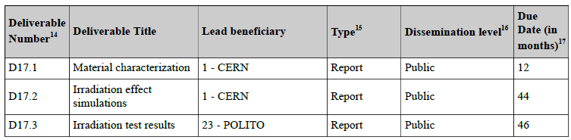
Deliverables

Slide 6
Deliverables and Milestones
Task | Year 1 |  |  |  | Year 2 |  |  |  | Year 3 |  |  |  | Year 4
 | Q1 | Q2 | Q3 | Q4 | Q1 | Q2 | Q3 | Q4 | Q1 | Q2 | Q3 | Q4 | Q1 | Q2 | Q3 | Q4
17.1 |  | M
17.2 |  |  |  | D |  |  |  |  |  |  |  |  |  | M
17.3 |  |  |  |  |  |  |  |  | M |  |  | M |  |  |  | D
17.4 |  |  |  |  |  |  |  |  |  |  |  |  |  | D
17.5 |  |  |  |  |  |  |  |  |  |  |  |  |  |  |  | M
1.4 |  |  |  |  |  |  |  | D

Slide 7
ARIES WP17 PowerMat: Workshop goals
The main goals of this workshop are:
  Define the WP work program for the next 6 – 12 months, including Deliverables and Milestones
  Foster discussions, exchanges and collaboration between partners
  Prepare the list of experiments, sampling, testing and characterization campaigns
  Define next steps and meetings, e.g. annual meeting (ARIES annual meeting in Riga, LV, 22-25 May ‘18)
You should not leave this event unless you clearly know what you should do in the next 6 – 12 months!
So let’s start …. And enjoy the Workshop

Slide 8
Task 17.1 - Actions
  WP Annual Meeting: one day at Riga ARIES meeting (Tuesday 22/5 or Friday 25/5)?
  There is a general consensus that we should profit of this opportunity with for at least the participation of all task leaders. Date be discussed soon (December. M. Tomut; A. Bertarelli).
  Deliverable 17.1: what to put in, what not (e.g MultiMat)?
  All the participants agree to include the characterization of non-irradiated materials (CERN: thermomechanical, UHV, microstructure; GSI: Raman Spectroscopy, thermomechanical; POLITO: dynamic characterization; POLIMI: coating characterization). Results of tests with beam should be included in a different document.
  Internal deliverable: March, 2018. All.
  Deliverable 17.2:
  First ideas to put irradiation tests, but also mechanical characterization.
  Two PhD thesis developed in the scope of EUCARD/ARIES were discussed (F. Carra, E. Quaranta).
  F. Carra asked for a publication of a monograph, waiting for the answer of V. Brunner. F. Carra

Slide 9
Task 17.1 - Actions
  Trans National Access
  Organize/verify TNA for participation to HRMT experiments (MultiMat, FlexMat ….). Who: CERN/GSI (ASAP. M. Pasquali)
  Outreach activities
    Workshop on HiRadMat potential + Advanced simulations and advanced materials. To be discussed (first contacts with Fiona in December ‘17)
    Special Issue on specialized journal on compilation of HiRadMat tests (including MME and STI), including theoretical and numerical predictions and instrumentation methods.
    Available journals (e.g. Dynamic Behavior of Materials) to be checked (Early ‘18. L. Peroni)
    Article on the workshop to be submitted by December, 5th for the Accelerating News issue scheduled on December, 15th (C. Accettura, A. Bertarelli)

Slide 10
Task 17.2 / 14.4 - Actions
Task 2: Materials development and characterization
(A. Bertarelli – CERN)
Task 14.4: Industries for resistant materials
(F. Carra– CERN)
  Produce MoGr material samples with different graphite types (Large flakes first).
  When: after Christmas. Who: CERN, BB. How many? CERN, BB to define. Not for the deliverable.
  Complete characterization of all the material used for MultiMat for the DEL 17.1. The schedule of the deliverable must start in January (CERN, GSI, POLITO)
  Thermomechanical characterization of metallic thin films.
  When: in time for DEL 17.1. Who: POLIMI. M. Beghi, E. Besozzi. Availability of samples to be checked (C. Accettura)

Slide 11
Task 17.2 / 14.4 - Actions
  Non-disclosure agreement for all the materials to include in DEL17.1 must be checked (CERN. J. Guardia)
  Temperature-dependent mechanical flexural characterization of MG, CFC, Graphite, CuCD.
  Who: CERN, BB, RHP. When: Springtime, to be available in summer.
  Dynamic Characterization of Carbide – Graphite
  Who: Polito, CERN, BB, RHP. Materials to be delivered in January, tested in February. Results publication in DEL 17.1 to be decided.
  Shape for CuCD test to be confirmed (F. Carra, L. Peroni, M. Scarpin)
  Fracture Mechanics characterization and NDT before tests.
  Given the brittle nature of carbonaceous materials, it is agreed that LEFM approach should be investigated. Optimal geometries and testing method should be investigated first.
  Who: Polito, CERN, GSI. When: early 2018
  Possibility to have NDT before mechanical tests should be investigated.
  Who: CERN

Slide 12
Task 17.3 - Actions
Task 3: Dynamic testing and online monitoring
(L. Peroni – POLITO)
  GSI irradiation experiment (CERN TNA).
  Possible beam availability in September, 2018 with Ca beam.
  FLUKA results to chose beam parameters. A. Lechner. Early ‘18.
  Details of the irradiation to be discussed in December, 2018 at WP14 meeting. M. Tomut, A. Bertarelli, C. Accettura, J. Guardia, M. Beghi, A. Lechner
  Starting fracture Mechanics characterization (see task 17.2)
  Simulations of HiRadMat experiments.
  M. Pasquali, C. Fichera, M. Portelli to start simulations in December.
  FLUKA maps update (A. Lechner, M. Frankl) by end of December, 2017

Slide 13
Task 17.3 - Actions
  Preparation of FlexMAT experiments.
  Possible time: end of May/June to be checked (M. Tomut).
  CERN to help GSI and POLITO with simulations (FLUKA team). Instrumentation set-up to be discussed in December (M. Tomut, M. Guinchard).
  The experiment could be included in the special issue on HiRadMat experiments.
  Impact tests on carbon based material at high temperature in vacuum.
  In 2-3 months at Polito. L. Peroni, M. Guinchard

Slide 14
Task 17.4 - Actions
Task 4: Simulation of irradiation effects and mitigation methods (A. Lechner – CERN)
  Update of FLUKA calculations quantifying the long-term radiation damage in HL-LHC collimators (including new loss scalings, extended to coatings, and covering also gas production) - CERN
  Definition of the requirements for the GSI irradiation campaign of CERN samples in 2018 (ion species, fluence requirements, equivalence with damage in LHC collimators) - GSI, CERN
  Discussions on co-operation with RaDIATE collaboration concerning coated examples to be irradiated in 2018 BLIP run (concerning DPA calculations, PIE etc.) - CERN, POLIMI
  Support to HiRadMat experiments in terms of energy deposition studies (e.g. MultiMat) - CERN

Slide 15
Task 17.4 - Actions
  Support for DPA calculations for irradiated GSI samples (diamonds etc.) - GSI, CERN
  Medium-term activities:
  Extend DPA, gas production studies to other devices devices/machines
    FLAIR beam dumps/catchers - GSI with guidance from CERN
    FCC collimators, FCC dump, HL-LHC dump, HE-LHC - GSI CERN

Slide 16
Task 17.5 - Actions
Task 5: Broader accelerator and societal applications
(M. Tomut – GSI)
  Optimize metal matrix for better response to fast extracted heavy ion beams –ongoing. GSI with RHP
  Optimize diamond particle sizes and distribution for different applications – to be started. RHP-GSI
  Optimize color centers in diamond for different applications (luminescence screens, QD’s and medical imaging) - using different doping recipe.
  GSI, collaboration LBNL
  Workshop with technology transfer on applications of new materials for advanced engineering solutions, efficient energy solutions, space, thermal management.
  Long-term project, but some proposals for the next meeting in Riga (All).

