Slide 1

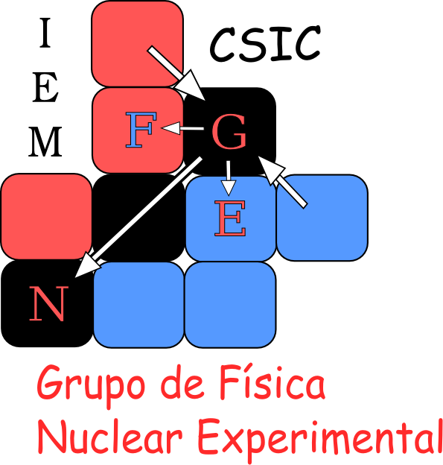
R3B setup for kinematical complete measurements, studies beyond the neutron drip-line ( ¹³Be)
MAGIsol – meeting Isolde September 20-21 2017
Olof Tengblad
IEM – CSIC Madrid
MAGIsol – meeting Isolde September 20-21 2017

Slide 2
NUSTAR – a facility for NUclear STructure & Astrophysis Research
R³B
Research with Relativistic
Radioactive Beams
Low energy and stopped beams
Cooled and stored beams
Super-FRS
Secondary beams produce by fragmentation and fission

Slide 3
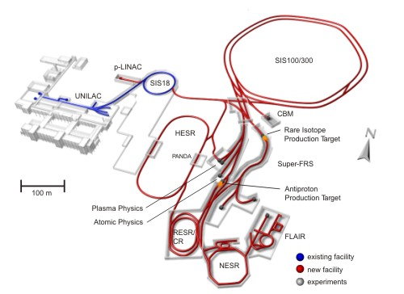
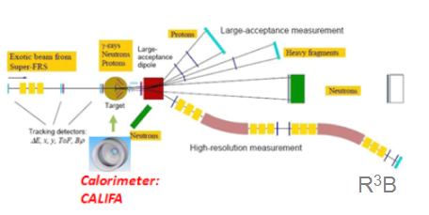
Reactions with Relativistic Radioactive Beams
FAIR (Facility for antiproton and ion research)
⁴⁰Ar¹¹⁺ @ 490 MeV/u
6·10¹⁰ ions/spill.
impact on
Production Target: Be 4 mg/cm²
Products are separated in FRS
FRS -separated isotopes directed to experiment
R³B
Isotope of interest impact on Reaction Target H, C, empty
p
n
n
p
H
Reaction fragments and gammas are detected
Notes:
For the ones that are new in the field and do not know how these experiments are performed I show this carton version.

Slide 4
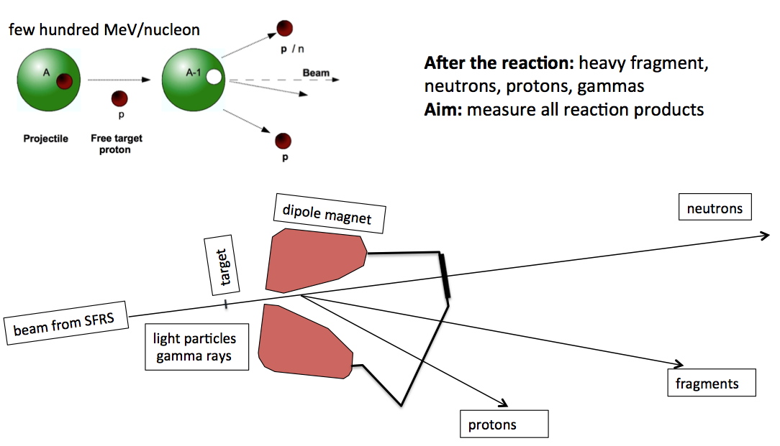
R3B Concept

Slide 5
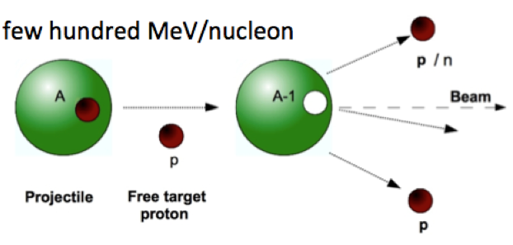
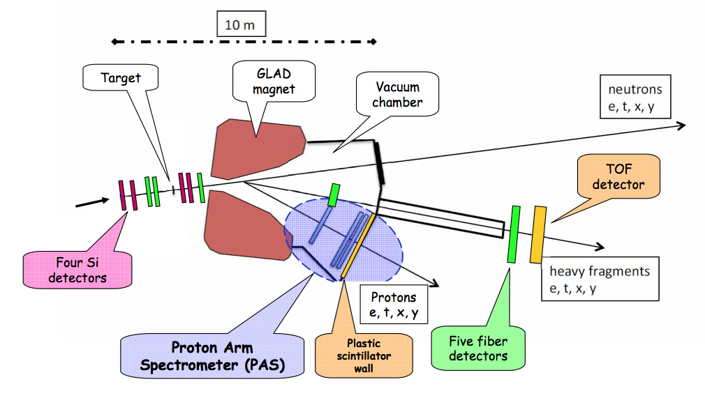
The R³B Concept & tracking system
For full kinematic reconstruction & reaction channel ID we need
for incoming and outgoing fragments, beam & gammas
Energy loss → Nuclear charge Z
Time of Flight → Mass identification
Trajectory → Momentum
Outgoing
fragments
Incoming
Cocktail beam
event by event identification

Slide 6
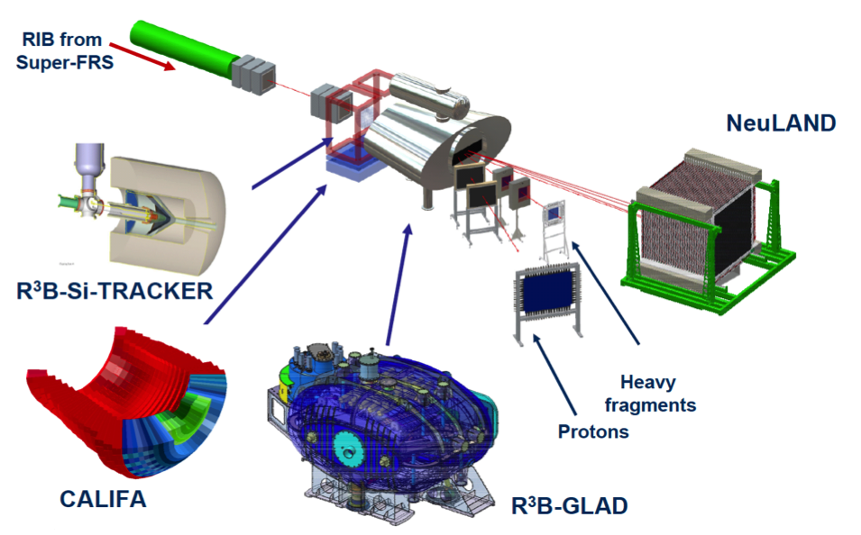
Reactions with Relativistic Radioactive Beams
R³B@FAIR
A universal fixed-target experiment for complete inverse-kinematics reactions with relativistic RIBs (~300 – 1500 MeV/u),
Experiments with the most exotic (<1 ion/s) and short-lived nuclei - exploring the isospin frontier at and beyond the drip-lines
Concept built on existing ALADIN-LAND experiment at GSI

Slide 7
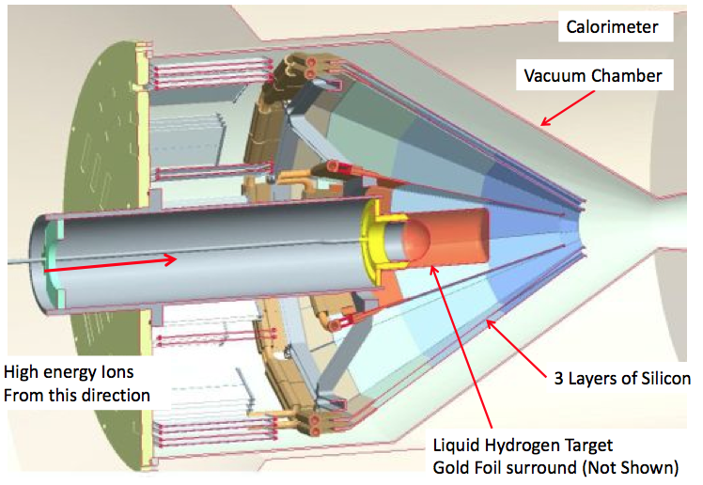
R3B: Si - tracker

Slide 8
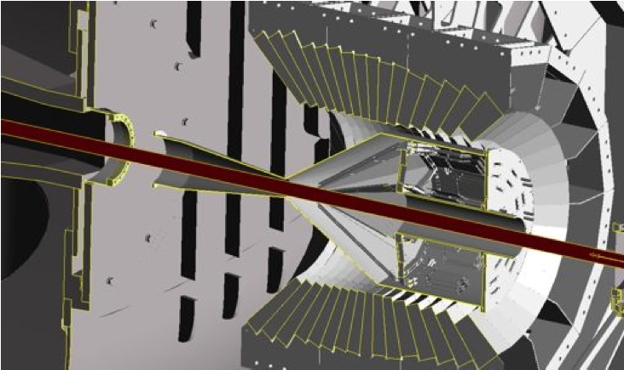
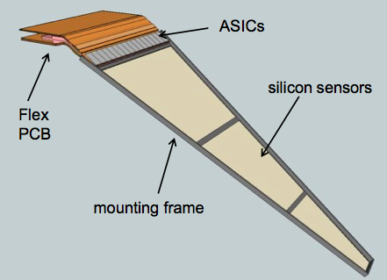
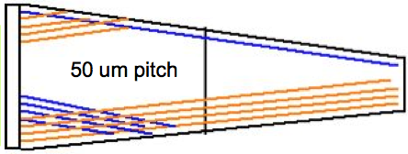
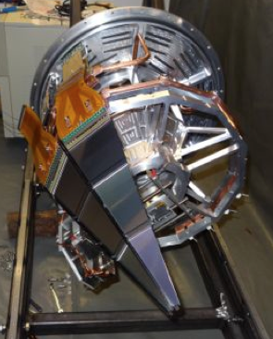
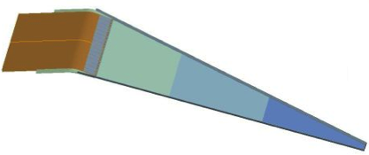
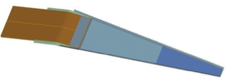
R3B: Si - tracker
120k Si strips
C fibre structure
Outer 300 μm
Univ. of Liverpool & Daresbury
M. Chartier, R. Lemon,
Alan Grant,
Inner 100 μm

Slide 9
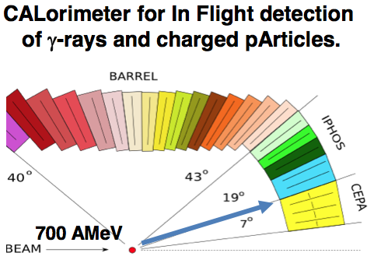
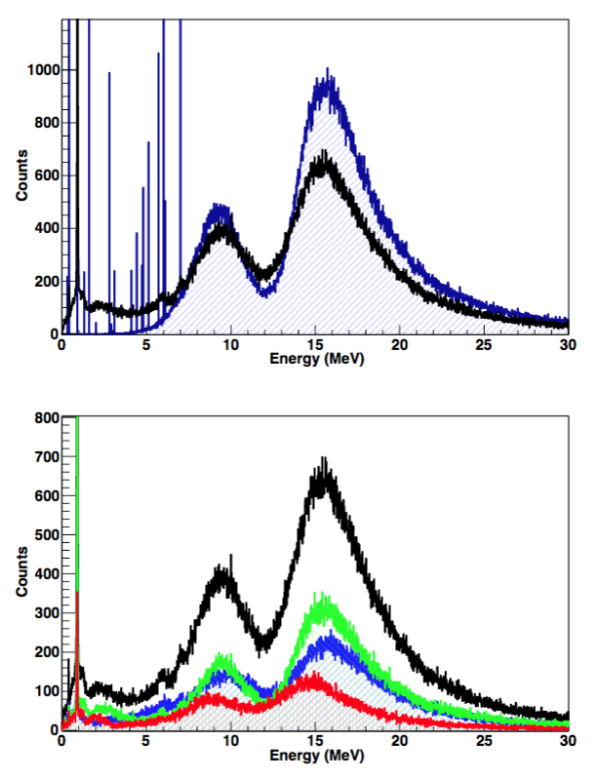

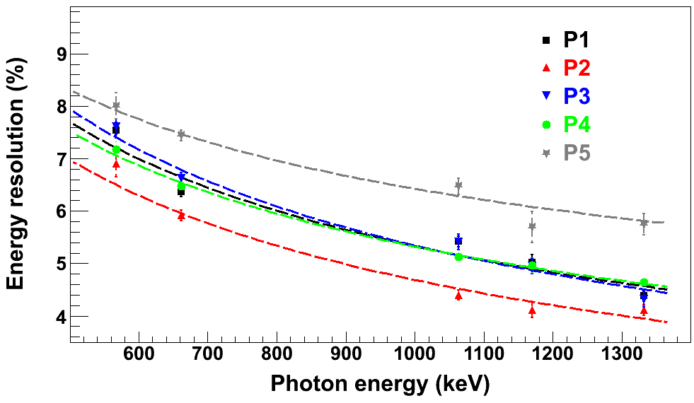
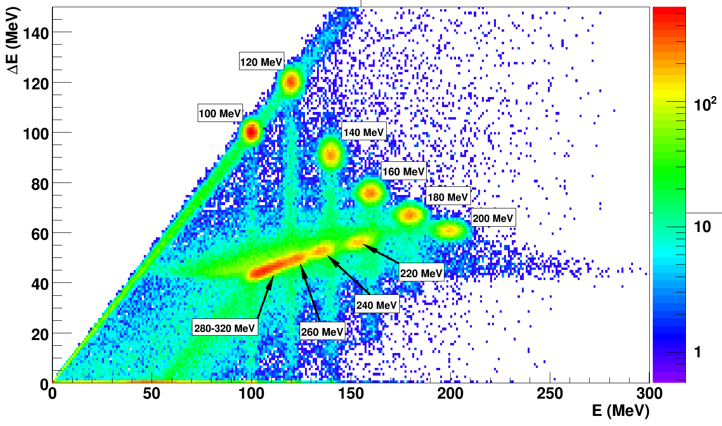
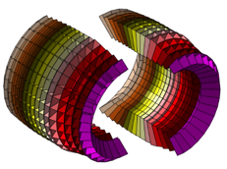
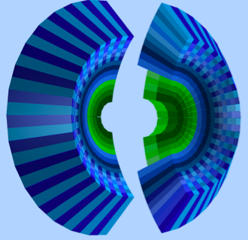
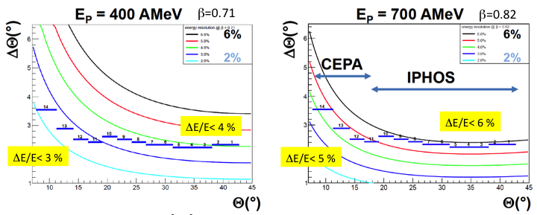
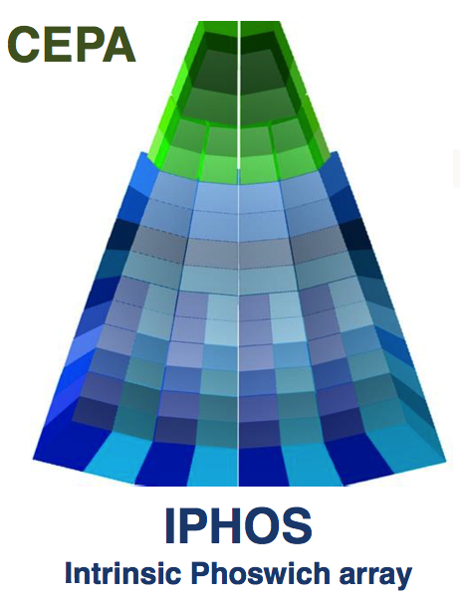
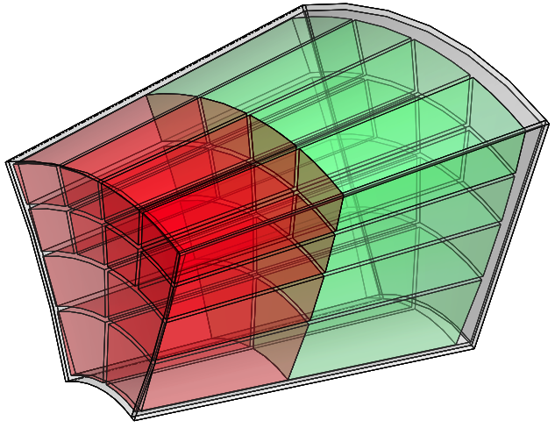
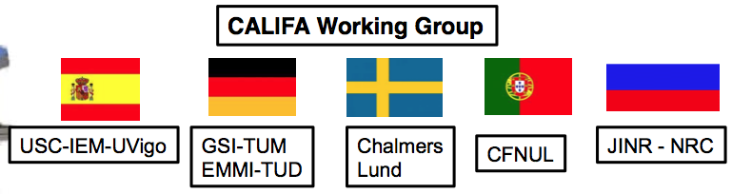
CALIFA
γ
γ
Barrel
Iphos
Cepa
γ
p
Barrel CsI(Tl)
p
p
CEPA LaBr/LaCL
IPHOS CsI(Tl)
2300 crystals = 2 Ton

Slide 10
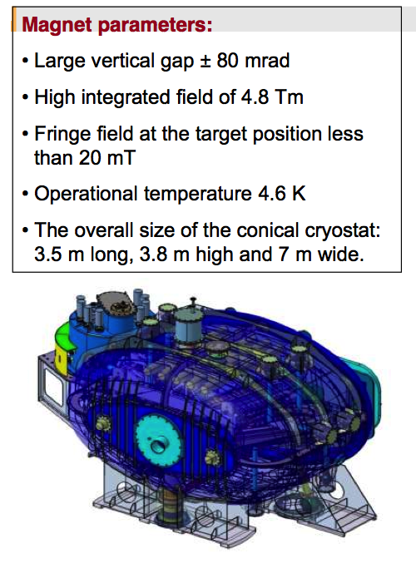
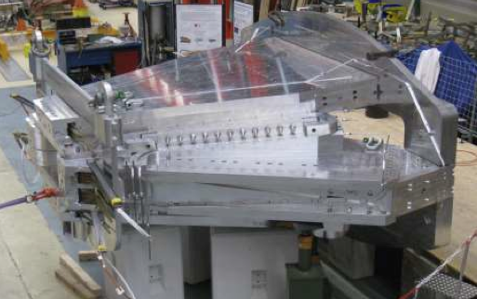
GLAD - Large-acceptance superconducting dipole magnet
@ GSI Cryoplant has been installed
Cryolines (33m) on site Compressor (+ Controls) test
Q4/2014. Cryoplant operation
Q4/2014 Infastructure installation
@CEA Saclay
• Magnet cold mass ready and tested, Dec 2013.
•Integration into cryostat mostly done.
•Delivery to GSI 2016, being cooled down.

Slide 11
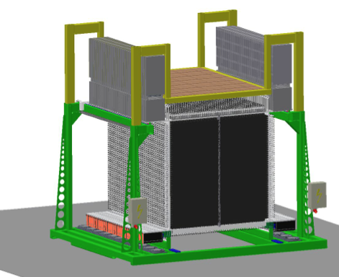
NeuLAND - High-resolution neutron ToF spectrometer
4 double-planes were used at Riken
for experimental campaign 2015-2016
NeuLAND detector parameters:
full active detector using RP/BC408
face sice 2.50 x 2.50 m2
active depth 3 m
3000 scintillator bars
6000 PM / readout channels
32 tons
K. Boretzky
NeuLAND design goals:
>90% efficiency for 0.2-1.0 GeV neutrons
Multi-hit capability for up to 5 neutrons
invariant-mass resolution: NeuLAND-target distance 35 m
∆E < 20 keV at 100 keV above the neutron threshold

Slide 12
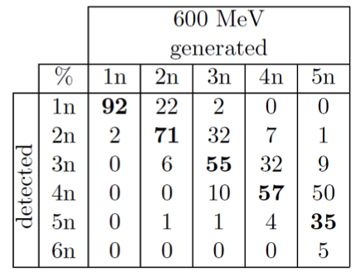
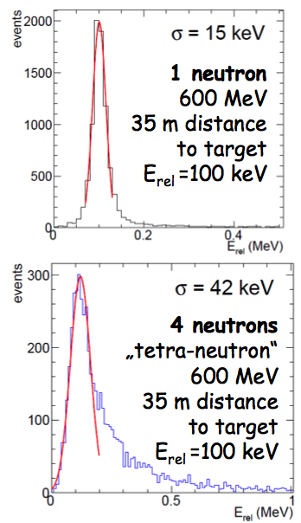
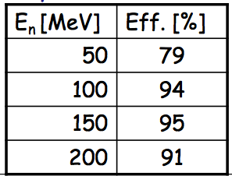
NeuLand
High multi-neutron detection
high resolution @ particle threshold
high efficiency for low neutron energies

Slide 13
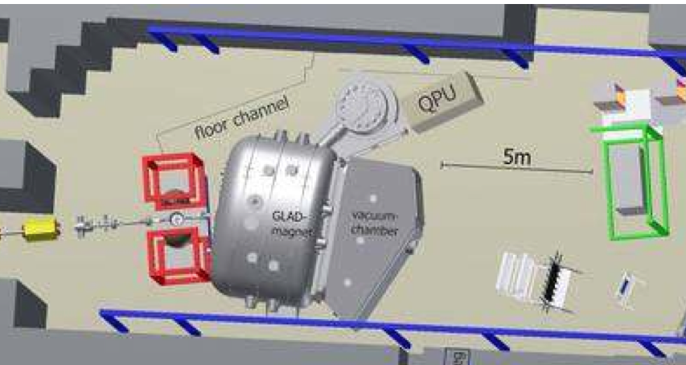
Schedule and first experiments @ GSI in Cave C
2014 Installation of 20% detectors NeuLAND and 10% CALIFA
Commissioning run was performed in Q3/2014
2015/18 Construction and installation of detector components
2018/19 Commissioning of full R3B setup (Cave C)
2019-2020 Physics runs at GSI (Cave C) (phase 0)
Experiments will make use of uniqueness of R3B:
Reactions at high beam energies up to 1 GeV/nucleon
Tracking and identification capability even for the heaviest ions - Multi-neutron tracking capability, high-efficiency calorimeter
Experiments possible for the first time:
4 neutron decays beyond the drip-line and for heavier n-rich isotopes
Kinematically complete measurements of quasi-free nucleon knockout reactions
Electric dipole and quadrupole nuclei beyond N=82, (polarizability, symmetry energy)
- Fission barriers from (p,2p) reactions (→ r-process)

Slide 14
Quasi-Free Scattering: Knockout reaction
Studying unbound nuclei ¹³Be using quasi-free scattering reactions
¹⁴B(p,2p)¹³Be
Target (CH₂)
Target (CH₂)
^{Proton}
Direct Reaction:
(p,2p), (p,np)
from initial to final states without intermediate compound state.
If both outgoing particles have the same masses, in the lab system:
θ_{a}
θ_{b}
θ_{a}+θ_{b}= 81º
¹⁴B
¹³Be
^{Proton}
¹³B
17.3ms
¹⁴B
12.5ms
¹⁵B
9.93ms
¹⁶B
Unbound
¹⁷B
5.08ms
¹⁸B
Unbound
¹⁹B
2.92 ms
¹²Be
21.5 ms
¹³Be
Unbound
¹⁴Be
4.35ms
θ_{a}+θ_{b}= 81º
14

Slide 15
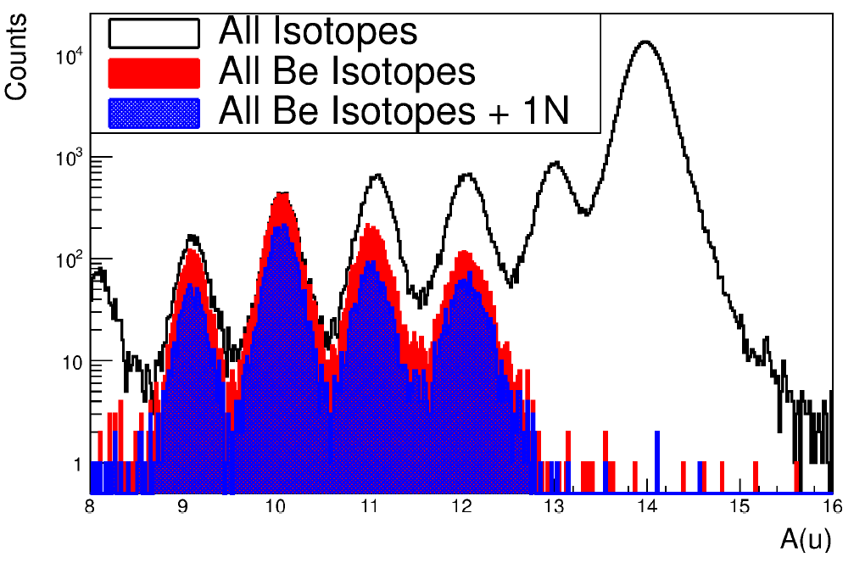
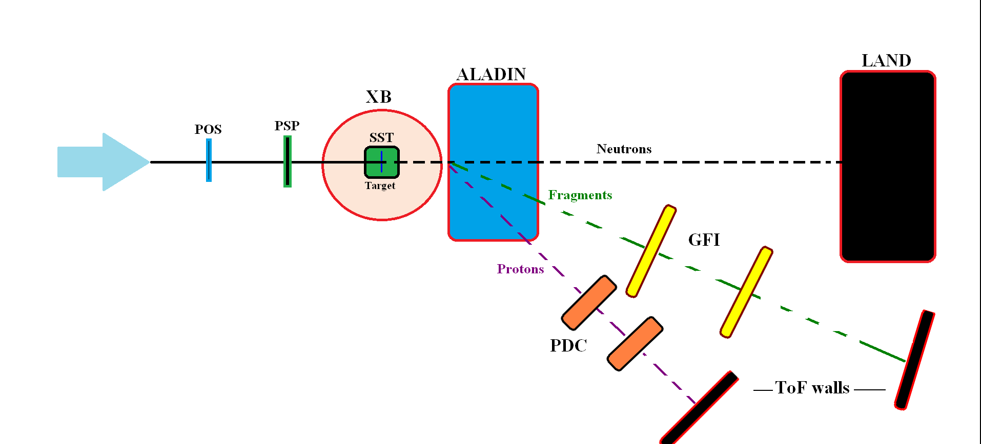
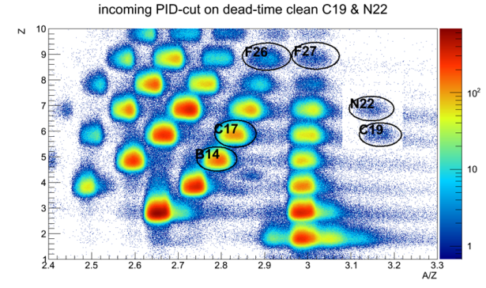
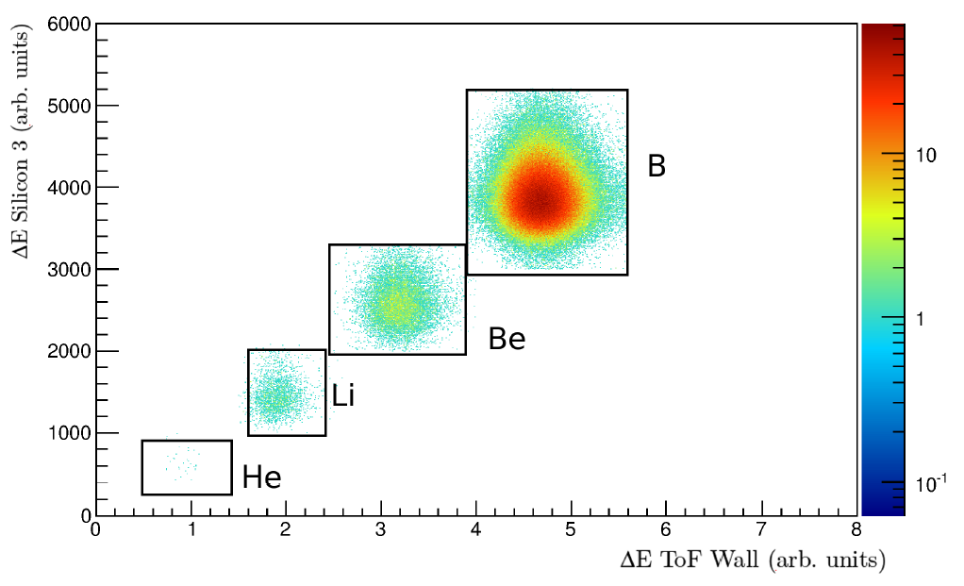
Experiment:Cave C
Mass spectrum with tracker condition
¹⁴B + p → (2pγ) + ¹²Be + n
Inverse & complete Kinematics
Primary beam: ⁴⁰Ar¹¹⁺ at 490 MeV/u
Intensity: 6·10¹⁰ ions/spill.
Production-target: Be 4011 mg/cm²
Charge identification plot

Slide 16
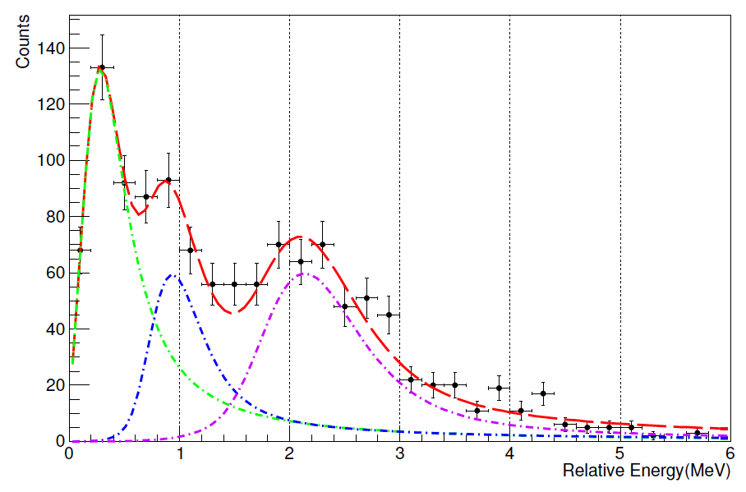
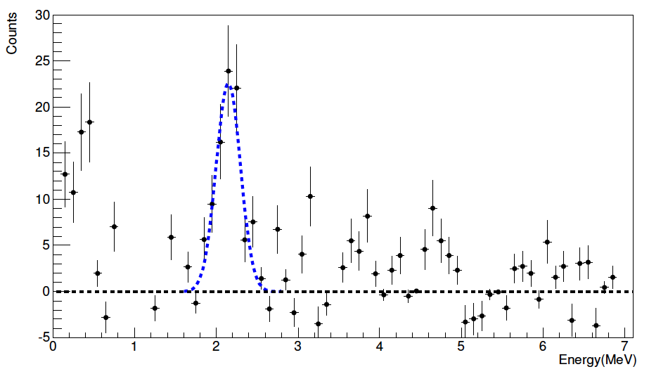
“Conclusion” ¹⁴Be(p,2p)¹³Be
Thesis: G. Ribeiro
¹²Be + n
0.95
3.05(8) (1/2⁺)
2.70 1⁻
T_{1/2}~ 300 ns
2.24 0⁺
2.16(6) (5/2⁺)
2.10 2⁺
n
+
γ
0.33(4) (1/2⁺)
0.0(4) 0⁺
γ
¹²Be
¹³Be
2.10 + 0.95(8) = 3.05(8)
Low statistics New proposal being presented to the FAIR PAC

Slide 17
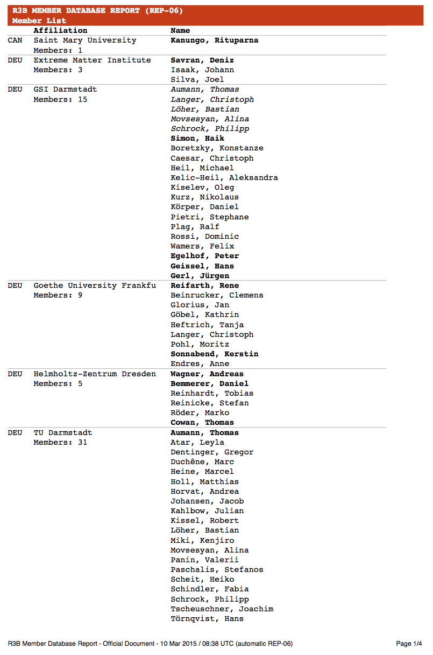
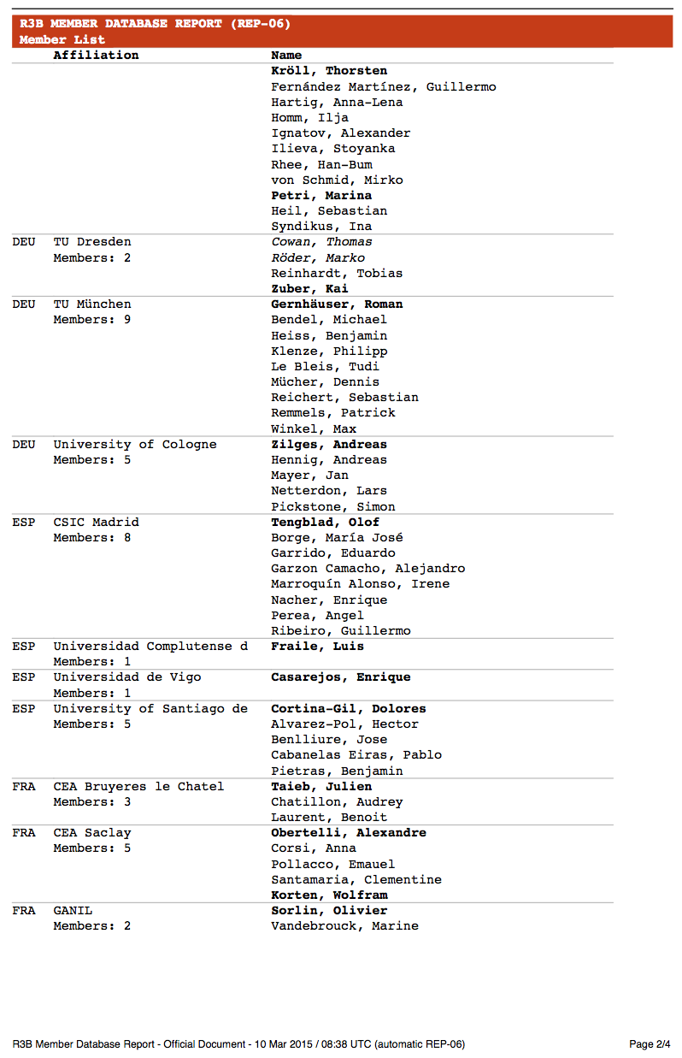
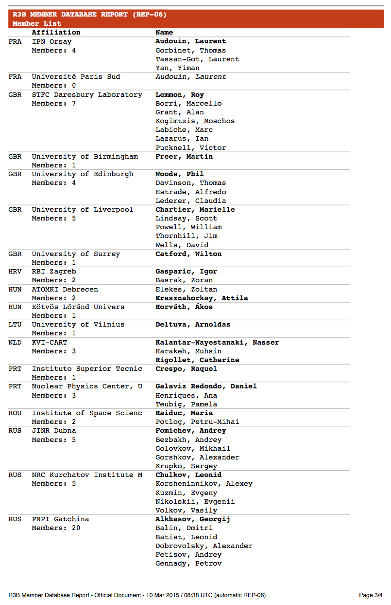
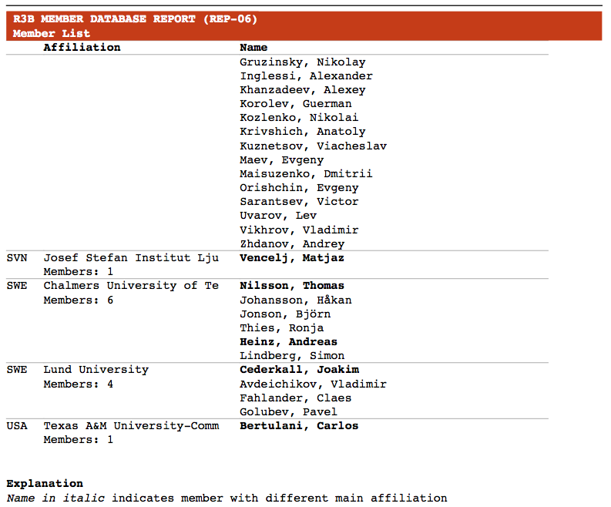
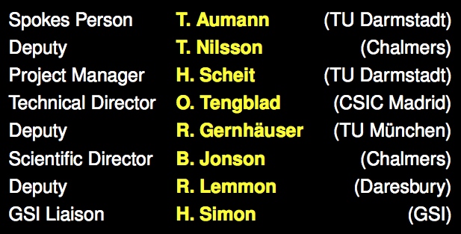
250 Members
40 Institutes
15 Countries

