Slide 1
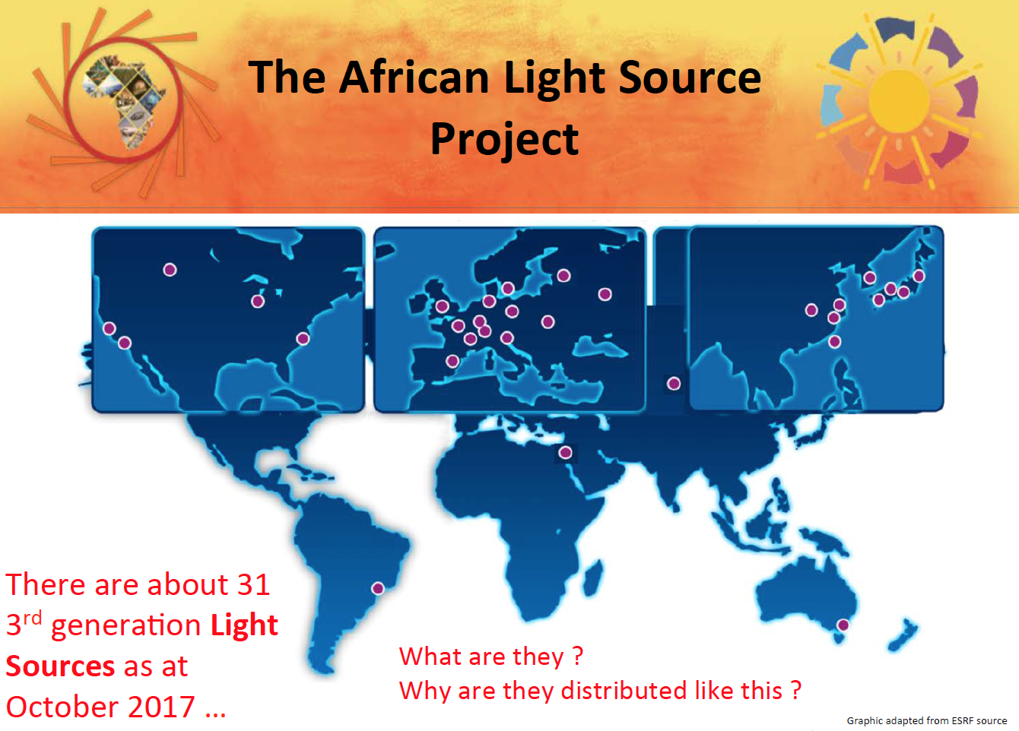


Simon Connell
School of Physics
University of Johannesburg http://physics.uj.ac.za/~connell/ simonhconnell@gmail.com
Connell, S. The African Light Source Project. Presentation at the World Science Forum (WSF): https://worldscienceforum.org/?ajax=1&block=Wsfresztvevok_Download&id=399
ACP2018
Simon’s slides are being delivered by:
Tabbetha Dobbins
Dept. of Physics & Astronomy
Rowan University

Slide 3
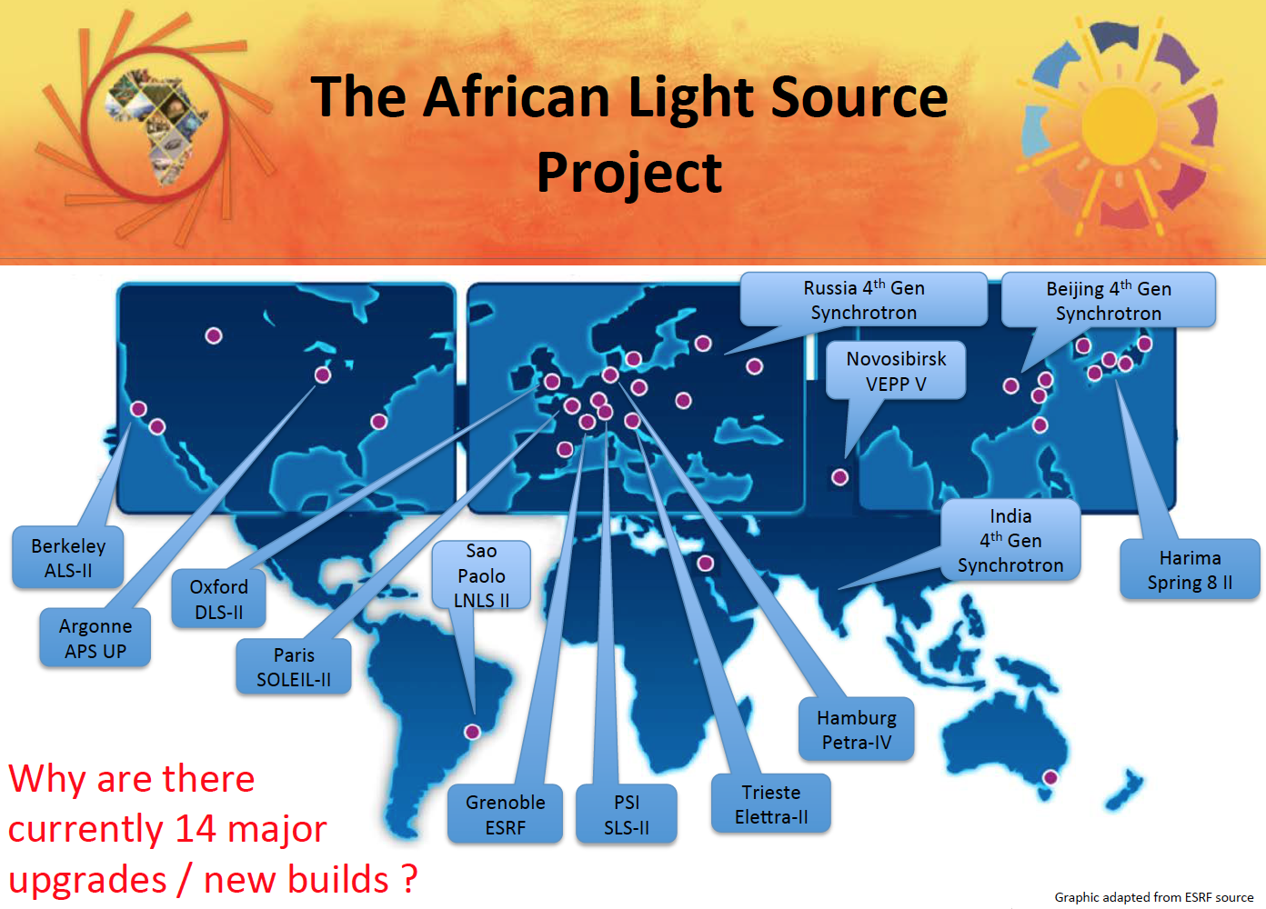

Slide 4


Slide 5
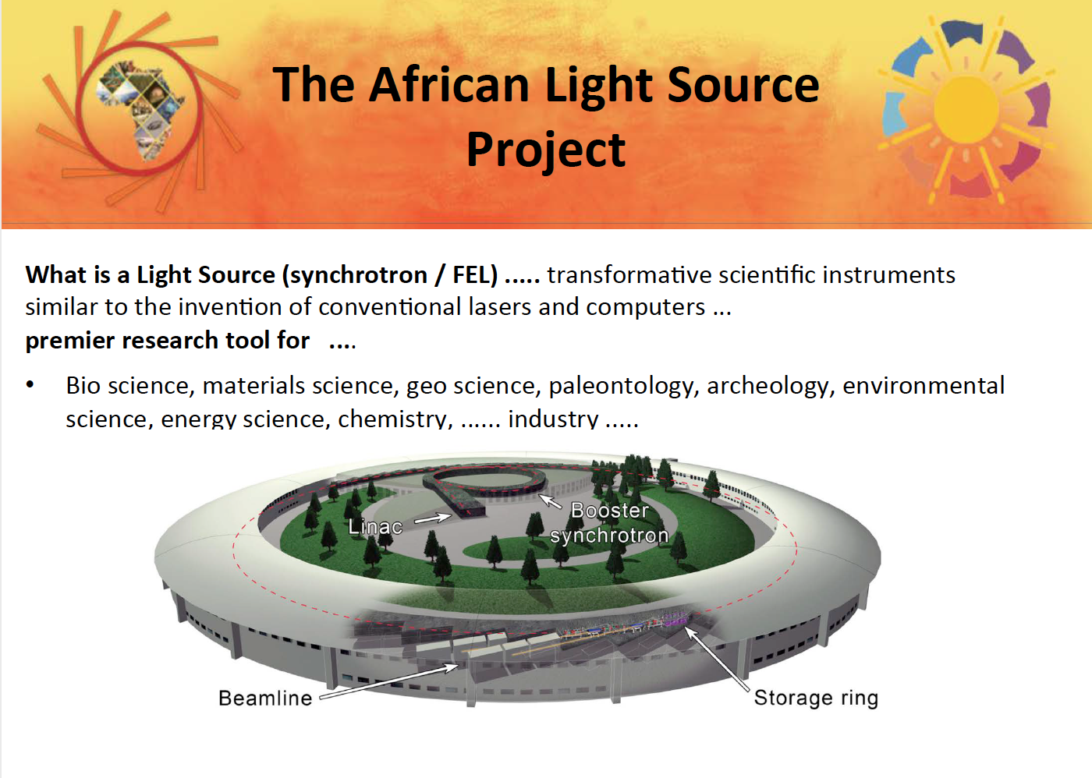

Slide 6


Slide 7
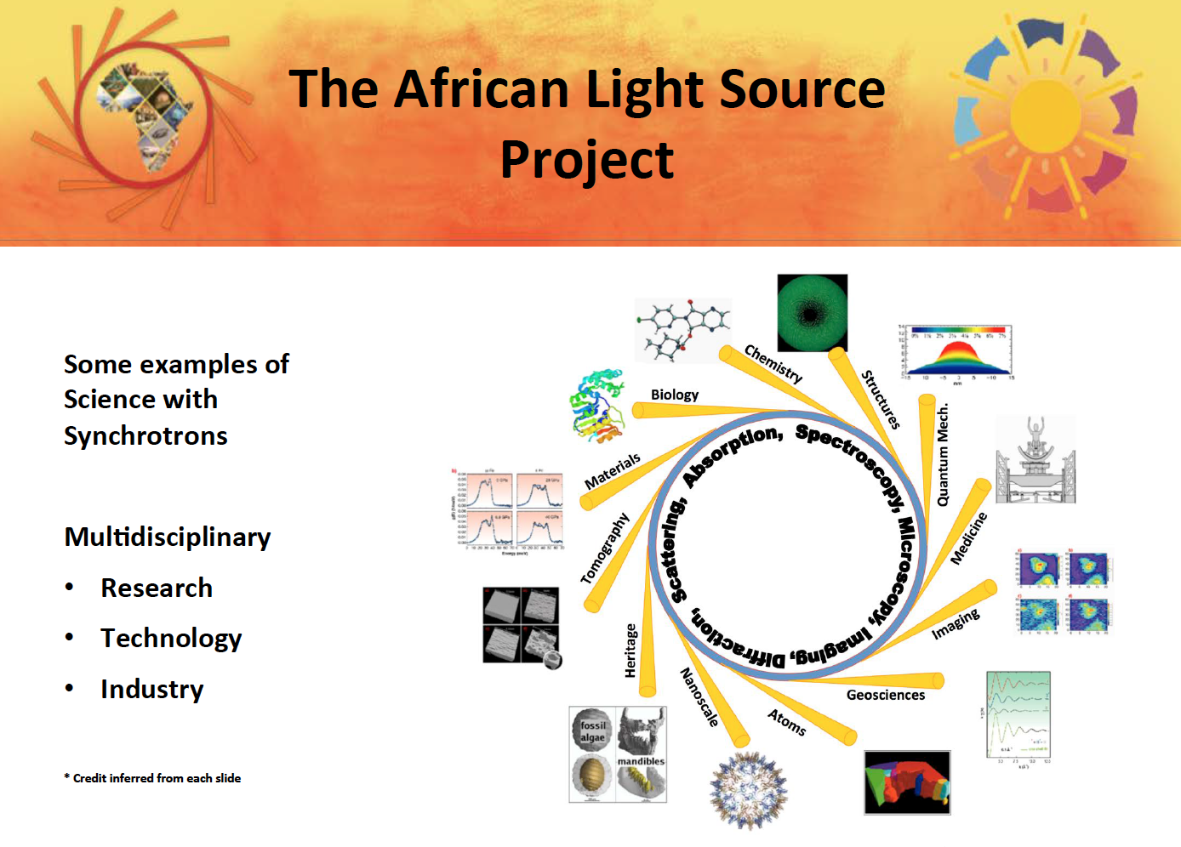

Slide 8
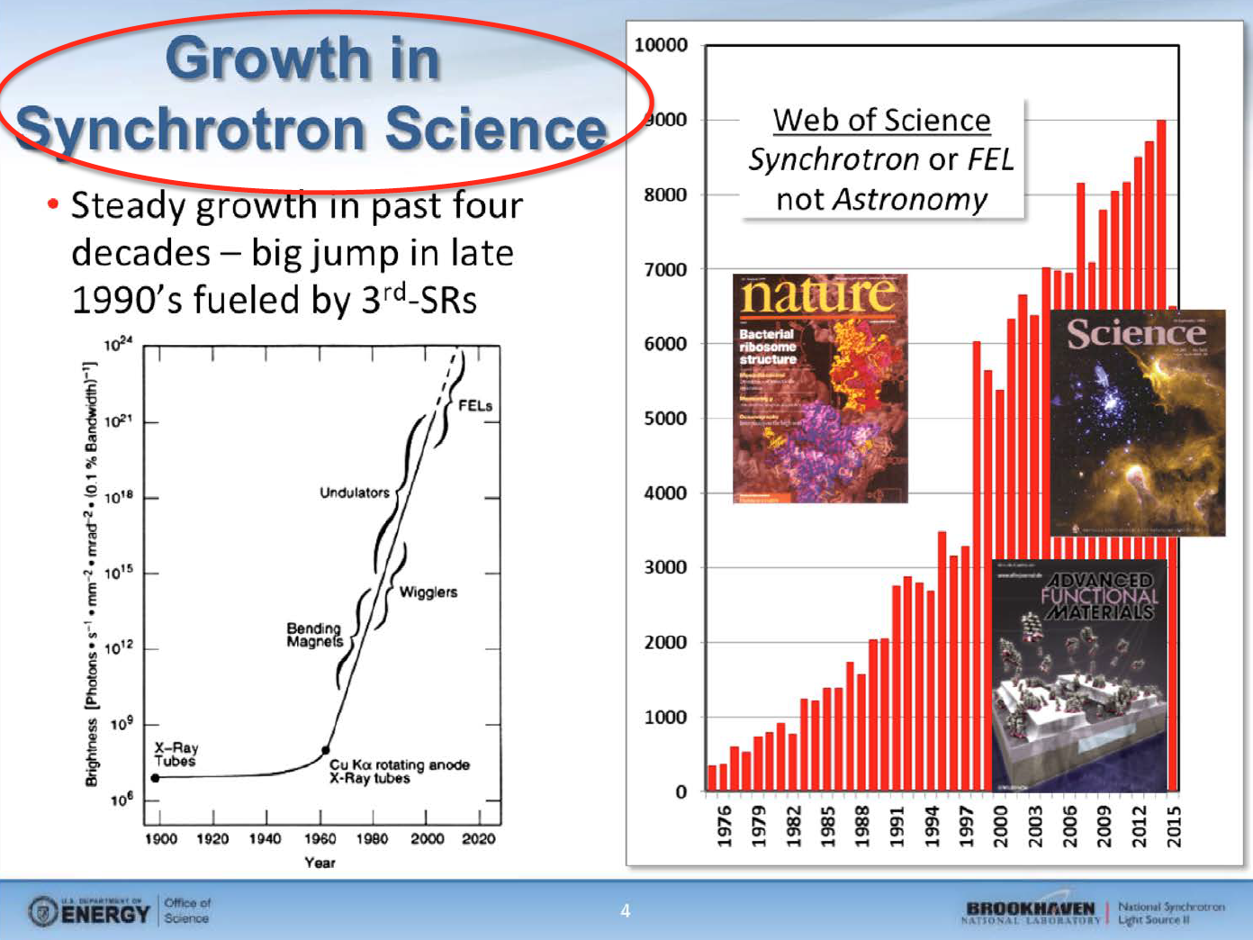

Slide 9
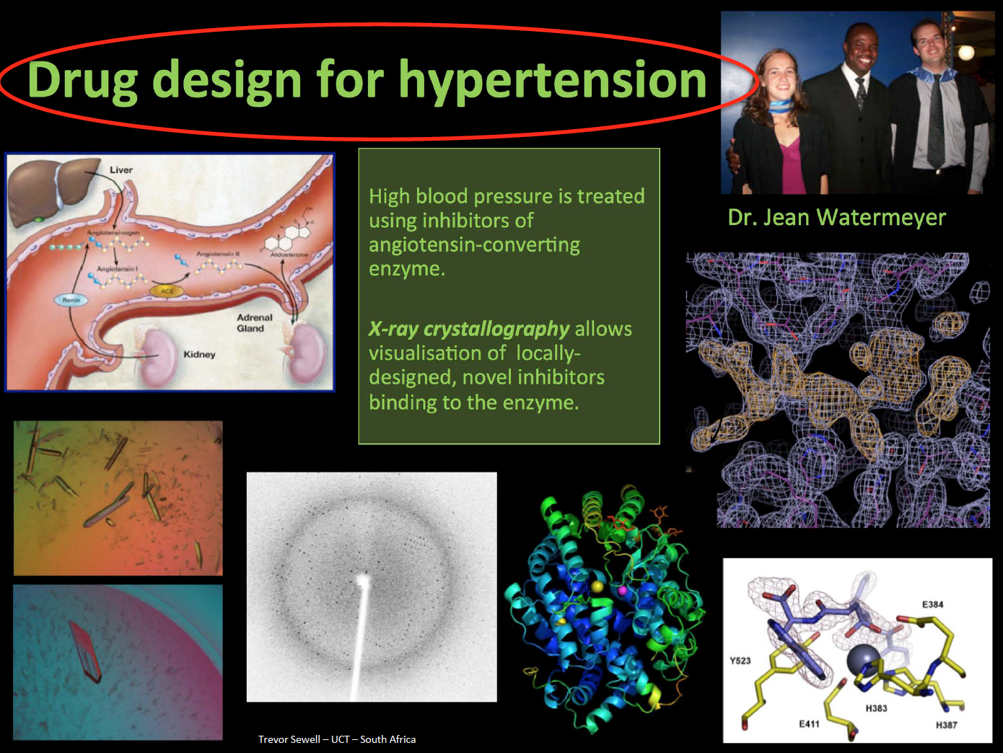

Slide 10
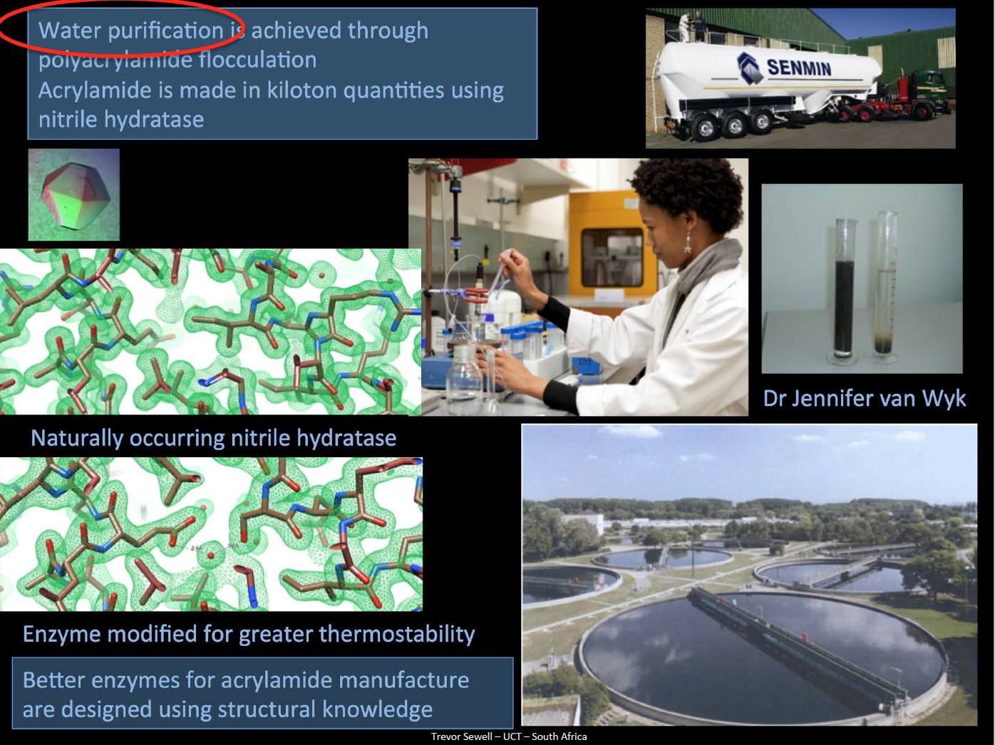

Slide 11
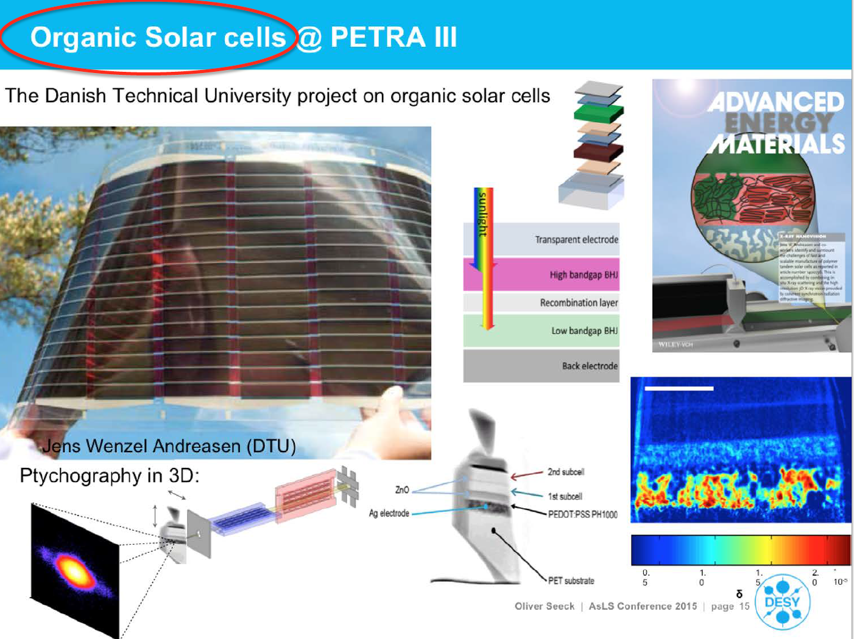

Slide 12
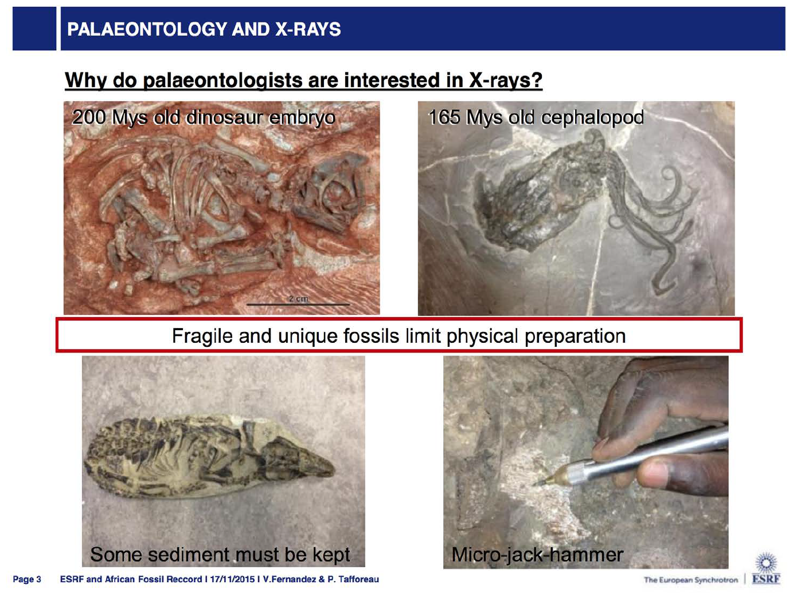

Slide 13
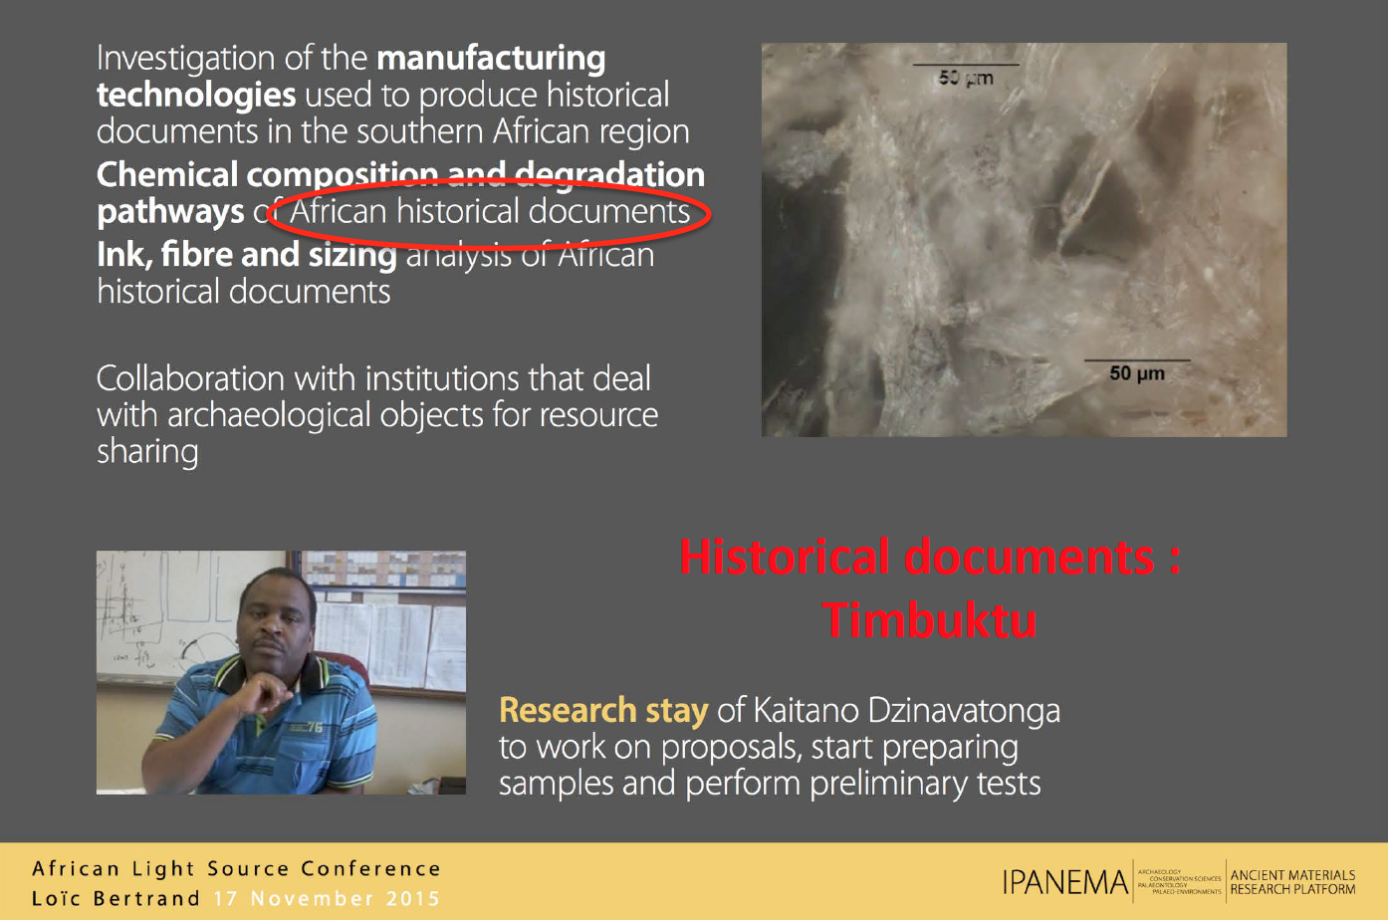

Slide 14
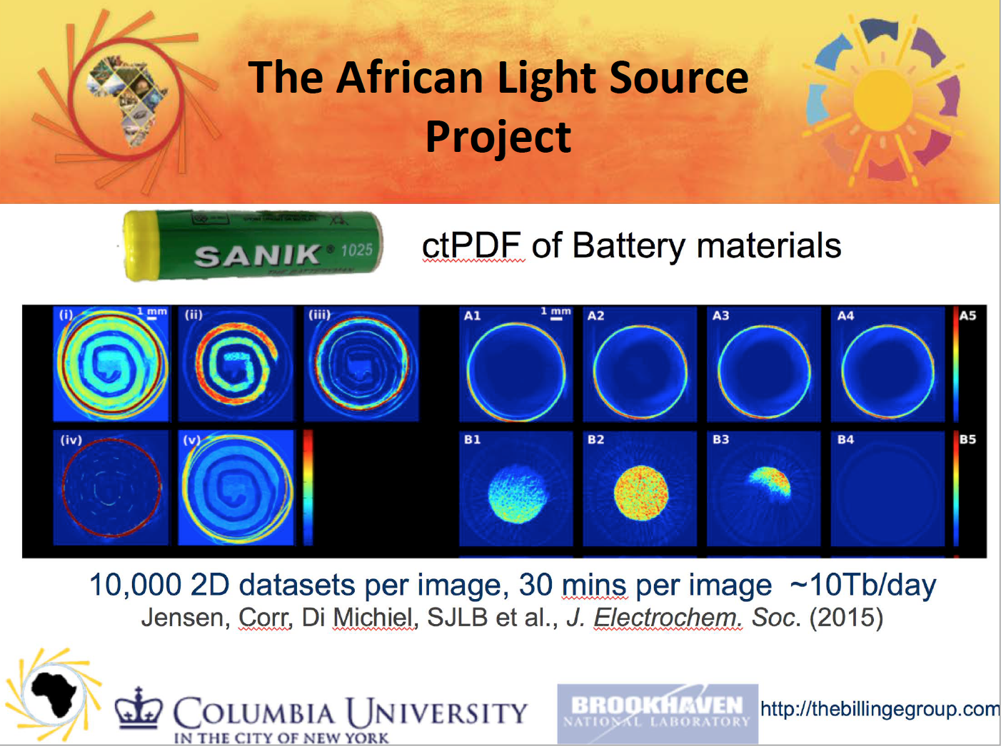

Slide 15
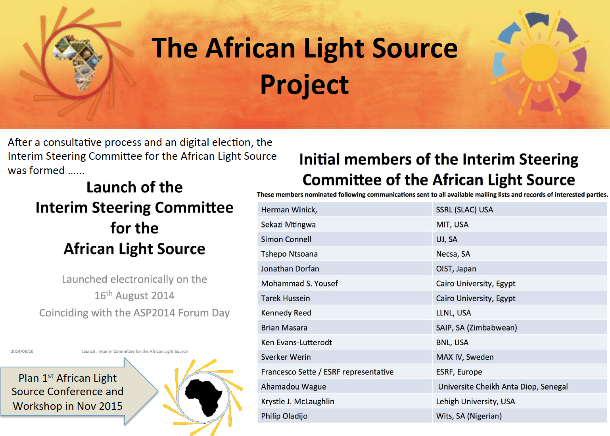

Slide 16


Slide 17
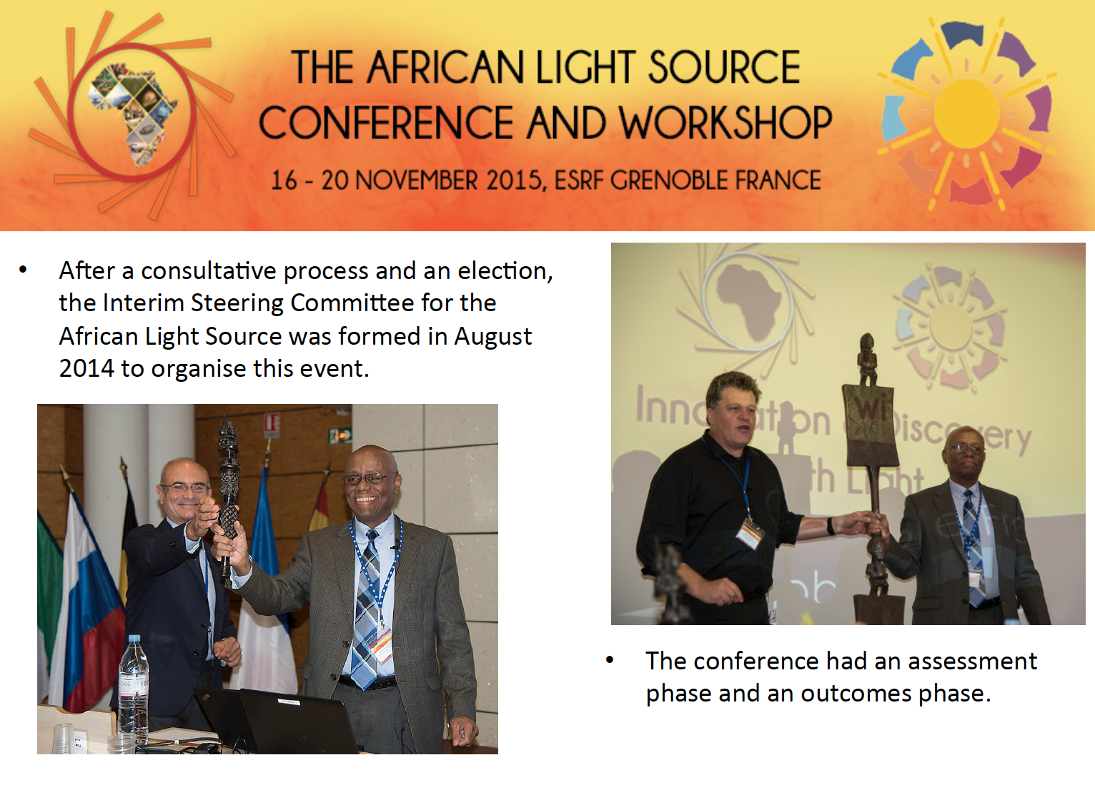

Slide 18
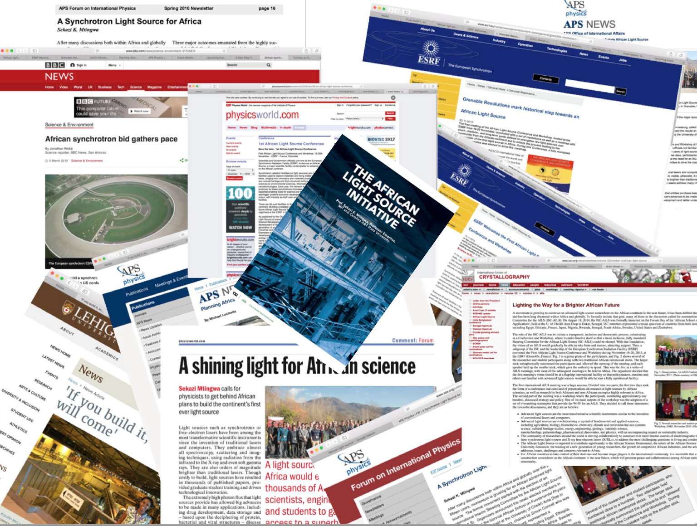

Slide 19
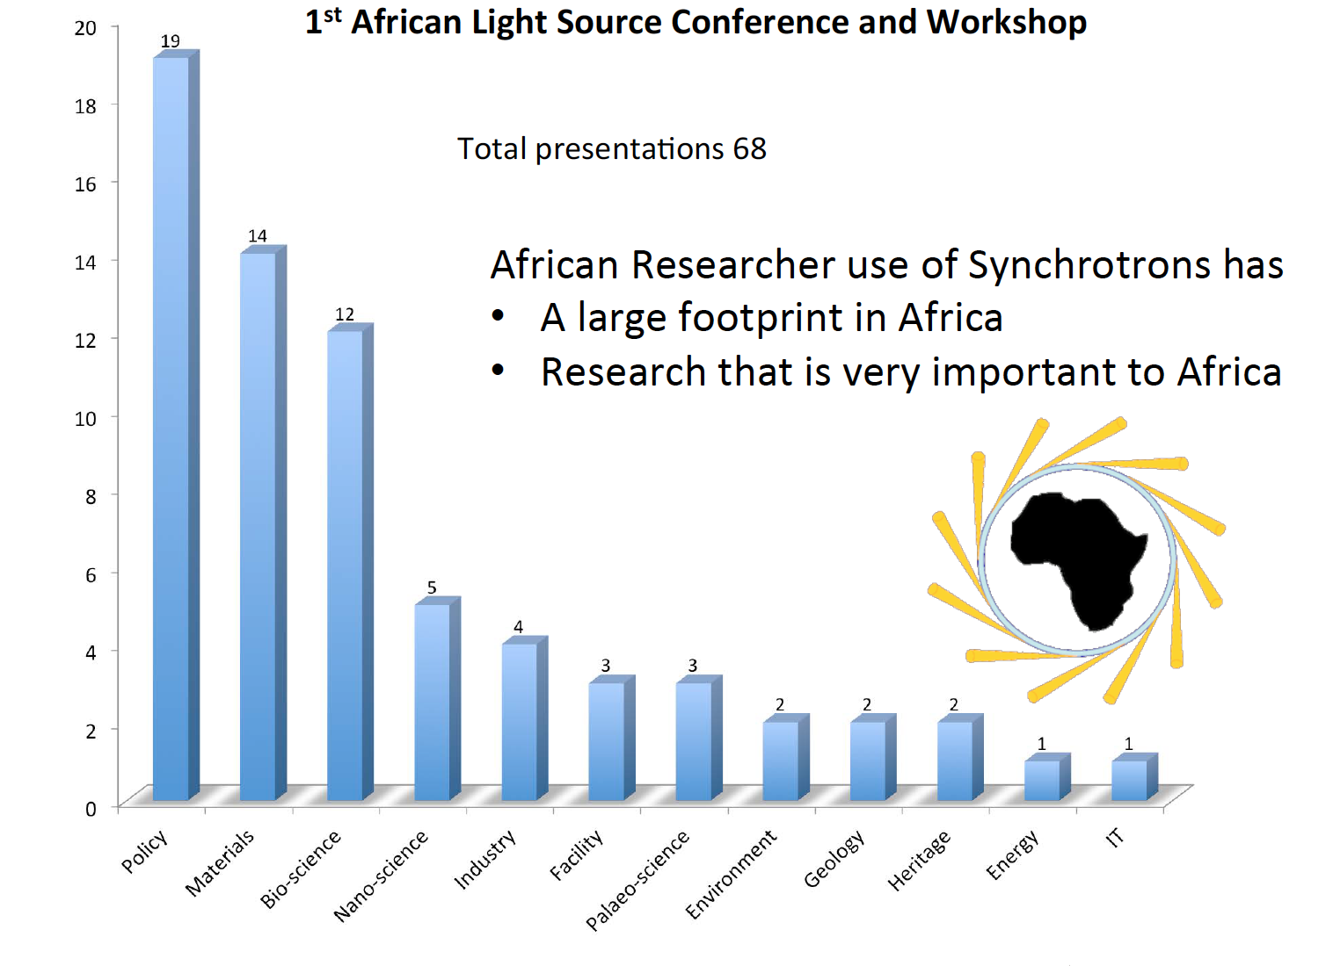

Slide 20
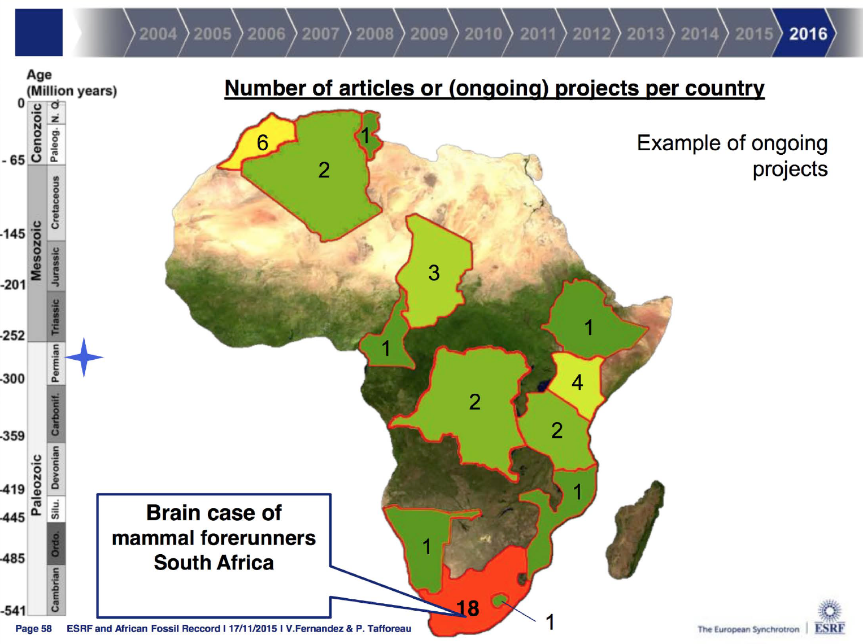

Slide 21
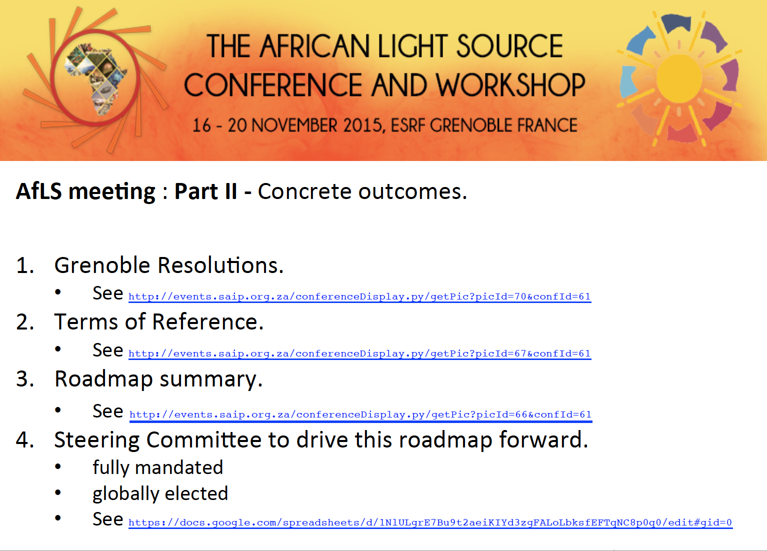

Slide 22


Slide 23


Slide 24


