Slide 1


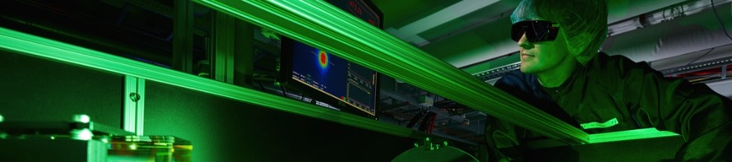

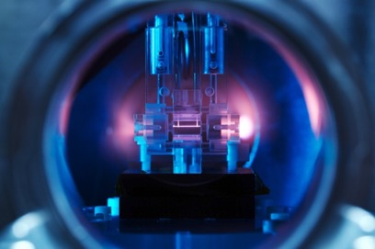


Plasma Accelerators / Compact Accelerators
Can we broaden accelerator impact with compact and cost-efficient accelerators?
African Conference on Fundamental Physics and Applications, or African Conference on Physics (ACP), June 28–July 4, 2018, Namibian University of Science and Technology (NUST), Windhoek Namibia
Ralph W. Assmann (DESY)
Coordinator EuPRAXIA
Lead Scientist DESY Accelerator R&D
This project has received funding from the European Union’s Horizon 2020 research and innovation programme under grant agreement No 653782.

Slide 2

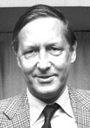



Particle Accelerators: Discovery Machines and Innovation Drivers
For Science, Industry and Society
Today: world-wide operate about 30,000 particle accelerators for science, medicine and industry
Most accelerators are used for industrial applications
Accelerators produced data for dozens of discoveries that were rewarded with nobel prizes.
Accelerators help saving lifes and curing people.
Physics: Cyclotron
Physics:
Stochastic
Cooling
Physics: Higgs particle
Chemistry: ribosoms

Slide 3

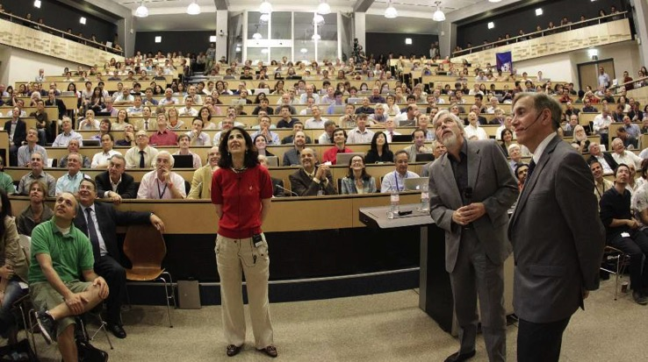


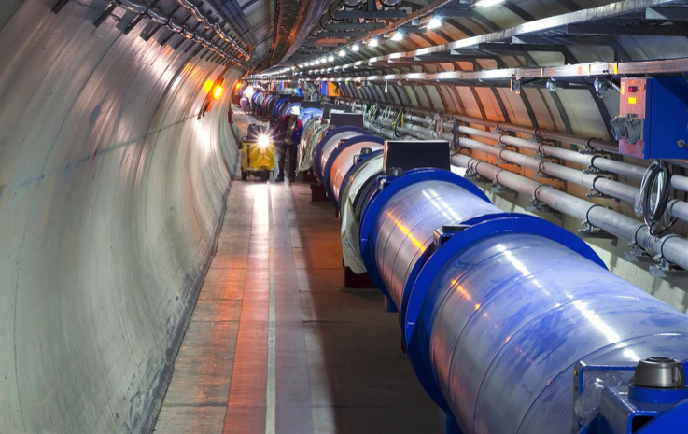
Probing for New Particles and Forces
Fundamental Research Particle Physics
Higgs
Seminar
4.7.
2012
LHC at CERN as a Masterpiece of Accelerator Science
Understanding fundamental laws
Protons at
6 thousand billion electron Volt
→ 27 km
27 km LHC at CERN (Europe)

Slide 4
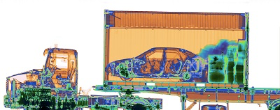

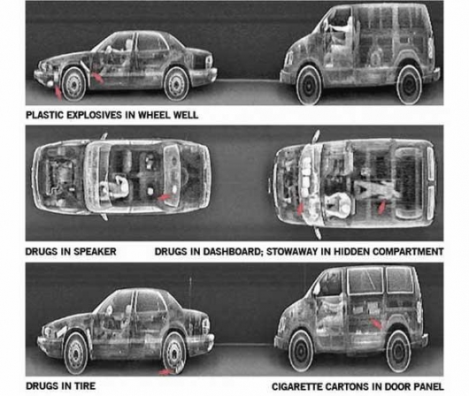
Producing X Rays for Inspection
Industry and Security
Nuctech (China)
Varian (USA)
X-Ray radiography – Cargo inspection with a compact 6 MeV linear electron accelerator
Electrons at
6 million
Electron Volt
Protecting people

Slide 5
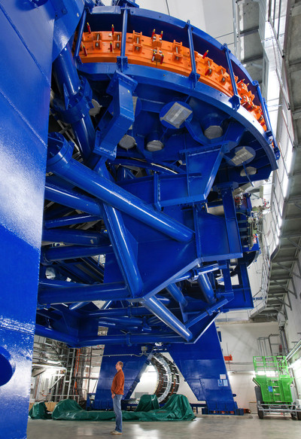
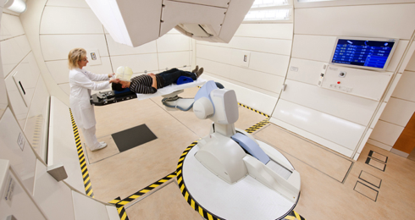
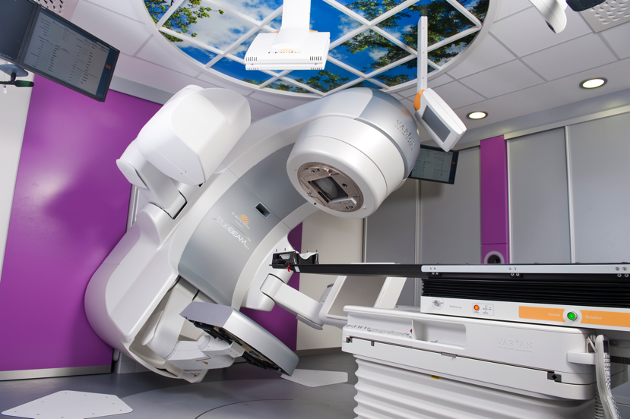
Irradiating and Destroying Tumor Cells
Medicine and Health
Heidelberg Ion-Beam Therapy Center (HIT)
Proton therapy
Varian TrueBeam STx Linac with BrailLab ExacTrac system at University Hospital Düsseldorf.
Electron therapy
up to 12 million electron Volt
Curing people

Slide 6
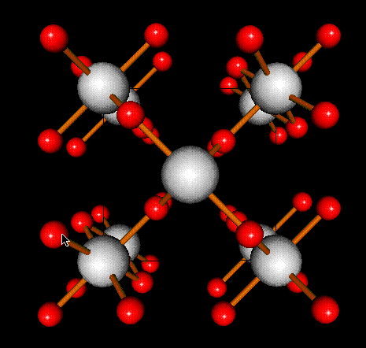
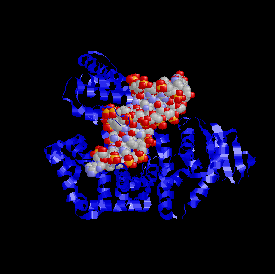
Producing Light and Filming Molecular Movies
Fundamental Research Physics, Structural Biology, Chemistry, Material Science
1900
2000
future
Era of Crystalline Matter
Era of Complex Matter
Ordered Structures, Equilibrium Phenomena, Phase Diagrams
you are here
Locally Ordered Structures, Nonequilibrium Phenomena, Transient States
State of the art accelerators for the best light possible
Synchrotron radiation
from accelerators
X-Ray Laser accelerators
+ High Brilliance SR accelerators
Lab-Based X-ray Sources

Slide 7
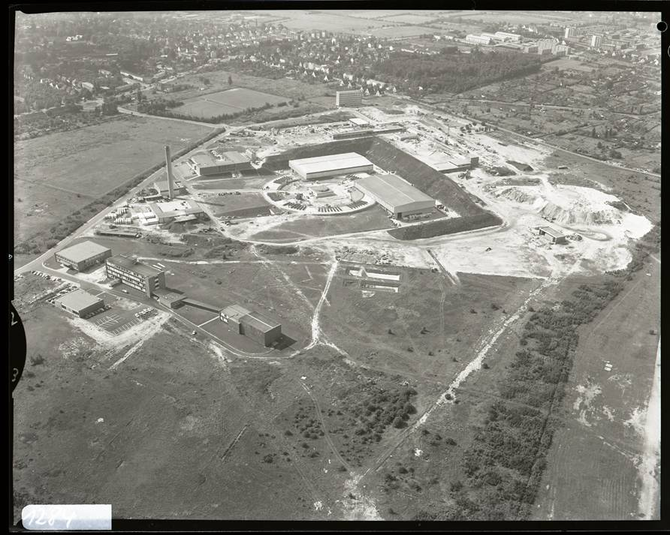

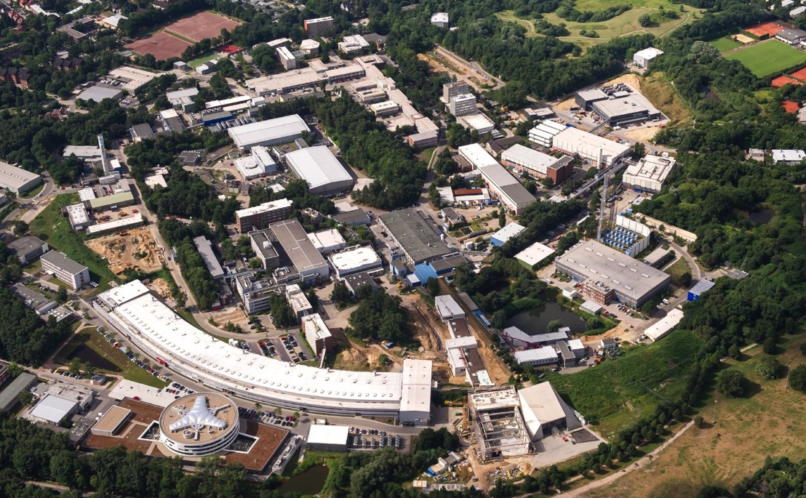

Particle Accelerators at DESY – Excellence in Photon Science
Hamburg (Germany): from 50 years ago to today (electrons up to 17 billion electron Volt)…
DESY
1962
SR
6 GeV
PETRA III
2010
FEL
17,5 GeV
P3X Ost
2015/16
EU.XFEL
2017
NanoLab
P3X Nord
2015
FLASH II
2015
variable gap U
FLASH
2005
4,2nm - 45nm
1,7nm 3rd harm
FEL
1,25 GeV
BUT:
Progress in Hamburg-based colliders limited by practical considerations on size and cost.

Slide 8
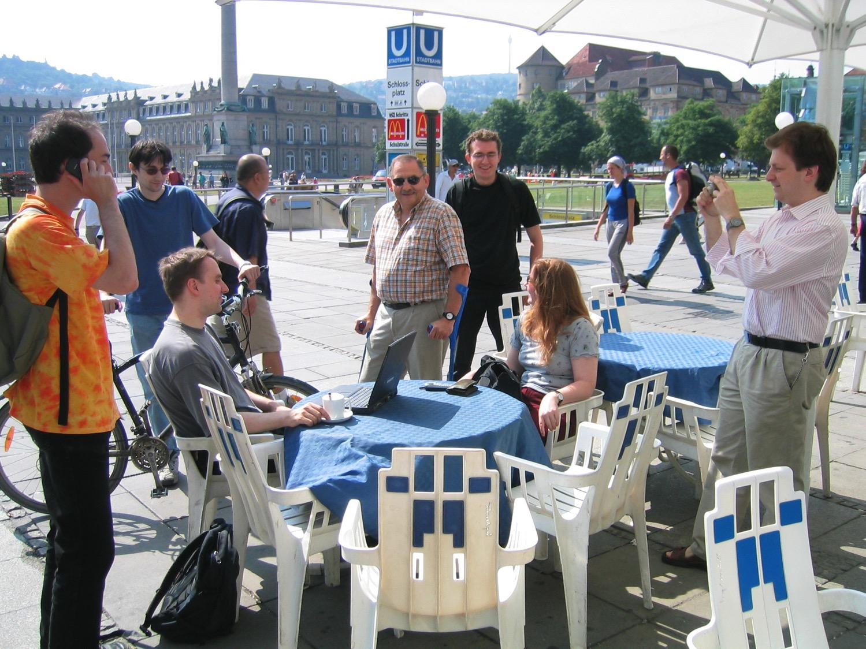
Germany
Today
Accelerator-Based Photon Science Research Affecting Everyday Life

Slide 9
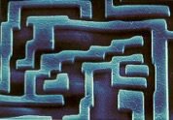
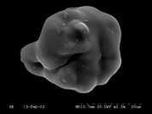
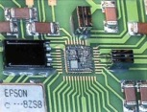
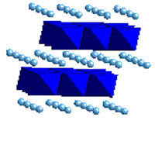
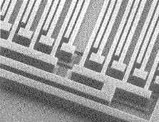
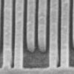
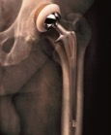
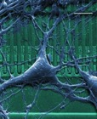
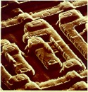
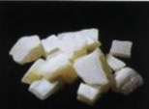
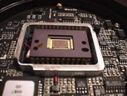
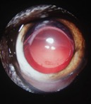
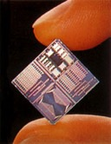
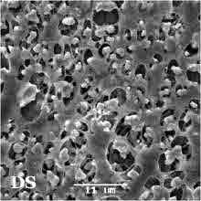
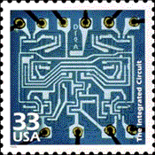
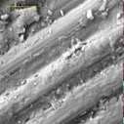
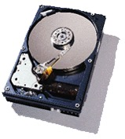
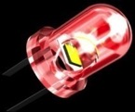
Germany
Today
GPS Navigation
Functional Materials
Air Bag
Accelaration Sensors
MEMS
Cosmetics
TiO₂ Nanoparticle
Pace Maker
Li-Batteries
New Materials for Energy
Accelerator-Based Photon Science Research Affecting Everyday Life
Mobile Phone
SAW Structures
Artificial Hips
Biocompatible
Materials
Glasses and Coatings
Optical Materials
UV Filter
Digital Camera
CCD Chip
Artificial Lens
Biocompatible
Polymers
Exact Time via satellite
Semiconductíng devices
Micro-Batteries
Intelligent Credit Card
Integrated Circuits
Bike Frame
Carbon Fibres
Composite Materials
GMR Read Head
Magnetic
Multilayers
LED Display
Photonic Materials
Taylored Materials at Work ….

Slide 10
Frontier Electron Beams and Directions for New Beams
Towards ultra-dense, highest brightness electron beams
Increase kinetic energy of particles (MeV – GeV – TeV)
More particles per bunch
(1 million – 100 billion)
Smaller transverse area
(1 nm – 1 mm smallest diameter)
Shorter bunches for access to ultra-fast science
(100 nm – 100 μm)
More bunches (1 – 1000)
MORE C O M P A C T TECH???
Length of bunch
(packet)
Transverse area

Slide 11
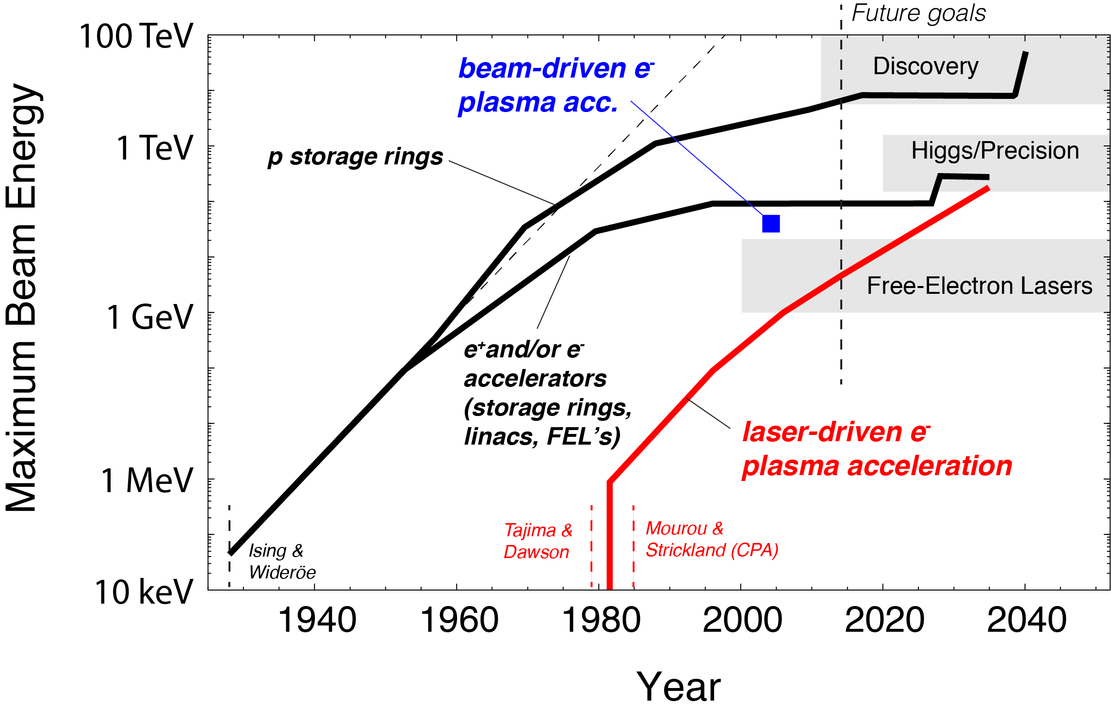
Slow Down in RF and Invention of A New Technology
Complementing RF based Accelerators with Plasma Accelerators!?
100 km
27 km
100 m

Slide 12
Slow Down in RF and Invention of A New Technology
Complementing RF based Accelerators with Plasma Accelerators!?
100 km
Shows potential of plasma acceleration for very high energies → HEP
27 km
100 m

Slide 13
Slow Down in RF and Invention of A New Technology
Complementing RF based Accelerators with Plasma Accelerators!?
100 km
Shows potential of plasma acceleration for very high energies → HEP
27 km
100 m
Plasma acc. today in regime required for FEL’s
→ Photon Science!

Slide 14
Slow Down in RF and Invention of A New Technology
Complementing RF based Accelerators with Plasma Accelerators!?
100 km
Shows potential of plasma acceleration for very high energies → HEP
27 km
100 m → 9 cm
Plasma acc. today in regime required for FEL’s
→ Photon Science!
Acceleration length (new versus conventional):
9 cm versus 100 m

Slide 15
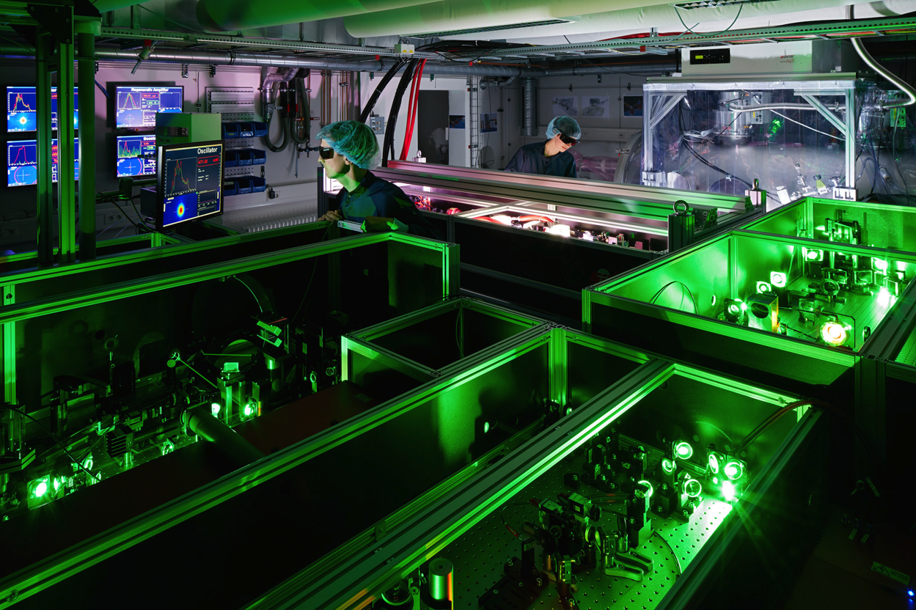

Hamburg: ANGUS Laser Laboratory for Accelerator R&D
200 TW Ti-Sa laser from Thales, laboratory at DESY & University Hamburg
22 thousand billion Volt per meter
(“LHC energy in 30 cm instead of 27 km” → not really)

Slide 16
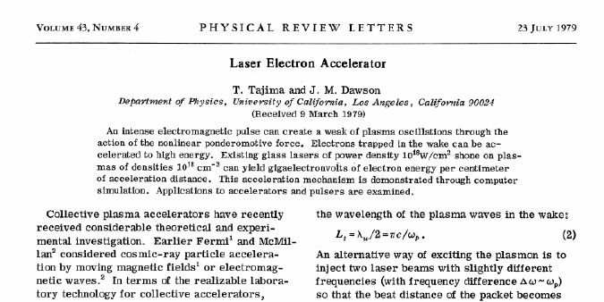

The Plasma Accelerator Concept
Overcome high-field limitations of metallic walls with dynamic plasma structures (undestructible)
New idea in 1979 by Tajima and Dawson: Wakefields inside a homogenous plasma can convert
transverse forces into longitudinal accelerating fields
Pondero-motive force of a laser
Space charge force of a charged particle bunch (e-, p+)
Accelerating gradients of 10 GeV/m to
1,000 GeV/m
or
Options for driving wakefields:
Lasers: Industrially available, steep progress, path to low cost
Limited energy per drive pulse (up to 50 J)
Electron bunch: Short bunches (need μm) available, need long RF accelerator
More energy per drive pulse (up to 500 J)
Proton bunch: Only long (inefficient) bunches, need very long RF accelerator
Maximum energy per drive pulse (up to 100,000 J)
Courtesy M. Kaluza

Slide 17
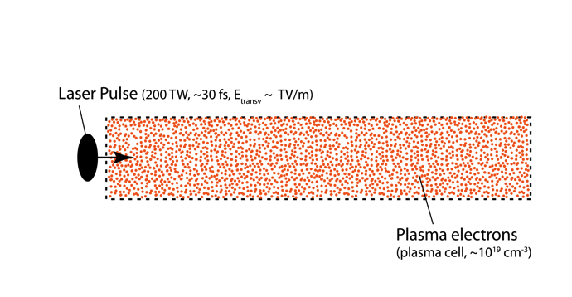
Plasma Acceleration
Internal injection
Works the same way with an electron beam as wakefield driver. But then usually lower plasma density. Ponderomotive force of laser is then replaced with space charge force of electrons on plasma electrons (repelling).
Like wakes left behind by a boat in water

Slide 18
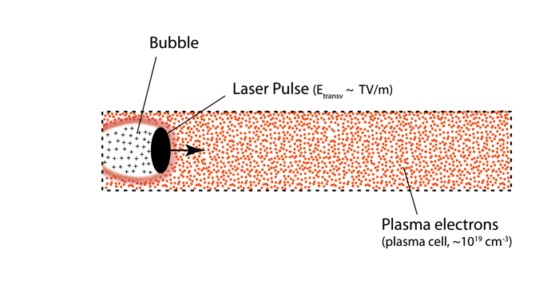
Plasma Acceleration
Internal injection
Like wakes left behind by a boat in water

Slide 19
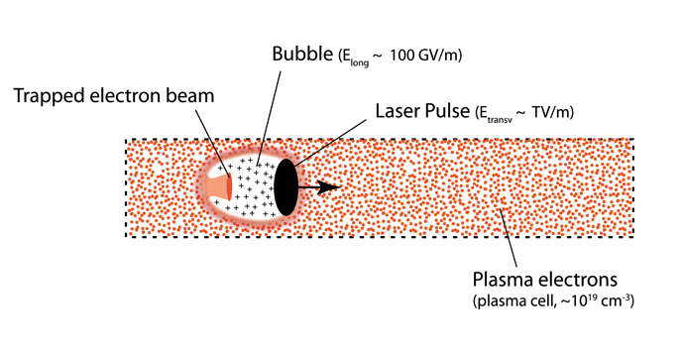
Plasma Acceleration
Internal injection → strong fields in the bubble suck in plasma electrons to form the electron beam
Like wakes left behind by a boat in water

Slide 20
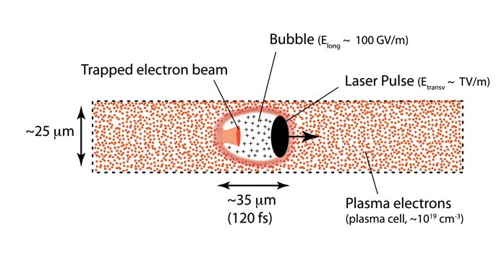
Plasma Acceleration
Internal injection (“bubble regime”)
Like wakes left behind by a boat in water

Slide 21
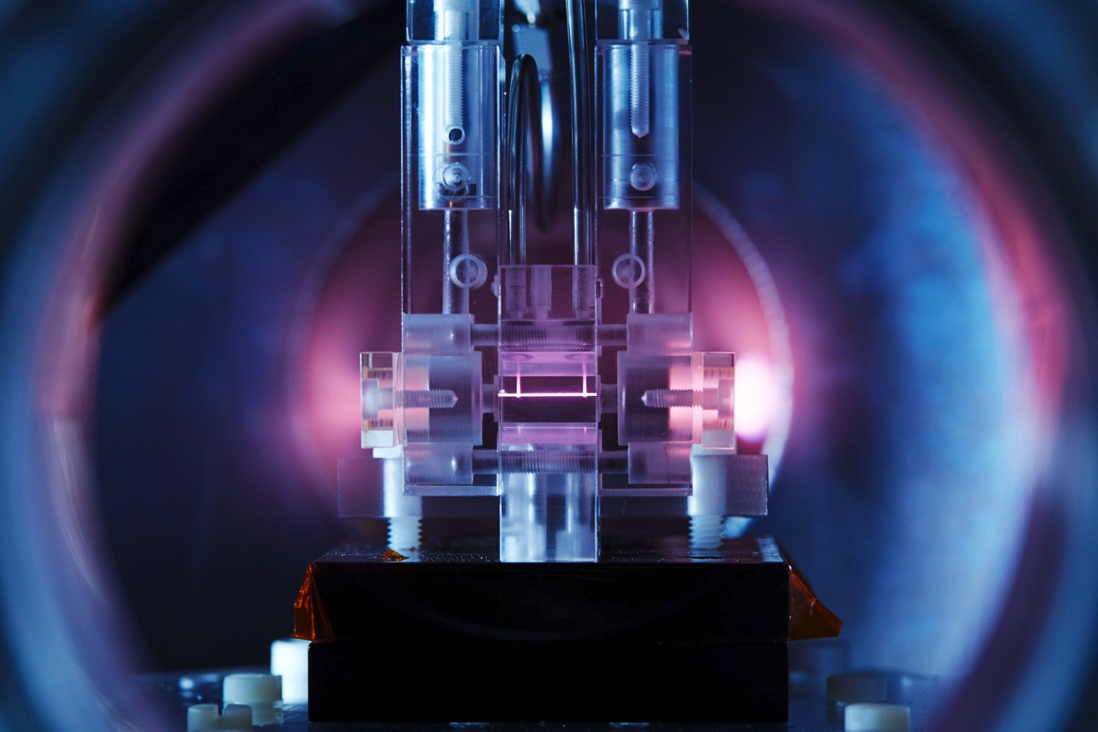
Laser Plasma Accelerator for Electron Beams
Plasma channel
Laser pulse
200 TW – 1 PW
“Bubble regime”, invented in Europe
Laser pulse
Electron beam

Slide 22
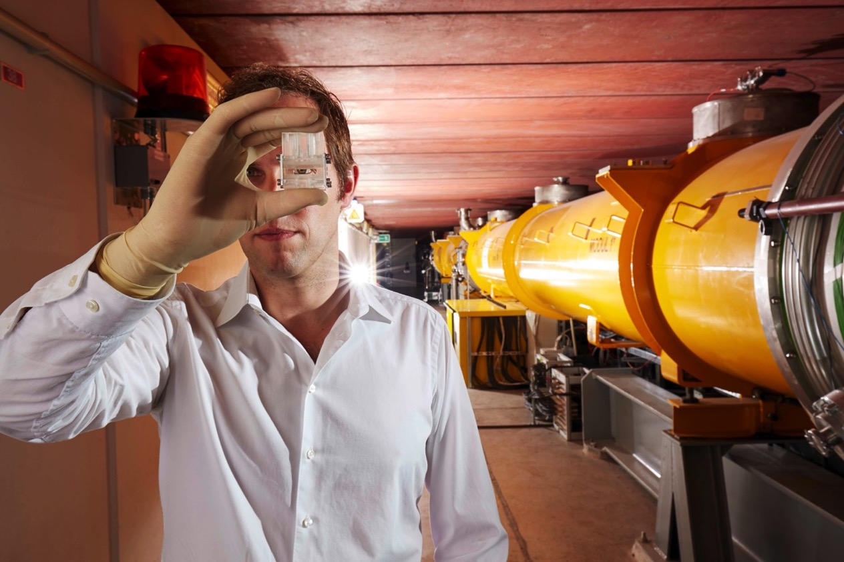
...and it is really much smaller!
A few cm’s of plasma create as much energy as the 100 m long S.C. FLASH linac
Accelerator size becomes almost negligible!
Do not forget the size of the laser, which is the dominant size here:
Fit a 10 billion electron Volt accelerator in 300 square-meter laboratory instead of 500 meter long accelerator tunnel!
¥
€
£
$

Slide 23

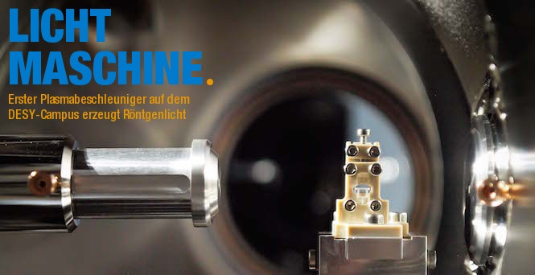
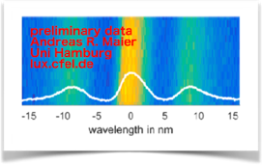
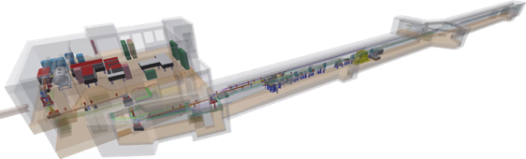
University Hamburg / DESY: LUX (A. Maier et al)
An laser-driven plasma R&D approach → towards FEL applications
A. Maier et al
About 400 MeV electrons from plasma accelerator, guide beam out of plasma, transport to undulator, generate X rays in undulator, dump electron beam, measure X rays (8 nm), first 24h operation. Latest: 1 GeV electron beam.
Next steps: towards harder X rays, lasing (saturation not possible in available length of undulator)

Slide 24














The European Opportunity
EUROPEAN
PLASMA RESEARCH
ACCELERATOR WITH
EXCELLENCE IN
APPLICATIONS
This project has received funding from the European Union’s Horizon 2020 research and innovation programme under grant agreement No 653782.

Slide 25
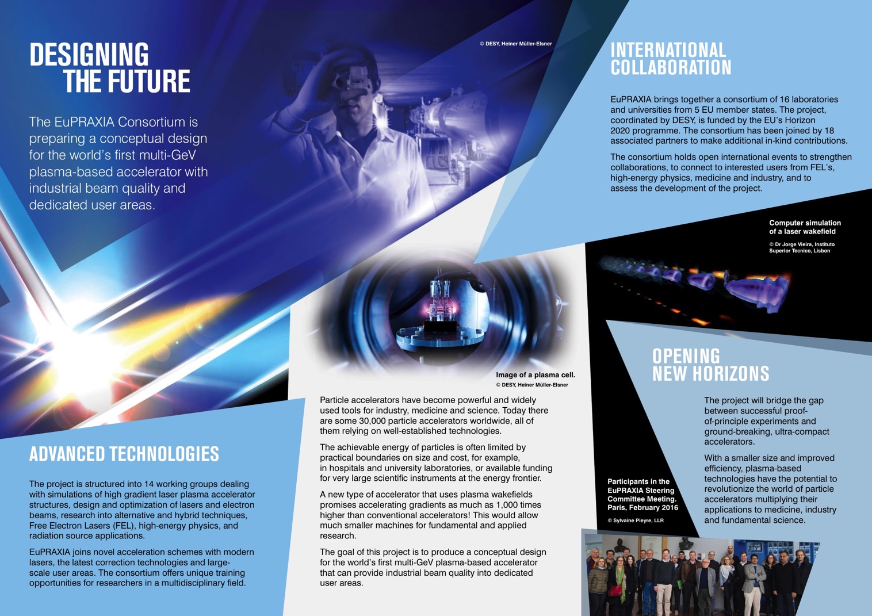

Slide 26
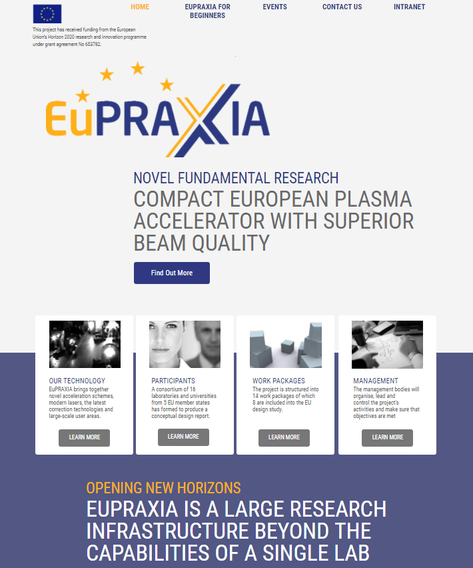

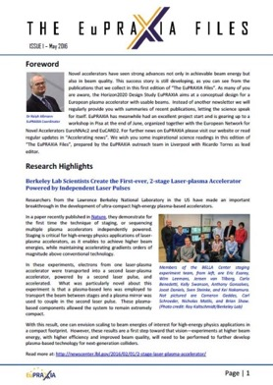
EuPRAXIA Horizon2020 Design Study
European Plasma Accelerator Infrastructure with Pilot Users
Collaboration brings together:
  Big science labs: photon science, particle physics
  Laser laboratories: high power lasers
  International laboratories: CERN, ELI (associated)
  Universities: accelerator research, plasma, laser
125 scientists in our work list
Start: 1 Nov 2015
End: 31 Oct 2019
Deliverable: Conceptual Design Report
www.eupraxia-project.eu
This project has received funding from the European Union’s Horizon 2020 research and innovation programme under grant agreement No 653782.

Slide 27
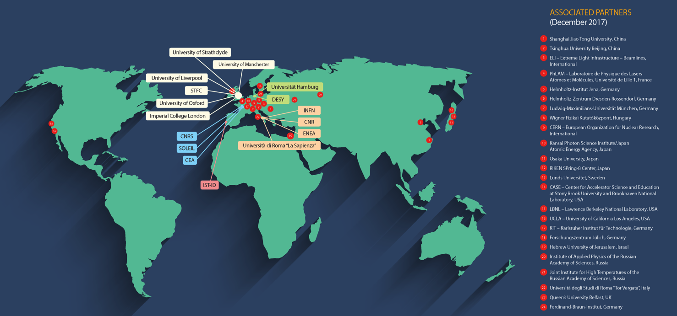
Collaboration of 40 institutes
From Europe, Asia and United States
16 EU laboratories are beneficiaries. 24 associated partners from EU, Europe, Asia and US contribute in-kind.
This project has received funding from the European Union’s Horizon 2020 research and innovation programme under grant agreement No 653782.

Slide 28
Where is Africa in EuPRAXIA?
Missing an African Collaborator while we have Asian and US institutes involved
Inviting African groups to collaborate with us.
Compact, laser-based accelerators are a medium term way to build up scientific infrastructure and research in additional countries.
We will look for resources to fund such a work.
Examples for possibilities:
  Doctors interested in medical applications (defining your needs with us)
  Groups interested in 3D design of facilities and technical components (students can work in Africa on PC’s and software that we organize, addressing our problems)
  Groups interested to send young scientist for participating in our experimental work in Germany, then analyzing data in Africa.
  Groups interested in lasers and their operation.
Email to: ralph.assmann@desy.de

Slide 29



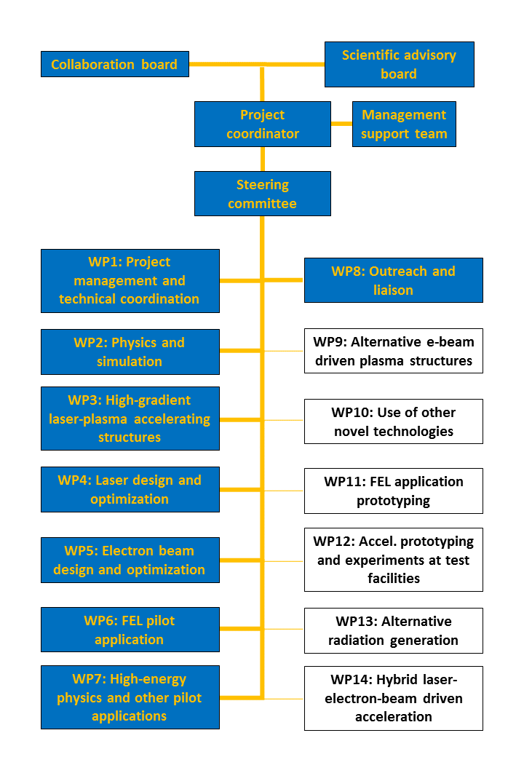






Management
Structure
Heads of Project and of Supervisory Boards
Steering Committee
This project has received funding from the European Union’s Horizon 2020 research and innovation programme under grant agreement No 653782.

Slide 30




A European Strategy for Accelerator Innovation
Required intermediate step between proof of principle and production facility
One accelerator unit!
PRESENT EXPERIMENTS
Demonstrating
100 GV/m routinely
Demonstrating GeV electron beams
Demonstrating basic quality
EuPRAXIA INFRASTRUCTURE
Engineering a high quality, compact plasma accelerator
5 GeV electron beam for the 2020’s
Demonstrating user readiness
Pilot users from FEL, HEP, medicine, ...
PRODUCTION FACILITIES
Plasma-based linear collider in 2040’s
Plasma-based FEL in 2030’s
Medical, industrial
applications soon
This project has received funding from the European Union’s Horizon 2020 research and innovation programme under grant agreement No 653782.

Slide 31
EuPRAXIA Objectives
EuPRAXIA is a conceptual design study for a 5 GeV electron plasma accelerator
Address quality. Show plasma accelerator technology is usable
Show benefit in size and cost versus established RF technology
Note: EuPRAXIA will initially be low power and low wall-plug power efficiency
Baseline (10 Hz): 10s of Watt with ~ 1 mJ/photon pulse energy
Efforts with industry and laser institutes to improve rep. rate & efficiency (incorporate fiber-based lasers with 30 % efficiency)
This project has received funding from the European Union’s Horizon 2020 research and innovation programme under grant agreement No 653782.

Slide 32

The 50 Billion Volt per Meter Linear Accelerator
RF injector
S-band linac
> 200 MeV
1 GeV
5 GeV
A
Laser-Driven Stages to 5 GeV
This project has received funding from the European Union’s Horizon 2020 research and innovation programme under grant agreement No 653782.

Slide 33

The 50 Billion Volt per Meter Linear Accelerator
RF gun & S-band structures
> 200 MeV
X-band structures
500 MeV
PWFA
accelerator
B
Beam-Driven Stages to 1 GeV
1 GeV
This project has received funding from the European Union’s Horizon 2020 research and innovation programme under grant agreement No 653782.

Slide 34

Targets in Facility Parameters
Overview of EuPRAXIA technical goals. Not self-consistent cases. Detailed and self-consistent parameter tables are available upon request.
This project has received funding from the European Union’s Horizon 2020 research and innovation programme under grant agreement No 653782.

Slide 35




The EuPRAXIA Facility (Under Design)
RF and TW laser system
PW laser system
~ 30 m
Plasma accelerator and user lines are on 1st level
RF and laser infrastructure are on 2nd level
This project has received funding from the European Union’s Horizon 2020 research and innovation programme under grant agreement No 653782.

Slide 36

Fits on the Parking Lot of the Hospital Copenhagen
Rigshospitalet Copenhagen
Illustrative example prepared for IPAC17 talk in Copenhagen
This project has received funding from the European Union’s Horizon 2020 research and innovation programme under grant agreement No 653782.

Slide 37

Versatile – Designed for Multiple Applications
High Energy – Accelerator R&D – Photon Science – Material – Medical – Industrial
This project has received funding from the European Union’s Horizon 2020 research and innovation programme under grant agreement No 653782.

Slide 38

Versatile – Designed for Multiple Applications
High Energy – Accelerator R&D – Photon Science – Material – Medical – Industrial
This project has received funding from the European Union’s Horizon 2020 research and innovation programme under grant agreement No 653782.

Slide 39



Medical Imaging with Plasma Accelerators
Some Unique Advantages – Already Working Today – Too Slow at the Moment
2015 publication from J.M. Cole et al., John-Adams-Institute, UK: “Laser-wakefield accelerators as hard x-ray sources for 3D medical imaging of human bone”. Nature Scientific Reports 5, 13244 (2015)
Laser plasma based betatron X ray source
This project has received funding from the European Union’s Horizon 2020 research and innovation programme under grant agreement No 653782.

Slide 40
Can the Facility REALLY Do ALL of This?
Another Advantage of Plasma Accelerators
PLASMA ACC.
“HOPA”
user area
HEP
Medicine
Industry
Material
PLASMA ACC.
capture
transport
LASER
PLASMA ACC.
capture
transport
FEL
user area
RF Driver
Injector
PLASMA ACC.
capture
transport
undulator
switch yard
diagnostic line
Laser pulses distributed to “small” plasma accelerators to drive many applications!
This project has received funding from the European Union’s Horizon 2020 research and innovation programme under grant agreement No 653782.

Slide 41


EuPRAXIA at SPARClab in Frascati
This project has received funding from the European Union’s Horizon 2020 research and innovation programme under grant agreement No 653782.

Slide 42

Impression of EuPRAXIA@SPARC_LAB at LNF
This project has received funding from the European Union’s Horizon 2020 research and innovation programme under grant agreement No 653782.

Slide 43





Hamburg Infrastructure – SINBAD
Under construction – will house laser-driven novel accelerators at DESY → ATHENA_{e} project at DESY
Ex-DORIS

Slide 44


Slide 45


Accelerator R&D Program of Helmholtz Association
Accelerator science as independent research
Latest news: ATHENA project approved for
29.99 M€ investment.
Funded by Helmholtz strategic funding and BMBF “Pakt für Forschung”

Slide 46









Press and Public Understand the Huge Potential
Examples from Germany
“Bigger, faster, more expensive: no way!”
“Can we have smaller machines?”
“Yes, we can!”
“The tiny particle accelerator”
This project has received funding from the European Union’s Horizon 2020 research and innovation programme under grant agreement No 653782.

Slide 47


Conclusions
Europe developing new high tech and compact accelerators
The long-term future is bright: there will be plenty of opportunities as technology advances!
EuPRAXIA Goals on 10-15 year time-scale:
  Demonstrate plasma-wakefield accelerated multi-GeV-scale electron beams with stability and quality sufficient for first pilot user experiments
  Contribute to the conception of new European accelerator facility
Compact accelerators broaden the use and benefits of accelerators for our societies, also opening new possibilities for Africa
We look for African collaborators and will try to find funds for supporting this...

Slide 48
Thank you for your attention
Looking for African collaborators
Email to: ralph.assmann@desy.de
Compact accelerators are a chance for everybody.
Plenty of things to do – we need your help!
Inviting African groups to collaborate with us.
We will look for resources to fund such a work.
This project has received funding from the European Union’s Horizon 2020 research and innovation programme under grant agreement No 653782.

