Slide 1


Medical accelerators
Marco Silari
CERN, 1211 Geneva, Switzerland
marco.silari@cern.ch

Slide 2
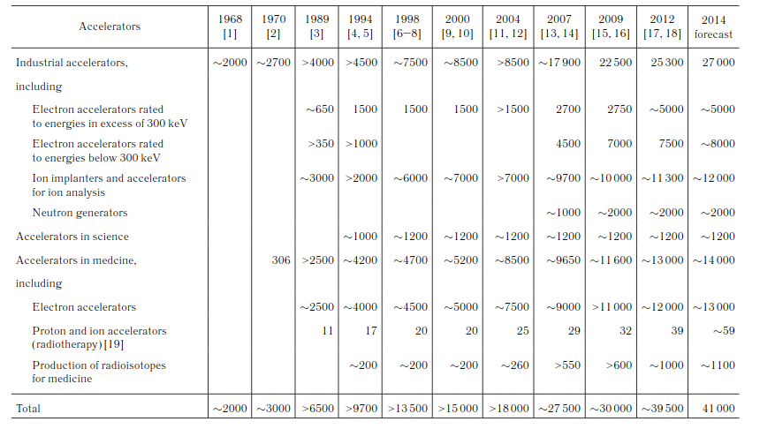
Particle accelerators operational in the world
Medical applications
Three main applications: 1) Scientific research, 2) Medical applications 3) Industrial uses
A. P. Chernyaev and S. M. Varzar, Particle Accelerators in Modern World, Physics of Atomic Nuclei, 2014, Vol. 77, No. 10, pp. 1203–1215.

Slide 3
Particle accelerators operational in the world
Medical applications
Three main applications: 1) Scientific research, 2) Medical applications 3) Industrial uses
A. P. Chernyaev and S. M. Varzar, Particle Accelerators in Modern World, Physics of Atomic Nuclei, 2014, Vol. 77, No. 10, pp. 1203–1215.

Slide 4
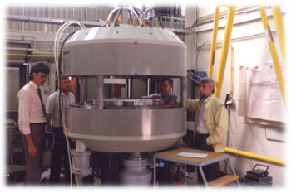
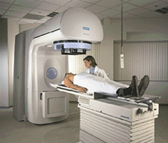
Particle accelerators for medical uses
Production of radionuclides with (low-energy) cyclotrons
  Imaging (PET and SPECT)
  Therapy
Electron linacs for conventional radiation therapy
  Including advanced modalities
Medium-energy cyclotrons and synchrotrons for hadron therapy with protons (250 MeV) or light ion beams (400 MeV/u ¹²C-ions)
  Accelerators and beam delivery

Slide 5
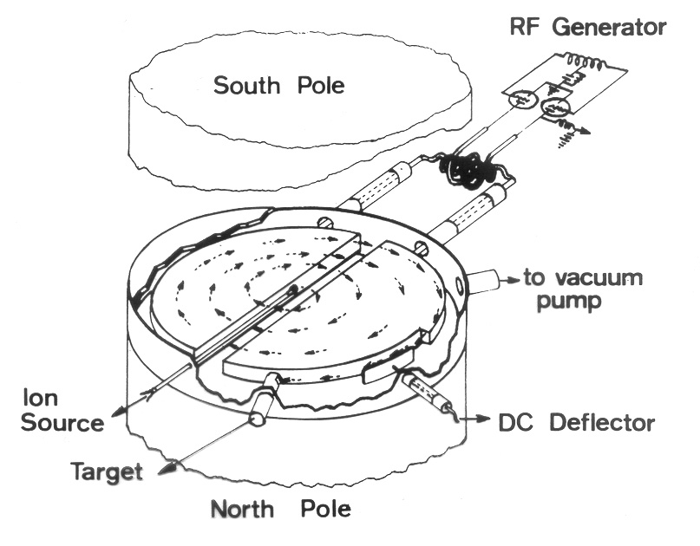
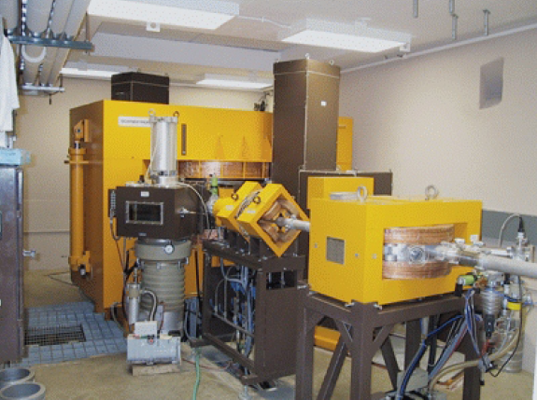
The cyclotron – The work horse for radionuclide production
Scanditronix MC40

Slide 6
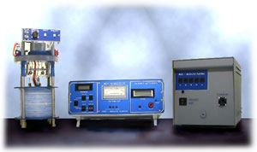
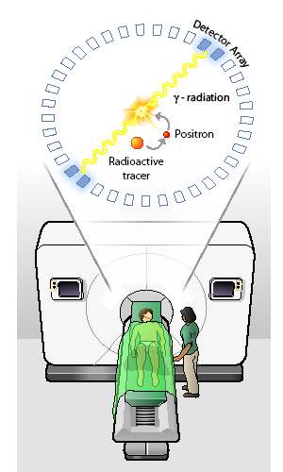
Positron Emission Tomography (PET)
PET camera
Mini-Cyclotron
Radiochemistry
J. Long, “The Science Creative Quarterly”,scq.ubc.ca

Slide 7
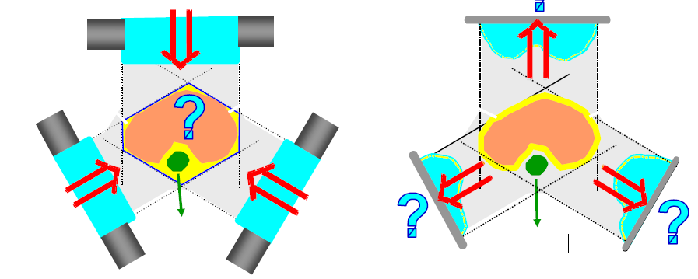
The rationale of radiation therapy
Treatment planning and dose delivery to tumour volume

Slide 8
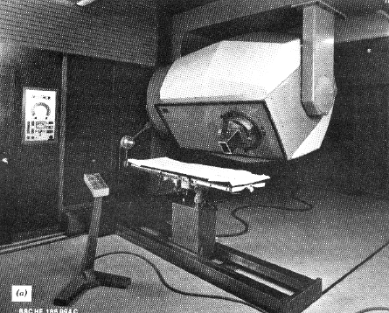
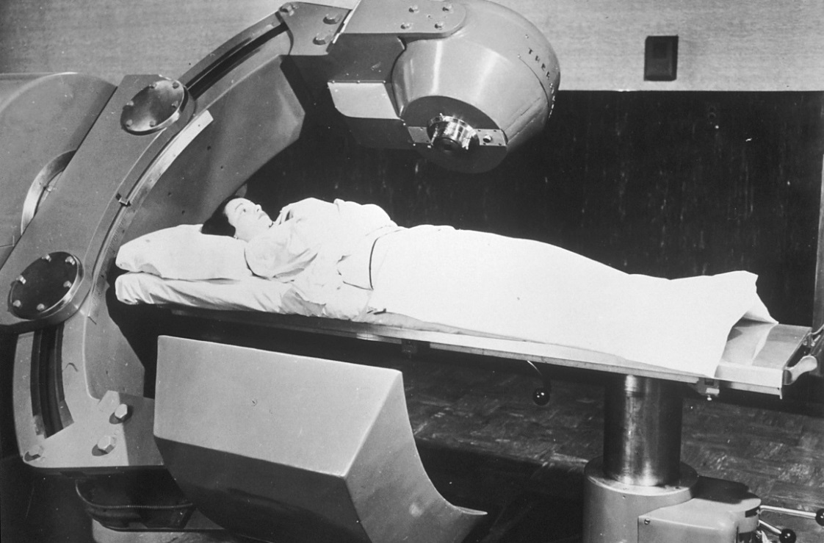
Past radiation therapy equipment
45 MeV Betatron
Co-60 unit
Photo: Wikipedia
Radiation therapy is much more than the radiation source. One also needs:
diagnostic equipment, CT scanners
treatment planning software
patient set-up devices
computers
a broad range of professional figures

Slide 9
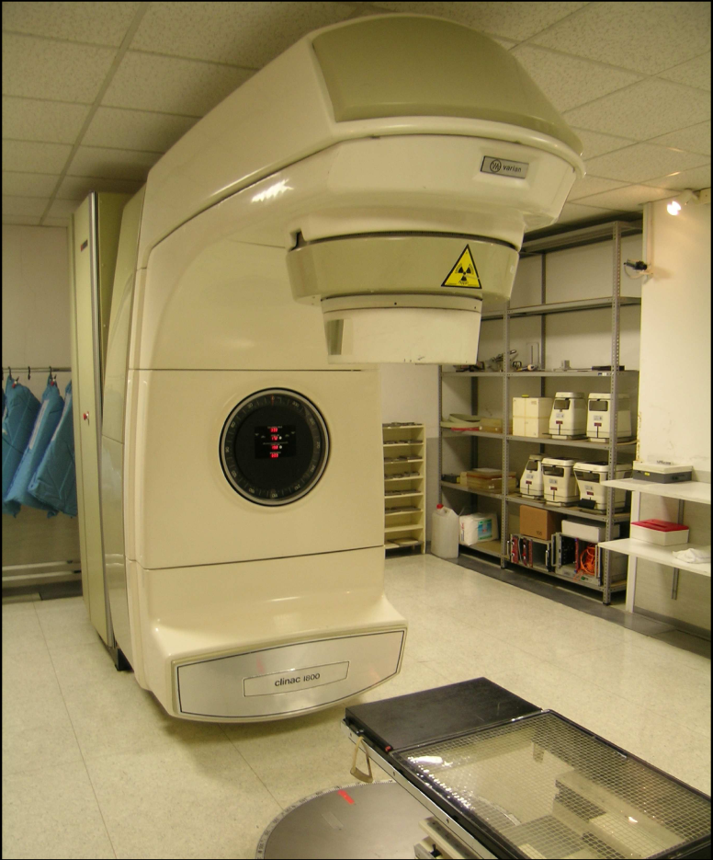
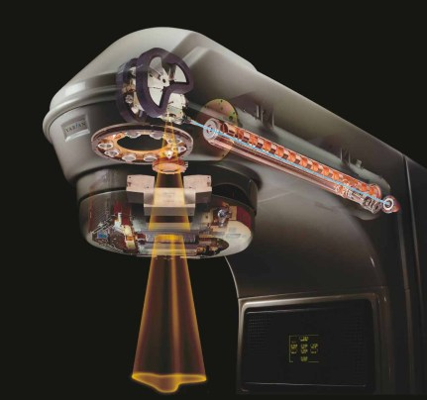
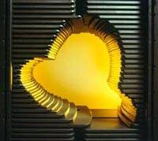
Medical electron linacs
e– + target → X-rays
Energy: 6-25 MeV
Dual e─ / γ beams
Varian Clinac 1800
Courtesy Varian Medical
target
Multi-leaf collimator

Slide 10
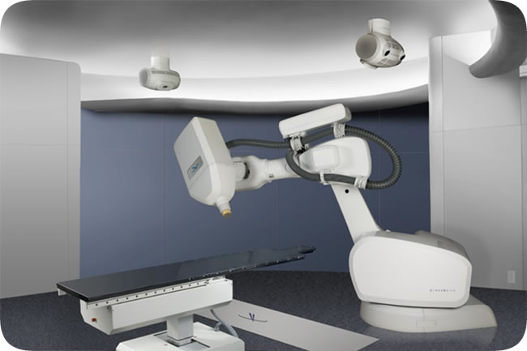
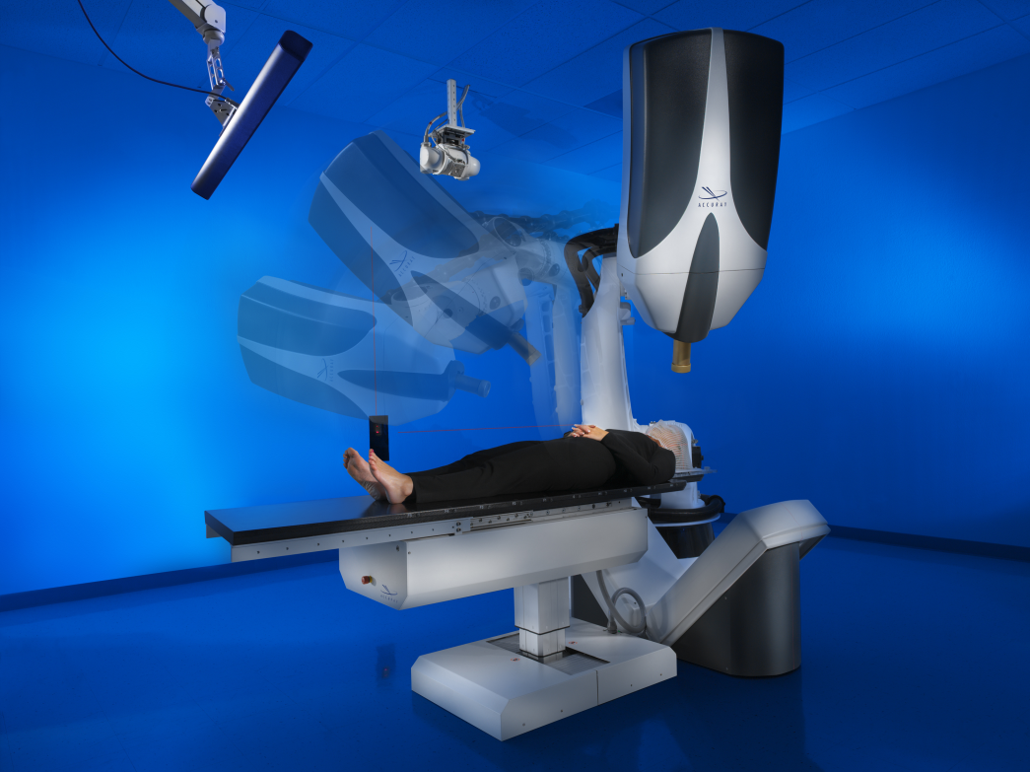
Cyber-knife robotic surgery system
6 MV Linac mounted on a robotic arm
No flattening filter
Uses circular cones of diameter 0.5 to 6 cm
Non-Isocentric
Average dose delivered per session is 12.5 Gy
Dose rate @ 80 cm = 400 cGy/min
http://www.accuray.com/Products/Cyberknife/index.aspx

Slide 11
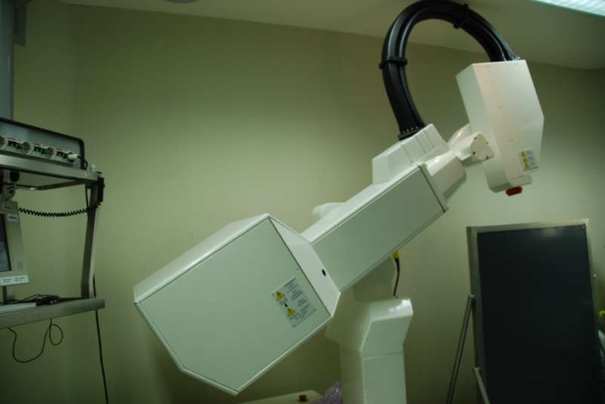
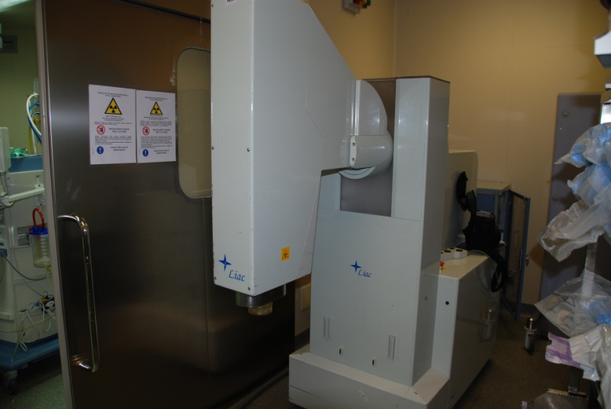
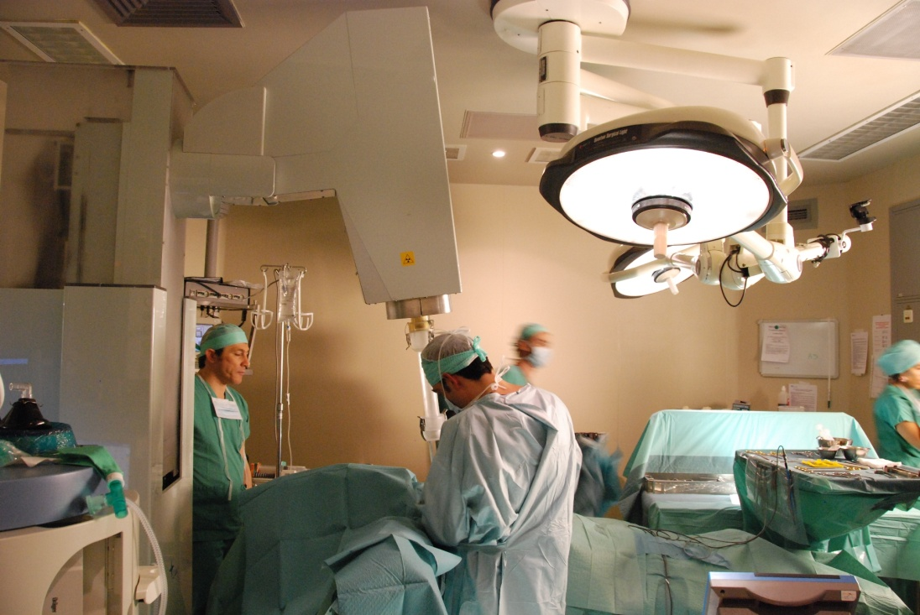
Intra-operative radiation therapy (IORT)
Small electron linac
Energy 6 – 12 MeV
Treatment with electrons only
Single irradiation
Three models of linac from three manufacturers

Slide 12
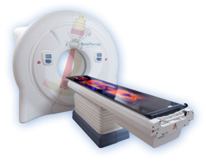
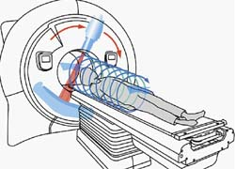
Helical tomotherapy
www.tomotherapy.com
Integrated CT guidance
  Integrated CT scanner allowing efficient 3D CT imaging for ensuring the accuracy of treatment
A binary multi-leaf collimator (MLC) for beam shaping and modulation
A ring gantry design enabling TomoHelical delivery
  As the ring gantry rotates in simultaneous motion to the couch, helical fan-beam IMRT is continuously delivered from all angles around the patient
  Very large volumes can be treated in a single set-up

Slide 13
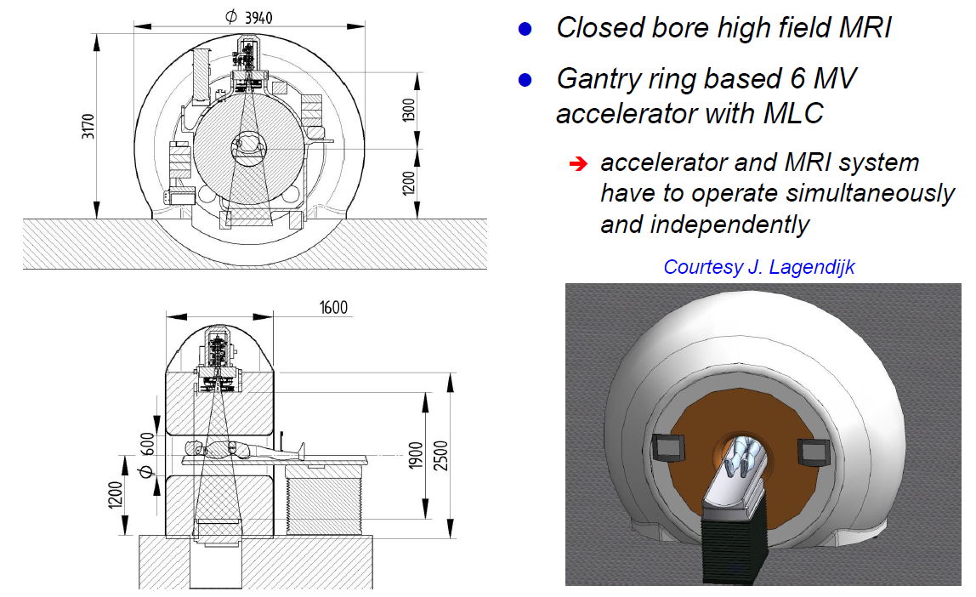
Hybrid MRI linac

Slide 14
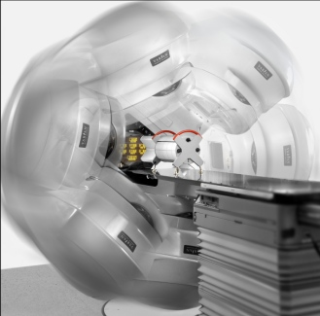
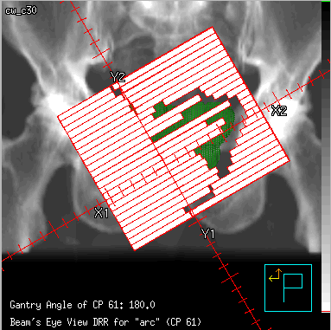
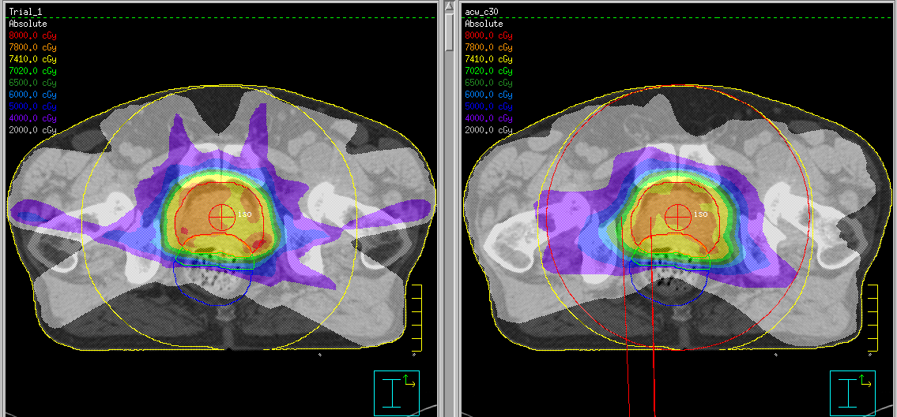
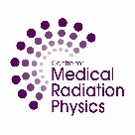

Volumetric Modulated “ARC” Radiation Therapy
Rotate linac gantry while modulating the beam
Fixed 6 or so gantry angles
VMAT
Name-Prof Peter Metcalfe
BSOC lecture 08

Slide 15
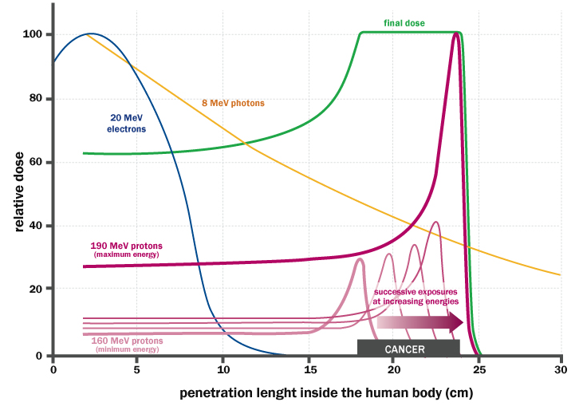
Particle therapy (hadron therapy)
Courtesy INFN, Italy

Slide 16
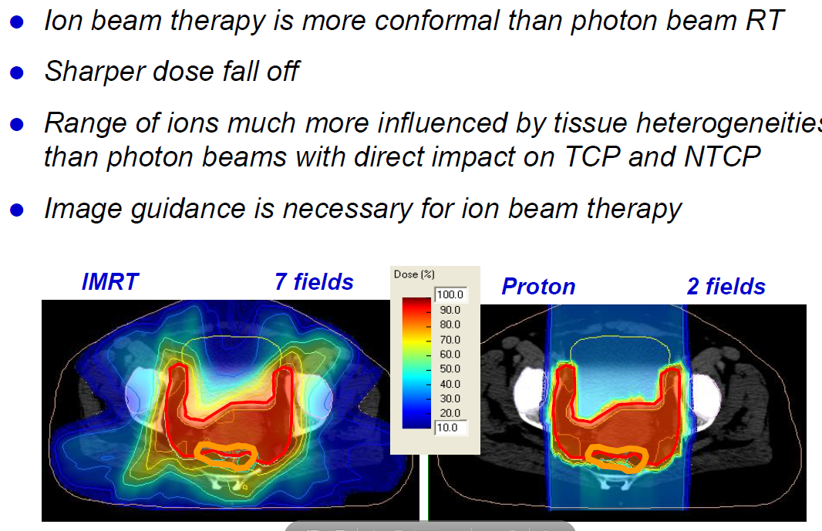
Treatment planning

Slide 17
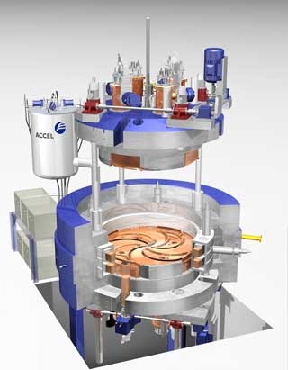
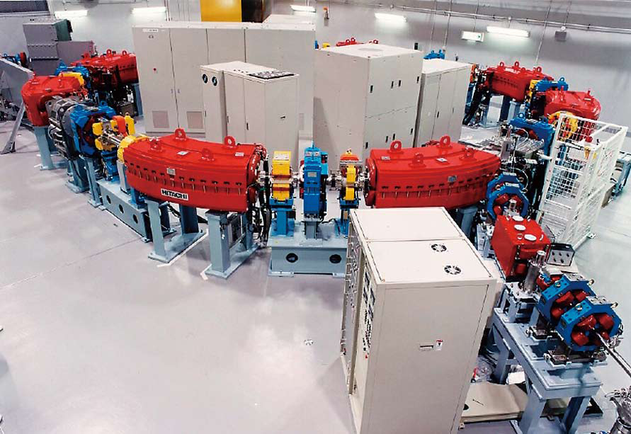
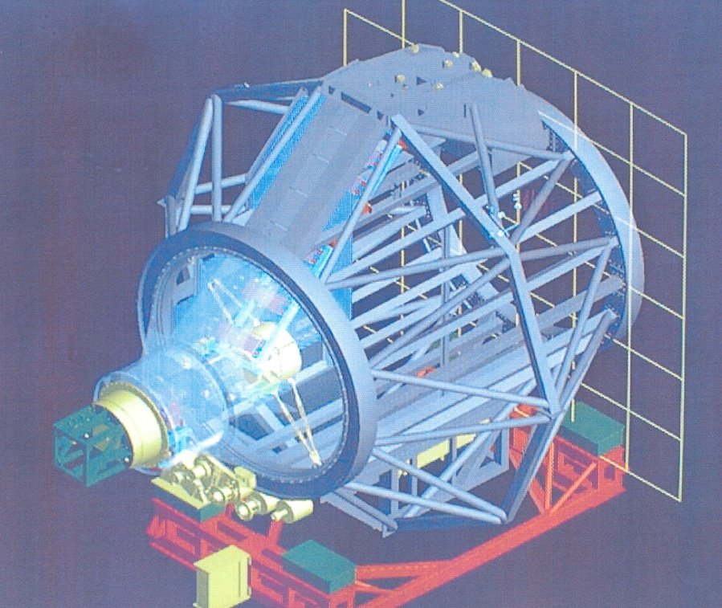
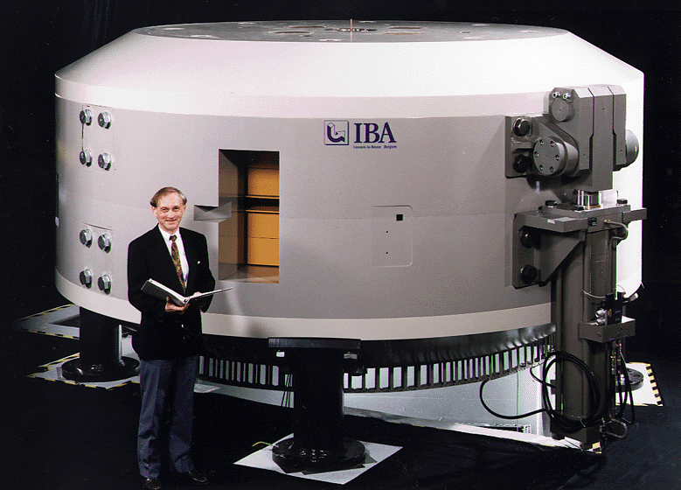
Cyclotrons, synchrotrons and gantries for proton therapy
Accel-Varian
(superconducting cyclotron)
IBA cyclotron
IBA proton gantry
Hitachi synchrotron

Slide 18
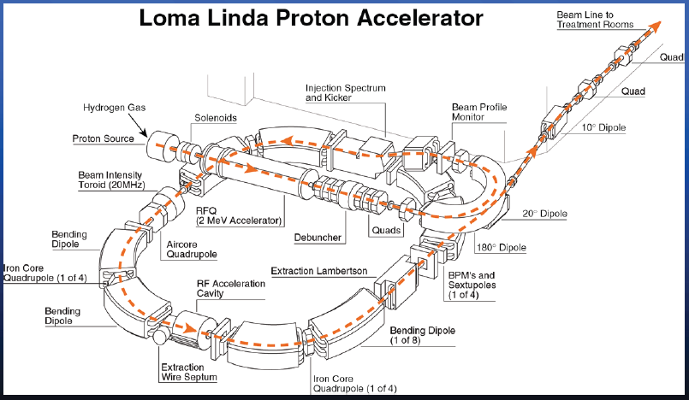
The LLUMC proton synchrotron
Loma Linda University Medical Center

Slide 19
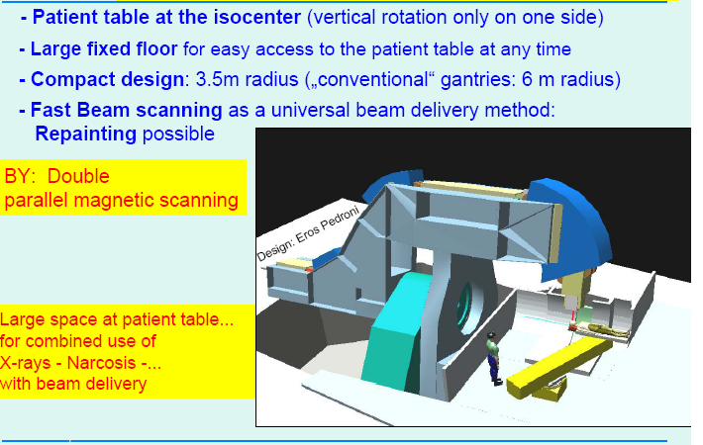
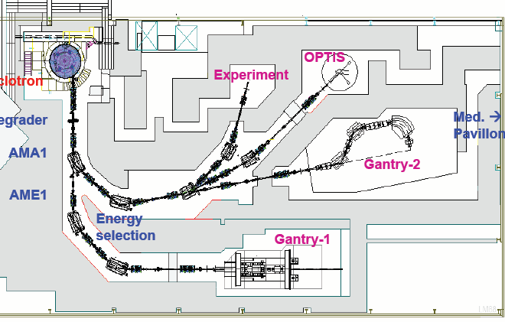
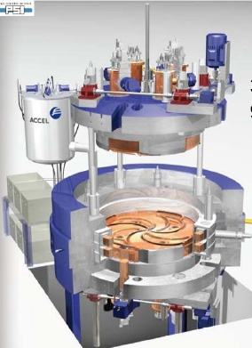
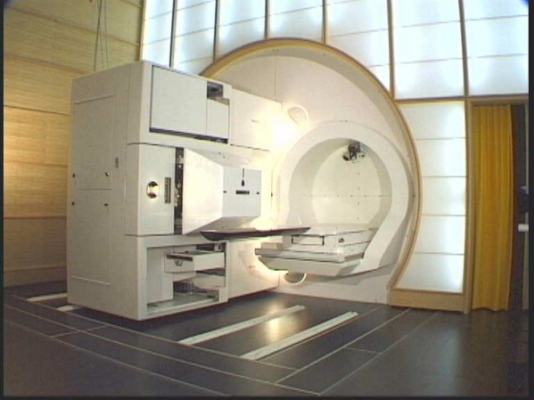
PROSCAN at Paul Scherrer Institut (PSI), Switzerland
ACCEL
SC cyclotron
250 MeV protons
Courtesy PSI and U. Amaldi , TERA
J.M. Schippers et al., NIM BB 261 (2007) 773–776

Slide 20
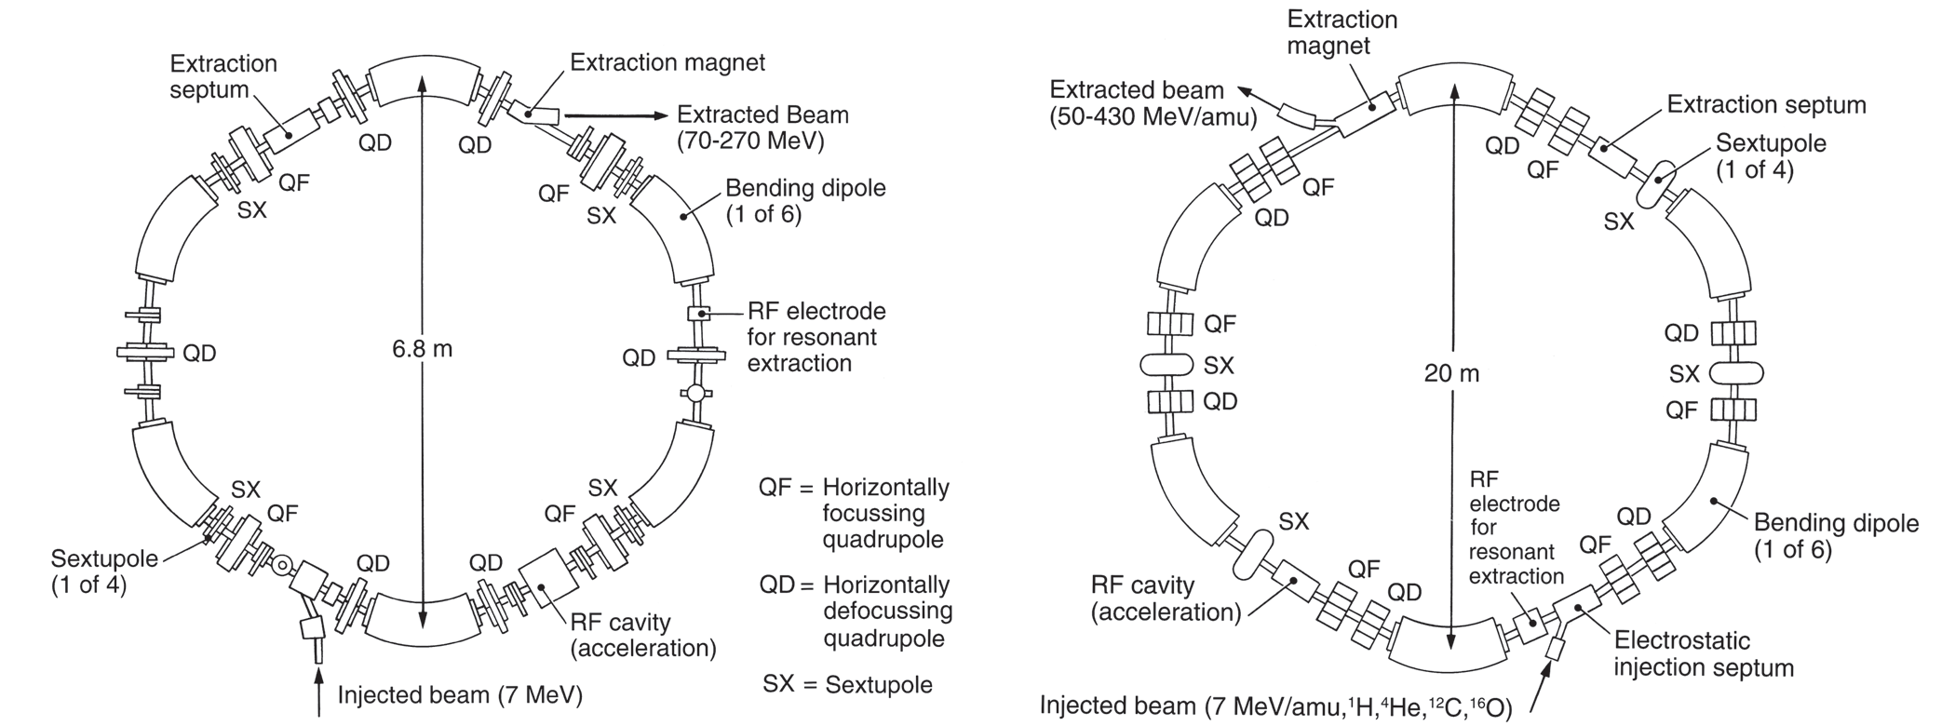
Proton versus carbon-ion synchrotrons
Hitachi proton synchrotron Siemens ion synchrotron
G. Coutrakon, Accelerators for Heavy-charged-particle Radiation Therapy,
Technology in Cancer Research & Treatment, Volume 6, Number 4 Supplement, August 2007

Slide 21
National Centre for Oncological Hadrontherapy, CNAO, Italy
Ion sources
Low Energy Beam Transport components
Courtesy S. Rossi, CNAO
Injector linac
Quadrupole magnets
RF cavity
Dipole magnets

Slide 22
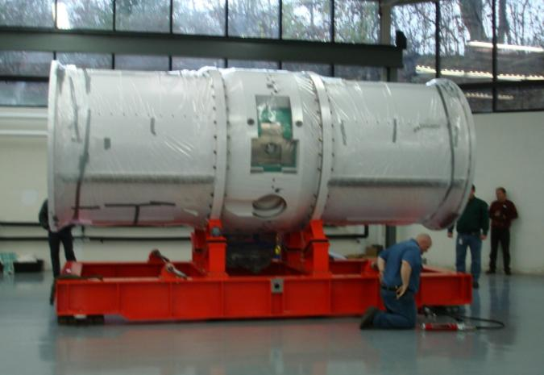
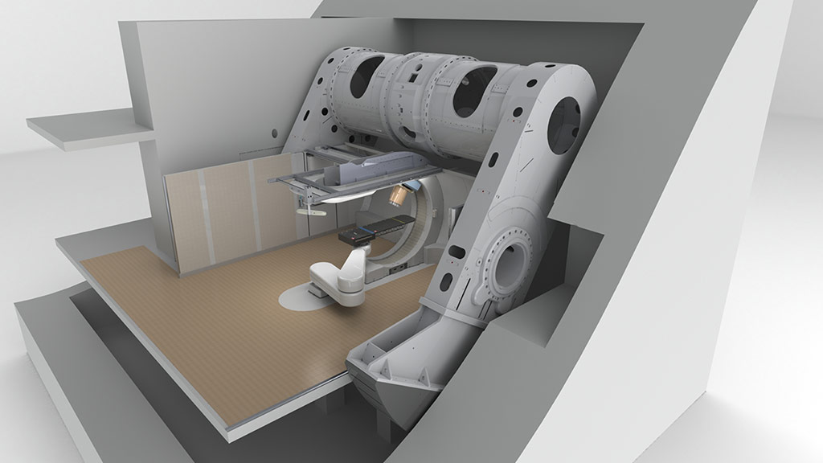
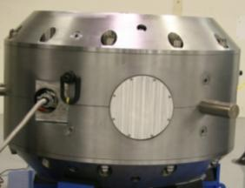
Mevion Medical Systems – single room facility
Synchrocyclotron

Slide 23
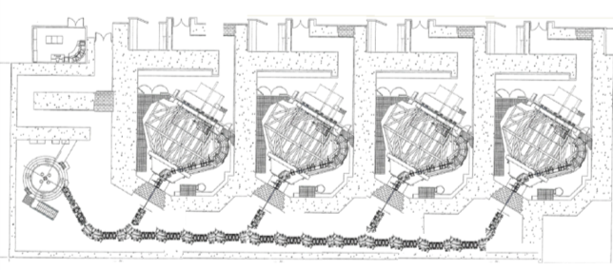
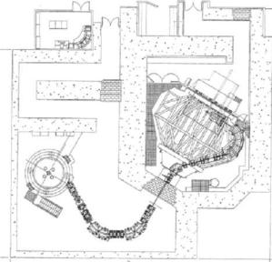
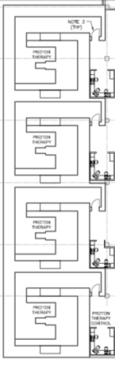

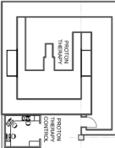

Multi-room versus single-room facilities
29 m (87ft)
2,240 m²
Other Proton Systems
812 m²
28 m (84 ft)
714 m²
Advantages of single-room facility:
Modularity
Reliability / back-up
PT treatment available at more hospitals
(Hopefully) cost
13 m (39 ft)
182 m²
14 m (41 ft)
Courtesy L. Bouchet, Still River Systems

Slide 24
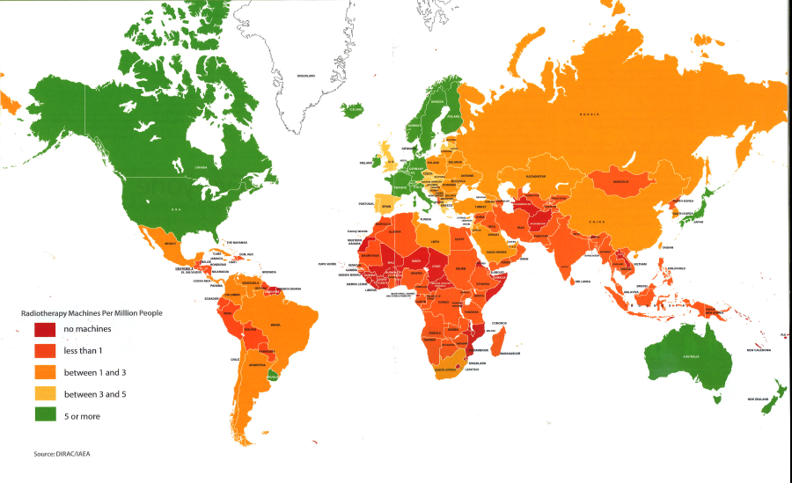
Availability of radiation therapy worldwide

Slide 25
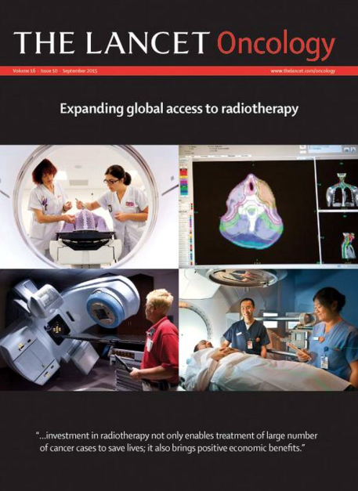

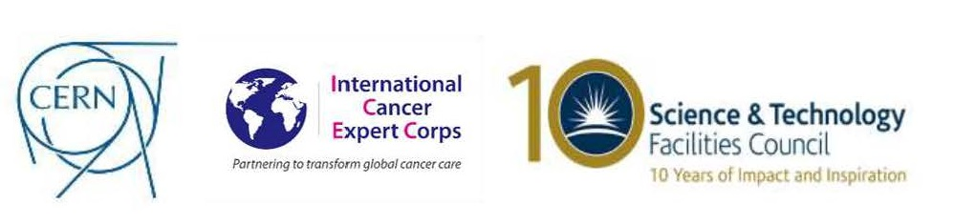
Challenges and expected developments in radiation therapy
CERN-ICEC workshop, CERN, November 2016
https://indico.cern.ch/event/560969/
CERN-ICEC-STFC workshop, CERN, October 2017
https://indico.cern.ch/event/661597/
September 2015

Slide 26
Global cancer burden and need for radiotherapy
According to estimates made by the International Agency for Research on Cancer (IARC), there are about 15 million new cancer cases per year worldwide, of which two thirds occur in developing countries.
The age distributions of cancer are, however, quite different between developed and developing countries; there are significantly more cancer cases in childhood, adolescence and young adults in developing countries, while cancer in the elderly dominates in developed countries
IAEA, Setting up a radiotherapy program, 2008
Need for
qualified professionals (radiation oncologists, medical radiotherapy physicists, radiotherapy technicians, radiation protection officers, maintenance engineers, etc.)
development of medical infrastructure for cancer treatment

Slide 27
Challenges in Radiation Therapy in Africa
Technology
23 of 54 countries have teletherapy services
20 had high- or low-dose brachytherapy resources
293 radiotherapy machines serving 1 billion individuals
1 machine per 3.6 million people
Abdel-Waheb et al, Lancet Oncology, 2013 / Grover et al, Front in Oncology, Jan 2015 / Balogun et al, Radiation Oncology, Aug 2016
Taken from Surbhi Grover’s lecture at the CERN-ICEC-STFC workshop, CERN, October 2017
Human resources
a gap of 7,500 oncologists, 6,000 physicists and 20,000 technicians in LMICs (in Africa: 1600 medical oncologists, 1000 medical physicists and 4000 technicians)
Taken from Andras Fehervary’s lecture at the CERN-ICEC workshop, CERN, November 2016

Slide 28
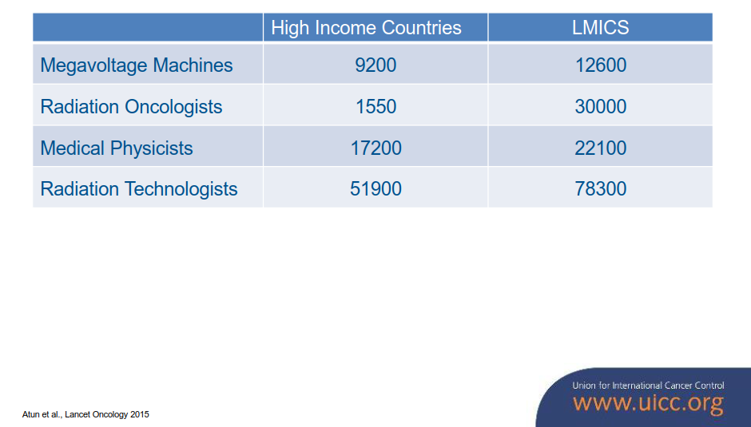
RT resources needed in 20 years from now
LMICS = Low Medium Income Countries
Taken from Mary Gospodarowicz’s lecture at the CERN-ICEC workshop, CERN, November 2016

Slide 29
Developing RT for challenging environments
Linacs
Ability to operate in a difficult environment
  Interruptions in electricity / power supply
  Heat / problem with temperature control
  Dust and humidity
Highly modular, so that faulty parts can easily be replaced
Self-diagnosing, in case of accelerator malfunctioning
Low power consumption
…
Screening
Improve screening and early diagnosis to make RT more effective
Need for
Qualified professionals: radiation oncologists, medical radiotherapy physicists, radiotherapy technicians, radiation protection officers, maintenance engineers, etc.
Related training programmes
Development of medical infrastructure

Slide 30
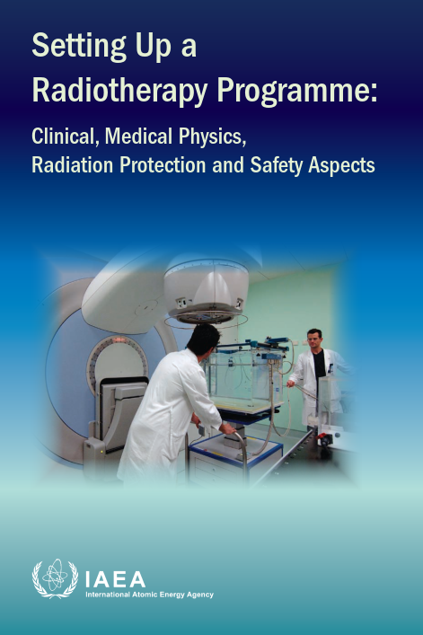
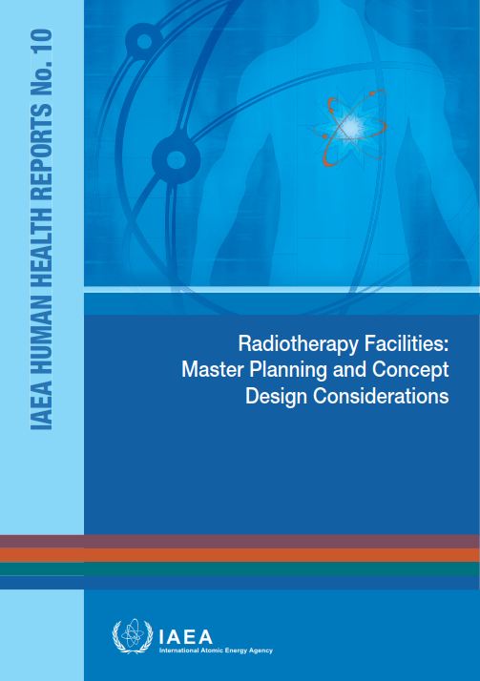
Guidelines

