Slide 1




Indoor Radon levels and the associated effective dose rate in selected buildings at Namibia University of Science and Technology (NUST)
Faculty of Health and Applied Scinces
Keendjele J¹, Zivuku M², Onjefu SA³
¹Department of Health Sciences, Faculty of Health and Applied Sciences, Namibia University of Science and Technology, Private Bag 13388, Windhoek, Namibia
²Department of Natural and Applied Sciences, Faculty of Health and Applied Sciences, Namibia University of Science and Technology, Private Bag 13388, Windhoek, Namibia
³Department of Natural and Applied Sciences, Faculty of Health and Applied Sciences, Namibia University of Science and Technology, Private Bag 13388, Windhoek, Namibia

Slide 2
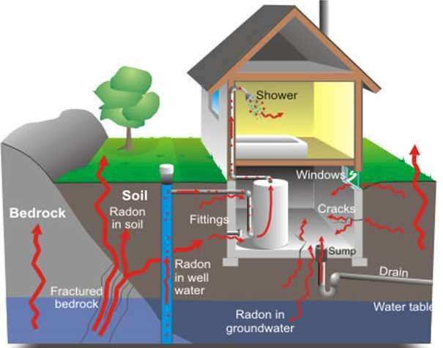
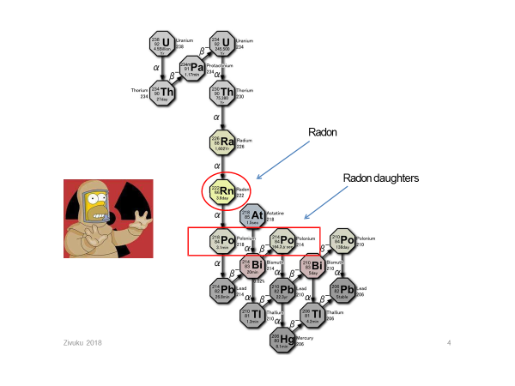
1.0 Introduction
Radon is an odorless, colorless radioactive gas in air and is ubiquitous
Originates from the disintegration of uranium in the earths crust.
Amount of radon depends on the soil type, geographical location and topography (Habshi et al, 1980).
Radon escapes easily from the ground into air where it decays into its progeny.

Slide 3
Uranium 238 decay series
²¹⁸Po, ²¹⁴Po

Slide 4
Formation of radon progeny aerosol
Aerosol deposition particle
Ventilation
deposition
Radon progeny
Radon gas
Radon gas

Slide 5
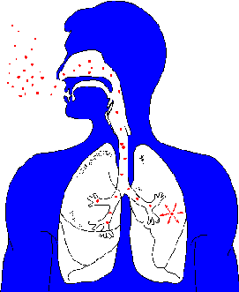
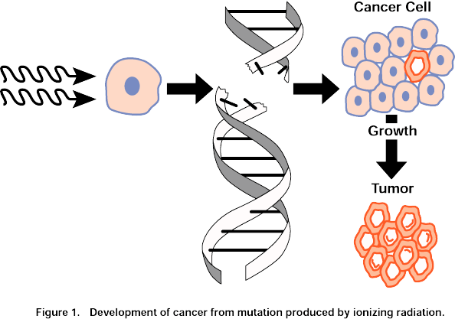
Radon in Lungs
Radon or decay products inhaled
Particles irradiate lungs
Irradiation can cause lung cancer (Yamada, 2006)
Radon

Slide 6
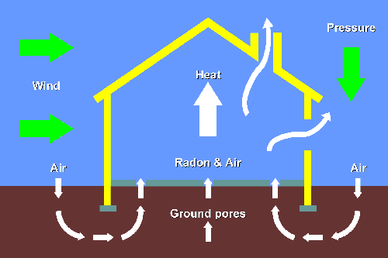
Radon in Buildings
From soil, radon enters the Lower parts of building “Stack effect”
Exhalation rate of radon depends on;
Properties of the buildings materials
Nature of the earth surface
Concentration of uranium and thorium
Permeability of soil
Ventilation rate and meteorological parameters

Slide 7
Why study radon concentration at NUST?
About 80% of the time is spent indoor either at work or at home.
In Namibia, the average worker spent 8 hours a day at work and this translates to 2000 hours a year.
Therefore it is important to measure and evaluate indoor radon concentration so as to minimize and protect the workers from occupational exposure due to radon.
The study was undertaken to measure and evaluate annual effective dose and the associated risk due to radon.

Slide 8
2.0 Materials and Method
Namibia University of Science and Technology (NUST) is an institution of higher learning in Namibia.
Located in the Capital Windhoek, it is located 22⁰ South Latitude and 17⁰ East longitude.
The institution is characterized by multi-storey building, some with basement.
Most of the buildings are made of bricks and cement while some are constructed of prefabricated materials.
Geology is composed of schist rocks known to have concentration of radon (Duggla et al, 2012).

Slide 9
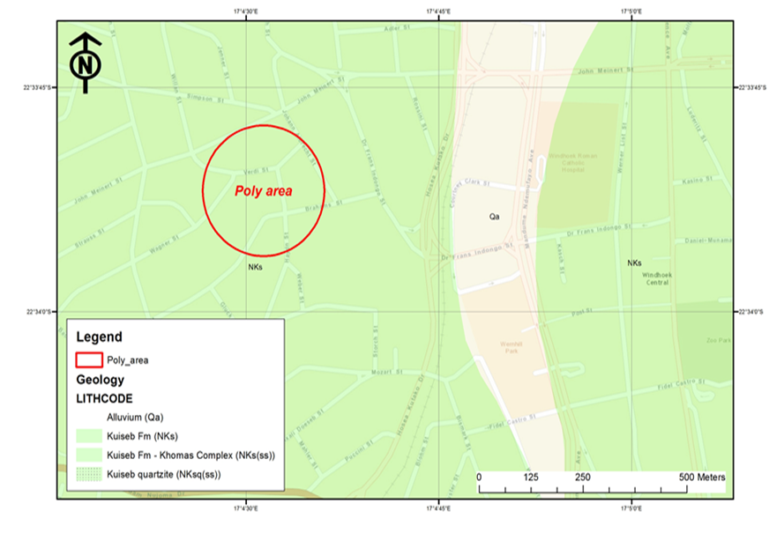
Map showing the location of NUST where Radon Gas Monitors were deployed
NUST

Slide 10
Deployment of Radon Gas Monitors (CR-39) and measurements
A total of 40 Radon Gas Monitors (CR-39) were deployed in 40 offices within the selected buildings at NUST (Health Science Building, Science and Technology Building, Library, Office Building and Elizabeth House.)
CR-39 radon gas monitors were deployed different levels of each building i.e. basement, ground floor, first and second floors.
The measurements were done over a period of three months.
After 90-day period the CR-39 gas monitors were retrieved, etched and analyzed at Landauer Nordic in Sweden.

Slide 11
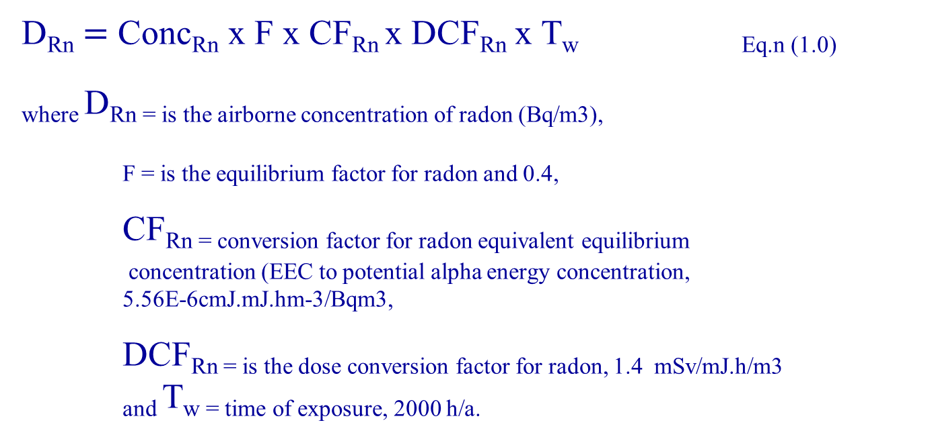
Absorbed Dose(D_{RN})
D_{Rn} $=$ Conc_{Rn} x F x CF_{Rn} x DCF_{Rn} x Tw Eq.n (1.0)
_{where} DRn = is the airborne concentration of radon (Bq/m3),
F = is the equilibrium factor for radon and 0.4,
CFRn = conversion factor for radon equivalent equilibrium
concentration (EEC to potential alpha energy concentration,
_{5.56E-6cmJ.mJ.hm-3/Bqm3,}
DCFRn = is the dose conversion factor for radon, 1.4 mSv/mJ.h/m3
_{and} Tw = time of exposure, 2000 h/a.

Slide 12
Annual Effective dose(H_{E})
The annual effective dose (H_{E}) can be calculated by applying tissue and radiation weighing factors as illustrated in equation 2.0 [13].
where, D_{Rn} = is the absorbed dose,
W_{R} = is the radiation weighting factors and the tissue
weighting factor for the lung 0.12.
HE (mSv/y) = D_{Rn} x W_{R} x W_{T} Eqn. (2.0)

Slide 13
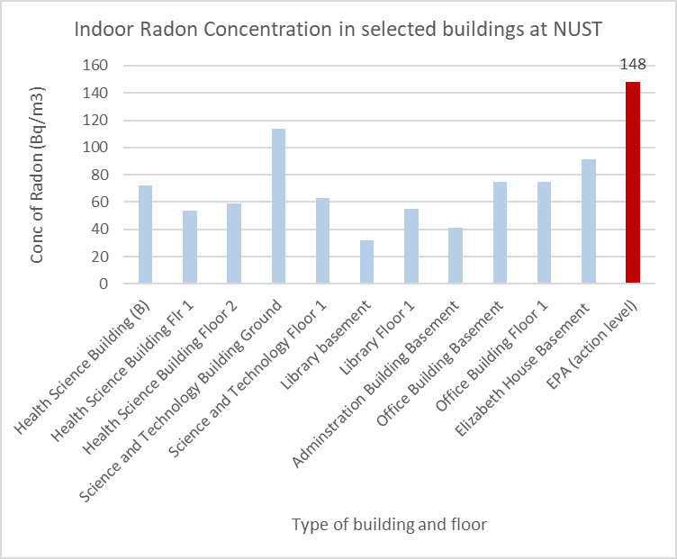
3.0 Results and discussion
The results for indoor radon concentration are presented in Figure 1.0
Figure 1.0 Indoor radon concentration Bq/m3 in selected buildings at NUST

Slide 14
Radon concentration
The radon concentrations in selected building varied from 32 Bq/m3 to 113.8 Bq/m3 with mean of 65.8 Bq/m3.
The average radon concentration is 1.5 times more than the world average of 39 Bq/m3 (UNSCEAR, 2000) and lower than the action levels recommended by EPA (148 Bq/m3), WHO (100 Bq/m3) and ICRP (200-600 Bq/m3).
Radon concentration varies with age of the building, occupancy and ventilation rate ( Science and Technology Building 113 Bq/m3 and Elizabeth House – basement 90 Bq/m3

Slide 15
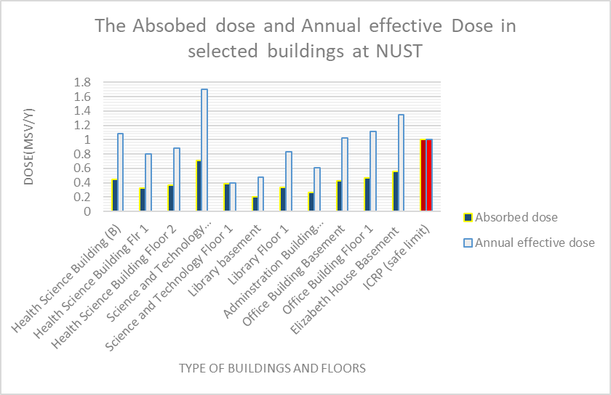
Absorbed dose and Effective annual dose
The results for the absorbed dose and annual effective dose in selected buildings at NUST are presented in Figure 2.0
Figure 2.0 The absorbed dose and annual effective dose due to indoor radon and its progeny from selected buildings at NUST

Slide 16
Absorbed Dose and Annual Effective Dose
The annual effective dose in the selected buildings at NUST varied from 0.4 to 1.70 mSv/y with an average of 0.93 mSv/y.
The average value is less than the global average dose from inhalation of radon from all sources (1 mSv/y).
Only Elizabeth House (1.35 mSv/y) and Science and Technology (1.70 mSv/y) have a significantly higher than the action level recommended by ICRP.
However, the values are less than the average world value from exposure all natural radiation sources (2.4 mSv/y).

Slide 17




Conclusion
This study showed the radon concentration, absorbed dose and annual effective dose from the selected buildings at NUST are within the safe limits recommended by ICRP and therefore these buildings do not pose any significant radiological hazard to workers and students.

Slide 18



Slide 19

References
Duggal.V. Rani, A., & Mehra, R., (2002). Indoor radon levels measurements in the dwellings of northern Rajasthan, India. Journal of advanced applied science, 316, 3956−3960.
Habshi, F., (1980).The recovery of uranium from phosphate rock: Progress and problems”, Proceeding of the second international Congress on Phosphorus Compounds, Institute Mondial du phosphate, 629-660.
ICRP., (1993). Protection against radon-222 at home and at work. Pergamon press, Oxford.
UNSCEAR, (2000). United Nations Scientific Committee on the Effects of Atomic Radiation. Sources and effects of ionizing radiation, Vol 1. United Nations publications.
Vaupotic, J., Indoor radon in Slovenia. Nuclear Technology and Radiation Protection, 18(2)(2003)36–43.
World Health Organisation (WHO)., (2009).Hand book on Indoor Radon, a public health perspective, Geneva, Switzerland.
Yamada, Y., Sun, Q., Tokonami, S., Akiba,S.,Zhuo, W., Hou, C., … et al., (2006). Radon–thoron, Discriminative measurements in Gansu Province, China, and their implication for dose estimates, Journal of Toxicology and Environmental Health, Part A, 69(7-8) 723–734.

