Slide 1
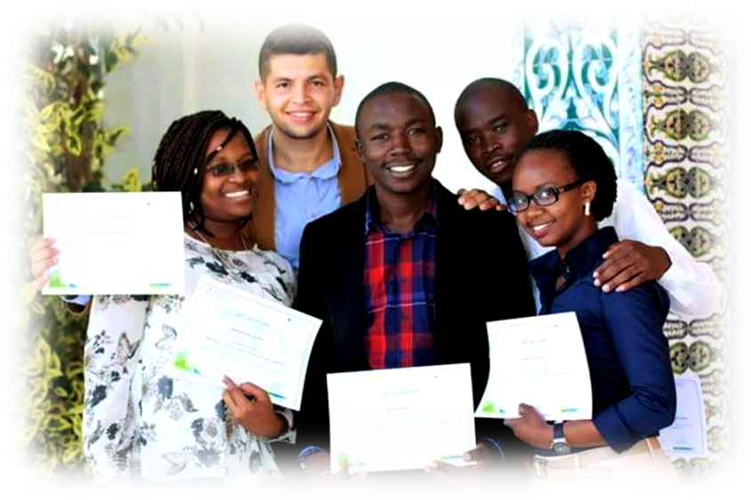

General Situation of Energy Production and Consumption in Africa
Daniel Ayuk Mbi EGBE
ANSOLE e.V Wagnergasse 25. 07743 Jena, Germany, daniel.egbe@ansole.org
Institute for Polymeric Materials and Testing, JKU Linz,
Altenbergerstr. 69, 4040 Linz, Austria, daniel_ayuk_mbi.egbe@jku.at
First Biennial African Conference on Fundamental Physics and Applications
28.06-04.07.2018, NUST, Windhoek, Namibia

Slide 2
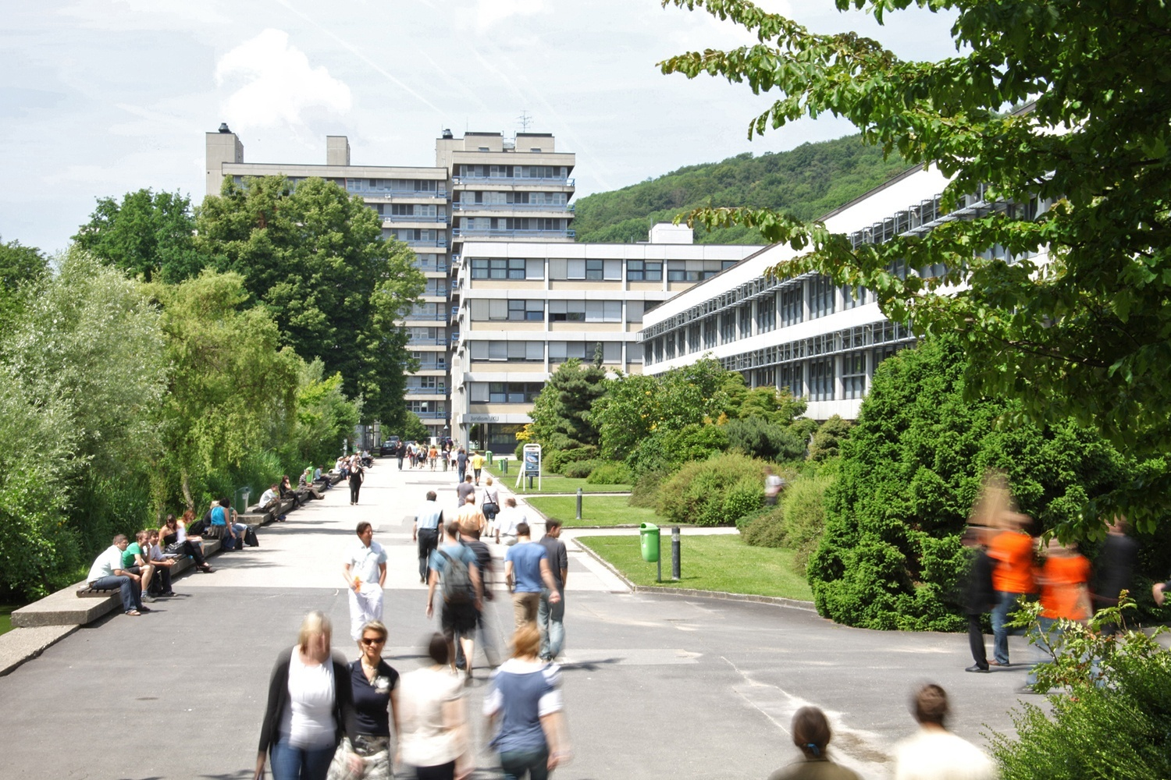
Johannes Kepler University Linz, Austria
~22 000 students
Faculty of Social Sciences
Faculty of Law
Faculty of Technical and Natural Sciences
Faculty of Medecine

Slide 3
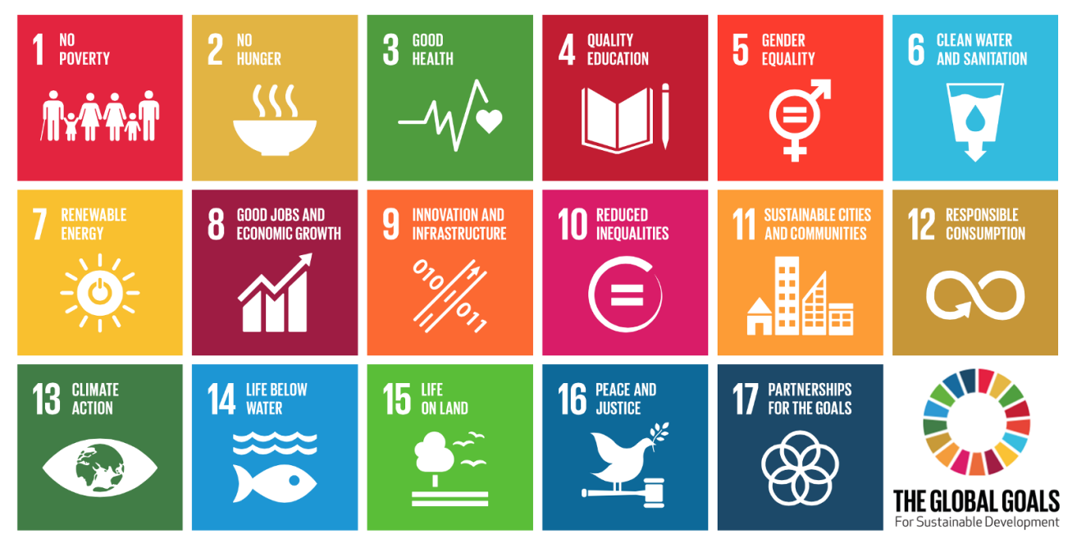
Development Plan of JKU Linz, Austria: 2019-2024
Sustainable Development: Science, Technologies & Management
Digital Transformation
https://www.un.org/sustainabledevelopment/sustainable-development-goals/

Slide 4
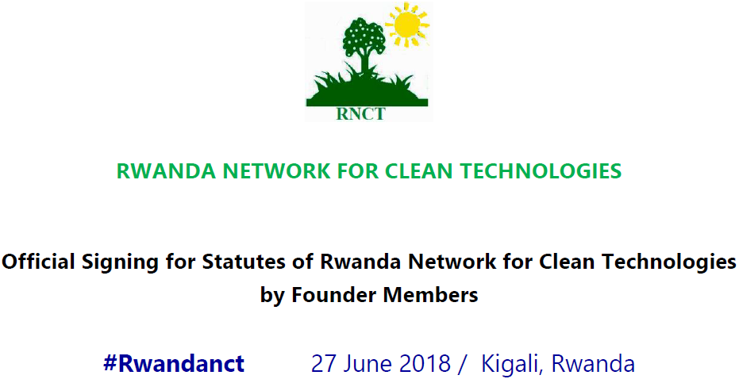
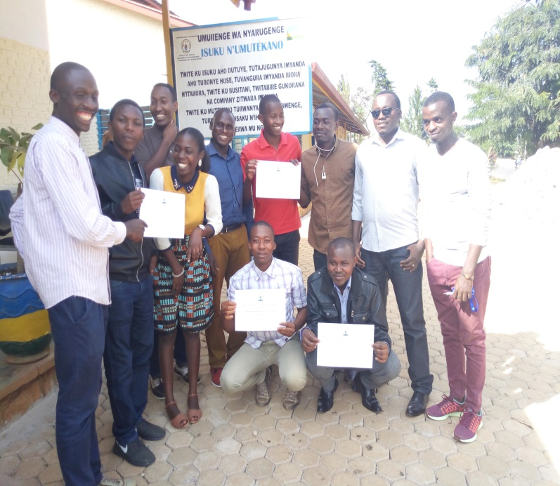

Slide 5
OUTLINE
My Research
Energy Situation in Africa
Research Networks

Slide 6
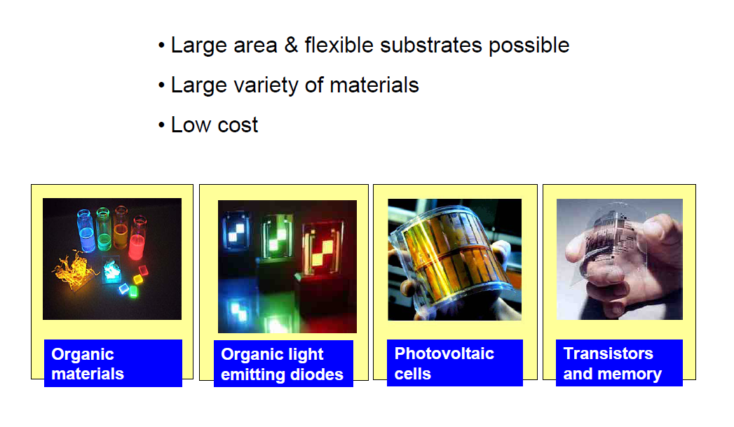
Organic Semiconductors
Images source: Karl Leo, TU-Dresden

Slide 7
Renewable Energies
♦Hydropower
♦Geothermal Energy
♦Solar Energy
Solarthermics
Photovoltaics
♦Ocean tides
♦Wind energy
♦Bioenergy (biomasses)
Photovoltaics
First Generation:
•Monocrystralline Si: η >16%
•Polycrystalline Si: η >12%
Second Generation
•Amorphous Si: η >8%
•CdTe: η > 8 %
•GaAs: η > 20%
•CIGS: η >12 %
Third Generation
•Grätzel-Cells: η > 11 %
•Organic Solar Cells: η >12 %
•Perovskite Solar Cells: η >20 %

Slide 8
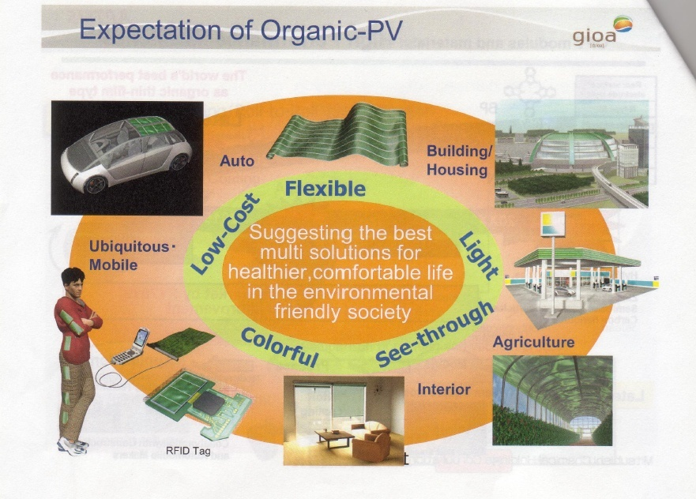
Source: Mitsubishi Chemicals

Slide 9
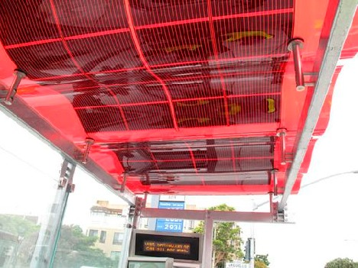
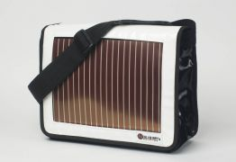

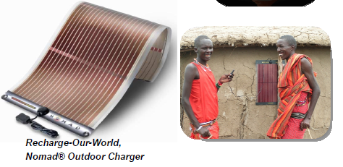
San Francisco Municipal Transportation Agency + Konarka +3 others

Slide 10
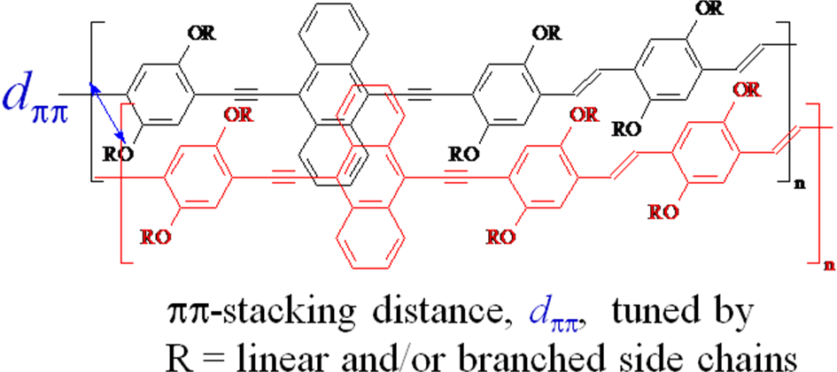
Effect of ππ-Stacking Distance
Phys. Status Solidi A. 2009, 12, 2695; Macromolecules 2010, 43, 1261;
Macromolecules 2010, 43, 306, J. Mater. Chem. 2010, 20, 9726

Slide 11
Correlation between pi-pi-Stacking Distance and Photovoltaic Performance
η≈ 3.0%
η≈ 3.8%
η≈ 2%

Slide 12
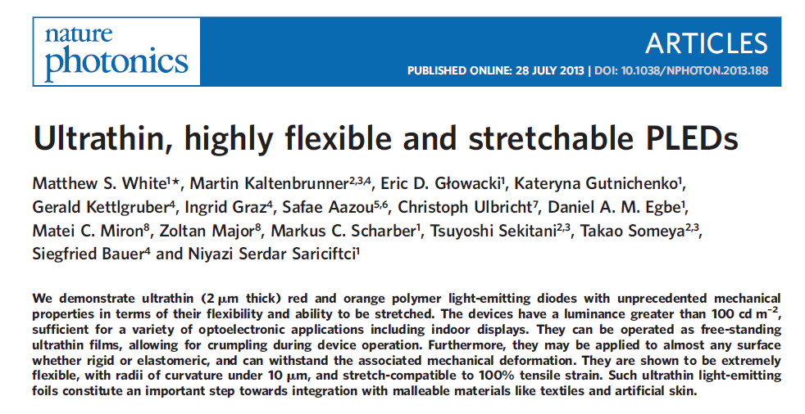


Slide 13
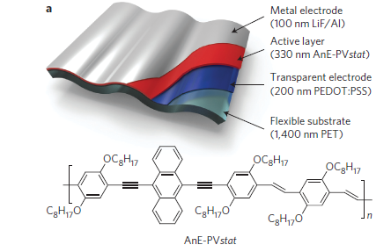
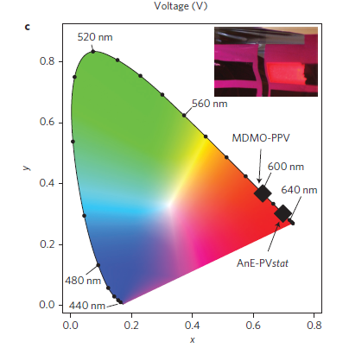
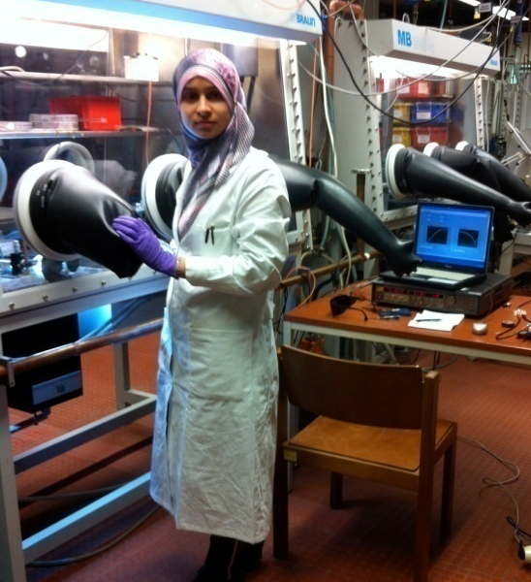
S. AAZOU (ANEX, Morocco-Austria)
Nature Photonics 2013, 7, 811-816

Slide 14
Africa’s energy sector is still best understood as 3 distinct regions:
North Africa, dependent on oil and gas
South Africa, dependent on coal
Rest Sub-Saharan Africa, largely dependent on biomass
Even oil-rich sub-Saharan African countries still continue
to rely on biomass to meet the bulk of their household energy
requirements (> 85 % in Nigeria)
Stephen Karekezi & Waeni Kithyoma, 2003

Slide 19

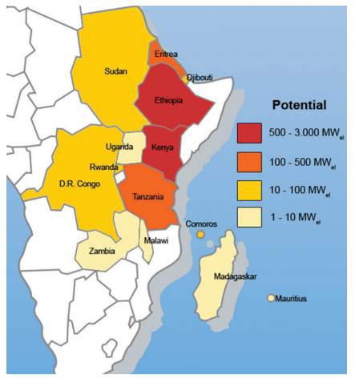
Energy resources in Africa
Energy potentials : renewable energy resources (geothermal)
Geothermal energy
More concentrated in Eastern Africa

Slide 20
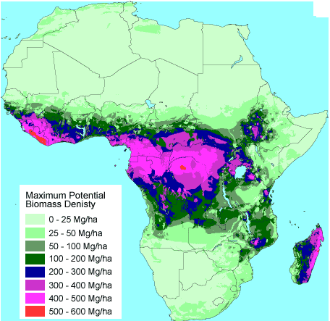
Energy resources in Africa
Energy potentials : renewable energy resources (biomass energy)
Biomass energy
25% of the global biomass reserves

Slide 21
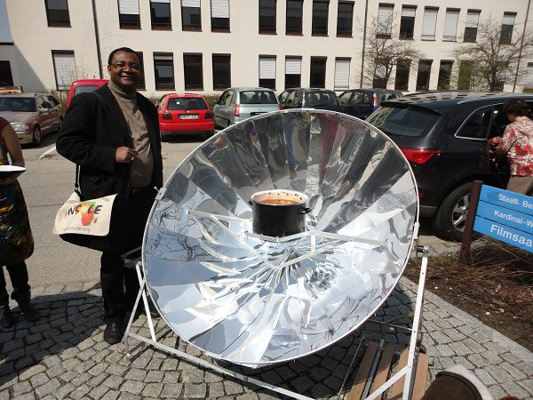
20. Internationale Solarkochertagung, Altötting, 20-21. April 2013

Slide 22
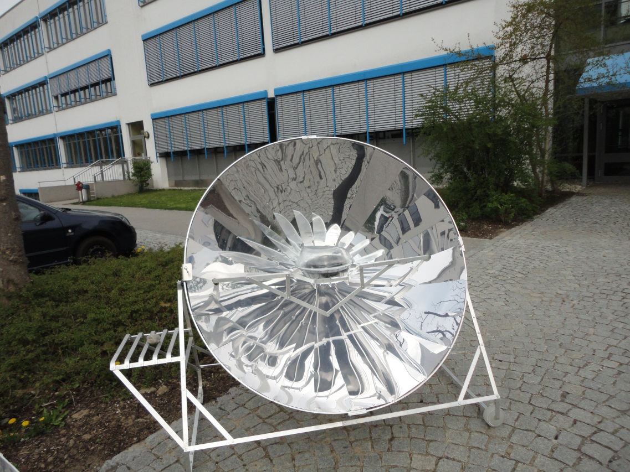
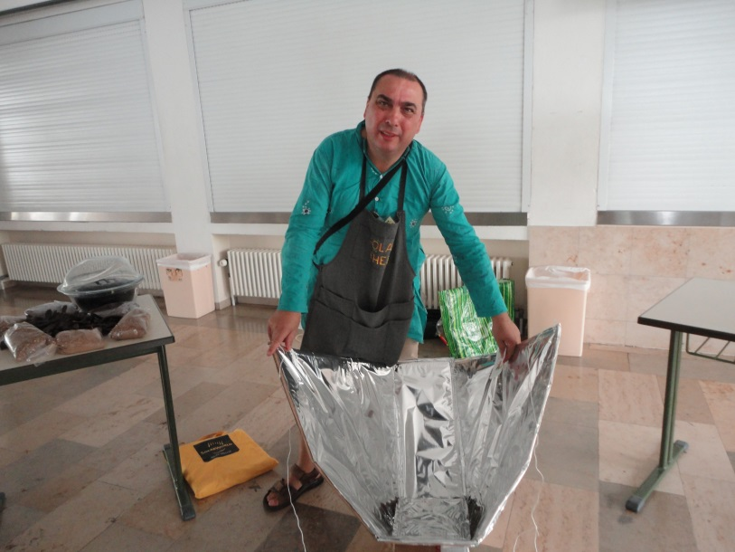
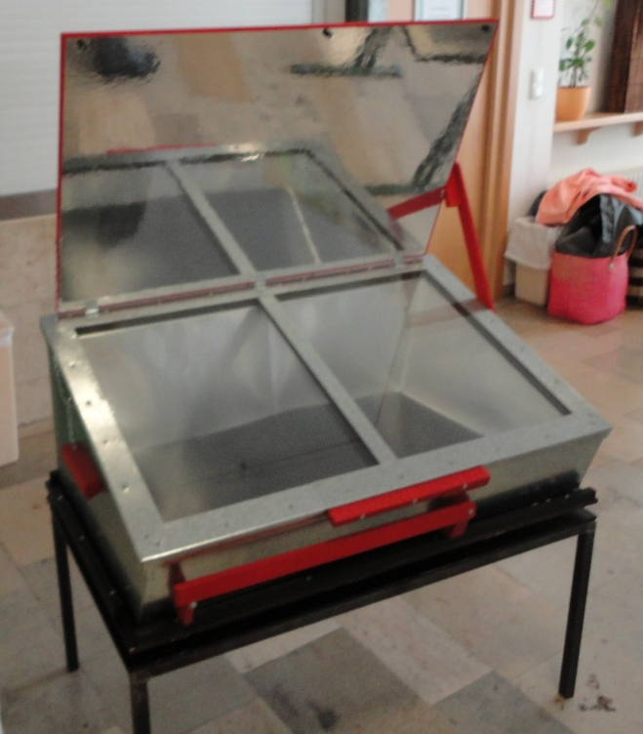
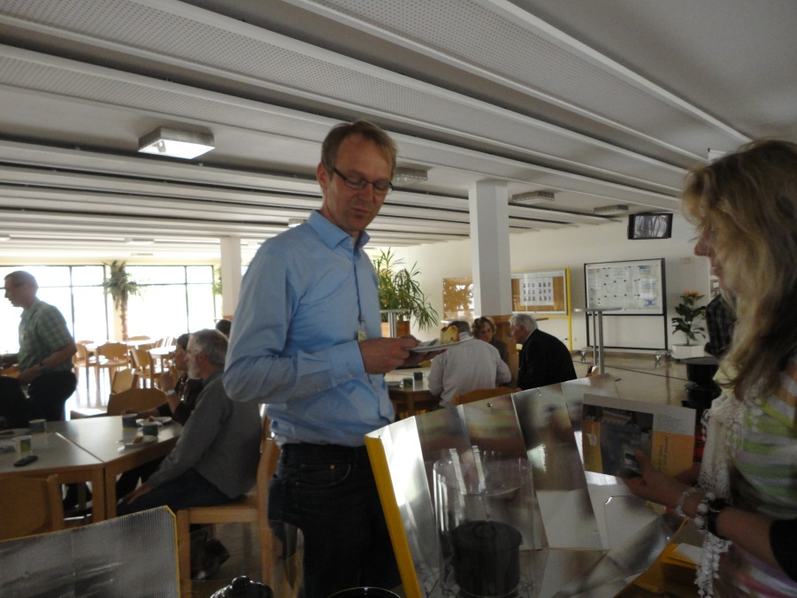
21. Internationale Solarkochertagung in Altötting (25-26. April 2015)

Slide 23
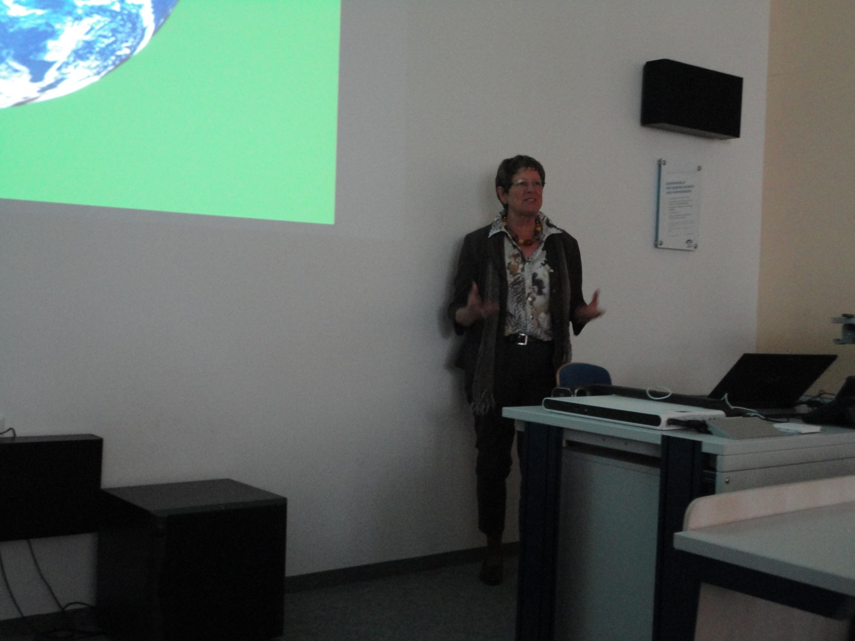
21.Int. Solarkochertagung: Ms Regula Ochsner, CEO of the swiss organisation
ADES (Association pour le Développement de L´Energie Solaire) presenting the
successful implementation of solar cookers in Madagascar. www.adesolaire.org

Slide 24
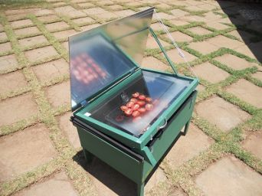
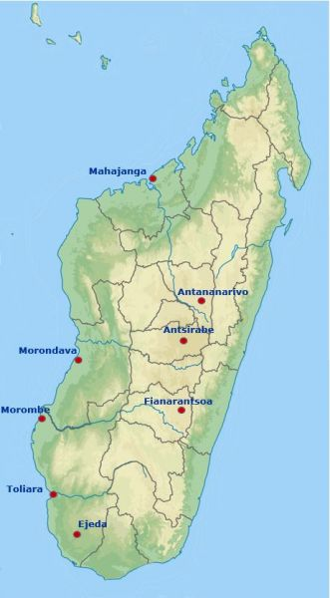
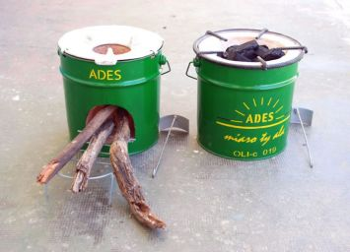
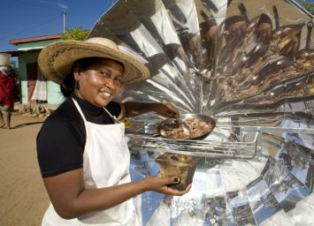
www.adesolaire.org

Slide 25
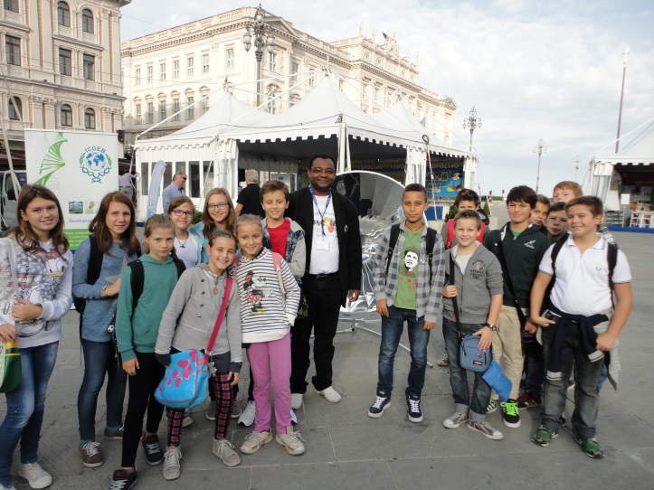
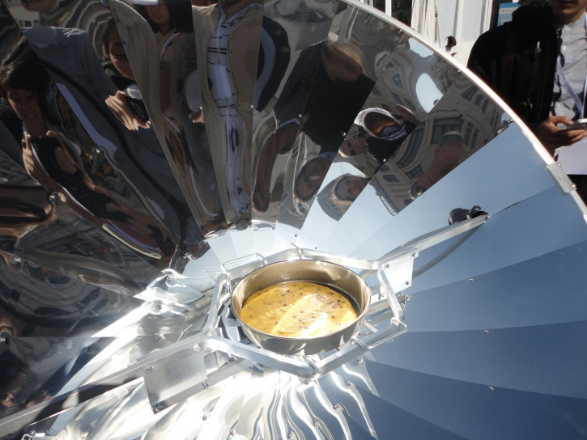
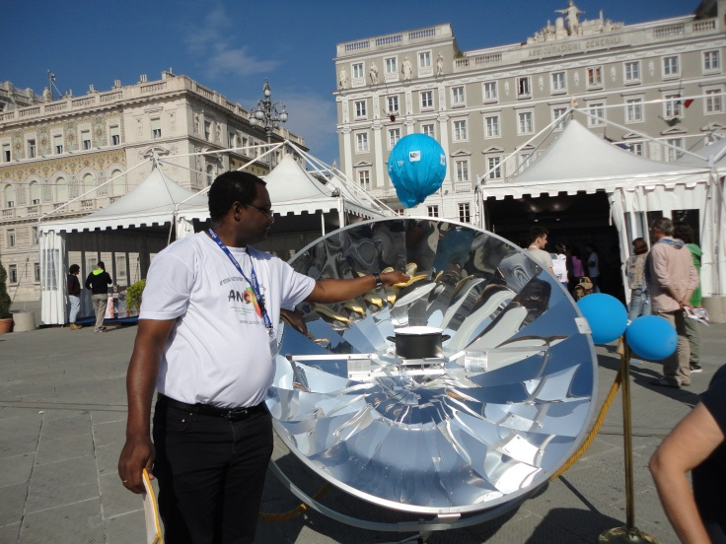
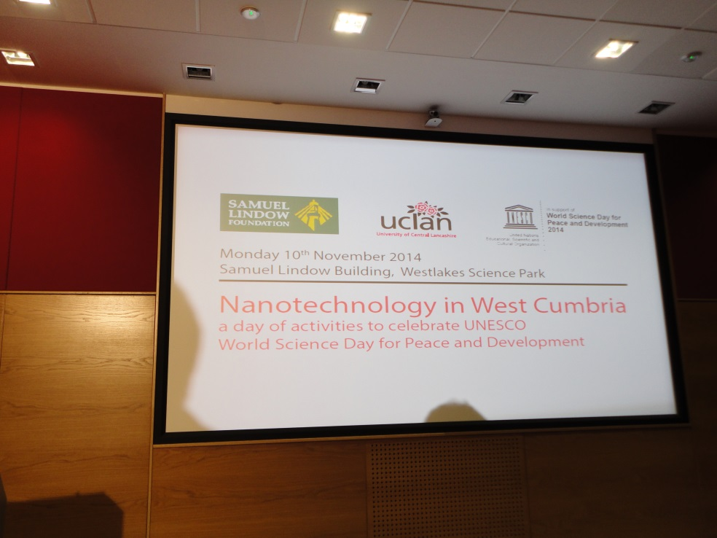
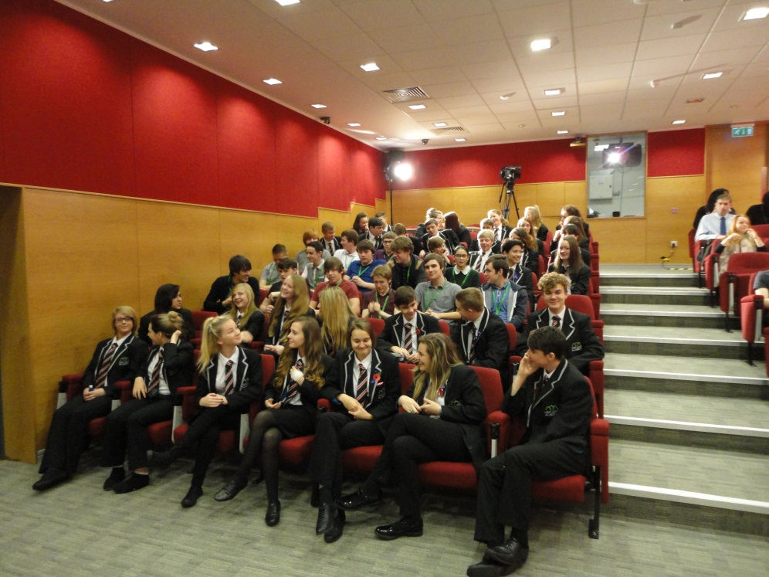
TriesteNext, Trieste, Italy 26-28 September 2014
Public Educational Mission of ANSOLE
UNESCO World Science Day, 10 Nov. 2014, UCLAN, Westlakes, Britain

Slide 26
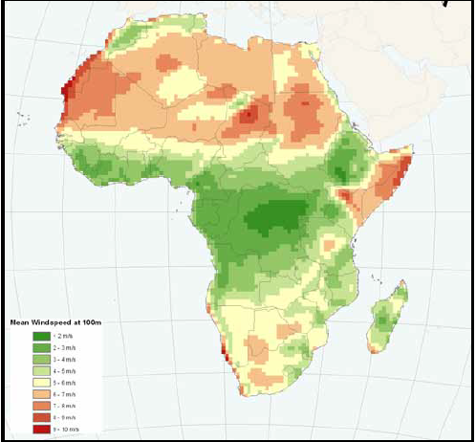
Energy resources in Africa
Energy potentials : renewable energy resources (wind energy)
Wind energy
20% of global energy
More concentrated in northern and southern parts of the continent

Slide 27
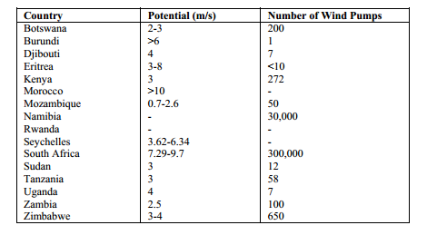
Energy resources in Africa
Energy potentials : renewable energy resources (wind energy)

Slide 28
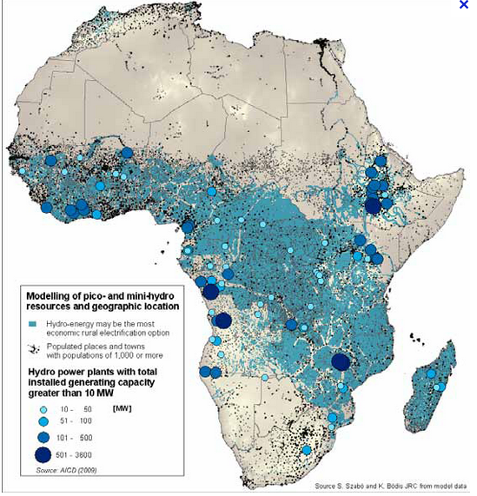
Energy resources in Africa
Energy potentials : renewable energy resources (hydro energy)
Hydro production potential of 1440 TWh/year

Slide 29
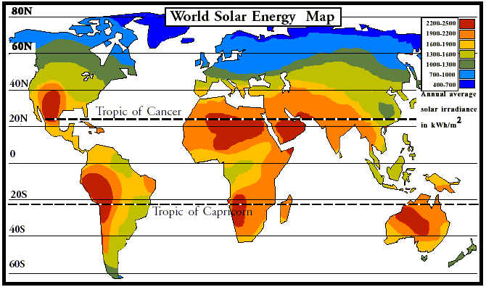
Source: www.google.com >>>www.inforse.org
PV Technologies: silicon technology adaptable to specific African environments,
Concentrated and Highly Concentrated Photovoltaics, Concentrated Solar Power,
3rd generation solar cells (Organic, DSSC, Perovskites)

Slide 30
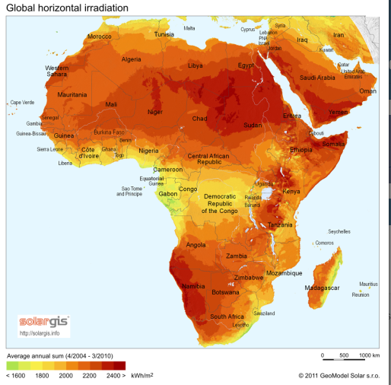
Energy resources in Africa
Energy potentials : renewable energy resources (solar energy)
Solar energy:
74% of the continent receives more than 1900 kWh/m²/year

Slide 31
An appropriate and adaptable technology takes into account:
Environmental and climatic conditions
>high temperatures
>long raining seasons,
>dusts
> etc.
Societal behavior
Purchasing power
According to the PhD thesis (2018) of Cristina Cabo Landeira of the University
of Santiago de Compostela (USC):
“PV systems design optimization as function of the climatic conditions”
Polycrystalline silicon solar cells are recommended for all climatic conditions

Slide 32
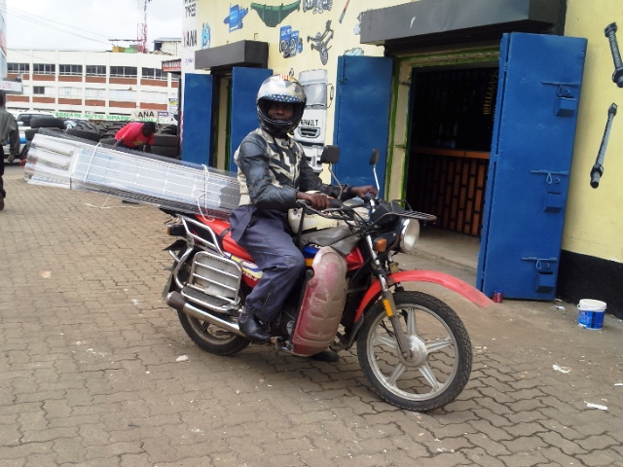
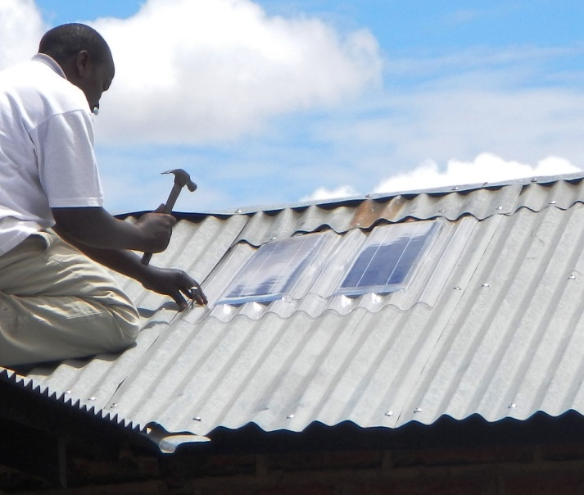
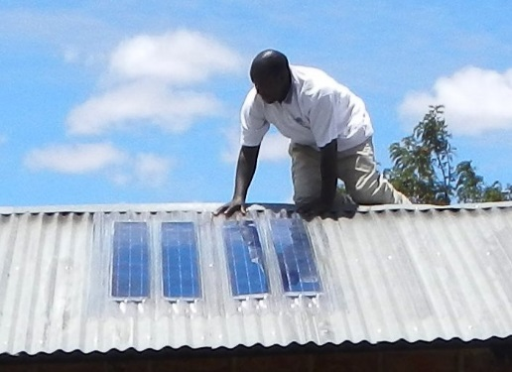
Example of an adaptable and affordable technology
Easy transportation of a rolled up
135 W panel on a motorbike
Solamander 36 W photovoltaic panel mounted on a corrugated roof and held in place with nails
Solamander 135 W photovoltaic panel
mounted on a corrugated roof

Slide 33
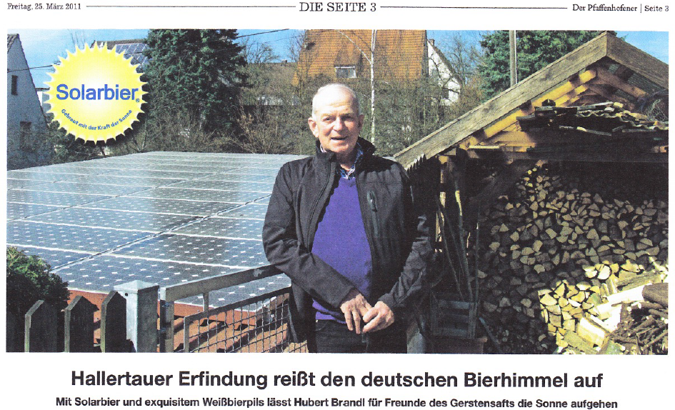
Founder of the „Solarbier“ concept: Hubert Brandl

Slide 34

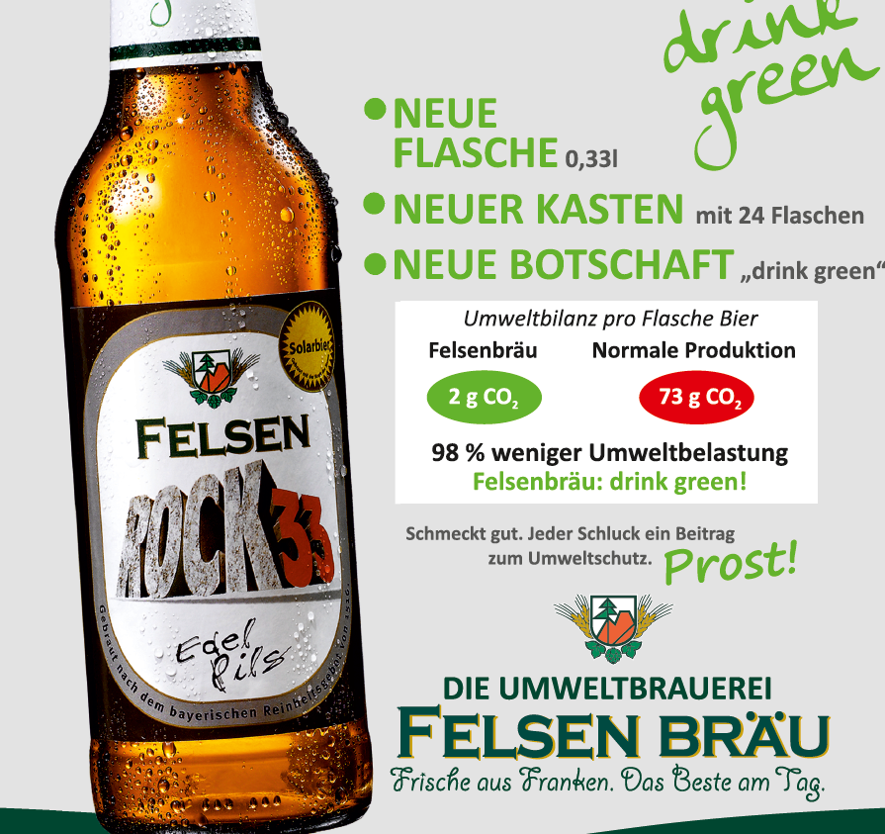

Slide 35







Solar Food Concept
Certification institutions:
www.solar-food.com

Slide 36
The appropriate use of the abundant solar energy can be regarded as a solution to the African energy problem. This requires highly qualified human resources at all levels.
Presence of local qualified skills lead to acceptance of renewable energy technologies and reduction of energy end-price.

Slide 37
Dr Akinwumi Adesina, President of African Development Bank, during 53rd Annual
Meetings of the Board of Governors this year in Busan, South Korea:
„Africa must prepare its people for the jobs of the future, not those of the past.
Africa must accelerate higher education, and vocational and technical training in
building the skills of the future. In particular, greater emphasis should be placed on
digitalisation, mathematics, material sciences, biotechnology, engineering, artificial
intelligence, robotics and quantum computing. These areas will dominate the industrial
revolution in the near future. And Africa must not be behind.
….
The continent needs to be strong in research and development. And this is a significant
challenge. According to UNESCO, regional averages of GDP shares committed to R&D are
2.1% for East Asia and the Pacific, 2.4% for North America and Western Europe,
and a vanishing 0.4% for Sub-Saharan Africa“
70 % of the research on renewable energy is theoretical.
Lack of funds for experimental research!

Slide 38
Some Solution Approaches
Pan African Universities (PAU) from the African Union (eg. PAUWES)
African Centres of Excellence (ACEs) financed by the World Bank Group
African Centre of Excellence (ACEs) financed by the African Development Bank
Scientific Networks (ANSOLE, BALEWARE, MSSEESA, etc.)
ANSOLE: African Network for Solar Energy
BALEWARE: Bridging Africa, Latin America and Europe on Water and Renewable Energies
Applications
MSSEESA: Materials Science and Solar Energy Network for Eastern and Southern Africa

Slide 39
MSSEESA
A network of 5 Universities: Nairobi, Eldoret (Kenya), Makerere (Uganda),
Dar Es Salam (Tanzania) and the University of Zambia
Funded by ISP (SIDA)
-Sharing of Laboratory Equipments
Exchange of students
Joint event
The coordination rotates after 3 years (a weakness of the network!)

Slide 40
Objectives of ANSOLE
Fosters technical and vocational education and training(TVET) in renewable energies (RE) at various skill levels (capacity building)
Fosters (experimental) research activities in RE & Water among African scientists and non-African scientists involved in the education of African students and experts (capacity building)
Promotes and encourages the use of RE in Africa (public education, substainable development, business mediation, environmental protection)

Slide 41
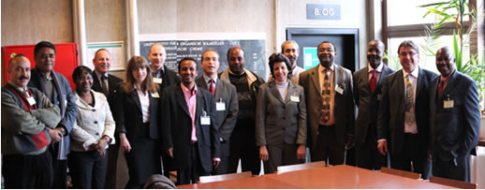
Brief History
Initiated on the 4th of November 2010 in Sousse, Tunisia
Launched on the 4th of February 2011 at LIOS, JKU Linz, Austria
Registered as „ANSOLE e.V.“ on the 26th of January 2012 in Jena, Germany
Participants at the Launching of ANSOLE on the 4th of February 2011

Slide 42
Stand July 2018
ANSOLE has >1100 members in:
44 African Countries: Algeria, Angola, Benin, Botswana, Burkina Faso, Burundi, Cameroon, Chad, Central African Republic, Congo-Brazzaville, Democratic Republic of Congo, Cote d´Ivoire, Djibouti, Egypt, Ethiopia, Gambia, Ghana, Guinée Conakry, Kenya, Liberia, Lesotho, Libya, Malawi, Mali, Mauritania, Mauritius, Morocco, Mozambique, Namibia, Niger, Nigeria, Rwanda, Senegal, Sierra Leone, Somalia, South Africa, Sudan, South Sudan, Tanzania, Togo, Tunisia, Uganda, Zambia, Zimbabwe.
31 non -African Countries: Albania, Austria, Belgium, Britain, Canada, Chile, China, Czech Republic, Dubai, Estonia, Finland, France, Germany, India, Ireland, Italy, Luxembourg, Jordan, Malaysia, Mexico, Holland, Palestine, Portugal, Russian Federation, Saudi Arabia, Scotland, Spain, Sweden, Switzerland, Taiwan,Turkey, and USA
Members from > 300 Universities

Slide 43








Logos of Institutional/Company Members

Slide 44
Membership to ANSOLE
Any individual or corporate person supporting the goals of the network can become a member, either by downloading, filling and then sending the membership application form to the coordinator (daniel.egbe@ansole.org) or by filling the online interactive membership form.
Membership fees
Personal member (Africa): 20 €/year
Personal member (rest of the World) and ANSOLE e.V. member: 30€ /year
Institutional member: 200€/year
Company member 600€/year

Slide 45
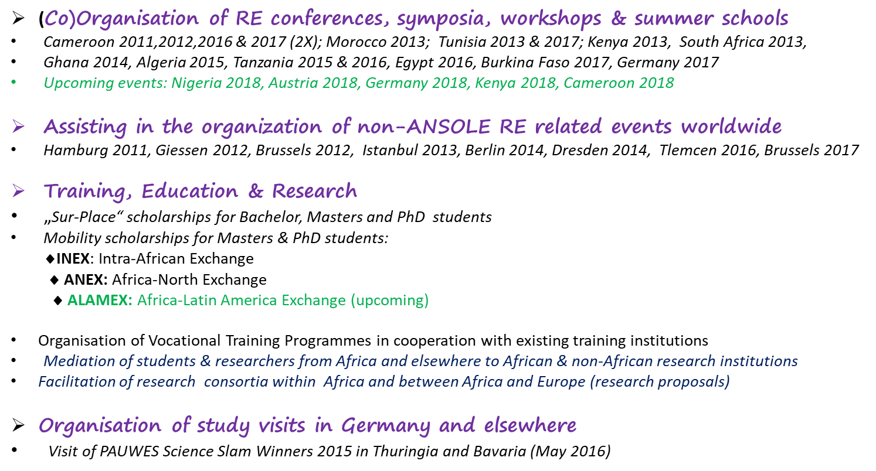
Activities of ANSOLE
-ICTP funding (2011-2016)
- Now seeking for other funders

Slide 46
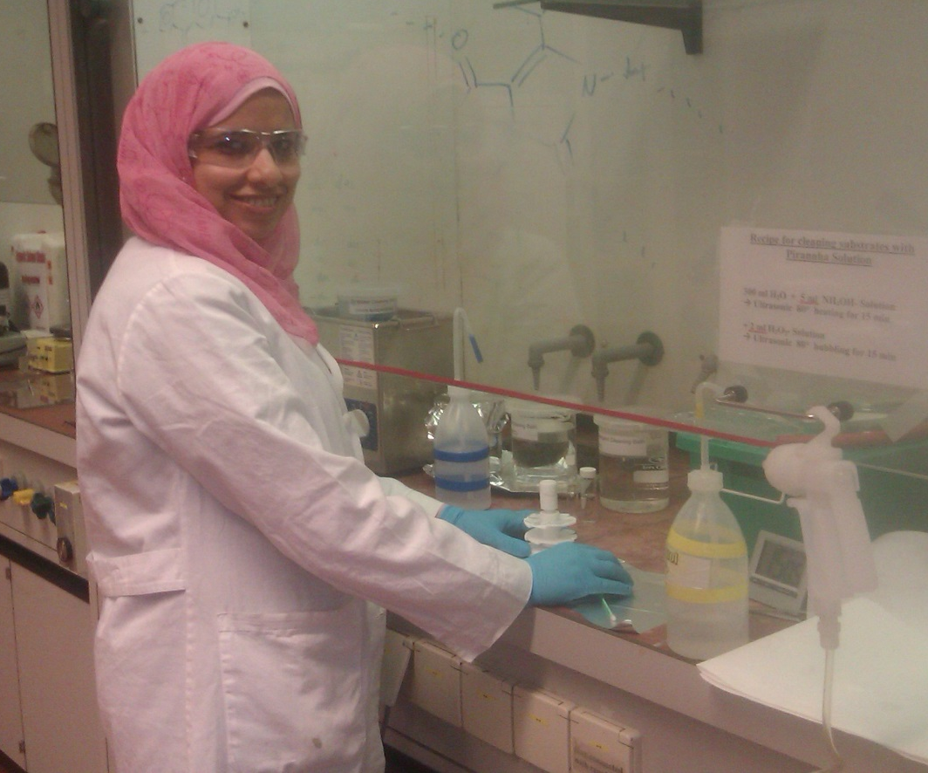
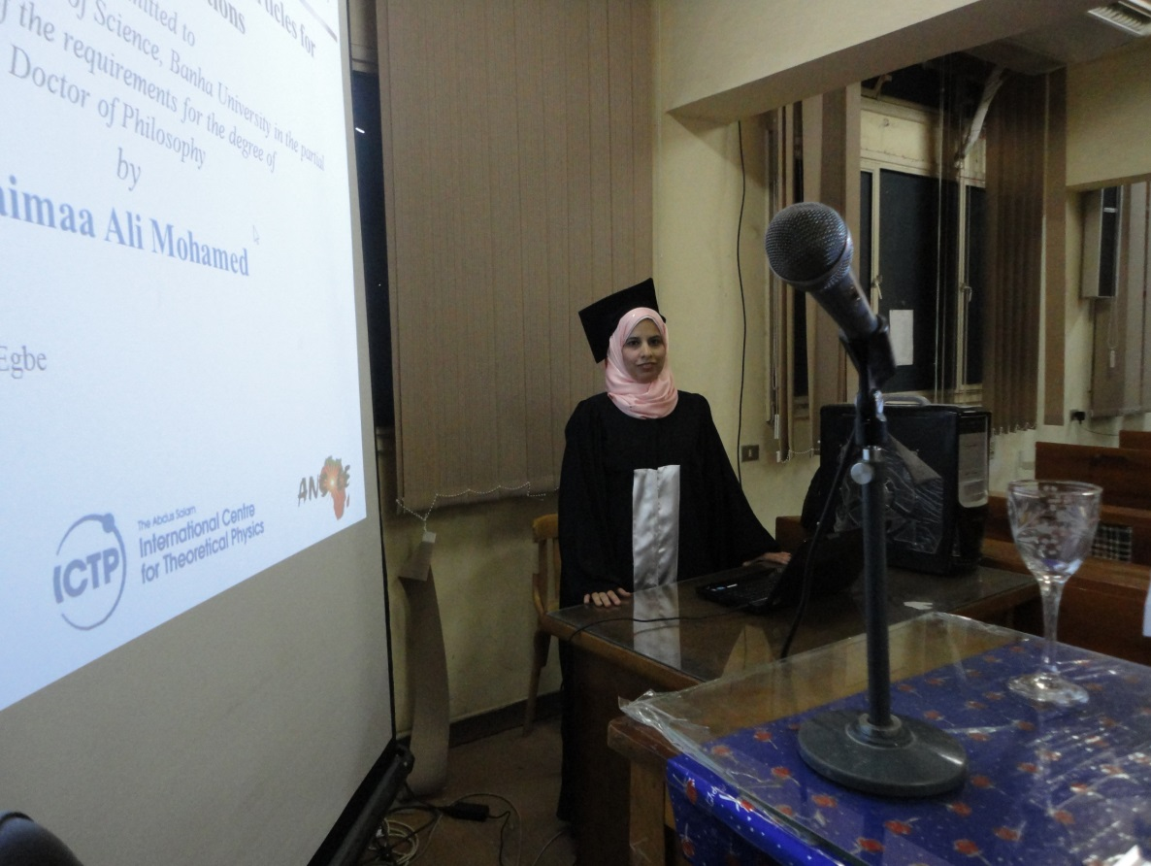
AFRICA-NORTH EXCHANGE (ANEX)
Egyptian PhD Fellow, Dr. Shaimaa Ali Mohamed: From experimental work at the Johannes
Kepler University Linz, Austria to PhD defense at Benha University, Egypt on 24 May 2015

Slide 47
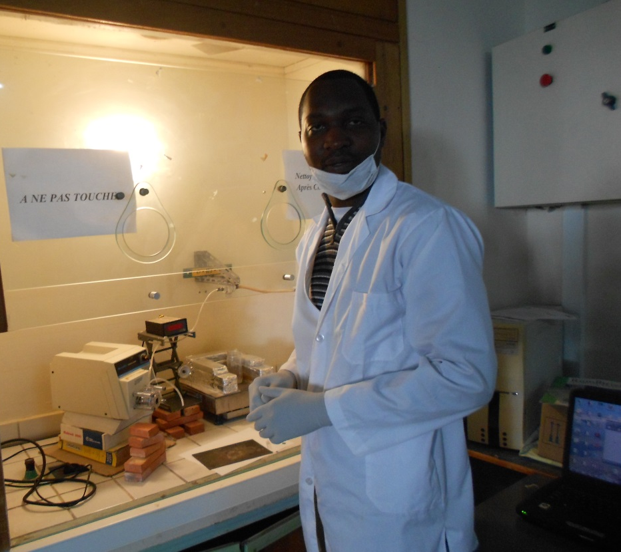
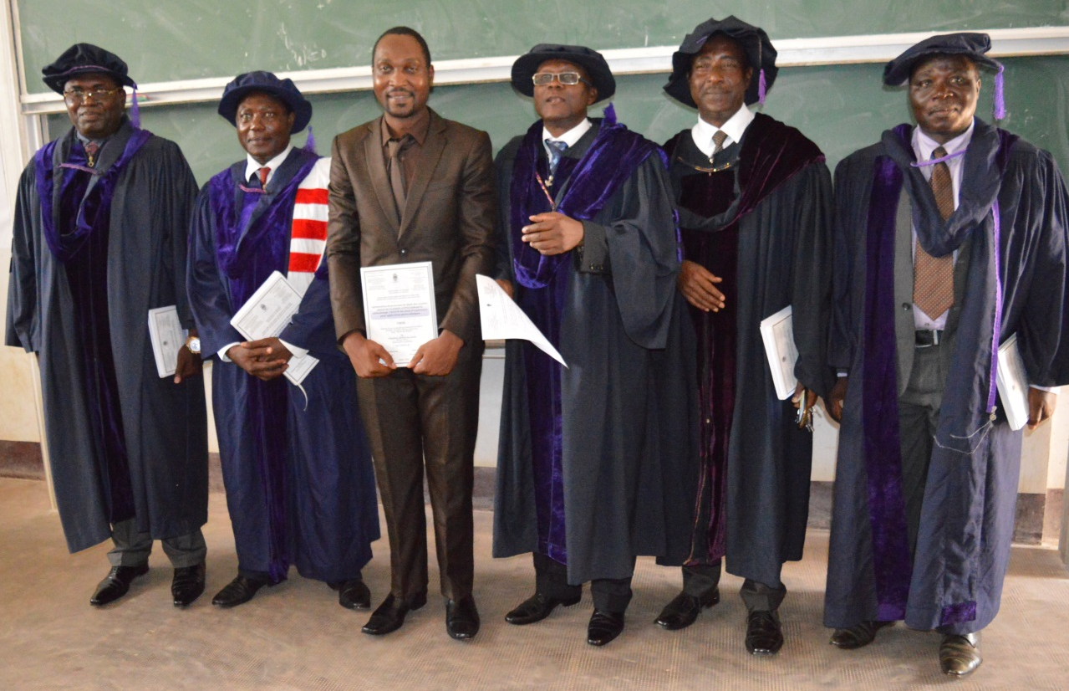
INTRA-AFRICA EXCHANGE (INEX)
Cameroonian PhD Fellow, Dr. Joël Hervé NKUISSI TCHOGNIA: From experimental work at the
University of Mohammedia in Morocco to PhD defense at the University of Yaounde I in
Cameroon in Oct. 2016

Slide 48
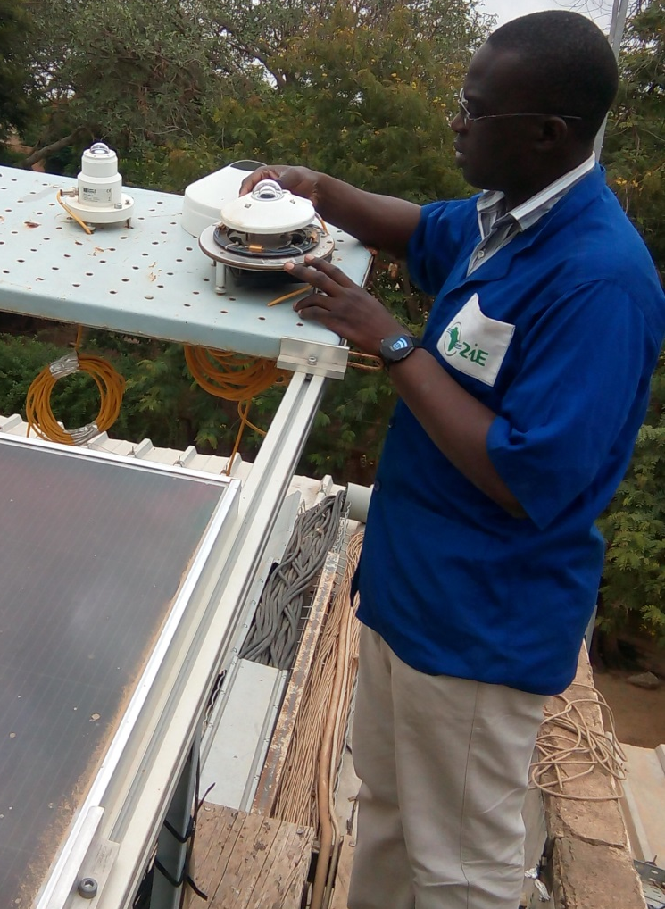
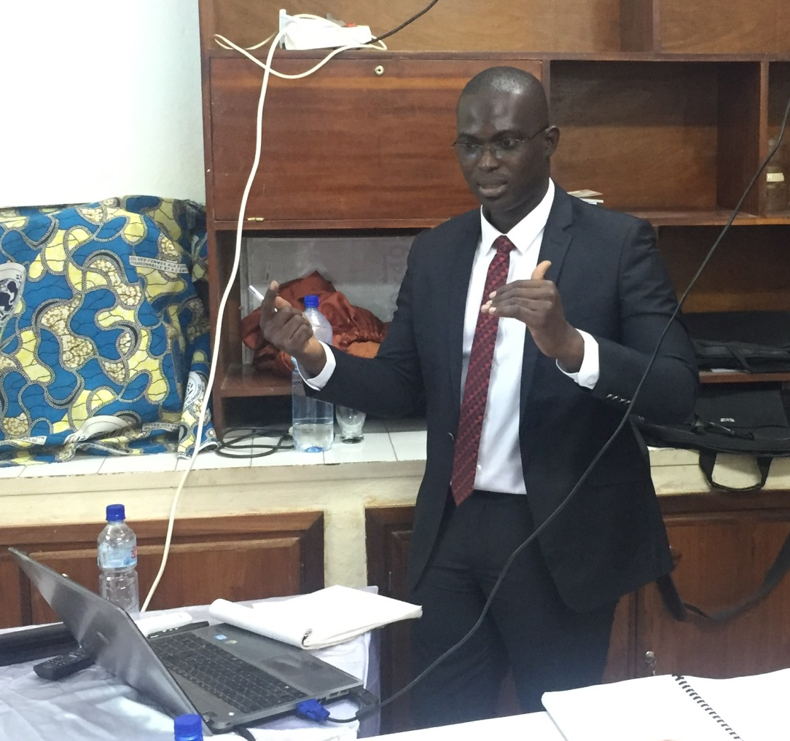
ANSOLE SUR-PLACE (ANSUP)
Beninese PhD Fellow, Dr. Alain Tossa at 2iE Ouagadougou Burkina Faso:
From experimental research to PhD defense on 26 January 2017

Slide 49






Some ANSOLE Graduates in 2017

Slide 50
Upcoming Events
ANSOLE DAYS 2018, 2-6 Sept, Mbouo Bandjoun, Cameroon (www.ansole.com)
Summer School on SDG6, 22-30 June 2019, NUST, Windhoek, Namibia
International Conference on Sustainability: Water & Renewable Energy
(ICS:WARE 2019), 1-3 July 2019, NUST, Windhoek, Namibia
ANSOLE DAYS 2019, Accra Ghana (Venue and date are still to be fixed)
Thank you for your attention

