Slide 1

A STUDY OF THE PROPERTIES OF THE FRONT-END ELECTRONICS OF THE COMPACT HIGH ENERGY CAMERA (CHEC) PROTOTYPE FOR GAMMA-RAY ASTRONOMY
S. Leach², M. Backes^{1,3}, J. Lapington², G. Cotter⁴,
for the CTA Consortium
¹Department of Physics, University of Namibia, Namibia
²Space Research Centre, University of Leicester, UK
³Centre for Space Research, North-West University, South Africa
⁴Department of Physics, University of Oxford, UK
BY: Mwashana Susana Nekwaya
Department of Physics
University of Namibia
Namibia
AFRICAN CONFERENCE
OF PHYSICS
JULY 2018
AFRICAN SCHOOL OF PHYSICS 2018

Slide 2
OUTLINE
INTRODUCTION TO FRONT-END ELECTRONICS (FEEs)
MAIN FOCUS OF THIS STUDY
RAW DATA WAVEFORMS
ANALYSIS PROCEDURE
PRELIMINARY RESULTS
CONCLUSION
REFERENCES

Slide 3
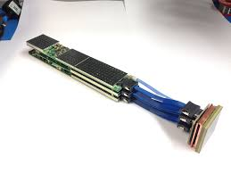
INTRODUCTION TO FRONT-END ELECTRONICS (FEE)
Electronics – key components of modern detector systems.
Purpose of FEE
Acquire electrical signal from sensor
Tailor time response to optimise for digitiser input.
Pulse shaping
Signal digitization
A characteristic CHEC-S FEE module

Slide 4
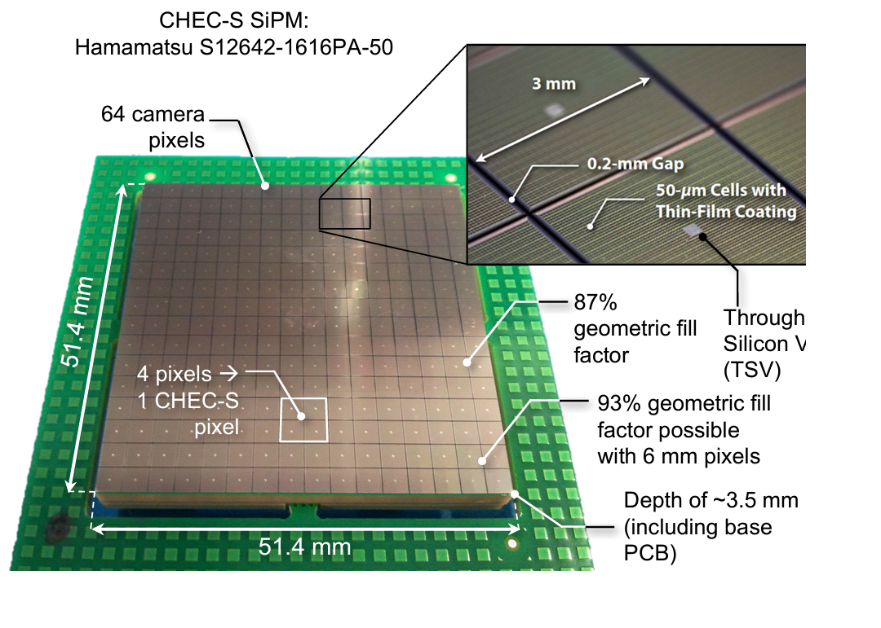
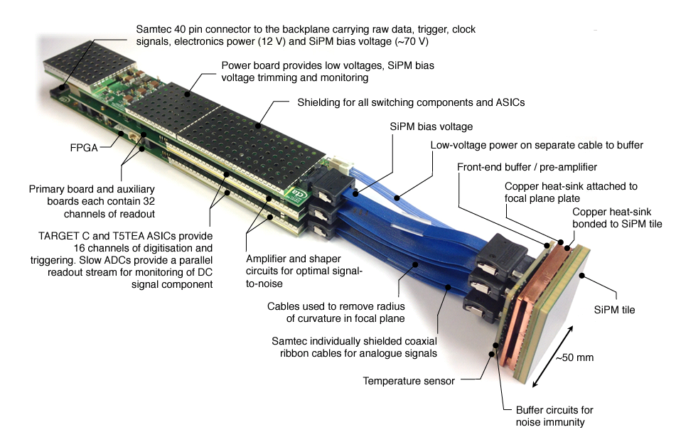
FEE COMPONENTS
Each CHEC-S Silicon Photomultiplier (SiPM) tile contains:
256 3 x 3 mm² pixels
combined in groups of four on a bias board
to provide the desired camera pixel size.
[White, R., 2017.Journal of Instrumentation.]
Thus each FEE has:
64 6mm x 6mm camera pixels
64 camera channels
1 pulse/channel for a single event
[De Franco, A. and Cotter, G., 2016. Journal of Instrumentation]

Slide 5
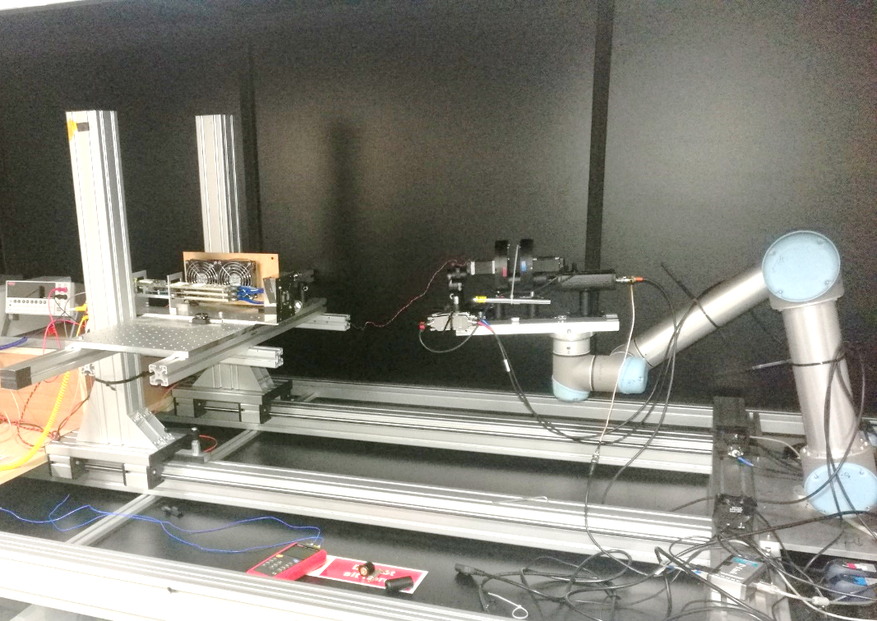
EXPERIMENTAL SETUP
Pulse generator
Robot arm + laser pointer and Filters
FEE module
Computer
C++, Python and ROOT
Picture: FEE Lab module in test at the University of Leicester, UK.

Slide 6
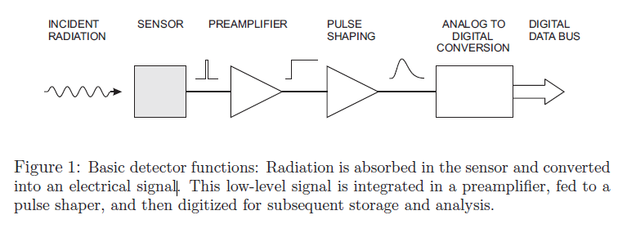
EXPERIMENT PROCEDURES
A controlled laser pulse at 1kHz, and 650 nm was fed to the SiPM with
1000 pe/ns for 128 ns.
The signal is then integrated in a preamplifier
and fed to a pulse shaper
The pulse then gets digitized for storage and measurement
A script is then run to obtain the amplitude values from the raw data waveforms
The amplitude is then anlysed further for parametarisation
[Spieler, H., 2003. Proc.2003 ICFA School on Instrumentation]

Slide 7
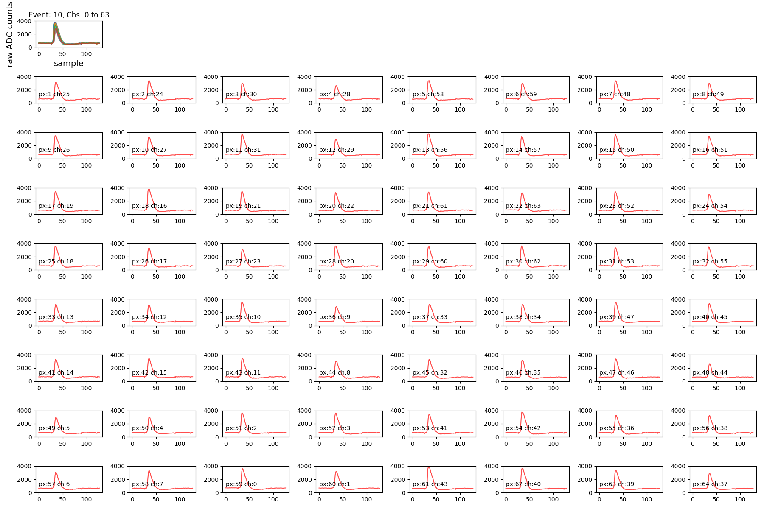
RAW DATA WAVEFORMS

Slide 8
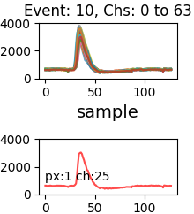
RAW DATA WAVEFORMS CONT…
Blow-up of a single pixel event plus the averaged waveform

Slide 9
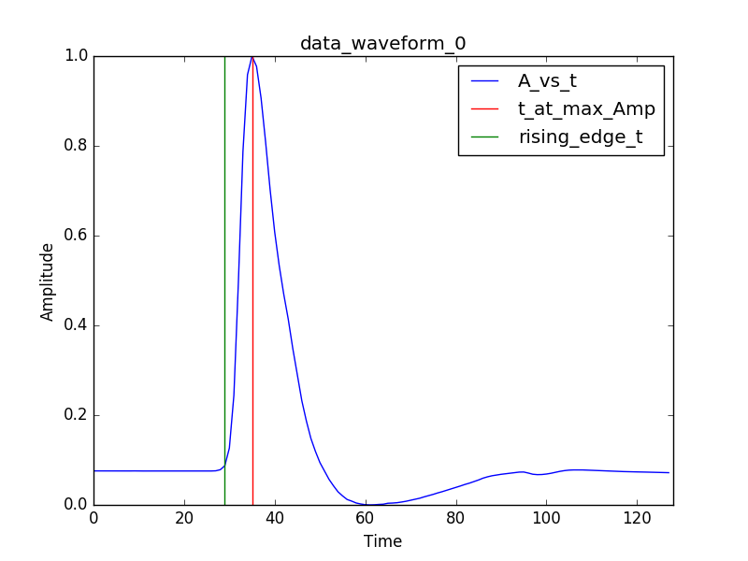
ANALYSIS PROCEDURE
Obtains the minimum amplitude value and calculates the undershoot value of the pulse.
Obtains the maximum amplitude from the data and prints the time at the peak.
Calculates the rise time of the pulse.
Calculates the mean and standard deviation for each of the waveforms
Calculates the Full Width at Half Maximum
Calculates the baseline and time at threshold values in order to get the rising edge of the pulse.

Slide 10
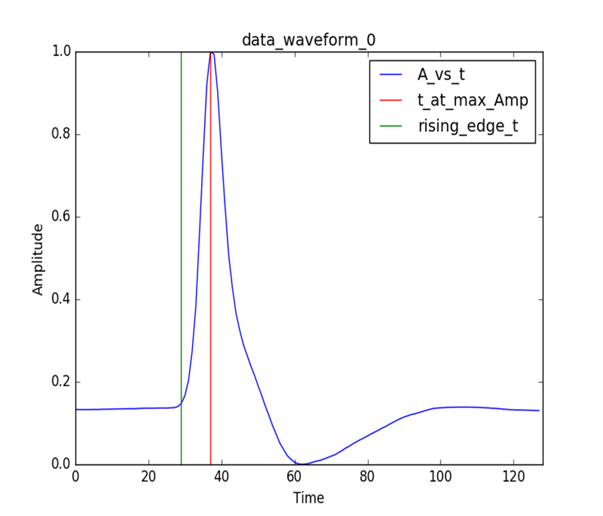
WHAT HAS BEEN DONE
Examined the output waveforms of the digitised shaped signal from the preamplifiers
Parameterised the preamplifier pulse shape for a single event.
Current result observations
The rise times for all the files analysed thus far are in the range of 7ns and 10ns.
FWHM are in the range of 8 and 10 ns.

Slide 11
OUTLOOK
Calculate the following values:
Baseline, time at threshold, FWHM, mean, standard deviation and rise time of averaged amplitude data for each channel.
Establish an automated waveform analysis procedure that will:
- Point out faulty preamplifier channels
- Determine the nature of the faulty channel depending on the
values of the pulse peak and pulse width.

Slide 12
REFERENCES
DANIEL, M., WHITE, R., BERGE, D., BUCKLEY, J., CHADWICK, P., COTTER, G., FUNK, S., GREENSHAW, T., HIDAKA, N., HINTON, J. and LAPINGTON, J., A Compact High Energy Camera for the Cherenkov Telescope Array. Power, 10, p.4.
De Franco, A., White, R., Allan, D., Armstrong, T., Ashton, T., Balzer, A., Berge, D., Bose, R., Brown, A.M., Buckley, J. and Chadwick, P.M., 2015, July. The first GCT camera for the Cherenkov Telescope Array. In 34th International Cosmic Ray Conference (ICRC2015) (Vol. 34).
De Franco, A. and Cotter, G., 2016. Test bench for front end electronic of the GCT camera for the Cherenkov Telescope Array. Journal of Instrumentation, 11(02), p.C02006.
Spieler, H., 2003. Analog and digital electronics for detectors. Proceedings of the 2003 ICFA School on Instrumentation, Itacuruca, Brazil.
White, R., 2017. CHEC: A Compact High Energy Camera for the Cherenkov Telescope Array. Journal of Instrumentation, 12(12), p.C12059.

Slide 13
We gratefully acknowledge financial support from the agencies and organizations listed here: http://www.cta-observatory.org/consortium_acknowledgments
THANK YOU!
We gratefully acknowledge financial support from the agencies and organizations listed here:
http://www.cta-observatory.org/consortium_acknowledgments

