Slide 1
Super FGD
-
Target Design
Design Pre optimization
Design issues
Envelope definitions

Slide 2
Super FGD Target Design_ FEA simplifications
Key numbers and assumptions (to start with…)
Overall target size: 2m x 1.8m x 0.6m high
Assumptions for CAD and FEA: scintillator cube is 15mm
Optimization is mandatory / target height (tight clearances on Z )… less tricky on X / Y
Try to simplify the FEA as much as possible (cubes vs equivalent pressure)
Double symmetries are considered to limit the model size (same results!)
Cubes are linked by friction (3 friction factors are considered: 0/0.5/1..)
300mm
400mm
Only 2 layers shown
Equivalent pressure
Center of target

Slide 3
Super FGD Target Design_ FEA simplifications
Don’t look at absolute deformations… size doesn't correspond to Target!
….Only for COMPARISONS!
Friction factor is 0.5
Pressure model shows ≈20% over deformations / cubes

Slide 4
Super FGD Target Design_ FEA simplifications
Friction factor is 0.0
Extreme cases with friction factors (0 and 1)… negligible effects (1 to 2% difference)
Friction factor is 1

Slide 5
Super FGD Target Design_ FEA simplifications
Only 2 layers shown
In case of 20 layers of cubes…
We keep the 20 % difference!
A simplified model (equiv. pressure on the bottom plane) can be used for global target FEA
(provide 20% margin in def!)

Slide 6
Super FGD Target Design_ FEA simplifications
Only 2 layers shown
In case of 20 layers of cubes…
We keep the 20 % difference!
A simplified model (equiv. pressure on the bottom plane) can be used for global target FEA
(provide 20% margin in def!)

Slide 7
Super FGD Target Design_ FEA simplifications
Full target: double symmetries (2m x1.8m x 0.6m).. A quarter model!
900mm
1000mm
¼ target total weight
Each panel as a SANDWICH MATERIAL (Airex + CFRP skin, see next)

Slide 8
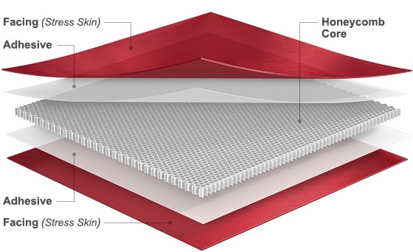
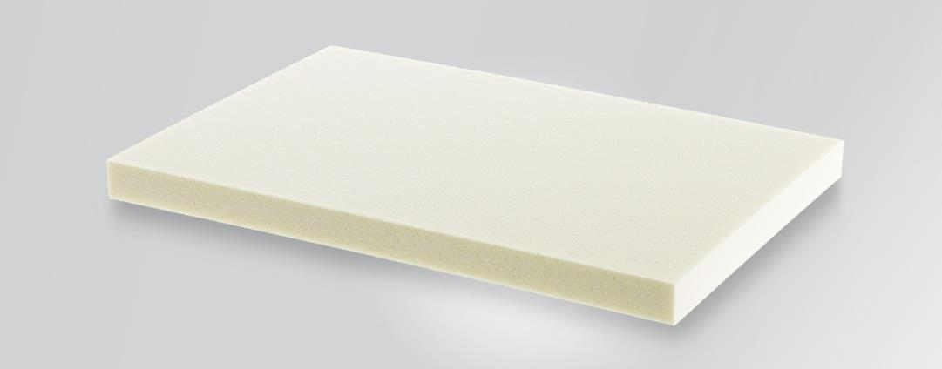
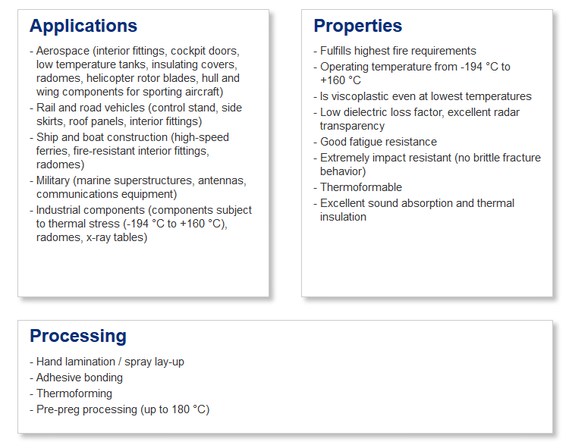
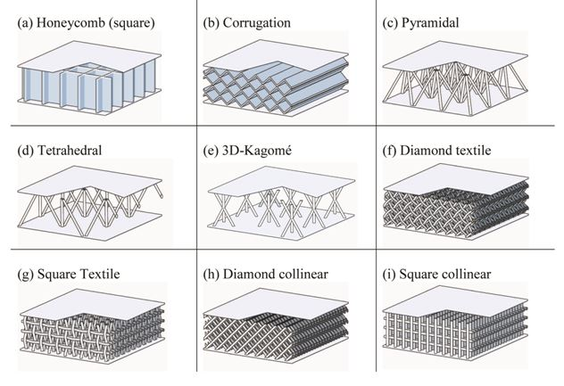
Super FGD Target Design_ FEA simplifications
various sorts of CORE materials
AIREX core material…
AIREX is OK up to 50 Mrad (guess OK for T2K…)
Transparency to particles, homogeneous in 3D, unlike the honeycomb…
Easy Bonding, not brittle, shock absorption…light!
Used in harsh environments

Slide 9
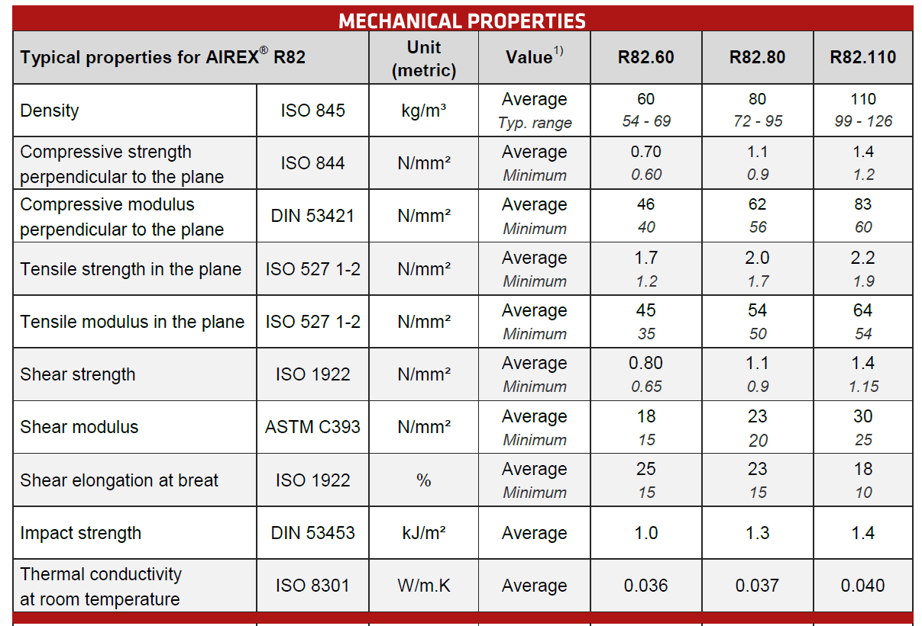
Super FGD Target Design_ FEA simplifications
AIREX core material…

Slide 10
Super FGD Target Design_ FEA simplifications
Full target: double symmetries (2m x1.8m x 0.6m).. A quarter model!
3.6mm in case of 20mm core / 2mm CFRP skins
(meaning < 3mm if not pressure equiv.)
4.6mm in case of 1mm CFRP skins

Slide 11
Super FGD Target Design_ FEA simplifications
Full target: double symmetries (2m x1.8m x 0.6m).. A quarter model!
1.4mm in case of 30mm core / 2mm CFRP skins
(meaning 1.1mm if not pressure equiv.)
1.7mm in case of 1mm CFRP skins
Stresses will be estimated with a more detailed mechanics…

Slide 12
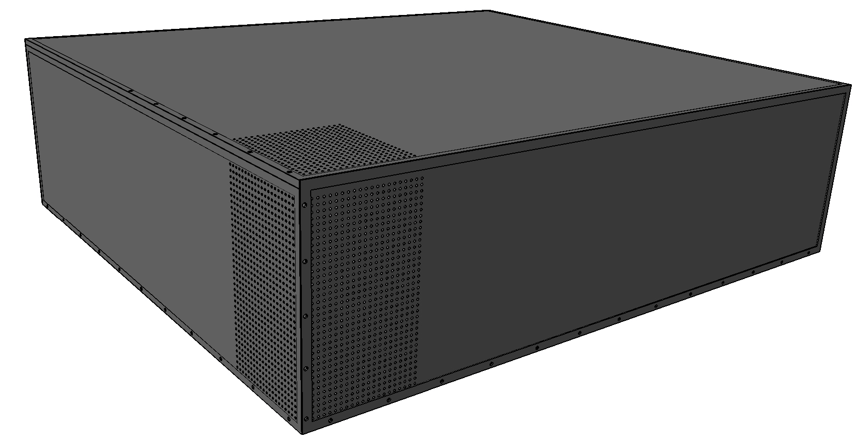
Super FGD Design & Envelope constraints
Design definition (and key numbers)
3 sides / 6 to be read out by siPM + electronics (bottom part is excluded)
Sci Cube size and numbers: 15mm / 134 (X) x 121(Y) x 37 (Z)…leading to 599918 cubes!!
Nearly 1.8 millions 1.2mm holes (3 per cubes)
2.5 Tons of scintillating material + mechanics and electronics…
26012 channels to be read out
2 m (X)
1.8 m (Y)
0.6 m
(Z)

Slide 13
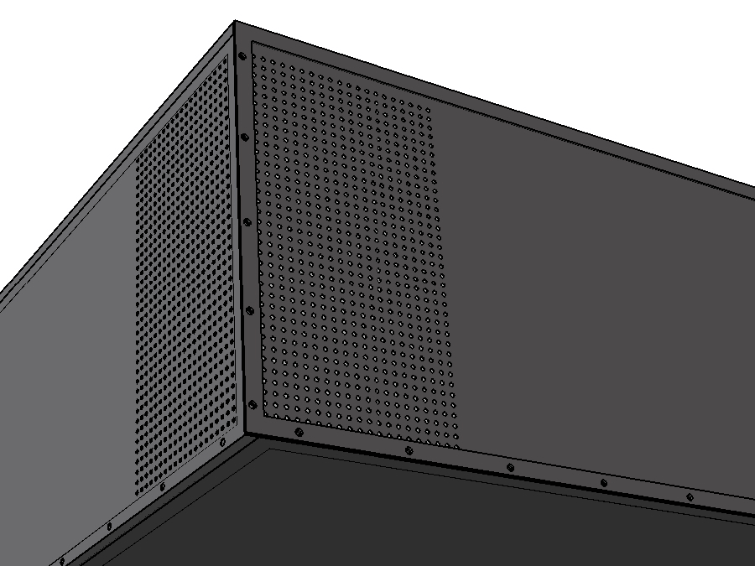
Super FGD Design & Envelope constraints
Only a few holes (for Fiber insertion)
are shown …
To keep CAD from scratching!
Each bottom corner will be equipped
with bracket (for connection to basket frame)
To be optimized / envelope constraint.

Slide 14
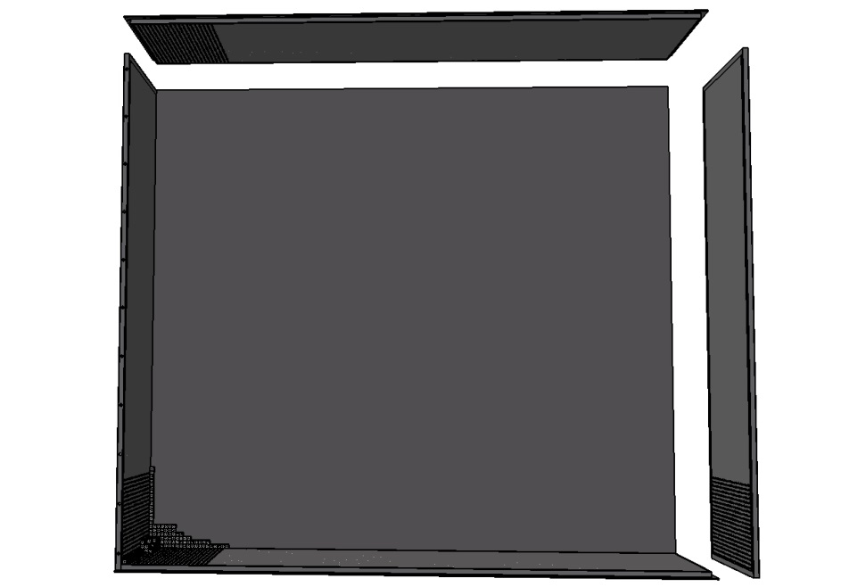
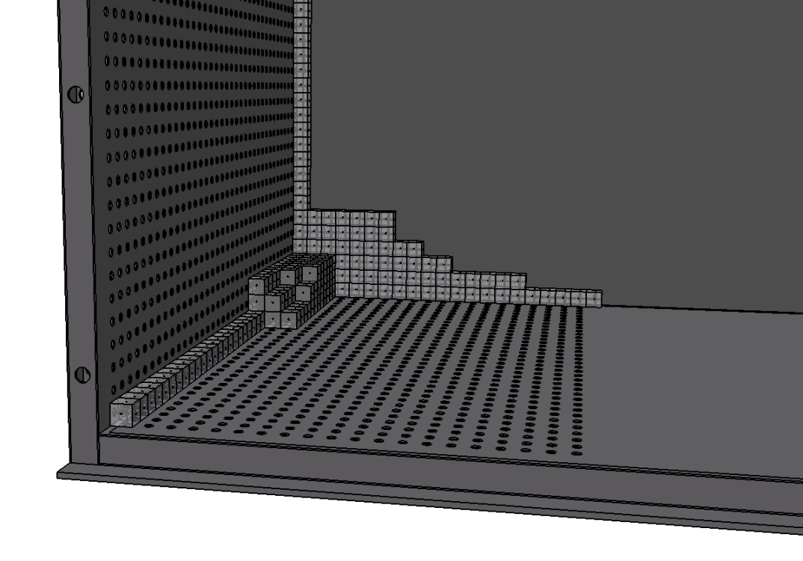
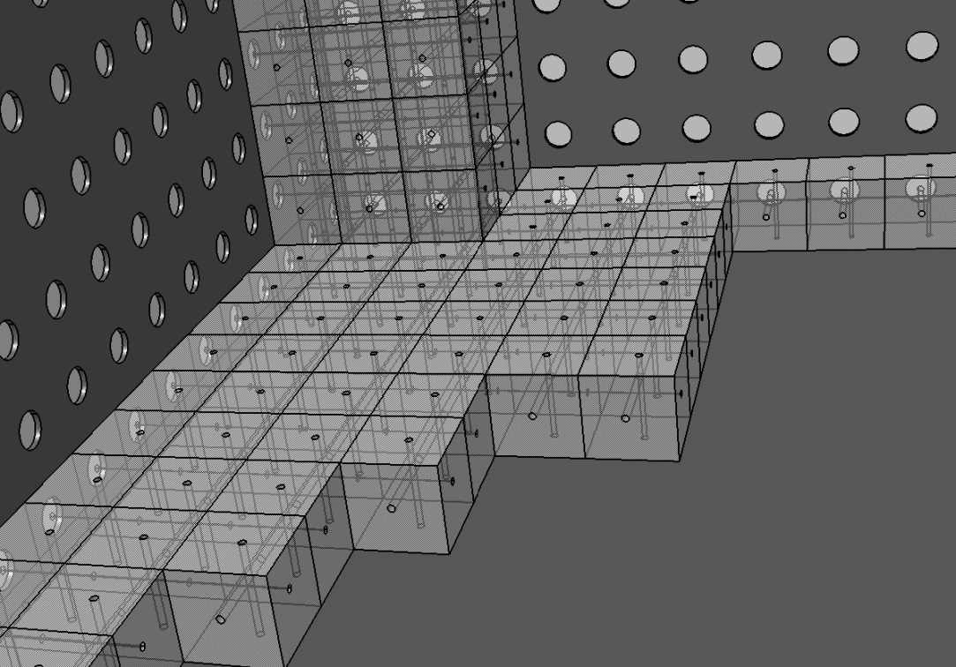
Super FGD Design & Envelope constraints
3 opposite planes will apply pressure to the cube assembly (thru “FOAM”)
3 NIDA planes to provide references:
- X, Y and bottom Z

Slide 15
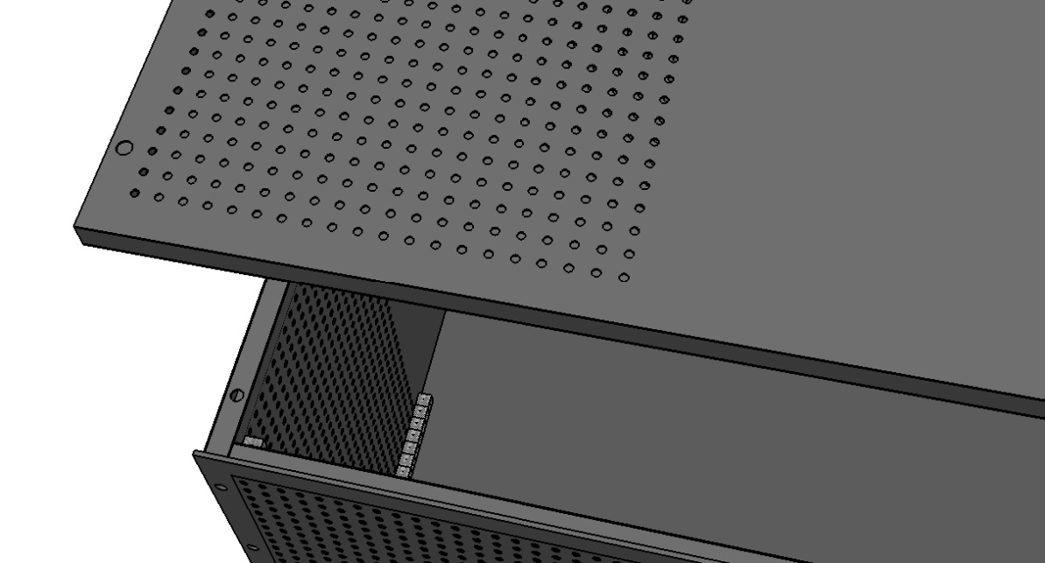
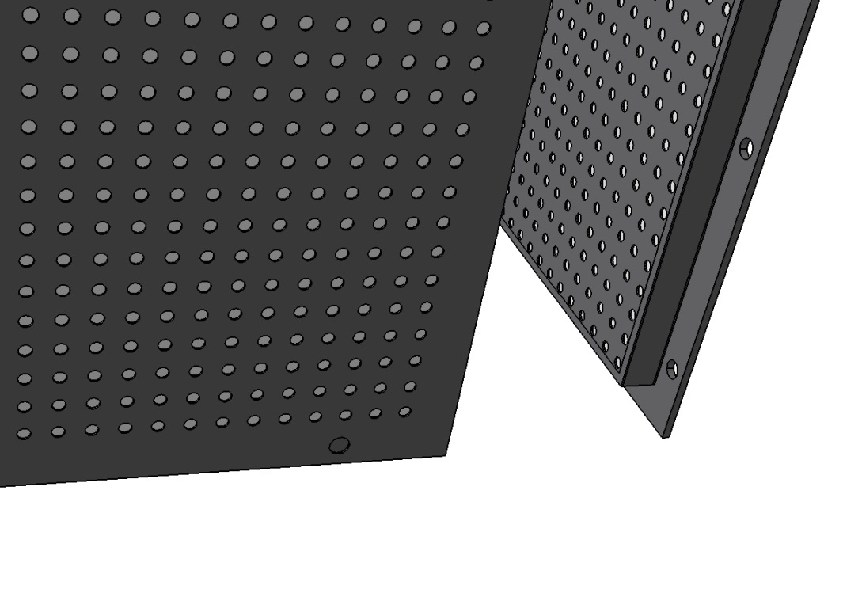
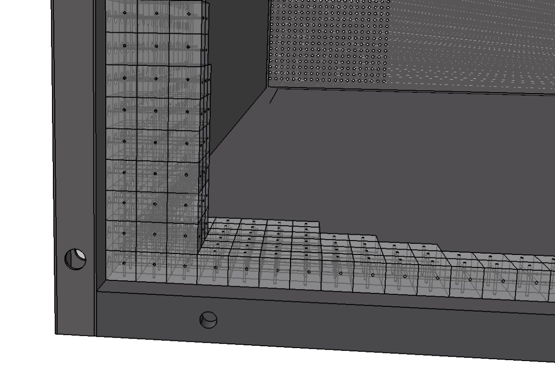
Super FGD Design & Envelope constraints
Constraints on NIDA frames
(screws are always needed… for panels connections)

Slide 16
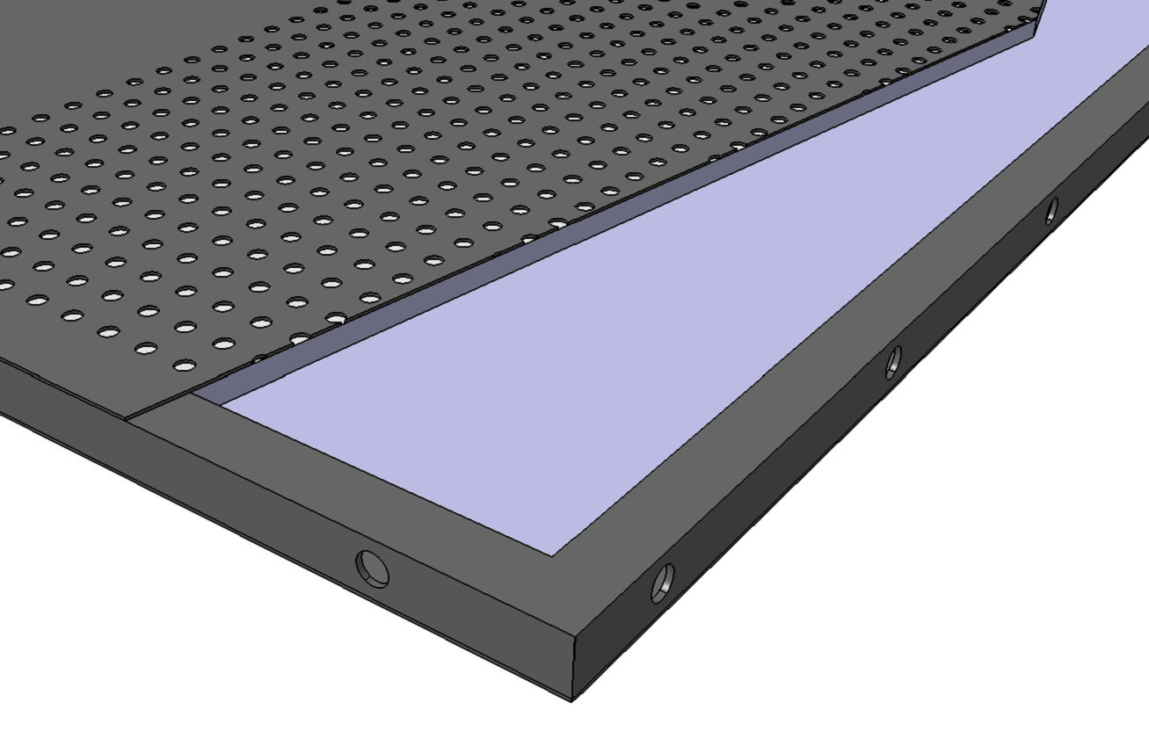
Super FGD Design & Envelope constraints
NIDA panel frame (to be seriously considered…)
Needed for screw inserts + load transmissions
AIREX core

Slide 17
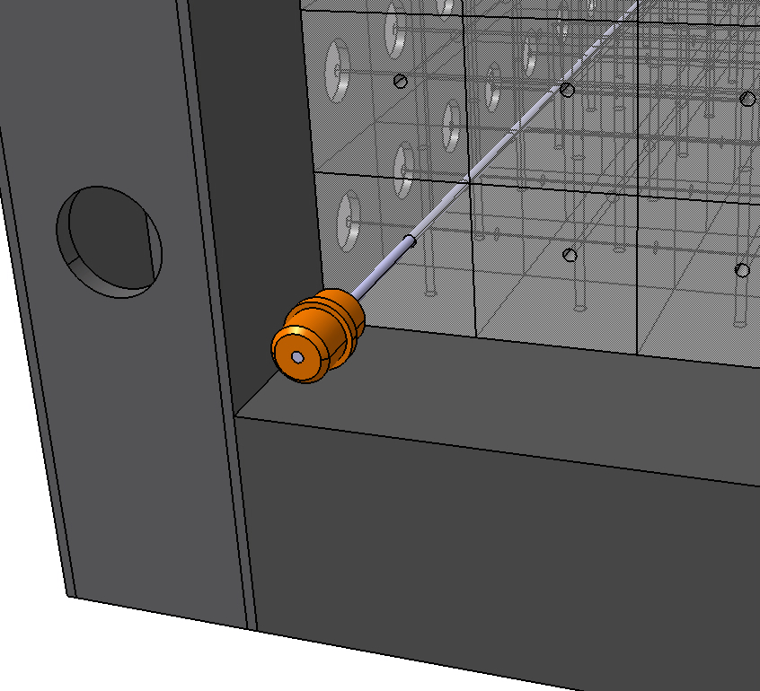
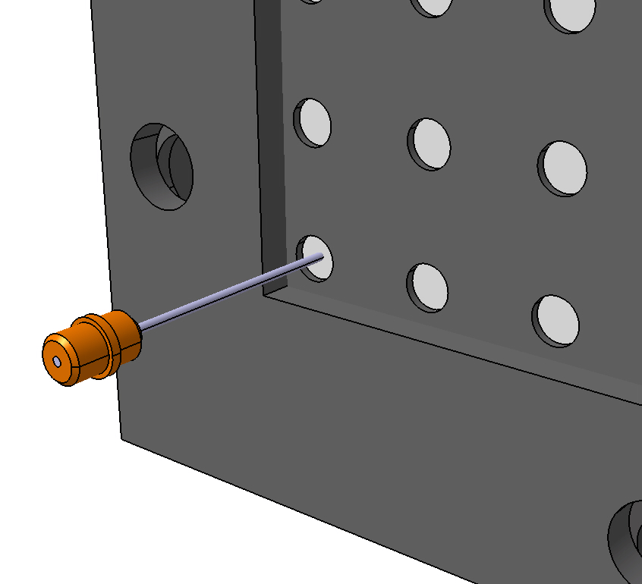
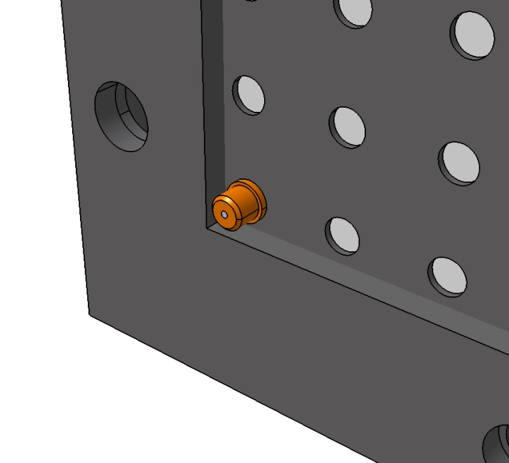
Super FGD Design & Envelope constraints
Only the male part is shown
Sci Fibre insertion and locking ..
Connector design to be optimized (fab + integration)
Clip system to connect the female part (incl. SiPM)… alla BabyMIND
Key issue: back PCB (micro coax cable connection)…
20mm is needed for female + PCB+ connector

