Slide 1
TPC Enplate upgrade
P. Colas
CEA Saclay Irfu/DPhP

Slide 2
A New endplate for the horizontal TPCs
New design – motivations and caveats
Charge spreading, DLC, results from LCTPC
Preliminary test for T2K ND280 upgrade

Slide 3
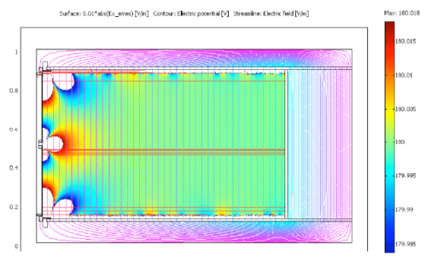
New design
The vertical TPCs are fine after 10 years : keep them operational.
Add 2 horizontal TPCs
Try a new configuration: ‘encapsulated resistive anode with grounded mesh’
  Charge spreading allows space point resolution improvement with less electronics channels
  The protection provided by the resistive foil allows lighter Font End Cards
  Less track distortions due to field homogeneity
  Less sensitive to noise
Caveats: dE/dx to be studied ; few mm dead area on edges might be necessary.

Slide 4
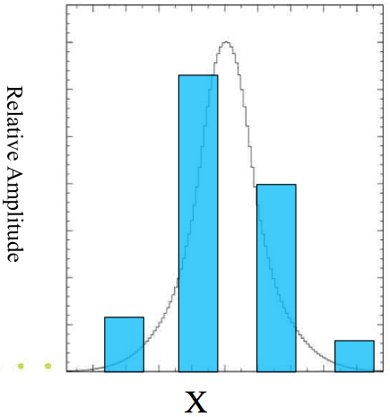
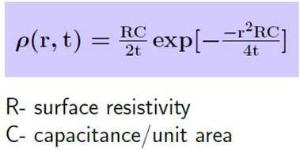
Charge spreading technique
Continuous RC network shares evenly the charge among several pads
mesh
~100μm Amplification gap:
E
B
resistive foil: ~75μm
insulator: ~100μm
pads
Gaussian spreading as a function of time with σ_{r} = sqrt(2t/RC)
t~shaping~few 100 ns
RC = 180 R(MΩ) /(d/175µ) ns/mm²

Slide 5
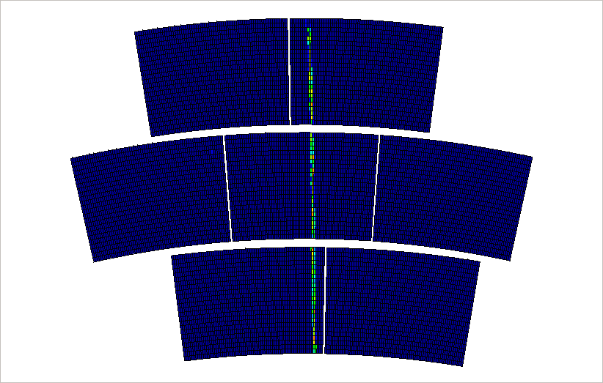
Real events from beam test at DESY (LC TPC R&D)

Slide 6
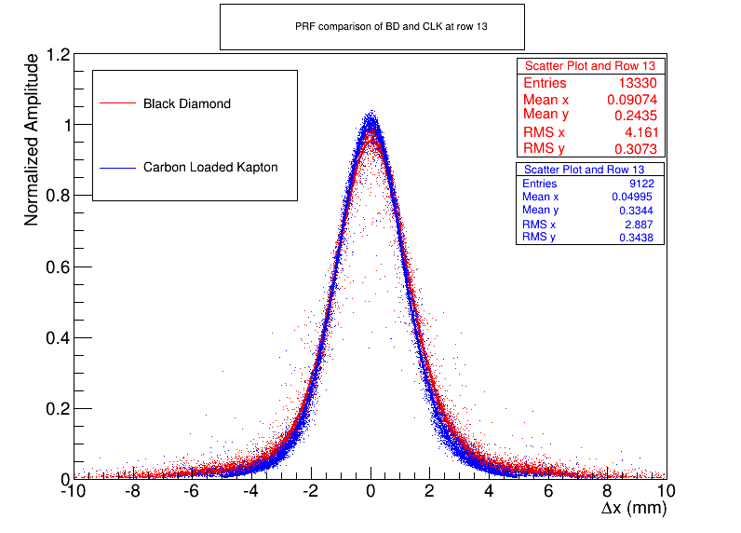
Pad Response function
Diamond-like Carbon
Carbon-loaded kapton

Slide 7
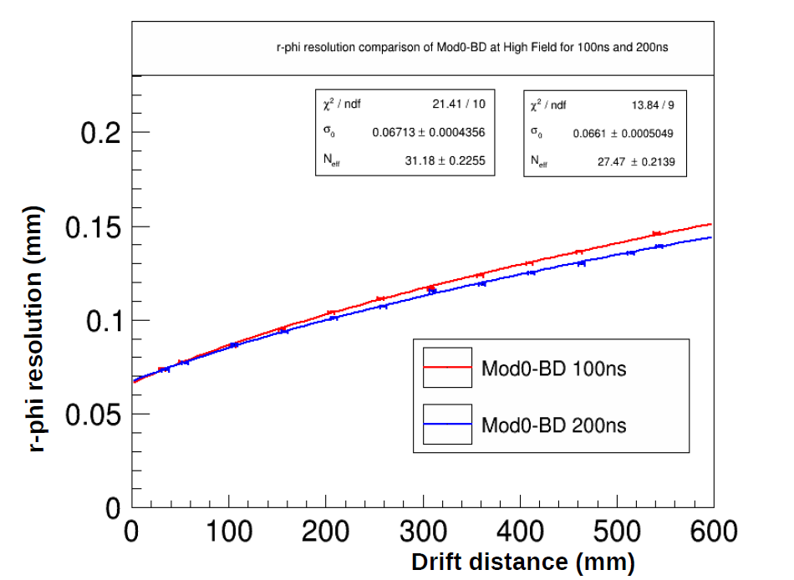
DLC : ‘Diamond-Like Carbon’

Slide 8
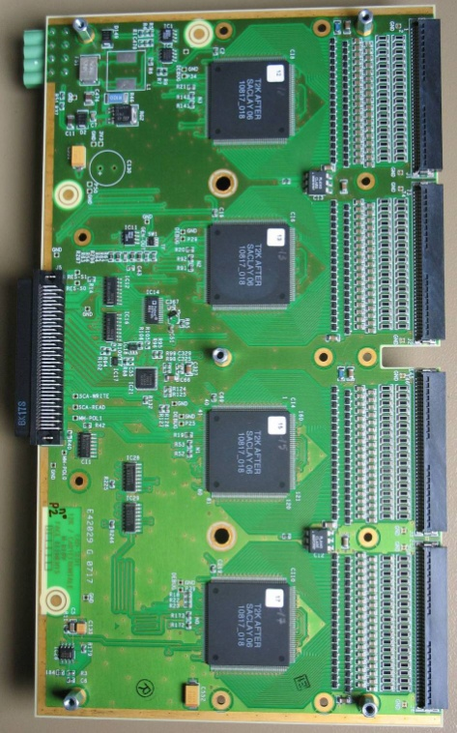
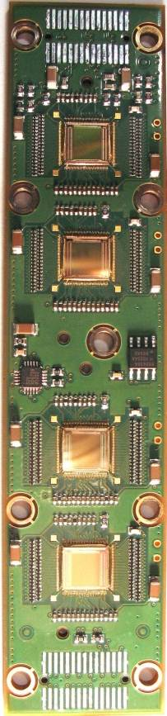
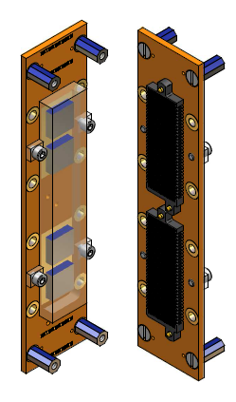
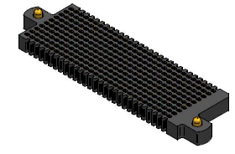
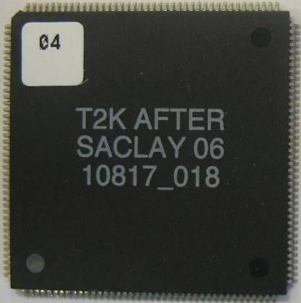
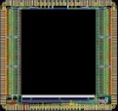
Integrated electronics for LC TPC prototype
Remove packaging and protection diodes
Wire –bond AFTER chips
Use 2 × 300 pins connector
FEC
25 cm
4,5 cm
12,5 cm
14 cm
3,5 cm
2,8 cm
3,5 cm
0,78 cm
Chip
0,74 cm
  The resistive foil protects against sparks

Slide 9
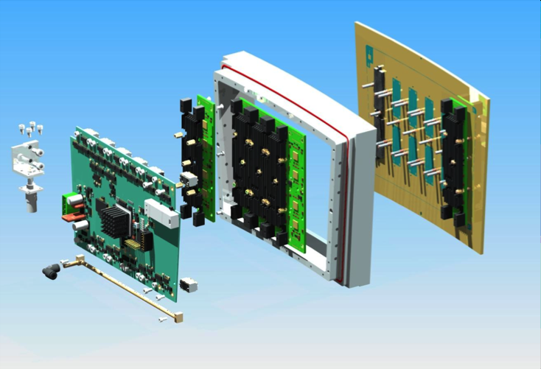
Experience from LC-TPC studies
17x21 cm² modules

Slide 10
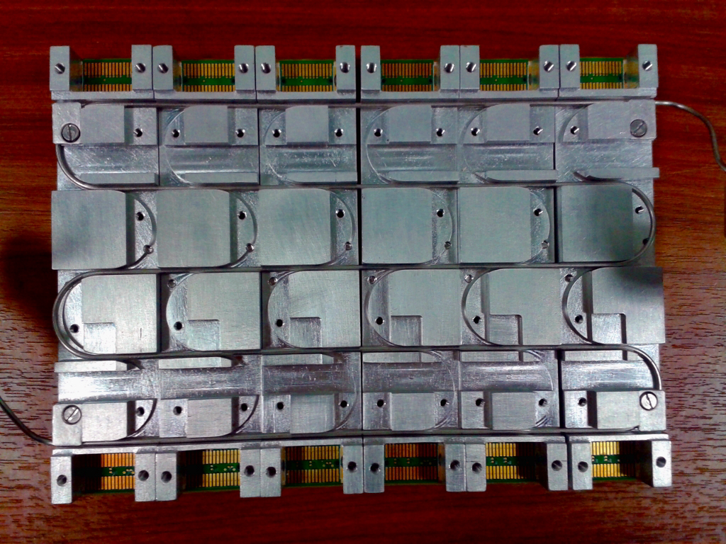
Cooling by 2-phase CO₂

Slide 11
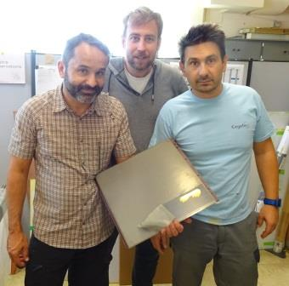
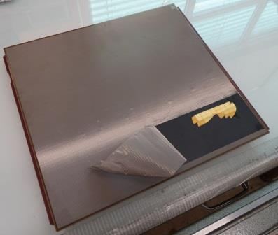
Test bench
For a proof-of-principle of charge spreading, use the T2K test bench.
Resistive anode never tested on a T2K module-size area (attempt in 2008)

Slide 12
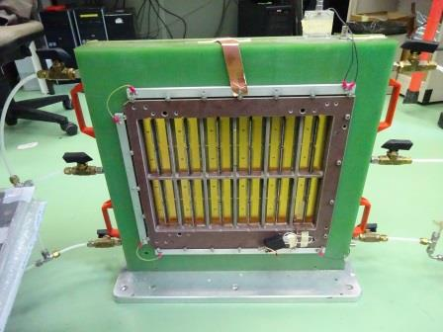
Test bench
Geneva U. testbox, moved to Saclay in July.
To be adapted to a sufficiently long drift to contain cosmics.

Slide 13
New detector
Grounded mesh encapsulating the detector
HV ring with vias
DLC-coated
kapton
PCB
Metal back-frame
PCB with
Readout pads

Slide 14
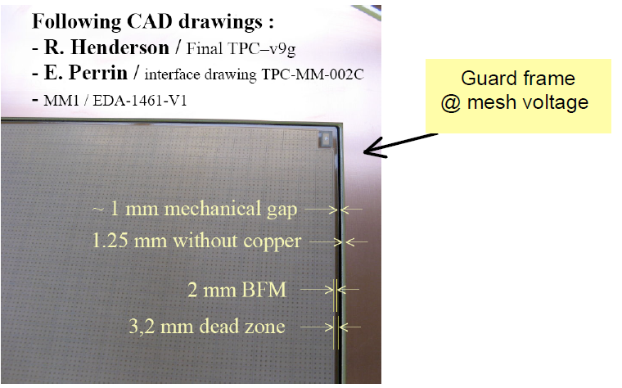
New detector – dead area
5 additional mm covered by insulator

Slide 15
Status of the Saclay cosmic-ray prototype
Drawings for the gasbox in progress (about 15 cm drift)
4 PCBs ordered (delivery planned Oct. 19)
2 will be bulked with DLC (mesh to ground, encapsulated DLC 2 MOhm/Sq on 50 µ Apical)
DLC sputtered on Apical end of August. Should be delivered second half of October
Selection of a readout electronics chain and of a cosmic trigger in progress
Hope to take the first cosmics this fall

Slide 16
New Stiffener (M. Riallot)

