Slide 1
Mechanics for front-end Electronics Of T2K-II TPCs
– A Few Conceptual Ideas
D. Calvet,
Irfu, CEA Saclay, 91191 Gif sur Yvette Cedex, FRANCE

Slide 2
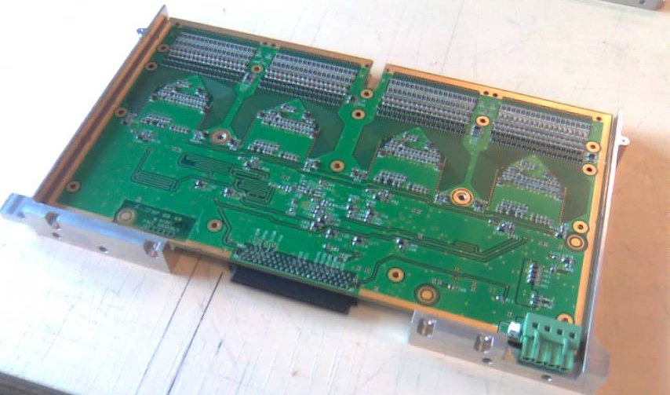
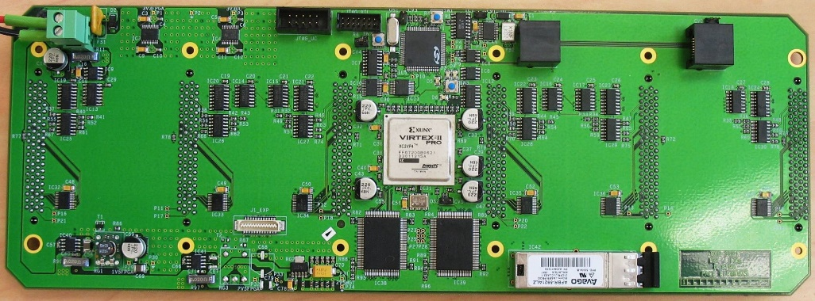
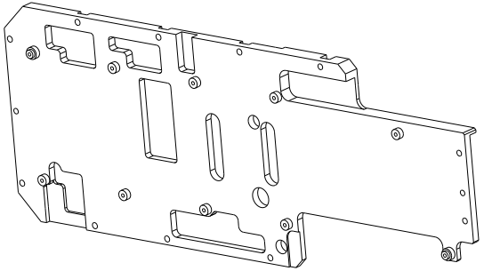
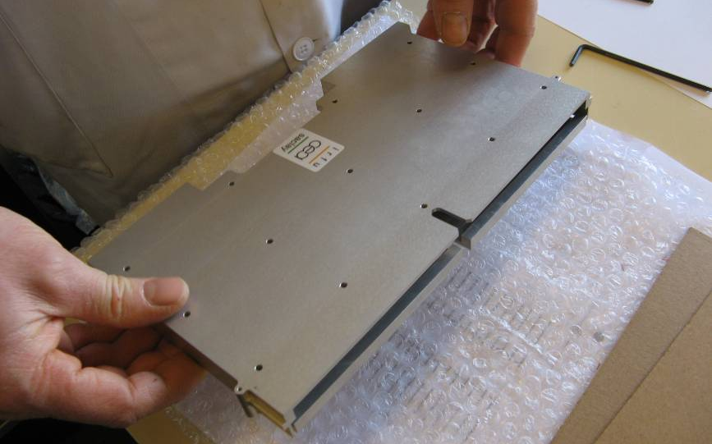


Mechanics Of Front-end Electronics on Existing T2K TPCs
Front-End Mezzanine Card and its carapace
Front-End Card and carapace
  Structure
  Shell structure for each FEC (2 pieces); 1 piece carapace for FEM + back-side shield (1 layer FR4 PCB)
  Thermal gap filler above major components, passive heat conduction

Slide 3
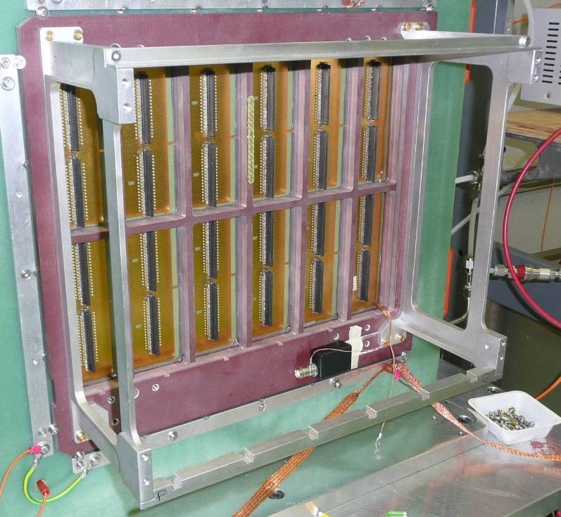
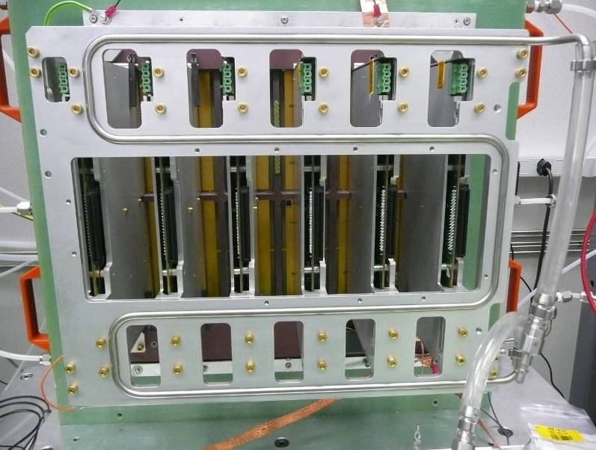
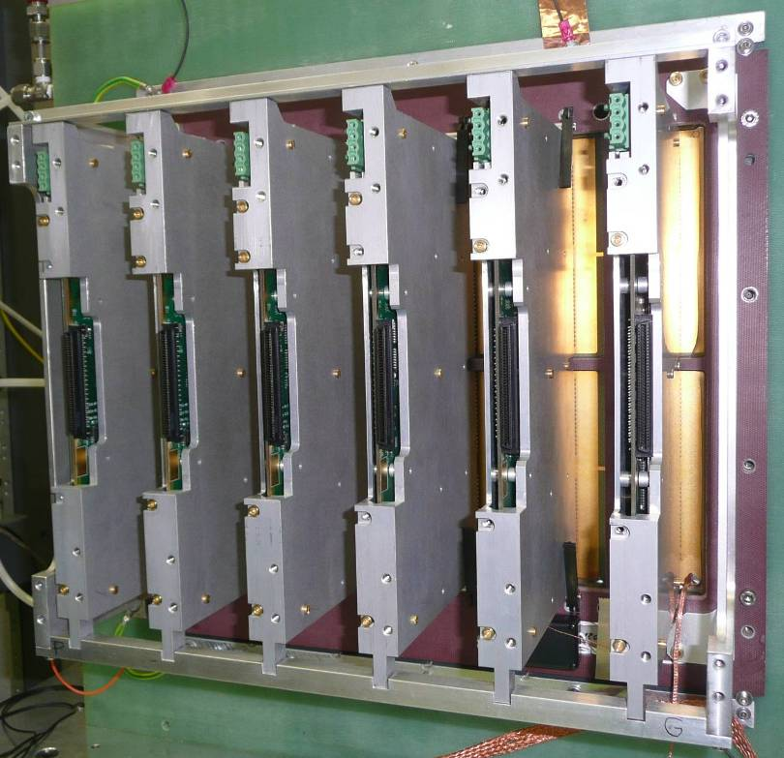
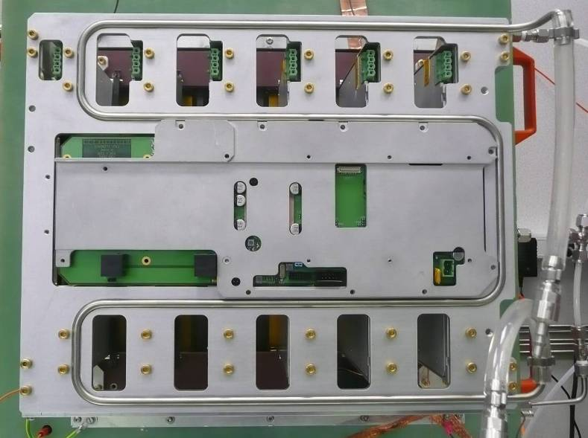
Mechanics Of Front-end Electronics on Existing T2K TPCs (cont)
Micromegas detector module
Front-End Cards with carapace
Fully assembled detector read-out module
Cooling plate with
Water circulation loop
Front-end electronics support structure
  Pros and Cons
  Robust and effective
  Heavy and expensive

Slide 4
T2K-II Front-end Electronics Volume Estimation
310 mm
~310 mm
250 mm
~250 mm
~70 mm
170 mm
FEC orthogonal to detector
(size identical to that of the current system)
FEC parallel to detector
(if possible)
  Comments
  Dimensions of electronic boards only, excluding cooling plates and mechanics
  FECs may be mounted // to detector only if protection circuits can be removed, i.e. resistive Micromegas
  First dimension estimate. Should be refined by detailed studies

Slide 5
Front-end Electronics Power Budget
Item | Phase I (existing) | Phase II (projected)
Pads per Micromegas Module | 1728 | 1152
FEC / FEM per Micromegas M. | 6 (288-channels) / 1 | 2 (576-channels) / 1
Power per FEC | 5 V * 1 A = 5 W | 4 V * 2 A = 8 W
Power per FEM | 5 V * 1 A = 5 W | 4 V * 1 A = 4 W
Power per Micromegas M. | 35 W | 20 W
Module per TPC end-plate | 12 | 8
Power per TPC end-plate | 420 W | 160 W
Number of TPC end-plates | 6 | 4
Total power dissipation | 2520 W | 640 W
  Comments
  Power reduction by: 1) less pads per module 2) less modules and end-plates 3) lower supply voltage
  Water cooling remains necessary because electronics placed in confined space

Slide 6
Towards Mechanics for T2K-II Front-end Electronics
  Constraints
  Volume needed for electronics strongly influenced by detector technology (resistive vs. metallic) because card orientation will change
  Need to be able to access TPC electronics in the simplest possible way for system maintenance
  Should not require crane to access electronics (needed to take TPC end-plate cover on existing TPCs)
  Principles
  Mechanical structure needed to hold the cards; card connectors only cannot support card weight
  Mechanics needed for each board to provide electromagnetic shielding, dust/shock protection and cooling
  May only be placed on the top side, rear side could use a simple screen (already done like this on FEM)
  Passive conduction to bring heat extracted from the cards to a module cooling plate with water circulation
  Experience return guides new objectives
  Do not use small diameter brass screws (too fragile, hard to remove when head is damaged)
  Simplify mechanics to reduce design time, manufacturing cost and weight

