Slide 1

Protected aperture in HL-LHC
R. Bruce, S. Redaelli
Acknowledgement: C. Bracco, R. De Maria, A. Lechner
2017.09.26
Notes:
2153

Slide 2
Introduction
Continuous effort to improve collimation hierarchy and hence reach in β*
  Tighter collimators => smaller protected normalized aperture => smaller β* allowed
  Main limitation in the LHC was in Run I and 2015 the risk of damaging tertiary collimators / triplets during asynchronous beam dumps

Slide 3
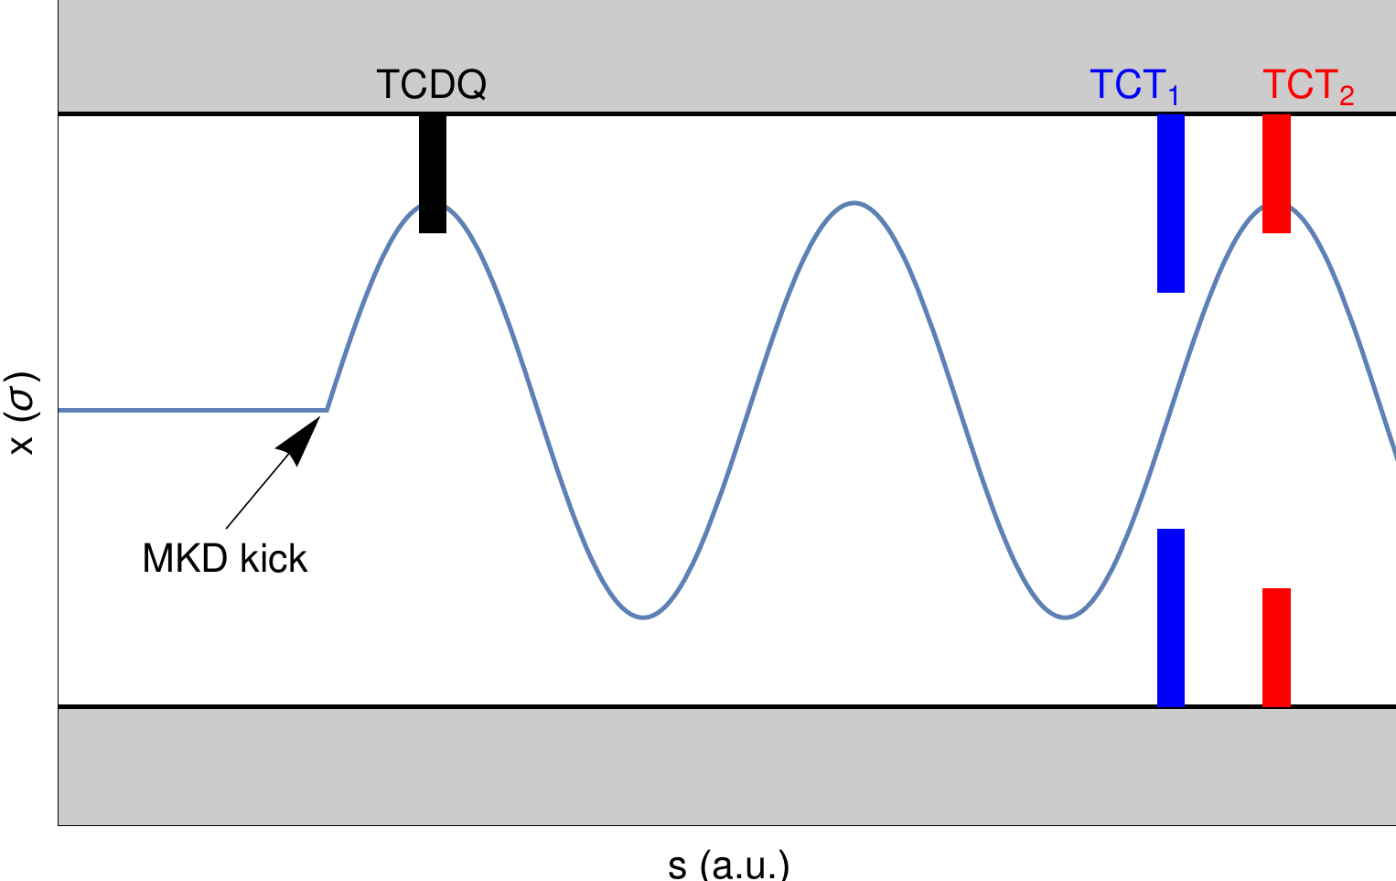
Introduction
Significant improvement in β*-reach in the LHC in 2016 / 2017
  matched phase advance between MKD-TCT
  Removes risk of TCTs being hit and damaged by primary impacts during asynchronous beam dumps
Nuclear Instruments and Methods in Physics Research A 848 (2017) 19–30

Slide 4
Application to HL-LHC?
Can we profit of this experience to improve the β*-reach in the HL-LHC?
  Possibilities discussed previously: R. De Maria in WP2 meeting 1/11/2016, R. Bruce in ColUSM 11/11/2016, R. Bruce at Chamonix 26/1/2017
  Published CERN report CERN-ACC-2017-0051
  In new version optics HL-LHC v1.3: MKD-TCT phase significantly improved
  Today: status of protected aperture in HL-LHC for different phase advance

Slide 5
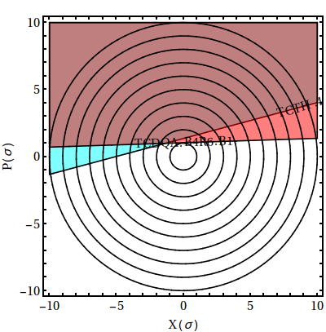
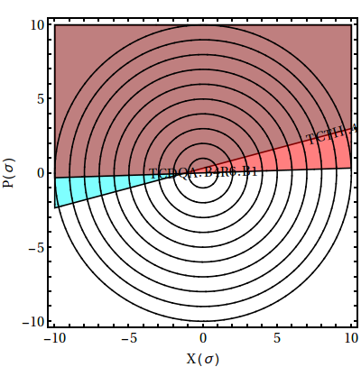
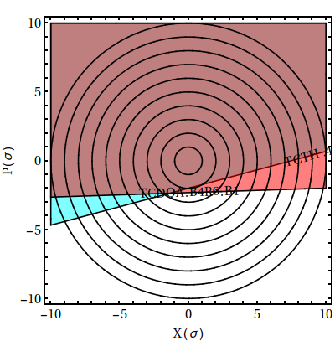
Studies of TCT losses during asynch dump
As for LHC, use phase-space integration to estimate losses on TCTs for each bunch during dump failure (type 2 single-module pre-fire – worst case).
  Integrate beam distribution over phase space area caught by studies bottleneck
  Fast study which does not require full optics for every studied case
  Disadvantage: does not treat secondary impacts.

Slide 6
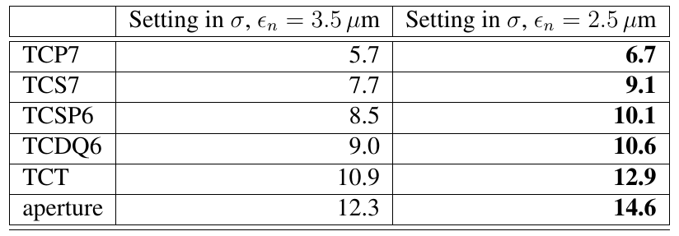
HL-LHC collimator settings, v1.2
  Present baseline: TCSP is at 10.1 σ, TCDQ at 10.6 σ, but likely that TCDQ can be tightened to 10.1 σ (2.5 um emittance)
  We don’t think we can move in TCDQ further due to robustness constraints (C. Bracco, A. Lechner)
    Decreasing margin TCP-TCSG doesn’t bring a gain at the moment
  As function of MKD-TCT phase, study how TCT and aperture can be tightened

Slide 7
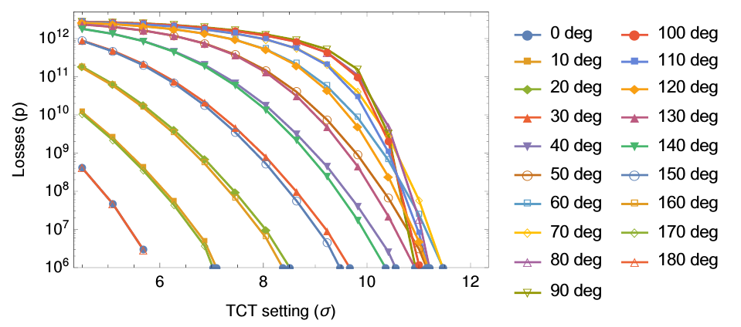
TCT losses vs phase and setting
Parametric study over phase and TCT opening, keeping the protection device (TCSP/TCDQ) fixed at 10.1 σ, normalized to 2.2e11 p/bunch
Next step: find intersection with damage limit for each phase and relate to setting
Using previously calculated limit of plastic deformation (5e9 protons, E. Quaranta et al. PRSTAB 20, 091002 2017) with additional factor 2 safety margin
  Further margin: Plastic deformation should not require exchange of collimator – can use 5th axis

Slide 8
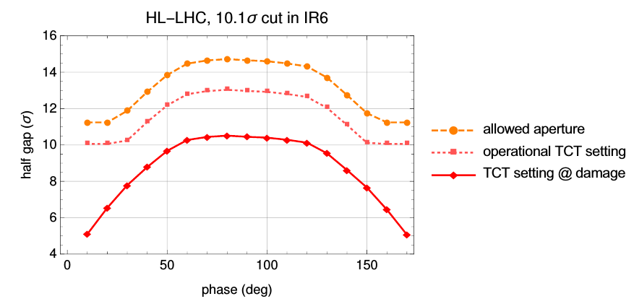
Allowed TCT setting and aperture in operation
TCT must operate sufficiently far outside the setting @ damage
Calculate operational setting and allowed aperture with methods used for LHC (PRSTAB 18, 061001 (2015)) accounting for orbit, β-beat, setup error etc.
Note: aperture from asynch dump only. Cleaning limits anyway to around 10.1 sigma
Worst case: aperture=14.6 σ
Best case: aperture=11.2 σ below 20 deg.
Note: 2.5 um emittance

Slide 9
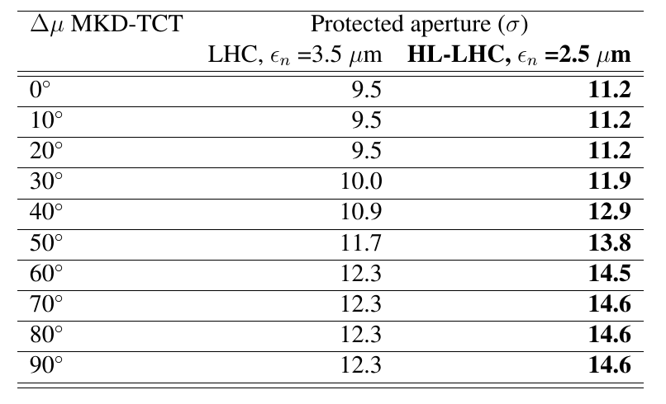
Protected aperture vs MKD-TCT phase

Slide 10
Phase advance in HL-LHC v1.3
optics | TCT6 IR1 B1 | TCT6 IR5 B1 | TCT6 IR1 B2 | TCT6 IR5 B2
HL-LHC v1.2 15 cm | 106 | 285 | 137 | 101
HL-LHC v1.3 15 cm | 180 | 155 | 154 | 152
For HL-LHC v1.2 optics: aperture should be above 14.6 σ.
For HL-LHC v1.3 optics: aperture should be above 11.9 σ.

Slide 11
Proposed new collimation hierarchy for v1.3
Collimator | Setting (LHC – 3.5 μm) | Setting (HL – 2.5 μm)
TCP7 | 5.7 | 6.7
TCS7 | 7.7 | 9.1
TCSP6 | 8.5 | 10.1
TCDQ6 | 8.5 | 10.1
TCT IR1/5 | 8.8 | 10.4
Aperture IR1/5 | 10.0 | 11.9

Slide 12
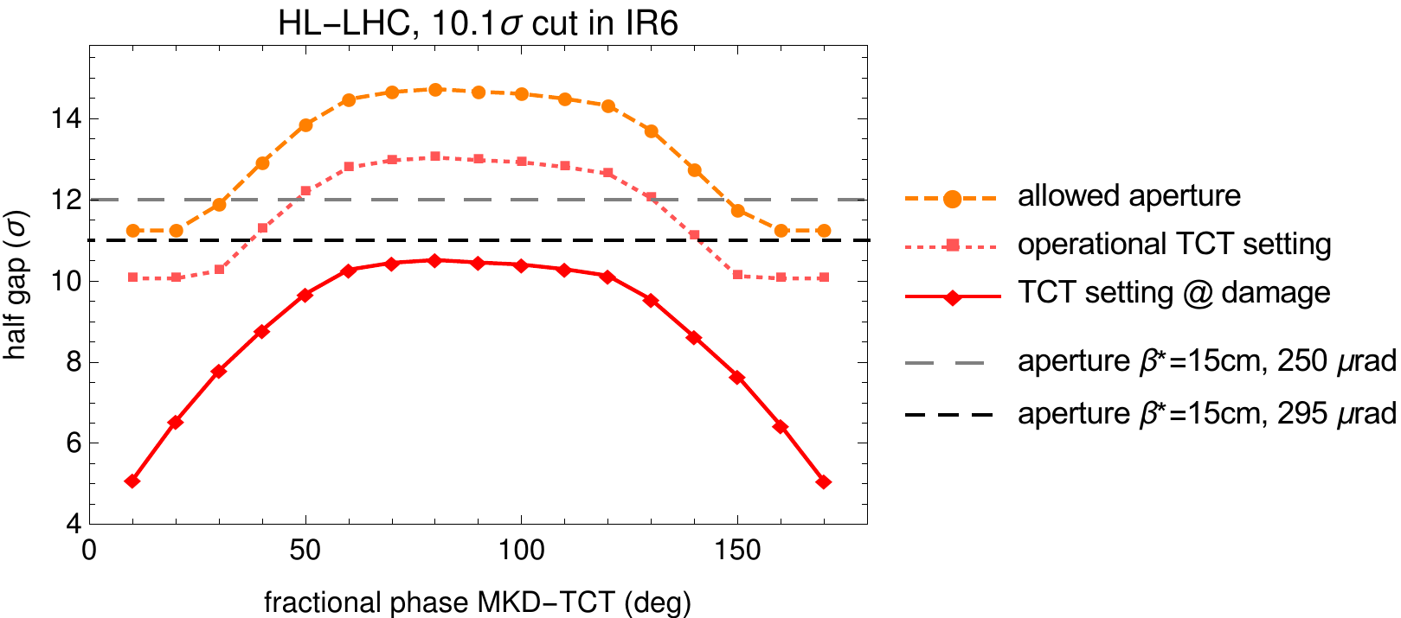
Translate aperture in β*-reach
Below 20 deg phase advance, we can almost recover 15 cm and 295 urad
For 30 deg phase, reach in β* is between 16 cm and 17 cm
Need to also decrease crossing angle to recover
At 30 deg: 250 urad (10.6 σ BB separation) gives enough aperture for β* =15 cm
Assuming 2.5 μm emittance
Aperture parameters from CERN-ACC-2017-0051

Slide 13
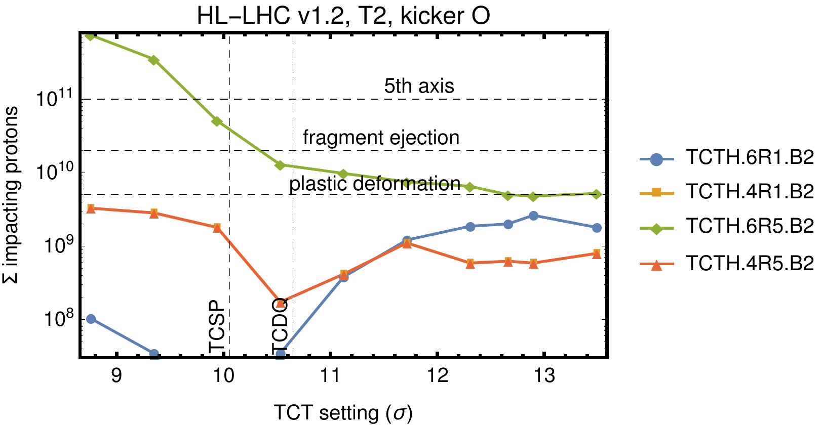
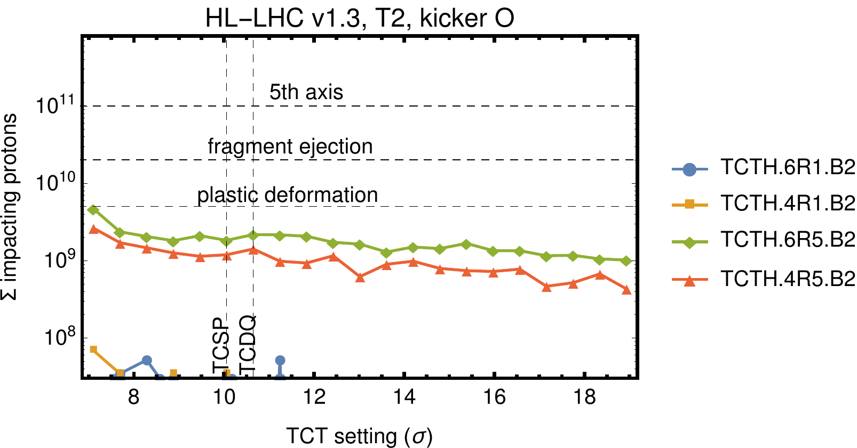
TCT asynch dump losses from SixTrack
Simulating type 2 single-module pre-fire with SixTrack
  Full magnetic tracking with collimation system in place
  Method described in NIM A 848 (2017) 19–30
As expected, only secondary impacts on TCTs over studied range of settings in HL-LHC v1.3

Slide 14
Conclusions
One main limitation for protected aperture and β* has been risk of damage on TCTs and triplets during asynch dumps
Studied how limitation varies as function of MKD-TCT phase
In HL-LHC v1.3, mitigated with good phase advance MKD-TCT as in LHC
Protected aperture for HL-LHC v1.3 is estimated at 11.9 σ
β*=15 cm can be recovered in this optics if 250 μrad crossing is used

