Slide 1


Update on heat load estimates
P. Dijkstal, G. Iadarola and G. Skripka
Thanks to: G. Arduini, R. De Maria, L. Mether, E. Metral, G. Rumolo
HLLHC-WP2 Meeting, 3 October 2017

Slide 2
Overview
The goal is to have a complete survey of the beam-induced heat loads on all beam screens including the effect of impedance, synchrotron radiation and e-cloud effects
Present status
Machine part | Status
IR twin bore magnets | Estimates were made and documented in CERN-ACC-2016-0112
Inner triplets the four experimental IRs | Estimates were made and documented in a report presently being circulated (present version here)
Arcs | In progress (see next slides), to be completed and documented…

Slide 3
Update on heat loads in the inner triplets
(for previous work see presentation given on 29 June)
Simulations for the corrector package

Slide 4
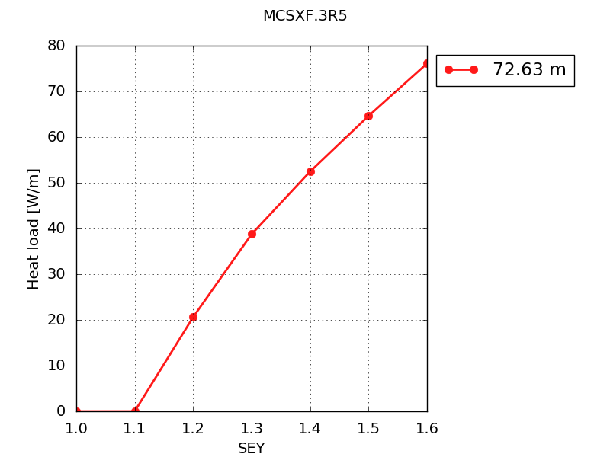
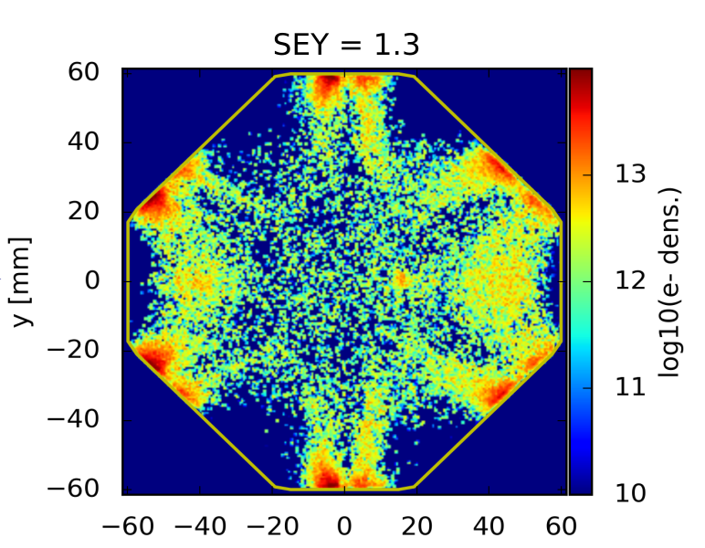
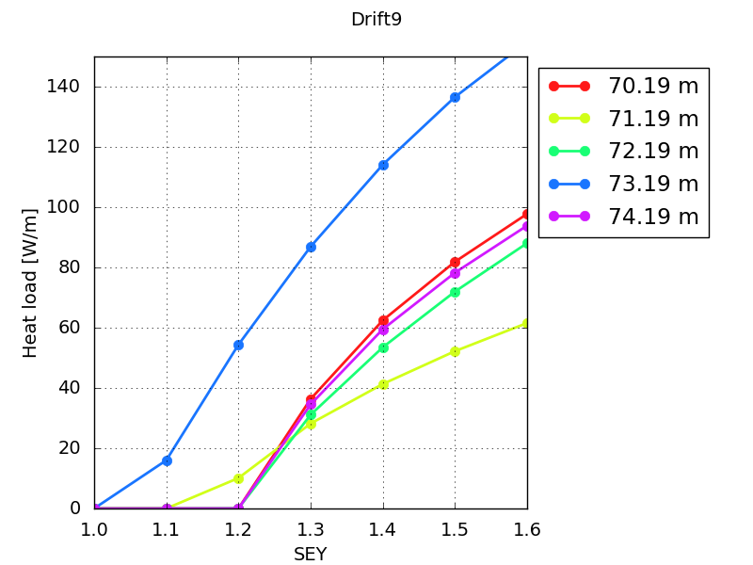
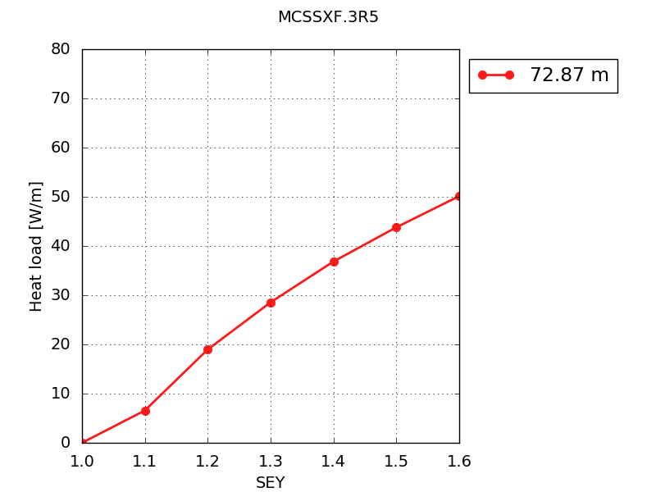
Update on the triplets – corrector package
No significant heat load expected with the coating in place (SEY<1.1)
Compared to the corresponding drifts:
  Multipoles have slightly lower threshold
  Multipoles show lower heat loads above threshold

Slide 5
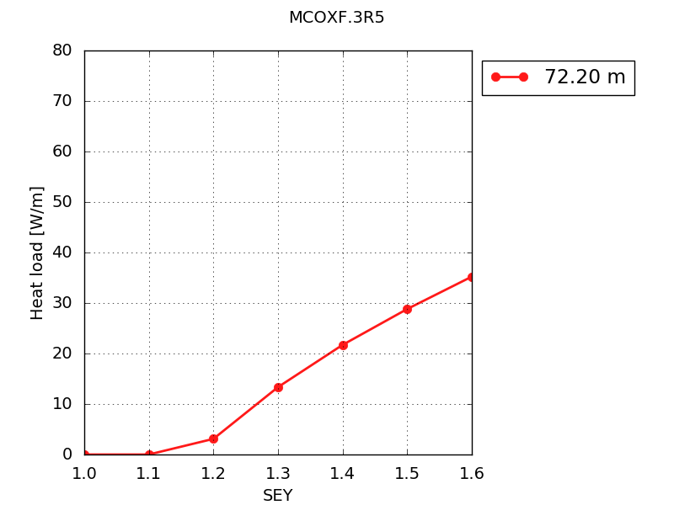
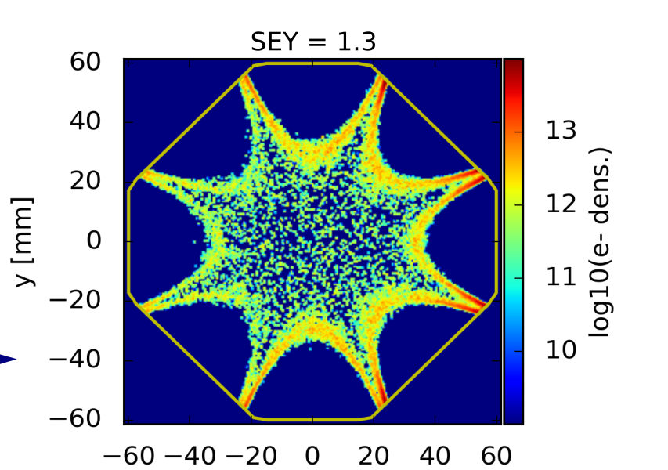
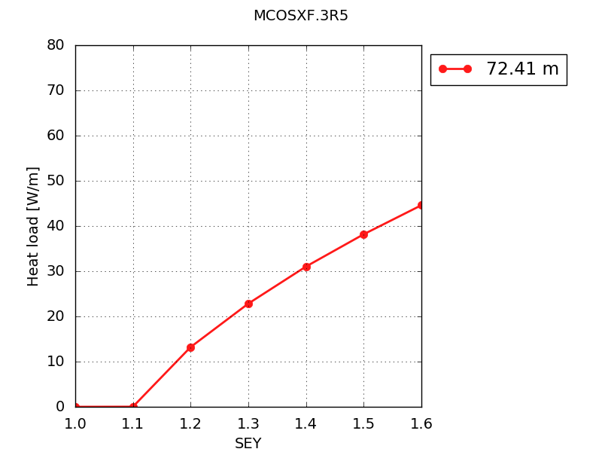
Update on the triplets – corrector package
No significant heat load expected with the coating in place (SEY<1.1)
Compared to the corresponding drifts:
  Multipoles have slightly lower threshold
  Multipoles show lower heat loads above threshold

Slide 6
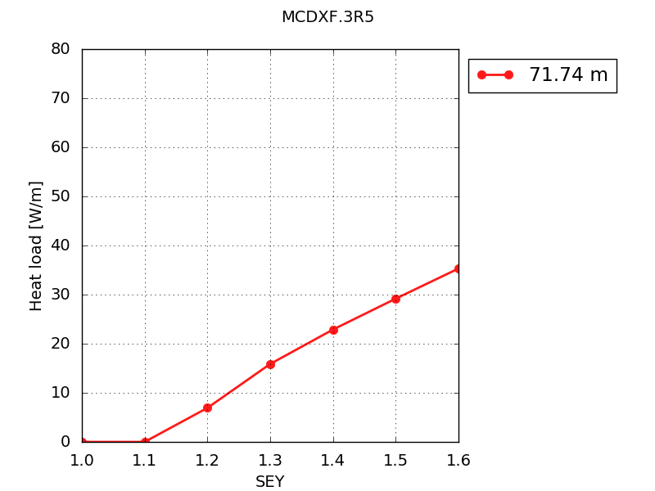
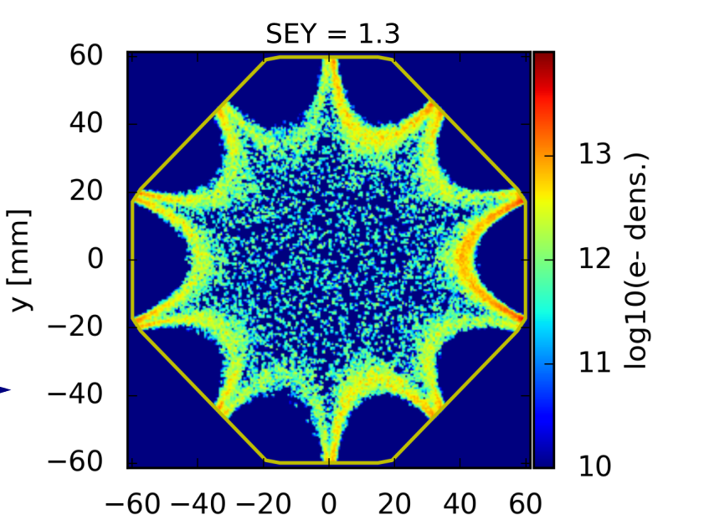

Update on the triplets – corrector package
No significant heat load expected with the coating in place (SEY<1.1)
Compared to the corresponding drifts:
  Multipoles have slightly lower threshold
  Multipoles show lower heat loads above threshold

Slide 7
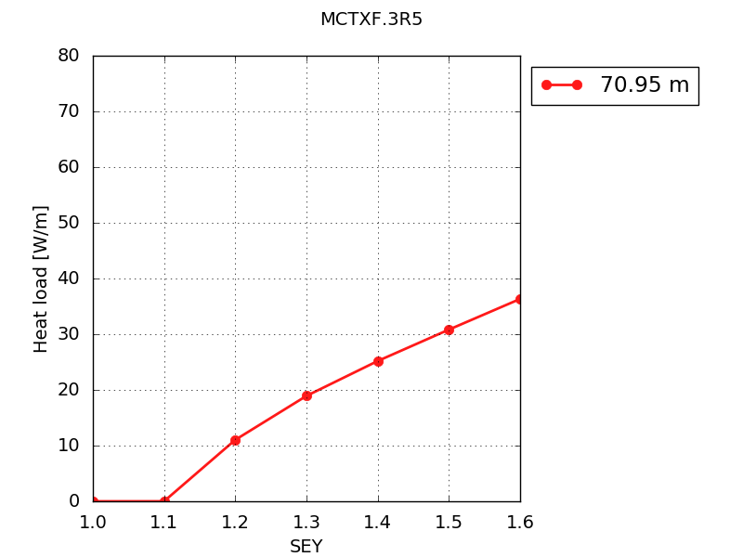
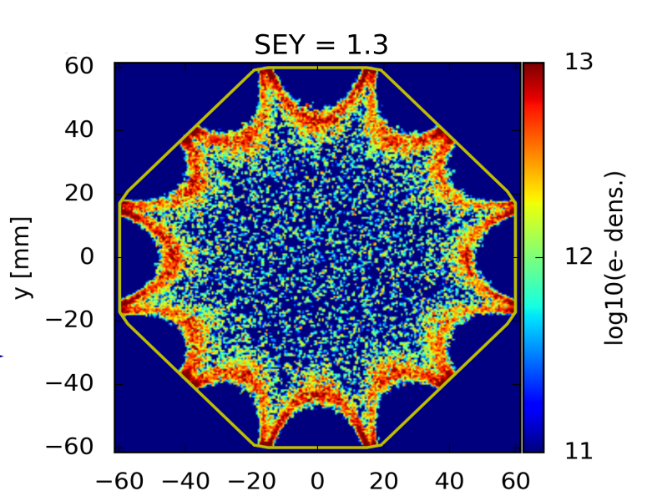
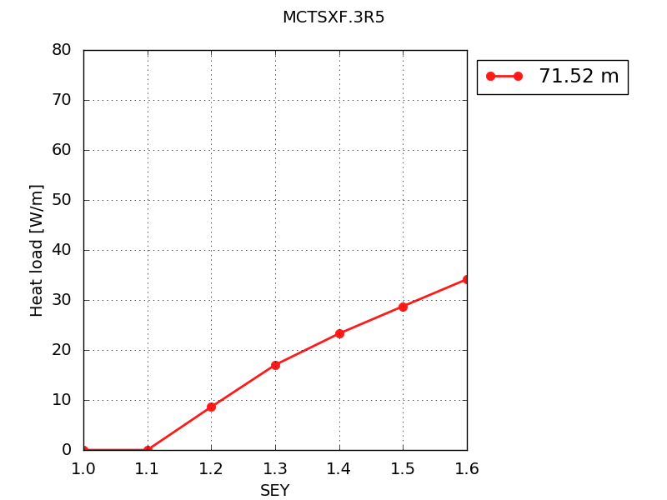
Update on the triplets – corrector package
No significant heat load expected with the coating in place (SEY<1.1)
Compared to the corresponding drifts:
  Multipoles have slightly lower threshold
  Multipoles show lower heat loads above threshold

Slide 8
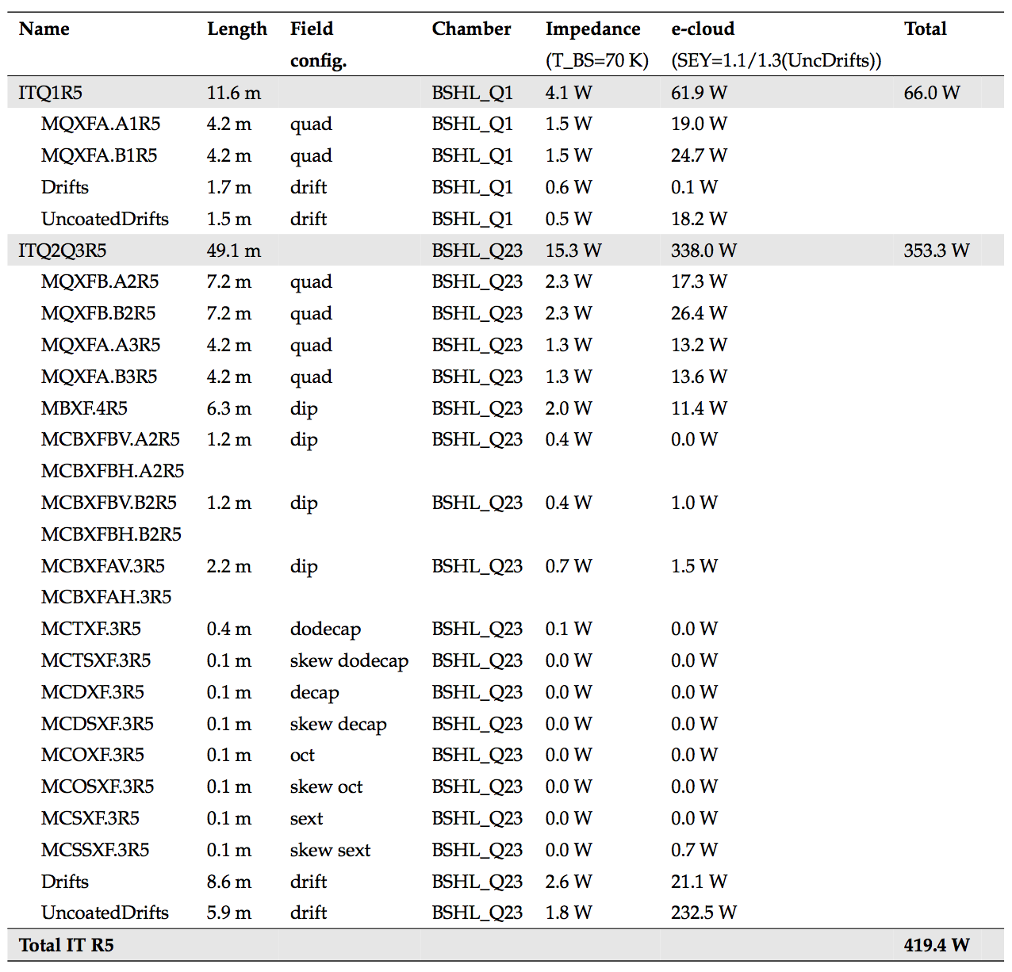
Update on the triplets: heat load tables
Triplets in IR1&5
Changes w.r.t. presentation given on 29 June:
Included corrector package
New nominal bunch length (9 cm)
Effect on the total smaller than 10%
See also G. Skripka and G. Iadarola, “Beam-induced heat loads on the beam screens of the inner triplets for the HL-LHC”, to be published, draft available here

Slide 9
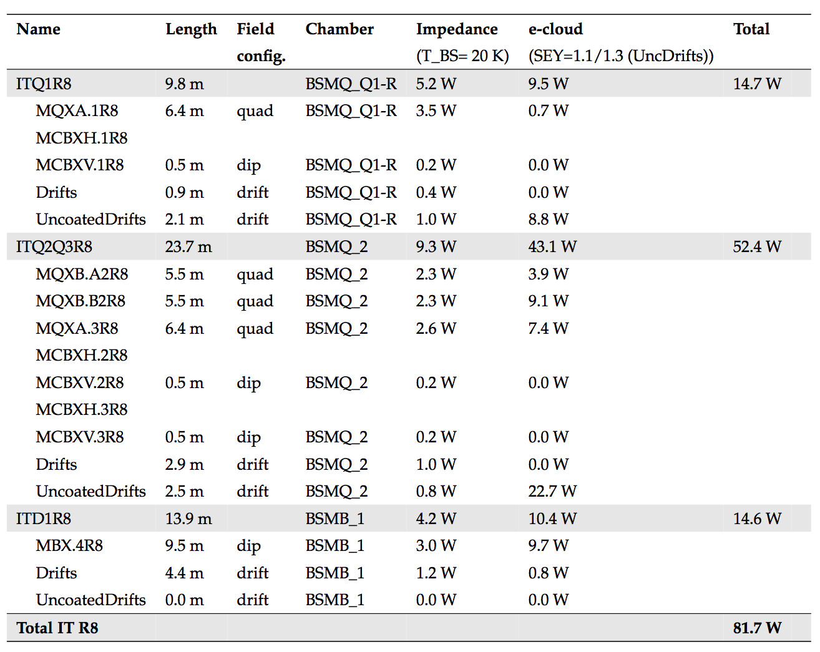
Update on the triplets: heat load tables
Triplets in IR2&8
Changes w.r.t. presentation given on 29 June:
New nominal bunch length (9 cm)
Effect on the total smaller than 10%
See also G. Skripka and G. Iadarola, “Beam-induced heat loads on the beam screens of the inner triplets for the HL-LHC”, to be published, draft available here

Slide 10
Heat load on the arc beam screen:
Status of ongoing work

Slide 11
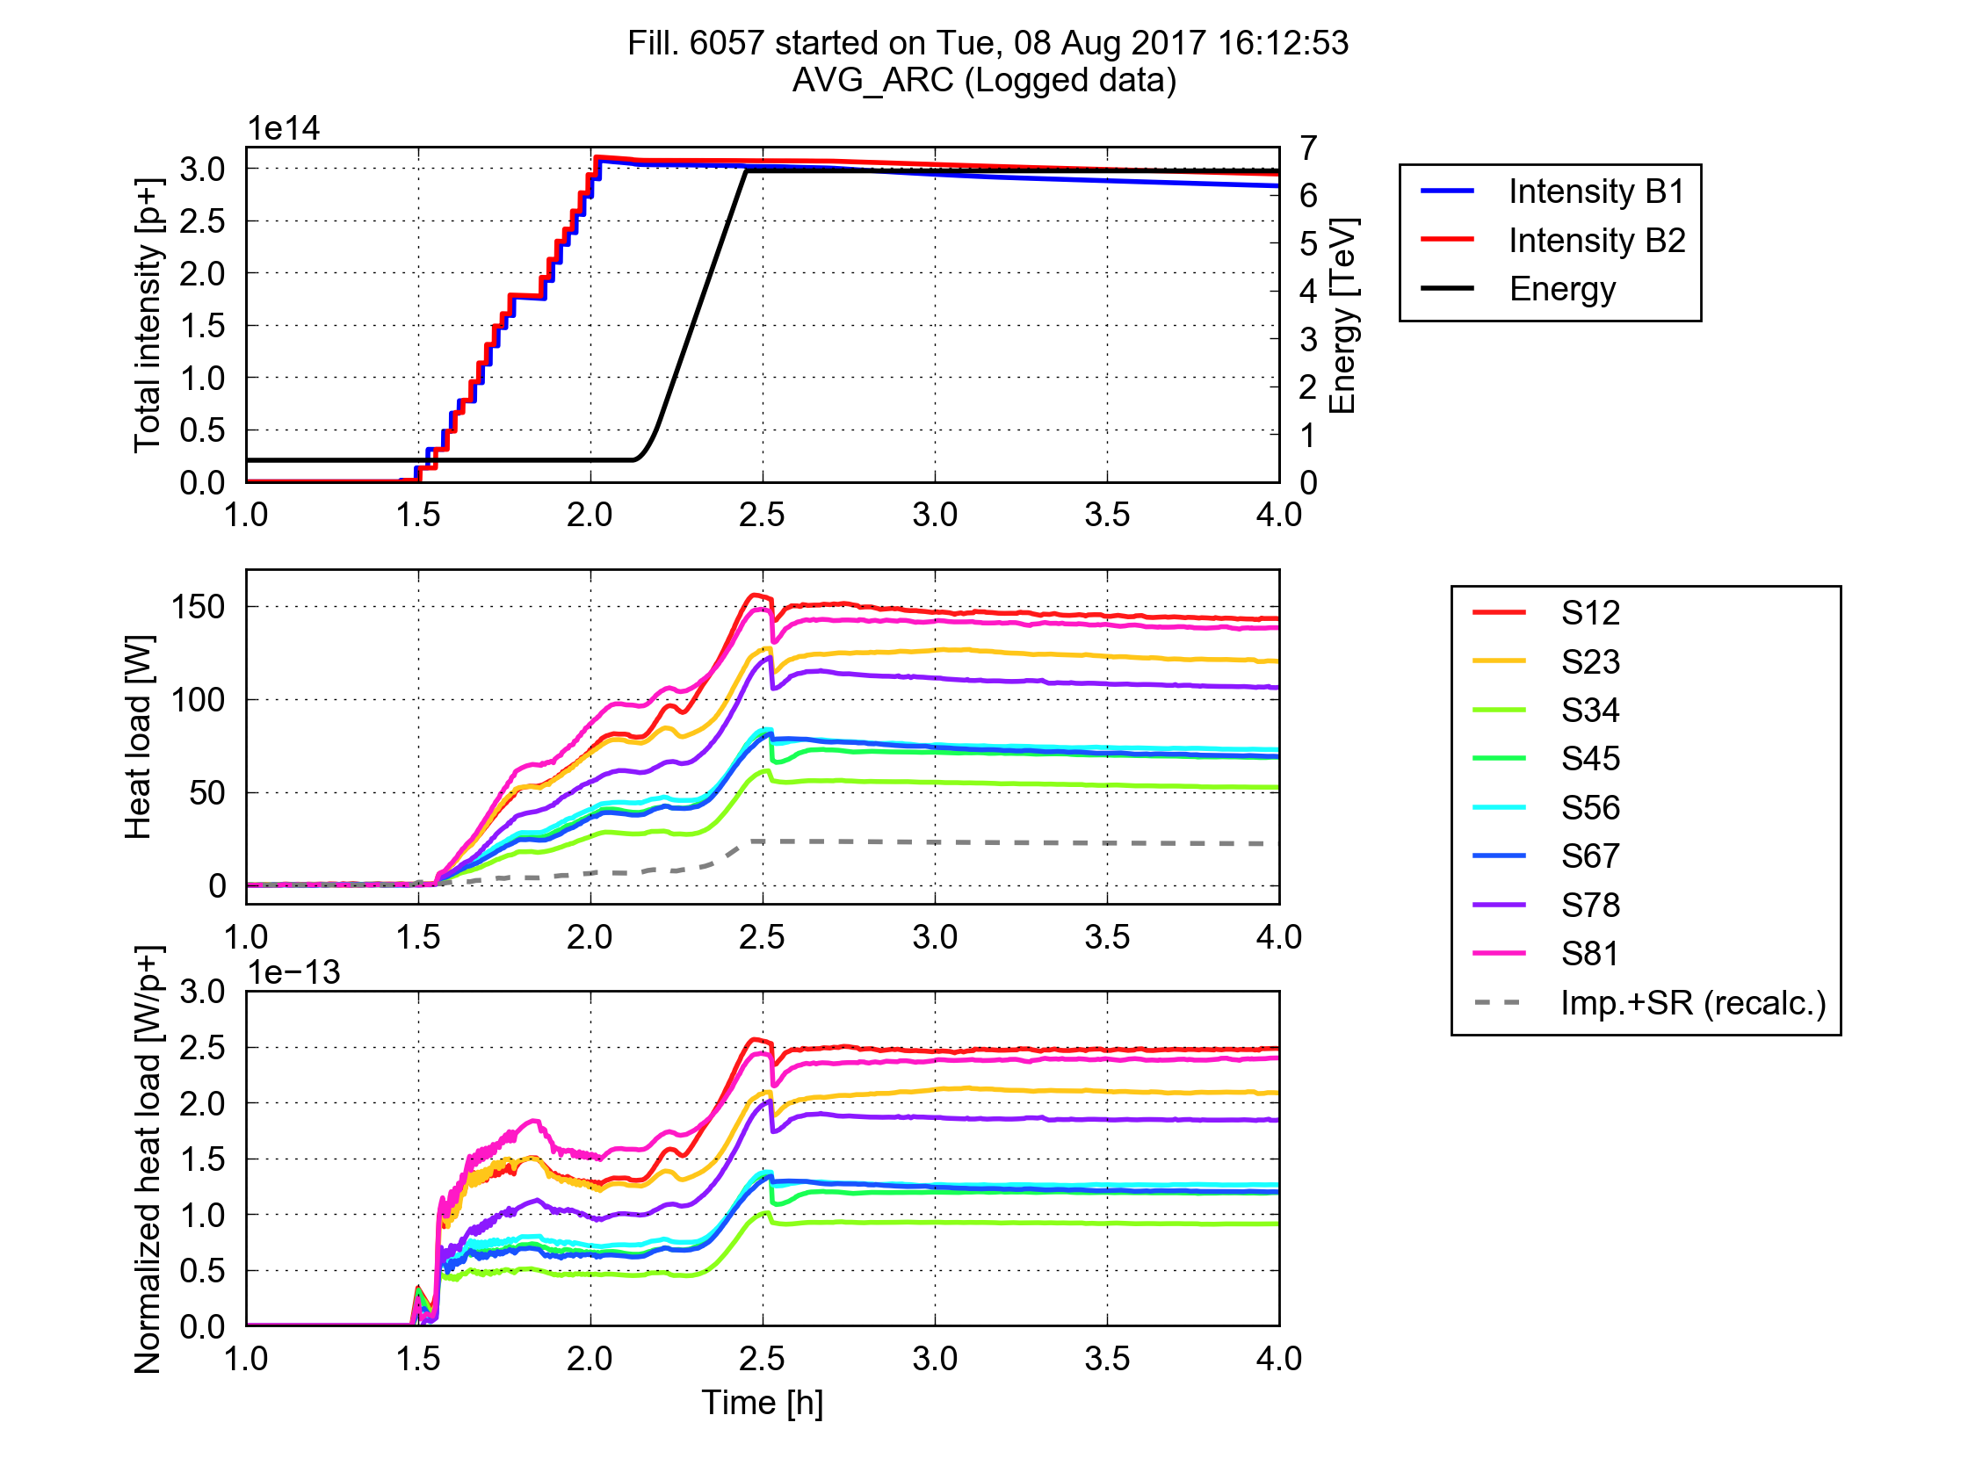
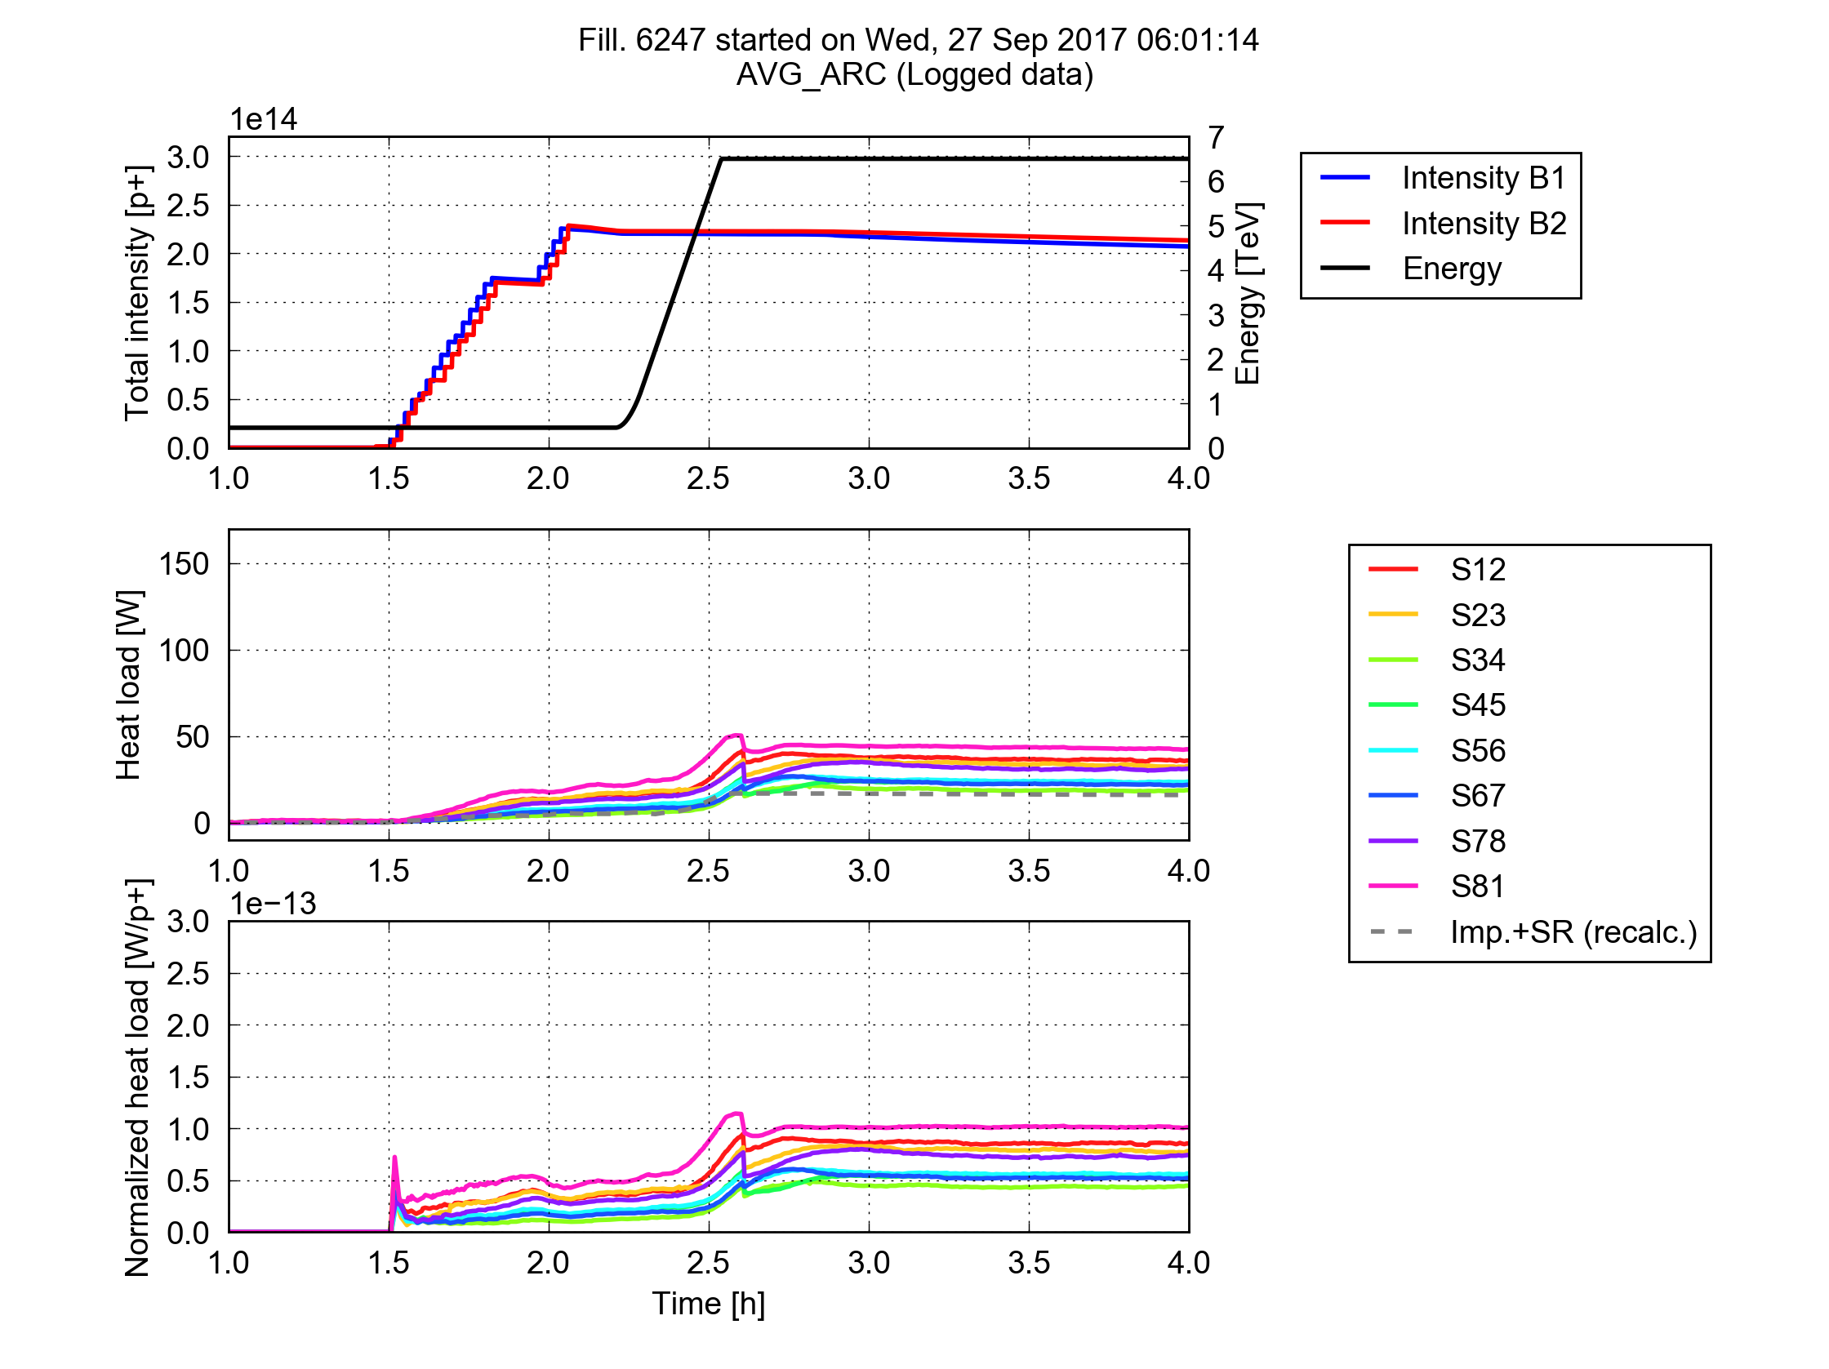
Arc heat loads – 2017 status
25 ns (2556b)
8b+4e (1916b)

Slide 12
Arc heat loads – the model
  Estimates are more delicate than for IRs due to the important role of photoelectrons generated by the beam synchrotron radiation
  Decided to focus on the present LHC at first to develop a solid model (to be then applied for HL-LHC predictions):
  Performed literature review to identify the best available knowledge on photoelectron yield for the LHC beam screens (correctly handling the effect of the saw-tooth)
  Defined the correct “recipe” to model the effect of photoelectrons from synchrotron radiation (implemented in a python tool):
  Evaluate the photon spectrum for an arbitrary energy
  Compute the number of “direct” and reflected photoelectrons
  Translate the information into the input parameters required by PyECLOUD
Details in P. Dijkstal et al., “Simulation studies on the electron cloud build-up in the elements of the LHC Arcs at 6.5 TeV”, to be published, draft available here

Slide 13
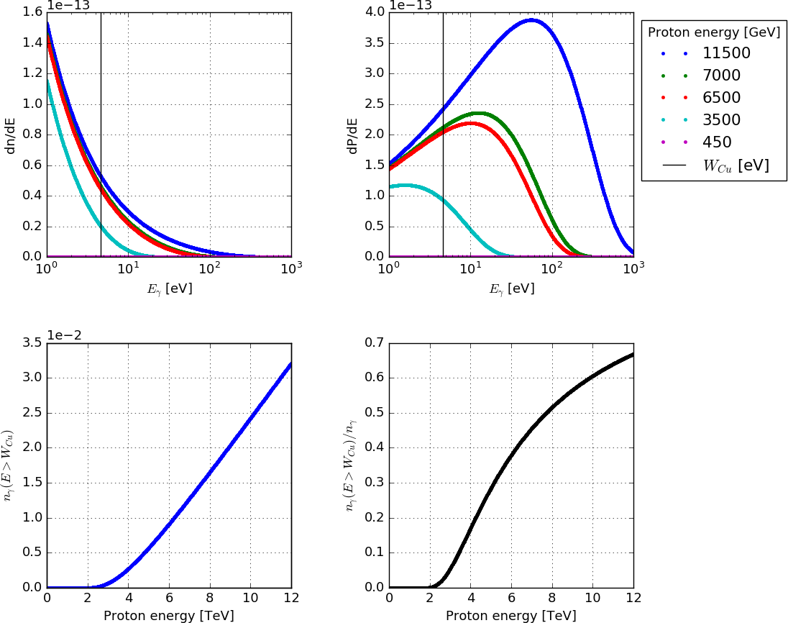
Arc heat loads – the model
  Synchrotron radiation spectra
  Number of photons above the Copper Work Function
Details in P. Dijkstal et al., “Simulation studies on the electron cloud build-up in the elements of the LHC Arcs at 6.5 TeV”, to be published, draft available here

Slide 14
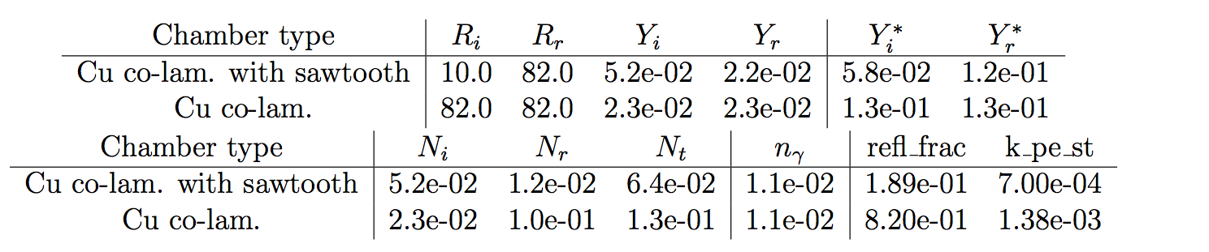
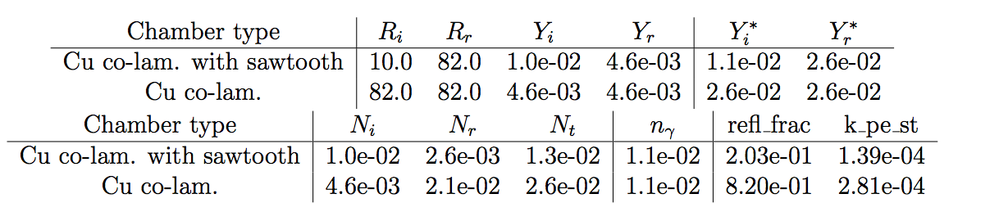
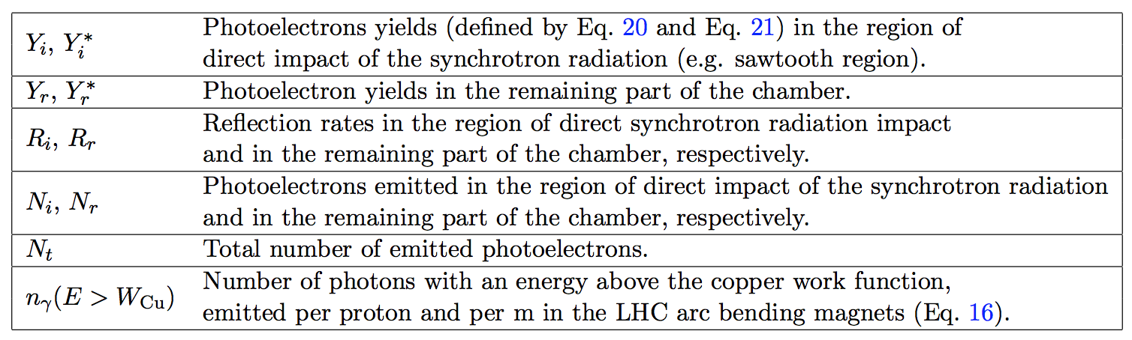
Arc heat loads – the model
  Estimates on the number of photons has to be combined with information photoelectron yield and reflectivity from lab measurements
    Need to take into account the presence of the sawtooth
  Available measurements show significant differences → Decided to compare two sets of parameters:
  “Conservative”
  “Optimistic”
  (also accounting for photon conditioning)
Details in P. Dijkstal et al., “Simulation studies on the electron cloud build-up in the elements of the LHC Arcs at 6.5 TeV”, to be published, draft available here
  Symbols:

Slide 15
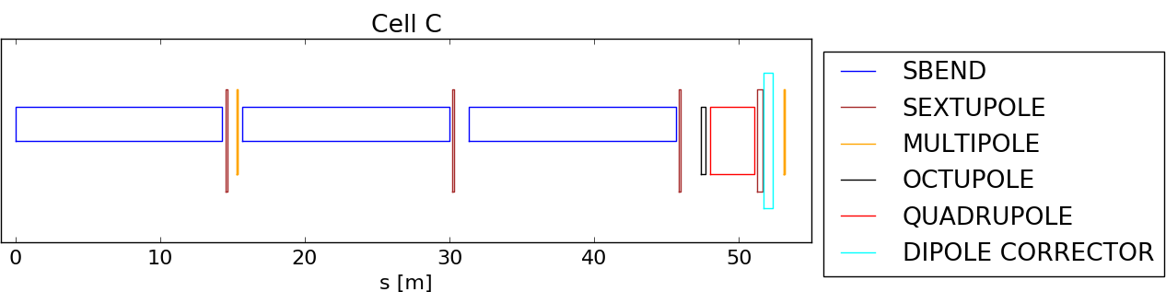
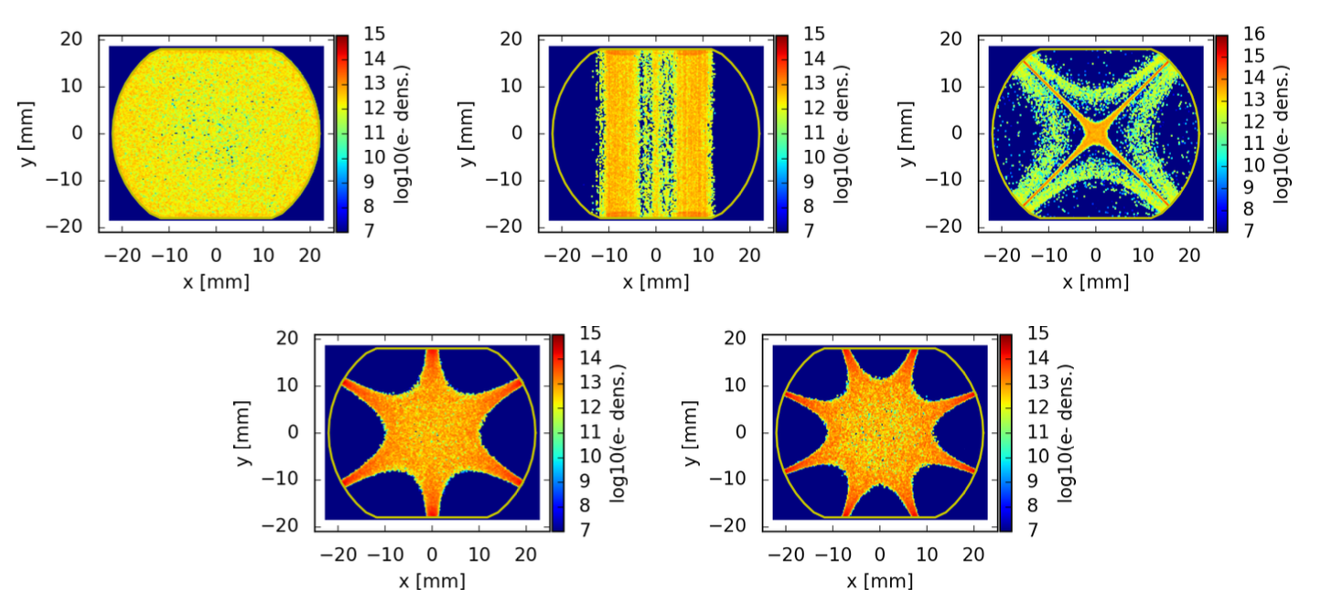
Arc heat loads – the model
  The defined models have been used to simulate all the element of the arc half-cell
Details in P. Dijkstal et al., “Simulation studies on the electron cloud build-up in the elements of the LHC Arcs at 6.5 TeV”, to be published, draft available here

Slide 16
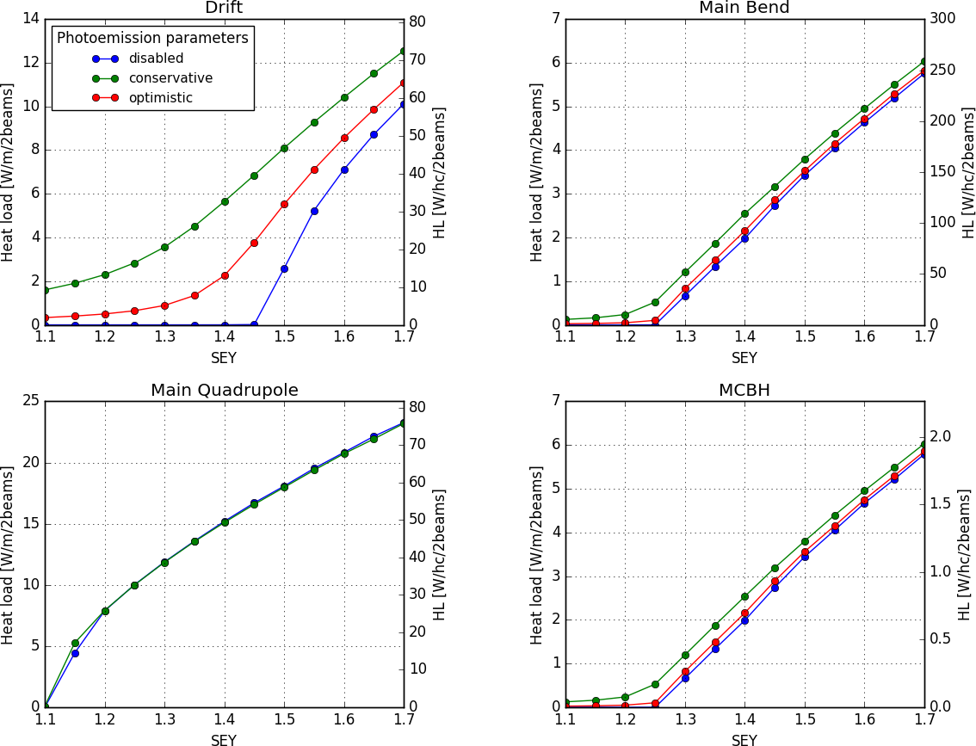
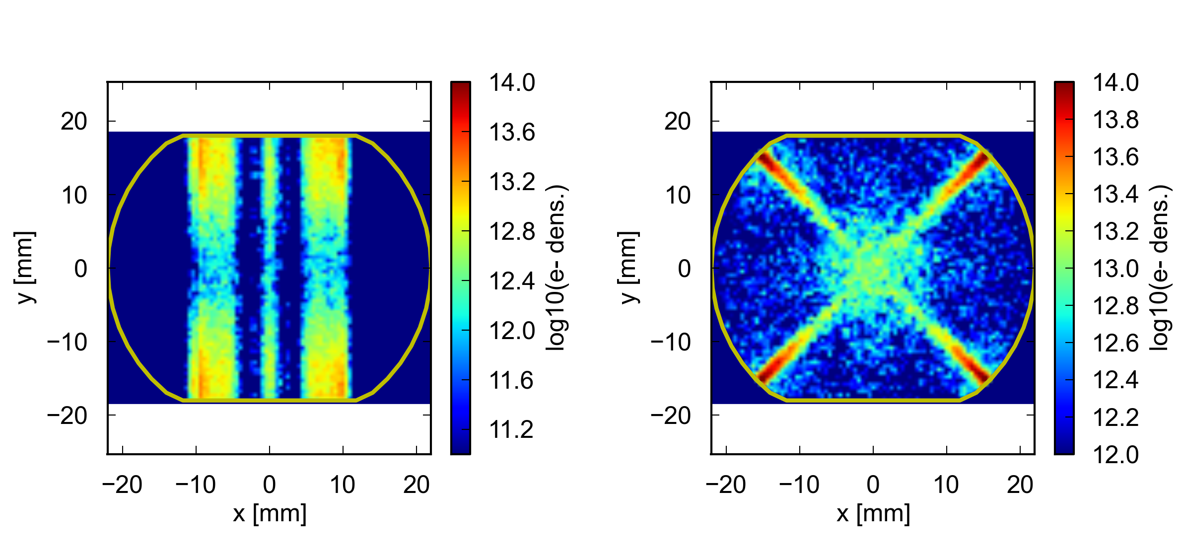
Arc heat loads – results for LHC beam parameters
  The defined models have been used to simulate all the element of the arc half-cell
Dipole
  The impact of the photoelectrons is very strong the drift sections:
  For the other elements, in the presence of a vertical magnetic field, only photoelectrons from reflected photons (<10%) can be accelerated by the beam and contribute to the heat load
Details in P. Dijkstal et al., “Simulation studies on the electron cloud build-up in the elements of the LHC Arcs at 6.5 TeV”, to be published, draft available here

Slide 17
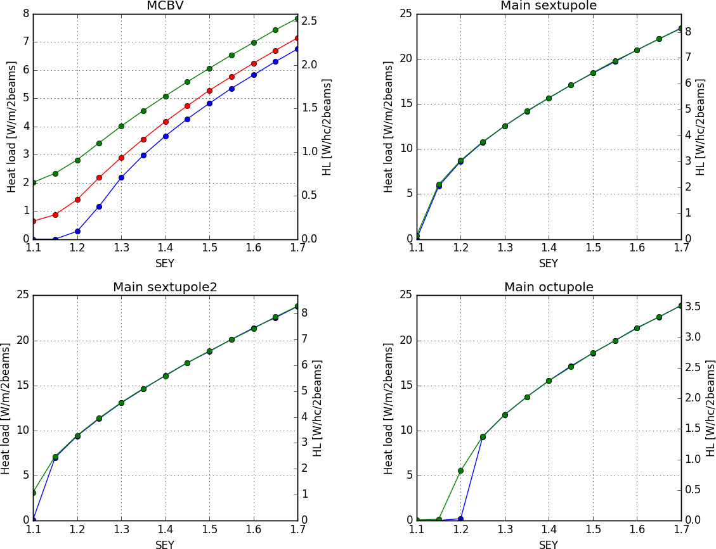
Arc heat loads – results for LHC beam parameters
  The defined models have been used to simulate all the element of the arc half-cell
Details in P. Dijkstal et al., “Simulation studies on the electron cloud build-up in the elements of the LHC Arcs at 6.5 TeV”, to be published, draft available here

Slide 18
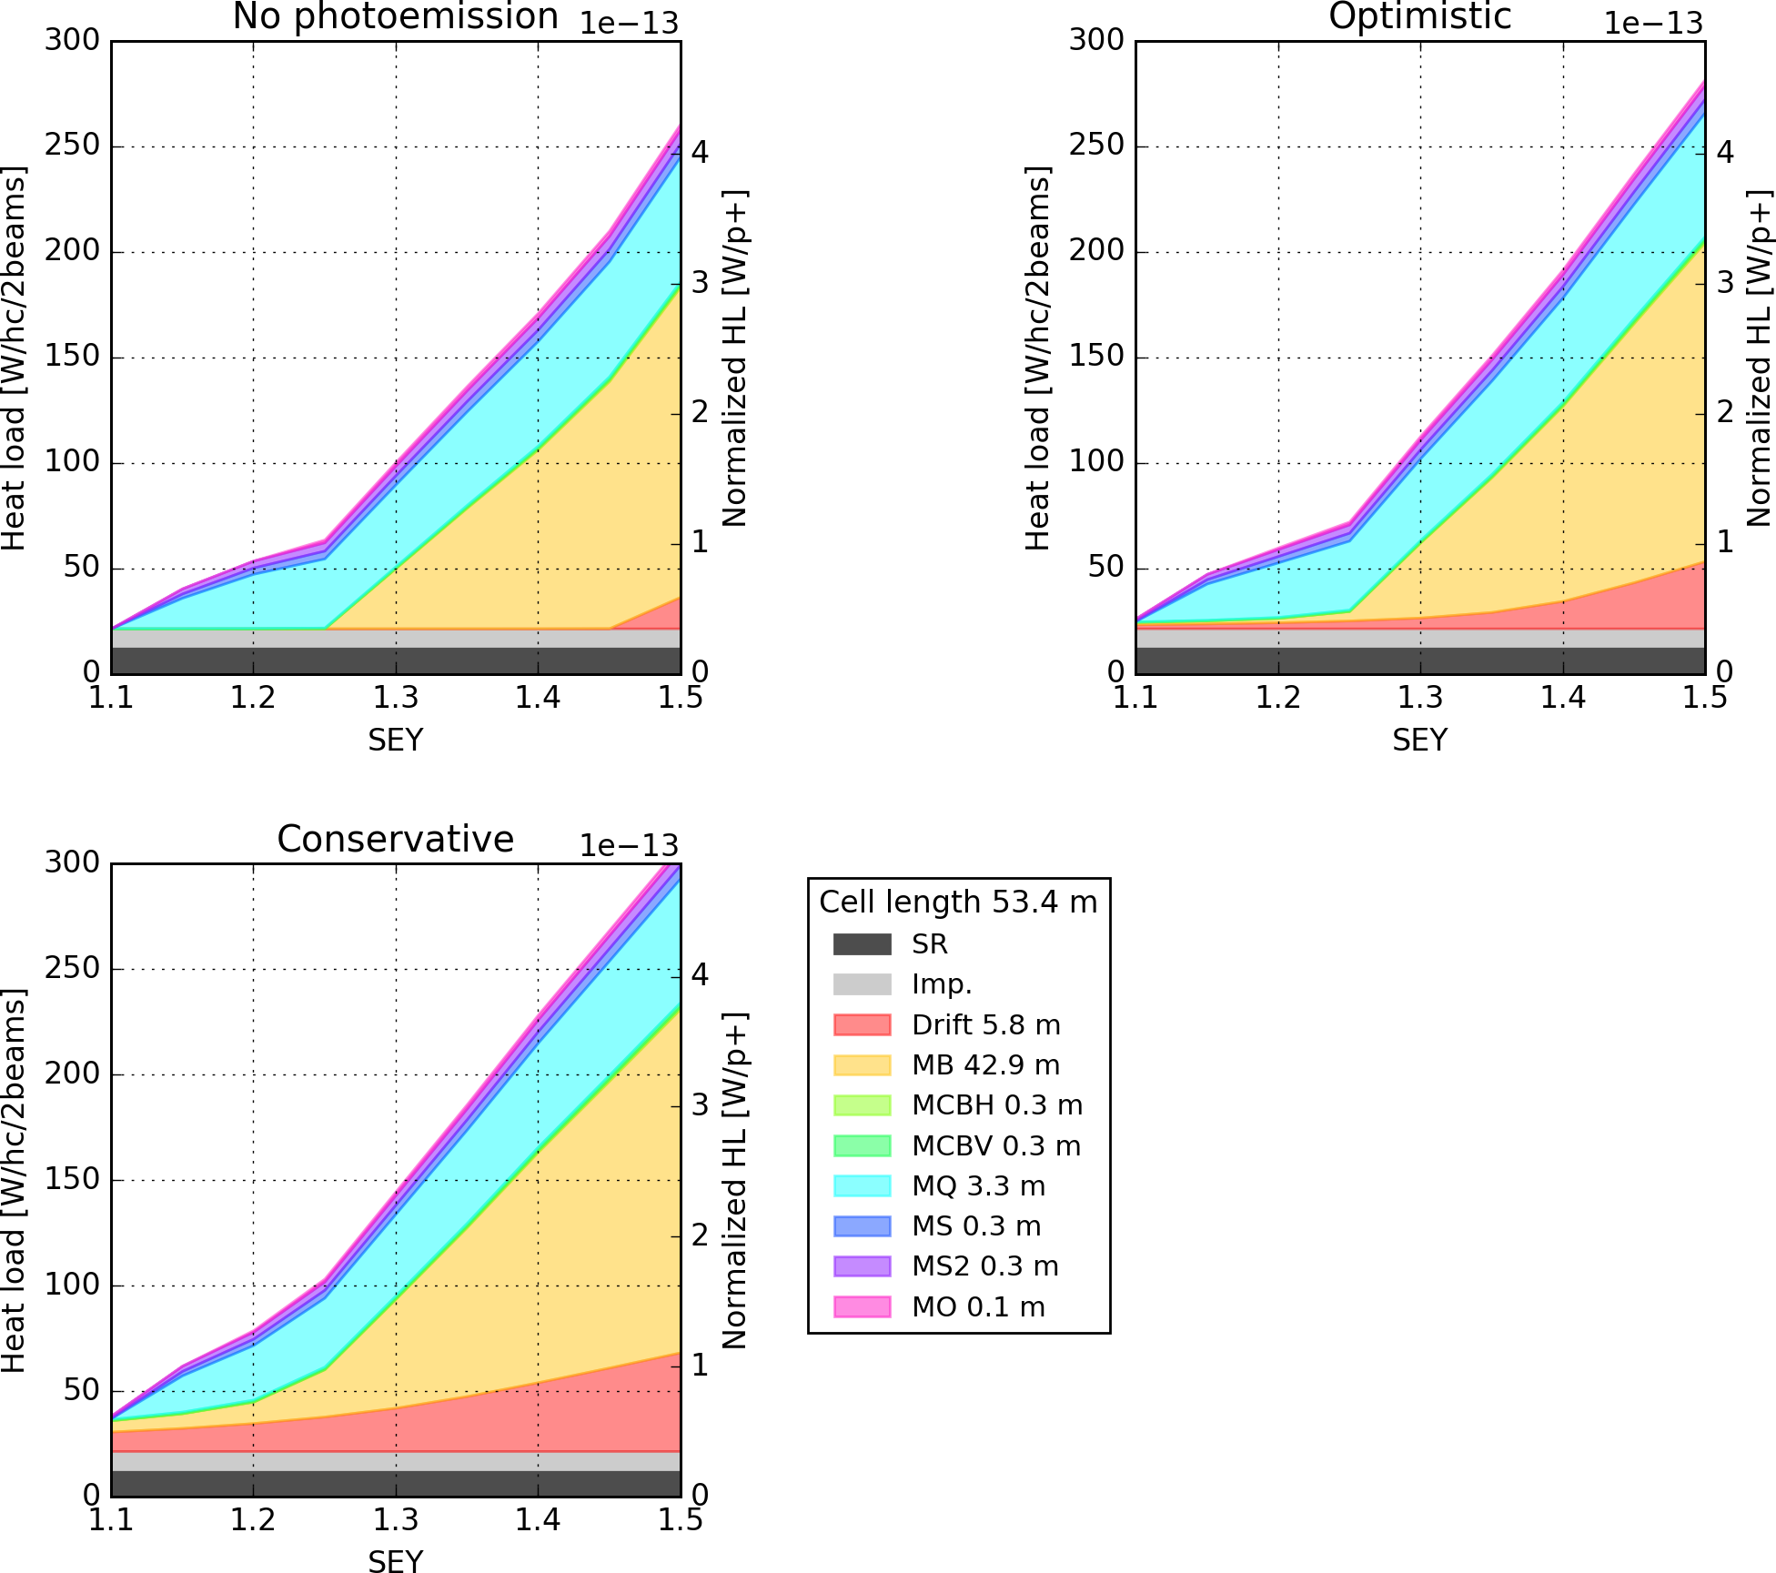
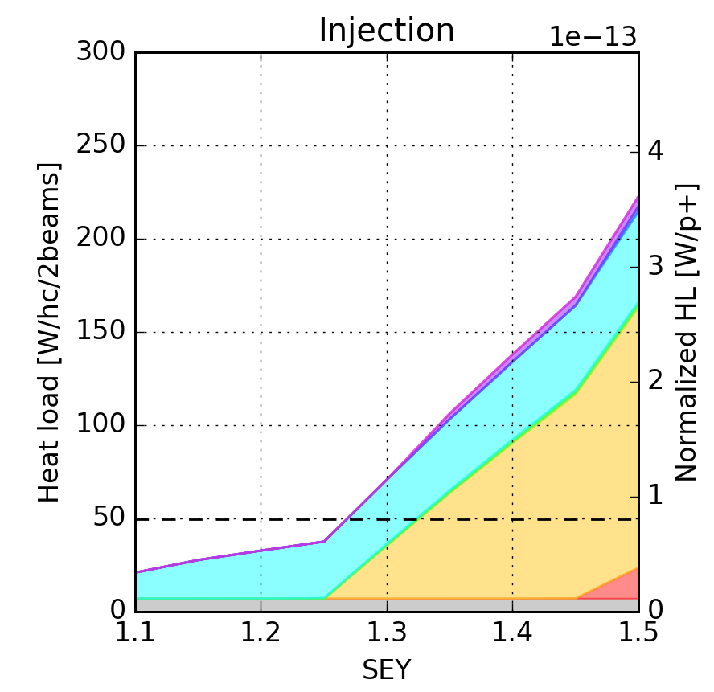
Arc heat loads – results for LHC beam parameters
Total loads
(assuming SEY uniform in the cell)
Details in P. Dijkstal et al., “Simulation studies on the electron cloud build-up in the elements of the LHC Arcs at 6.5 TeV”, to be published, draft available here

Slide 19
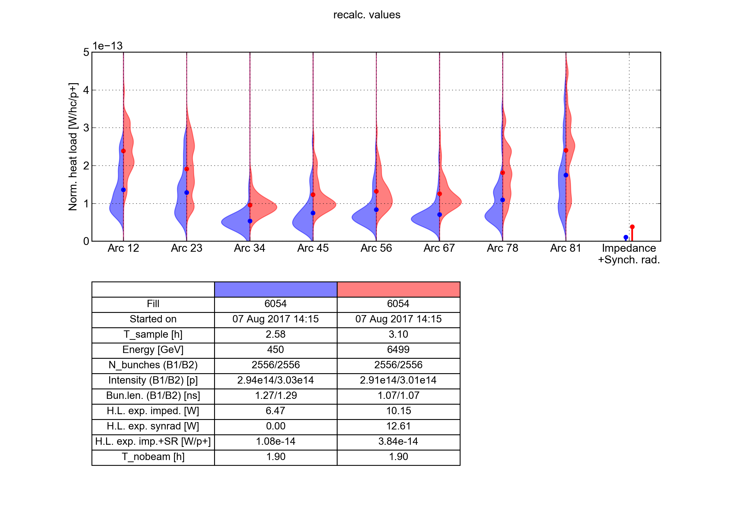
Arc heat loads: SEY estimate based on measurements
  We started by using the conservative parameter set→ analysis will be repeated with the “optimistic” and cross-checked against measurements at injection energy…
Simulations
Measurements
450 GeV
6.5 TeV

Slide 20
Arc heat loads: SEY estimate based on measurements
  We started by using the conservative parameter set→ analysis will be repeated with the “optimistic” and cross-checked against measurements at injection energy…
Simulations
Measurements
Avg. high load sectors (S12, S81): SEY = ~1.3
Avg. low load sectors (S34, S45, S56, S67): SEY = ~1.15
Worst cells in the ring: SEY = ~1.4
Best cells in the ring: SEY = ~1.1
  Based on these assumptions:

Slide 21
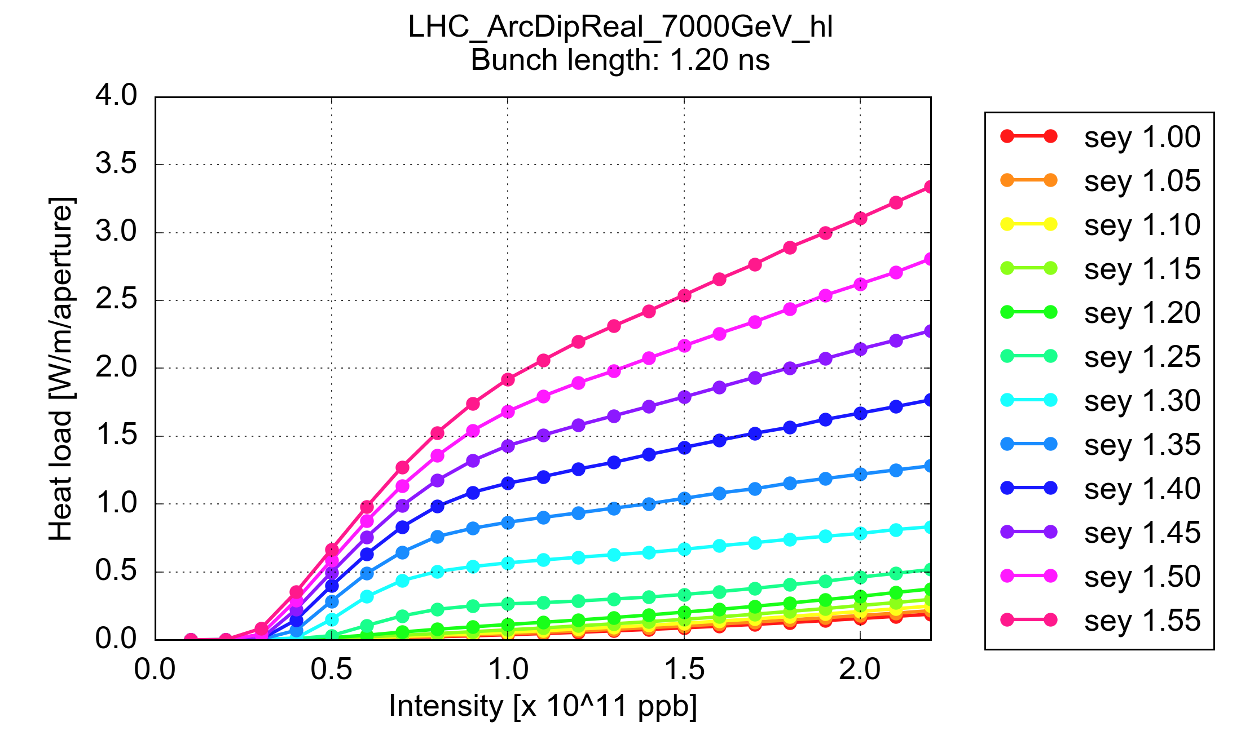
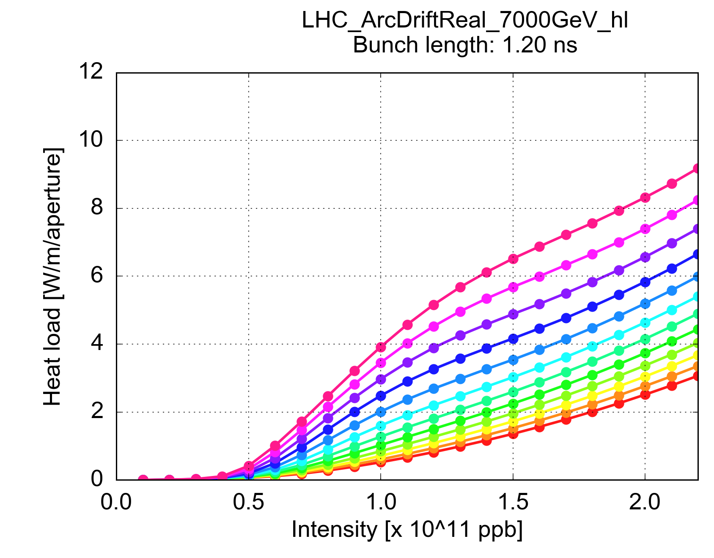
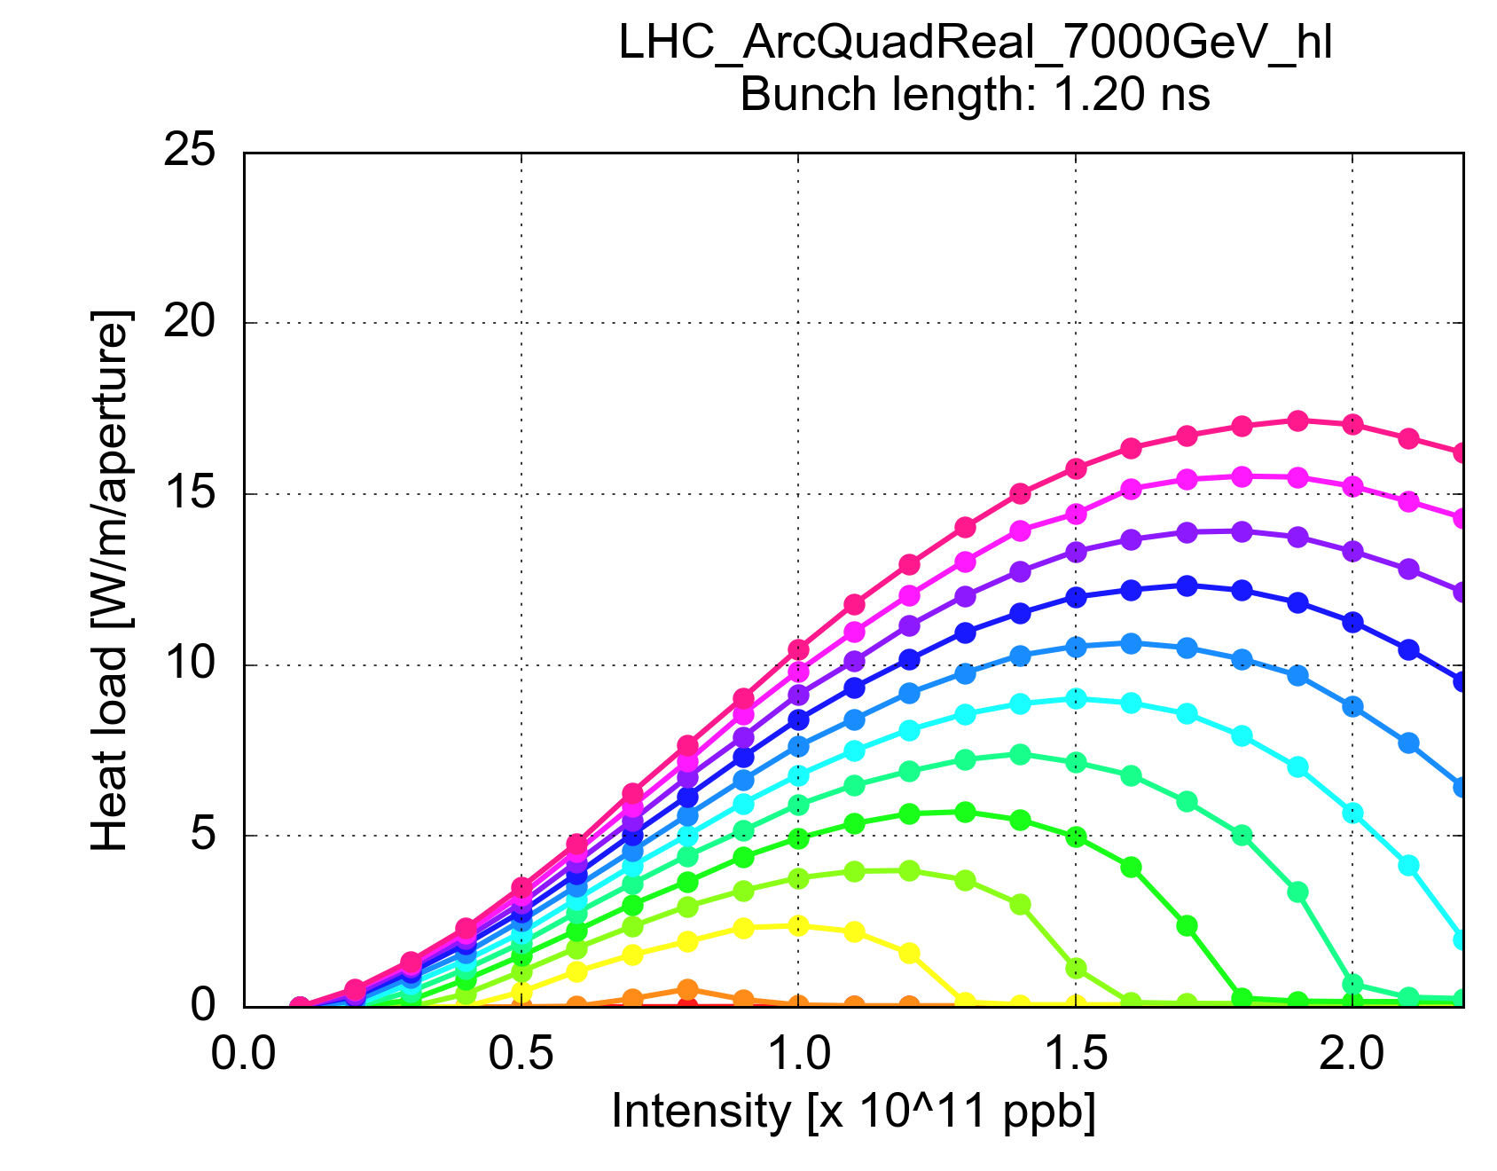
Arc heat loads: simulations for HL-LHC
  Conservative parameter set used for the photoelectrons
  Different trends with bunch intensity observed for dipoles, quadrupoles and drifts
  Significant heat load from the drifts even for low SEY

Slide 22
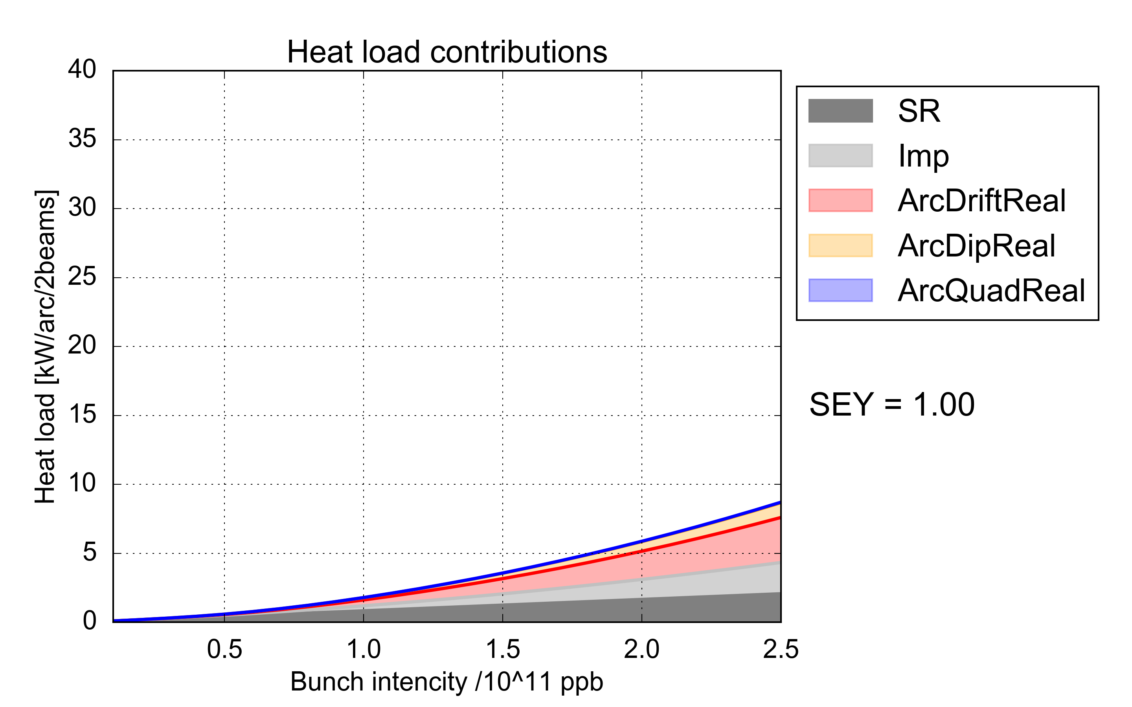
Arc heat loads: simulations for HL-LHC
  HL-LHC collisions
  8 kW/arc (~160W/hcell)
  For high bunch intensity significant heat load is observed already for low SEY (from impedance, synchrotron radiation, photoelectrons in the drifts)

Slide 23

Arc heat loads: simulations for HL-LHC
  HL-LHC collisions
  8 kW/arc (~160W/hcell)
  For high bunch intensity significant heat load is observed already for low SEY (from impedance, synchrotron radiation, photoelectrons in the drifts)

Slide 24
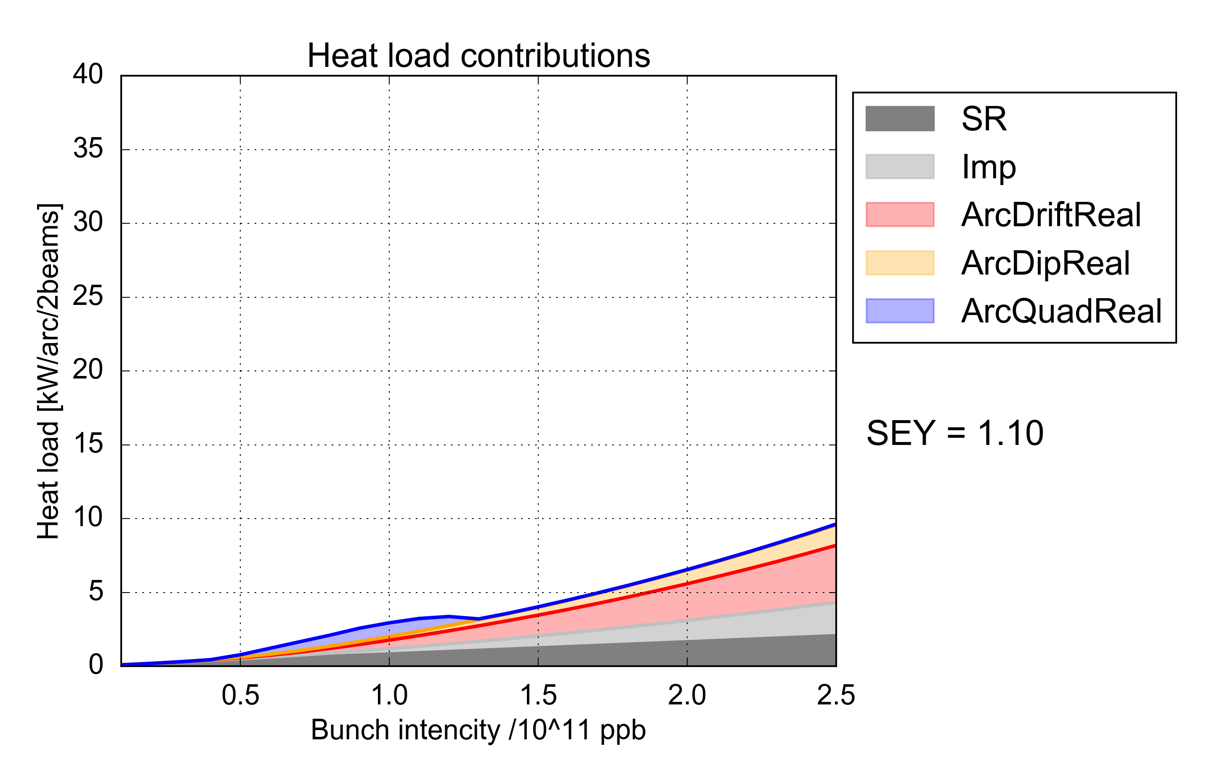
Arc heat loads: simulations for HL-LHC
  HL-LHC collisions
  8 kW/arc (~160W/hcell)
  For high bunch intensity significant heat load is observed already for low SEY (from impedance, synchrotron radiation, photoelectrons in the drifts)

Slide 25
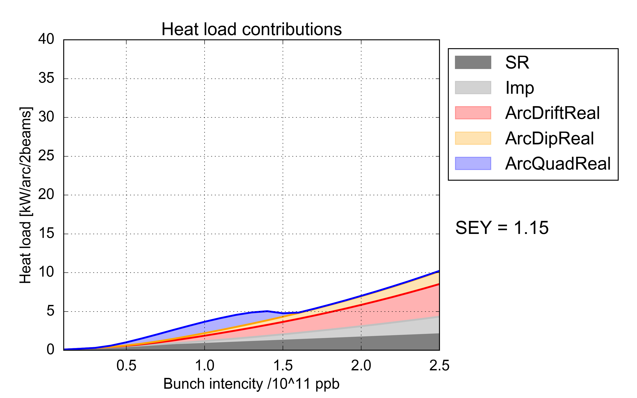
Arc heat loads: simulations for HL-LHC
  HL-LHC collisions
  8 kW/arc (~160W/hcell)
  Present situation in the low-load sectors
  For high bunch intensity significant heat load is observed already for low SEY (from impedance, synchrotron radiation, photoelectrons in the drifts)
  Present conditioning achieved in the low-load sectors is compatible with HL-LHC

Slide 26
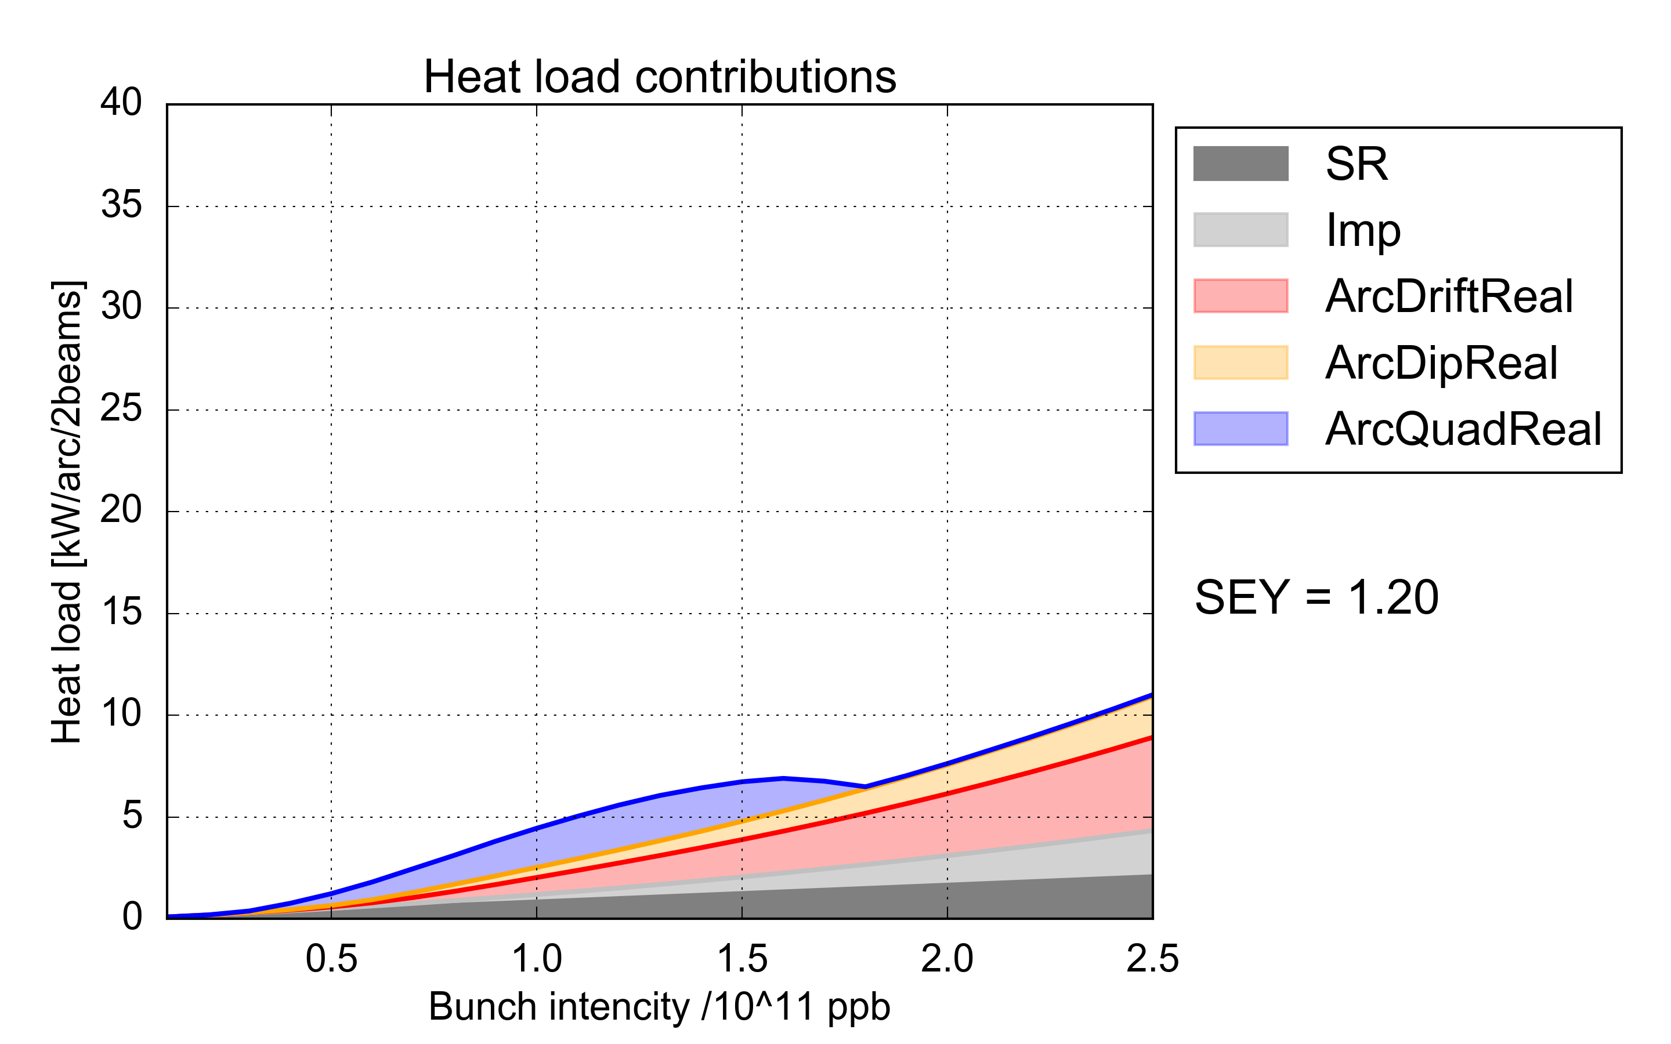
Arc heat loads: simulations for HL-LHC
  HL-LHC collisions
  8 kW/arc (~160W/hcell)
  For high bunch intensity significant heat load is observed already for low SEY (from impedance, synchrotron radiation, photoelectrons in the drifts)
  Present conditioning achieved in the low-load sectors is compatible with HL-LHC

Slide 27
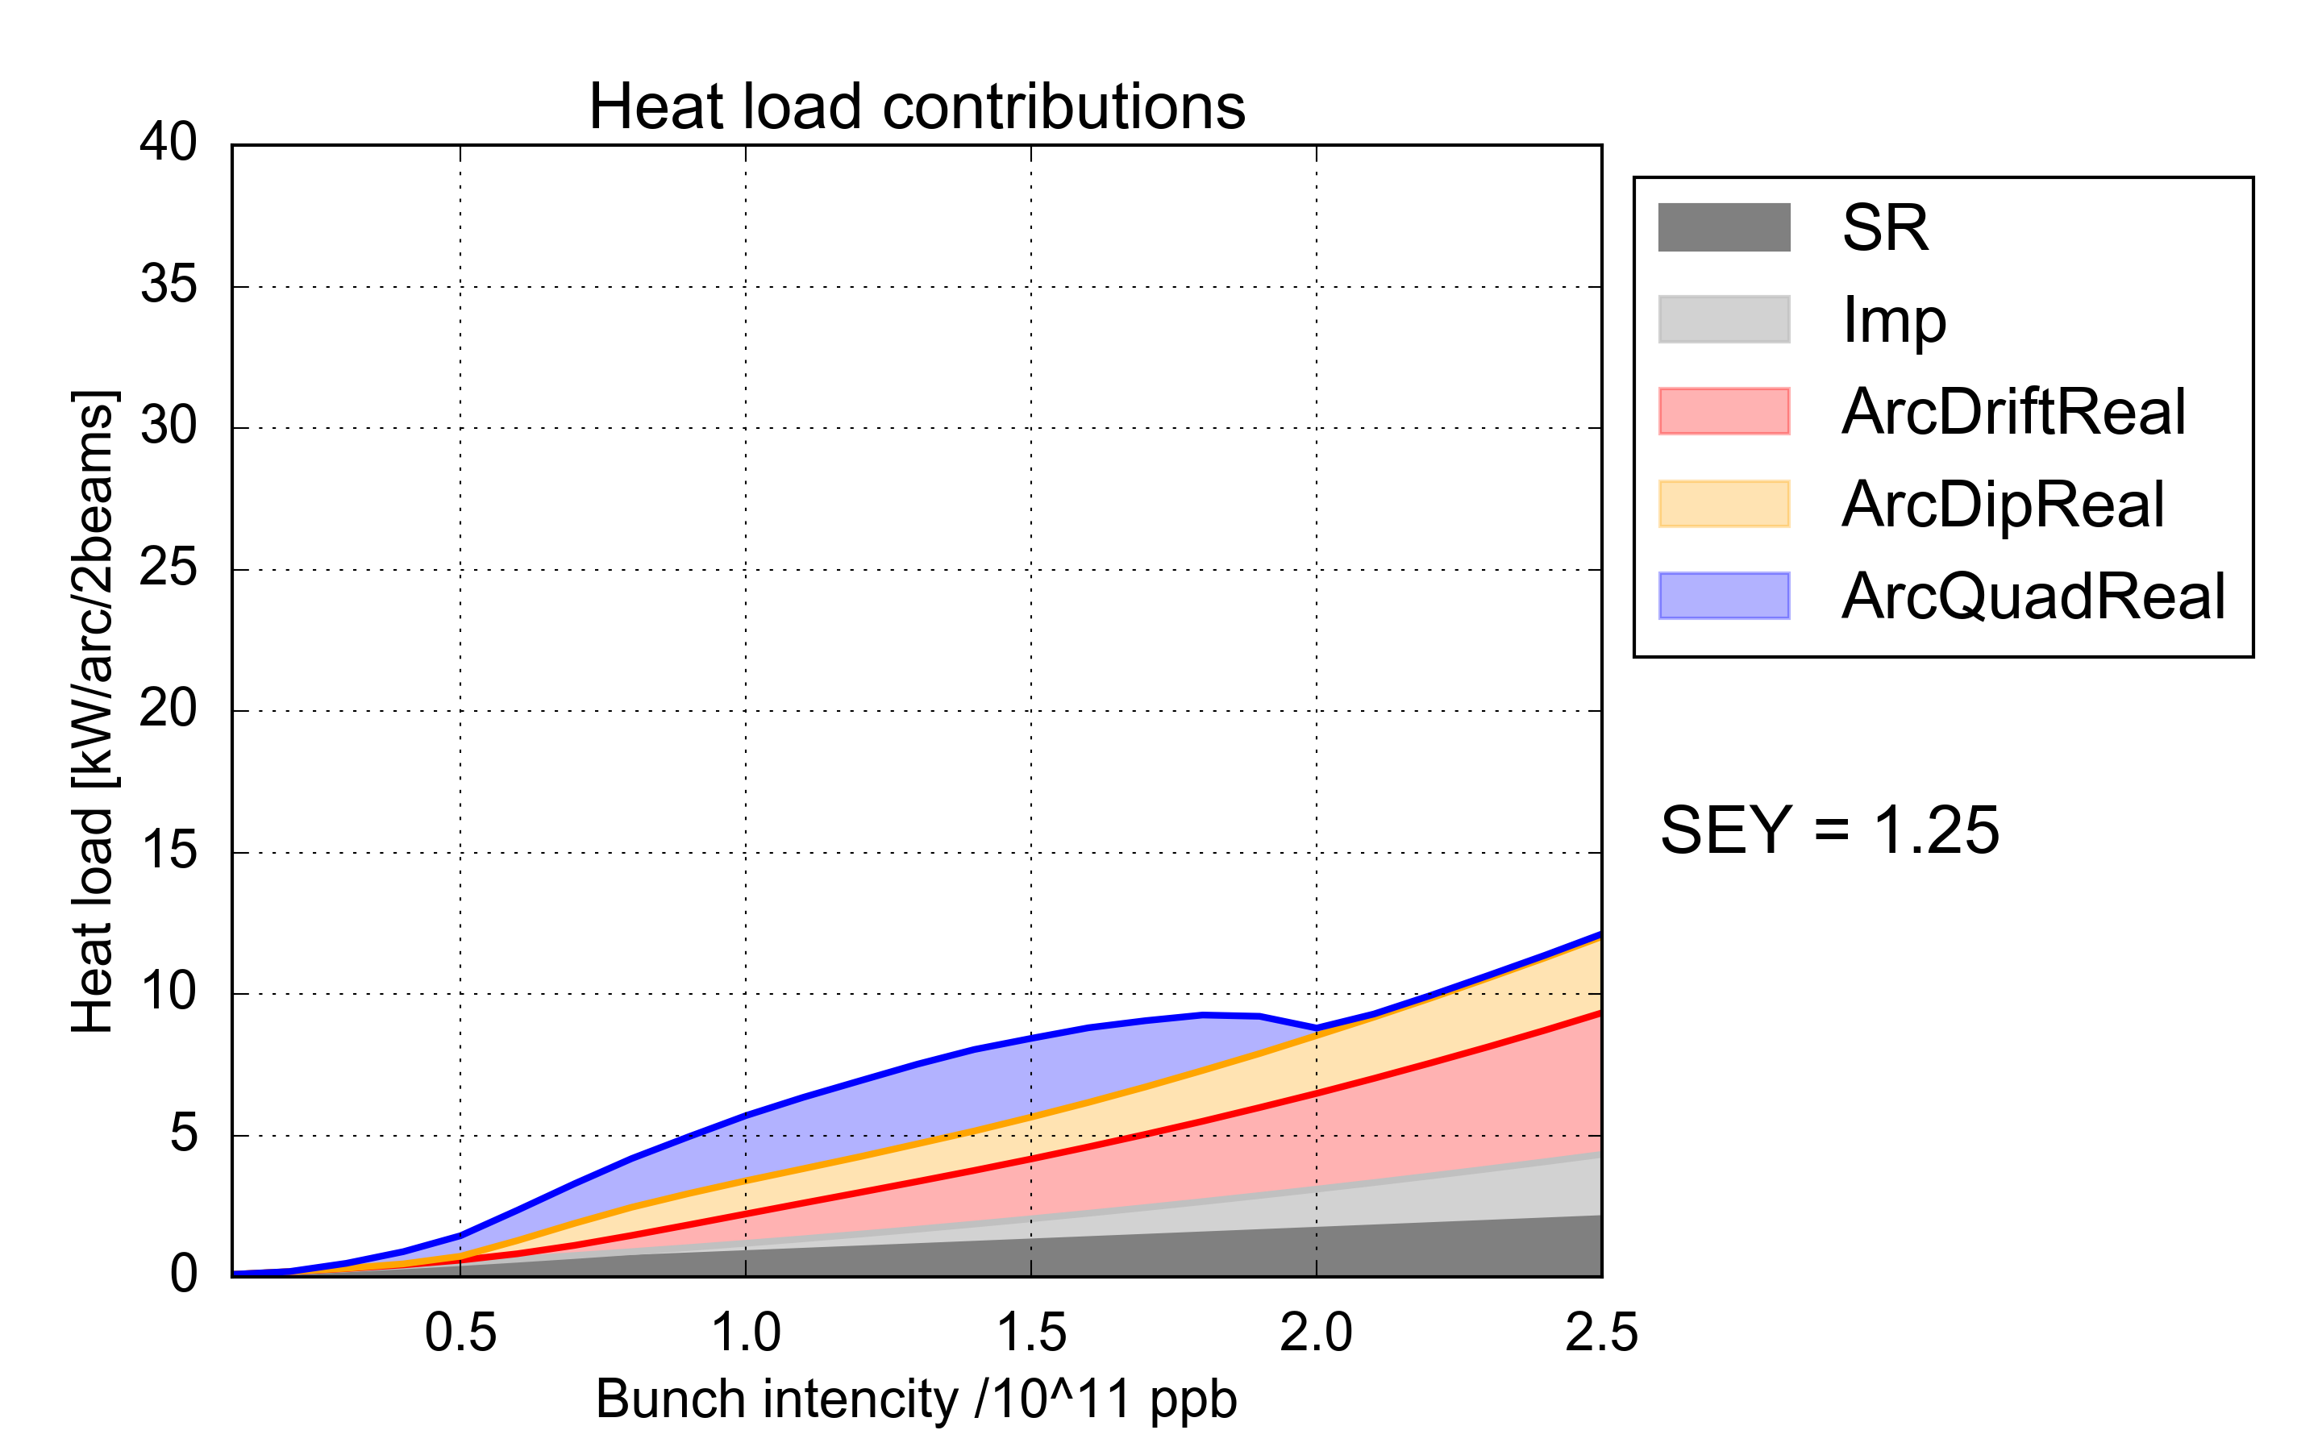
Arc heat loads: simulations for HL-LHC
  HL-LHC collisions
  8 kW/arc (~160W/hcell)
  For high bunch intensity significant heat load is observed already for low SEY (from impedance, synchrotron radiation, photoelectrons in the drifts)
  Present conditioning achieved in the low-load sectors is compatible with HL-LHC

Slide 28
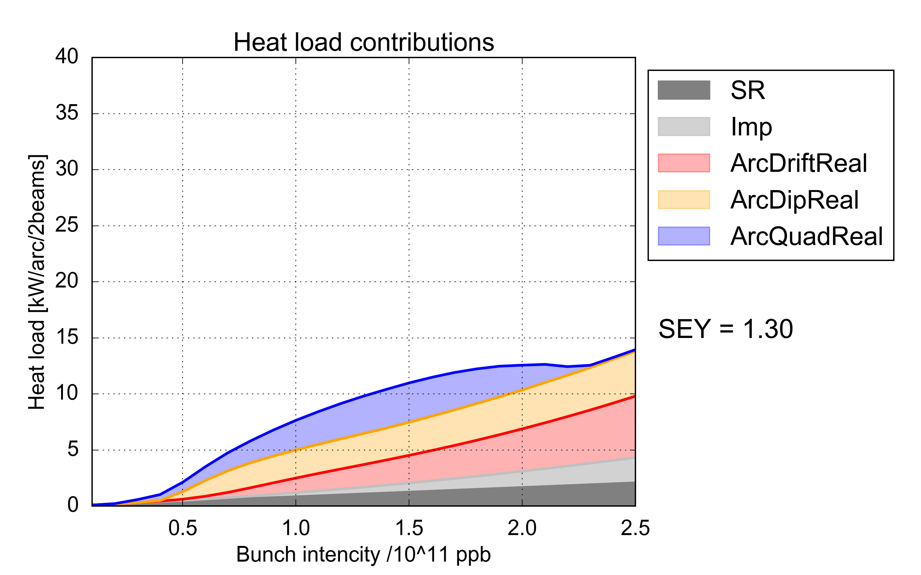
Arc heat loads: simulations for HL-LHC
  HL-LHC collisions
  8 kW/arc (~160W/hcell)
  Present situation in the high-load sectors
  For high bunch intensity significant heat load is observed already for low SEY (from impedance, synchrotron radiation, photoelectrons in the drifts)
  Present conditioning achieved in the low-load sectors is compatible with HL-LHC
  Expected heat load for the high-load sectors is ~12 kW/arc!

Slide 29
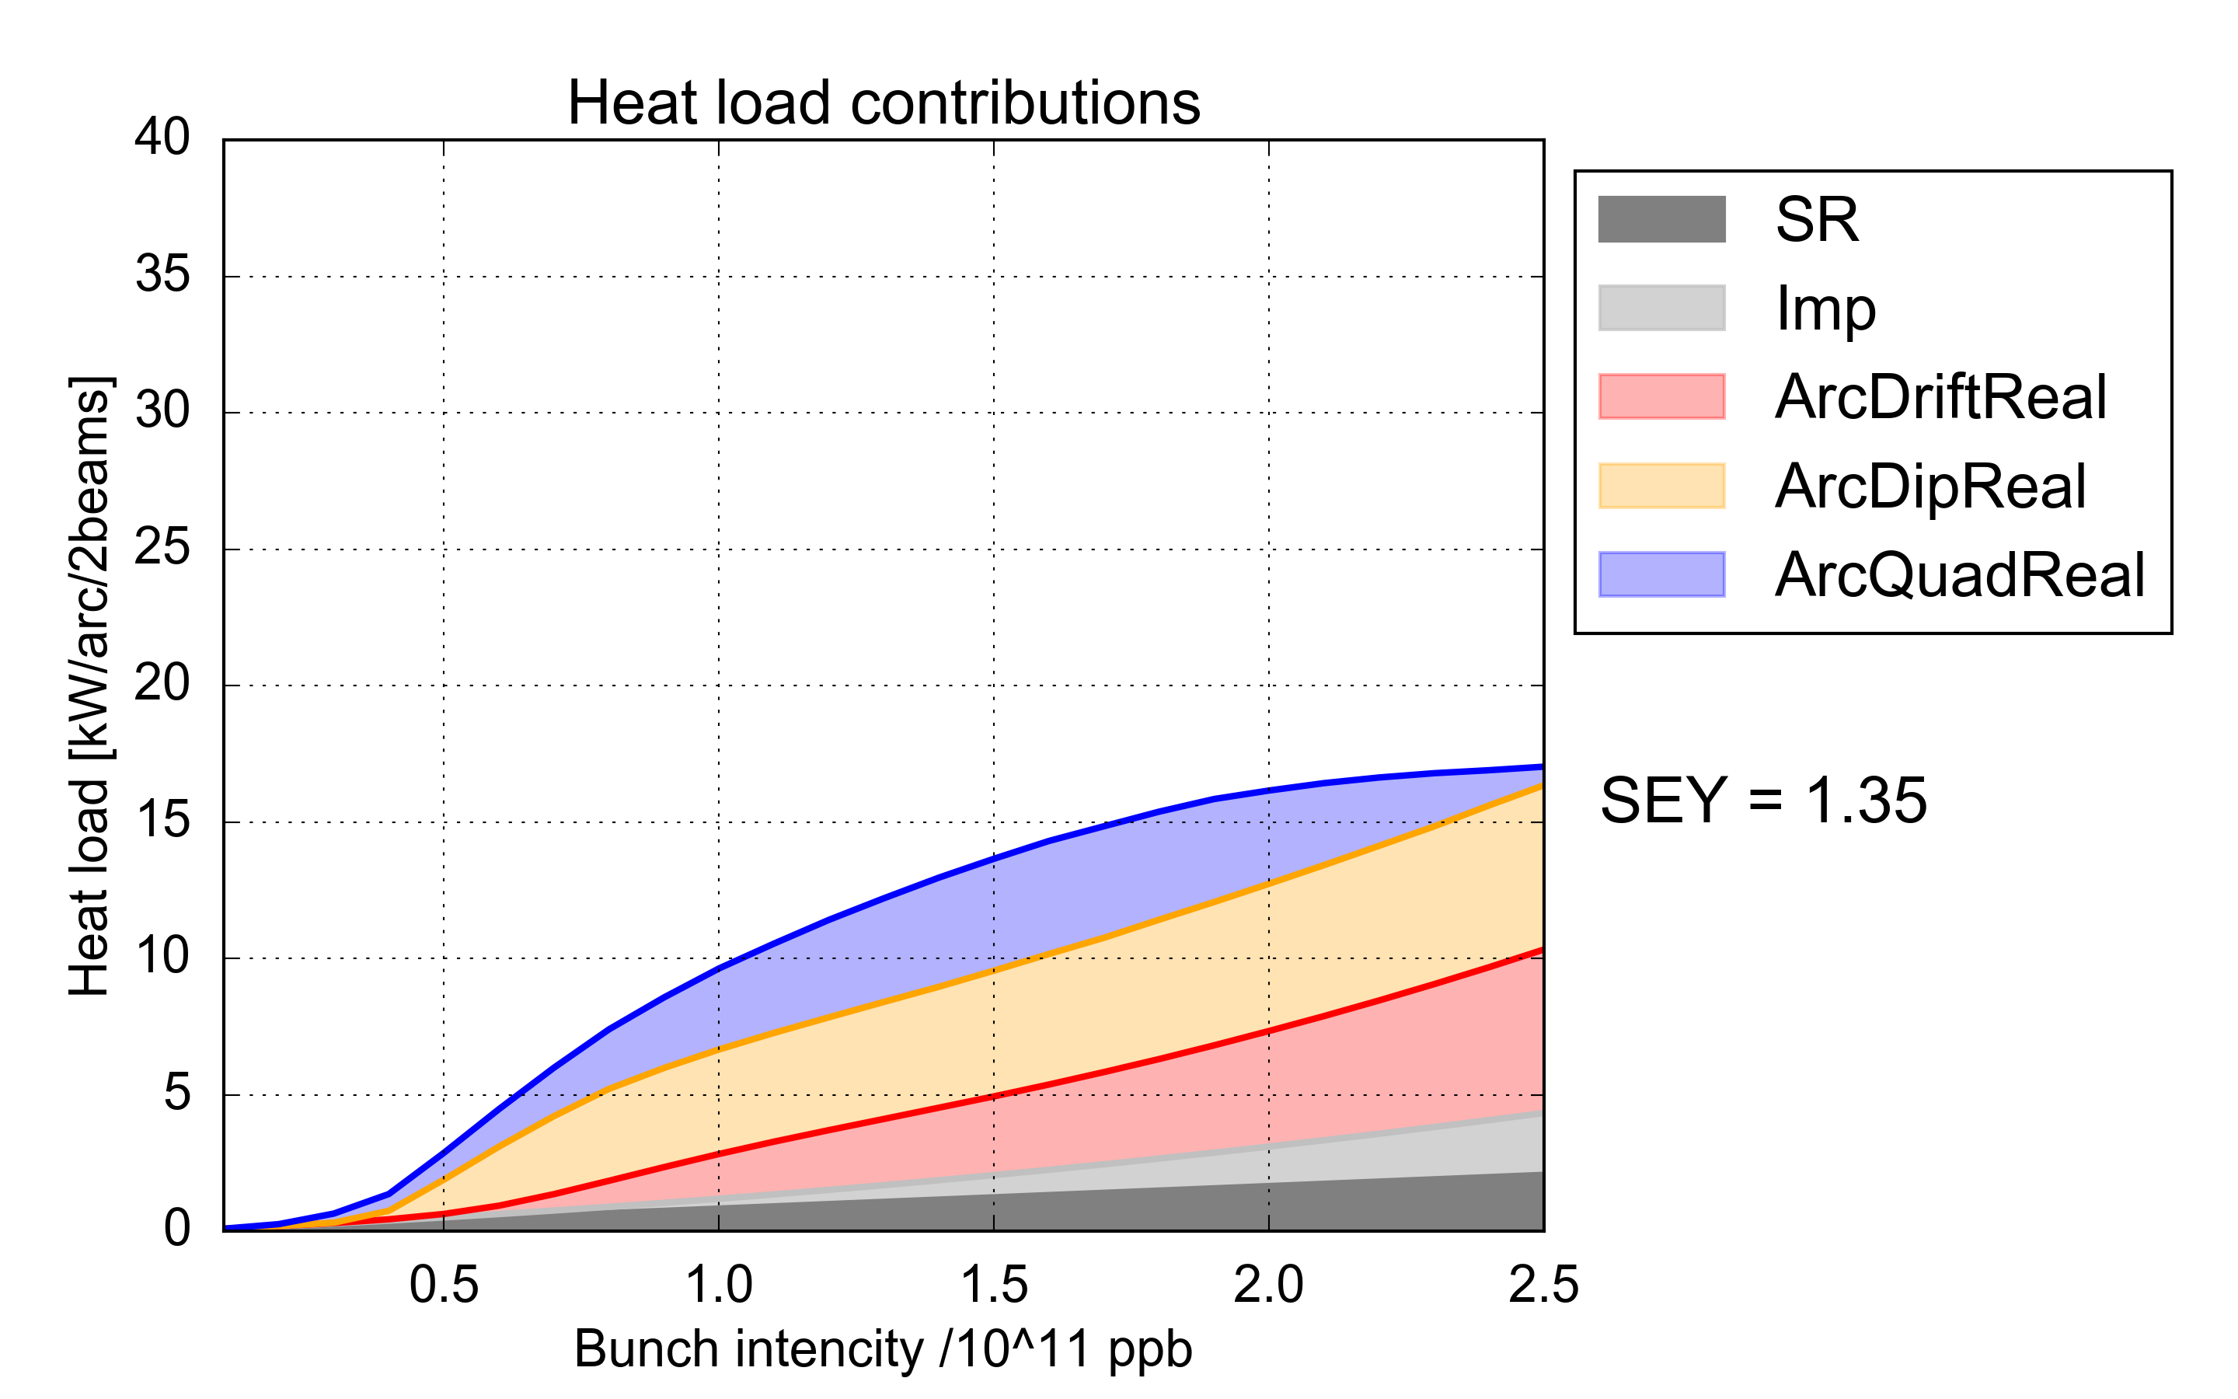
Arc heat loads: simulations for HL-LHC
  HL-LHC collisions
  8 kW/arc (~160W/hcell)
  For high bunch intensity significant heat load is observed already for low SEY (from impedance, synchrotron radiation, photoelectrons in the drifts)
  Present conditioning achieved in the low-load sectors is compatible with HL-LHC
  Expected heat load for the high-load sectors is ~12 kW/arc!

Slide 30
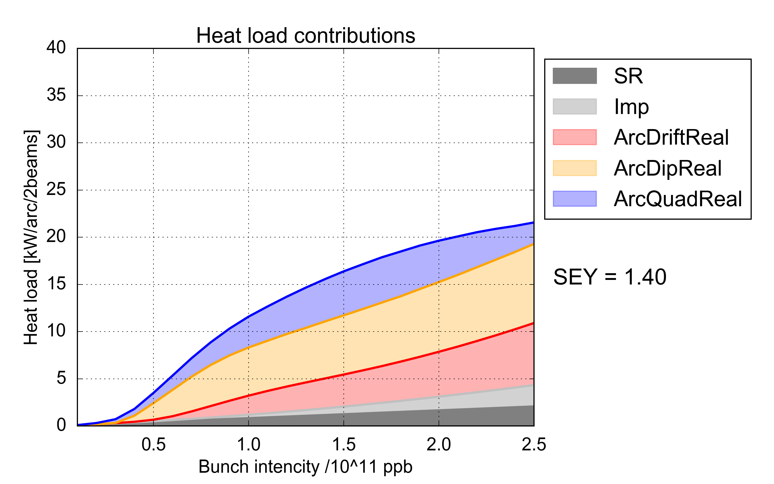
Arc heat loads: simulations for HL-LHC
  HL-LHC collisions
  8 kW/arc (~160W/hcell)
  For high bunch intensity significant heat load is observed already for low SEY (from impedance, synchrotron radiation, photoelectrons in the drifts)
  Present conditioning achieved in the low-load sectors is compatible with HL-LHC
  Expected heat load for the high-load sectors is ~12 kW/arc!

Slide 31
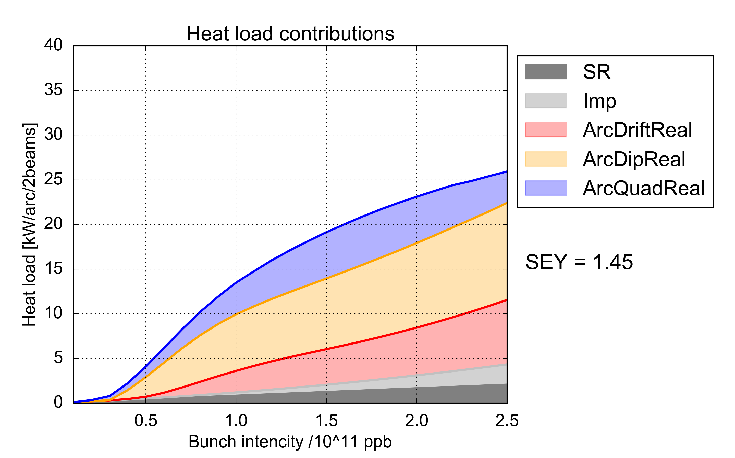
Arc heat loads: simulations for HL-LHC
  HL-LHC collisions
  8 kW/arc (~160W/hcell)
  For high bunch intensity significant heat load is observed already for low SEY (from impedance, synchrotron radiation, photoelectrons in the drifts)
  Present conditioning achieved in the low-load sectors is compatible with HL-LHC
  Expected heat load for the high-load sectors is ~12 kW/arc!

Slide 32
Arc heat loads: simulations for HL-LHC
  HL-LHC collisions
  8 kW/arc (~160W/hcell)
  For high bunch intensity significant heat load is observed already for low SEY (from impedance, synchrotron radiation, photoelectrons in the drifts)
  Present conditioning achieved in the low-load sectors is compatible with HL-LHC
  Expected heat load for the high-load sectors is ~12 kW/arc!

Slide 33
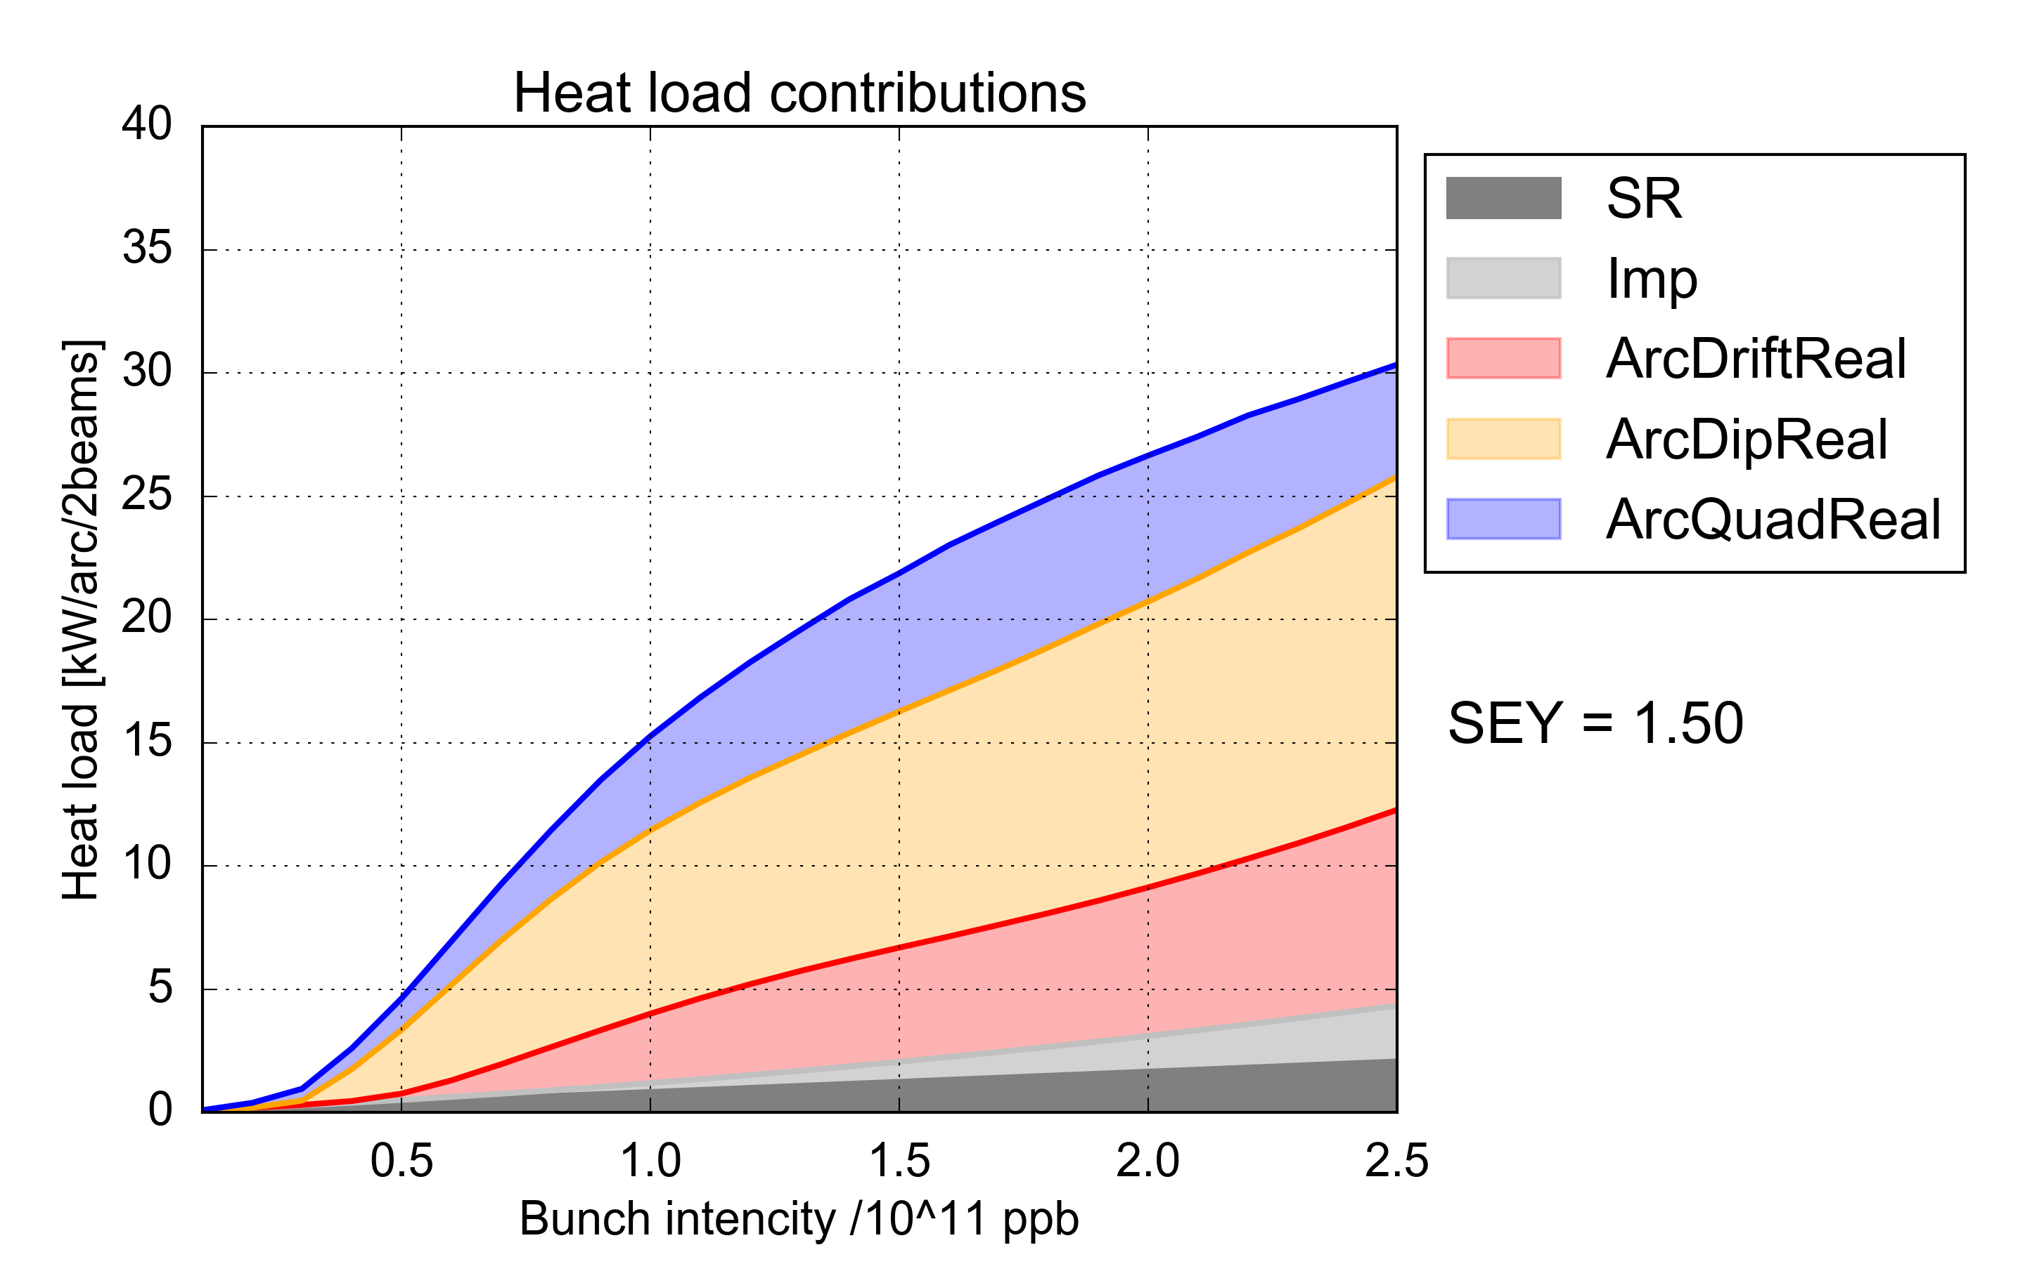
Arc heat loads: simulations for HL-LHC
  HL-LHC collisions
  8 kW/arc (~160W/hcell)
  For high bunch intensity significant heat load is observed already for low SEY (from impedance, synchrotron radiation, photoelectrons in the drifts)
  Present conditioning achieved in the low-load sectors is compatible with HL-LHC
  Expected heat load for the high-load sectors is ~12 kW/arc!

Slide 34
Summary and conclusions
  Heat load estimates for Inner Triplets and other magnets in the IR have been finalized including the effect of impedance and e-cloud effects
  Ongoing work to estimate HL-LHC heat loads on the arcs beam screens (more complicated due to the effect of photoelectrons generated by synchrotron radiation)
    Developed a detailed model including all elements of the arc half-cell and taking into account the effect of photoelectrons
    Simulations for LHC beam parameters compared with heat load measurements to quantify the present conditioning state of the machine (SEY values) → Large differences observed between different arcs
    With these values we made first extrapolations for HL-LHC (using a “conservative” parameter set for photoelectrons → to be refined):
      For the low-load sectors, the present conditioning state would be sufficient to operate with HL-LHC beam parameters (with little margin…)
      This is not the case for the high-load sectors, where the expected load goes beyond 10 kW/arc
    It is necessary to identify and suppress source of large heat loads in S12, S23, S78, S81 in order to allow operation with HL-LHC beam parameters
    Still margin on available cooling capacity will be quite limited
      Heat load on LSS magnets in IR2 and IR8 will affect the neighboring arcs → Low SEY coating of these matching sections is desirable

Slide 35
Thanks for your attention!

Slide 36
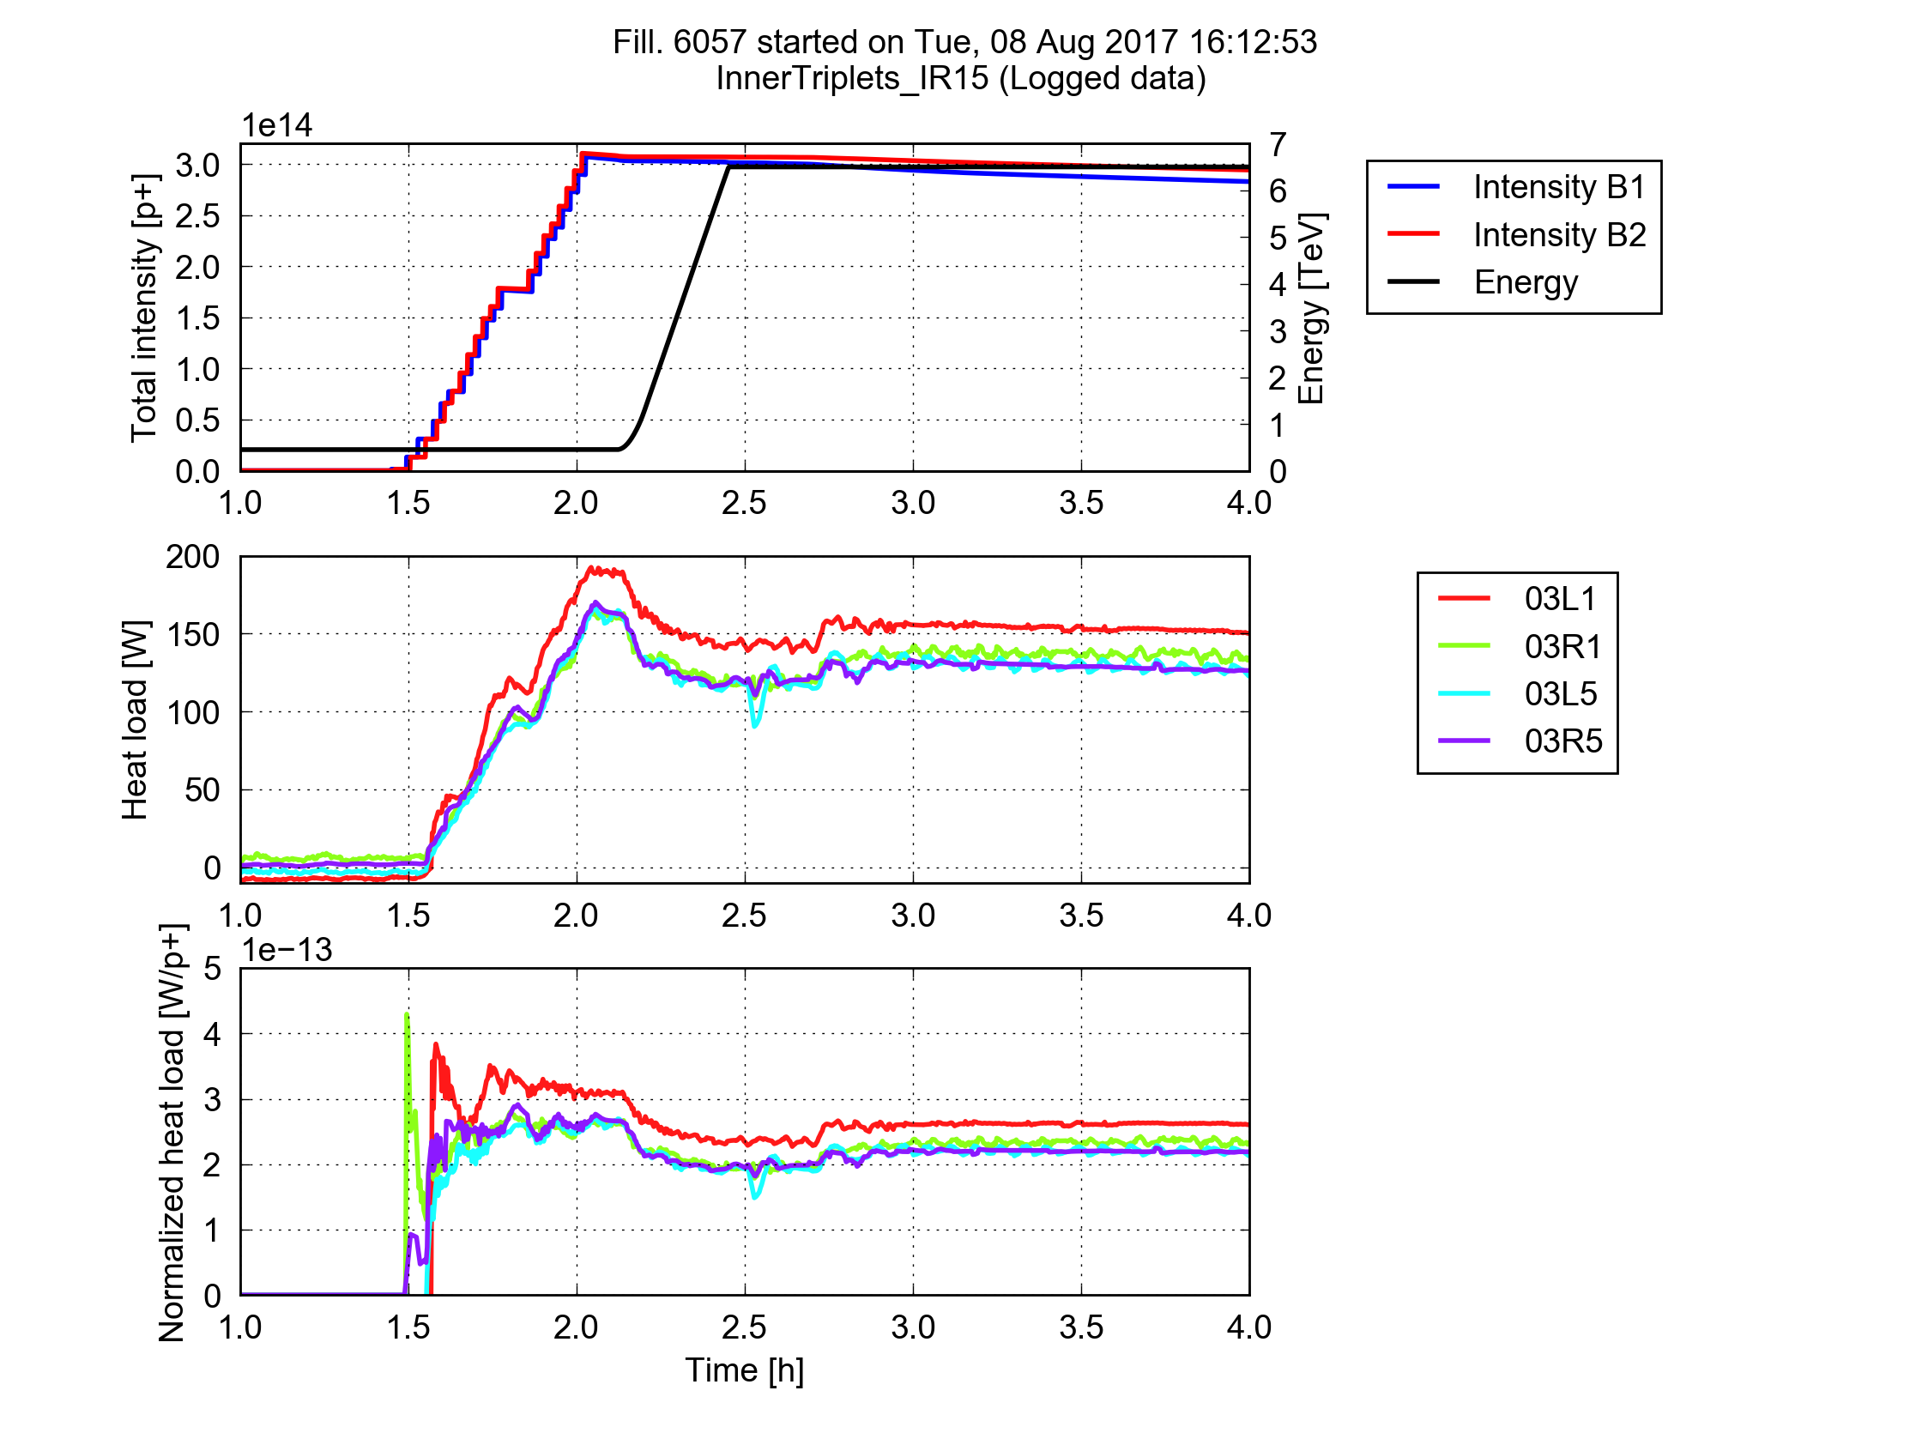
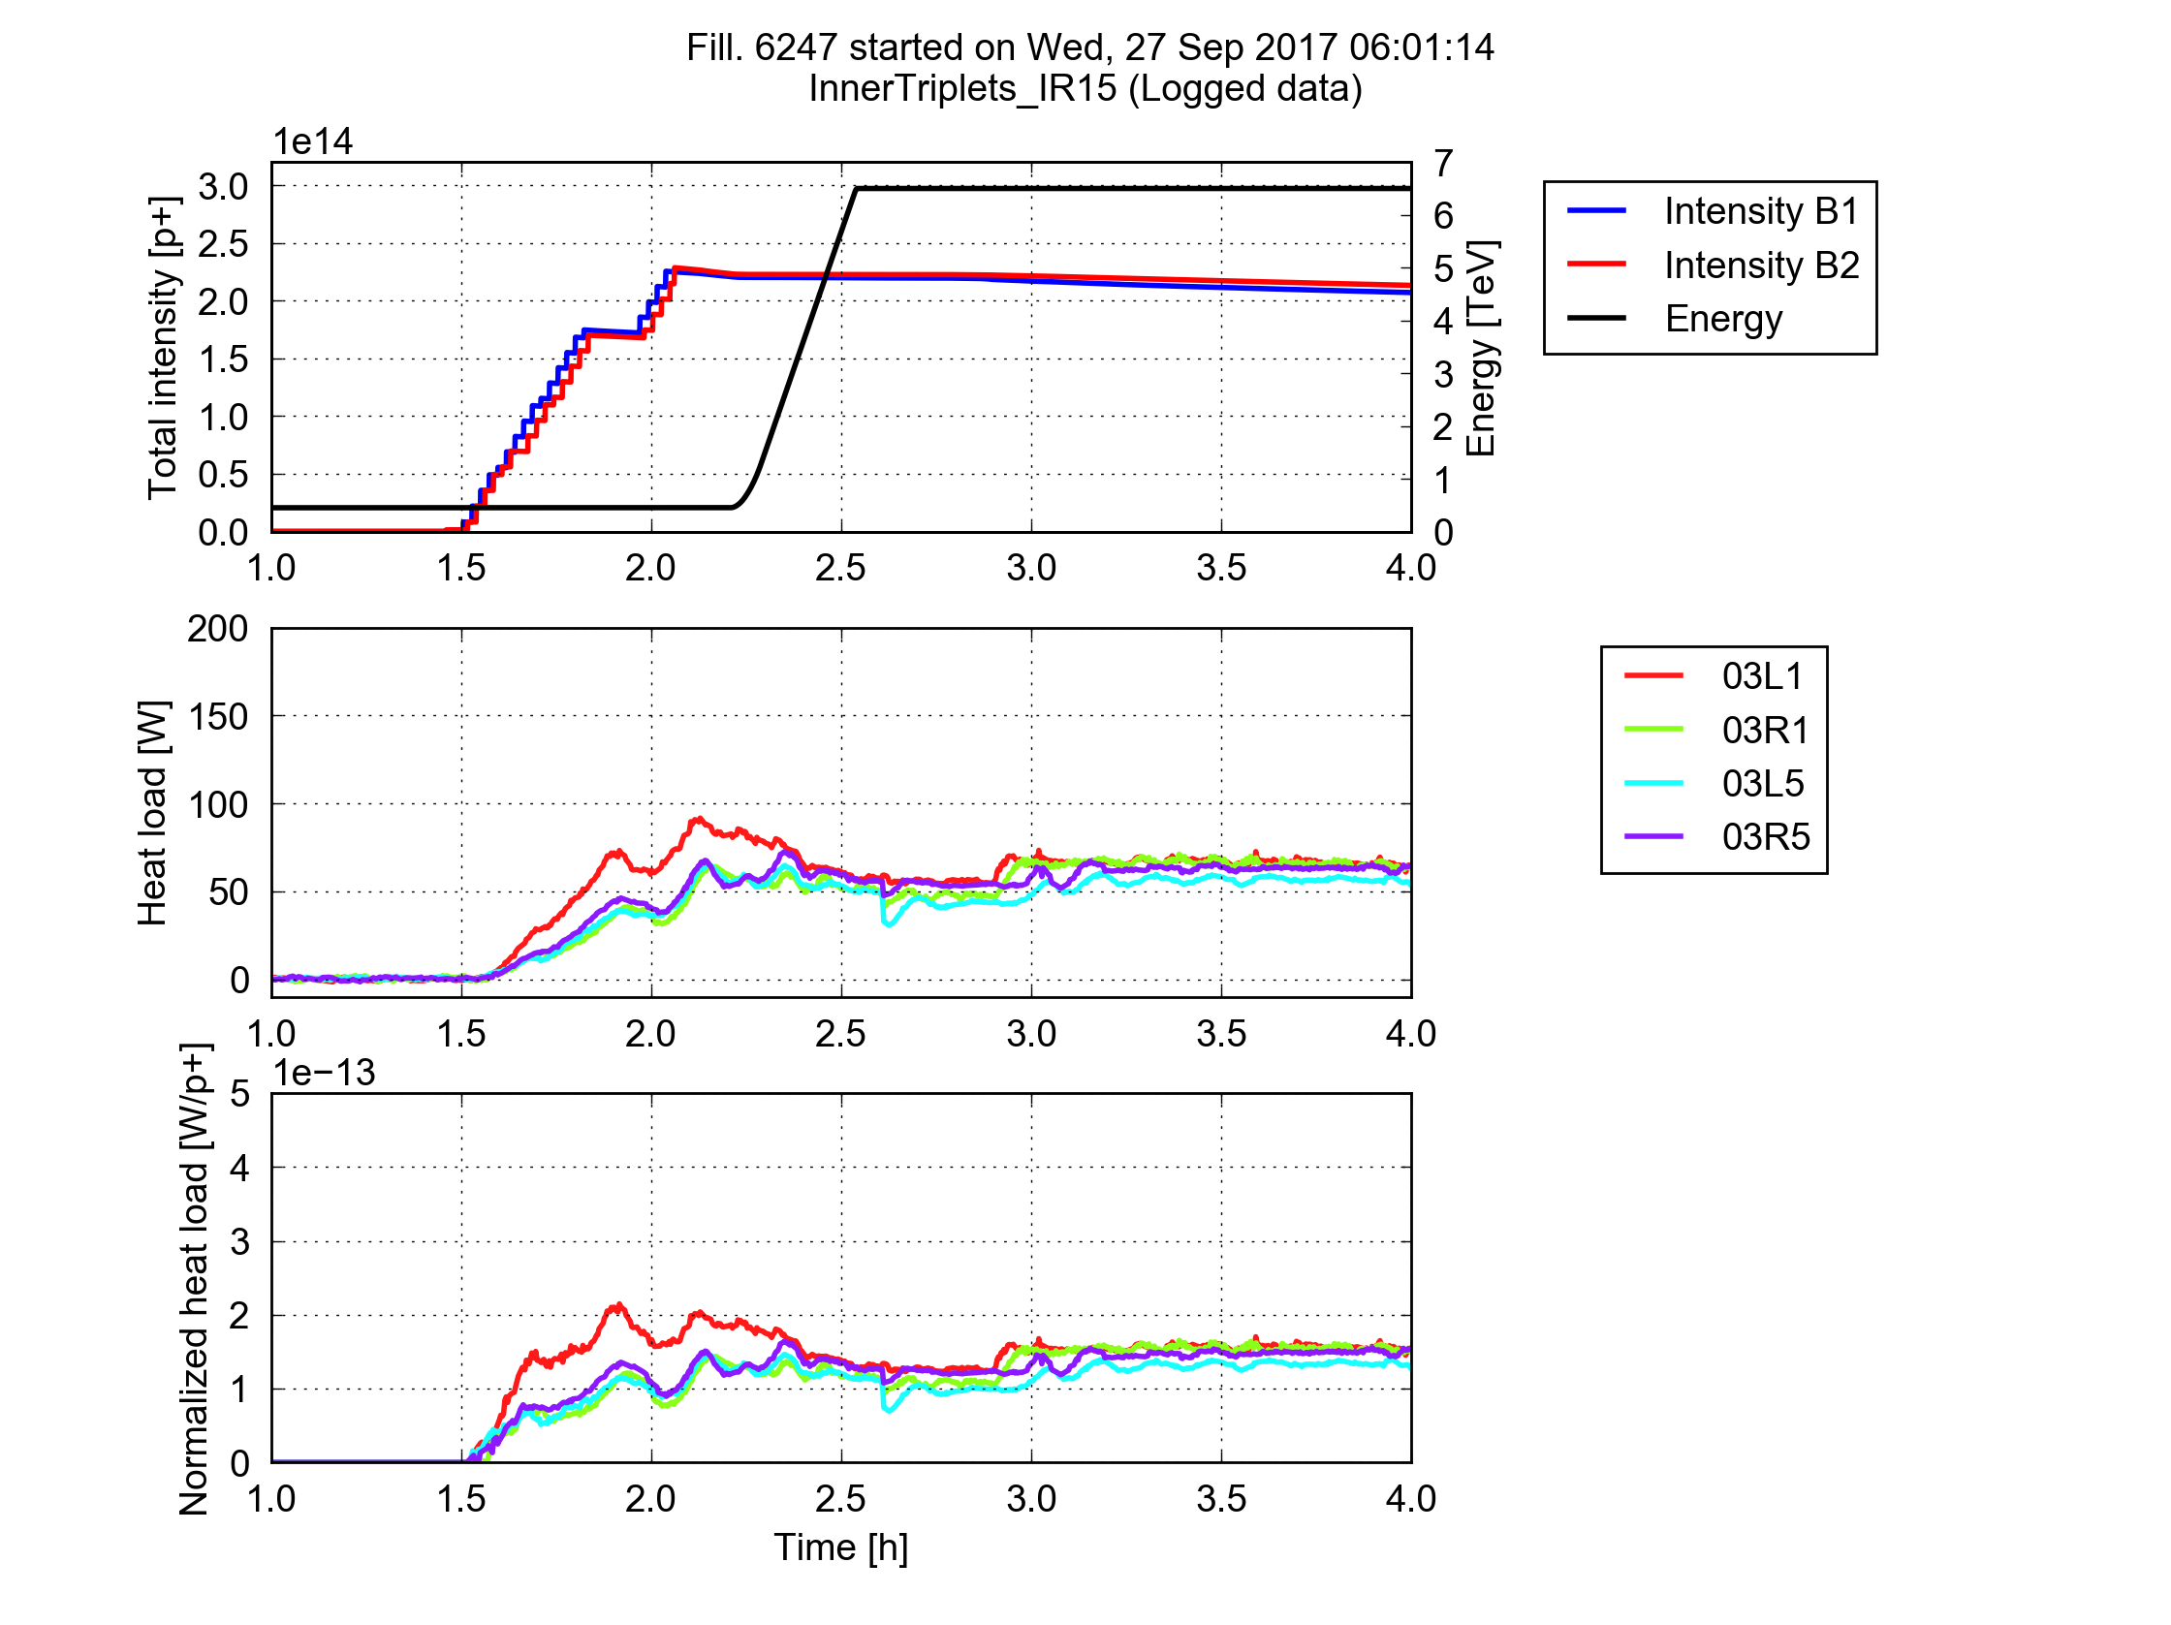
25 ns (2556b)
8b+4e (1916b)

