Slide 1
Stability with electron cloud
A. Romano, G. Iadarola, G. Rumolo
Many thanks to: G. Arduini, D. Cesini, K.Li, L. Mether, E. Mètral and the INFN-CNAF institute in Bologna

Slide 2
  PyECLOUD-PyHEADTAIL simulation
  Understanding of EC phenomena heavily relies on PyECLOUD-PyHEADTAIL simulations
  Simulations are very demanding in terms of time and computational resources → multi-scale problem
    in space: small beam (~100 um) in a big chamber (4 cm)
    in time: 1 ns for the e- motion, 1 to 10 s for instability development
  Recent work has been focused on increasing the performance of the simulation tools ⁽¹⁾
    “telescopic” grid introduced in the Particle in Cell solver
    exploit parallel computing through a new parallelization layer (PyPARIS)
    → Allowed gaining new insight on scenarios that were previously inaccessible!
(1) G. Iadarola et al, “THPAB043 (2017)

Slide 3
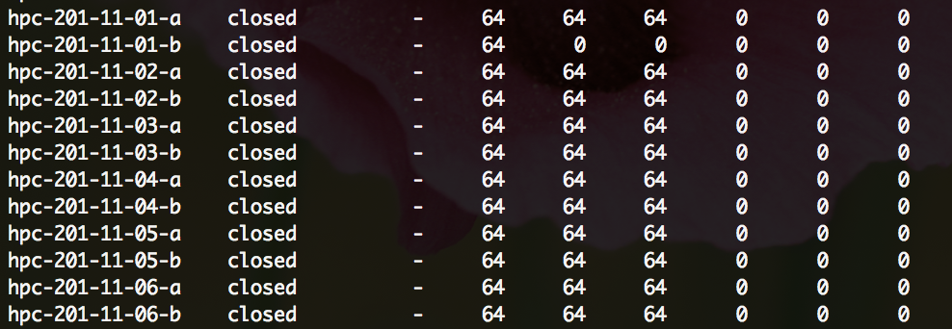
  HCP cluster at INFN-CNAF
  Typical simulation study requires hundreds of CPUs (8-16 CPUs per job) and 3-4 week to simulate 10⁴ turns
    HPC cluster at INFN-CNAF (in Bologna) extensively used for this purpose
  New HPC cluster dedicated to CERN studies ⁽¹⁾
    12 nodes running in LSF (32 cores each) → 384 CPUs with hyper-threading enable
    Simulations running steadily since June ☺
A. Falabella, “HPC Cluster at CNAF: a brief introduction”, ABP-CWG meeting #18

Slide 4
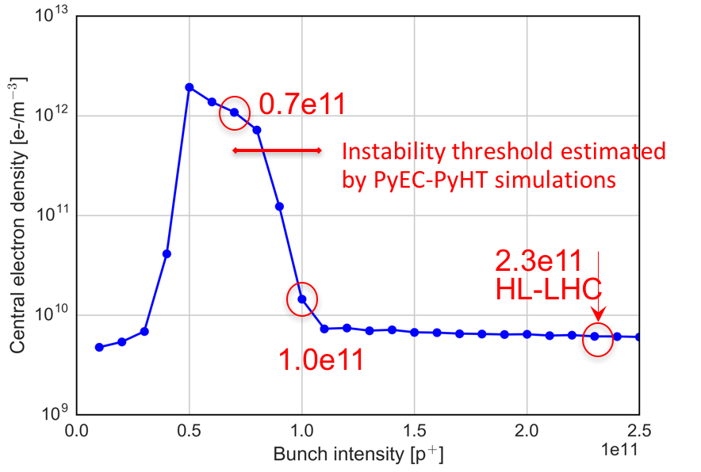
  Lessons learned from LHC 1/2
  EC in dipoles is not expected to drive instabilities both at injection and flattop energy
    the onset of instability development in dipoles depends on the electron density seen by the beam⁽¹⁾→ in the present conditioning state of the LHC estimated density below the instability threshold
    however the situation changes significantly when the bunch intensity decreases w.r.t. the nominal parameters → observations of instabilities in collisions consistent with our simulation studies ⁽²⁾ ☺
H. Bartosik et al., “BENCHMARKING HEADTAIL WITH ELECTRON CLOUD INSTABILITIES OBSERVED IN THE LHC”, ECLOUD12
A. Romano et al., “Instabilities in stable beams”, presentation at the ½ -day internal review of LHC performance limitations during run2

Slide 5
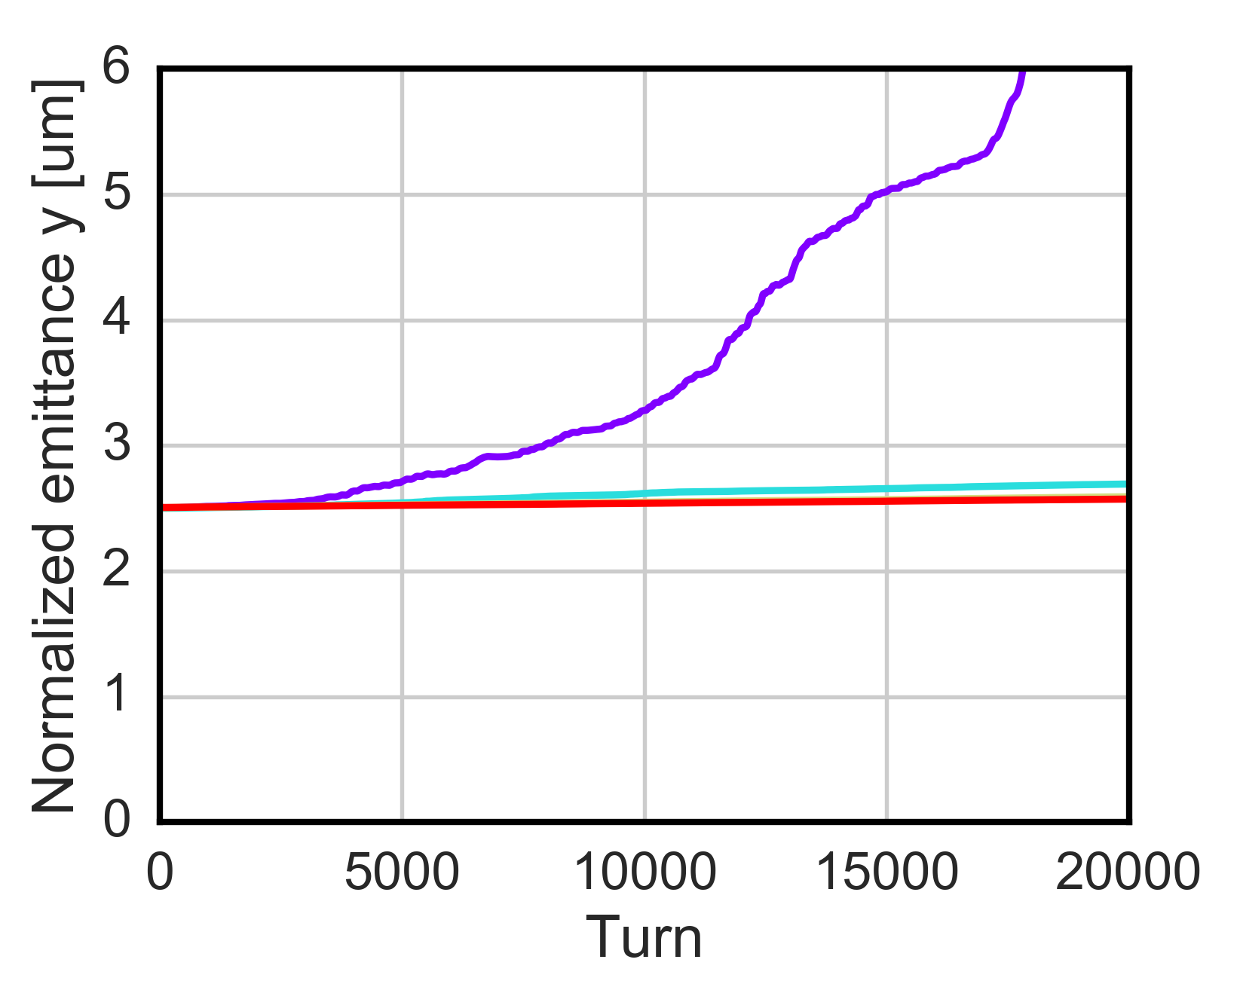
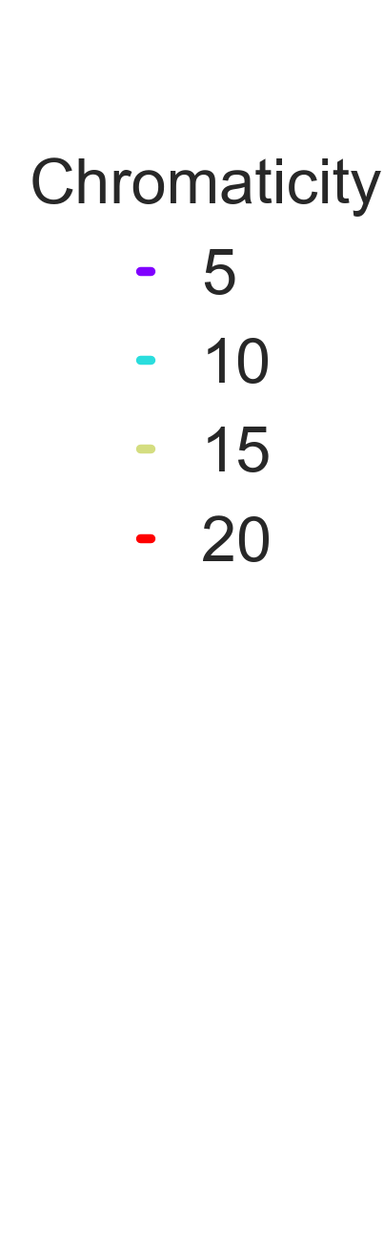
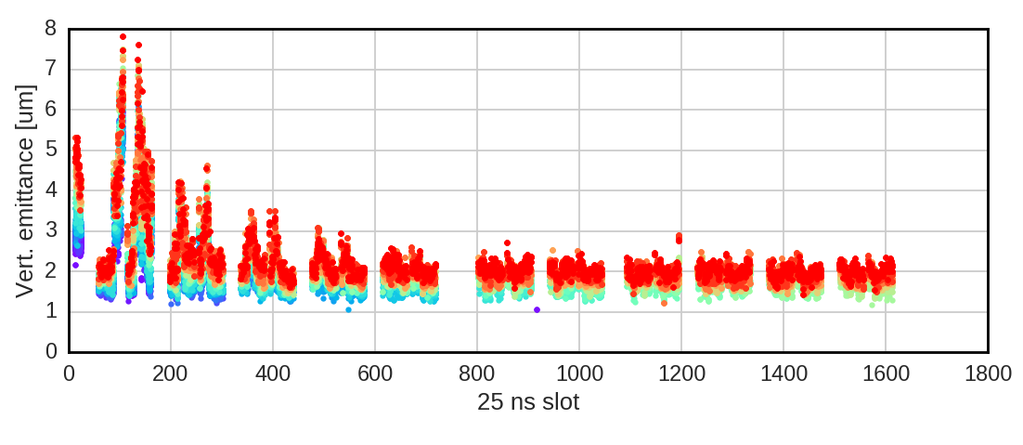
  Lessons learned from LHC 2/2
  EC in quadrupoles alone is a key driver of instabilities at the LHC injection energy ⁽¹⁾
    simulations allowed explaining instabilities observations → large chromaticity values, relatively high octupoles current and a fully functional feedback system were needed to reach a satisfactory emittance preservation
    instability suppressed when increasing the beam energy up to 6.5 TeV due to the increased beam rigidity
Bunch-by bunch emittance measurements
Simulation studies
Oct [A]
Chromaticity
6.5
5/5
13
5/5
13
10/10
13
15/15
26
15/15
52
15/15
52
10/15
52
20/15
(1) A. Romano et al., “Electron cloud induced instabilities in the LHC”, presentation at the Joint Ecloud-PyHEADTAIL Meeting

Slide 6
  Instability simulations for the HL-LHC
The interaction of a single bunch with an EC has been simulated in the dipole and quadrupole magnets separately
The parameters used are listed below
Parameters | Value @ 450 GeV | Value @ 7 TeV
N_{b} (p/bunch) | 0.6-2.4 x 10¹¹ | 0.6-2.4 x 10¹¹
𝜀_{x,y} (𝛍m) | 2.0 | 2.5
𝜎_{z} (cm) | 10.4 | 9.0
B (T, T/m) | 0.53, 12 | 8.3, 188.2
V_{400MHz} | 8 | 16
<𝛽_{x}> , <𝛽_{y}> | 92.7, 93.2 | 92.7, 93.2
Pre-squeezed optics → we can scan the beta function to study the impact of the ATS scheme ….

Slide 7
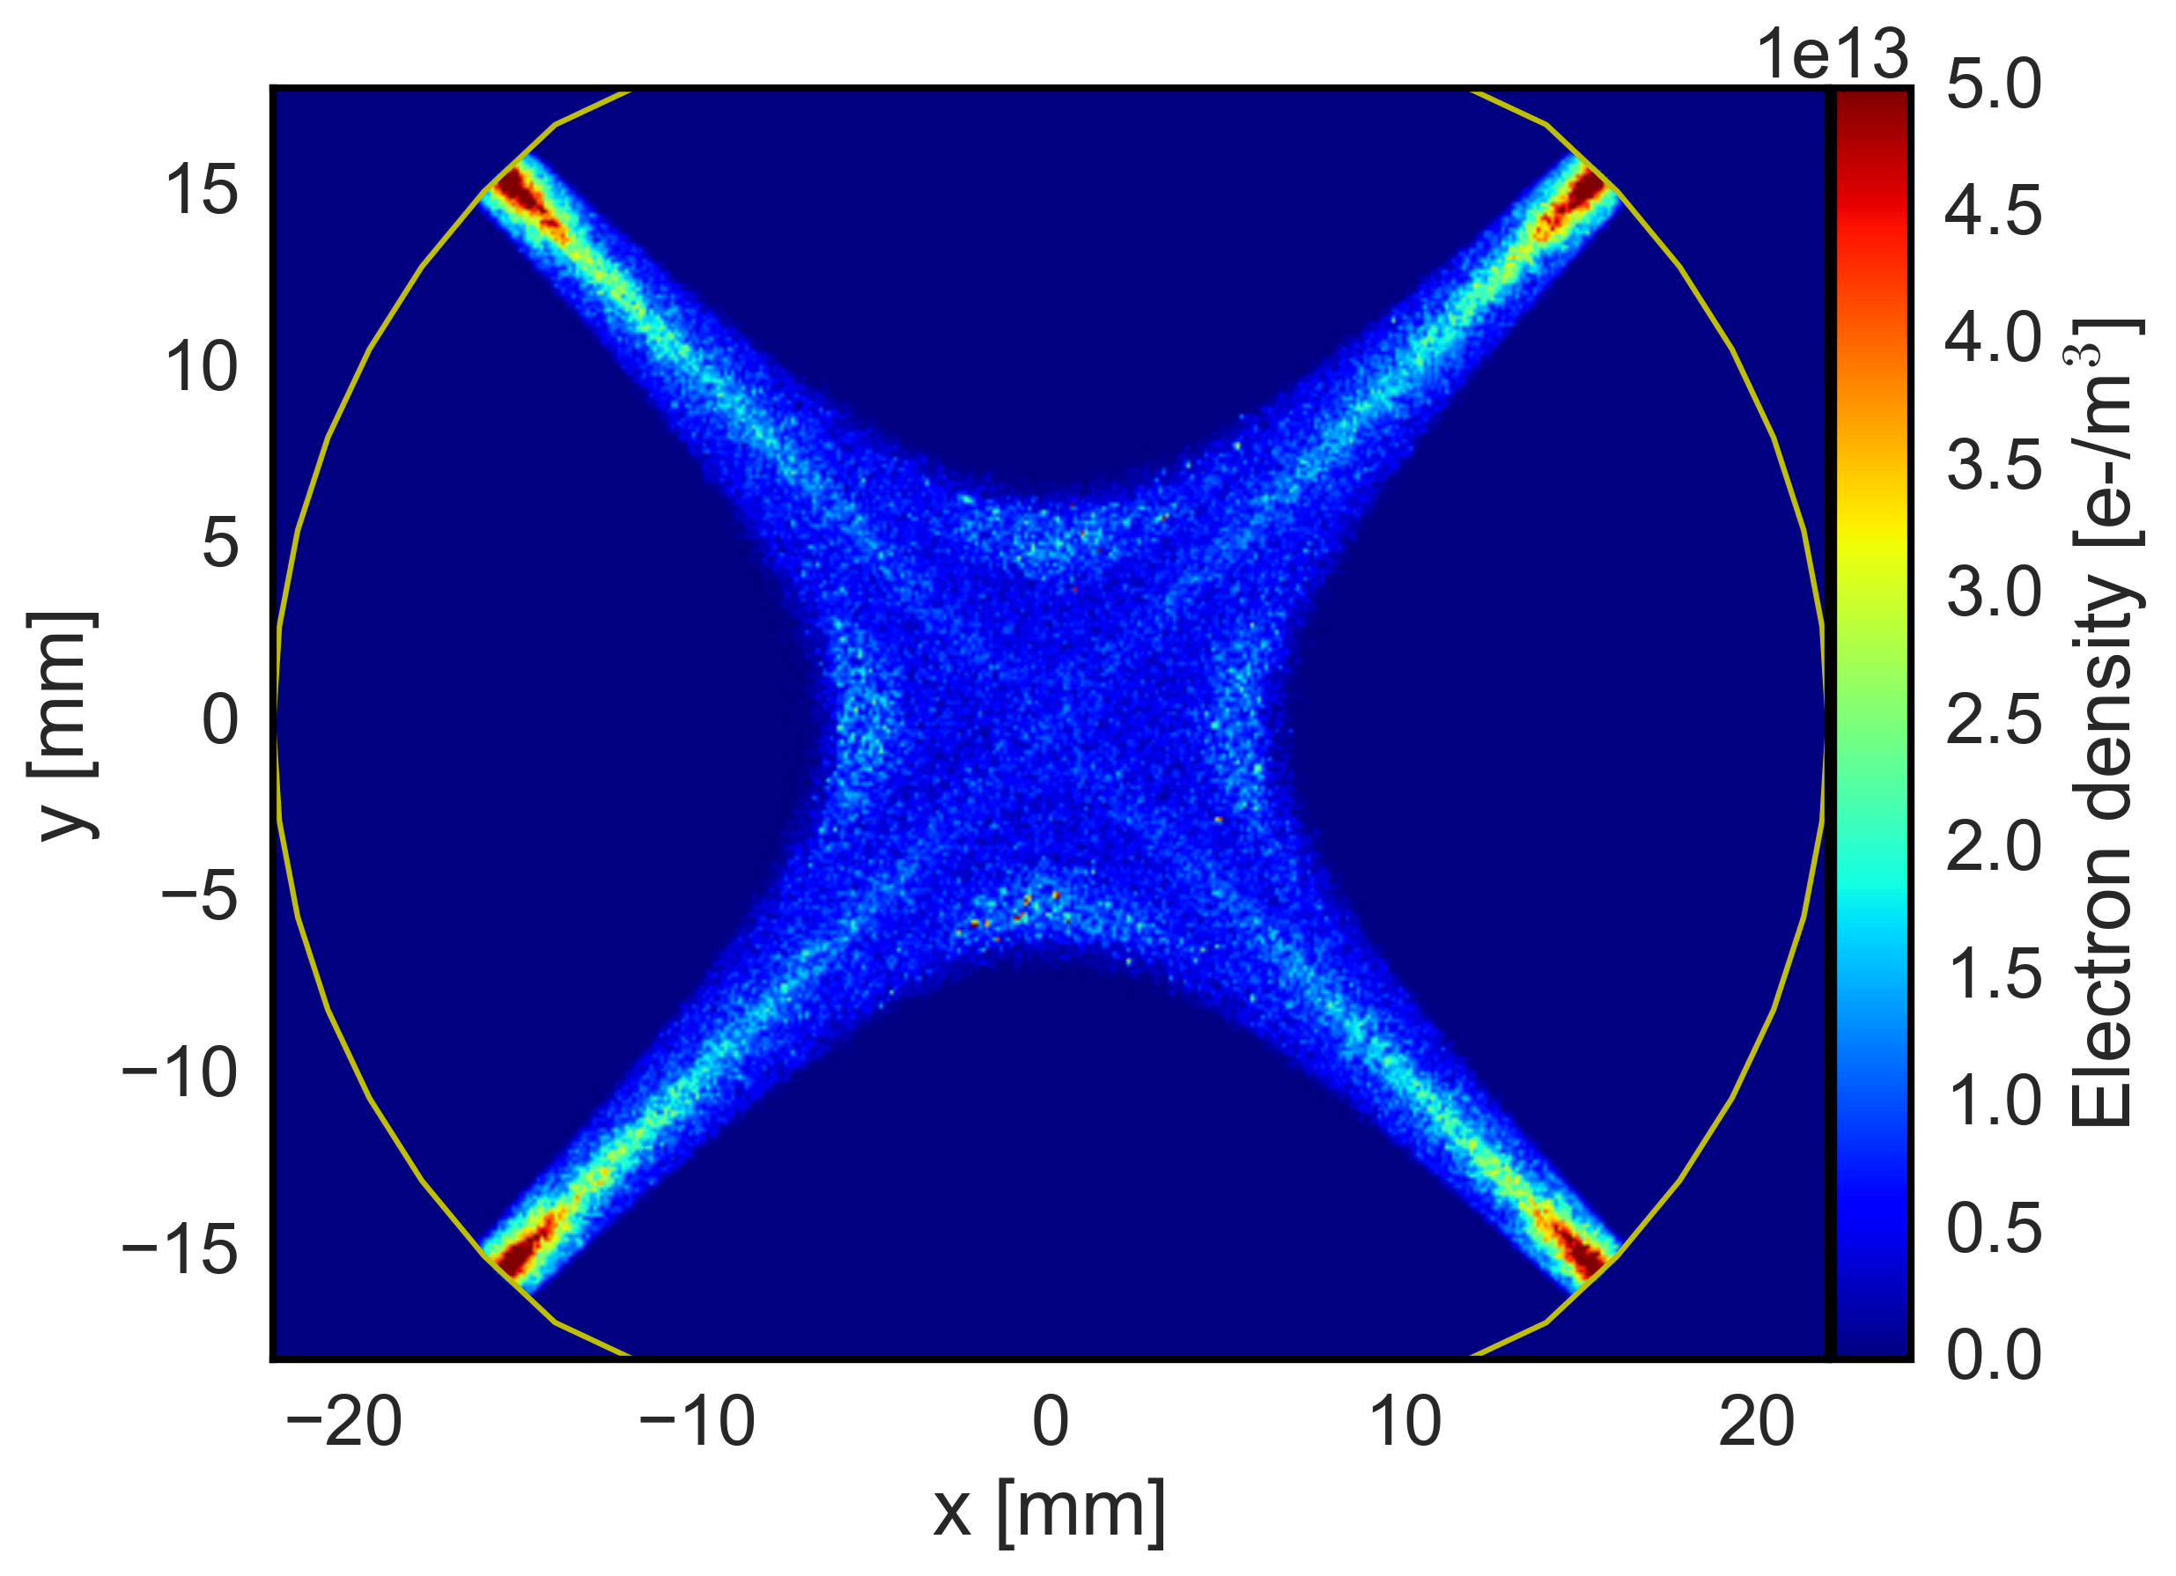
EC induced instability: quadrupole magnets
Due to electron trapping from magnetic field gradients EC density at the beam location can be very high
The EC pinch dynamics in the quadrupoles can be very sensitive to the initial phase space distribution again due to the trapping effects
    a realistic initial distribution of electron in the quadrupoles from build-up has to be used to assess the threshold for the coherent instability → self-consistent simulations with build-up ⁽¹⁾
We want to study the impact of the beam intensity on the instability development → Which initial EC distribution has to be taken into account?
(1) G. Iadarola et al., “EFFECT OF ELECTRON CLOUD IN QUADRUPOLES ON BEAM INSTABILITY”, IPAC15

Slide 8
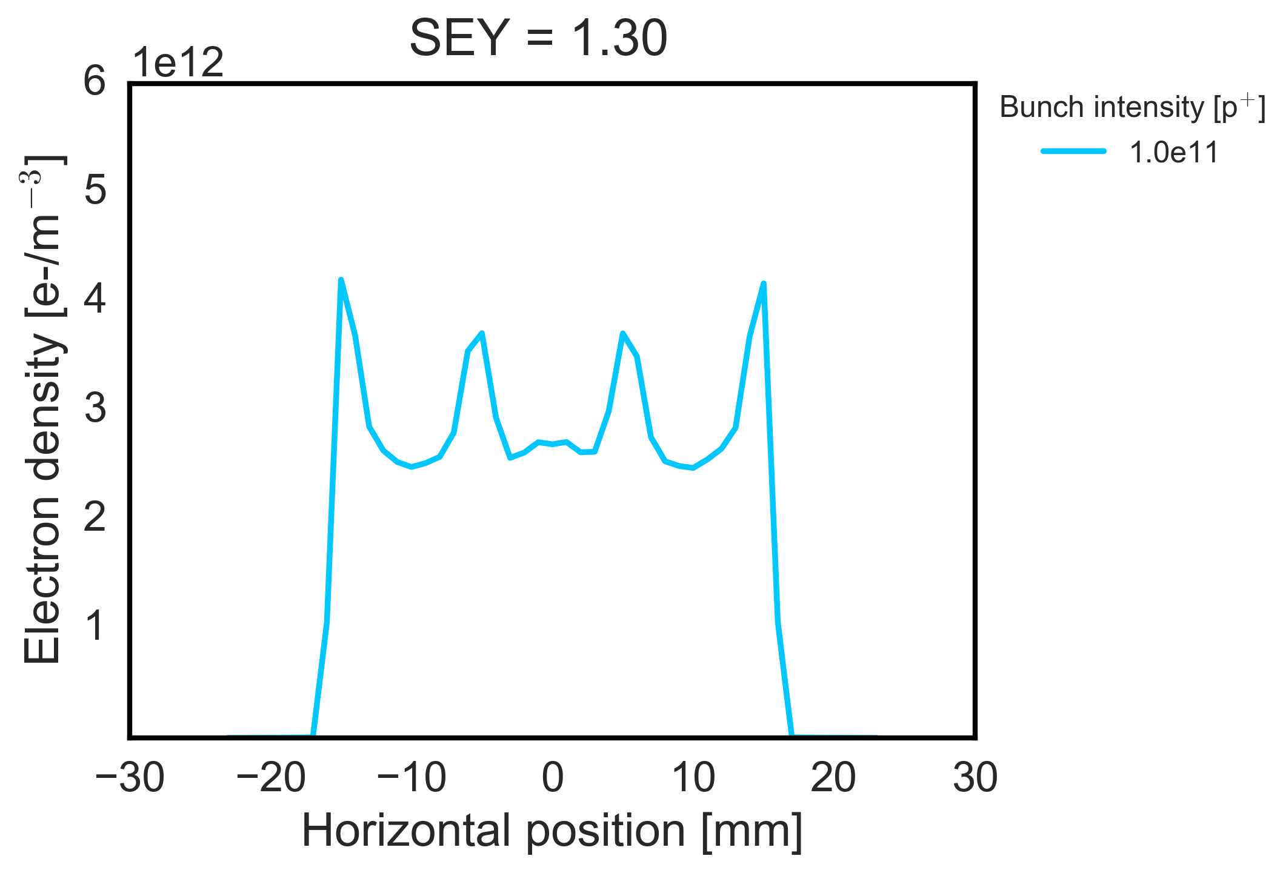
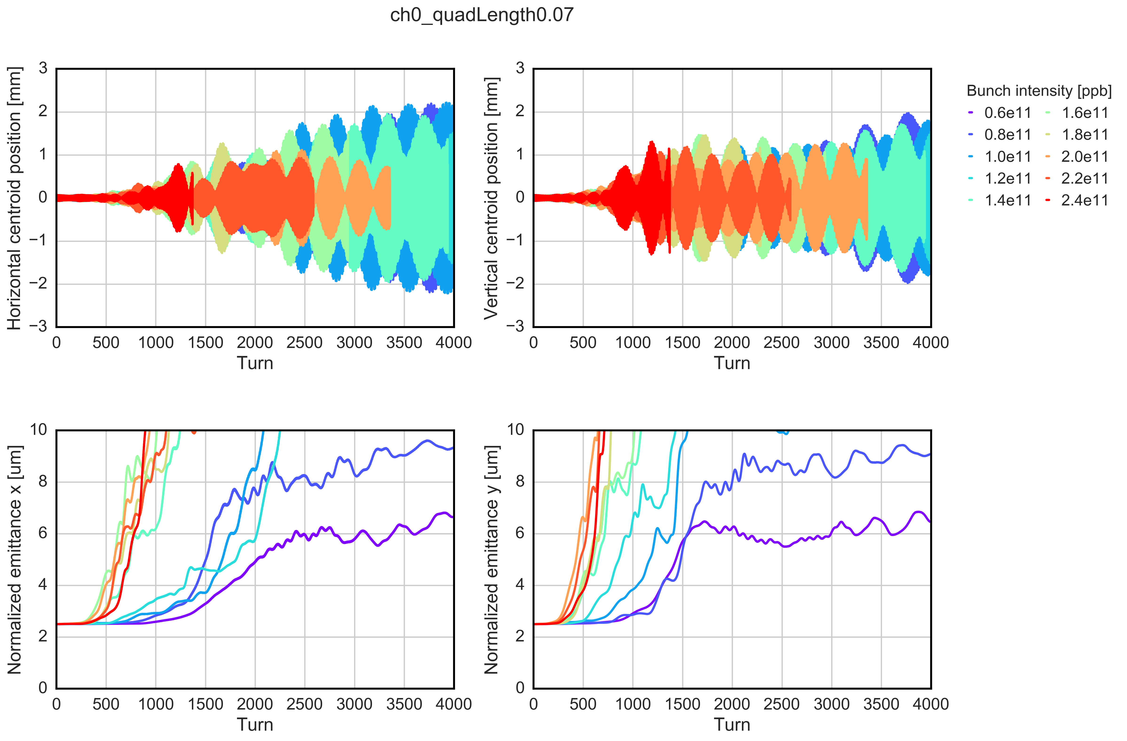
Impact of the initial electron distribution
  At first we wanted to investigate separately the effect of the intensity increase on the instability mechanism for the same initial EC distribution
    EC distribution computed for N_{b} =1.0e11 and then used it as input for a set of instability simulations → realistic distribution from build-up but not self-consistent with intensity
    Instability rise-time is much faster for higher beam intensities
EC density profile from
build-up simulations
  (Realistic total length of quadrupoles, NO chromaticity, NO octupoles, NO damper)

Slide 9
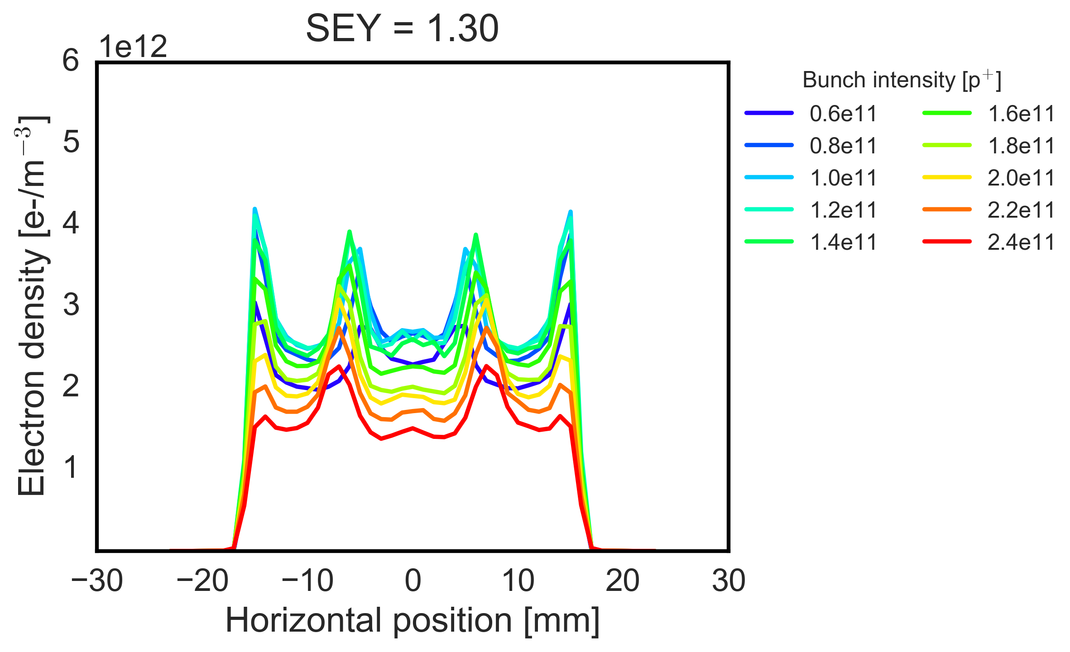
Impact of the initial electron distribution
  At first we wanted to investigate separately the effect of the intensity increase on the instability mechanism for the same initial EC distribution
    EC distribution computed for N_{b} =1.0e11 and then used it as input for a set of instability simulations → realistic distribution from build-up but not self-consistent with intensity
    Instability rise-time is much faster for higher beam intensities
  However, the EC density profile estimated for different bunch intensity shows that for increasing bunch intensities, the electron density decreases significantly all over the chamber
EC density profile from
build-up simulations

Slide 10
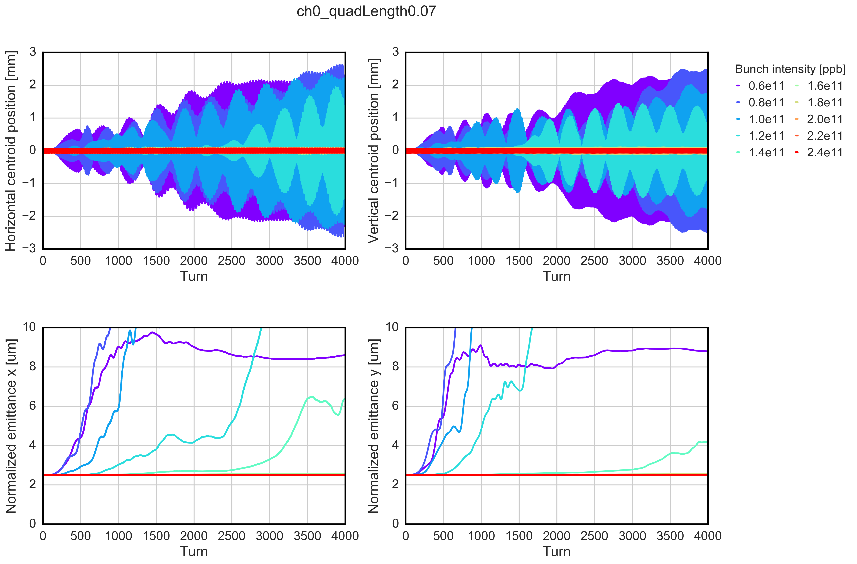
Impact of the initial electron distribution
Initial distribution from build-up assuming
N_{b} = 1.0e11→ same input for all cases
Initial distribution from build-up computed “ad-hoc” for each bunch intensity (self-consistent)
The electron density is overestimated (up to a factor 2) when using the same EC distribution (computed for N_{b} =1.0e11) as input for a set of instability simulations
Relying on self-consistent simulations
  Instability observed for lower bunch intensity → larger EC density in the chamber
  For higher bunch intensity the e- density is not sufficient to drive the bunch unstable

Slide 11
Impact of the initial electron distribution
Initial distribution from build-up assuming
N_{b} = 1.0e11→ same input for all cases
Initial distribution from build-up computed “ad-hoc” for each bunch intensity (self-consistent)
To estimate correctly the instability threshold we need run self-consistent simulations with bunch intensity → initial EC distribution computed “ad-hoc” for different bunch intensities and used as input for instability simulations
In these conditions the increase of the bunch intensity has a beneficial impact on the beam stability
The electron density is overestimated (up to a factor 2) when using the same EC distribution (computed for N_{b} =1.0e11) as input for a set of instability simulations
Relying on self-consistent simulations
  Instability observed for lower bunch intensity → larger EC density in the chamber
  For higher bunch intensity the e- density is not sufficient to drive the bunch unstable

Slide 12
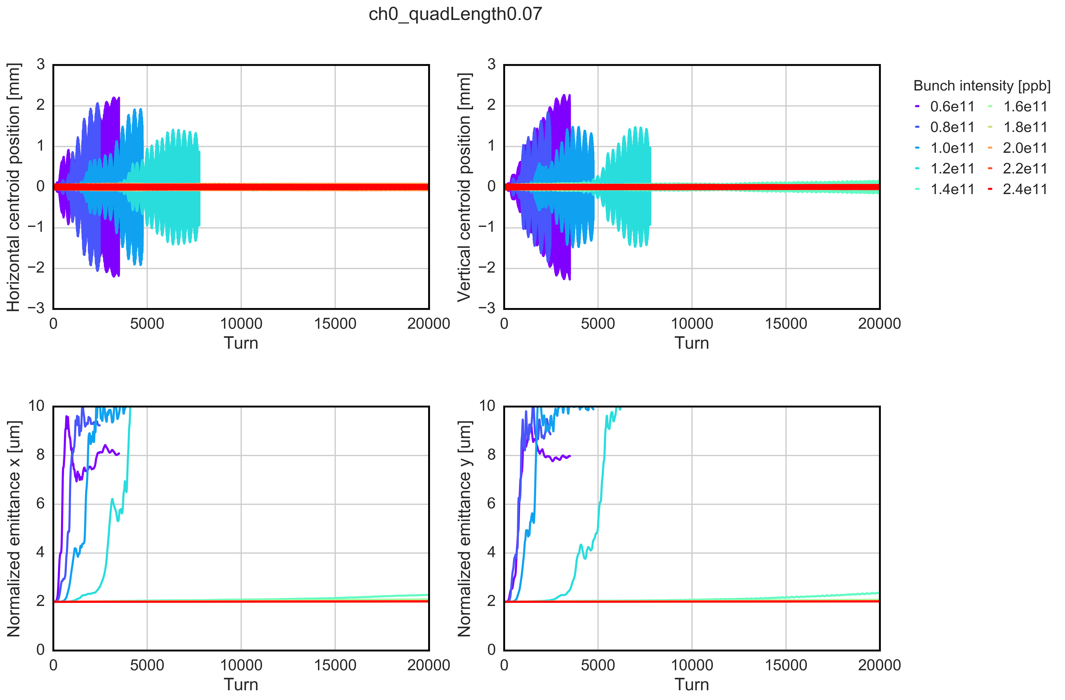
Arc quadrupoles @ 450 GeV: only EC
Instability observed in both planes, consistently with the symmetry of the e-cloud dynamics in the quadrupoles
  Unlike LHC, EC in quadrupoles is not expected to drive instabilities at injection within the beam intensity upgrade foreseen by HL-LHC (N_{b}=2.3e11 p/bunch) → provided that intensity dependence from build-up simulations is confirmed experimentally
EC in quads | Damper | Chromaticity | Octupoles current
SEY 1.3 | OFF | 0/0 | 0
  (similar behaviour in the horizontal plane)

Slide 13
Arc quadrupoles @ 450 GeV: only EC
Instability observed in both planes, consistently with the symmetry of the e-cloud dynamics in the quadrupoles
  Unlike LHC, EC in quadrupoles is not expected to drive instabilities at injection within the beam intensity upgrade foreseen by HL-LHC (N_{b}=2.3e11 p/bunch) → provided that intensity dependence from build-up simulations is confirmed experimentally
EC in quads | Damper | Chromaticity | Octupoles current
SEY 1.3 | ON | 0/0 | 0
In order to identify potential stabilization mechanisms we need to study the unstable cases (far from the realistic scenario …)
  (similar behaviour in the horizontal plane)

Slide 14
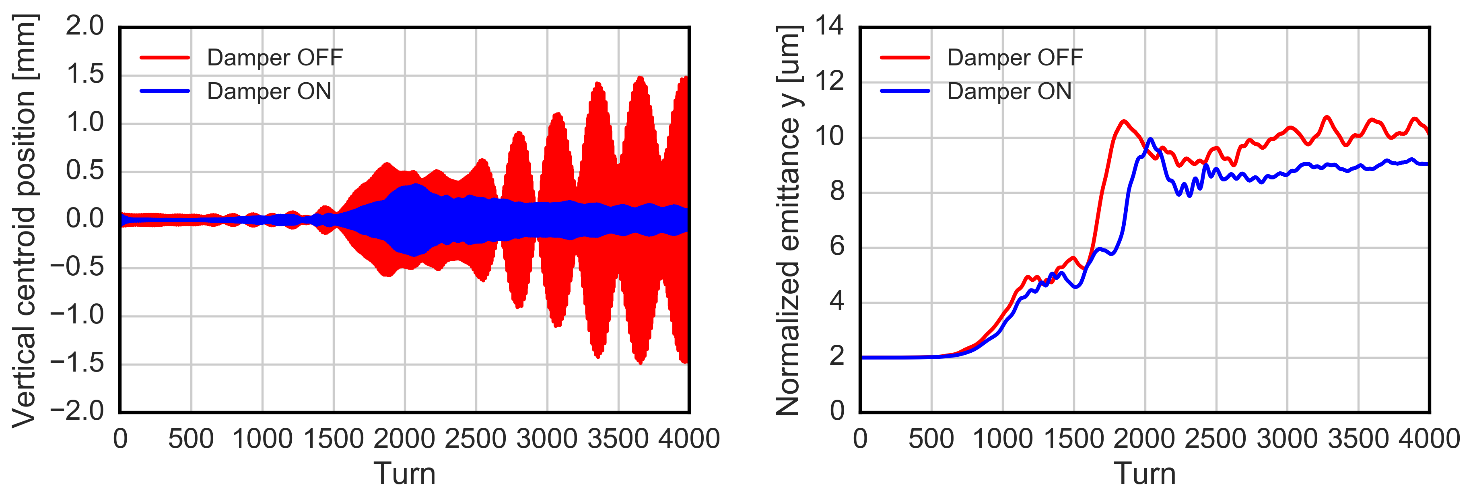
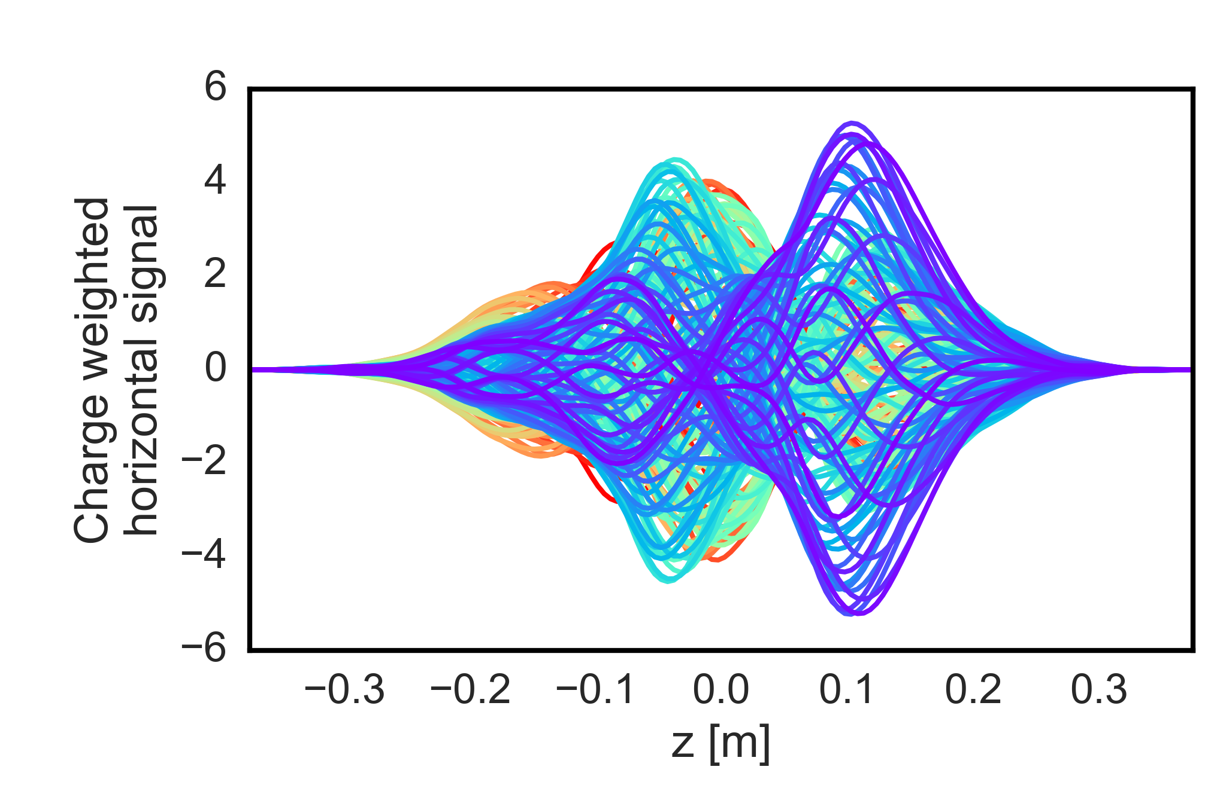
Arc quadrupoles @ 450 GeV: transverse feedback effect
Feedback system helps in reducing the centroid oscillation but not the emittance growth
  Higher order modes excited → cannot be damped by the traditional damper
  Consistent with the machine observation during the scrubbing run → higher damper gain helped to mitigate fast losses
EC in quads | Damper | Chromaticity | Octupoles current
SEY 1.3 | ON | 0/0 | 0
  N_{b} = 1.0e11 ppb
  (similar behaviour in the horizontal plane)
Notes:
Visot in lhc … scrubbing run

Slide 15
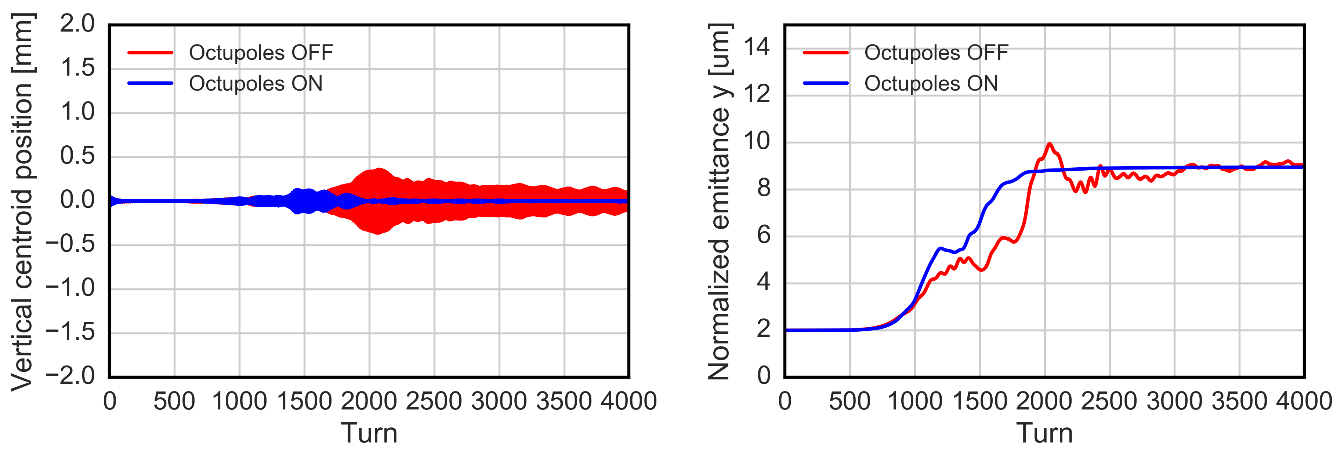
Arc quadrupoles @ 450 GeV: octupoles effect
Mild stabilizing effect of octupoles alone → emittance growth still visible
Octupoles might be less effective due to the smaller beam emittance → next step: detailed emittance and octupole scan
EC in quads | Damper | Chromaticity | Octupoles current
SEY 1.3 | ON | 0/0 | 26 A
  N_{b} = 1.0e11 ppb
  (similar behaviour in the horizontal plane)

Slide 16
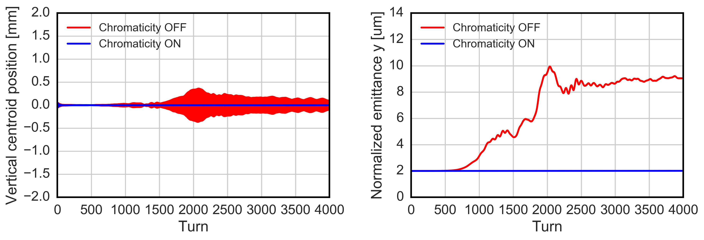
Arc quadrupoles @ 450 GeV: chromaticity effect
Strong impact on the emittance growth and on the bunch oscillation as well
  Large chromaticity values can ensure the beam stability
EC in quads | Damper | Chromaticity | Octupoles current
SEY 1.3 | ON | 20/20 | 0
  N_{b} = 1.0e11 ppb
  (similar behaviour in the horizontal plane)

Slide 17
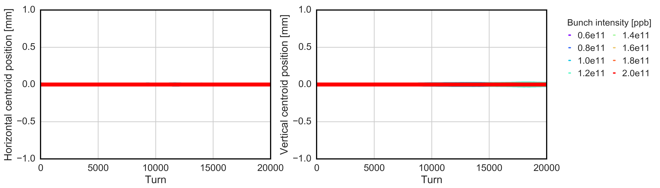
Arc quadrupoles @ 7 TeV: only EC
For bunch intensities larger than 2.0e11 the multipacting process does not occur for SEY=1.30
Strong stabilizing effects of the increased beam energy → effect of the increased beam rigidity
Few unstable cases around LHC-like intensities can be observed in only the vertical plane, developing after 10k simulated turns
  Due to higher intensity EC in quadrupoles should not be an issue in HL-LHC
EC in quads | Damper | Chromaticity | Octupoles current
SEY 1.3 | OFF | 0/0 | 0

Slide 18
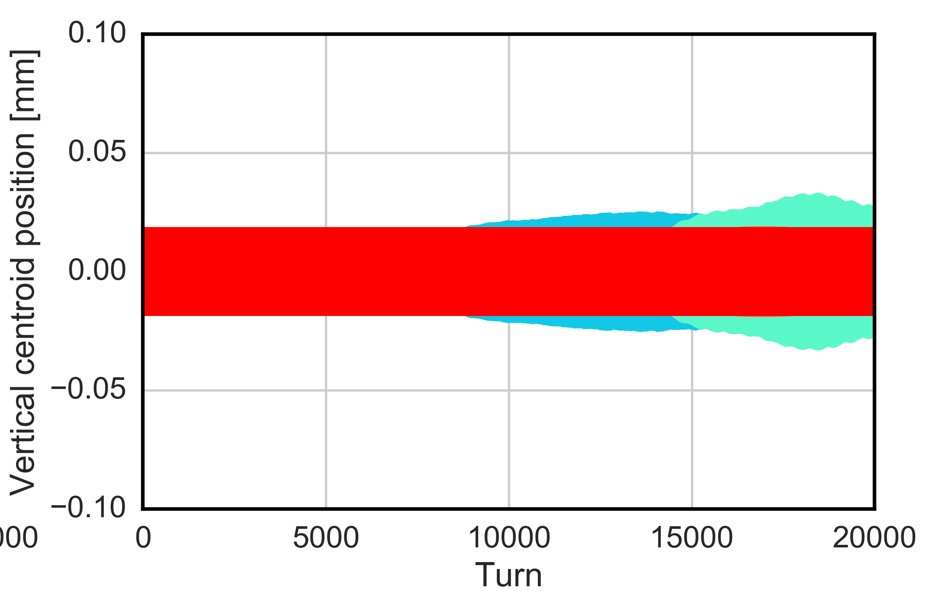
Arc quadrupoles @ 7 TeV: only EC
For bunch intensities larger than 2.0e11 the multipacting process does not occur for SEY=1.30
Strong stabilizing effects of the increased beam energy → effect of the increased beam rigidity
Few unstable cases around LHC-like intensities can be observed in only the vertical plane, developing after 10k simulated turns → to be simulated together with damper, chromaticity and octupoles
  EC in quadrupoles should not be an issue in HL-LHC
EC in quads | Damper | Chromaticity | Octupoles current
SEY 1.3 | OFF | 0/0 | 0

Slide 19
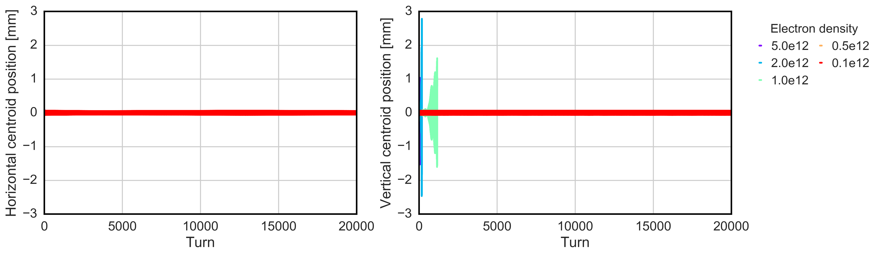
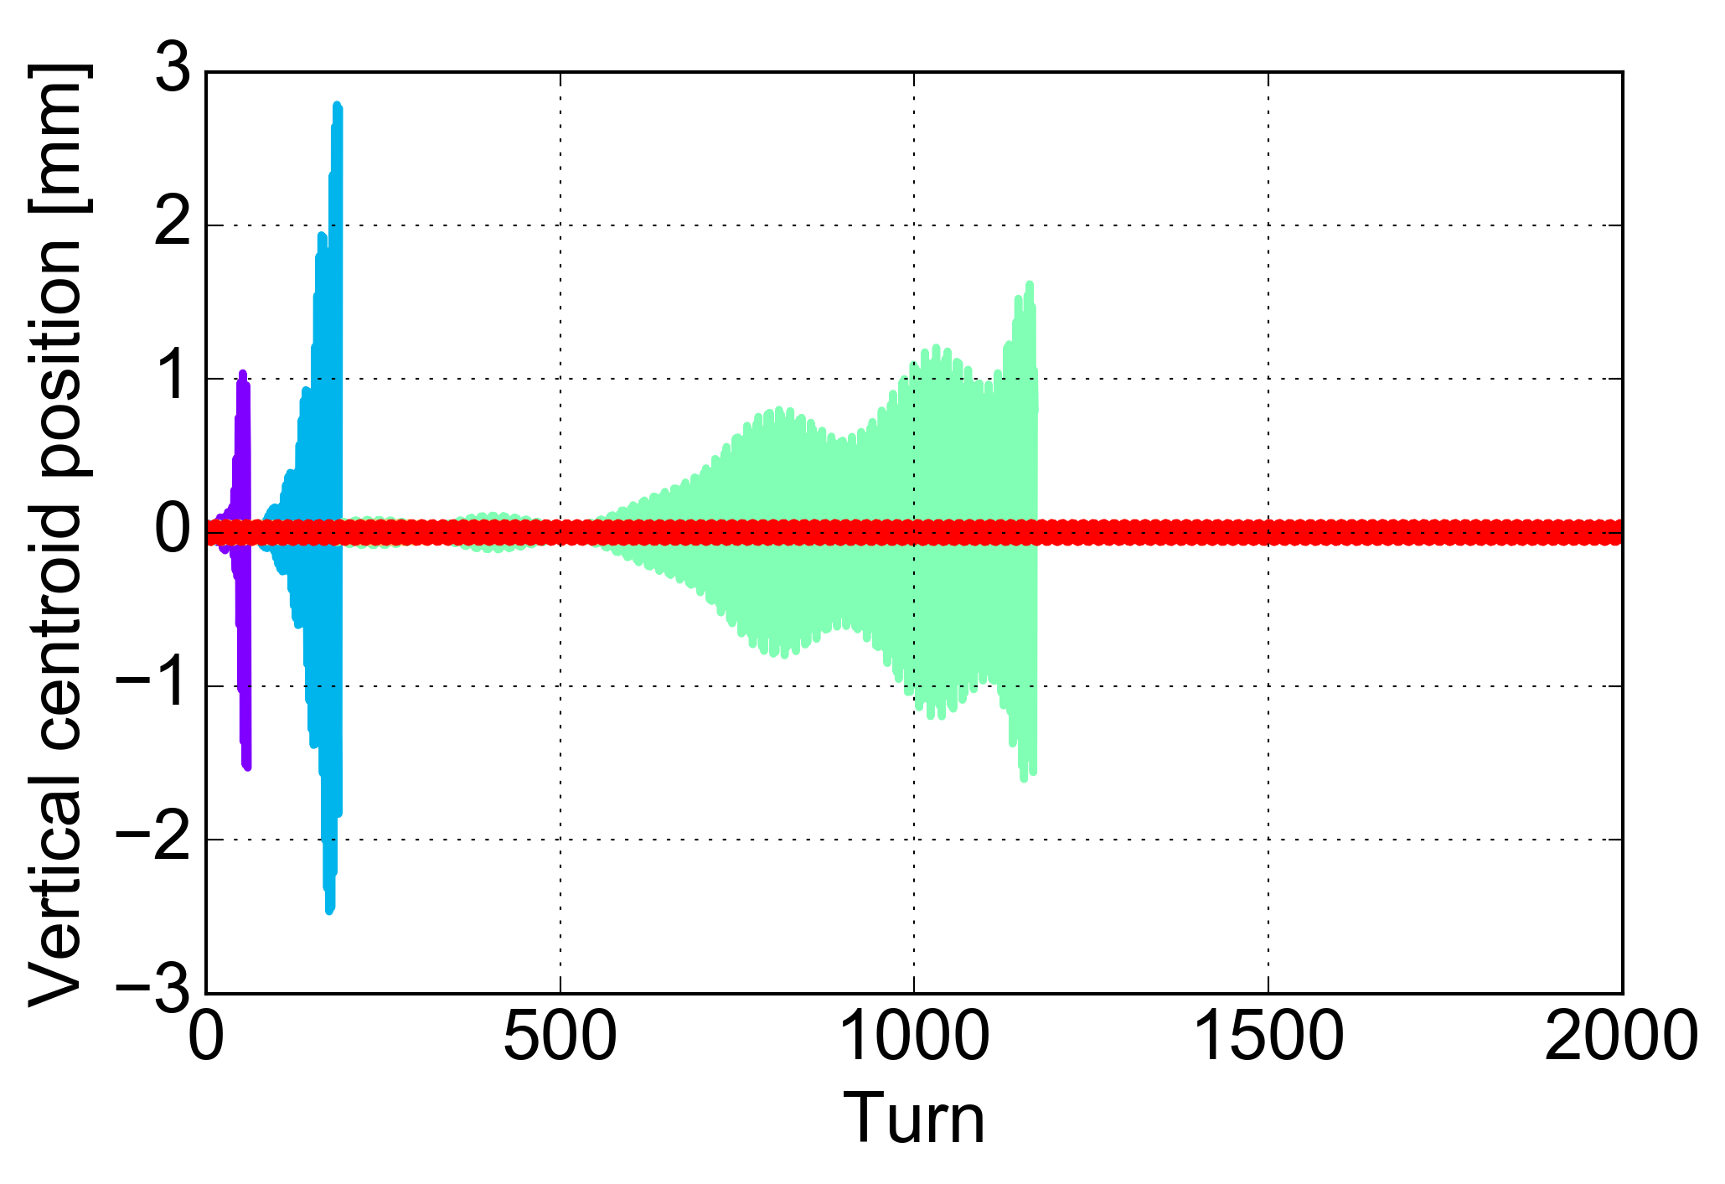
Arc dipoles @ 450 GeV: a first look
EC distribution is initialized uniform within the dipole chamber and its density is scanned → good approximation⁽¹⁾
Instabilities observed only in the vertical plane
  fast rise-time for large e- densities
  instability threshold at around 1e12 e-/m³
EC density in Dip | Damper | Chromaticity | Octupoles current
1e11-5e12 | OFF | 0/0 | 0
  N_{b} = 2.2e11 ppb
(1) H. Bartosik et al., “BENCHMARKING HEADTAIL WITH ELECTRON CLOUD INSTABILITIES OBSERVED IN THE LHC”, ECLOUD12

Slide 20
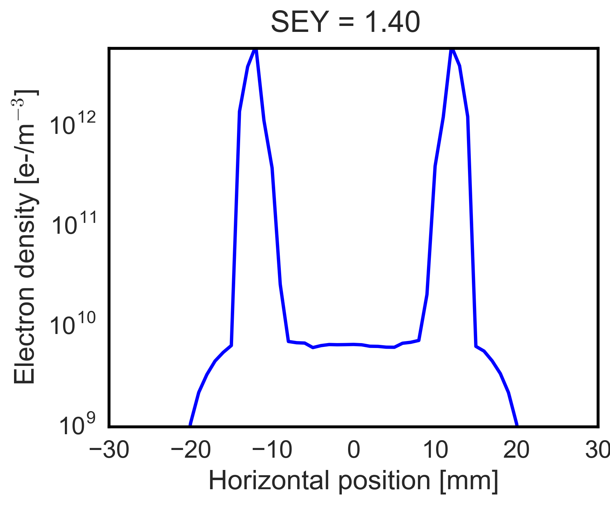
Arc dipoles @ 450 GeV: a first look
EC distribution is initialized uniform within the dipole chamber and its density is scanned → good approximation⁽¹⁾
Instabilities observed only in the vertical plane
  fast rise-time for large e- densities
  instability threshold at around 1e12 e-/m³
  Estimated e- density from PyECLOUD build-up simulations
  SEY_{DIP} = 1.40
Central density well below the estimated instability threshold
(1) H. Bartosik et al., “BENCHMARKING HEADTAIL WITH ELECTRON CLOUD INSTABILITIES OBSERVED IN THE LHC”, ECLOUD12

Slide 21
Conclusions
  Simulation results show that the beam intensity increase foreseen by the HL-LHC has a beneficial impact on the beam stability
  Unlike LHC, the EC in quadrupoles in HL-LHC is not expected to drive the beam unstable both at injection and flattop energy → provided that intensity dependence from build-up simulations is confirmed experimentally
    However potential mitigation strategies have been investigated → strong stabilizing effect from large chromaticity (20/20) and mild effect from octupoles and damper
    Next steps → scan in beam emittance, octupoles current, chromaticity and beta function
  Preliminary studies in dipoles show that the EC density in the beam chamber is well below the estimated instability threshold → EC induced instabilities are not expected

Slide 22
Thanks for your attention!

