Slide 1
Beam-beam checks
R. De Maria

Slide 2
Code MadX vs SixTrack
SixTrack
xv(1,j) -> x; xv(2,j) -> y;
clobeam(1,imbb(i)) -> x_{CO}
clobeam(2,imbb(i)) -> y_{CO}
ed(ix) -> sep x; ek(ix) -> sep y
rho2b -> distance from bb element
crkveb(j)=xv(1,j)-clobeam(1,imbb(i))+ed(ix)
cikveb(j)=xv(2,j)-clobeam(2,imbb(i))+ek(ix)
rho2b(j)=crkveb(j)*crkveb(j)+cikveb(j)*cikveb(j)
c6t_elem->value[12] = el_par_value_recurse("xma",p->p_elem);
c6t_elem->value[13] = el_par_value_recurse("yma",p->p_elem);
el->out_2 = c1p3*(el->value[12] - beamx);
el->out_3 = c1p3*(el->value[13] - beamy);
Madx to SixTrack
xma -> bb posx; yma -> bb posy
beamx -> x_{CO}; beamy -> y_{CO};
el->out_2 -> sepx; el->out_2 -> sepy;
xm = node_value('xma ')
ym = node_value('yma ')
xs = track(1,itrack) - xm
ys = track(3,itrack) - ym
rho2 = xs * xs + ys * ys
Madx Track
xma -> bb pos x; yma -> bb pos y
rho2 -> distance from bb element
Thanks Jean-Baptiste for point it out!

Slide 3
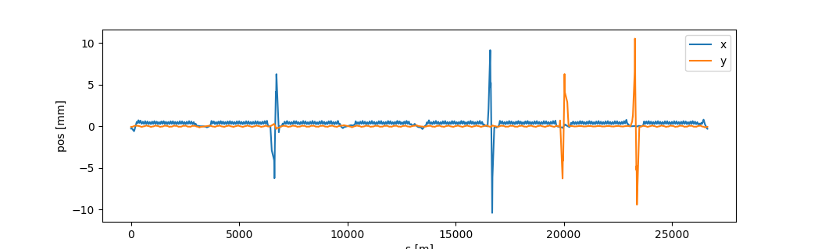
LHC old model
IP1
IP5
IP8
IP2
Tracked orbit with δ>0, close to the closed orbit on old LHC model (LHC V6.4 executed in 2012 using V4.4.38) used in the test suite to check for regressions.
Positive dispersion, positive crossing angle in IP5/IP1, negative crossing angle in IP2/IP8
->Same sign conventions as MadX.

Slide 4
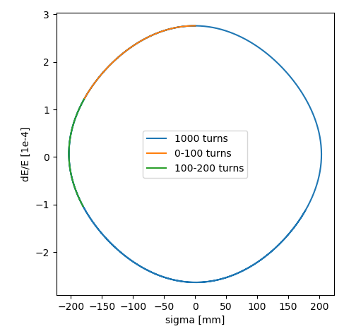
Synchrotron motion
LHC is above transition energy.
Positive energy deviation ->
Larger radius ->
Longer revolution period ->
Accumulate delay ->
Negative position in bunch.
Delta and sigma (~T in mad) have same sign convention as MadX (beware of orbit5=-t in sum table).
tail
head

Slide 5
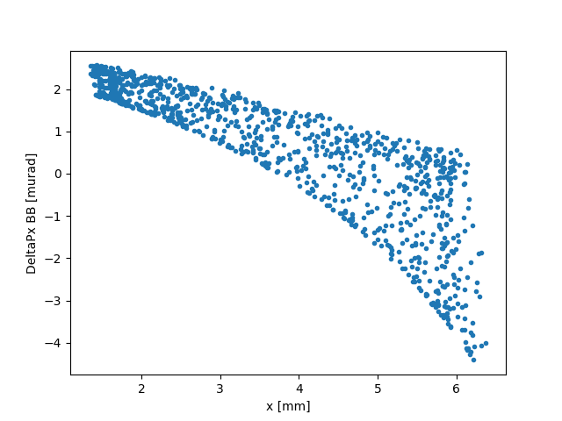
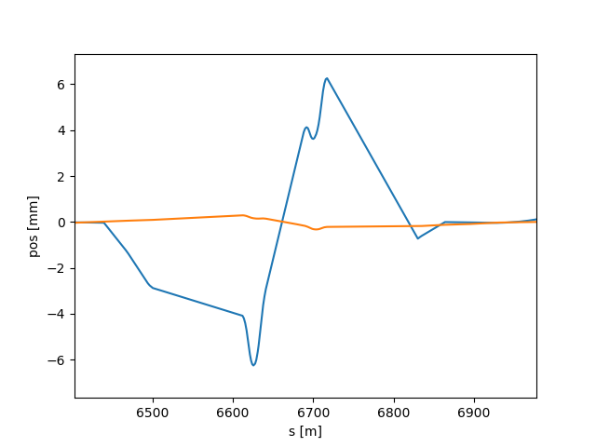
Beam–beam kick as a function of position
6th LR right Beam 1 close to the TAS
Negative separation in the SixTrack input file (fort.2)
bbip5pr6 20 -6.434372e+00 1.18895e-03 1.000000e+00
Kicks get larger for positive orbit outside the ring.
Element beam-beam effectively at x~9.6 mm from the reference orbit.
Closed orbit

Slide 6
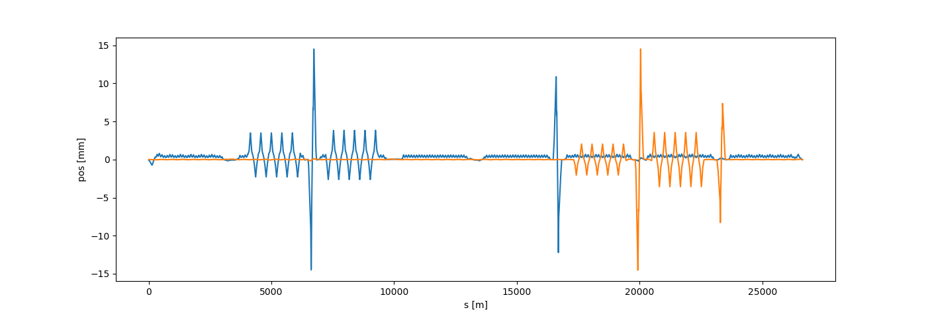
HLLHC Orbit
IP1
IP5
IP8
IP2
Tracked orbit with δ>0, close to the close orbit. Recent HL-LHC model with expert interface.
Positive dispersion, positive crossing angle in IP5/IP1/IP2, negative in IP8
Same sign conventions as MadX.

Slide 7
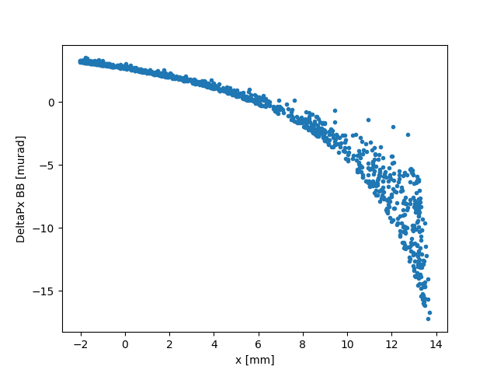
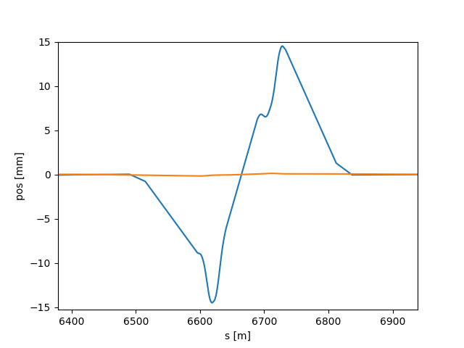
Beam–beam kick as a function of position
6th LR right Beam 1 close to the TAS
Negative separation in the input file
(EXPERT interface)
bb_par.r5b1_6 0 0.28168 0.2814381 -11.4444 1e-07 1
BB lens effective at 17.1 mm outside the ring with respect to the reference orbit.
Closed orbit

Slide 8
Next steps
Look at crab crossing and head-on slices (RF curvature effects taken into account) with Dario and Nikos.
Final decision on whether fix converters (old input wrong, new input correct) or SixTrack (old results wrong, new results correct).

Slide 9
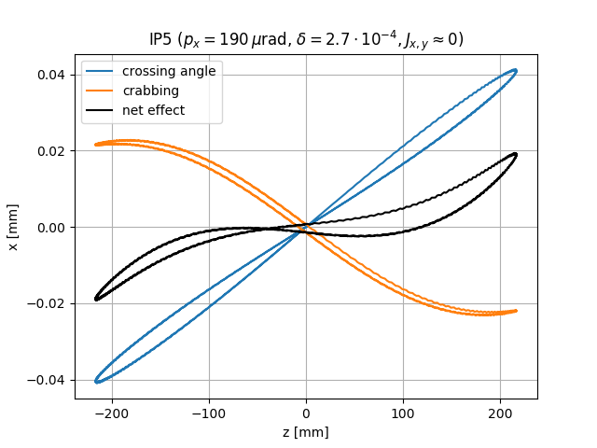
Crab crossing (preliminary)
Assuming s_{IP}=0 and t_{CO}=0, a particle arriving at (–t) in s=0 will be at s=ct at t=0
x(s=ct,t=0) = x(s=0,t=-t) + p_{x}(s=0,t=-t)*ct
Understand effect of dispersion,
crab non-closure,
crab phase-errors..

