Slide 1
Revisiting particle dynamics with synchrotron radiation in LEP with MADX and MAD8
John Jowett
For references and background see
https://indico.cern.ch/event/618760/

Slide 2
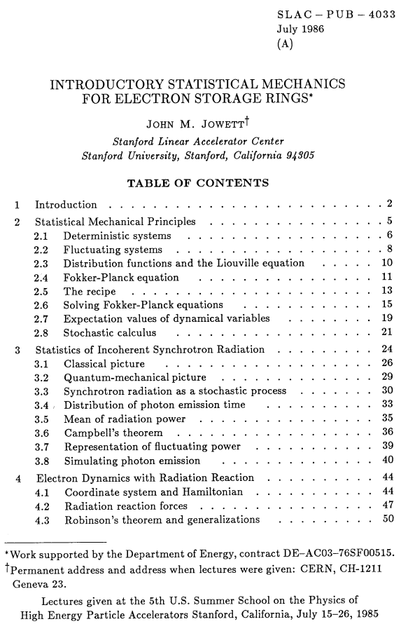
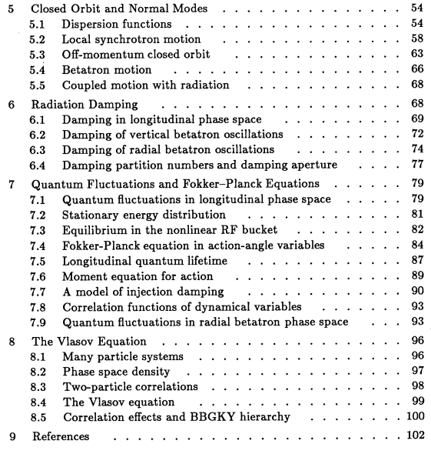
Theoretical background: USPAS 1985

Slide 3
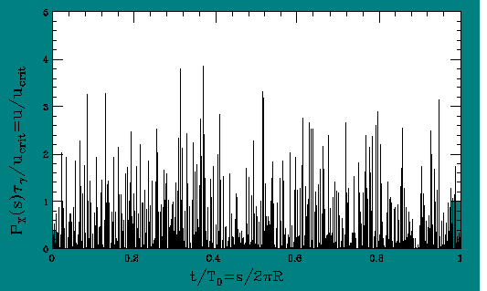
Stochastic Radiation Power
Random emission time and photon energy
Instantaneous radiation power
Simulated photon emission in a fixed magnetic field
See SLAC Summer School for further details. Representation of power can be approximated or simplified in various ways of which this is one.

Slide 4
General equations of motion
Combine Hamiltonian and radiation reaction
  Special form applies in Courant-Snyder coordinates only.
  Define radiation coupling
  functions, dependences on
  momenta
  (root of Robinson Theorem):
Stochastic differential equations of motion

Slide 5
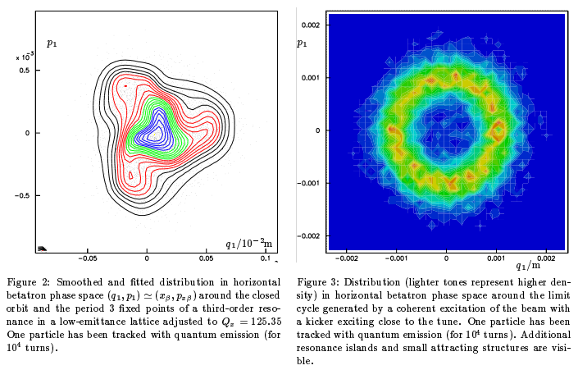
EPAC paper introduced MAD8 implementation 1994

Slide 6
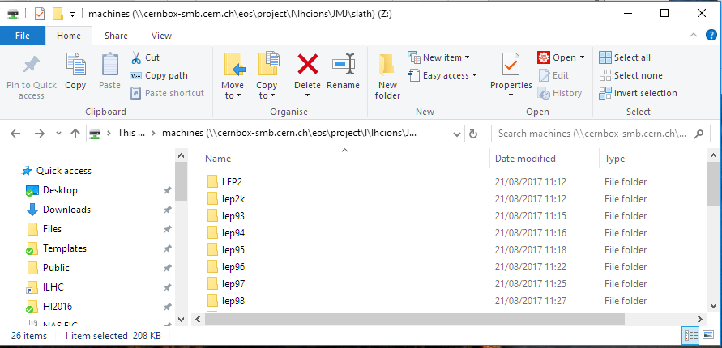
LEP optics database in MADX format - notebook
Conversion of LEP optics database to MADX format
  Not absolutely complete but sufficient
  Available on CERN EOS file system in LHCions project space
    So OK for Windows or Linux users

Slide 7
Tests with MAD8
Large scale systematic Monte-Carlo evaluation of many LEP optics done during 1990s
  Machines generated and corrections applied as in operation
    Closed orbit – same correctors for both beams
    Coupling, tunes, chromaticity, etc
  Error generation, applied to reverse sequence for other beam
  Correlations of beam parameters with errors
    Eg vertical dispersion
  Tracking with radiation damping for dynamic aperture
    4-D scans of 6D phase space of initial conditions
  Tracking with quantum fluctuations for beam distributions

Slide 8
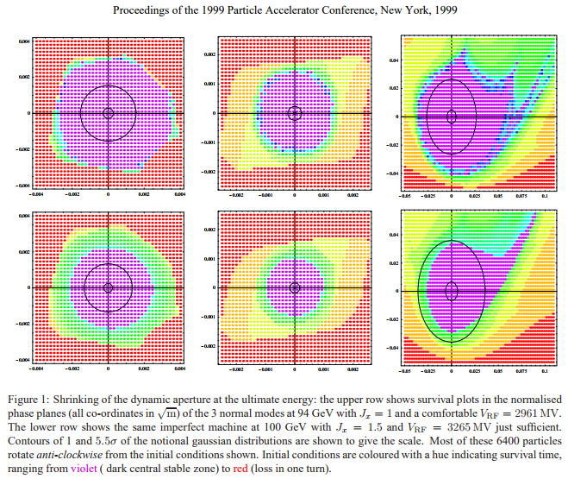
Example dynamic aperture vs RF voltage

Slide 9
Reviving LEP in MAD8
Although process was based on Mathematica some MAD8 tracking data was saved in EPIO format
  Had to use PAW (predecessor of ROOT) to access these files
  Still the only possibility, I can’t remember how …
Recent tests recovered essential MAD8 functionality with this restriction
  Shorter tracking runs still accessible in detail
  I will not go into detail on this since few people in this group are using MAD8 now
  Briefly show notebook
Conclusion
  You can still use MAD8 for optics with radiation etc
  Some advantages over MADX:
    Thick lens tracking (no need for thin-lens version of optics)
    Mais-Ripken optical functions in TWISS3

Slide 10
Reviving LEP in MADX
Switch to notebook
Conclusions
  EMIT seems to work for beam parameters (coupled emittances etc)
  No TWISS3 but TWISS seems OK for many purposes
  Tracking only possible with a thin-lens conversion
  Tracking results are close enough to MAD8 in test cases (allowing for thick/thin optics differences)
  Possible to access full data from tracking with quantum fluctuations
  I did not test symplectic tracking with radiation
    Special canonical transformation, gives true closed orbit, tunes, etc but no radiation damping (see references)

Slide 11
Access to this material
As mentioned, a copy of the LEP optics database with original MAD8 files plus new MADX versions is available on EOS
Contains copies of the Mathematica notebooks used to:
  Generate MADX files in the database
  Get LEP working with radiation in MAD8
  Get LEP working with radiation in MADX with comparisons to the MAD8 results
To try these, you need to make your own copies of the notebooks somewhere else

Slide 12
BACKUP SLIDes

