Slide 1
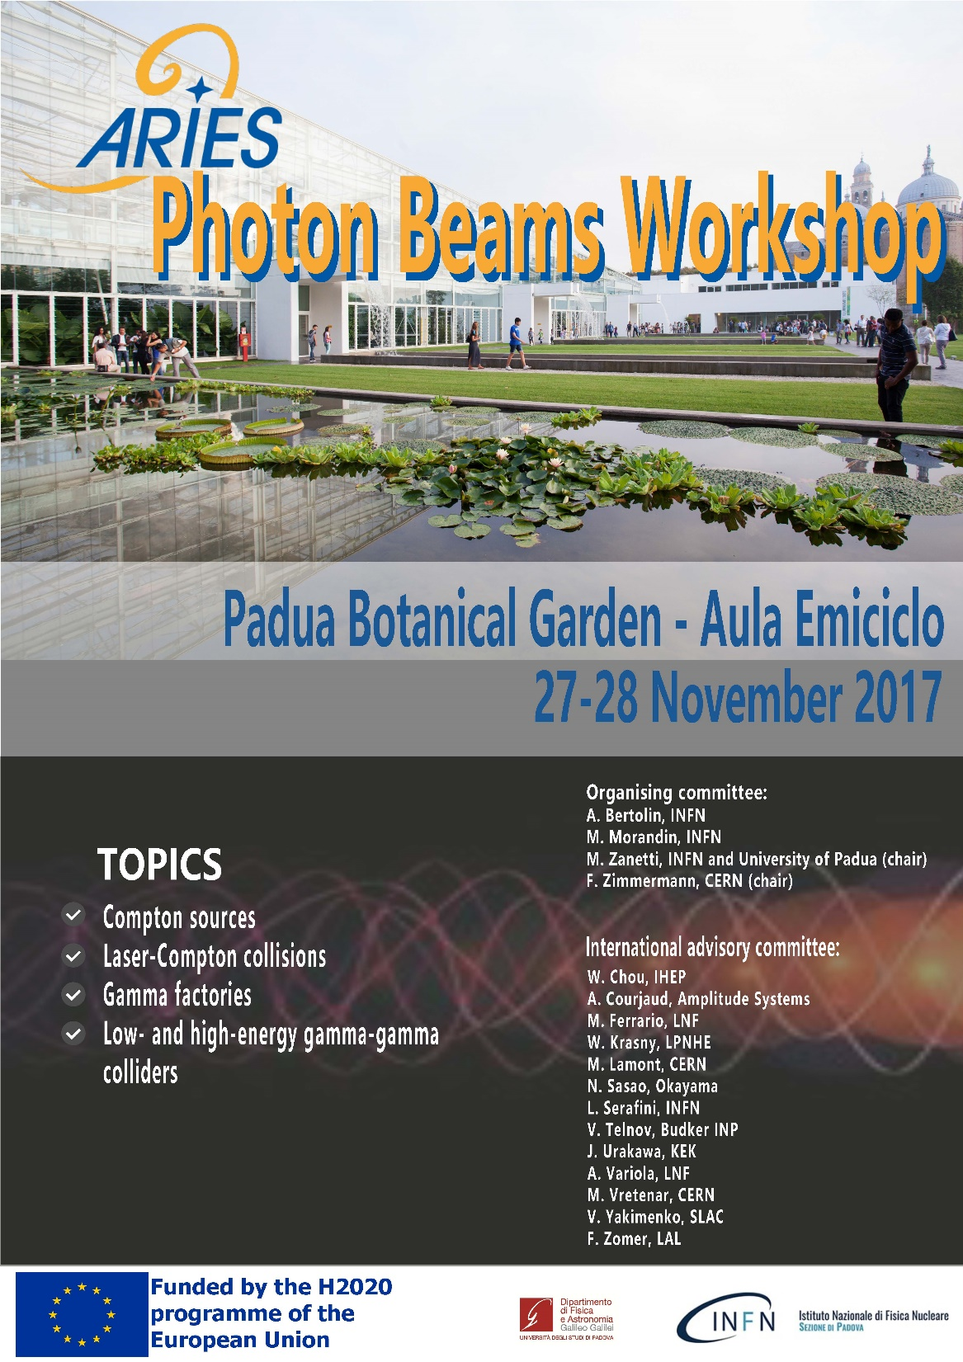
Photon Beams workshop
Padua
27-28 November 2017
introduction to ARIES WP6
and workshop topics
Frank Zimmermann, CERN

Slide 2
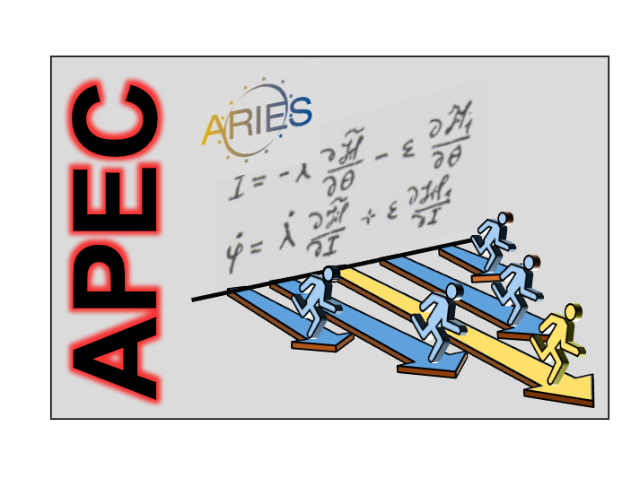
G. Franchetti
improving Accelerator PErformance and new Concepts – APEC (WP6)
Alessandro Drago (INFN-LNF), Giuliano Franchetti (GSI), Johannes Gutleber (CERN), Klaus Höppner (HIT), Florian Hug (JGU), Mauro Migliorati (U. Roma Sapienza), Marco Zanetti (INFN Padua), Frank Zimmermann (CERN)

Slide 3
APEC in a nutshell
5 scientific tasks with the goals
to improve the performance of the next generation of accelerators (MESA, FAIR, HL-LHC, ThomX…) ,
to advance the design of the “next next” generation of accelerators (FCC, LHeC, …) , and
to investigate and rank accelerator options for the long-term future (photon colliders, muons, crystals, nanotubes, gravitational waves,…)

Slide 4
WP6 APEC tasks
Task 6.1. Coordination and Communication (F. Zimmermann, CERN; G. Franchetti, GSI)
Task 6.2. Beam Quality Control in Hadron Storage Rings and Synchrotrons (G. Franchetti, GSI; F. Zimmermann, CERN)
Task 6.3. Reliability and Availability of Particle Accelerators (J. Gutleber, CERN; K. Höppner, HIT Heidelberg)
Task 6.4. Improved Beam Stabilization (M. Migliorati, La Sapienza/INFN; A. Drago, INFN-LNF)
Task 6.5. Beam Quality Control in Linacs and Energy Recovery Linacs (F. Hug, JGU Mainz)
Task 6.6. Far Future Concepts & Feasibility (M. Zanetti, Padova/INFN; F. Zimmermann, CERN)

Slide 5
Task 6.6 Far Future Concepts & Feasibility
Analysis of the potential of crystals for charged-particle bending or particle acceleration
Development of advanced photon colliders, including gamma-gamma and photon-nucleon colliders
Assessment of advanced muon-collider concepts without ionization cooling
Assessment of the potential use of large storage rings for gravitational wave detection or generation
Assessing and ranking a basket of future concepts with regard to “future feasibility” and physics cases
White list of ranked future options

Slide 6
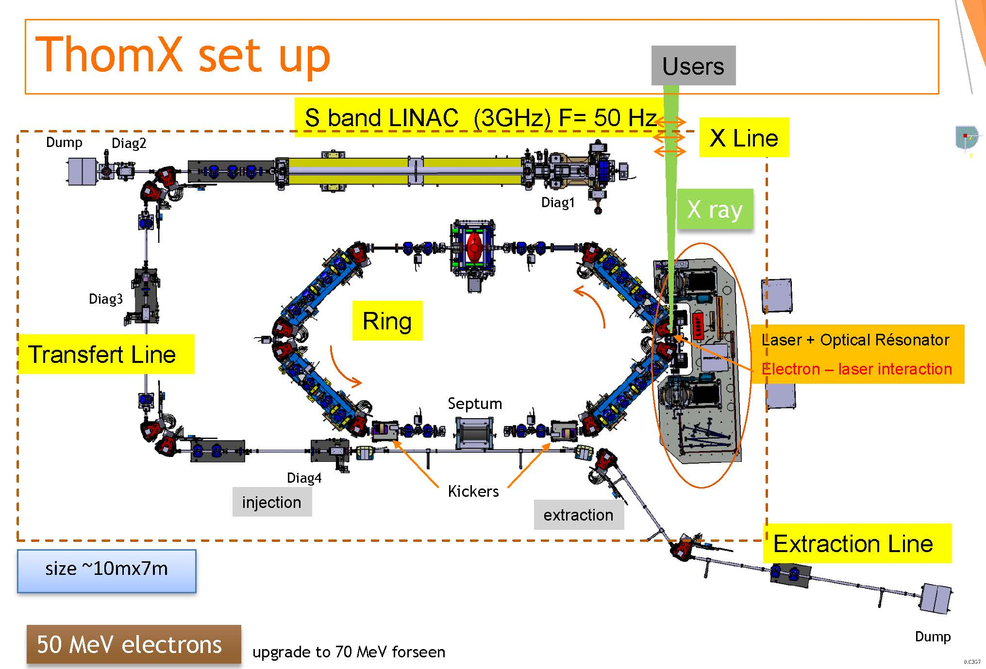
ThomX at LAL – commissioning in 2018
under construction
H. Monard

Slide 7
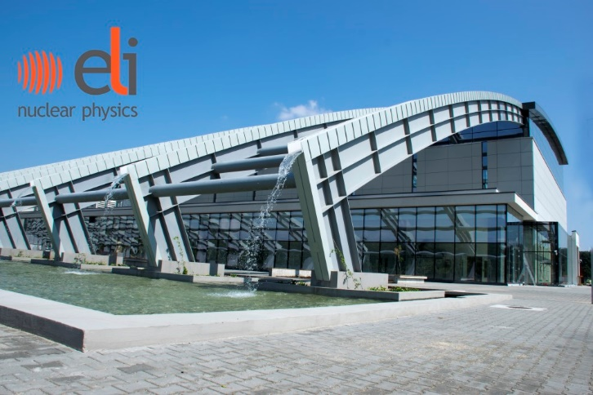
ELI-NP in Magurele
high intensity laser system, with two 10 PW laser arms able to reach intensities of 10²³ W/cm² and electrical fields of 10¹⁵ V/m
intense (10¹³ γ/s), brilliant γ beam, ~ 0.1 % bandwidth, with E _{γ} up to 19.5 MeV, which is obtained by incoherent Compton back scattering of a laser light off a very brilliant, intense, classical electron beam (E_{e} up to 720 MeV) produced by a warm LINAC

Slide 8
some references from the last 35 years
gamma-gamma colliders – a long history
I.F. Ginzburg, G.L. Kotkin. V.G. Serbo and V.I. Telnov, “Colliding γe and γγ Beams Based on the Single-Pass e±e− Colliders (VLEPP Type),” Nucl. Instr. and Meth. 205 (1983) 47.
I.F. Ginzburg, G.L. Kotkin, S.L. Panfil, V.G. Serbo, and V.I. Telnov, “Colliding γe and γγ Beams Based on Single-Pass e+e– Accelerators II. Polarization Effects, Monochromatization Improvement,” Nucl. Instr. and Meth. 219 (1984) 5-24
V. Telnov, “Principles of Photon Colliders,” Nucl. Instr. And Meth. A 355 (1995) 3-18
K.-J. Kim, A. Zholents et all., “NLC ZDR Appendix B Second Interaction Region For Gamma-Gamma, Gamma-Electron and Electron-Electron Collisions,” SLAC SLAC-R-474, LBL-PUB-5424, LBNL-PUB-5424, UCRL-ID-124161 ... (1996)
V. Telnov et al., “The Photon Collider at TESLA,” Int. Journal of Modern Physics A Vol. 19, No. 30 (2004) 5097–5186
S. A. Bogacz, J. Ellis, L. Lusito, D. Schulte, T. Takahashi, M. Velasco, M. Zanetti, F. Zimmermann, “SAPPHiRE: a Small Gamma-Gamma Higgs Factory,” arXiv 1208.2827 (2012)
EuCARD SAPPHiRE Day 2013,
https://indico.cern.ch/event/231263

Slide 9
from US-MAP (2015) to Italian μ-collider (2017)
key challenges
~10¹³-10¹⁴ μ / sec
tertiary particle pgπgμ:
fast cooling
(τ=2μs)
by 10⁶ (6D)
fast acceleration
mitigating μ decay
background
from μ decay
Positron Beam
e+ ring
μ⁺
LHeC-class e+ source & e+ acceleration at 45 GeV
(circular/linear options)
μ⁻
isochronous rings
100 KW target
key challenges
~10¹¹ μ / sec from e⁺e⁻gμ+μ−
key
R&D
10¹⁵ e+/sec, 100 kW class target, NON destructive process in e+ ring
M. Boscolo

Slide 10
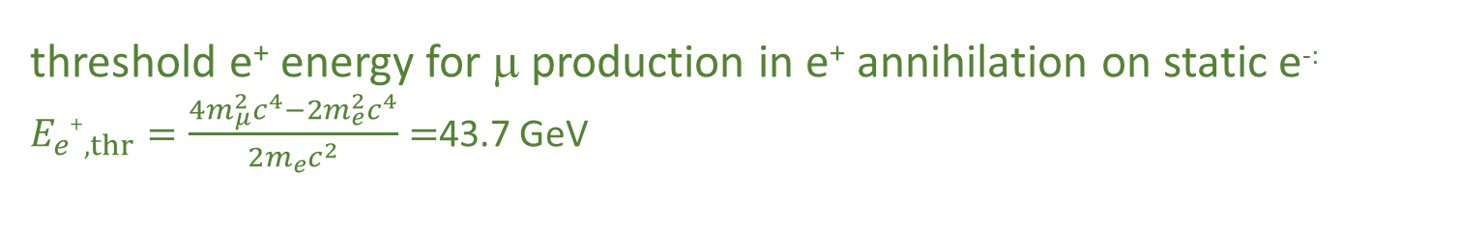
threshold e⁺ energy for μ production in e⁺ annihilation on static e^{-:}
$E_{e+,thr}=\frac{{4m}_{μ}^{2}c^{4}−2m_{e}^{2}c^{4}}{2m_{e}c^{2}}=$43.7 GeV
→ we could use the FCC-ee e⁺ ring (or the FCC-ee top-up booster, or a LEP3,…) as internal target ring for μ production!
e⁺ production rates achieved (SLC) or needed
 | S-KEKB | SLC | CLIC (3 TeV) | ILC (H) | FCC-ee (Z) | Italian μ collider
10¹² e⁺ / s | 2.5 | 6 | 110 | 200 | 5 | 1000
X 18
X 33
X 165
LHC based Gamma Factory could provide 100x more e⁺/s than needed

Slide 11


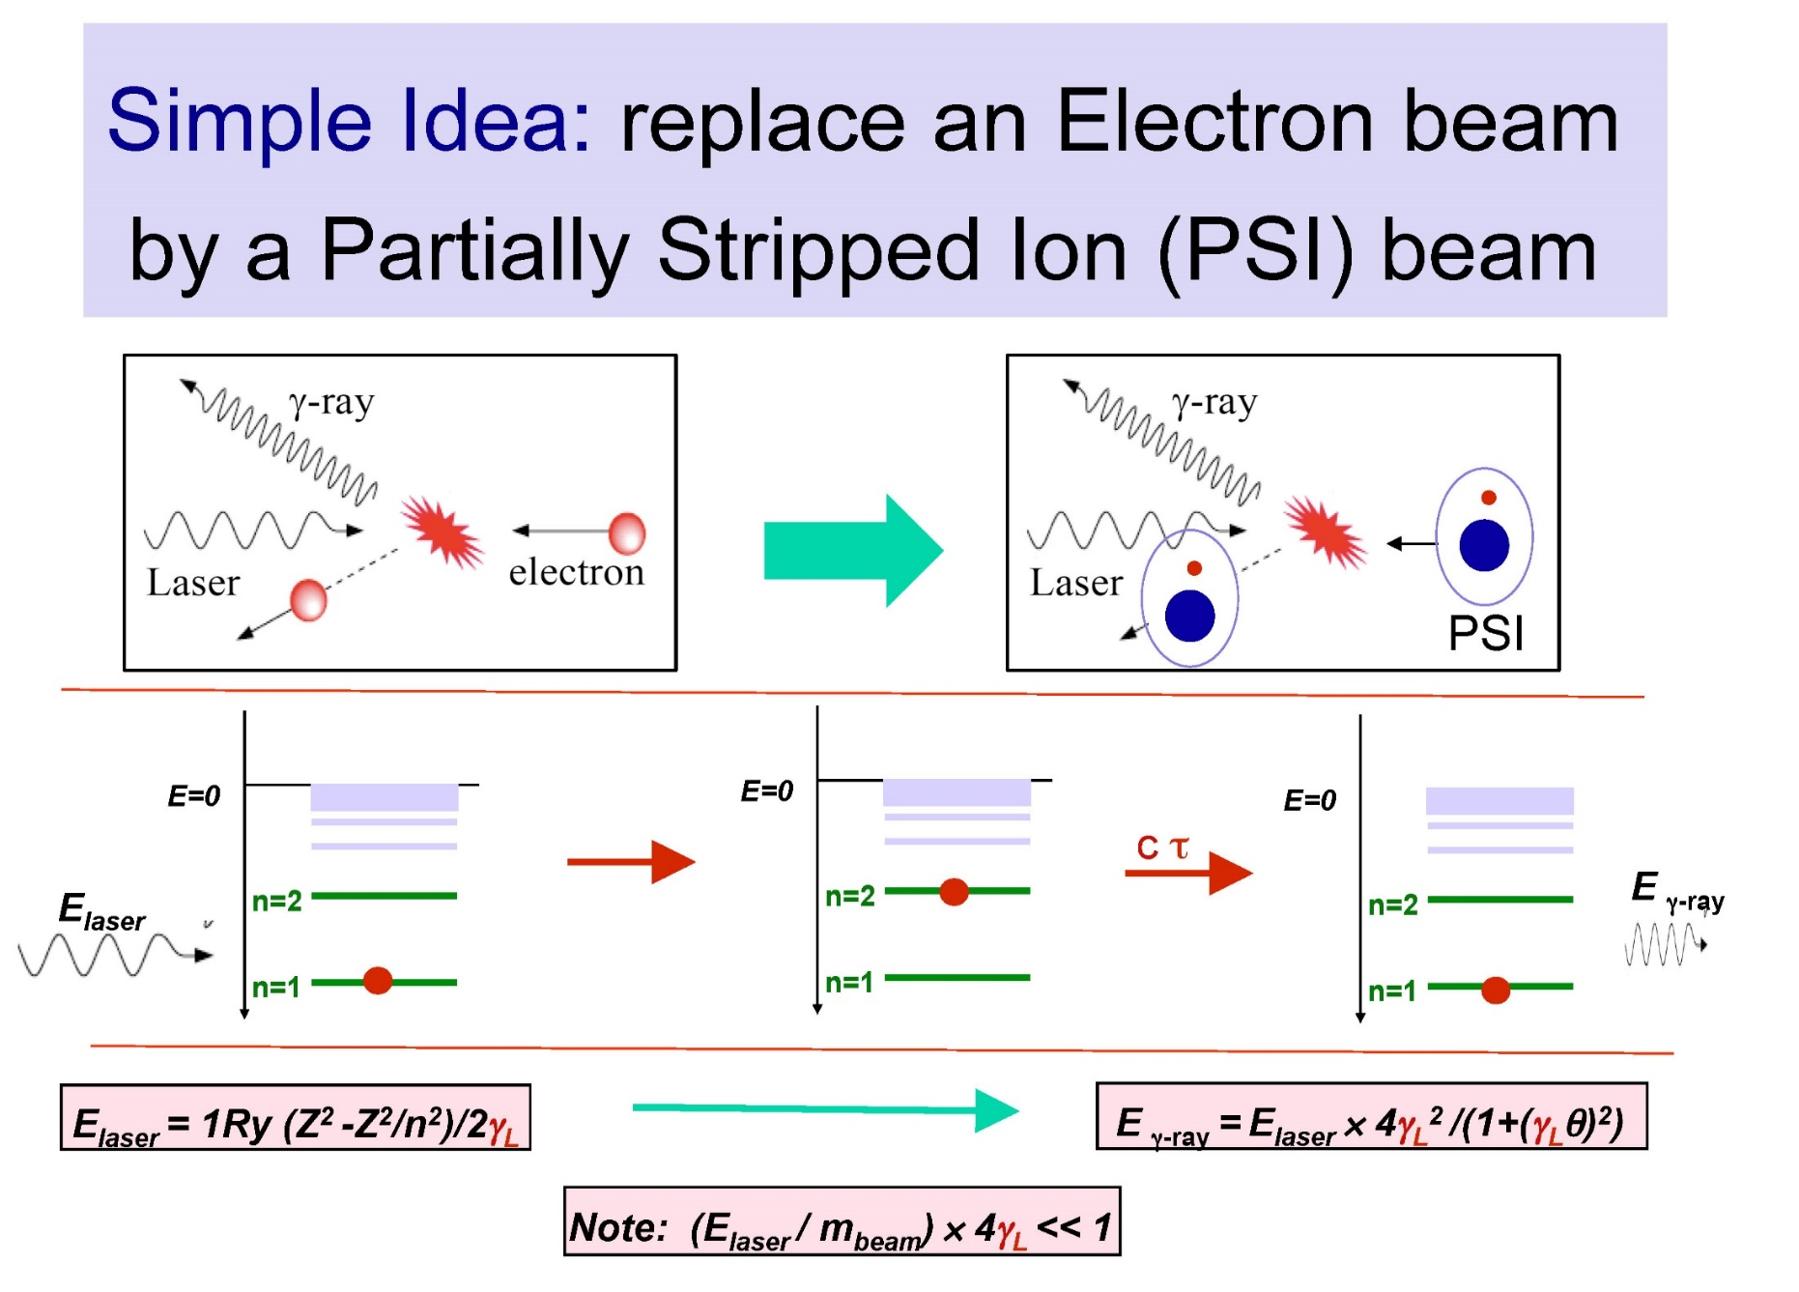
“Gamma Factory” based on “PSI”
Compton back scattering at LHC or FCC
high photon energies,
high cross section
W. Krasny

Slide 12
Workshop themes:
recent and future facilities, Thom-X, ELI, far future
photon-beam collision schemes and hardware
laser technologies
laser-based photon-beam collisions
FEL based approaches
Compton sources, gamma-gamma colliders, gamma factories
Gamma Factory R&D program

Slide 13
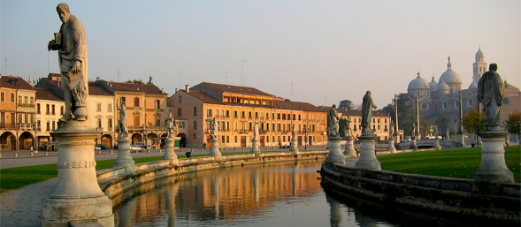
wishing us a creative and most stimulating workshop!

