Slide 1
Some implementations of optical resonators in accelerators
Outlook
First iplementations with cw lasers
Pulsed laser cavities
ThomX, some details

Slide 2
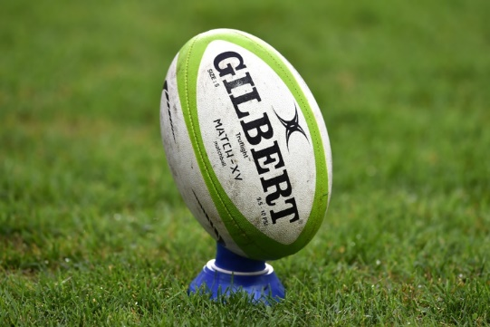
Cw NdYag laser
Cavity Finesse 26000
Power 1.5 kW
Mirrors from LMA/Lyon
Analog feedback & very low linewidth cw oscillator

Slide 3
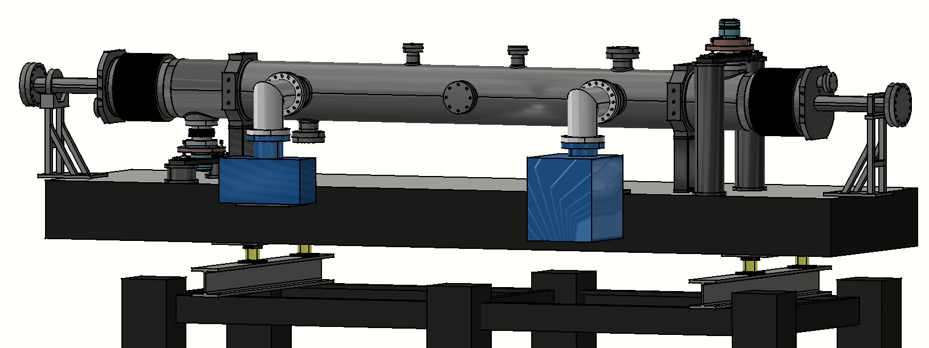
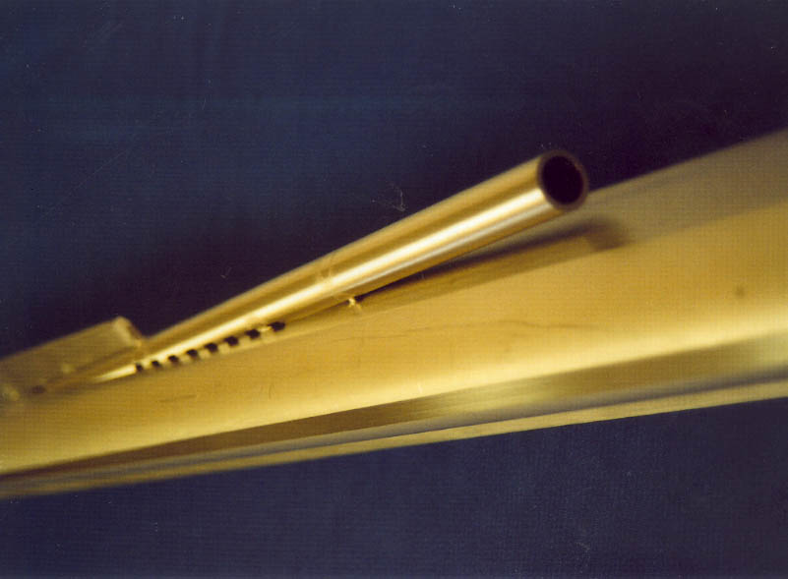
Pompes ioniques
soufflet
Beam pipe
polarimeter
~2000
DESY / HERA
~30GeV
laser
Support
miroir
Support
miroir
Amortisseurs
passifs
CW laser
2 mirrors, 2 m long
Finesse~25000
Power ~3kW
Mirrors from LMA/Lyon

Slide 4
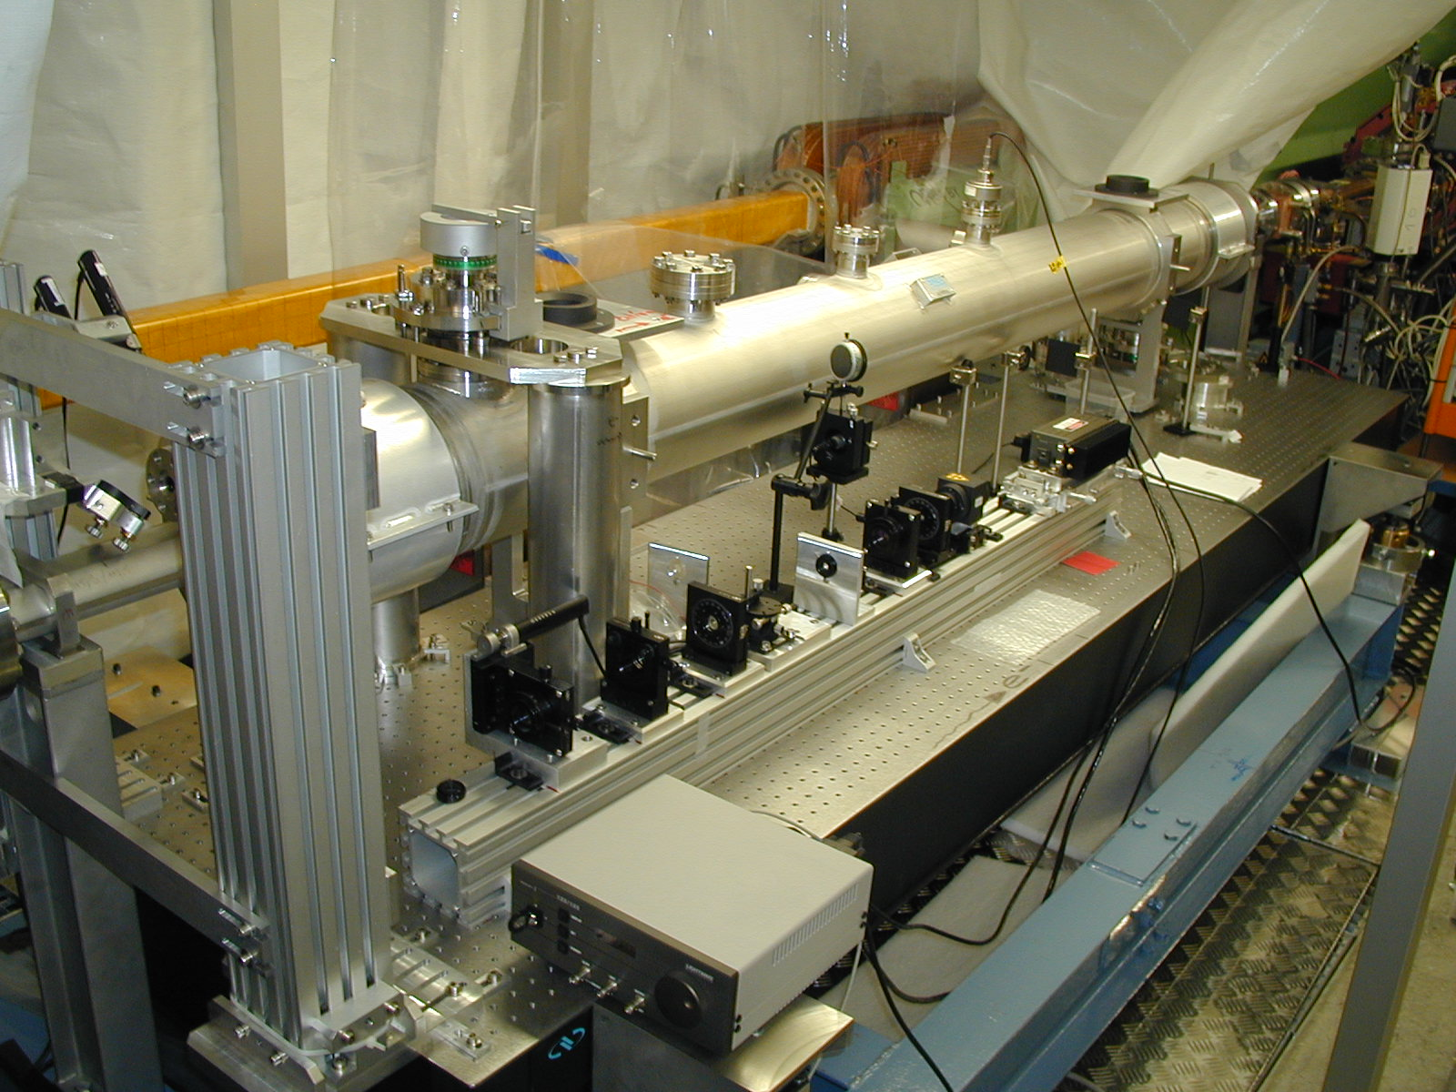
Tube protons

Slide 5
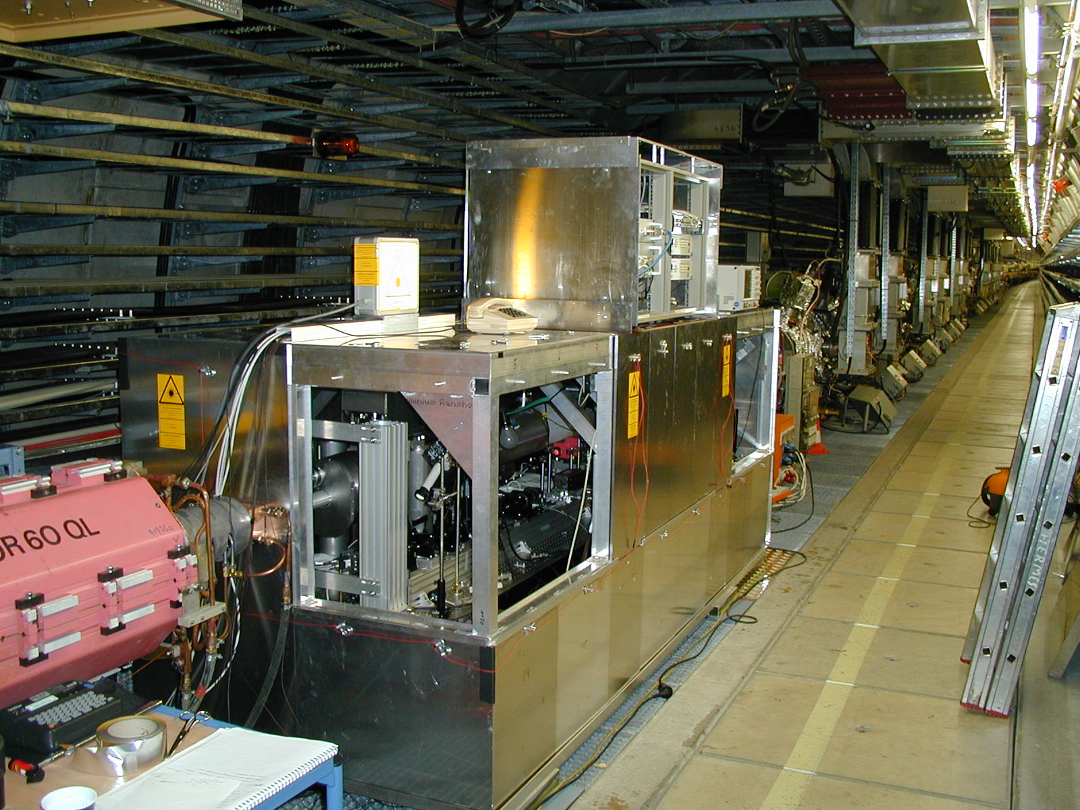
Blindage (3 mm pb) +
isolation thermique
(sandwitch Alu/isolant/Alu)

Slide 6
2-mirror cavity
Cw laser
Installed in ATF / KEK
Laser-wire

Slide 7
2-mirror cavity &
7ps pulsed laser
3ns green laser
Donuts beam

Slide 8
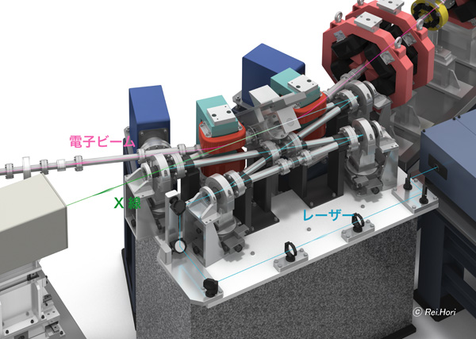
Planar 4-mirror cavity
2 planar mirrors
➔ synchronization
2 spherical mirrors
➔ Mode focusing
78 ps pulses, 4-mirror cavity & compensation of
ellipticity ➔ cavity finesse ~ 1700

Slide 9
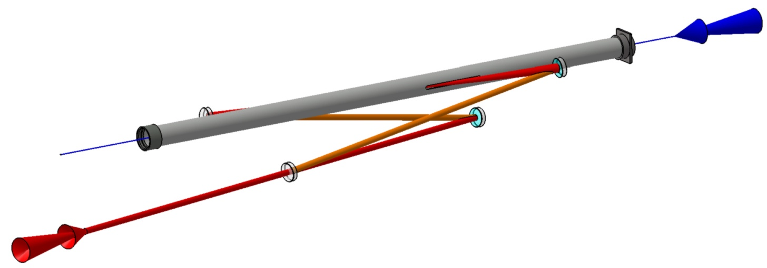
Non planar 4-mirror cavity for ATF
(LAL/KEK/CELIA/LMA)
Contrat ANR
2008-2012
Polarised positron source
Circularely polarized eigen mode
10ps pulsed laser
~50kW stored average power
Mirrors from LMA/Lyon
ATF beam pipe: 5mm slit…
2 spherical mirrors
Angle laser / e⁻ beam= 8°
ATF e⁻ beam
laser/beam
Interaction point
Injection laser
2 flat mirrors

Slide 10
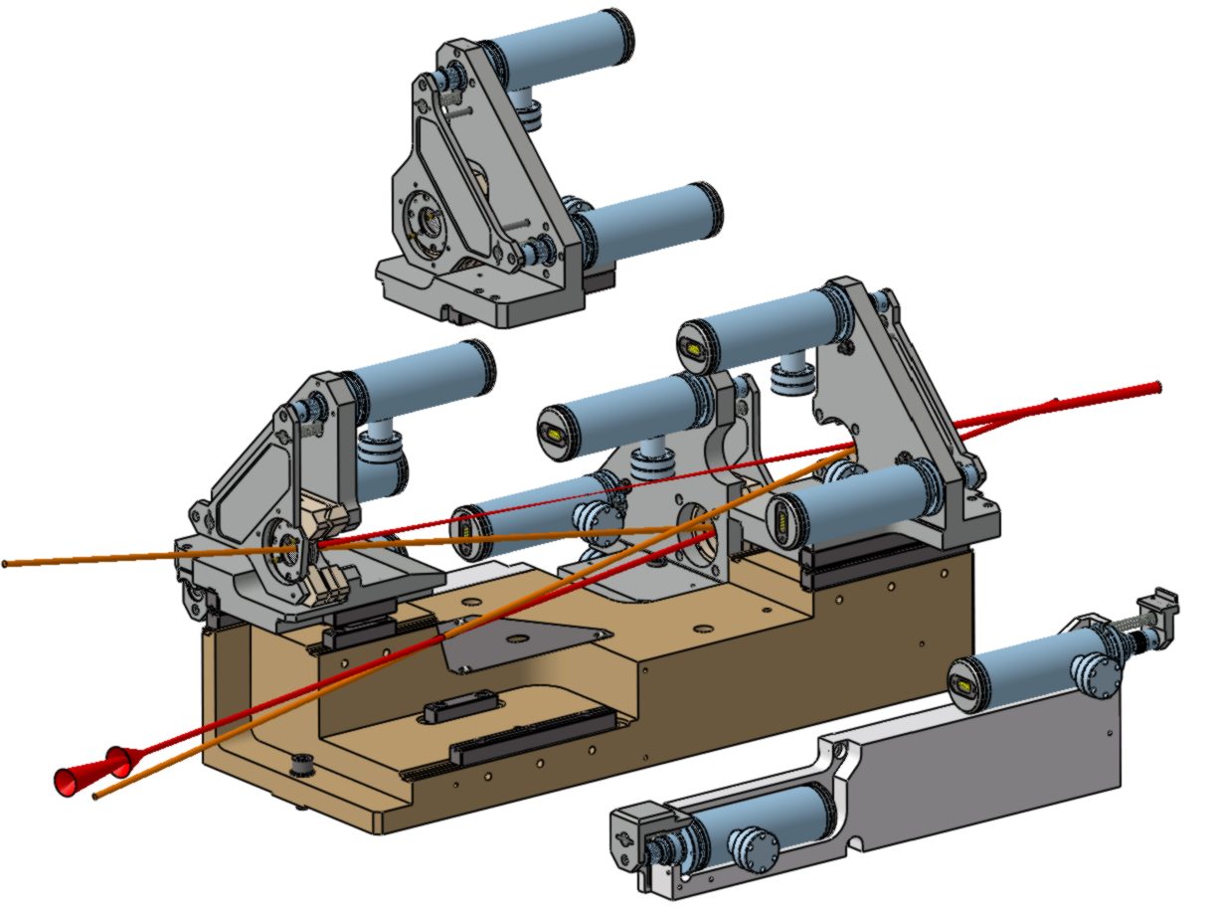
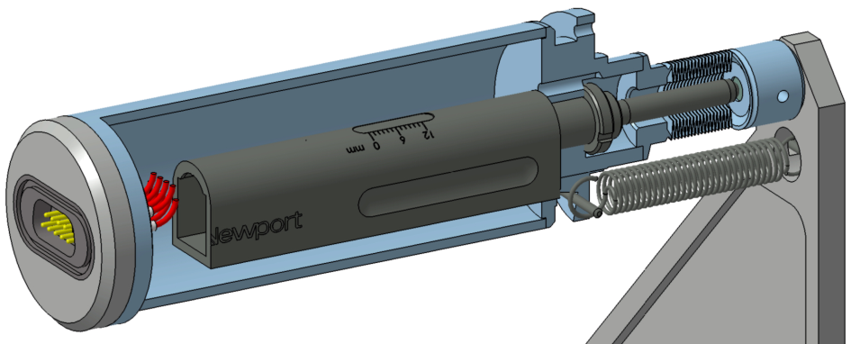
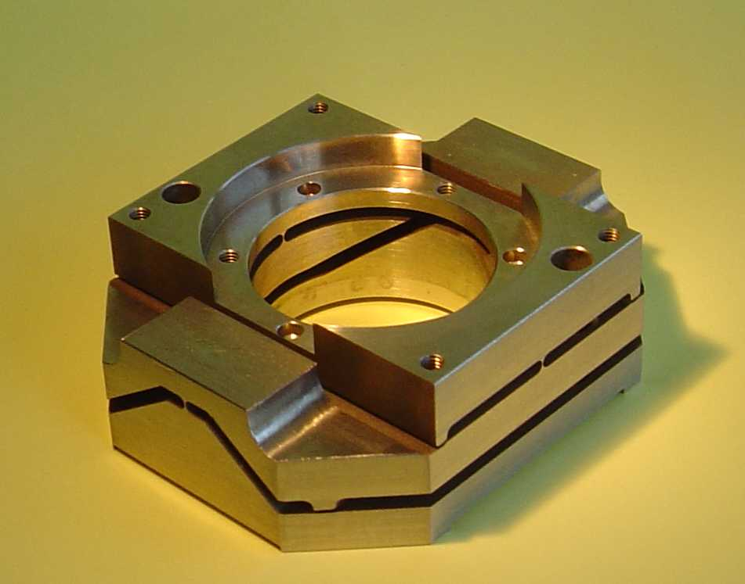
OVERALL DESIGN PRINCIPLE
θx
actuator
Gimbal mounts→ θx θy ± 10 mrad
Encapsulated
commercial
stepper motor
bellow
θy
translation : 3 balls on guide rail and plan
translation Z actuators

Slide 11
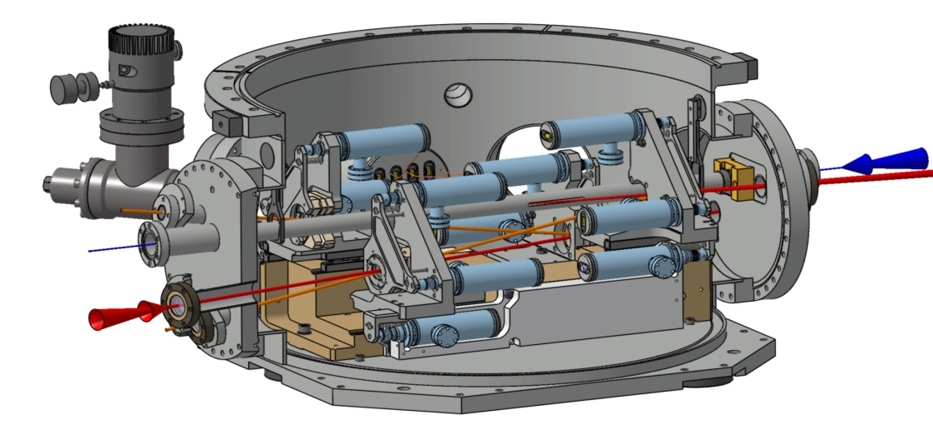
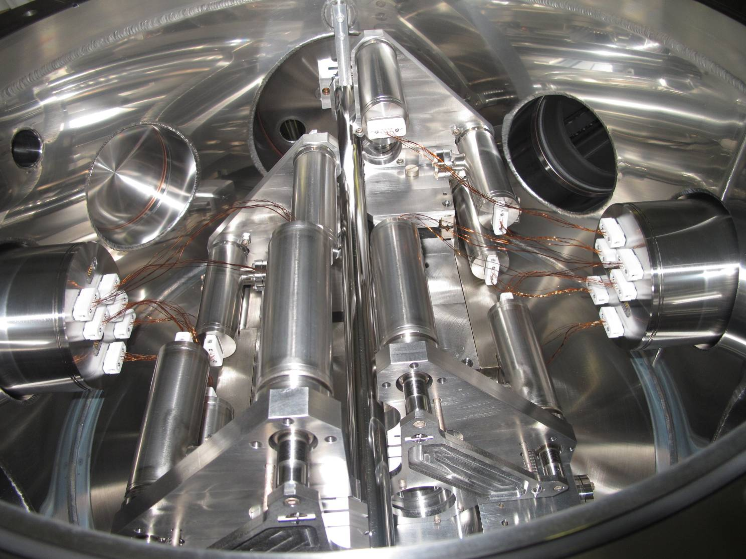
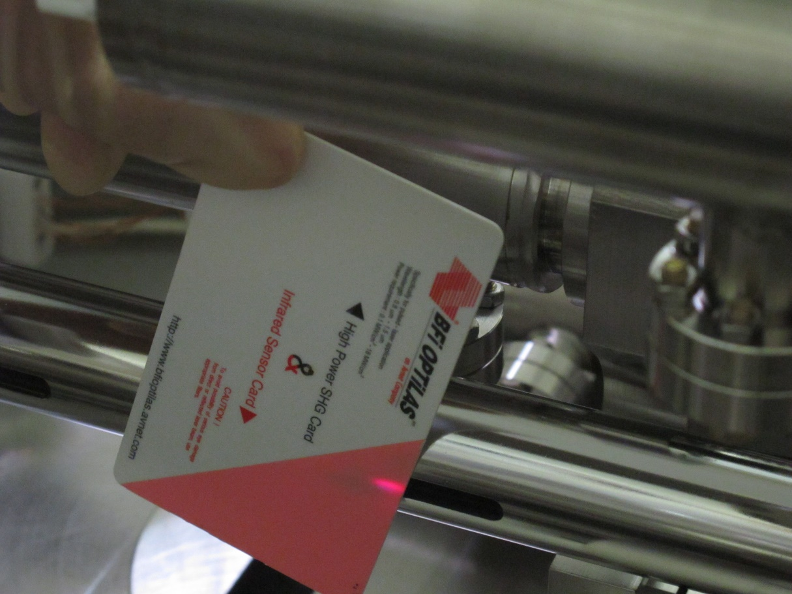
Vacuum vessel for ATF
e-
5 mm slit on beam pipe inside cavity
500mm

Slide 12
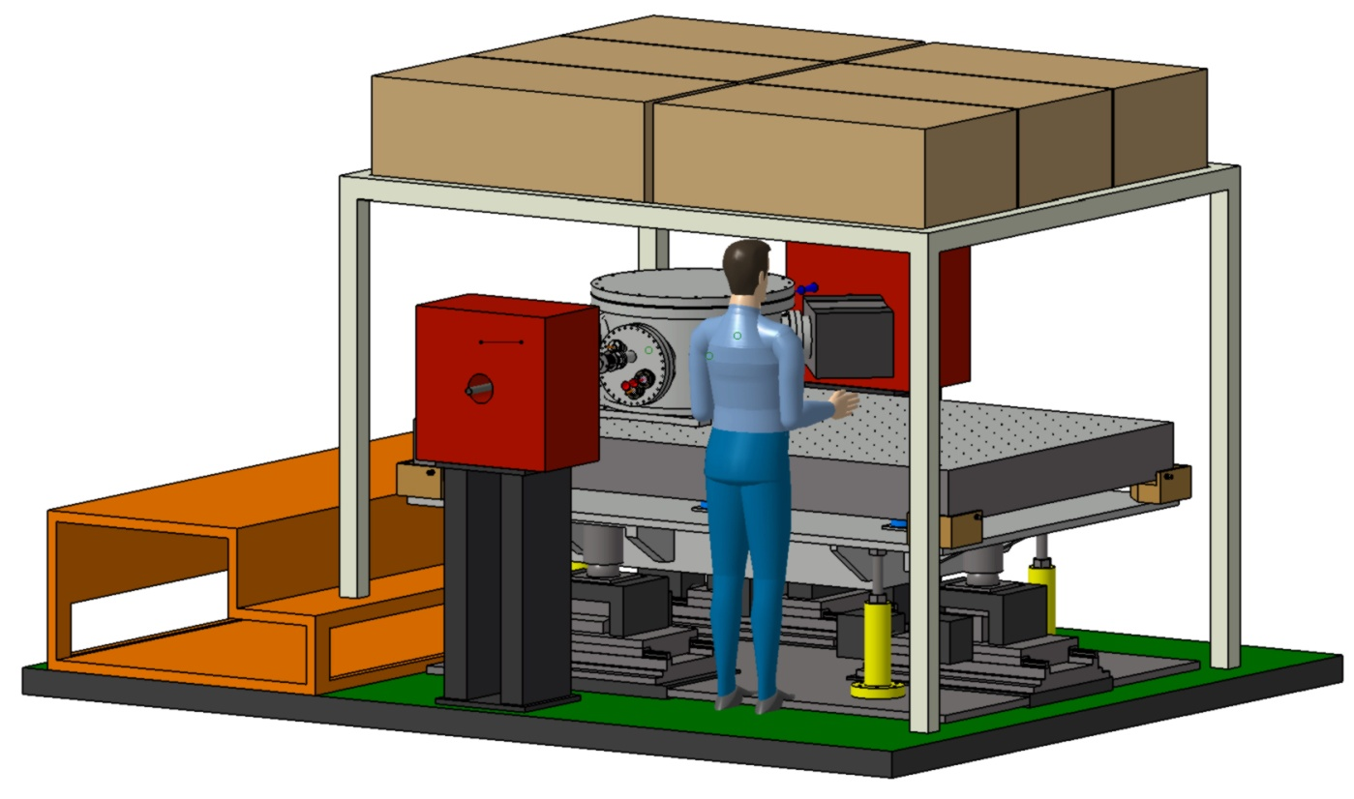
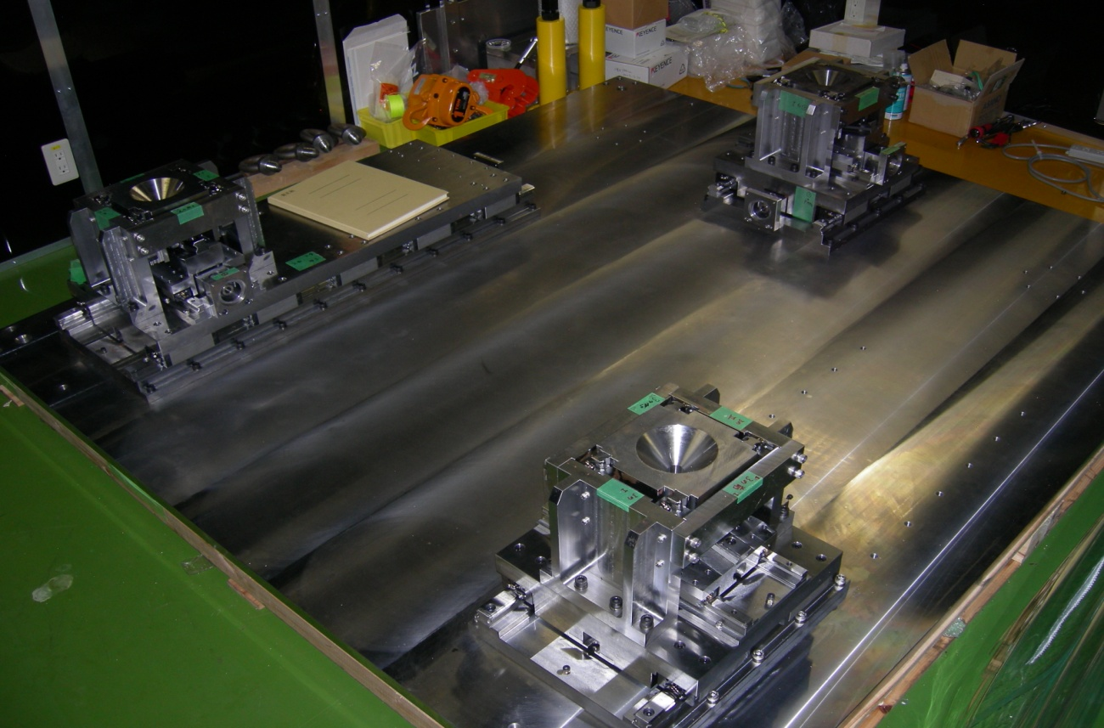
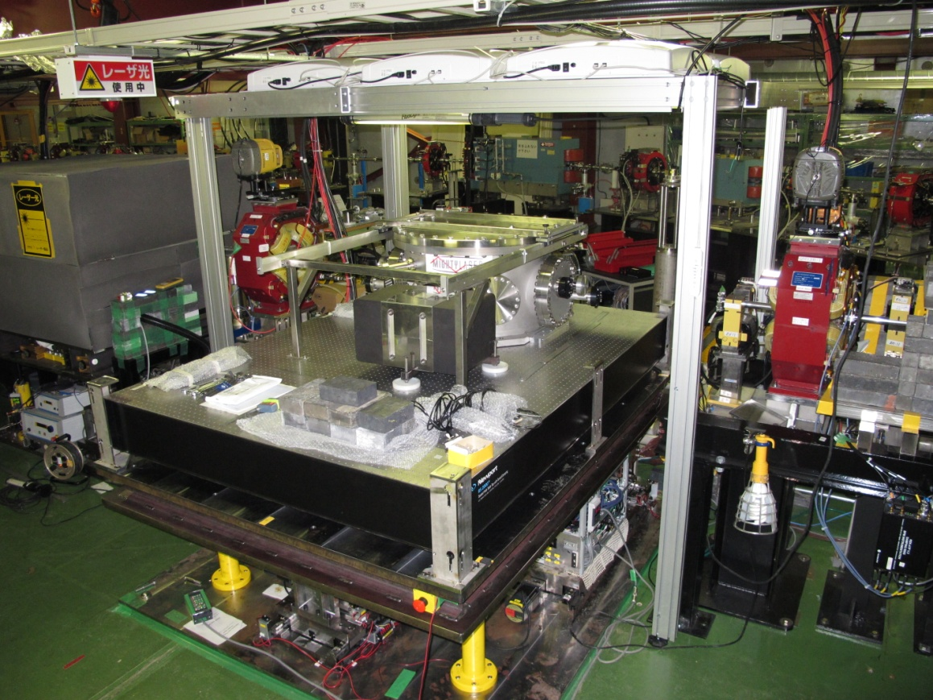
Implementation
at ATF / KEK
Funahasi-san’s
ATF
micrometric
table mount
system
Assumed ATF Beam Line
Pulse Motor Port
for
Up-Down Move
Pulse Motor Port
for
Horizontal Move
From KEK / Hirotaka-san

Slide 13
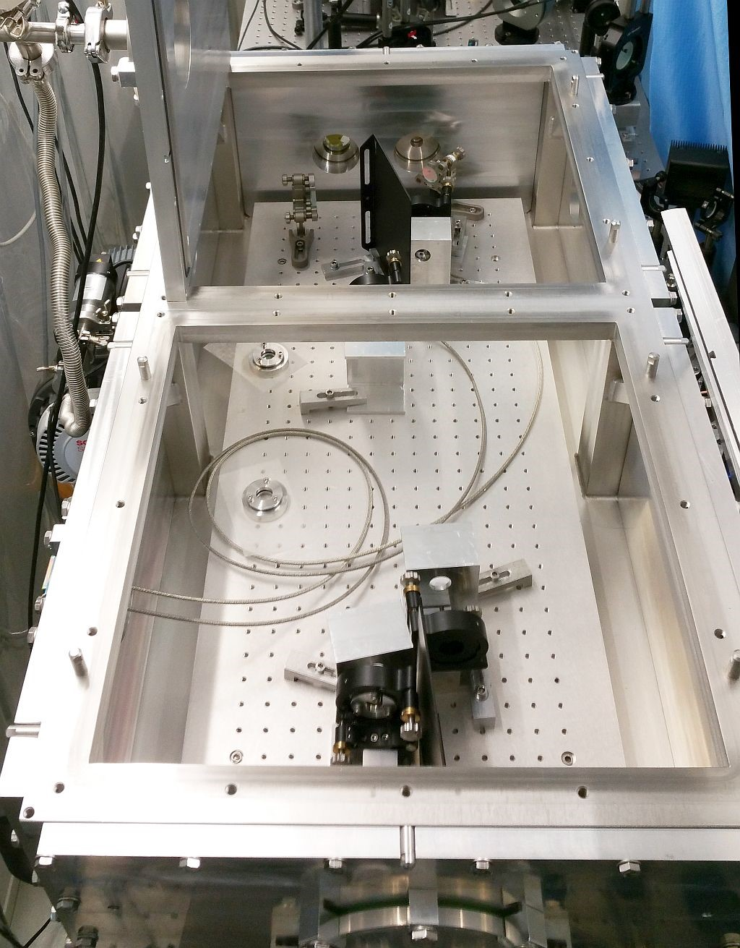
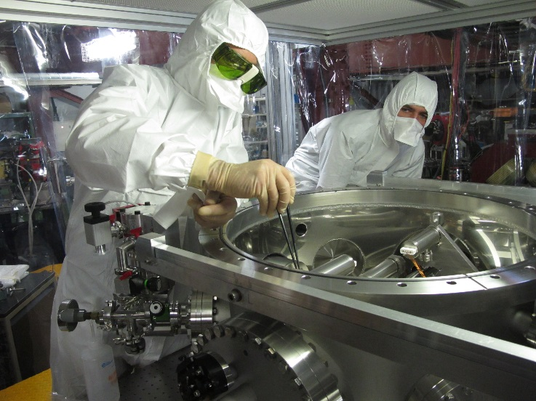
‘main issues’ :
cleanliness
(very low loss mirrors coatings)
‘Complexe’ dynamical behaviour
with high average power
  ➔ feedback instability …
R&D going on with cavities
Stable run of hours with ~100 kW (LAL)
Modal instability when reaching ~400kW (LAL)
Collaboration with KEK and recently with Minalo’s group
Pierre Favier

Slide 14
Idea at KEK that avoid high average power

Slide 16
K. Sakaue
Very promessing for LINACS

Slide 17

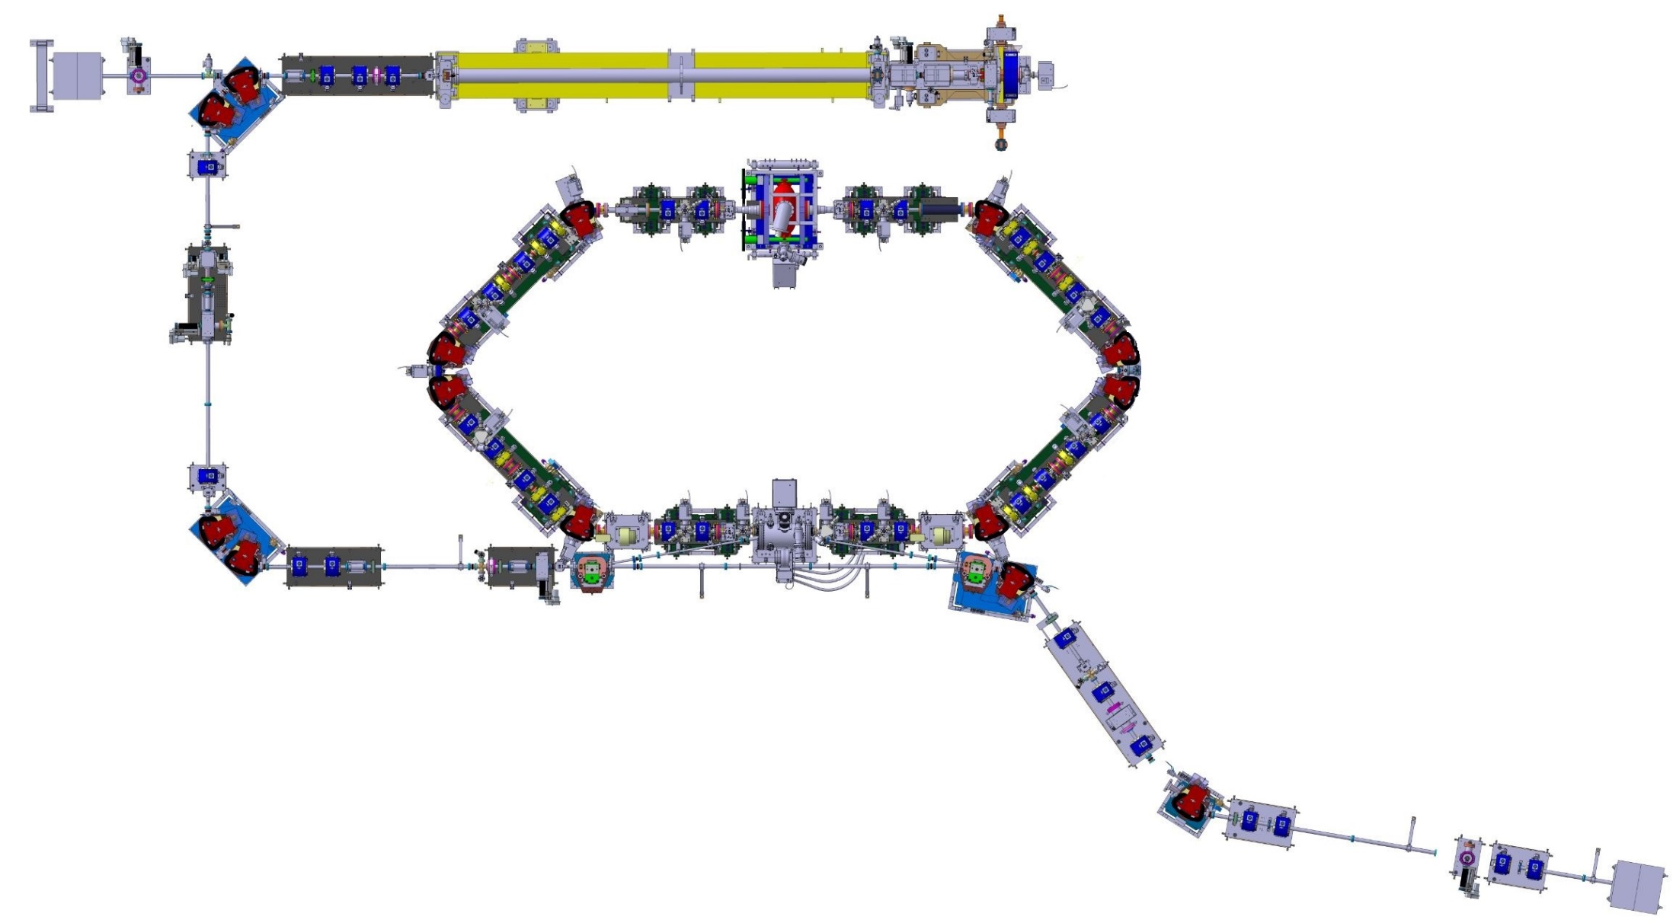
Interaction area
~ 18 meters
Notes:
ThiS is the electron machine.
Here : the electron gun with photocatode
Then : accelerating section
A transfert line
Then the electron is stocked in the ring
Finally a extraction line and the dump.
The interaction point is here

Slide 18
No space
Interaction point
200mm
Notes:
There is only 20 cm between the dipoles. It’s very tight.

Slide 19
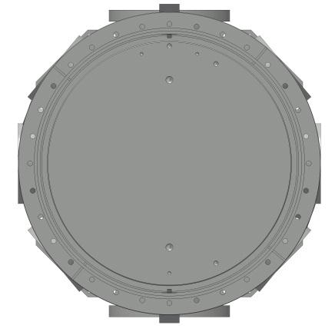

Not possibile to integrate 1 vacuum chamber
Diameter 800 mm
Notes:
It is not possible to integrate 1 vacuum chamber like a mightylaser chamber because it is too larged !

Slide 20
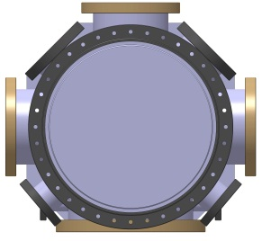
X ray
2 vacuum chambers
Interaction point
350 diameter
Notes:
The laser beam cross the electron beam with 2 degrees in order to get out the x ray in the middle of mirrors.

Slide 21
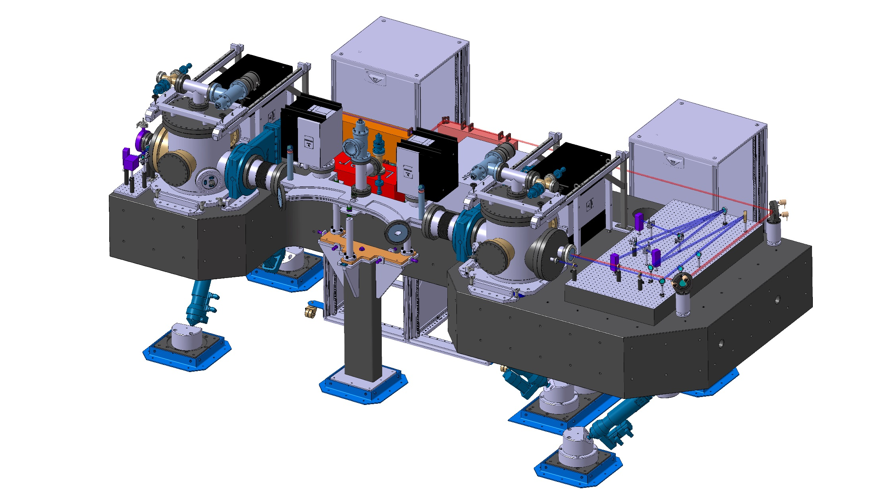
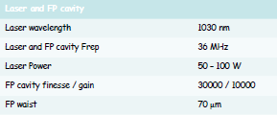
Miroir plan 4
Compton 20 mrad
(half angle)
Miroir plan 1
Laser
Miroir sphérique 2
e-
IP
Miroir sphérique 3
~ 2100 mm
Optical path : ~ 9 mètres (30 Mhz)
Laser oscillator rep. rate & CEP locking
@ Δν/ν ~10⁻¹²
Notes:
So you can see the 2 vacuum chambers connected by interaction chamber (in blue)

Slide 22
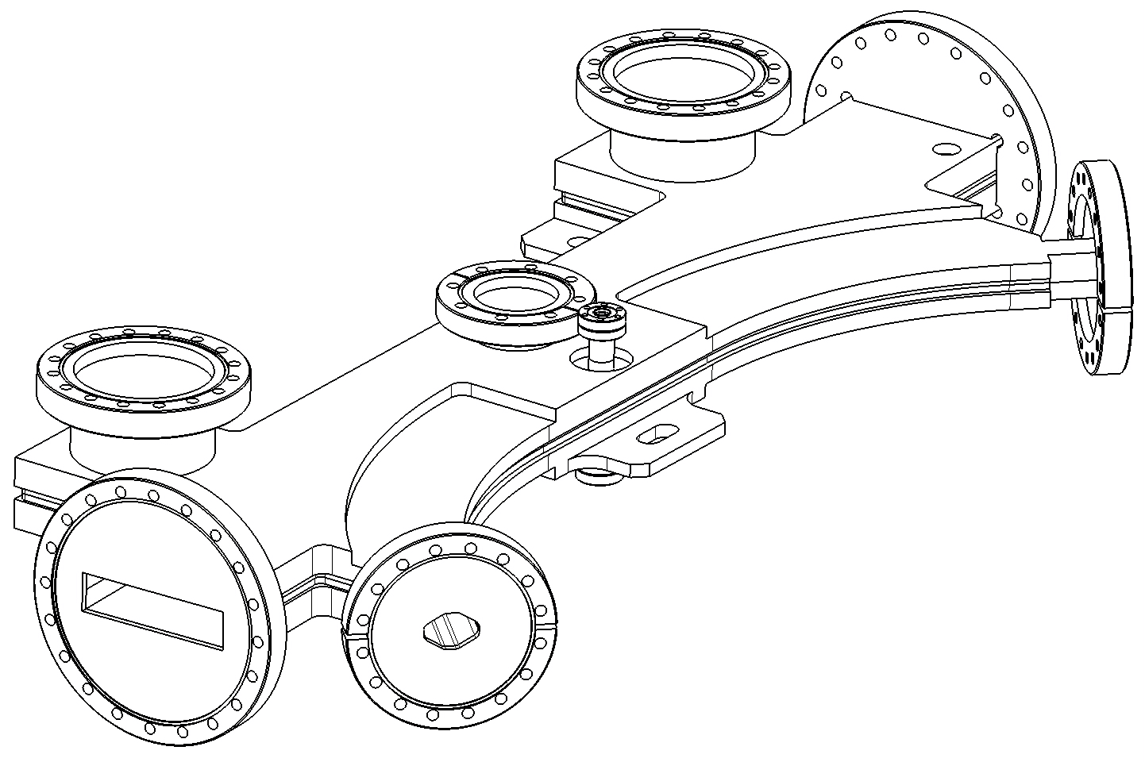
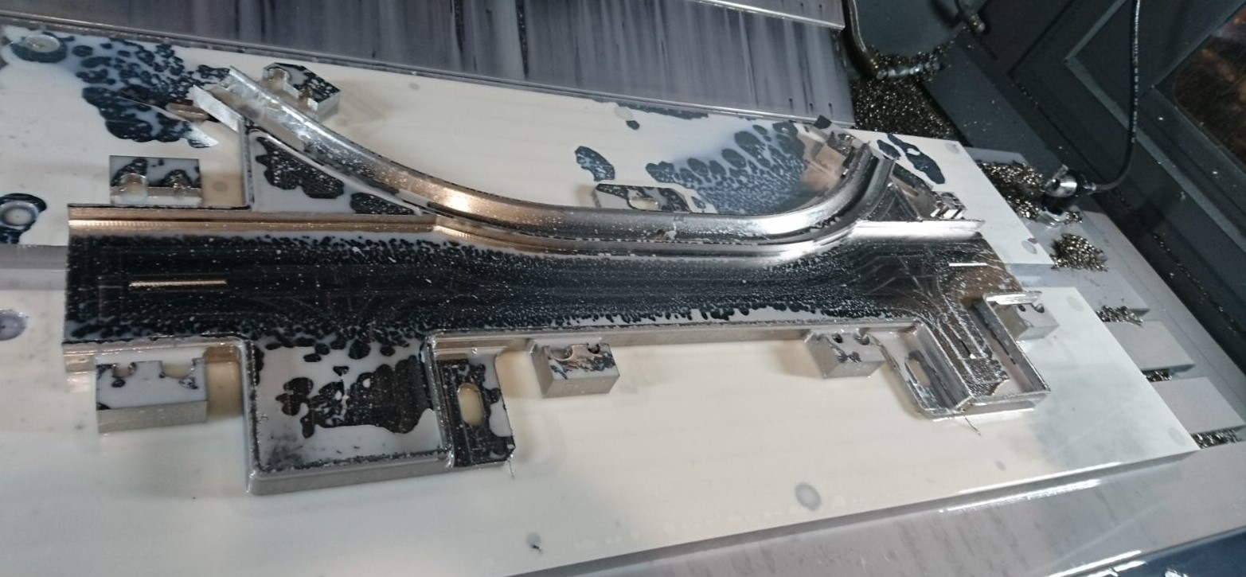
Chambre de dipôles
RIAL Vacuum Comp.
Notes:
The IP chamber is used to make connection between the two mirrors cavity and the electron ring,
There are two parts, one octogonal section for the electron beam and one rectangular section for the laser beam.
The two parts are connected by 2 slits.

Slide 23
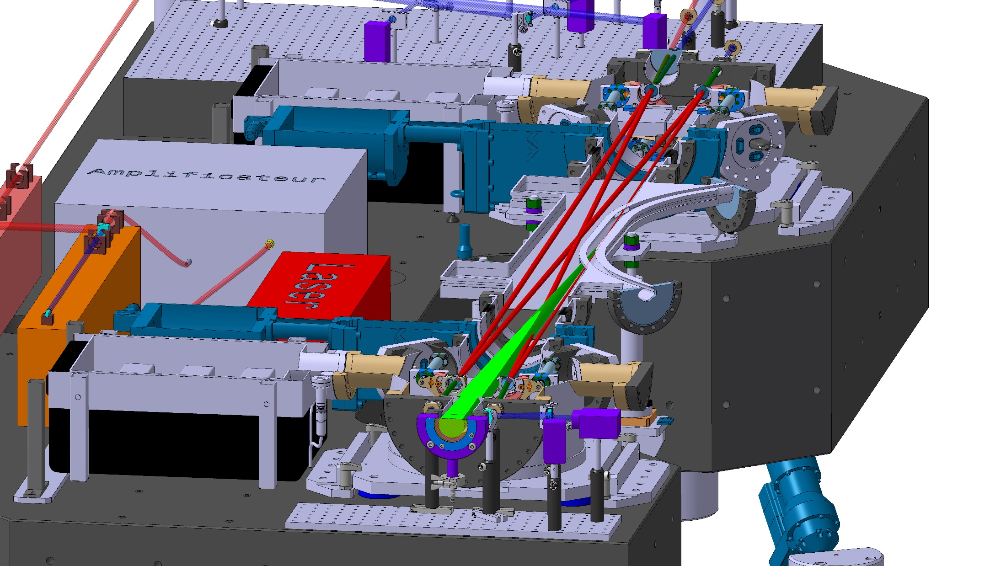
Slits for laser and X ray
Chambre de dipôles
Notes:
So this is a cut section of cavities. We can see the 2 slits who connect the laser to electron.

Slide 24
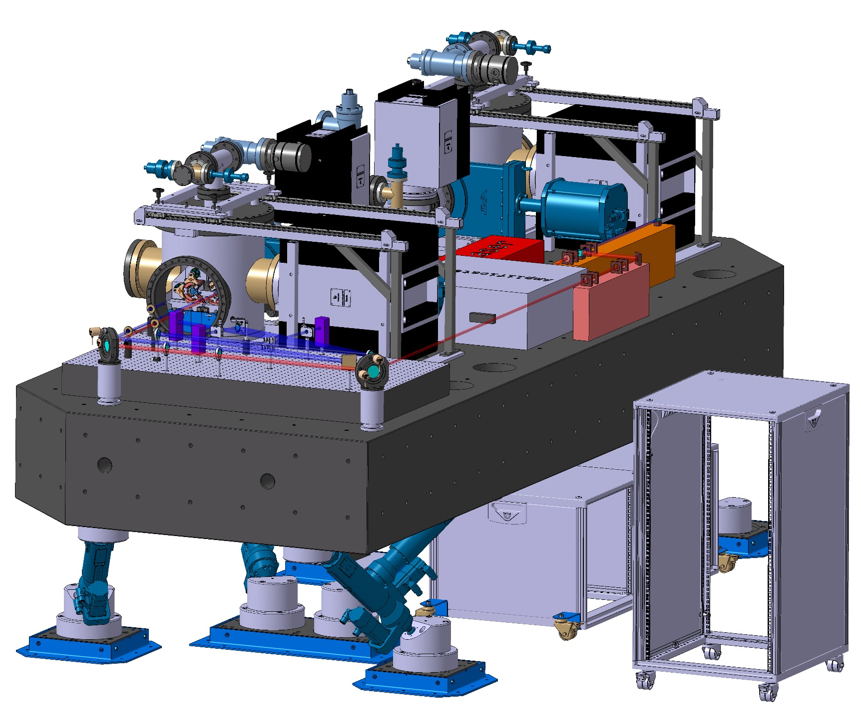
Mirror adjustment system
Chambre de dipôles
Notes:
Now, I will talk about the mirror adjustment system

Slide 25
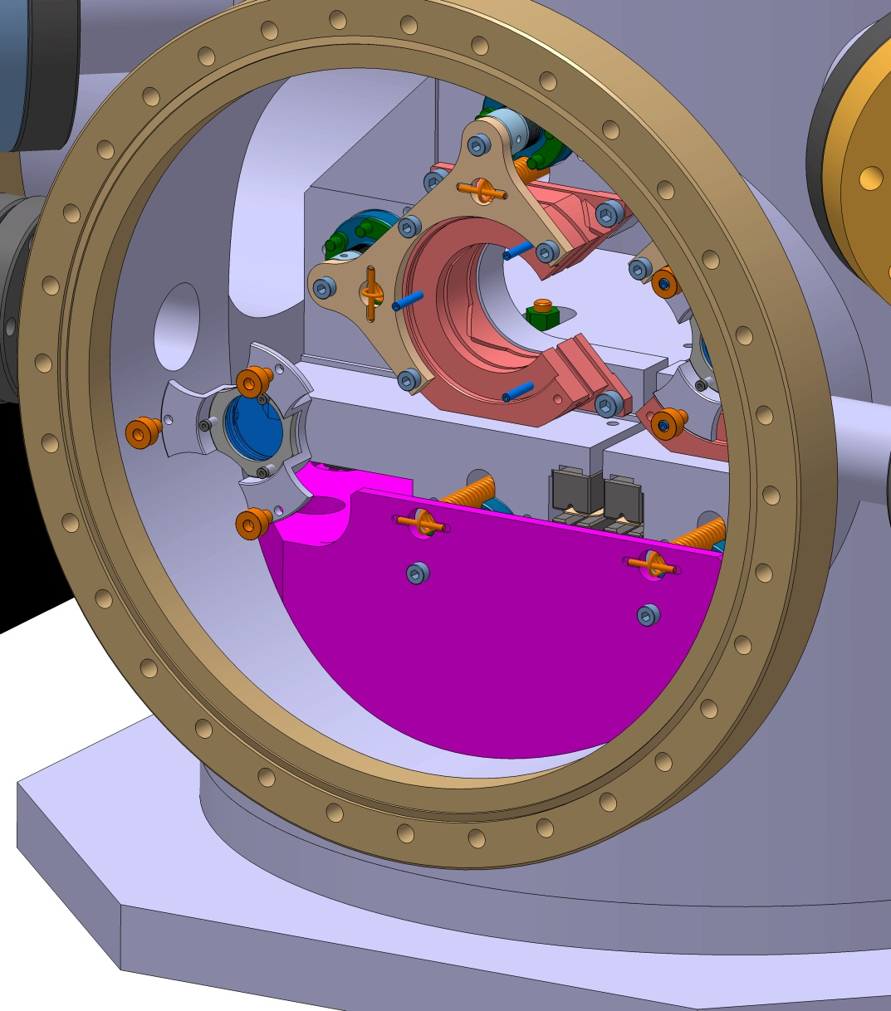
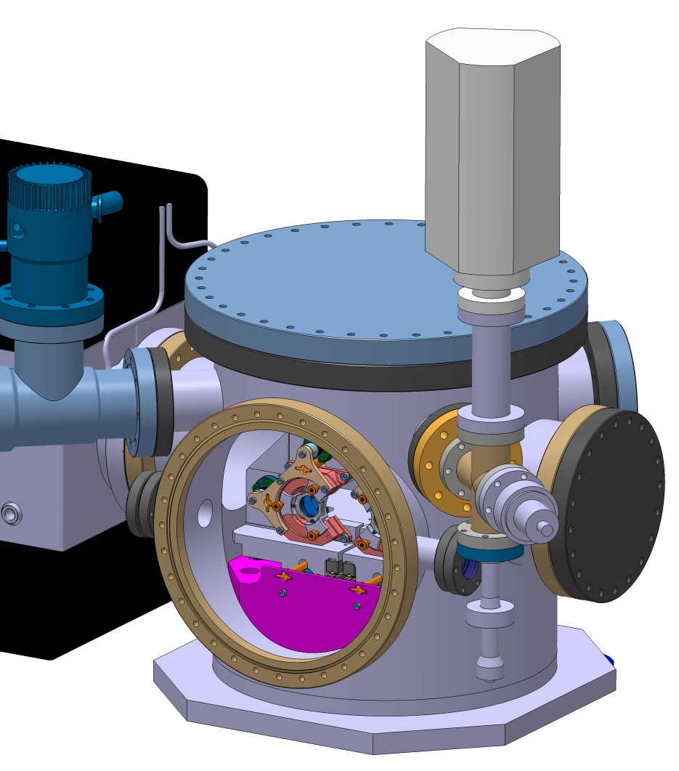
Enceinte à vide
DN250CF flange
Notes:
The vacuum chamber allowed to install easier the mirrors by a 250 flange on the side.

Slide 26
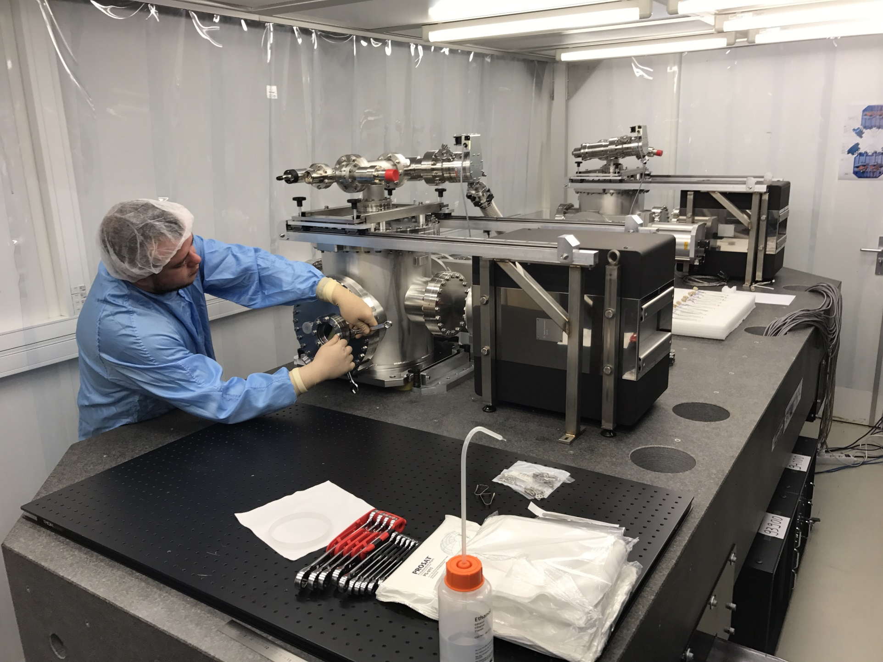
Ajustment mirror acces
Notes:
Here the mirror acces on side

Slide 27
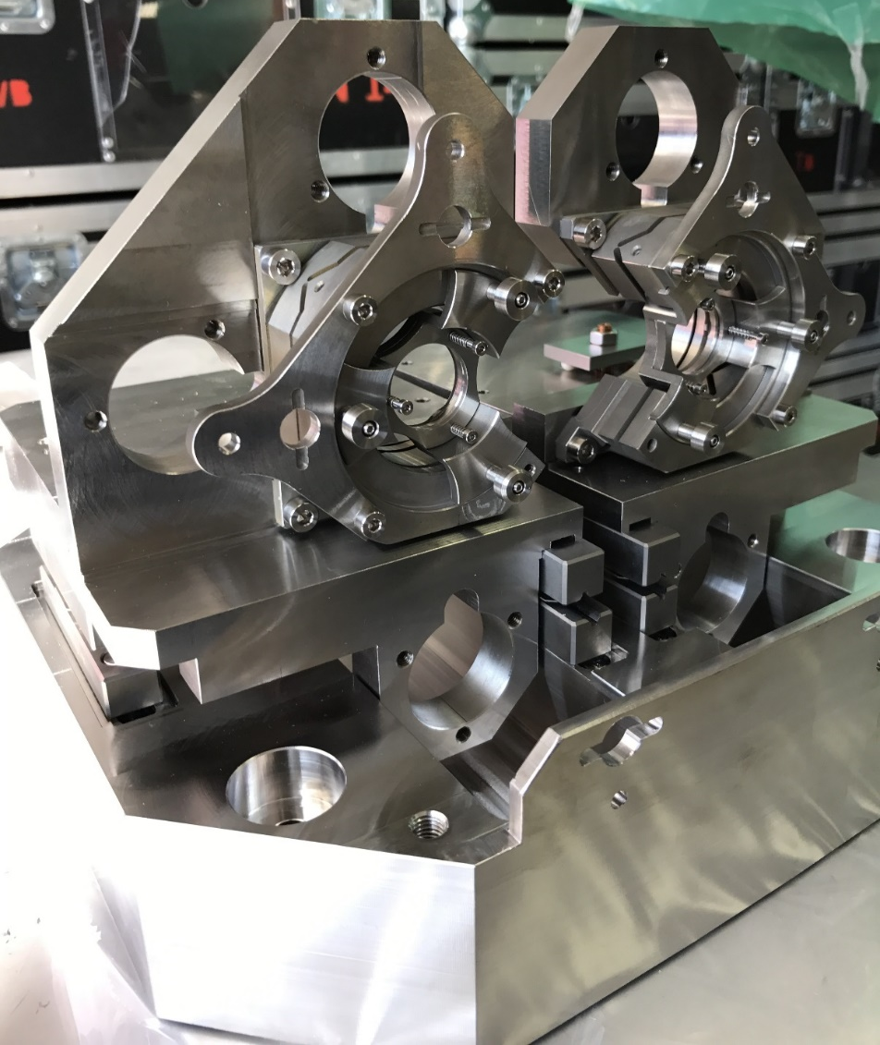
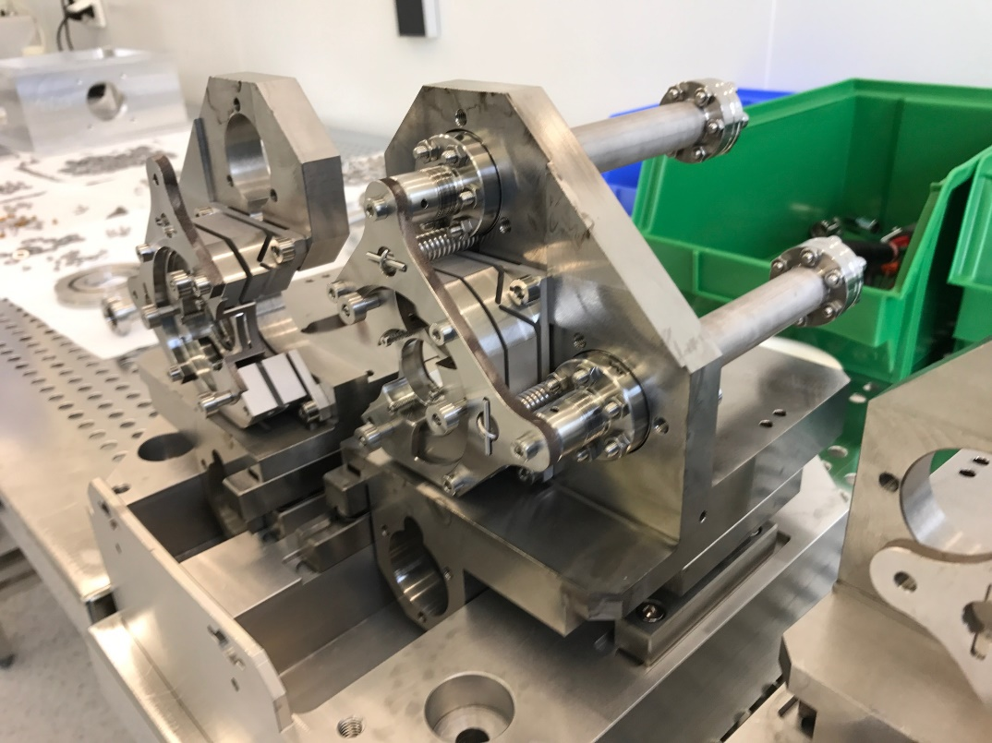
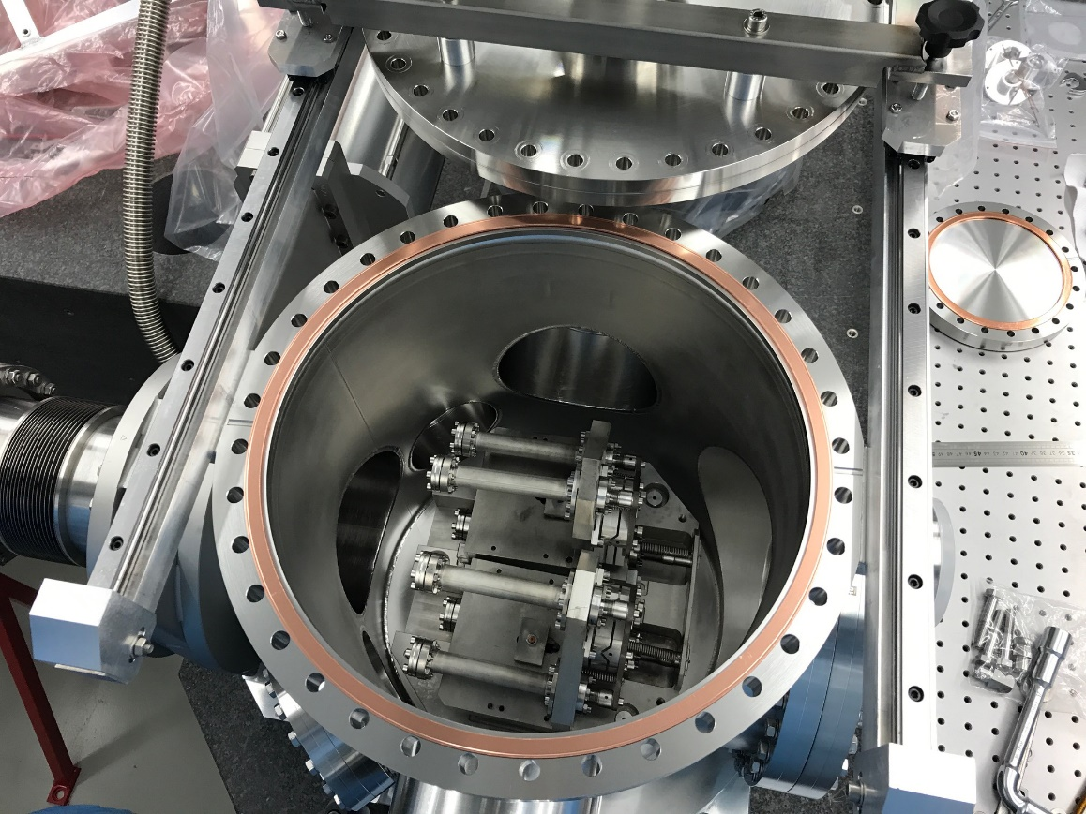
Notes:
Inside the chamber you can find 2 trucks on stainless steal heavy base

Slide 28
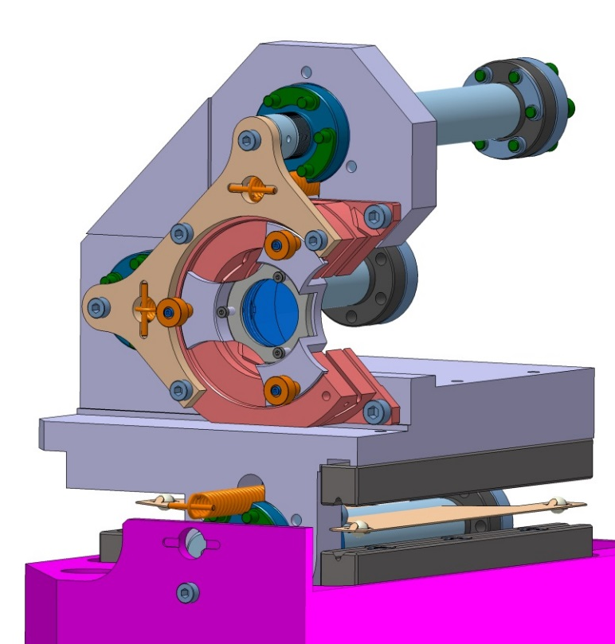
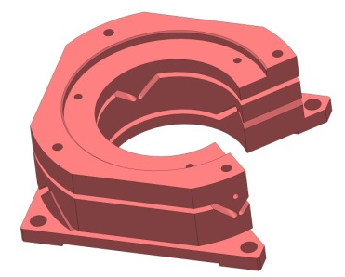
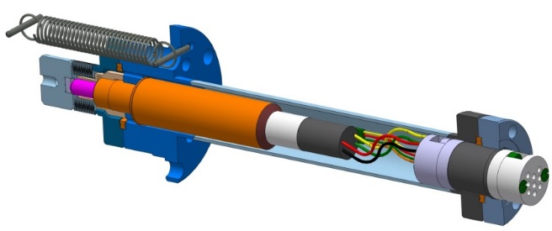
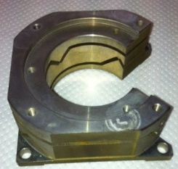
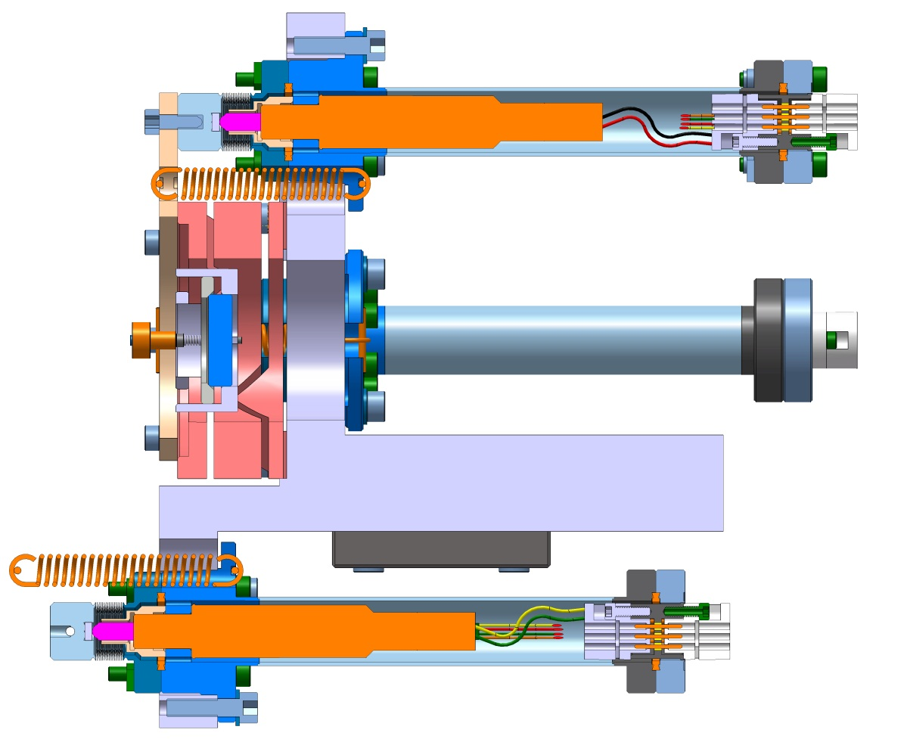
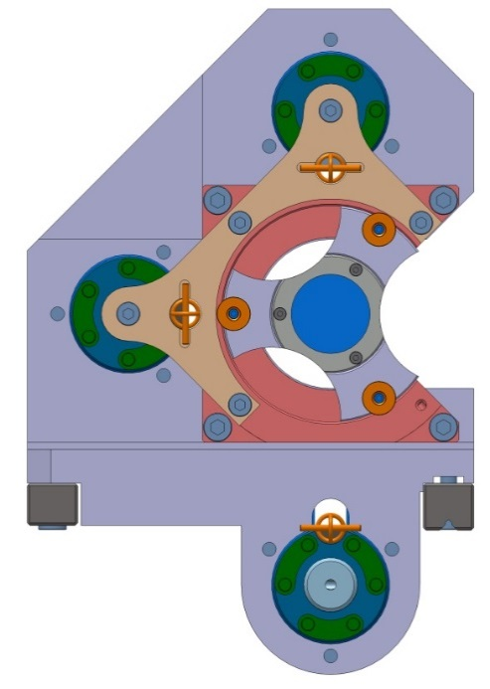
Système d’ajustement des miroirs
The flex part allows to rotate around the center
Step motor
Ceramic
Sub-C connector
3 ceramic balls on tracks
Ajustment of frequency or focalisation
Notes:
This is a truck’s detail.
There are 2 step motors encapsulated (no contact with a vacuum) who push the flexor to have a rotation around the center of mirror
And one step motor who push the heavy base for a translation in order to adjust the frequency (for the plan mirror) or the focalisation (for spherical mirror) .
This translation is made thanks to tracks and 3 ceramic balls (2 on « v » track and 1 on plan track)
The resolution of the motors is 0,1 micrometer.

Slide 29

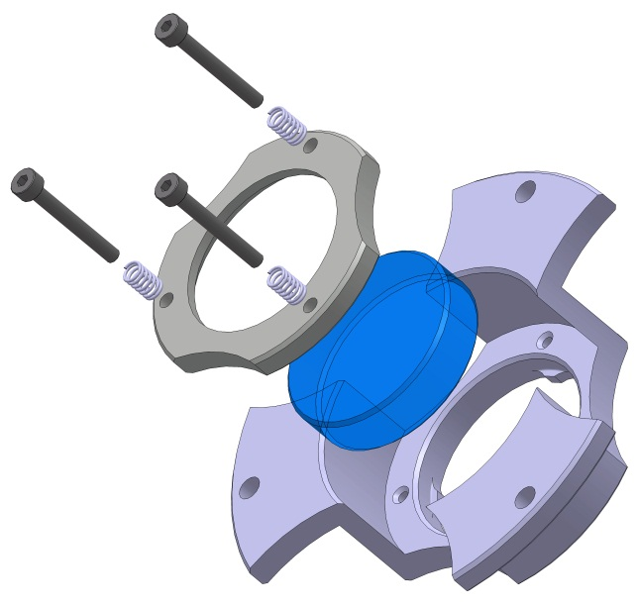
ThomX 1’’ mirror mount
Notes:
Here the mirror mounting.
We use springs to have a good pressure on the mirror. The pressure is on the chanfer in order to not stress the optic

Slide 30
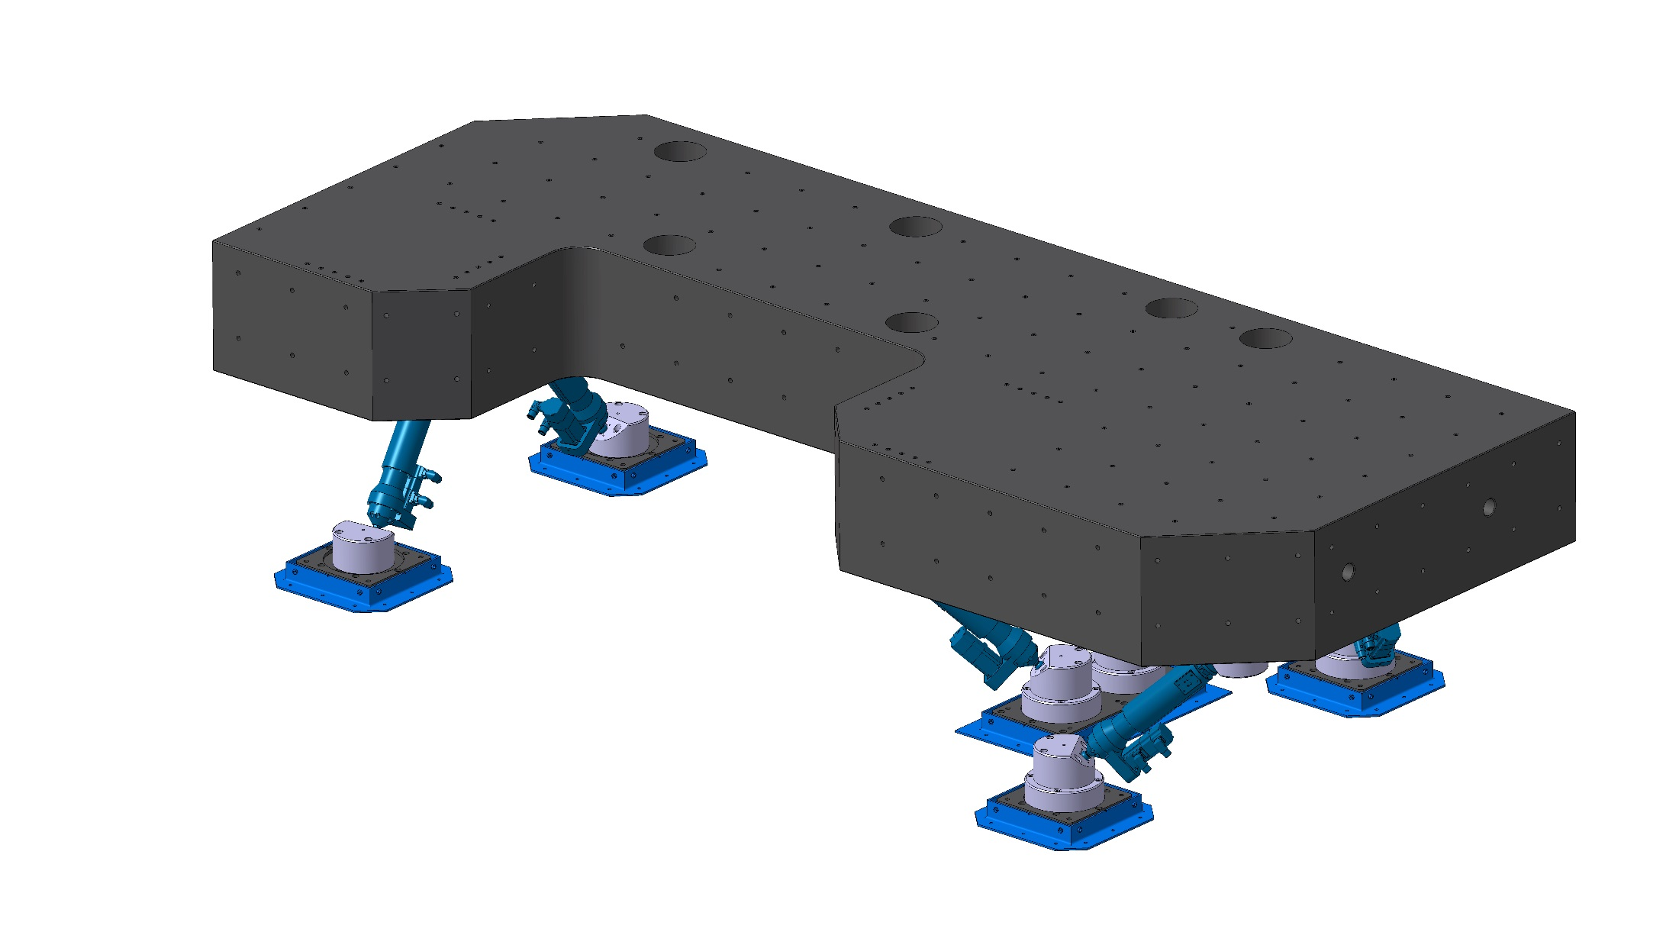
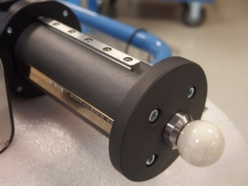
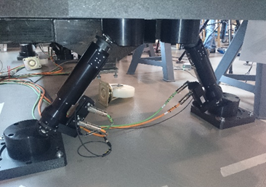
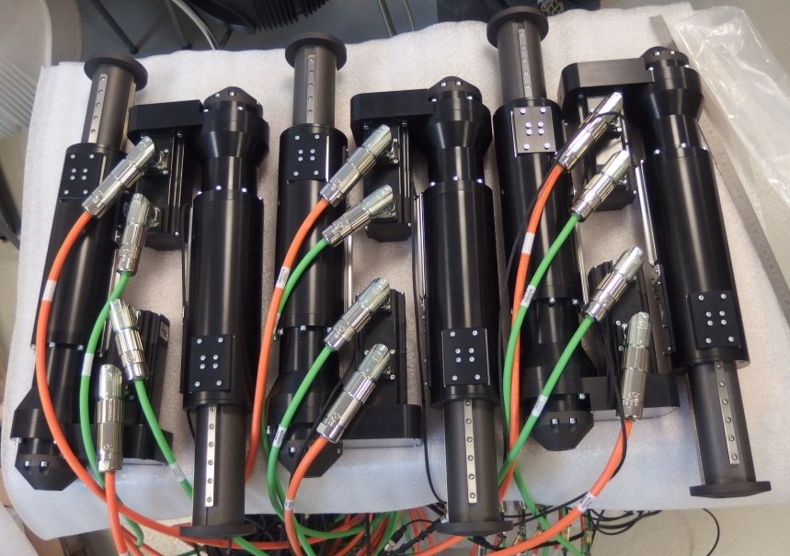
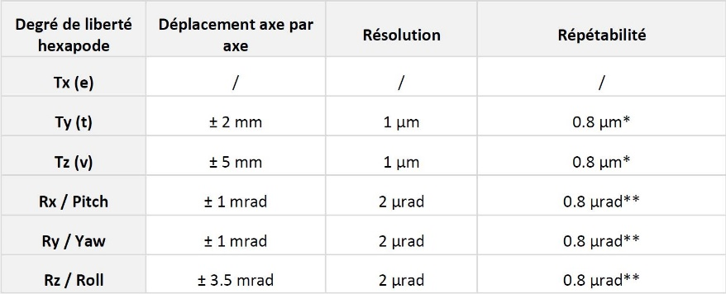
Notes:
The fabry perot cavity is installed on a big granit table ( around 6 tonnes) with hexapod (made by a french compagny called SYMETRIE) for match the electron beam
The hexapode allowed to 6 mouvments (3 rotations, 3 translations) around the interaction point.
We have a very high resolution about 1 micrometer for translation and 2 microradian for rotation.

Slide 31
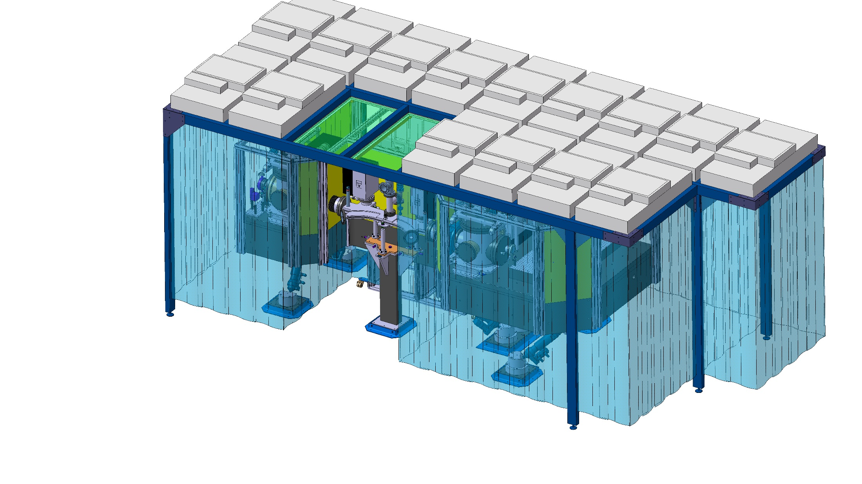
Notes:
The assembly is under the air flow ISO5 with an airlock.

Slide 32
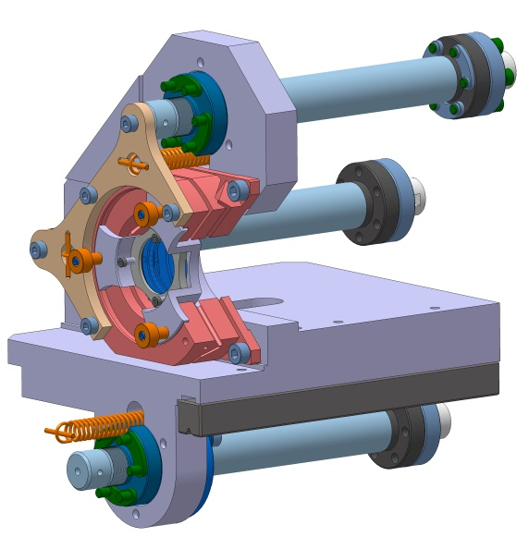

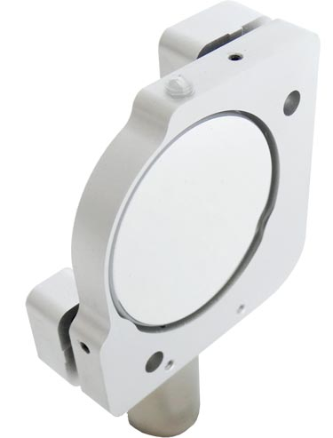
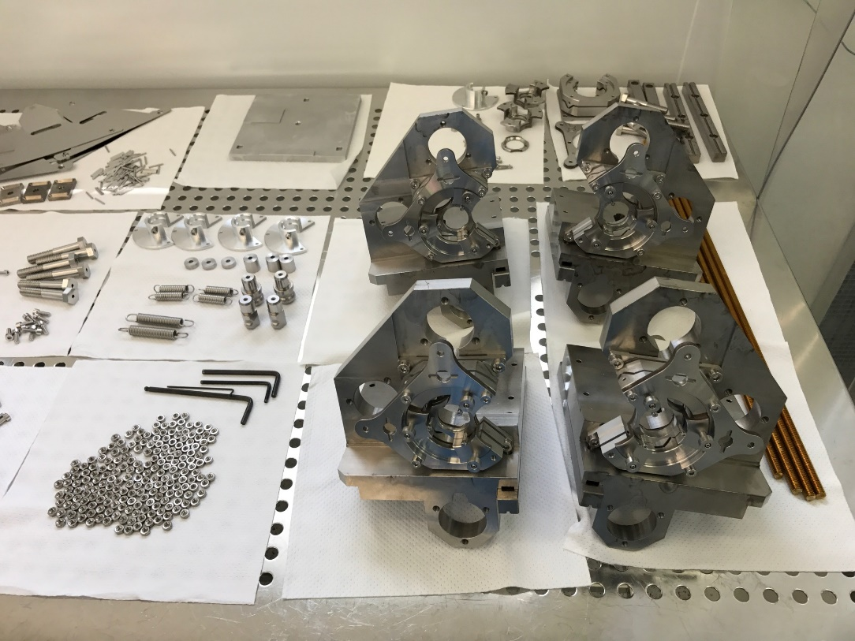
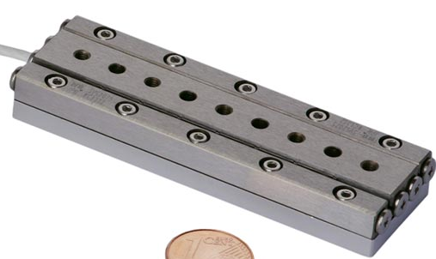
Slip-Stick Piezo technology
Very compact
Very simple and easy to use …
Quite complexe ultra-high vacuum mecanics
& tedious assembly
1 nm
Futur ?
Notes:
For ThomX or Mighty laser we used Ultra high Vacuum Technologie (around 10-10 mbar) BUT if you need a vacuum level around 10-6 ou 10-7, WE USE a standar part with vacuum compatibility,
This is Differents standards parts with Piezo technologie.
You can see the compacity of the system. It is less complicated but we keep a very good resolution in order to piezo technologie

Slide 33

Global architecture
Laser oscillator and fiber amplifier
Amplificateur
Cavité optique
Anneau e_
Low phase noise
Oscillator
IP
<P> ~ 10 mW
<P> ~ 150 W
<P> ~ 500 kW
Strecher
5 mW
Amp. #1
150 W
Compressor
Amp. #2
Amp. #3
CELIA Lab.
Gain ~ 30000

Slide 34



laser system
fiber amplifier
Max power : 210 W
Stability over 90h @ 104 W :
210 W
η=69%
Fiber amplifiers are very efficients
CELIA Lab.

Slide 35




laser system
fiber amplifier : laser beam quality
Beam quality at high power
0A/4W
5A/97W
11A/200W
8A/158W
CELIA Lab.

Slide 36
Feedback technology well known (from
metrology)
At LAL we reached 400kW with a
25000 finesse cavity with new generation
of COMMERCIAL low noise Yb dopped oscillators
(which was not the case few years ago …)

Slide 37
Summary & issues
Optical resonators for Compton scattering
Fibre laser & low noise oscillator are now available
Optical axis very stable in our 4-mirror optical cavities
High finesse mirrors require cleanliness …
Quite complex mechanical system
  Shortening the cavity ➔ higher e-bunch frequency
  Use Slip-strick piezos of other technologies
Modal instabilities are for now limiting the average stored power
  R&D going on
  At lest 100kW-400kW will be provided for ThomX starting
Burst cavity proposed/tested at KEK
  Promising for LINACs

Slide 38


Beam pipe : aperture slit of 5mm
Place for
ATF beam pipe
Mirror mount troncated
to decrease incident
angle : 8°

Slide 39





Notes:
Concerning the vacuum level, all parts is made for UHV.
We design, clean, make baking and leakcheck test at 10-10mbar/l/s all parts
We are 4 Ionic pumps (around 1300 L/s)
2 turbo pump
6 gauges
in situ baking system at 150 °C
2 mass spectrometers

