Slide 1
STAR project:
The Italian Compton Source and the interaction chamber
Alberto Bacci INFN-MIlano
November 28th, 2017, Padova (IT)
Notes:
Meglio dire Thomson source e magari cambiare anche il titolo

Slide 2
Index
  A Brief view of Thomson/Compton European Sources
    One Big Facility & four smaller one
    The Sparc-Thomson Interaction Chamber
  The STAR project: Southern Europe Thomoson back scattering source for Applied Research
    Location & Funds; Dimension/Cost projects Scaling
    Beam-line & main characteristics
    Interaction Chamber
    Source performances
  Conlcusions

Slide 3
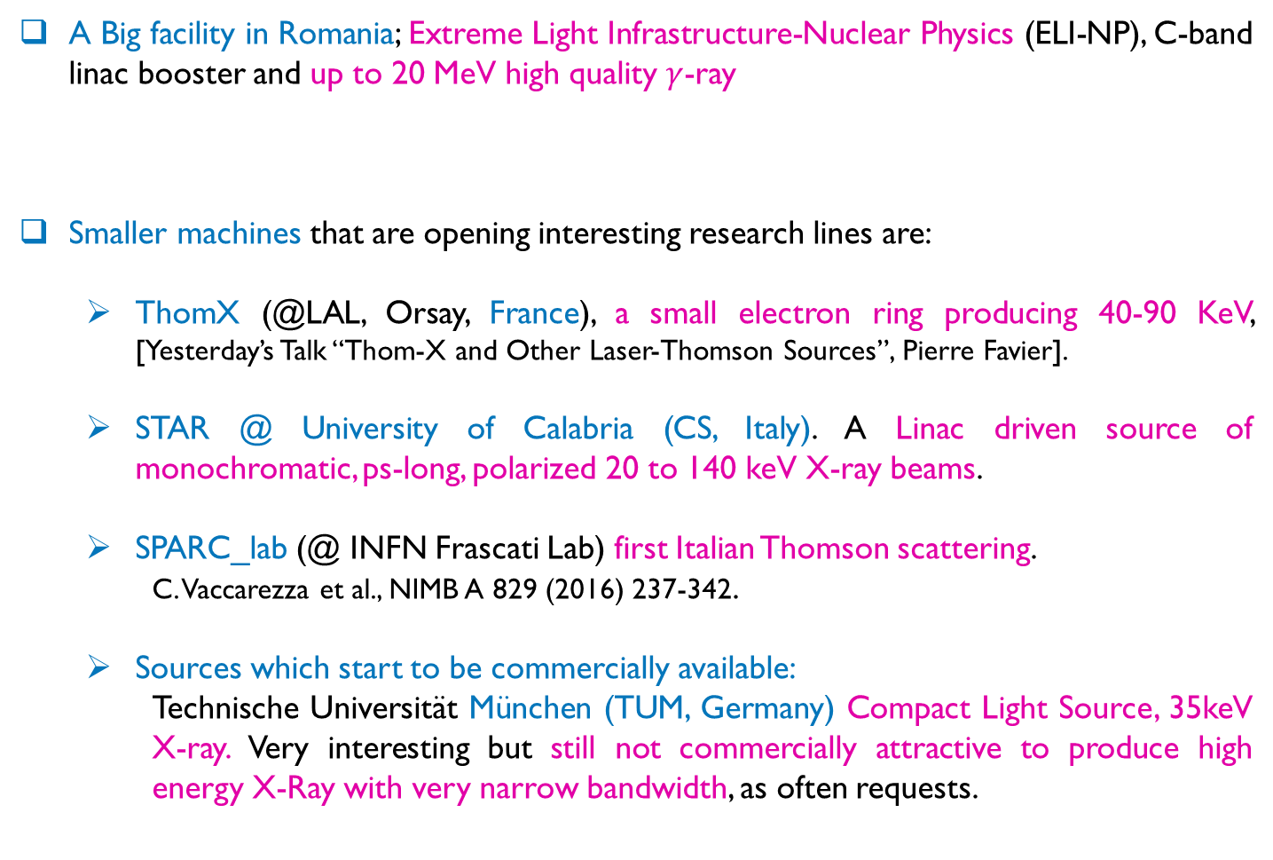
European Thomson/Scattering X-Ray sources
A Big facility in Romania; Extreme Light Infrastructure-Nuclear Physics (ELI-NP), C-band linac booster and up to 20 MeV high quality $γ$-ray
Smaller machines that are opening interesting research lines are:
  ThomX (@LAL, Orsay, France), a small electron ring producing 40-90 KeV, [Yesterday’s Talk “Thom-X and Other Laser-Thomson Sources”, Pierre Favier].
  STAR @ University of Calabria (CS, Italy). A Linac driven source of monochromatic, ps-long, polarized 20 to 140 keV X-ray beams.
  SPARC_lab (@ INFN Frascati Lab) first Italian Thomson scattering.
    C. Vaccarezza et al., NIMB A 829 (2016) 237-342.
  Sources which start to be commercially available:
    Technische Universität München (TUM, Germany) Compact Light Source, 35keV X-ray. Very interesting but still not commercially attractive to produce high energy X-Ray with very narrow bandwidth, as often requests.

Slide 4
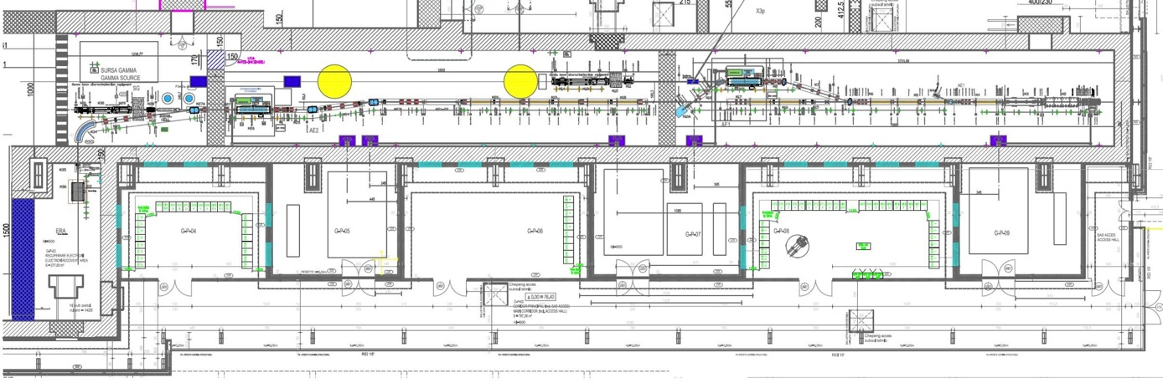
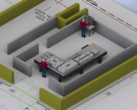
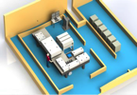
  A big machine: ELI-NP Layout
e– beam
dump
Interaction Point
High Energy
e– beam
dump
Interaction Point
Low Energy
Photogun
multibunch
beam
coll&diag
beam
coll&diag
e– beam
dump
Racks
Room
Control
Room
Racks
Room
Interaction Laser
High Energy
e– RF LINAC
High Energy
720 MeV
Interaction Laser
Low Energy
e– RF LINAC
Low Energy
300 MeV
Photo–drive Laser
e– source
Notes:
Mettere le energie degli elettroni nei due IP e l’energia del laser di interazione.

Slide 5
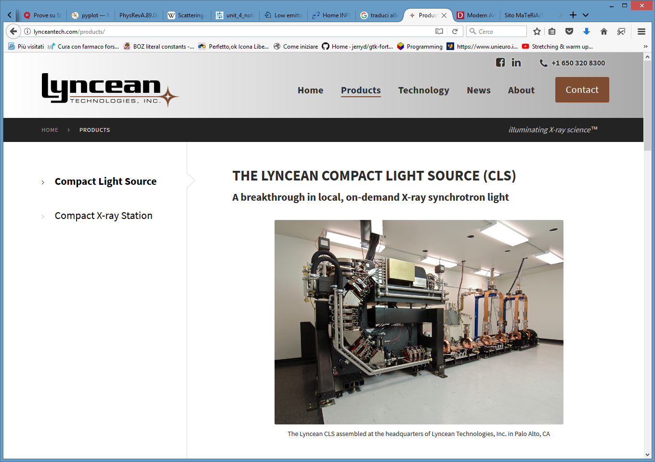
Compact Light Source @ Monaco (Germany): Commercially available
Notes:
disassemble

Slide 6
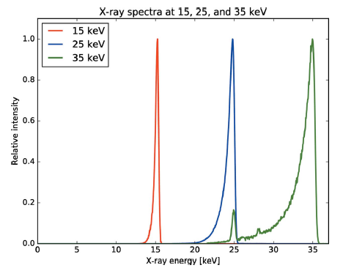
Compact Light Source @ Monaco (Germany): Commercially available
Notes:
Mettere il tempo di vita dell’anello di elettroni (reiniettano a 25 Hz)
Hanno una collimazione fissa

Slide 7
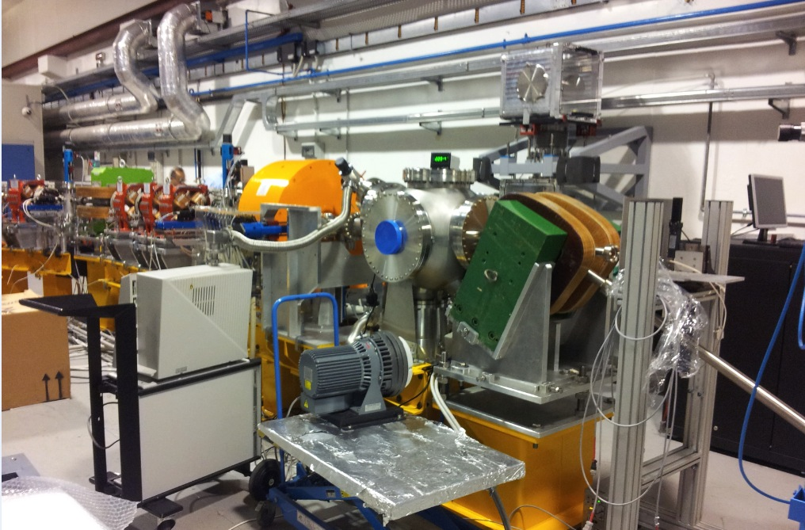
SPARC_LAB thomson Line
Huge solenoid,
Bmax 1.2 T
  Results in Ref:C. Vaccarezza et al., NIMB A 829 (2016) 237-342.

Slide 8

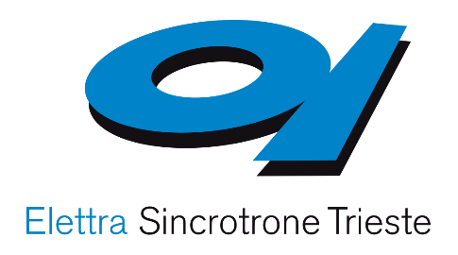


The STAR Project
STAR brief description:
A Monochromatic & tunable & ps-long & polarized X-ray beam from 20 to 140 keV.
Experiments on matter science, cultural heritage analysis and radiological imaging, by using micro-tomography, are planned.
An Yb:Yag 100 Hz, 150mJ colliding laser (Amplitude).
Actors in the project :
UNICAL (UNIversità della CALabria)
CNISM (Consorzio Nazionale Interuniversitario per le Scienze fisiche della Materia)
Sincrotrone Trieste
INFN (Istituto Nazionale di Fisica Nucleare)
Notes:
Not Entering in Merit

Slide 9
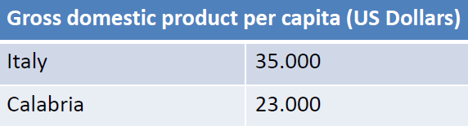

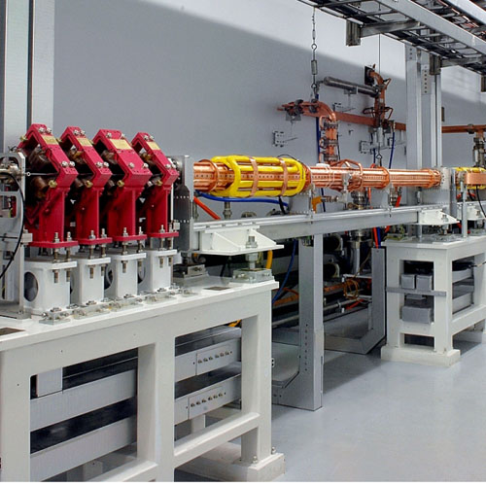
Location & Funds
The economical support comes from the EU for Regional Convergence (including Calabria)
Development Funds for the community, including research infrastructures
Calabria
‘nduja
licorice
since ever
by now

Slide 10
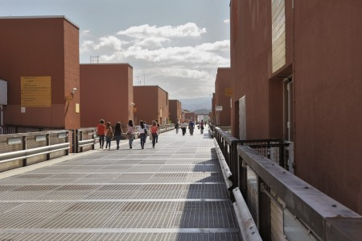
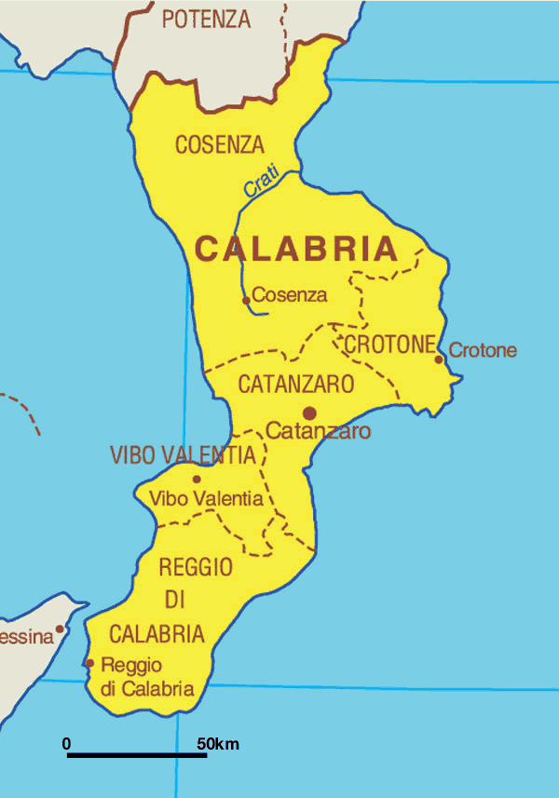
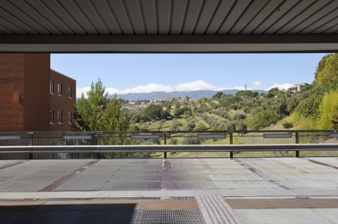
Location
University of Calabria (UNICAL):
International Architect competition in 1974 (won by Gregotti Bureau), built in 1977
35.000 Students
Strong physics department (strong collaborations with CERN)

Slide 11


Dimensions & Costs Scaling
$$∼10$$
$$∼10$$
E. Puppin Courtesy
Notes:
Mettere che le dimensioni e i costi sono ok per un ospedale

Slide 12
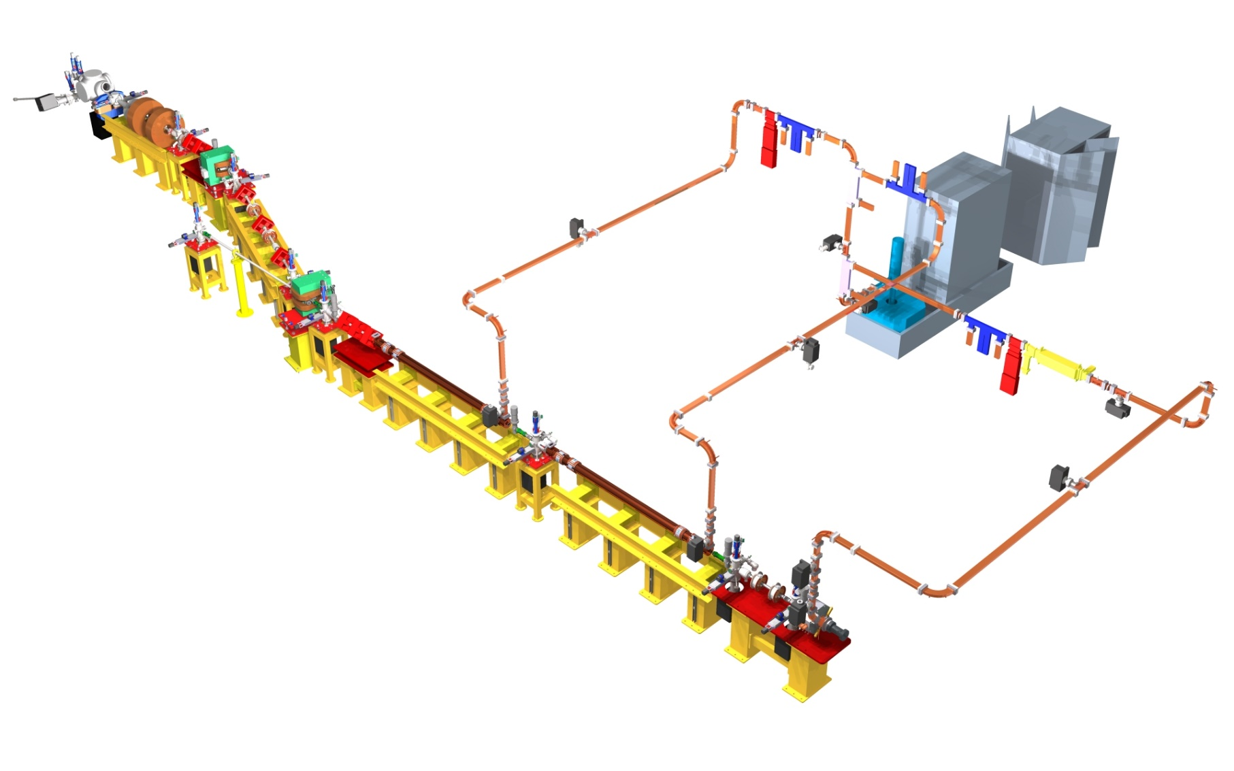
STAR project layout
Electron Energy: Phase 1) 60 MeV, 2) 80 MeV, 3) up to 110 MeV
55 MW
100Hz RepRate
Designed to be easily upgradable
by G. Di Raddo
Notes:
Dogleg shields X-ray line from the background radiation due to Linac dark current.
Per la fisica nucleare la polarizzazione è importante. Per thomson e Quasi Thomson è sempre
Polarizzato (segue il laser), per energie superiori, in regime Compton, ci sono processi tali per cui si perde la polarizzazione
To host

Slide 13
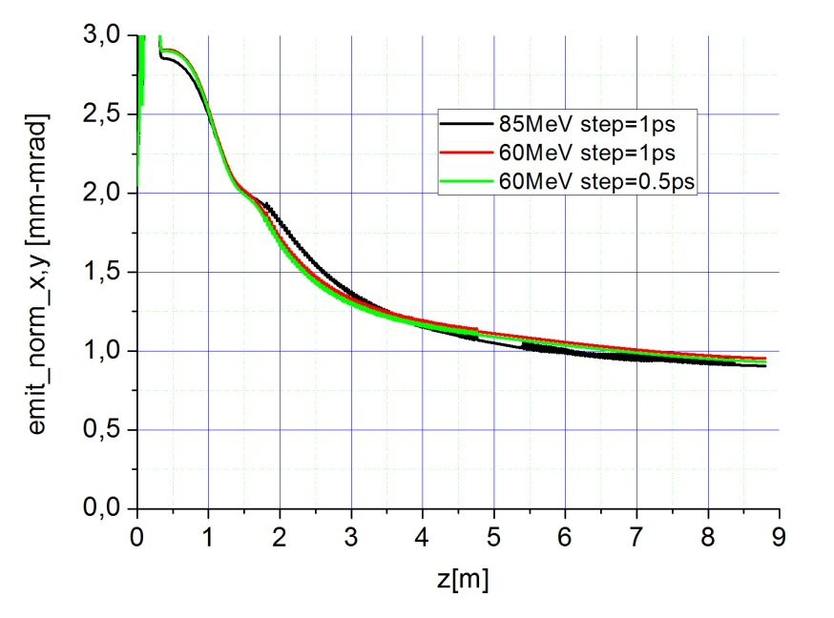
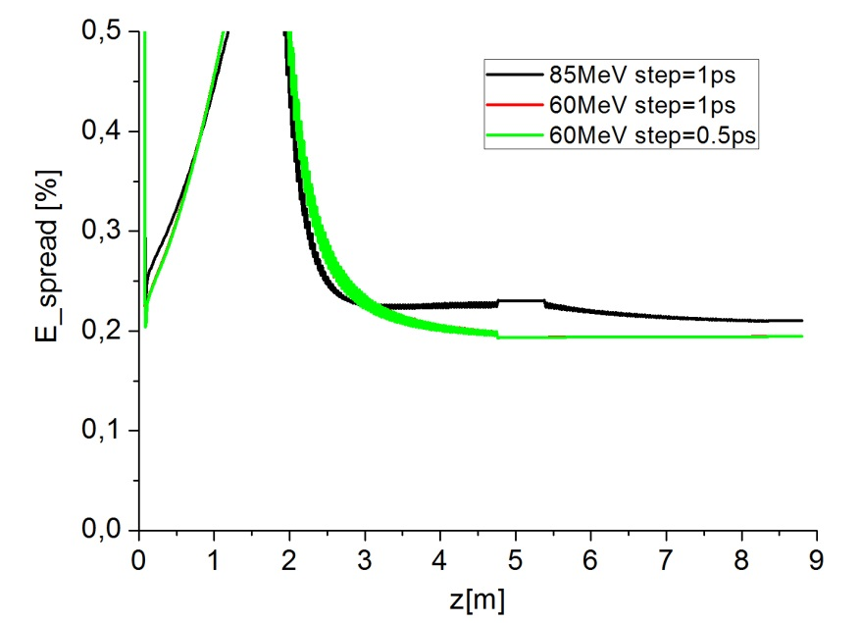
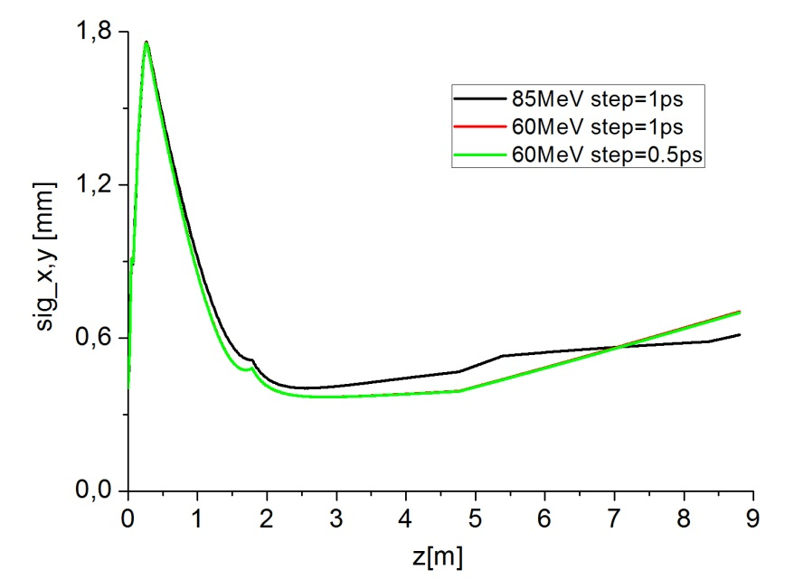
Injector Optimization (1-8.8m) for the two phases: 60 MeV and 85 MeV
60 MeV – one S-band TW SLAC cavity
Sig_t=3.4ps (Gaussian pulse)
Sig_x=340 micron
Charge=0.5 nC
85 MeV – two S-band TW SLAC cavities
Sig_t=3.7ps (gauss pulse)
Sig_x=320 micron
Charge=0.5 nC
5000mp Astra simulations
60MeV case
long drift

Slide 14
A new interaction chamber scheme 1/3
very expensive
250-300k€
2 x Cavity BPM
2 x Movable permanent Quads fousing channel
New scheme
The Interaction Chamber is a diagnostic chamber, with a laser entrance as tested at Fermi_lab (Trieste) for the cathode laser; (as planned @ Eli-np & STAR)

Slide 15
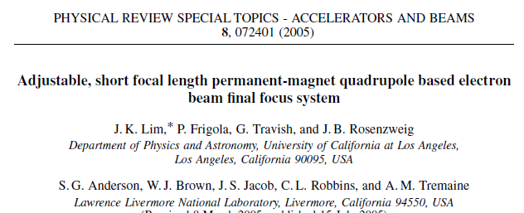
A new interaction chamber scheme 2/3
At realative low energy (as at STAR, 0.5 nC for 60-100 MeV) the focusing channel have to be as compact as possible
Up to
650 T/m

Slide 16
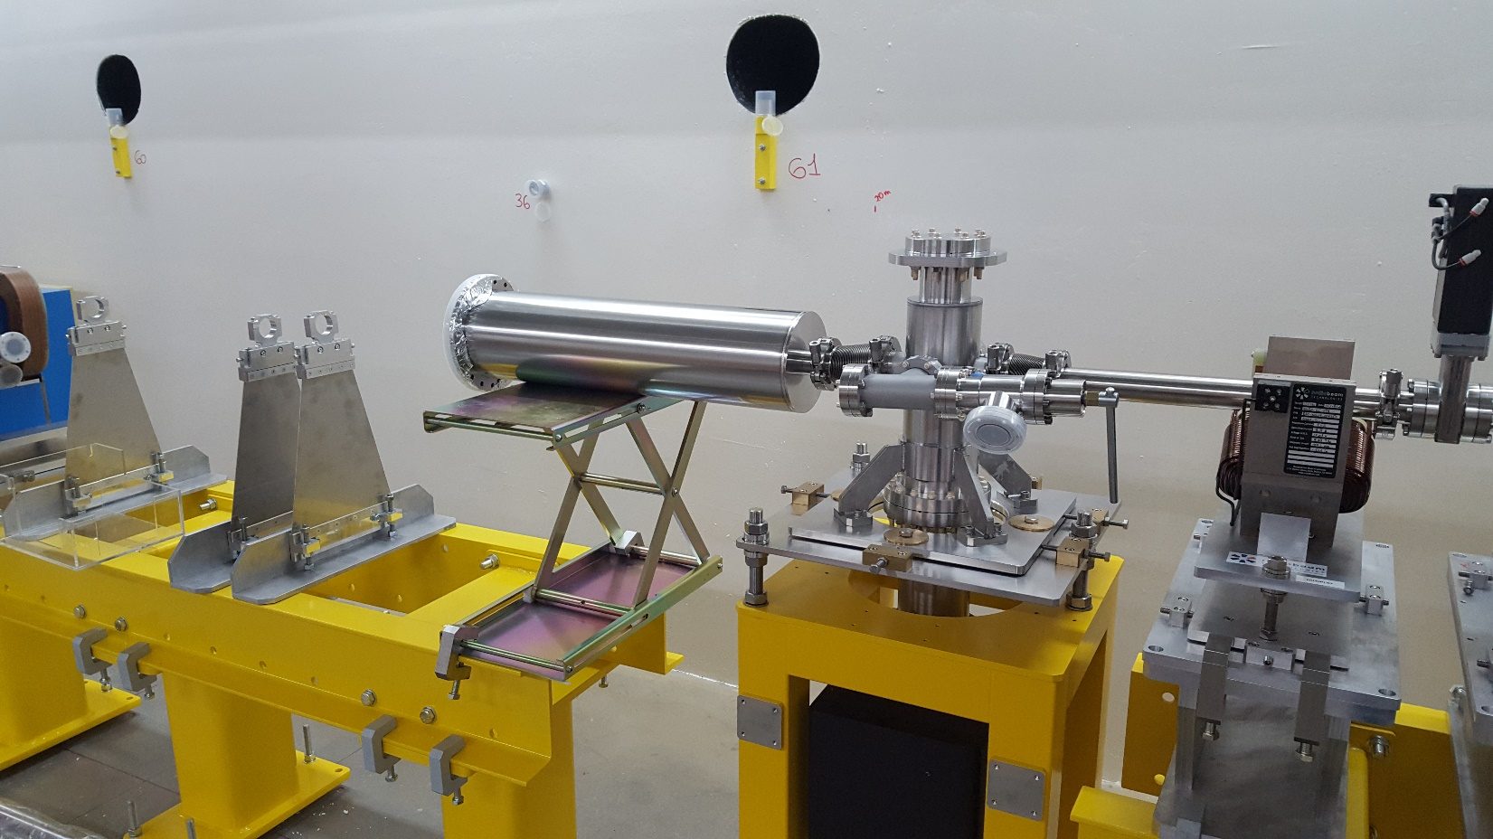
A new interaction chamber scheme 3/3
Laser entrance to IP = 120 mm
f_laser=1500 mm
IP_angle = 2.3°
(e⁻ vs laser)

Slide 17
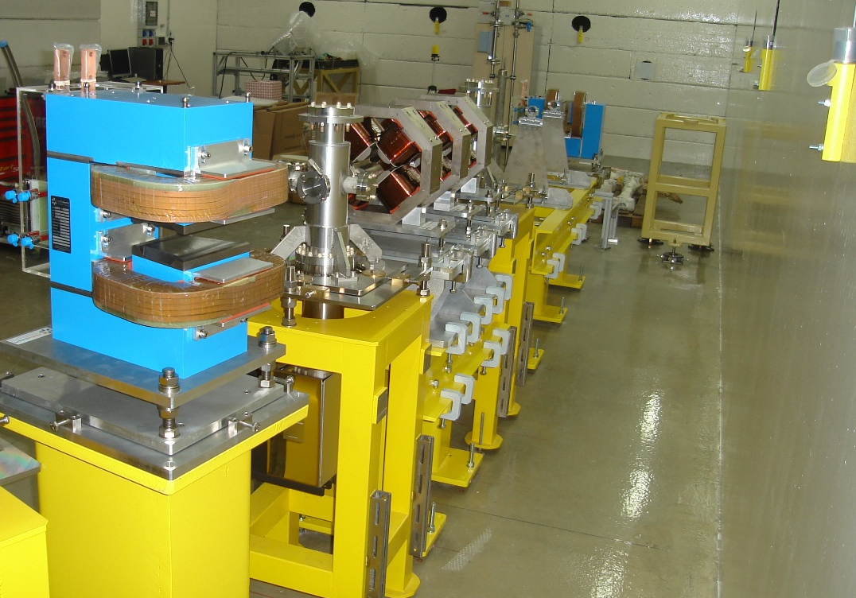
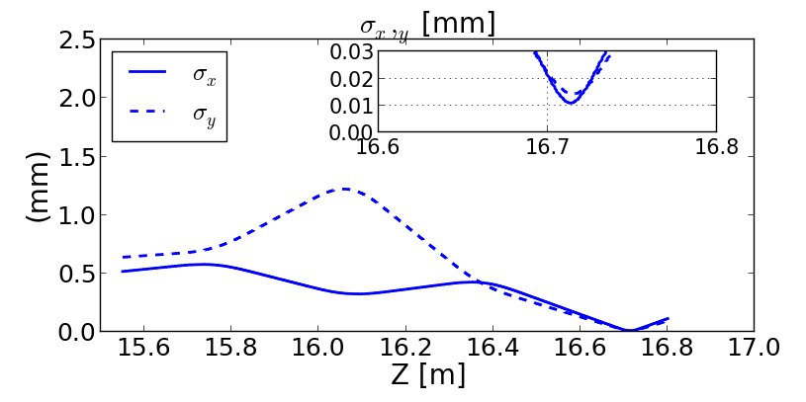
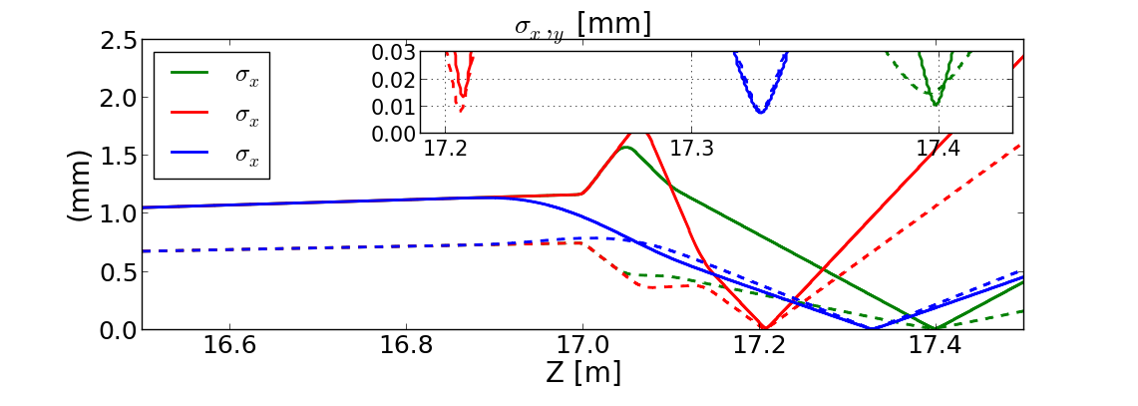
The Focusing channel
We studied more solutions, starting from Permanent Quadrupole and Solenoids
Final Fusing Channel
Focusing Channel Comparison
Permanent Quads as product by Radia Beam T (RBT) short Focal lenght
One Solenoid as @ SPaRC
RBT Permanent Channe (red case), with long Focal lenght
Focal performance
Focusing Channel
Electromagnet
Quadrupoles
~ f = 0.5m

Slide 18
Source performances 1/3
Electron beam Parameters
Electron Energy [MeV] | 59.81
Bunch charge [nC] | 0.5
Bunch length rms [mm] | 0.93
Normalize Emit. x,y [um] | 1.7, 1.8
Energy Spread % | 0.2
Spot size rms; x,y@ IP | 9.5, 13.2
Interaction Laser Parameters
Pulse energy [mJ] | 150
Pulse Lenght rms [ps] | 1.9
Spot size w0, rms [um] | 28
Wavelegth [nm] | 1029

Slide 19
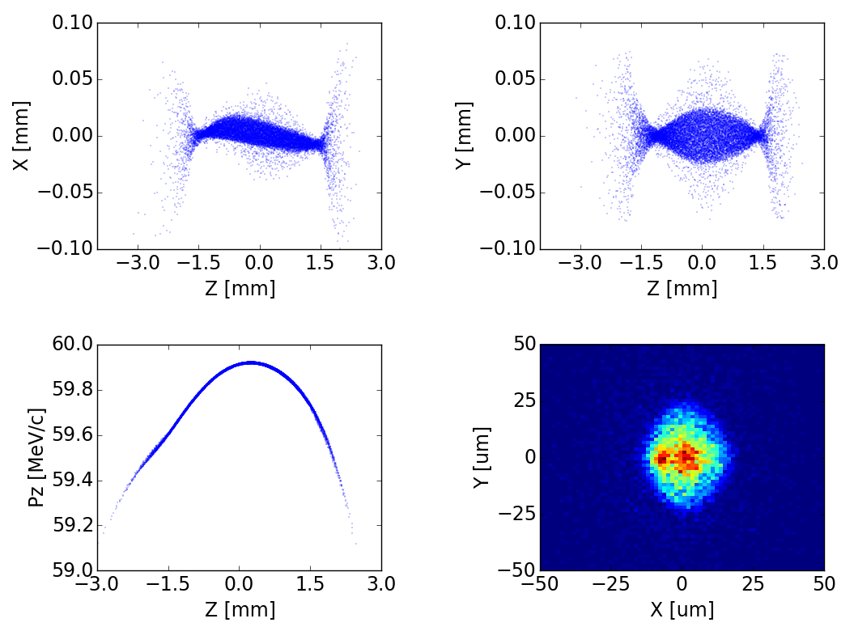
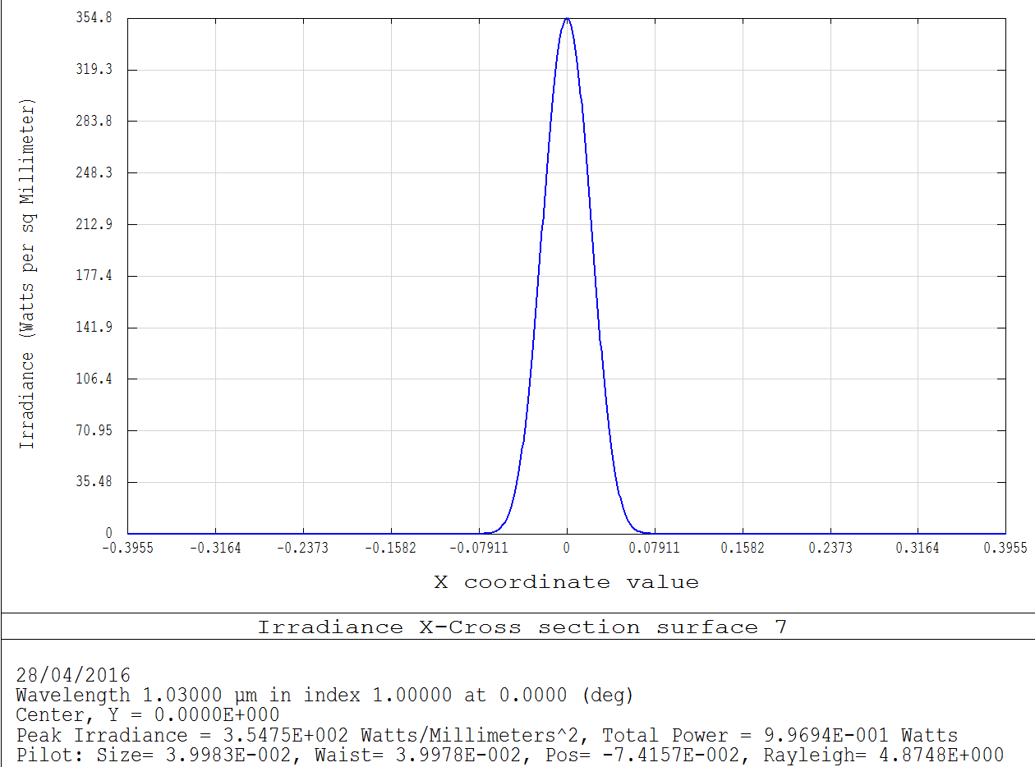
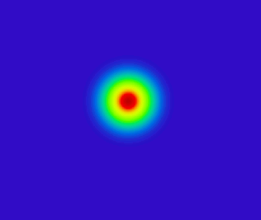

Source performances 2/3
Simulated Electron Bunch @ Interaction Point
Simulated Laser pulse @ Interaction Point
$$W_{0}≃30 μm$$

Slide 20
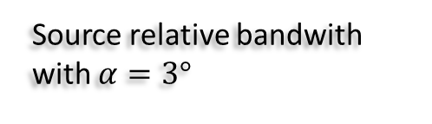
Source performances 3/3
Old IP chamber α_{IP} = 10°
New IP chamber α_{IP} = 2.3° (here α_{IP} = 3° , to be conservative)
New IP chamber
Old IP chamber
Source Flux vs Laser-electrons scattering angle
I. Drebot courtesy
10% bandwith
Source relative bandwith with $α=3°$
I. Drebot courtesy

Slide 21
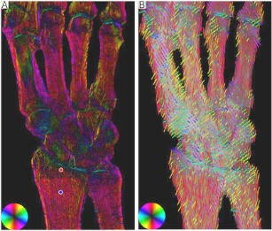
In Conclusion
Compton/Thomson X-ray Sources, in the last few years, by simulations & by recent experimental results have shown great advantages in more and more fields:
radiological medical imaging, matter science, study of the historical finds (e.g. unroll of burnt papyrus), etc. …
Further the possibility to produce synchrotron radiation by not huge machines easily overcoming 100keV x-ray energy with small ( order of 10 meters)
Thanks for your attention
Waiting for to TURN-ON of ITALIAN and EU machine, let see news @ Munich CLS
“Trabecular bone anisotropy imaging with a compact laser-undulator synchrotron x-ray source”, C. Jud* at al. Scientific Reports 7, Article number: 14477; Online: 03 November 2017 * Tecnical University of Munich
Microfractures are often missed in classical radiographs; x-ray vector radiography (XVR) can overcome this limitation: degree of anisotropy and orientation of scattering structures
Notes:
due to limited spatial resolution, x-ray radiography cannot provide information on the microstructure of the trabecular bone

