Slide 1

Beam stability and cooling aspects for the partially stripped ions in the storage rings (LHC/SPS)
Alexey Petrenko (CERN, Budker INP)
Photon Beams Workshop, 28.11.2017, Padua

Slide 2
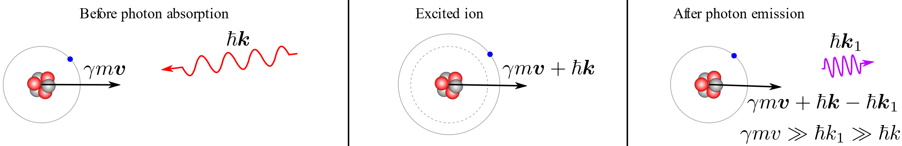

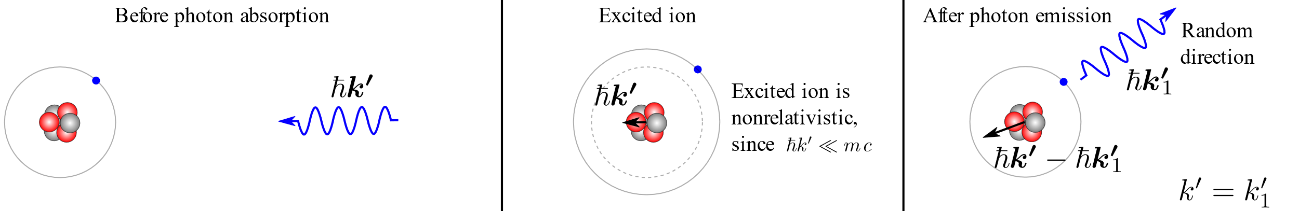
Laser-ion interaction kinematics
In the lab frame:
In the ion’s frame:
Longitudinal cooling: because energy loss grows with ion energy:
Transverse cooling: because all components of ion momentum are lost due to the photon scattering but only the longitudinal component is restored in the RF resonator.
Heating: because angle of photon emission in the ion’s frame is random.
We would like to find an equilibrium between the cooling and heating processes.

Slide 3
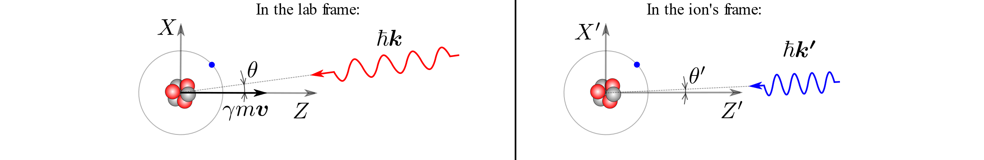
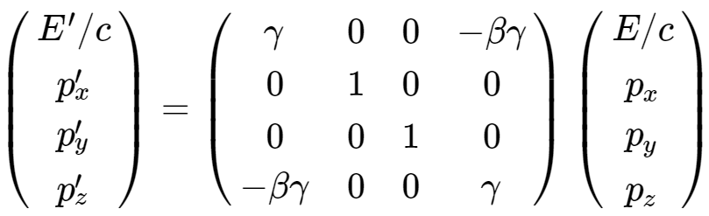
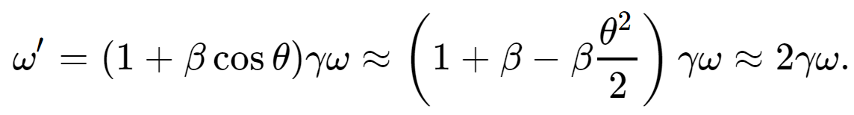
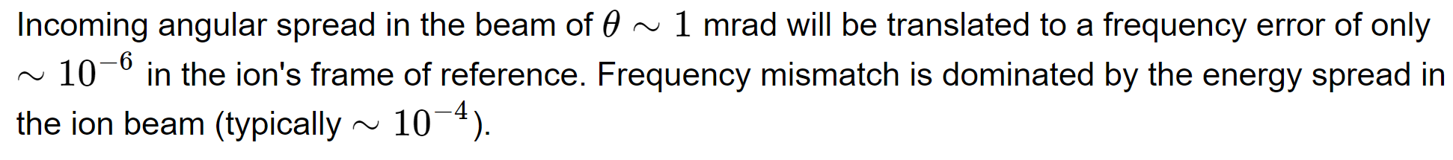
Photon absorption
4-vector Lorentz transformation:

Slide 4
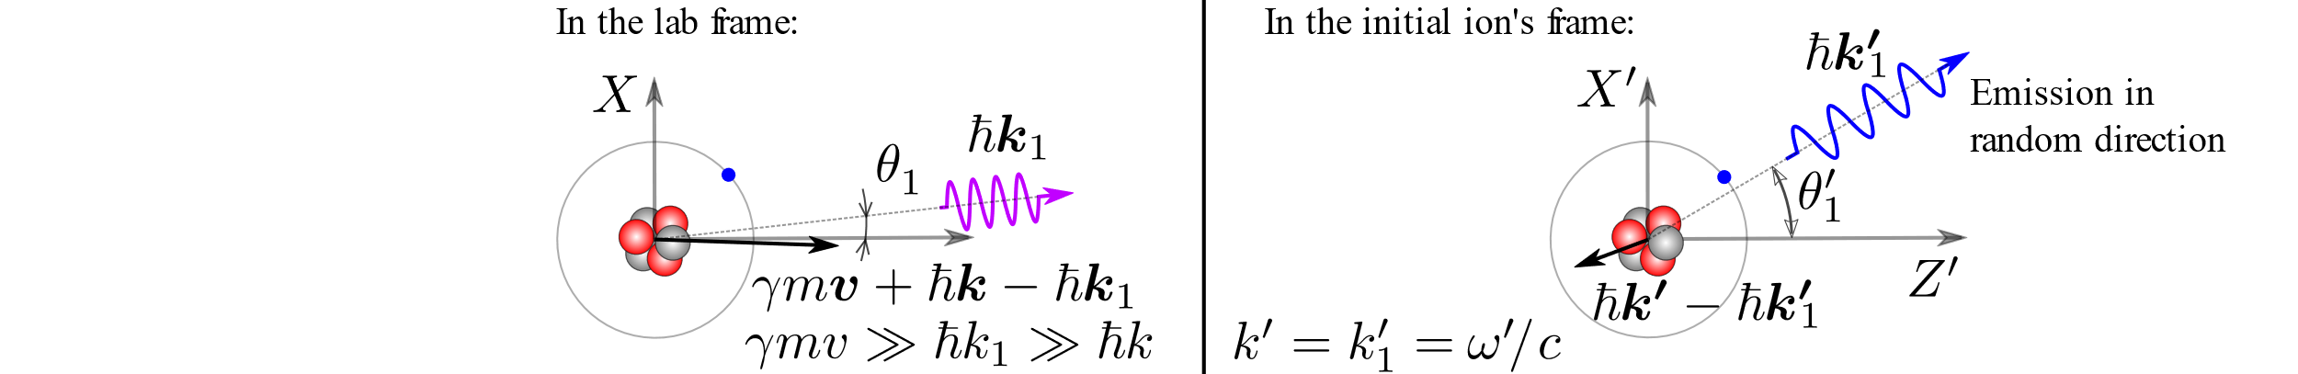
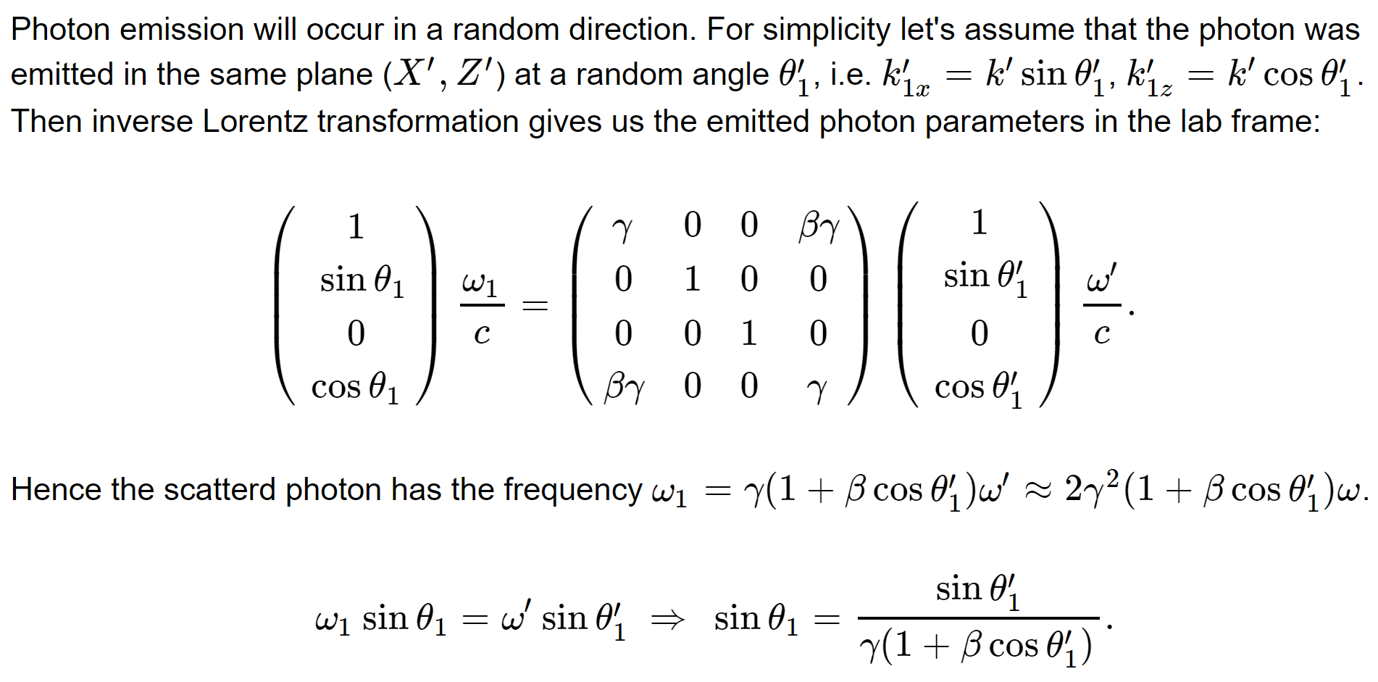
Photon emission

Slide 5
The LHC example:
Lead ion with one electron:
Ion charge Z = 81, mass A = 208, γ = 2928, p_{z} = 567 TeV/c,
ℏω′ = 69 keV (Lyman-alpha line), laser ℏω = 12 eV, emitted gamma ℏω_{1,max}= 402 MeV,
typical angle of emission θ₁ ~ 1/γ ~ 0.3 mrad.
Typical transverse kick due to gamma emission:
p_{x}/p_{z}~ ℏω′/p_{z}c ~ 69 keV/567 TeV ~ 10^{‒7} mrad.
Typical transverse beam parameters at the LHC interaction point for example:
Transverse beam size = 0.026 mm, angular spread = 0.026 mrad (10⁵ times higher).
Typical energy spread in the beam is Δp/p ~ 10^{‒4}, while the average δp_{z} due to the photon emission is 200 MeV/c => δp_{z} / p_{z} = 200 MeV / 567 TeV = 3.5· 10^{‒7} => Δp/δp ≈ 300, even with one scattering per turn the longitudinal effects will be significant in 100s of turns.
First of all we should consider the influence of photon emissions on the synchrotron oscillations.

Slide 6
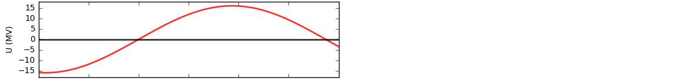
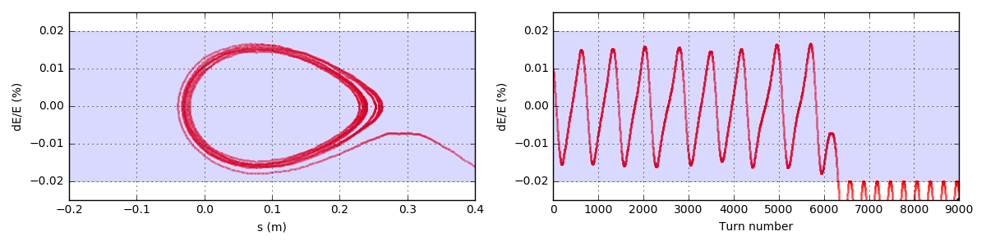
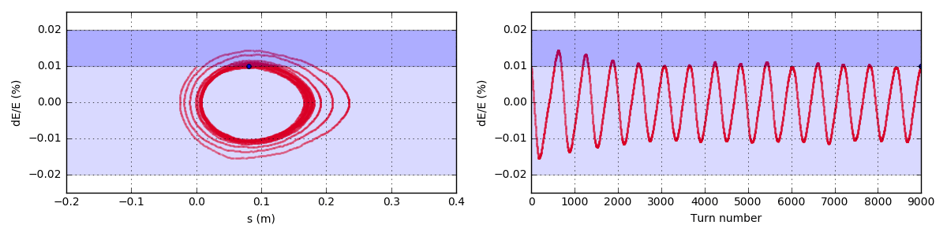
Longitudinal laser cooling is important to stabilize the ion motion:
The important effect of photon emissions on ion beam dynamics is in the energy loss of the partially stripped ion. This energy loss is randomly distributed from 0 to 400 MeV in this case of Pb ion with one remaining electron in the LHC. This randomness excites uncontrolled growth of synchrotron oscillations leading to a loss of ion from the RF-bucket:
4.0 scatterings
per ion
per turn
The synchrotron oscillations can be stabilized by a small change in the spectral distribution of the laser beam (or by adding another low-power laser):
4.4 scatterings
4.0 scatterings
per ion
per turn
Simulation details: http://www.inp.nsk.su/~petrenko/misc/ion_cooling/animations/

Slide 7
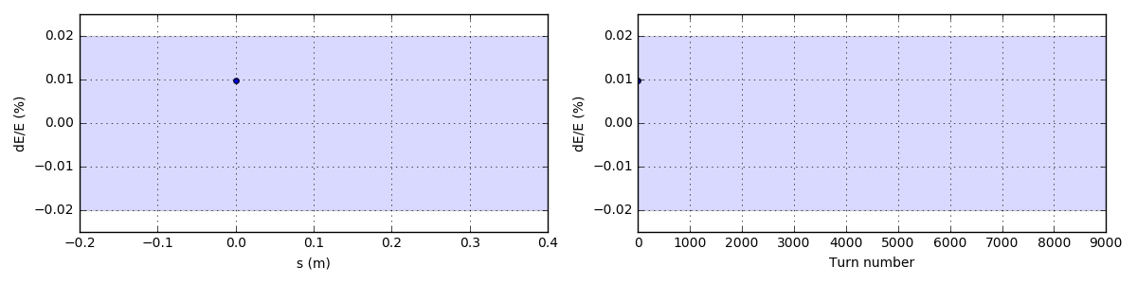
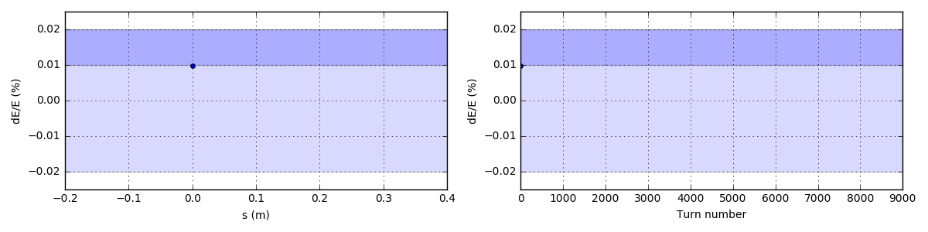
Longitudinal laser cooling is important to stabilize the ion motion:
The important effect of photon emissions on ion beam dynamics is in the energy loss of the partially stripped ion. This energy loss is randomly distributed from 0 to 400 MeV in this case of Pb ion with one remaining electron in the LHC. This randomness excites uncontrolled growth of synchrotron oscillations leading to a loss of ion from the RF-bucket:
4.0 scatterings
per ion
per turn
The synchrotron oscillations can be stabilized by a small change in the spectral distribution of the laser beam (or by adding another low-power laser):
4.4 scatterings
4.0 scatterings
per ion
per turn
Simulation details: http://www.inp.nsk.su/~petrenko/misc/ion_cooling/animations/

Slide 8
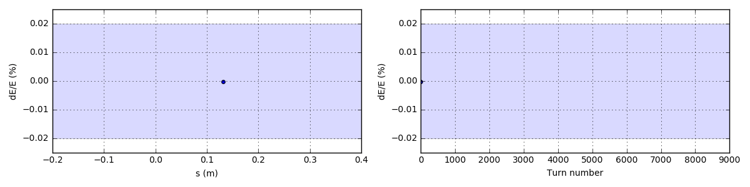
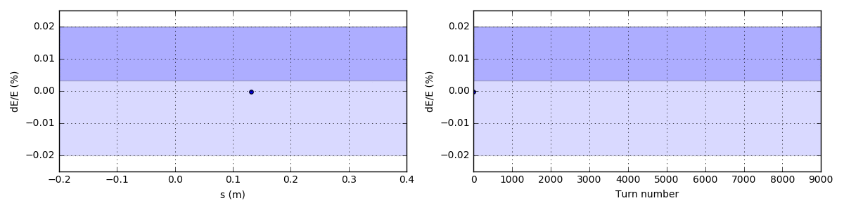
Longitudinal laser cooling is important to stabilize the ion motion:
The important effect of photon emissions on ion beam dynamics is in the energy loss of the partially stripped ion. This energy loss is randomly distributed from 0 to 400 MeV in this case of Pb ion with one remaining electron in the LHC. This randomness excites uncontrolled growth of synchrotron oscillations leading to a loss of ion from the RF-bucket:
6.0 scatterings
per ion
per turn
The synchrotron oscillations can be stabilized by a small change in the spectral distribution of the laser beam (or by adding another low-power laser):
6.6 scatterings
6.0 scatterings
per ion
per turn
Simulation details: http://www.inp.nsk.su/~petrenko/misc/ion_cooling/animations/

Slide 9
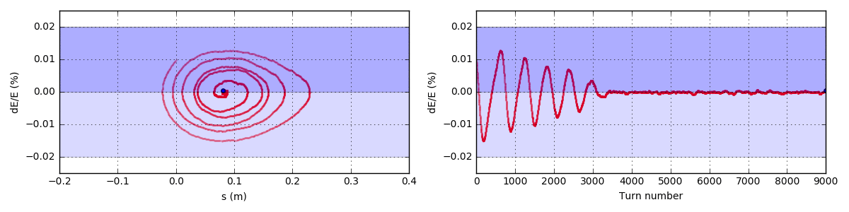
Fast longitudinal cooling
4.4 scatterings
4.0 scatterings
per ion
per turn
Fast longitudinal cooling idea: E. G. Bessonov, R. M. Feshchenko Stimulated Radiation Cooling. RuPAC’2008.
Simulation details: http://www.inp.nsk.su/~petrenko/misc/ion_cooling/animations/

Slide 10
There are several ways to cool high-energy hadron beams
1. Synchrotron radiation cooling
For protons and ions occurs naturally at very high energies. Takes hours. For the AWAKE-like PWFA applications probably practical only starting from the energy of High-Energy LHC (a project to upgrade LHC to 12-16 TeV).
2. Optical stochastic cooling
Was seriously considered for the Tevatron. Can be applied for protons in the LHC (for luminosity leveling and beam halo control). The test experiment with electrons is under construction at Fermilab. For details see: V. Lebedev. Optical Stochastic Cooling (2012).
V. Lebedev and A. Romanov. Optical Stochastic Cooling at IOTA Ring (2015).
E. Bessonov, M. Gorbunkov, A. Mikhailichenko. Enhanced optical cooling system test in an electron storage ring (2008) – fast version of optical stochastic cooling.
3. Laser cooling of partially stripped ions
Well-developed at low-energy. Cooling is faster at high energy because the energy radiated by the ion grows as γ². Never tested above few 100 MeV/u. Also interesting as an intense source of gamma-photons: see the talks of W. Krasny on The Gamma Factory Initiative.
4. Coherent electron cooling V. Litvinenko and Ya. Derbenev, PRL 102, 114801 (2009).

Slide 11
Broad-band cooling vs fast cooling (SPS):
The natural width of the absorption line (~10⁻⁶) typically << Doppler shift due to energy spread (~10⁻⁴)
1. Broad-band laser covers the full spectrum of particle energies:
See: E. G. Bessonov and K.-J. Kim. Radiative Cooling of Ion Beams in Storage Rings by Broad-Band Lasers, PRL, 1996.
For illustration the rate of cooling is much faster
Cooling in all planes. The time of cooling is the time to radiate full ion energy E.
For the SPS at gamma = 200, and Z = 14 (H-like Si), scattered light ~100 keV => assuming ~100 scatterings per ion per turn (intense laser) N_{turns} ~ 200·14·2·0.932 GeV / (100e-6 GeV · 100) ~ 10⁶ turns or 20 sec.
Energy loss is proportional to E²
2. Broad-band laser with a sharp low-frequency cut-off:
See: E. G. Bessonov, R. M. Feshchenko Stimulated Radiation Cooling. RuPAC’2008.
Energy loss
Much faster cooling, but only longitudinal. Time of cooling is the time to radiate energy spread ΔE.
Similar estimate for the SPS gives ~100 turns. This method is fast enough for the SPS even with only one scattering per ion per turn (t_{cool} ~ 0.1 sec)
No energy loss

Slide 12
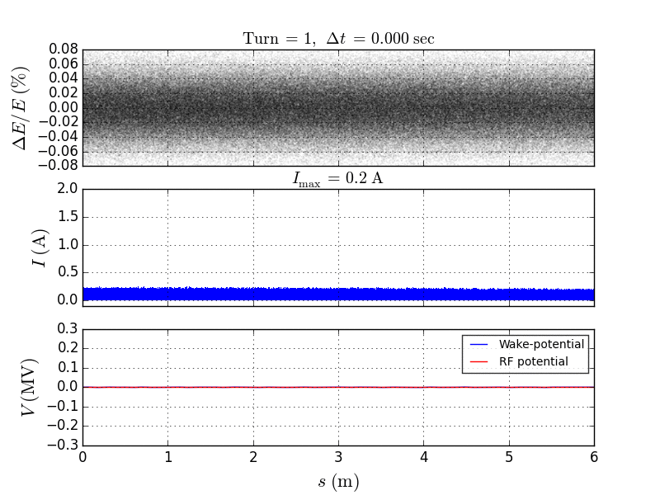
Some collective effects: fast cooling of unbunched beam (SPS)
Xenon with 7 remaining electrons in the SPS
SPS longitudinal impedance model from C. Zannini’s talk with some input from T. Argyropoulos (in 2012)

Slide 13
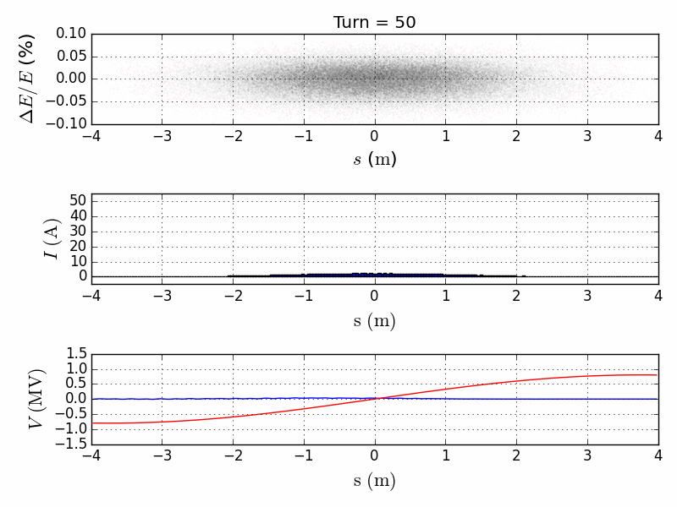
Some collective effects: bunch compression by triang. laser spectr.
Xenon with 7 remaining electrons in the SPS
SPS longitudinal impedance model from C. Zannini’s talk with some input from T. Argyropoulos (in 2012)

Slide 14
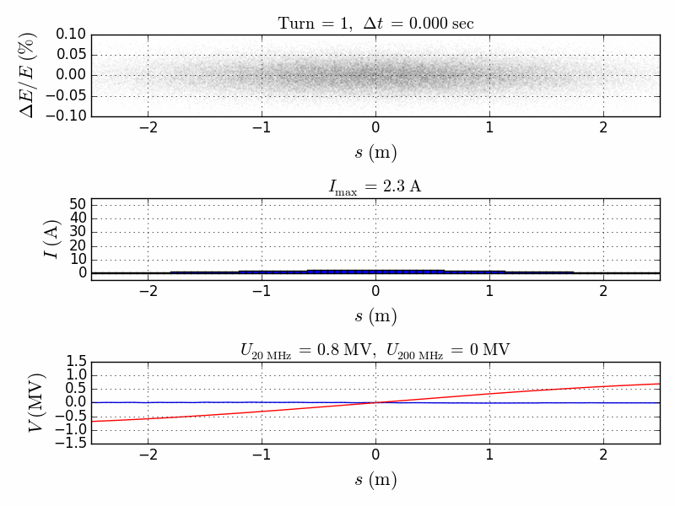
Some collective effects: bunch compression by triang. laser spectr.
For a very short bunch the wakefield is no longer valid (need higher frequency impedance model)
SPS longitudinal impedance model from C. Zannini’s talk with some input from T. Argyropoulos (in 2012)

Slide 15
Possible transfer of fast longitudinal cooling to transverse plane:
To achieve fast cooling of transverse betatron oscillations the coupling between x and E should be employed. For example two laser cooling systems can be used: one in the region with negative dispersion which converts transverse oscillations into longitudinal, and another one in the region with zero dispersion which cools the longitudinal oscillations:
Frequency filter(?)
Laser amplifier
RF-resonator
Cooling of vertical betatron oscillations can be achieved by coupling them to the horizontal oscillations with a skew quadrupole for example (such coupling is normally present in the ring because of small tilts of dipoles and quadrupoles).
Also one laser combining both functions can be used. Such laser should have modulation of intensity both in frequency and in space and it should be placed in the location with significant dispersion function.

Slide 16
Conclusions
The main effect of the resonant photon scattering off the ultra-relativistic partially stripped ions is the longitudinal momentum loss of the ion.
The resonant nature of photon absorption opens many interesting possibilities for selective manipulations with such ion beams: fast longitudinal cooling (or heating), collimation, compression, micro-bunching, etc.
The Gamma-Factory at the top LHC energy will require some form of longitudinal cooling in order to deal with excitation of synchrotron oscillations due to the random emitted photon energy (randomness in the photon emission angle).
Plenty of things to study, especially different collective effects:
PSI stripping due to the intrabeam scattering (V. Teltov’s suggestion).
Longitudinal and transverse stability due to collective effects (impedances).
Many thanks to W. Krasny and E. Bessonov for stimulating discussions!

Slide 17
Back-up slides

Slide 18
Partially stripped ions in the SPS
D. Manglunki et al. CERN's Fixed Target Primary Ion Programme. IPAC’2016.
J. Wenninger et al. Energy Calibration of the SPS with Proton and Lead Ion Beams. PAC’2005:
(fully str.)
100x less than in AWAKE.
Maybe could be optimized for high beam charge.
Number of charges: 9·10¹⁰ 3.2·10¹⁰ 2.5·10¹⁰
Less than in AWAKE 3x less 10x less 10x less
Production efficiency for partially stripped ions can be higher than for the fully stripped ions.
Possible variant: Xe⁴⁷⁺ (7 electrons left, N-like). γ = 162. Atomic excitation ⁴S_{3/2} → ⁴P_{3/2}. Krypton laser: 647 nm (1.87 eV) will be converted to gamma-photons with E_{max} = 196 keV. I_{sat.} = 1.7·10⁸ W/cm² , decay length = 3.4 cm => with a 1 mm wide beam to have one interaction per turn we need a single laser pulse energy ≈ 1.7·10⁸ W/cm² · 0.1·0.1 cm² · 3.4 cm / (3·10¹⁰ cm/sec) ≈ 0.2 mJ => Average laser power ~ 0.2·10⁻³ J / (7000 m / 3·10⁸ m/sec) ~ 10 W.
(Xe⁴⁷⁺ suggested by Bessonov and Kim PRL’1996 and in W. Krasny’s proposal for gamma-factory test at SPS).

Slide 19
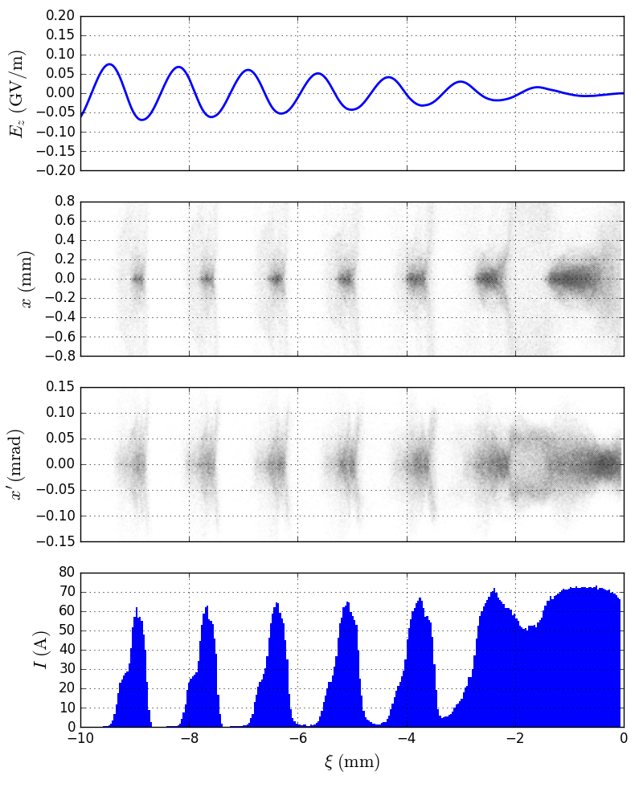
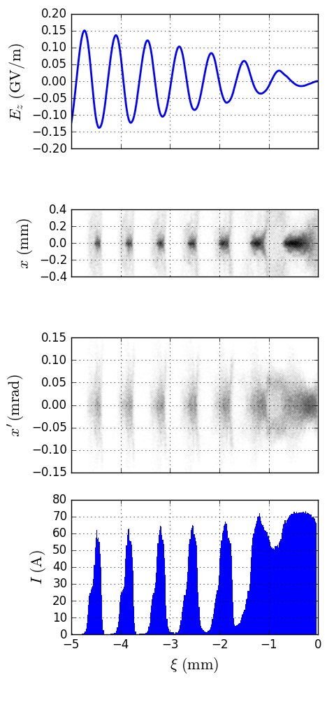
General scaling of beam parameters with plasma density
n_{plasma} = 7∙10¹⁴ cm⁻³
n_{plasma} = 4x(7∙10¹⁴ cm⁻³)
2x higher wakefield
2x smaller transv. size => 4x higher beam density.
The same angular spread => 2x lower beam emittance required.
The same current => 2x less particles needed to drive 2x higher wake.
(Also 2x less
accelerated particles).
10x less particles with 10x lower emittance and the same current can potentially drive 10x higher wakefield.
Maximum plasma density is essentially defined by the transverse beam emittance.
Higher peak current is needed to reduce the number of micro-bunches => less strict tolerances on plasma density.

Slide 20
Beam cooling due to synchrotron radiation
For details see A. Valishev. Synchrotron Radiation Damping, Intrabeam Scattering and Beam-Beam Simulations for HE-LHC.
Transverse oscillations are damped because all components of particle momentum are lost due the SR but only the longitudinal component is restored in RF-resonator => transverse oscillations are damped over the time it takes to radiate the whole energy of the particle. Synchrotron oscillations (energy) are damped over the similar time because energy loss per turn U₀ is increasing with the particle energy (as E⁴/R):
Minimum equilibrium emittance and energy spread is defined by the quantum fluctuations of the SR. For heavy particles this limit can be very low.
Parameter | LHC (p-p) | HE-LHC 12.5 | HE-LHC 16.5 | FCC (p-p)
Beam energy | 7 TeV | 12.5 TeV | 16.5 TeV | 50 TeV
Number of protons in a single bunch | 1.2∙10¹¹ | 2.5∙10¹¹ | 1.3∙10¹¹ | 10¹¹
Damping time of transverse oscillations | 25.8 hours | 4.5 hours | 1.9 hours | 1.1 hour
Damping time of longitudinal oscillations | 13 hours | 2.3 hours | 1 hour | 0.5 hour
Initial normalized emittance | 3.8 mm∙mrad | 2.5 mm∙mrad | 3 mm∙mrad | 2.2 mm∙mrad
Min. equilibrium normalized emittance | 0.001 mm∙mrad | 0.006 mm∙mrad | 0.01 mm∙mrad | 0.05 mm∙mrad
Initial relative energy spread | 10^{–4} | 10^{–4} | 0.9∙10^{–4}
Min. equilibrium relative energy spread | 1.4∙10^{–6} | 2.5∙10^{–6} | 3.4∙10^{–6}
Some data also from W. Bartmann et al. Beam dynamics issues in the FCC
Intra-beam scattering introduces heating proportional to the beam intensity:
HE-LHC (16.5 TeV) LHC
100 h
60 h
At lower bunch intensity initial growth time will be proportionally longer.
For details see V. Lebedev. Tevatron Luminosity Evolution Model and its Application to the LHC.

Slide 21
http://indico.cern.ch/event/298052/contribution/2/attachments/560064/771562/SPS_impmodel.pptx

Slide 22
