Slide 1


Working Point Studies
LIU-PS Beam Dynamics WG 28/09/2017
F.Asvesta
H.Bartosik , A.Huschauer, Y.Papaphilippou, M.Serluca, G.Sterbini

Slide 2
Overview
Motivation
Frequency Map Analysis
  On-momentum particles
  Off-momentum particles
Machine Development and Simulation Studies
  Vertical Tune Scans (space charge dominated)
  3rd Order Skew Resonance Compensation
  Vertical Tune Scans (non- space charge dominated)
Summary

Slide 3
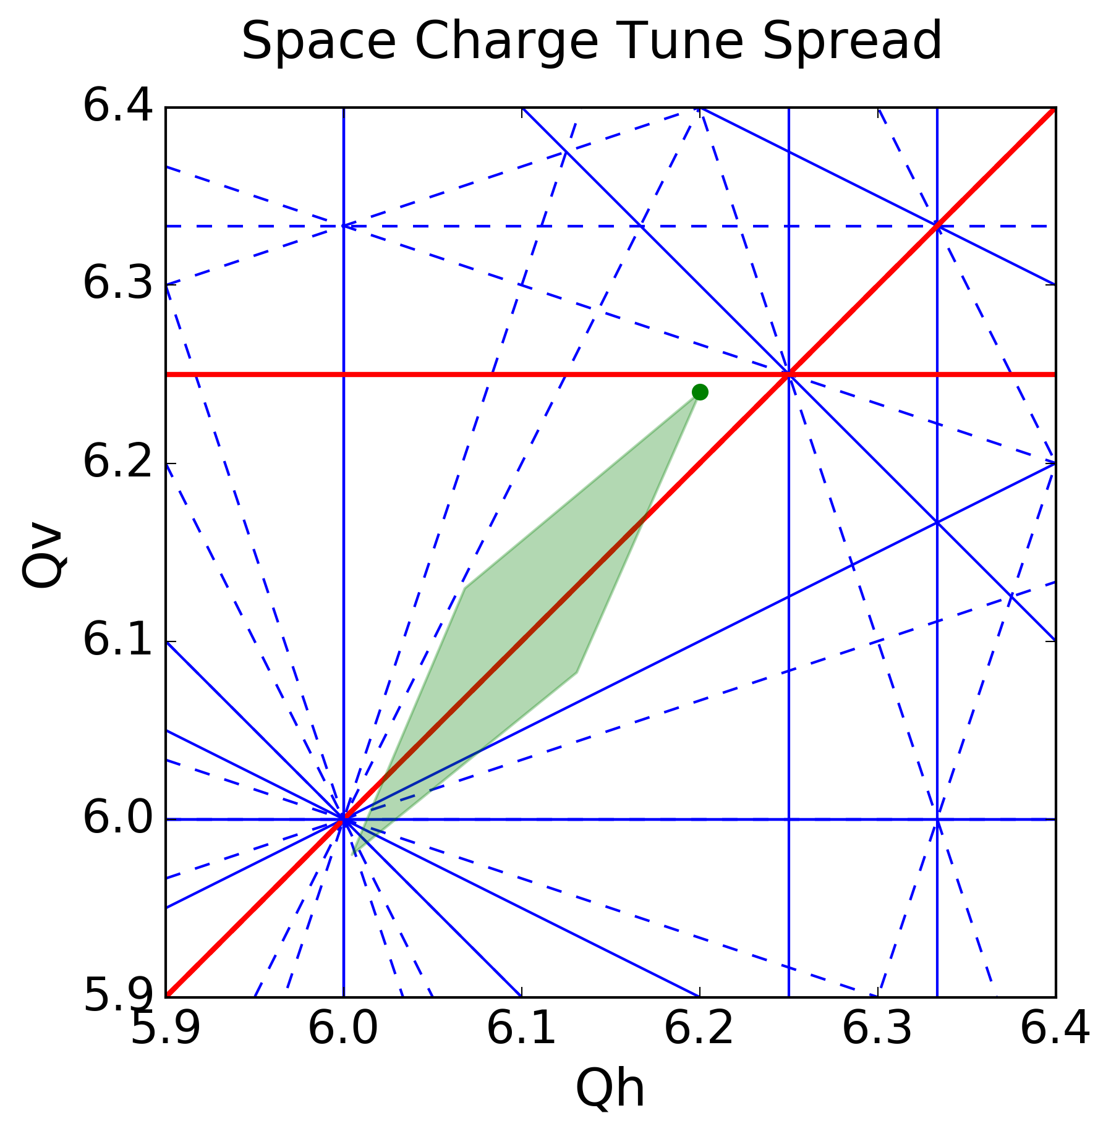
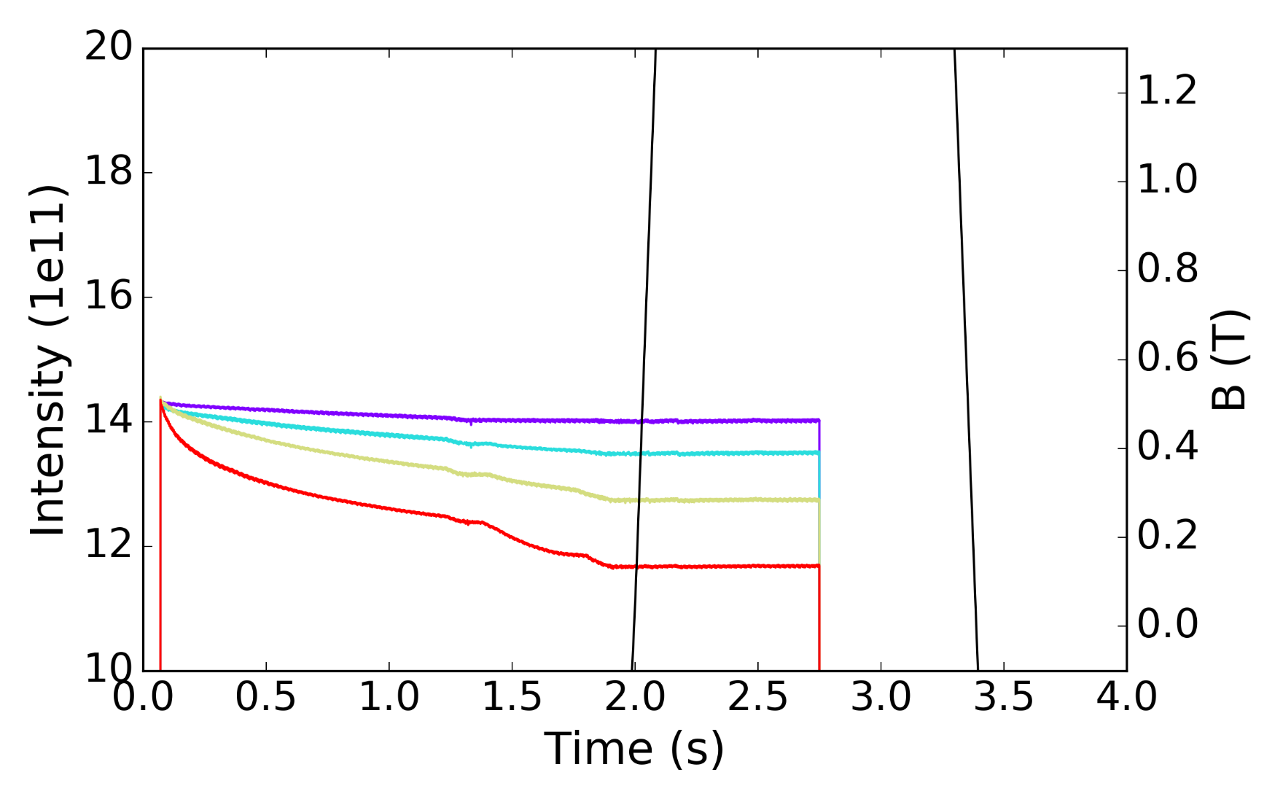
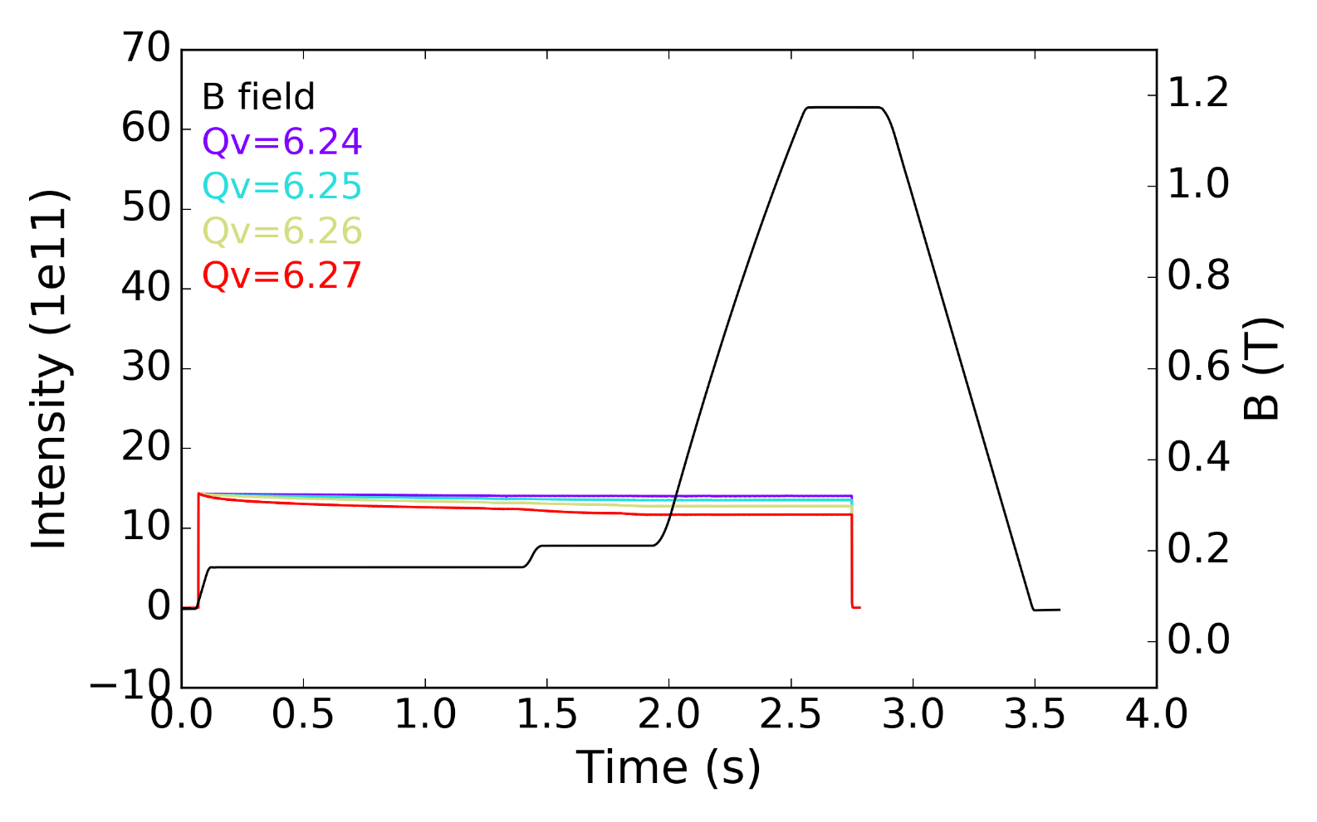
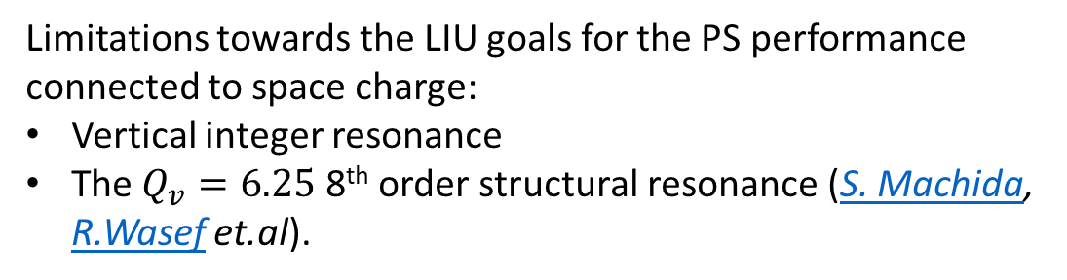
Motivation
Limitations towards the LIU goals for the PS performance connected to space charge:
Vertical integer resonance
The $Q_{v}=6.25$ 8th order structural resonance (S. Machida, R.Wasef et.al).
Space charge tune spread in the PS
for LHC-type beams.

Slide 4
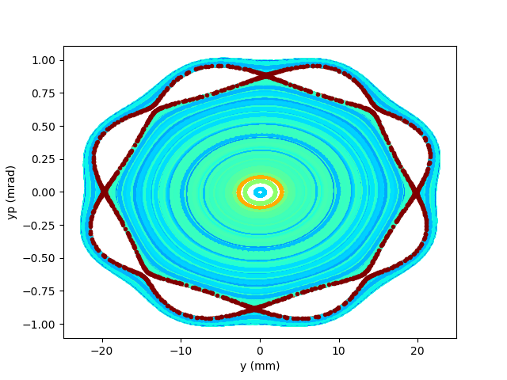
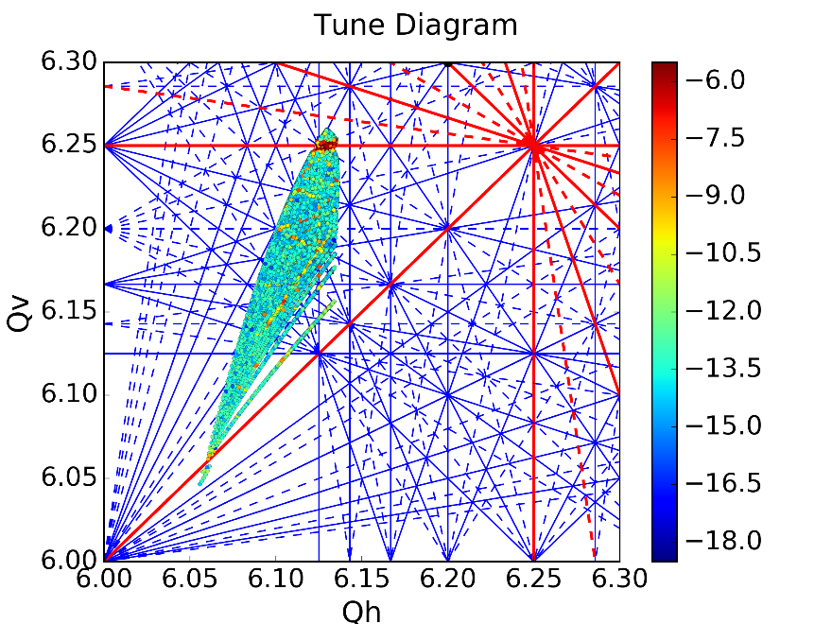
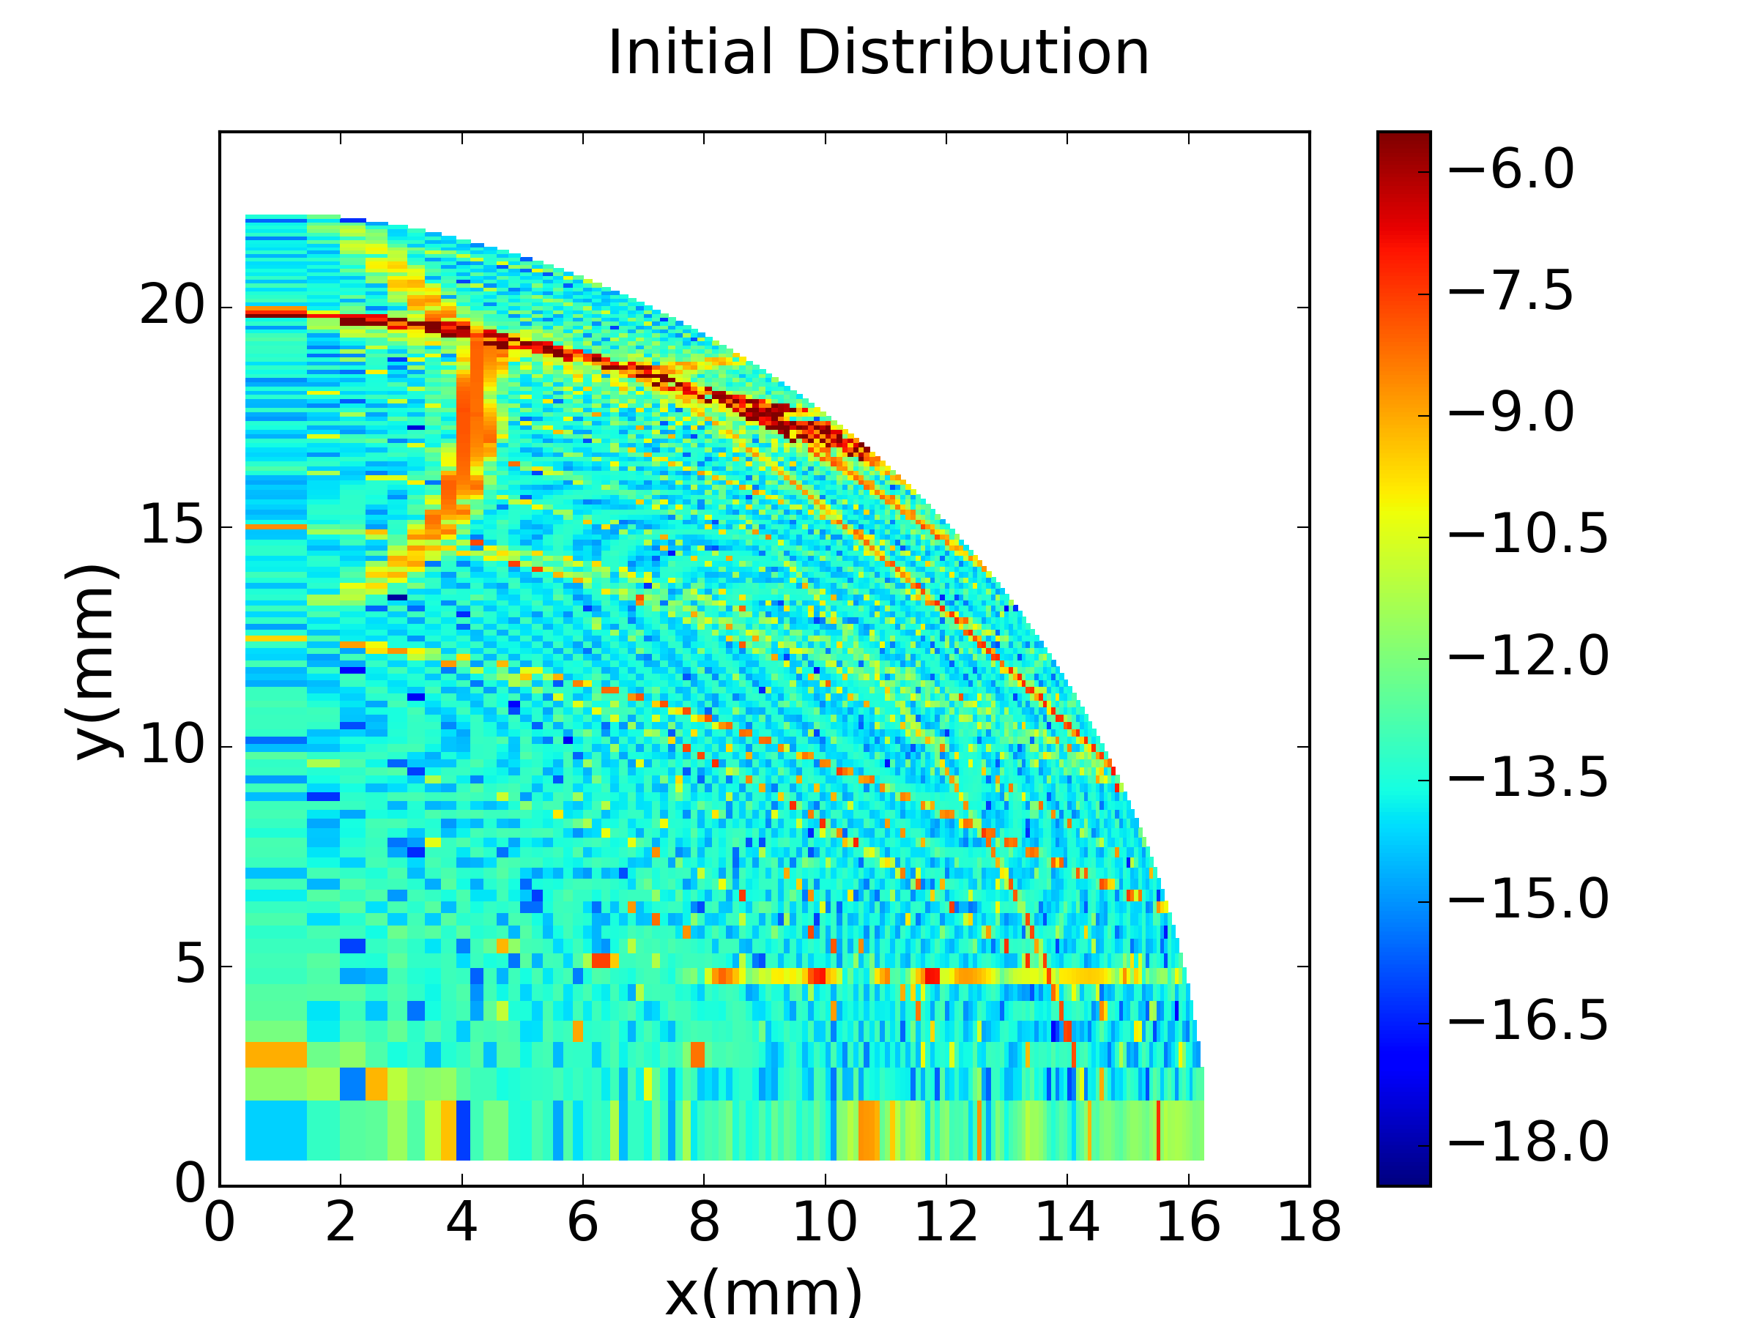
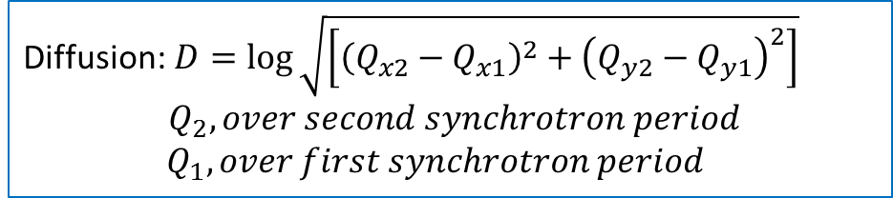
Frequency Maps
Diffusion:$D=\log{\sqrt{\left[{\left(Q_{x2}−Q_{x1}\right)}^{2}+{\left(Q_{y2}−Q_{y1}\right)}^{2}\right]}}$
$${ Q}_{2}, over second synchrotron period$$
$Q_{1}, over first synchrotron period$
Tunes of individual particles
calculated over one synchrotron period
Resonance lines up to 8th order
Tracking of on-momentum particles under the influence of space charge using the Py-ORBIT Frozen model
(electric field calculated for bi-Gaussian distribution using Bassetti Erskine formula) .
Working Point
Initial position in the transverse plane of the tracked particles

Slide 5
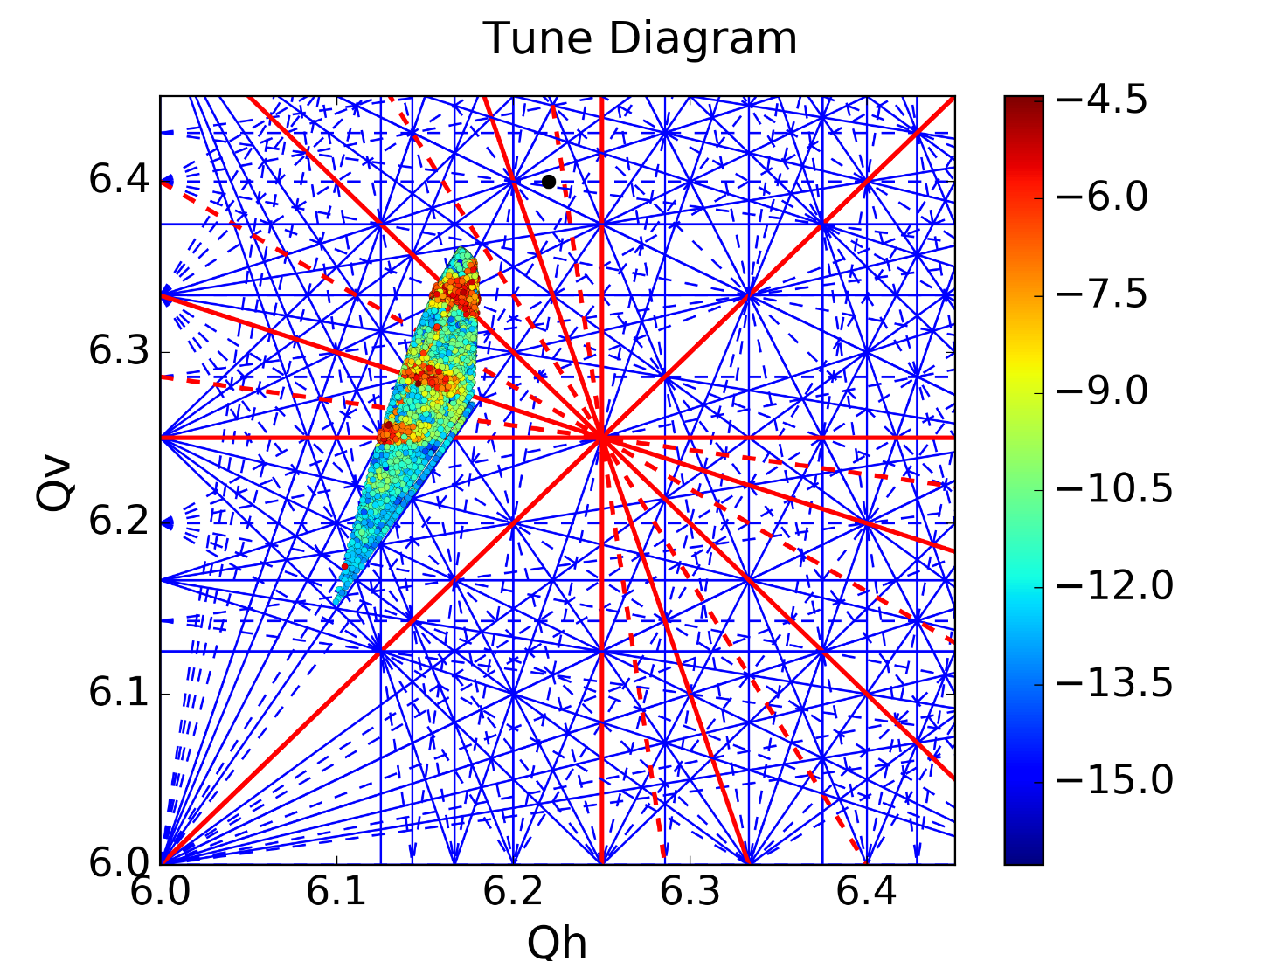
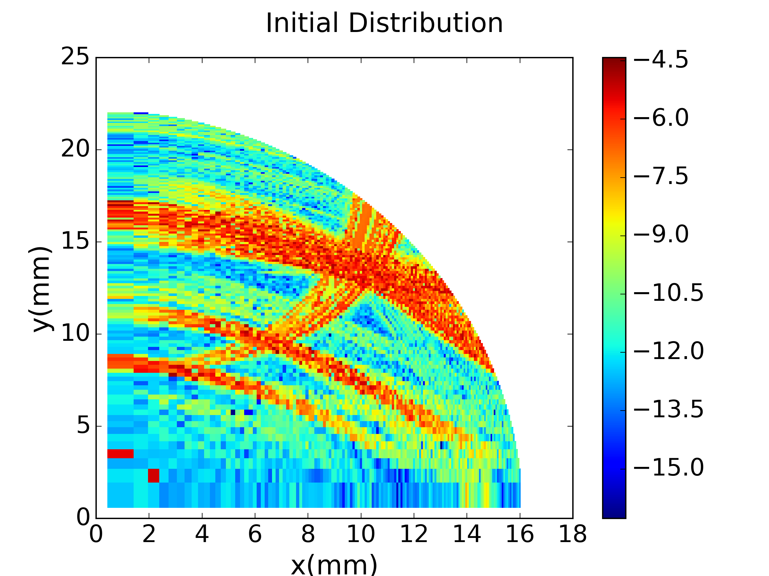
Frequency Maps
Tracking of off-momentum particles under the influence of space charge using the Py-ORBIT Frozen model
More particles trapped by the resonances due to the periodic crossing
Excitation of all the 8th order structural resonances

Slide 6
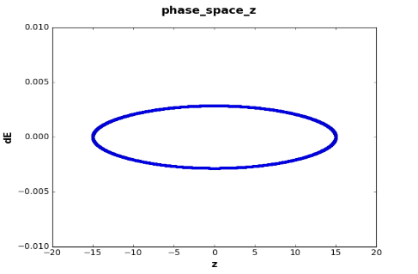
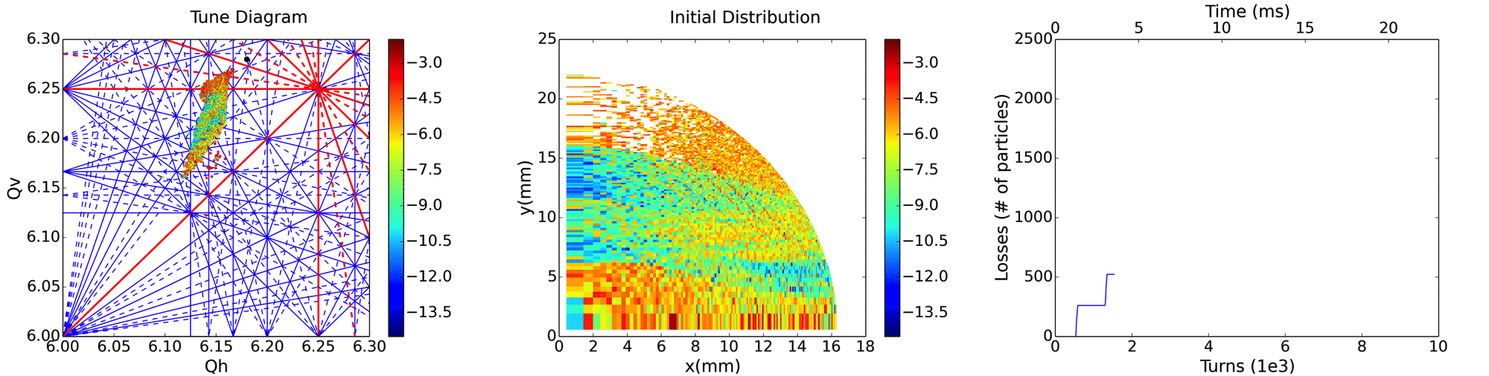
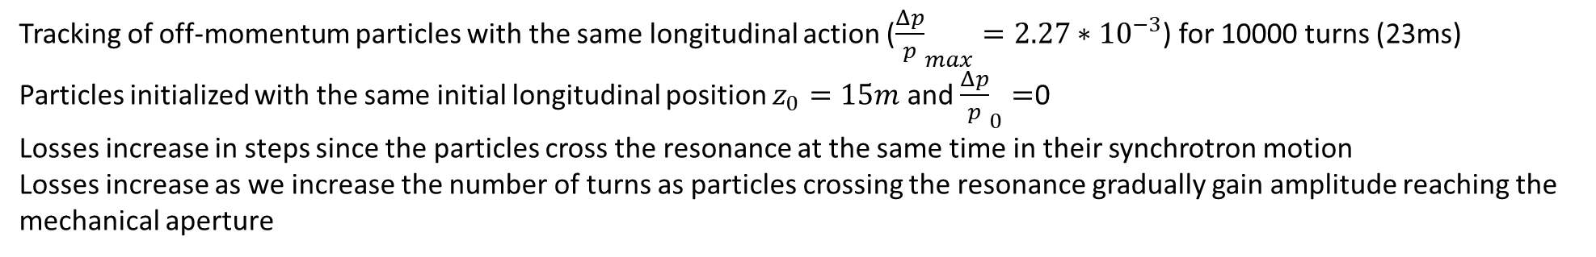
Frequency Maps
Longitudinal Phase Space
Tracking of off-momentum particles with the same longitudinal action (${\frac{Δp}{p}}_{max}=2.27{∗10}^{−3}$) for 10000 turns (23ms)
Particles initialized with the same initial longitudinal position $z_{0}=15m$ and ${\frac{Δp}{p}}_{0}=$0
Losses increase in steps since the particles cross the resonance at the same time in their synchrotron motion
Losses increase as we increase the number of turns as particles crossing the resonance gradually gain amplitude reaching the mechanical aperture

Slide 7
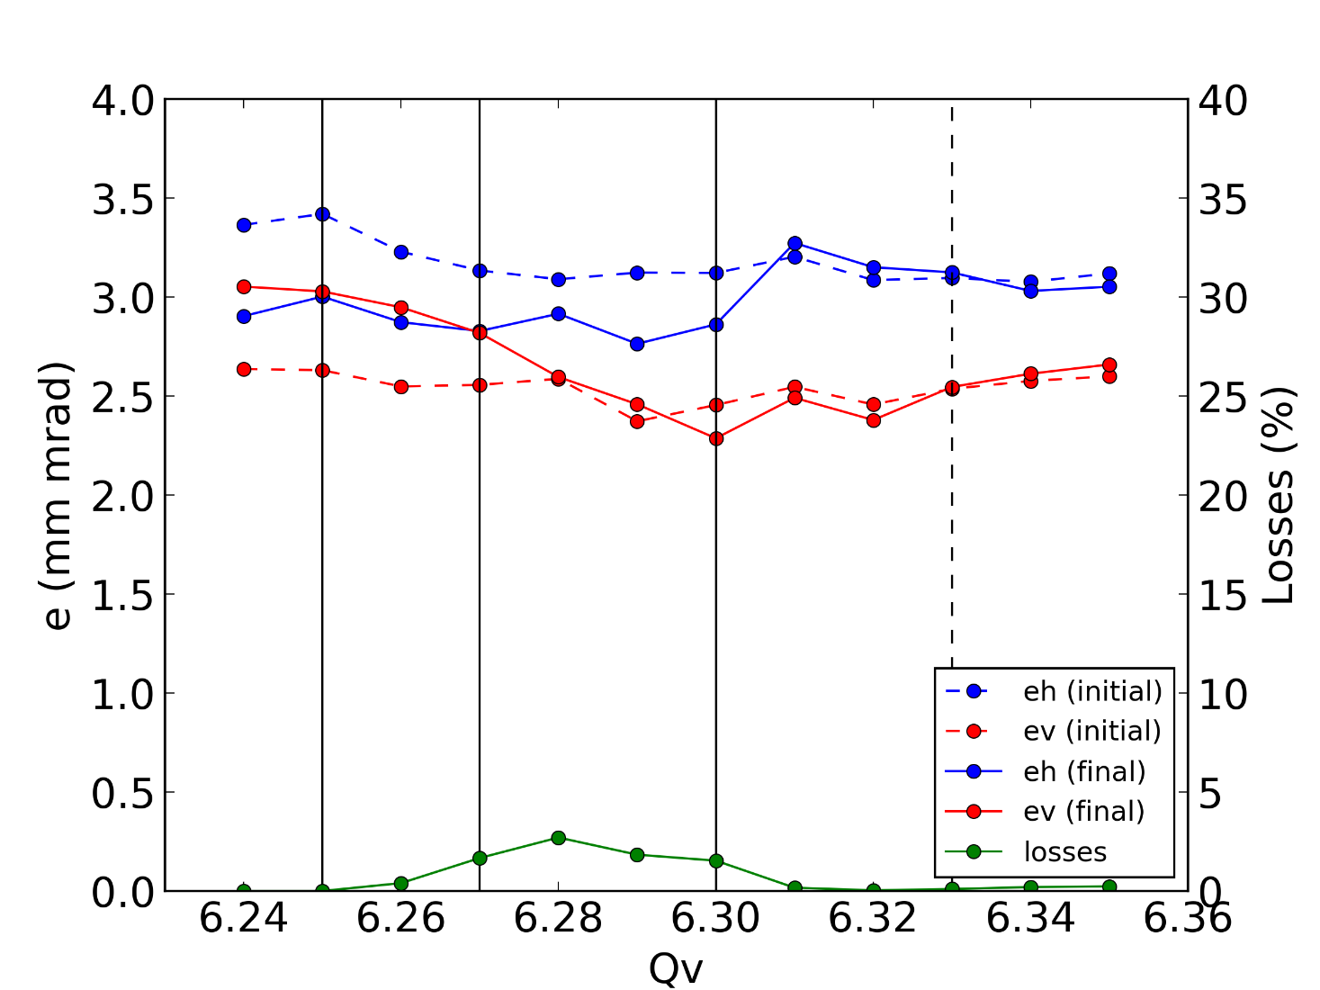
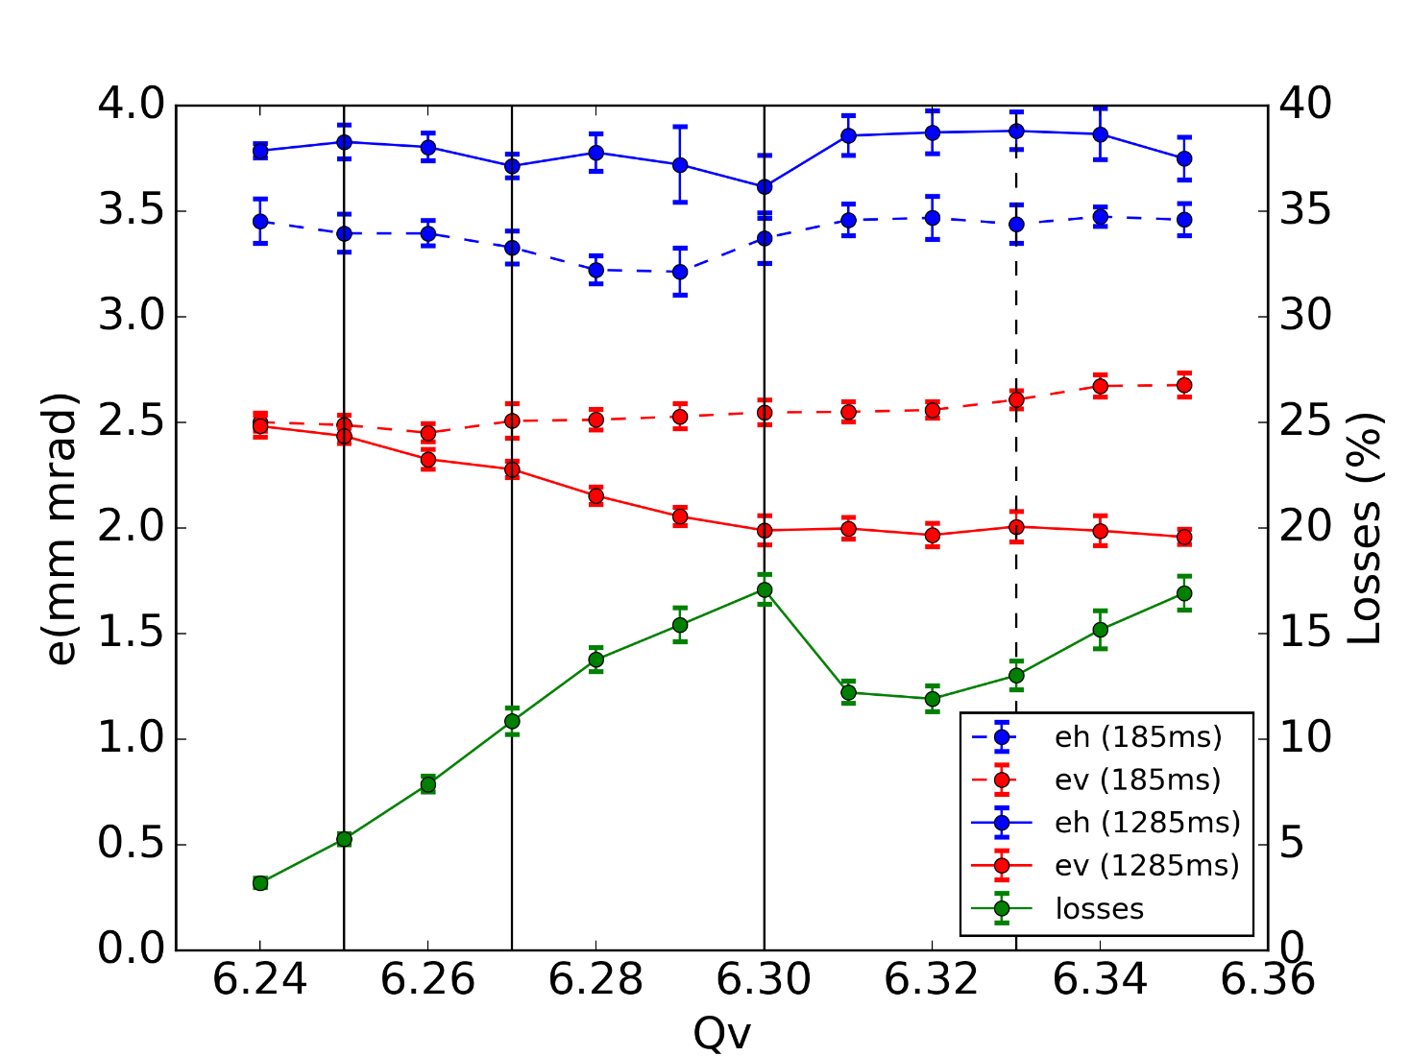

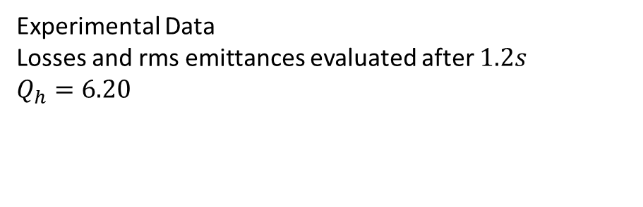
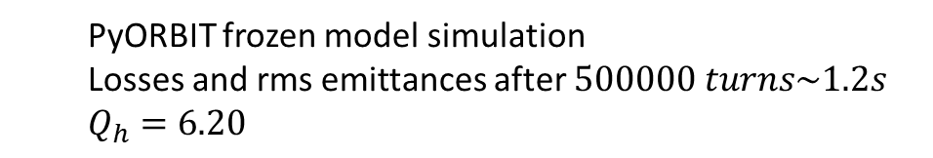
Vertical Tune Scan
  PyORBIT frozen model simulation
  Losses and rms emittances after $500000 turns\sim 1.2s$
  $$Q_{h}=6.20$$
Experimental Data
Losses and rms emittances evaluated after $1.2s$
$$Q_{h}=6.20$$
LHC25ns Single Bunch
Vertical Chromaticity Corrected
Transverse Feedback ON
Coupling Corrected
Beam parameters are kept the same throughout the scan
3rd
4th / 8th
3rd
4th / 8th
4th / 8th
4th / 8th
4th / 8th
4th / 8th

Slide 8
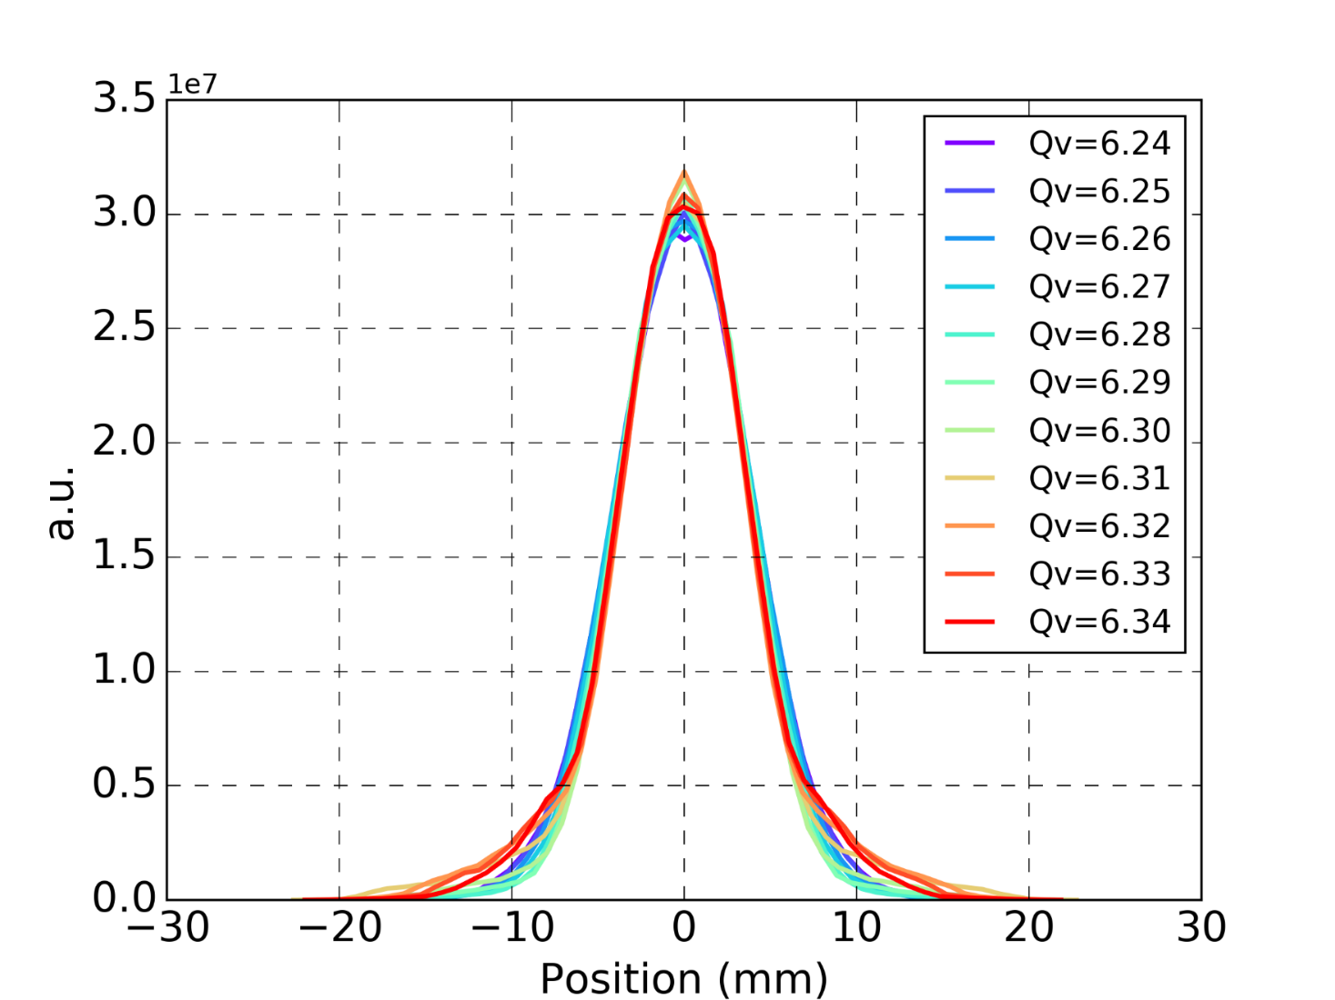
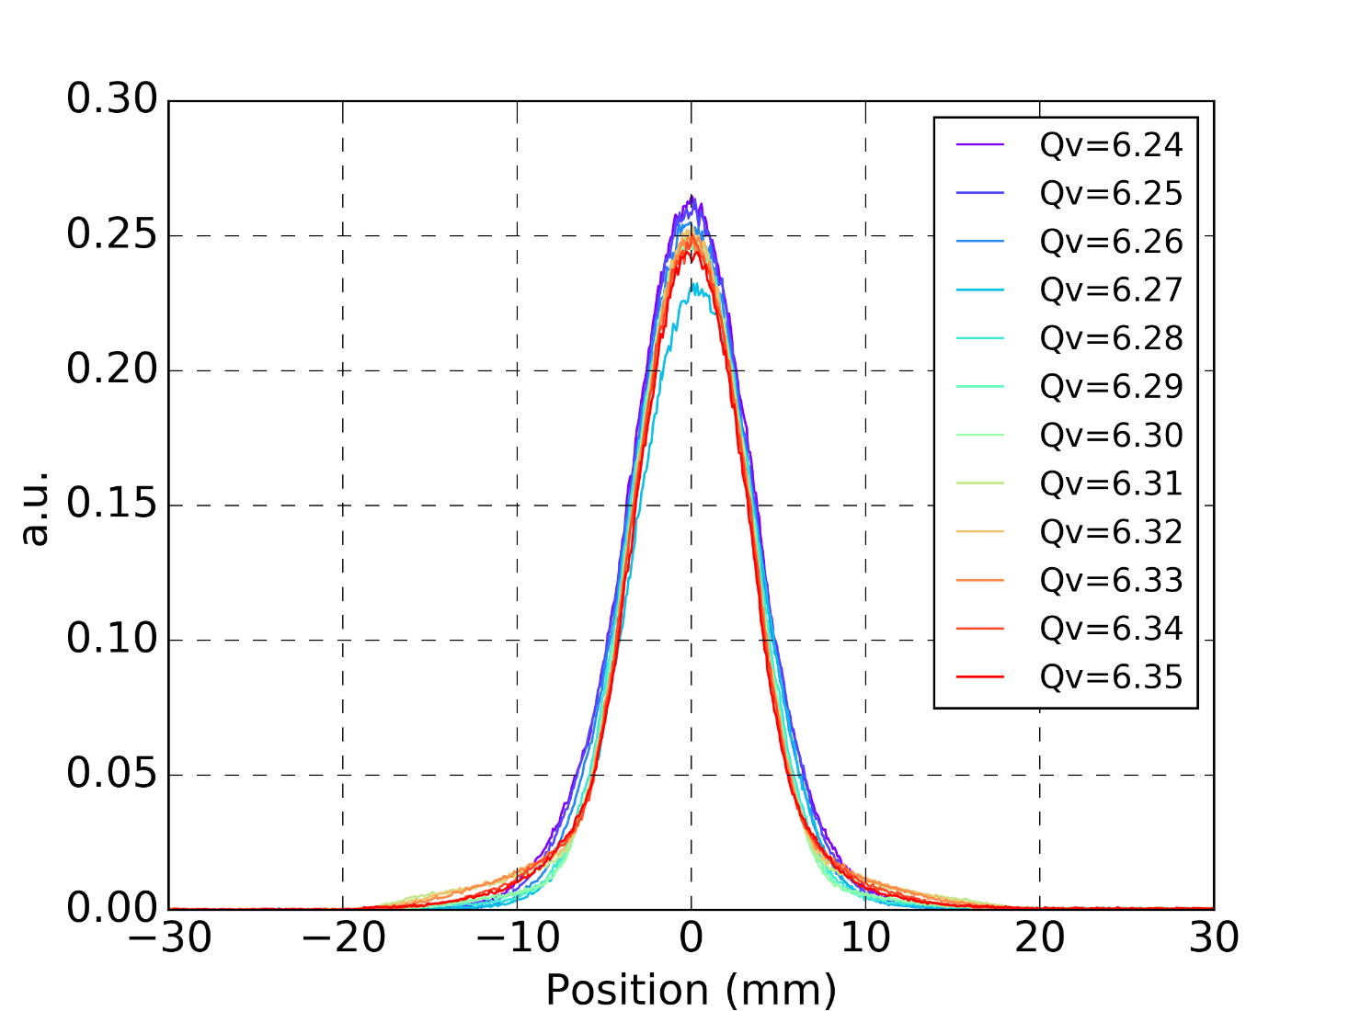
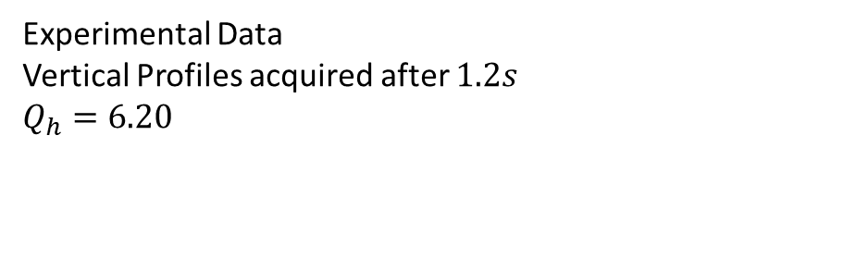
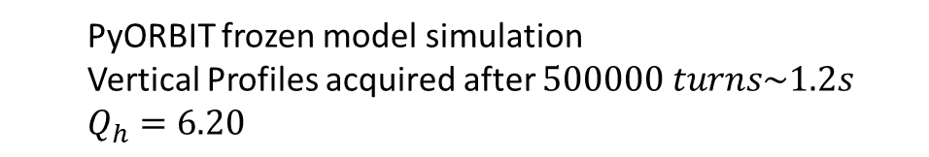
Vertical Beam Profiles
  PyORBIT frozen model simulation
  Vertical Profiles acquired after $500000 turns\sim 1.2s$
  $$Q_{h}=6.20$$
Experimental Data
  Vertical Profiles acquired after $1.2s$
$$Q_{h}=6.20$$

Slide 9
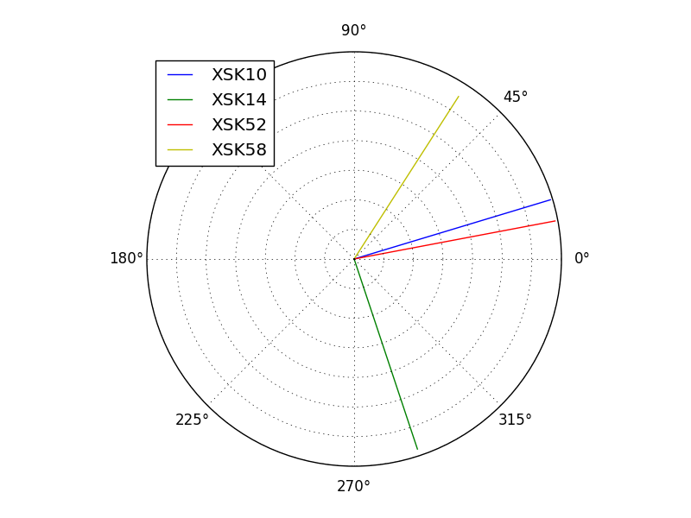
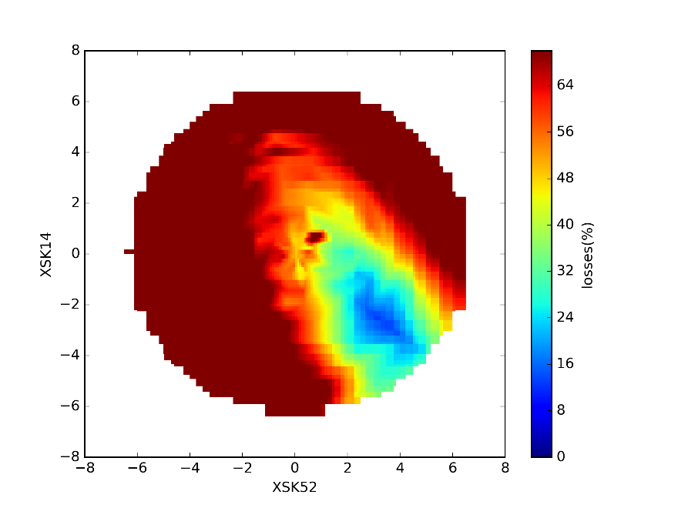
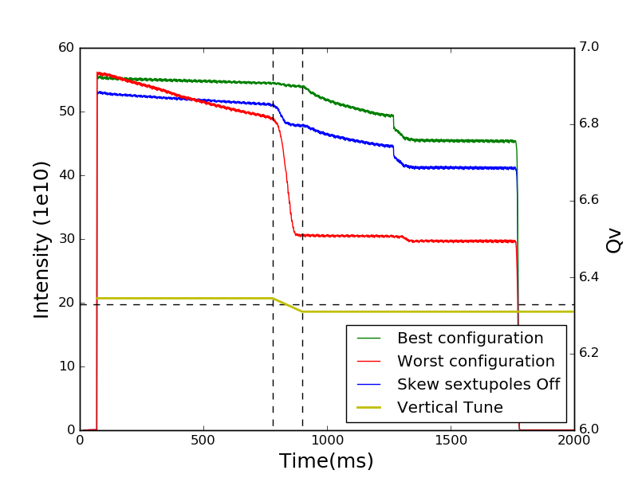
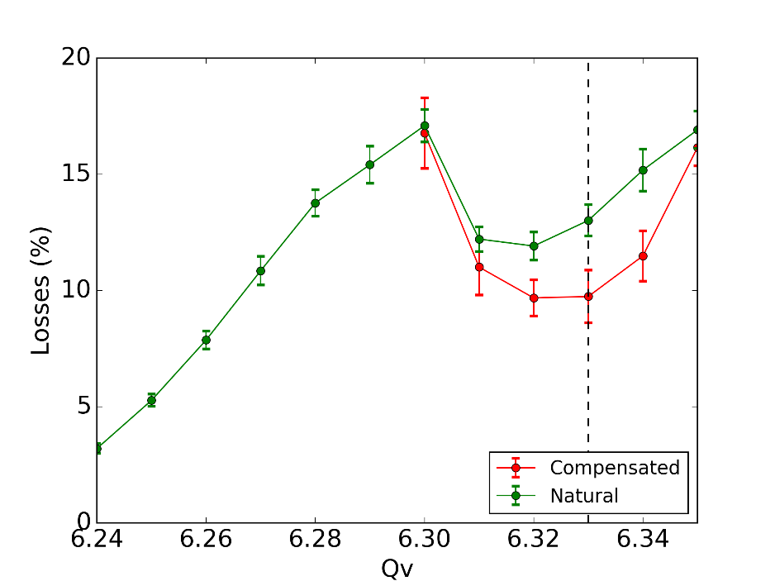
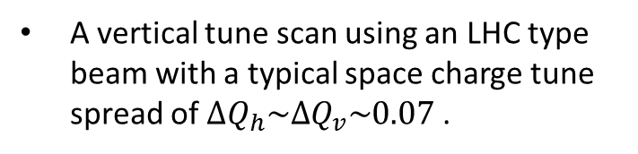
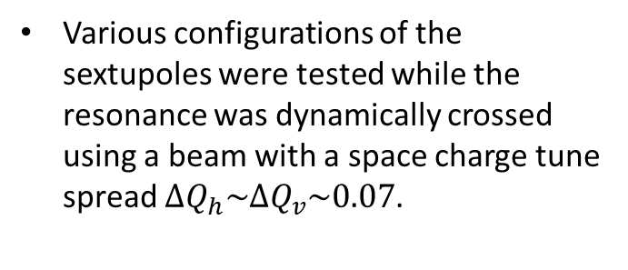
3rd Order Skew Resonance
Calculation of the resonance driving terms using PTC for the available skew sextupoles.
Various configurations of the sextupoles were tested while the resonance was dynamically crossed using a beam with a space charge tune spread $ΔQ_{h}\sim ΔQ_{v}\sim 0.07$.
Evaluating the beam losses in the time period of the tune change the best configuration for the resonance compensation was selected.
A vertical tune scan using an LHC type beam with a typical space charge tune spread of $ΔQ_{h}\sim ΔQ_{v}\sim 0.07$ .

Slide 10
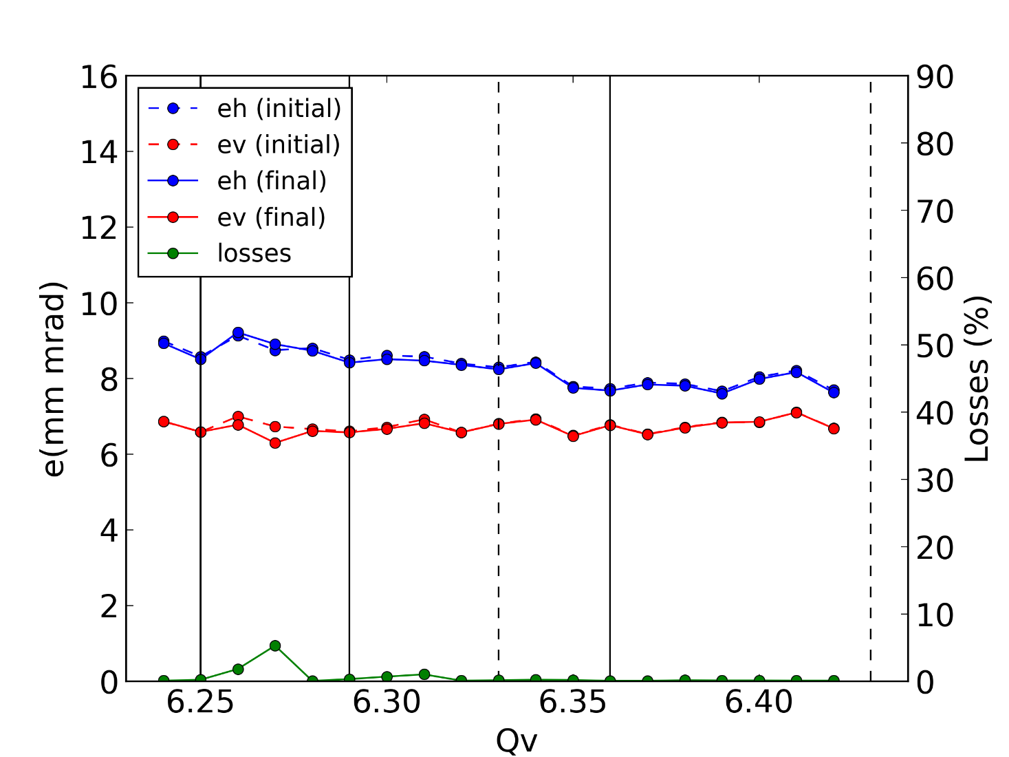
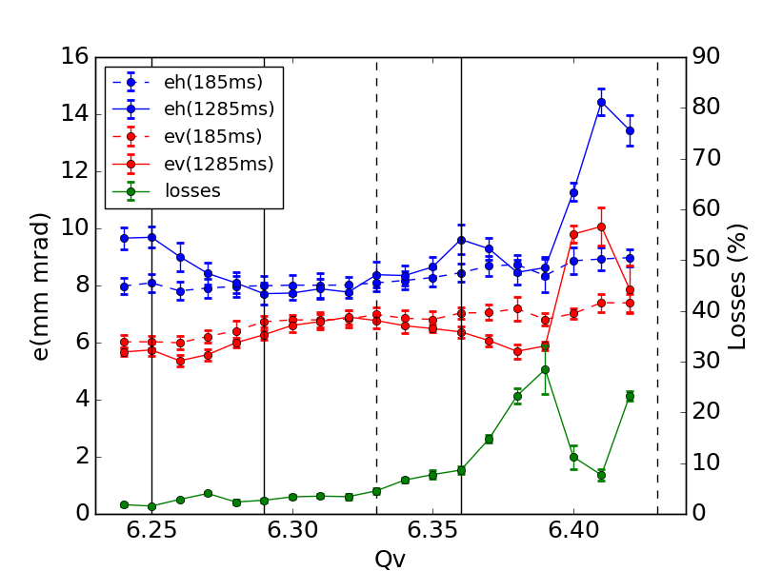
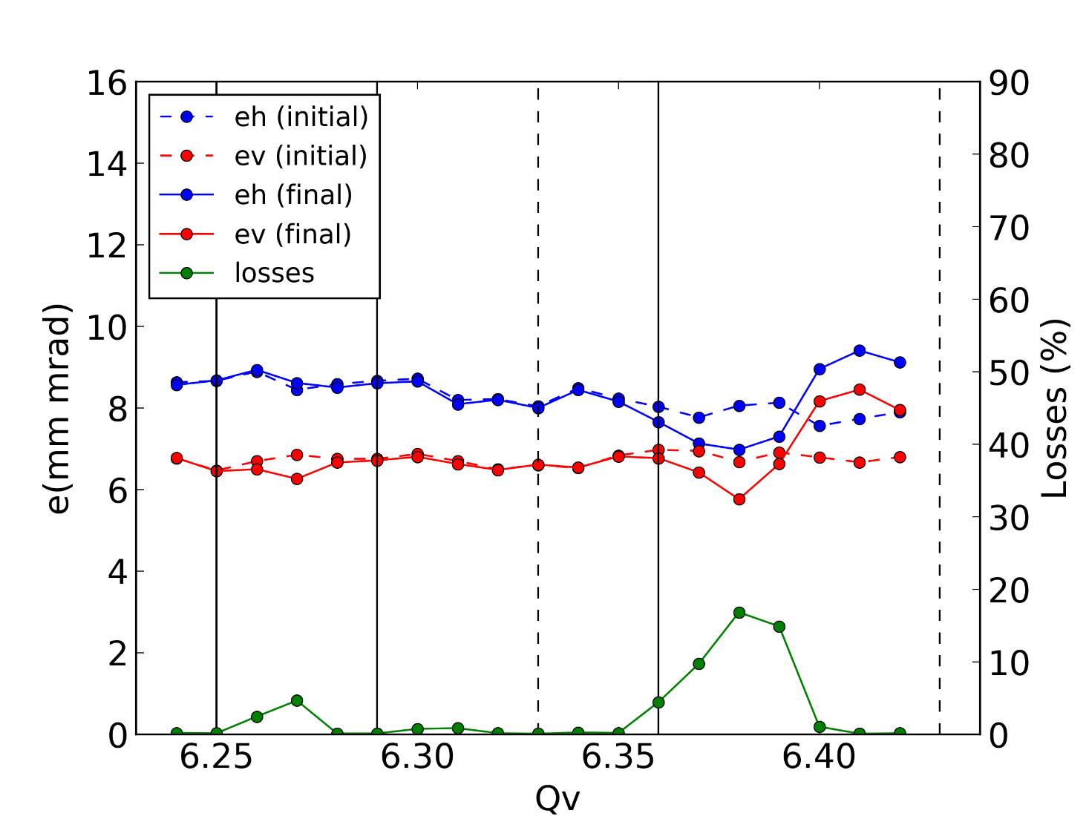
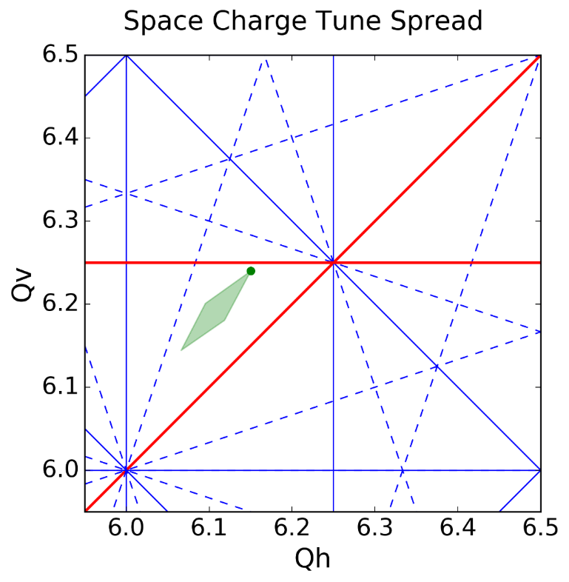
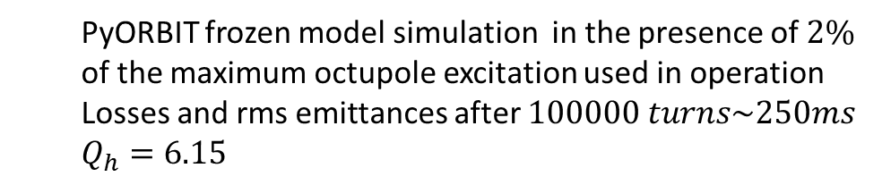
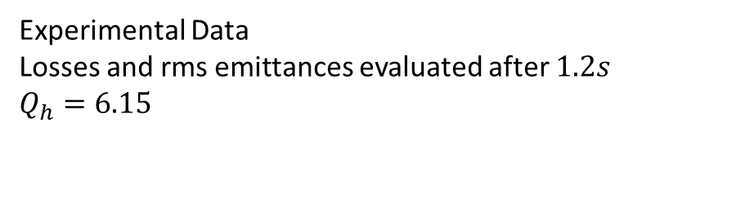
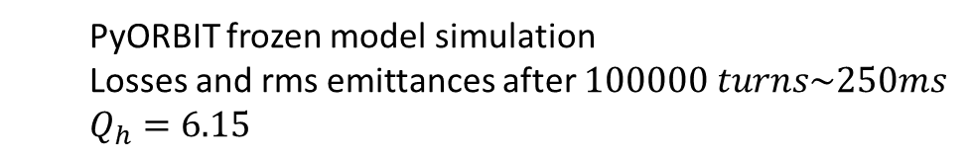
Vertical Tune Scan
  PyORBIT frozen model simulation
  Losses and rms emittances after $100000 turns\sim 250ms$
  $$Q_{h}=6.15$$
  PyORBIT frozen model simulation in the presence of $2\%$ of the maximum octupole excitation used in operation
  Losses and rms emittances after $100000 turns\sim 250ms$
  $$Q_{h}=6.15$$
Experimental Data
Losses and rms emittances evaluated after $1.2s$
$$Q_{h}=6.15$$
LHCINDIV Single Bunch
Vertical Chromaticity Natural
Transverse Feedback ON
Coupling Corrected
Skew resonance Compensated
Beam parameters are kept the same throughout the scan
3rd
4th / 8th
3rd
3rd
4th / 8th
3rd
4th / 8th
4th / 8th
4th / 8th
4th / 8th
4th / 8th
3rd
4th / 8th
4th / 8th
3rd

Slide 11
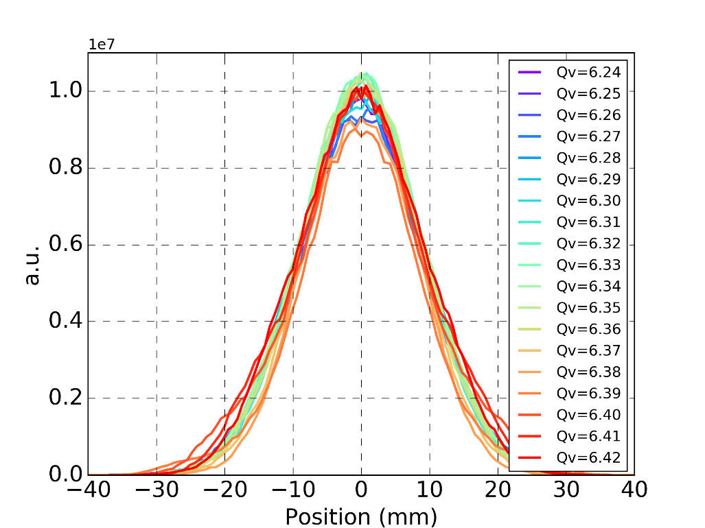
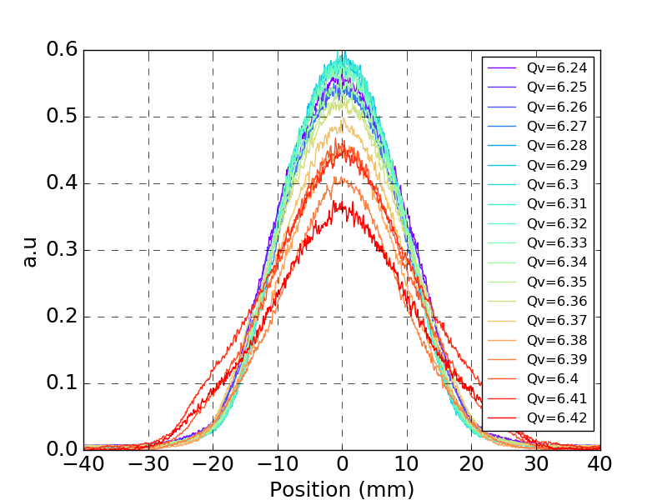
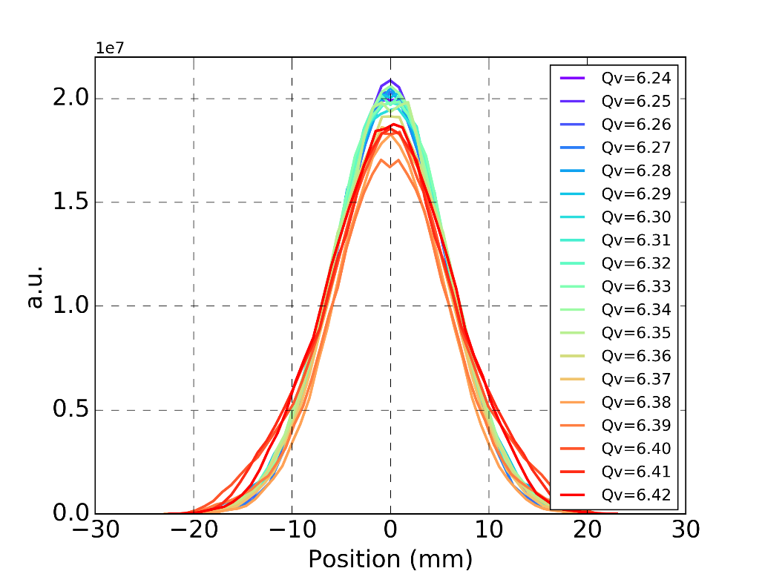
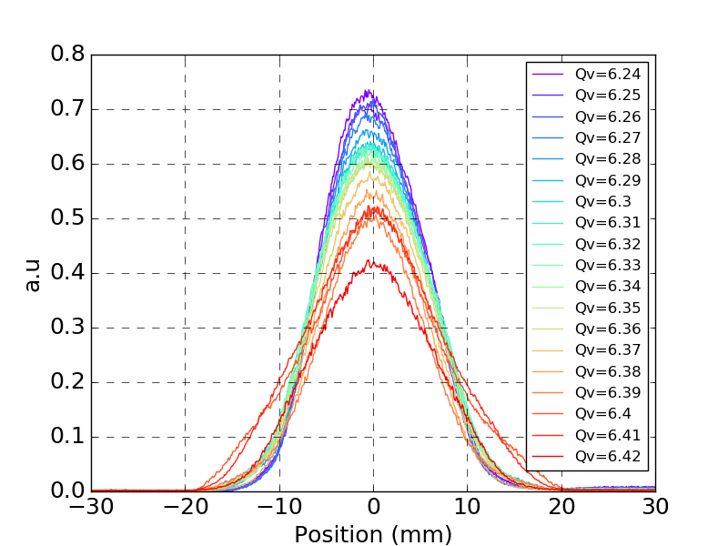
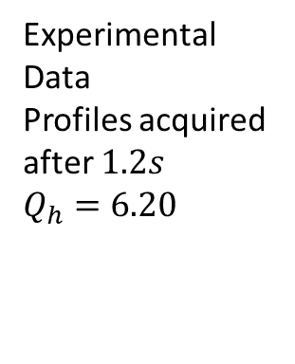
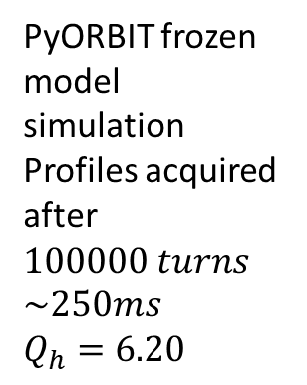
Vertical Beam Profiles
Horizontal
Profiles
Horizontal
Profiles
PyORBIT frozen model simulation
Profiles acquired after $100000 turns$
$$\sim 250ms$$
$$Q_{h}=6.20$$
Experimental Data
  Profiles acquired after $1.2s$
$$Q_{h}=6.20$$
Vertical
Profiles
Vertical
Profiles

Slide 12
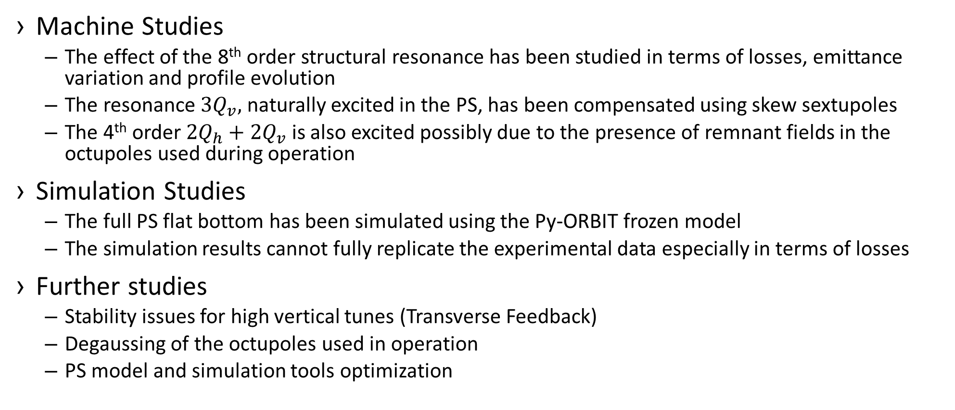
Summary & Outlook
Machine Studies
  The effect of the 8th order structural resonance has been studied in terms of losses, emittance variation and profile evolution
  The resonance ${3Q}_{v},$ naturally excited in the PS, has been compensated using skew sextupoles
  The 4th order $2Q_{h}+2Q_{v}$ is also excited possibly due to the presence of remnant fields in the octupoles used during operation
Simulation Studies
  The full PS flat bottom has been simulated using the Py-ORBIT frozen model
  The simulation results cannot fully replicate the experimental data especially in terms of losses
Further studies
  Stability issues for high vertical tunes (Transverse Feedback)
  Degaussing of the octupoles used in operation
  PS model and simulation tools optimization
Thank you for your attention

Slide 13
Back up

Slide 14
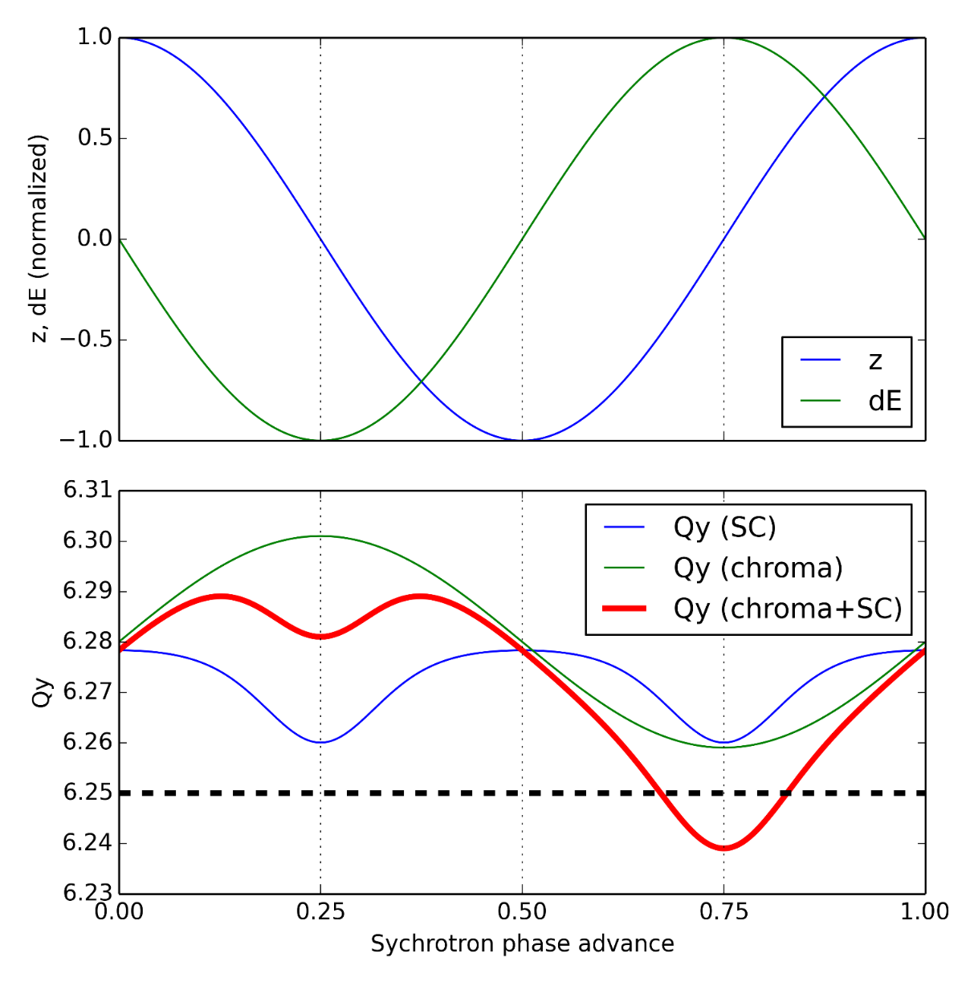
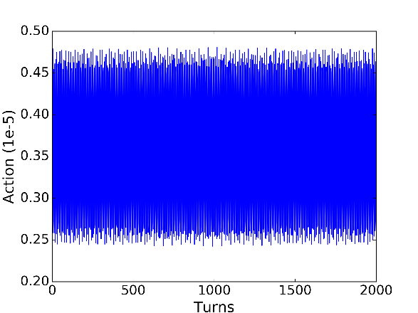
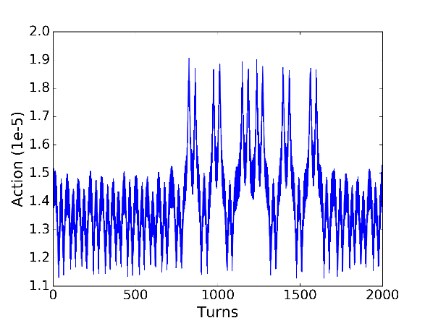
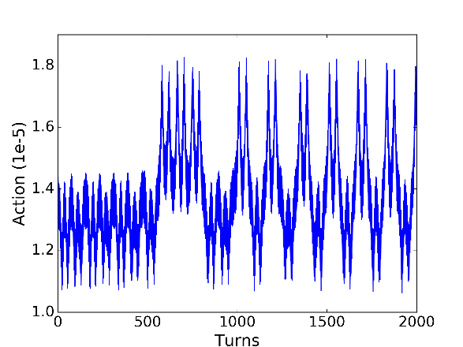
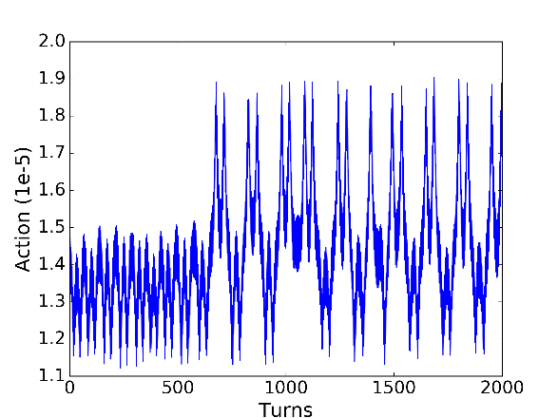
Resonance crossing

Slide 15
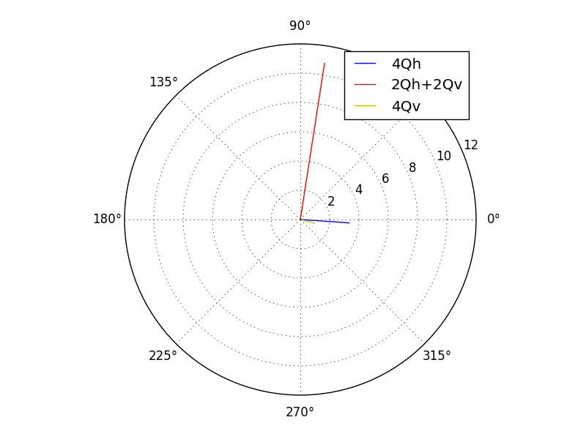
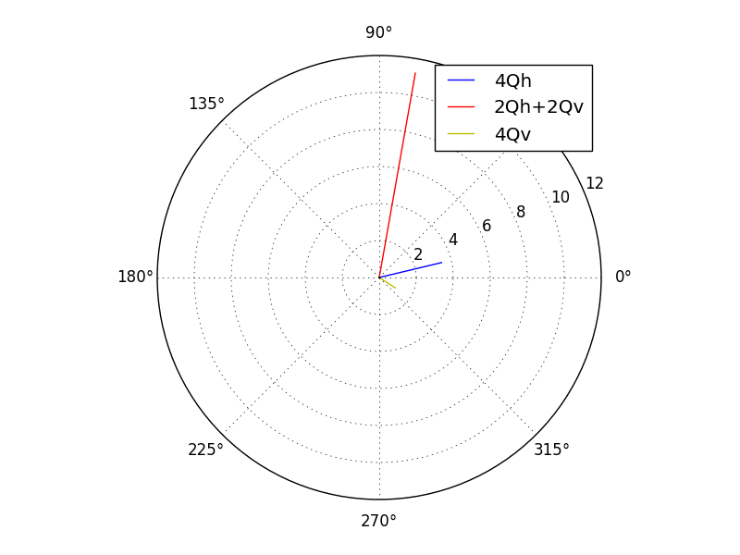
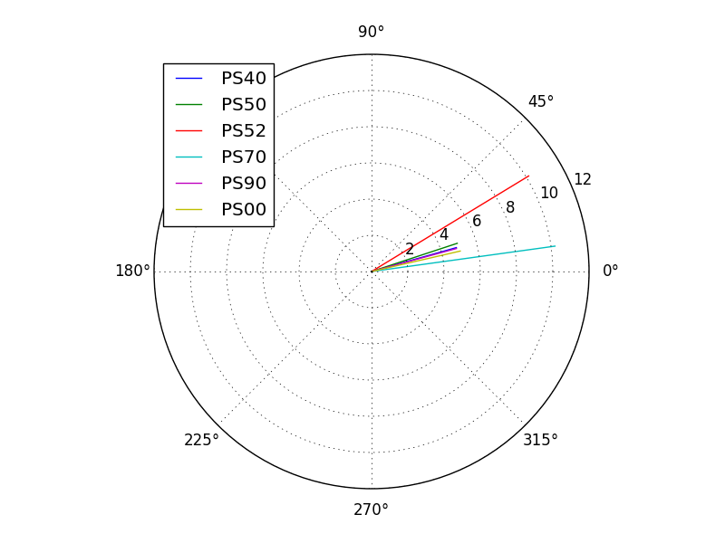
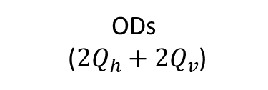
Resonance driving terms for the MTE octupoles
PS55
PS39
ODs
(${2Q}_{h}+{2Q}_{v}$)

Slide 16





Vertical Tune Scan
PyORBIT frozen model simulation simulation in the presence of $2\%$ of the maximum octupole excitation used in operation and the reverse compensation of the 3rd order skew
Losses and emittances after ~$100000 turns\sim 250ms$ ONGOING
$$Q_{h}=6.20$$
PyORBIT frozen model simulation simulation in the presence of $2\%$ of the maximum octupole excitation used in operation
Losses and emittances after ~$500000 turns\sim 1.2s$ ONGOING
$$Q_{h}=6.20$$
Experimental Data
Losses and rms emittances evaluated after $1.2s$
$$Q_{h}=6.20$$
4th / 8th
4th / 8th
3rd
3rd
4th / 8th
4th / 8th
4th / 8th
4th / 8th
4th / 8th
3rd
4th / 8th
4th / 8th

