Slide 1


Club Presidents Meeting
20 September 2017

Slide 2
Agenda
  GDPR – General Data Protection Regulation- David Foster
  Club Buildings & Space – Joelle Belleman
  Amendment to Club Rules Document
  Reminder of CERN Club Rules
  Finances – subsidies and contracts
  Insurance
  Access
  Atomiade 2018
  AOB

Slide 3
Amedment to Section 6 Club Rules
As per my message 24 May 2017, and following the Staff Council meeting, the below amendments were unanimously approved on 20 June 2017, the CERN Clubs rules have now been amended to include the following two clauses:
Dans mon email du 24 mai concernant l’ amendement de la Section 6 du règlement des clubs et suite à la décision unanime de l’AP de les approuvé les 2 clauses font partie des règles des clubs
6.8 Toutes les transactions financières dans le cadre des activités du club doivent passer par la trésorerie du club. En particulier, aucun transfert direct d’argent entre membre et instructeur ne peut être accepté.
6.9 La trésorerie du club peut être associée à un compte bancaire. Dans ce cas le compte bancaire doit être au nom du club. En aucun cas la trésorerie du club ne peut être associée à un compte bancaire ouvert au nom d’un membre du club ou de son trésorier.

Slide 4
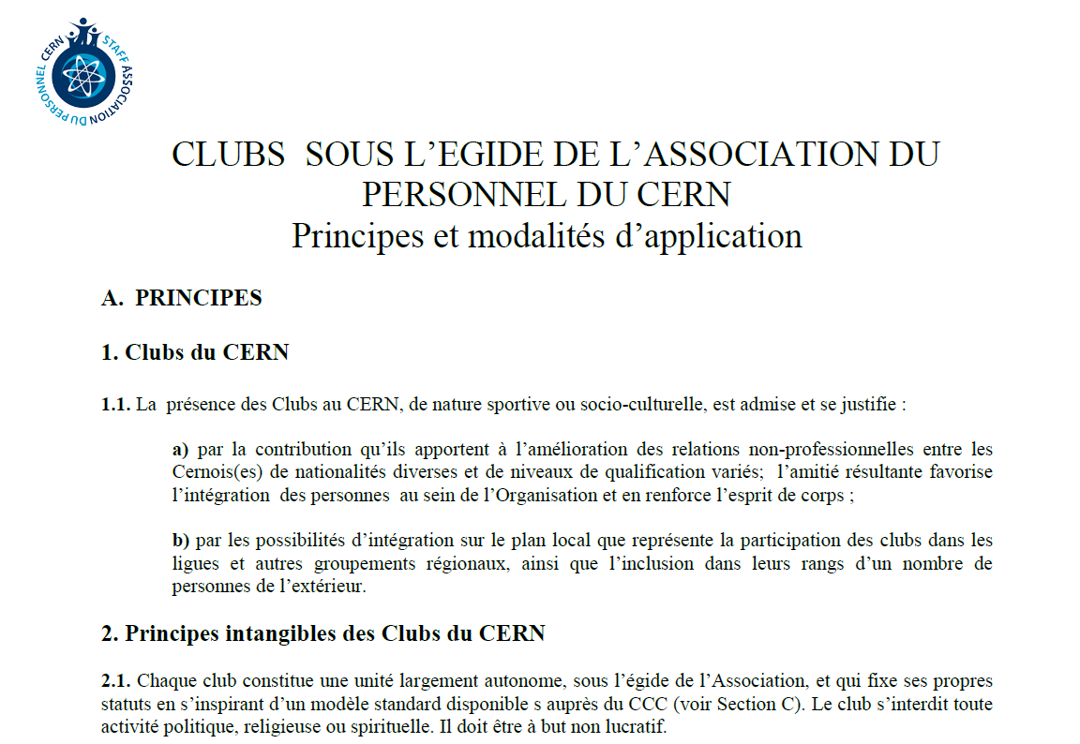
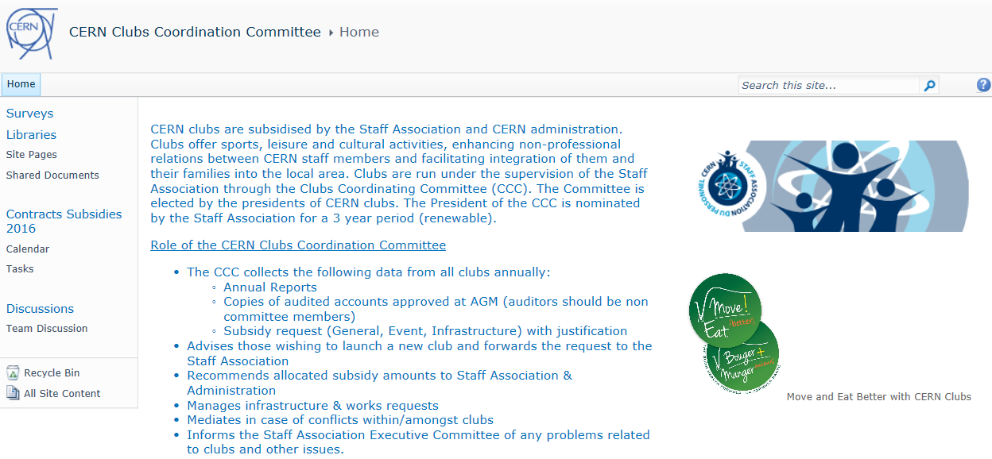
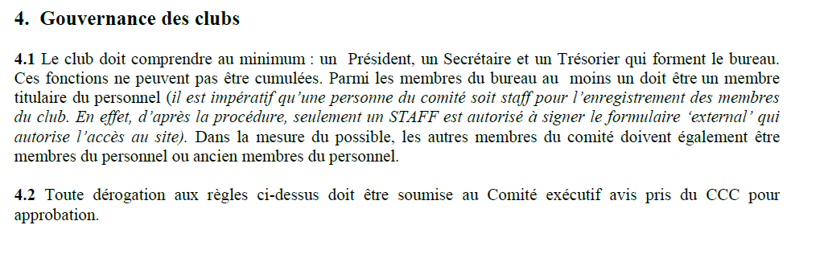
Reminder of Club Rules

Slide 5
Financial Policy (reminder)
Spirit
  Some clubs entirely independent
  Some clubs need regular financial support to survive
  Some clubs need ad-hoc assistance
  Some clubs need space not money
  We want to encourage new clubs & activities
  We want to support maximum number diverse clubs (old & new)
  We want a long term planning view
  20kchf for ‘Events’ – managed by Staff Association

Slide 6
Club Responsibilities
Submit Annual Report + Audited Accounts
  If not Subsidy/Contract will not be provided
Adhere to:
  Club Statutes and or Federation, if applicable
  CERN Code of Conduct
  Operational Circular Nº5 (OC5)
  CERN Clubs’ Rules and Procedure for Recognition.
In case of conflicts/problems
  Contact CCC
Clubs which fail to respect the above risk being sanctioned.

Slide 7
Financial Results 2017

Slide 8
2017 Contracts
Club Name | Contract Amount
Astronmy Club | Fr. 500.00
Basketball Club | Fr. 1,500.00
Canoe-Kayak Club | Fr. 3,500.00
CERN Choir | Fr. 1,750.00
CERN Technical Modelling Club | Fr. 1,000.00
Cricket Club | Fr. 800.00
Croquet Club | Fr. 2,500.00
Fly Fishing Club | Fr. -
Football Club | Fr. 3,000.00
Golf Club | Fr. 1,000.00
Ice Hockey Club | Fr. 3,000.00
Learning Classical Music Club | Fr. 1,000.00
MusiClub | Fr. 4,000.00
Orienteering Club | Fr. 2,000.00
PhotoClub | Fr. -
Rugby Club | Fr. 1,500.00
Running Club | Fr. 1,500.00
Scuba Club | Fr. 2,000.00
Softball Club | Fr. 800.00
Table Tennis Club | Fr. 3,000.00
Volleyball Club | Fr. 3,000.00
Yachting Club | Fr. 4,000.00
Grand Total | Fr. 41,350.00
4.8% 2016
Notes:
2 k less – thanks Fly Fishing, Photo and Ice Hockey

Slide 9
2017 Subsidies
Club | Subsidy AmountApproved by CCC
CERN Choir | 1’500
CERN Technical Modelling Club | 3’150
Cricket Club | 300
Filmmakers' Club | 2’000
Fly Fishing Club | 800
Jazz Club | 3’136
Martial Arts Club (1) | 1’500
MusiClub | 2’000
Ski Club | 450
Solar Club (2) | 2’500
Table Football | 4’800
Volleyball Club | 1’500
Yachting Club | 1’500
Grand Total | 25’136.00
^{1 en attente reponse CLUB}
^{2 en attente reponse CLUB}
17% 2016

Slide 10
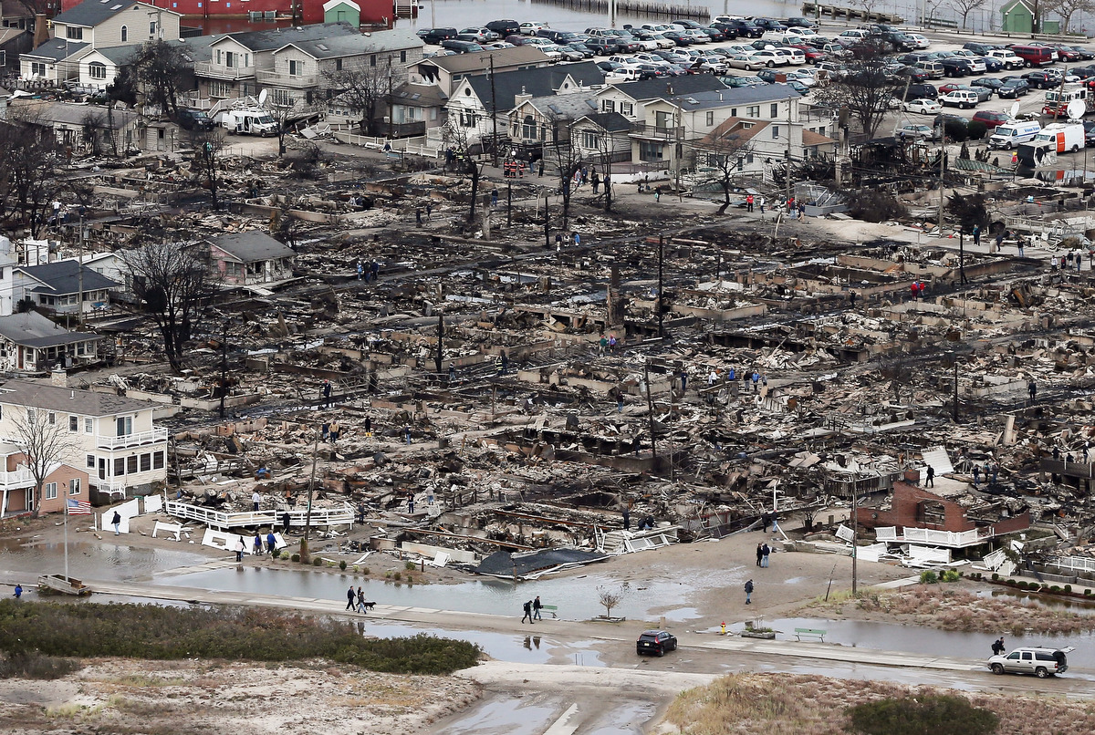
Insurance
Notes:
Staff Association has insurance policies:
Responsabilite Civile (all clubs covered)
Fire, Flood, Theft (those clubs who have provided declaration)
Insurance Broker informed us that some clubs are NOT covered….
All clubs on CERN Swiss Site OK
Clubs on Prevessin & External NOT OK
Resp Civil not OK in FR, nor in rooms with multiple occupancy.
Everything within CERN Perimeter (Meyrin & Prevessin) covered – Flood and Fire NOT theft, can be covered by CERN insurance
No resp civil
We are looking into it.

Slide 11
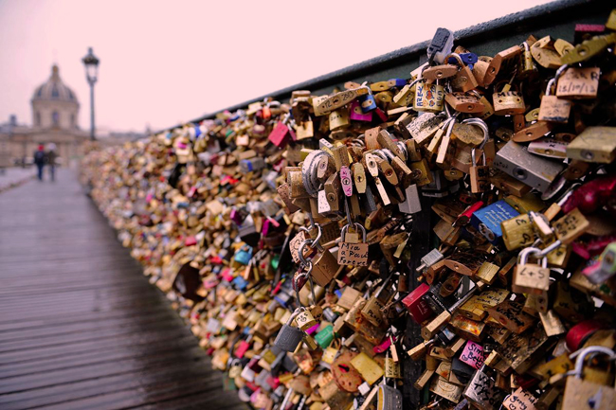
Access
Notes:
Refer to OC 02 Conditions of access to fenced parts of CERN Site.
Children under age of 16 (unless accompanied by their parents) are not accepted on the site.
Registration Service will not provide access cards to individuals wishing simply to accompany kids on site.
Barracks
Padlock issues – zone has to be secured at night.
Please remind your members that the padlock code should be scrambled once it’s been opened.

Slide 12

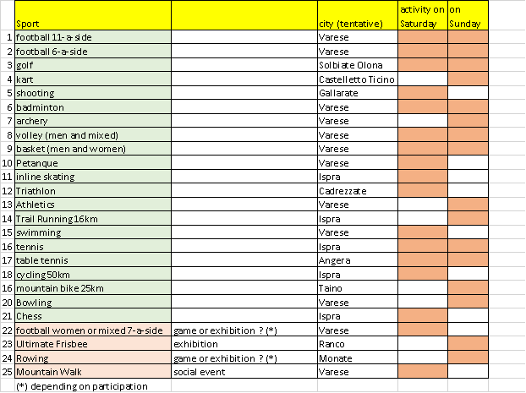
Atomaide 2018
The participation fee is now 270€ all-in (incl. accommodation, meals, sports facilities, transport to the sports venues, entertainment on 2 nights etc.; hotel rates have been negotiated and amount to 150€/person/3 nights). Golf fee is 400 €.
Notes:
Refer to OC 02 Conditions of access to fenced parts of CERN Site.
Children under age of 16 (unless accompanied by their parents) are not accepted on the site.
Registration Service will not provide access cards to individuals wishing simply to accompany kids on site.
Barracks
Padlock issues – zone has to be secured at night.
Please remind your members that the padlock code should be scrambled once it’s been opened.

Slide 13
CCC members
Simon Baird (Music)
Olivier Barriere (Kayak)
Rachel Bray (Fitness) Chairperson
Roberto Divia - Thank you Roberto!
Bruce Flockhart (Model)
Miguel Marquina (Record & Micro)
Jerome Pierlot - Thank you Jerome!
Arie Van Praag - Thank you Arie!
Ray Veness (Rugby)

Slide 14
CCC New Members
Richard Catherall (Scuba)
Hervé Cornet (Running)
Christophe Haen (Music)

Slide 15
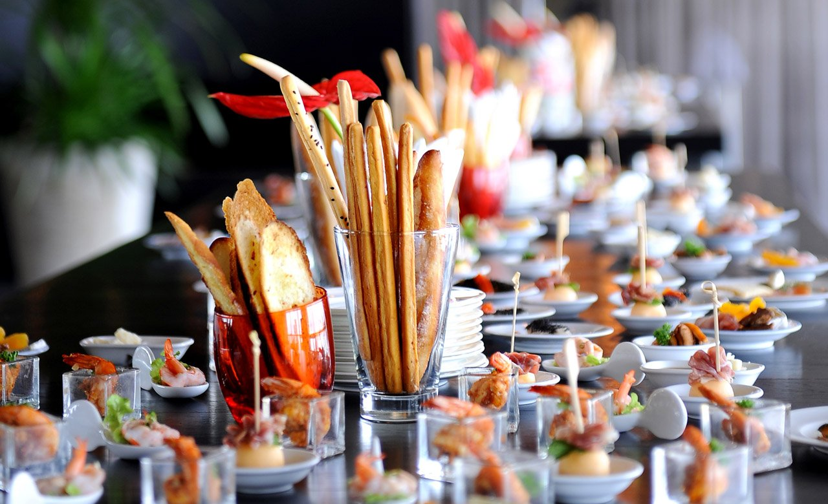
AOB & ‘Thank Yous’
Staff Association, CERN Administration, SMB (Infrastructure, Security, Access), Registration Office, Service Desk Staff, CERN Clubs Space Manager, CCC Members, Go Sport,…
Thank you Club Presidents & Committee Members:
wishing you and your clubs every success and now,…

Slide 16
2016 Contracts
Club Name | Contract Amount
Astronmy Club | Fr. 500.00
Basketball Club | Fr. 1,000.00
Canoe-Kayak Club | Fr. 3,500.00
CERNChoir | Fr. 1,750.00
CERN Technical Modelling Club | Fr. 1,000.00
Cricket Club | Fr. 800.00
Croquet Club | Fr. 2,500.00
Football Club | Fr. 4,000.00
Golf Club | Fr. 1,000.00
Ice Hockey Club | Fr. 6,000.00
Learning Classical Music Club | Fr. 1,000.00
MusiClub | Fr. 4,000.00
Orienteering Club | Fr. 2,000.00
PhotoClub | Fr. 500.00
Rugby Club | Fr. 1,500.00
Running Club | Fr. 1,500.00
Scuba Club | Fr. 2,000.00
Softball Club | Fr. 800.00
Table Tennis Club | Fr. 3,000.00
Volleyball Club | Fr. 3,000.00
Yachting Club | Fr. 4,000.00
 | Fr. 43,350.00

Slide 17
2016 Subsidies
Club | ccc amount
Arts Visuels | 100.00
Basketball Club | pending
Billiards and Snooker Club | 1,800.00
Canoe-Kayak Club | 1,500.00
CERN Choir | 2,000.00
Cricket Club | 200.00
Filmmakers' Club | 5,000.00
Fly Fishing Club | 800.00
Frisbee Club | 50.00
Jazz Club | pending
Learning Classical Music Club | 600.00
Martial Arts Club | 960.00
Natures et Abeilles | 250.00
PhotoClub | 1,200.00
Scuba Club | F4,500.00
Ski Club | 700.00
Table Tennis Club | 210.00
Volleyball Club | Pending
WoMen's Club
Yachting Club | 1,500.00
 | 21,340

