Slide 1



House renovation
… share experience
house-renovation-forum@cern.ch
Subscribe

Slide 2
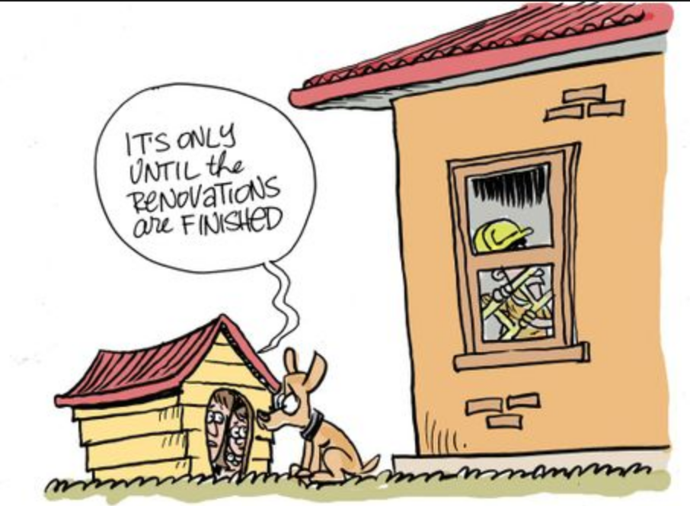
House/flat renovation: have you ever….?
NO!
  It might happen!
YES, I already suffered those pains!
  It might happen AGAIN!

Slide 3

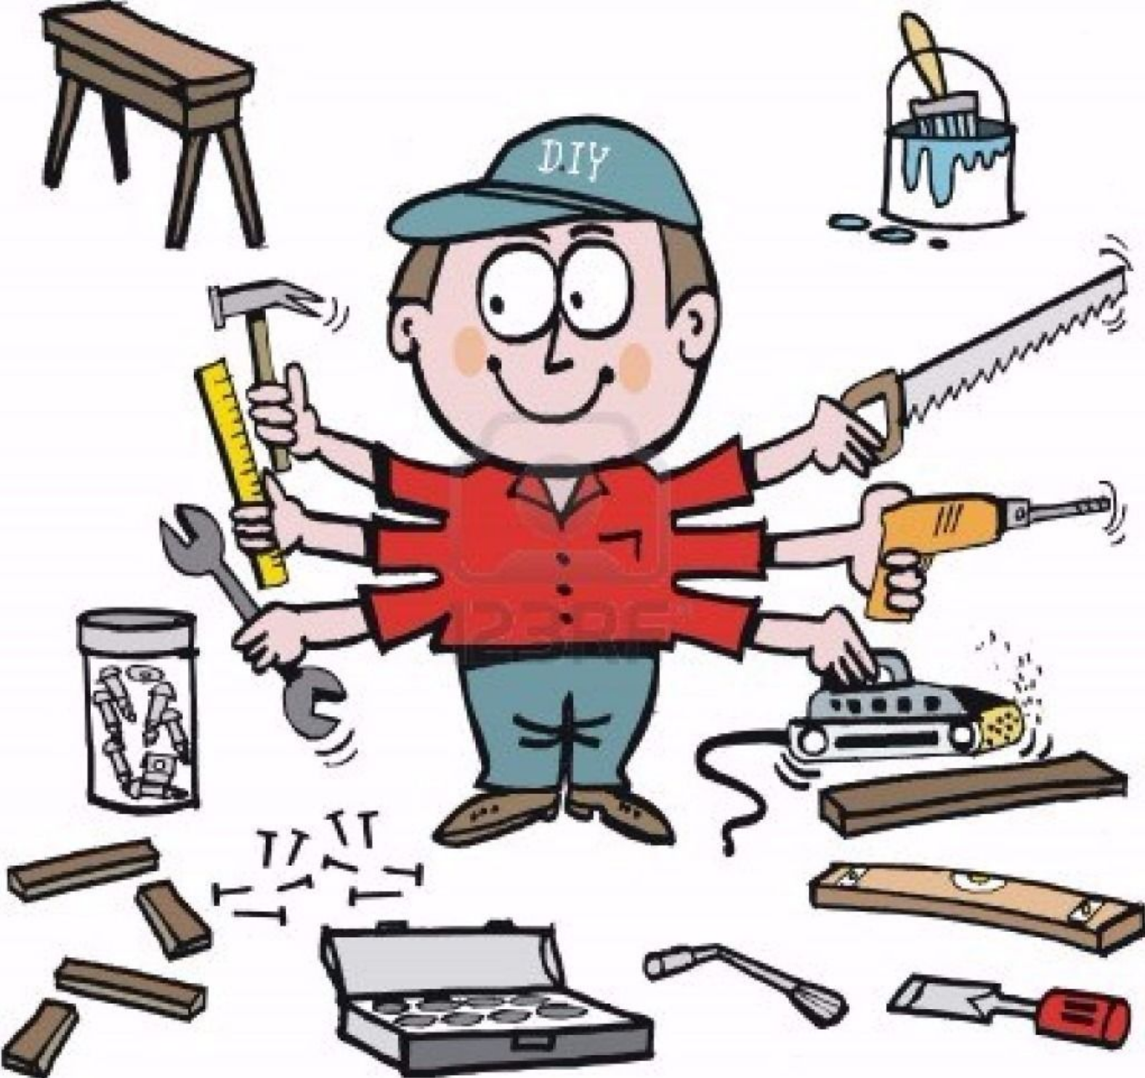
What do you (maybe) want??
Go-green
  (if not fully, at least try a bit!)
Get good “artisans”
New fancy house security system
Save money?

Slide 4
Reality:
My French is not as fluent as I thought
  Yours is maybe better, but are you able to understand really all the tiny technical details?...
Laws (e.g. incentives) I (think I) knew in my country are actually different here
Here around is expensive
  At least wrt what my dad tells me!
Difficult to get good unbiased suggestions!

Slide 5
How: share experience!
CERN: many competencies!
  And we are curious!
We have many people who, moving from abroad, came here and (re)did a lot of things in their flats/houses
Why not share our experiences?
  Unbiased skilled suggestions can be huge time (and money) saving
house-renovation-forum@cern.ch
Subscribe

