Slide 1



UPDATE on the CLIC POSITRON SOURCE
Cafer Bayar (Ankara University/CERN)
Dr. Steffen Doebert (CERN)
Dr. Andrea Latina (CERN)
Prof. Dr. Abbas Kenan Çiftçi (Ankara University)

Slide 2
INTRODUCTION
The CLIC Injector Complex
Our previous studies
Current status
Pre-injector linac results at 3 GeV and 5 GeV options
Injector linac results at 3 GeV and 5 GeV options
Proposal: Alternative injector complex
Conclusion and Outlook
CLIC Beam Physics Meeting 28 September 2017 CERN
Cafer Bayar

Slide 3
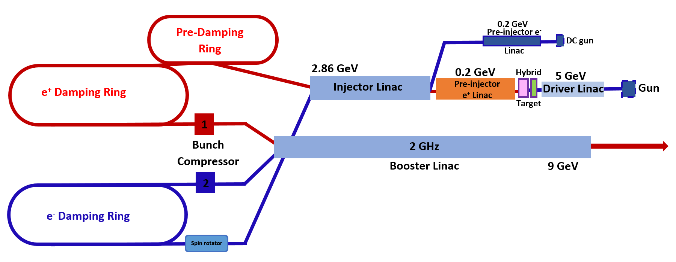
The CLIC Injector Complex
We have designed and optimised the beam transport and acceleration from the target to the pre-damping ring.
The goal of the study is to maximize the positron yield accepted by the pre-damping ring.
CLIC Beam Physics Meeting 28 September 2017 CERN
Cafer Bayar

Slide 4
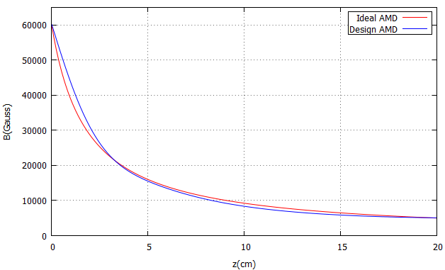
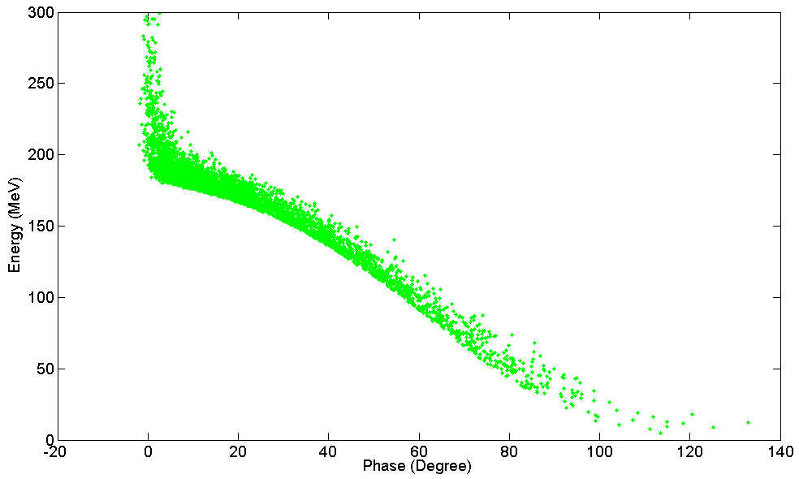
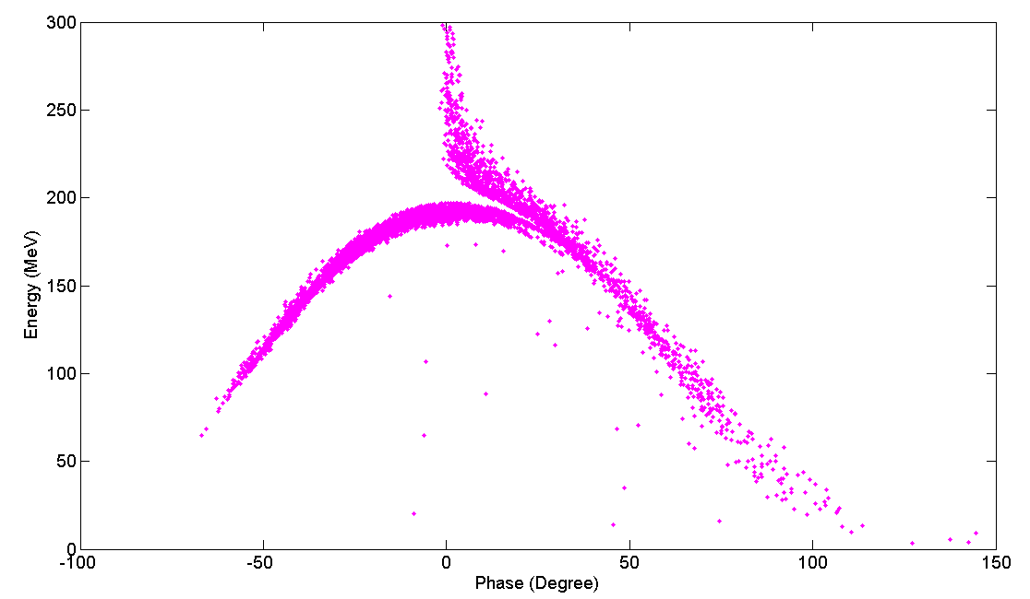
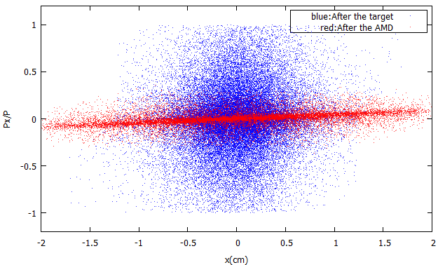
our previous studies: The Pre-Injector Linac
The total yield: 8.0 e+/e- 2.8 e+/e- 1.09 e+/e- 0.98 e+/e- (effective)
e+
Target
AMD
Solenoid
TW Structures
The effective yield : (-20,20) degrees in phase and (150,250) MeV in energy
Total yield: 0.89 e+/e-
Effective yield: 0.50 e+/e-
Total yield: 0.93 e+/e-
Effective yield: 0.48 e+/e-
Parameters of the accelerating structures in the Pre-Injector linac
Acceleration
Deceleration
Parameters | Unit | Value
Cell length | cm | 5
Frequency | GHz | 2
Phase advance per cell | π | 2/3
Average axial electric field | MV/m | 15
The yield is defined as the total number of positrons at the exit of the amorphous target compared to the number of electrons impinging onto the crystal target
CLIC Beam Physics Meeting 28 September 2017 CERN
Cafer Bayar

Slide 5
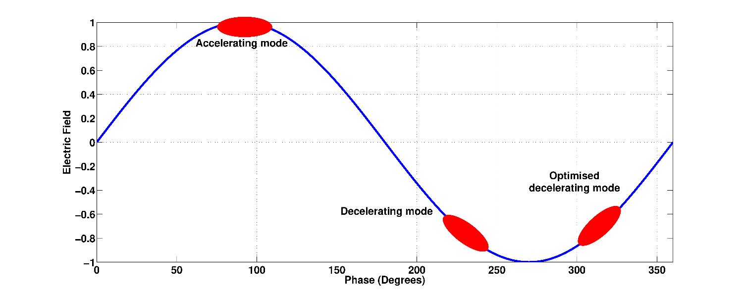
OUR PREVIOUS STUDIES: OPTIMIZATION IN THE PRE-INJECTOR LINAC
The decelerating mode creates a second peak in the phase spectrum.
For the optimization, a phase of 40 degrees after maximum deceleration is optimum.
Optimized Decelerating mode
Accelerating mode
Decelerating mode
CLIC Beam Physics Meeting 28 September 2017 CERN
Cafer Bayar

Slide 6
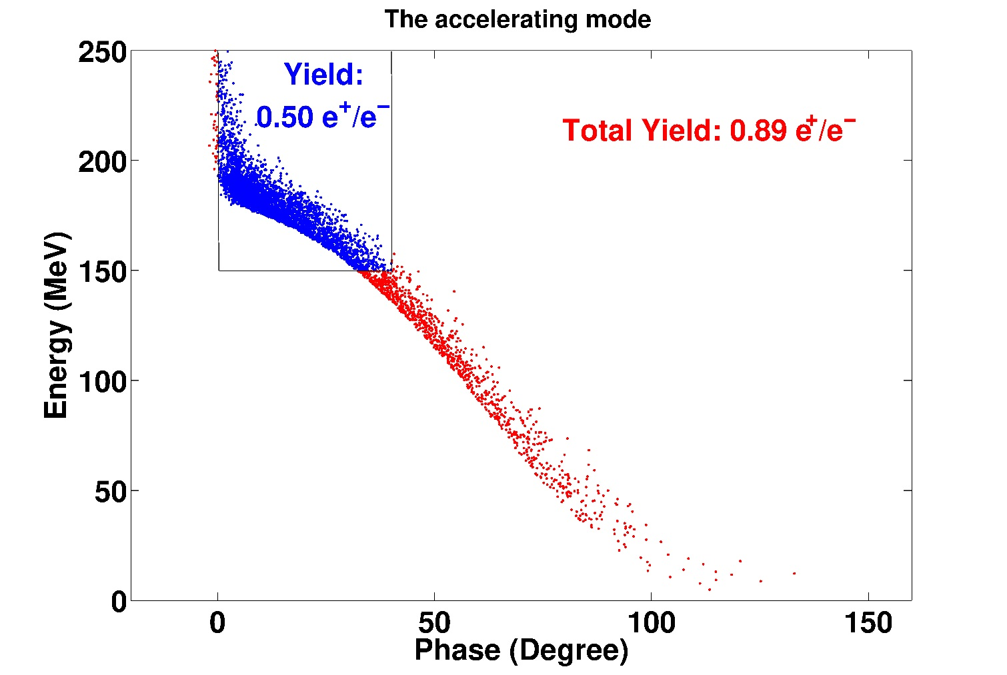
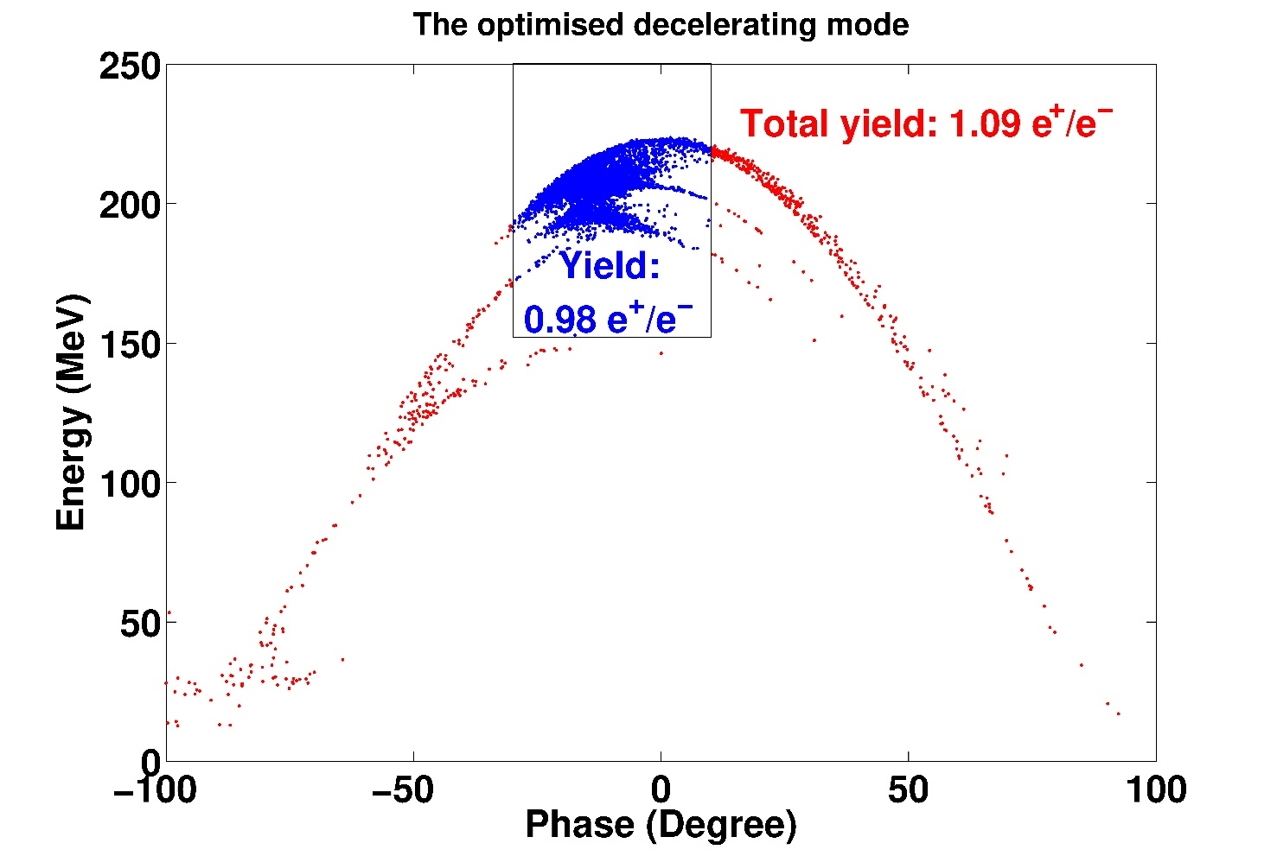
OUR PREVIOUS RESULTS: PRE-INECTOR LINAC
The effective yield : (-20,20) degrees in phase and (150,250) MeV in energy
The optimised decelerating mode result in almost a factor two higher yield compared to the accelerating mode which has a yield of 0.5 e+/e.
CLIC Beam Physics Meeting 28 September 2017 CERN
Cafer Bayar

Slide 7
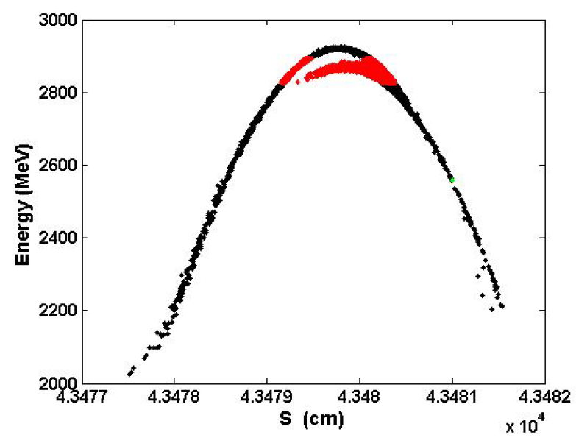
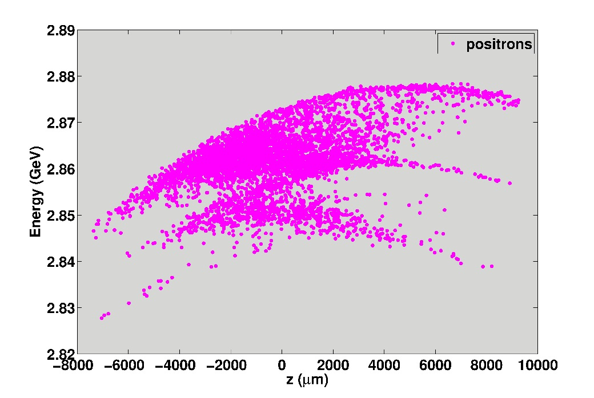
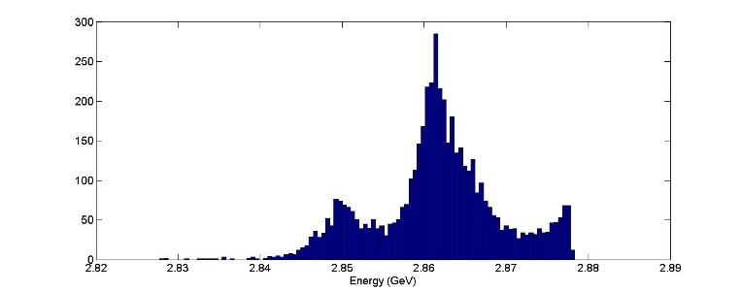
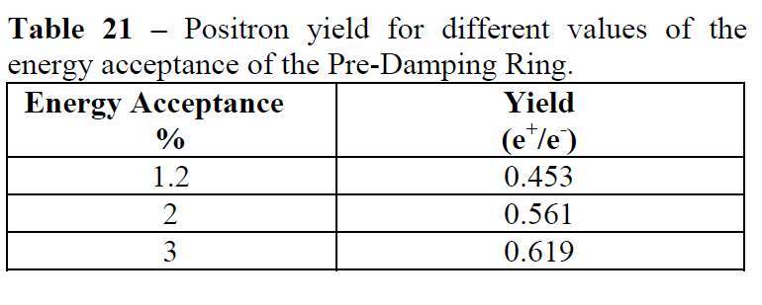


our previous studies: Injector Linac
*CDR
Our previous results
*Positron yield (CDR): 0.70 $e^{+}/e^{−}$
Positron yield, 0.97 $e^{+}/e^{−}$, is increased by a factor of 2.5.
Energy acceptance → 1%: → yield: 0.39 $e^{+}/e^{−}$
All positrons by 99 % are transported.
All positrons are within 1% acceptance window of the pre-damping ring.
http://cds.cern.ch/record/1277226/files/CERN-OPEN-2010-020.pdf
The yield is defined as the total number of positrons at the exit of the amorphous target compared to the number of electrons impinging onto the crystal target
CLIC Beam Physics Meeting 28 September 2017 CERN
Cafer Bayar

Slide 8
our previous studies
Total yield at the entrance of the pre-damping ring: 0.97 e+/e-
Positron yield: 0.97 e+/e- within 1% acceptance window
Positron yield at the entrance of the pre-damping ring is increased by a factor 2.5 compared to the CLIC CDR
This result allows to reduce the beam current of the electron driver linac impinging onto the target
It provides significant cost savings for electron driver linac
A single target station can be used for the first stage of CLIC at 380 GeV
In the original study for the CDR, two station including a hybrid target and a pre-injector linac was assumed in parallel at this stage
C. Bayar, A. K. Ciftci, S. Doebert and A. Latina, “Design and Optimisation of the Positron Production Chain for CLIC from target to the Damping Ring”, Nuclear Inst. and Methods in Physics Research, A. Reference: NIMA 59959, 7 July 2017.
DOI: http://dx.doi.org/10.1016/j.nima.2017.07.010
CLIC Beam Physics Meeting 28 September 2017 CERN
Cafer Bayar

Slide 9
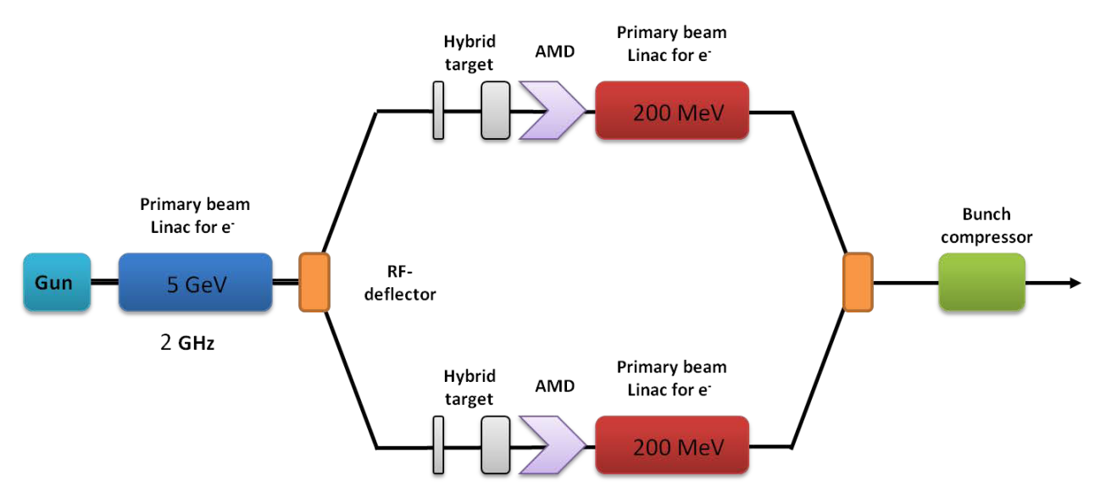
OLD positron source in cdr
We have removed parallel station and bunch compressor due to the optimization of the pre-injector linac
CLIC Beam Physics Meeting 28 September 2017 CERN
Cafer Bayar

Slide 10
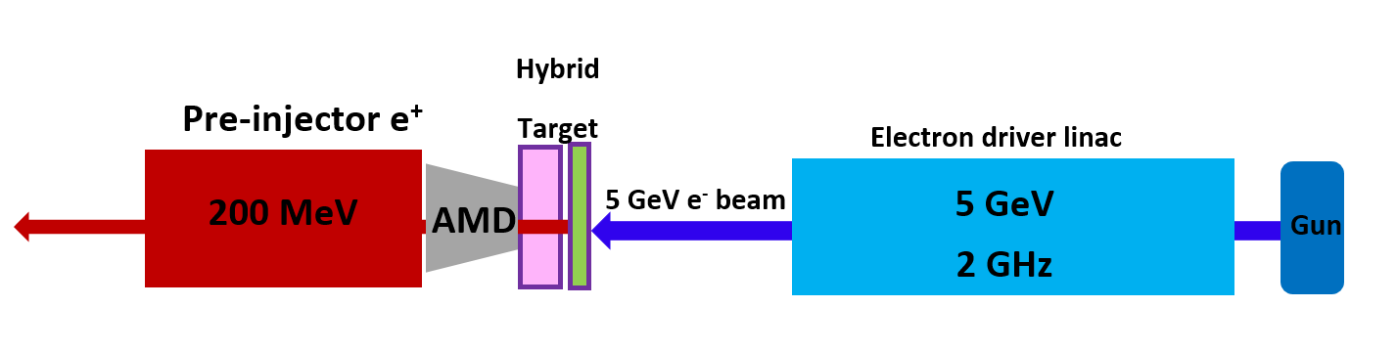
NEW positron source
We have removed parallel station and bunch compressor due to the optimization of the pre-injector linac
CLIC Beam Physics Meeting 28 September 2017 CERN
Cafer Bayar

Slide 11
current status
Two options are considered:
The first is to use the electron driver linac with lower beam current at 5 GeV
The second is to use the electron driver linac with higher beam current (double) at 3 GeV
In the new studies:
An energy option of 3 GeV to produce the positrons on the target
An energy option of 5 GeV to produce the positrons on the target
Tracking simulation and optimization of the positron source from target to damping ring
An alternative baseline has been proposed for the CLIC injector complex
CLIC Beam Physics Meeting 28 September 2017 CERN
Cafer Bayar

Slide 12
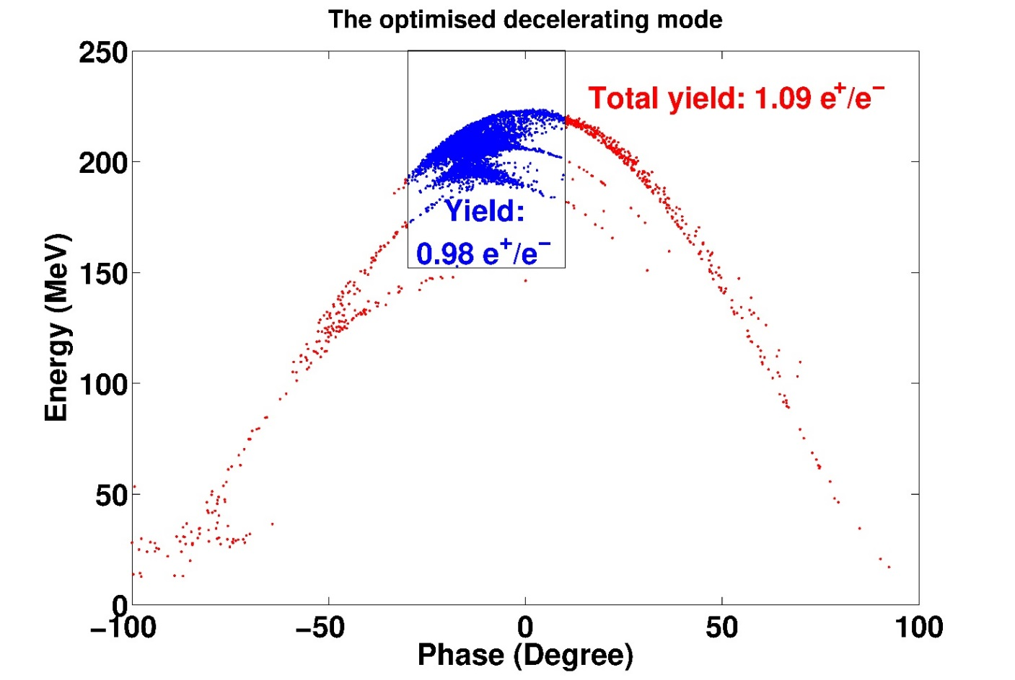
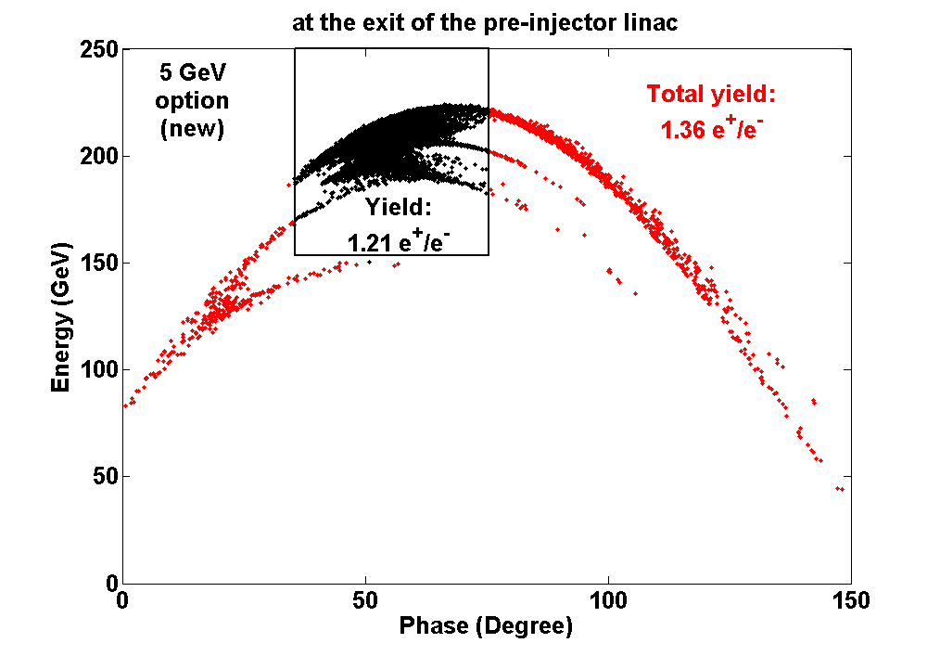
The new Pre-Injector Linac results at 5 GEV OPTION
5 GeV option (previous)
5 GeV option (new)
The effective yield : (-20,20) degrees in phase and (150,250) MeV in energy
Energy (GeV) | Target exit (e⁺/e⁻) | AMD exit (e⁺/e⁻) | Total yield (e⁺/e⁻) | Effective yield (e⁺/e⁻)
5 (new) | 7.14 | 3.06 | 1.36 | 1.21
5 (previous) | 8.00 | 2.80 | 1.09 | 0.98
5 (CDR) | 8.00 | 2.10 | 0.95 | -
*Positrons at the target exit are generated for 3 GeV and 5 GeV options by Yanliang Han
CLIC Beam Physics Meeting 28 September 2017 CERN
Cafer Bayar

Slide 13
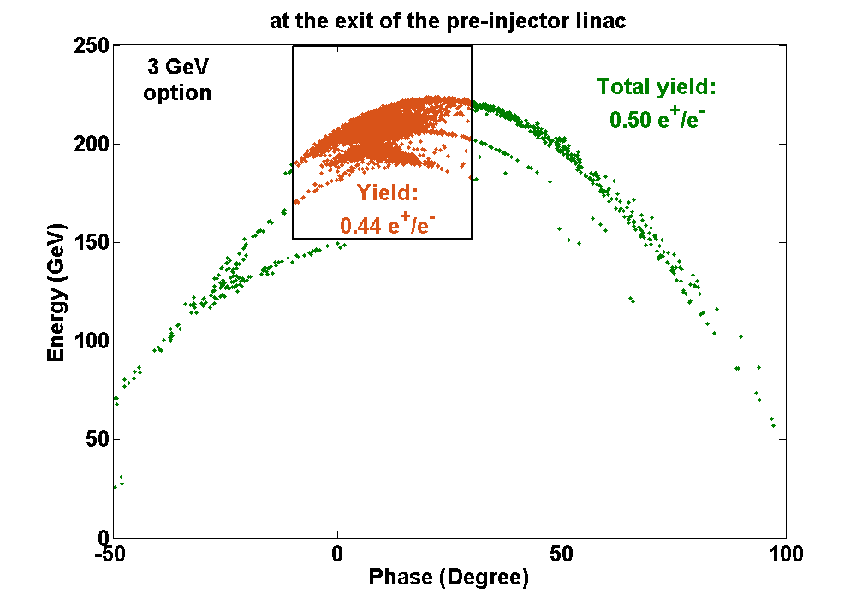
The new Pre-Injector Linac results at 3 gev OPTION
3 GeV option
In 3 GeV option, the effective yield is around 0.44 e⁺/e⁻.
The effective yield : (-20,20) degrees in phase and (150,250) MeV in energy
Energy (GeV) | Target exit (e⁺/e⁻) | AMD exit (e⁺/e⁻) | Total yield (e⁺/e⁻) | Effective yield (e⁺/e⁻)
3 (new) | 4.18 | 1.38 | 0.50 | 0.44
5 (new) | 7.14 | 3.06 | 1.36 | 1.21
5 (previous) | 8.00 | 2.80 | 1.09 | 0.98
5 (CDR) | 8.00 | 2.10 | 0.95 | -
CLIC Beam Physics Meeting 28 September 2017 CERN
Cafer Bayar

Slide 14
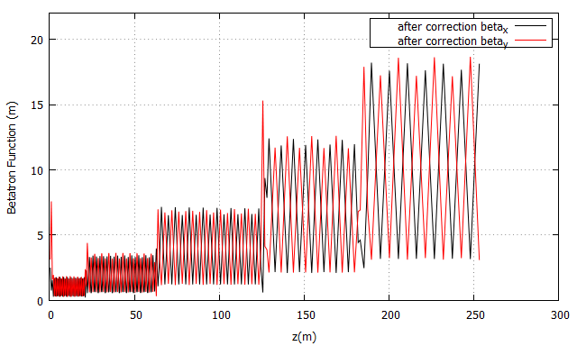
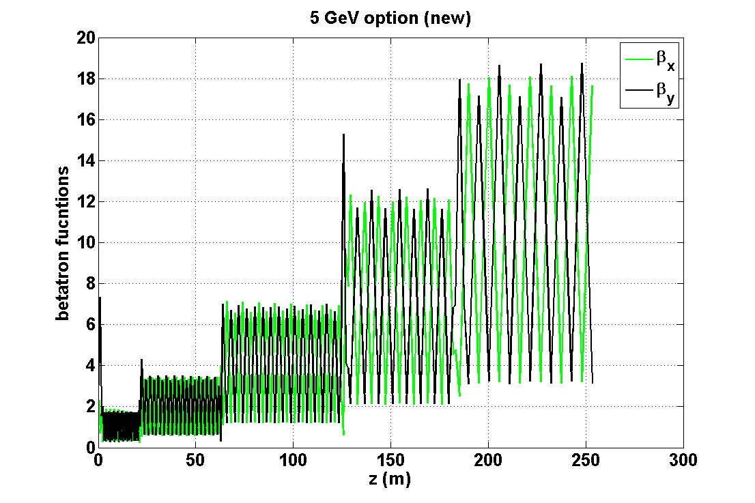
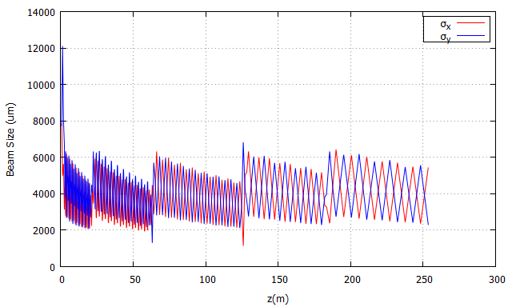
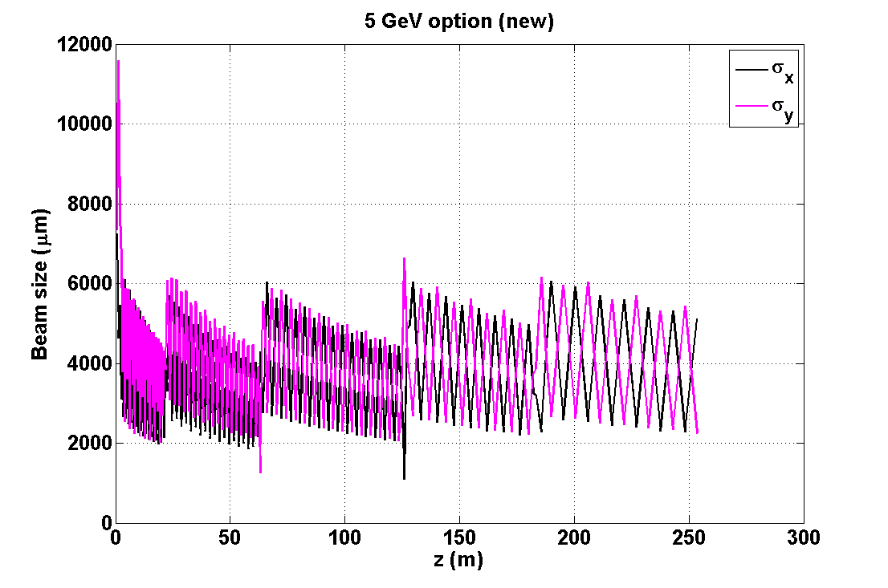
Beta functions and beam size along the injector linac
5 GeV option (previous)
5 GeV option (new)
Betatron functions and beam sizes are compatible with each other.
The 3σ beam size does not exceed the iris aperture (2 cm) along the beam line with the exception of the first matching section.
CLIC Beam Physics Meeting 28 September 2017 CERN
Cafer Bayar

Slide 15
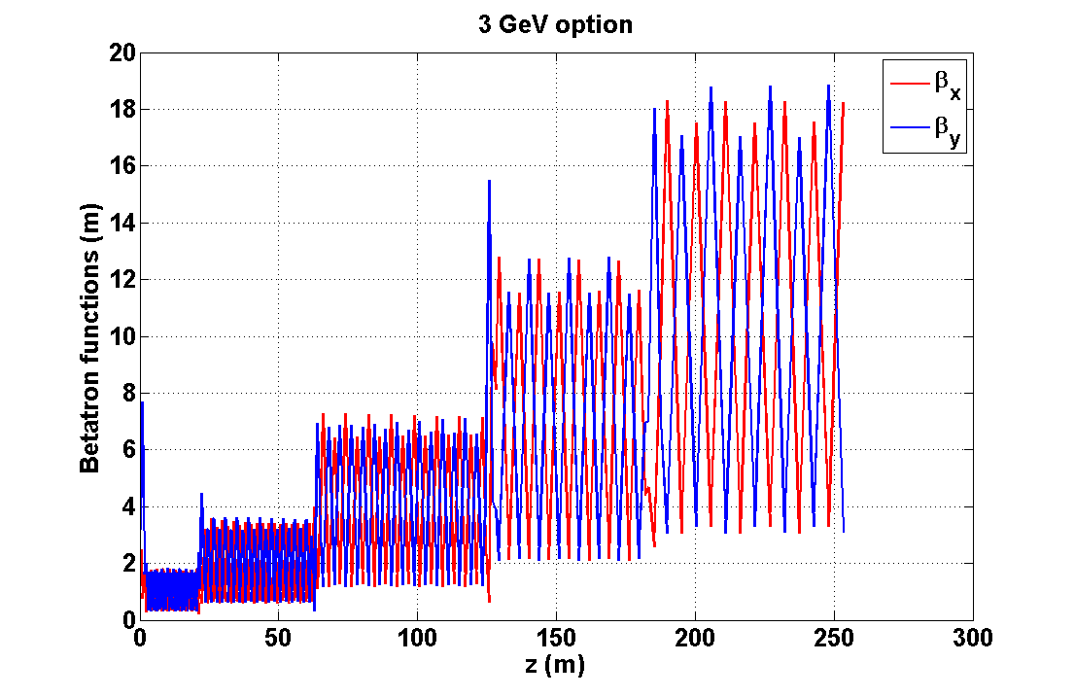
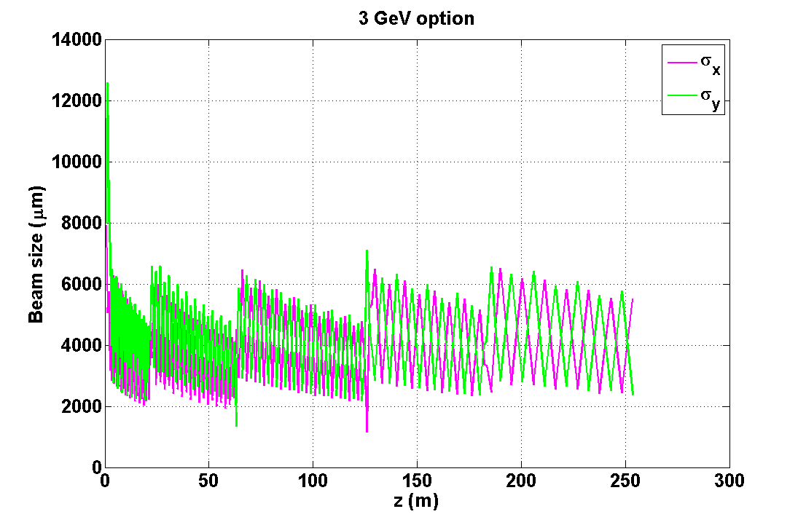
Beta functions and beam size along the injector linac
3 GeV option
CLIC Beam Physics Meeting 28 September 2017 CERN
Cafer Bayar

Slide 16
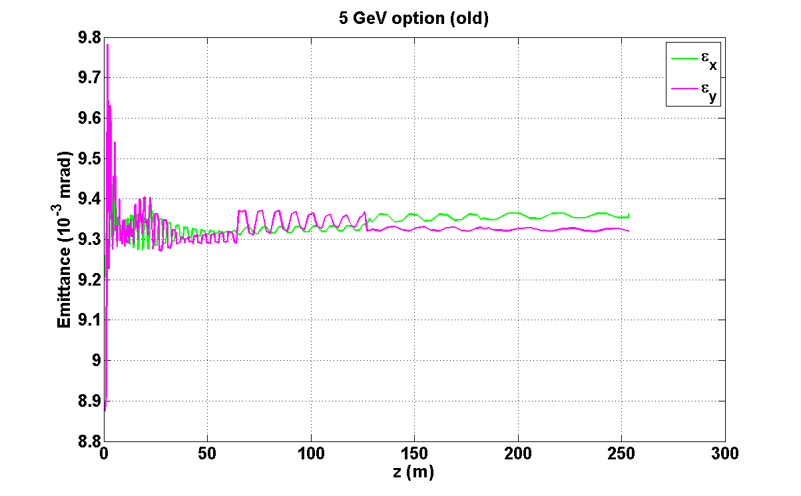
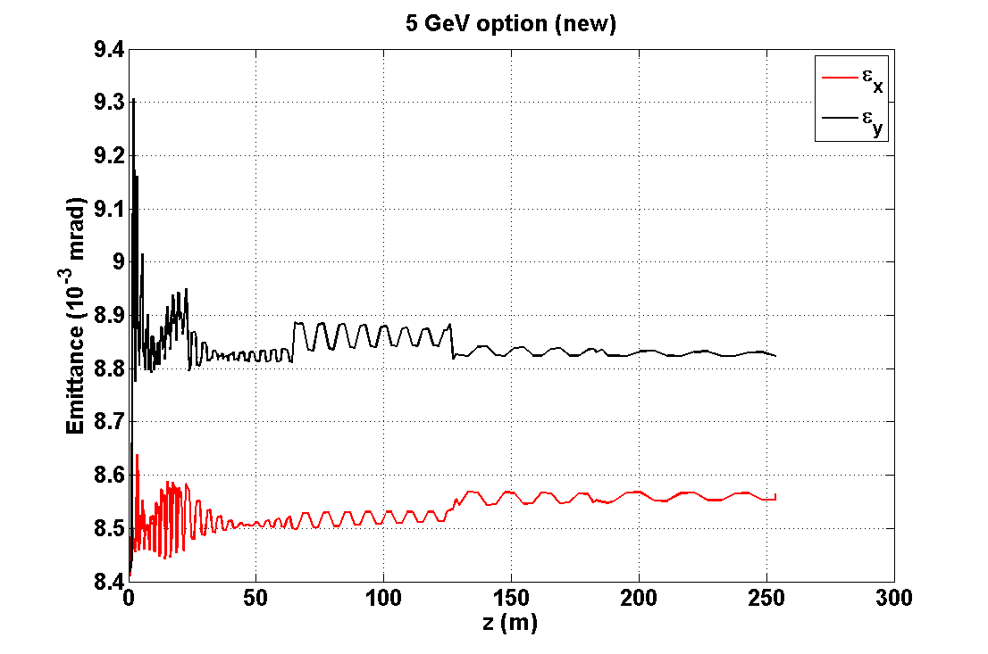
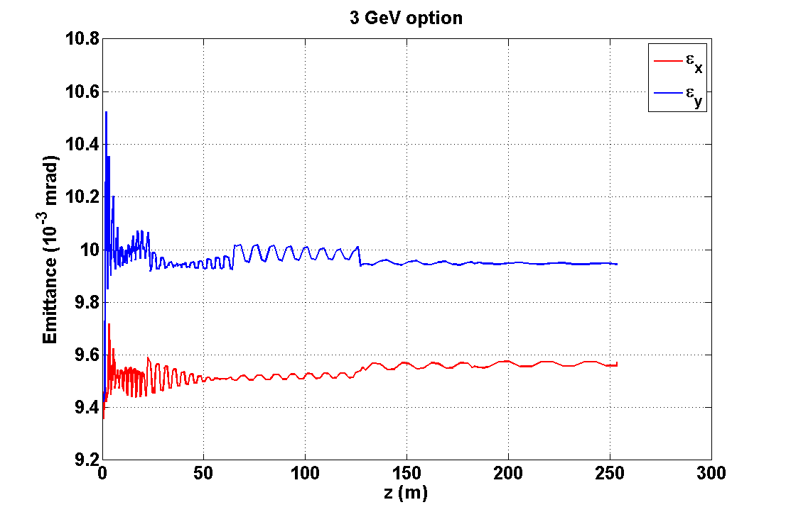
Emittance evolution along the injector linac
5 GeV option (previous)
5 GeV option (new)
3 GeV option
Emittance evolution along the beam line is acceptable for each option.
CLIC Beam Physics Meeting 28 September 2017 CERN
Cafer Bayar

Slide 17

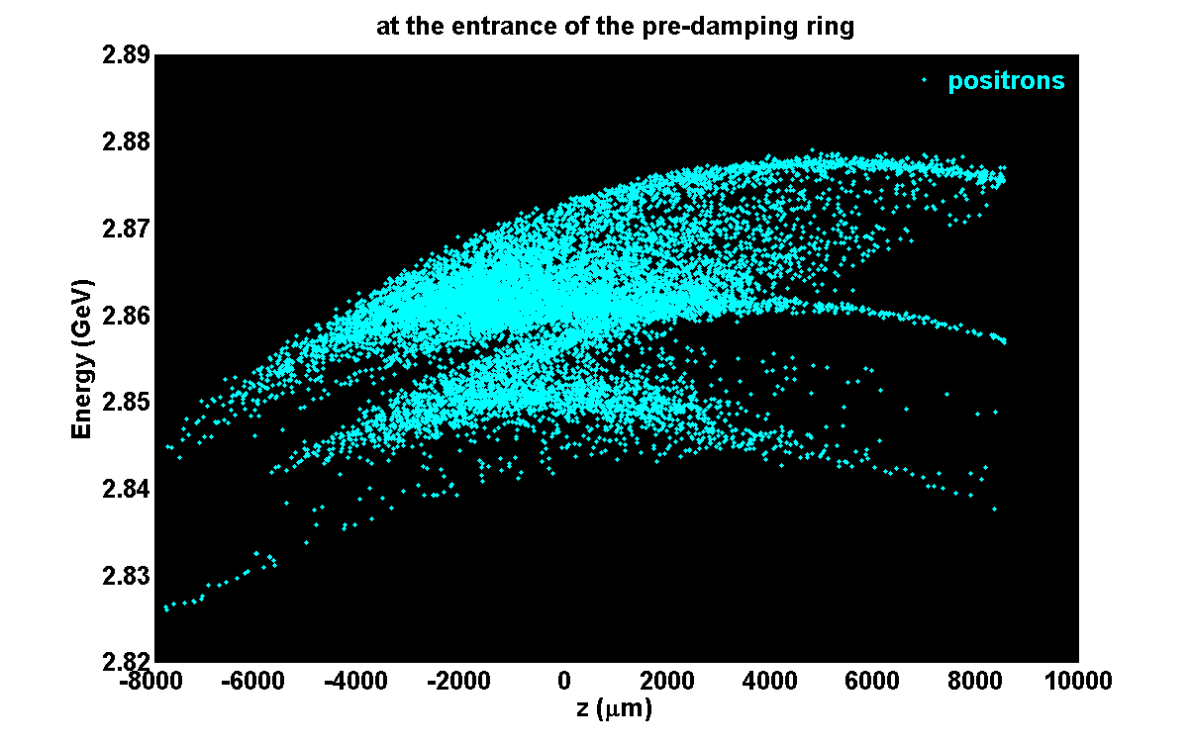
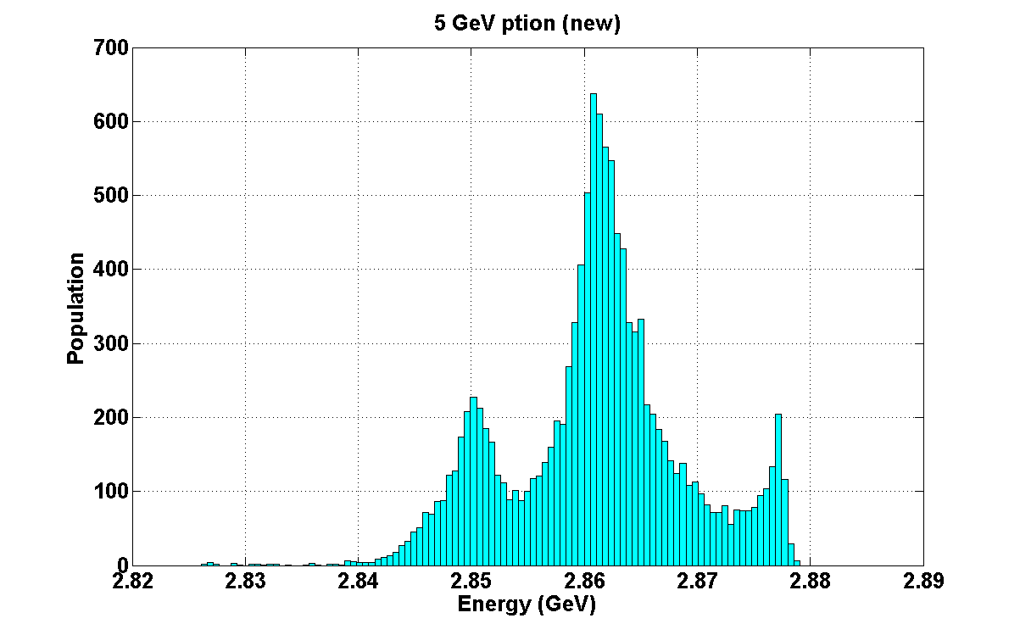
PHASE SPACE at the entrance of the pre-damping ring
5 GeV option (previous)
5 GeV option (new)
The energy spread is smaller than 1%.
Similar result is obtained by new positron distribution compared to previous one at 5 GeV.
Positron yield: 0.97 e⁺/e⁻
Positron yield: 1.21 e⁺/e⁻
Energy (GeV) | Injector linac exit (e⁺/e⁻)
5 (new) | 1.21
5 (previous) | 0.97
5 (CDR) | 0.39
CLIC Beam Physics Meeting 28 September 2017 CERN
Cafer Bayar

Slide 18
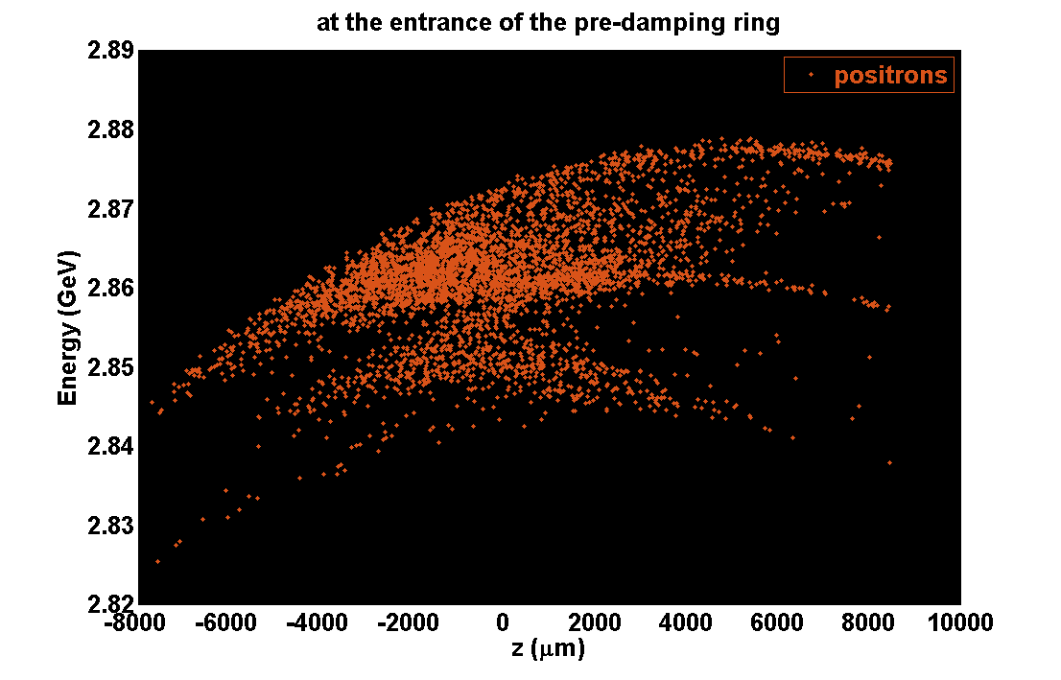
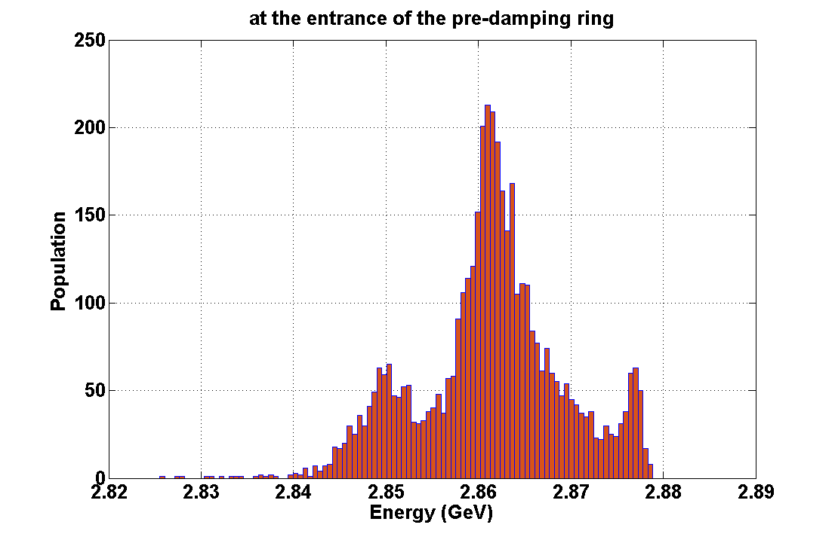
PHASE SPACE at the entrance of the pre-damping ring
3 GeV option
Positron yield: 0.43 e⁺/e⁻
Energy (GeV) | Injector linac exit (e⁺/e⁻)
3 (new) | 0.43
5 (new) | 1.21
5 (previous) | 0.97
5 (CDR) | 0.39
The positron yield amounts to 0.43 e⁺/e⁻ is higher than the 0.39 e⁺/e⁻ which were previously estimated and published in CDR.
In 3 GeV option, sufficient positron yield can be obtained at the entrance of the pre-damping ring
CLIC Beam Physics Meeting 28 September 2017 CERN
Cafer Bayar

Slide 19
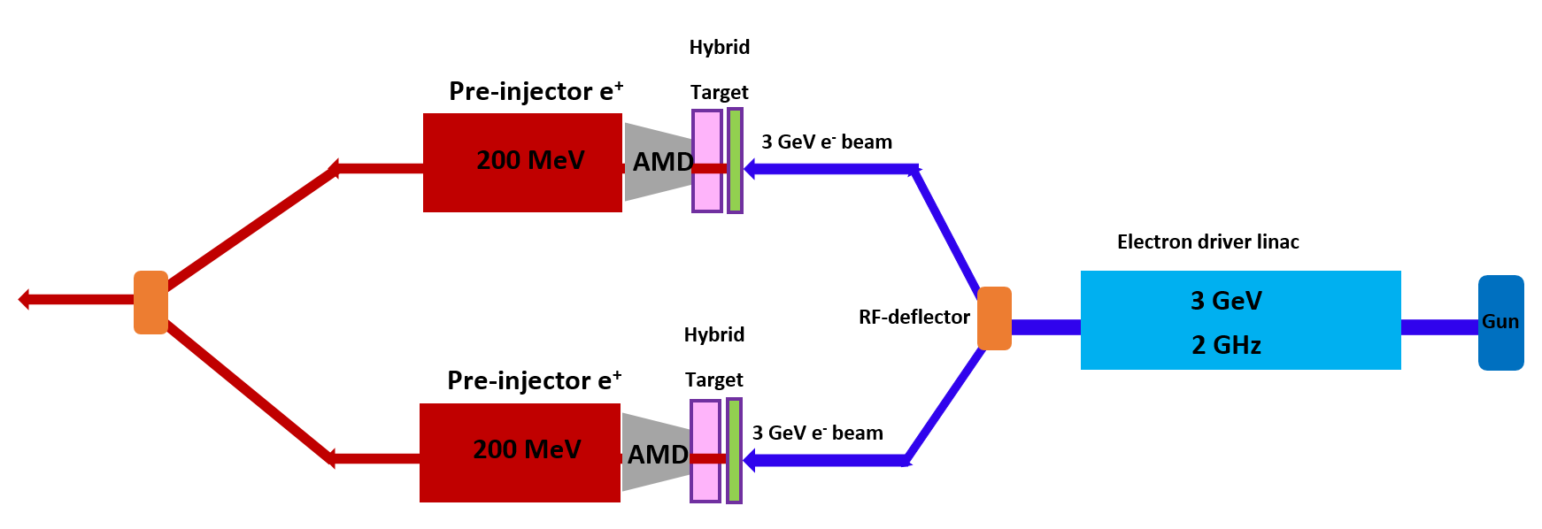
3 GeV and 5 gev options
3 GeV option
Two target station in parallel includes a hybrid target, AMD and pre-injector linac
A driver electron linac with higher beam current at 3 GeV could be used
5 GeV option
A single target station can be used
A driver electron linac with lower beam current at 5 GeV could be used
CLIC Beam Physics Meeting 28 September 2017 CERN
Cafer Bayar

Slide 20
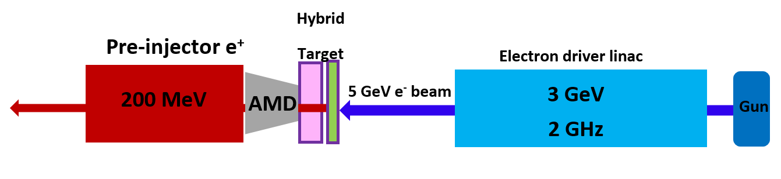
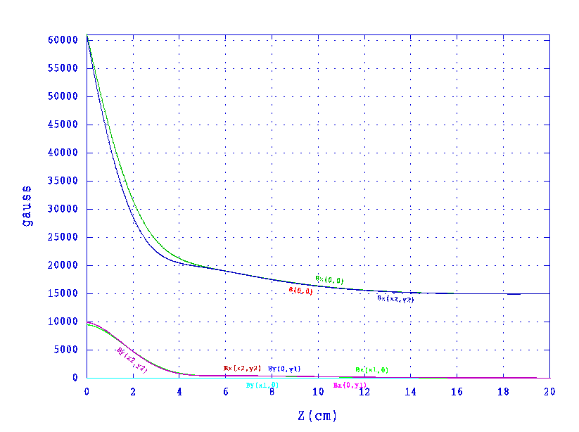
FURTHER POSSIBLE IMPROVEMENT for 3 gev OPTION
The effective yield at the exit of the pre-injector linac: (-20,20) degrees in phase and (150,250) MeV in energy
3 GeV option
by a single target
Energy (GeV) | AMD field (T) | Solenoidal field (constant) (T) | Effective yield (e⁺/e⁻)
3 (improved) | From 6 to 1.5 | 1.5 | 0.76
3 (new) | From 6 to 0.5 | 0.5 | 0.44
5 (new) | From 6 to 0.5 | 0.5 | 1.21
5 (previous) | From 6 to 0.5 | 0.5 | 0.98
AMD field
from 6 T to 1.5 T
Further improvements are still possible for 3 GeV option.
During the simulations, It became clear that increasing the aperture of the AMD and the accelerating structure would directly increase the as well increasing the strength of the solenoidal field around the pre-injector linac.
A single target station would be used with a lower current in the driver electron linac, if sufficient positron yield could be provided by a factor 2.
However, it remains to be seen if such changes are technically viable.
CLIC Beam Physics Meeting 28 September 2017 CERN
Cafer Bayar

Slide 21
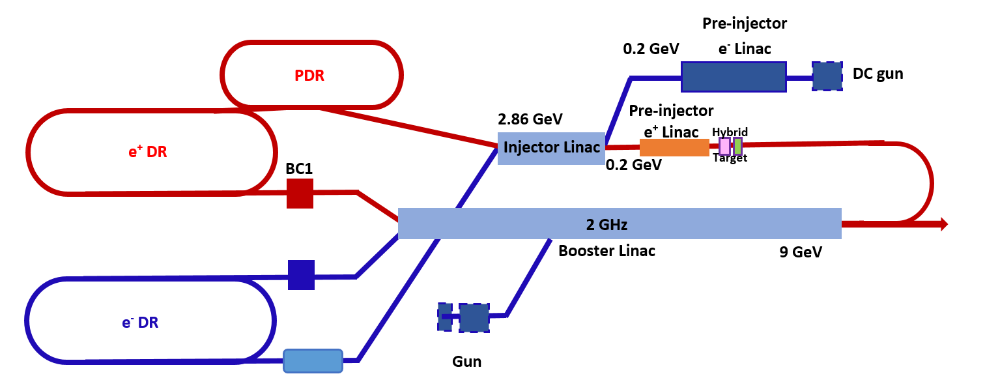
Proposal: Alternative injector complex
The 5 GeV driver electron linac could be removed.
We propose that the booster linac could be used to generate the positrons on the target.
Removing the 5 GeV driver electron linac would provide a significant cost saving.
But in the alternative option, three bunch trains should be considered in the booster linac and in the rf system would need to be upgraded to accommodate longer rf pulses and higher beam loading.
In addition, the beam loading compensation for all three beam will be very challenging.
Further studies would be needed to seriously consider this option.
In the high current beam especially for positrons, the effect of the beam-loading must be studied.
6 GeV energy gain
CLIC Beam Physics Meeting 28 September 2017 CERN
Cafer Bayar

Slide 22
CONCLUSION and OUTLOOK
5 GeV option could be used with a single target station and lower beam current
3 GeV option could be used with two target stations and higher (double) beam current
Alternative injector complex should be considered seriously
In the next step:
The budget estimation must be done for 3 GeV and 5 GeV options
In 3 GeV option, the positron yield at the exit of AMD and pre-injector could be increased by a further optimization
In 3 GeV option, the positron yield at the entrance of the pre-damping ring should be increased by a factor 2 if we want to use lower beam current in the driver electron linac and a single target station
In alternative injector complex:
  The booster linac must be re-optimized for a lower energy electron beam around 3 GeV or 5 GeV.
  In the high current beam especially for positrons, the effect of the beam-loading must be studied.
CLIC Beam Physics Meeting 28 September 2017 CERN
Cafer Bayar

Slide 23
Thank You for your attention

