Slide 1

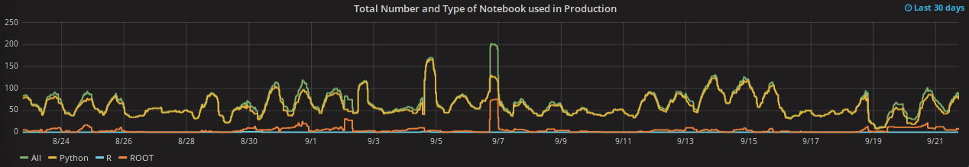
SWAN protoservice
Massimo Lamanna IT/ST
Danilo Piparo EP/SFT
Initiated as a collaboration between EP SFT and IT ST
  CERNBox and ROOT teams
  Users in several departments/activities
  Presently operated jointly by EP SFT and IT ST
  Initial emphasys on Jupyter notebooks, Python ecosystem and files sync&share
Recently being extended to reach out the Spark world
  Collaboration between IT DB and EP SFT

Slide 2








Hadoop Service Commitment to Support NXCALS
Central logging and analytics platform for all the accelerator systems
Critical service for LHC – no data, no beam
Speed
HBase
Gobblin
Kafka
30s
30s
Log. Proc.
Batch
Log. Proc.
100mS
HDFS
Compactor
7 min
7 min
CCDB
Schema Partition
Provider
Storage
Current throughput:
  700 GB/day, 60M events/day
Credit: Jakub Wozniak, BE-CO-DS

Slide 3
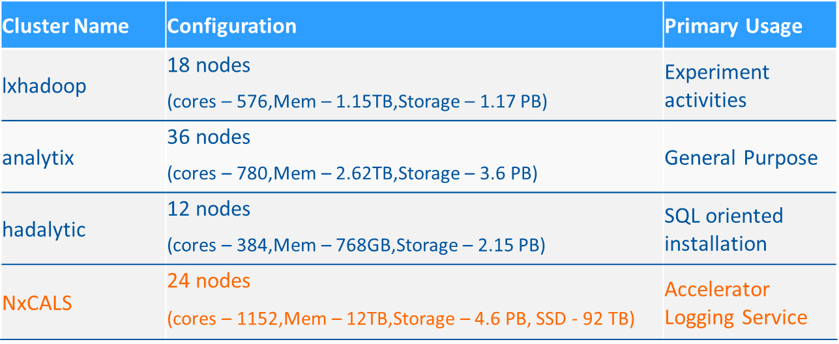
Hadoop Clusters at CERN IT
3 current production clusters (+ 1 for QA)
A new system for BE NXCALs (accelerator logging) platform
  Coming in Q4 2017 + Critical production service

Slide 4
SWAN and Hadoop, Spark
IT-DB + EP-SFT worked on integration of Hadoop and Spark with Jupyter notebooks (SWAN)
  Configuration and integration with Docker containers
  Software stack, alignment with cvmfs
  Security (Kerberos) + encryption (work in progress)
Spark + notebooks
  More use cases
  BE controls, Physics (CMS Big Data, Totem) + potentially many more

